Slide 1
A Comparative Assessment of Evolvable Martian ISRU Propellant Production for Future Human Missions
Stephen J. Hoffman, Ph.D. The Aerospace Corporation
Michael B. Chappell NASA Marshall Space Flight Center
Steven R. Oleson NASA Glenn Research Center
Elizabeth R. Turnbull NASA Glenn Research Center
Jared F. Congiardo NASA Kennedy Space Center
AIAA SciTech Forum
Orlando, FL
6 - 10 January 2025

Slide 2
Introduction and Background
NASA’s “Moon to Mars Strategy and Objectives Development” calls for the demonstration of “…Mars in situ resource utilization (ISRU) capabilities to support an initial human Mars exploration campaign”
One of the highest leverage and potentially early ISRU applications is making ascent vehicle propellant
Surface infrastructure on Mars is needed before this leverage is attainable
  The infrastructure scope and complexity needs to be better understood
  Advantages may not be apparent until use on multiple missions
Five Case studies examined and compared
  Deliver all CH₄ and O₂ propellant (for the Mars ascent vehicle) as cargo from Earth.
  Deliver CH₄ propellant as cargo from Earth; make O₂ propellant from Martian atmosphere.
  Deliver water as cargo from Earth; combine with CO₂ from Martian atmosphere to make CH₄ and O₂ propellant.
  Water is mined from buried Martian ice; combine with CO₂ from Martian atmosphere to make CH₄ and O₂ propellant.
  Water is mined from “average” Martian regolith; combine with CO₂ from Martian atmosphere to make CH₄ and O₂ propellant.

Slide 3
Common Assumptions across Case Studies (1 of 2)
Mission assumptions
  The Mars Ascent/Lander Vehicle (MALV) is the common vehicle delivering crew and cargo to the Martian surface. This is also the crew ascent vehicle.
  One MALV launch per Mars trajectory opportunity (approximately once every 26 months).
  The ascent vehicle is fully loaded with propellant before the crew lands.
    Consequently, two crew-capable MALVs are required for each crew’s mission.
  Surface infrastructure is deployed, integrated, operated, and maintained entirely by robotic means.
  ISRU infrastructure elements are sized using typical characteristics of the Martian feedstock material; no assumptions about use of a specific surface site.

Slide 4
Common Assumptions across Case Studies (2 of 2)
Infrastructure assumptions
  Surface infrastructure divided into four general categories
    Mobility
    Power
    Propellant production
    Cryogenic liquefaction and maintenance
  Common infrastructure elements used wherever possible with multiple units used to meet the individual Case Study need
  Infrastructure elements separated by at least 1000 m from the nearest MALV (protection from exhaust plume debris)

Slide 5
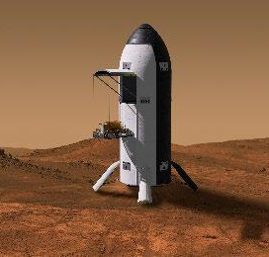
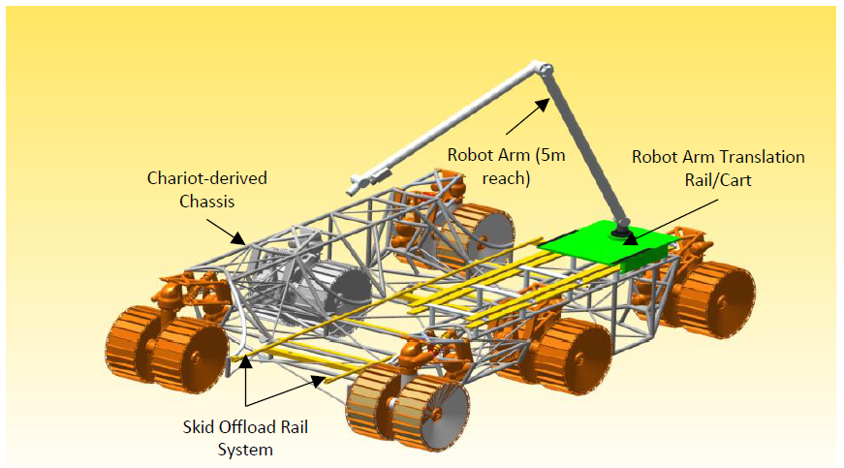
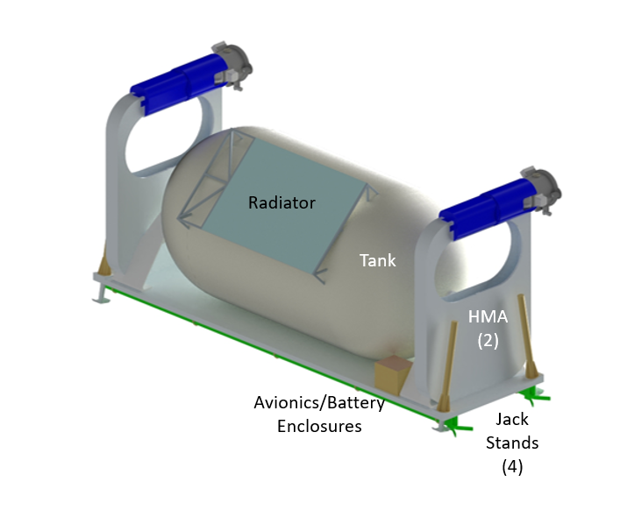
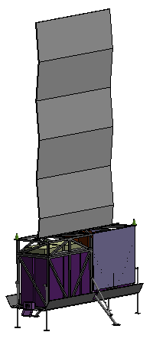
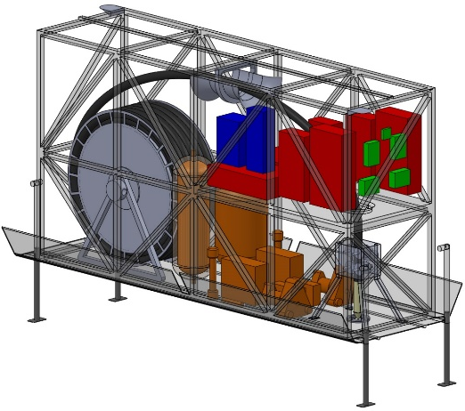
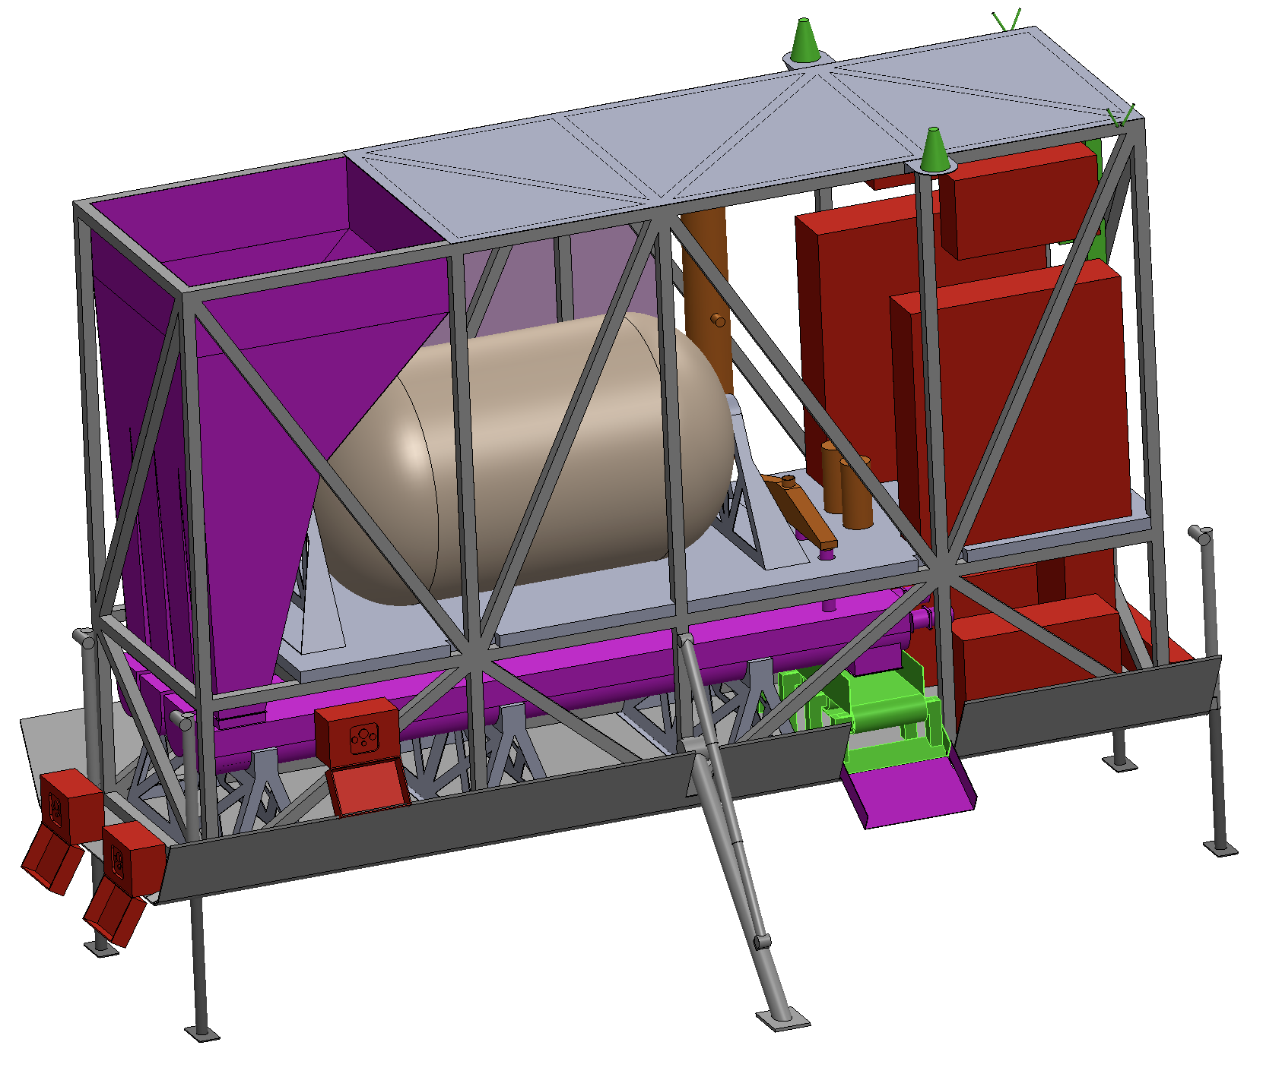
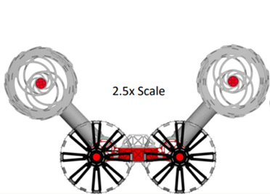
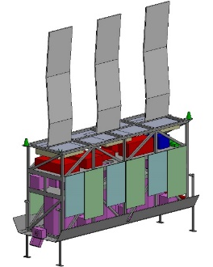
Infrastructure Elements
MALV
Mobility Transport Chassis
Liquid Transportation Pallet
(cryogenic version shown)
Cryocooler and Propellant Production Pallet Examples
Borehole Water Production Pallet
Surface Mining Water Production Pallet
Excavator (RASSORX)

Slide 6
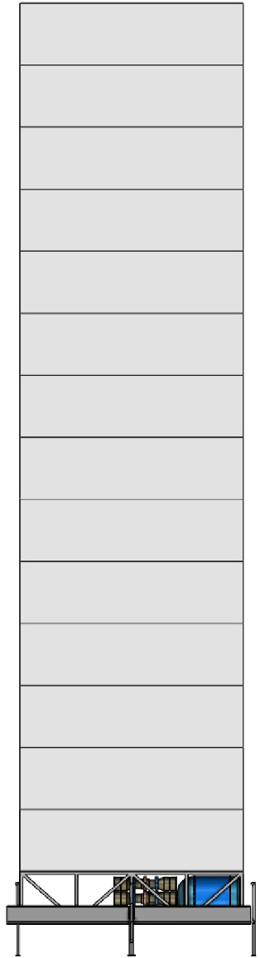
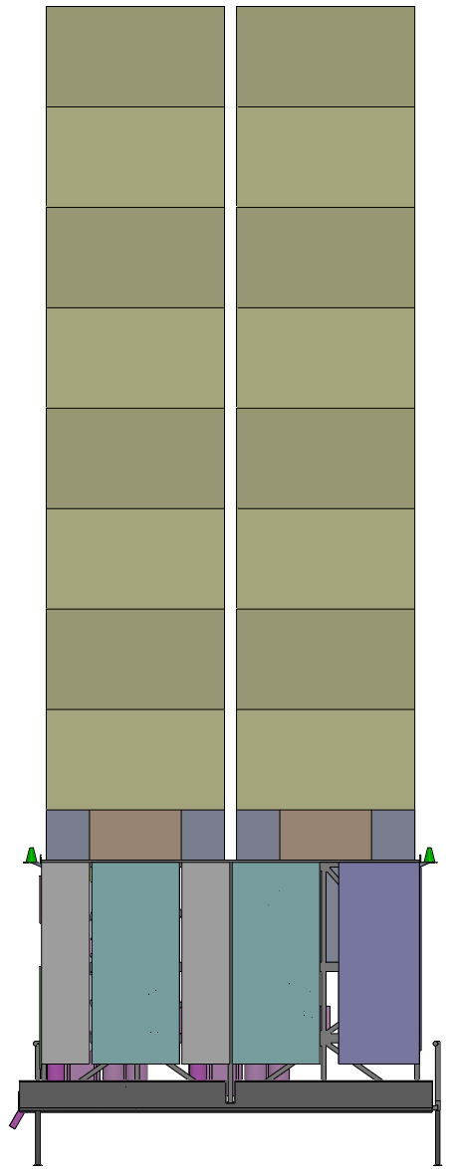
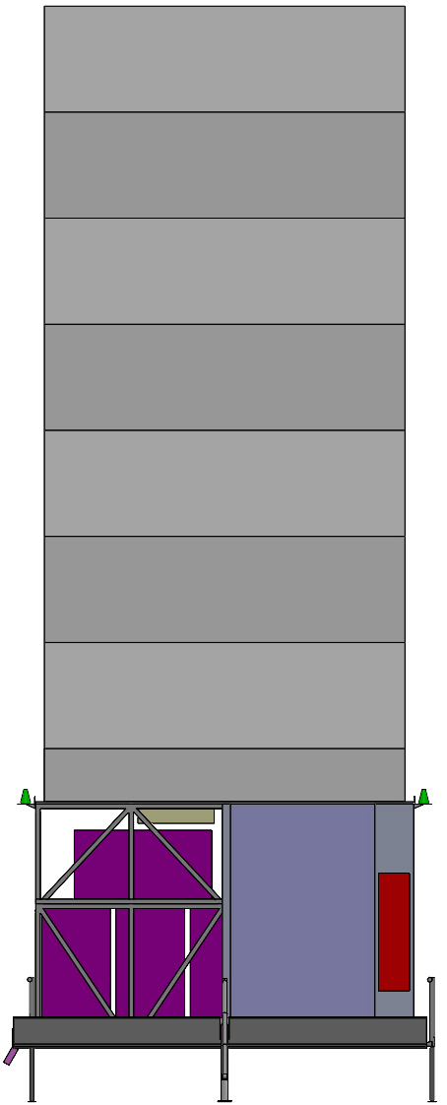
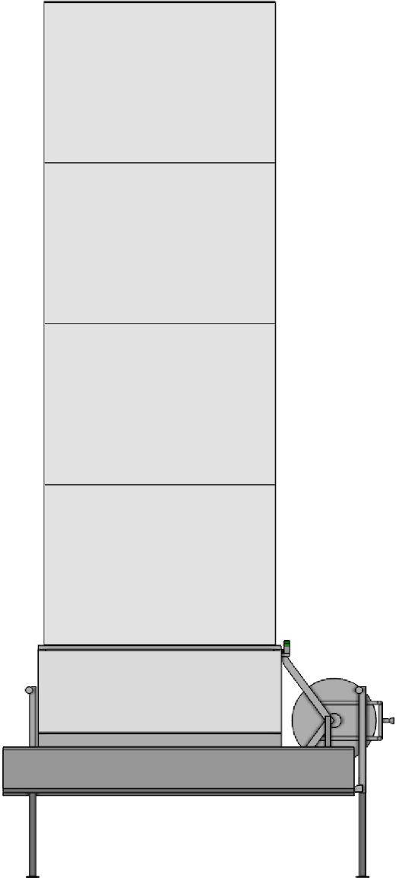
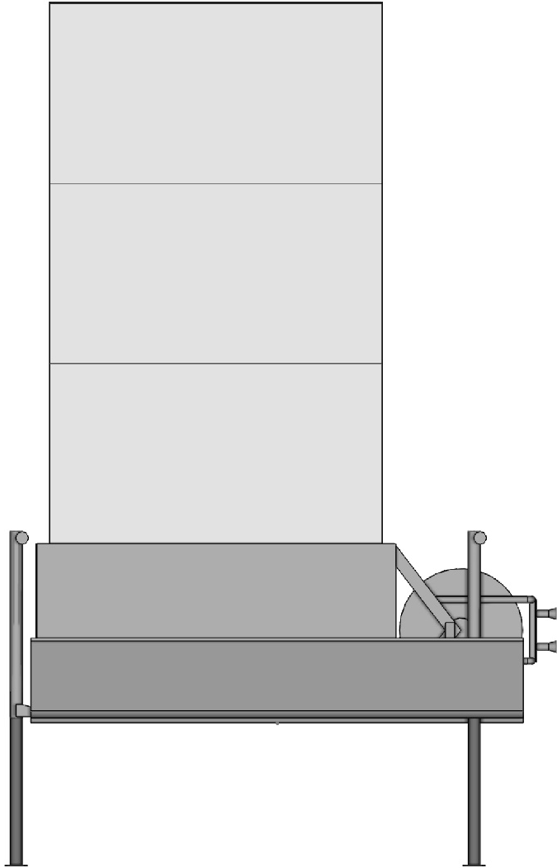
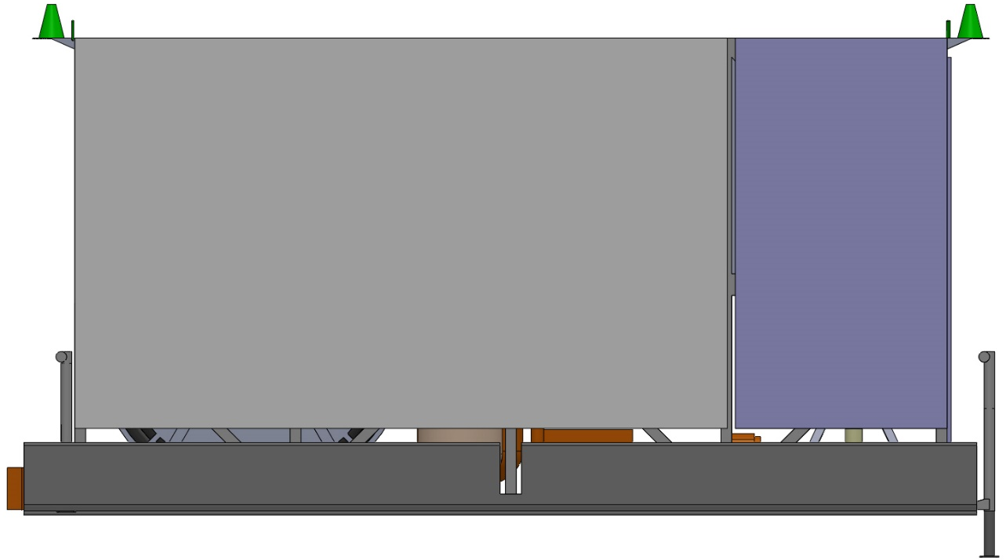
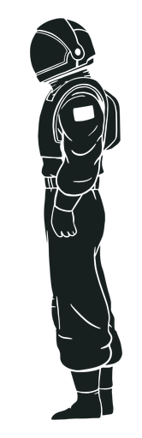
Example: Case 4 “Borehole Mining” Surface Infrastructure
ISRU System
Total Mass: 5.5 t ea
Peak Power Need: ~62 kWe ea
Qty for 300t system: 3
Note: This image only shows elements designed by the Compass team. Additional items including the Surface Water Transport, Autonomous Chassis and Water Storage on the MALV are also needed.
Fission Surface Power
Total Mass: 10 t
(including auxiliary pallets)
Power Provided: 40 kWe
Qty for 300t system: 7
Cryocooler System
Total Mass: 3.5 t ea
Peak Power Need: ~20 kWe ea
Qty for 300t system: 2
Borehole Mining System
Total Mass: ~1.9 t ea Peak Power Need: ~27.5 kWe ea (only 1 pulls power)
Qty for 300t system: 2 (for redundancy)
FSP Control System
FSP User Power System
Approx. 6 ft (1.8 m)
Approx. 6 ft (1.8 m)

Slide 7
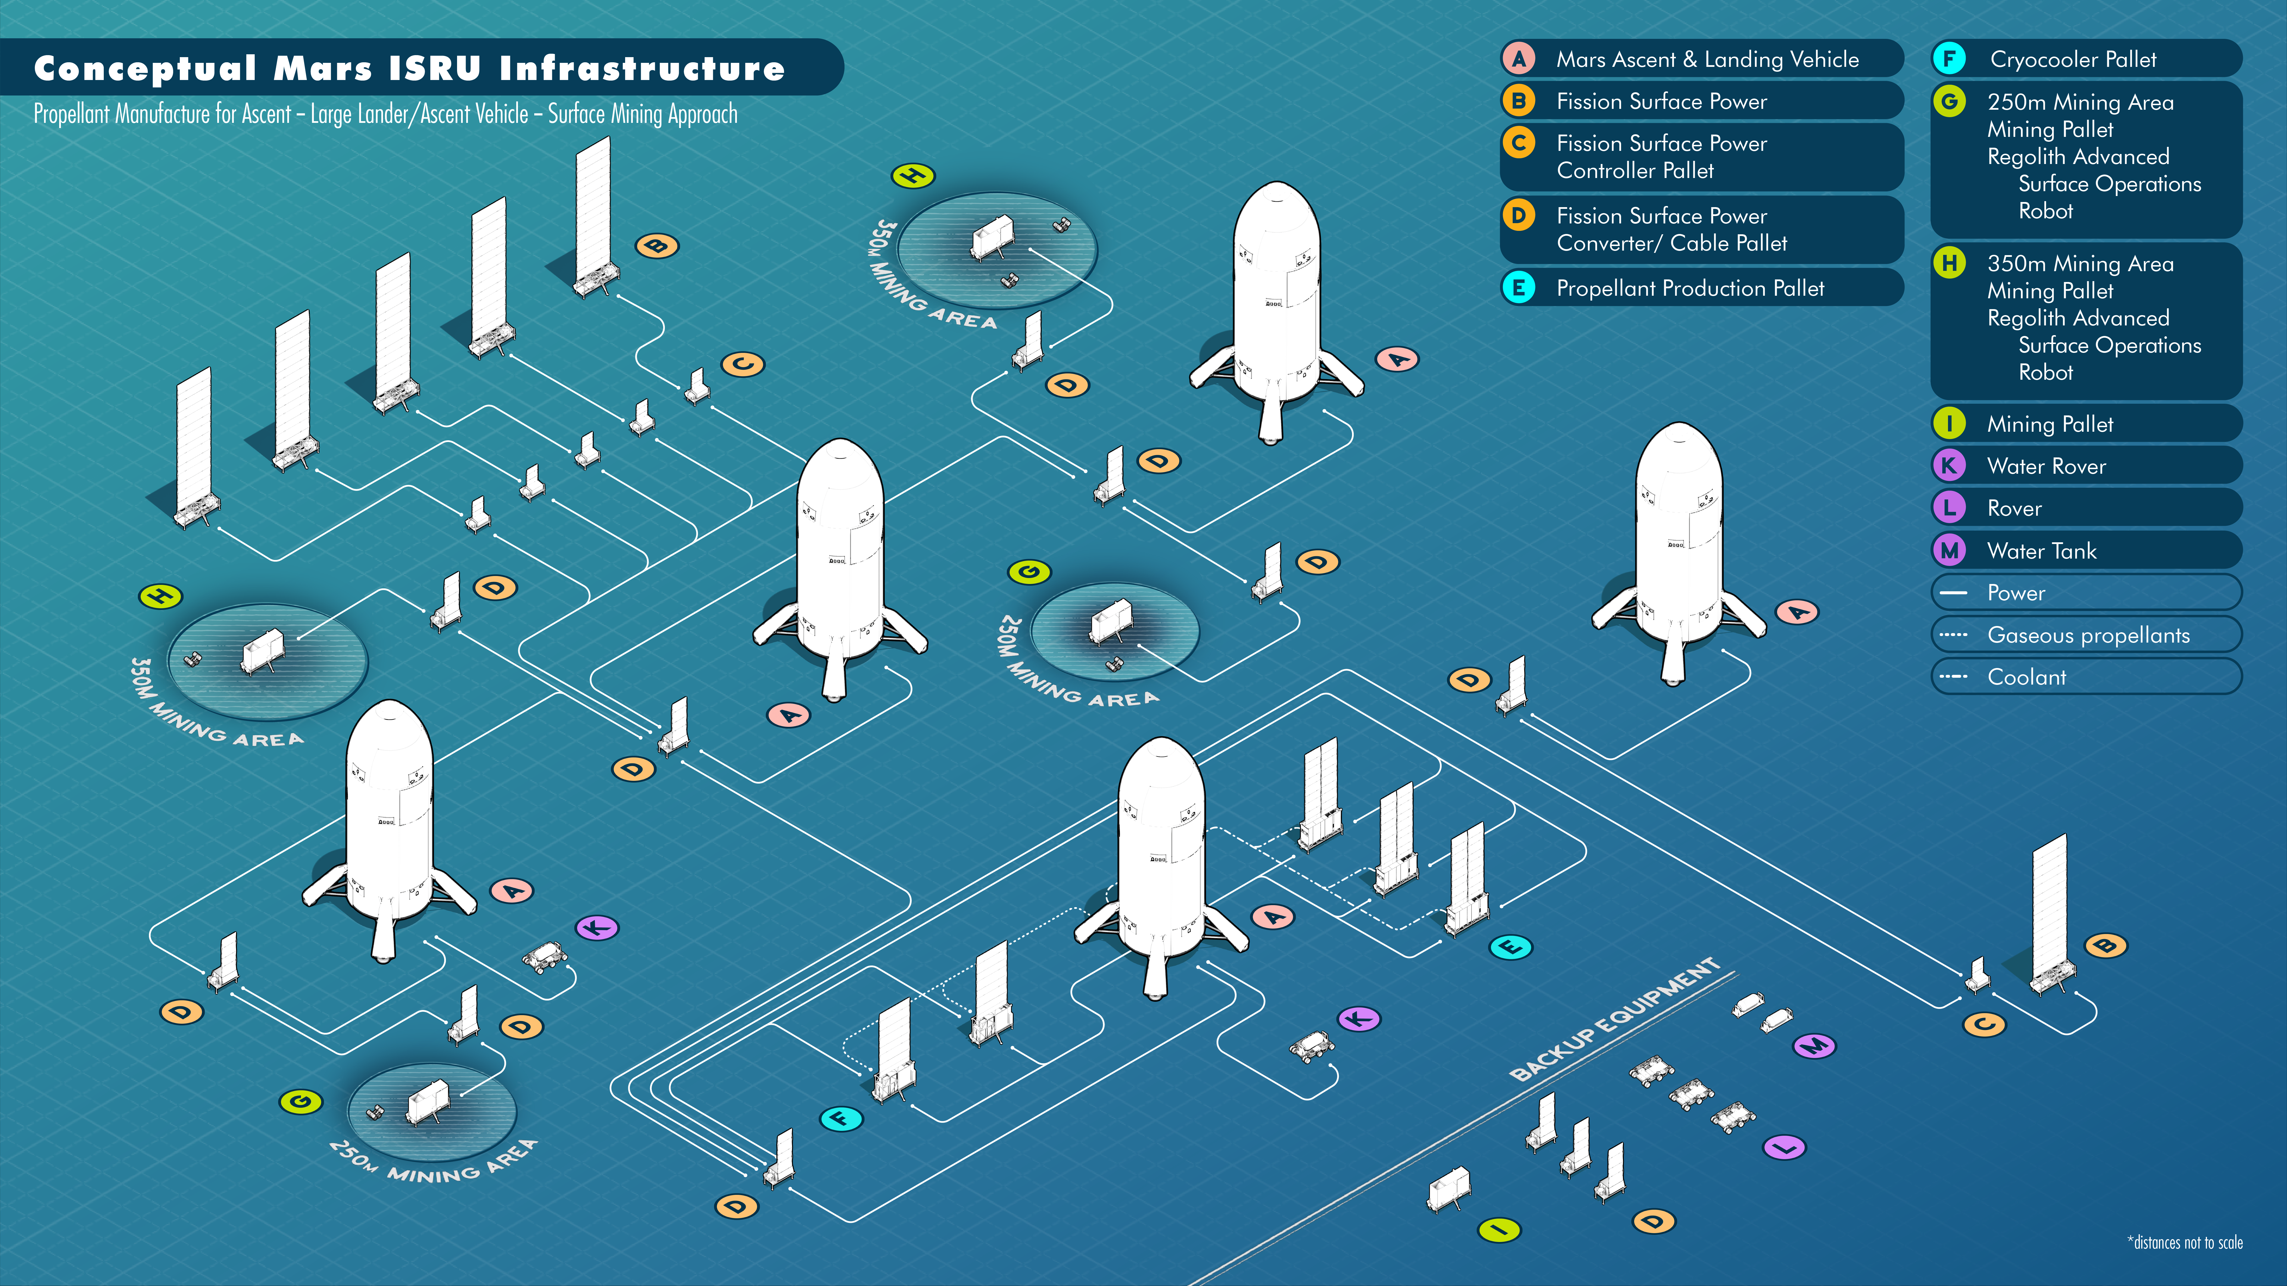
Example: Case 5 “Surface Mining” Surface Infrastructure

Slide 8
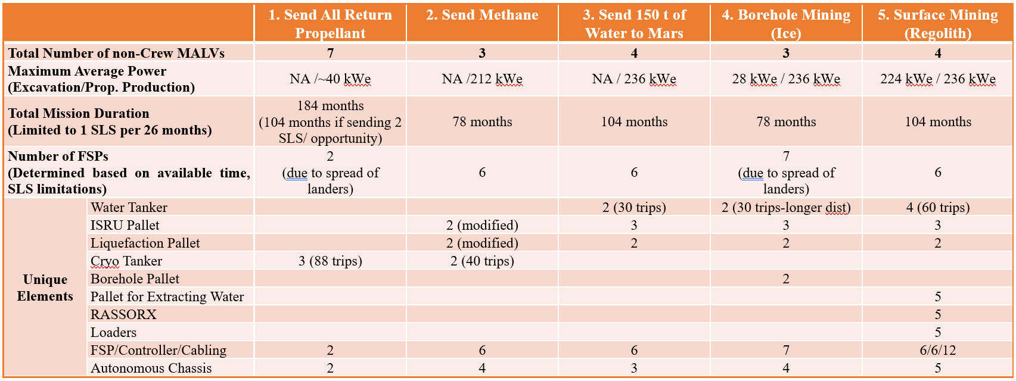
Summary of Results: Table 1

Slide 9
Conclusions: Individual Case Studies
Case 1 (“Send All Return Propellant”)
  Requires the least amount of surface infrastructure – essentially no ISRU propellant production infrastructure.
  Requires the most cargo MALVs to deliver the ascent propellant.
Case 2 (“Send All Methane to Mars”)
  Cuts the number of cargo MALVs needed by more than half (compared to Case 1).
  Cuts the time to establish this capability by more than half (compared to Case 1).
  One of two options requiring the least number of cargo MALVs, therefore one of the shortest amounts of time to establish an ISRU capability.
Case 3, 4, and 5
  All use the same surface infrastructure to convert water and atmospheric CO₂ into CH₄ and O_{2.}
  The only difference is the source of the water and the means to collect it.
Case 3 (“Send 150t of Water to Mars”)
  At least two cargo MALVs needed for each ascent, if infrastructure is reused.
Case 4 (“Borehole Ice Mining”)
  One of two options requiring the least number of cargo MALVs, therefore one of the shortest amounts of time to establish an ISRU capability.
  Constrained to surface sites with access to buried ice.
Case 5 (“Surface Regolith Mining”)
  Significant surface operational complexity; regolith mass gathered and processed is likely a minimum of ~100 times the water mass needed
  Surface site location is unconstrained (if sufficient loose regolith is available)

Slide 10
Conclusions
Capability Evolution
  Several potential evolutionary paths (from simpler to more complex capabilities) emerged if infrastructure used for more than one crew.
    Spreads surface infrastructure development cost over a longer period of time.
    Builds confidence in complex infrastructure operations in an incremental fashion.
    No reliability assessment was performed during these assessment, so additional lifetime work is needed.
  An example: Case 1 has the least amount of surface ISRU infrastructure, but the elements used are common across all the other cases.
  Another example: Case 3 has all propellant production and cryogenic cooling infrastructure needed for Cases 3, 4, and 5, allowing the ultimate choice of water source to be deferred.
General Observation
  No single case emerged as “better” in all aspects when compared to the others.
    Distinct advantages and disadvantages emerged, some tied to the common assumptions.
  Specific mission objectives may determine if these advantages or disadvantages are important for choosing among the cases.

Slide 11
Backup

Slide 12
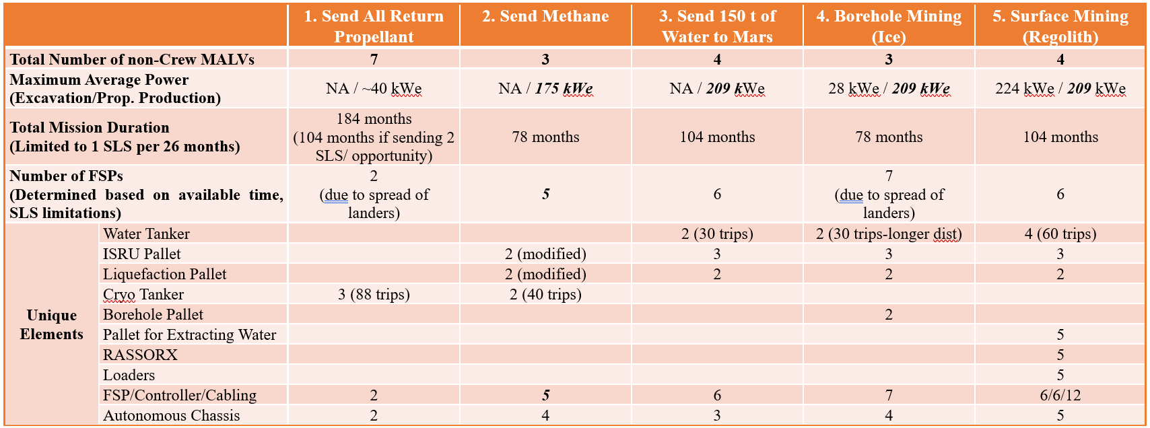
Summary of Results: Table 2

