Slide 1
Fluidic Fence Flow Control on a 30° Swept Wing in Compressible Freestreams
Evan J. McFadden & Jeffrey P. Bons
The Ohio State University
Mechanical and Aerospace Engineering
2025 AIAA SciTech Forum, Jan. 6th – 10th

Slide 2
Motivation

Slide 3
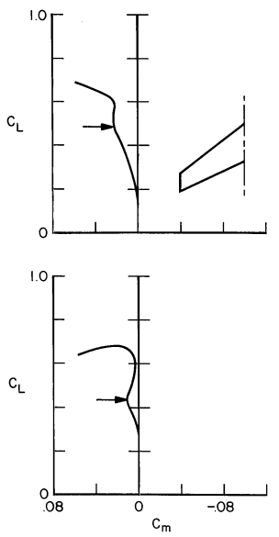
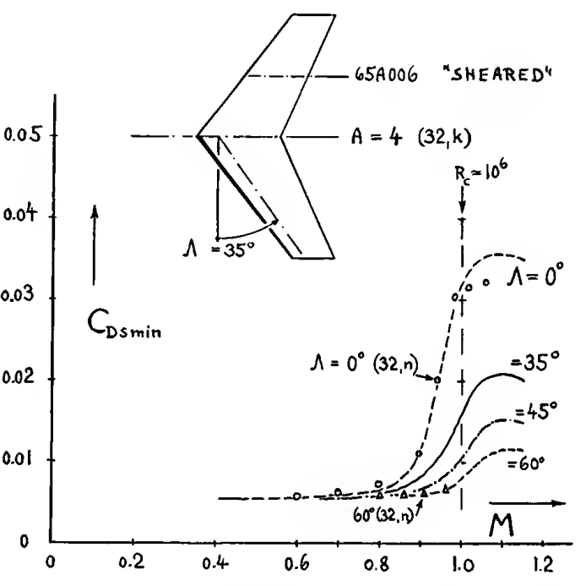
Swept Wing Design
Designed for high-speed flight
Drag rise at high subsonic Mach numbers weakened by sweeping the wing
Complicated stall patterns in low-speed flight
Susceptible to sudden pitch break and loss of lift
Dependent on Mach number
[Hoerner, 1965]
[Harper and Maki, 1964]

Slide 4
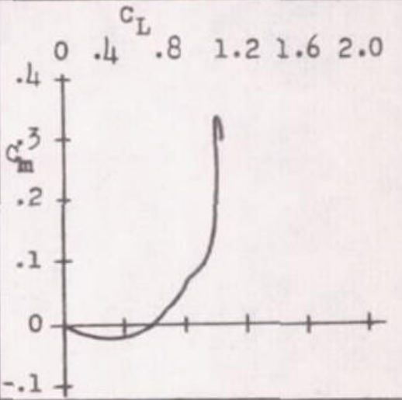
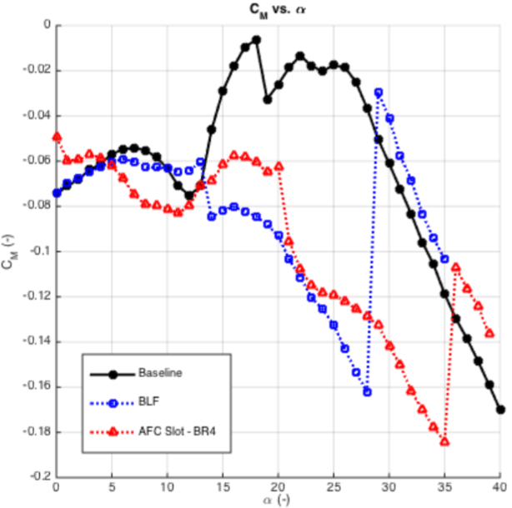
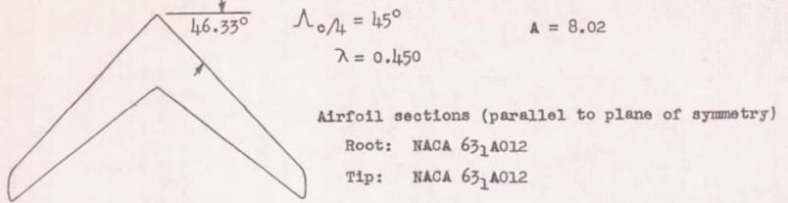
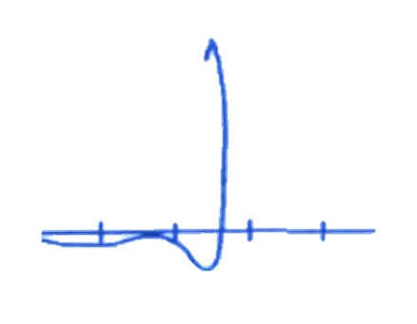
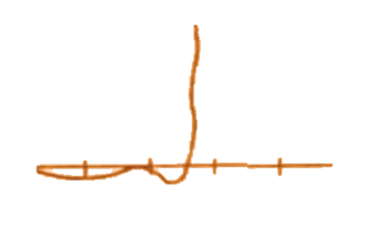


Fence-type flow control methods
Passive control techniques and high lift devices can modify the pitch performance
An active ‘fluidic fence’ via slot blowing mimics passive fence benefits
  Lower drag penalty, can be actuated ‘as-needed’
[Pratt and Shields, 1952]
+
0
–
[Walker and Bons, 2018]
C_{M}
0°
α
40°

Slide 5
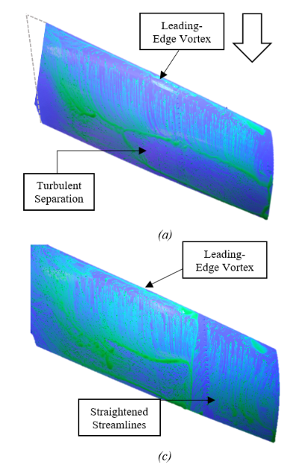
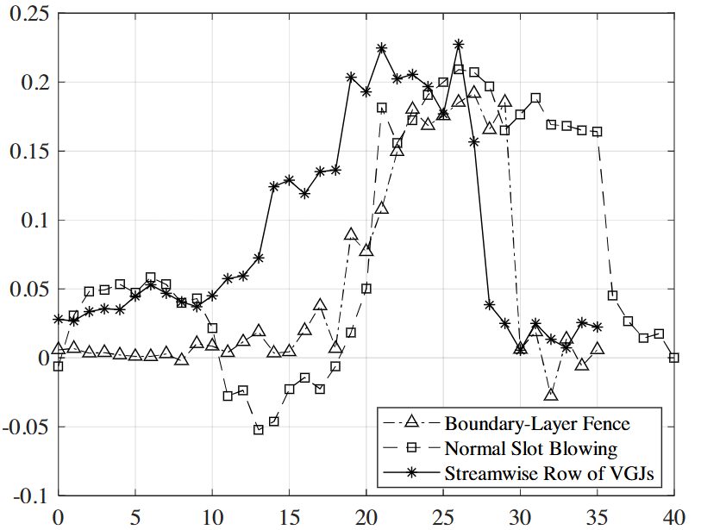
Fence-type flow control methods
Obstruction of spanwise flow on suction surface improves flow on outboard wing
Lift increment over wide range of α, especially with VGJs
[McFadden et al, 2023]
M = 0.05
Re = 10⁵
α = 15°
Fluidic fence
ΔC_{L}
α (°)
[McFadden et al, 2022]

Slide 6
Study Objectives
Test the performance of a streamwise row of vortex generating jets in compressible freestreams for enhanced AFC utility
Evaluate how performance scales with AFC cost metrics at higher Mach numbers

Slide 7
Methods

Slide 8
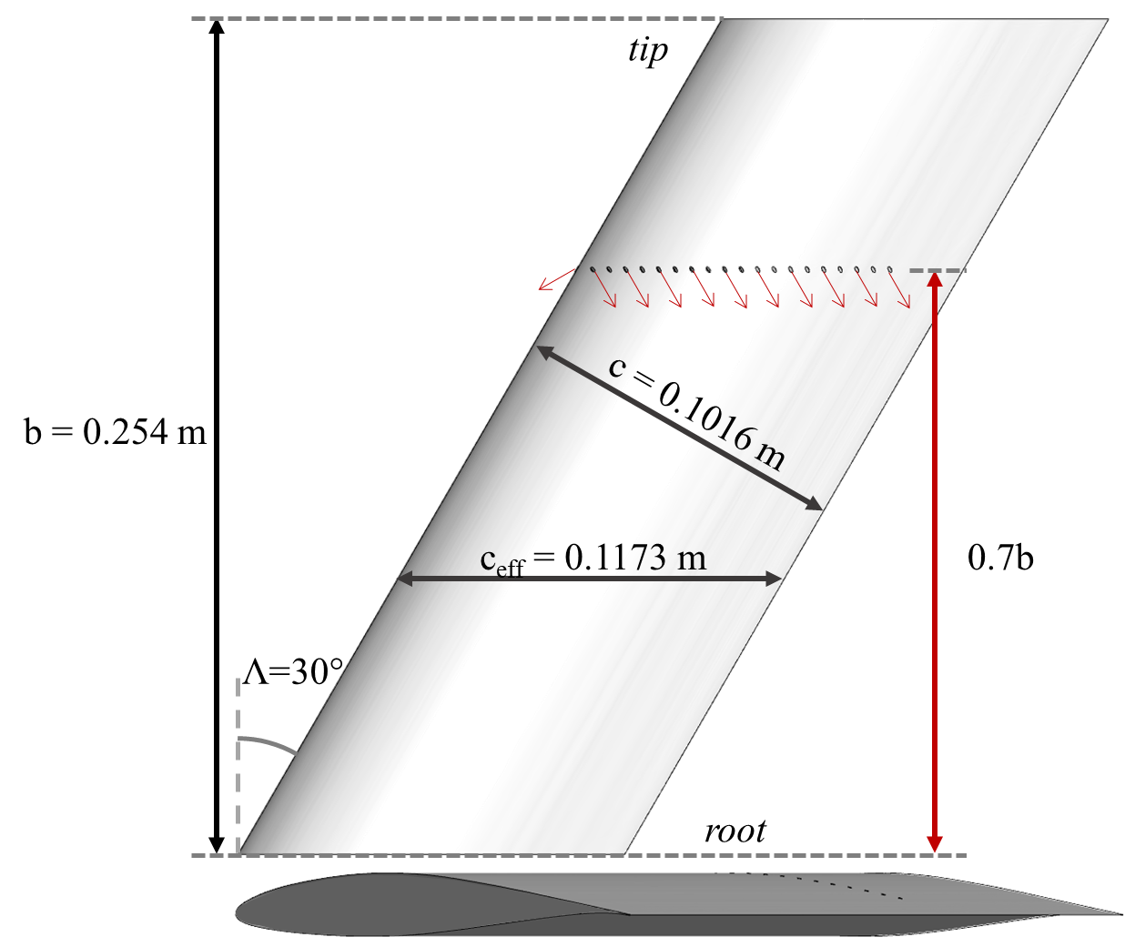
Model Details
30° Swept Wing
AR=4.3, no taper
NACA 64₃-618 airfoil along true chord, c
Active flow control at 70% span
Test article for previous AFC studies, experimental and computational

Slide 9
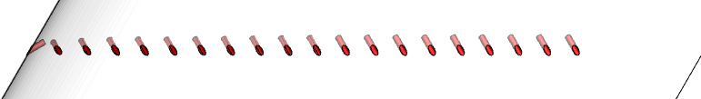
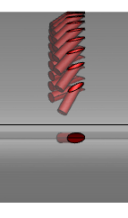
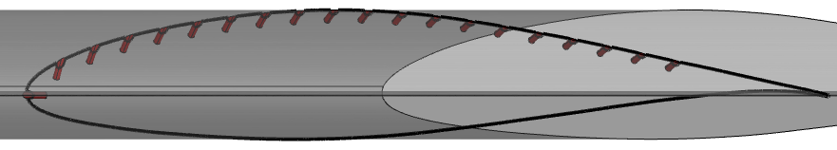
Active Flow Control Method
20 vortex generating jets (VGJs)
1mm diameter, placed 5 diameters apart
60° skew, 30° pitch (relative to local surface curvature)
  Leading edge jet constrained to 90° skew
Flat face specified as inlet BC
30° pitch
60° skew
TOP
5mm
FRONT
SIDE

Slide 10
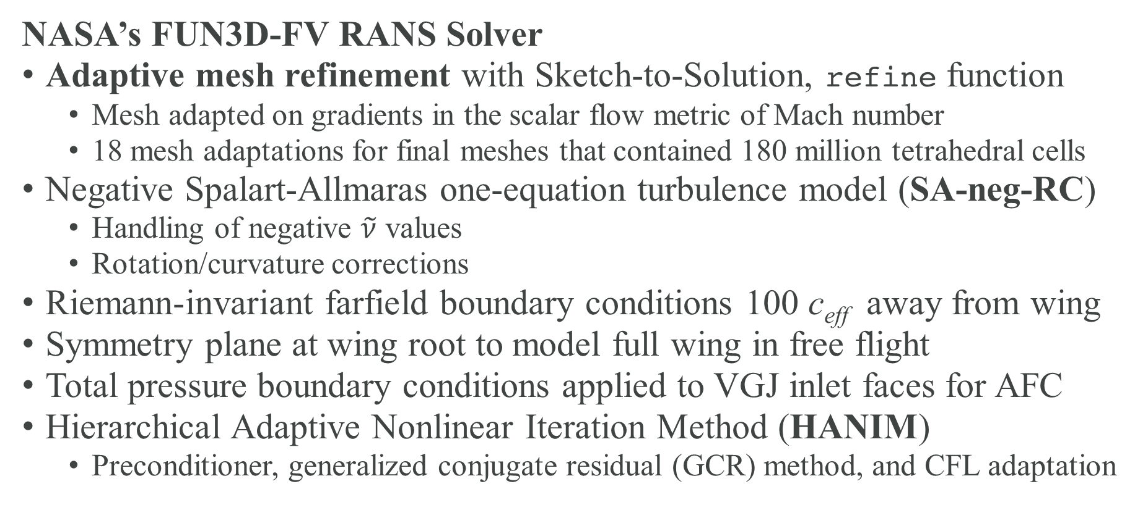
CFD Methods
NASA’s FUN3D-FV RANS Solver
Adaptive mesh refinement with Sketch-to-Solution, refine function
  Mesh adapted on gradients in the scalar flow metric of Mach number
  18 mesh adaptations for final meshes that contained 180 million tetrahedral cells
Negative Spalart-Allmaras one-equation turbulence model (SA-neg-RC)
  Handling of negative $\tilde{ν}$ values
  Rotation/curvature corrections
Riemann-invariant farfield boundary conditions 100 c_{eff} away from wing
Symmetry plane at wing root to model full wing in free flight
Total pressure boundary conditions applied to VGJ inlet faces for AFC
Hierarchical Adaptive Nonlinear Iteration Method (HANIM)
  Preconditioner, generalized conjugate residual (GCR) method, and CFL adaptation

Slide 11
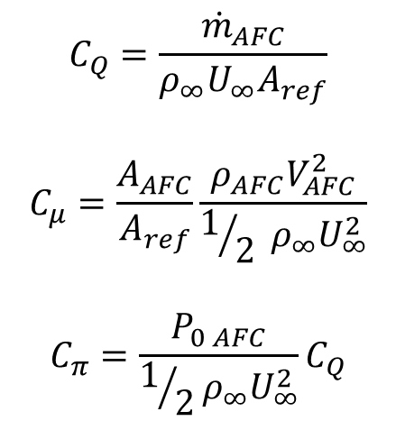
Test Matrix
4 freestream Mach number setpoints, 2 angles of attack at each (5° & 10°)
  First Mach number matched low-speed wind tunnel conditions
Targeted a constant mass flow coefficient (C_{Q}) at each setpoint
 | M = 0.051 | M = 0.30 | M = 0.5 | M = 0.7
Mach | 0.051 | 0.300 | 0.500 | 0.700
Temperature (K) | 300 | 300 | 300 | 300
Velocity (m/s) | 17.8 | 104.2 | 173.6 | 243.1
Re | 1.0e5 | 5.8e5 | 9.7e5 | 1.4e6
Angles of attack | 5°, 10° | 5°, 10° | 5°, 10° | 5°, 10°
PR_{AFC} | 1.05 | 2.54 | 4.21 | 4.83
C_{Q} | 0.0024 | 0.0027 | 0.0029 | 0.0028
C_{µ} | 0.0223 | 0.0138 | 0.0074 | 0.0065
C_{π} | 1.374 | 0.130 | 0.084 | 0.056
VR | 4.62 | 2.54 | 1.26 | 1.14
$$C_{Q}=\frac{{\dot{m}}_{AFC}}{ρ_{∞}U_{∞}A_{ref}}$$
$$C_{μ}=\frac{A_{AFC}}{A_{ref}}\frac{ρ_{AFC}V_{AFC}^{2}}{1/2 ρ_{∞}U_{∞}^{2}}$$
$$C_{π}=\frac{P_{0 AFC}}{1/2ρ_{∞}U_{∞}^{2}}C_{Q}$$

Slide 12
Results

Slide 13
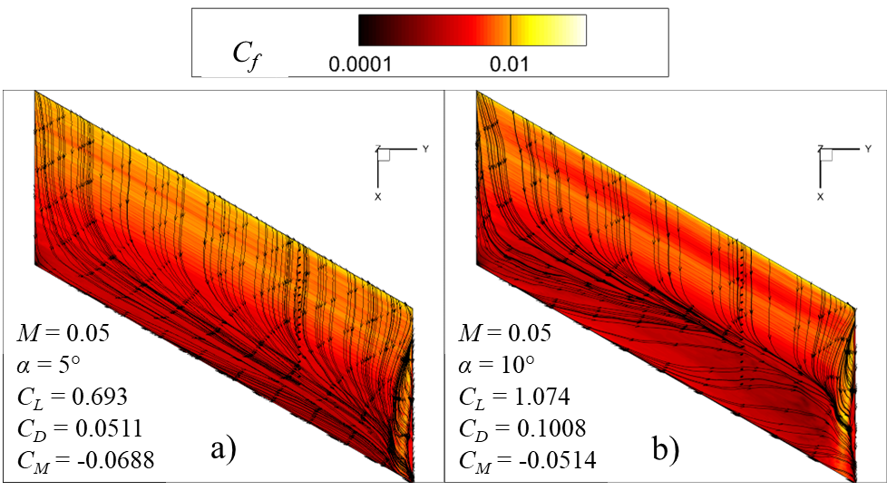
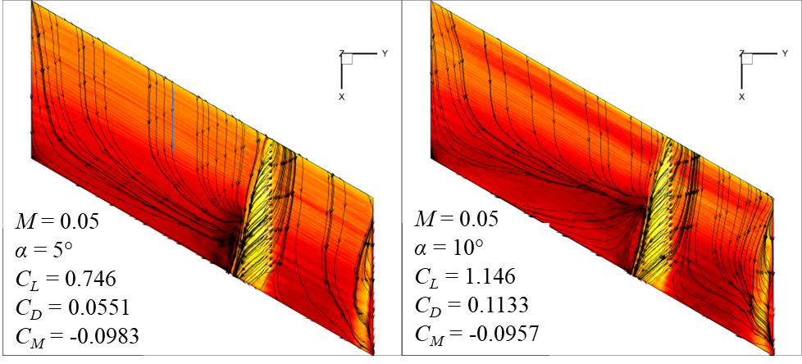
Low-Speed (M = 0.05) Results
V∞
Baseline:
Spanwise flow development
Trailing-edge separation
AFC:
Flow improved on outboard wing section
  ~7% lift enhancement at each angle of attack
Entrainment, streamlines turning towards fluidic fence
ΔC_{L} = 7.7%
ΔC_{D} = 7.9%
ΔC_{M} = 42.8%
ΔC_{L} = 6.7%
ΔC_{D} = 12.4%
ΔC_{M} = 86.3%

Slide 14
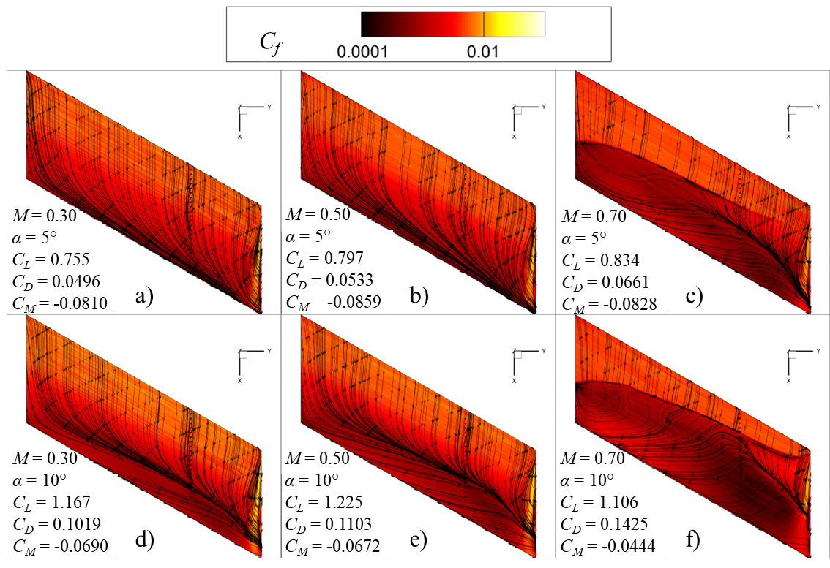
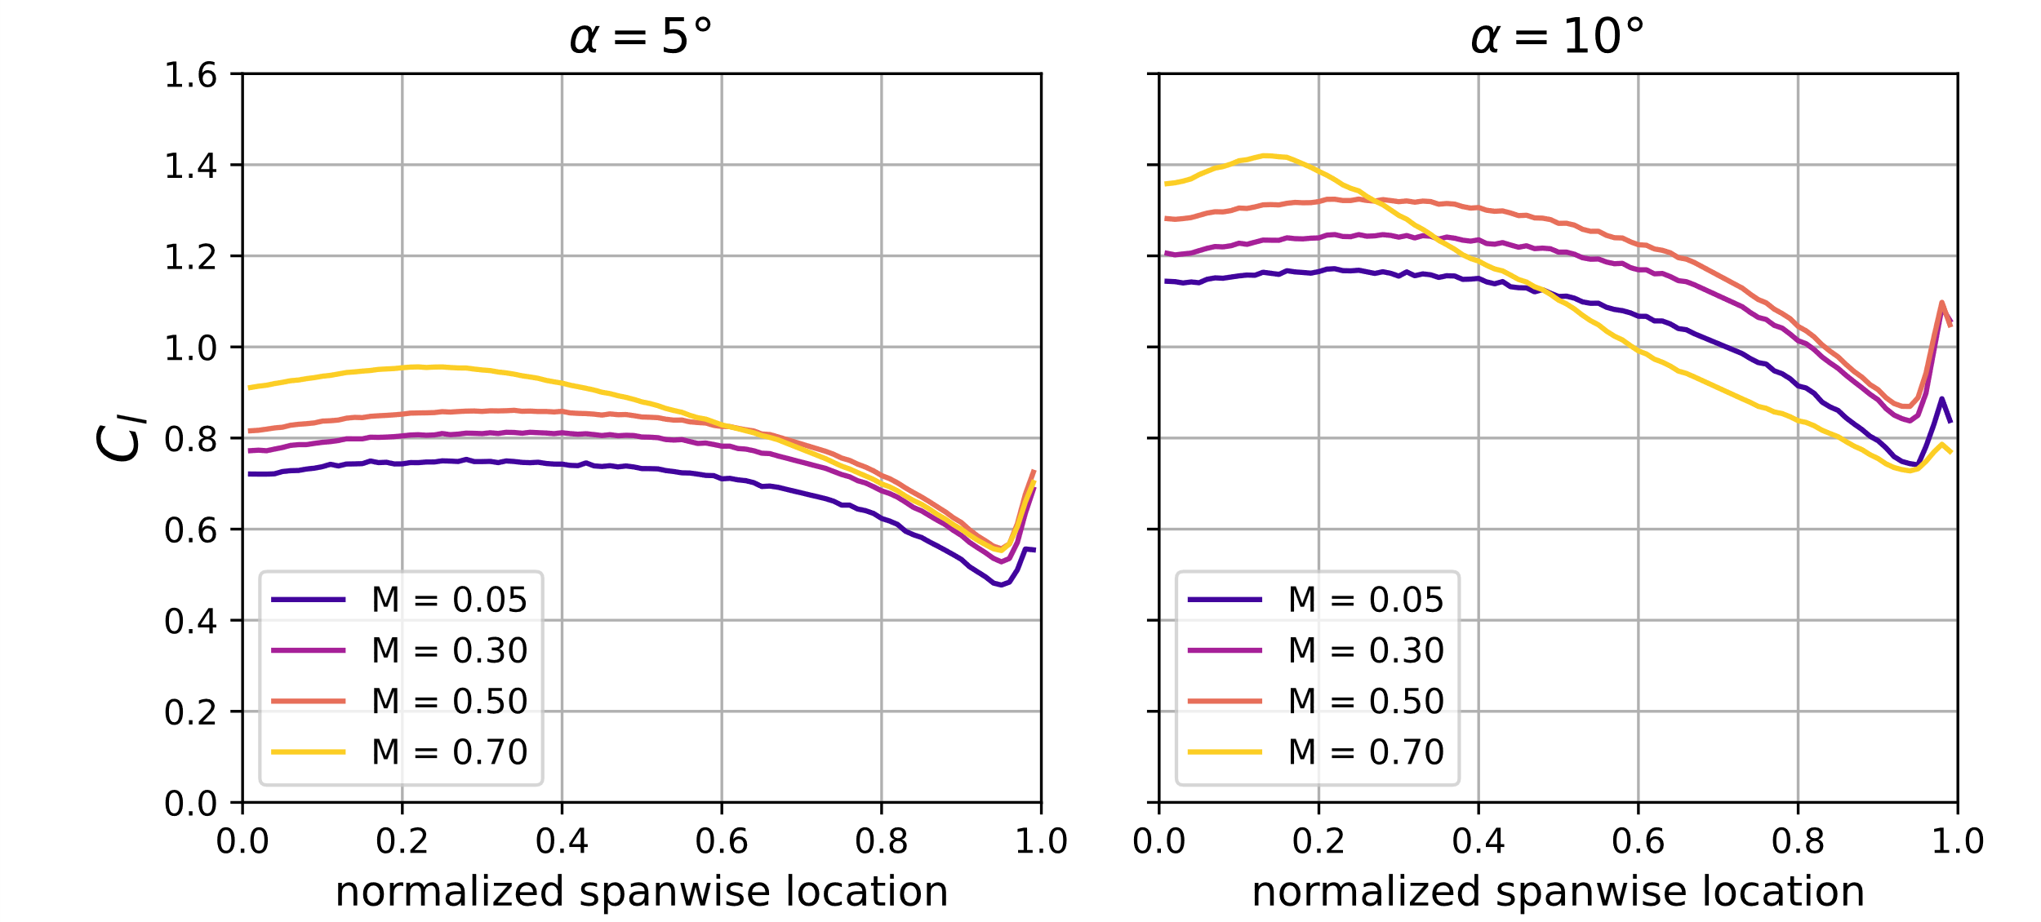
Baseline wing performance
V∞
Spanwise flow development more rapid with Mach
  TE separation line moves forward on chord
C_{l} drop-off with span intensifies with M

Slide 15
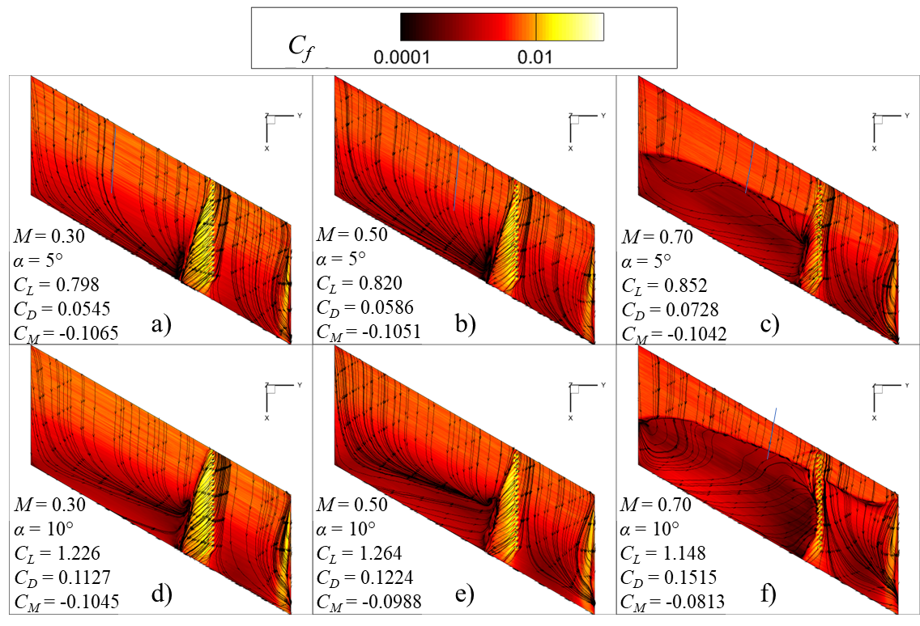
AFC wing performance
V∞
Obstructs inboard spanwise-oriented flow
Outboard attached flow
Shock-induced separation significantly reduced
Smaller local AFC impact
  Linked to constant C_{Q}
ΔC_{L} = 5.7%
ΔC_{D} = 9.9%
ΔC_{M} = 31.5%
ΔC_{L} = 3.0%
ΔC_{D} = 9.9%
ΔC_{M} = 22.3%
ΔC_{L} = 2.1%
ΔC_{D} = 10.0%
ΔC_{M} = 25.8%
ΔC_{L} = 5.0%
ΔC_{D} = 10.7%
ΔC_{M} = 51.5%
ΔC_{L} = 3.2%
ΔC_{D} = 10.9%
ΔC_{M} = 47.1%
ΔC_{L} = 3.8%
ΔC_{D} = 6.3%
ΔC_{M} = 82.8%

Slide 16
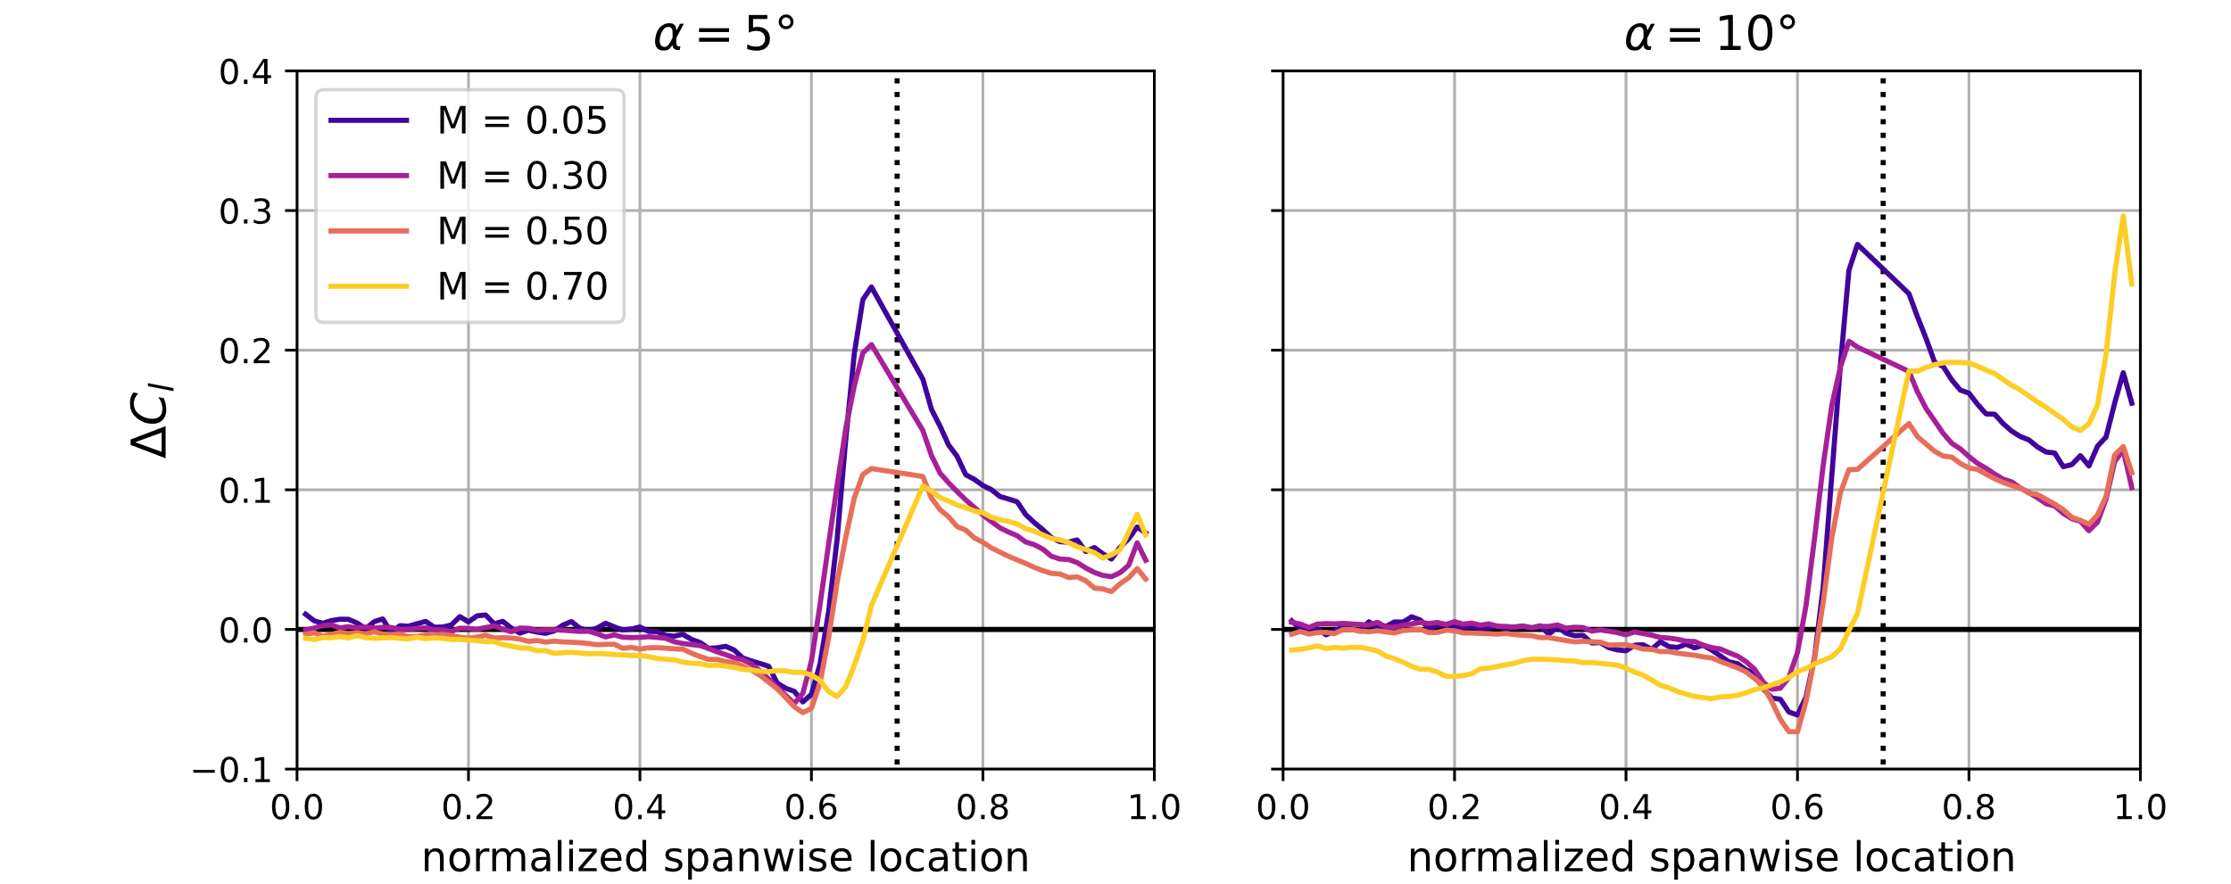
Section lift distributions
ΔC_{l} highest for low M
  Monotonic with Mach until shock-induced separation becomes relevant
Inboard losses due to blowing
Lift enhancements highest immediately surrounding VGJs
Effect of wingtip vortex re-introduced for M = 0.7, α = 10°
Baseline Lift Distributions
ΔC_{l} due to AFC

Slide 17
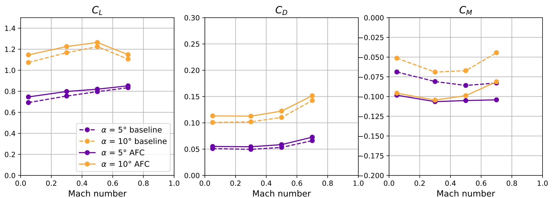
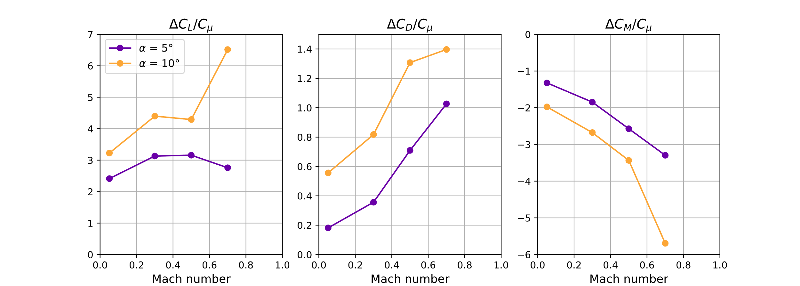
Force Coefficient Summary
Lift and drag always increase with actuation
Pitching moment more negative with actuation
Normalizing with C_{µ} demonstrates high Mach effectiveness
  C_{µ} is expensive

Slide 18
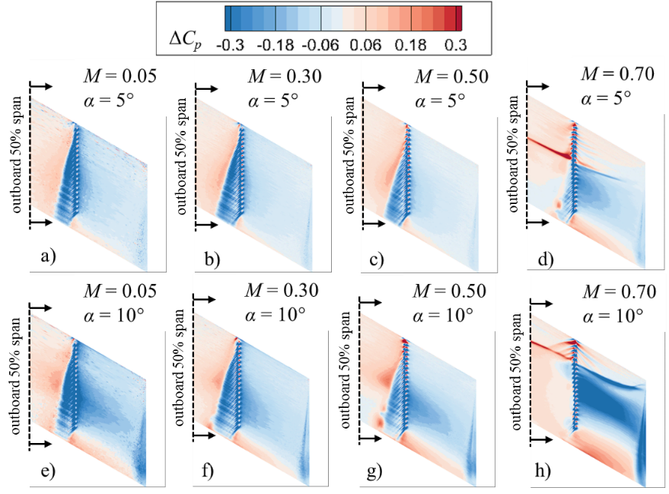
Local changes in pressure coefficient
V∞
ΔC_{p} further aft for higher Mach
Region of decreased pressure gets smaller with Mach
Saturated streaks of ΔC_{p} from movement of SS shock
ΔC_{l} due to AFC

Slide 19
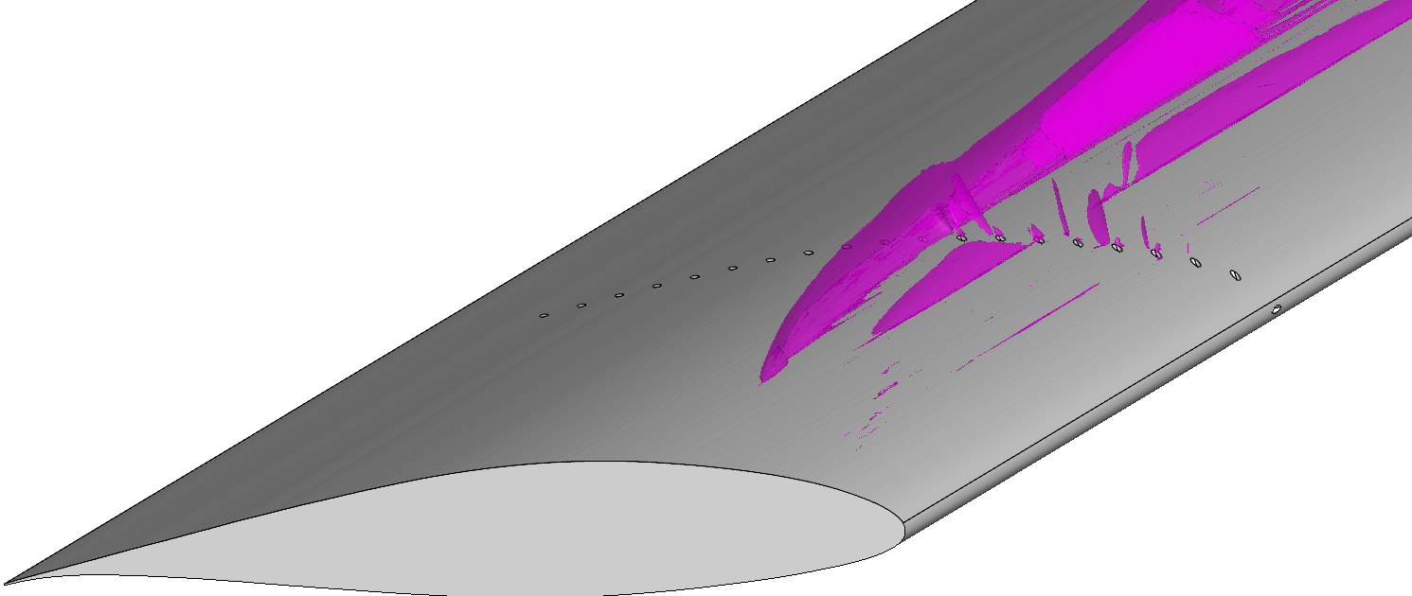
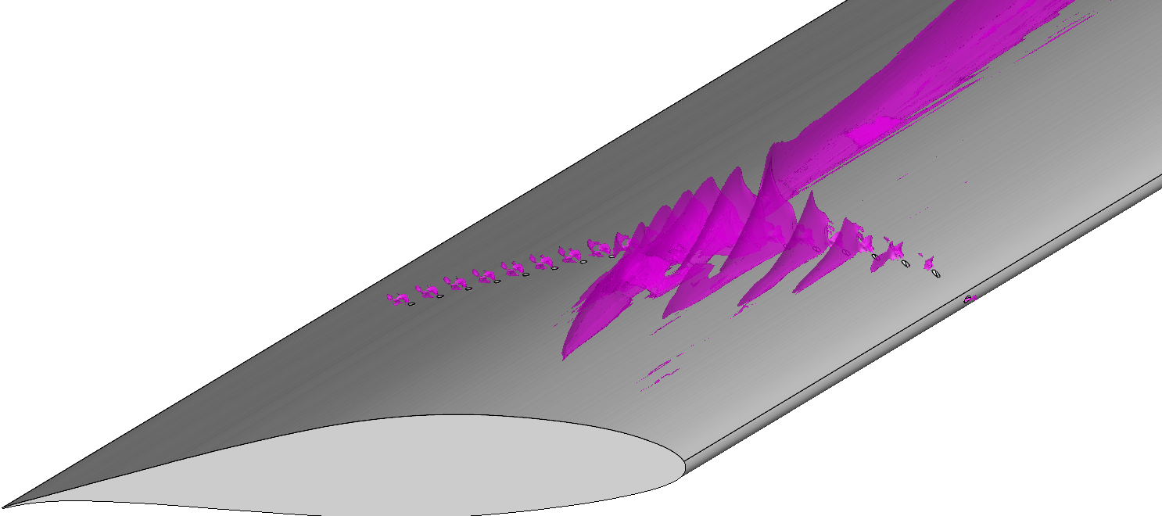
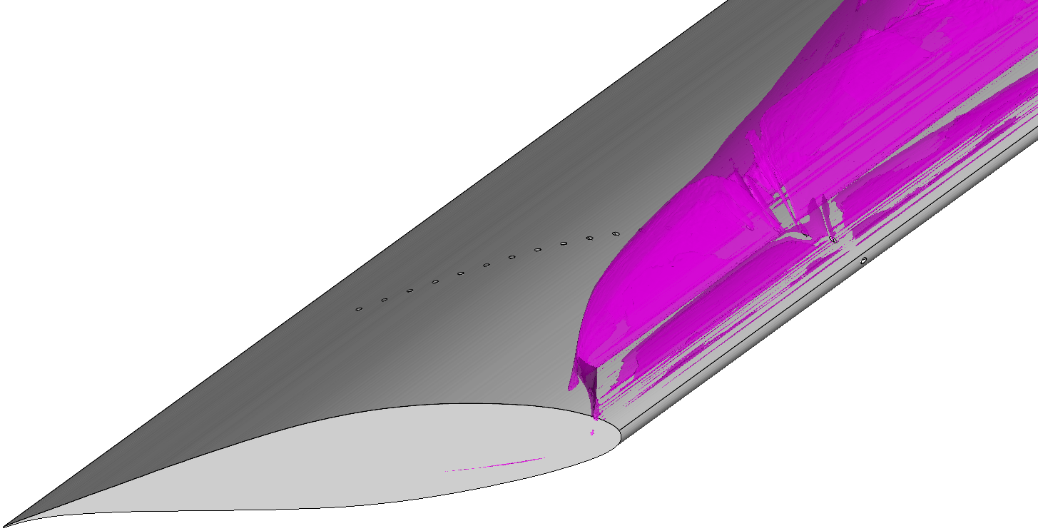
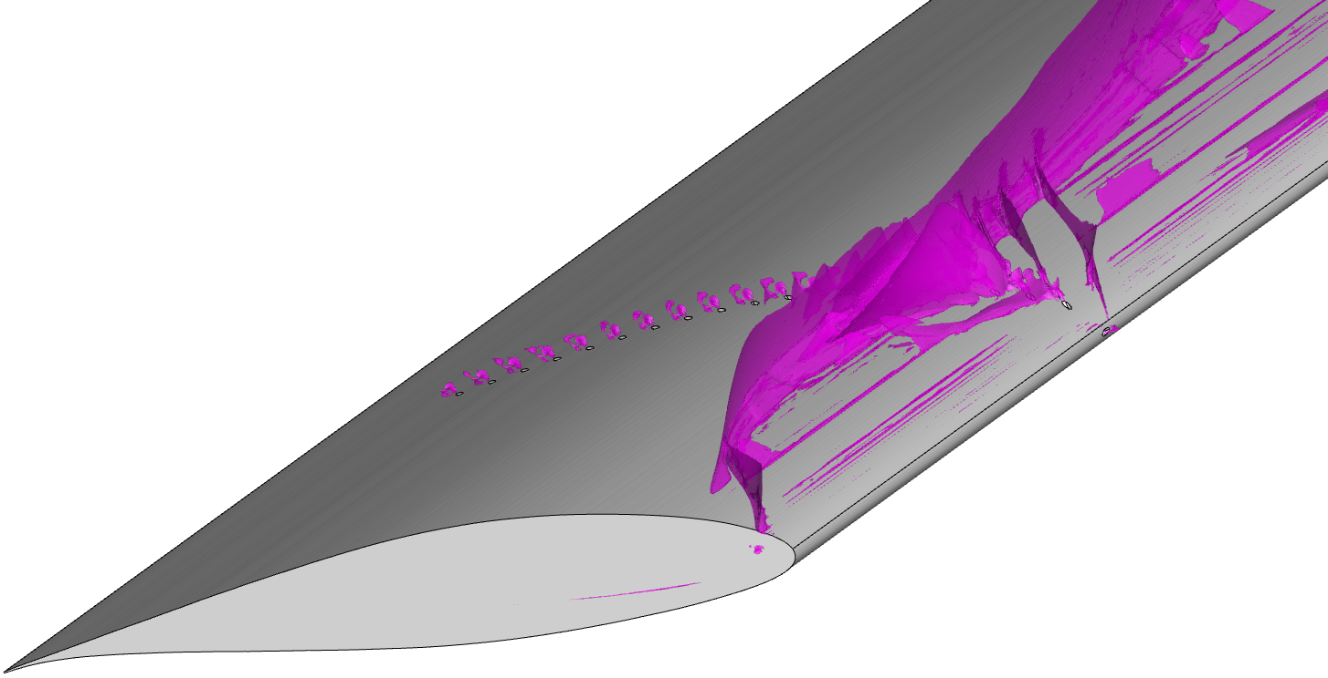
Change in Shock Location for M = 0.7
Baseline
α=5°
AFC
α=5°
Baseline
α=10°
AFC
α=10°

Slide 20
Conclusions
Streamwise row of VGJs tested computationally at freestream Mach numbers of 0.05, 0.3, 0.5, and 0.7 at constant C_{Q}
Flow improvements found outboard of control, as with previous studies
  Consistently decreased pitching moment, good for control
Increments in lift decreased with Mach number, effect of C_{Q}
  7.7% to 2.1% ΔC_{L} at α = 5°
  6.7% to 3.8% ΔC_{L} at α = 10°
Change in pressure coefficients found further aft on suction surface with M
Intriguing interplay with suction surface shock at M = 0.7
  Potential for other applications with shock features, reducing separation

Slide 21
References
Hoerner, S. F., Fluid-Dynamic Drag, published by the author, Bakersfield, CA, 1965, Chap. 15.
Harper, C. W. and Maki, R. L., "A Review of the Stall Characteristics of Swept Wings," NASA TN D-2373, 1964. https://ntrs.nasa.gov/citations/19640014908.
Pratt, G. L., and Shields, E. R., “Low-Speed Longitudinal Characteristics of a 45° Sweptback Wing of Aspect Ratio 8 with High-Lift and Stall-Control Devices at Reynolds Numbers from 1,500,000 to 4,800,000,” National Advisory Committee for Aeronautics Research Memo NACA R&M L51J04, 1952. https://ntrs.nasa.gov/citations/19930086963.
Walker, M. M. and Bons, J. P., "The Effect of Passive and Active Boundary-Layer Fences on Swept-Wing Performance at Low Reynolds Number," in 2018 AIAA Aerospace Sciences Meeting, Kissimmee, FL, 2018. https://doi.org/10.2514/6.2018-0793.
McFadden, E. J., Brandt, P. J. and Bons, J. P., "Swept-Wing Active Flow Control with a Streamwise Row of Vortex Generating Jets," AIAA Journal, vol. 61, no. 3, pp. 1142-1150, 2023. https://doi.org/10.2514/1.J062302.
McFadden, E. J., Brandt, P. J. and Bons, J. P., “The Effect of Spanwise Location of a VGJ Fluidic Fence on Swept Wing Performance,” in AIAA Aviation 2022 Forum, Chicago, IL, 2022. https://doi.org/10.2514/6.2022-3468.

Slide 22
QUESTIONS

Slide 23
Backup Slides

Slide 24

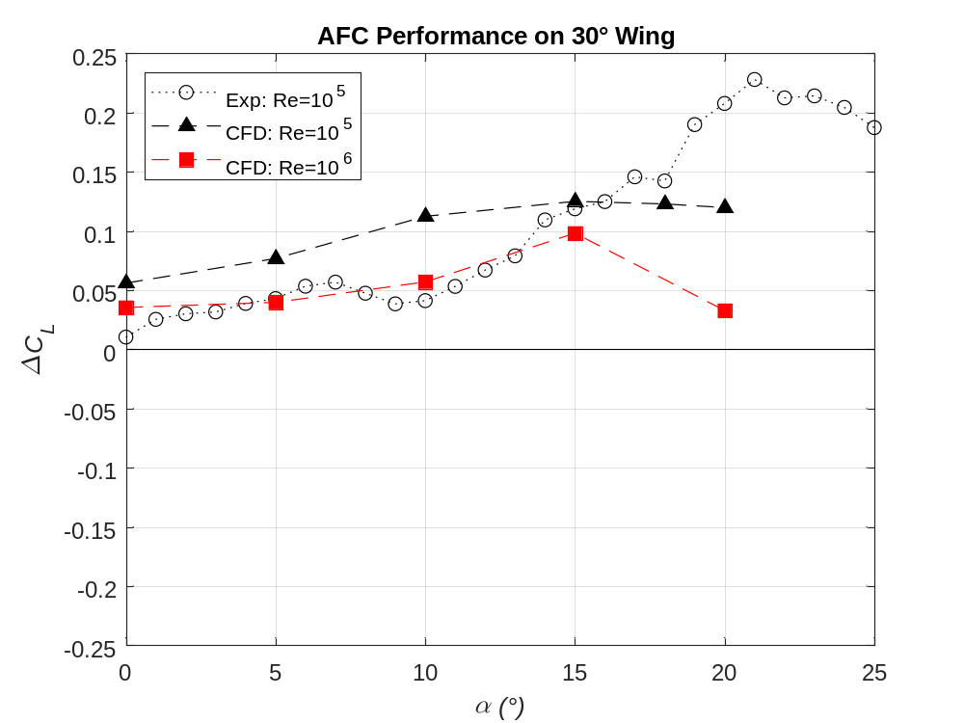
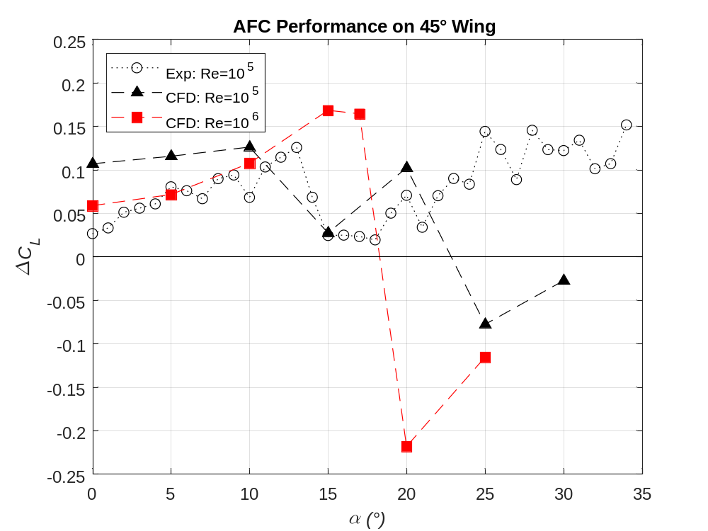
Leading-Edge Sweep and Reynolds Number Variation For Fluidic Fence Active Flow Control
Increasing Re from 10⁵ to 10⁶
VGJ Fluidic Fence @ Re=1,000,000
Benefits generally decrease at higher freestream Reynolds number
Note: CFD computes decrements to lift performance at high angles of attack

Slide 25
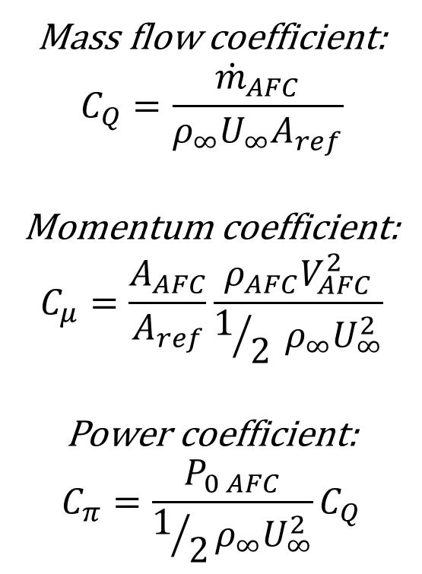
Active Flow Control System Costs
AFC cost metrics for required air supply
Design complexity = $$
Added weight = $$
Impact on cruise drag and fuel burn = $$
Goal: Minimize AFC cost, maximize AFC utility
Mass flow coefficient:
$$C_{Q}=\frac{{\dot{m}}_{AFC}}{ρ_{∞}U_{∞}A_{ref}}$$
Momentum coefficient:
$$C_{μ}=\frac{A_{AFC}}{A_{ref}}\frac{ρ_{AFC}V_{AFC}^{2}}{1/2 ρ_{∞}U_{∞}^{2}}$$
Power coefficient:
$$C_{π}=\frac{P_{0 AFC}}{1/2ρ_{∞}U_{∞}^{2}}C_{Q}$$

Slide 26
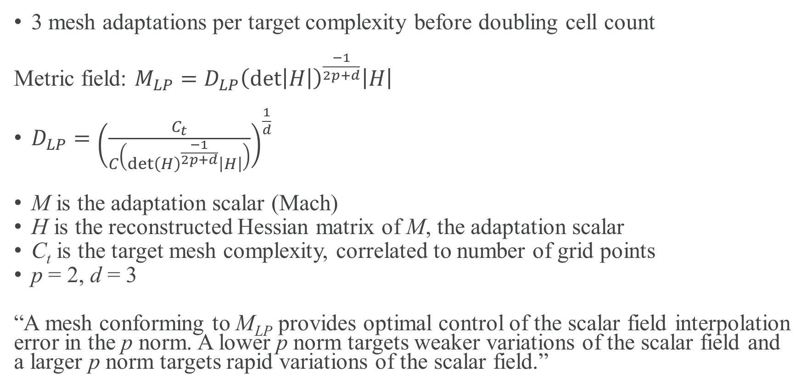
Sketch-to-Solution
3 mesh adaptations per target complexity before doubling cell count
Metric field: $M_{LP}=D_{LP}{\left(\det\left|H\right|\right)}^{\frac{−1}{2p+d}}\left|H\right|$
$D_{LP}={\left(\frac{C_{t}}{C\left(\det{{\left(H\right)}^{\frac{−1}{2p+d}}}\left|H\right|\right)}\right)}^{\frac{1}{d}}$
M is the adaptation scalar (Mach)
H is the reconstructed Hessian matrix of M, the adaptation scalar
C_{t} is the target mesh complexity, correlated to number of grid points
p = 2, d = 3
“A mesh conforming to M_{LP} provides optimal control of the scalar field interpolation error in the p norm. A lower p norm targets weaker variations of the scalar field and a larger p norm targets rapid variations of the scalar field.”

