Slide 1
Comparative Performance of Entry Simulations using Guided Human-Scale Landers at Mars
Evan Roelke (AMA/NASA LaRC)
Alejandro Pensado (AMA/NASA LaRC), Rafael Lugo (NASA LaRC)
Breanna Johnson, Daniel Matz (NASA JSC)
AIAA SciTech Forum and Exposition 2025
January 10, 2025

Slide 2
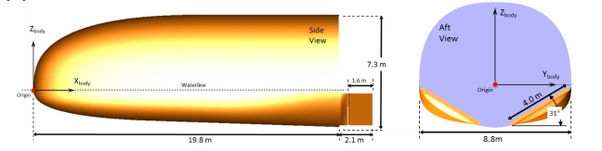
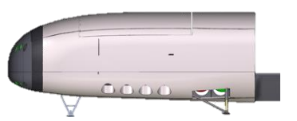
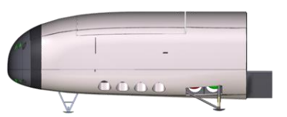
Overview
Numerous studies in the past decade have considered human-scale Mars landers
This work considers a mid-L/D, rigid lifting body
  Scaled up Co-Optimization Bluntbody Re-entry Analysis Mid-L/D Rigid Body (CobraMRV) concept to match ballistic coefficient of commercial concept
  Scale is not dimensionally 1:1 to target a desired ballistic coefficient
  Alternative vertical landing ConOps explored
The goal of this task is to test novel guidance algorithms and architectures in two simulations
  Program to Optimize Simulated Trajectories II (POST2): Flight-validated, multi-body 6DOF tool developed at NASA Langley Research Center
  Genesis: Julia-based successor to Flight Analysis and Simulation Tool (FAST) developed at NASA Johnson Space Center
  Identify processes needed to get to “apples-to-apples” simulation setup
  Demonstrate cross-simulation flyoff V&V
7.3 m
19.8 m
Cerimele, C.J., Robertson E.A., Sostaric, R. R., Campbell, C. H., Robinson, Matz, D. A., Johnson, B. J., Stachowiak, S. J., P., Garcia, J. A., Bowles, J. V., Kinney, D. J., and Theisinger, J. E., “A Rigid Mid-Lift-to-Drag Ratio Approach to Human Mars Entry, Descent, and Landing,“ AIAA Guidance, Navigation, and Control Conference, 2017.
45 m
10 m
Notes:
MACHETE class vehicle

Slide 3
Outline
Mission Concept of Operations
Guidance Algorithms
Results
  Simulation Environment Comparison
  Aerodynamics Comparison
  Entry Phase Comparisons
  Powered Descent Comparisons
Key Takeaways
Conclusions & Forward Work

Slide 4

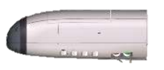
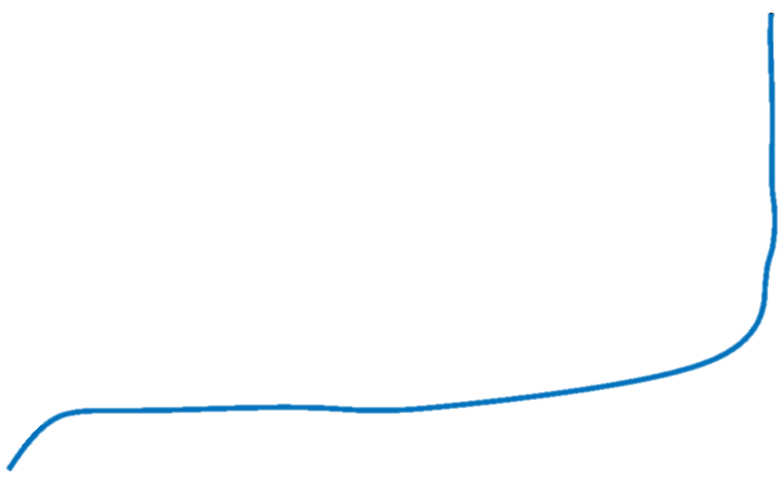
Concept of Operations
(1) Atmospheric Entry
(2) Guidance Initialization
(5) Powered Descent
(4) Pitch Up for SRP
(3) Terminal Area Energy Management (TAEM)
(6) Touchdown
SRP: Supersonic Retropropulsion
Notes:
TAEM (fix bank angle to null crossrange)

Slide 5
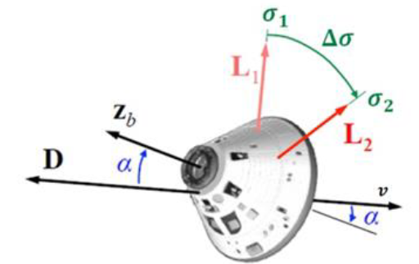
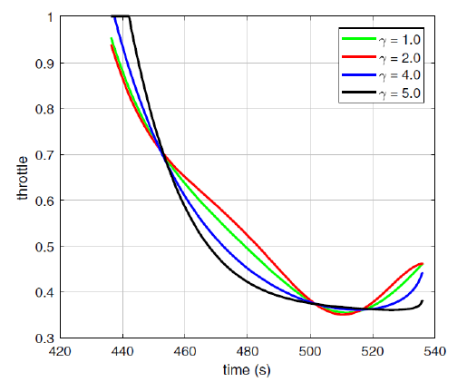
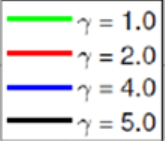
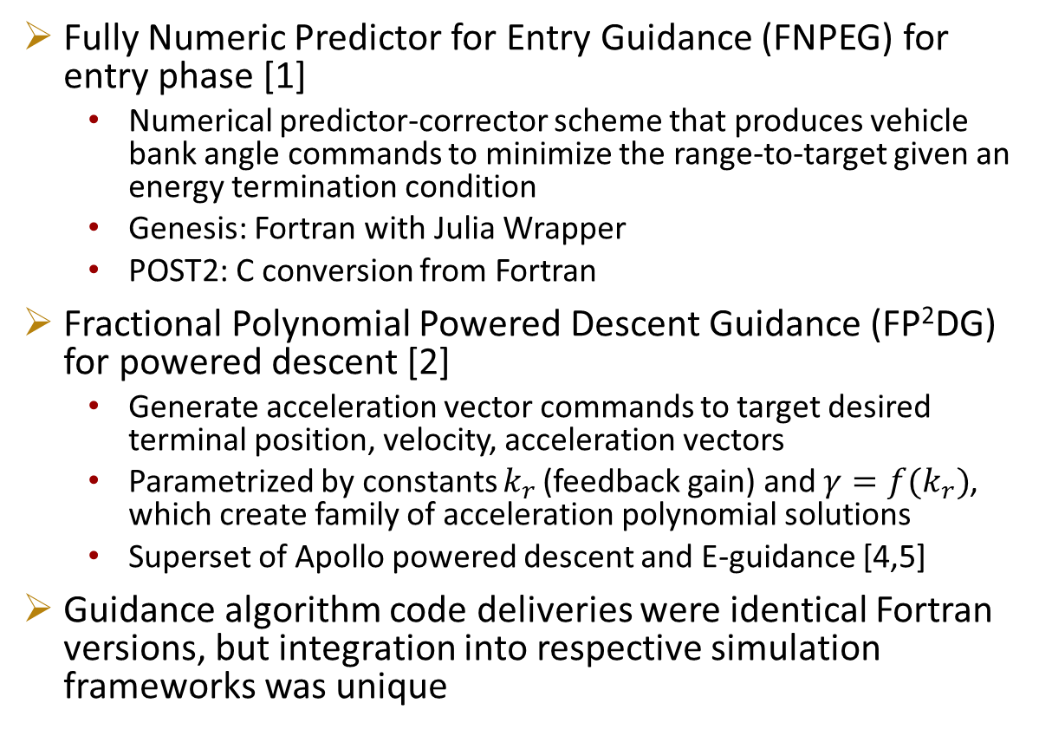
Guidance Algorithms
Fully Numeric Predictor for Entry Guidance (FNPEG) for entry phase [1]
  Numerical predictor-corrector scheme that produces vehicle bank angle commands to minimize the range-to-target given an energy termination condition
  Genesis: Fortran with Julia Wrapper
  POST2: C conversion from Fortran
Fractional Polynomial Powered Descent Guidance (FP²DG) for powered descent [2]
  Generate acceleration vector commands to target desired terminal position, velocity, acceleration vectors
  Parametrized by constants $k_{r}$ (feedback gain) and $γ=f(k_{r})$, which create family of acceleration polynomial solutions
  Superset of Apollo powered descent and E-guidance [4,5]
Guidance algorithm code deliveries were identical Fortran versions, but integration into respective simulation frameworks was unique
Bank angle modulation visualization
Throttle
[1] Lu, P., "Entry guidance: a unified method." Journal of Guidance, Control, and Dynamics, 2014. Vol 37, No. 3, pp 713-728.
[2] Lu, P., “Theory of Fractional-Polynomial Powered Descent Guidance,” Journal of Guidance, Control, and Dynamics, March 2020. Vol 43, No. 3. pp. 398-409.
Time (s)
Engine throttle polynomial families using FP²DG with k_{r}=15 [3]
Notes:
Note Fortran code delivery was identical. Integration into respective simulation was different

Slide 6
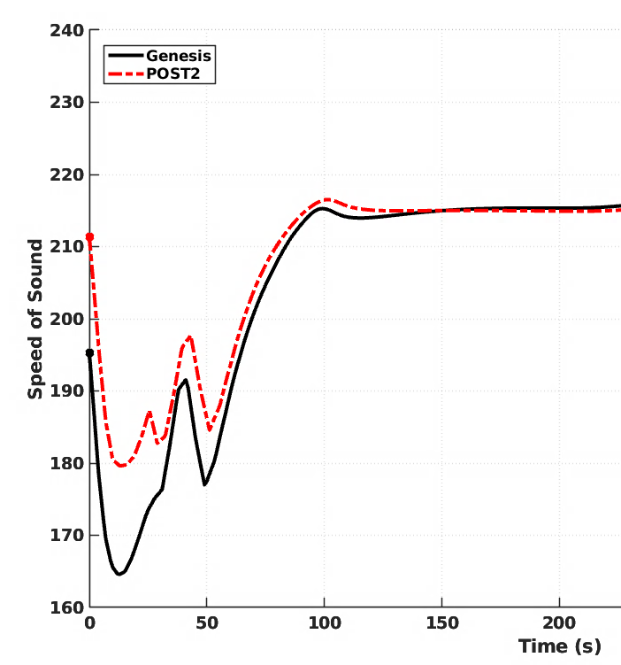
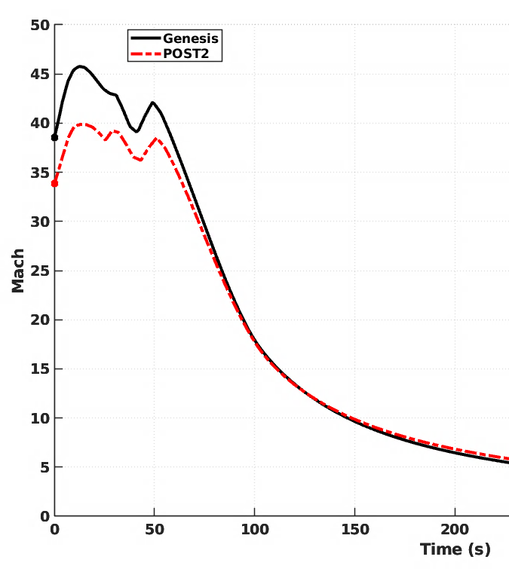
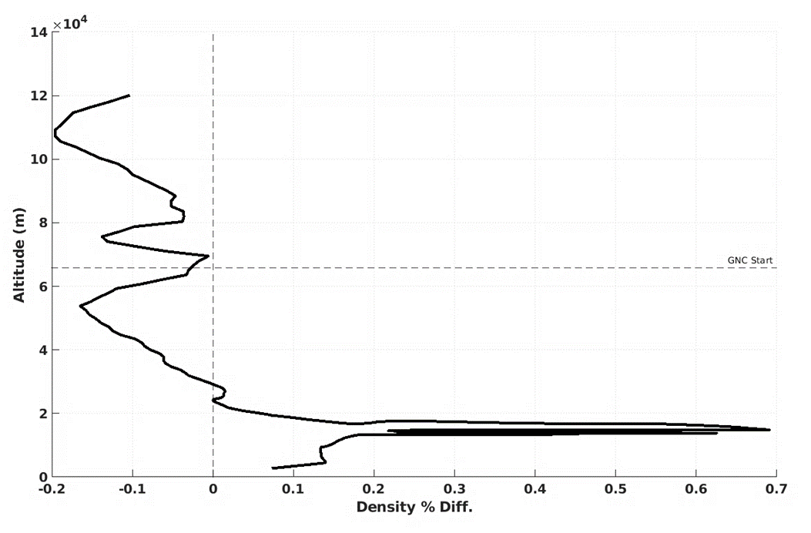
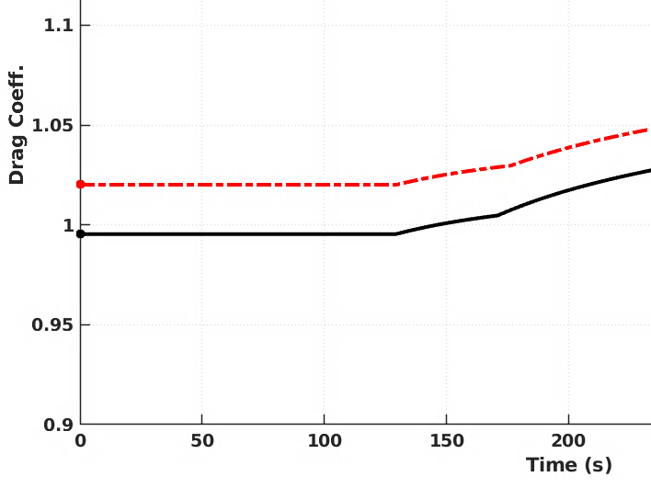
Results: Simulation Environment
Difference in speed of sound was noted between the simulations (likely due to differences in Knudsen number computations or known MarsGRAM 2010 Speed of Sound bug)
  Leads to a difference in Mach number at high altitudes and thus a slight discrepancy in aerodynamic coefficients
Overall, percent differences between the two simulation atmospheric densities varied by <1% at all altitudes
Even with common inputs we had difficulty matching GRAM output
  Additional verification required to ensure MarsGRAM outputs are 1:1
Speed of Sound (m/s)
Mach
GNC Start
Drag Coeff.
Altitude (m)
Density Diff. (%)

Slide 7
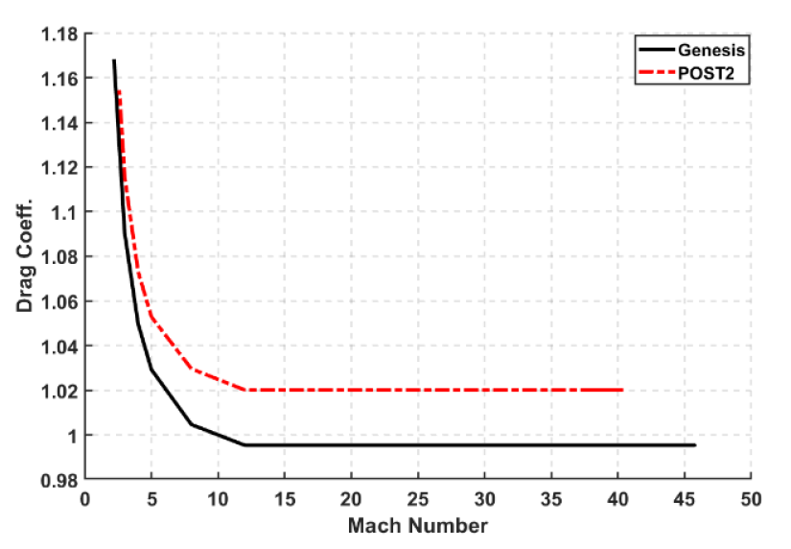
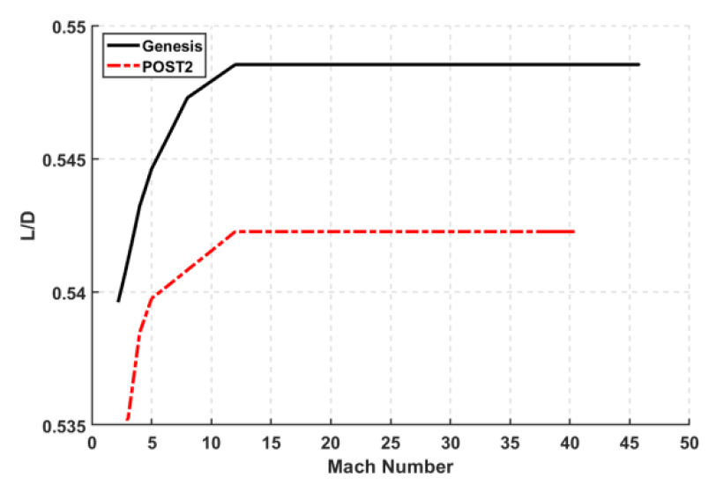
Results - Aerodynamics
Minor discrepancies in aerodynamics attributed to Mach number differences
Regardless, ~1% difference in L/D at start of simulation suggests performance will be similar but minor differences could manifest
L/D = 0.5485
~1% difference
L/D = 0.5422
C_{D} = 1.020
C_{D} = 0.995

Slide 8
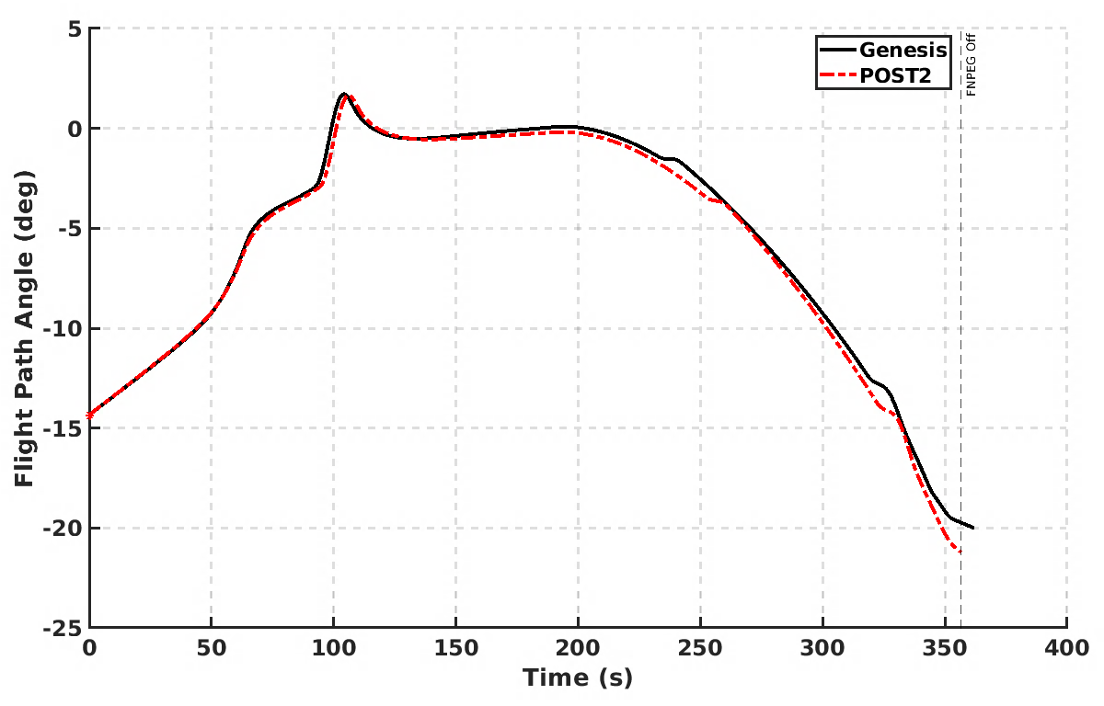
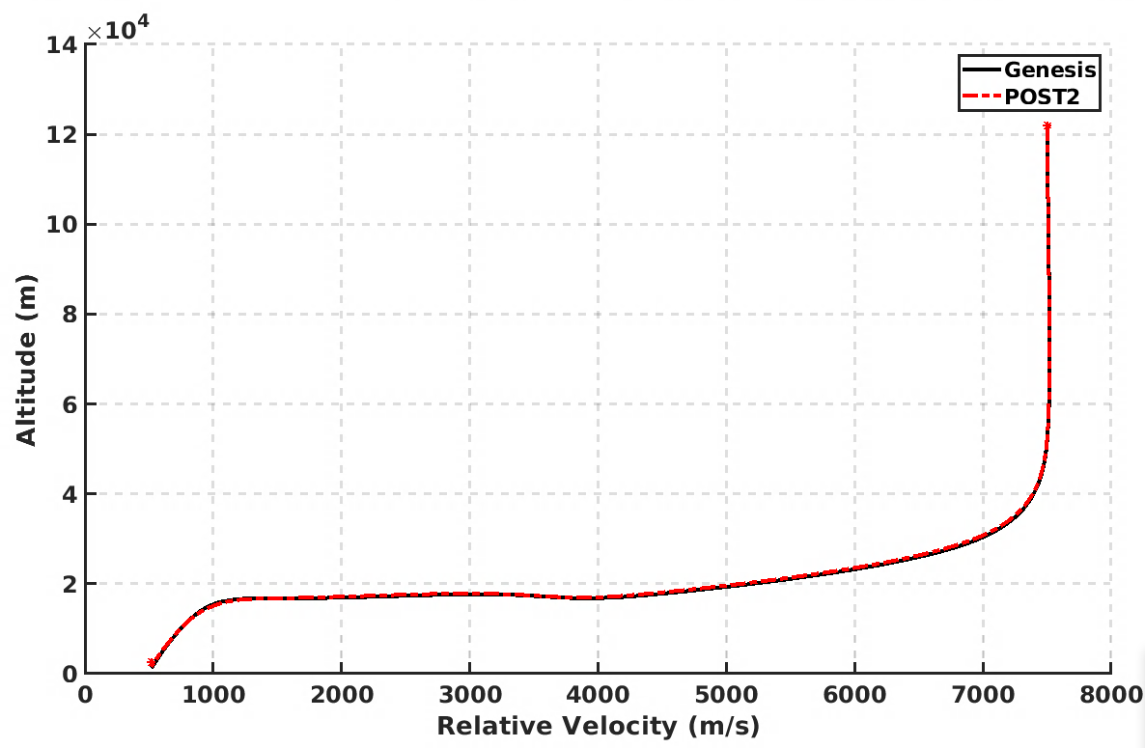
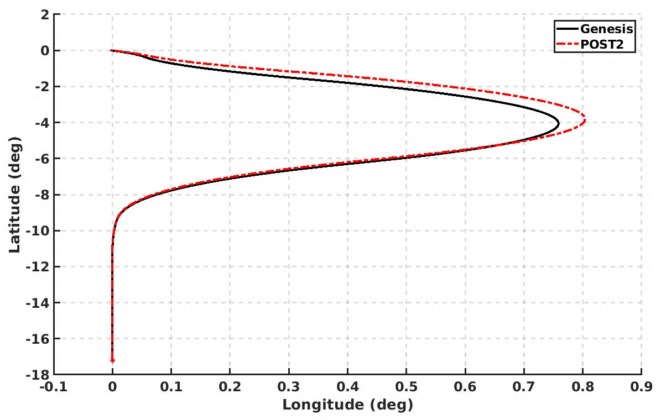
Results – Entry Trajectory
Overall trajectory agreement
Minor deviations expected due to differences in aerodynamics, atmosphere
Trajectories still converge to entry termination target latitude/longitude despite this
Flight Path Angle (deg)
Entry interface
Entry interface
Time (s)
Altitude (m)
Latitude (deg)
Entry interface
Relative Velocity (m/s)
Longitude (deg)
Notes:
Same entry state. Differences in aero/atmos propagate through, especially due to differences between GNC knowledge/predictor trajectories

Slide 9
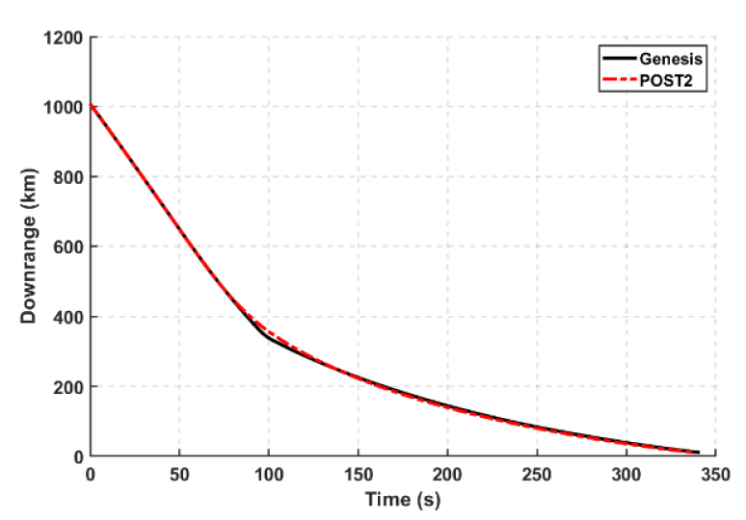
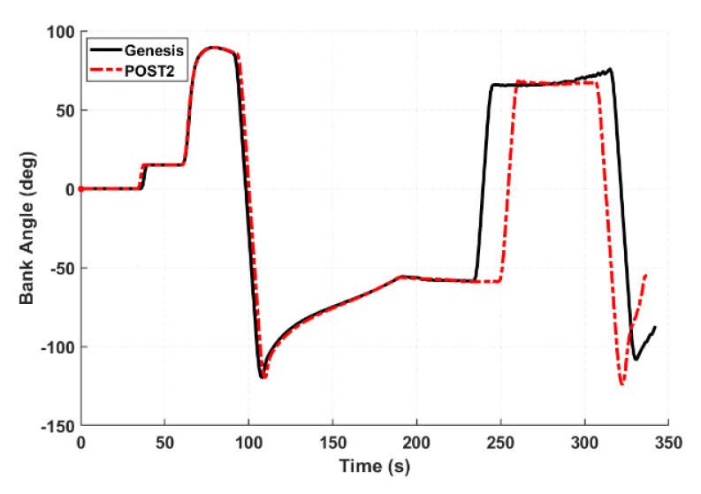
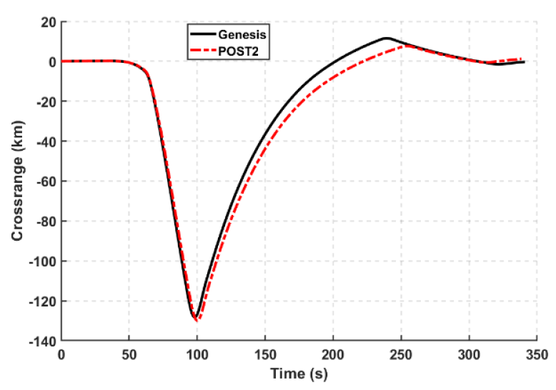
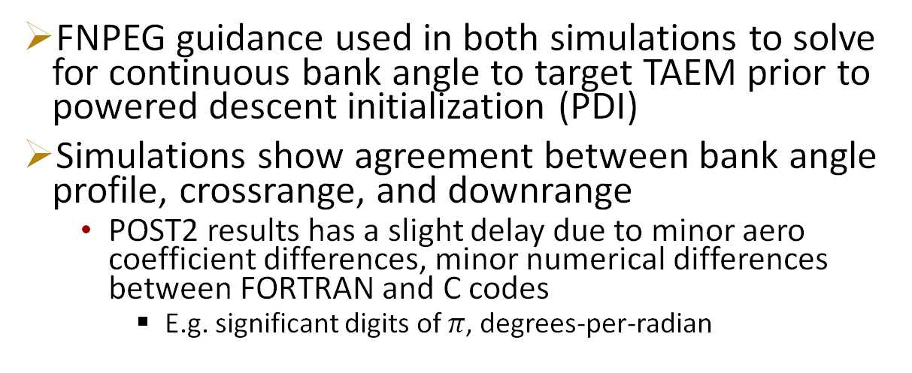
Results – Entry Guidance
FNPEG guidance used in both simulations to solve for continuous bank angle to target TAEM prior to powered descent initialization (PDI)
Simulations show agreement between bank angle profile, crossrange, and downrange
  POST2 results has a slight delay due to minor aero coefficient differences, minor numerical differences between FORTRAN and C codes
    E.g. significant digits of $π$, degrees-per-radian
Downrange (km)
Time (s)
Bank Angle (deg)
Crossrange (km)
Time (s)
Time (s)

Slide 10
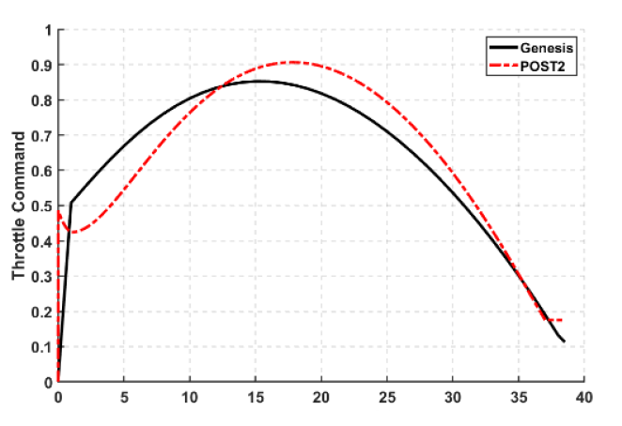
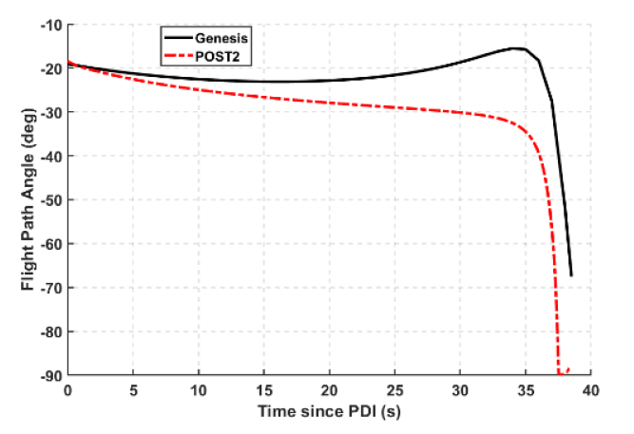
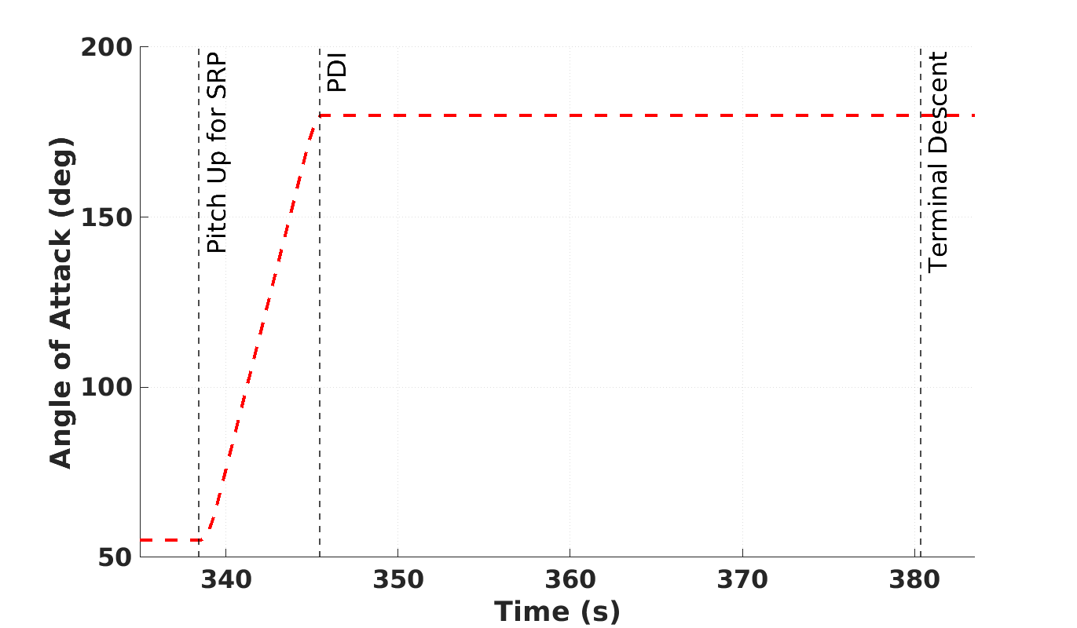
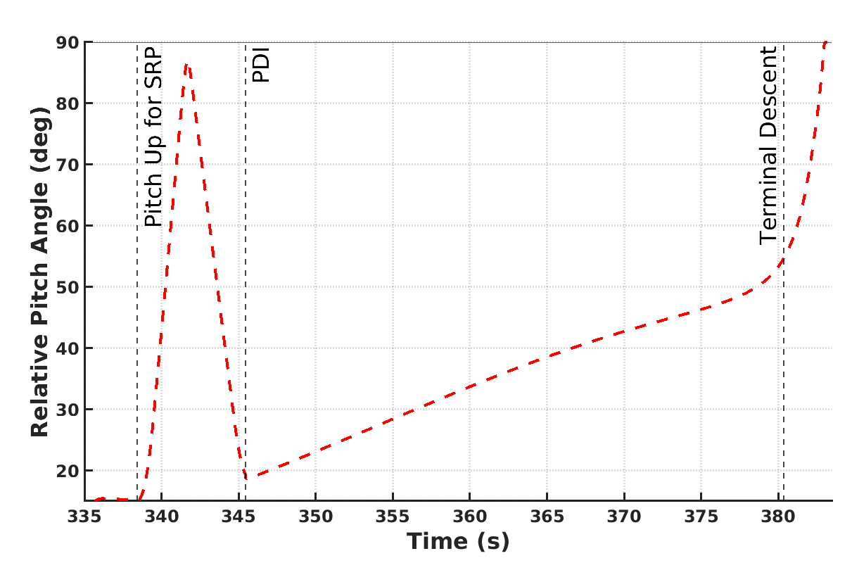
Results –Pitch-Over and Powered Descent
Slight differences in how simulations modeled period between entry termination and PDI
  POST2 simulation modeled a pitch-over maneuver (bottom) to fly at 180º angle of attack
  Genesis did not model a pitch-over maneuver. Instead used a Universal Powered Guidance (UPG) Bolza soft landing routine to predict PDI
Throttle command profiles very similar between two simulations
  Minor differences in how simulations model periods between entry termination and PDI
Flight path angle shown to reach -90º in POST2 simulation (vertical landing).
  Previous Genesis simulation work with FP²DG has shown -90º is achievable even for 6-DOF trajectories, but time constraints prevented it in this work
+X
+X
V
+Z
V
+Z
Time since PDI (s)
POST results only
Notes:
Pitch-over modeled as thrust-assisted increase in angle of attack, pitch angle over 7s period

Slide 11
Simulation Comparison Effort Matrix
Challenges were noted during this comparison effort such as different ways of interfacing guidance algorithms with simulation frameworks and ill-defined initial scope
  Task scope grew as work progressed, introducing hurdles that halted progress until their completion
A comparison effort matrix was developed that includes a range of conceivable comparison levels to characterize the quality of this comparison effort
Note that a project could have different levels for models and comparison effort (level 2 in each case for this effort)
Level | Models | Level | Comparison Effort
1 | High-level project definitions of environment and vehicle Independent implementations of environment, vehicle, and GN&C models | 1 | Co-plotting of performance results Low-level effort to identify sources of differences
2 | Some shared environment, vehicle, and/or GN&C models Project definitions of environment and vehicle models High-level project definitions of GN&C models | 2 | Co-plotting of performance results Some effort to reconcile differences
3 | Project definitions of environment vehicle, and GN&C models Majority shared environment, vehicle, and GN&C models Some subsystem unit tests Some integrated system tests | 3 | Detailed comparisons of nominal time histories and relevant parameters Elevated effort to reconcile differences
4 | Shared environment, vehicle, and GN&C models with version control Shared configuration-controlled inputs of common models Formal definitions of common coordinate systems Shared subsystem unit tests Shared integrated system tests | 4 | Version-controlled outputs with shared plotting routines Detailed comparisons of nominal and selected off-nominal time histories of dynamics and relevant parameters Detailed comparisons of statistical performance parameters Thorough and detailed effort to reconcile differences
Notes:
-NOTE: say that we will try to use this on future projects to test its applicability

Slide 12
Conclusion & Future Work
This work presented simulation comparison of a human-scale, mid-L/D, vertically-landing entry vehicle at Mars between POST2 (LaRC) and Genesis (JSC) and showed several differences
  Minor simulation environment differences were noted that led to slight discrepancy in aerodynamics
  Trajectories and bank angle profiles differed slightly, but desired entry termination conditions were achieved in both simulations
  Similar powered descent throttle and flight path angle profiles were observed between the simulations despite differences in simulation modeling of the period between entry termination and PDI
This work showed that there is complexity in characterizing the comparison effort
  A simulation comparison effort matrix was developed and assessed as a useful tool to address this issue
Future Work
  Resolve speed of sound/simulation environment differences
  Sync CONOPs between POST2 and Genesis
  Run Monte Carlo trajectories and compare simulation results
  Iterate further on simulation comparison effort matrix

Slide 13
Acknowledgements:
  The team thanks Matthew Andreini of Analytical Mechanics Associates for support and insight into building the POST2 simulation environment for this work.
Questions?
evan.roelke@nasa.gov daniel.a.matz@nasa.gov
rafael.a.lugo@nasa.gov breanna.j.johnson@nasa.gov
alejandro.r.pensado@nasa.gov

Slide 14
BACKUP

Slide 15
Challenges
+X
POST2: Pitch up / flying backwards
  When pitching over to land vertically, vehicle flies at an angle of attack of 180 and must land at relative pitch angle of 90º
  Dealing with multiple flight orientations caused challenges in confirming orientation for both guidance inputs and outputs
FNPEG debugging
  The teams went down a rabbit hole to compare FNPEG performance due to differences between code
  Discussed more on next slide
+Z
V
+X
V
+Z

Slide 16
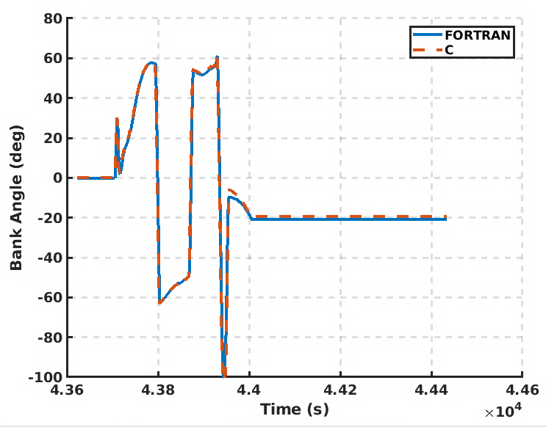
FNPEG Implementation Challenges
A major component of this work involved debugging differences in FNPEG guidance performance
  Two different versions of FORTRAN-FNPEG were being used by each team
  No common version control, “truth” source, etc.
Debugging efforts resulted in converting LaRC’s FNPEG FORTRAN version to C, which improved speed of customizability
  Both teams had independently developed ways to provide custom aerodynamics, atmospheric routines (e.g., via C function pointers), adding new inputs/outputs, etc
  C code was validated against previous low-L/D test case
Lesson learned: Propose a common repository for guidance algorithms between simulation teams
  Could be extended for more assets such as data and other models
  Can we leverage developer.nasa.gov?
  STMD/LAND Domain is investigating

