Slide 1
Preliminary Design of Robotic Control Software for Mars Sample Return – Capture, Containment, and Return System
Presentation Author/Presenter:
Jacob Taylor Cassady
NASA Langley Research Center
AIAA SciTech, 6-10 January 2025
Contributors:
Ashok K. Prajapati, Elizabeth J. Geist
NASA Goddard Space Flight Center
Jeffrey A. Angielski
HII Mission Technology Corporation
Bradley C. Tse, Benjamin L. Osborne
Microtel LLC
Joseph B. Lattisaw, Francis B. Hallahan
Embedded Flight Systems Inc.

Slide 2
Agenda
Mars Sample Return (MSR) Campaign Overview
Capture Containment and Return System (CCRS) Hardware
Robotic Transfer Assembly System (RTAS) Conops
Avionics
Flight Software (FSW)
Robot Software (RSW)
Conclusion

Slide 4
Capture, Containment, and Return System Hardware

Slide 5
Robotic Transfer Assembly System Con-ops
RTAS has atomic actions called motion primitives
Position, active hold, active limp, etc.
Motion primitives are combined to create behaviors.
Open-Loop Actuator with Contact Switch Post-Motion Confirmation, etc.
RTAS is controlled by software called Robot Software (RSW)

Slide 6
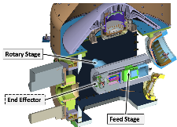
Avionics
Modular Unified Space Technology Avionics for Next Generation (MUSTANG) Processor Board
Spaceflight heritage: Magnetospheric Multiscale Mission, Global Precipitation Measurement Mission and more.
Includes RTG4 FPGA supporting SpaceWire and UART.

Slide 7
Flight Software
Built upon the open-source core Flight System (cFS) framework developed by NASA Goddard Space Flight Center.

Slide 8
RSW
Main Task
Core logic and FSM
Interfaces with hardware and software bus.
Worker Task
For offloading expensive operations
Message queues used for prioritizing messages and inter-task communication.

Slide 9
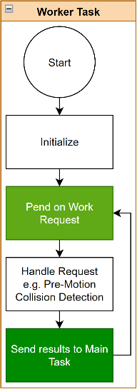
RSW Task Design

Slide 10
RSW Finite State Machine

Slide 11
Conclusion
NASA Office of Inspector General:
“before the MSR Program is approved to proceed from formulation into development, viable alternatives to the Program’s mission architecture considered – including mission launch and sample return alternatives”
Consequently, CCRS development was stopped after Preliminary Design Review.
https://oig.nasa.gov/wp-content/uploads/2024/03/ig-24-008.pdf

Slide 12
Thank You!
Questions?
Refer to paper for more on:
Command and Telemetry definitions
Operation Phase specifics
Motion Primitives and Behavior definitions
Software Engineering and Testing
Functional Testing
Static Analysis
Unit Testing

