Slide 1


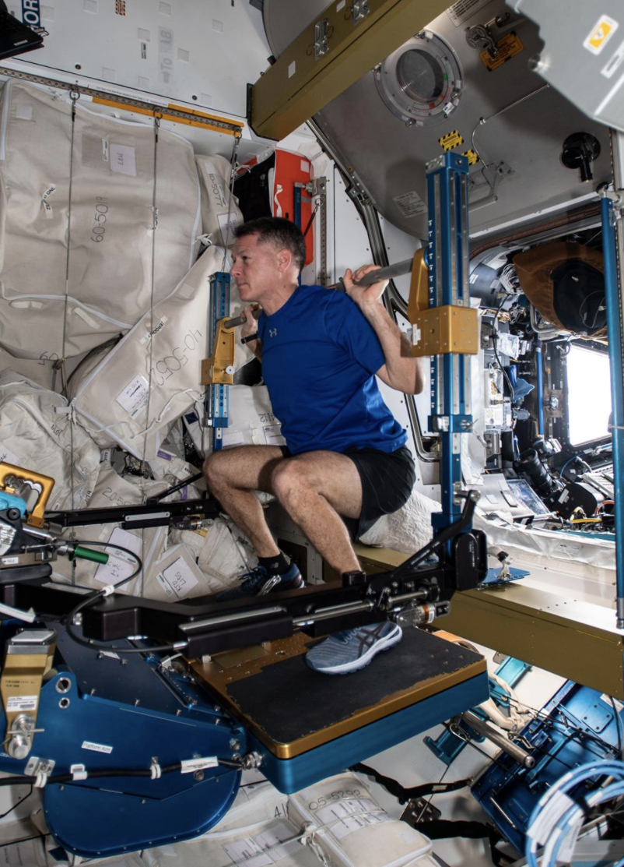
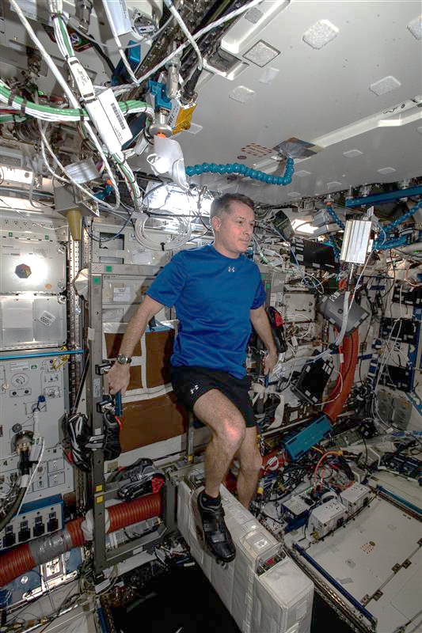
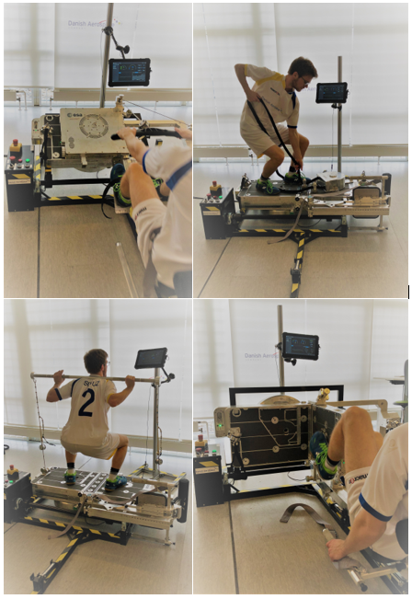
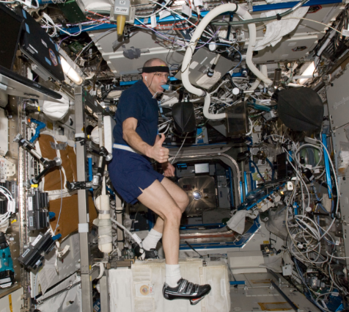
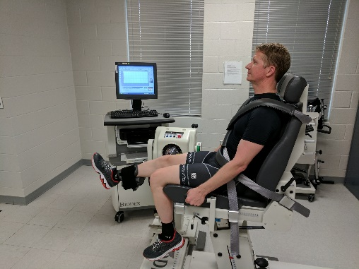
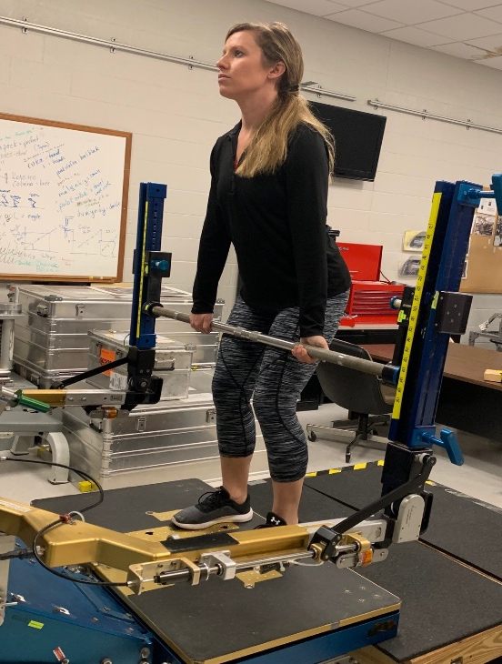
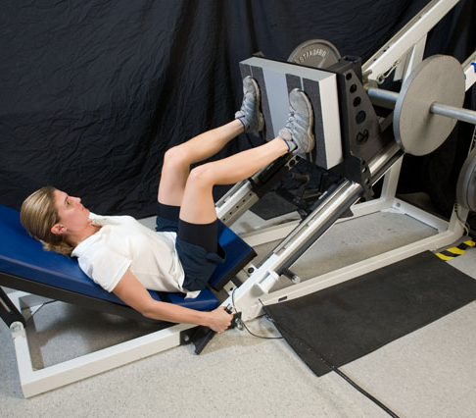
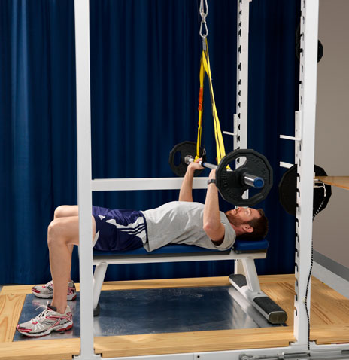
Effects of Replacing Treadmill Running with Alternative Exercise Countermeasures During Long-Duration Spaceflight On ASTRONAUT HEALTH AND PERFORMANCE
A.N. Varanoske¹, B.J. Prejean¹, N.C. Strock¹, D. Conly¹, B.T. Peters¹, E.S. Morant¹, D.N. Gardner², L.L. Cooper³, J.D. Sibonga⁴, S.M. Smith⁴,
S.R. Zwart⁵, E.R. Spector¹, M. Young⁴, & K. Marshall-Goebel⁴
¹KBR, Houston, TX, USA; ²University of Houston-Clear Lake, Houston, TX, USA, ³JES Tech, Houston, TX, USA, ⁴NASA Johnson Space Center, Houston, TX, USA;
⁵University of Texas Medical Branch, Galveston, TX, USA
Abstract
Methods
INTRODUCTION: Current exercise countermeasures on the International Space Station (ISS) include treadmill running, cycle ergometry, and resistive exercise, which are used to protect crewmember health and performance during long-duration spaceflight. However, exploration vehicles for Artemis missions to the Moon and beyond will have volume and power restrictions, requiring exercise hardware to have a smaller footprint and use fewer resources. Thus, recent efforts have focused on developing exercise devices that provide both aerobic and resistive capabilities on one platform without including a treadmill. The European Enhanced Exploration Exercise Device [E4D] is one such apparatus. It is critical to validate the efficacy of using exploration-focused exercise modalities to preserve muscle strength, aerobic fitness, bone density, and sensorimotor performance. Thus, the aim of this study is to determine the effectiveness of using nominal ISS exercise devices for an entire mission compared to exploration-forward exercise modalities to determine if a treadmill is required to maintain current levels of protection during long-duration missions.
METHODS: Crewmembers are assigned to one of three groups: 1) Controls (n ≥ 40), who partake in nominal exercise on the ISS, including running on the Treadmill with Vibration Isolation and Stabilization 2 (T2), cycling on the Cycle Ergometer with Vibration Isolation and Stabilization (CEVIS), and strength training on the Advanced Resistive Exercise Device (ARED); 2) Active Group 1, who exercise on the CEVIS and ARED only (n = 8); and 3) Active Group 2, who perform aerobic and resistive exercise on the E4D only (n = 8). For Active Group 1, nominal exercise on T2 will be replaced with corresponding exercise on CEVIS. For Active Group 2, a dedicated exercise prescription will be designed to maximize the capabilities of the E4D to include resistive exercise, cycle ergometry, rowing, and rope pulling. Crewmembers in both Active groups are not permitted to perform treadmill exercise for the entirety of their flight. Health and performance markers, including bone mineral density (dual-energy x-ray absorptiometry [DXA]), body composition (DXA), cardiovascular fitness (cycle VO2peak), muscle strength and endurance (isometric/isokinetic testing, power endurance testing), sensorimotor performance (sit-to-stand, obstacle course), postural control (computerized dynamic posturography), and blood and urine biochemical markers of bone metabolism will be assessed before, during, and after spaceflight.
RESULTS: Fifteen subjects (4 Active [CEVIS + ARED], 11 Control) have been recruited. Data collection is ongoing.
CONCLUSIONS: This study will assess the efficacy of using exploration exercise modalities, including removing the treadmill exercise capability or exclusively using the E4D, compared to the nominal ISS exercise regimen across an entire mission on bone, muscle, aerobic, and sensorimotor health and performance. Findings from this study will help provide a recommendation on whether these exploration exercise modalities can sufficiently protect against physiological deconditioning during spaceflight or whether a treadmill may be required to maintain current levels of protection during future exploration class spaceflight missions.
Crewmembers are assigned to one of three groups:
    Control Group (n ≥ 40): nominal in-flight exercise on the ISS, including running on T2, cycling on CEVIS, and resistance exercise on ARED
    Active Group 1 (n = 8): exploration-focused in-flight exercise prescription, including cycling on CEVIS and resistance exercise on ARED (Figure 1)
      Aerobic exercise that would nominally occur on T2 will be replaced with additional exercise on CEVIS (no T2)
    Active Group 2 (n = 8): exploration-focused in-flight exercise prescription, including both aerobic and resistance exercise on the E4D (Figure 2)
      Novel exercise device not yet examined on ISS
      Dedicated exercise prescription will maximize capabilities on E4D, including resistive exercise, cycle ergometry, rowing, and rope pulling (no T2)
Figure 1: Active Group 1 exercise equipment: ARED (left) and CEVIS (right). Source: NASA
Figure 2: Active Group 2 exercise equipment: E4D. Source: DAC
The following measures will be obtained in all subjects (Table 1): Blood biochemical markers, urine markers of bone metabolism, sensorimotor performance, isokinetic testing, aerobic capacity (VO_{2peak}) testing, computerized dynamic posturography, and dual-energy x-ray absorptiometry (data shared with MEDB and Standard Measures)
Additional outcome measures collected in Active Groups: Obstacle course, muscle strength and endurance testing (Figure 3), in-flight urine collections
Table 1: List of testing to be completed by study participants.
Test | Pre-flight | In-flight | Post-flight
Sensorimotor Performance
Sit-to-stand with walk & turn | L-180 (±45), L-60 (±30) | N/A | R+0 (landing and JSC), R+5* (±1), R+9 (±2), R+14 (±2)*, R+30 (±3)*
Obstacle course | L-180 (±45)*, L-60 (±30)* | N/A | R+0 (JSC)*, R+5 (±1)*, R+9 (±2)*, R+14 (±2)*, R+30 (±3)*
Computerized dynamic posturography | L-225 (±45), L-60 (±30) | N/A | R+1*, R+8 (±2)
Blood and Urine Biochemistry, Body Composition, Bone
Blood collection | L-90 (±90) | FD30 (±15), R-30 (±30) | R+30 (±15)
48-hour (24-hour for in-flight) urine collection | L-60 (±30) | FD30 (±15)*, FD90 (±45)*, R-30 (±30)* | R+0, R+25 (±5)
Dual-energy x-ray absorptiometry | L-585 (±45), L-105 (±75) | N/A | R+20 (±15)
Physical Performance
VO_{2peak} (cycle) | L-365 (±30), L-60 (±30) | FD14 (±2), FD75 (±7), R-14 (±5) | R+5 (±2), R+30 (±4)
Isokinetic testing | L-225 (±45), L-60 (±30) | N/A | R+5 (±1), R+14 (±1), R+30 (±2)
Isometric mid-thigh pull | L-180 (±45), L-60 (±30) | FD14 (±2), FD45 (±2)*, FD75 (±2)*, monthly*, R-14 (±2) | R+5 (±1), R+14 (±2)*, R+30 (±3)
Leg press strength and power endurance | L-180 (±45)*, L-60 (±30)* | N/A | R+5 (±1)*, R+14 (±2)*, R+30 (±3)*
Bench press strength and power endurance | L-180 (±45)*, L-60 (±30)* | N/A | R+5 (±1)*, R+14 (±2)*, R+30 (±3)*
Background
*Test conducted only on Active subjects, not as part of MEDB or Standard Measures study; L: days prior to launch; FD: flight day; R: days prior to (-) or following (+) return
Microgravity exposure during long-duration spaceflight induces muscular and aerobic deconditioning, which can be mitigated using in-flight exercise countermeasures¹⁻⁴.
Crewmembers on the International Space Stations (ISS) currently utilize treadmill running (Treadmill with Vibration Isolation and Stabilization 2 [T2]), cycle ergometry (Cycle Ergometer with Vibration Isolation System [CEVIS]), and resistive exercise (Advanced Resistive Exercise Device [ARED]) as in-flight countermeasures for protection against physiological deconditioning¹⁻⁴.
Exploration vehicles for Artemis and beyond will have significant volume and power restrictions, requiring exercise hardware to be lightweight, have a smaller footprint, and use fewer resources.
  Due to the large footprint of the treadmill and the ability to bundle cycling and resistive training into a single device, this has resulted in the development of exercises devices that both aerobic and resistive training on one platform, but do not have a treadmill.
  One such device is the European Enhanced Exploration Exercise Device (E4D), which provides rowing, cycling, rope-pulling, and resistive exercise capabilities in one device.
It is critical to validate the efficacy of this exploration-focused exercise modality of cycling and resistive exercise alone as well as other devices (i.e., E4D) on preserving muscle strength, aerobic fitness, bone density, and sensorimotor performance.
This study will allow us to provide a recommendation on whether cycling and resistive exercise are sufficient or if a treadmill is required to maintain current levels of countermeasure protection.
A
B
C
D
E
Figure 3: Physical performance assessments completed in the Zero T2 study.
A) Cycle ergometer in-flight VO_{2peak} testing; B) Isokinetic testing; C) Isometric mid-thigh pull testing; D) Leg press strength and endurance testing; E) Bench press strength and endurance testing
Statistical Analyses:
Bayesian generalized linear mixed-effects models will be constructed in which each metric is regressed onto T2 usage and time along with nested random effects to account for data dependencies due to multiple measurements per crewmember and multiple control sources. A sensitivity analysis will be performed in which multiple prior distributions will be considered.
HRP Risks Addressed
Risk of Impaired Performance Due to Reduced Muscle Mass, Strength & Endurance
Risk of Reduced Physical Performance Capabilities Due to Reduced Aerobic Capacity
Risk of Bone Fracture due to Spaceflight-Induced Changes to Bone
Risk of Impaired Control of Spacecraft/Associated Systems and Decreased Mobility Due to Vestibular/Sensorimotor Alterations Associated with Spaceflight
Risk of Injury and Compromised Performance Due to EVA Operations
Purpose
Results
References
To determine the physiological effects of using exploration-focused exercise modalities and prescriptions during an entire ISS spaceflight mission compared to nominal ISS exercise to determine if a treadmill is required to maintain current levels of protection during long-duration spaceflight missions.
Data collection for this study is currently in progress:
  n = 4 Active Group 1 Subjects (CEVIS + ARED only)
  n = 11 Control Subjects
  Note: Active Group 2 recruitment will begin once E4D is on the ISS (estimated Spring 2025)
Sibonga J, Matsumoto T, Jones J, Shapiro J, Lang T, Shackelford L, Smith SM, Young M, Keyak J, Kohri K, Ohshima H. Resistive exercise in astronauts on prolonged spaceflights provides partial protection against spaceflight-induced bone loss. Bone. 2019 Nov 1;128:112037.
Levine BD, Lane LD, Watenpaugh DE, Gaffney FA, Buckey JC, Blomqvist CG. Maximal exercise performance after adaptation to microgravity. Journal of Applied Physiology. 1996 Aug 1;81(2):686-94.
Mulavara AP, Peters BT, Miller CA, Kofman IS, Reschke MF, Taylor LC, Lawrence EL, Wood SJ, Laurie SS, Lee SM, Buxton RE. Physiological and functional alterations after spaceflight and bed rest. Medicine and Science in Sports and Exercise. 2018 Sep;50(9):1961.
Moore Jr AD, Downs ME, Lee SM, Feiveson AH, Knudsen P, Ploutz-Snyder L. Peak exercise oxygen uptake during and following long-duration spaceflight. Journal of Applied Physiology. 2014 Aug 1;117(3):231-8.
Supported by the NASA Human Research Program and NASA Mars Campaign Office

