Slide 1
Decision Aid for Conjunction Risk Mitigation by Differential Drag
Dr. Jim Clark
Dr. Dolan Highsmith
The Aerospace Corporation & NASA CARA
35th Space Flight Mechanics Meeting
Kaua’i, Hawaii, Jan 19-23, 2025

Slide 2

What is differential drag?
Propagation assumes a particular drag area.
Changing a satellite’s drag has a net propulsive effect!

Slide 3
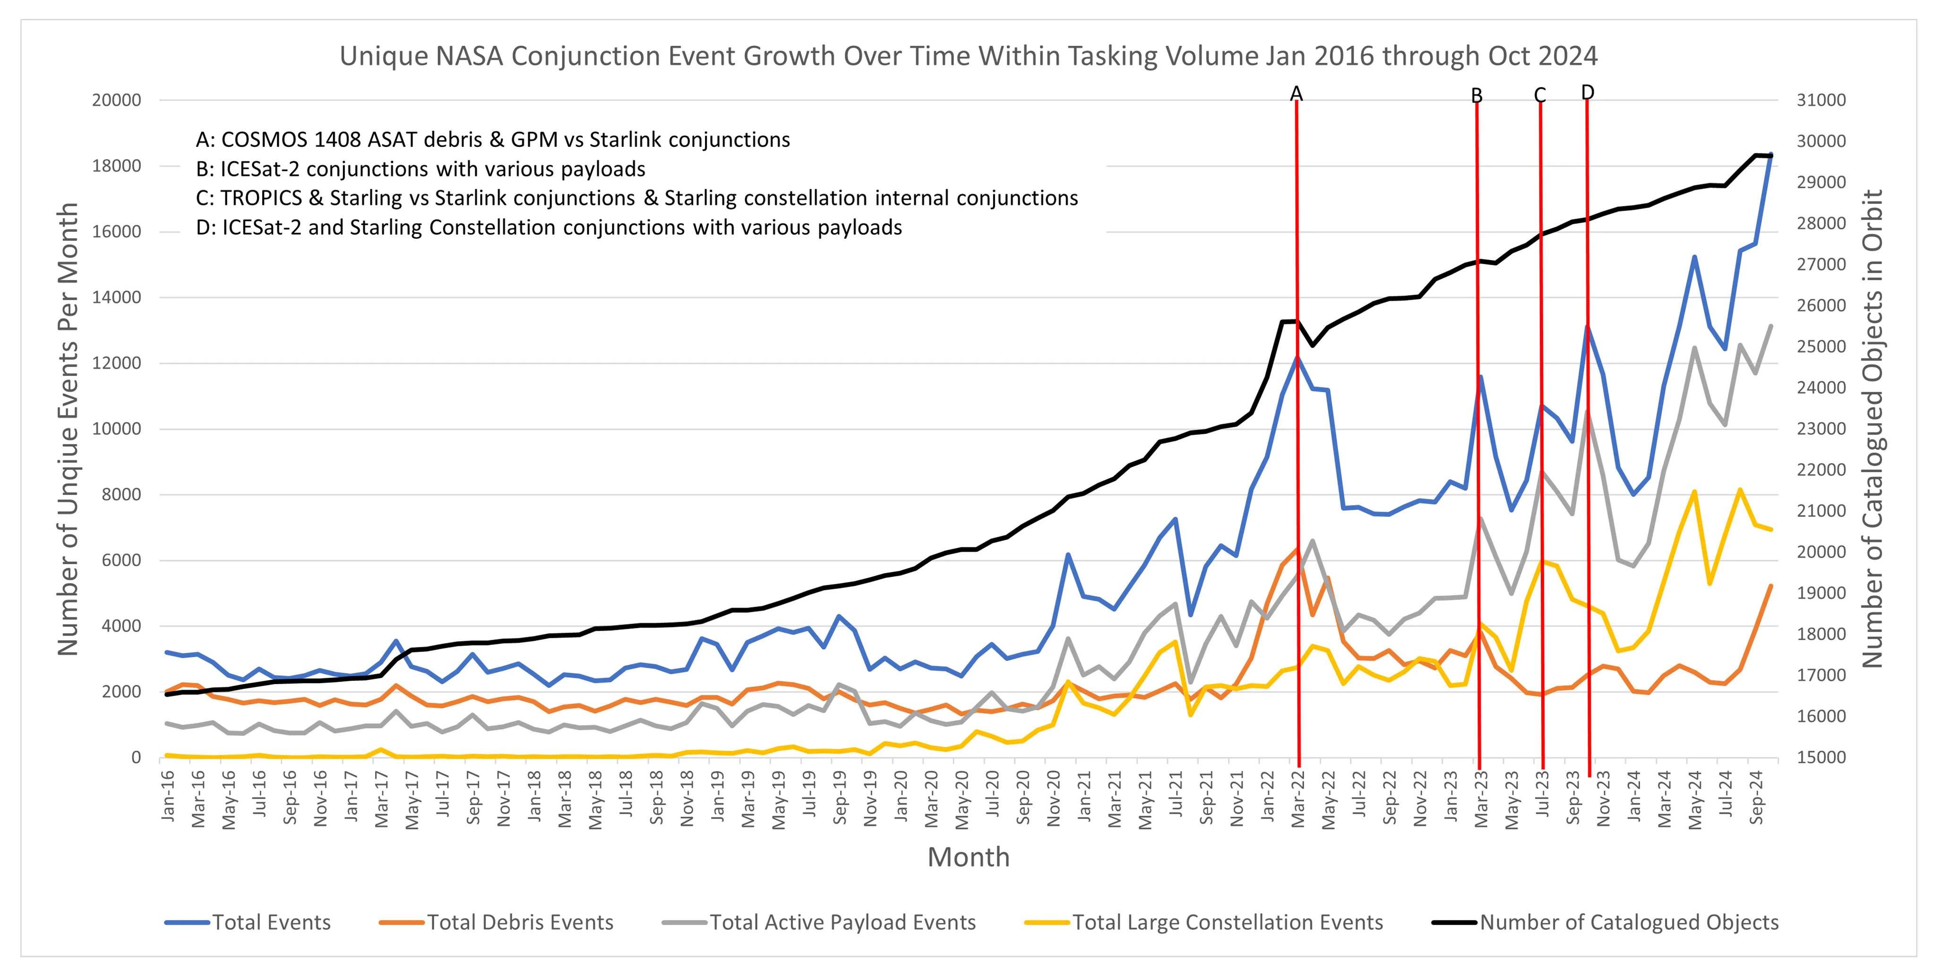
Why does CARA Analysis need a decision aid?
CARA’s missions are seeing more and more conjunctions.
Missions without propulsion want to explore their options for collision risk mitigation.
(Missions with propulsion want to explore their options!)

Slide 4
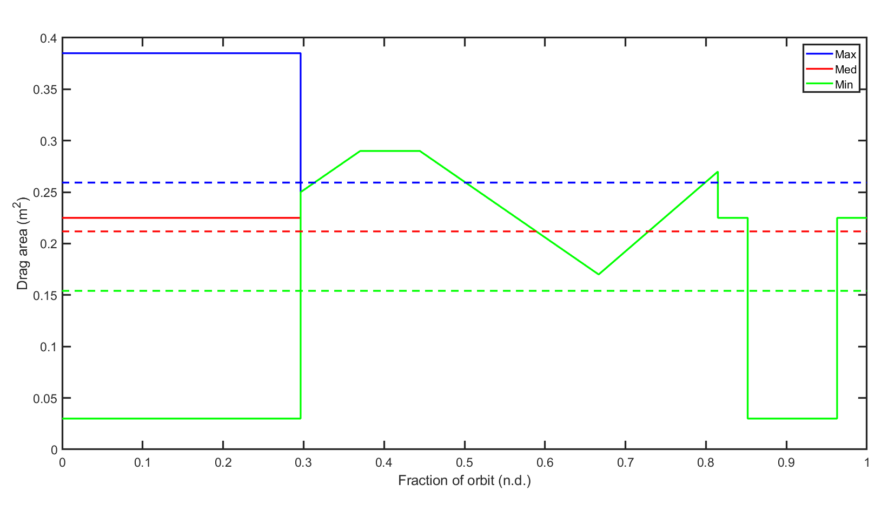
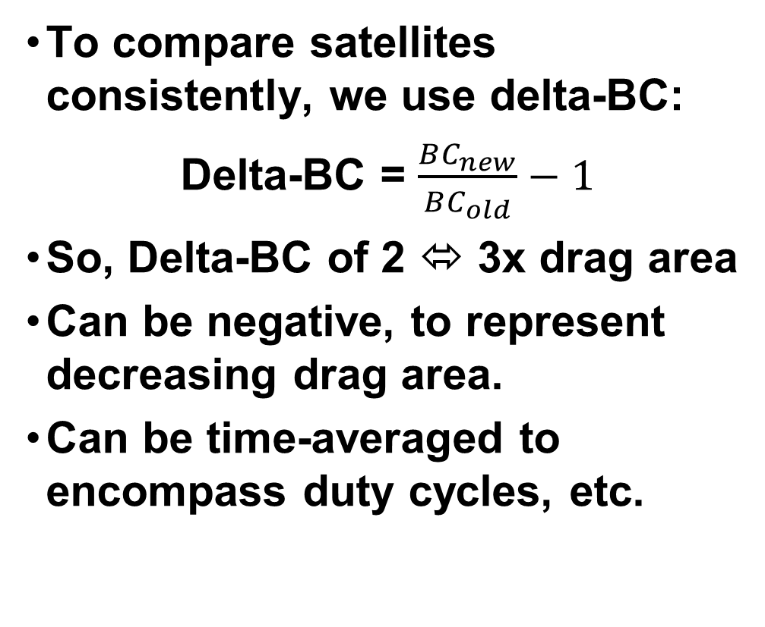
The Δ-B-Cs of differential drag
To compare satellites consistently, we use delta-BC:
Delta-BC = $\frac{BC_{new}}{BC_{old}}−1$
So, Delta-BC of 2 ⬄ 3x drag area
Can be negative, to represent decreasing drag area.
Can be time-averaged to encompass duty cycles, etc.
BC: Ballistic Coefficient = (area/mass)

Slide 5
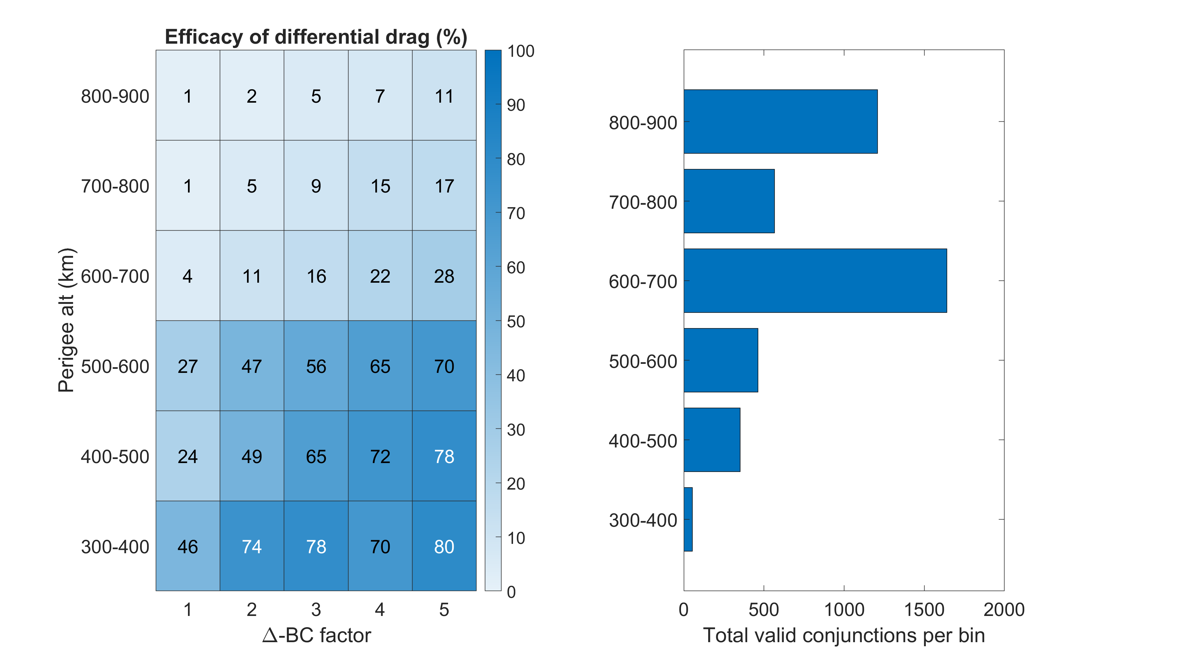
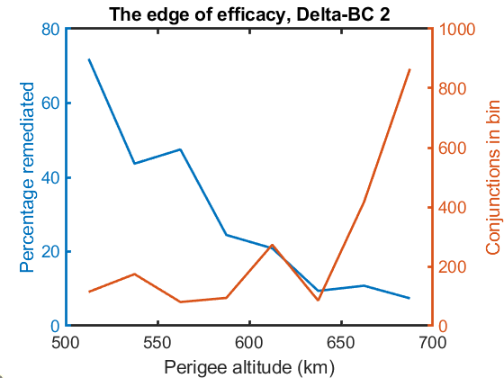
Can my satellite use differential drag?
~4,300 historical conjunctions with Pc > 1E-4 at TCA-3 days.
Using CARA’s Maneuver Trade Space (MTS) tool, propagate with different delta-BCs. Final Pc < 3E-6?
There seems to be a clear breakpoint in the 500-600 km range, around delta-BC of 2.
Zooming in, 560 km is (close to) the 50% point.
Pc: Probability of collision
TCA: Time of Closest Approach

Slide 6
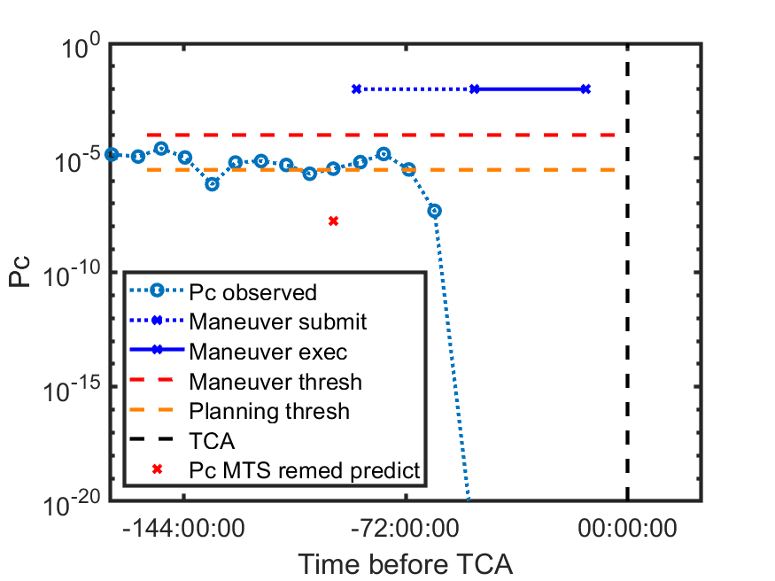
Validation
To validate MTS’s analysis, we compared to another NASA mission that uses drag for risk mitigation. (Delta-BC = 2.2, perigee ~520 km, ~48-hr maneuvers)
In most cases: qualitative agreement, tending conservative

Slide 7
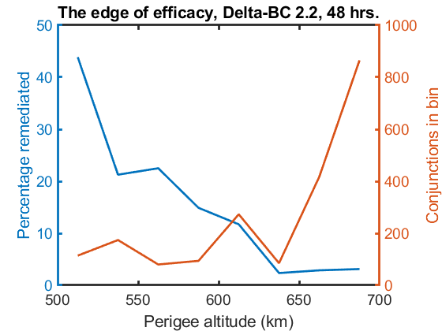
Validation
Of the 16 conjunctions we identified, 11 were remediated, which is consistent with expectations!
The one “optimistic” error was from a plan that was superseded by a shorter one (true negative).
Predict \ Actual | Remediated | Not Remediated
Remediated | 7 | 1*
Not Remediated | 4 | 5

Slide 8
Application – Mission Design Support
A mission with very large solar panels asked us to evaluate differential-drag for risk mitigation.
Orbit not yet fixed, 500-700 km
Unfortunately, their mission constraints restrict their time-averaged delta-BC.
Theoretical max efficacy…
…Actual efficacy.
0.68
… 8 9 10

Slide 9
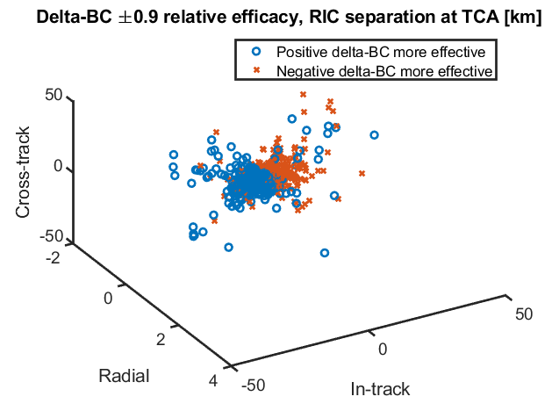
Other considerations
Positive vs. negative delta-BC
  Usually more ‘upside’ going positive, but if the mission doesn’t have much delta-BC and has to make the most of it, CARA can advise them how to best reduce collision risk.

Slide 10
Conclusion
A mission:
  Perigee below ~560 km
  Able to triple its drag area
  For 3 days straight
  (or a greater factor for less time)
Can count on differential drag to remediate many high-interest conjunction events.
This is a very high bar to clear! Much higher than formation maintenance, etc.
CARA is exploring other aspects of differential drag:
  What efficacy is ‘worth pursuing’ vs. acceptable as a substitute for propulsion?
  What counts as remediation?

Slide 11
Diff-drag efficacy, 3 days, 100% duty cycle

Slide 12
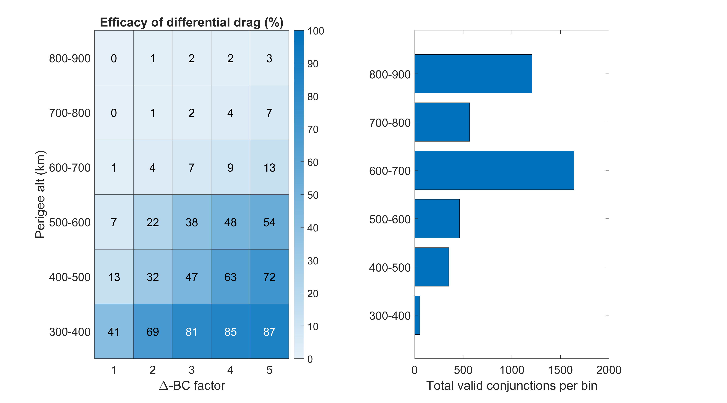
Diff-drag efficacy, 2 days, 100% duty cycle

Slide 13
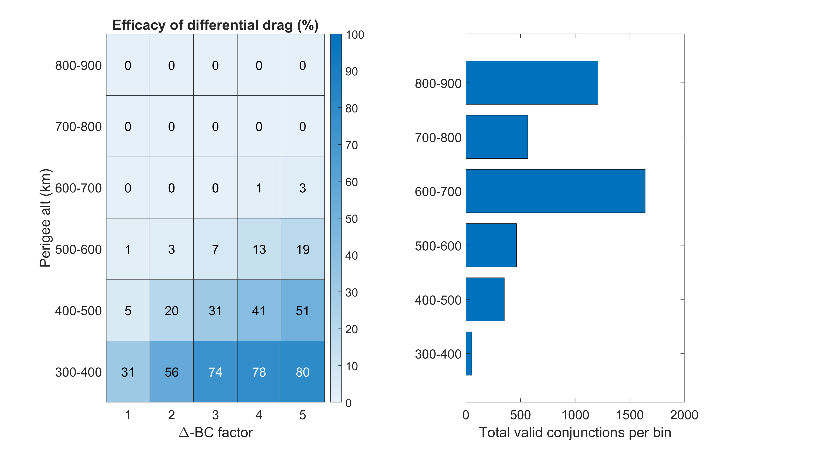
Diff-drag efficacy, 1 day, 100% duty cycle

Slide 14
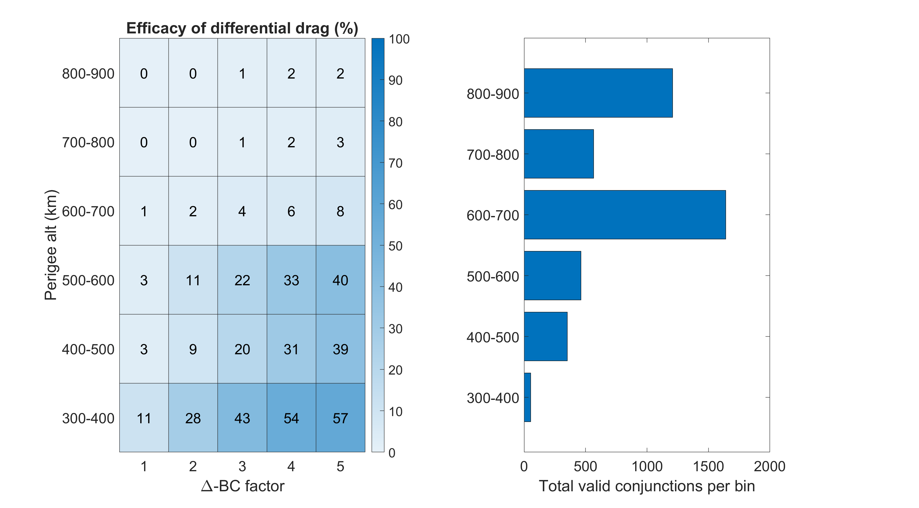
Diff-drag efficacy, 3 days, 30% duty cycle

Slide 15
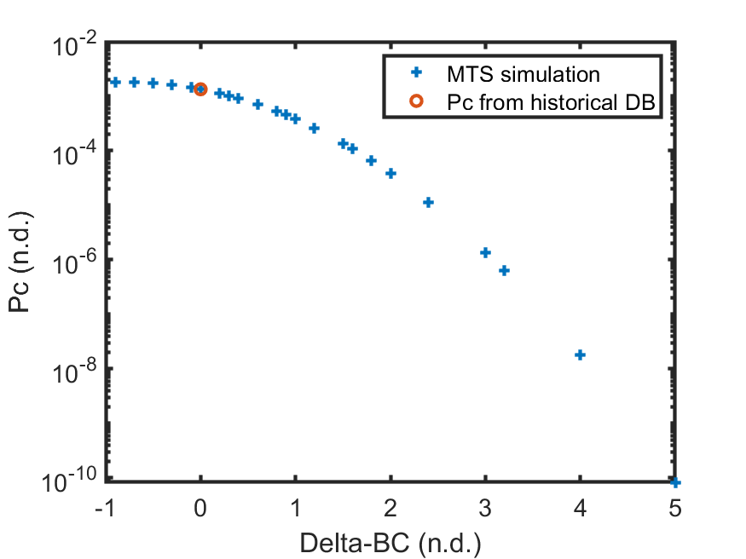
Evaluation of differential drag
~4,300 historical conjunctions with Pc > 1E-4 at TCA-3 days.
Take that state, propagate with different delta-BCs, compare to original
  Should be close to the historical DB value at delta-BC = 0
  Mostly ‘more is more’, but some conjunctions behave a little differently…

Slide 16
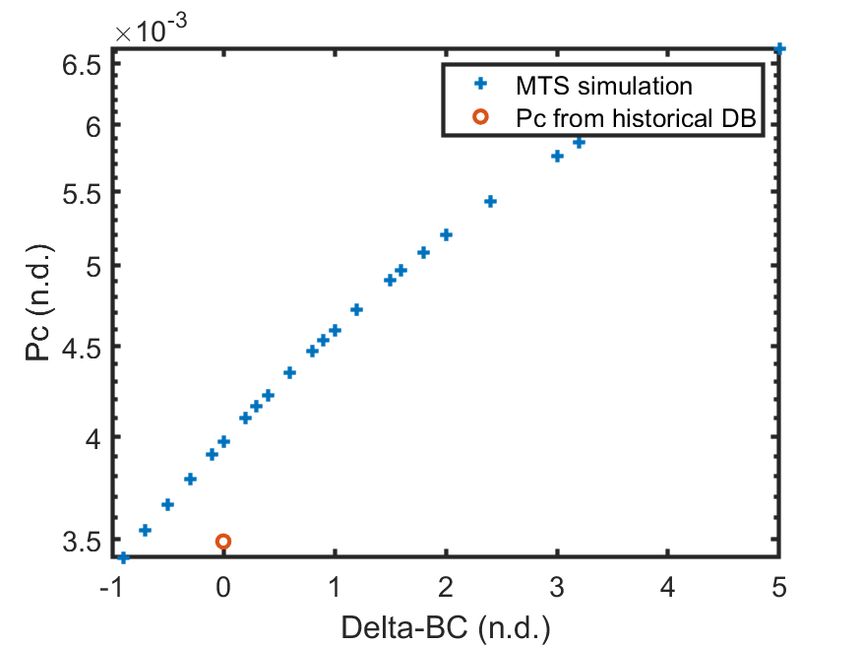
Evaluation of differential drag
~4,300 historical conjunctions with Pc > 1E-4 at TCA-3 days.
Take that state, propagate with different delta-BCs, compare to original
  Should be close to the historical DB value at delta-BC = 0
  Mostly ‘more is more’, but some conjunctions behave a little differently…

Slide 17
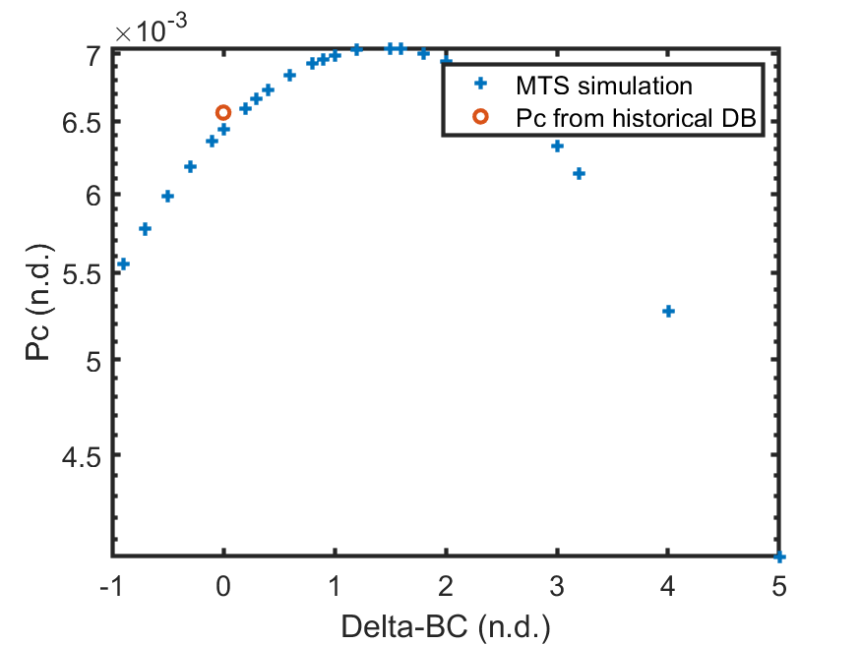
Evaluation of differential drag
~4,300 historical conjunctions with Pc > 1E-4 at TCA-3 days.
Take that state, propagate with different delta-BCs, compare to original
  Should be close to the historical DB value at delta-BC = 0
  Mostly ‘more is more’, but some conjunctions behave a little differently…

