Slide 1
Gap Analysis of UAS Manuals and Hazards
Ethan Jordan
Carlos Paradis
Misty Davies
Charles Werner

Slide 2
Context
Advanced Air Mobility is impacting emergency and disaster response operations
  Unmanned Aircraft Vehicles (UAS) Examples:
    Search and Rescue operations
    Scene Reconstruction for Disaster Damage Assessment
However, the use of UAS introduce safety risks to the National Air Space

Slide 3
Goal
Find ways to improve UAS mission safety
  How to find safety practices (“mitigations”)?
    Operational Manuals
      City, County, State, cross-county, etc
    Advisory Circulars (AC 1072A)
    FAA Orders (Risk Management System Appendix – Waiver Process)
    Recordings of agencies
    Waiver Provisions
  How to find when things went wrong? (Hazards)
    FAA Accident DB, ASRS, NEISS (“toy” accidents), NTSB – All narratives

Slide 4
Method
Goal: Find ways to improve UAS mission safety
  But how do we “group” this large collection of text containing mitigations and hazards so we can compare them?
  We chose to use Model Based Systems Engineering

Slide 5
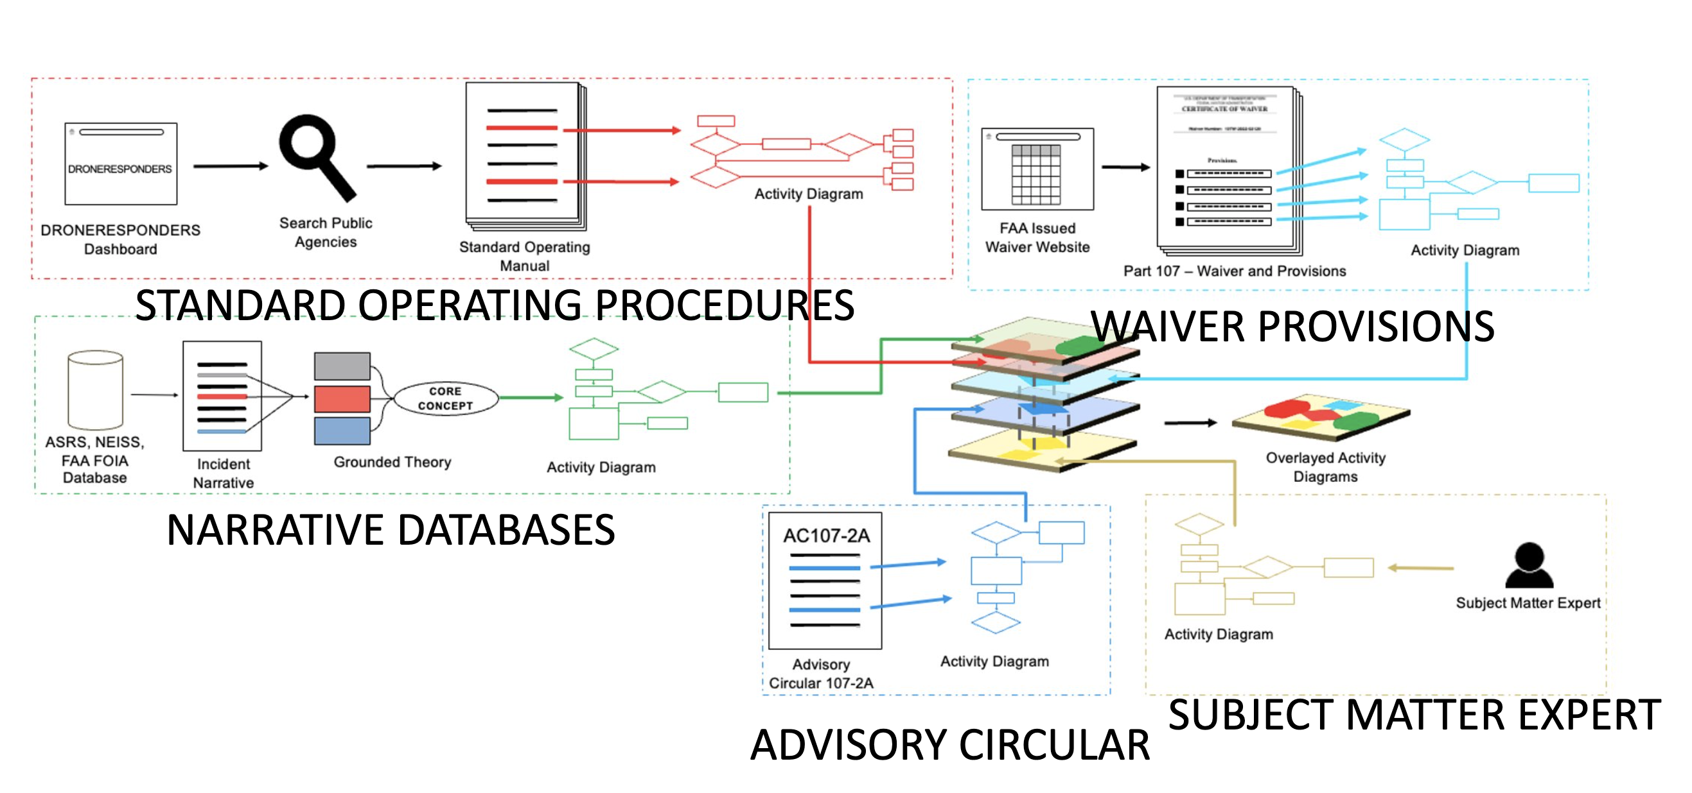
Method

Slide 6
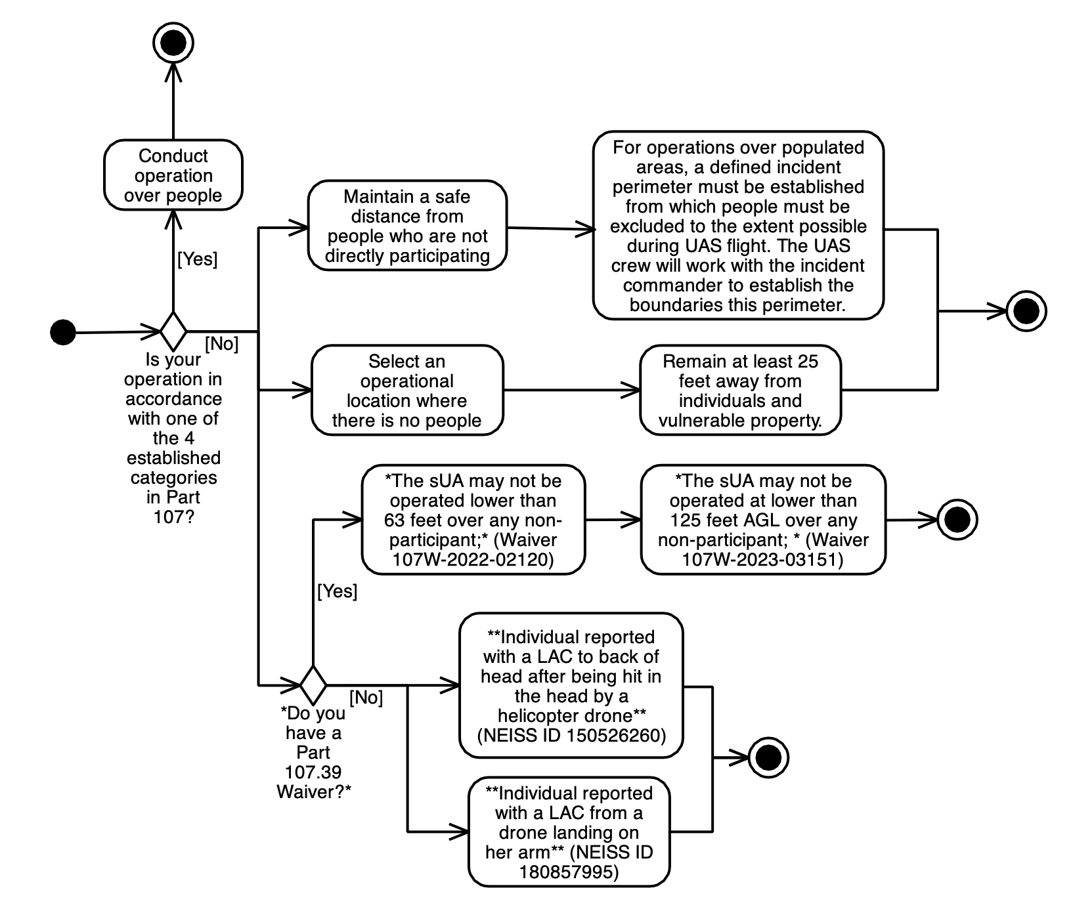
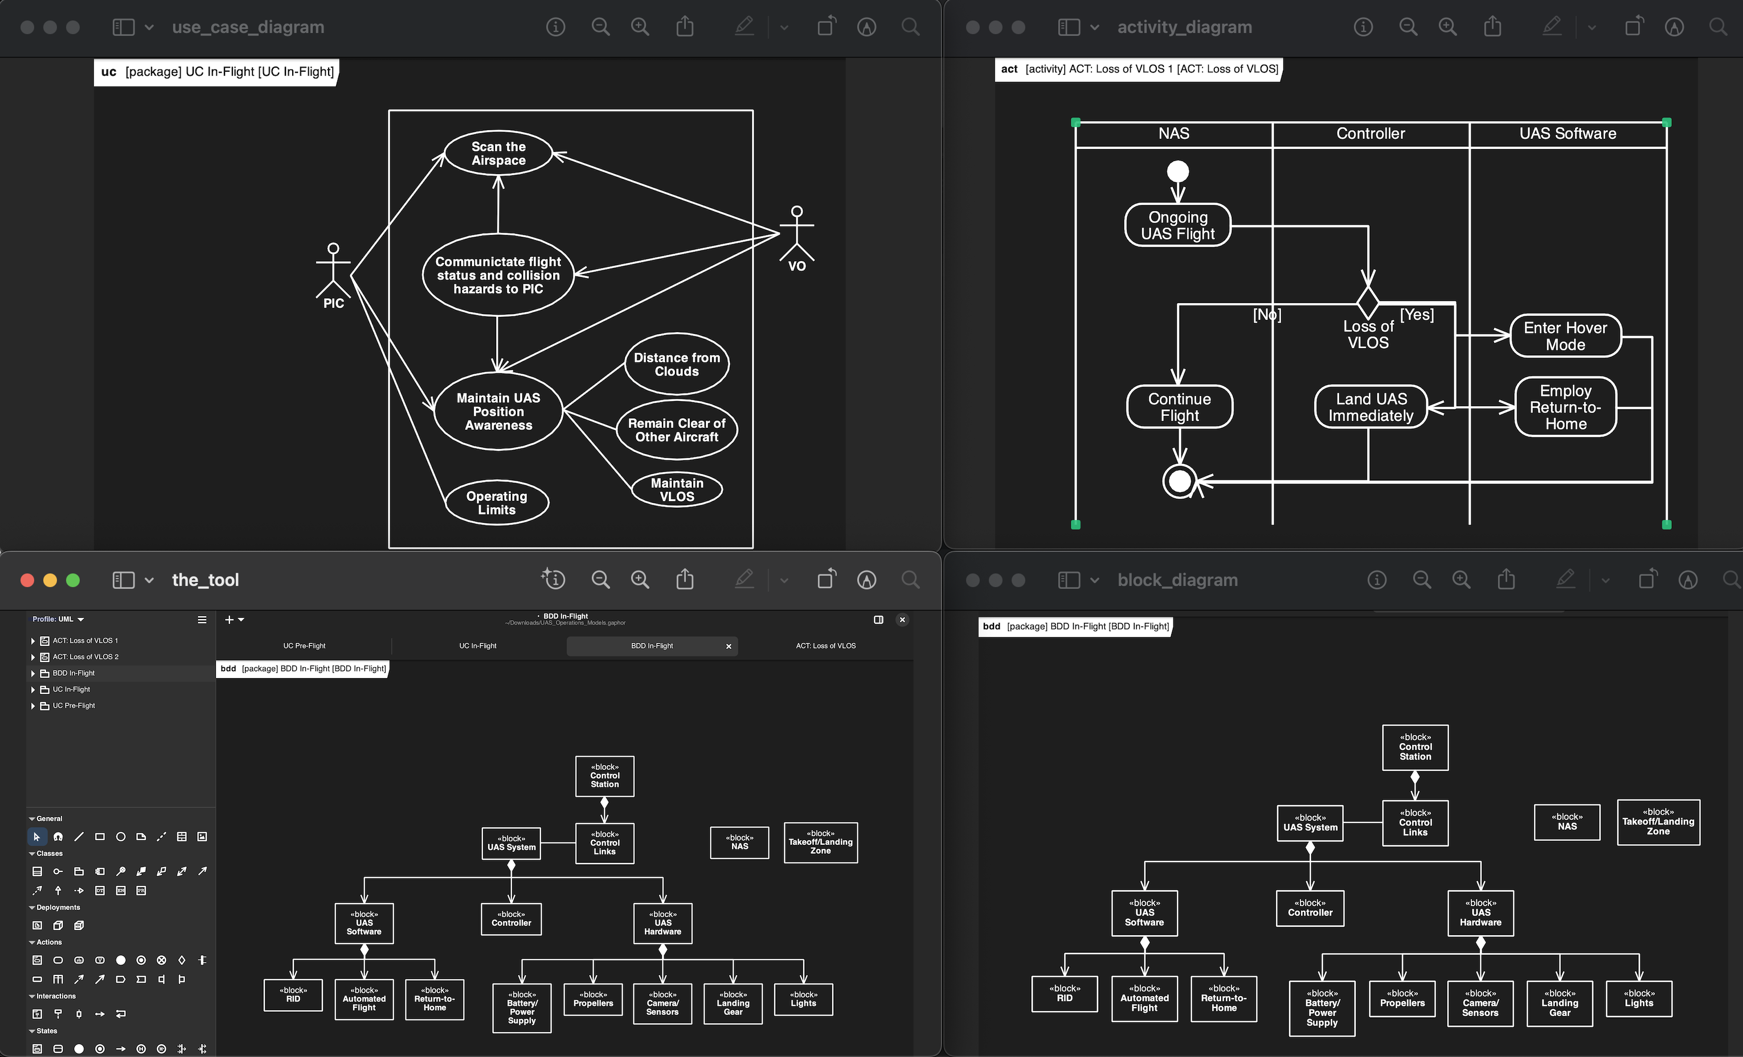
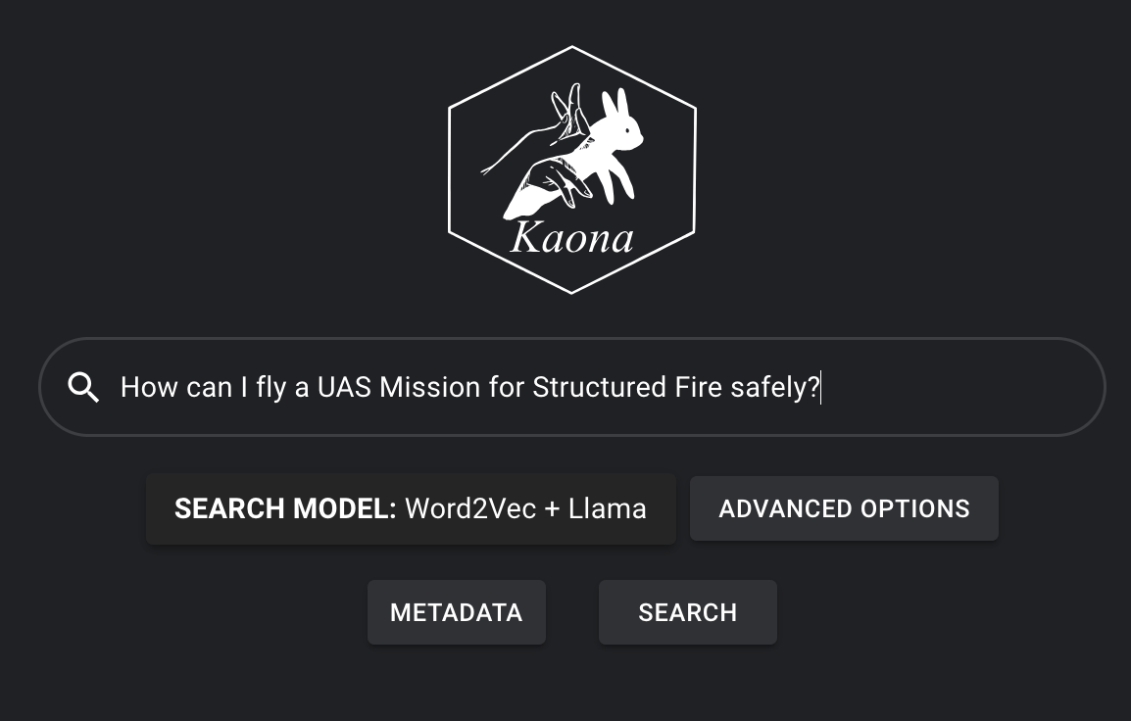


Method
The goal is to identify the gaps between mitigations and hazards, validate through agency interviews, and make it operational through a chatbot
Fire
Department
Manual
Step 1. Accumulated
Mitigations and Hazards
Step 2. Identify where hazards occur in safety procedures
Step 3. Given a manual, compare safety mitigations and hazards for gaps
Survey
✓
✓
✓
Step 4. Validated identified gaps through interviews
Step 5. Use findings for larger-scale survey validation
Step 6. Chatbot answering mission questions

Slide 7
Modeling Example
An intuition on information overlap across different sources and its model representation

Slide 8
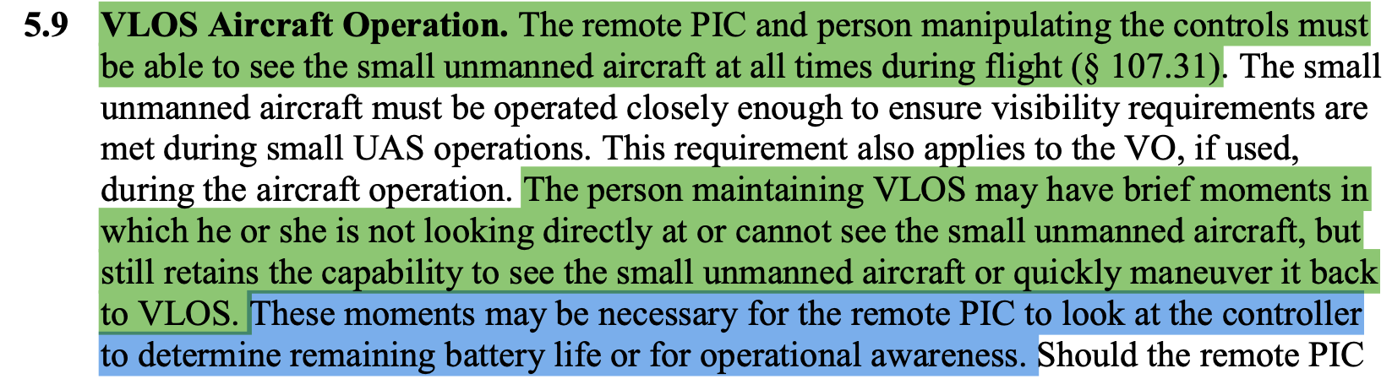
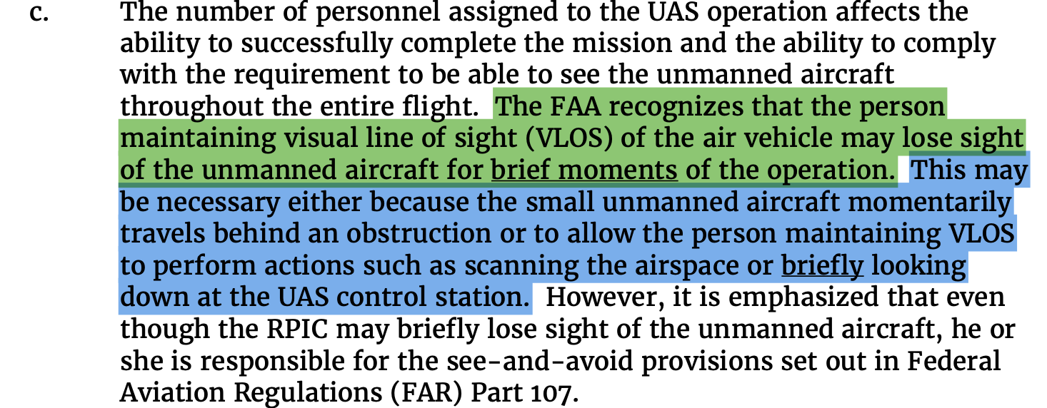
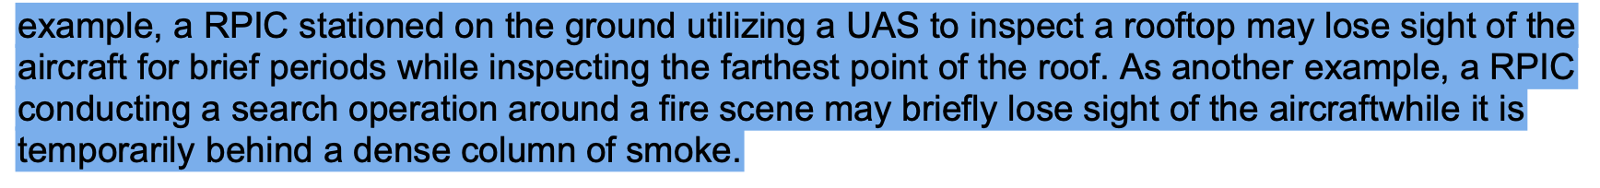
Example 1 – Overlapping VLOS from AC1072A and Operational Manuals
Different mitigation statements on loss of Visual Line of Sight
AC 107-2A
Fire Operational Manual 1
Fire Operational Manual 2

Slide 9
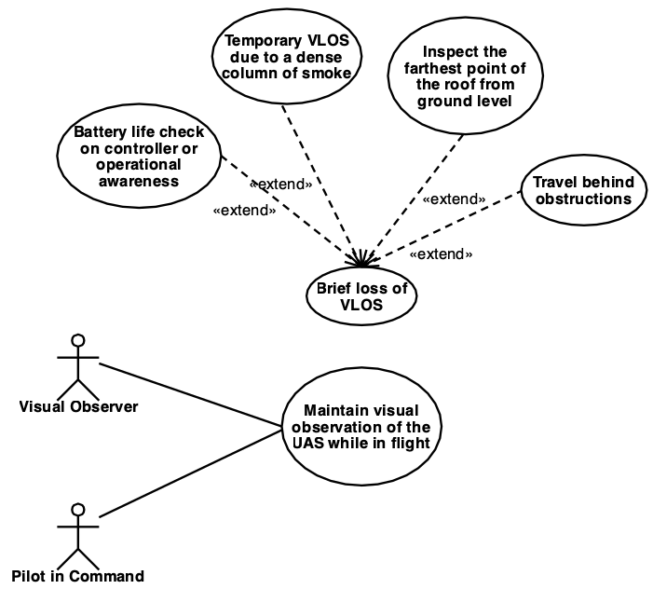
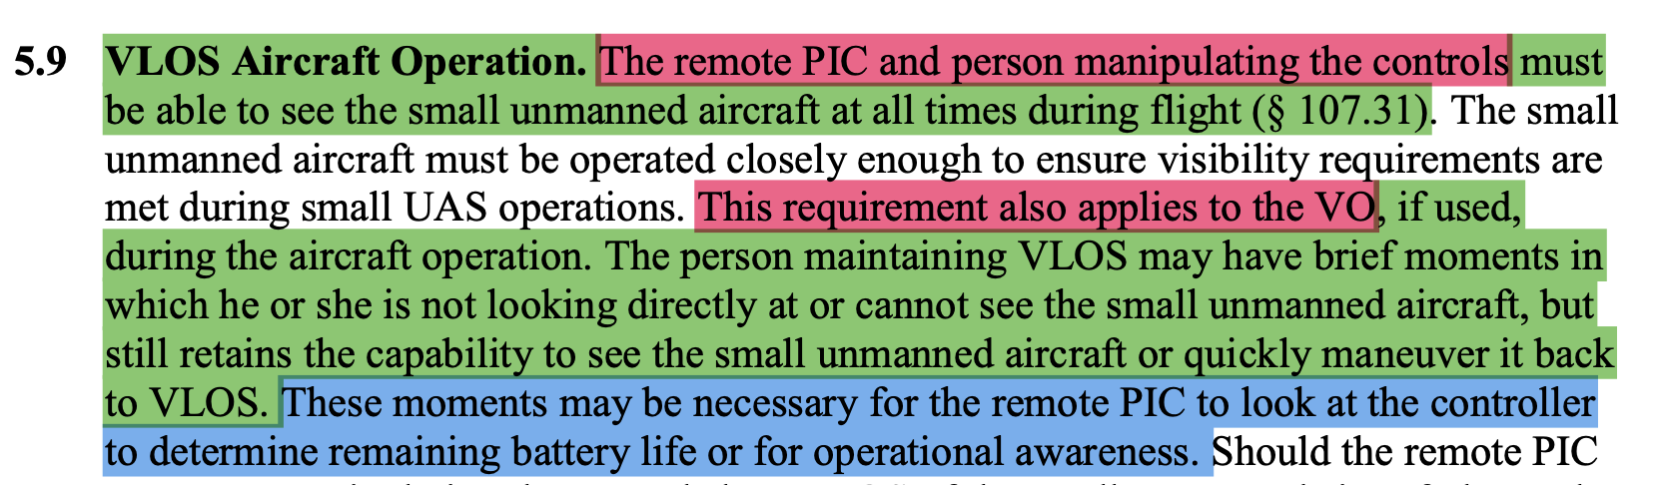
Use Case Diagram
Loss of VLOS due to Battery life checks and operational awareness
Loss of VLOS cross-source overlap
Actors
AC 107-2A
Inflight Merged Use Case

Slide 10
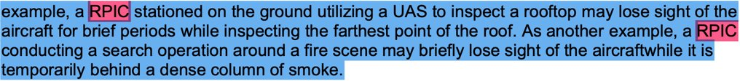
Use Case Diagram
Loss of VLOS due to presence of smoke and roof inspection
Loss of VLOS cross-source overlap
Actors
Fire Operational Manual 1
Inflight Merged Use Case

Slide 11
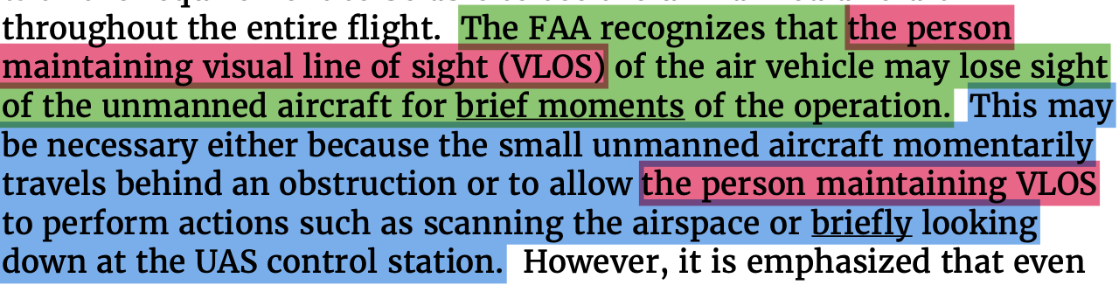
Use Case Diagram
Loss of VLOS due to travel behind obstruction
Loss of VLOS cross-source overlap
Actors
Fire Operational Manual 2
Inflight Merged Use Case

Slide 12
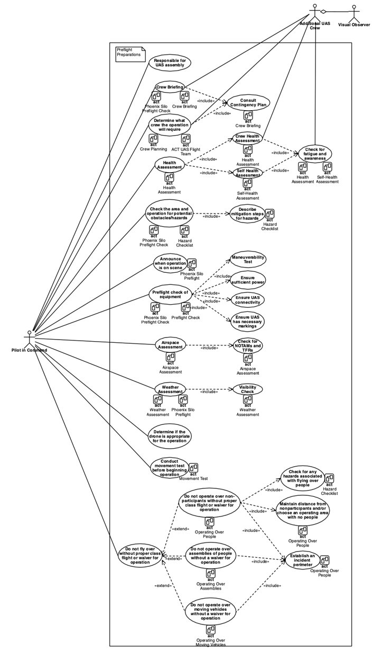
Example - Use Case
Preflight Merged Use Case Model
Use Case Model serves to accumulate overlapping information

Slide 13
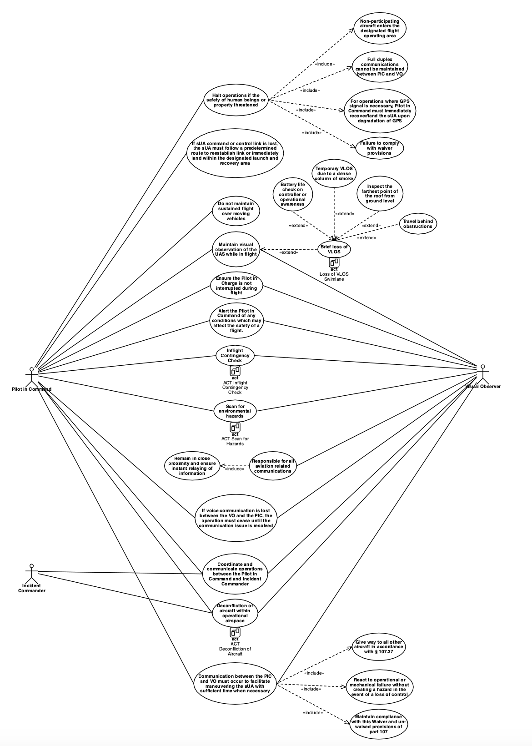
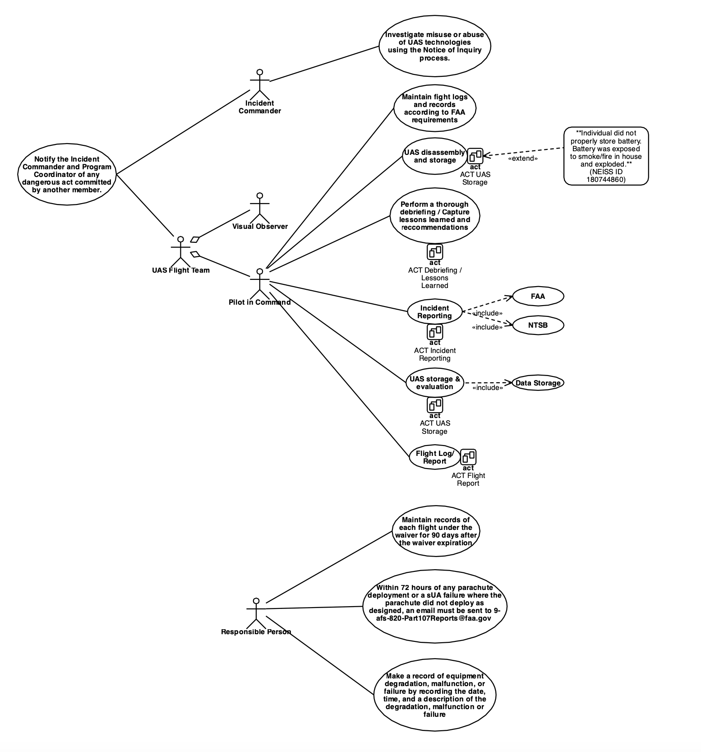
Pre-Flight
Example – Preflight, Inflight, Postflight Use Cases (Work in Progress)
In-Flight
Post-Flight

Slide 14
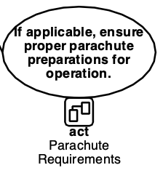
Activity Diagrams
In-Flight
Post-Flight
Pre-Flight
Pre-Flight

Slide 15
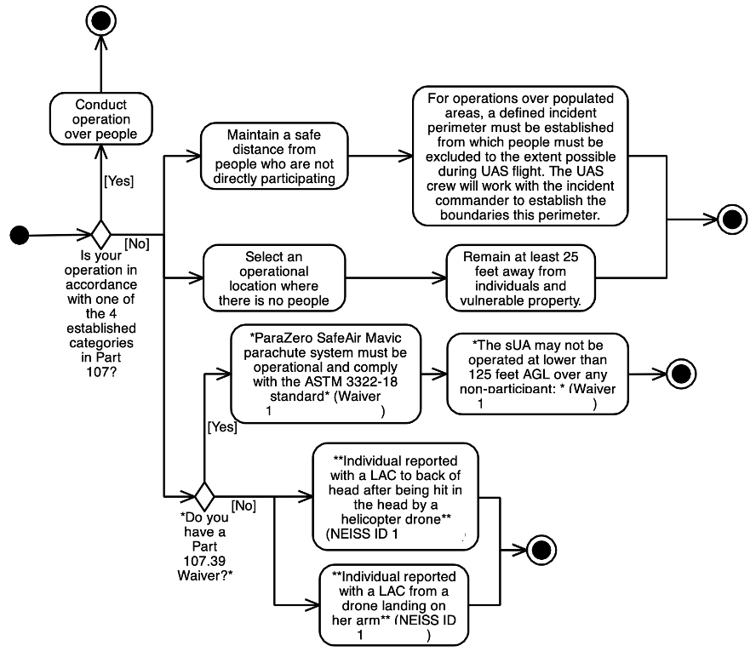
Activity Diagrams
In-Flight
Post-Flight
Pre-Flight
Operation Over People Activity Diagram
Use cases can be further expanded in activity diagrams
Parachute Requirements
Activity Diagram
Pre-Flight

Slide 16
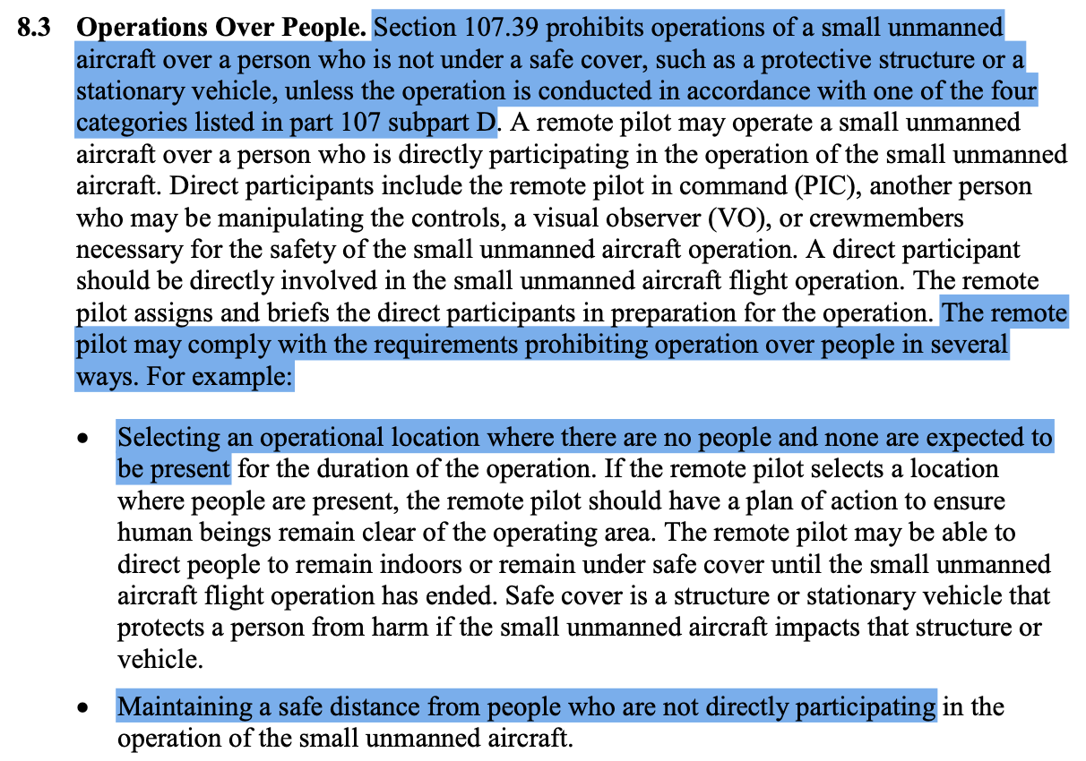

Activity Diagram – Operating Over People
The activity diagram aggregates:
  - AC107-2A
Activity Diagram - Operating Over People

Slide 17
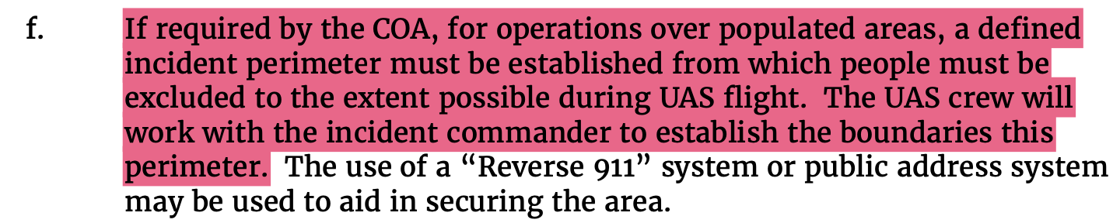
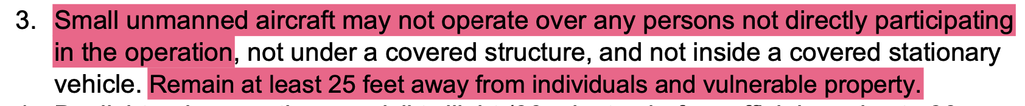
Activity Diagram – Operating Over People
The activity diagram aggregates:
  - AC107-2A
  - OP Manual
Activity Diagram - Operating Over People
Fire Operational Manual 2
Fire Operational Manual 3

Slide 18
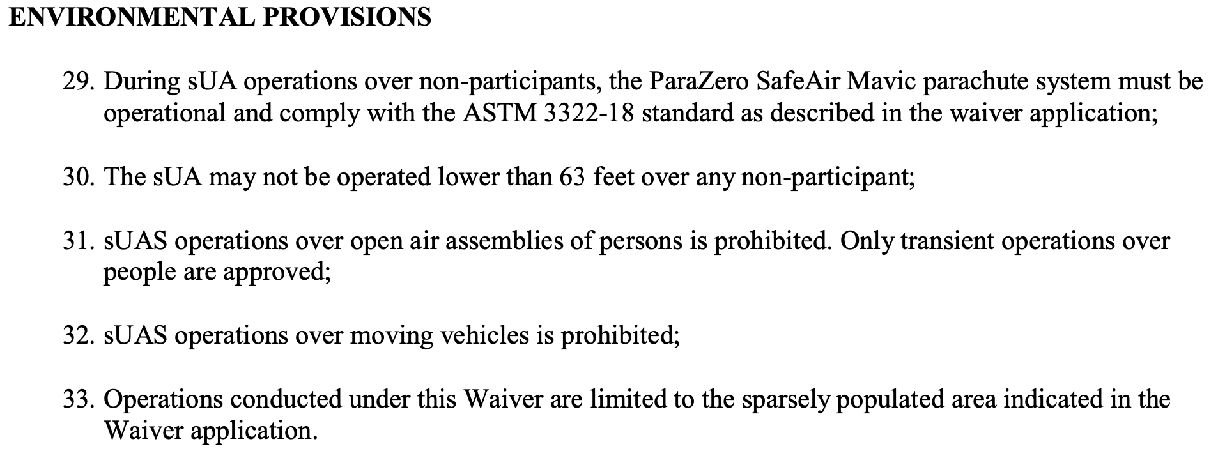
Activity Diagram – Operating Over People
The activity diagram aggregates:
  - AC107-2A
  - OP Manual
  - Waivers
Activity Diagram - Operating Over People
Activity Diagram - Operating Over People

Slide 19
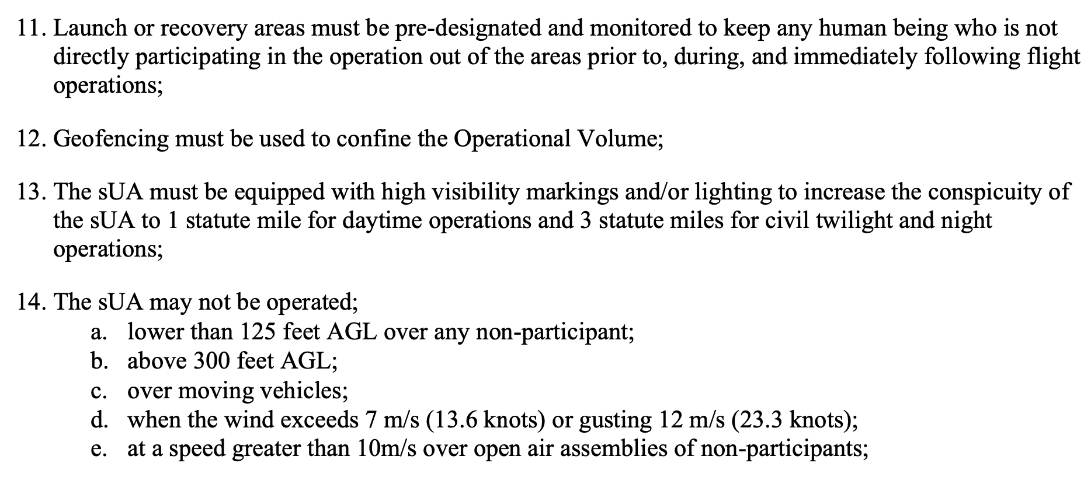
Activity Diagram – Operating Over People
The activity diagram aggregates:
  - AC107-2A
  - OP Manual
  - Waivers
Activity Diagram - Operating Over People
Activity Diagram - Operating Over People

Slide 20
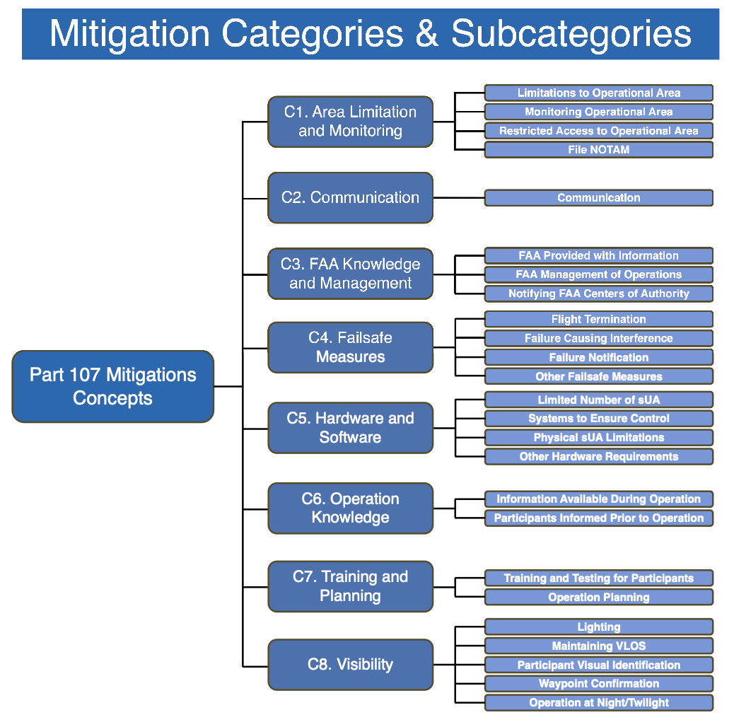
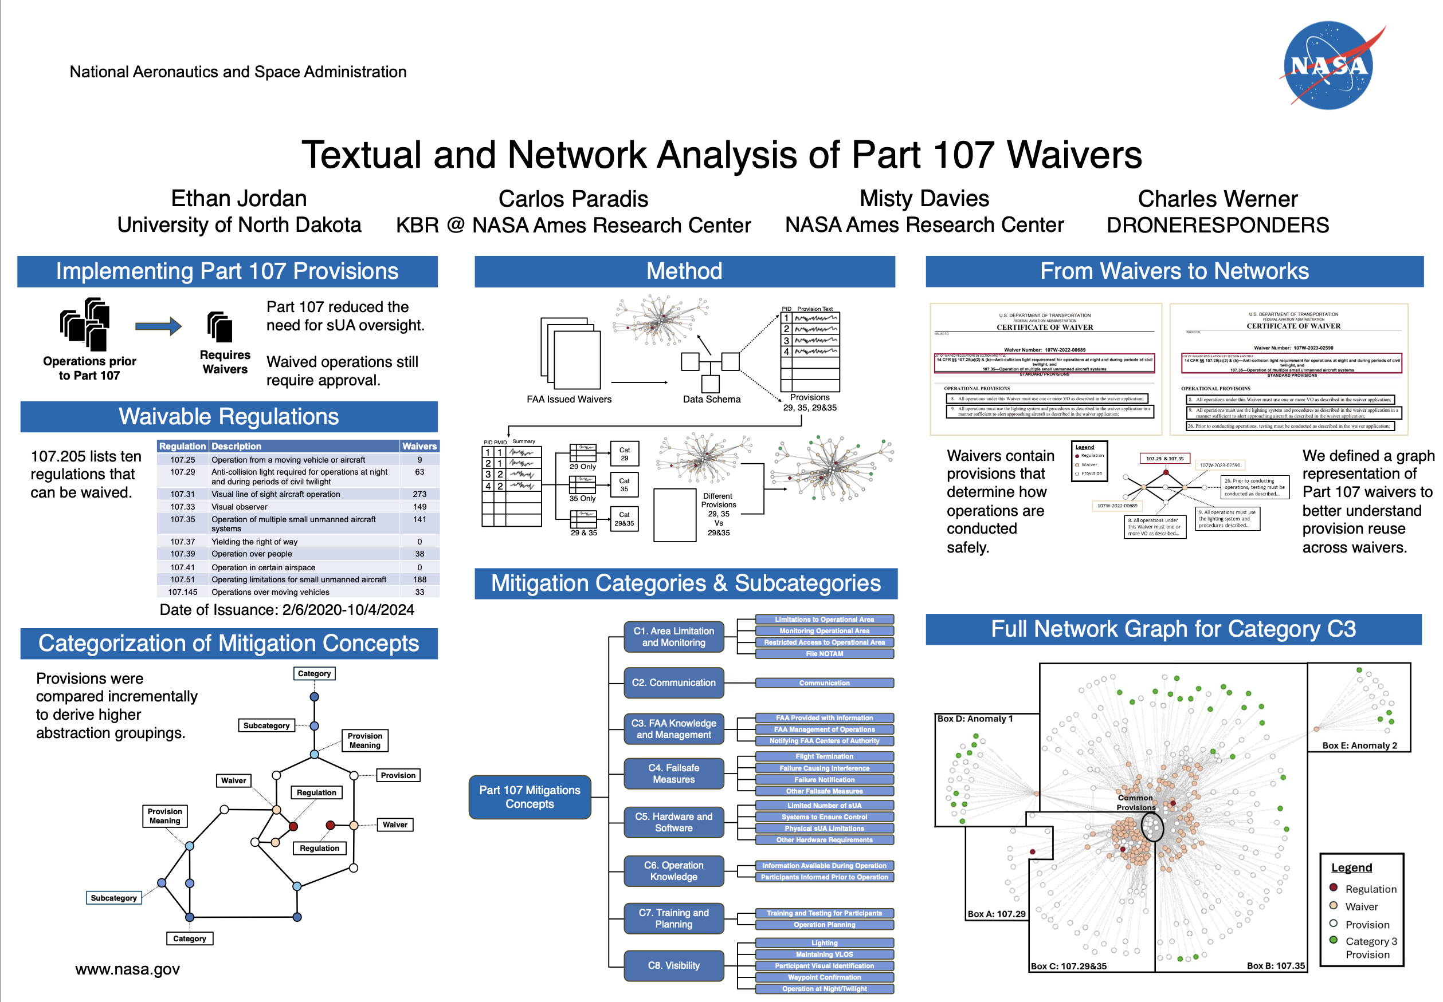
Activity Diagram – Operating Over People
The activity diagram aggregates:
  - AC107-2A
  - OP Manual
  - Waivers
Activity Diagram - Operating Over People
Activity Diagram - Operating Over People
DASC’24
Textual and Network Analysis of Title 14 CFR Part 107 Waivers

Slide 21
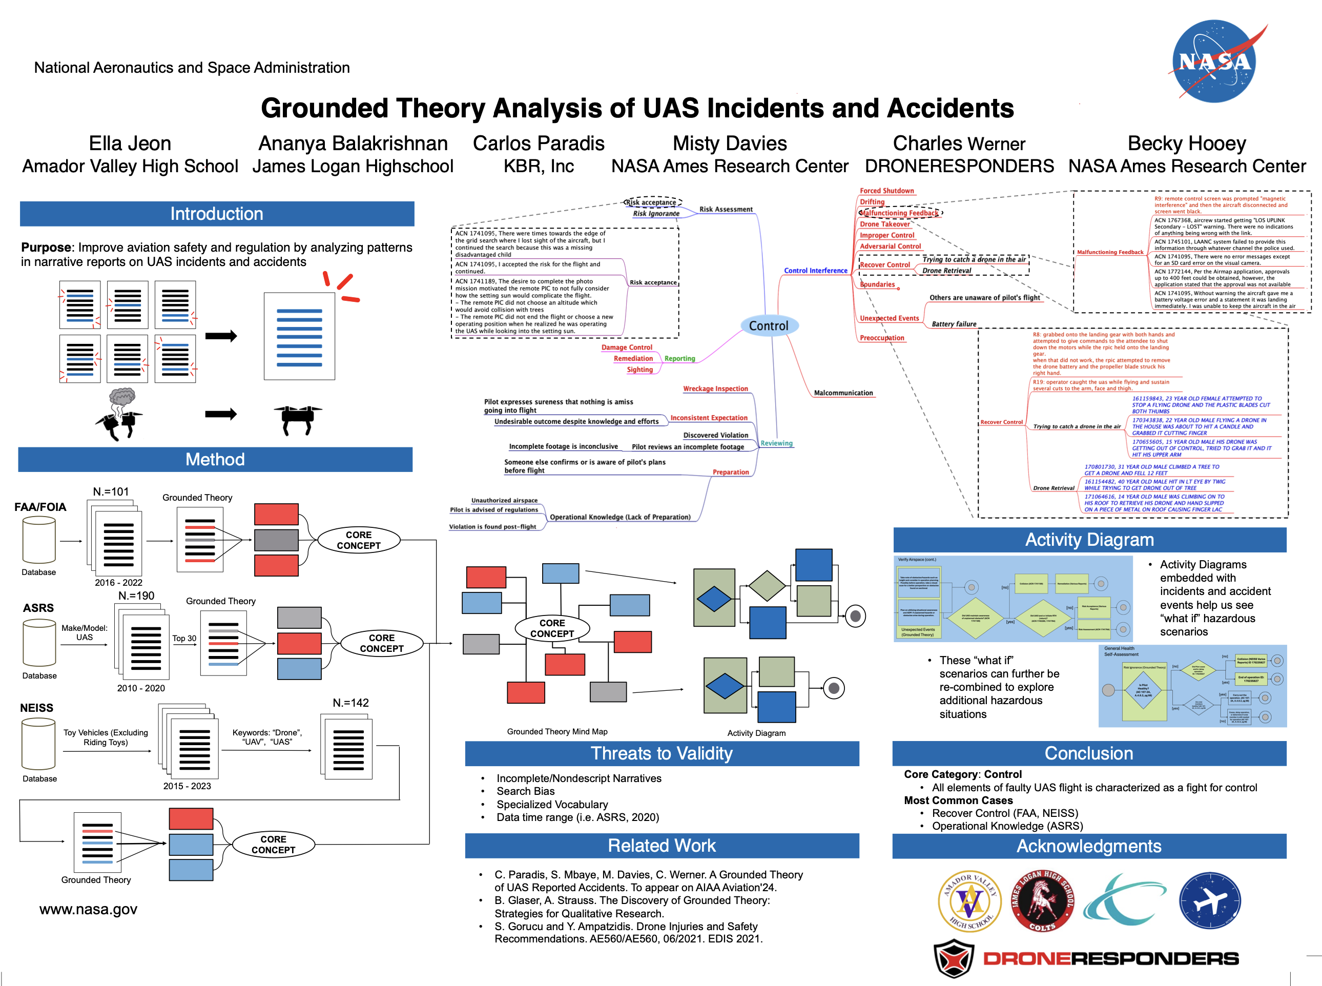
Activity Diagram – Operating Over People
The activity diagram aggregates:
  - AC107-2A
  - OP Manual
  - Waivers
  - Hazards
Activity Diagram - Operating Over People
Activity Diagram - Operating Over People
1 05/02/2015
DX LAC SCALP 27YOF
PATIENT WITH LAC TO BACK OF HEAD & LT UPPER FH
SHE WAS HIT IN HEAD ACCIDENTALLY BY A HELICOPTER DRONE FLOWN ANOTHER PERSON
1 08/26/2018
12 YOF C/O
FOREARM LACERATION S/P A
FREIND'S DRONE LANDED ON HER ARM WHILE THEY WERE BOATING DX LACERATION OF LEFT FOREARM
Aviation’24
Grounded Theory of UAS Reported Accidents

Slide 22
Activity Diagram – Operating Over People
Hazards are included in the diagram so we can see where they occur
Activity Diagram - Operating Over People
Activity Diagram - Operating Over People

Slide 23
Activity Diagrams
In-Flight
Post-Flight
Pre-Flight
Operation Over People Activity Diagram
Constructed Activity Diagrams can be used to identify Operational Manual Gaps
Parachute Requirements
Activity Diagram
Pre-Flight

Slide 24
Manual Evaluation
Fire
Department
Manual
In-Flight
Post-Flight
Manual Evaluation
Pre-Flight
Operational Manual
In-Flight

Slide 25
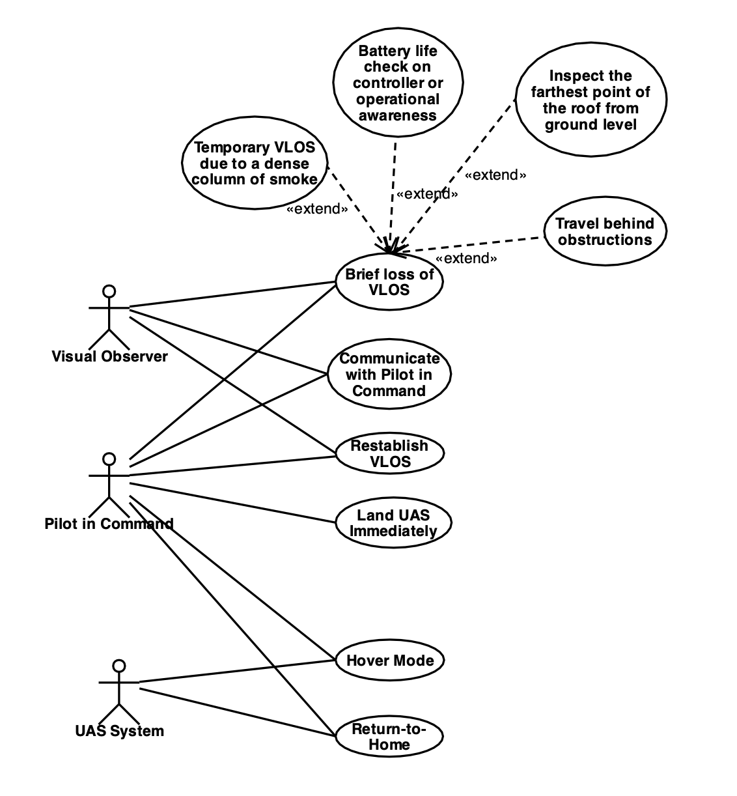
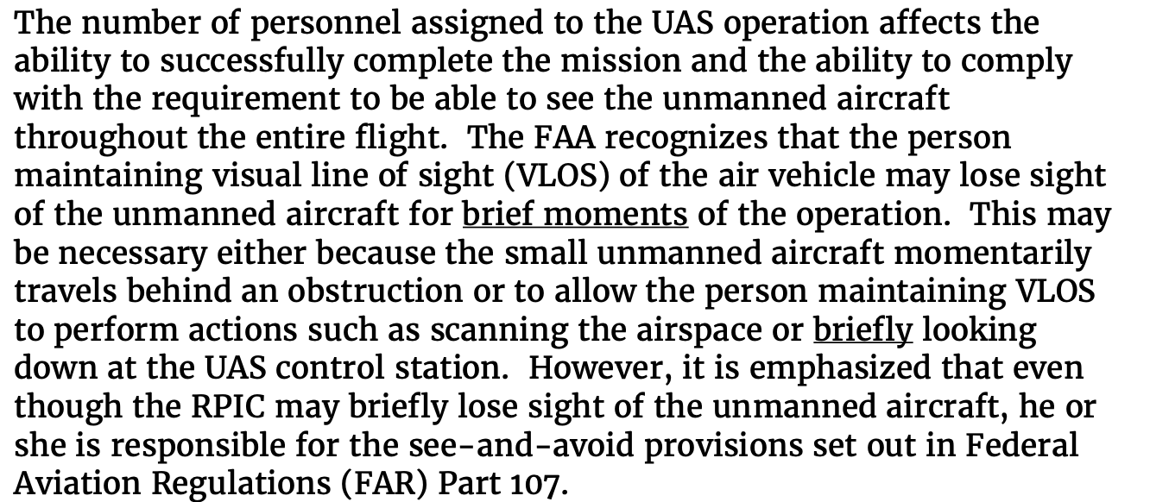
Example – Operational Manual – New information added to the model
Fire
Department
Manual

Slide 26
Example – Operational Manual – Information that could be added to Manual
Fire
Department
Manual

Slide 27
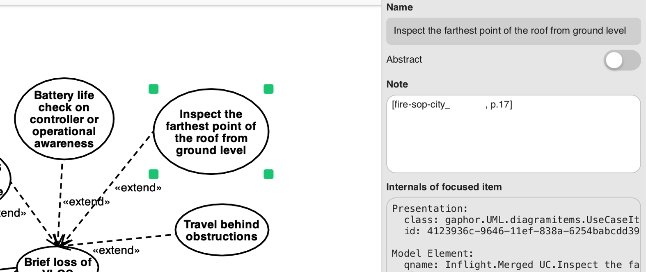
Example – Operational Manual – Document Traceability
We preserved the source data references to serve as context for the chatbot model

Slide 28
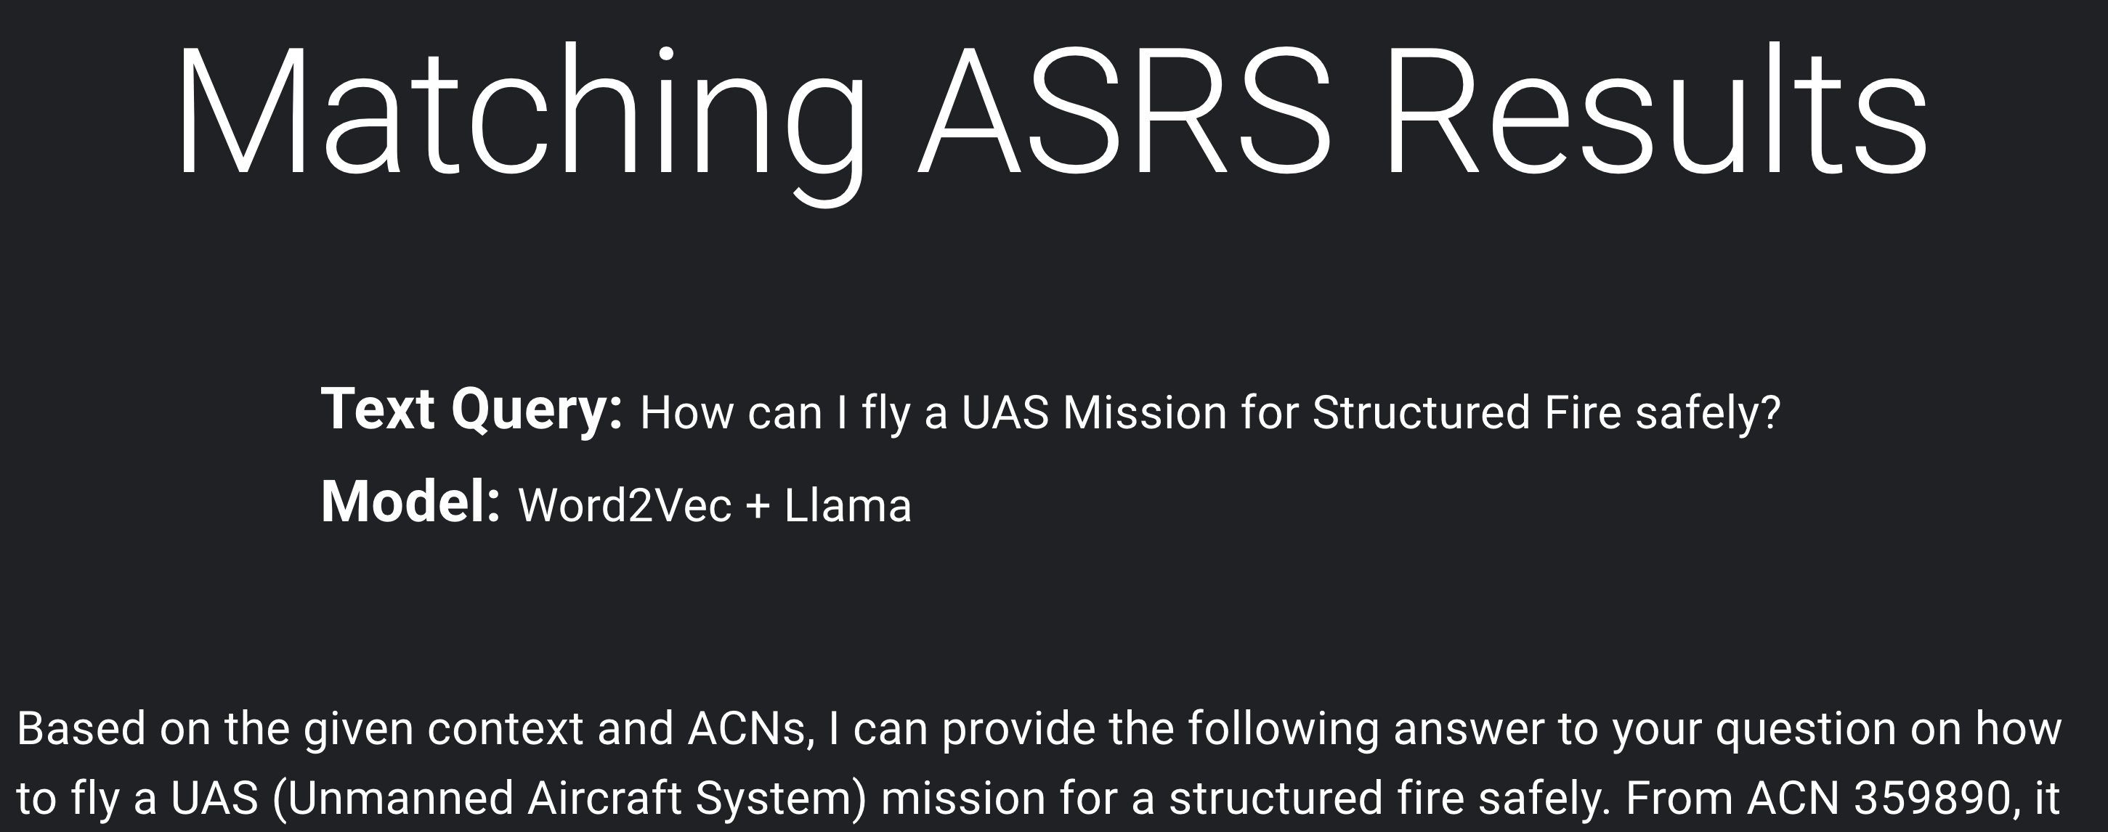
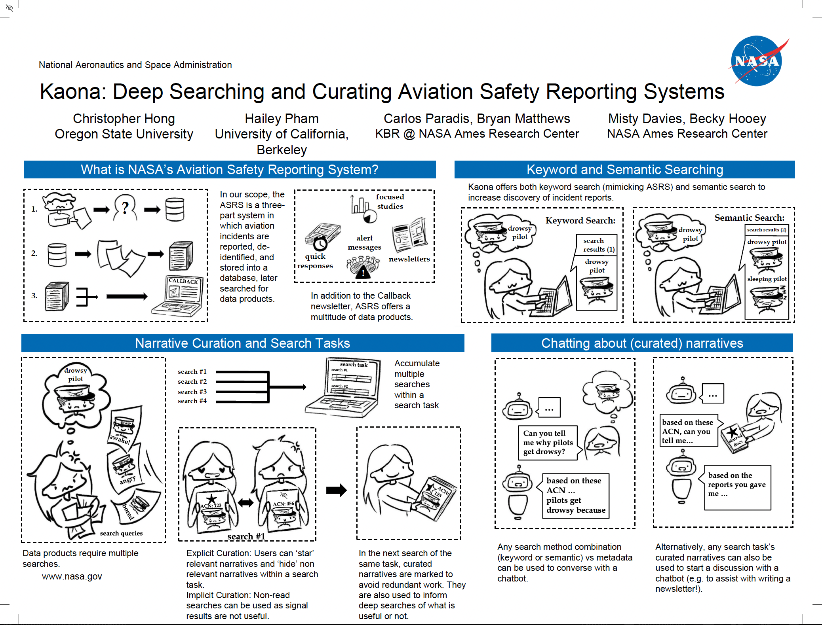
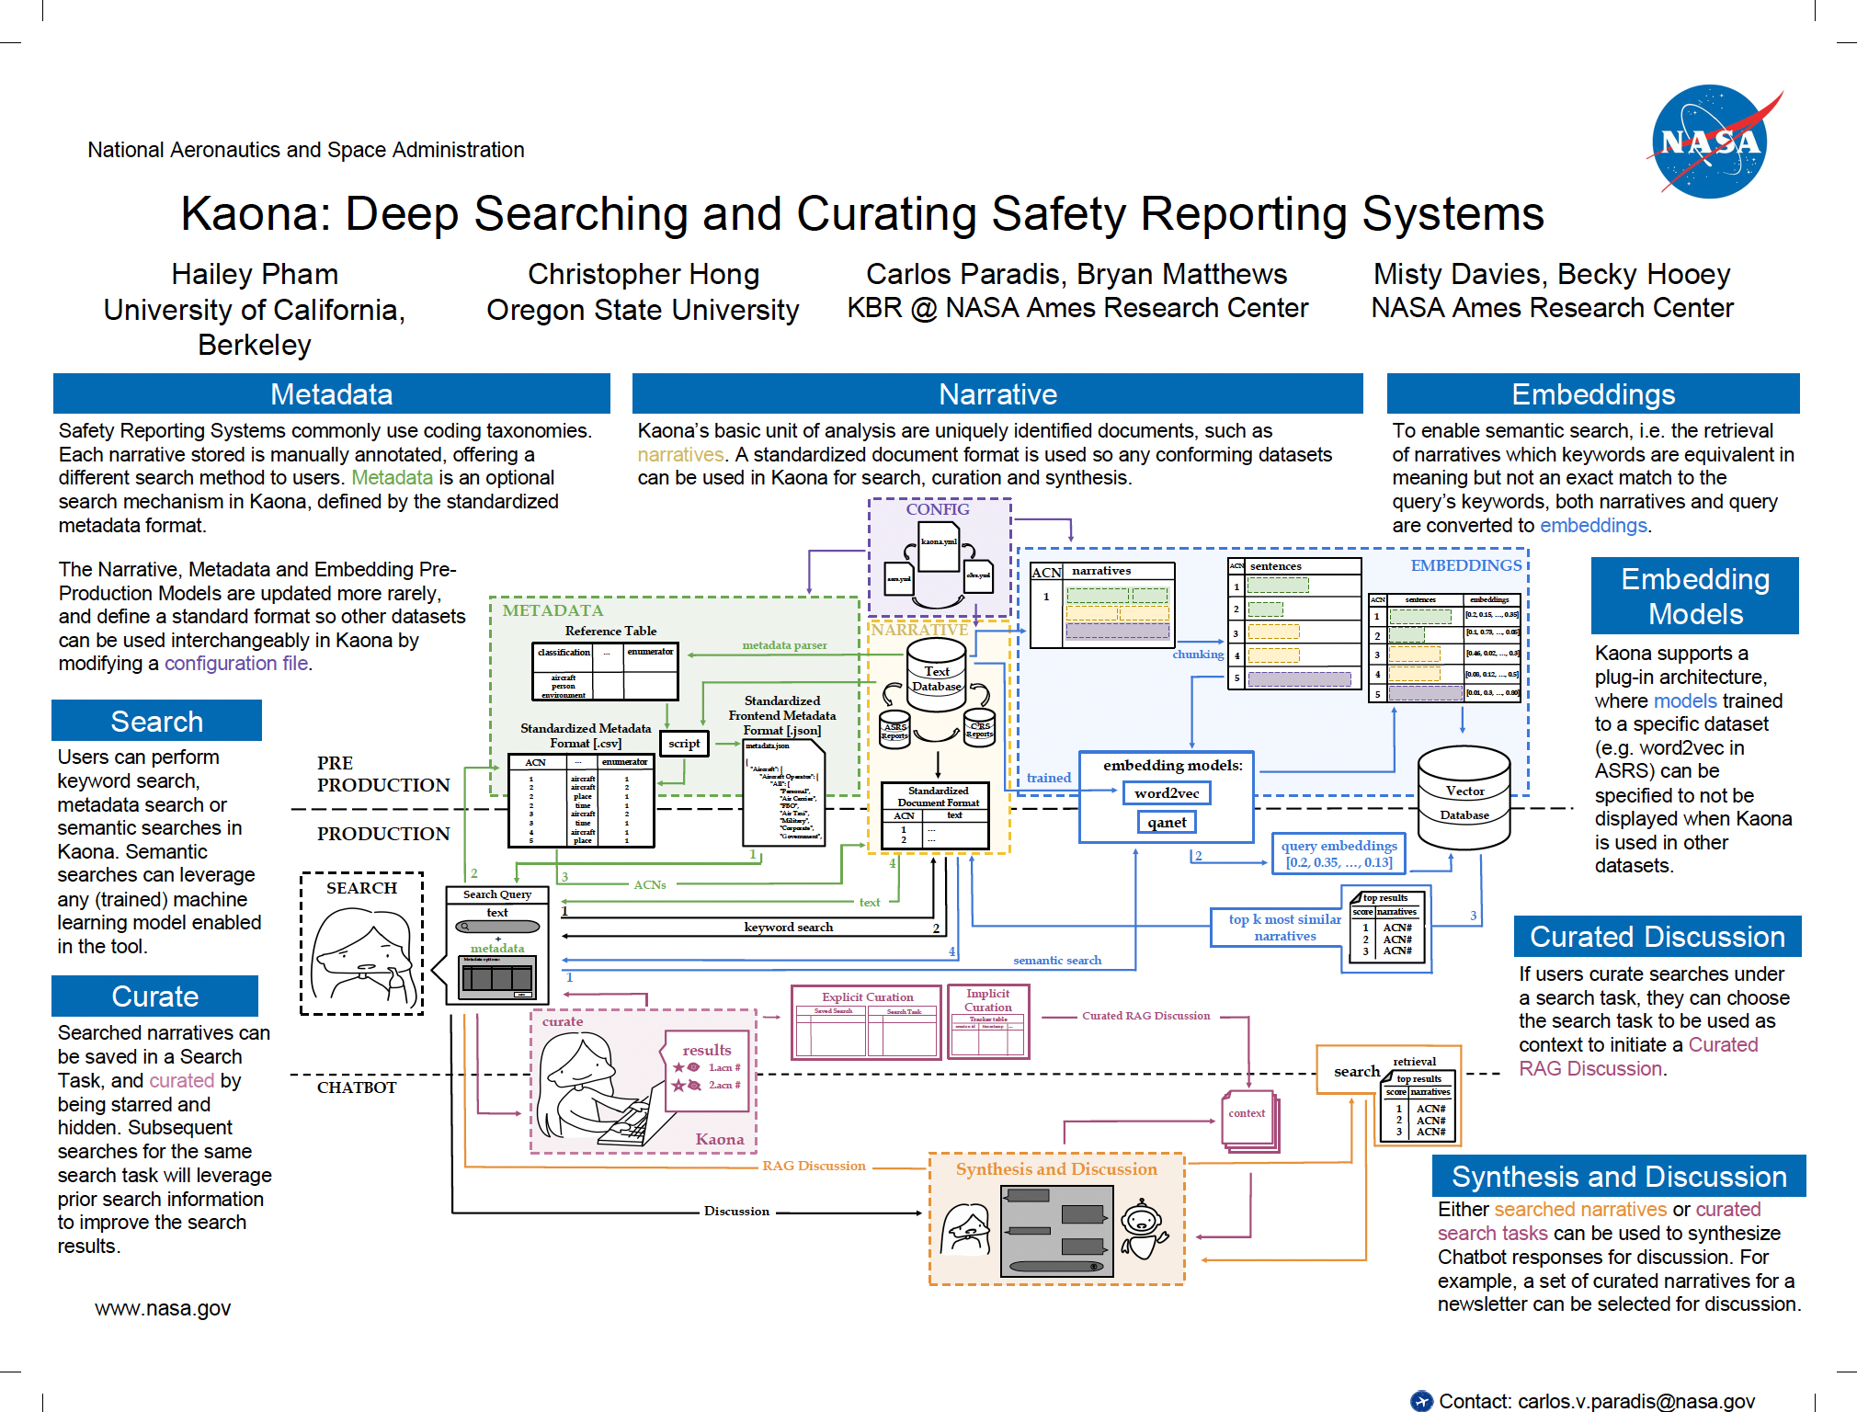
Chatbot (Work in Progress)
Scitech’25
Kaona: Deep Searching and Curating Data from Aviation Safety Reporting Systems

Slide 29
Hurricane Recovery Example
An example using our methodology on a hurricane scenario

Slide 30
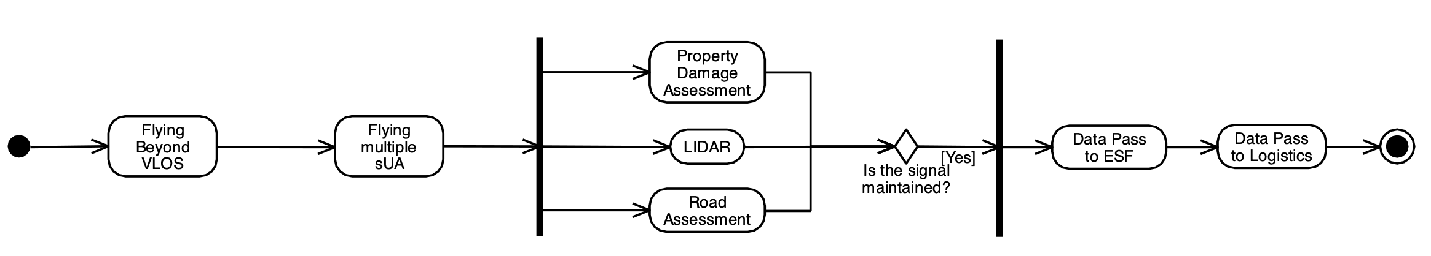
Interview
20:47 […]
21:03 […] you had multiple drones and we had beyond visual light of sight […]

Slide 31
Interview
21:28 […] one drone would fly with LIDAR […]
21:42 […] another would perform property damage assessment […]
21:52 […] and another for road assessment […]

Slide 32
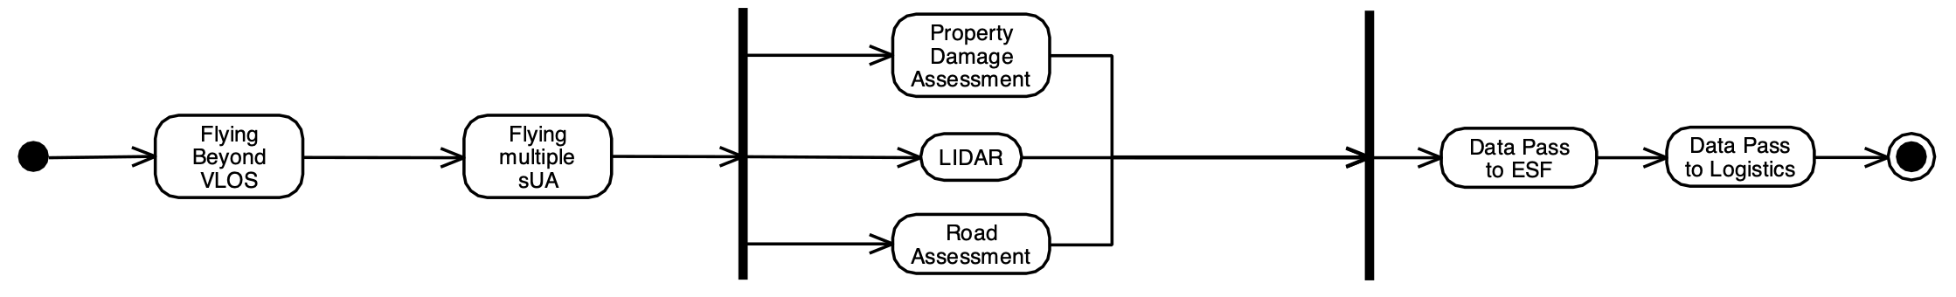
Interview
22:12 […] the data could be passed to ESF […] and then to logistics […]

Slide 33
Hurricane Recovery Example
An example using our methodology on a hurricane scenario

Slide 34
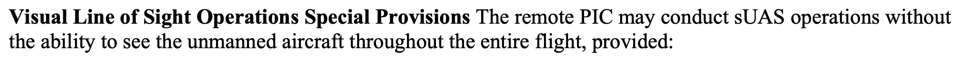
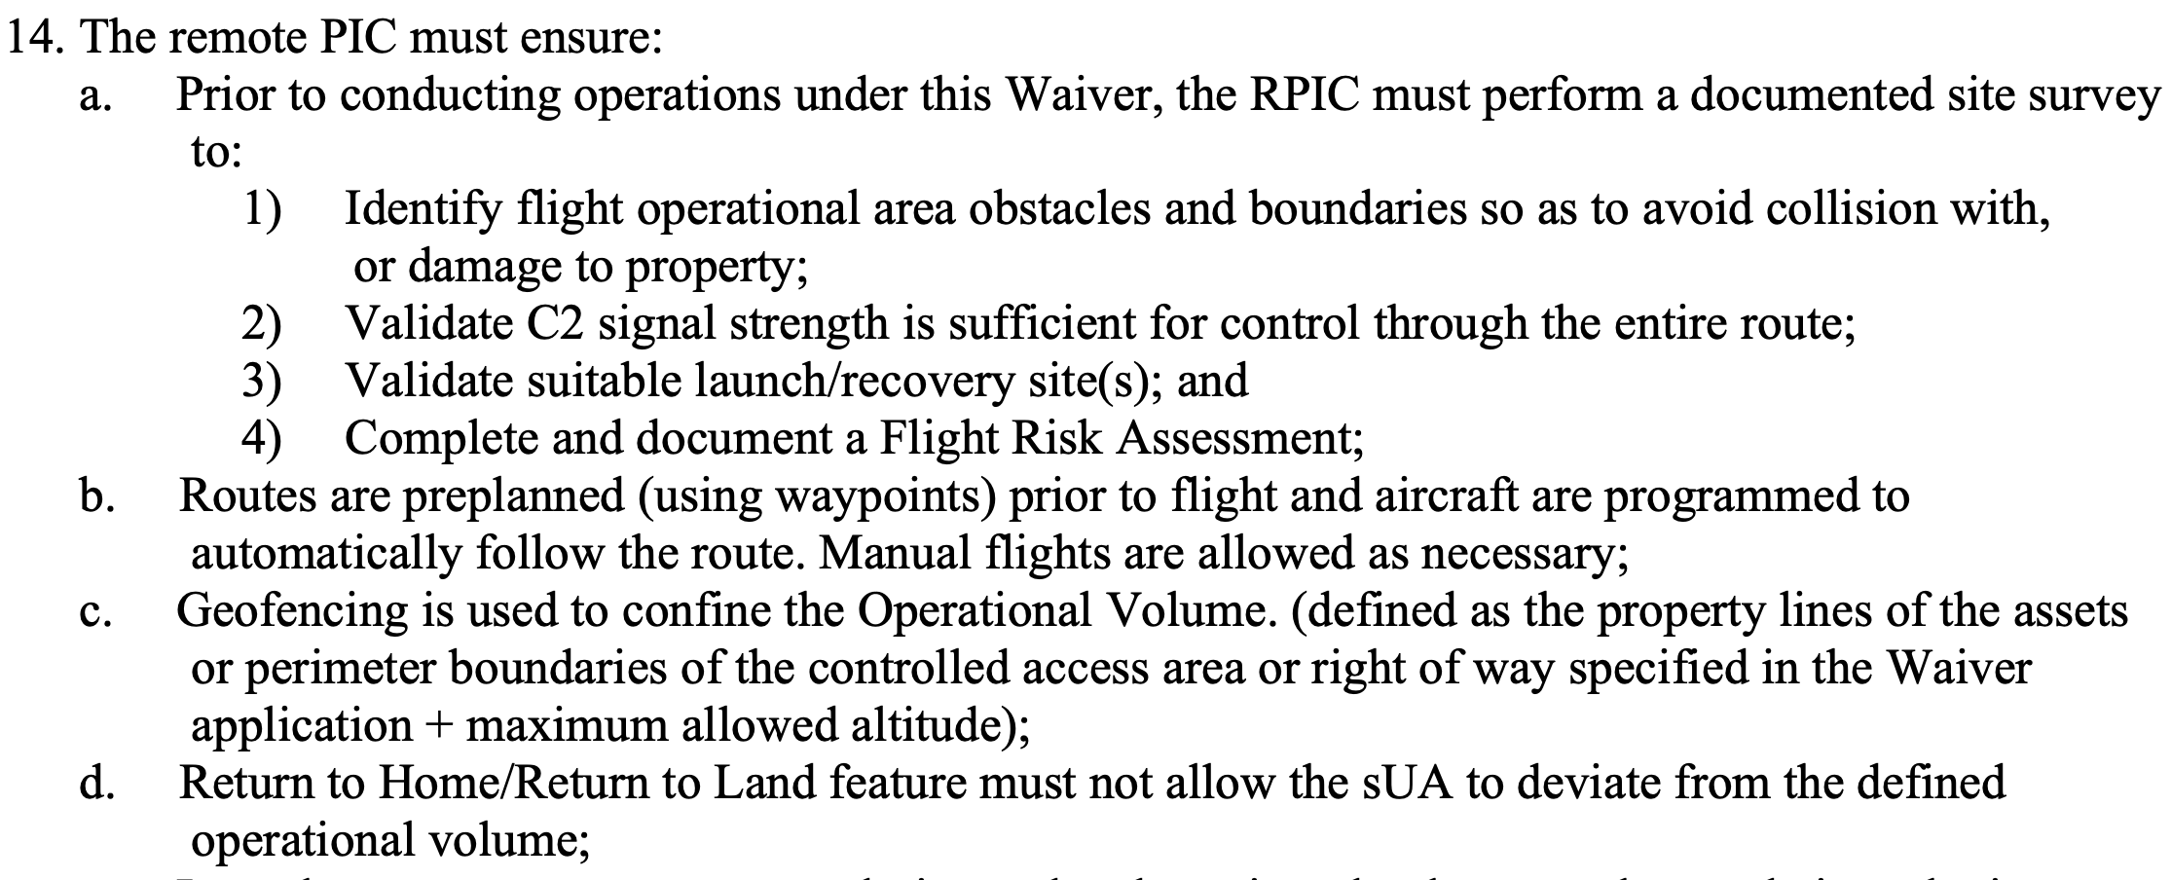
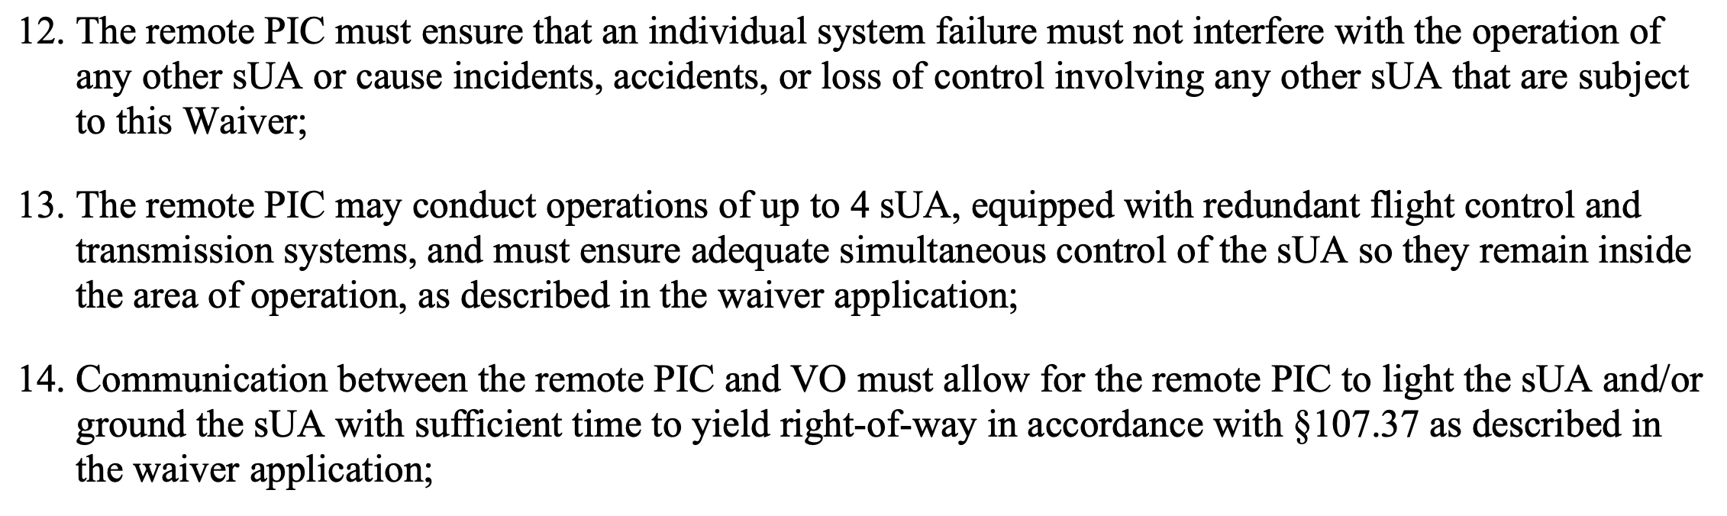
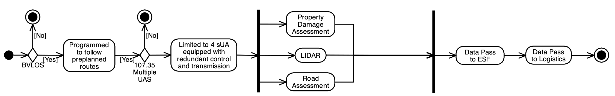
Mitigations - Waiver Provisions – Beyond VLOS and Multiple sUAS
DASC’24
Textual and Network Analysis of Title 14 CFR Part 107 Waivers

Slide 35
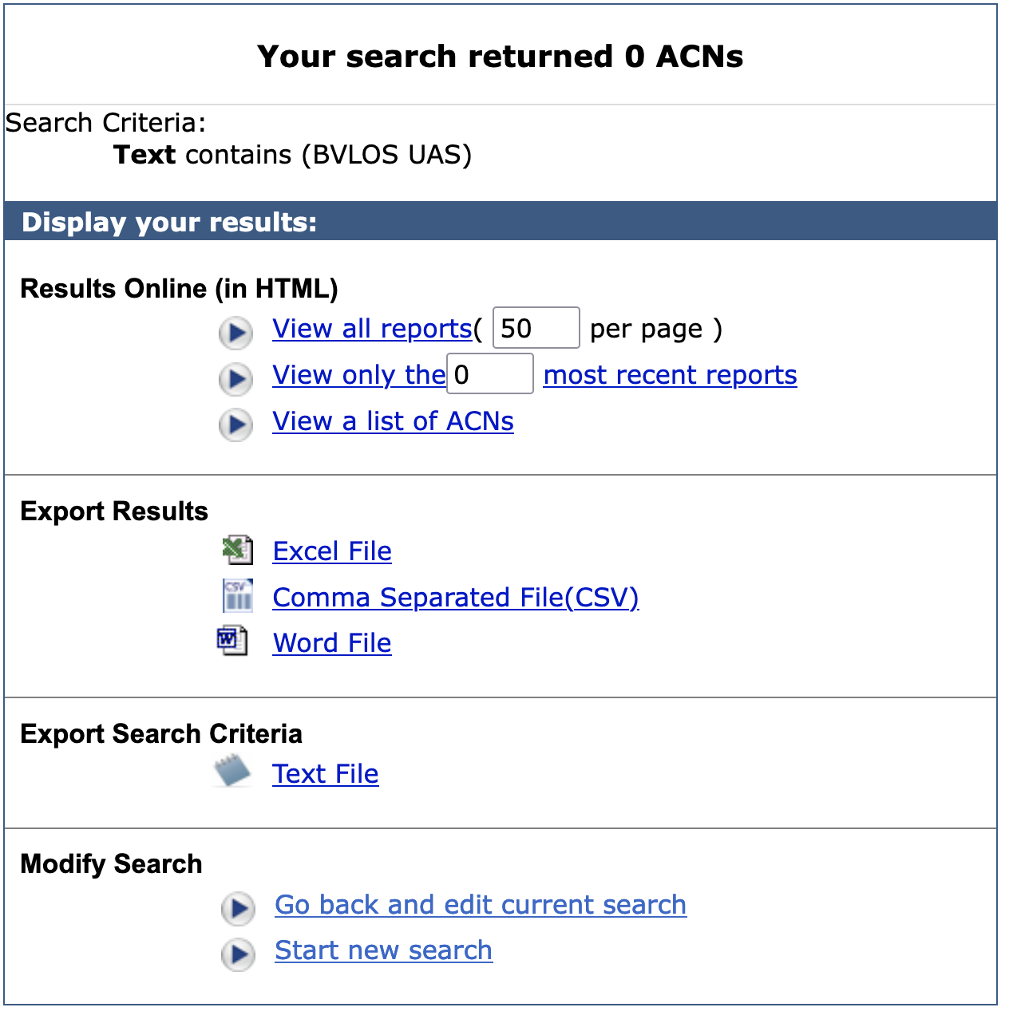
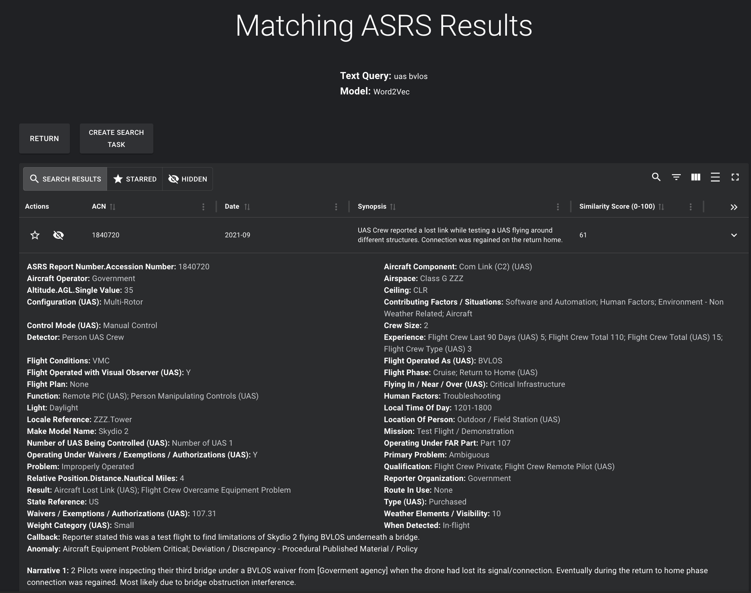
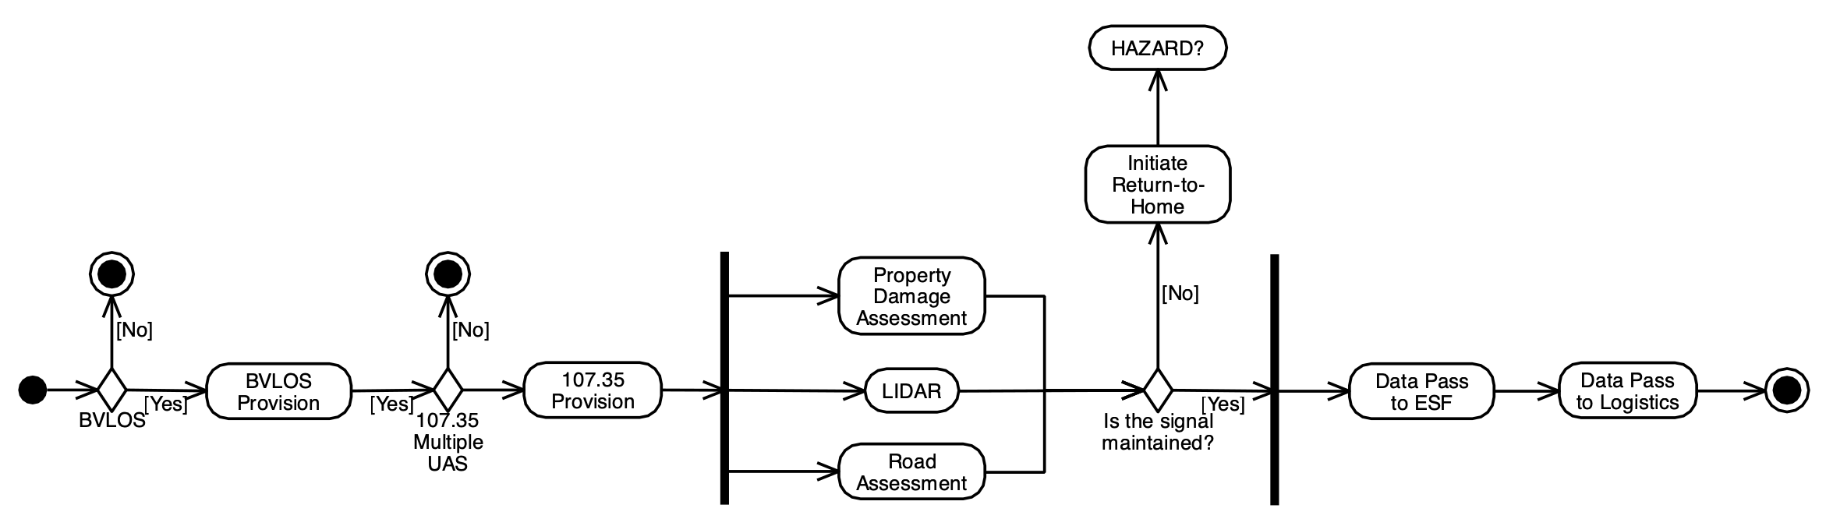
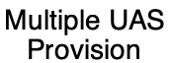
Hazards – Lost Signal
Scitech’25
Kaona: Deep Searching and Curating Data from Aviation Safety Reporting Systems

Slide 36
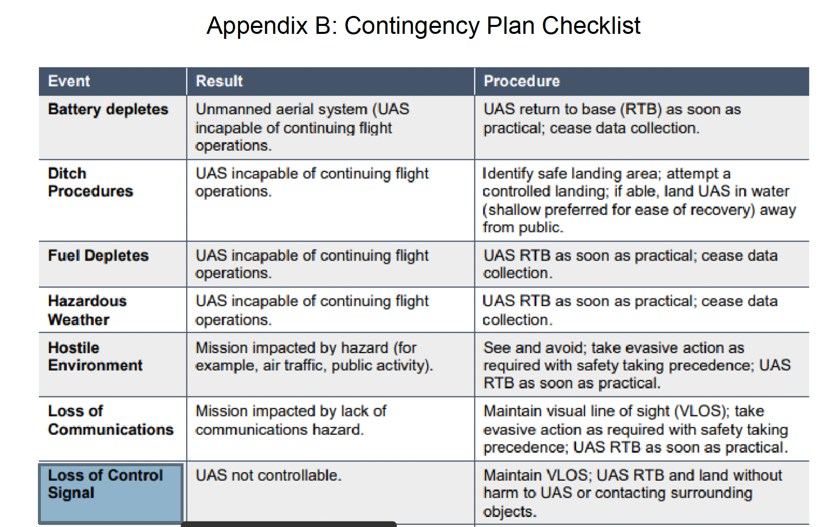
Hazards – Lost Signal

Slide 37
Hazards – Lost Signal and Return-to-Home/Base (RTH/RTB)
Does not apply

Slide 38
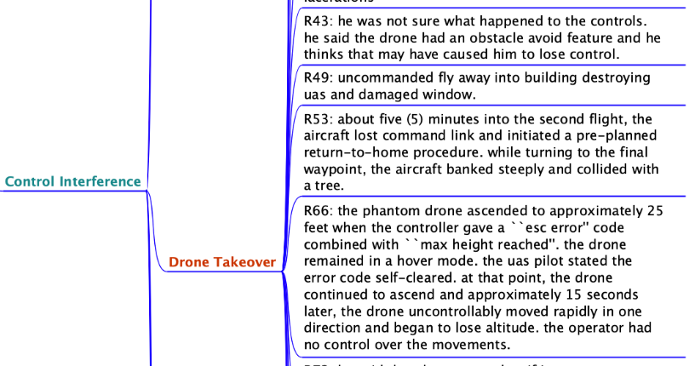
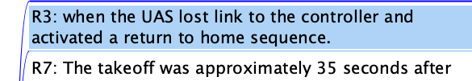
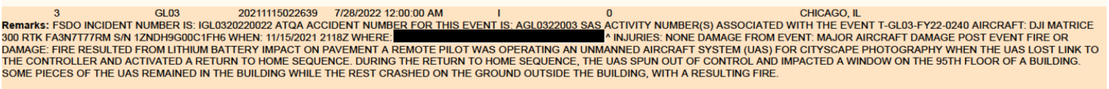
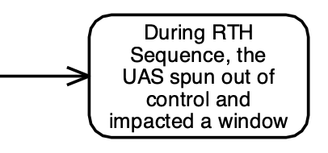
Hazards – Lost Signal and Return-to-Home/Base (RTH/RTB)
Aviation’24
Grounded Theory of UAS Reported Accidents
Thematic Synthesis (Grounded Theory)
Additional Hazard Context

Slide 39
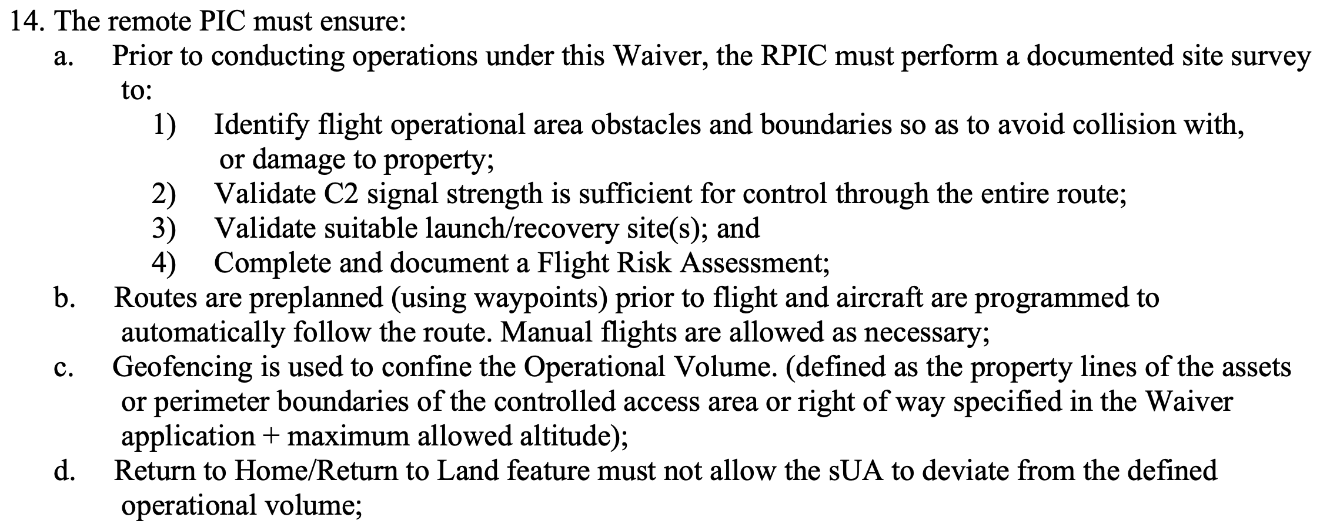
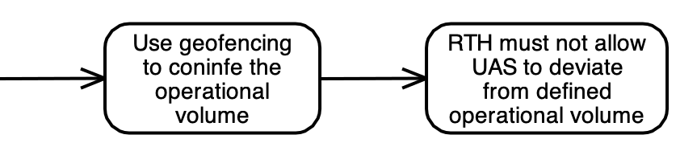

Hazards – Lost Signal and Return-to-Home/Base (RTH/RTB)
Aviation’24
Grounded Theory of UAS Reported Accidents
Thematic Synthesis (Grounded Theory)
Additional Hazard Context

Slide 40

In Conclusion
The three-year partnership aims to:
  gather safety metrics to identify patterns and common risks, along with proposed solutions to prevent or lessen the impact of the hazards.
carlos.v.paradis@nasa.gov
https://castor.ndc.nasa.gov/intime/home

