Slide 1
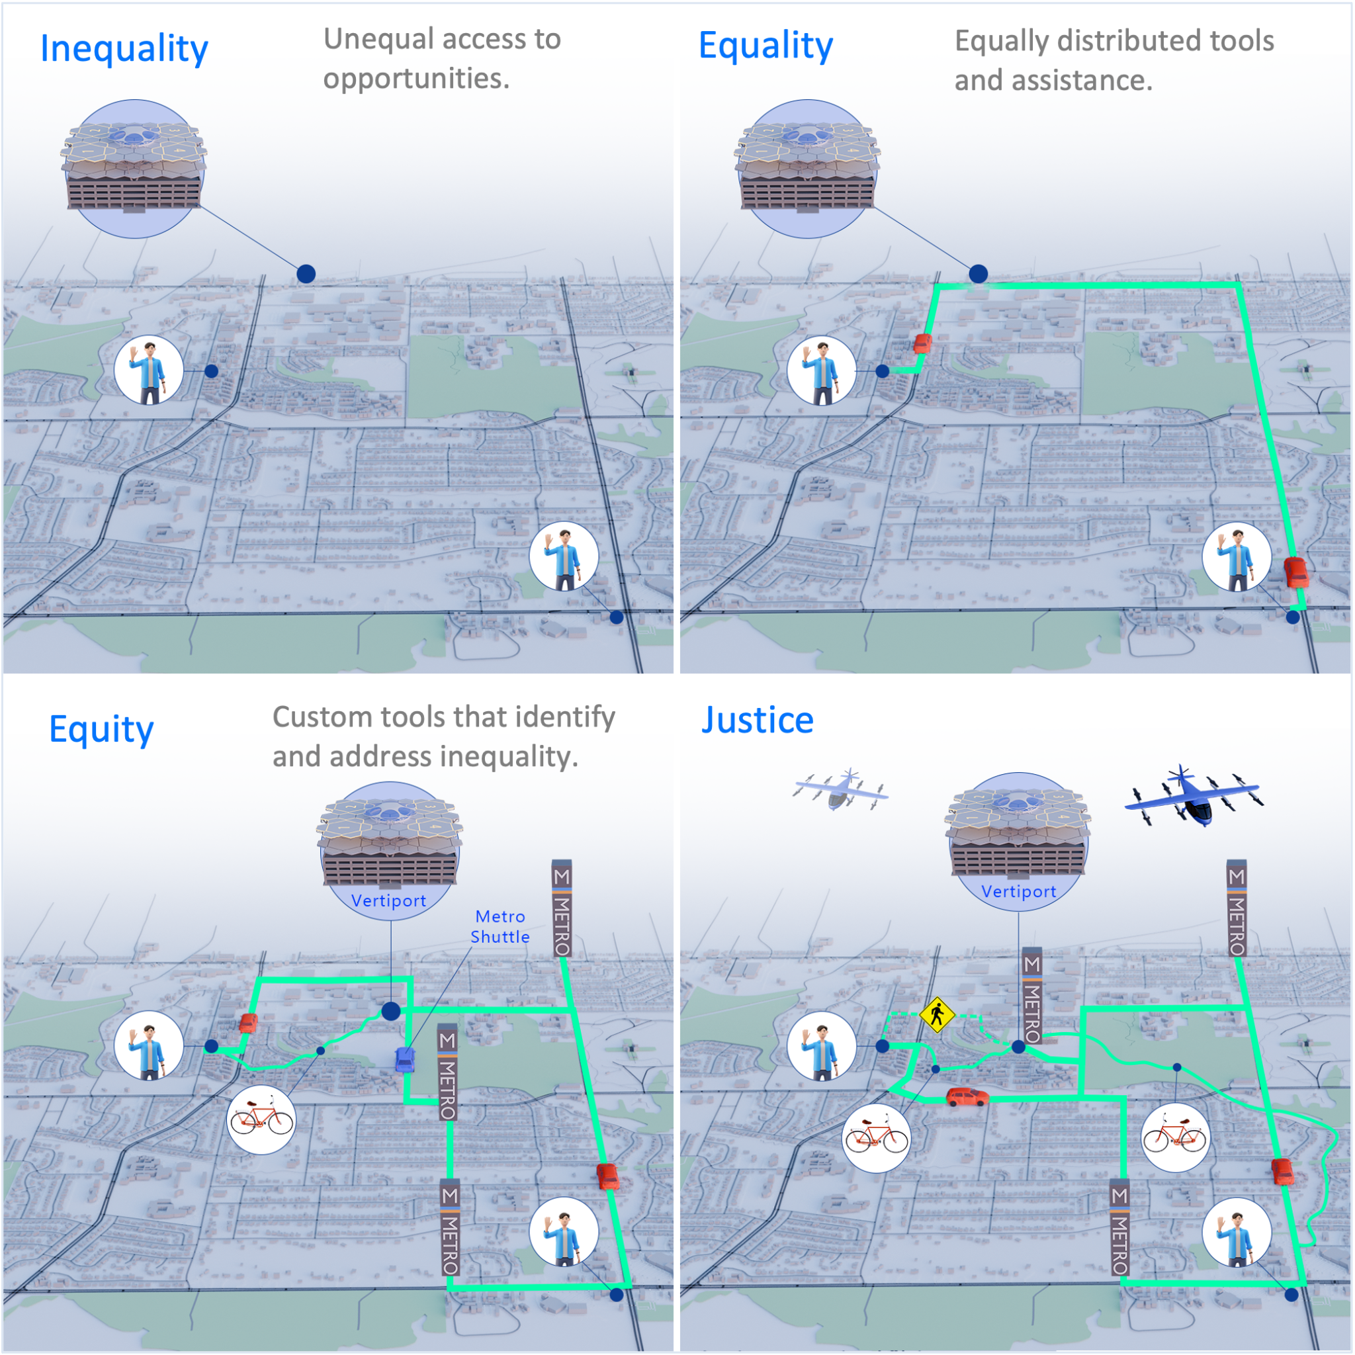













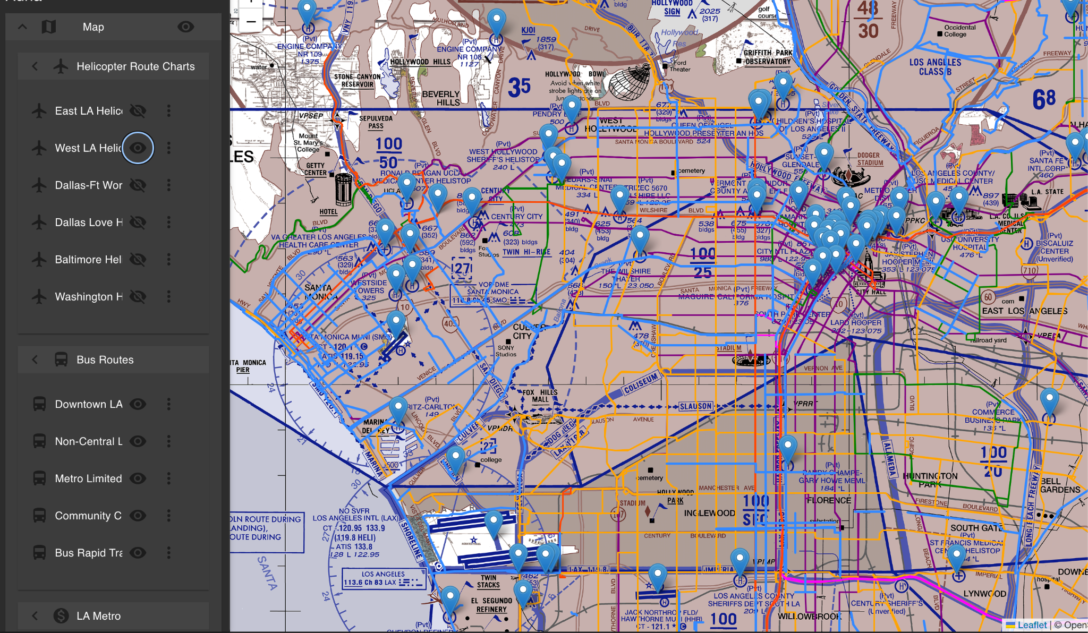
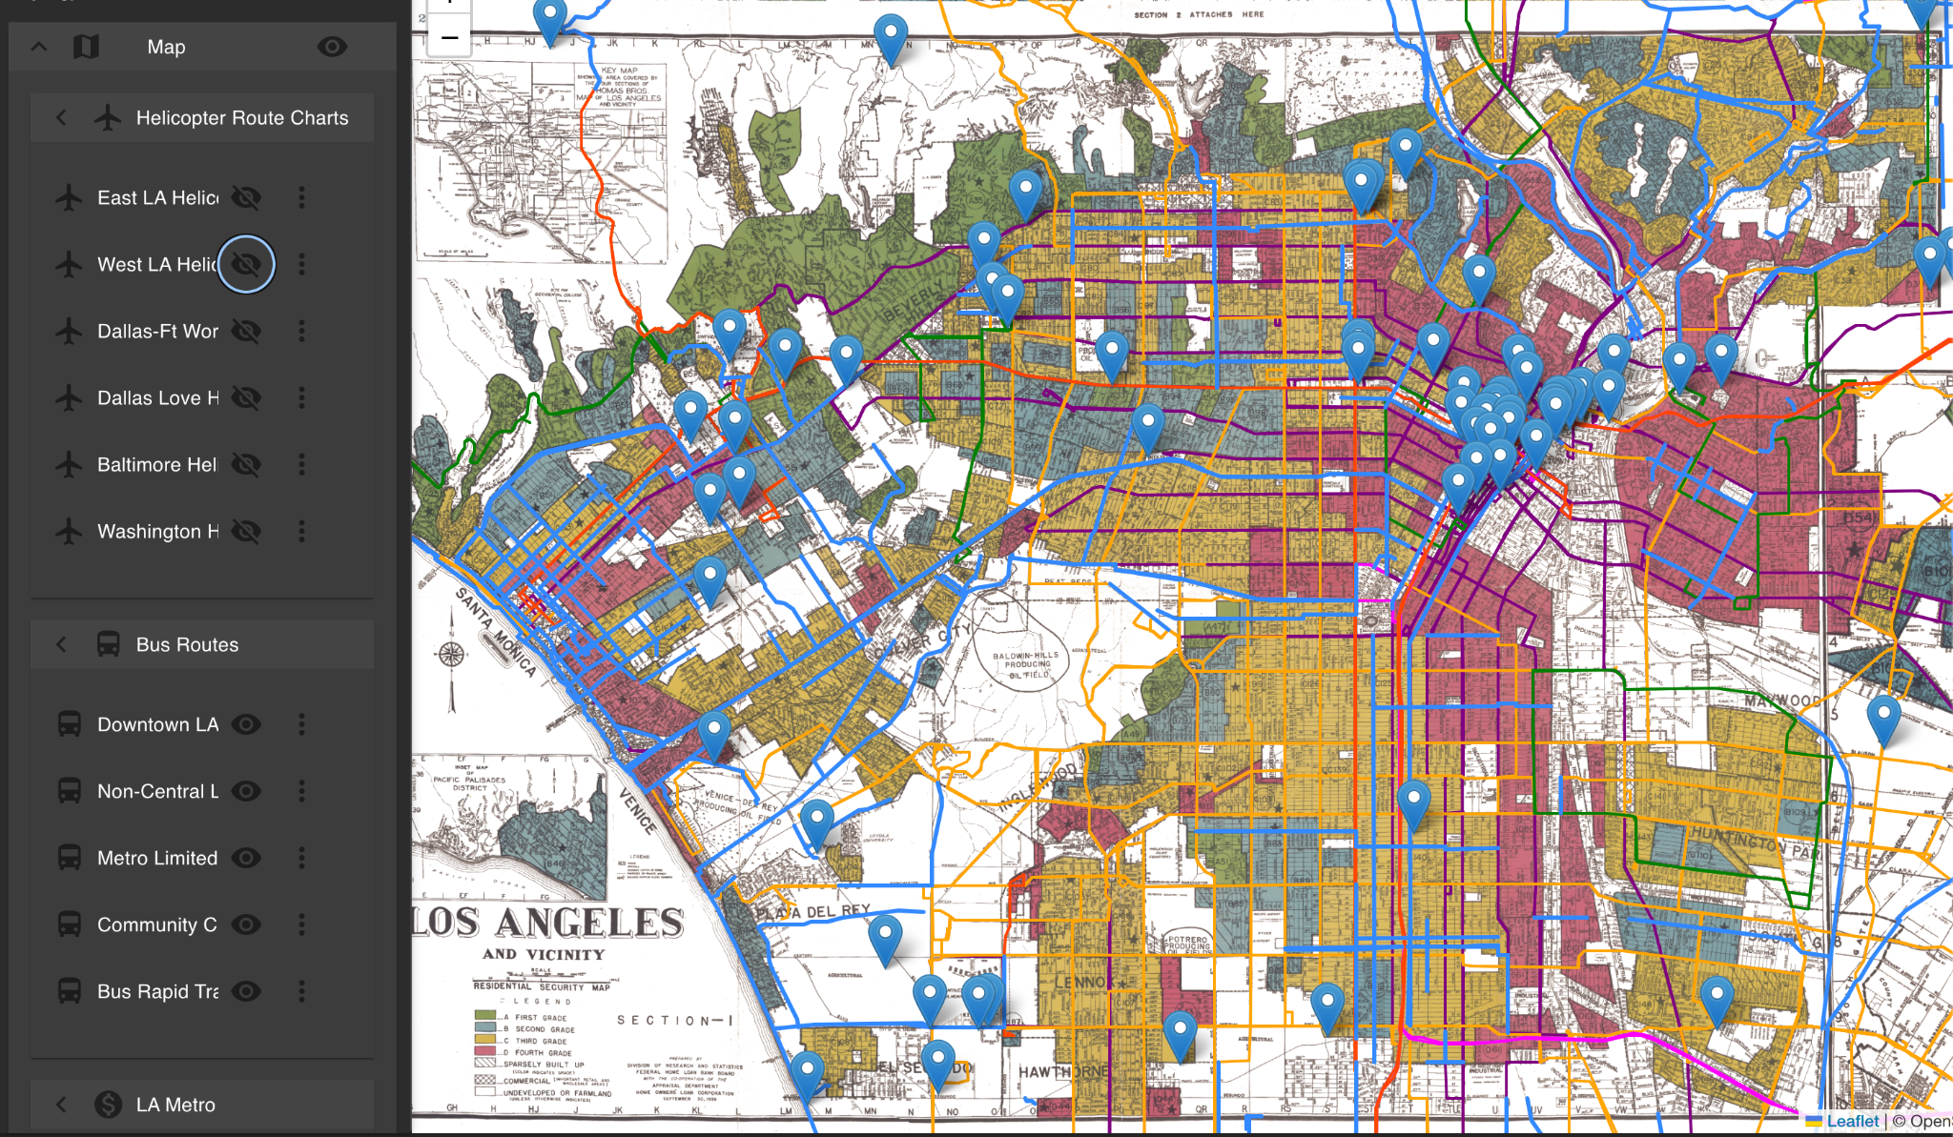
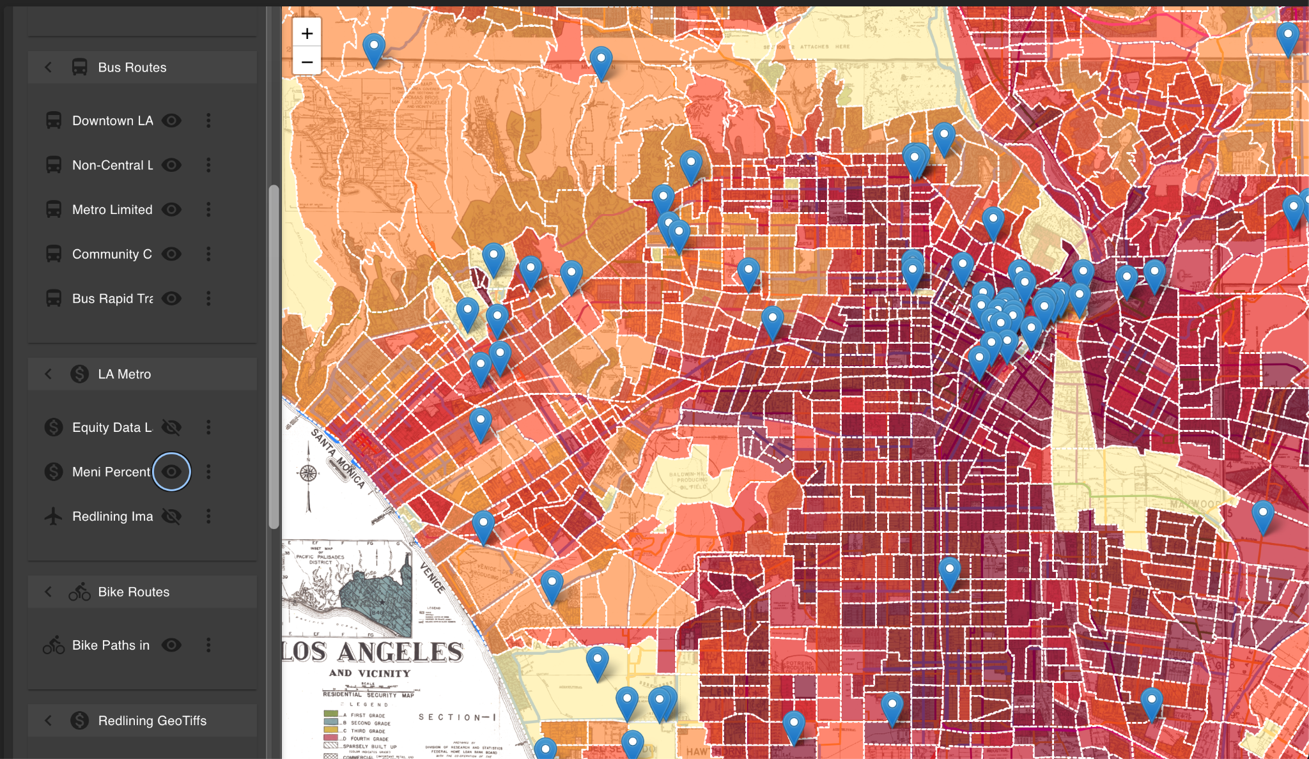
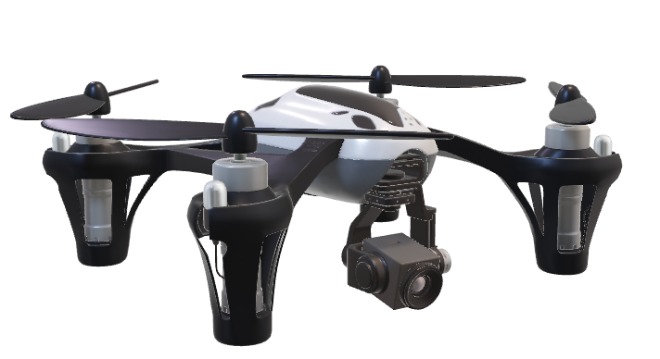




State of the Art and Practice for Equity in Urban Air Mobility
Arneal Montejo
University of Illinois at Chicago
Tyvonne W. Kelly
Sacramento State University
Carlos Paradis
KBR, Inc.
Misty Davies
NASA Ames Research Center
Introduction
Method
Residents in underrepresented communities face inequity, where the benefits of transportation systems benefits are not fairly distributed.
Without proper planning, Urban Air Mobility will worsen an already inequitable transportation system [1].
State of the Art
Papers
“Transportation equity”
Guo et al. 2020
“Equity of OR bike share OR …”
“Urban Air Mobility”
Jiang et al. 2024
“Air taxi OR simulation OR …”
(
)
Title | Author | Journal | Relevance Score | Cited From
"UAM" OR "Air Taxi" OR "Air-Taxi" OR "Urban Air Mobility"
AND
"justice of" OR "equity of"
OR
“Transportation” AND “Transit”
AIAA
Search Hits: 50
IEEE
Usable Hits: 5
Evaluate and Score Relevancy
AIAA
Science Direct
Google Scholar
Science Direct
Preliminary Search Publications [2,3]
Define Search Query Parameters
Apply Search on a Journal Database
Candidate Papers
References
Snowballing Tool #1
Snowballing Tool #2
Papers
New keywords (e.g. “UAV”)
Title | Author | Journal | Relevance Score | Cited From
Reverse Snowballing
Author et al.
Papers
Filter Out
Irrelevant Papers
Cited By
Snowball Method
Benefits and Burdens
Recommendations
Forward Snowballing
Selected Papers for Full Review and Analysis
•…
•…
Author et al.
Find related articles
Start of Art and Practice Benefits and Burdens List
Benefits
Population Mobility
Population Jobs
Economic Development
Cleaner Transportation
Market Development
More Flexible Than VTOL
Public Service
Infrastructure Development
Burdens
Noise
Fare Cost
Mode Competition
Privacy
Physical Accessibility
Safety
Gentrification
High energy consumption
In order for the AAM industry to succeed in the market, public acceptance is necessary [4].
We also found a considerable gap when searching for tools or maps that can assist planners when choosing locations for vertiports with other relevant data.
Author et al.
Other Publications of the Same Author
•…
•…
•…
•…
Journal X
Journal X
2024
…
2023
…
2022
…
…
By Author et al.
State of the Art Recommendations
State of the Art Benefits and Burdens
Other Publications of the Same Journal
Proper Community Outreach Programs
Poor Community Outreach Programs
State of Practice
Urban Ground Mobility
Yes
Convert and Raster
Early Use Cases
Accessibility
Noise Levels
Long
Range
Transportation
Plan
Extract data and data dictionary if available
Find how DOT uses this index
Auna Data Layer
•…
•…
•…
•…
Department of Transportation Plans or Studies [5]
Equity Indexes [6] Present?
State of Art and Practice Recommendations
Auna Data Layers
No
Related Work
Urban Air Mobility
Find other demographic or transit data considerations
Consider insights and applications to other DOTs
Utilize knowledge to transfer onto AAM considerations
[1] Collareno. “THE FLIGHT PATH TO TRANSPORTATION EQUITY: HOW LEGISLATORS CAN ENSURE THAT URBAN AIR MOBILITY DELIVERS INCLUSIVE TRANSPORTATION SERVICES.” 2023.
https://illinoislawreview.org/wp-content/uploads/2023/03/Collareno.pdf.
[2] Guo, Yujie, Zhiwei Chen, Amy Stuart, Xiaopeng Li, and Yu Zhang. 2020. “A Systematic Overview of Transportation Equity in Terms of Accessibility, Traffic Emissions, and Safety Outcomes: From Conventional to Emerging Technologies.” Transportation Research Interdisciplinary Perspectives 4 (March): 100091. https://doi.org/10.1016/j.trip.2020.100091.
[3] Jiang, Xuan, Yuhan Tang, Junzhe Cao, Vishwanath Bulusu, Hao (Frank) Yang, Xin Peng, Yunhan Zheng, Jinhua Zhao, and Raja Sengupta. “Simulating Integration of Urban Air Mobility into Existing Transportation Systems: Survey.” American Institute of Aeronautics and Astronautics, July 2, 2024. https://arc.aiaa.org/doi/10.2514/1.D0431.
[4] US Government Accountability Office. “TRANSFORMING AVIATION Stakeholders Identified Issues to Address for ‘Advanced Air Mobility’ Report to Congressional Committees United States Government Accountability Office.” 2022. https://www.gao.gov/assets/gao-22-105020.pdf.
[5] Manaugh, Kevin, Madhav G. Badami, and Ahmed M. El-Geneidy. “Integrating Social Equity into Urban Transportation Planning: A Critical Evaluation of Equity Objectives and Measures in Transportation Plans in North America.” Transport Policy, November 25, 2014. https://www.sciencedirect.com/science/article/abs/pii/S0967070X14002145?via%3Dihub.
[6] Beiler, Michelle Oswald, and Mona Mohammed. “Exploring Transportation Equity: Development and Application of a Transportation Justice Framework.” Transportation Research Part D: Transport and Environment, June 21, 2016. https://www.sciencedirect.com/science/article/abs/pii/S1361920916303406?via%3Dihub.
AAM
Framework
Lack of Equity Consideration in UAM
•…
•…
•…
•…
Department of Transportation AAM Plans or Studies
Utilize lessons learned from UGM to find equity considerations
Compare UGM to UAM equity considerations
State of Practice Benefits and Burdens
State of Practice Recommendations
Contact: carlos.v.paradis@nasa.gov

