Slide 1
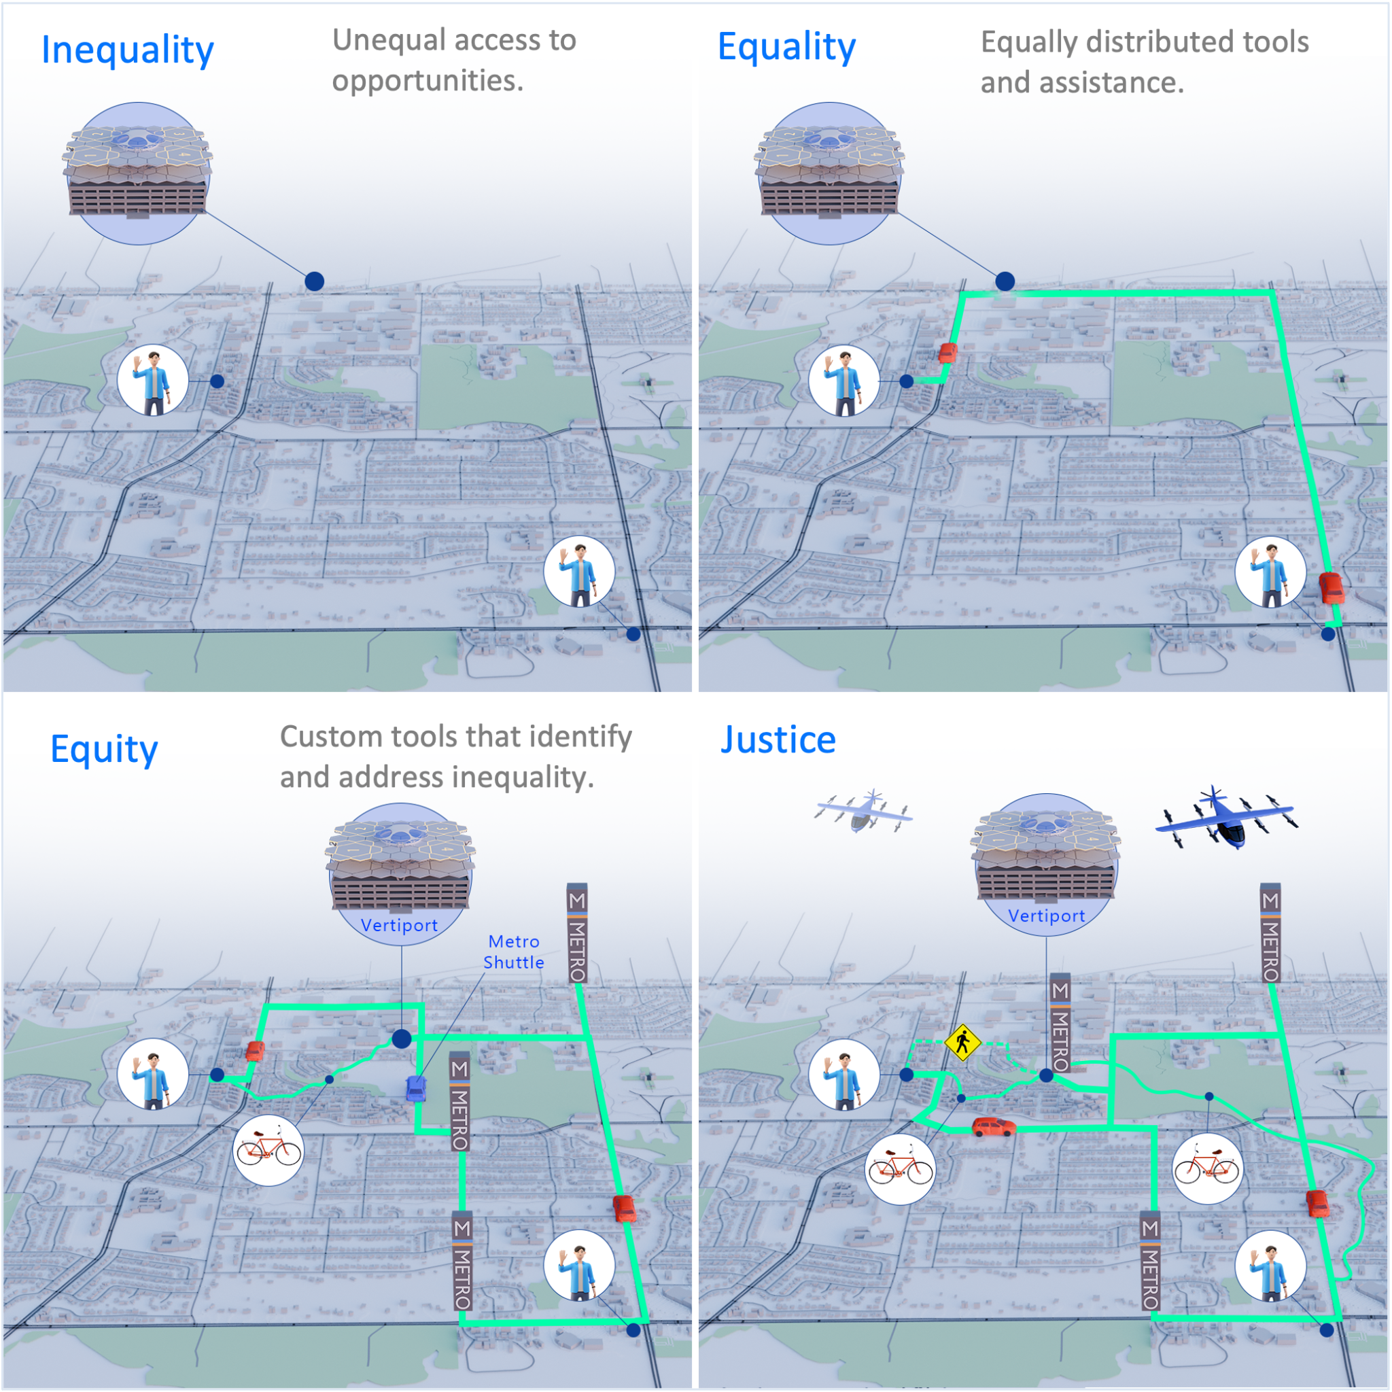
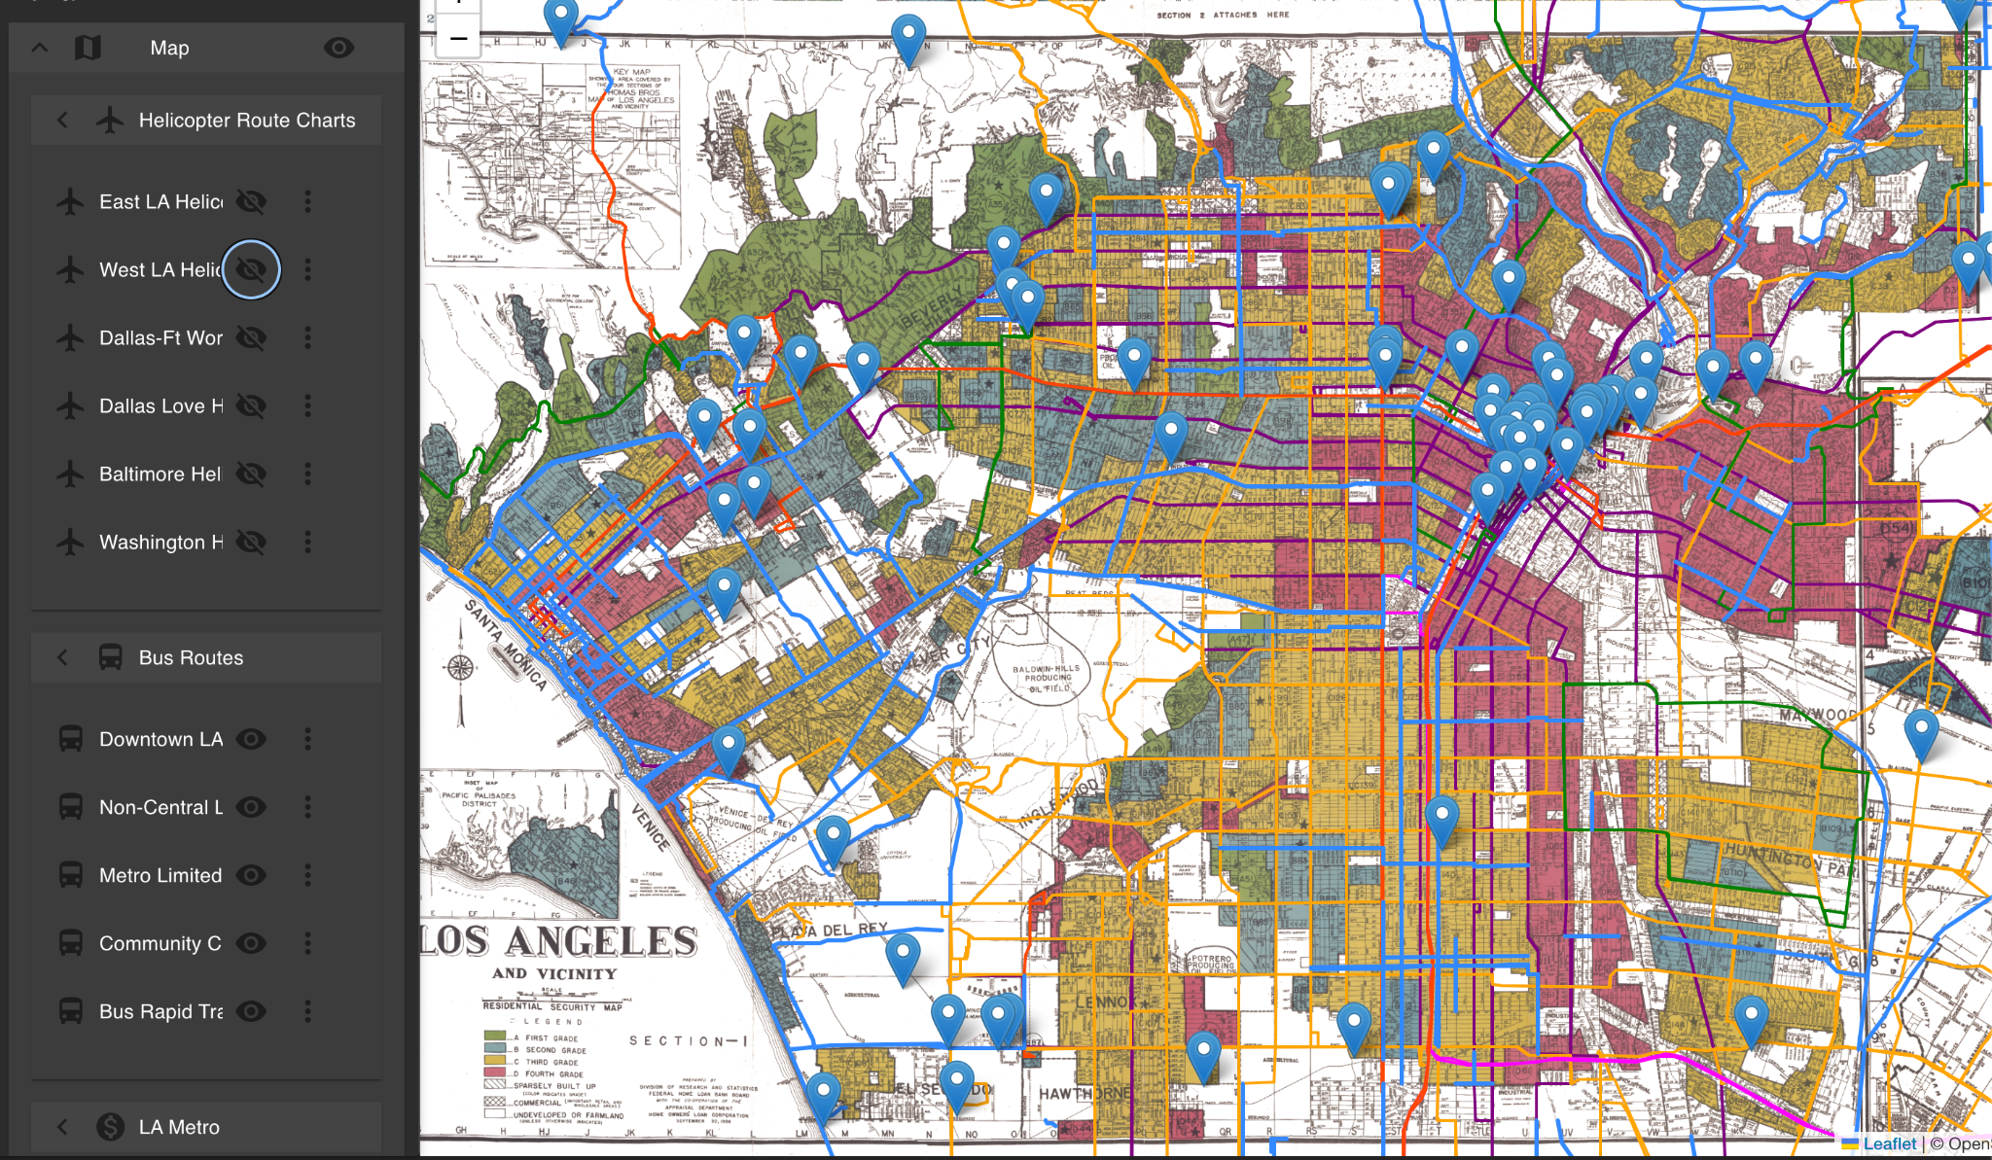
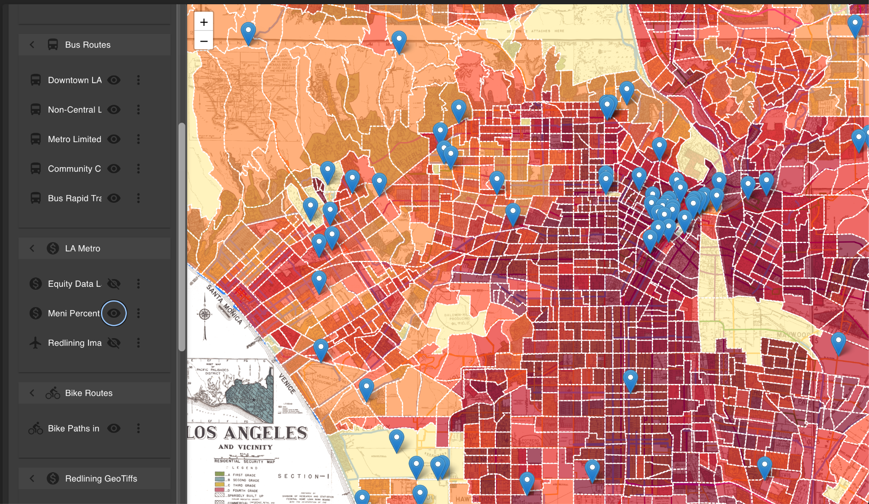
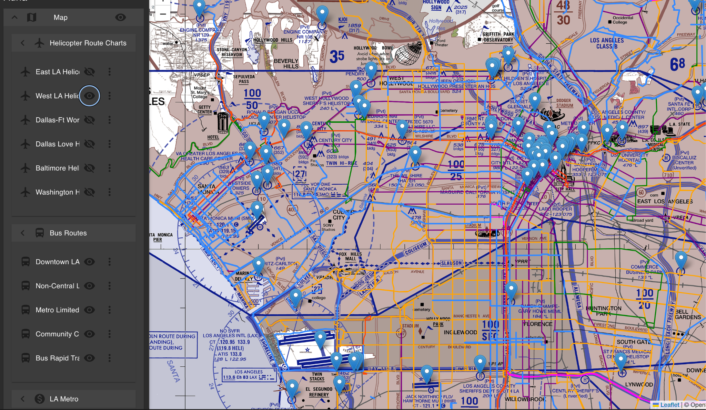




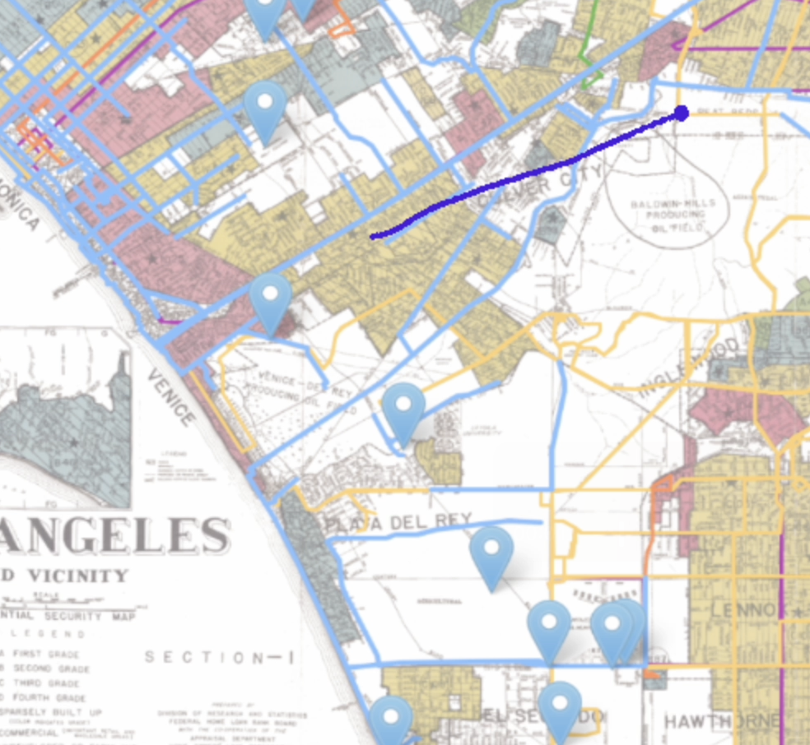
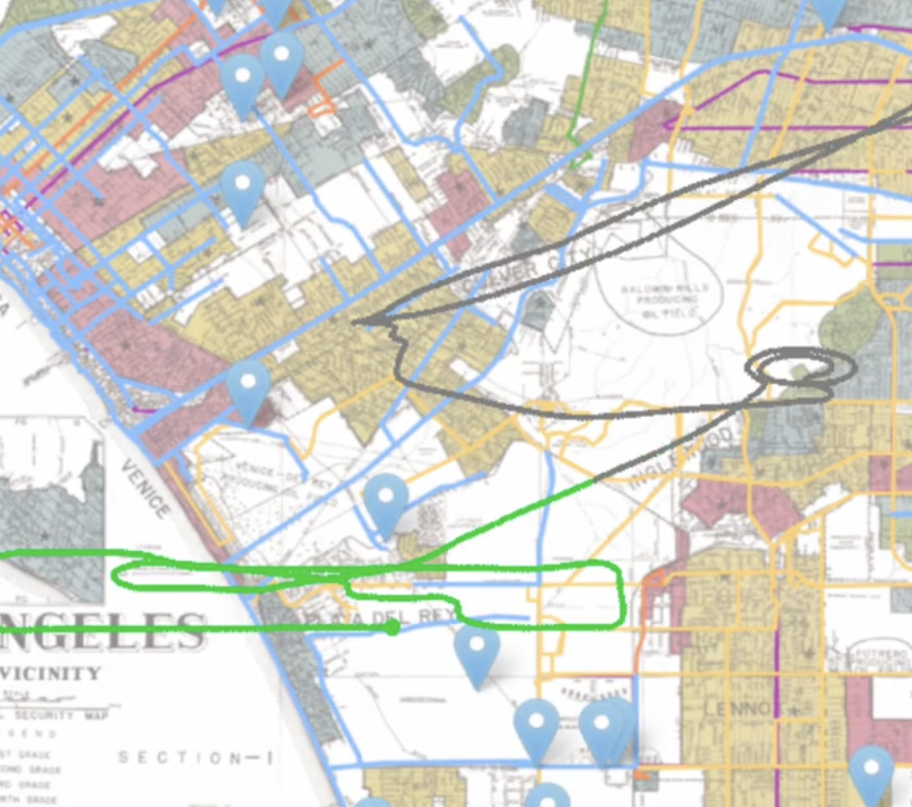




Auna: A Geospatial System for Assessing Equity in Multimodal Mobility
Kiana Partovi
University of Nevada Reno
Vedant Malhotra
University of Nevada Reno
Carlos Paradis
KBR @ NASA Ames Research Center
Misty Davies
NASA Ames Research Center
Introduction
Injustice, Equity and Urban Air Mobility
Planners may employ digital modeling and scenario planning when considering vertiport placement for equitable impact [3]. Auna support this process.
Cities in U.S. face inequity, where transportation systems benefits and burdens are not fairly distributed.
Without proper planning, Urban Air Mobility will worsen an already inequitable transportation system [1].
Previous modality of transportation have had widely varying effects on equity, such as neighborhood segregating highways [2].
Geographic Information Systems (GIS) can serve as a fundamental tool in the process of identifying underserved communities [3].
The opportunity to develop a new mode while recognizing prior injustices allows planners to impact policy [4].
References
Urban Ground and Air Mobility Simulation
[1] Collareno, Kevin. "The Flight Path to Transportation Equity: How Legislators Can Ensure That Urban Air Mobility Delivers Inclusive Transportation Services." U. Ill. L. Rev. (2023)
[2] Nelson, Robert K., LaDale Winling, et al. "Mapping Inequality: Redlining in New Deal America." Edited by Robert K. Nelson and Edward L. Ayers. American Panorama: An Atlas of United States History, 2023. https://dsl.richmond.edu/panorama/redlining.
[3] Beiler, Michelle Oswald, and Mona Mohammed. “Exploring Transportation Equity: Development and Application of a Transportation Justice Framework.” Transportation Research Part D: Transport and Environment, June 21, 2016.
[4] Cohen, Adam, Susan Shaheen, and Yolanka Wulff. "Planning for Advanced Air Mobility." (2024).
[5] Rothfeld, Raoul, Milos Balac, Kay O. Ploetner, and Constantinos Antoniou. "Agent-based simulation of urban air mobility." In 2018 Modeling and Simulation Technologies Conference, p. 3891. 2018.
[6] Rothfeld, Raoul Leander. "Agent-based Modelling and Simulation of Urban Air Mobility Operation." PhD diss., Technische Universität München, 2021.
TIME
A
B
Agent Plan
Plan
Links
Acknowledgements
TAXI
Home
Work
Home
Now
Agent Plan
Agent Plan
Resources
Each agent has predefined plans of what they do in a day. These plans involve how the agent gets to a destination, and through what type of vehicle (personal, shared/taxi) [5].
Through MATSim-UAM, agents can either operate their own vehicle or use a shared vehicle, which acts as a taxi service. Agents wait their turn to utilize the vehicle. These plans define how everything operates [6].
The results of the simulation can then be visualized via a path and color trail on a map. Each path represents an agent travelling.
MATSim-UAM (Future)
Contact: carlos.v.paradis@nasa.gov

