Slide 1
Validation and Development of a Fast-Running CFD Model for the No-Vent Fill of Liquid Propellant Tank
January 6-10 , 2025
H. Q. Yang – CFDRC/JSEG, Fluid Dynamics Branch (MSFC-ER42)
Jacob Brodnick – NASA, Fluid Dynamics Branch (MSFC-ER42)
Brian Richardson– NASA, Fluid Dynamics Branch (MSFC-ER42)
AIAA SciTech 2025
Orlando, FL

Slide 2
Background
  The Fluid Dynamics Branch within the Propulsion Systems Department at the Marshall Space Flight Center is currently supporting multiple programs in need of in-space Cryogenic Fluid Management (CFM) analysis.
    Space Launch System (SLS) upper stages
    Commercial Lunar Payload Services (CLPS)
    Human Landing System (HLS)
    Nuclear Thermal Propulsion (NTP) systems
  Understanding of thermodynamics and efficient propellant tank filling in space is important for vehicle and mission design.
    The No-Vent Fill (NVF) technique can prevent liquid propellant from being expelled overboard during propellant transfer and requires minimal hardware.
    Modeling the NVF process highlights the importance of ullage condensation, which is enhanced by agitation or mixing of the tank contents.
    During the no-vent fill operation, this mixing may be induced by an axial jet of incoming liquid from bottom orifice.
    Computational Fluid Dynamics (CFD) tool validation of ground testing promotes confidence in prediction of NVF processes for low gravity environments, i.e., on-orbit propellant transfer.

Slide 3
Modeling Methodology
Loci-STREAM-VoF Code at MSFC
  The Volume of Fluid (VoF) method has excellent conservation properties and provides a robust method for modeling interfacial flows.
  The formulation includes initialization, interface reconstruction and VoF advection.
  Coupling to flow solver includes modification to face density, accounting for body forces due to gravity and surface tension and modification of the energy equation.
  Basic verification and validation cases included dam break, wave propagation, bubble evolution, surface tension driven channel flow, and fully compressible two-phase tracking using VoF.
  VoF module has been developed in the Loci framework developed at Mississippi State University.
  The VoF module is coupled to the Loci-STREAM CFD solver, a pressure based highly parallelized all-speed flow solver.
    Can be applied to problems involving tens of millions of cells on thousands of processors with good scaling properties

Slide 4
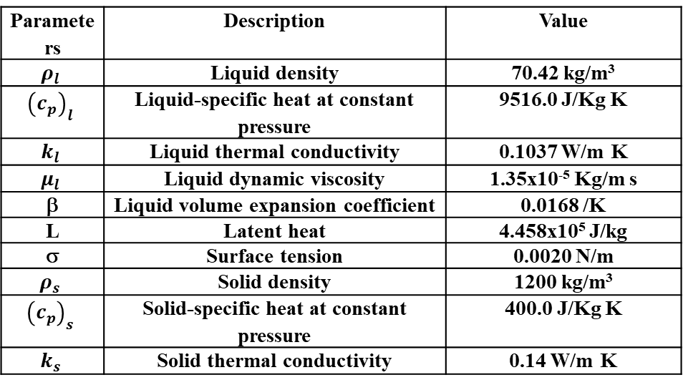
Simulation Setup and Inputs
Multiple validation studies were conducted each with comparable baseline simulation setups and inputs
Many sensitivity studies have been conducted but most are not shown here for brevity
Baseline Loci-STREAM-VoF Model Setup
  Turbulence model: k-ω-SST
  Mesh size: 2d-aximmetric, 8.6K and 19.6K cells
  Numerical treatment of phase change: Implicit
  Hertz-Knudsen mass transfer coefficient: Cm=1.0x10⁻³
  Parametric: 1.0x10⁻⁴ to 1.0x10⁻²
  Energy equation: Enthalpy-based (temperature form)
  Saturation condition model: Antoine Equation
  CFL number: 0.1; Time step size: 0.01 second
  Gas phase properties: NIST
  Conjugate heat transfer: Aluminum wall
Parameters | Description | Value
$$ρ_{l}$$ | Liquid density | 70.42 kg/m³
$${\left(c_{p}\right)}_{l}$$ | Liquid-specific heat at constant pressure | 9516.0 J/Kg K
$$k_{l}$$ | Liquid thermal conductivity | 0.1037 W/m K
$$μ_{l}$$ | Liquid dynamic viscosity | 1.35x10⁻⁵ Kg/m s
β | Liquid volume expansion coefficient | 0.0168 /K
L | Latent heat | 4.458x10⁵ J/kg
σ | Surface tension | 0.0020 N/m
$$ρ_{s}$$ | Solid density | 1200 kg/m³
$${\left(c_{p}\right)}_{s}$$ | Solid-specific heat at constant pressure | 400.0 J/Kg K
$$k_{s}$$ | Solid thermal conductivity | 0.14 W/m K

Slide 5
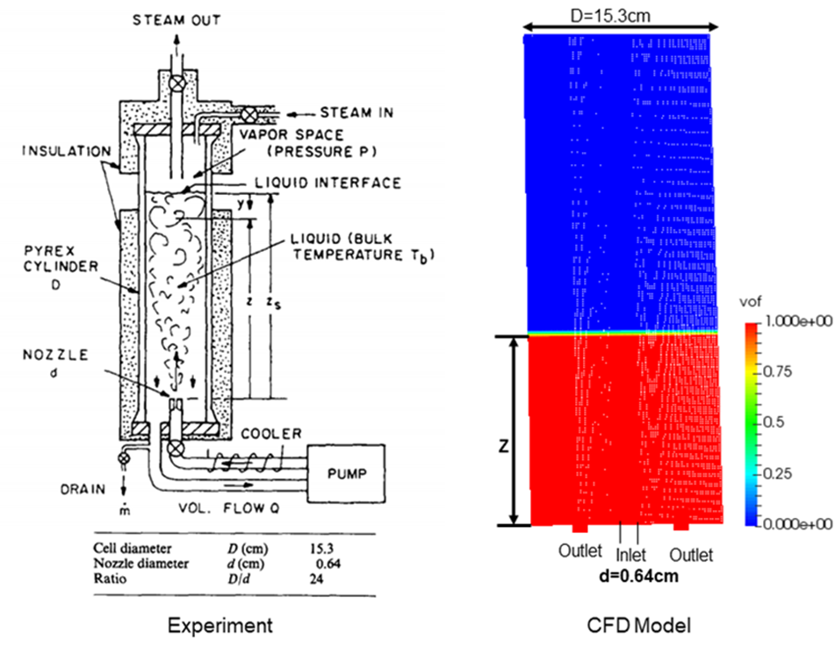
Steady Mixing Experiment
Objective
  Validate a CFD analysis methodology for submerged jet driven interface turbulence
    Interface turbulence drives condensation in corresponding NVF processes
    Promotes confidence in NVF validation when only system level data is available for comparison to analysis results
Experiment
  Interface turbulence for steady state mixing was measured via laser doppler velocimetry
  Empirical correlations were developed to encompass jet-to-tank size and dimensionless fill level (tank aspect ratio)
Experimental Tank Schematic
Brown et al., Int. J. Heat and Mass Transfer, 1990
Computational Model
Mesh and Boundary Conditions

Slide 6
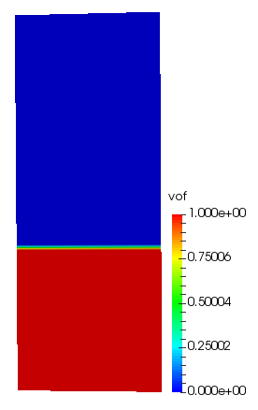
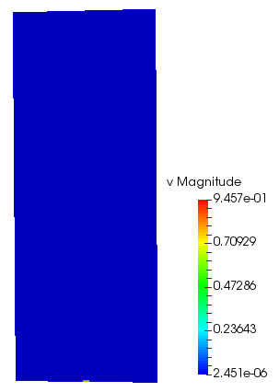
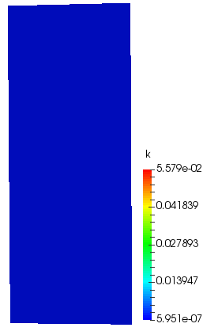
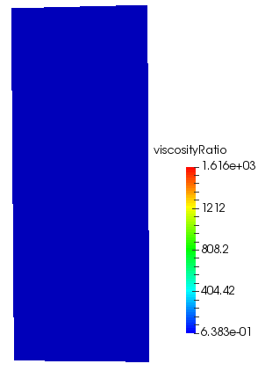
Turbulence Interface Velocity Validation
Inlet Jet Velocity: 0.934m/s; z/D=0.967
T
VOF
VOF
Velocity Magnitude
Turbulence
kinetic energy
Viscosity ratio

Slide 7
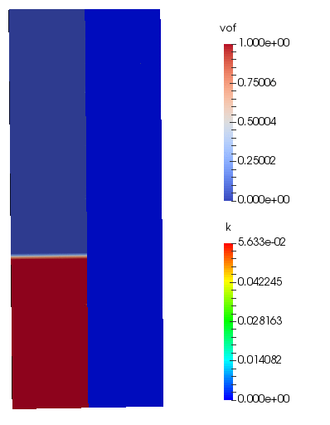
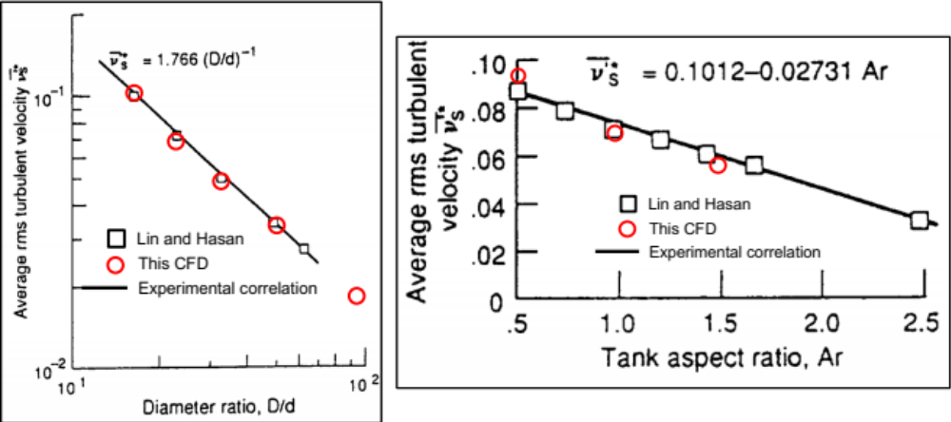
Validation of Interfacial Turbulence
Validation Results
  Excellent agreement with interface turbulent velocity correlation was achieved
  Using this modeling methodology, heat transfer between fluid phases during NVF operations is expected to be captured well
Animation of CFD Results
Left: Liquid Fraction
Right: Turbulent Kinetic Energy
Interface Turbulent Velocity
Jet Size Dependence
Interface Turbulent Velocity
Fill Level Dependence

Slide 8
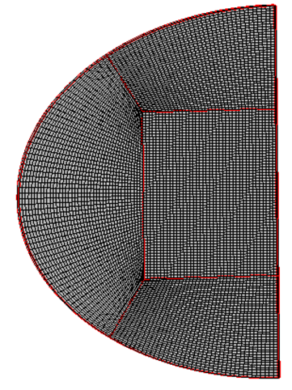
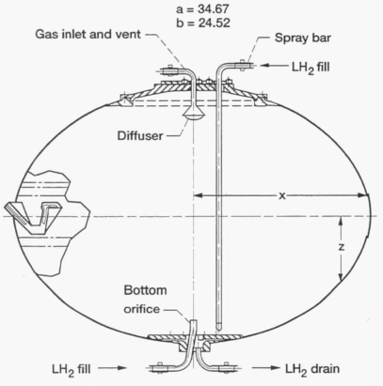
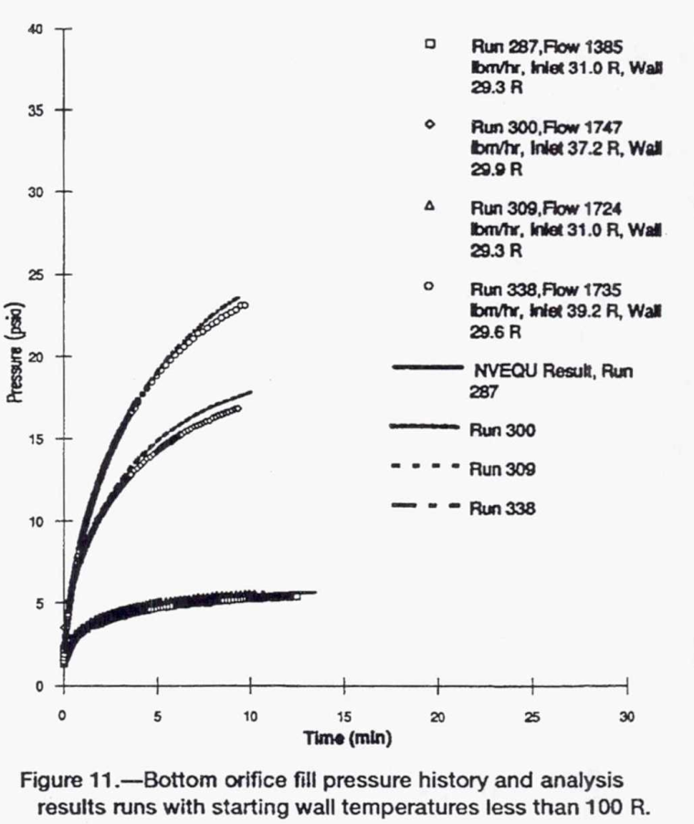
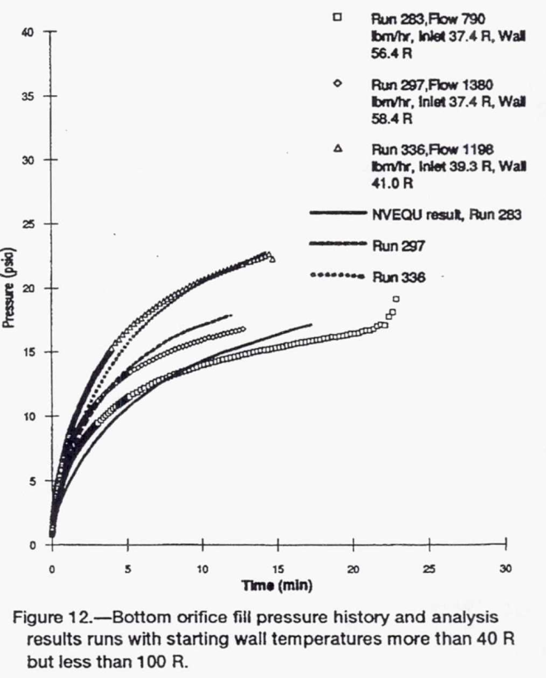
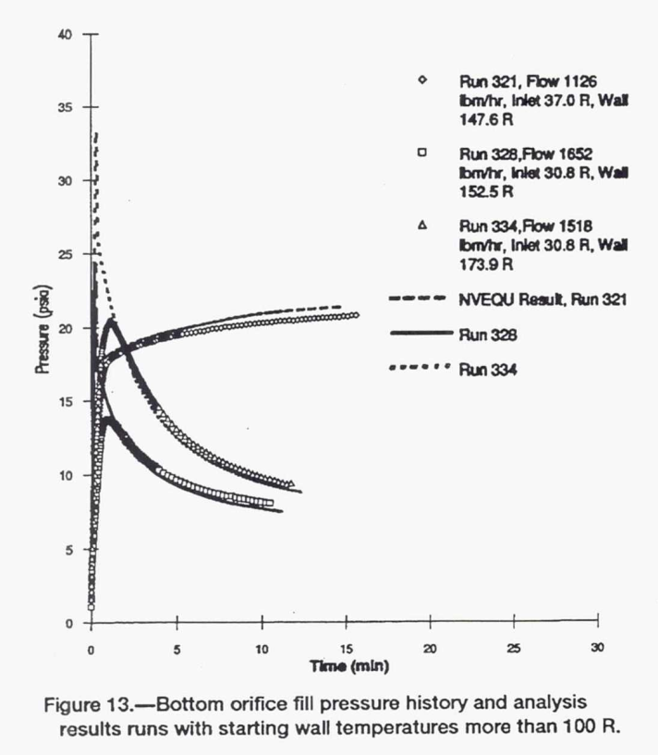
No-Vent Fill Experiment
Objective
  Validate a CFD analysis methodology for a no-vent fill operation via a submerged jet
    Pressure transient drives transfer flow rate and stall condition
Experiment
  Pressure and temperature transients for submerged jet tank filling were measured at the NASA GRC Ksite facility
  Comparisons to ullage pressure transients for a variety of initial tank temperatures and inflow rates are shown
Computational Model
Mesh and Boundary Conditions
Experimental Tank Schematic
Chato et al., NASA-TM-106293
Experimental Pressures
Initially Cold Walls
Experimental Pressures
Initially Warm Walls
Experimental Pressures
Initially Hot Walls
No Slip
Wall
RUN # | 300 | 309 | 338 | 283 | 297 | 336 | 321 | 328 | 334
Inlet Liquid Temp. (K) | 20.66 | 17.22 | 21.77 | 20.78 | 20.77 | 21.61 | 20.55 | 17.11 | 17.11
Flow Rate (kg/s) | 0.22 | 0.2176 | 0.219 | 0.0997 | 0.1742 | 0.151 | 0.142 | 0.208 | 0.192
Wall Temp. (K) | 16.61 | 16.28 | 16.44 | 31.33 | 32.44 | 22.77 | 82.00 | 84.72 | 96.60
Bottom Diffuser
Bottom Orifice

Slide 9
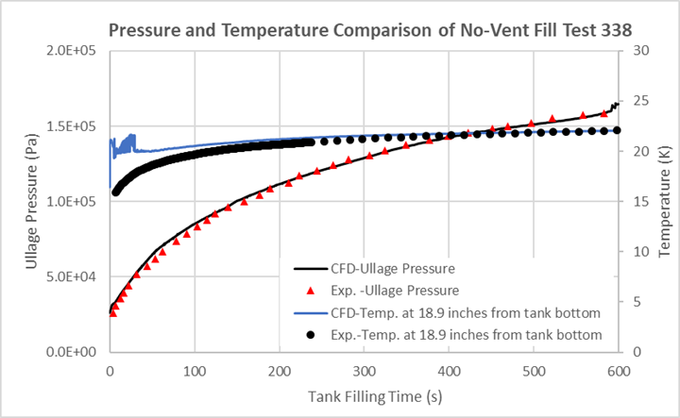
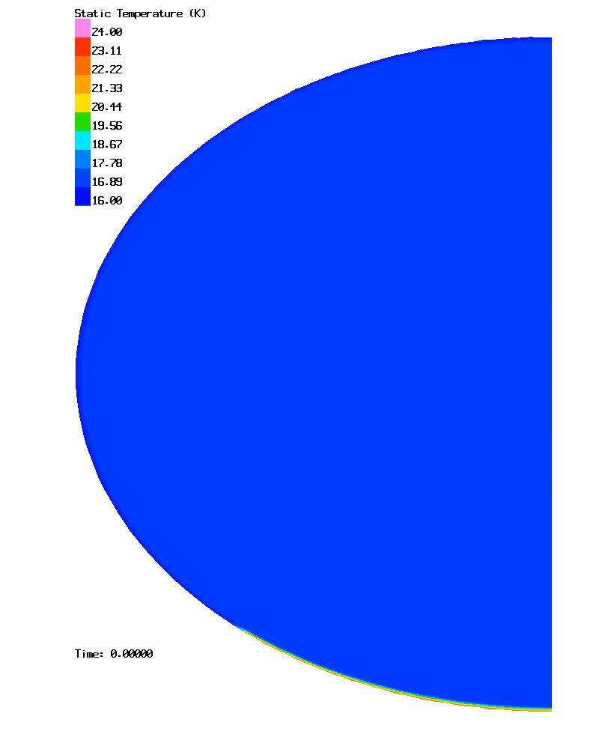
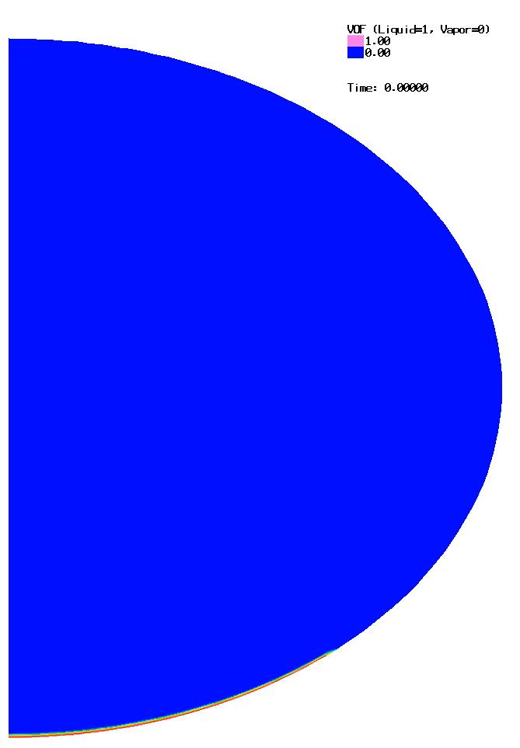
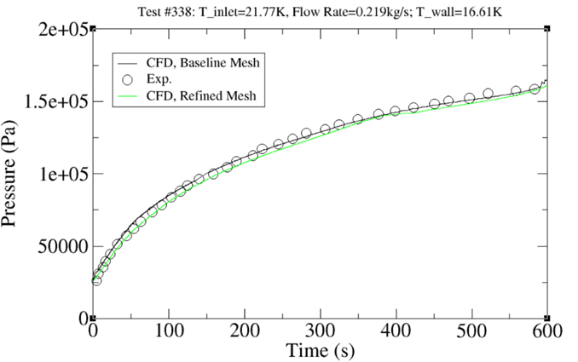
Validation of NVF Pressures: Cold Wall
Run #338: Bottom Orifice
T_{jet}=21.77K; T_{wall}=16.44; Q=0.219kg/s
Pressure and Temperature Comparisons
Mesh Sensitivity
Temperature
VOF

Slide 10
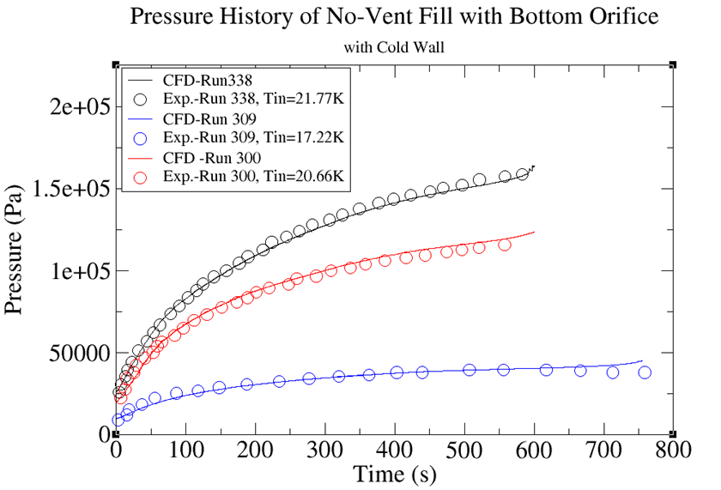
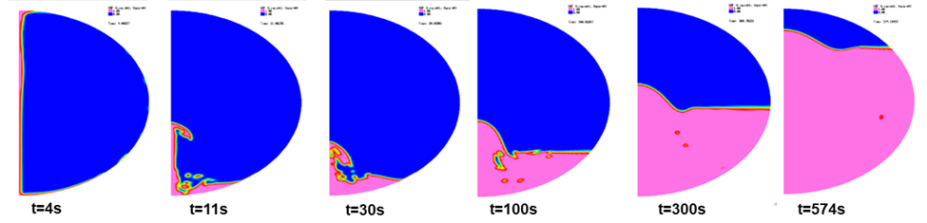
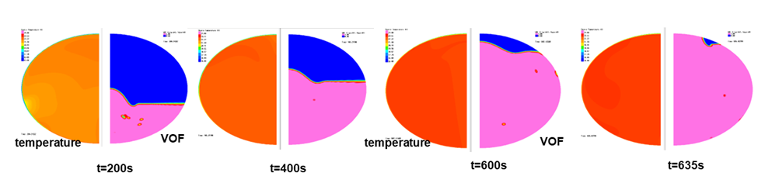
Validation of NVF Pressures: Cold Wall
  Jet velocities were significant enough in some cases to deform the liquid surface throughout filling
  Nearly isothermal conditions were observed during filling demonstrating a maximum condensation rate was achieved via jet-based mixing
  Pressure transients were well validated for initially cold wall temperatures
Time History of CFD Analysis Results – Run 338
Liquid Fraction
Left: Temperature / Right: Liquid Fraction

Slide 11
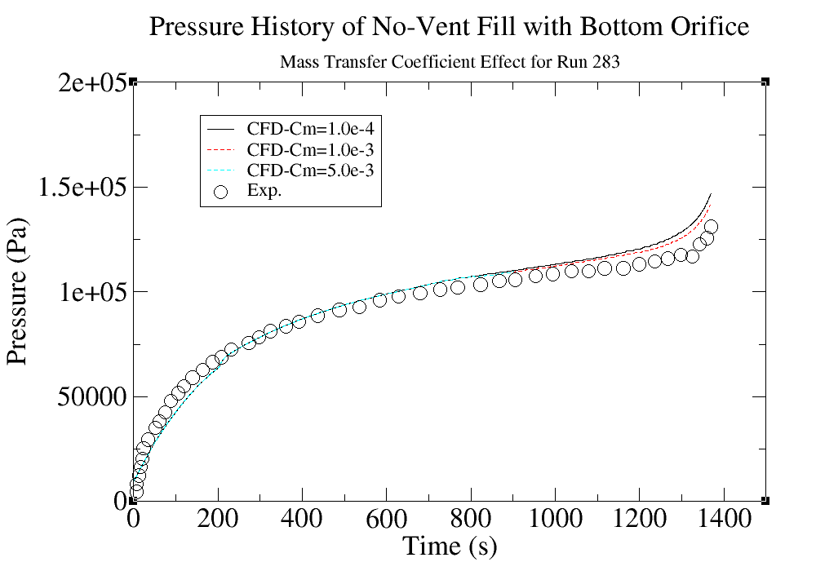
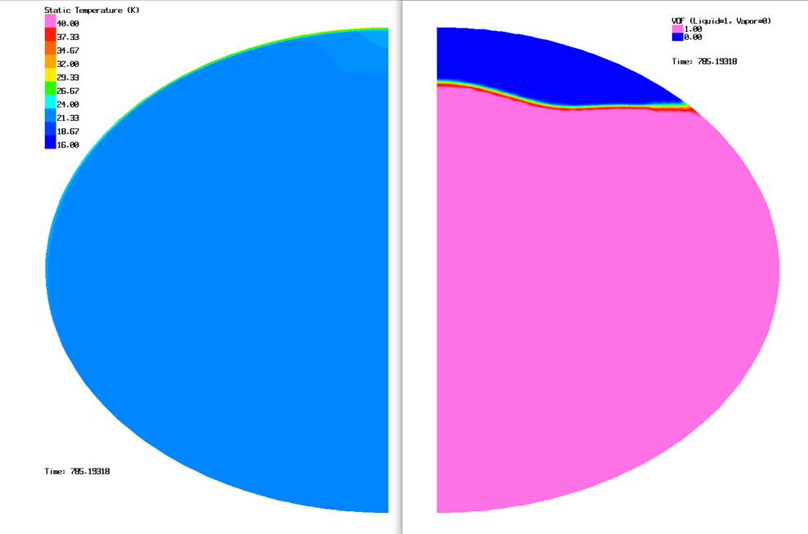
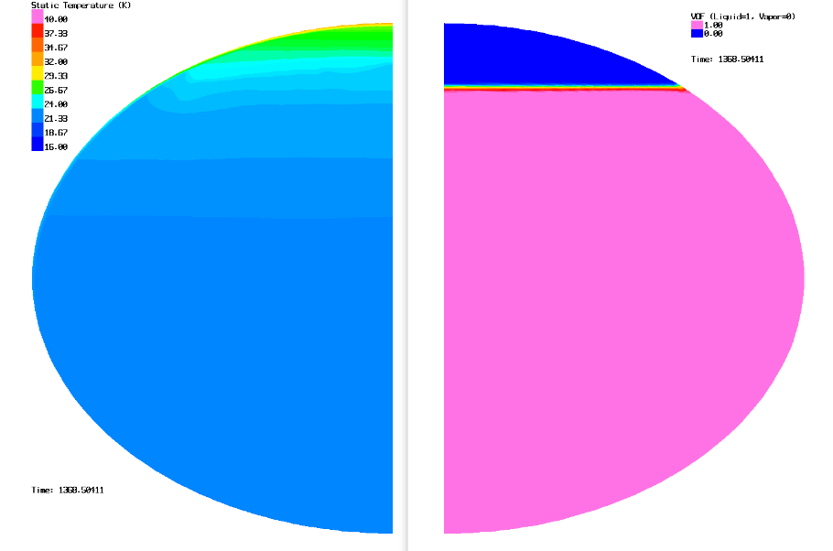
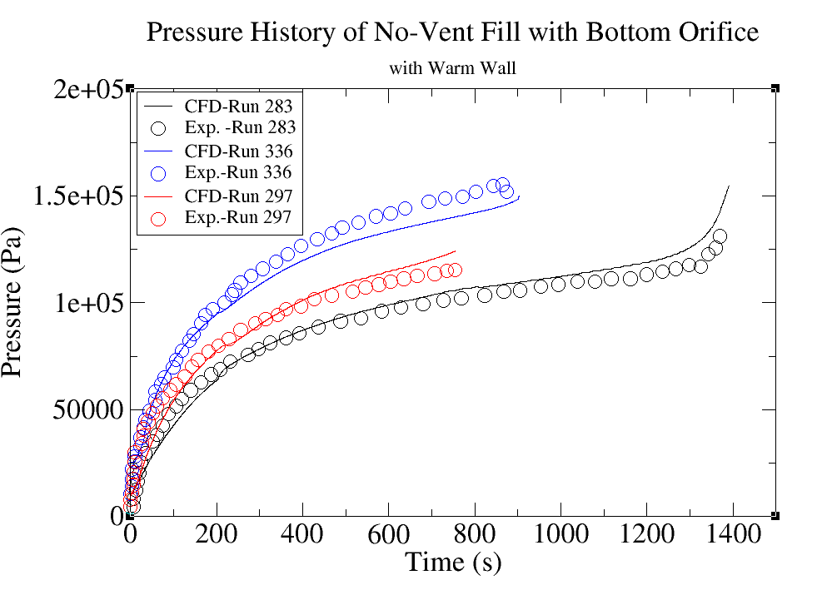
Validation of NVF Pressures: Warm Wall
  Comparable dynamics were observed when increasing initial wall temperatures from cold to warm
  Little dependence on the Hertz-Knudsen mass transfer coefficient was observed demonstrating convergence was already reached given the baseline simulation setup
  Pressure transients were well validated for initially warm wall temperatures
CFD Analysis Results – Run 297 vs. Run 283
C_{m}=1.0x10⁻⁴
Temperature
Liquid Fraction
Temperature
Liquid Fraction
Run 297
Run 283

Slide 12
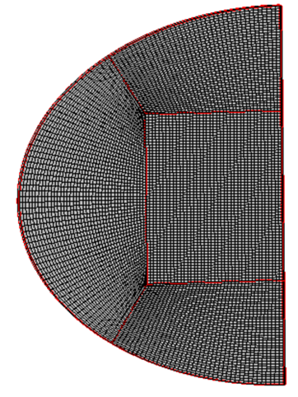
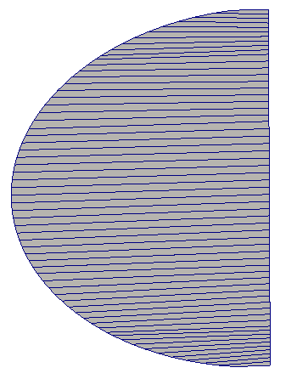
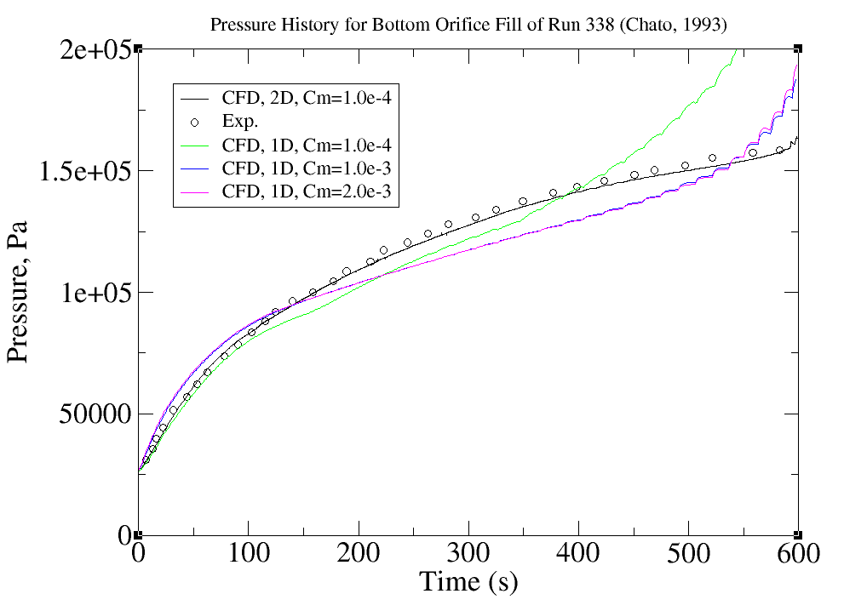
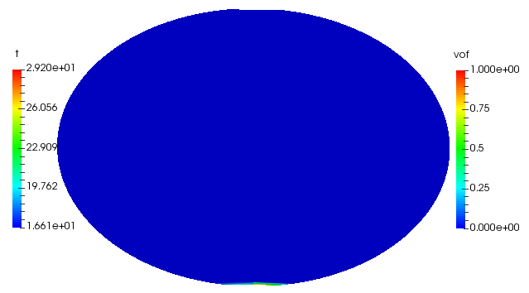
1D No-Vent Model Development
1D CFD Model Development
  Reduced dimension from high fidelity CFD, yet, higher dimension than the lump parameter model
  Conservation of all the physics
  Same input file.
  Fast running and enable parametric study.
  Enable the design and trade studies.
Run 338

Slide 13
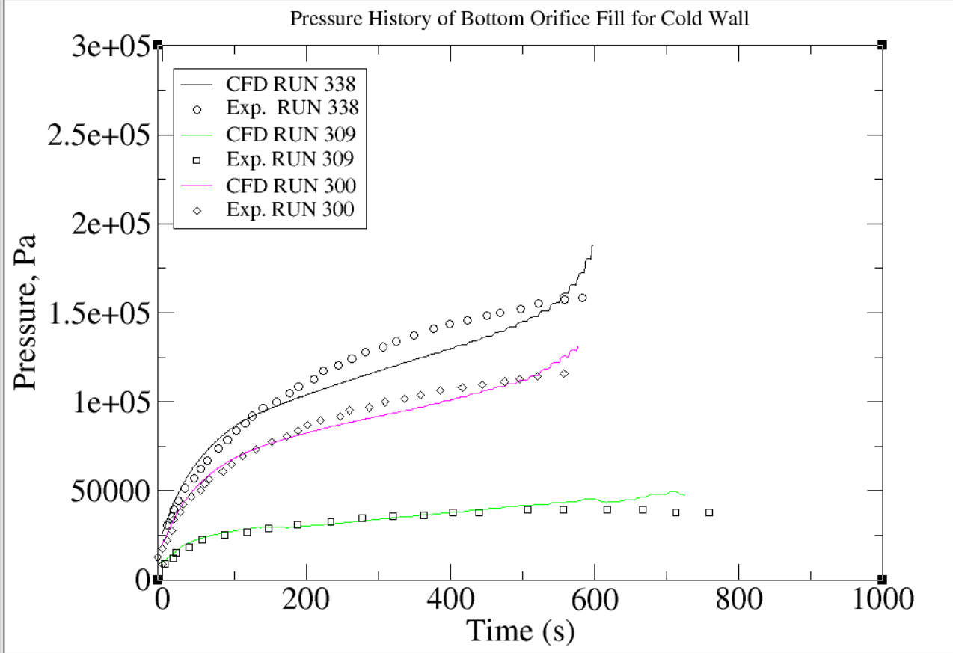
1D No-Vent Validation: Cold Wall

Slide 14
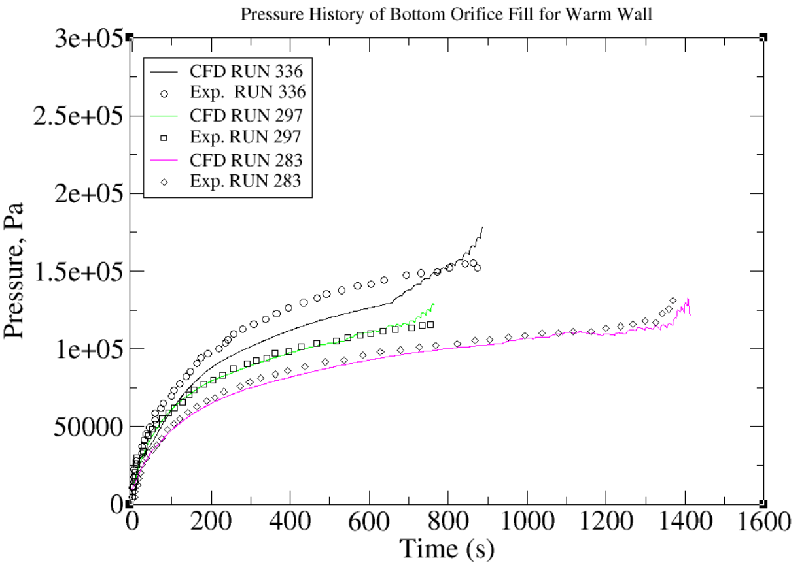
1D No-Vent Validation: Warm Wall

Slide 15
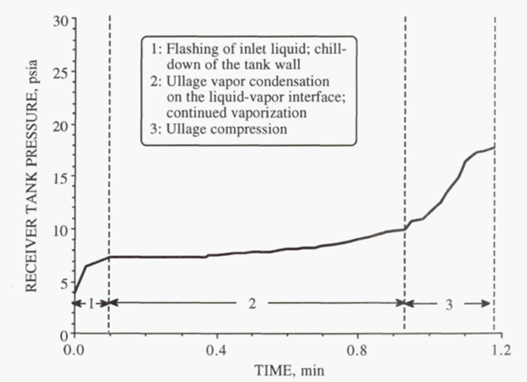
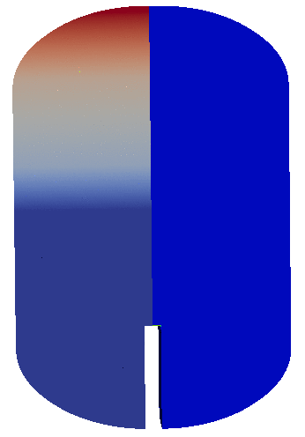
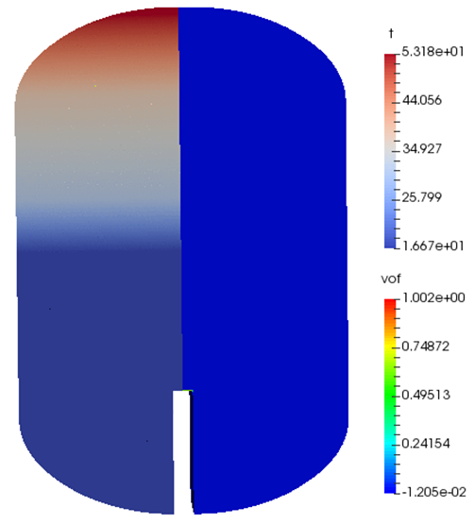
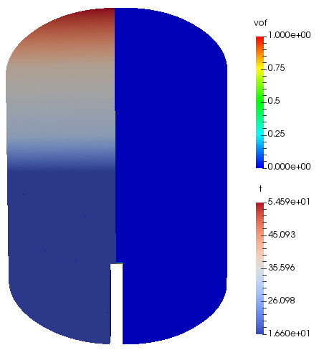
Validation of NVF Pressures: Hot Wall
Hot wall validation is underway with some challenges
  As the incoming jet flashes, the high-speed vapor forms to cool the ullage and wall
    Preliminary results of a separate validation effort are shown demonstrating sensitivity of jet breakup during flashing to mass transfer coefficient
      Experiment by Moran et. al. NASA-TM-105273
    Both droplet resolution and mass transfer coefficient convergence will be needed
      Temporal resolution of VoF advection and high phase change rates lead to long simulation durations which are currently prohibitively expensive
Resolved Flashing and Cooled Ullage
C_{m}=3.0x10⁻²
Unresolved Flashing and Hot Ullage
C_{m}=1.0x10⁻³
Temperature
VOF
Temperature
VOF

Slide 16
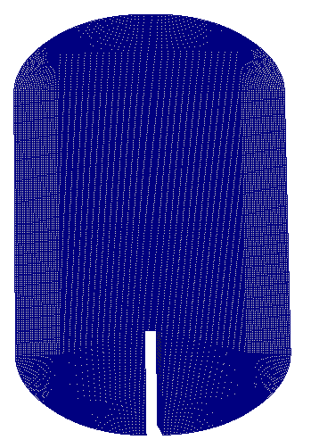
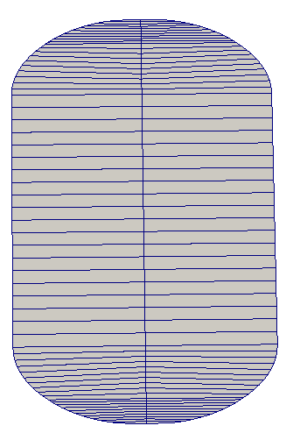
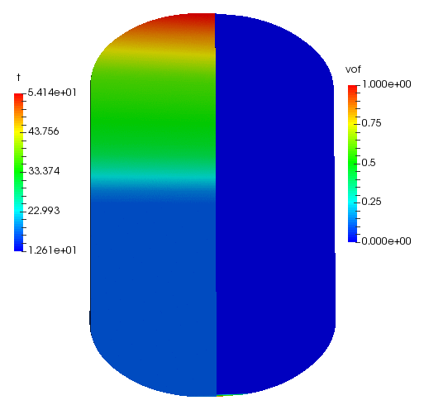
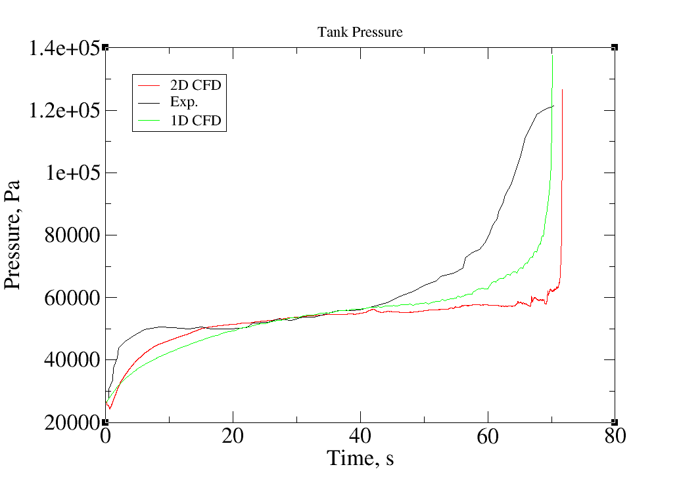
1D VOF Simulation Models
No Vent Fill: Upward Pipe Discharge
  Initial condition: stratified temperature from exp.
  No noncondesable gas.
  Inlet T=18.00; Ullage P=2.26e4 Pa.
  Varied mass transfer coefficients.
  Conjugate heat transfer
  1D mesh
2D to 1D

Slide 17
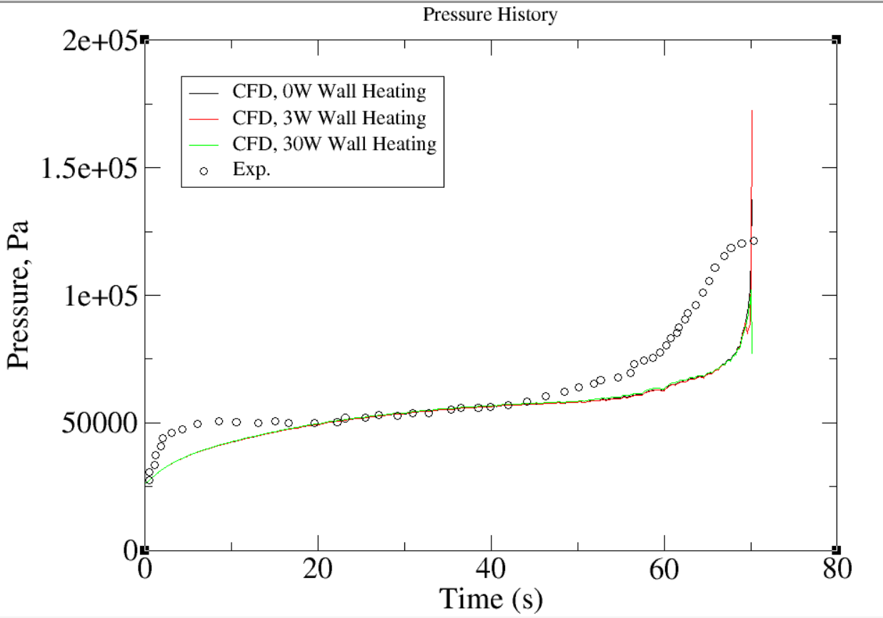
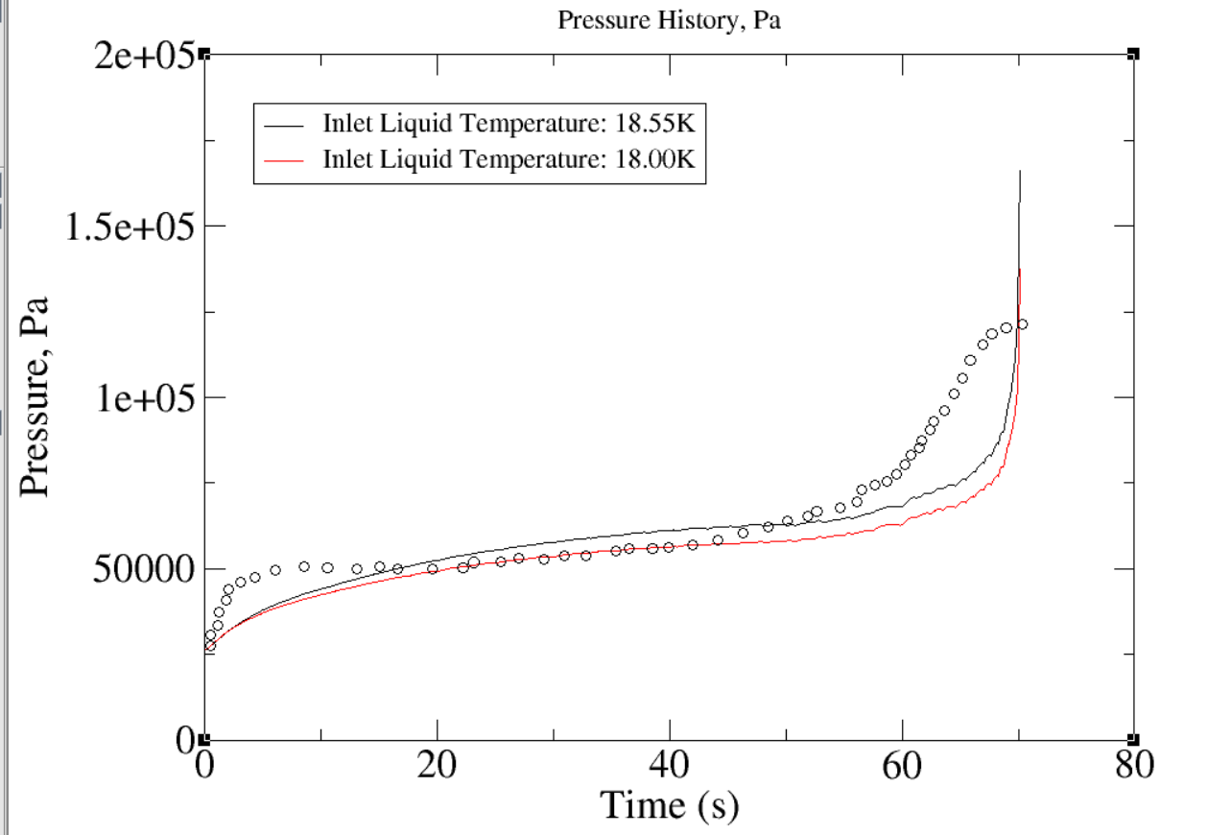
1D VOF Simulation Models
No Vent Fill: Upward Pipe Discharge
  Initial condition: stratified temperature from exp.
  No noncondesable gas.
  Inlet T=18.00 and 18.55; Ullage P=2.26e4 Pa.
  Mass Transfer Coefficient 1.0e-3
  Conjugate heat transfer
  1D mesh

Slide 18
Conclusion
  A model validation effort for the prediction of cryogenic propellant tank no-vent fill using the Loci-STREAM-VoF code has been conducted
  Validation of the liquid-vapor interface turbulence velocity using previous experimental data showed good agreement at different fill levels;
  Validation of the CFD Stanton number for mass transfer provided an adequate mass transfer coefficient range;
  Consistent pressure agreements were found in the pressure history for both cold and warm conditions;
  The variations of final pressure with flow rate and inlet liquid temperature were well predicted by the CFD simulation;
  The application of NVF for high initial wall temperatures will be studied in future work;
  The application of NVF for low-gravity conditions will be studied in future work.

