Slide 1
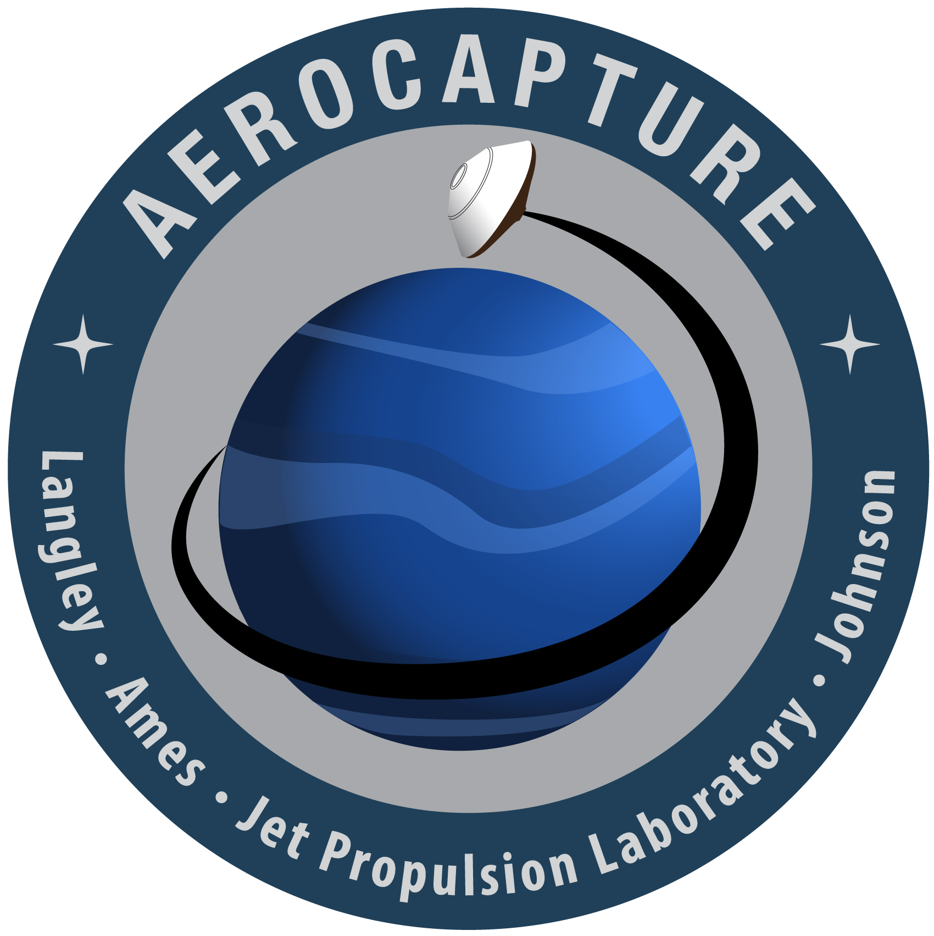
Improvements to Thermal Protection System Design of Aerocapture Systems for Uranus Orbiters
Jonathan Morgan
NASA Ames Research Center, Moffett Field, CA, 94035
Joseph Williams
Analytical Mechanics Associates INC., Moffett Field, CA, 94035

Slide 2
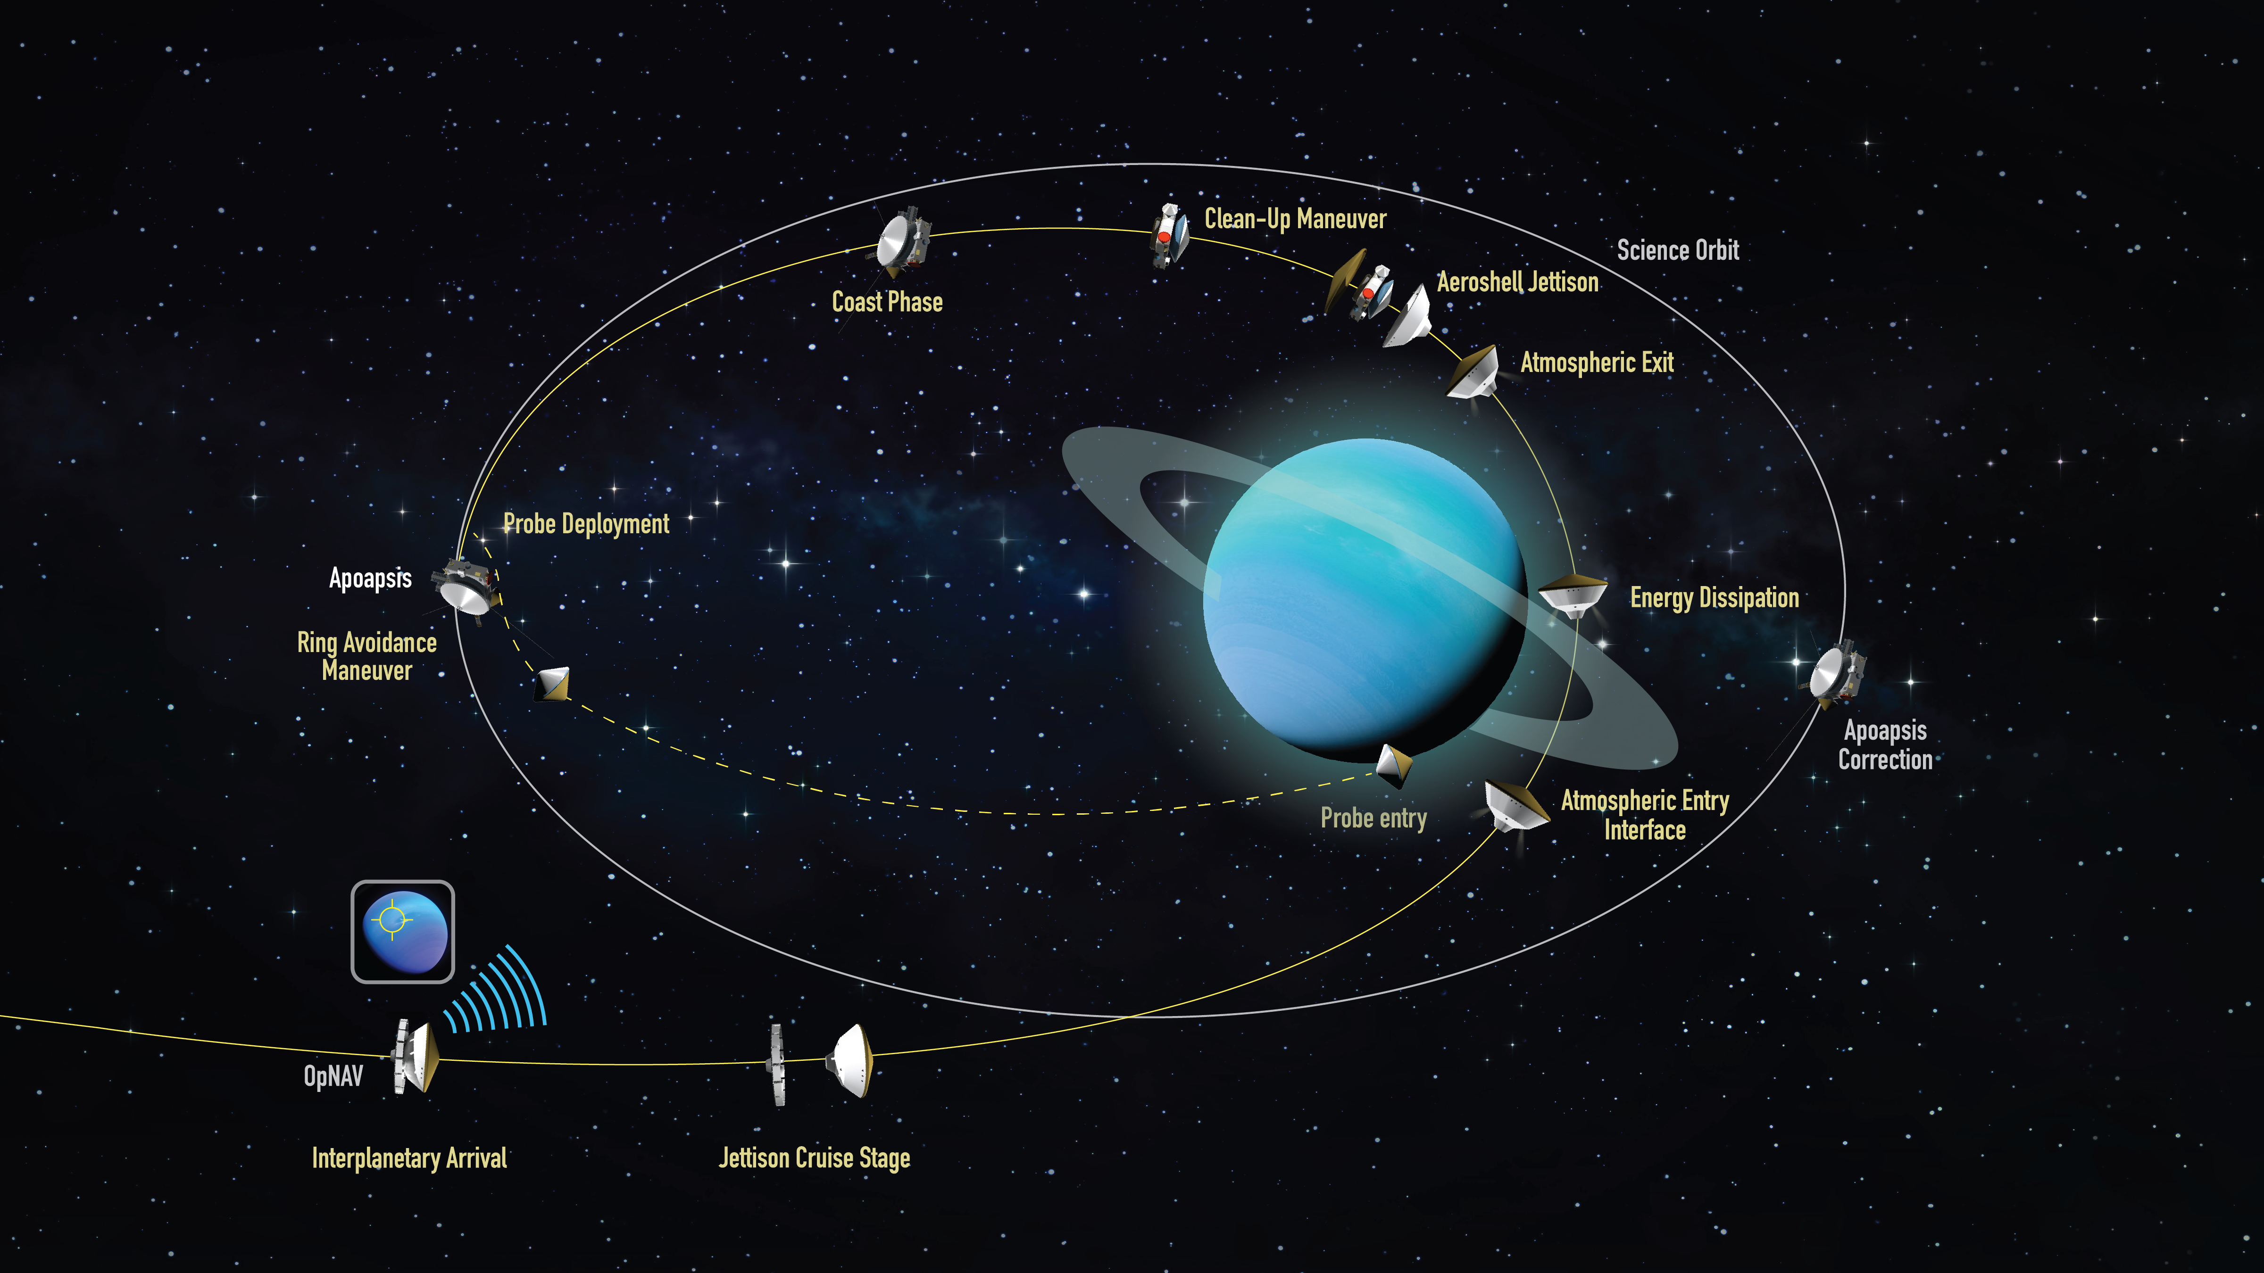
Outline
Updates to Environments and Vehicle Architecture
Forebody TPS
  Con-Ops Sensitivities
Aftbody TPS
Conclusions and Forward Work
Concept of Operations for Uranus Orbiter Probe Aerocapture mission

Slide 3
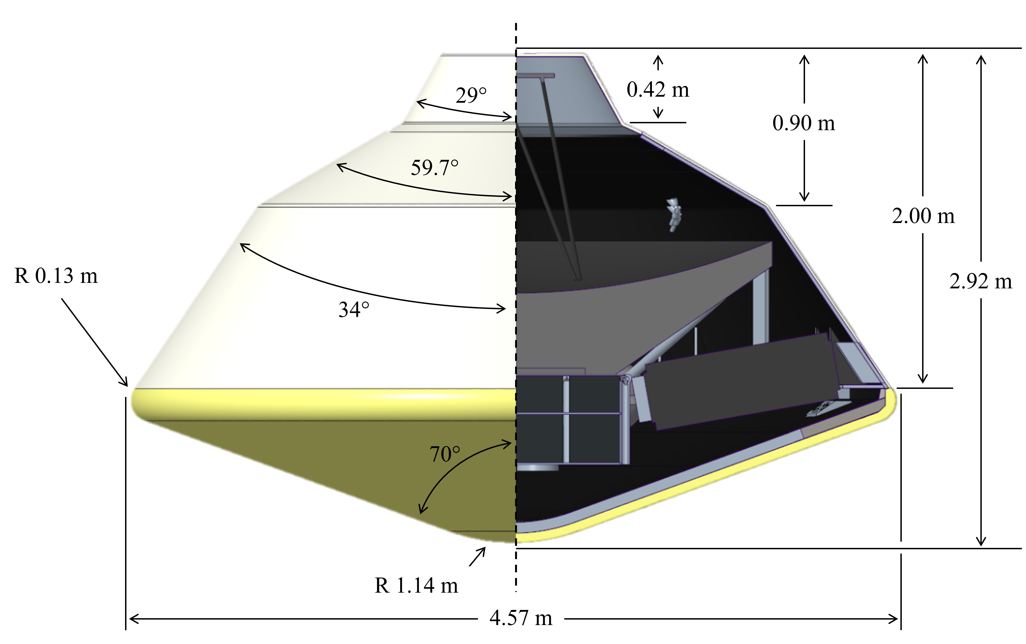
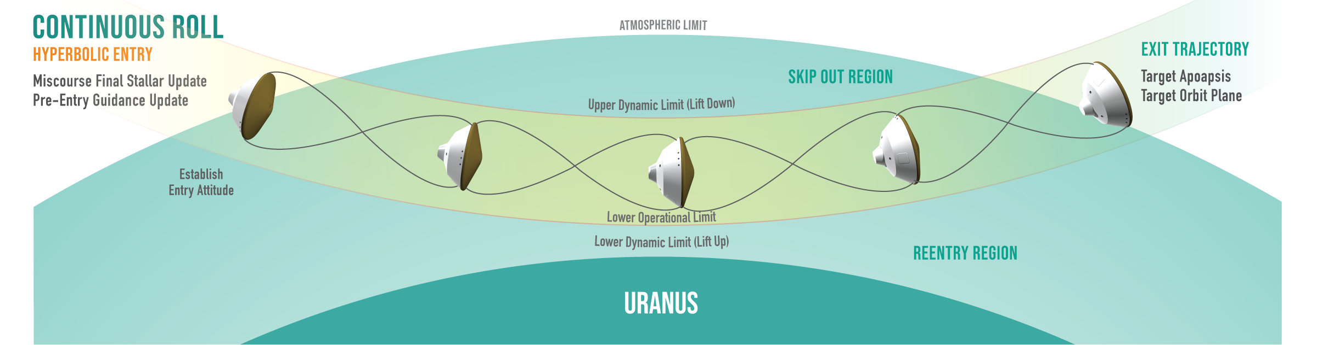
What is Aerocapture?
The concept vehicle is a scaled version (4.57m) of the Mars Science Laboratory (MSL) Vehicle for the following reasons:
  Better knowledge in aerodynamics.
  Success in Bank Angle Modulation implementation.
  Favorable packaging for items like the large antennae needed for deep-space communications.
  Better knowledge of how to integrate TPS on forebody and afterbody.
More details on Aerocapture at Uranus: S. Dutta et al., AIAA SciTech 2024 AIAA-2024-0714

Slide 4
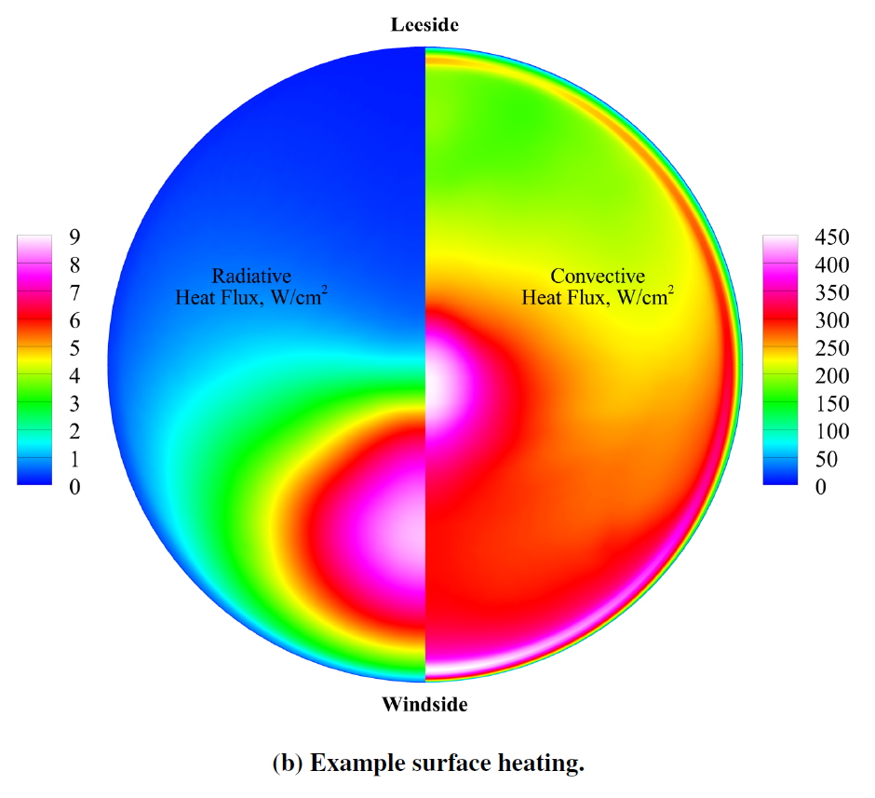
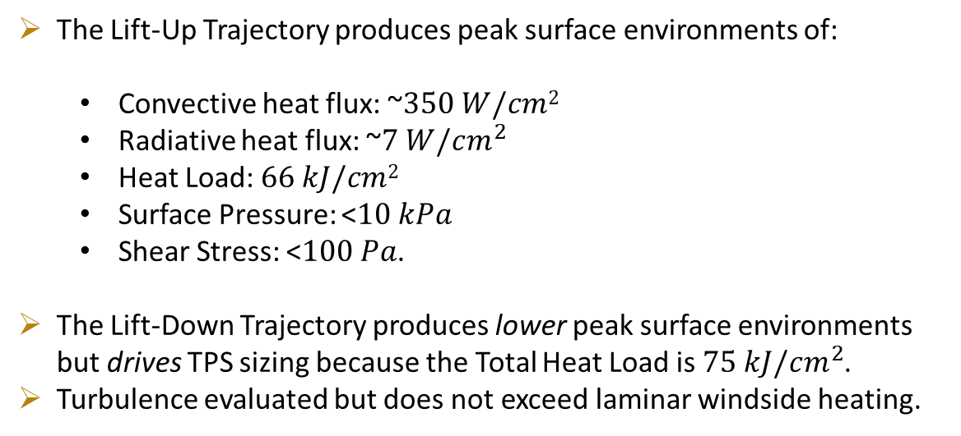
Updates to Forebody Aeroshell Environments
The Lift-Up Trajectory produces peak surface environments of:
  Convective heat flux: ~$350 W/cm2$
  Radiative heat flux: ~$7 W/cm^{2}$
  Heat Load: $66 kJ/cm2$
  Surface Pressure: <$10 kPa$
  Shear Stress: <$100 Pa$.
The Lift-Down Trajectory produces lower peak surface environments but drives TPS sizing because the Total Heat Load is $75 kJ/cm^{2}$.
Turbulence evaluated but does not exceed laminar windside heating.
7
~350
3.5
~175
0
0
Scoggins, J., Hinkle, A., Agam, S., and Patel, M., “Forebody Aeroheating Environments for a Uranus Aerocapture System using a Mars-Heritage Entry Vehicle,” 2025 AIAA SciTech Conference, Orlando, FL, 2025
Heat flux is asymmetric due to the vehicle’s angle of attack as it flies through the atmosphere. Analysis assumed a fixed bank angle while the vehicle would likely rotate around the wind vector to fly a trajectory between Lift-Up and Lift-Down.

Slide 5
Forebody TPS & Con-Ops Sensitivities

Slide 6
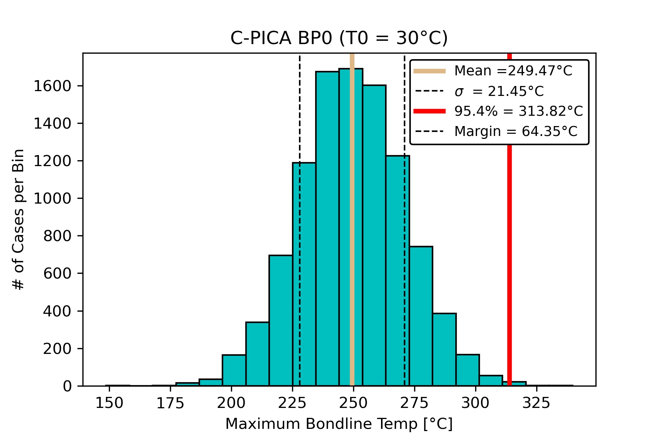
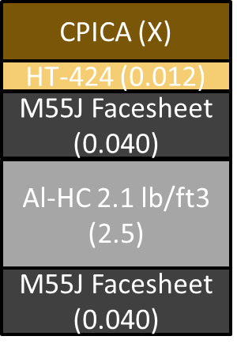
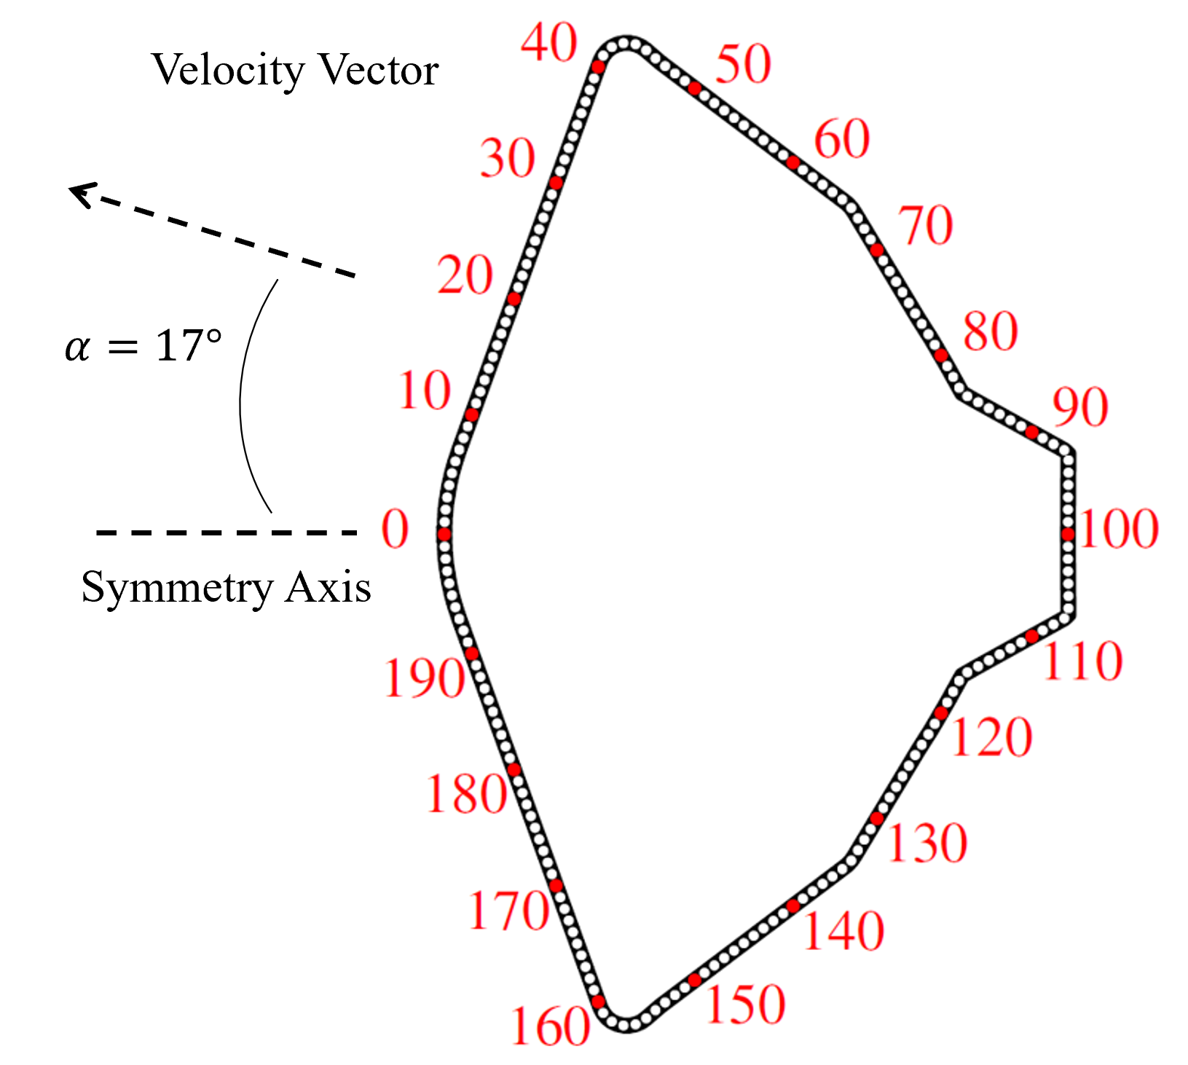
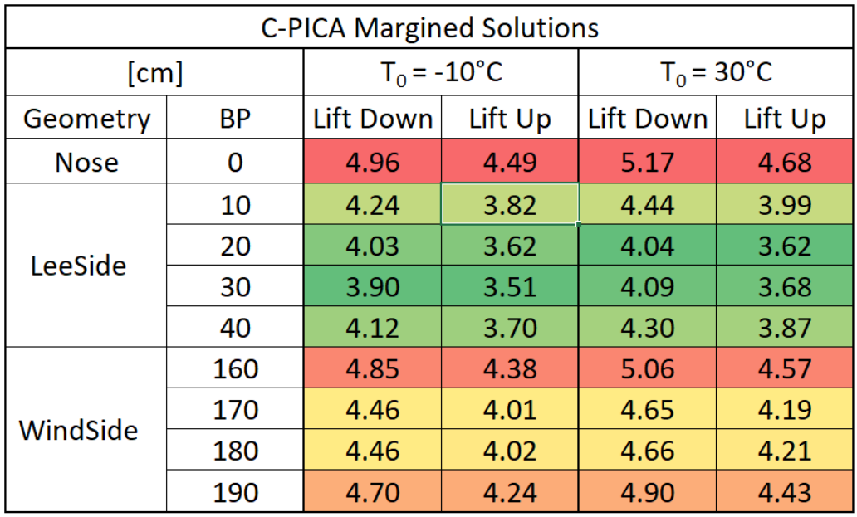
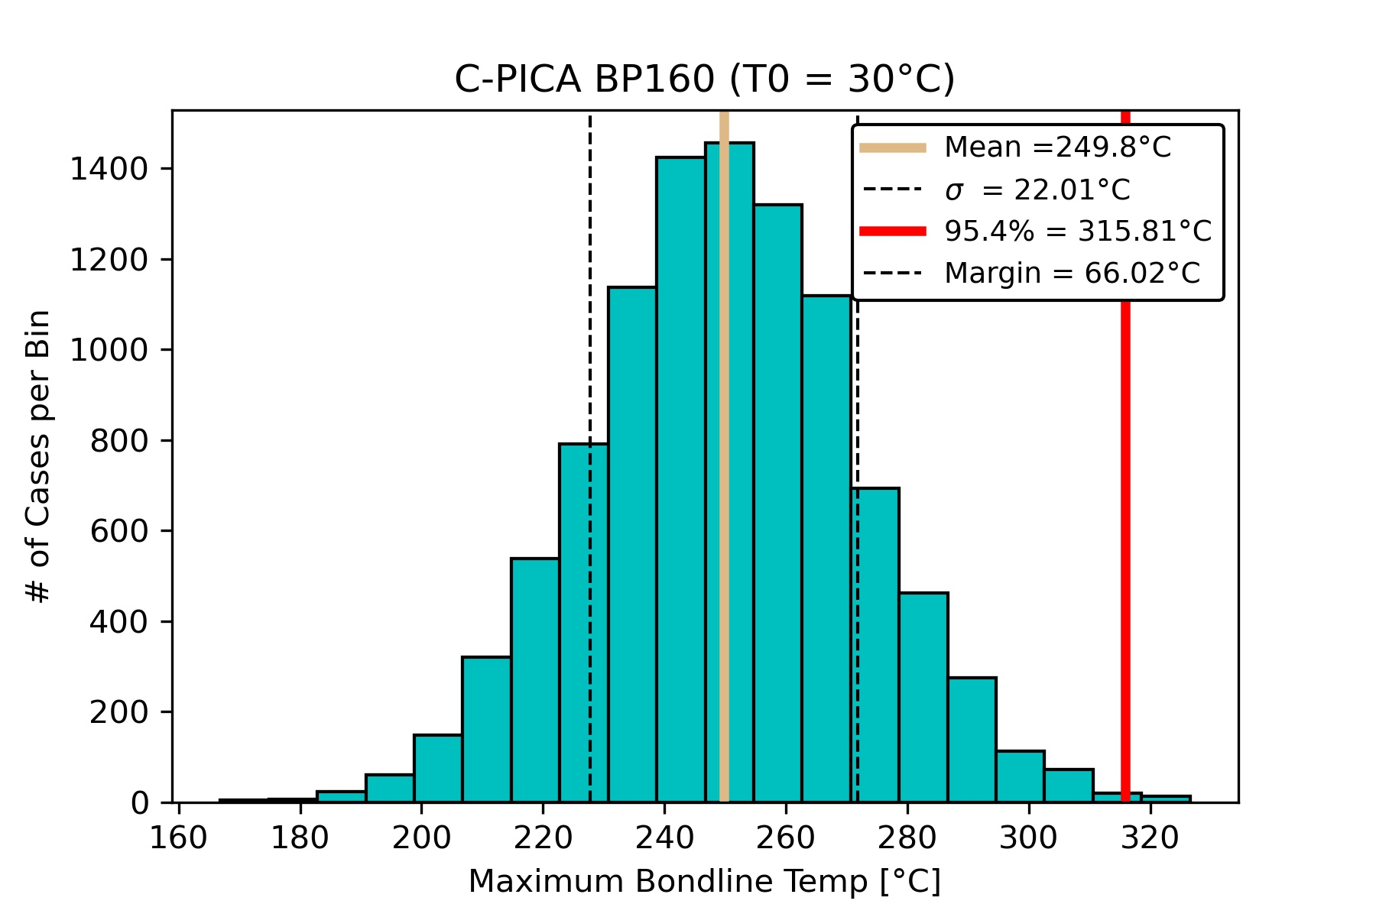
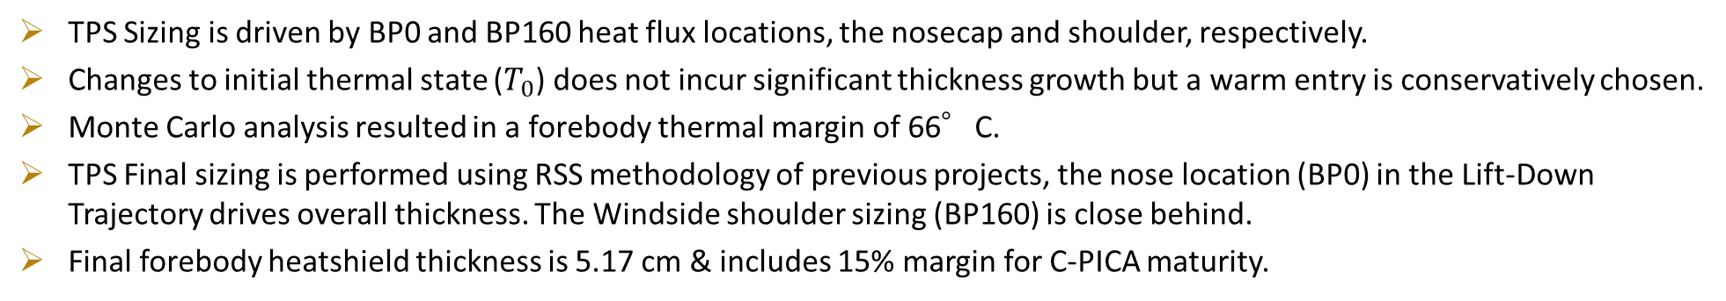
Forebody TPS Setup and Sizing
TPS Sizing is driven by BP0 and BP160 heat flux locations, the nosecap and shoulder, respectively.
Changes to initial thermal state ($T_{0}$) does not incur significant thickness growth but a warm entry is conservatively chosen.
Monte Carlo analysis resulted in a forebody thermal margin of 66°C.
TPS Final sizing is performed using RSS methodology of previous projects, the nose location (BP0) in the Lift-Down Trajectory drives overall thickness. The Windside shoulder sizing (BP160) is close behind.
Final forebody heatshield thickness is 5.17 cm & includes 15% margin for C-PICA maturity.

Slide 7
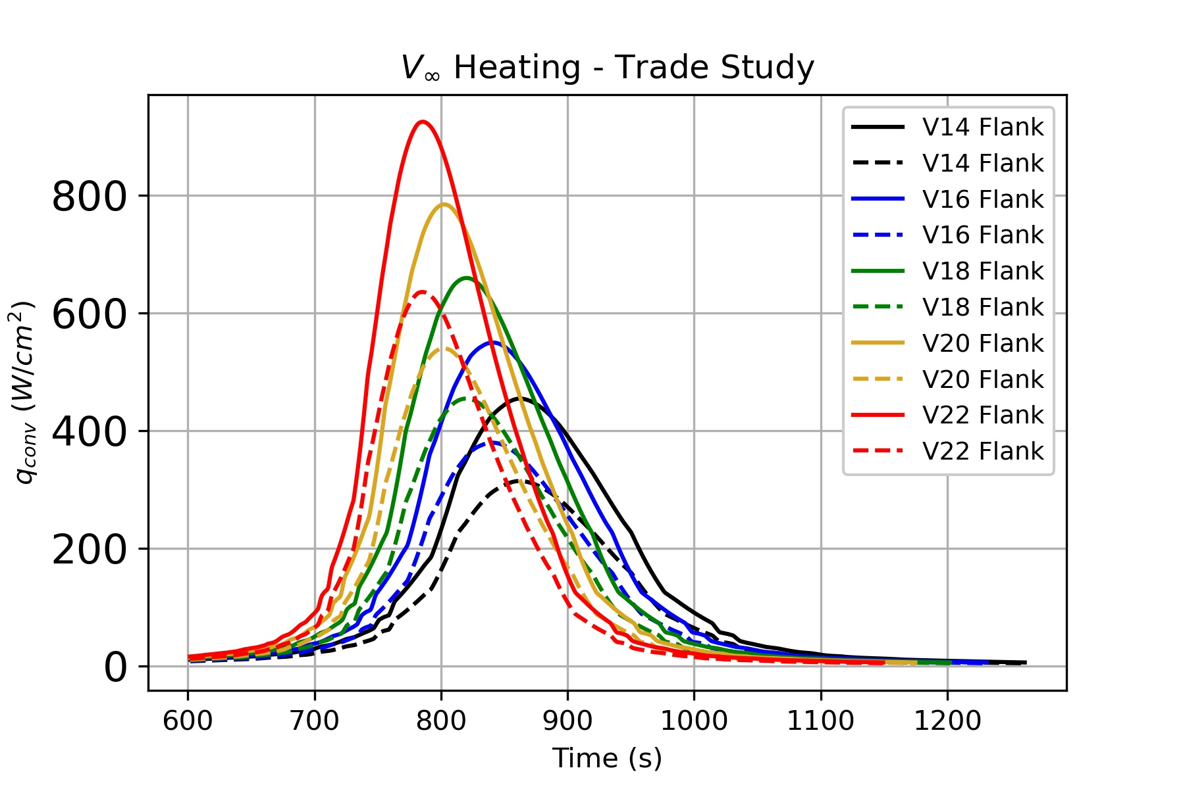
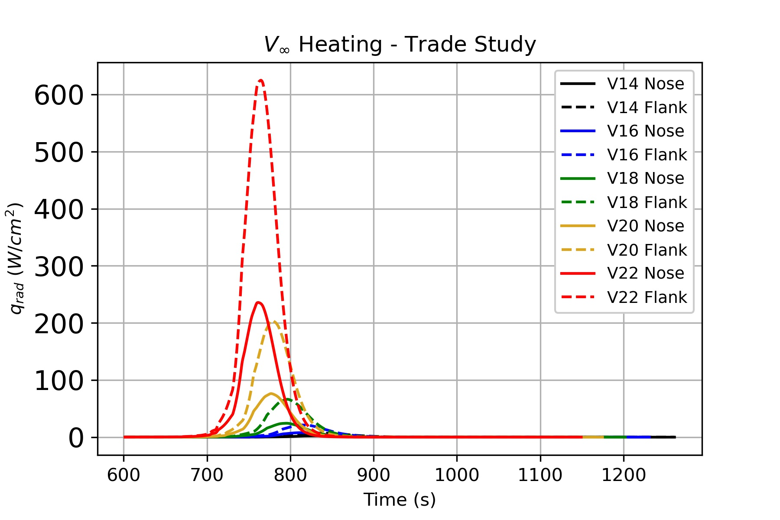
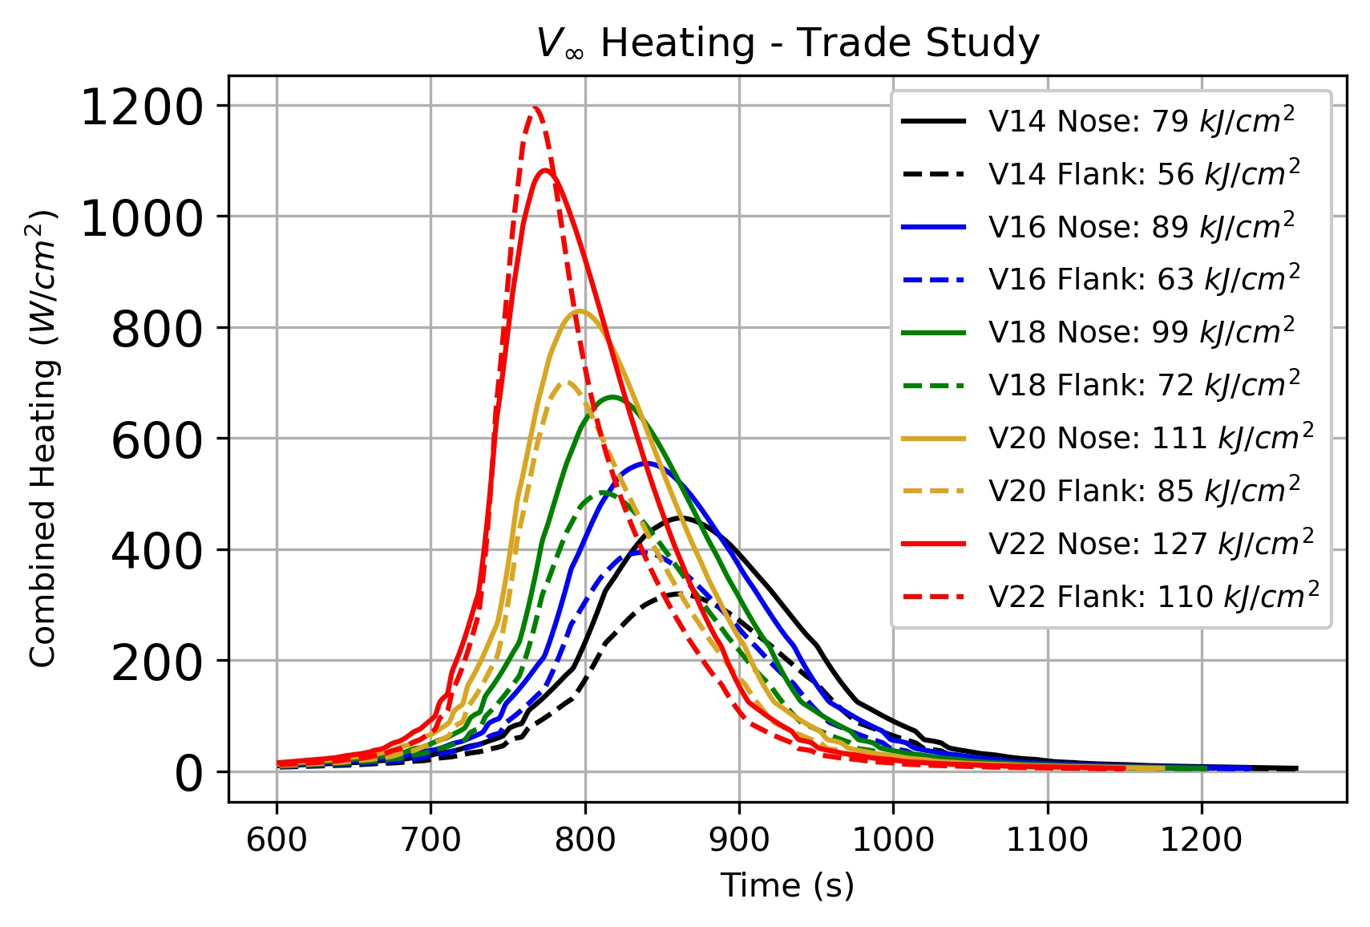

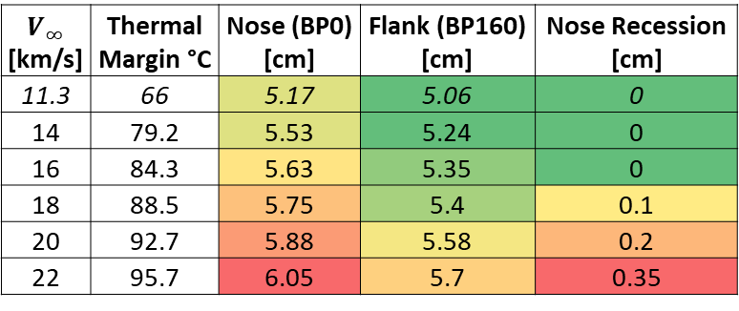


Understanding Forebody TPS Sensitivity to Changing Arrival Velocity
Future vehicles may provide increased capability, allowing for later launches with greater arrival velocities.
Combined Heat Flux across $V_{∞}$ Range
Convective Heat Flux across $V_{∞}$ Range
Radiative Heat Flux across $V_{∞}$ Range
$$V_{∞}$$ [km/s] | Thermal Margin °C | Nose (BP0) [cm] | Flank (BP160) [cm] | Nose Recession [cm]
11.3 | 66 | 5.17 | 5.06 | 0
14 | 79.2 | 5.53 | 5.24 | 0
16 | 84.3 | 5.63 | 5.35 | 0
18 | 88.5 | 5.75 | 5.4 | 0.1
20 | 92.7 | 5.88 | 5.58 | 0.2
22 | 95.7 | 6.05 | 5.7 | 0.35
Changing arrival velocities has a direct impact on the forebody environments.
While C-PICA has been tested to this heat flux but Tiled C-PICA with an appropriate gap-filler will need evaluation at heat flux beyond 600 W/cm².
As velocity increases, radiative heat flux increases non-linearly from ~10% total heating to nearly 40% of total heat flux.
While total heat flux increased by 3x and heat load increase by ~1.6x, sized thickness only increases by ~1.2x due to activation of sublimation mode for energy transfer (surface temperatures > 3000°C) – C-PICA becomes more efficient as other ablation modes are activated!

Slide 8
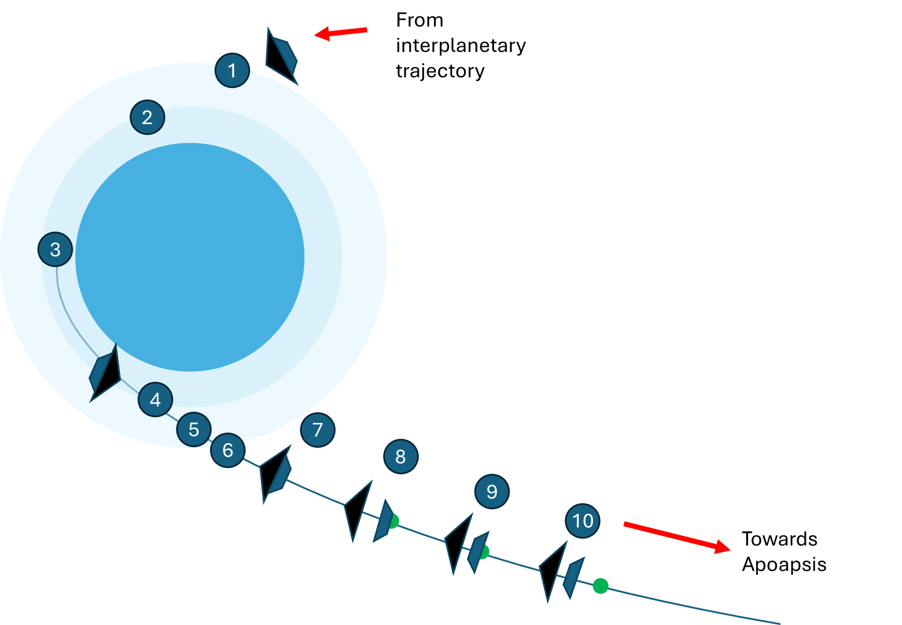
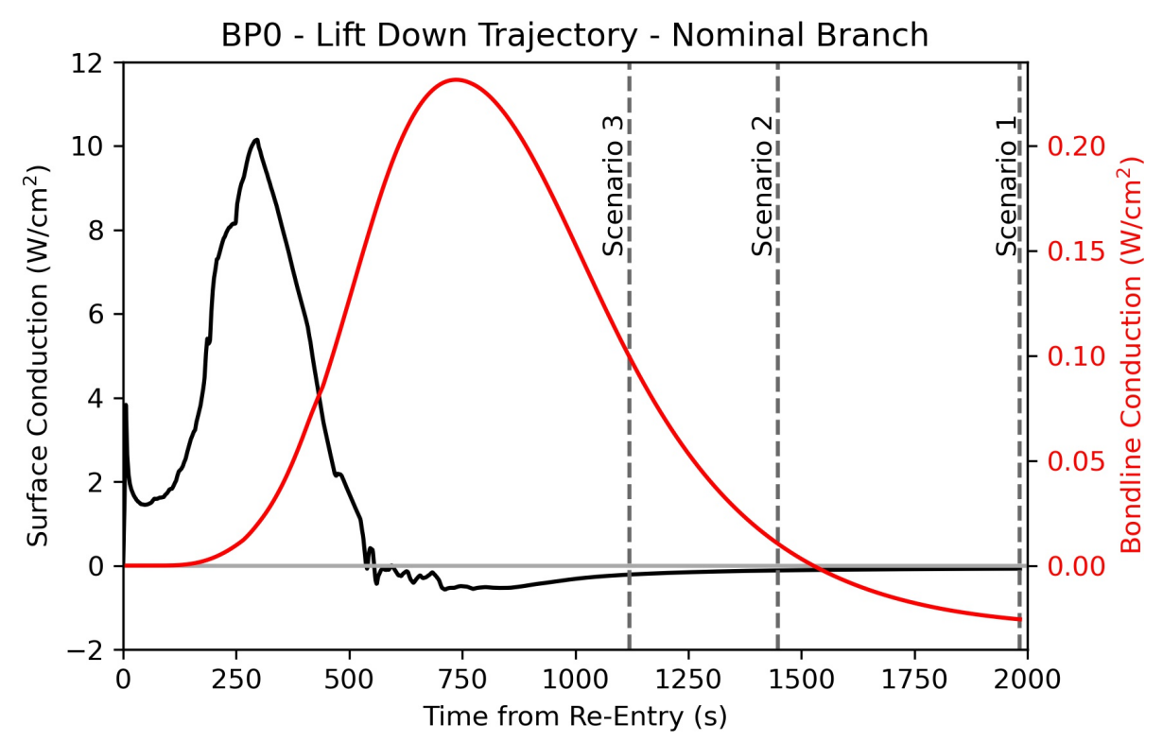
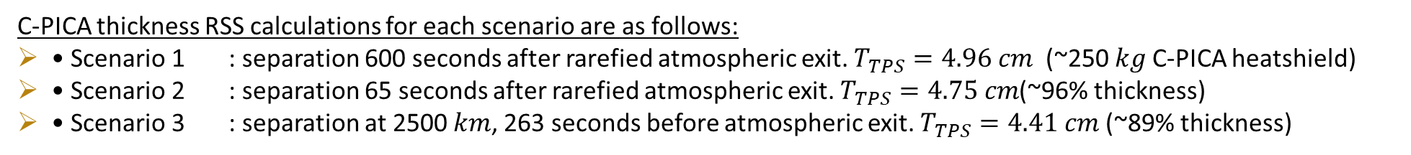
Altering Aeroshell Separation for Mass Savings
Separating early when conduction is positive cuts off this conduction. Separating after yields no benefit.
C-PICA thickness RSS calculations for each scenario are as follows:
• Scenario 1 : separation 600 seconds after rarefied atmospheric exit. $T_{TPS}=4.96 cm$ (~250 𝑘𝑔 C-PICA heatshield)
• Scenario 2 : separation 65 seconds after rarefied atmospheric exit. $T_{TPS}=4.75 cm$(~96% thickness)
• Scenario 3 : separation at 2500 𝑘𝑚, 263 seconds before atmospheric exit. $T_{TPS}=4.41 cm$ (~89% thickness)
Reducing time between atmospheric exit and heatshield separation can save approximately 10% of heatshield mass to be reallocated. The mass may be retained as margin against uncertainty in trajectory or environment.

Slide 9
Aftbody TPS

Slide 10
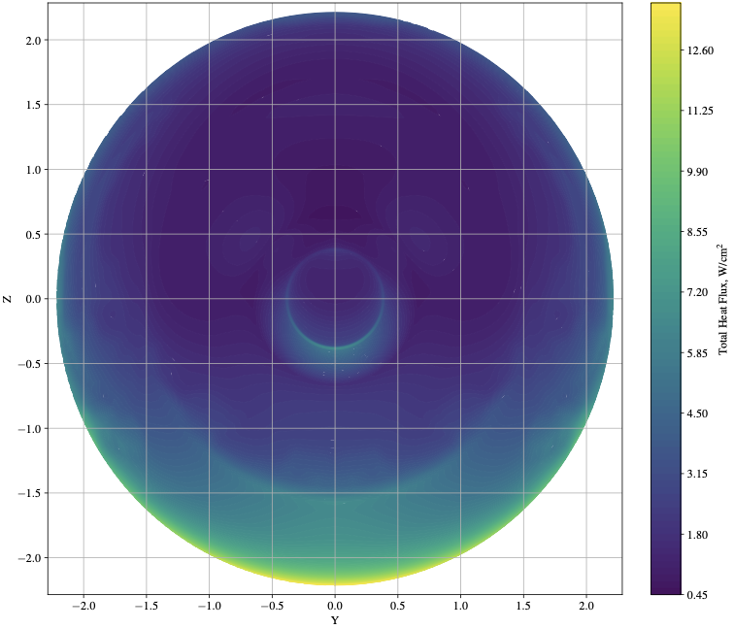
Updates to Aftbody Aeroshell Environments
1st ramp
~40
2nd ramp
3rd ramp
Disk
Leeward
Combined Heat Flux (W/cm²)
Windward
~20
0
Previous heat flux estimates were based on best practice for Pre-Phase A studies (~10% forebody heat flux, 5% pressure).
3D CFD Peak heat flux is constrained to the windward shoulder region. Zones are broadly split windward – leeward, with transitions occurring between geometric segments.
Given the relatively extreme environments near the shoulder at the windward side of the vehicle, TPS can be tailored based on the environments to optimize mass.

Slide 11
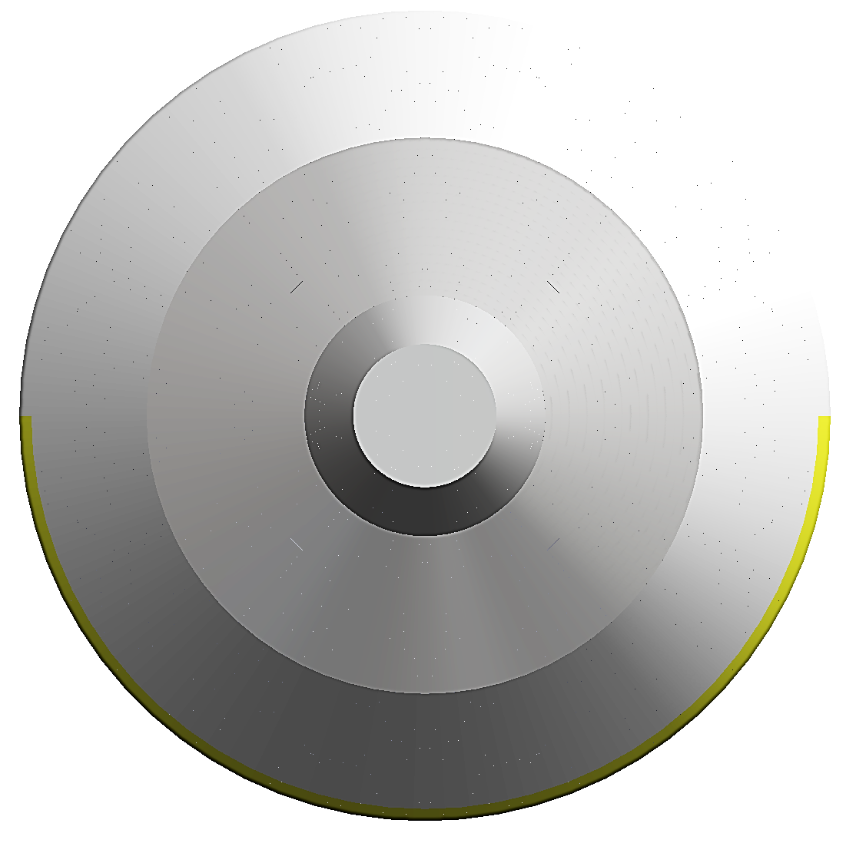
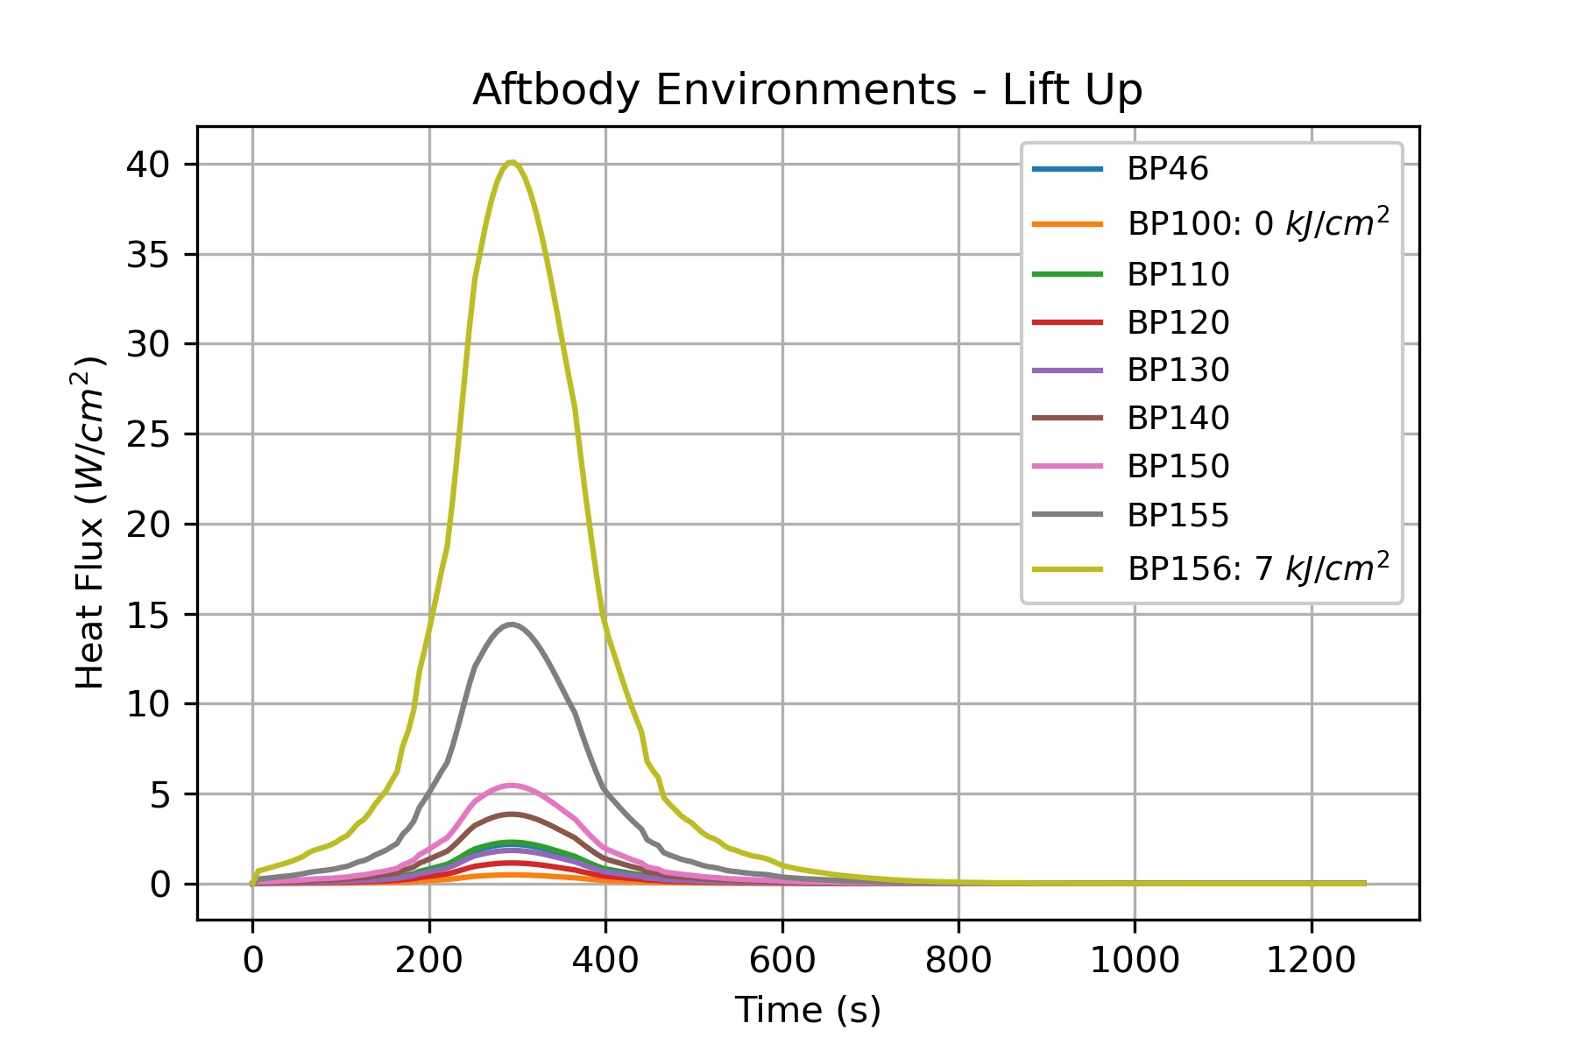
Aftbody TPS – Heritage Scheme
SLA-561V
SLA-561V
Acusil II
Acusil II
Acusil II
A heritage scheme of TPS may look like SLA-561V and Acusil II, as was done for MSL, Mars2020, and Dragonfly.
Advantage: the TPS implemented is well characterized for the heat flux and pressure, and has the RF-transparency that may be desired, along with heritage implementation practices. This scheme is robust against higher arrival velocities, too.
Disadvantage: Mass is a maximum as the TPS are not optimized for heat flux levels.

Slide 12
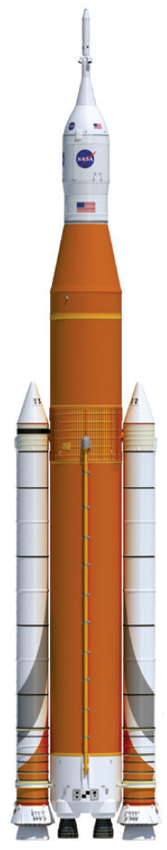
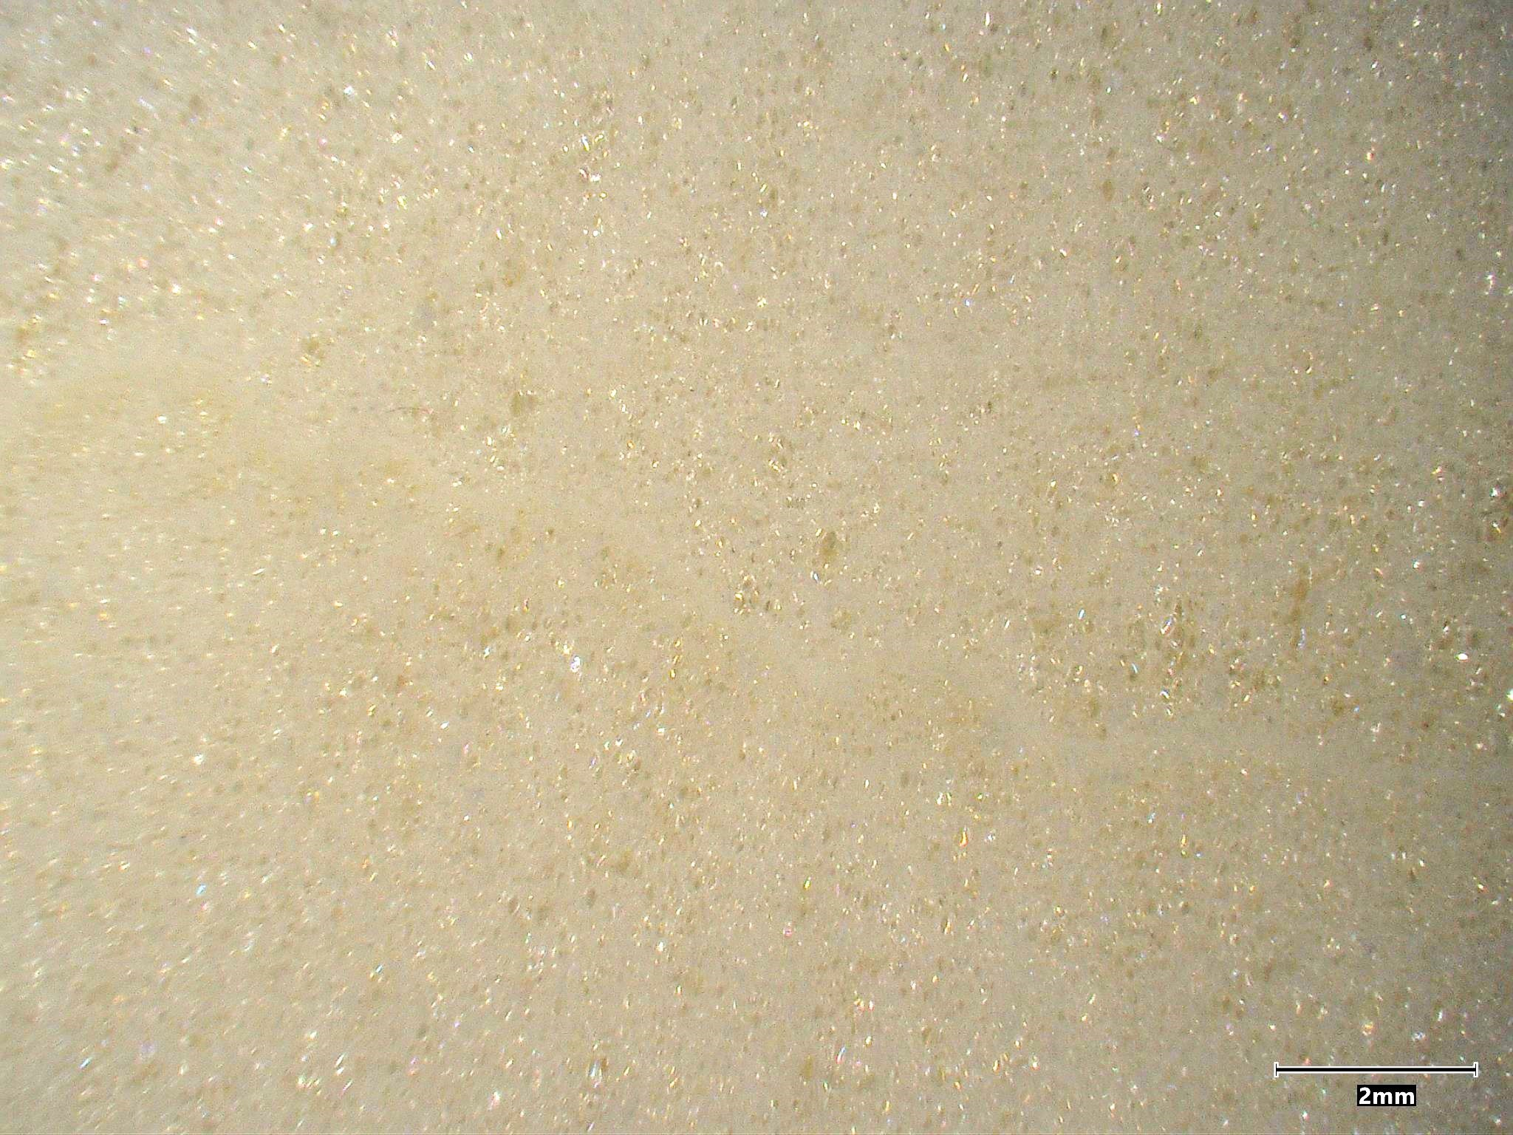
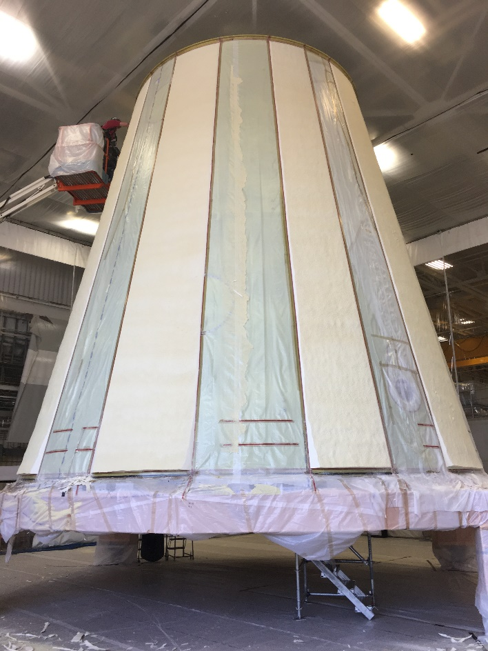
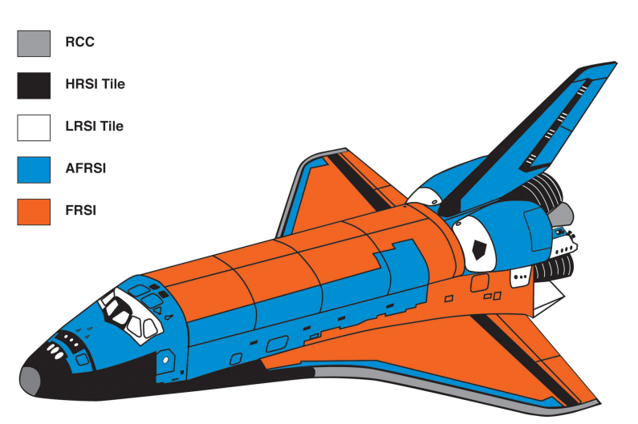
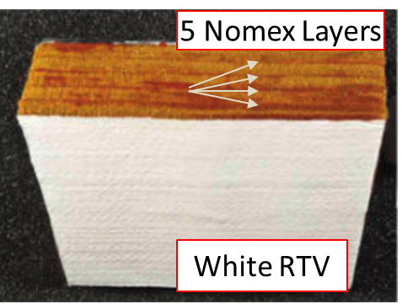
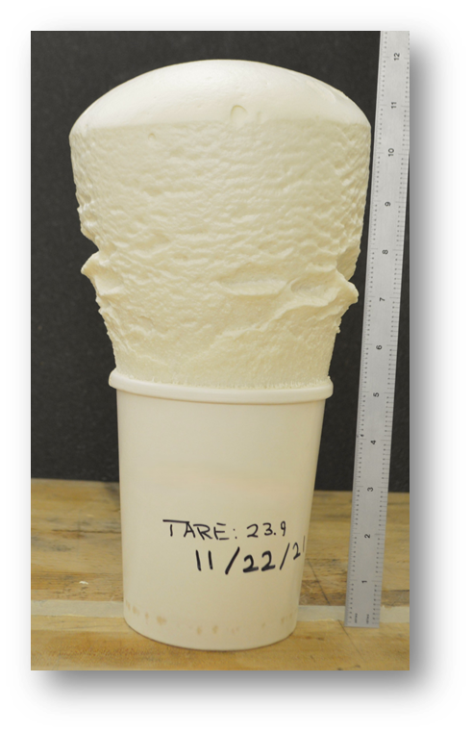
Very Low-$ρ TPS$
SOFI (S-180)
FRSI
Felt Reusable Silica Insulation (FRSI) is a heat-treated Nomex blanket with an OML layer of RTV for optical properties and waterproofing use on Shuttle.
Blankets are woven in 3-foot square sections and then bonded using RTV-560.
Has been tested up to 30 W/cm² and it is noted that char shrinks and is brittle.
Spray-On Foam Insulation (SOFI) is a low-heat flux optimized TPS that can cover large areas.
SOFI is currently qualified for use on SLS, and has been executed with both a manual and robotic spray process.
SOFI has been tested up to 18 W/cm² showing stable recession.
FRSI is a heritage TPS that may generate significant mass-savings over low-heat flux regions.
SOFI is a promising solution that can save time and mass, but needs relevant aerothermal and space environment evaluation!

Slide 13

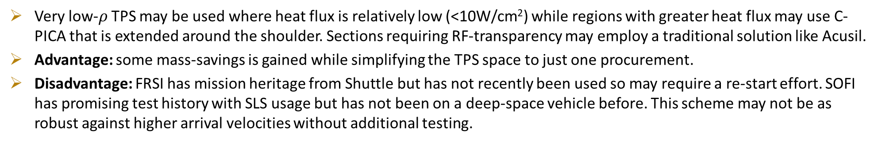

Aftbody TPS –Tailored TPS
Very Low-$ρ$ TPS
CPICA
Acusil II
Acusil II
Very Low-$ρ$ TPS
Acusil II
C-PICA
Very low-$ρ$ TPS may be used where heat flux is relatively low (<10W/cm²) while regions with greater heat flux may use C-PICA that is extended around the shoulder. Sections requiring RF-transparency may employ a traditional solution like Acusil.
Advantage: some mass-savings is gained while simplifying the TPS space to just one procurement.
Disadvantage: FRSI has mission heritage from Shuttle but has not recently been used so may require a re-start effort. SOFI has promising test history with SLS usage but has not been on a deep-space vehicle before. This scheme may not be as robust against higher arrival velocities without additional testing.

Slide 14

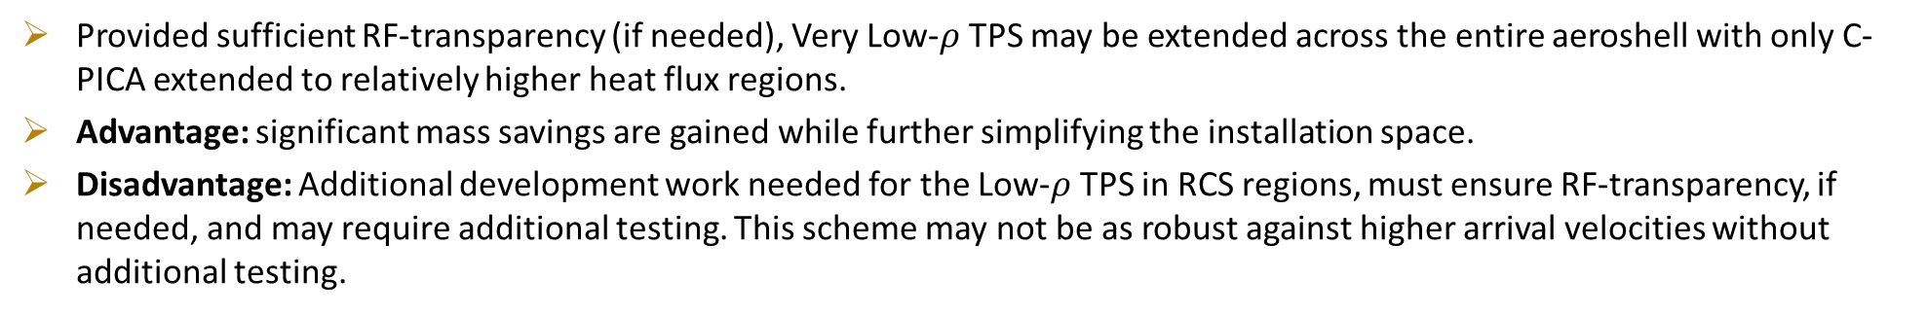

Aftbody TPS – Single TPS & CPICA Lip
CPICA
Very Low-$ρ$ TPS
Acusil II
Very Low-$ρ$ TPS
C-PICA
Provided sufficient RF-transparency (if needed), Very Low-$ρ$ TPS may be extended across the entire aeroshell with only C-PICA extended to relatively higher heat flux regions.
Advantage: significant mass savings are gained while further simplifying the installation space.
Disadvantage: Additional development work needed for the Low-$ρ$ TPS in RCS regions, must ensure RF-transparency, if needed, and may require additional testing. This scheme may not be as robust against higher arrival velocities without additional testing.

Slide 15
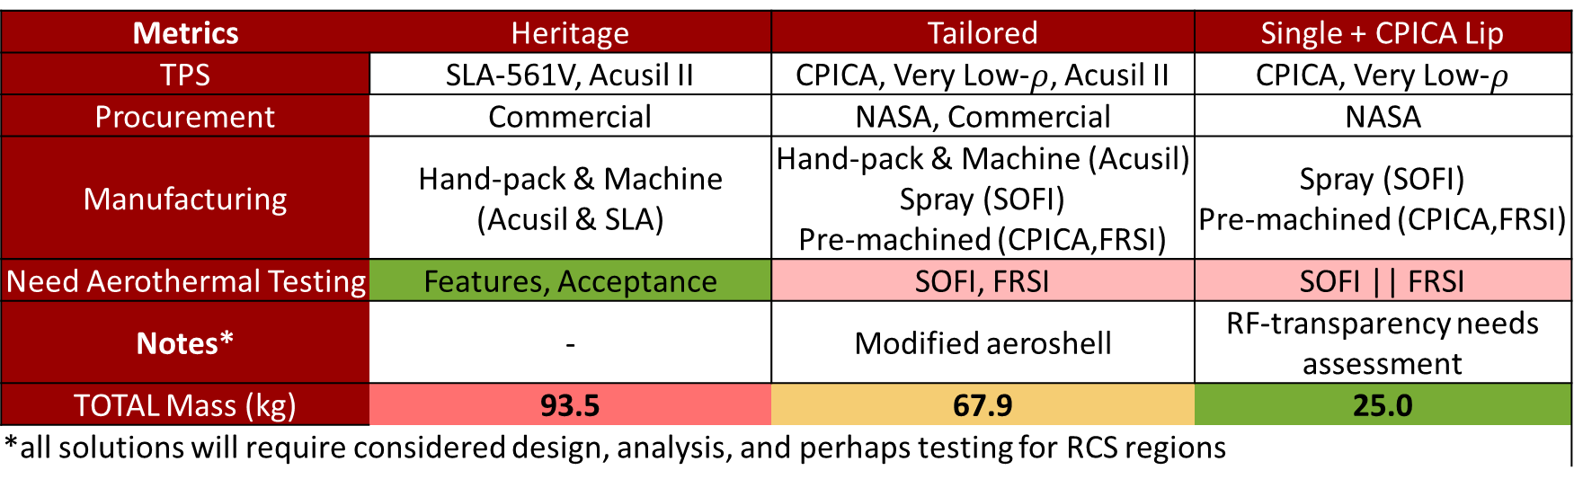
Final Mass Estimates with Tailoring
A homogenous TPS with an extended C-PICA shoulder ring is shown to be a worthwhile solution with residual development and necessary aerothermal testing.
There is significant experience using a heritage system like that of Mars2020 & Dragonfly, and the current experience base with the material makes for a reasonable baseline solution at the cost of mass over other schemes.
  It is likely that only design features and flight lots would need aerothermal testing.
  Acusil II accounts for most of the mass for any TPS scheme in which it is used.
Better
Worse
Metrics | Heritage | Tailored | Single + CPICA Lip
TPS | SLA-561V, Acusil II | CPICA, Very Low-$ρ$, Acusil II | CPICA, Very Low-$ρ$
Procurement | Commercial | NASA, Commercial | NASA
Manufacturing | Hand-pack & Machine (Acusil & SLA) | Hand-pack & Machine (Acusil) Spray (SOFI) Pre-machined (CPICA,FRSI) | Spray (SOFI) Pre-machined (CPICA,FRSI)
Need Aerothermal Testing | Features, Acceptance | SOFI, FRSI | SOFI || FRSI
Notes* | - | Modified aeroshell | RF-transparency needs assessment
TOTAL Mass (kg) | 93.5 | 67.9 | 25.0
*all solutions will require considered design, analysis, and perhaps testing for RCS regions

Slide 16
Conclusions
NASA and commercial suppliers currently have TPS solutions that meet the needs of an aerocapture mission to Uranus.
With future performance gains in launch vehicles, increasing the arrival velocity to Uranus can be supported by tiled C-PICA with additional qualification.
Con-Ops of aeroshell separation can be optimized for aeroshell mass-savings or C-PICA heatshield mass may be retained for margin against uncertainty in trajectory and environment.
Aftbody TPS is currently un-optimized for heat flux levels, while TPS from Shuttle and SLS may be developed for use.
Material System | Manufacturing State | Aerothermal Needs | Additional Needs Identified
C-PICA & RTV-560 | Ready (with contract) | System-scale testing
SLA-561V | Ready (with contract) | Features, Acceptance
Acusil-II | Ready (with contract) | Features, Acceptance
FRSI | Custom-order with from commercial entities. | Arc-jet and materials campaign | RF-transparency evaluation.
SOFI | Currently supporting SLS, material is available. | Arc-jet and materials campaign | RF-transparency evaluation.

Slide 17
Other UOP Aerocapture Work at AIAA SciTech 2025
Aerocapture to Uranus Overview: Dutta, S., Shellabarger, E., Scoggins, J. B., Gomez-Delrio, A., Lugo, R., Deshmukh, R., Tackett, B., Williams, J., Johnson, B., Matz, D., Geiser, J., Morgan, J., Restrepo, R., and Mages, D., “Uranus Flagship-class Orbiter and Probe Using Aerocapture.” 2025 AIAA SciTech Conference, Orlando, FL, 2025.
Vehicle Design: Gomez-Delrio, A., Davis, W., Deshmukh, R., and Dutta, S., “Design Considerations for Aerocapture Delivery of Uranus Orbiter and Probe,” 2025 AIAA SciTech Conference, Orlando, FL, 2025.
Trajectory Analysis: Deshmukh, R., Dutta, S., and Chadalavada, P., “6-DOF Uranus Aerocapture Trajectory Analysis,” 2025 AIAA SciTech Conference, Orlando, FL, 2025.
Forebody Aeroheating: Scoggins, J., Hinkle, A., Agam, S., and Patel, M., “Forebody Aeroheating Environments for a Uranus Aerocapture System using a Mars-Heritage Entry Vehicle,” 2025 AIAA SciTech Conference, Orlando, FL, 2025.
Aerodynamics: Shellabarger, E., Scoggins, J., Hinkle, A., Deshmukh, R., Dutta, S., Agam, S., and Patel, M., “Aerodynamics of a Uranus Aerocapture System using a Mars-Heritage Entry Vehicle,” 2025 AIAA SciTech Conference, Orlando, FL, 2025.
Navigation: Chadalavada, P., Deshmukh, R., Lugo, R., Dutta, S., Benhacine, L., and Mages, D., “Onboard Navigation Error Analysis for Aerocapture at Uranus,” 2025 AIAA SciTech Conference, Orlando, FL, 2025.
Vehicle Control: Sandoval, S., and Matz, D., “A Comparison of Bank Control and Direct Force Control for Aerocapture at Uranus,” 2025 AIAA SciTech Conference, Orlando, FL, 2025.
Vehicle Control: Palazzo, T., “Hybrid Bank Angle and Angle of Attack Control Strategies for Uranus Aerocapture,” 2025 AIAA SciTech Conference, Orlando, FL, 2025.

Slide 18
Back-Up

Slide 19
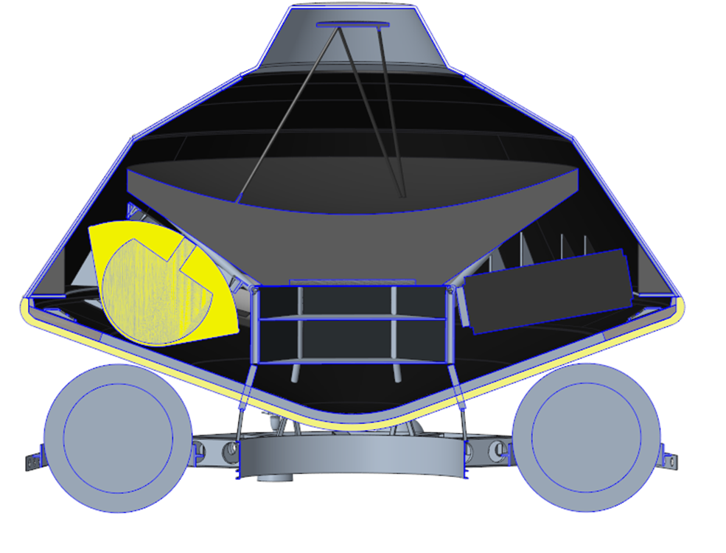
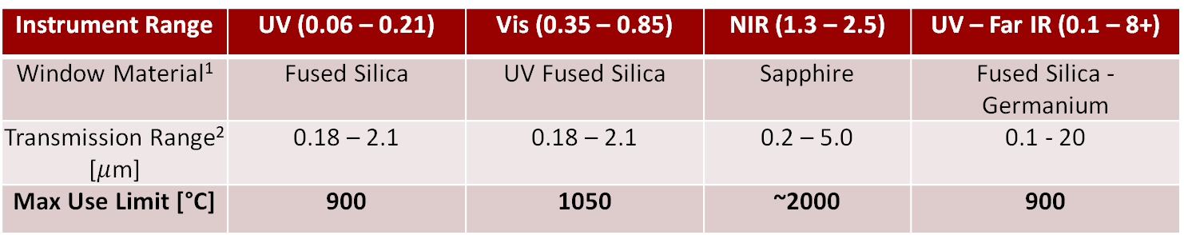
Windows for Science
Window material is thermally viable for nearly all locations excepting the WW Lip.
  Sapphire windows for NIR may be used here.
Window material may experience reduced transmission as temperatures increase, but one study found that inert atmospheres have little effect on materials like sapphire, while others like fused silica may experience attenuation.
More challenging may be fitting optical equipment where desired for observation, so fiber optics should be leveraged where possible combined with radomes or slanted ports.
Leeward
Windward
Instrument Range | UV (0.06 – 0.21) | Vis (0.35 – 0.85) | NIR (1.3 – 2.5) | UV – Far IR (0.1 – 8+)
Window Material¹ | Fused Silica | UV Fused Silica | Sapphire | Fused Silica - Germanium
Transmission Range² [$μ$m] | 0.18 – 2.1 | 0.18 – 2.1 | 0.2 – 5.0 | 0.1 - 20
Max Use Limit [°C] | 900 | 1050 | ~2000 | 900

Slide 20
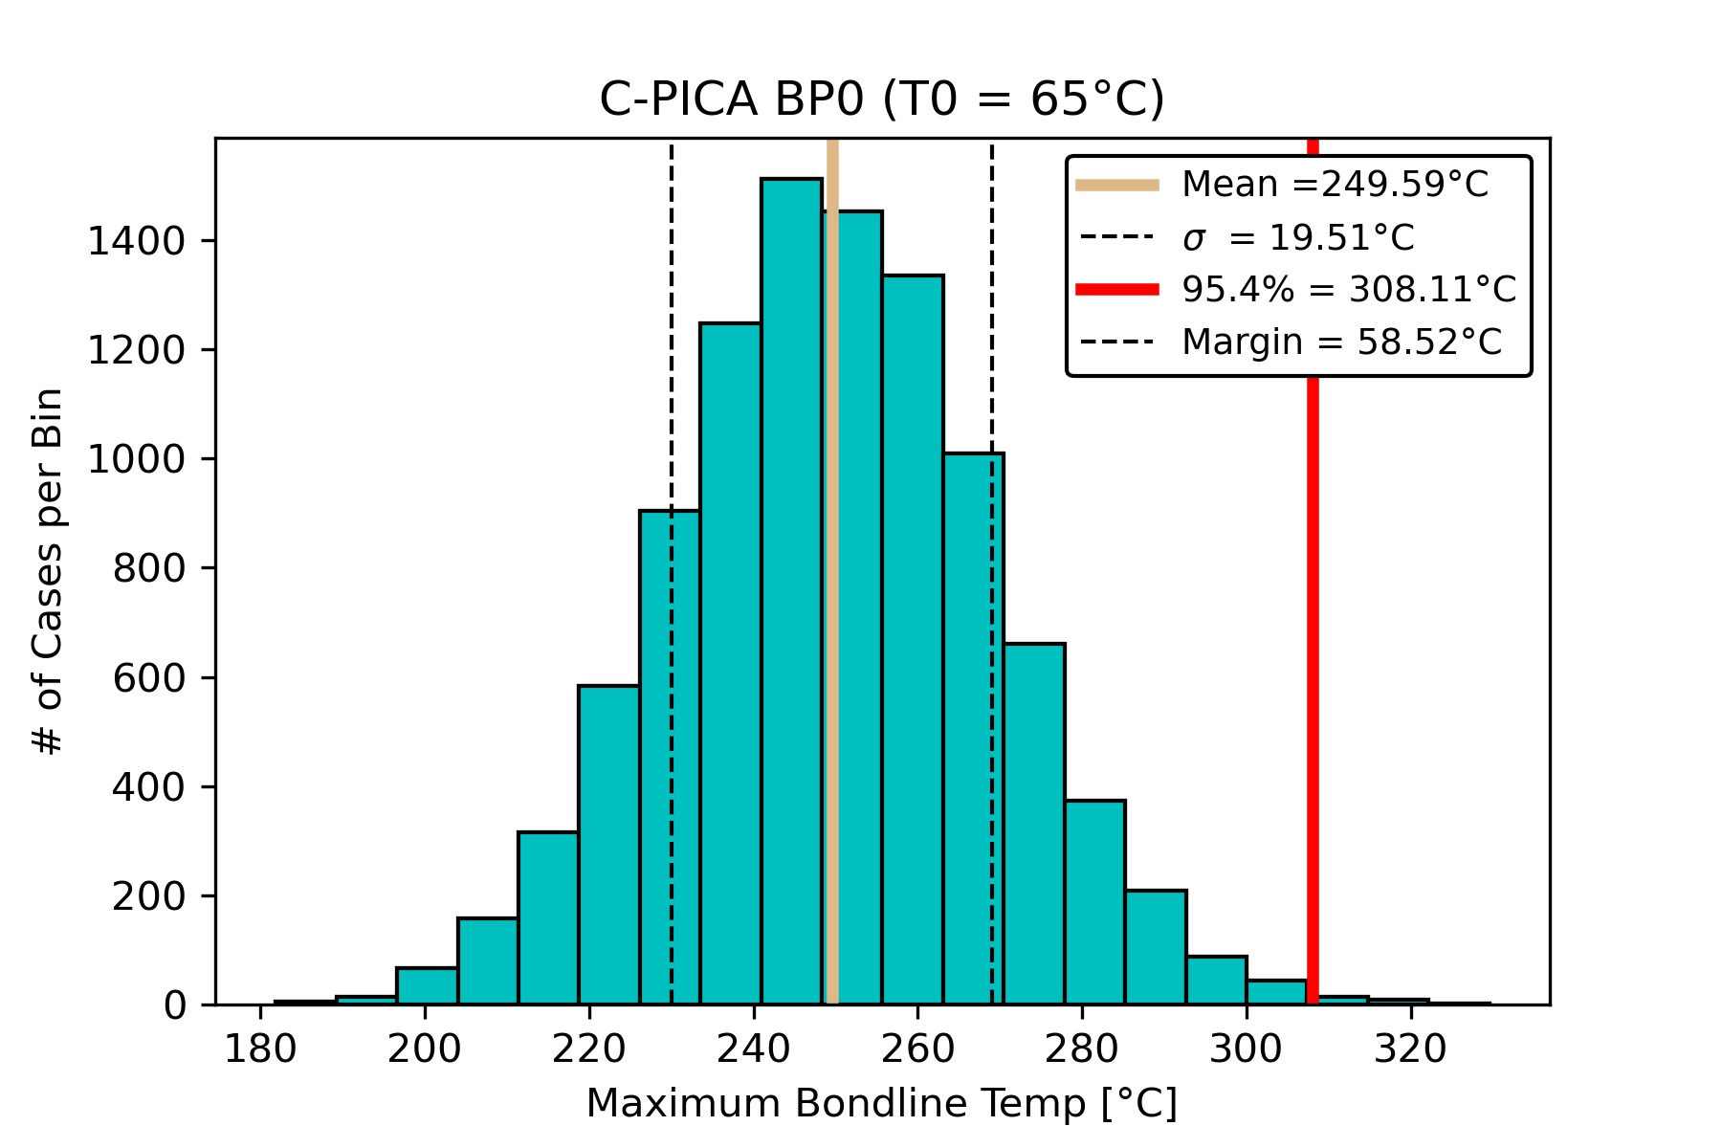
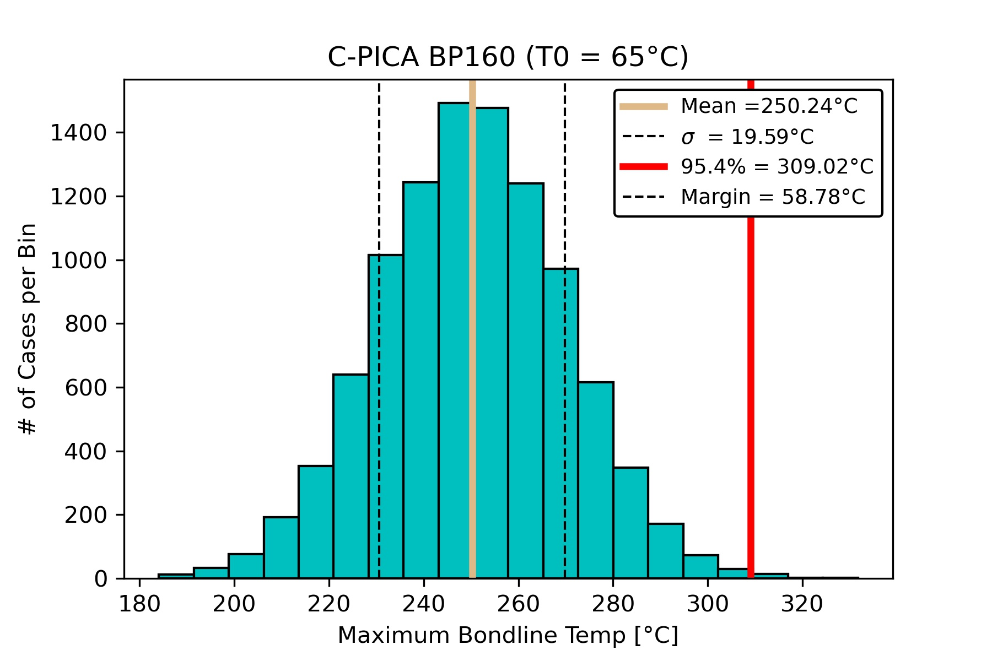
MCFIAT – Forebody T_0

Slide 21
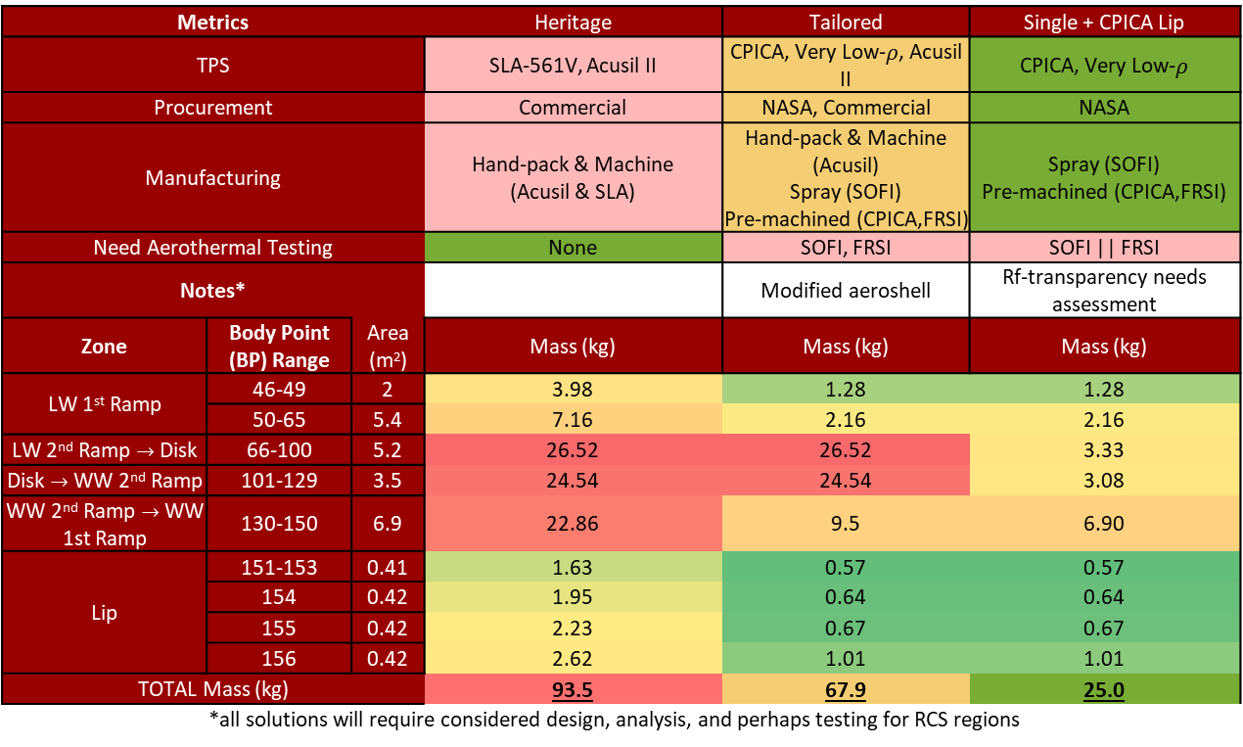
TPS Detail Aftbody Space
Metrics | Metrics |  | Heritage | Tailored | Single + CPICA Lip
TPS | TPS |  | SLA-561V, Acusil II | CPICA, Very Low-$ρ$, Acusil II | CPICA, Very Low-$ρ$
Procurement | Procurement |  | Commercial | NASA, Commercial | NASA
Manufacturing | Manufacturing |  | Hand-pack & Machine (Acusil & SLA) | Hand-pack & Machine (Acusil) Spray (SOFI) Pre-machined (CPICA,FRSI) | Spray (SOFI) Pre-machined (CPICA,FRSI)
Need Aerothermal Testing | Need Aerothermal Testing |  | None | SOFI, FRSI | SOFI || FRSI
Notes* | Notes* |  |  | Modified aeroshell | Rf-transparency needs assessment
Zone | Body Point (BP) Range | Area (m²) | Mass (kg) | Mass (kg) | Mass (kg)
LW 1st Ramp | 46-49 | 2 | 3.98 | 1.28 | 1.28
 | 50-65 | 5.4 | 7.16 | 2.16 | 2.16
LW 2nd Ramp $→$ Disk | 66-100 | 5.2 | 26.52 | 26.52 | 3.33
Disk $→$ WW 2nd Ramp | 101-129 | 3.5 | 24.54 | 24.54 | 3.08
WW 2nd Ramp $→$ WW 1st Ramp | 130-150 | 6.9 | 22.86 | 9.5 | 6.90
Lip | 151-153 | 0.41 | 1.63 | 0.57 | 0.57
 | 154 | 0.42 | 1.95 | 0.64 | 0.64
 | 155 | 0.42 | 2.23 | 0.67 | 0.67
 | 156 | 0.42 | 2.62 | 1.01 | 1.01
TOTAL Mass (kg) | TOTAL Mass (kg) |  | 93.5 | 67.9 | 25.0
 | *all solutions will require considered design, analysis, and perhaps testing for RCS regions

