Slide 1

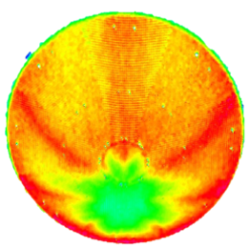
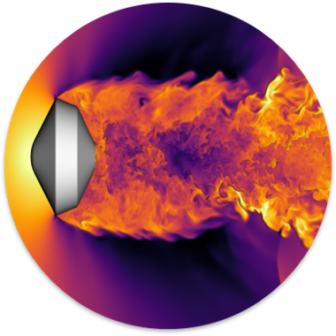
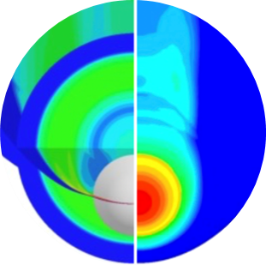
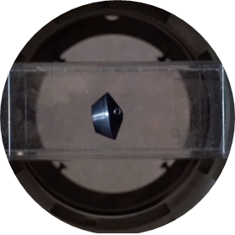
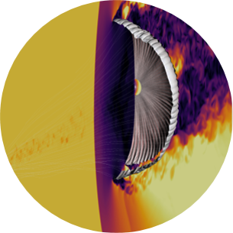
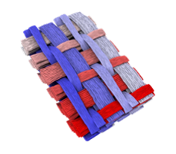
Pterodactyl: 6-DOF Integration of Guidance and Control Algorithms in Genesis
Z. Bashir¹, Q. McKown², K. M. Baldonado³, S. D’Souza⁴, B. Johnson³, B. Margolis⁴, W. Okolo⁴
AIAA SciTech 2025: GNC Entry, Descent and Landing Technology Overviews | 01.07.25 | quincy.e.mckown@nasa.gov
¹Jacobs, Inc (NASA JSC)
²AMA, Inc (NASA ARC)
³NASA JSC
⁴NASA ARC

Slide 2

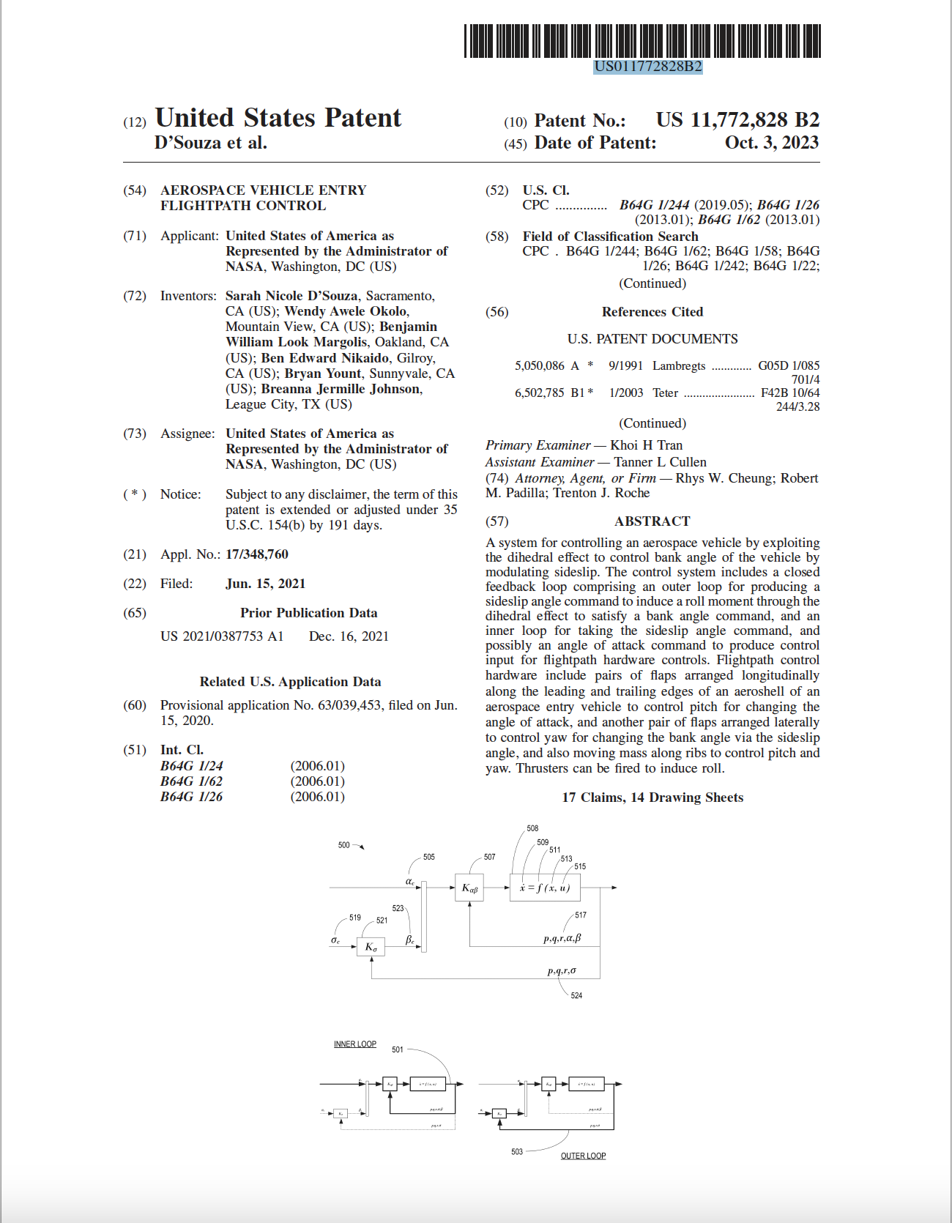
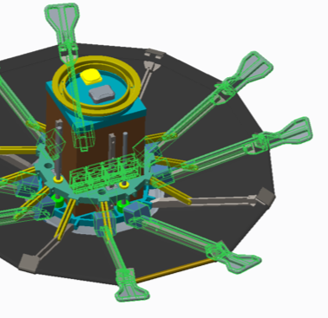
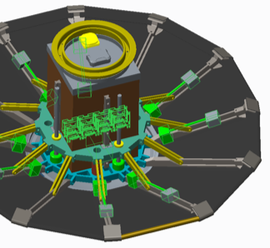
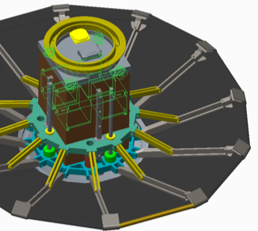
Pterodactyl Background
Pterodactyl is a project that aids in the development of guidance and control solutions for entry vehicles
Patent issued (Patent # US011772828B2) for this technology: “Aerospace Vehicle Entry Flightpath Control” (October 2023)
Pterodactyl developed distinct guidance and control strategies*:
  Angle of attack and sideslip angle modulation (alpha-beta) OR
  Bank angle modulation (yaw-to-bank)
  across different vehicle configurations and control systems*:
  Asymmetric and Symmetric aeroshells
  Three different control systems: flaps, mass movement, and RCS
Mars2020 Simplified Entry & Descent
Mass Movement
Reaction Control System (RCS)
Flaps
*See AIAA SciTech 2021 Pterodactyl series [S. D’Souza, B. Margolis, B. Johnson, et. al.]
Notes:
Originally developed specifically for dev’s, but have been built to be agnostic

Slide 3
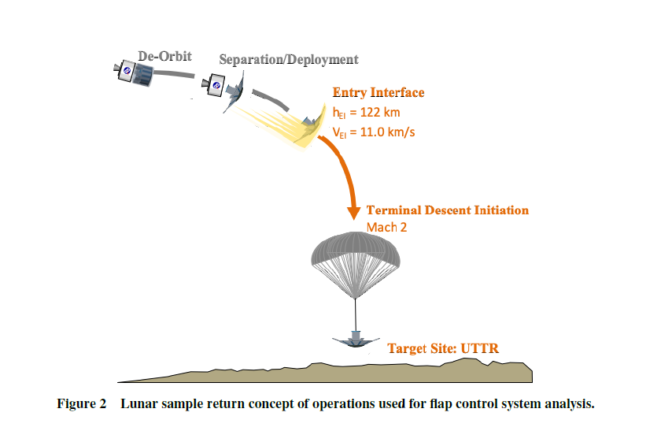
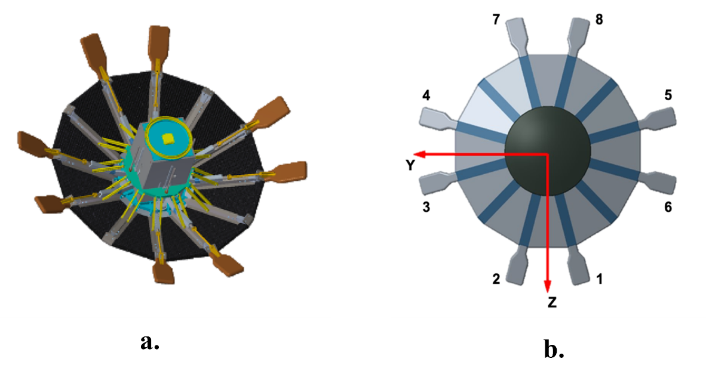
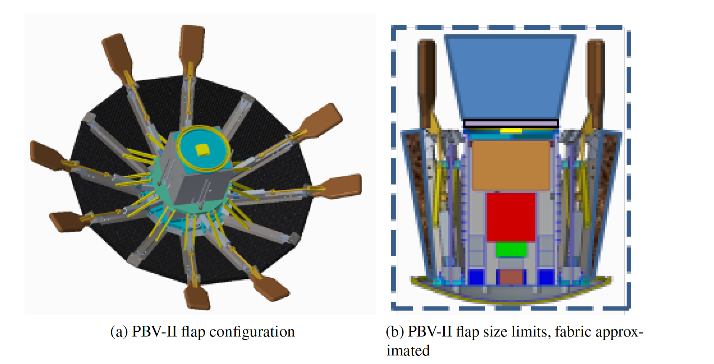
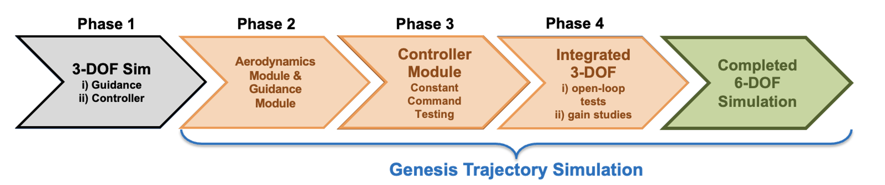
Methodology
Integrate the Pterodactyl guidance and control algorithms in a 6-DOF simulation
  Previous work showed separate 3-DOF trajectory simulations (translational motion + rotational dynamics) with Guidance and Control derived separately
Leverage recent advancements in trajectory software capabilities, specifically Julia-based Genesis
Case study is Earth entry at lunar return speeds with articulating flaps on symmetric ADEPT vehicle (PBV-II/a)
Mars2020 Simplified Entry & Descent
Lunar sample return concept of operations
PBV-II Forebody & Aftbody View

Slide 4
Guidance Algorithms
Utilize Gauss-Newton method within predictor-corrector logic to search for the best command angle magnitude versus energy profile (normalized specific mechanical energy) to achieve a minimal miss distance
Fully Numerical Predictor-corrector Entry Guidance (FNPEG) for yaw-to-bank
  Generates bank angle commands to roll the vehicle’s lift vector using a non-zero trim angle of attack (CG offset)
  Manages downrange error with linear angle profile with respect to energy (bank angle)
  Manages crossrange error with deadband-based lateral logic or predictive lateral logic (bank reversals)
FNPEG Uncoupled Range Control (FNPEG URC) for alpha-beta
  Manages downrange error with linear angle profile with respect to energy (angle of attack)
  Manages crossrange error with azimuth-based proportional-derivative control law (sideslip angle)
Notes:
total lift vector assuming a fixed angle of attack profile
Bank reversals:, the sign of the commanded bank angle can be changed using two different methods i) deadband-based lateral logic or ii) predictive lateral logic based on desired number of reversals
$$e=\frac{1}{r_{dist}}−\frac{V^{2}}{2}$$

Slide 5
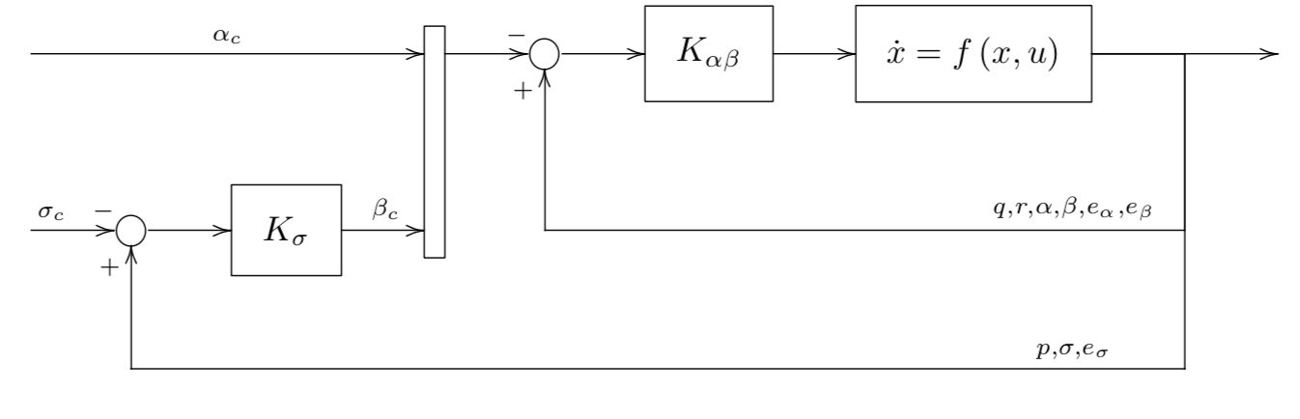
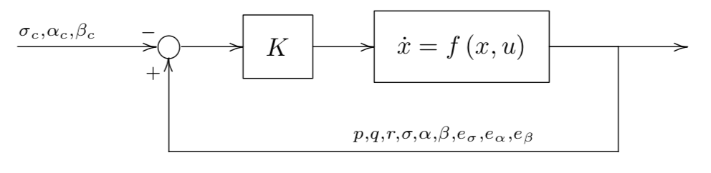
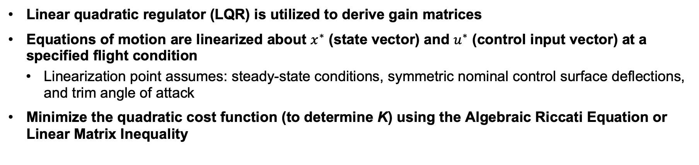
Control Algorithms
Linear quadratic regulator (LQR) is utilized to derive gain matrices
Equations of motion are linearized about $x^{∗}$ (state vector) and $u^{∗}$ (control input vector) at a specified flight condition
  Linearization point assumes: steady-state conditions, symmetric nominal control surface deflections, and trim angle of attack
Minimize the quadratic cost function (to determine K) using the Algebraic Riccati Equation or Linear Matrix Inequality
Control Law: $u=u^{∗}−K\left(x−x_{c}\right)$
Control input
Control input linearized point
Feedback gain matrix
Current state
Commanded state
Control Diagram for Alpha-Beta Controller
Control Diagram for Yaw-to-Bank Controller

Slide 6
Code Base Architecture
PteroAero.jl
Based on Cart3D-derived aerodynamic data, allows query for force and moment coefficients from input state Mach, wind angles, and eight flap deflection angles. Leverages superposition to calculate these coefficients from (1) body and (8) flap contributions.
PteroController.jl
Intakes the current state of the vehicle, the desired state of the vehicle (depending on controller architecture), and calculates the flap deflections using pre-defined gain matrices (Kmat for alpha-beta or Kab and Kbank for yaw2bank).
Integrated6DOFDriver.jl
Instantiates the case study vehicle and integrates the guidance and control modules in a Genesis 6-DOF simulation, leveraging FlightSoftwareRateGroup’s
Leverage Julia’s modularity and Genesis’s function-based programming

Slide 7
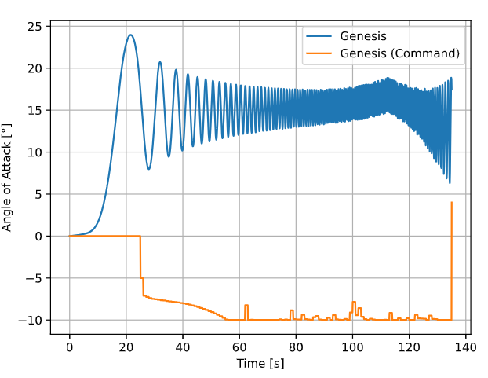

Controller Tuning
Workflow to Generate Gains
Criticality
Generate gain matrices from existing Python code base
“Knobs” for each gain set: dynamic pressure and cost parameters
Input gain matrices into Genesis driver and Julia controller modules
Kmat for alpha-beta
K_ab and K_bank for yaw2bank
Run 6-DOF Genesis simulation
Report crossrange / downrange miss distance and evaluate tracking performance
Gain matrices used in uncoupled 3-DOF did not generate similar performance in coupled 6-DOF
  Hypothesis: higher DOF’s, coupled simulation necessitates greater control authority
Sensitivity studies
  Investigated one-variable-at-a-time (OVAT)
  Inconsistent trends when multiple variables were tuned simultaneously
  Physical limitations not considered
6-DOF simulation with 3-DOF controller
>40 gain matrices
coupled with dozens of gain scheduling schemes were tested in 6-DOF to achieve “best performer”
Angle of Attack [°]
Time [sec]
Coupled 6-DOF necessitated additional controller tuning from uncoupled 3-DOF
Notes:
Integrated6DOFDriver.jl / PteroController.jl

Slide 8
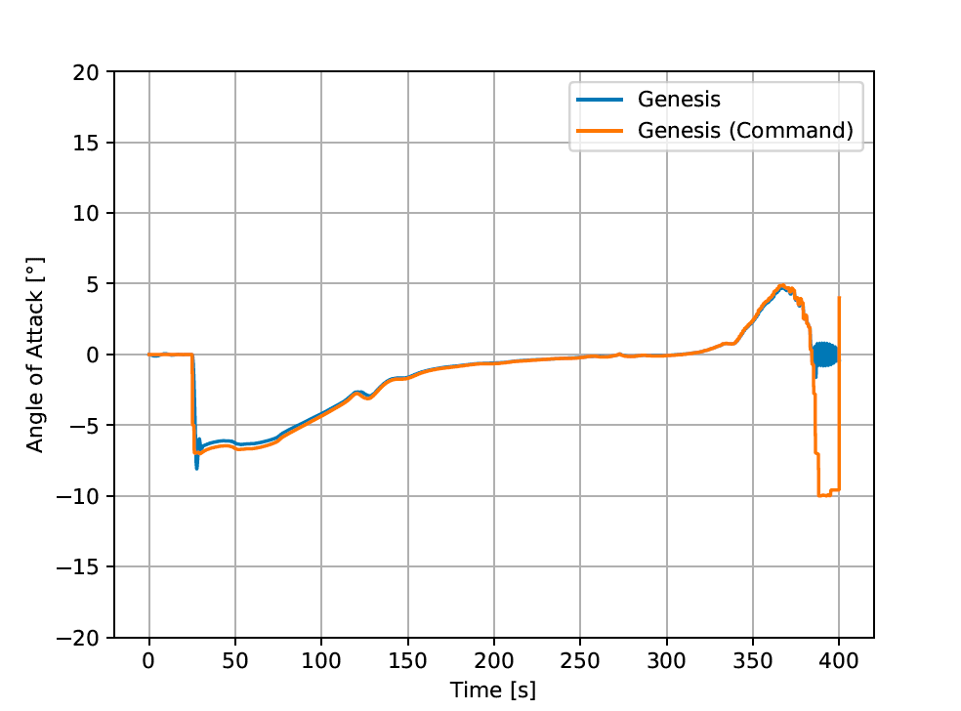
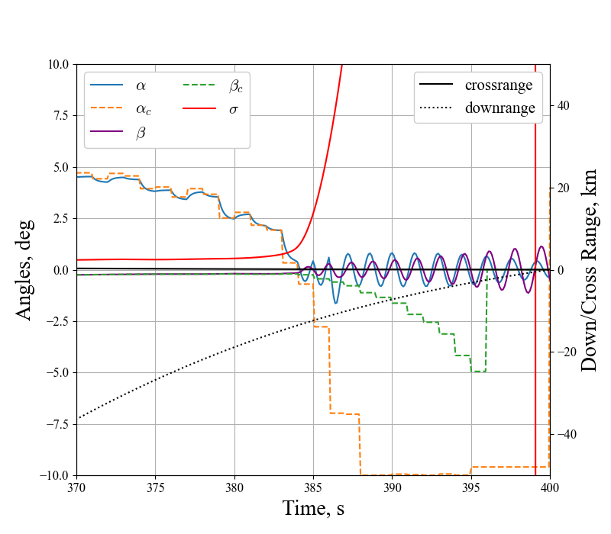
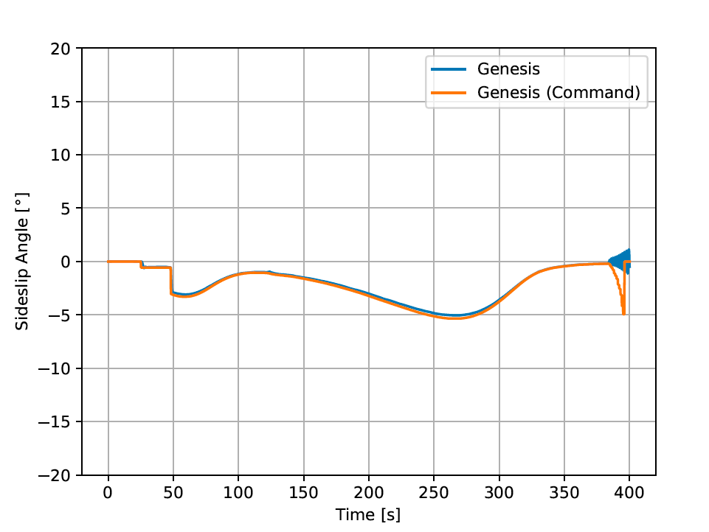
6-DOF Alpha-Beta Results
Baseline Guidance Targets
Best performer gain matrix designed with a “high” dynamic pressure (14.7 kPa) and increased alpha cost (2x 3-DOF)
Angle of Attack [°]
Time [sec]
Sideslip Angle [°]
Crossrange: 17 m
Downrange: 8 m
Time [sec]
Great tracking observed until end of trajectory, which was not shown in uncoupled 3-DOF; several hypotheses necessitate further work
Notes:
crossrange and downrange distance for this run were 16.6 m and 7.6 m

Slide 9
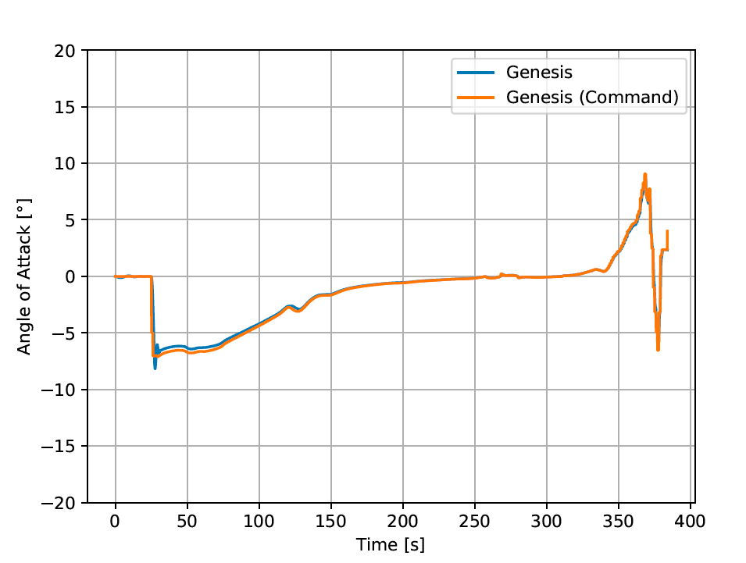
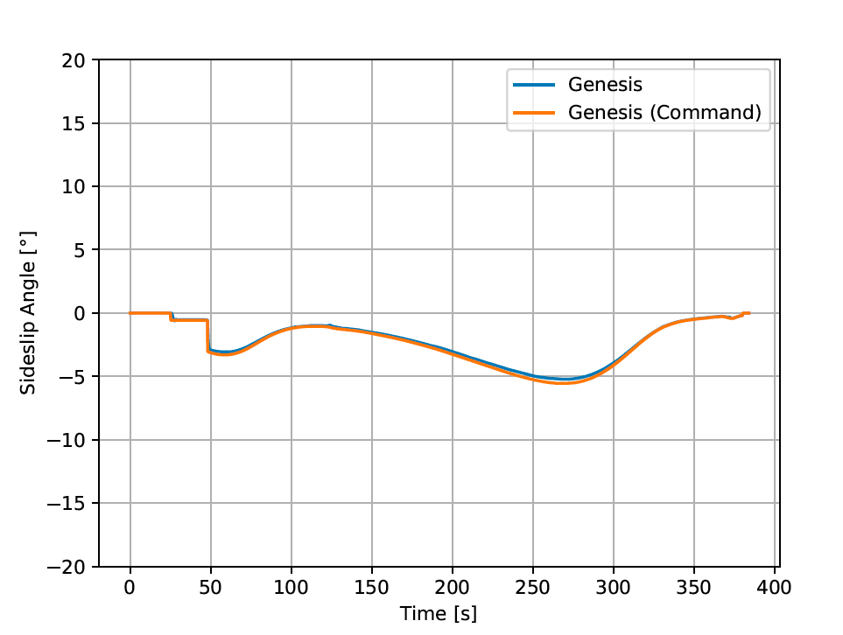
6-DOF Alpha-Beta Results
Updated Guidance Target Velocity (Guidance Shaping)
Guidance target Mach: 2.0 [parachute deployment] → 4.4
Crossrange: 5 m
Downrange: 870 m
Obvious G&C coupling; consider aerodynamic database impacts at Mach 5 crossover

Slide 10
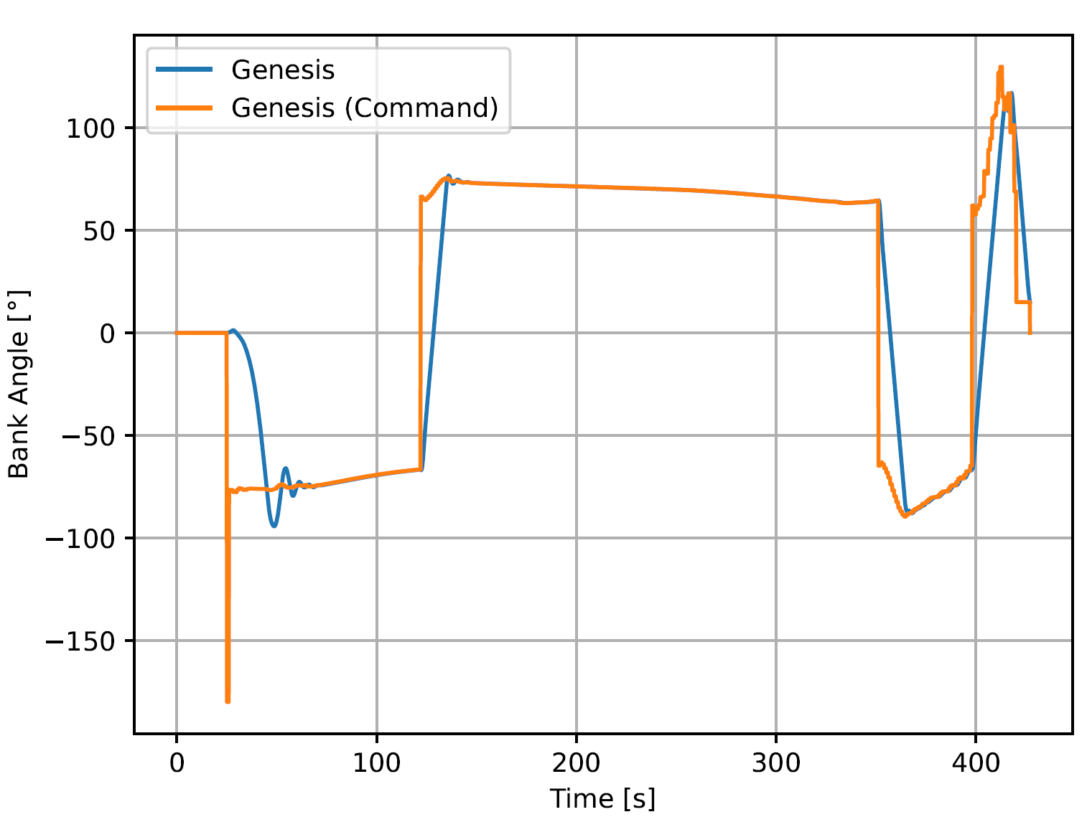
6-DOF yaw-to-bank “Best Performer” Results
Baseline Guidance Targets
Similar tracking observed between different gain matrices
  Less sensitivity compared to alpha-beta
  Impacted by bank angle limiter
  Acceptable miss distance noted even in cases where tracking qualitatively appeared underperforming
Best performance from gain set derived at “low” dynamic pressure (100 Pa)
  Crossrange: -36 m
  Downrange: 91 m
Sensitives and robustness of yaw-to-bank require an in-depth analysis through Monte Carlo simulations
  Trends with inputs were not obvious, inter-dependence on gain’s dynamic pressure and bank error bound
Easier to achieve similar performance (miss distance) to uncoupled 3-DOF compared to alpha-beta controller
Notes:
The yaw-to-bank controller employs novel mechanisms to alter the bank angle command via bank angle limits. Changes to the implementation of this limiter, at values of < 1º

Slide 11
Lessons Learned & Forward Work
Lessons Learned
Methodical investigations ensured correct implementation
  Testing of each model on its own within Genesis with selected capabilities on/off
  Single deflection hold commands to ensure controller behavior is correct
Yaw-to-bank was less sensitive to different gain matrices and showed relative robustness to achieving miss distance despite qualitative tracking behavior
  Aerodatabase is constant with bank angle
  Holds angle of attack constant (trim)
Alpha-beta control required more involved tuning and guidance shaping
Forward Work
For yaw-to-bank, probe robustness and sensitivity with Monte-Carlo simulations
For alpha-beta, investigate possible events that caused tracking degradation near the end of the trajectory
Enable time-dependent (“live”) calculation of gains
  Simple dynamic pressure gain scheduling employed with no obvious benefit
  Results shown use single gain matrix throughout simulation
Notes:
Alpha-beta forward work hypothesis:
Only integrated “cross-coupled” effect (guidance + control)?
Aerodynamics at Mach 5 crossover?
Operating envelope or controllability threshold?
pressure , rather than De-couple reliance on existing Python code base for generating controller gains
Concerns with backwards compatibility and versioning
If instantiated in Genesis code base, allows for

Slide 12
References
Alunni, A. I., D’Souza, S. N., C., B., Okolo, W. A., Nikaido, B. E., Margolis, B. W., Johnson, B. J., Barton, J. D., Lopez, G., Wolfarth, L. S., and Hays, Z. B., “Pterodactyl: Trade Study for an Integrated Control System Design of a Mechanically Deployable Entry Vehicle,” AIAA SciTech 2020 Forum, AIAA, Orlando, FL, 2020.
Okolo, W. A., Margolis, B. W., D’Souza, S. N., Yount, B. C., Barton, J. D., & Johnson, B. J. (2022). Development and Evaluation of Control Architectures for a Mechanically Deployed Entry Vehicle. Journal of Spacecraft and Rockets, 59(4), 1228-1239.
Margolis, B. W., Okolo, W. A., D’Souza, S. N., Johnson, B. J., “Pterodactyl: Guidance and Control of a Symmetric Deployable Entry Vehicle using an Aerodynamic Control System,” AIAA SciTech SciTech 2021 Forum, AIAA, Virtual, 2021.
Johnson, B. J., Rocca-Bejar, D., Lu, P., Nikaido, B. E., Yount, B. C., D’Souza, S. N., and Hays, Z. B., “Pterodactyl: Development and Performance of Guidance Algorithms for a Mechanically Deployed Entry Vehicle,” AIAA SciTech 2020 Forum, AIAA, Orlando, FL, 2020.
Reddish, B. J., Nikaido, B. E., D’Souza, S. N., Hawke, V., and Kang, H., “Pterodactyl: Aerodynamic Modeling for a Symmetric Deployable Earth Entry Vehicle with Flaps,” AIAA SciTech 2021 Forum, AIAA, 2021.
Murri, D. G., Matz, D. A., Hoffman, D. A., Berndt, J. S., Brown, S. C., and Prokop, L. E., “Improvements to the Flight Analysis and Simulation Tool (FAST) and Initial Development of the Genesis Flight Mechanics Simulation for Ascent, Aerocapture, Entry, Descent, and Landing (A2EDL) Trajectory Design,” NASA/TM-20210014622, Apr 2021.
Lu, P., “Verification of a Fully Numerical Entry Guidance Algorithm,” Journal of Guidance, Control, and Dynamics, Vol. 40, No. 2, 2017, pp. 230-247.
D’Souza, S. N., Okolo, W. A., Margolis, W., L., Nikaido, B. E., Yount, B., Johnson, B. J., Aerospace Vehicle Entry Flightpath Control. US 1772828 B2, 2023.

Slide 13
Questions?

Slide 14
Back Up

Slide 15
Vehicle Properties
Parameter | Units | PBV-II | PBV-IIa
Mass | kg | 703.3 | 702.4
Ixx | kg-m² | 651.2 | 693.7
Iyy | kg-m² | 513.4 | 572.2
Izz | kg-m² | 512.9 | 512.0
Ixy = Iyz | kg-m² | 0 | 0
Ixz = Izx | kg-m² | 0 | -35.23
CG measured from nose | [m, m, m] | [-0.458, 0, 0] | [-0.469, 0, -0.079]

Slide 16
Aerodatabase
Angle of attack (𝛼) [deg] | Sideslip angle (𝛽) [deg] | Mach | Flap Deflection [deg]
-20, -15, -10, -5, 0 | 0, 5, 10, 15, 20 | 2, 5, 10, 15, 20, 31, 40 | -45, -20, 0,10, 20, 30

Slide 17
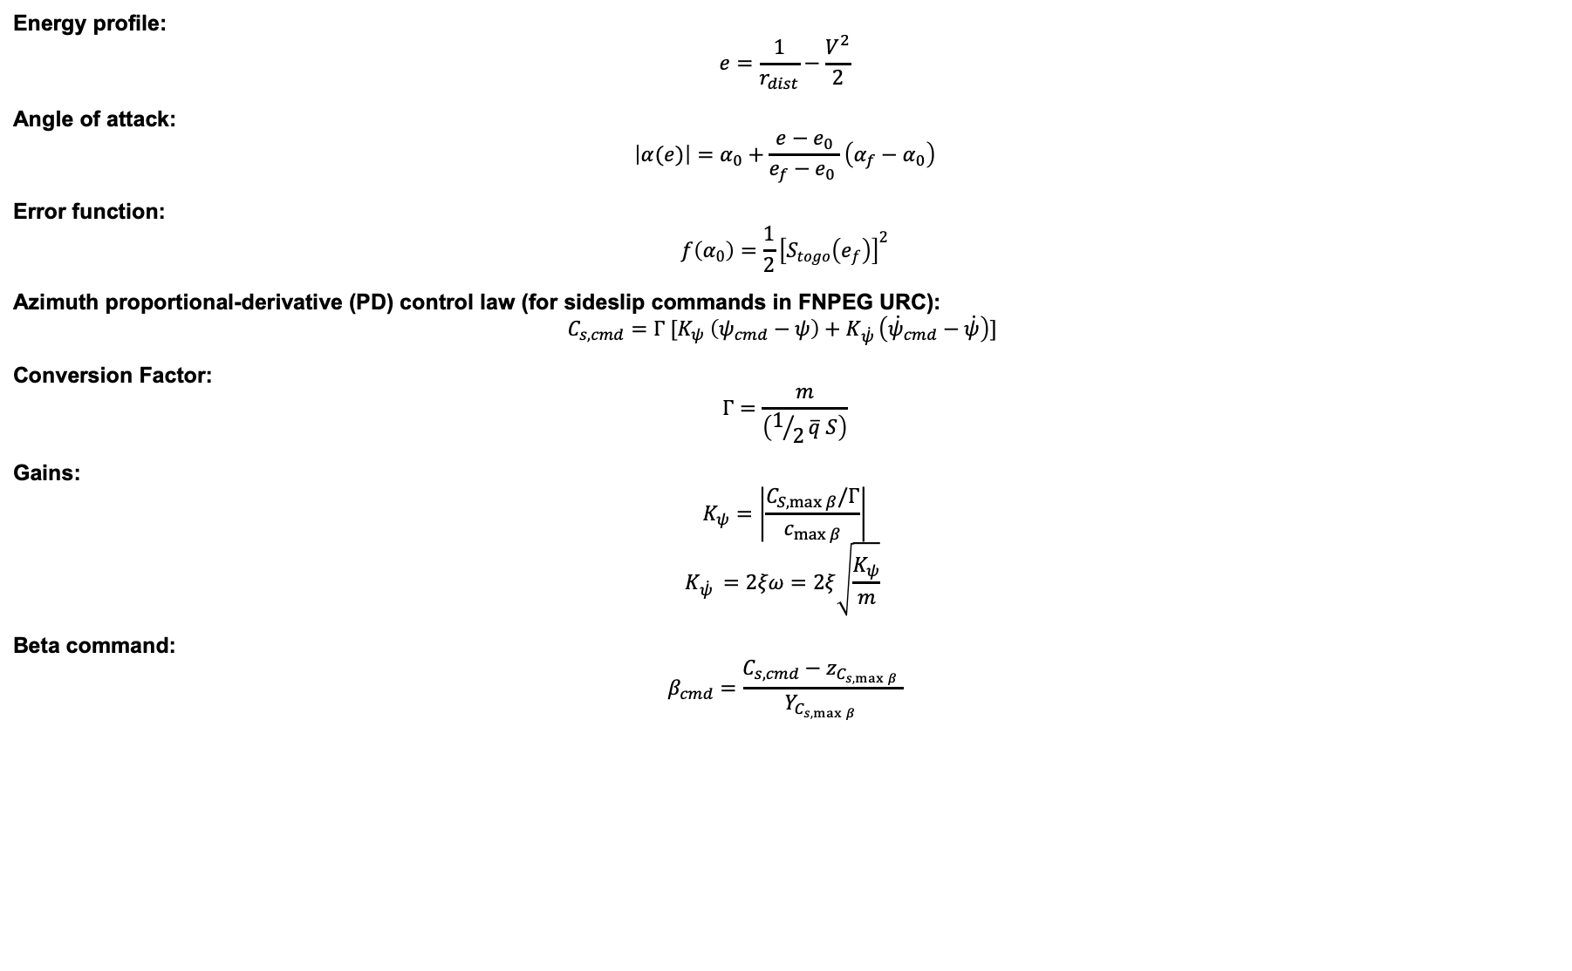
Guidance Algorithm Equations
Energy profile:
$$e=\frac{1}{r_{dist}}−\frac{V^{2}}{2}$$
Angle of attack:
$$\left|α(e)\right|=α_{0}+\frac{e−e_{0}}{e_{f}−e_{0} }\left(α_{f}−α_{0}\right)$$
Error function:
$$f\left(α_{0}\right)=\frac{1}{2}{\left[S_{togo}\left(e_{f}\right)\right]}^{2}$$
Azimuth proportional-derivative (PD) control law (for sideslip commands in FNPEG URC):
$$C_{s,cmd}=Γ [K_{ψ} \left(ψ_{cmd}−ψ\right)+K_{\dot{ψ }}\left({\dot{ψ}}_{cmd}−\dot{ψ}\right)]$$
Conversion Factor:
$$Γ=\frac{m}{\left(1/2\overline{q} S\right)}$$
Gains:
$$K_{ψ}=\left|\frac{C_{S,\max{β}}/Γ}{c_{\max{β}}}\right|$$
$$K_{\dot{ψ }}=2ξω=2ξ\sqrt{\frac{K_{ψ}}{m}}$$
Beta command:
$$β_{cmd}=\frac{C_{s,cmd}−z_{C_{s,\max{β}} }}{Y_{C_{s,\max{β}} }}$$
Notes:
This alpha-magnitude profile, $\left|α(e)\right|$, is parameterized by a linear function of the normalized specific mechanical energy, $e$
FNPEG URC’s, like FNPEG’s, numerical method solves a least-squares problem with a single univariate function to find the $α_{0}$ needed to minimize the error function
$S_{togo}$ defines the great-circle range to the target site. The calculated $α_{0}$ and $e_{0}$ are used to predict the resultant trajectory within each prediction-correction cycle, and if the calculated $α_{0}$ does not meet the terminal constraint on the error of the range to target, then the Gauss-Newton scheme corrects the trajectory by updating $α_{0}$ until the error of the range to target is within limits.
A corresponding procedure is defined for FNPEG guidance with $σ$ instead of $α$.
Yaw-to-bank
where $K_{ψ}$ is the proportional gain on azimuth error, $K_{\dot{ψ }}$is the proportional gain on azimuth rate error, and Γ is the
conversion factor from the side force acceleration to $C_{s}$.
$$Γ=\frac{m}{\left(1/2\overline{q} S\right)}$$
where $\overline{q}$ is the sensed dynamic pressure and S is the aerodynamic reference area of the vehicle. The gains are defined by
$$K_{ψ}=\left|\frac{C_{S,\max{β}}/Γ}{c_{\max{β}}}\right|$$
$$K_{\dot{ψ }}=2ξω=2ξ\sqrt{\frac{K_{ψ}}{m}}$$
where $C_{S,\max{β}}$ is the maximum side force coefficient achievable dependent on the user-input for the vehicle configuration, $c_{\max{β}}$ is a user-input gain to scale with the maximum expected side force, 𝑚 is the estimated vehicle mass, 𝜉 is the desired damping ratio, and 𝜔 is the desired augmented frequency. Using the aforementioned expressions, the commanded sideslip angle is determined by
$$β_{cmd}=\frac{C_{s,cmd}−z_{C_{s,\max{β}} }}{Y_{C_{s,\max{β}} }}$$

Slide 18
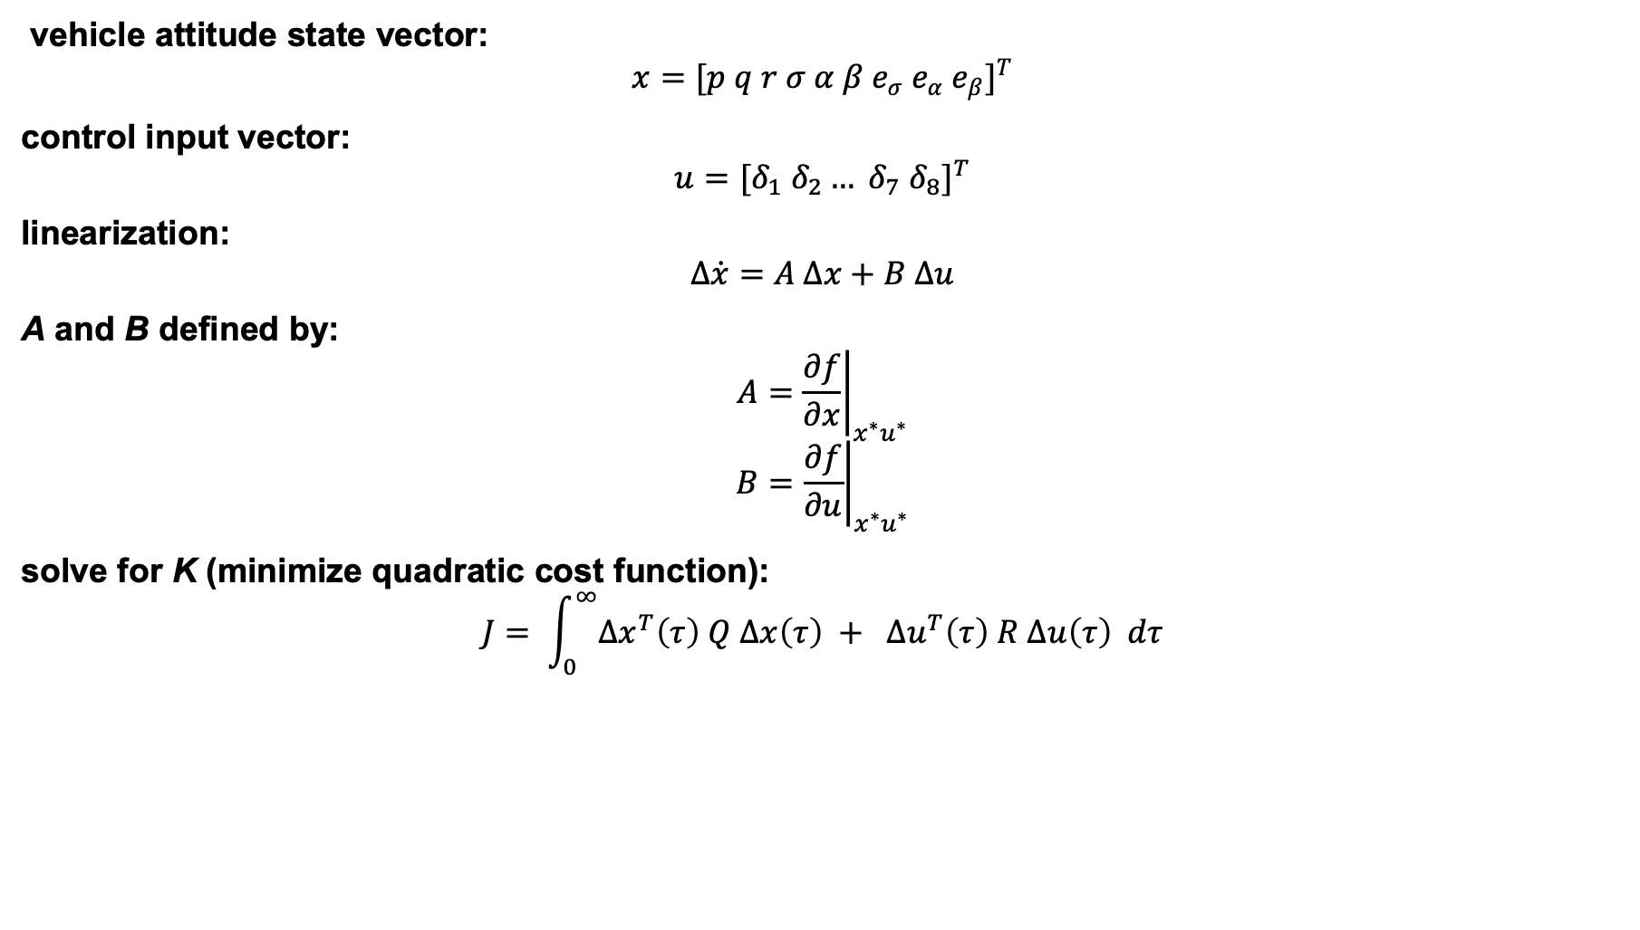
Control Algorithm Equations
vehicle attitude state vector:
$$x={[p q r σ α β e_{σ} e_{α} e_{β}]}^{T}$$
control input vector:
$$u={[δ_{1} δ_{2}… δ_{7} δ_{8}]}^{T}$$
linearization:
$$∆\dot{x}=A ∆x+B ∆u$$
A and B defined by:
$$A={\left.\frac{∂f}{∂x}\right|}_{x^{∗}u^{∗}}$$
$$B={\left.\frac{∂f}{∂u}\right|}_{x^{∗}u^{∗}}$$
solve for K (minimize quadratic cost function):
$$J= \int_{0}^{∞}{Δx^{T}\left(τ\right) Q Δx\left(τ\right) + Δu^{T}\left(τ\right) R Δu\left(τ\right) dτ}$$
Notes:
$f(x,u)$ is the vector-valued function of the derivatives for each state variable concatenated together
state matrix, $A$, and the input matrix, $B$
Algebraic Riccati Equation or Linear Matrix Inequality depending on the case

Slide 19
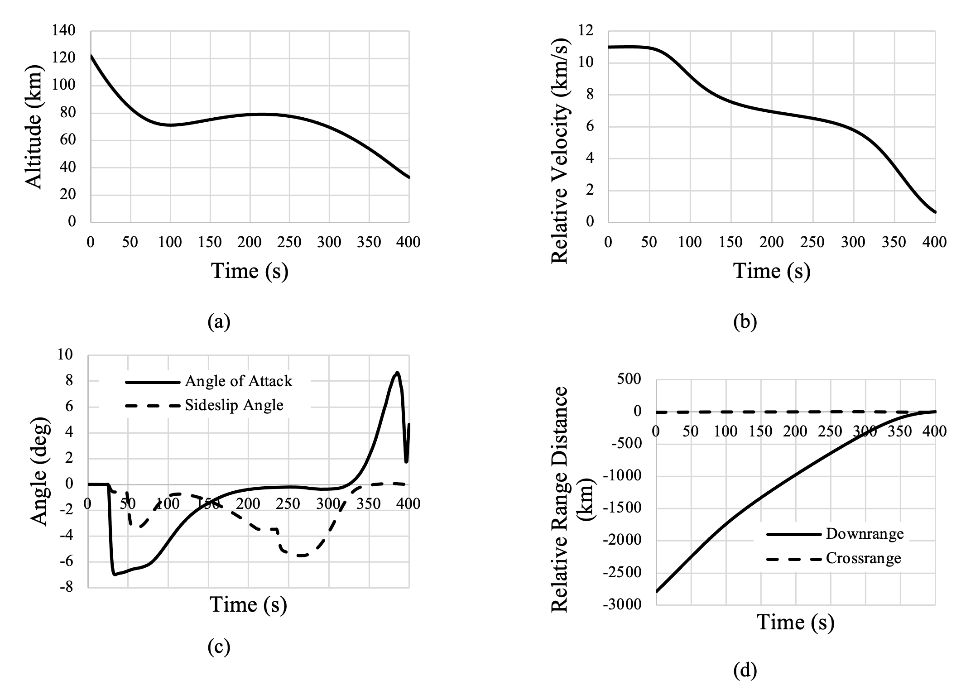
FNPEG URC Alpha-Beta 3-DOF Results

Slide 20
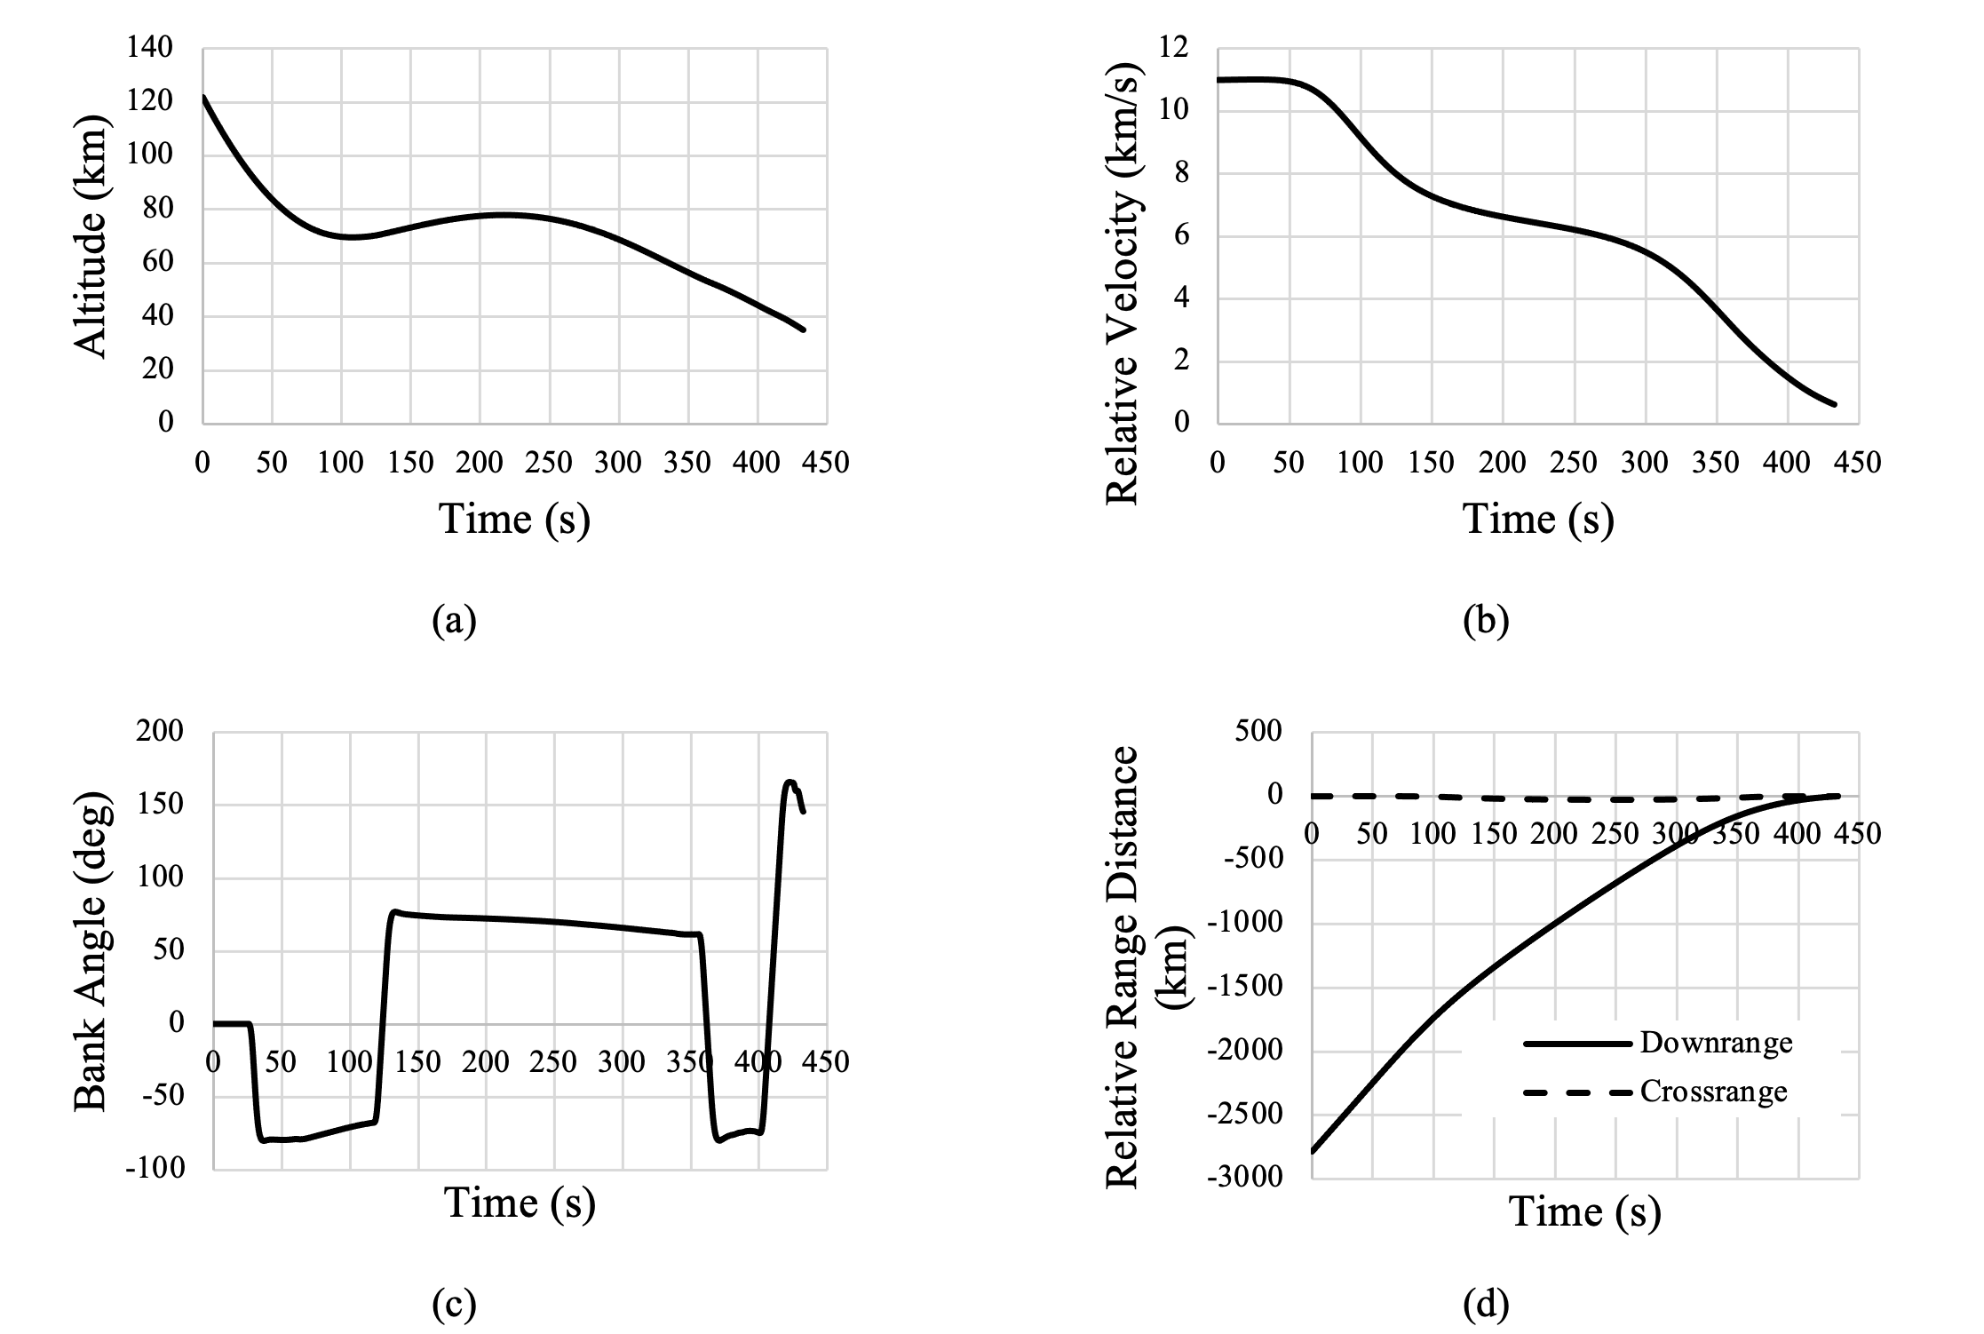
FNPEG Yaw-to-Bank 3-DOF Results

Slide 21
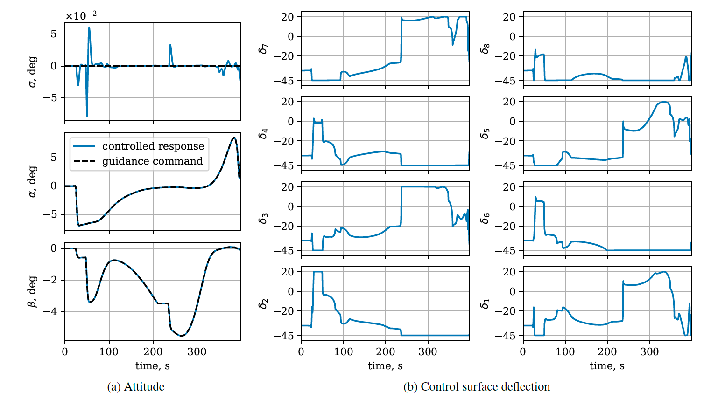
3-DOF Control Results for alpha-beta

Slide 22
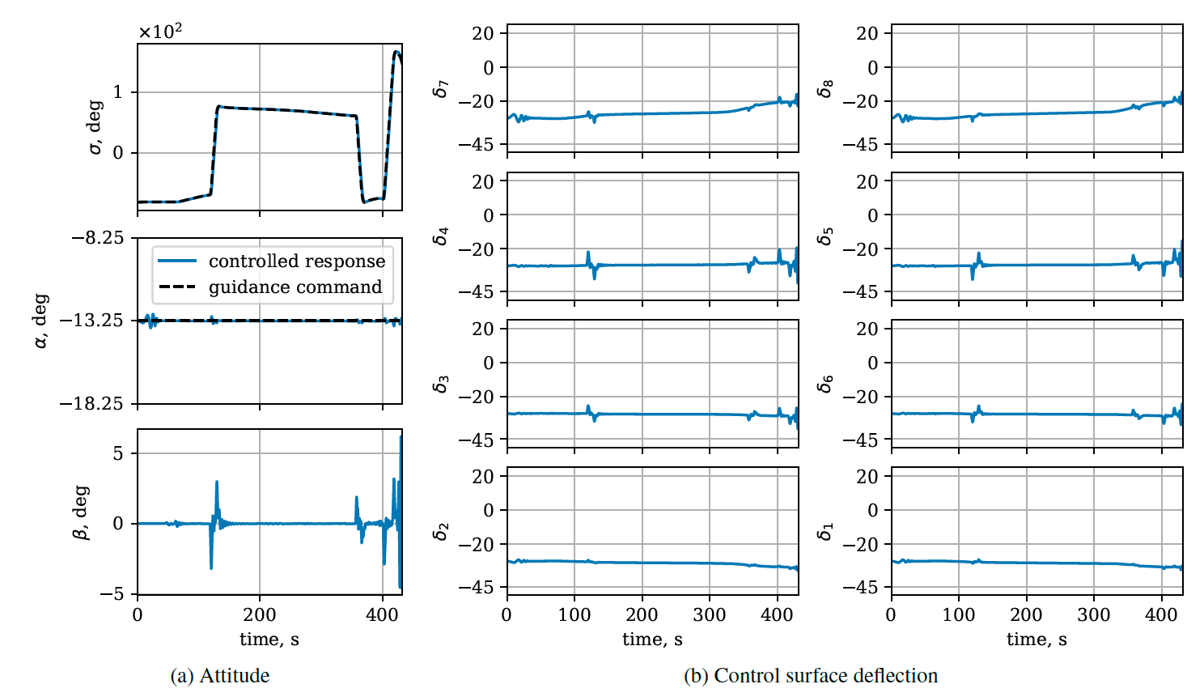
3-DOF Control Results for Bank Angle

Slide 23
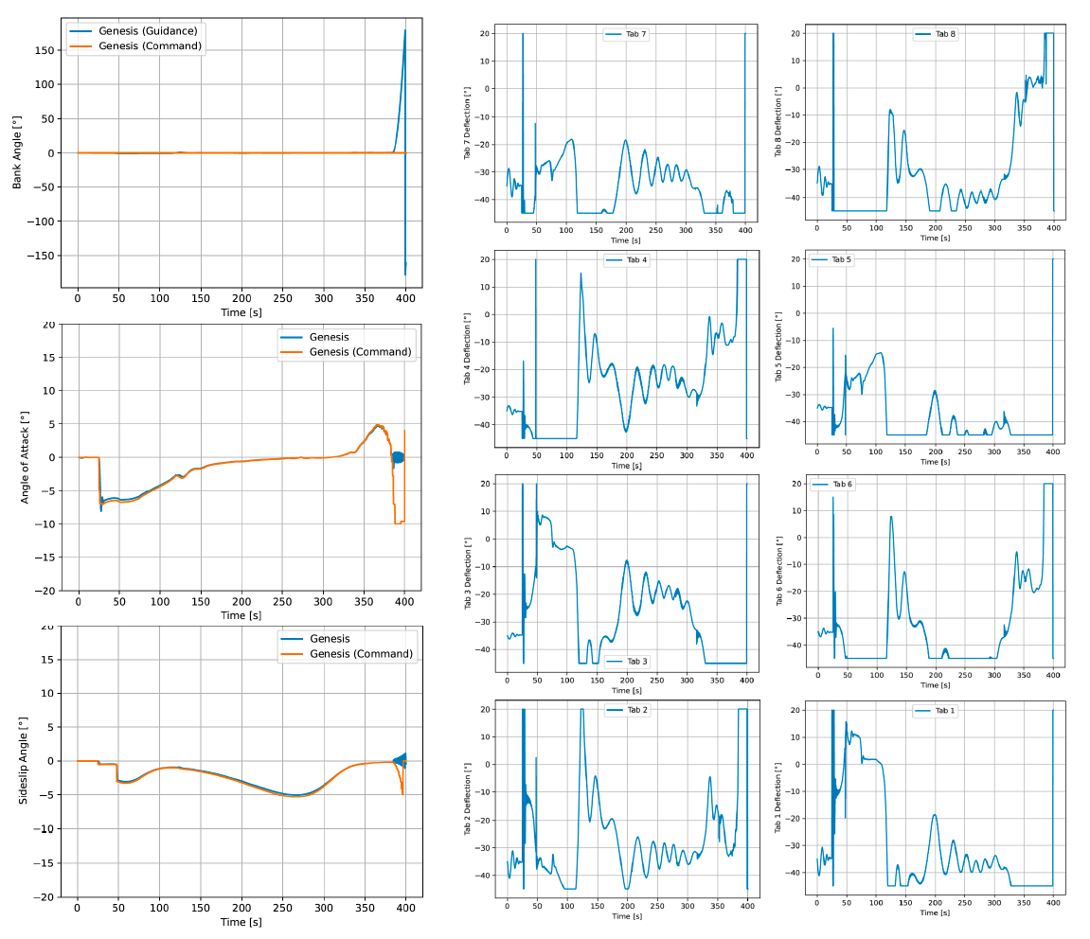
Wind Angles and Flap Deflection Responses for Baseline Target Values (Target Final: Mach 2.1)
Baseline Guidance

Slide 24
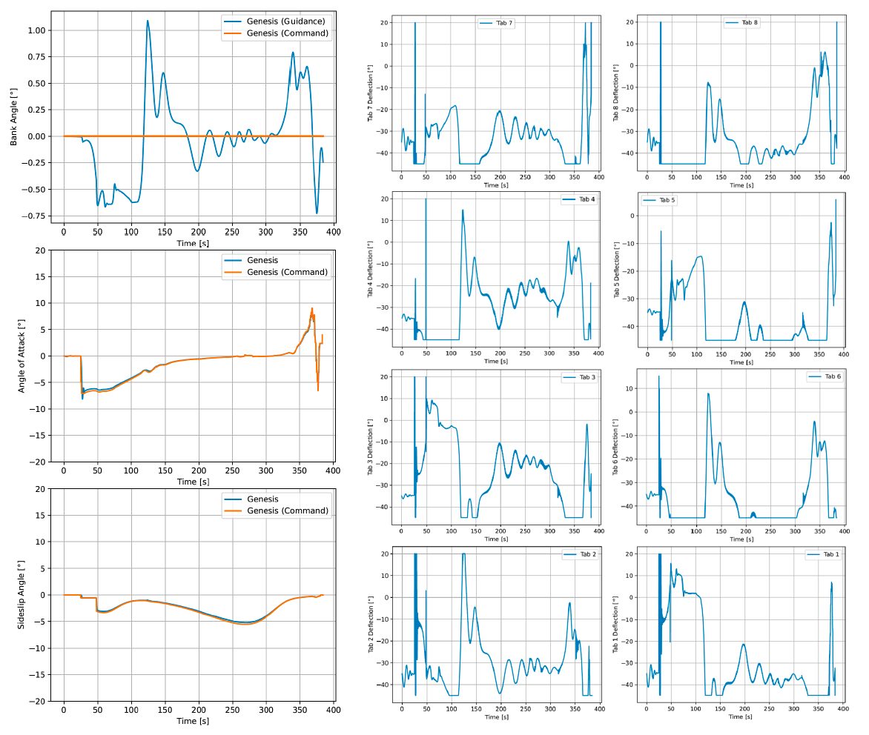
Wind Angles and Flap Deflection Responses for Changed Target Values (Target Final: Mach 4.4)
Updated Guidance

Slide 25
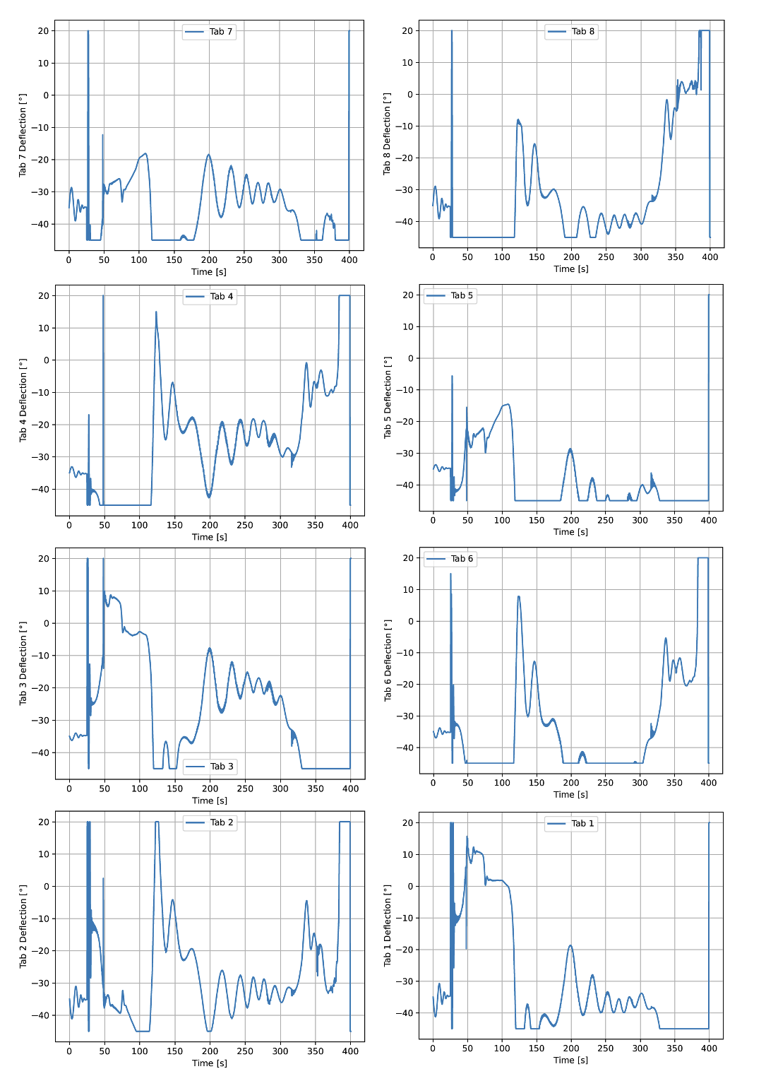
Alpha-Beta Flaps Comparison
3-DOF vs. 6-DOF Baseline Guidance Targets

Slide 26
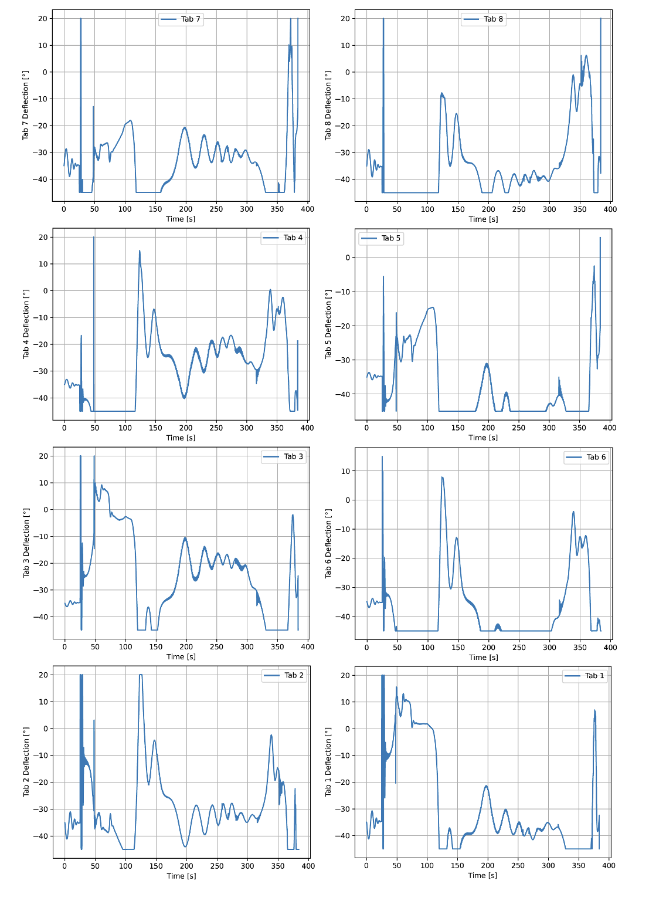
Alpha-Beta Flaps Comparison
3-DOF vs. 6-DOF Updated Guidance Target Velocity (Guidance Shaping)

Slide 27
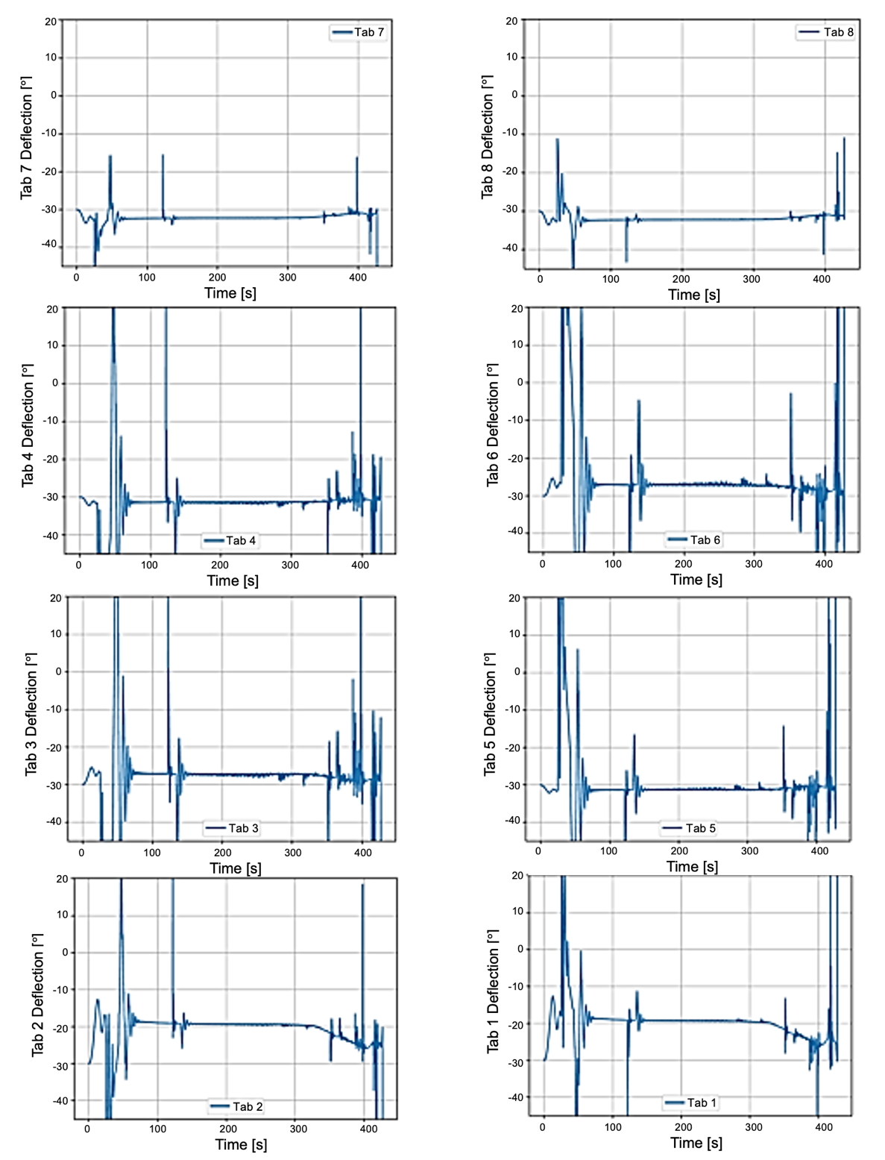
Tab Deflection Response for Yaw-to-Bank with 100 Pa Dynamic Pressure Controller Case
Genesis
Genesis (Command)

