Slide 2

Systems Engineering Processes and Methods:
AIAA SCITECH 2025
Tracing NASA Contributions Toward Aviation Safety Stakeholder Guidance
Darisha Vidrine, MS, Samantha Infeld, PhD, Doug Agyemang, Michael Vincent, Kyle Ellis, PhD, Summer Brandt, PhD, Wendy Okolo, PhD
National Aeronautics and Space Administration
Notes:
Hello Everyone, Thank you for joining today to hear our presentation on Tracing NASA Contributions Toward Aviation Safety Stakeholder Guidance.
My name is Darisha Vidrine. I am a graduate student of Embry-Riddle Aeronautical University pursing a Master of Science in Systems Engineering. I am also a volunteer Safety Team Representative of the Federal Aviation Administration.
Over the past year, I had the opportunity to work with the NASA System Wide Safety Team and contribute toward the research and development of autonomous capabilities of the In-time Aviation Safety Management System. To my (right/left) are my colleagues Dr. Samantha Infeld and Douglas Agyemang. Dr. Infeld will share “….” And Doug will share his experience on the Verification and Validation processes.

Slide 3
NASA’s System-Wide Safety Project

Slide 4

NASA’s System-Wide Safety Project
Need for integrated safety management of emerging aviation operations
In-Time Aviation Safety Management System (IASMS)
Notes:
NASA’s System-Wide Safety (SWS) project was created in response to the aviation industry’s need for more proactive, predictive, and integrated safety management as more diverse, dense, and automated aerial operations emerge in our shared airspace.

Slide 5
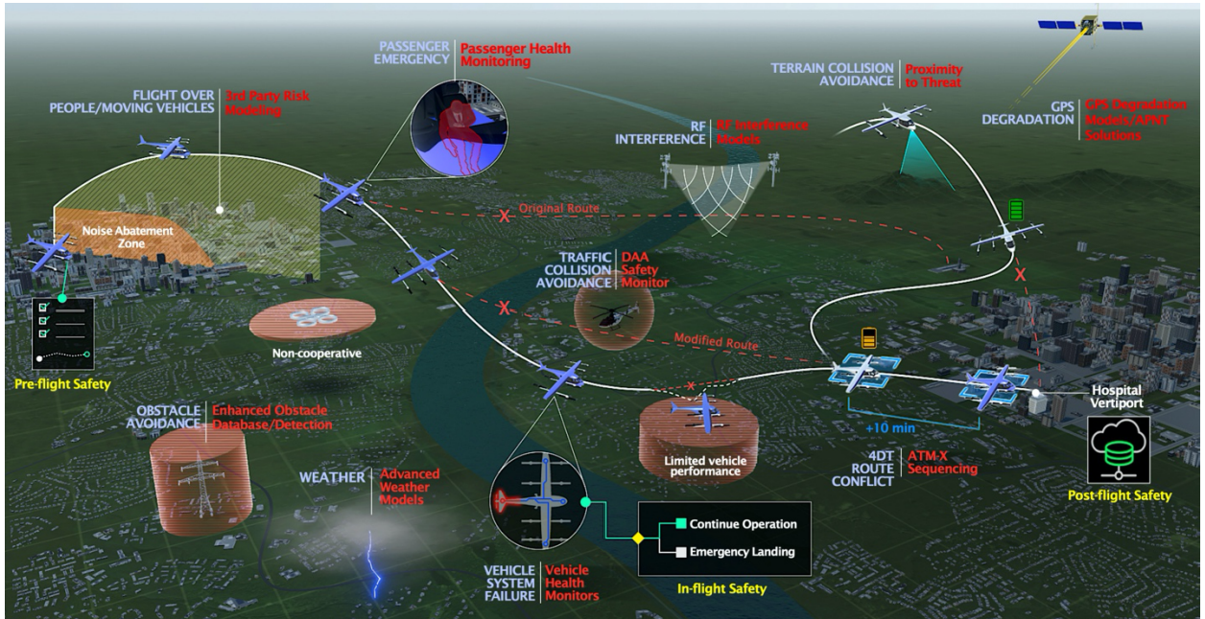
SWS Goals
Developing and maturing
IASMS Services, Functions, and Capabilities (SFCs)
Validated assurance methods
Functional requirements for IASMS applications
Notes:
The System Wide Safety goal is to create a system that can anticipate potential safety issues before they occur, allowing for timely interventions by:
Developing and maturing IASMS Services, Functions, and Capabilities (SFCs) for traditional commercial aviation and the merging of new Advanced Air Mobility operations into the existing infrastructure,
Developing and maturing validated assurance methods to inform certification paths for autonomous functions,
And developing functional requirements for IASMS applications addressing varying risk levels and complexity.
This approach not only enhances safety but also improves efficiency and reliability in aviation operations.

Slide 6
SWS Sub-Project Teams
The SWS project addresses these goals through sub-project teams that focus on:
The research and testing of software to implement IASMS capabilities and assurance of autonomous functions for traditional and emerging operations
The testing and evaluation of integrated IASMS services, functions, and capabilities.
Developing the overarching concept of operations and architecture that clearly address stakeholder needs
Notes:
The SWS Project addresses these goals through sub-project teams that focus on the research and testing of software to implement IASMS capabilities and assurance of autonomous functions for traditional and emerging operations. The testing and evaluation of integrated IASMS Services, Functions and Capabilities, and developing the overarching concept of operations and architecture that clearly address stakeholder needs.

Slide 7
System Design Process
Notes:
As a research and technology project, System-Wide Safety is working in the early “System Design Process” of Concept and Technology Development”, or “Phase A”,

Slide 8
System Design Process
Needs, Goals, and Objectives Flow
IASMS System Functions
Decomposing System Functions into Potential Behaviors
Validating architecture through traceability:
FAA Unmanned Aerial System Safety Risk Management Guidance
National Academies Safety Assurance Recommendations
IASMS Research and Autonomy Verification & Validation Roadmaps
Notes:
This process starts with defining the needs, goals, and objectives of the IASMS acquired from stakeholder input which is used to develop relevant use-case scenarios and the concept of operations.
The NGOs then help to inform the conceptual architecture framework and decompose system functions into potential behaviors.
We then seek stakeholder guidance to validate the architecture with source documents such as the FAA Unmanned Aerial Systems Safety Risk Management Policy Guidance, the National Academies Aviation Safety Assurance recommendations, the NASA and Flight Safety Foundation IASMS Research Roadmaps and the Autonomy Verification and Validation Roadmaps.

Slide 9
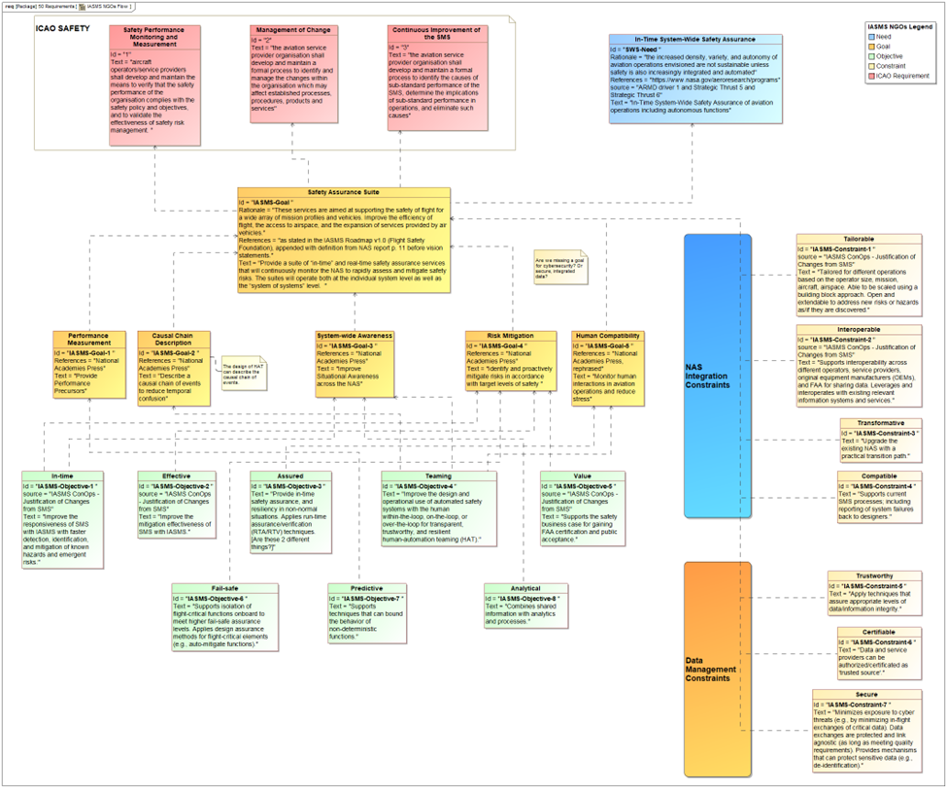
Needs, Goals, & Objectives (NGO)
Notes:
Here is a diagram of the NGO flow capturing need, goals, objectives of stakeholders as well as the National Airspace and Data Management Constraints of the system.

Slide 10
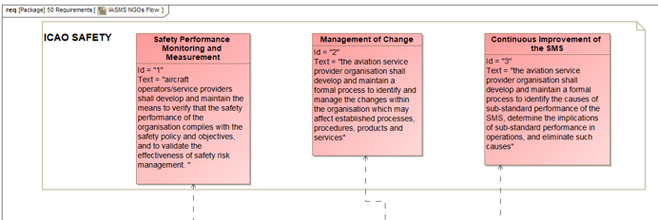
Frame 1: International Civil Aviation Organization
Notes:
In Frame 1 of the diagram the International Civil Aviation Organization Requirements for a safety management system that is expanded to In-Time operations. Safety Performance Monitoring and Measurement, Management of Change, and Continuous Improvement of the Safety Management System.

Slide 11
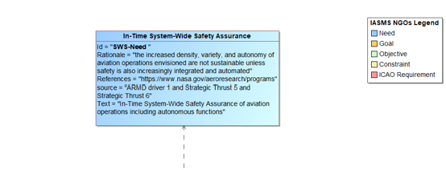
Frame 2: In-Time SWS Assurance
Notes:
In Frame 2: NASAs Aeronautics Research Mission Directorate Strategic Plan states a need for In-Time SWS Assurance

Slide 12
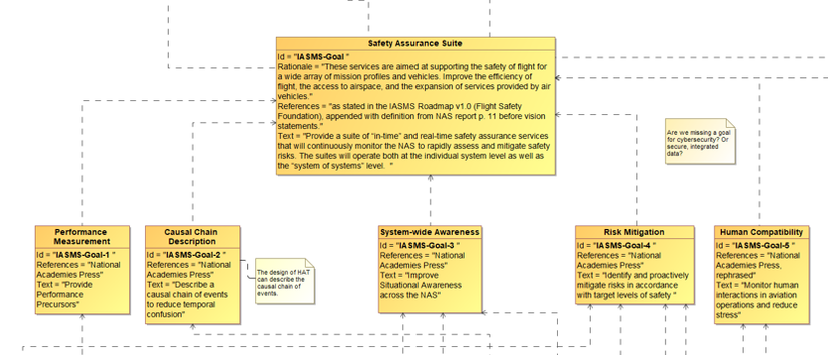
Frame 3: IASMS Goals
Notes:
The goals for a Safety Assurance Suite as described in the IASMS research roadmap traces to the need. There are five sub goals here that capture recommendations from the National Academies report.

Slide 13
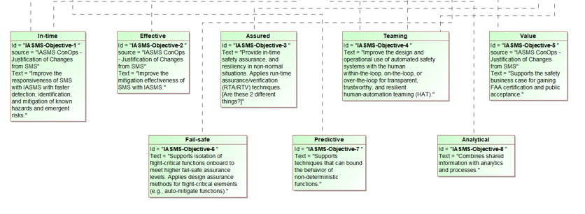
Frame 4: IASMS Objectives
Notes:
Here we trace the connections to the eight objectives of a system that operates in-time, effectively, assured, fail-safe, predictive, analytical, and demonstrates human-autonomy teaming and value. It is a continuing process to clarify the objectives that do not trace to one of the functional IASMS goals but may be put in the context of a constraint.

Slide 14
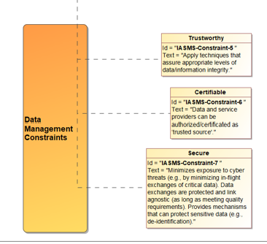
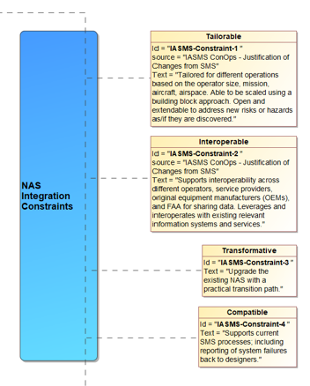
Frame 5: Constraints
Notes:
Here we show the Data Management and National Airspace System Integration constraints that flow from the Safety Assurance Suite goal.

Slide 15
Conceptual Architecture
Notes:
From the NGO flow we are able to model the IASMS functional architecture.

Slide 16
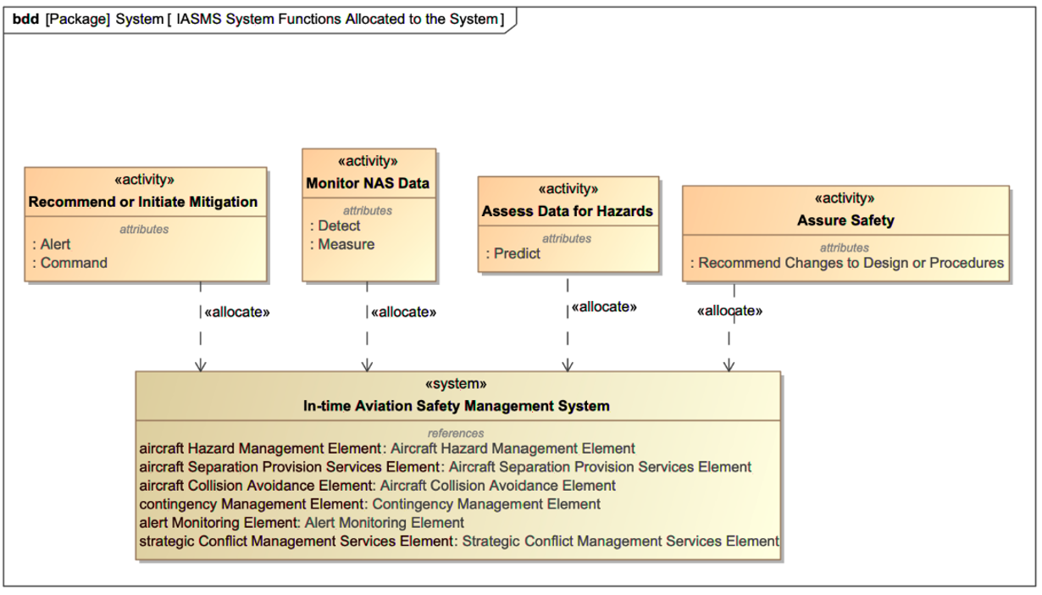
IASMS Functions Allocated to System
Notes:
The block definition diagram pictured here shows the IASMS architecture envisioned as the system performing the system behaviors of “mitigate”, “monitor”, “assess”, and “assure” as activities allocated by the system.
Note to self (not to be read aloud):
Purpose: A BDD is used in systems engineering to represent the system’s structure. It shows the components (blocks) of a system and their relationships.
Elements: It typically includes blocks (representing physical or logical components), their properties, and relationships (such as associations, dependencies, and generalizations).
Focus: The BDD focuses on the static structure of the system, providing a blueprint of the system’s architecture.

Slide 17
Conceptual Architecture
Organized by hazard type they may manage
The SFCs hosted and accessed by any agent will depend on the operation, operator, or autonomy involved
Composed of sets of services and functions (SFCs) and data interfaces for the inputs and outputs of those services
Notes:
Within the conceptual architecture, capabilities are organized by hazard type they may manage. The potential IASMS behaviors are composed of sets of services and functions (SFCs) and data interfaces for the inputs and outputs of those services and functions hosted across agents, depending upon the details of the aviation operation in which they will be implemented.

Slide 18
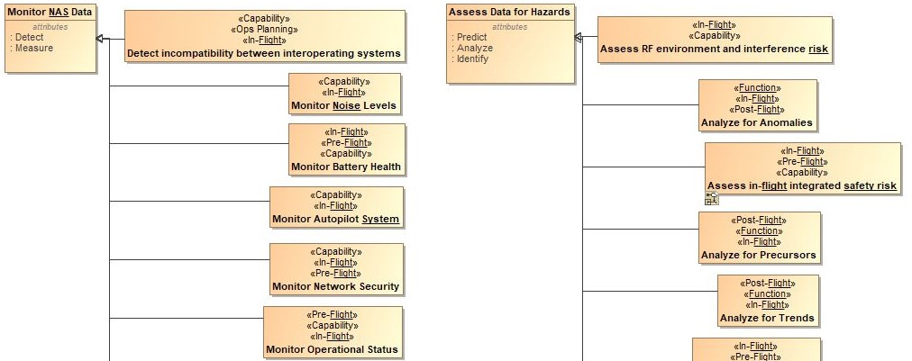
IASMS Functions with Potential Behaviors
Notes:
The IASMS system functions are specialized to behaviors. This is one perspective on how we can categorize the range of potential IASMS behaviors or general capabilities to respond to different hazards. to specific aviation operations of pre-flight, in-flight, and post-flight.
Note to self (not to be read aloud):
Purpose: A Functional Model is used to describe the functions or behaviors of a system. It represents what the system does rather than how it is structured.
Elements: It includes functions, inputs, outputs, and the flow of data or control between functions. Focus: The Functional Model focuses on dynamic behavior and the logical flow of operations within the system.

Slide 19
Descriptive Modeling of Roadmaps and Agency Guidance

Slide 20
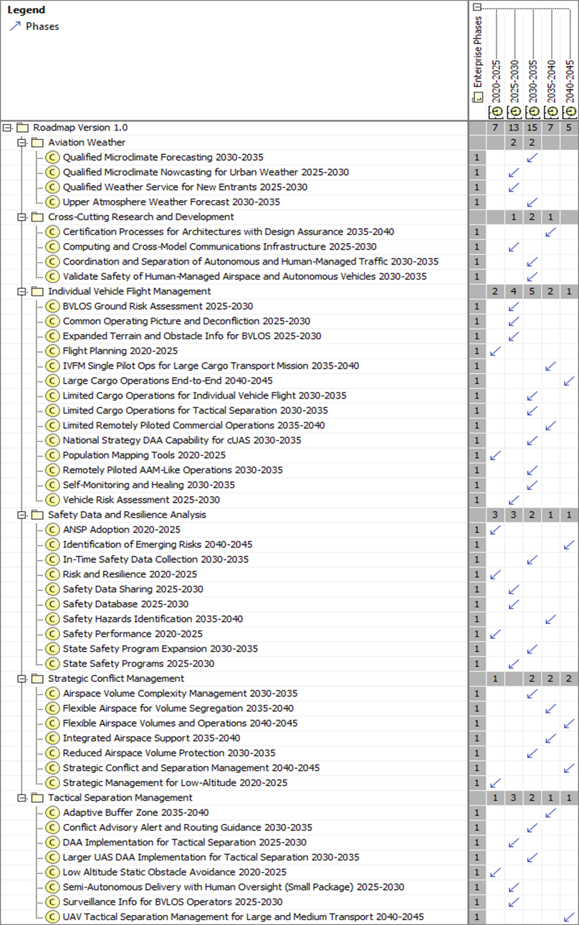
IASMS Research Roadmap in Strategic Model
Notes:
The In-Time Aviation Safety Management System research roadmap is divided into six major sections (or swim lanes) capturing various research areas also known as the functional requirements of Safety Data and Resilience Analysis, Strategic Conflict Management, Tactical Separation Management, Tactical Separation Management, Aviation Weather, and Cross-Cutting Research and Development. Each section captures a set of capabilities or activities anticipated to be available within a given time frame between now and 2045. By modeling the capabilities outlined in the roadmap, we can highlight NASA's System-Wide Safety project research activities, which will support the aviation industry in developing each capability.

Slide 21
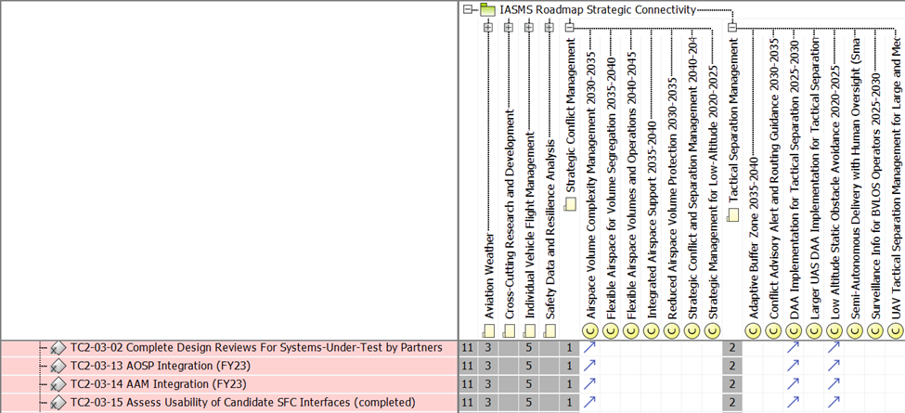
IASMS Research Roadmap Traceability
Notes:
During the IASMS Research Roadmap Traceability task, the project highlighted the limited transparency in defining progress solely through milestones that grouped capabilities or objectives without specifying them in the milestone or activity definitions. As shown in the matrix, SFCs tested and integrated within Technical Challenge 2 (TC2) included functionalities for managing airspace, detect-and-avoid separation, and obstacle avoidance in an urban scenario with small UAS. This process confirmed that each technical challenge conducts research addressing multiple essential capabilities across the aviation industry. This insight was valuable for project management and systems engineering, however, it also posed a challenge for direct tracing from the project to the roadmap.
As a result, we decided to create a milestone attribute for traceability to an appropriate roadmap or project objective for future milestone approval procedures. Additionally, we established a potential close-out activity for current subprojects to trace tasks or groups of tasks completed to the capabilities defined in research roadmaps, allowing them to display subproject impacts formally without using milestones as the alignment objects.

Slide 22
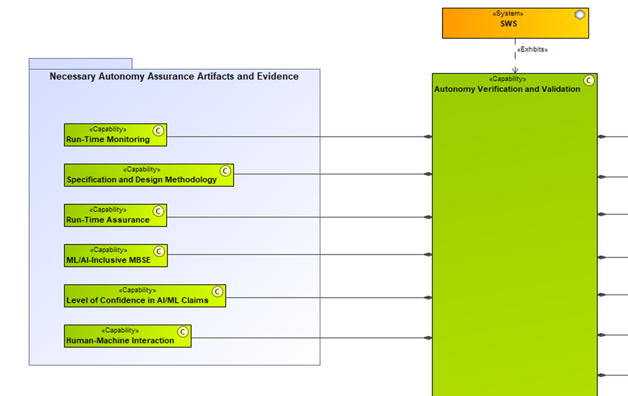
Autonomy V&V: Support Capabilities
Notes:
The Autonomy Verification and Validation Roadmap and Vision 2045 is built on six key areas: autonomy use cases, verification techniques, human-autonomy interaction, runtime techniques, new applications, and autonomy software certification. With the help of the Technical Challenge 4 (TC4) manager, we refined these into four research categories for better tracking: autonomy use cases, new autonomy areas in aviation, AI technology gaps needing V&V techniques, and certification paths for autonomous technology. Each category includes advanced capabilities from the roadmap, modeled as UAF "Capabilities" and shown through the SWS project, not IASMS. Using MBSE to track SWS milestones to these capabilities aids in project planning and communication with stakeholders.

Slide 23
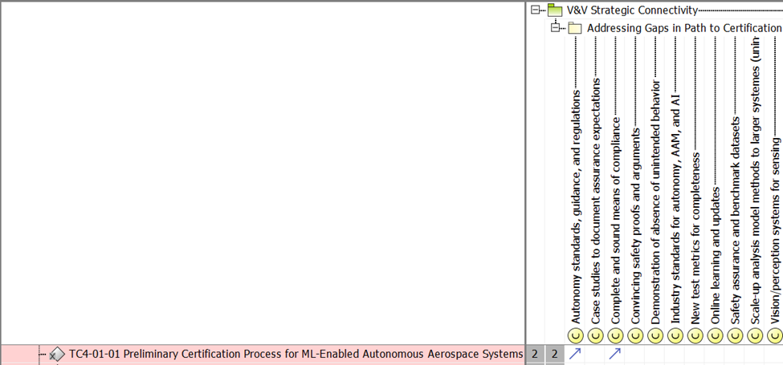
Autonomy V&V: Roadmap Traceability
Notes:
With the Autonomy V&V Roadmap Traceability, The Technical Challenge 4 results were integrated into milestone reporting, addressing certification gaps for machine-learning components. Current and planned activities will trace these capabilities to ensure clear project impact by early 2025.

Slide 24
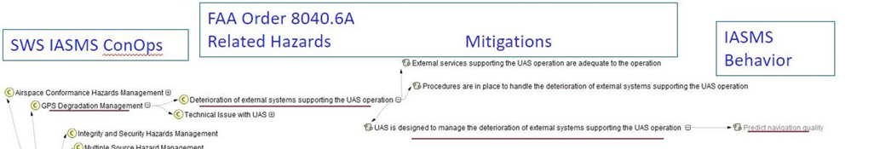
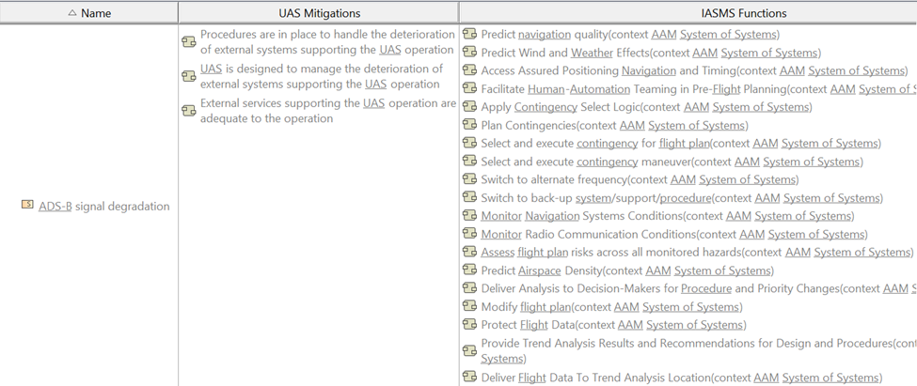
FAA Order 8040.6A UAS SRM Policy Guidance
Appendix B Relation Map
Notes:
The relation map diagram was created with Appendix B UAS hazards, mitigations, and outcomes contained in FAA Order 8040.6A listing hazards for uncrewed aerial systems, mitigations in the form of infrastructure, training, procedures, and automated safety functions.
The project aligns with FAA Safety Risk Management Policy by mapping IASMS Hazard Management Strategic Capabilities to the hazards in the FAA table through descriptive modeling. It also traces the automated safety function mitigations in the FAA table to the IASMS behaviors that incorporate these functions

Slide 25
NASA-FAA Advanced Air Mobility Research Transition Team

Slide 26
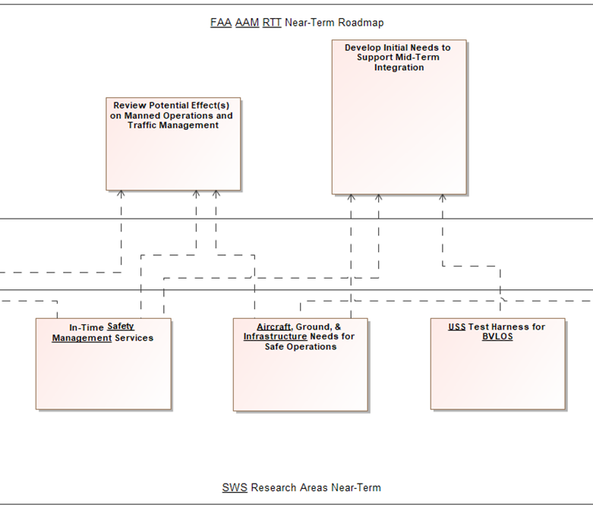
FAA AAM Research Transition Team
Notes:
The FAA's roadmap outlines goals for Advanced Air Mobility (AAM).
The System-Wide Safety (SWS) project, part of the joint NASA and FAA Research Transition Team for AAM, intends to align its subproject tasks and research areas with these goals. By creating formal traces here from SWS research areas to AAM goals, the project aids team communication and establishes a traceability flow from the AAM mission to research products and IASMS architecture elements that support these goals.

Slide 27
Conclusion

Slide 28
In Conclusion
Traceability methods were implemented to link the research work and system architecture elements developed at NASA with community-created roadmaps and FAA aviation guidance.
The process encountered challenges because project milestones did not decompose problem-solving along the same dimensions as the roadmaps.
Despite these obstacles, the traceability activities prompted a reassessment of project activity planning.
The traces established in the SysML model of the IASMS facilitate the recording and presentation of traceability information in various visual formats.
This visualization was instrumental in demonstrating the project's impact and its alignment with societal needs to NASA management and our industry and organizational partners.
Notes:
This progression shows that while there were challenges, the traceability methods and data visualization were essential steps that led to a reassessment of planning to better align with the intended goals.

Slide 29
Acknowledgements
The SWS ConOps team developed the vision for the IASMS concept of operations, including the statements used as IASMS objectives. This includes especially Kyle Ellis, Lance Prinzel, Paul Krois, Jim Ackerson, Michael Vincent, Misty Davies, Nikunj Oza, Robert Mah, Chad Stephens, Wendy Okolo, and Joe Coughlan.
The main authors of the IASMS Roadmap developed in coordination with the System-Wide Safety project at NASA, include Flight Safety Foundation Contributors Deborah Kirkman, Jan de Regt, Kaleb Gould, Debra Moch-Mooney, and Jessie Mooberry.
The authors of the Autonomy Verification and Validation Roadmap include SWS team member Guillaume Brat, who assisted in developing the framework of autonomy V&V capabilities and areas relevant to use for SWS research and IASMS architecture validation.
SFCs developed and tested by NASA are described in multiple publications by the research group under SWS team member Steve Young, including most recently a Technical Memo describing the software and test results. Steve contributed to the functional architecture with his foundational knowledge of the IASMS concept, consulting on generalizations of SWS software to capabilities terms, and approving additions to the needed IASMS behaviors identified by the systems engineering team.

Slide 30
References
[1] National Academies of Sciences, Engineering, and Medicine. 2018. In-time Aviation Safety Management: Challenges and Research for an Evolving Aviation System. Washington, DC: The National Academies Press. https://doi.org/10.17226/24962
[2] Ellis, K., Krois, P., Koelling, J., Prinzel, L., Davies, M., Mah, R., and Infeld, S. 2021. Defining Services, Functions, and Capabilities for an Advanced Air Mobility (AAM) In-time Aviation Safety Management System (IASMS). 2021 AIAA Aviation. https://doi.org/10.2514/6.2021-2396
[3] Section 2.2 An Overview of the SE Engine by Project Phase, NASA Systems Engineering Handbook, February 6, 2019. https://www.nasa.gov/reference/systems-engineering-handbook/
[4] International Civil Aviation Organization, “Safety Management Manual,” ICAO Doc 9859, Fourth Edition, 2018. https://www.icao.int/safety/safetymanagement/pages/guidancematerial.aspx
[5] National Aeronautics and Space Administration, “NASA Aeronautics Strategic Implementation Plan,” 2023. https://www.nasa.gov/directorates/armd/armd-strategic-implementation-plan/
[6] Flight Safety Foundation, “IASMS Research Roadmap Version 1 2025-2045”. 2023. Under NASA Grant 80NSSC21M0187.
[7]Section 4.1 Stakeholder Expectations Definition, NASA Systems Engineering Handbook, February 6, 2019. https://www.nasa.gov/reference/systems-engineering-handbook/

Slide 31
References
[8] Ellis, K., Krois, P., Koelling, J., Prinzel, L., Davies, M., & Mah, R. 2021. A Concept of Operations and Design Considerations for an In-time Aviation Safety Management System (IASMS) for Advanced Air Mobility (AAM). 2021 AIAA Sci Tech Virtual Event. Reston, VA: AIAA.
[9] International Council on Systems Engineering (INCOSE). 2023. Model-based systems engineering (MBSE). Guide to the Systems Engineering Body of Knowledge (SEBoK). https://sebokwiki.org/wiki/Model-Based_Systems_Engineering_(MBSE)
[10] The Object Management Group (OMG). 2023. Unified Architecture Framework. Object Management Group. https://www.omg.org/uaf/index.htm
[11] Brat, G., Yu, H., Atkins, E., Sharma, P., Cofer, D., Durling, M., Meng, B., Alexander, C., Borgyos, S., Fan, C., Garg, K., Topcu, U., and Bakirtzis, G., “Autonomy Verification & Validation Roadmap and Vision 2045,” NASA/TM-20230003734, 2023. https://ntrs.nasa.gov/citations/20230003734.
[12] Federal Aviation Administration Order 8040.6A, “Unmanned Aircraft Systems Safety Risk Management Policy”, 2023. https://www.faa.gov/regulations_policies/orders_notices/index.cfm/go/document.information/documentID/1042092

Slide 32

Tracing NASA Contributions Toward Aviation Safety Stakeholder Guidance
Copyright © [Darisha Vidrine/National Aeronautics and Space Administration]. Published by the American Institute of Aeronautics and Astronautics, Inc. with permission.

