Slide 1
Gas Phase Effects on Slosh Dynamics
2025 AIAA SciTech Forum
January 6, 2025
Jacob M. Brodnick – NASA, Fluid Dynamics Branch (MSFC-ER42)
Marco D. Sansone – ASED, Fluid Dynamics Branch (MSFC-ER42)
Hong Q. Yang – ASED, Fluid Dynamics Branch (MSFC-ER42)

Slide 2
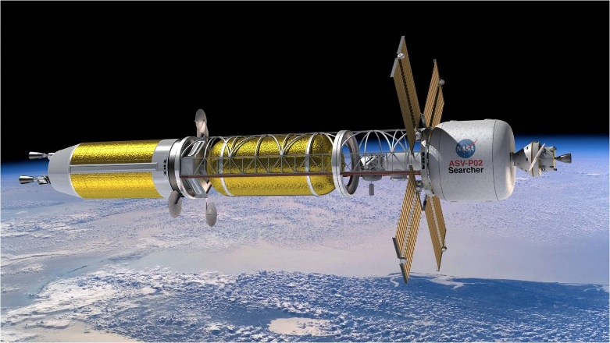
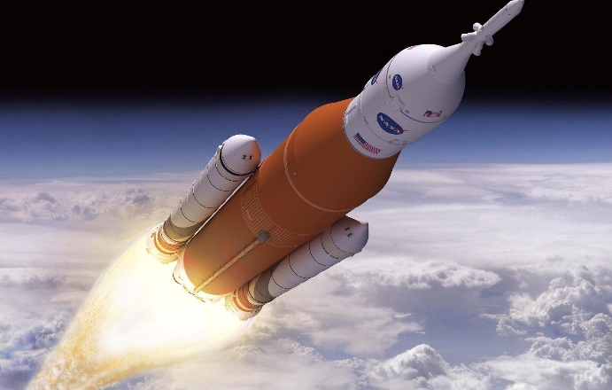
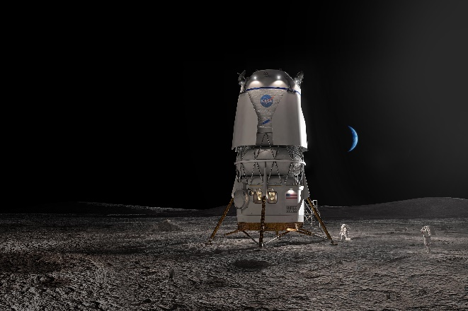
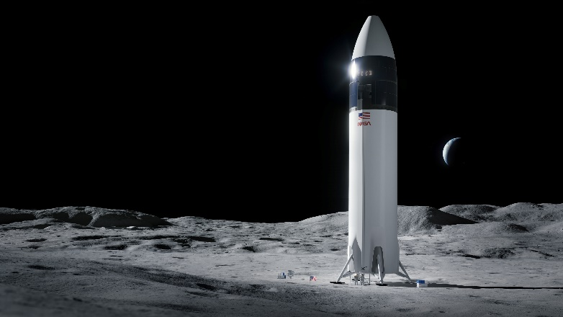
Executive Summary
Gas phase effects on slosh dynamics were quantified using computational fluid dynamics (CFD) simulation for a range of liquid-to-gas density ratios.
Historical slosh modeling using potential flow solutions typically neglects gas phase effects.
Regardless, the results have been shown to compare well with slosh ground tests typically performed with water and air at standard temperature and pressure.
CFD analysis reveals that as the density ratio decreases, slosh dynamics change due to the relative increase in gas inertia and thus influence on liquid motion.
The result is a profound impact on slosh dynamics over certain parameter spaces particularly for liquid hydrogen.
Gas phase effects on slosh dynamics should be considered in slosh models especially for liquid hydrogen propellant tanks.
Nuclear Thermal Propulsion Concept – NASA
Space Launch System – NASA
Blue Moon Concept – Blue Origin
Starship Concept – SpaceX

Slide 3
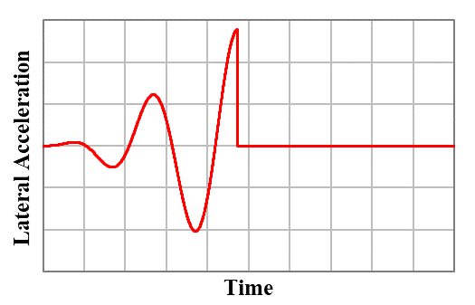

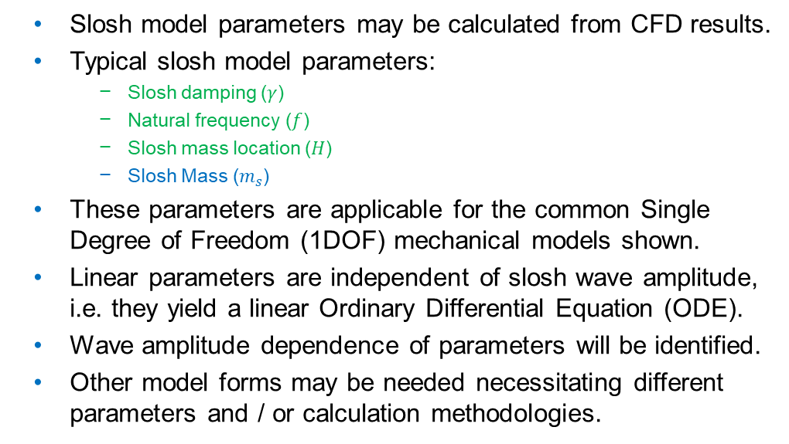

Slosh Model & Parameter Calculations
Slosh model parameters may be calculated from CFD results.
Typical slosh model parameters:
Slosh damping ($γ$)
Natural frequency ($f$)
Slosh mass location ($H$)
Slosh Mass ($m_{s}$)
These parameters are applicable for the common Single Degree of Freedom (1DOF) mechanical models shown.
Linear parameters are independent of slosh wave amplitude, i.e. they yield a linear Ordinary Differential Equation (ODE).
Wave amplitude dependence of parameters will be identified.
Other model forms may be needed necessitating different parameters and / or calculation methodologies.
Common Mechanical Models of Slosh
Settled Free Surface
Slosh Mass
$$k$$
Fixed Mass
Pendulum Model
Spring-Mass-Damper Model
$$m\frac{d^{2}θ}{dt^{2}}+2γω_{n}m\frac{dθ}{dt}+\frac{mg}{L}θ=\frac{ma}{L}$$
$$m\frac{d^{2}x}{dt^{2}}+2γω_{n}m\frac{dx}{dt}+kx=ma$$
Free Decay Method
Forced Periodicity Method
$$f=\frac{2}{t_{i+1}−t_{i}}$$
$$H=\frac{M_{i}}{F_{i}}$$
$$γ=\ln\left(\frac{\left|x_{t,i}\right|}{\left|x_{t,i+1}\right|}\right)/π$$
ODE Solution for the Applied Forcing
$$\frac{m}{m_{t}}=\frac{x_{t,0}}{A_{0}}\left(ω_{n}^{2}−ω_{f}^{2}\right)$$

Slide 4
Modeling Gas Phase Effects on Slosh
While some development on a mechanical model that includes the gas phase has been done by the authors, the work is immature and is an area that can be expanded upon.
Consider a mechanical model like that illustrated here where an additional pendulum was added to represent the gas mass.
It is apparent that liquid must move the gas in a container while sloshing.
Due to the low speed of typical slosh dynamics and the corresponding incompressibility of the gas phase, a rigid connection between the pendulum masses is likely needed.
This results in intuitive behavior where gas inhibits liquid motion and counteracts lateral liquid force.
While supporting development of NASA’s Space Launch System, the author’s chose to modify parameters for a common mechanical slosh model, accounting only for liquid dynamics, to represent gas phase effects.
This approach was also used in this body of work.
Parameter uncertainties were expanded to explicitly account for a range of density ratios.
This choice minimized the burden of modifying established vehicle stability modeling methodology and validation requirements.
Explicit accounting for the gas phase would be preferable in future slosh modeling prompting development of a model similar to that shown.
Gas Slosh Mass
Liquid Slosh Mass
Liquid Fixed Mass

Slide 5
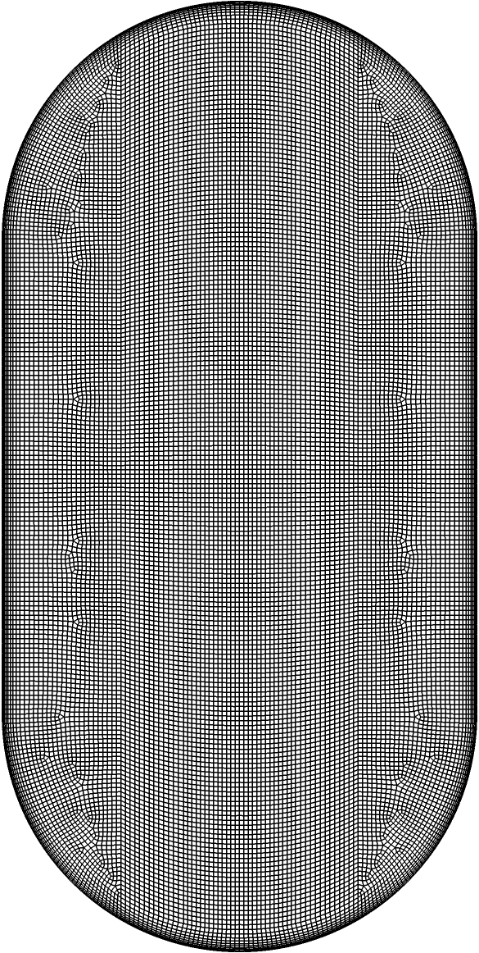
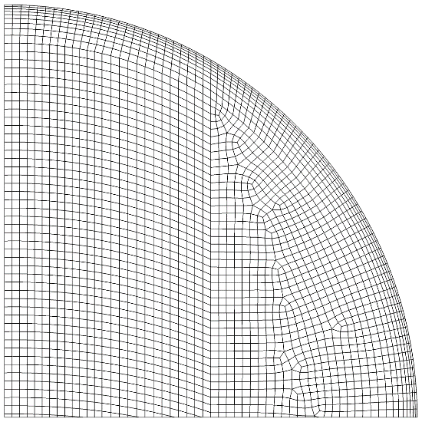
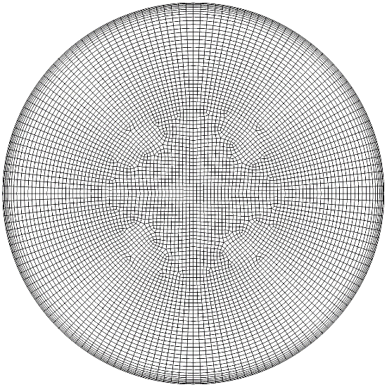
Simulation Methodology
CFD solver Loci/STREAM-VoF
Unsteady pressure based finite volume Navier-Stokes solver
1st order accuracy in space and time
Laminar model equations
Volume of Fluid (VoF) method of distinct phase representation
Maximum time step of 0.01 s with a courant number limiter for gas-liquid interface cells to aid VoF advection accuracy
Generic large-scale three-dimensional tank
No tank internal geometry was modeled
4 m long and 2 m radius cylindrical barrel section
2 m radius hemispherical domes
Adiabatic no-slip walls
Constant standard Earth gravity (9.81 m/s²)
Incompressible water and compressible air at 300 K and 14.7 psia
Modified gas molecular mass to vary density via the ideal gas law
Neglected any natural convection and phase change
Nominal Computational Mesh
Tank Cross-section
Forward Dome
A
A
Modeled Gas Molecular Mass (g/mol) | Gas Density (kg/m^3) | Liquid Density (kg/m^3) | Liquid-to-Gas Density Ratio
28.89 | 1.17 | 996.56 | 850
288.9 | 11.7 | 996.56 | 85
2889 | 116 | 996.56 | 8.5
Section A-A

Slide 6
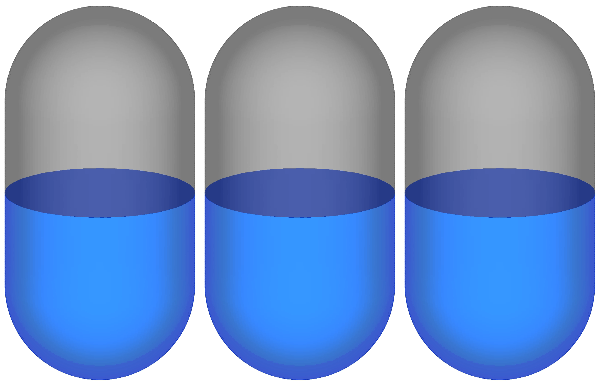
Observed Slosh Dynamics
Low amplitude linear regime slosh waves were excited to demonstrate slosh behavior dependence upon liquid-to-gas density ratio.
Slosh characteristics are independent of wave amplitude in the linear regime just like the linearized mechanical models.
Wave amplitude dependence at larger wave amplitudes was not investigated.
Animations of liquid dynamics for a range of density ratios at a 50% fill level are shown.
Forcing at the natural frequency from a potential flow solution excited slosh motion.
The tank was stopped upon reaching a target time allowing free decay of the slosh wave.
Slosh oscillations clearly desync over time demonstrating a difference in at least natural frequency.
Animation of Liquid Dynamics during Slosh
Density Ratio = 850
Density Ratio = 85
Density Ratio = 8.5

Slide 7
Mesh Convergence Study
Slosh model parameters, other than slosh mass, were quantified using numerous computational meshes to ensure solution convergence with spatial resolution.
Solution verification becomes more important when validation cannot be performed.
Authors are trying to identify appropriate experimental data that may be used for a validation activity.
Ranges for both nominal cell sizes and boundary layers were assessed to capture shear stresses within the fluids and along the wall.
A growth rate of 1.2 was held for every mesh containing a boundary layer.
Fluid properties for air and water were used yielding a high liquid-to-gas density ratio.
Slosh model parameters are expected to compare favorably to industry standard potential flow solutions and historical experimental data.
Illustration of Cell Parameters
Sensitivity Study Name | Nominal Cell Edge Length (mm) | Cell Edge Length Normal to Wall (mm) | # Volume Cells
Nominal Cell Size | 10 | 10 | 71.0 M
 | 20 | 20 | 9.0 M
 | 40 | 40 | 1.1 M
 | 80 | 80 | 0.14 M
 | 160 | 160 | 0.018 M
Boundary Layer 1 | 20 | 1 | 10.9 M
 | 20 | 3 | 10.0 M
 | 20 | 9 | 9.3 M
 | 20 | 20 | 9.0 M
Boundary Layer 2 | 40 | 1 | 1.7 M
 | 40 | 3 | 1.5 M
 | 40 | 9 | 1.3 M
 | 40 | 20 | 1.2 M
 | 40 | 40 | 1.1 M
Cell Edge Length Normal to Wall
Nominal Cell Edge Length

Slide 8
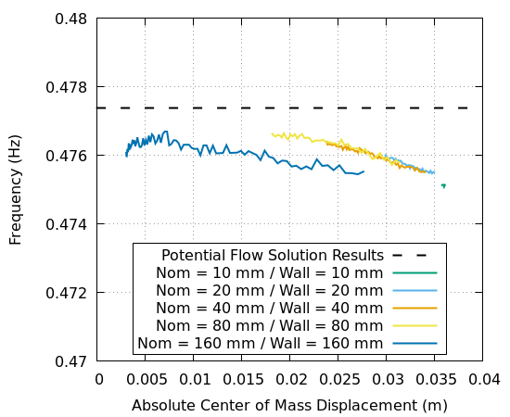
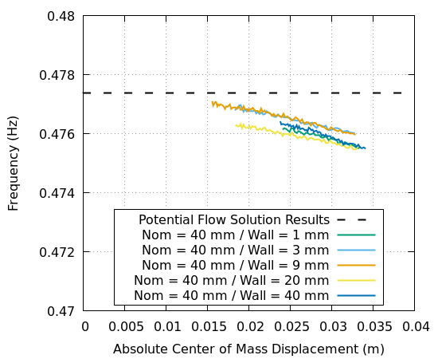
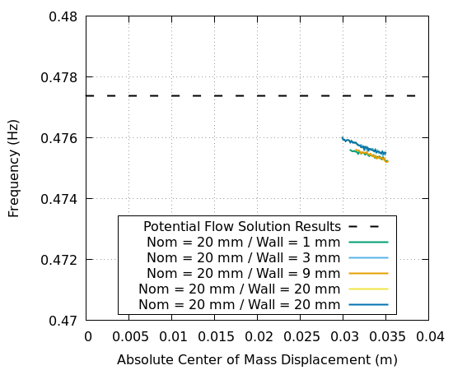
Mesh Convergence Study
Natural Frequency:
Natural frequency showed little dependence on spatial resolution and was within 0.75% of the potential flow solution.
Nominal Cell Size Sensitivity
Boundary Layer
Sensitivity 1
Boundary Layer
Sensitivity 2

Slide 9
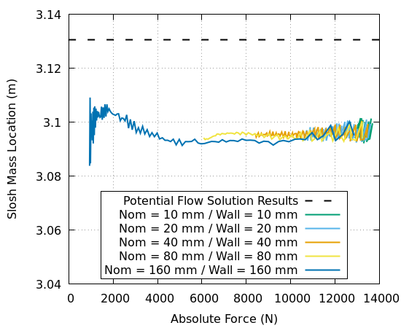
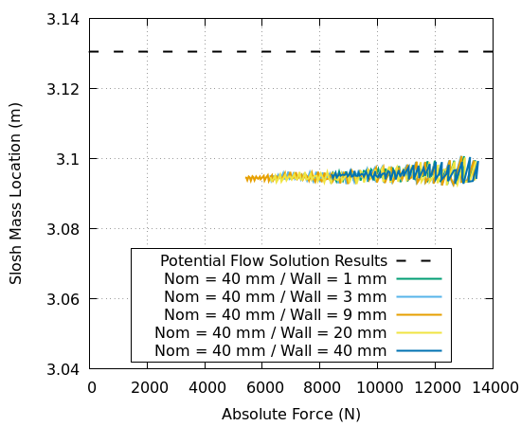
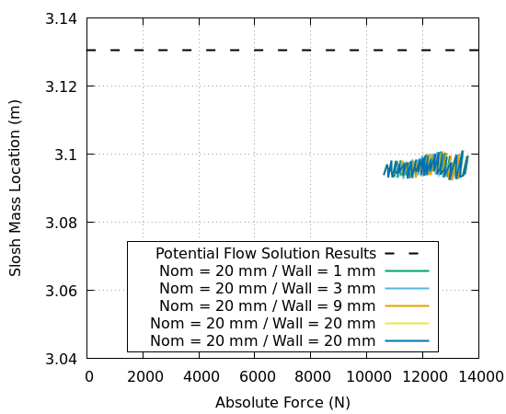
Mesh Convergence Study
Slosh Mass Location:
Slosh mass location also showed little dependence on spatial resolution and was within 1.5% of the potential flow solution.
Nominal Cell Size Sensitivity
Boundary Layer
Sensitivity 1
Boundary Layer
Sensitivity 2

Slide 10
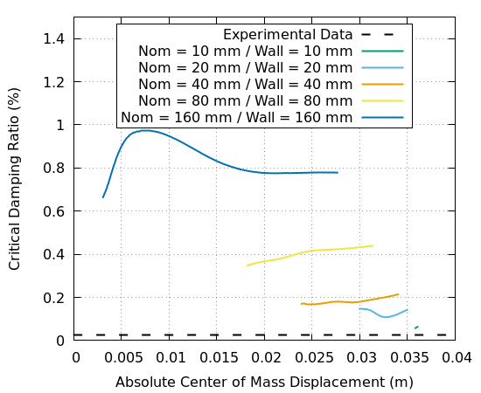
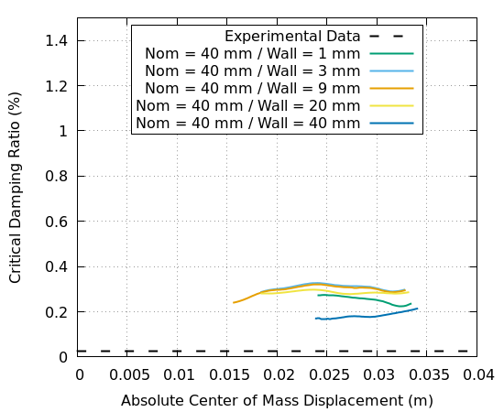
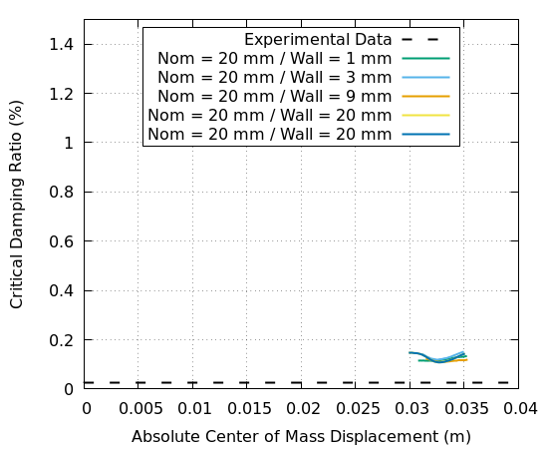
Mesh Convergence Study
Damping reported later should be used only to understand trends with density ratio.
Critical Damping Ratio:
Critical damping ratio varied significantly with spatial resolution.
This parameter is highly sensitive especially for low magnitude linear regime bare tank damping quantification.
Mesh used in further study offers limited damping error and computational efficiency.
Nominal cell edge length of 40 mm and cell edge length normal to the wall of 9 mm
Nominal Cell Size Sensitivity
Boundary Layer
Sensitivity 1
Boundary Layer
Sensitivity 2

Slide 11
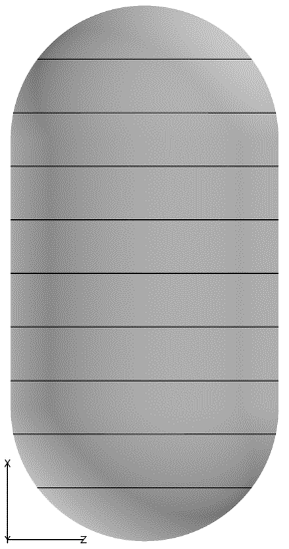
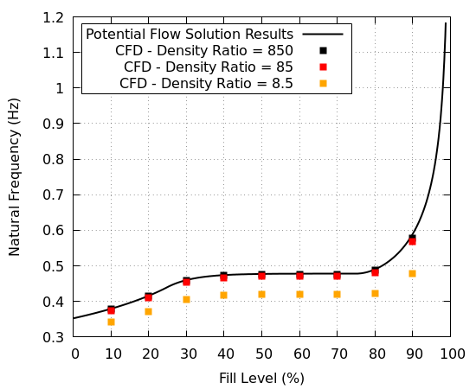
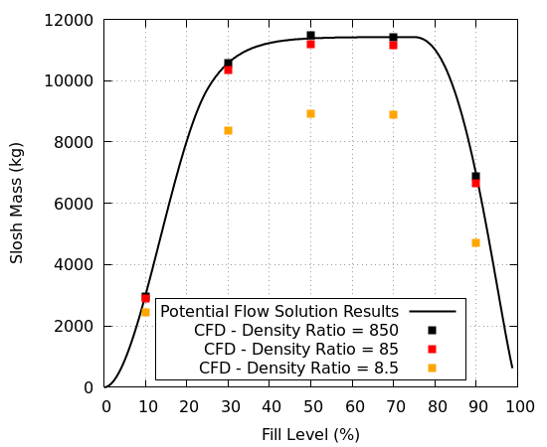
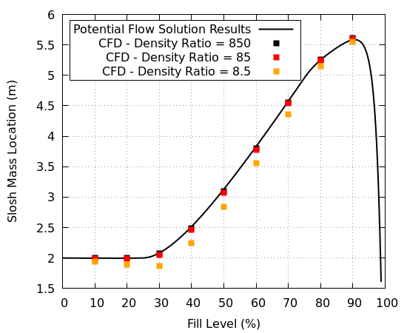
Liquid-to-Gas Density Ratio Study
Non-damping Slosh Model Parameters:
Analysis results compare very well with a potential flow solution at high density ratios but decrease with decreasing density ratio.
Significant deviation in these parameters from the potential flow solution, beyond the typical margins carried by a vehicle program, begins around a density ratio of less than 85.
Tank Geometry
Fill levels at 10% by volume increments shown

Slide 12
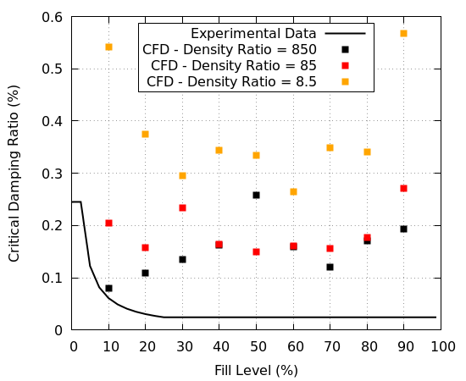
Liquid-to-Gas Density Ratio Study
Critical Damping Ratio:
Analysis results exceeded historical experimental data due to the chosen spatial resolution.
However, critical damping ratio was found to generally increase with decreasing density ratio.
Using damping from high density ratio testing or analysis will be conservative for vehicle stability analyses where damping generally increases stability.
Tank Geometry
Fill levels at 10% by volume increments shown

Slide 13
Conclusion
Liquid slosh characteristics were shown to change as liquid-to-gas density ratio decreased using CFD analysis.
Analysis results compared very well with potential flow solutions of non-damping slosh model parameters where expected, for high liquid-to-gas density ratios.
Natural frequency, slosh mass, and slosh mass location all decreased with decreasing density ratio.
Critical damping ratio generally increased with decreasing density ratio.
For fluid properties in water and air ground tests or typical LOX or storable propellant tanks, liquid dynamics dominate the bulk slosh motion.
Gas inertia and dynamics become important as fluid properties move towards those for high pressure LCH4 and LH2 propellant tanks.
More work is needed to identify experimental data that may be used to validate the findings in this paper.
Additionally, theoretical work is needed to develop an accurate slosh model that includes gas dynamics for future use.

