Slide 1
Intermittency Model for Coupled CFD-Stability Transition Analysis in Hypersonic Flows
Ethan Vogel and Meelan Choudhari
NASA Langley Research Center
AIAA SciTech Forum
FD 20 - Instability and Transition V
January 7, 2025
Notes:
Record of Accomplishment for FW.2.L.03.02.009.
Note: this is the template used in FW to document the milestone completion. This is accompanied by a 1-page highlight slide.
BLUE text is wording from Presidents budget.

Slide 2
Outline
Introduction
Coupled LASTRAC-CFD analysis
Form of the Intermittency Model
Determination of Intermittency Model Parameters
Development of the Intermittency Model
Summary and Observations
Ongoing/Future Work
Conclusions

Slide 3
Introduction and Motivation
Transition in high-speed flows is both difficult to predict and important for design
Transition location is often given more focus than transition characteristics
Transition zone width, the rate of heat increase over transition, and overshoot of expected turbulent values are all important
Previous presentations have outlined the ability of coupled CFD-stability analysis to predict transition onset in hypersonic flows
  This capability does not yet have an associated intermittency model developed for hypersonics
This study examines an intermittency model for high-speed flows for use with coupled stability-RANS analysis
  Framework isolates intermittency from other considerations
  Findings expected to be transferrable to other applications

Slide 4
Outline
Introduction
Coupled LASTRAC-CFD analysis
Form of the Intermittency Model
Determination of Intermittency Model Parameters
Development of the Intermittency Model
Summary and Observations
Ongoing/Future Work
Conclusions

Slide 5
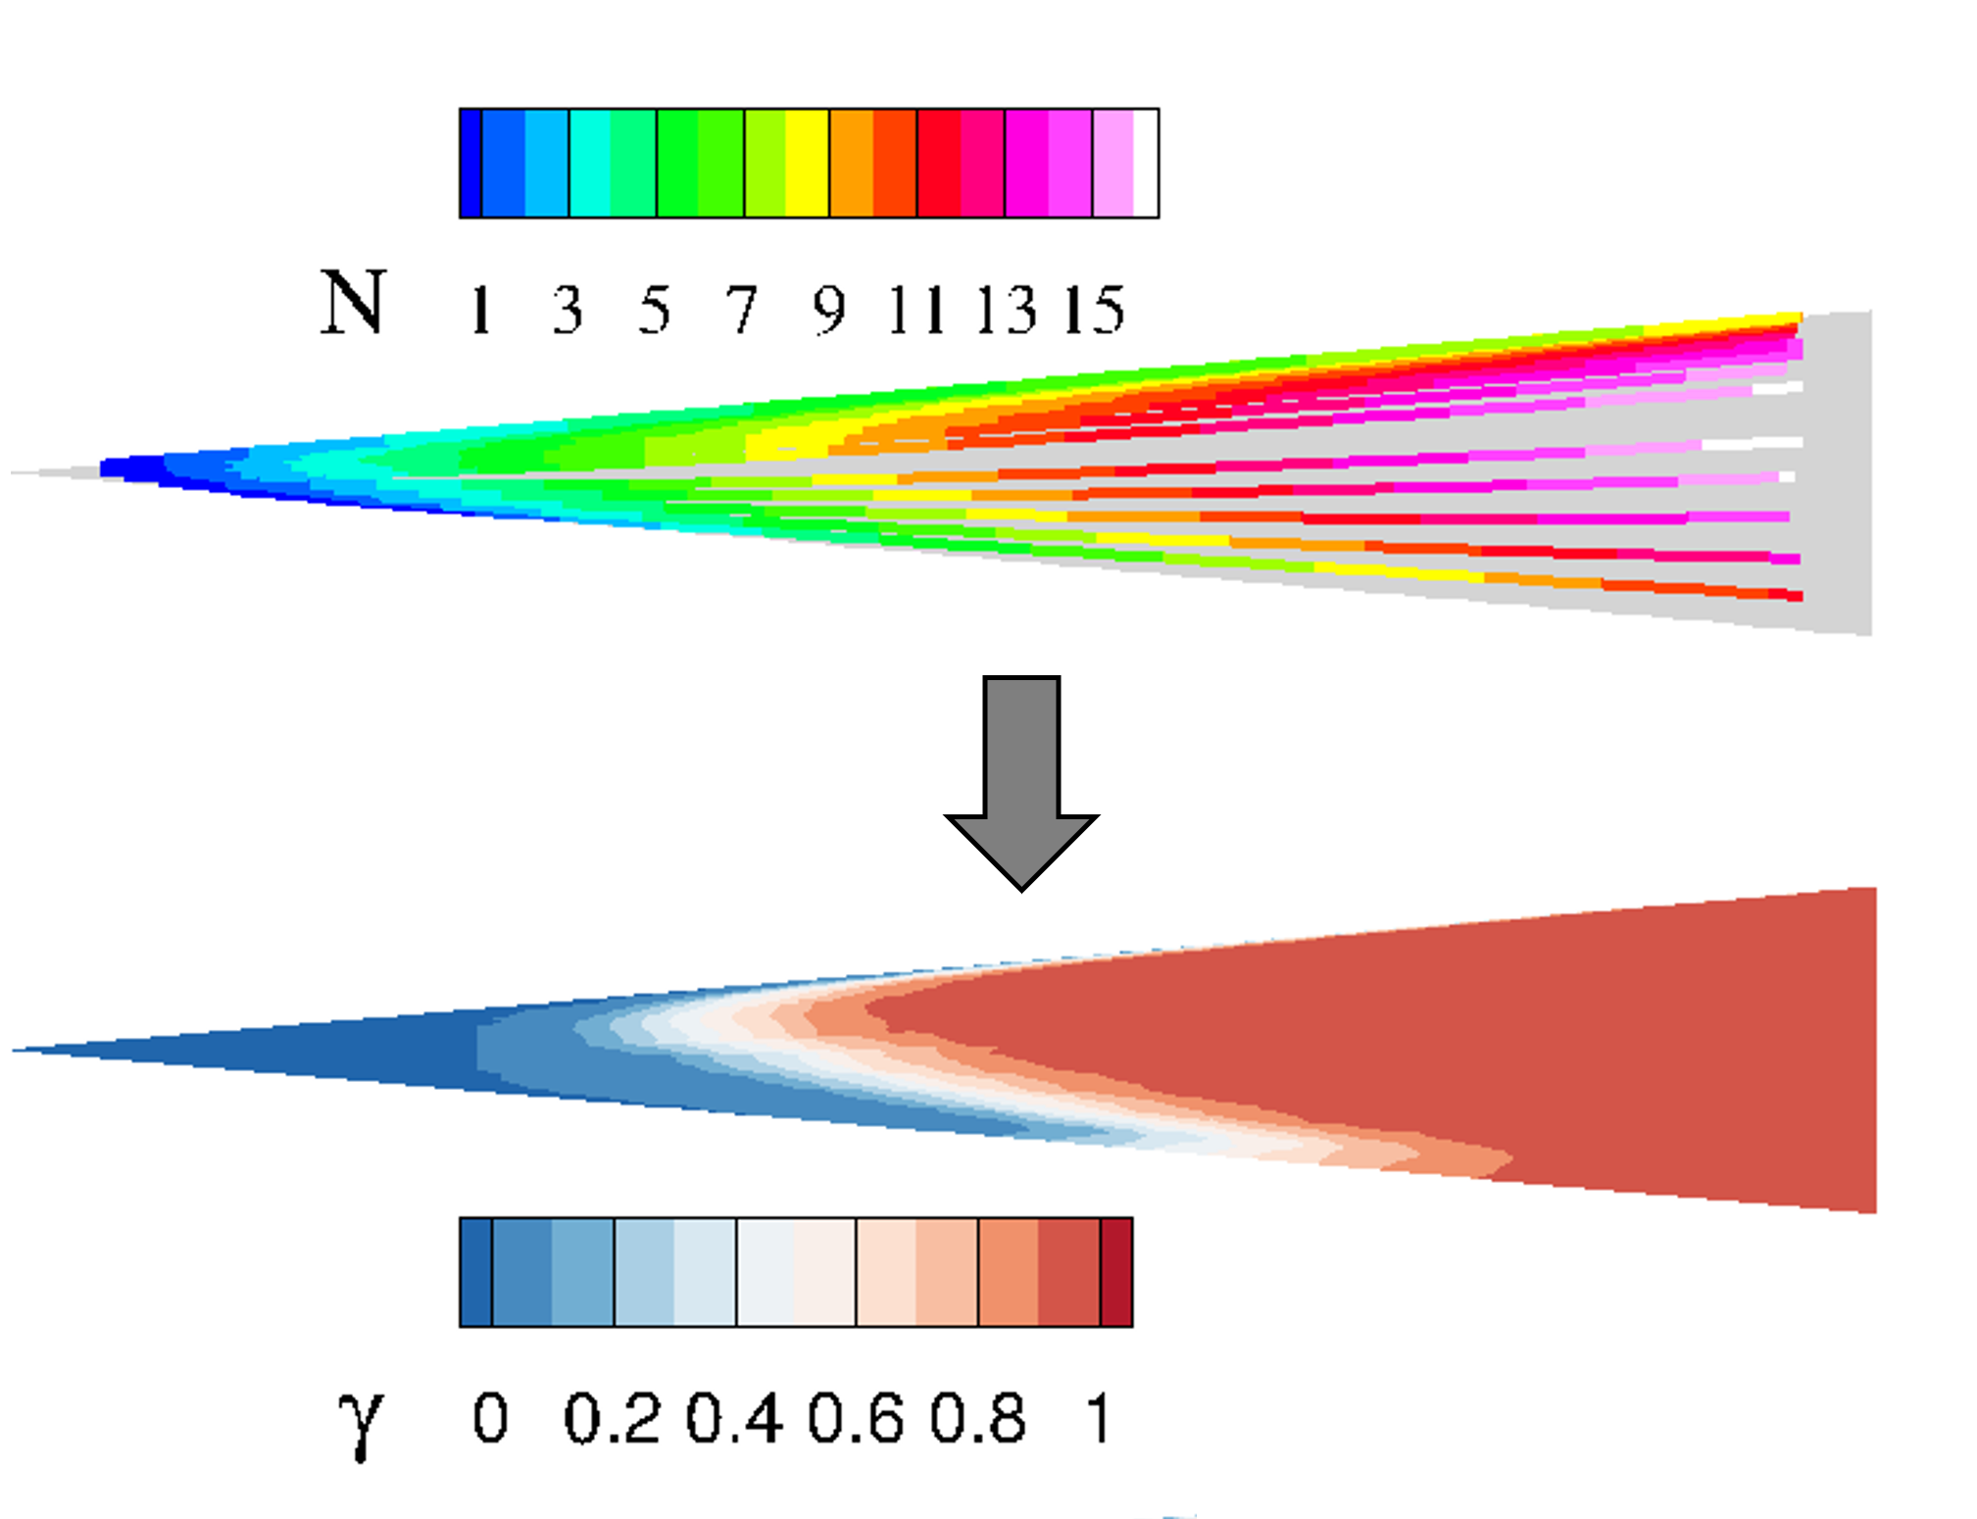
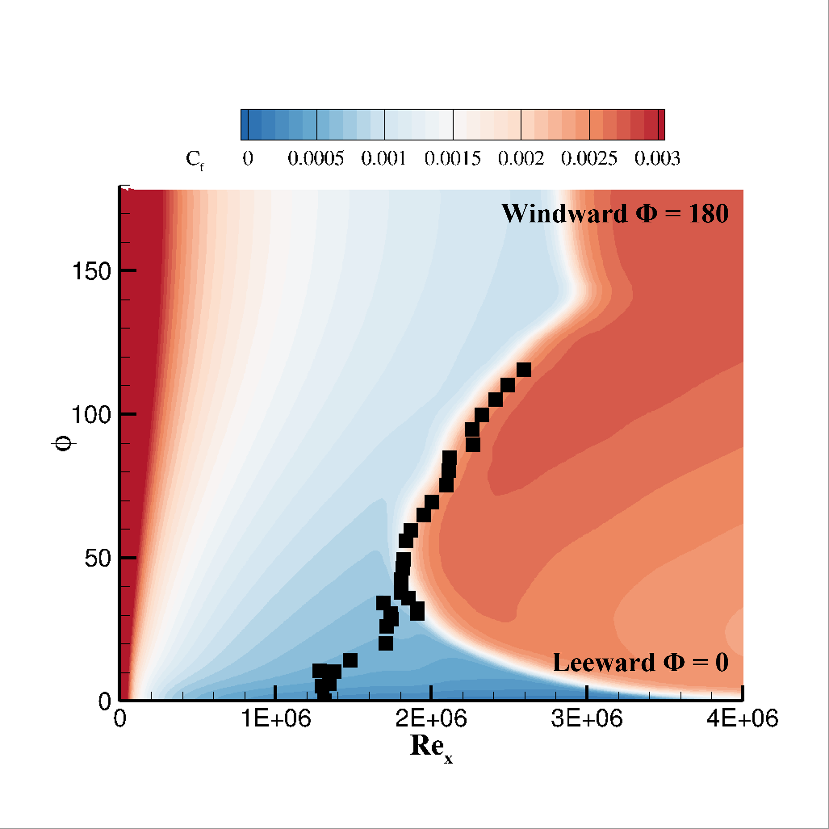
Coupled Stability Analysis
Utilizes RANS solver (OVERFLOW) and stability solver (LASTRAC) to identify and specify transition in a RANS simulation using stability analysis
  Similar computational cost to transport-based models
  Inclusive of all relevant physics in most cases
  Slightly more restrictive mesh quality/size constraints
OVERFLOW
  Structured overset RANS solver
  Subdomain export capabilities
  Surface intermittency prescription via input files
  HLLE++ with van Albada limiter
  SA and SST capabilities
LASTRAC
  LST and PSE capabilities
  Interfaced with Python scripting layer
  Compatibility with unstructured base flow files
Visual demonstration of coupled CFD-Stability

Slide 6
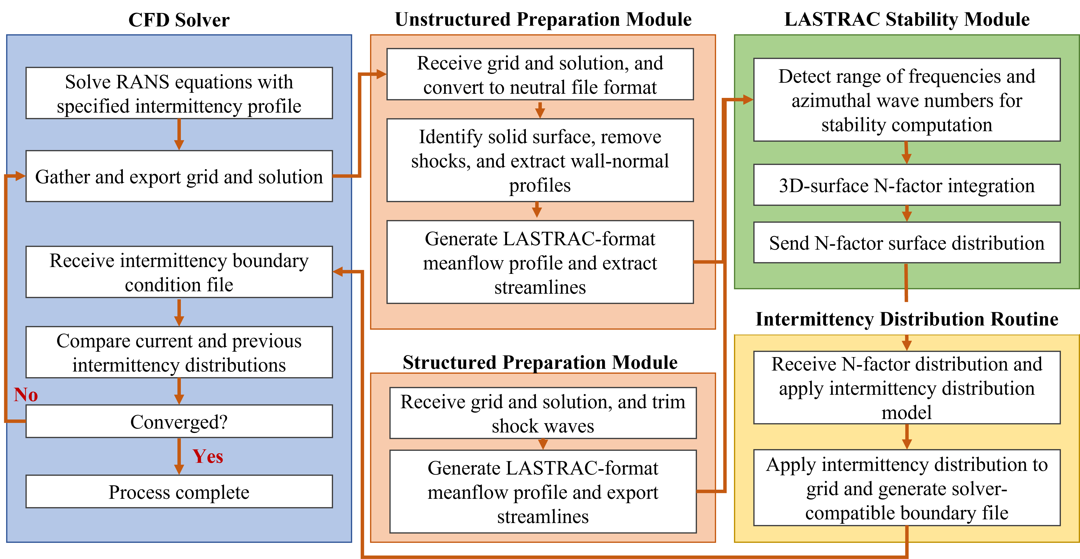
Coupled Stability Analysis
6

Slide 7
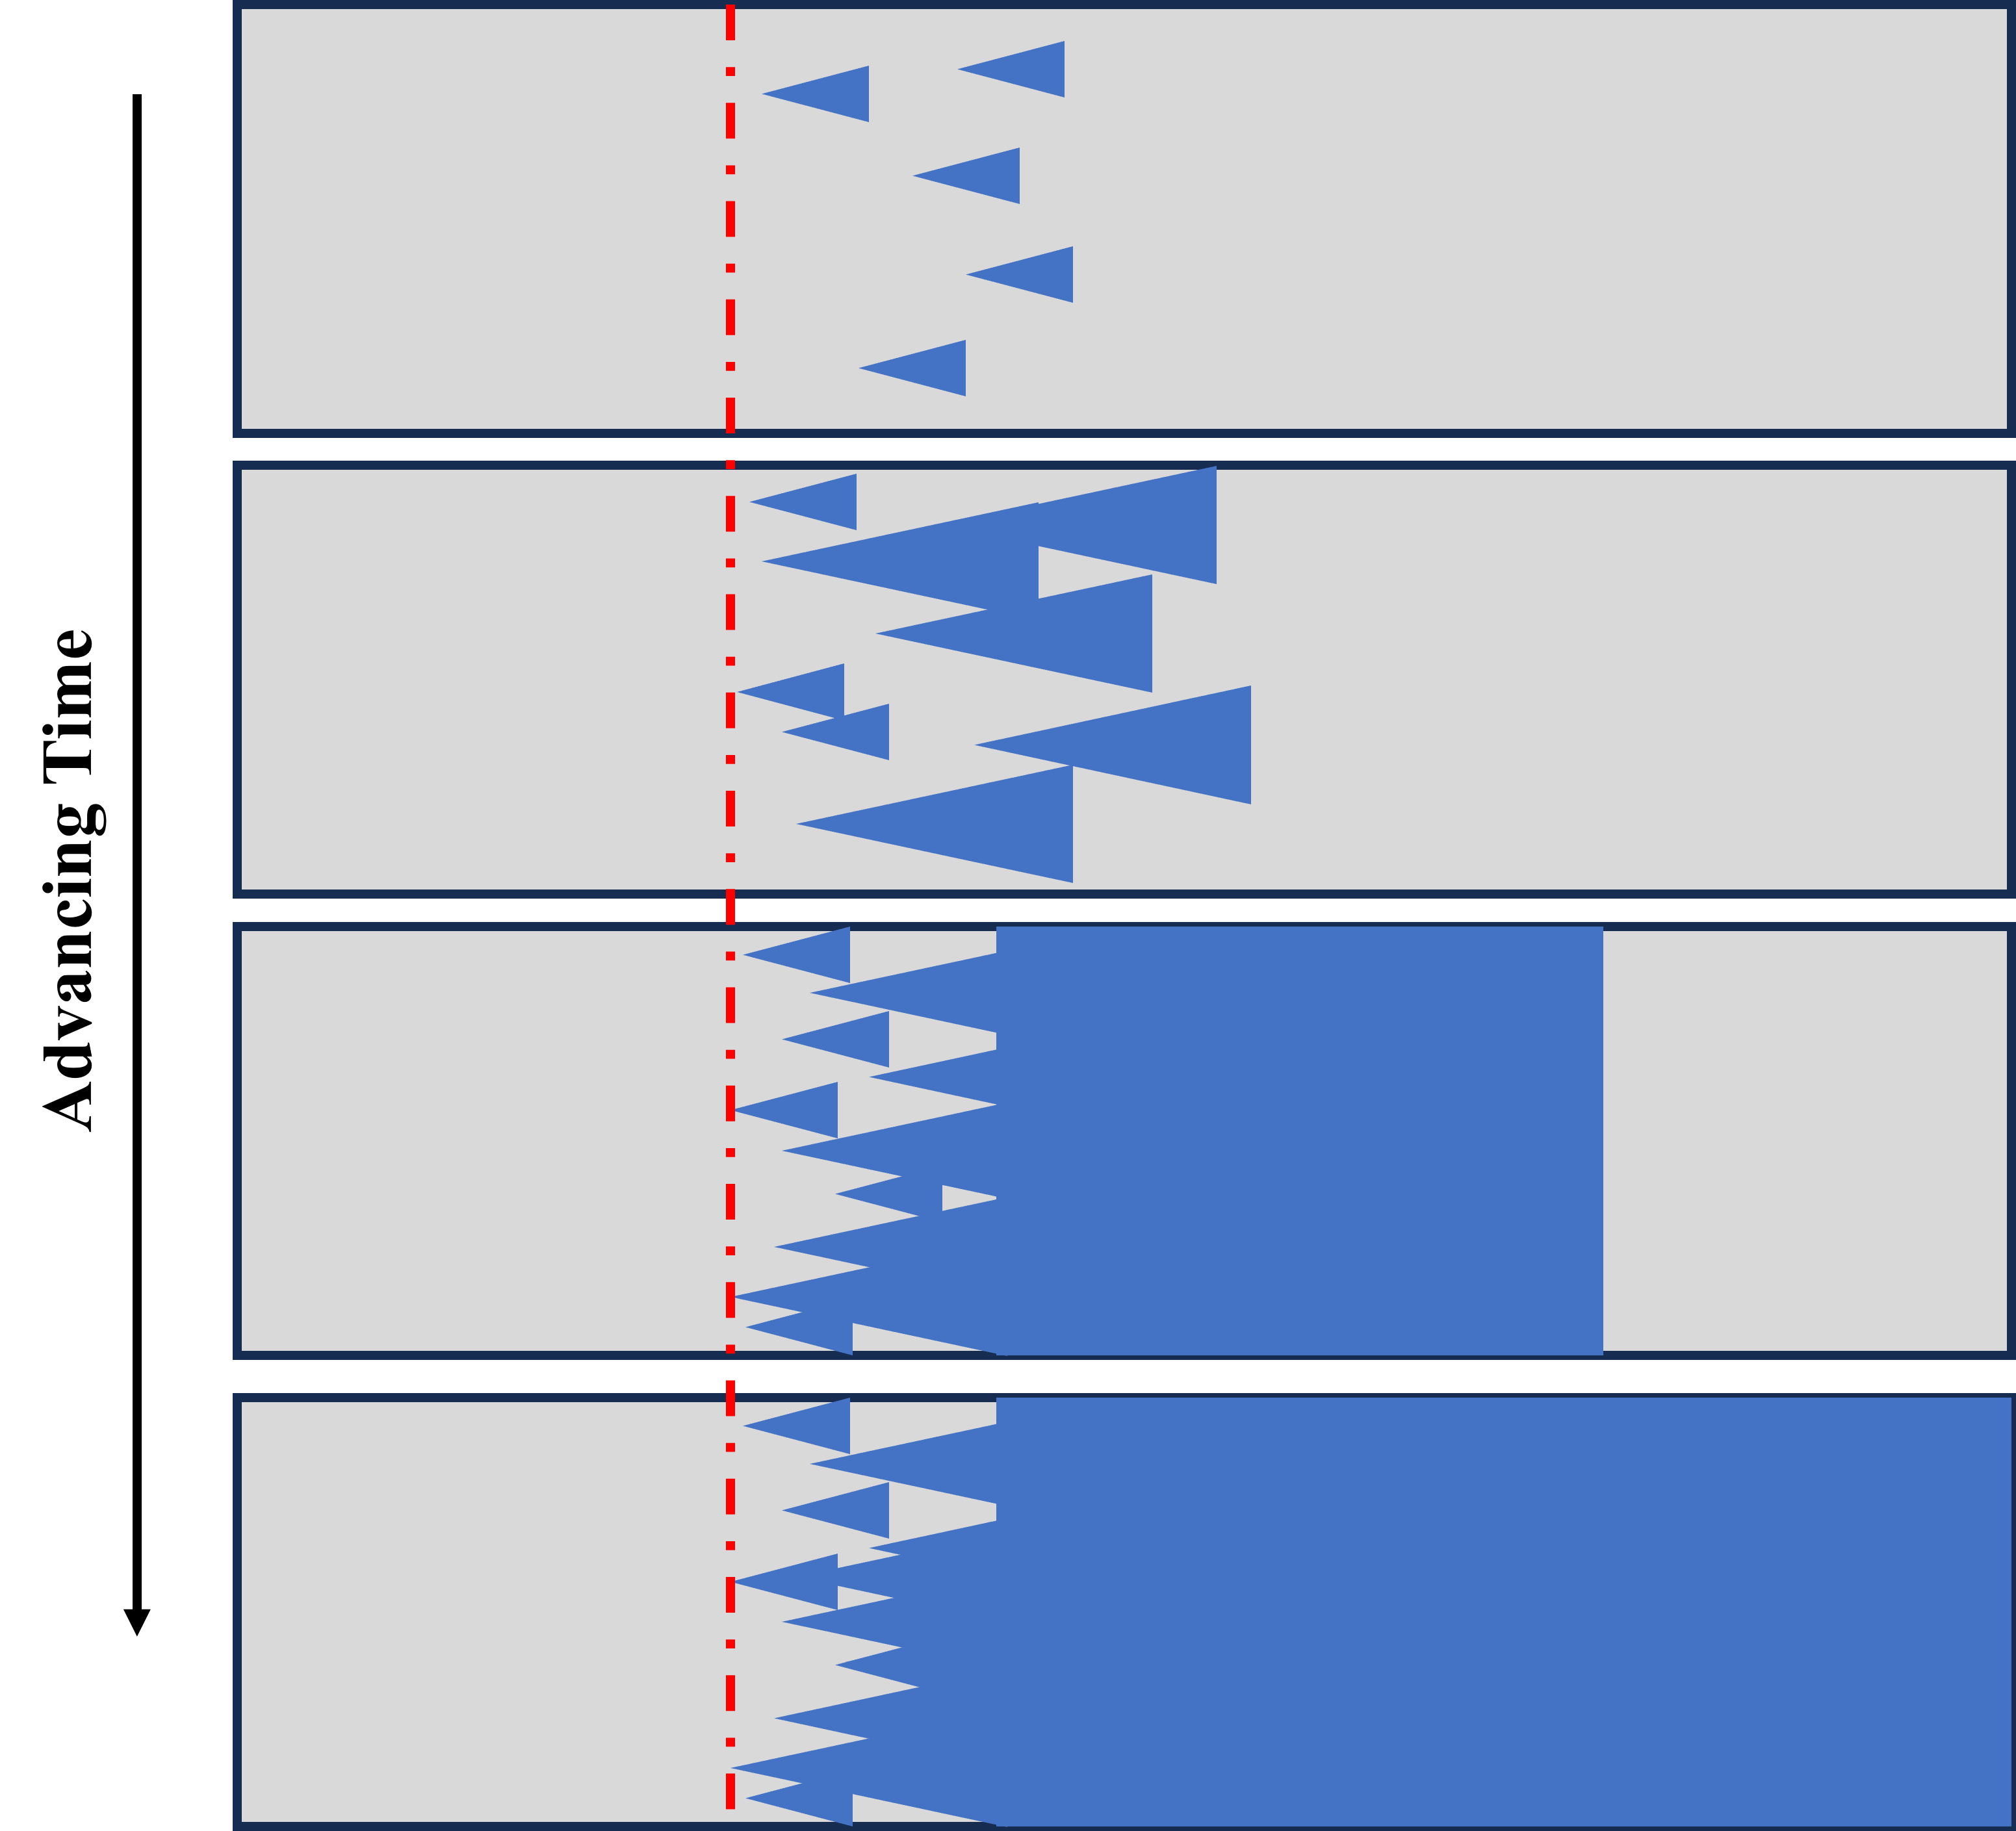
Intermittency
Intermittency is an index indicating “how turbulent” a point in a flow is
The definition is context-dependent
  For clarity, different variables will be used for experiment vs RANS
Γ: Experimental intermittency
  Defines the fraction of time a given point in a flow is turbulent
  Strictly bounded to values > 1
  Related to the initiation and spreading of turbulent spots
γ: Computational intermittency
  A RANS parameter intended to mimic the time-averaged impact of experimental transition in RANS flows
  Can take values > 1 if the user so desires
  Multiplies production terms (or eddy viscosity) of turbulence models
Overshoot cases may require γ > 1, even though these values are forbidden for Γ
Diagram of intermittency in experiments. Adapted from Narashima et al. for demonstration purposes
7

Slide 8
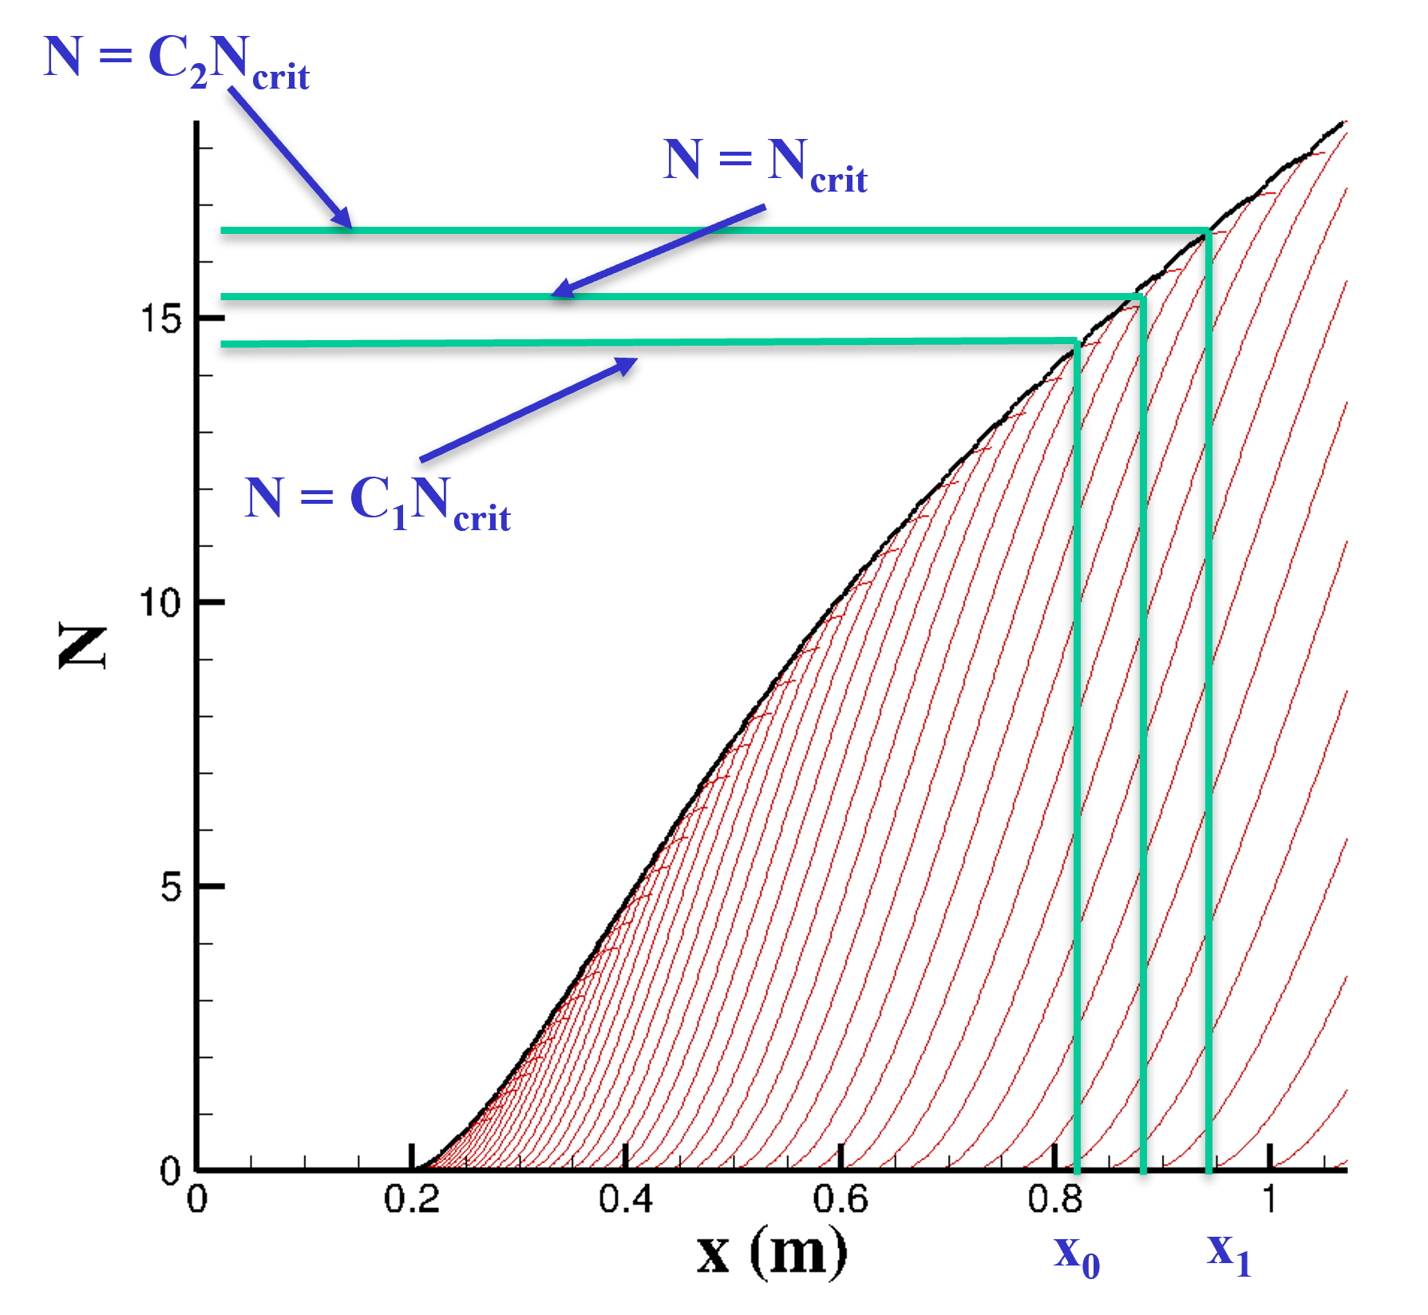
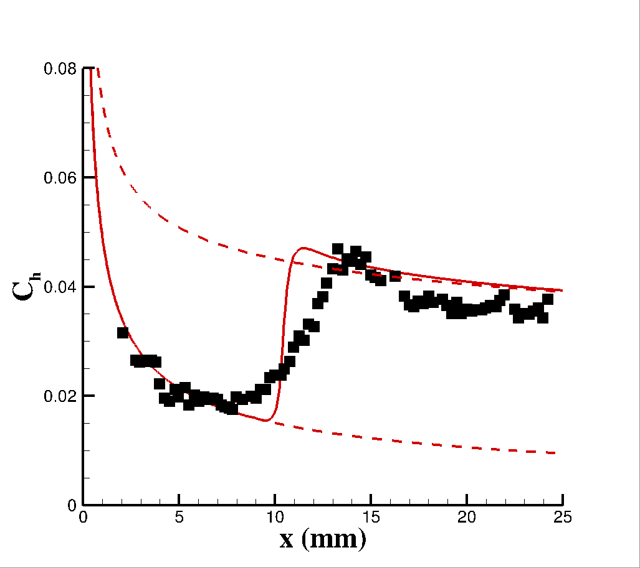
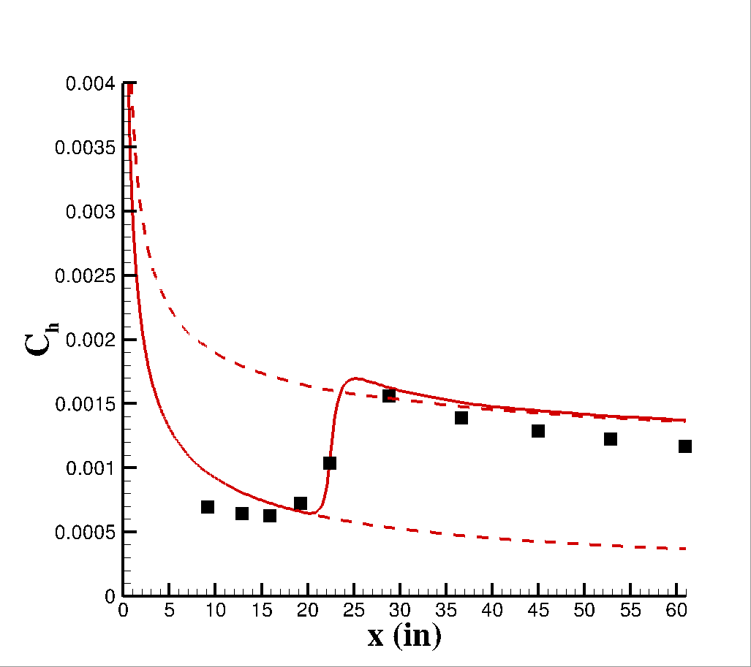
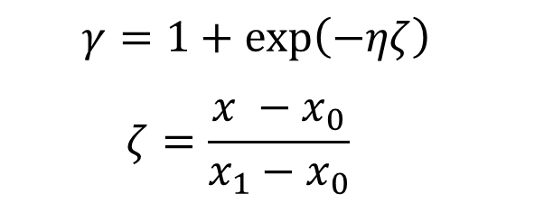
Previous Intermittency Model Form
Previous intermittency model inherited from low-speed flow based on N-factor envelope is poorly suited for hypersonics
  No overshoot capability
  Sensitive to geometric complexity
  Transition occurs too abruptly
Need to develop something more robust and accurate for hypersonics
Mach 6 Straight Cone
Mach 10 Straight Cone
  $$γ=1+\exp\left(−ηζ\right)$$
  $$ζ=\frac{x −x_{0}}{x_{1}−x_{0}}$$
8

Slide 9
Outline
Introduction
Coupled LASTRAC-CFD analysis
Form of the Intermittency Model
Determination of Intermittency Model Parameters
Development of the Intermittency Model
Summary and Observations
Ongoing/Future Work
Conclusions

Slide 10
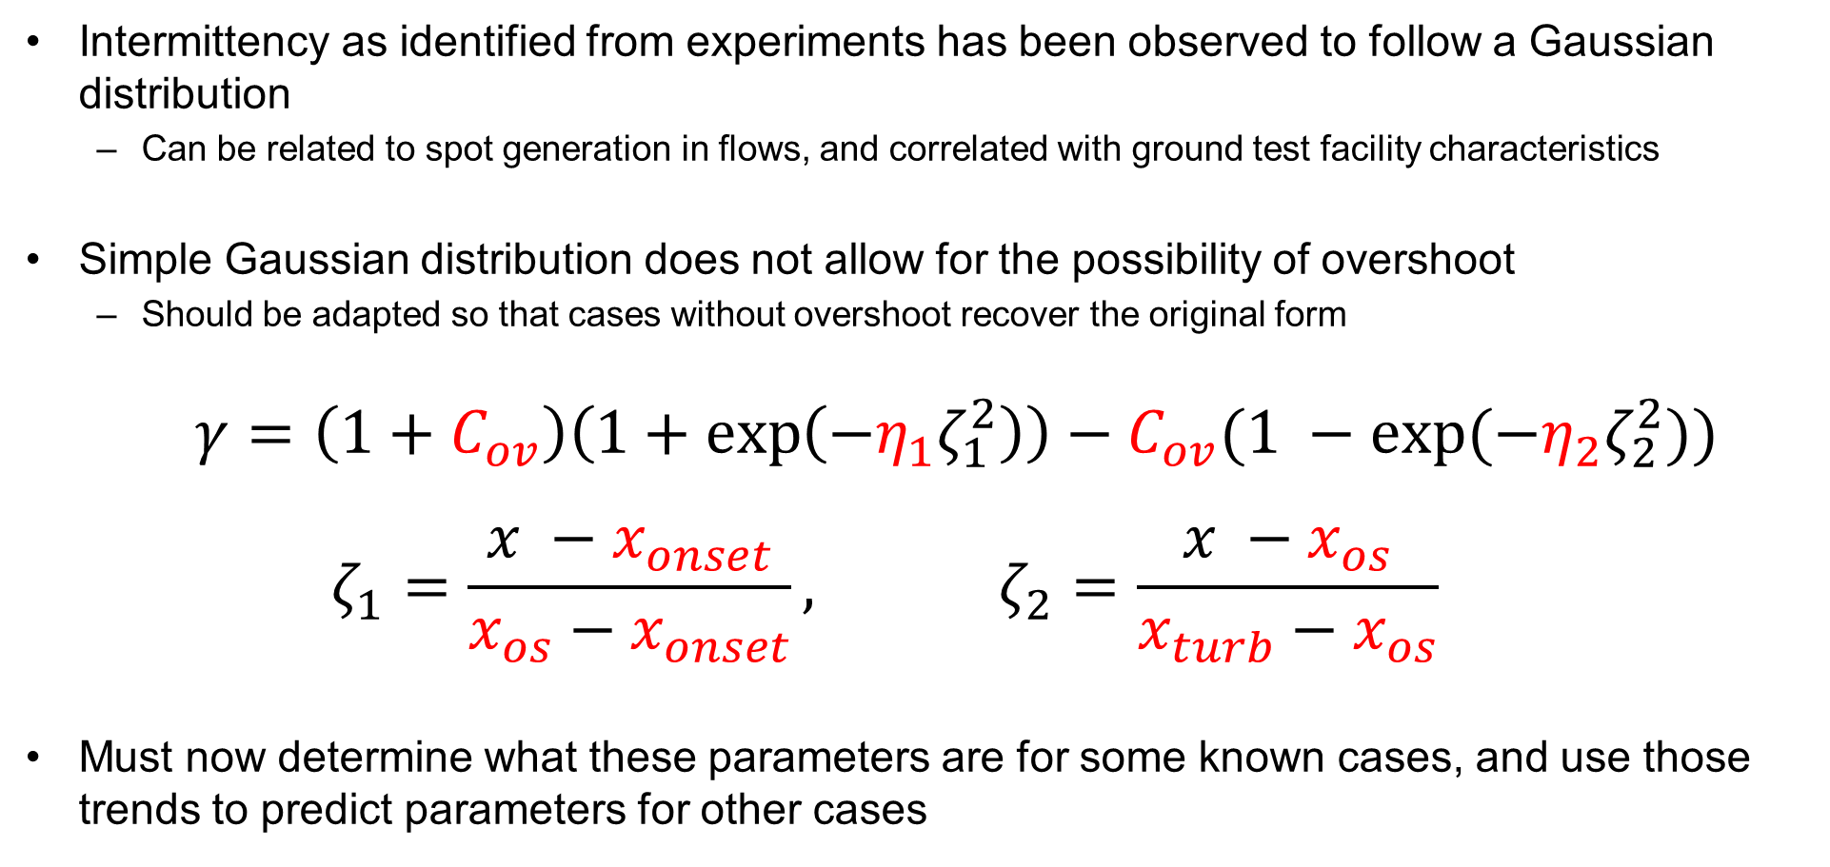
Intermittency Model Form
Intermittency as identified from experiments has been observed to follow a Gaussian distribution
  Can be related to spot generation in flows, and correlated with ground test facility characteristics
Simple Gaussian distribution does not allow for the possibility of overshoot
  Should be adapted so that cases without overshoot recover the original form
  $γ=\left(1+C_{ov}\right)\left(1+\exp\left(−η_{1}ζ_{1}^{2}\right)\right)−C_{ov}(1 −\exp{(−η_{2}ζ_{2}^{2})})$
  $$ζ_{1}=\frac{x −x_{onset}}{x_{os}−x_{onset}}, ζ_{2}=\frac{x −x_{os}}{x_{turb}−x_{os}}$$
Must now determine what these parameters are for some known cases, and use those trends to predict parameters for other cases
10

Slide 11
Test Cases
Test cases identified from the open literature
  29 Cases Total
  Mostly ground test, some flight
Data must provide transition zone heat transfer (or recovery factor) profiles for inclusion
  Some data sets from previous studies had to be omitted
  Entire transition zone must be captured by experiments
Presently restricted to 1st and 2nd mode (axisymmetric) cases
  Future work will expand to more complex cases and crossflow
Facility | Mach Number(s) | Facility Type | Test Cases | Data Use
LaRC 20-inch Mach 6 | 6 | Conventional | 4 | Baseline Training
Larch Mach 3.5 Tunnel | 3.5 | Quiet | 3 | Baseline Training
AEDC Tunnel B | 8 | Conventional | 8 | Pressure Gradient Analysis
AEDC Tunnel 9 | 10 + 14 | Conventional | 4 | Baseline Training
TU Braunschweig HLB | 5.9 | Conventional | 3 | Baseline Training
VKI Longshot Tunnel | 6 + 8 | Conventional | 3 | Baseline Evaluation
Virtual VKI Tunnel | 8 | Conventional (DNS) | 1 | Baseline Evaluation
CUBRC LENS 1 | 9.9 | Conventional | 1 | Baseline Training
HIFiRE-1 Flight Test | ~5 | Flight | 3 | Flight Training
LaRC Free Flight | ~3.5 | Flight | 2 | Flight Training
11

Slide 12
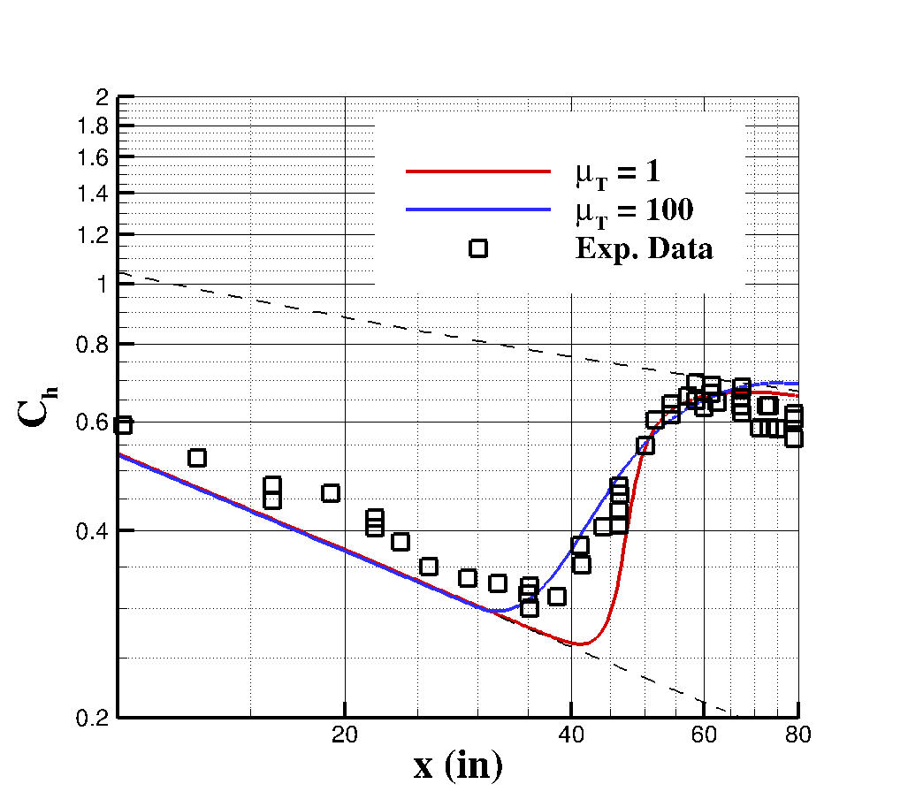
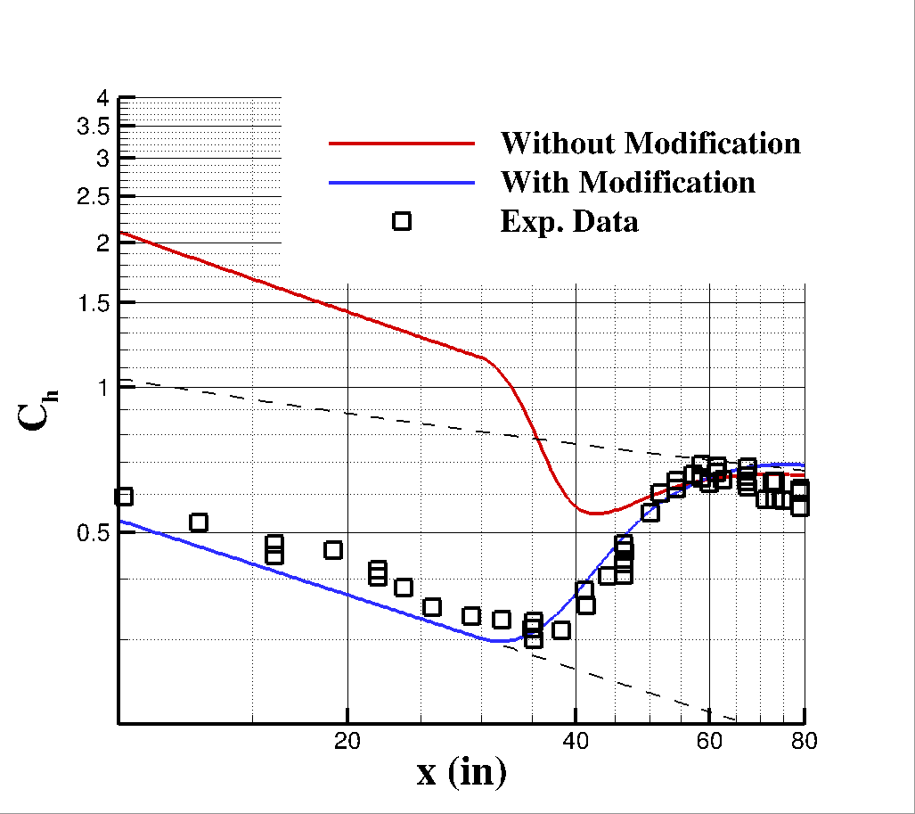
Modification to SA Model
Usually, intermittency is coupled to turbulence models via the production of turbulence quantities
  Larger values of eddy viscosity ratio → more gradual transition
  Excessive freestream eddy viscosity erodes solution quality
Introduce modification to SA-neg so that intermittency multiplies eddy viscosity rather than production
  Directly yields more gradual transition
  Allows much larger values of μ_{T} than are otherwise permissible
Modified result with two different values of eddy viscosity ratio
Large eddy viscosity ratio (100) with and without modification
12

Slide 13
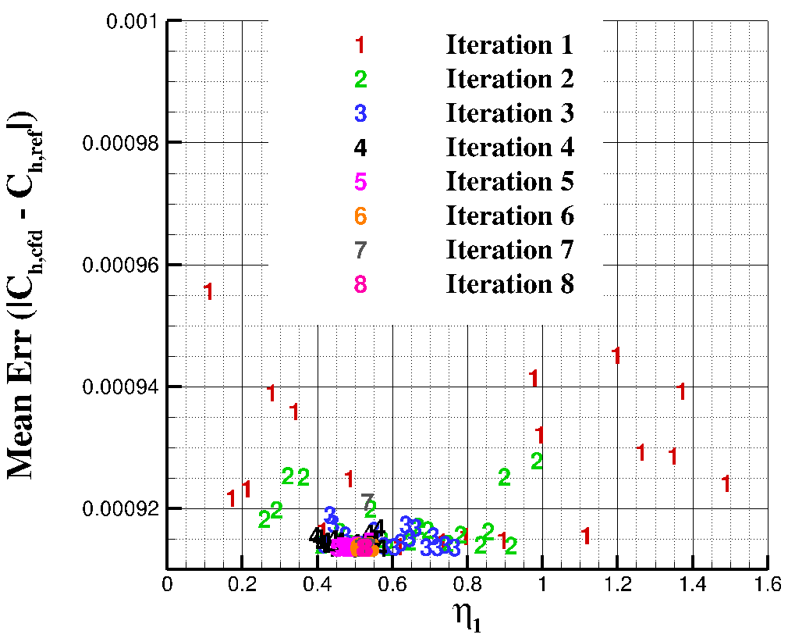
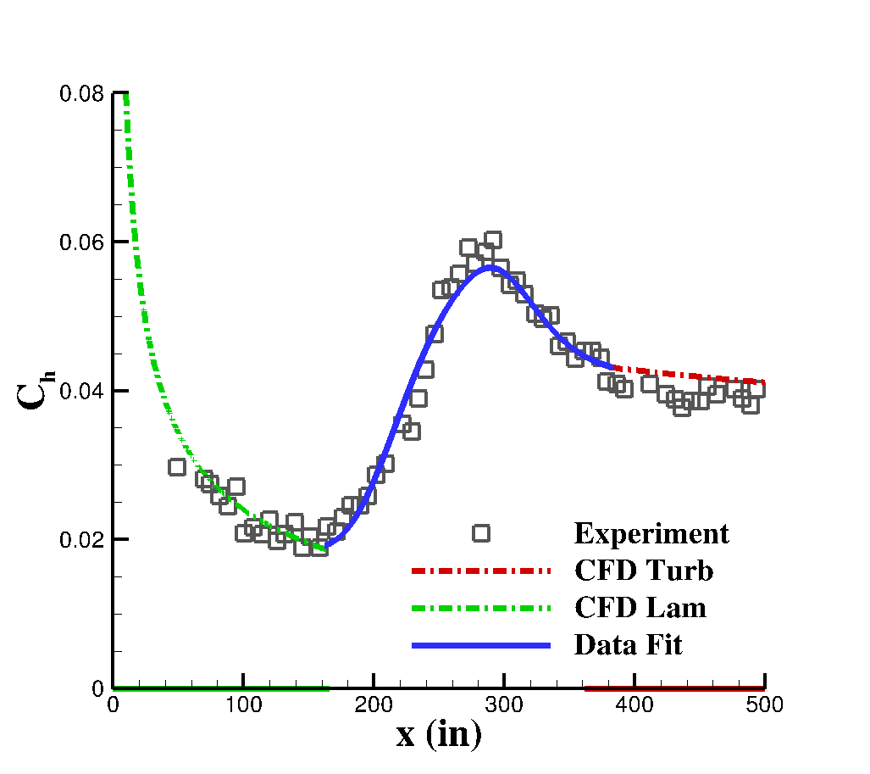
Identification of Intermittency Parameters
Experimental data processed to ensure agreement with CFD in the laminar & turbulent regions
  Provides a consistent basis for error evaluation relative
Need to identify the 6 independent variables for each of the training cases
  Desired output is known, but inputs are not
  This is a black box problem, and so an iterative approach must be taken
Utilize an iterative, domain reduction algorithm with pseudo-random sampling.
  Conduct 10 iterations of 20 samples per iteration
  Overshoot and exponents limited to ensure reasonable values
Specify acceptable range for each input
Generate 20 sets of inputs within acceptable range
Conduct simulation with each set of parameters
x 10
Evaluate error for each and identify best performing input set
Reduce acceptable range by 50%, centered on best performing input
13

Slide 14
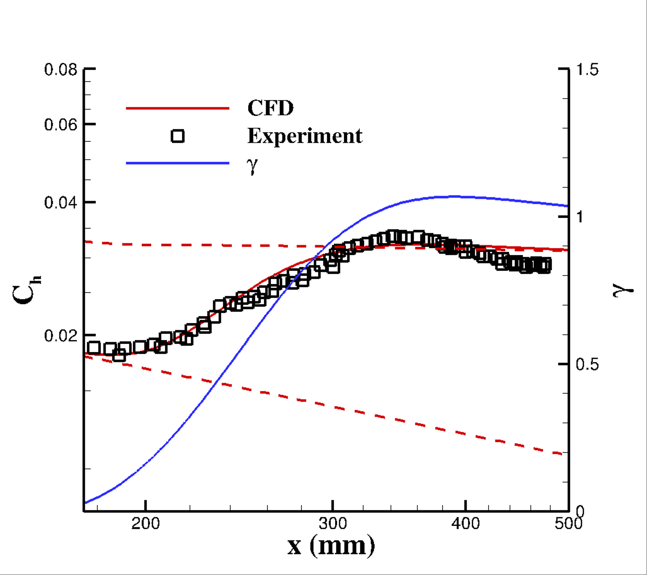
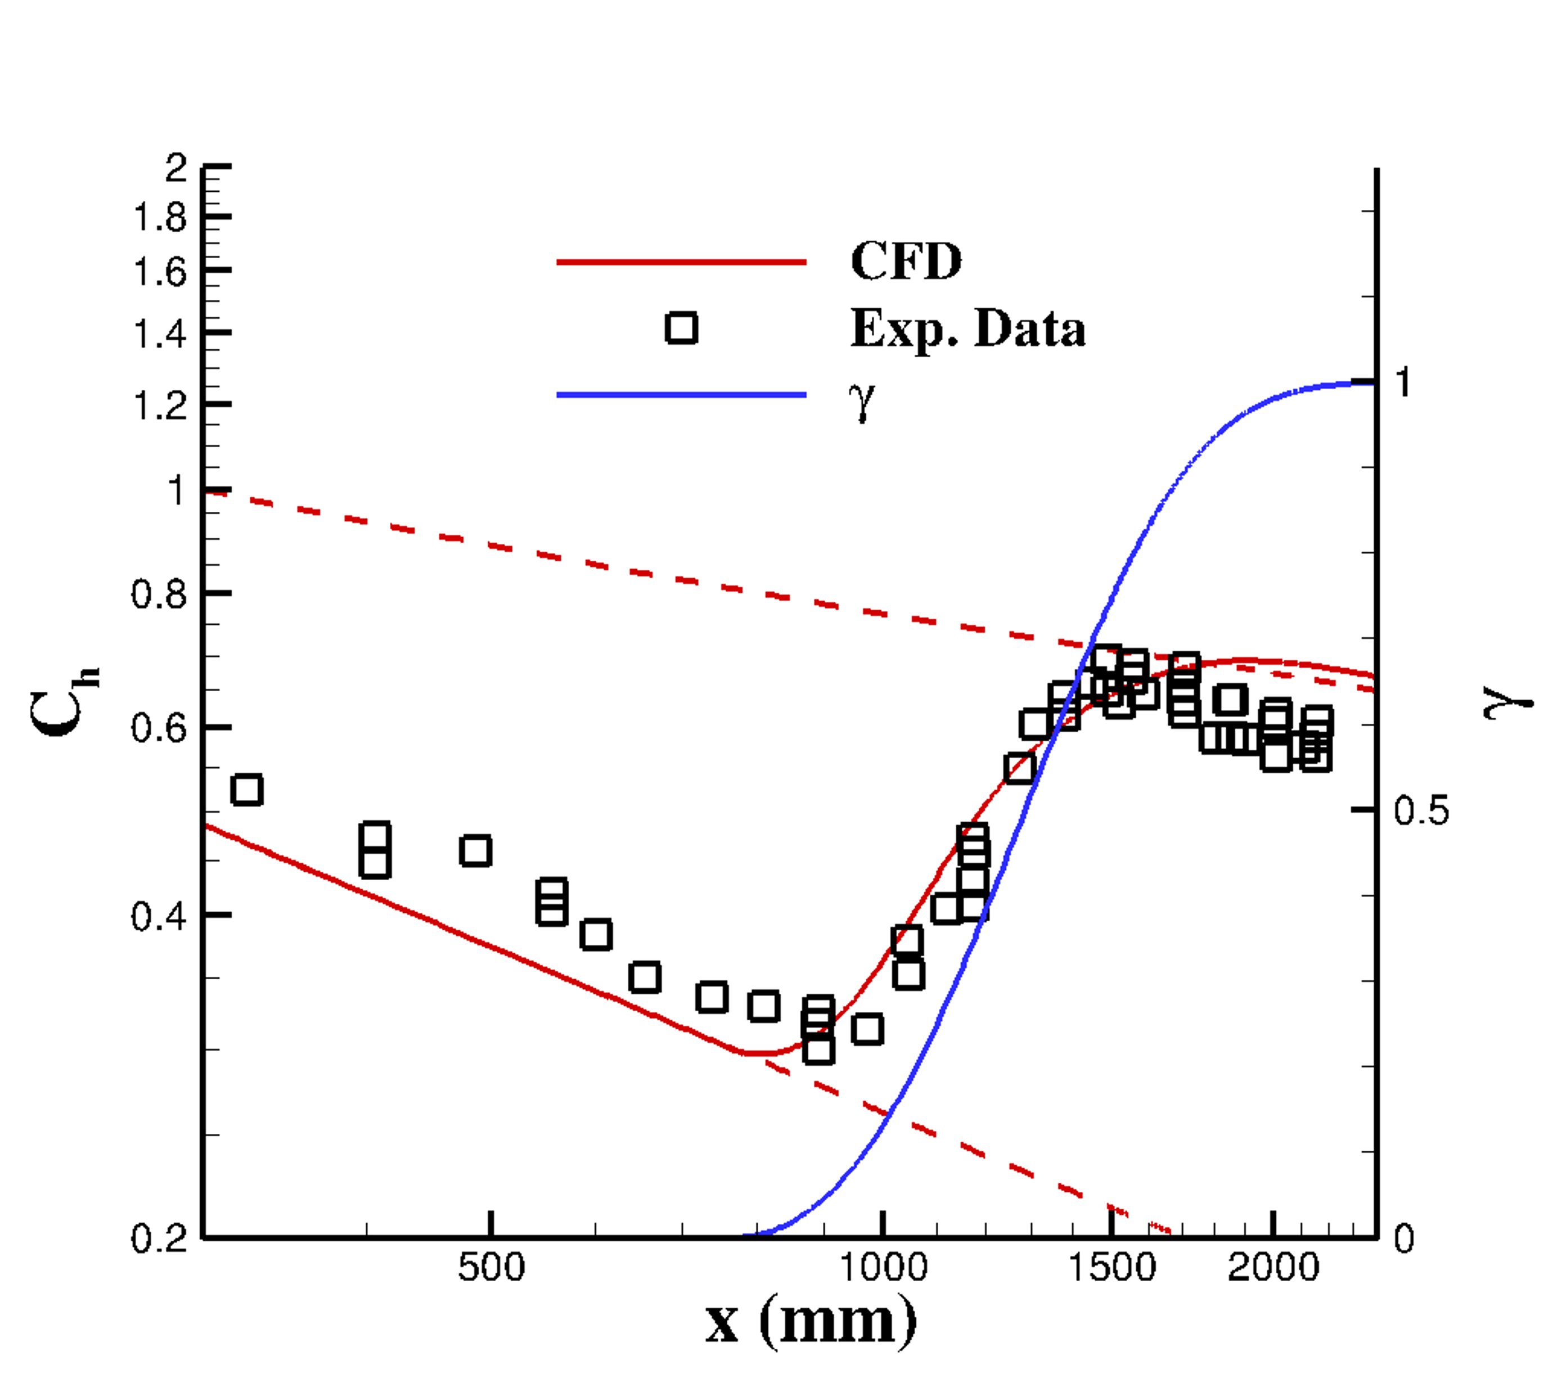
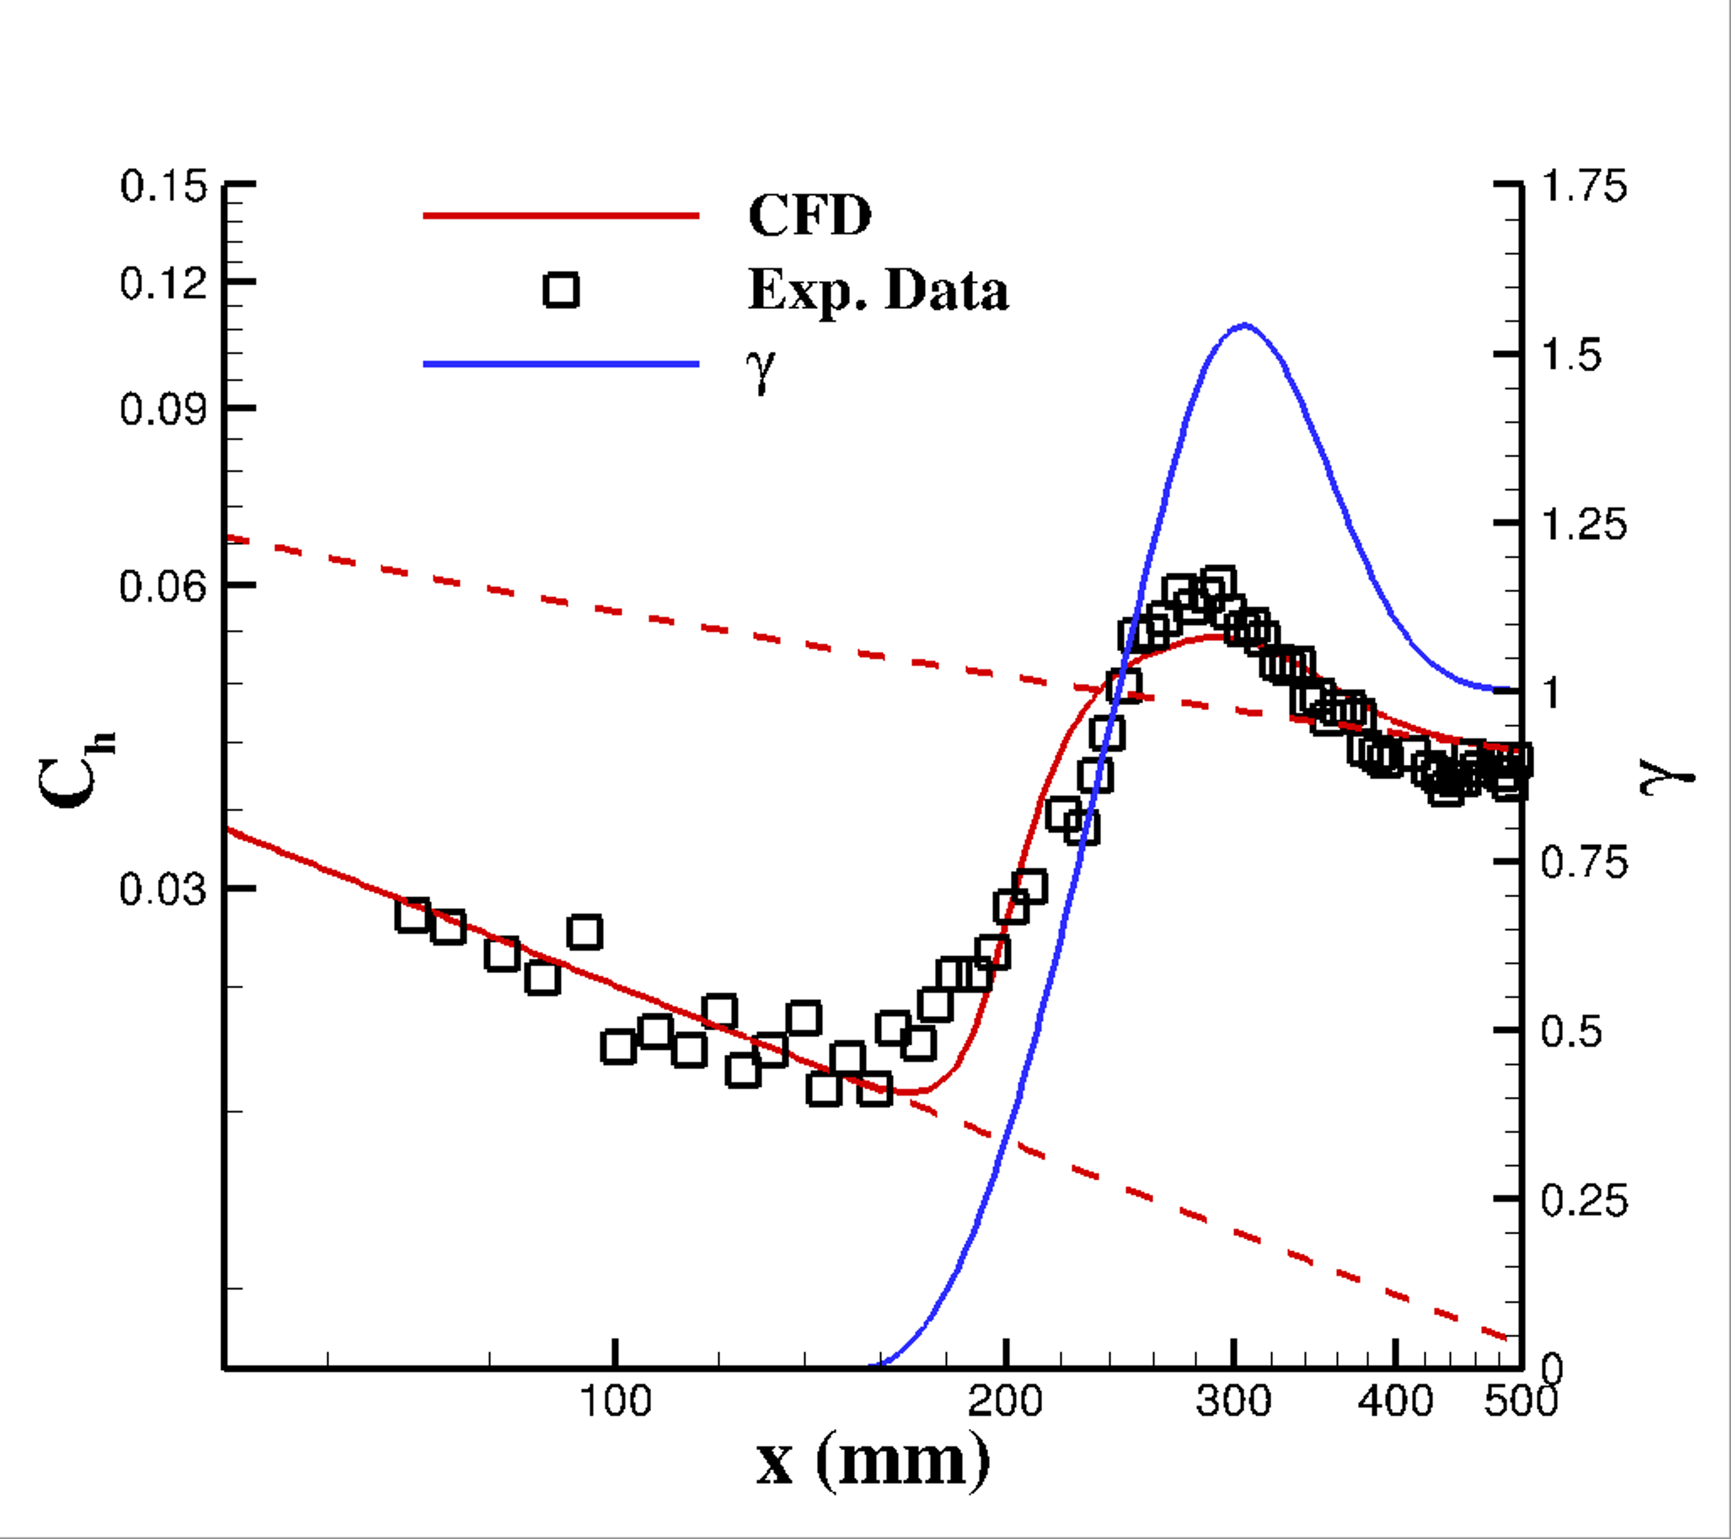
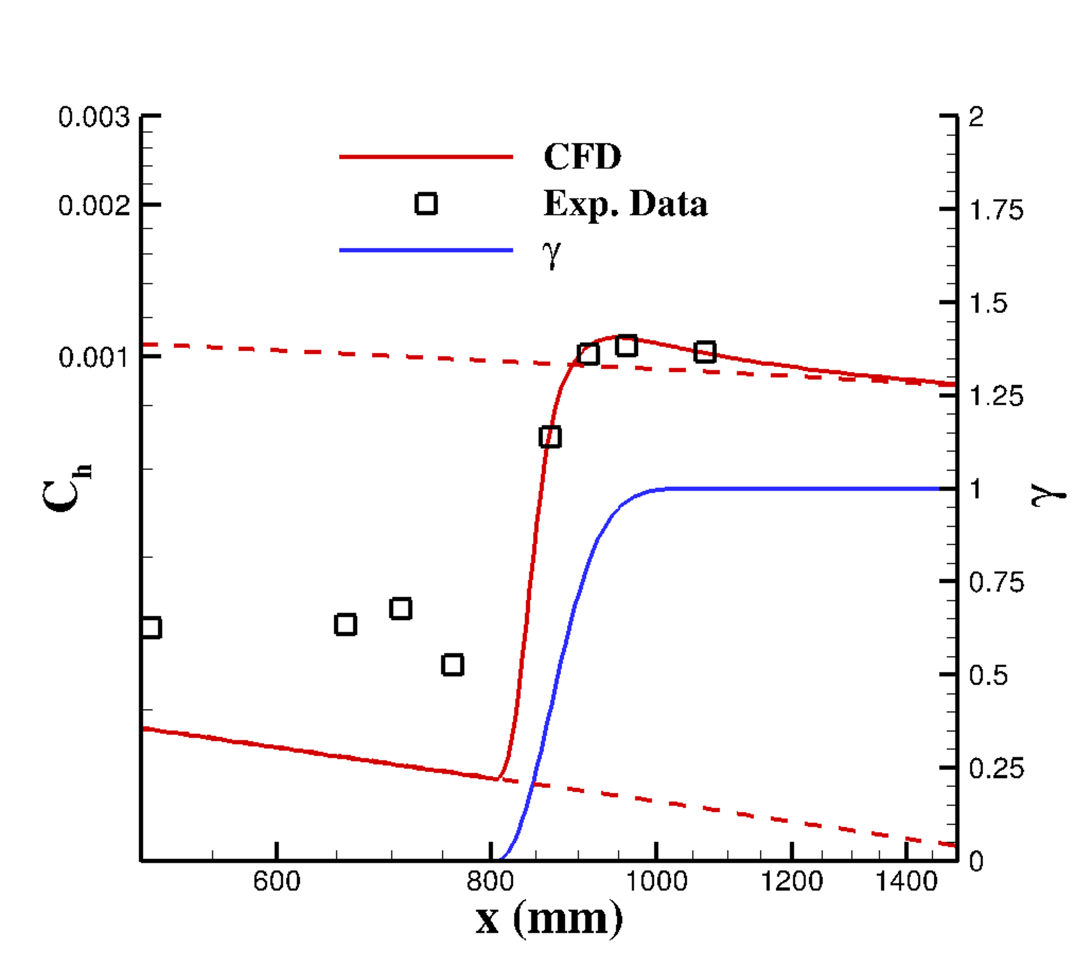
Identification of Intermittency Parameters
Each test case is simulated 200 times
  Optimization repeated for select cases to ensure consistency
Agreement with experimental transition characteristics was achieved in all test cases
Convergence of these test cases provide a basis to compare freestream parameters to intermittency parameters
With the intermittency parameters for the training data known, a model can be developed
14

Slide 15
Outline
Introduction
Coupled LASTRAC-CFD analysis
Form of the Intermittency Model
Determination of Intermittency Model Parameters
Development of the Intermittency Model
Summary and Observations
Ongoing/Future Work
Conclusions

Slide 16
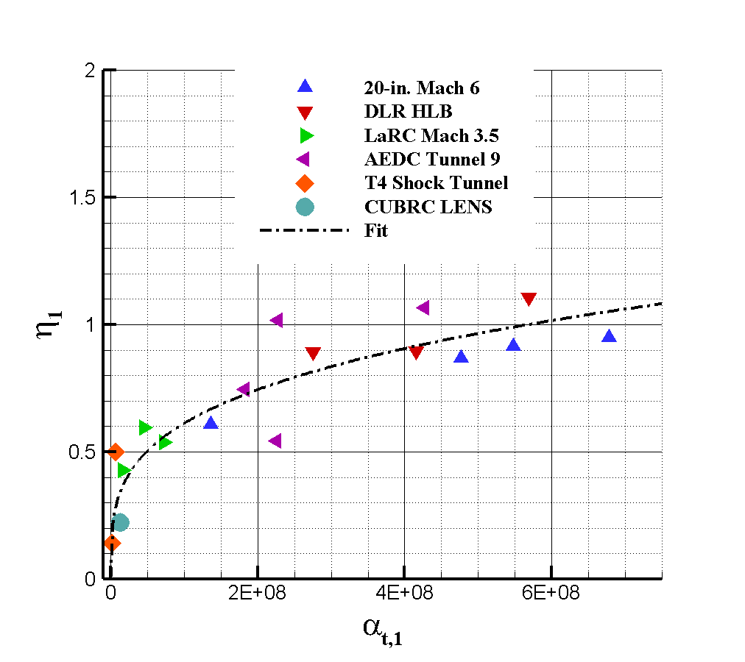
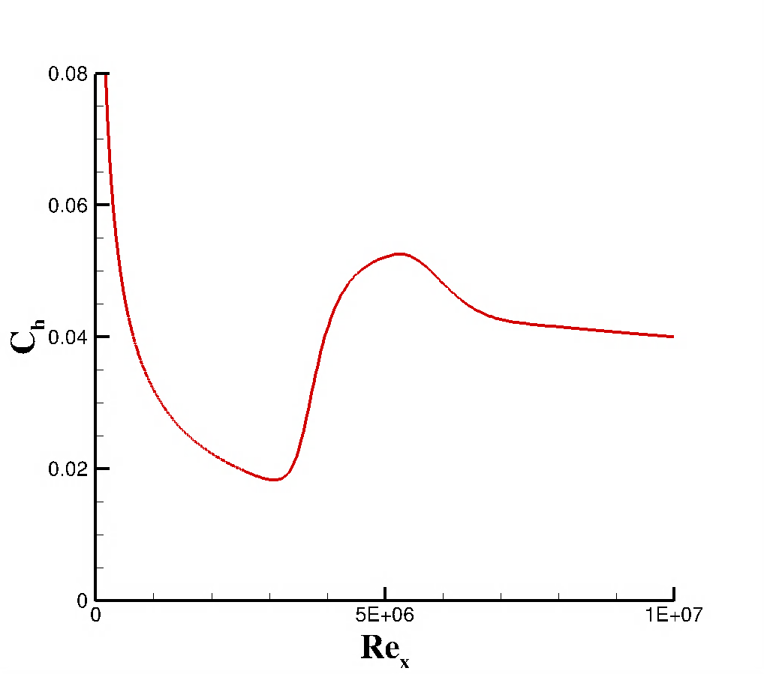
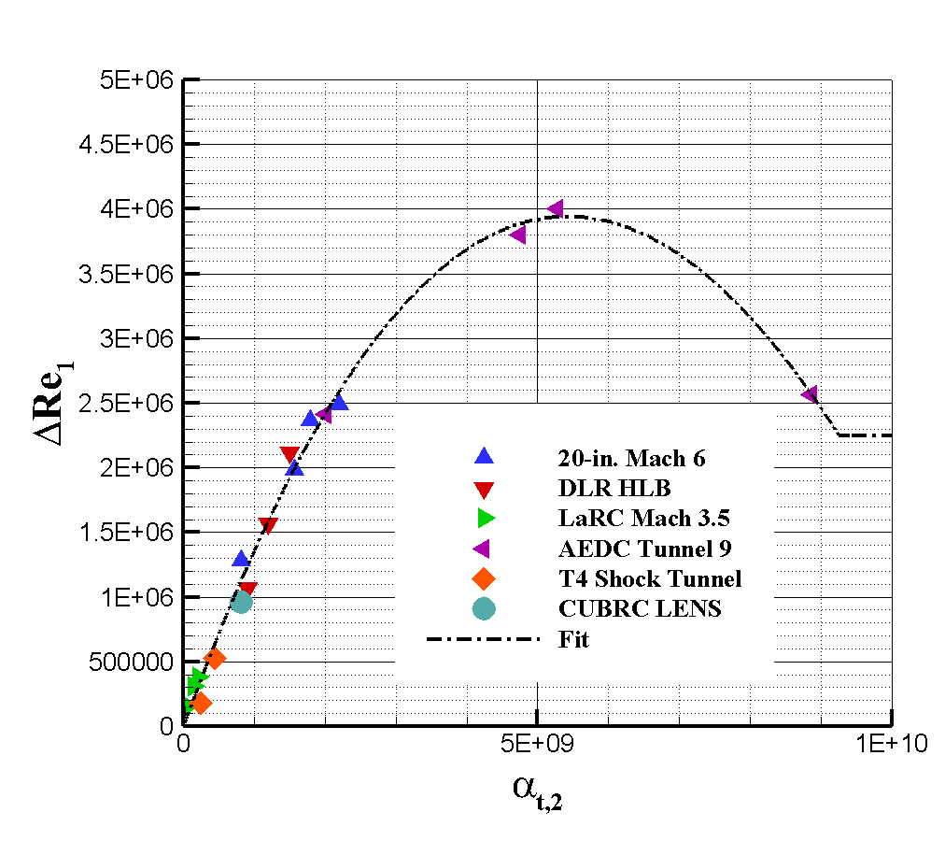


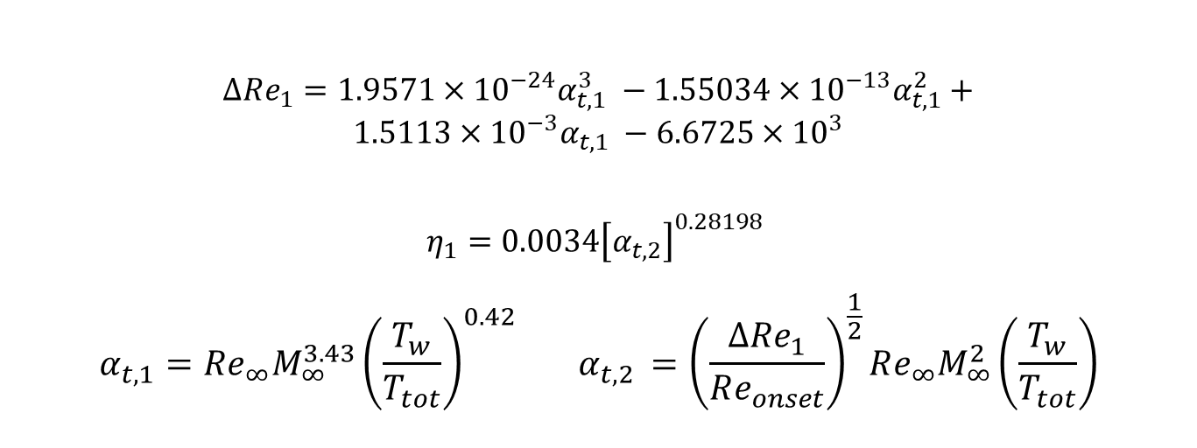
Intermittency Model: Baseline Parameters
Because onset location will be known in practice, the five parameters are reduced to 4 for the model.
Presently, ground and flight test correlations are separated
  Merging the distinct correlations is a future goal
$$ΔRe_{1}$$
$$ΔRe_{2}$$
$$ΔRe_{1}=1.9571×{10}^{−24}α_{t,1}^{3} −1.55034×{10}^{−13}α_{t,1}^{2}+$$
$$1.5113×{10}^{−3}α_{t,1} −6.6725×{10}^{3}$$
$$η_{1}=0.0034{\left[α_{t,2}\right]}^{0.28198}$$
$$α_{t,1}=Re_{∞}M_{∞}^{3.43}{\left(\frac{T_{w}}{T_{tot}}\right)}^{0.42} α_{t,2 }={\left(\frac{ΔRe_{1}}{Re_{onset}}\right)}^{\frac{1}{2}}Re_{∞}M_{∞}^{2}\left(\frac{T_{w}}{T_{tot}}\right)$$
16

Slide 17
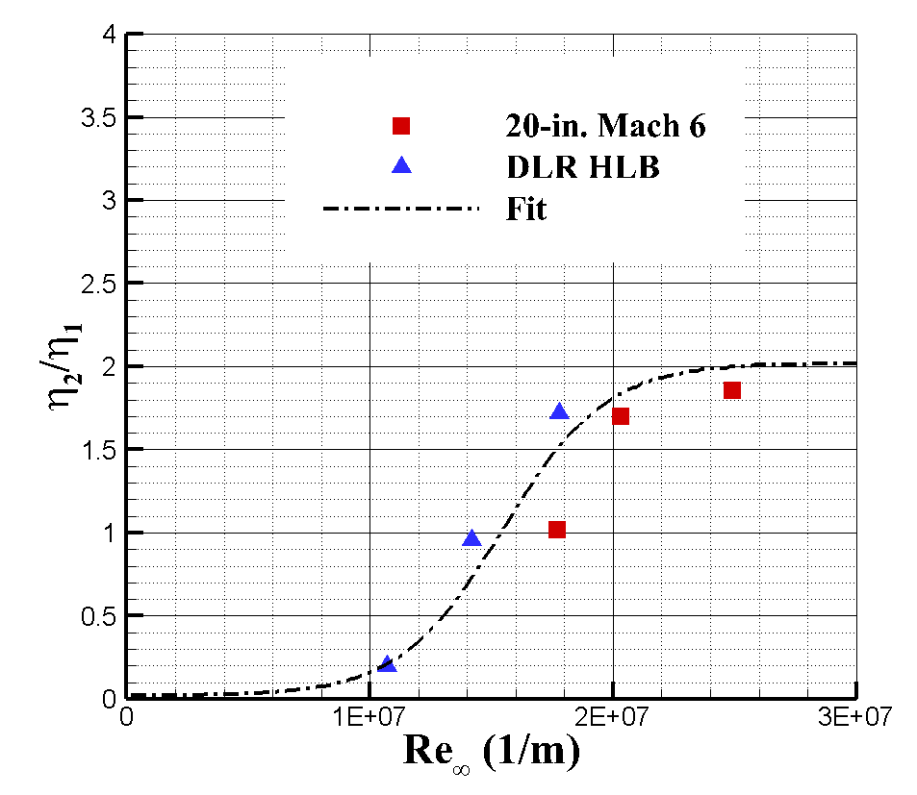
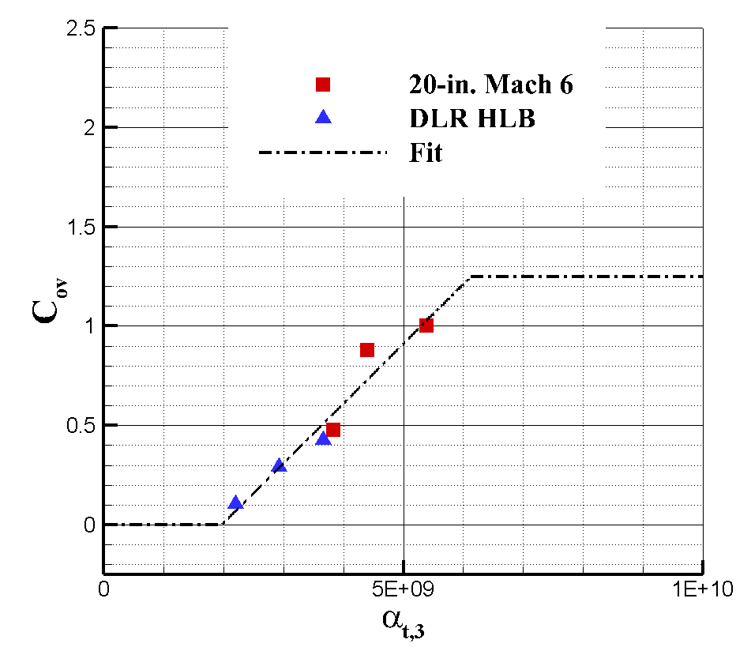
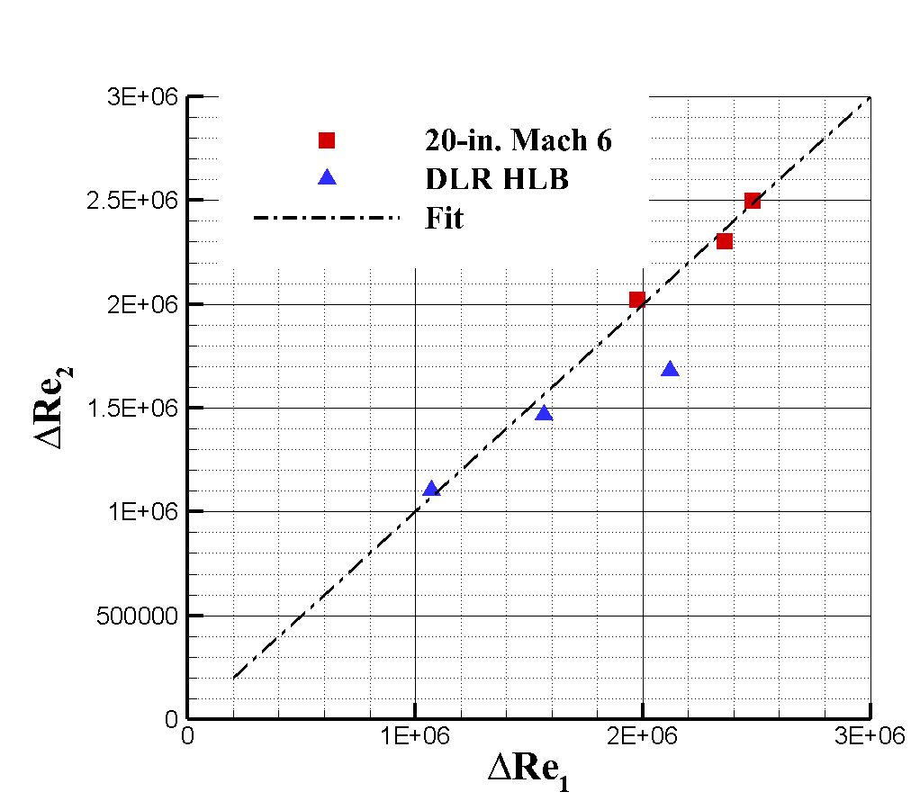
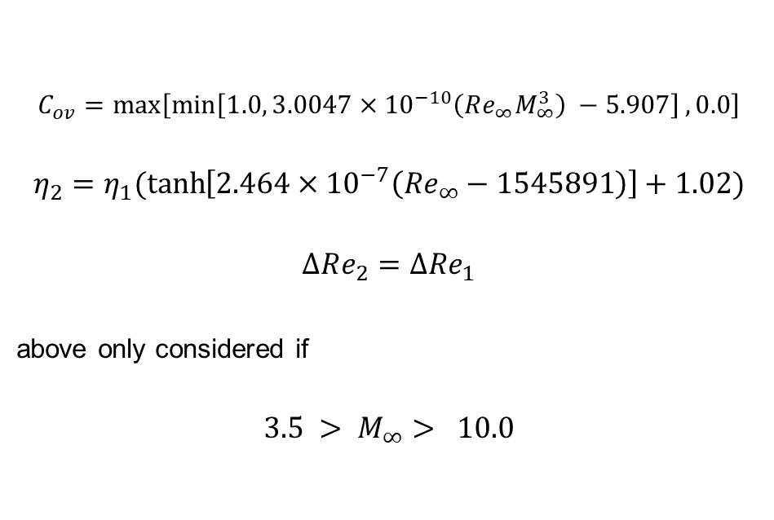
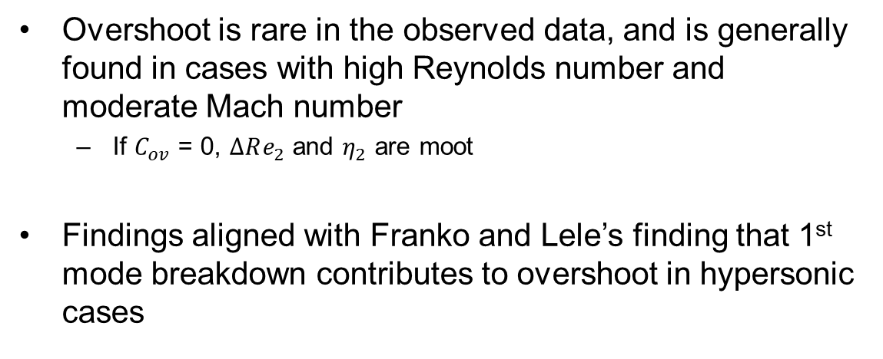
Intermittency Model: Overshoot Cases
Overshoot is rare in the observed data, and is generally found in cases with high Reynolds number and moderate Mach number
  If $C_{ov}$ = 0, $ΔRe_{2}$ and $η_{2}$ are moot
Findings aligned with Franko and Lele’s finding that 1st mode breakdown contributes to overshoot in hypersonic cases
$$C_{ov}=\max\left[\min\left[1.0, 3.0047×{10}^{−10}\left(Re_{∞}M_{∞}^{3}\right) −5.907\right],0.0\right]$$
$$η_{2}=η_{1}(\tanh\left[2.464×{10}^{−7}\left(Re_{∞}−1545891\right)\right]+1.02)$$
$$ΔRe_{2}=ΔRe_{1}$$
above only considered if
$${3.5 > M}_{∞}> 10.0$$
17

Slide 18
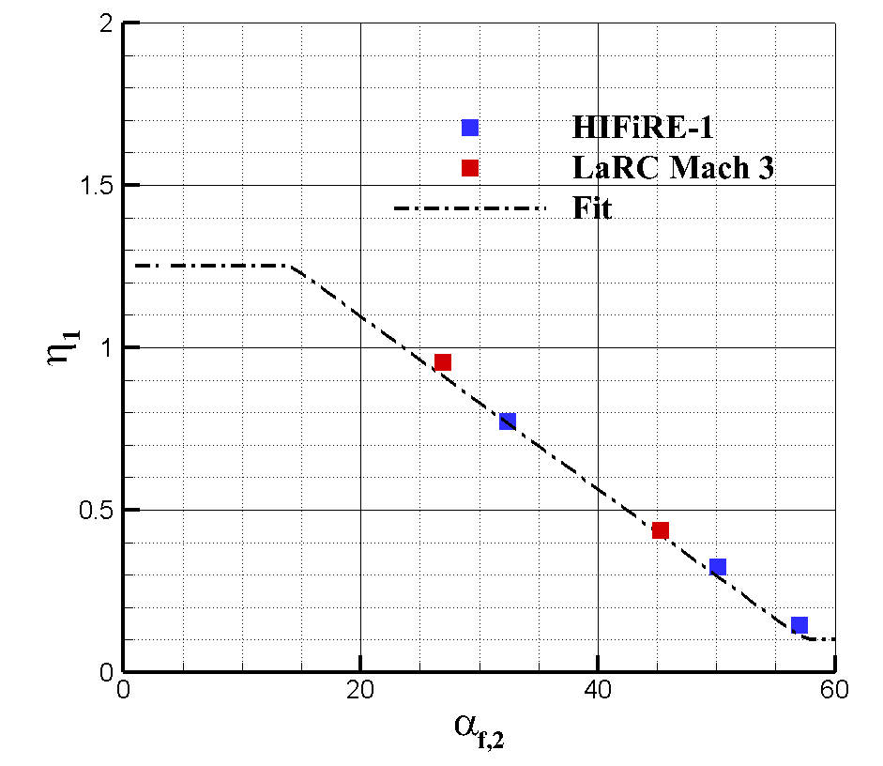
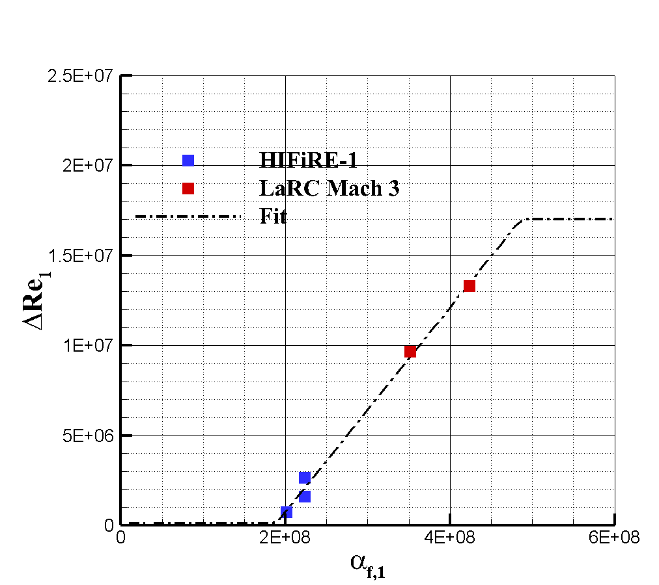
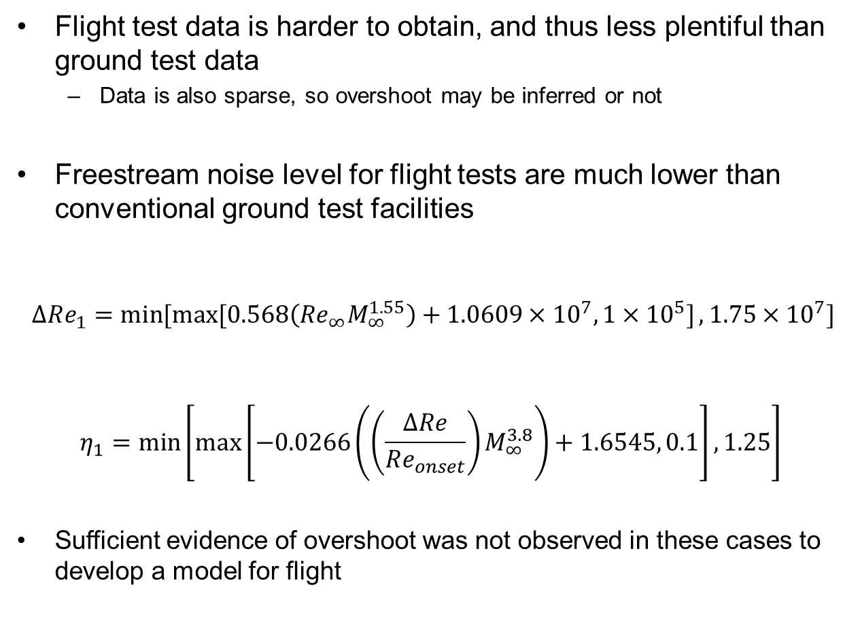
Intermittency Model: Flight Cases
Flight test data is harder to obtain, and thus less plentiful than ground test data
  Data is also sparse, so overshoot may be inferred or not
Freestream noise level for flight tests are much lower than conventional ground test facilities
$$ΔRe_{1}=\min{[\max{[0.568\left(Re_{∞}M_{∞}^{1.55}\right)+1.0609}×{10}^{7}, 1×{10}^{5}]}, 1.75×{10}^{7}]$$
$$η_{1}=\min\left[\max\left[−0.0266\left(\left(\frac{ΔRe}{Re_{onset}}\right)M_{∞}^{3.8}\right)+1.6545, 0.1\right],1.25\right]$$
Sufficient evidence of overshoot was not observed in these cases to develop a model for flight
18

Slide 19
Outline
Introduction
Coupled LASTRAC-CFD analysis
Form of the Intermittency Model
Determination of Intermittency Model Parameters
Development of the Intermittency Model
Summary and Observations
Ongoing/Future Work
Conclusions

Slide 20
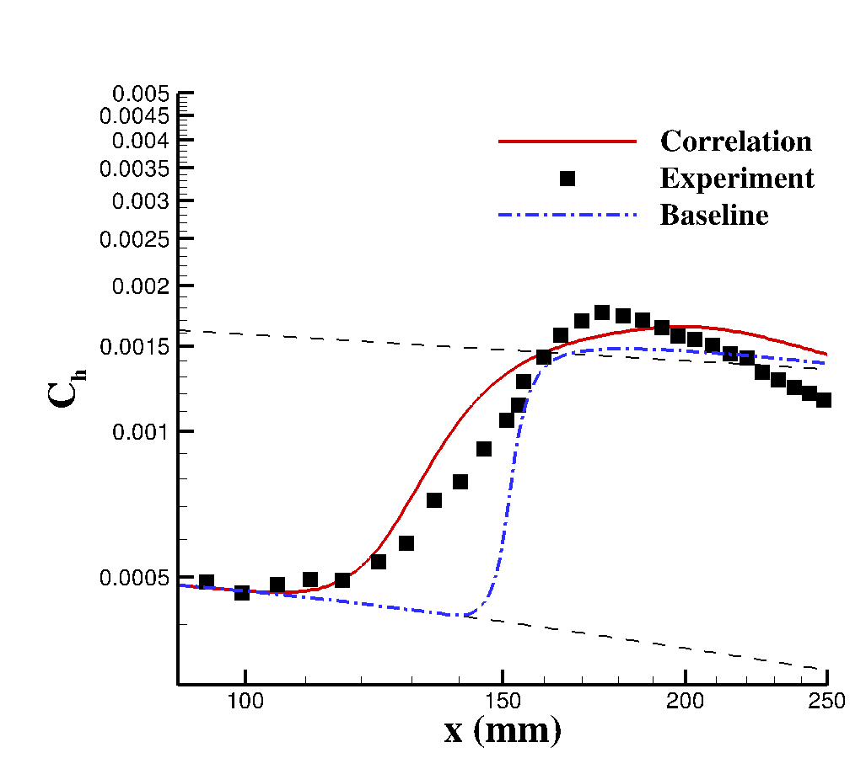
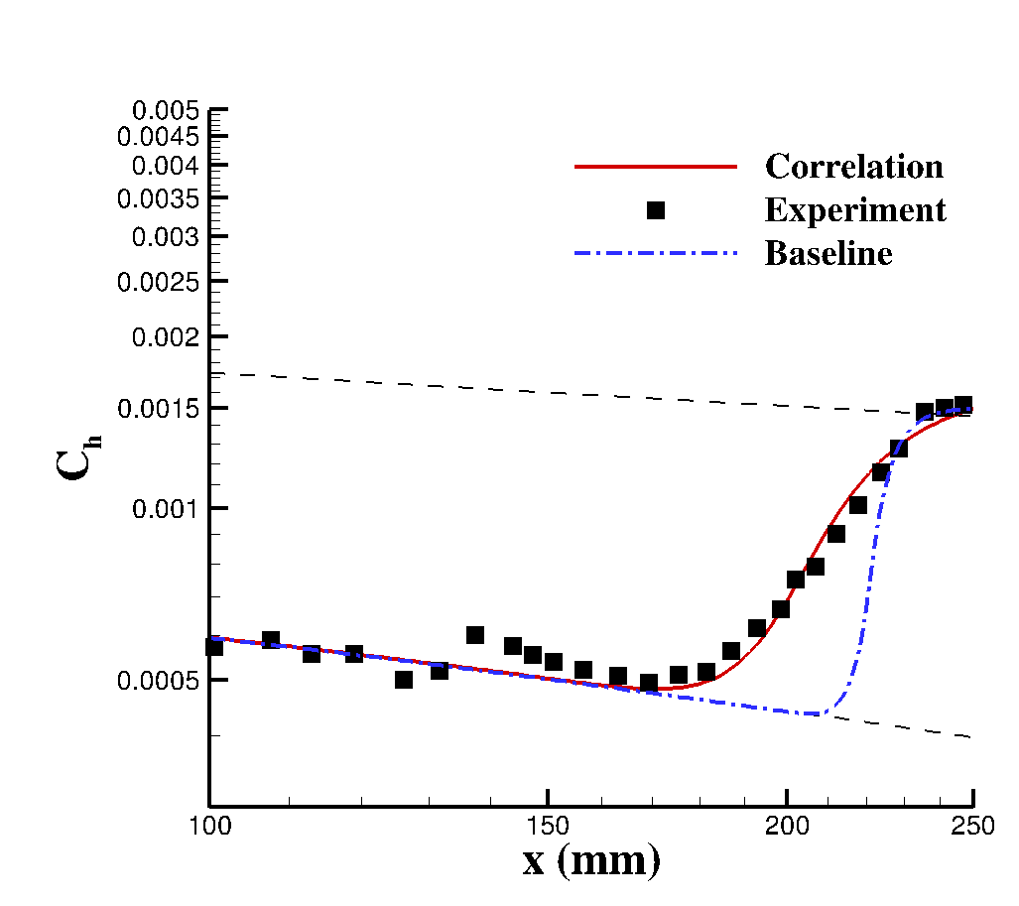
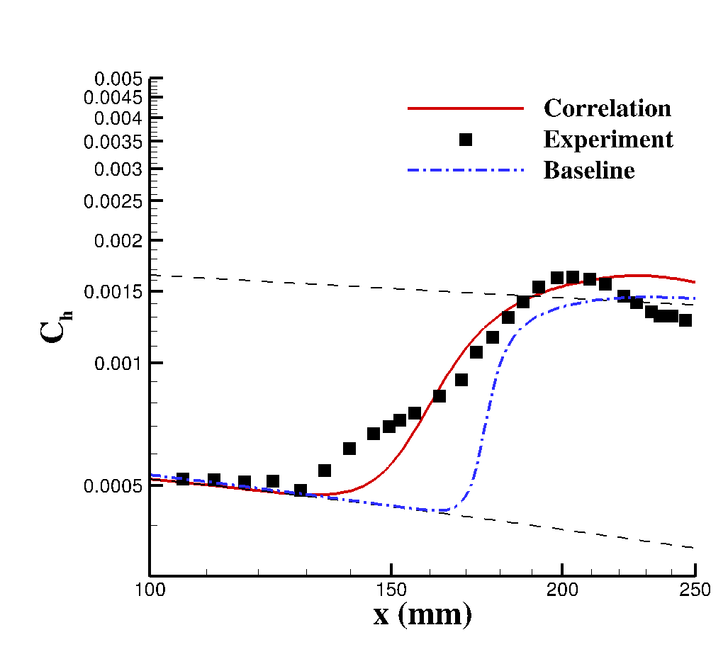
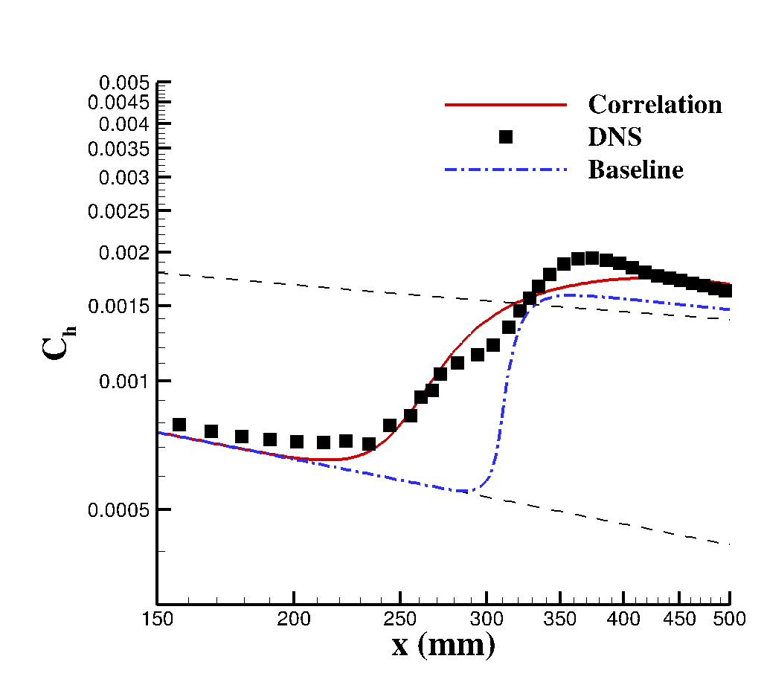
Independent Test Cases
Four VKI cases are held aside to evaluate the performance of the model for ground test cases
  Three cases are experimental data, and one case is “virtual tunnel” DNS
Model provides significant improvement over the baseline model
Higher Reynolds number cases show more disagreement
Experimental turbulent values disagrees slightly with SA downstream of transition
M = 6
Re = 2.71e7 /m
M = 6
Re = 1.81e7 /m
M = 6
Re = 2.28e7 /m
M = 8
Re = 1.22e7 /m
20

Slide 21
Outline
Introduction
Coupled LASTRAC-CFD analysis
Form of the Intermittency Model
Determination of Intermittency Model Parameters
Development of the Intermittency Model
Summary and Observations
Ongoing/Future Work
Conclusions

Slide 22
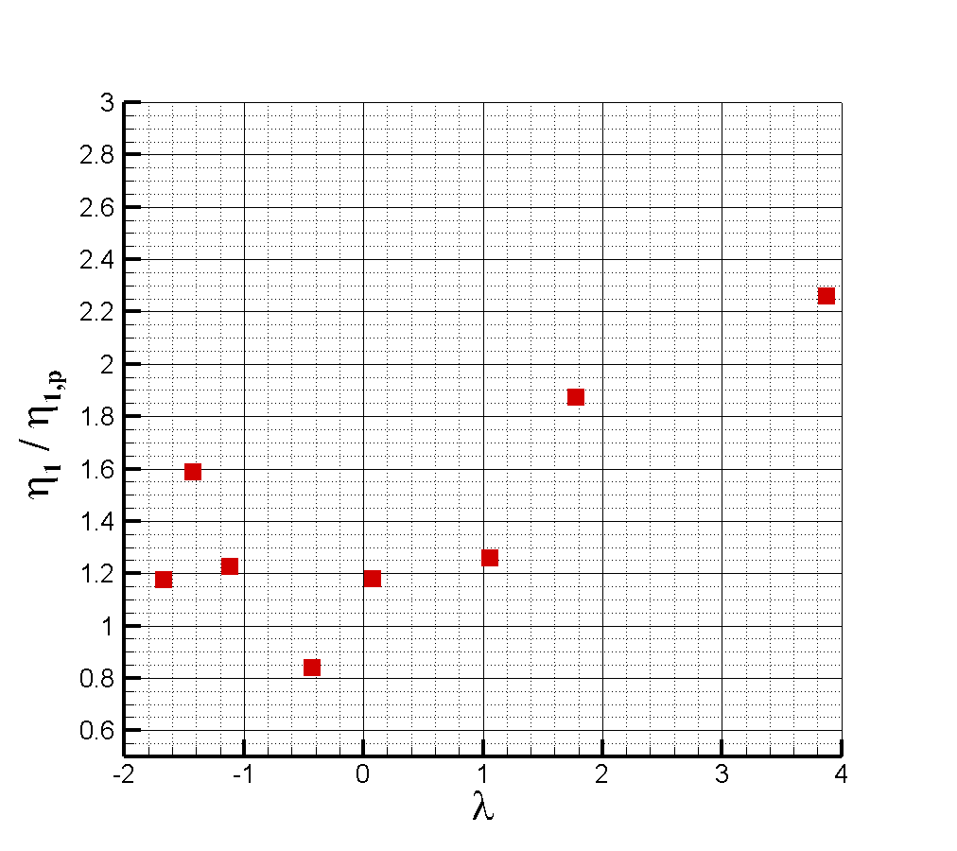
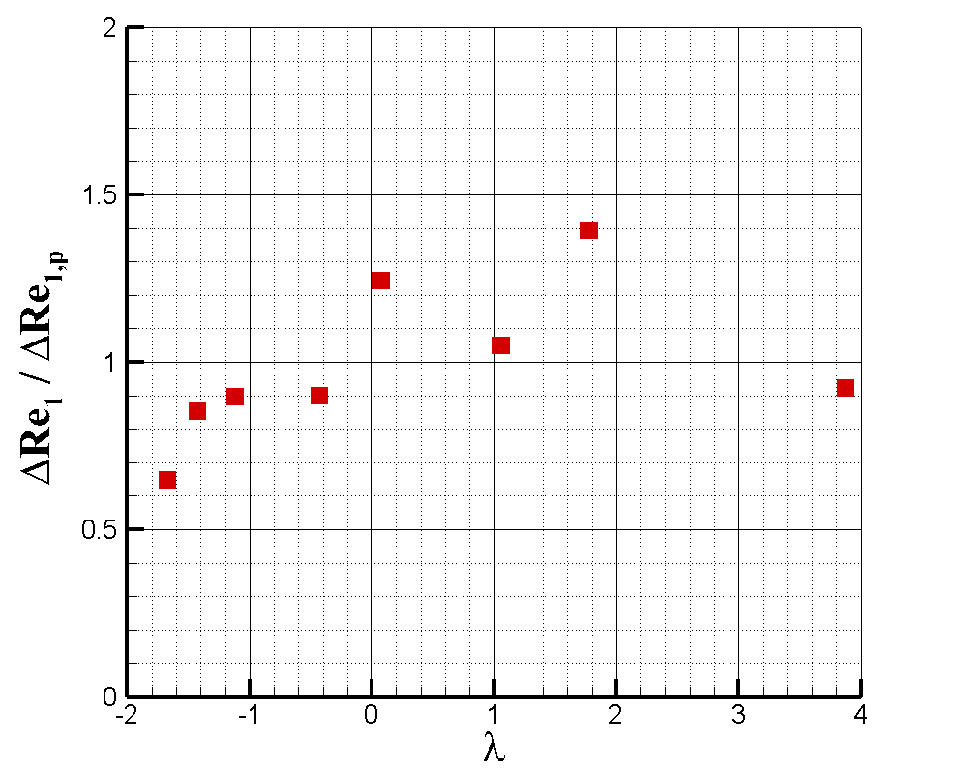
Ongoing Work: Pressure Gradient
Kimmel et al. provide data with nonzero pressure gradient
  Corresponds to experiments in AEDC tunnel B
  Older than most other data sets in the study
Transition zone width, exponent, and potentially overshoot are dependent on pressure gradient
  Both cases appear to approximately recover the baseline
Reynolds number is lower than other ground test cases
  Need additional straight cone data to extricate low-Reynolds number effects and pressure gradient effects
Data demonstrate significant scatter in transition location and overshoot
22

Slide 23
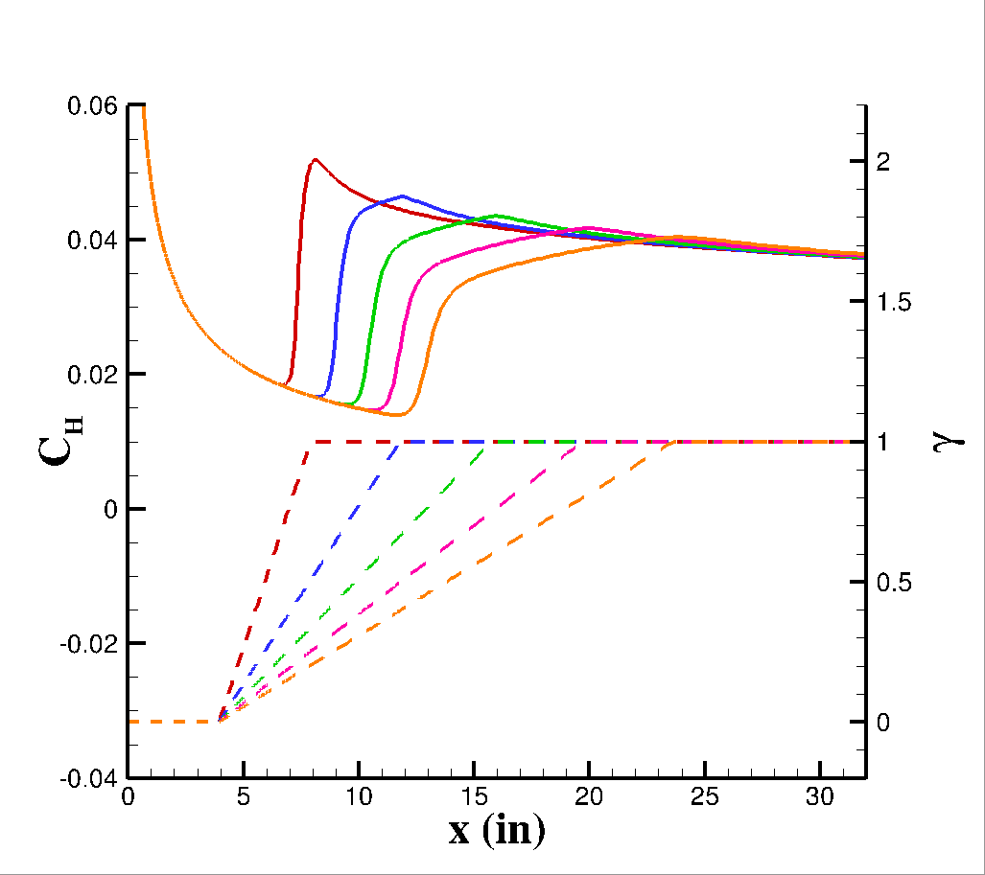
Other Ongoing Work
Variable Turbulent Eddy Viscosity (μ_{T}):
  The present model assumes a constant (large) freestream eddy viscosity ratio
  Preliminary analysis finds that allowing the optimizer to change eddy viscosity may yield relationship between optimum freestream eddy viscosity ratio and noise level
    Optimum μ_{T} for LaRC Mach 6 cone ≈ 84
    Optimum μ_{T} for HIFiRE-1 Flight Test ≈ 3
  Potential to merge flight cases with rest of database
Additional Test Cases
  CUBRC LENS cases for high Mach number, low Reynolds number cases
  Investigate the impact of nose bluntness Reynolds number
Integration with Other Models
  Process of developing the model is generalizable to arbitrary modeling and CFD inputs/outputs
    Can change the parameters of the present model (i.e. adding μ_{T})
  Relax SA modification and/or integrate with SST
Response of the unmodified SA-neg turbulence model to various intermittency distributions
23

Slide 24
Outline
Introduction
Coupled LASTRAC-CFD analysis
Form of the Intermittency Model
Determination of Intermittency Model Parameters
Development of the Intermittency Model
Summary and Observations
Ongoing/Future Work
Conclusions

Slide 25
Conclusions
An intermittency model has been developed for use with coupled CFD-stability analysis
  The model considers cases over a broad range of Mach number, Reynolds number, and freestream noise environment
The model utilizes a Gaussian distribution of intermittency and a modification to the application of the SA-neg-noft2 turbulence model
Model demonstrates significant improvement over baseline intermittency distribution for all test cases examined
Future work will focus on the effects of freestream turbulent eddy viscosity ratio, pressure gradient, and turbulence model
Process for model tuning is amenable to applications for other model forms, including transport-based transition models (Langtry Menter, Coder AFT, etc.)
25

Slide 26
References
Kimmel, R. L., Adamczak, D., Paull, A., Paull, R., Shannon, J., adn Myles Frost, R. P., and Alesi, H., “HIFiRE-1 Ascent-Phase Boundary-Layer Tranition,” Journal of Spacecraft and Rockets, Vol. 52, No. 1, 2015. https://doi.org/10.2514/1.A32851.
Horvath, T. J., Berry, S. A., Hollis, B. R., Chang, C.-L., and Singer, B. A., “Boundary Layer Transition on Slender Cones in Conventional and Low Disturbance Mach 6 Wind Tunnels,” 32nd Fluid Dynamics Conference and Exhibit, American Institute of Aeronautics and Astronautics, 2002.
Chen, F.-J., Malik, M. R., and Beckwith, I. E., “Boundary-Layer Transition on a Cone and Flat Plate at Mach 3.5,” AIAA Journal, Vol. 27, No. 6, 1989.
Wagner, A., Kuhn, M., Schramm, J. M., and Hannemann, K., “Experiments on Passive Hypersonic Boundary layer control using ultrasonically absorptive carbon–carbon material with random microstructure,” Experiments in Fluids, Vol. 54, No. 10, 2013, pp. 1606–1616. https://doi.org/10.1007/s00348-013-1606-3.
Franko, K. J., and Lele, S. K., “Breakdown Mechanisms and Heat Transfer Overshoot in Hypersonic Zero Pressure Gradient Boundary Layers,” Journal of Fluid Mechanics, Vol. 730, 2013, p. 491–532. https://doi.org/10.1017/jfm.2013.350.
Merlet, C. F., and Rumsey, C. B., “Supersonic Free-Flight Measurements of Heat Transfer and Transition on a 10 degree Cone having a Low Temperature Ratio,” , March 1961. NASA TN D-951.
Grossir, G., Masutti, D., and Chazot, O., “Flow characterization and- boundary layer transition studies in VKI hypersonic facilities (Invited),” AIAA Paper 2015-0578, 2015. https://doi.org/10.2514/6.2015-0578.
Marineau, E. C., Moraru, G., Lewis, D. R., Norris, J. D., Lafferty, J. F., and Johnson, H. B., “Investigation of Mach 10 Boundary Layer Stability of Sharp Cones at Angle-of-Attack, Part 1: Experiments,” AIAA Paper 2015-1737, 2015. https://doi.org/10.2514/6.2015-1737.
Spalart, P. R., and Allmaras, S. R., “A One-Equation Turbulence Model for Aerodynamic Flows,” AIAA Paper 1992-439, 1994. https://doi.org/10.2514/6.1992-439.
Narasimha, R., “The Laminar-Turbulent Transition Zone in the Boundary Layer,” Progress in Aerospace Sciences, Vol. 22, 1985, pp. 29–80. https://doi.org/10.1016/0376-0421(85)90004-1.
Hildebrand, N., Chang, C.-L., Choudhari, M. M., Li, F., Nielson, E., Venkatachari, B. S., and Paredes, P., “Coupling of the FUN3D Unstructured Flow Solver to the LASTRAC Stability Code to Model Transition,” AIAA Paper 2022-1952, 2022. https://doi.org/10.2514/6.2022-1952.
26

Slide 27
Acknowledgements
This research is sponsored by the NASA Hypersonic Technology Project (HTP)
Computations included in this work were utilized the LaRC K midrange supercomputing cluster along with the computational resources provided by the NASA High-End Computing (HEC) Program through the NASA Advanced Supercomputing (NAS) Division at the Ames Research Center.
27

Slide 28
Thank you!

