Slide 1
Sensitivity of Simulated Radiative Emission from Nitrogen Flows to Chemical Parameters
Kaelan Hansson¹,
Brett Cruden¹, Thomas West², and Aaron Brandis³
¹AMA Inc. at NASA Ames, ²NASA Langley Research Center, ³NASA Ames Research Center
AIAA SciTech 2025
Notes:
TODO: Affiliations

Slide 2
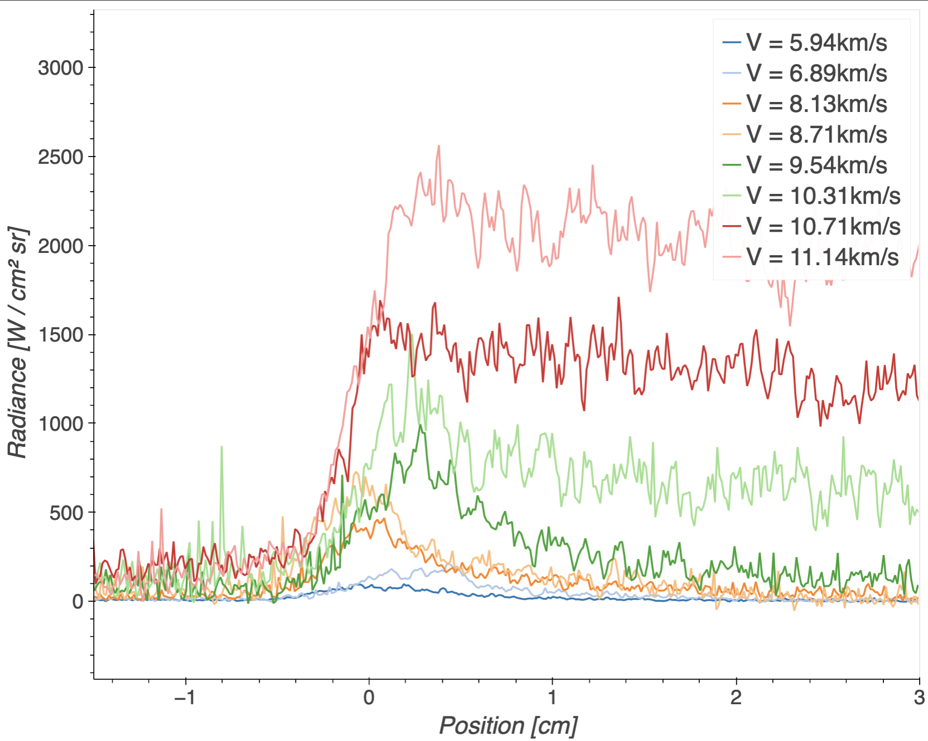
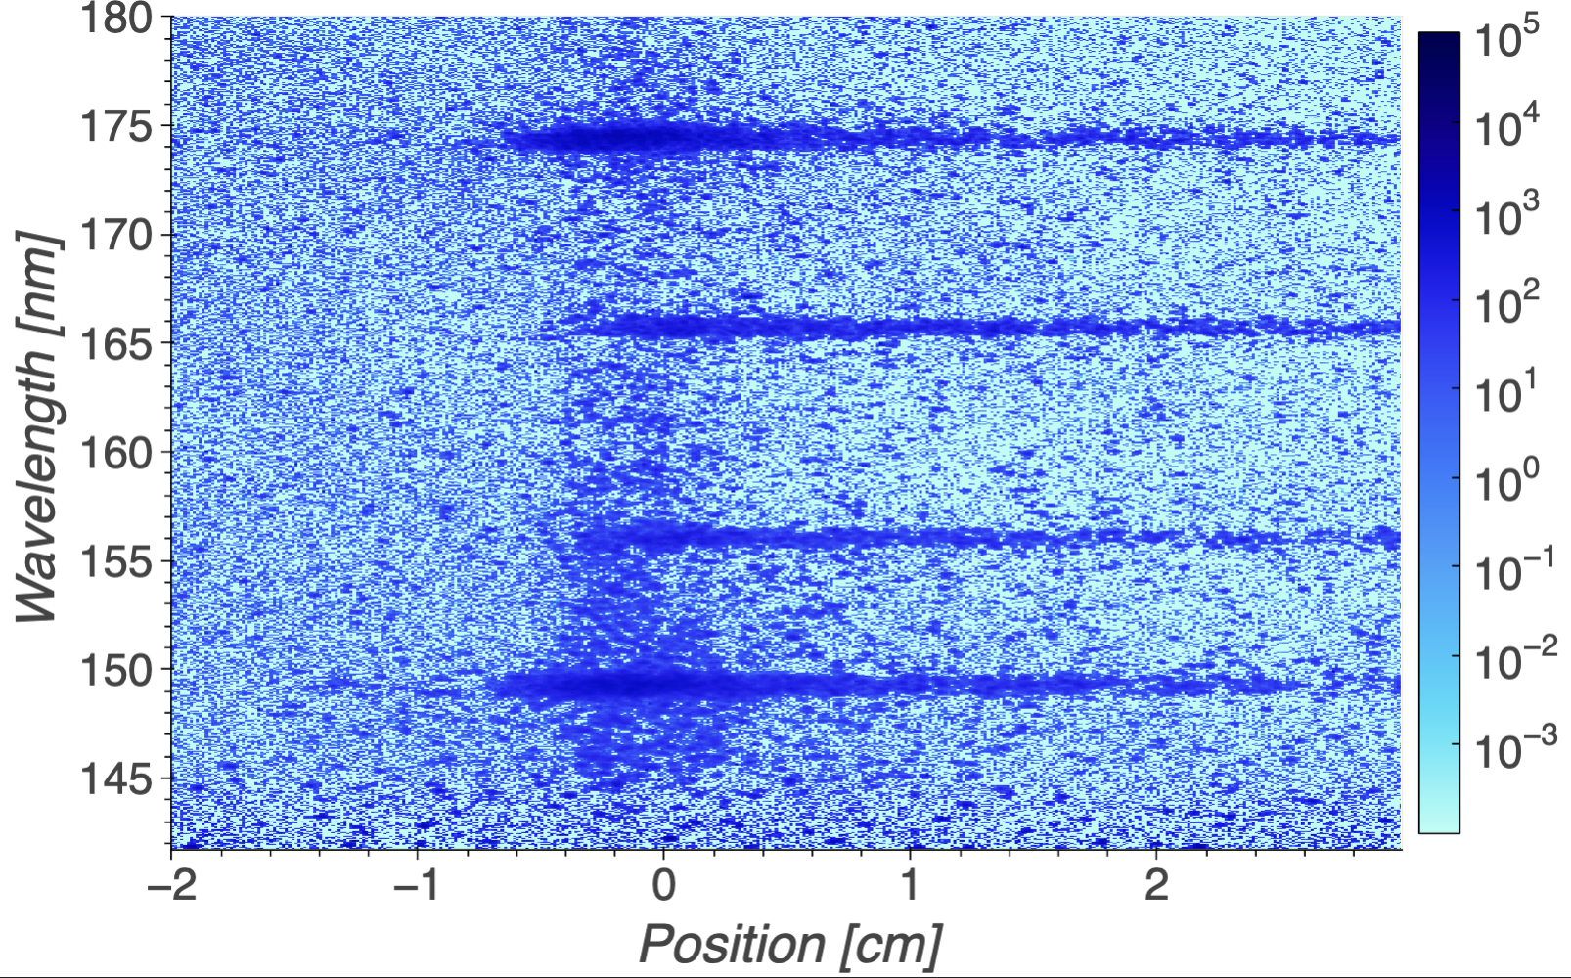
EAST Experiment
Pure nitrogen campaign (Test 62)
Velocities range from 6 to 11 km/s
Burst Diaphragm
Electric Arc
Camera

Slide 3
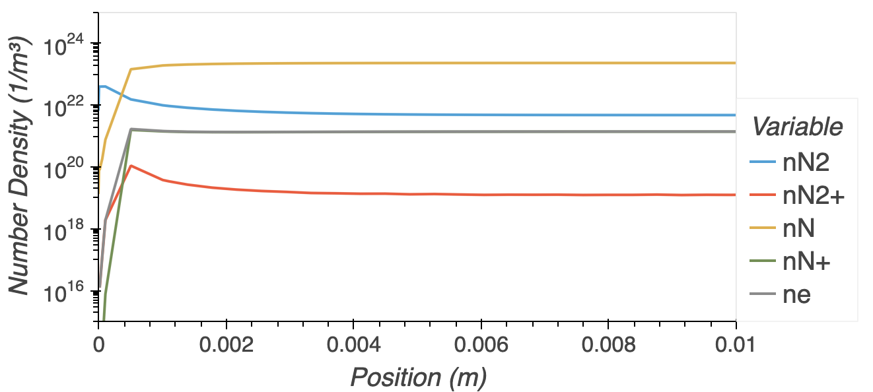
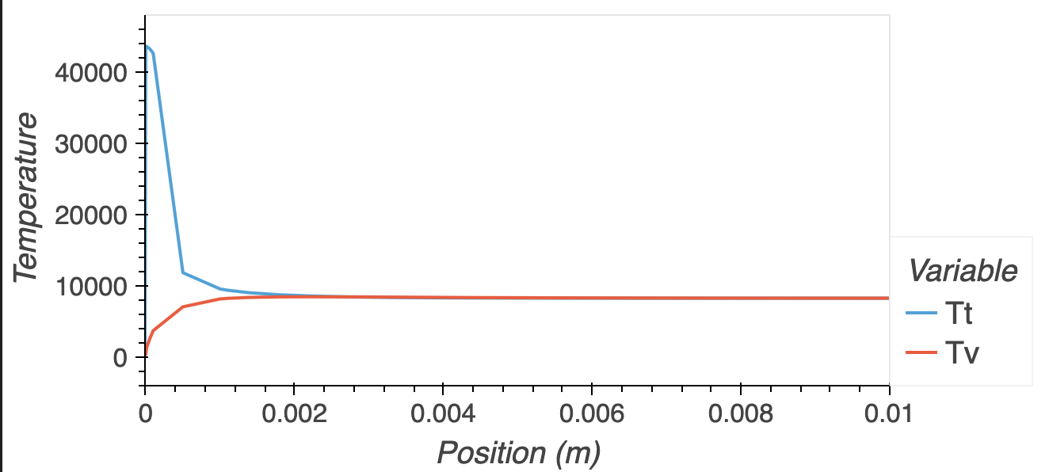
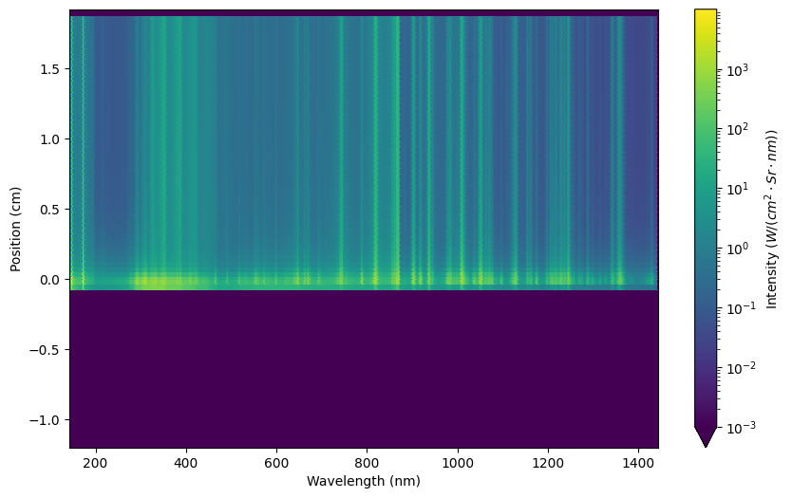
Modeling : DPLR - NEQAIR
CFD: DPLR
  Same software used for predictions of heating for flight missions
  Relies on database of non-equilibrium thermochemical data
Line-By-Line Spectra: NEQAIR
  Used for radiative heating predictions
  Uses a separate database of chemical data for state resolved Quasi Steady State (QSS) model
Inconsistencies between numerical models and experiments are often attributed to incorrect chemical parameters

Slide 4
Background
Current attempts to incorporate new data into DPLR-NEQAIR have resulted in poorer predictions.
Codependence of parameters requires wholistic calibration of rate data (Bayesian methods)
This calibration requires large software infrastructure to perform sampling and analysis
This framework can be verified by performing a sensitivity analysis
Focus on spectrally resolved sensitivities against a variety of chemical parameters
Electron Number Density in EAST (pure Nitrogen flow)
as predicted by various Nitrogen models
From Cruden 2018

Slide 5
Modeling : DPLR - NEQAIR
CFD: DPLR
  Run in space marching mode
    No viscosity
    Overpredicts at shock
  Calculates chemical and thermal evolution
Line-By-Line Spectra: NEQAIR
  Takes fluid data and calculates a spectra
  Quasi Steady State (QSS) assumption used to calculate excited states

Slide 6
Sampling Input Variables
Parameters Varied
Chemical rates in DPLR
  Reaction rates (4 parameters)
  Millikan and White relaxation times
QSS parameters in NEQAIR
  Heavy particle quenching rates
  Heavy particle dissociation rates
  Electron impact excitation rates and cross sections
  Predissociation times
Total number of parameters: 819
Parameters held constant
Shock speed
Camera convolution settings
Tube initial temperature
Tube pressure
Camera offsets
DPLR and NEQAIR use the same rate in different units
Some state specific rates in NEQAIR can be aggregated into DPLR rates
Large python library written to store chemical data with uncertainties and write out database files
Current Inconsistency: State resolved electron impact dissociation in NEQIAR against lumped reaction in DPLR
6

Slide 7
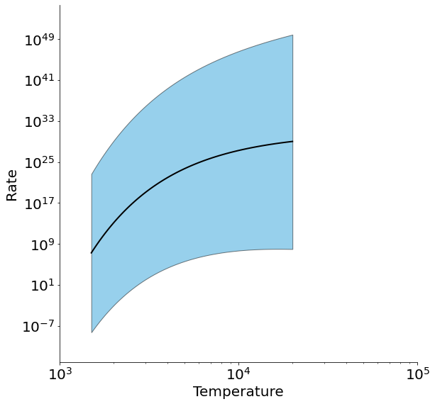
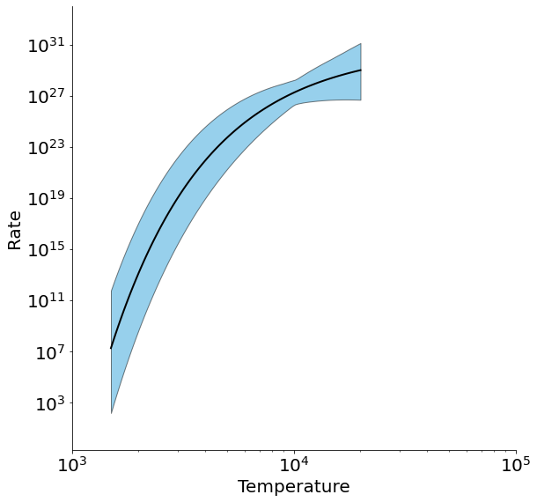
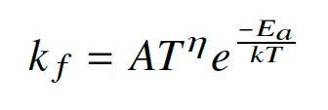
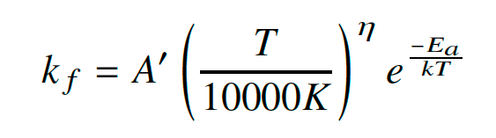
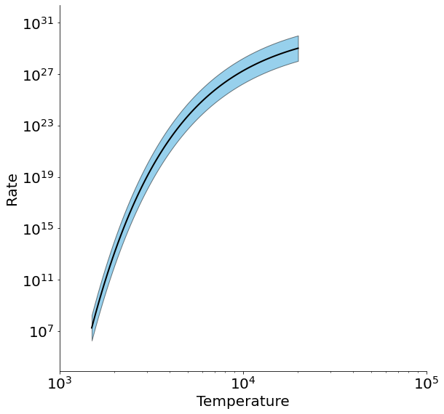
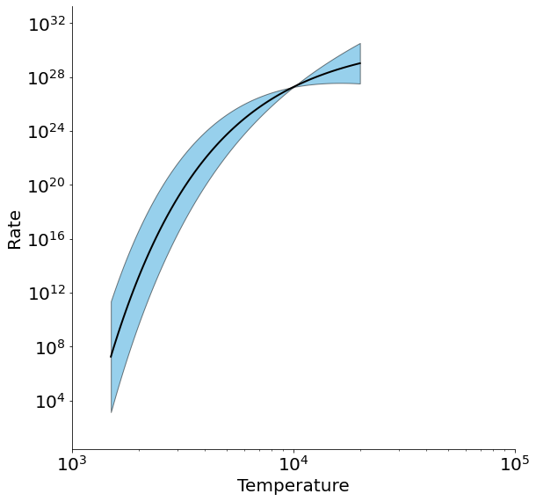
Reaction Rate Sampling
Sampling prefactor
Sampling exponent

Slide 8
Output Variables
Ten spectral ranges selected from Brandis et al.
Only take intensity from 0.5 to 1.0 cm behind the shock
Two metrics:
  Integrated radiance: Typically used for heat flux calculations
  Log-likelihood: Used for calculating the Bayesian posterior

Slide 9
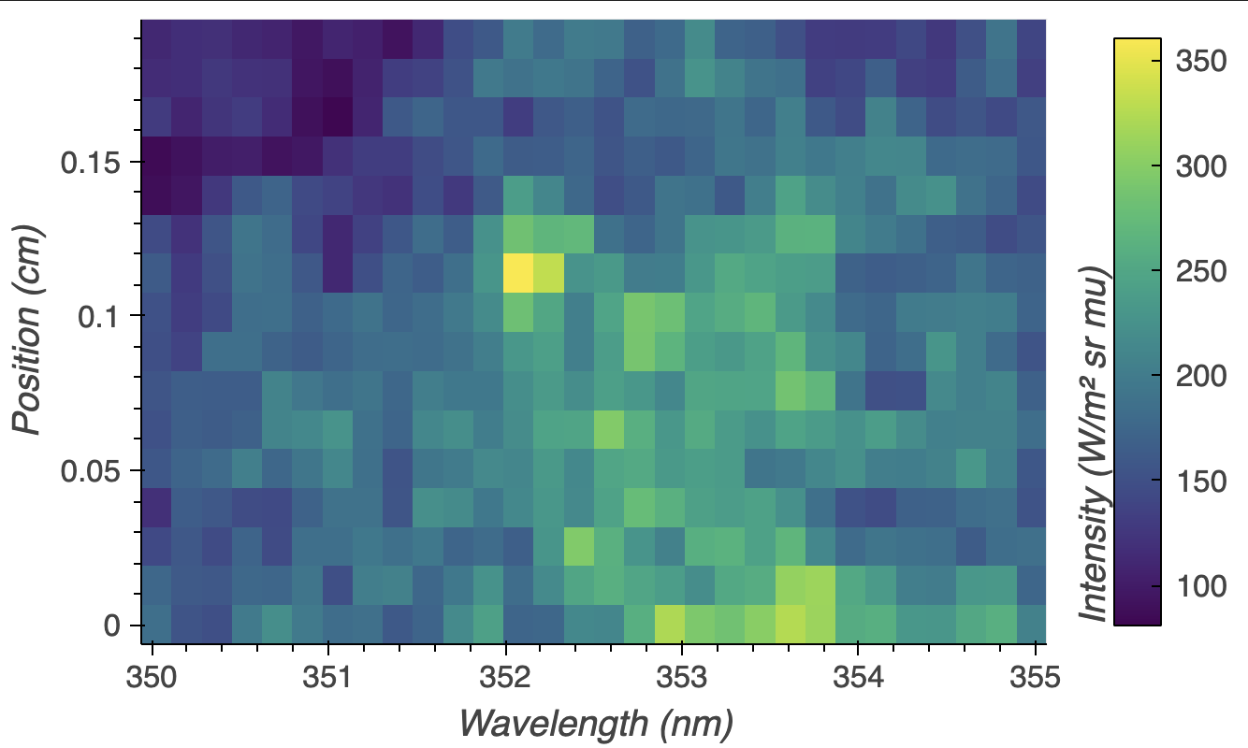
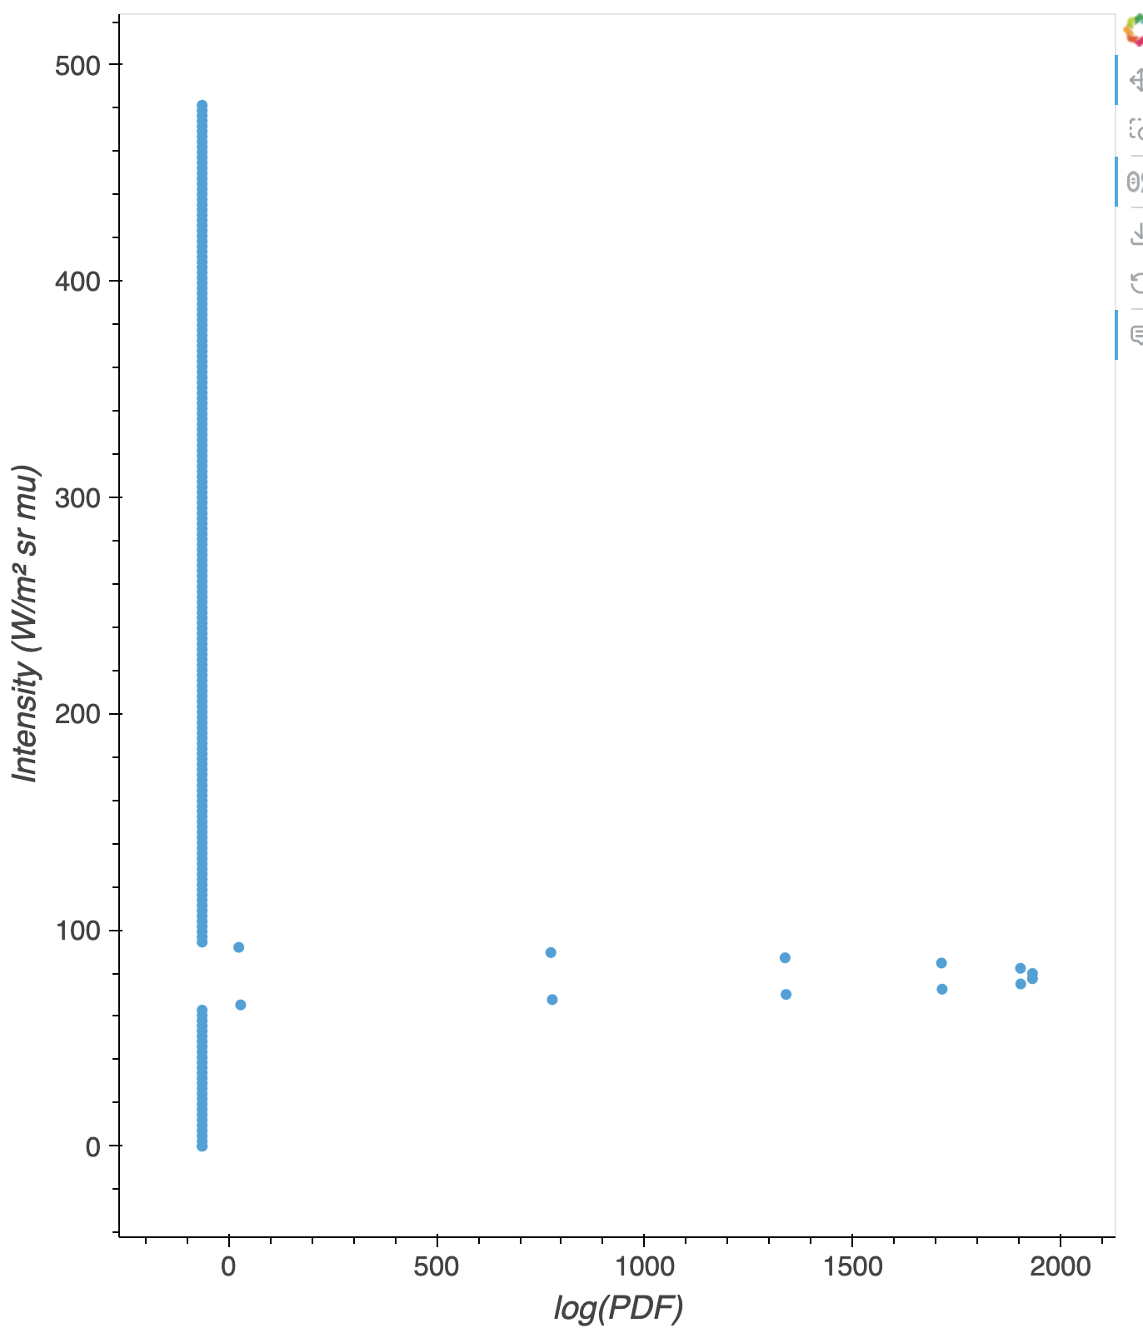
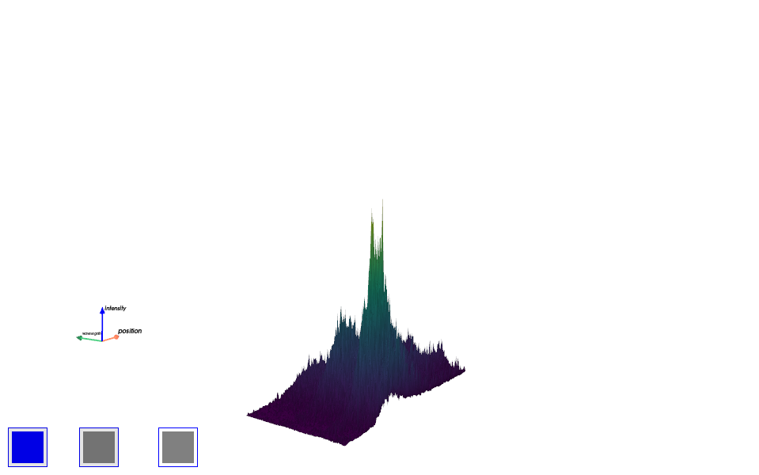
Log-Likelihood: Error Scoring
EAST

Slide 10
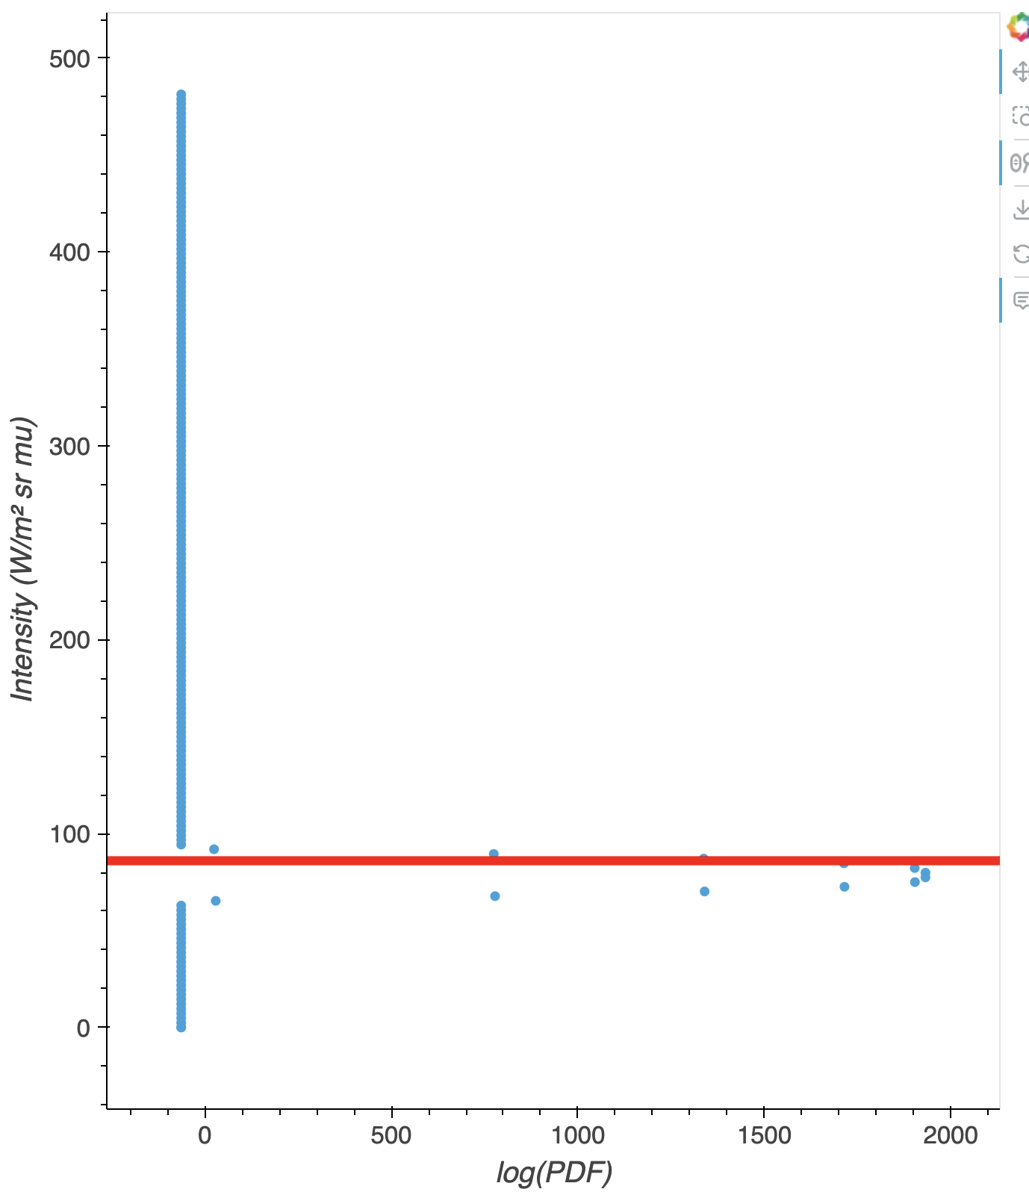
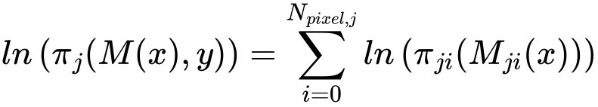
Log-Likelihood: Error Scoring
EAST
Analogous to root mean squared error!
NEQAIR
π | Likelihood function
M | Model evaluation
x | Chemical parameters
y | Experimental data

Slide 11
Output Variables
Ten spectral ranges selected from Brandis et al.
Only take intensity from 0.5 to 1.0 cm behind the shock
Two metrics:
  Integrated radiance: Typically used for heat flux calculations
  Log-likelihood: Used for calculating the Bayesian posterior

Slide 12
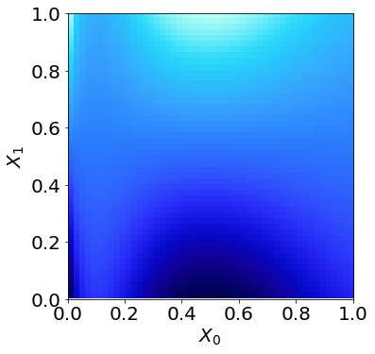
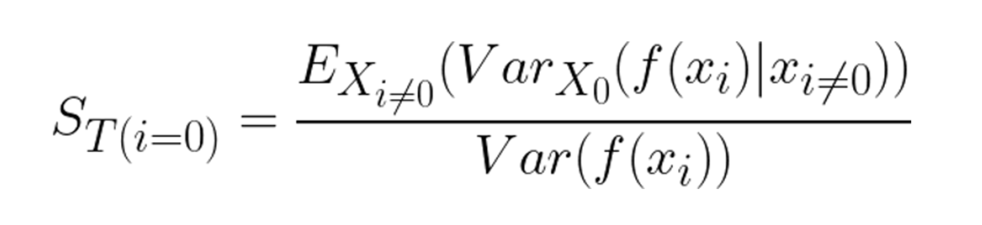
Total Sobol Index

Slide 13
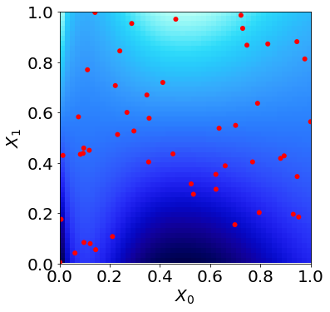
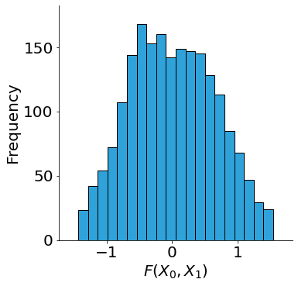
Total Sobol Index

Slide 14

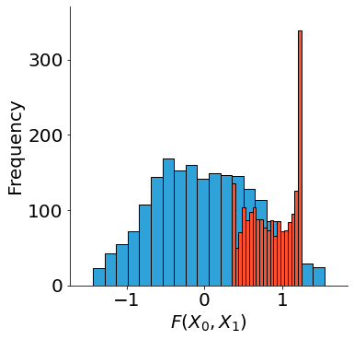
Total Sobol Index

Slide 15

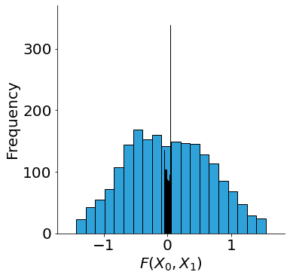
Total Sobol Index

Slide 16
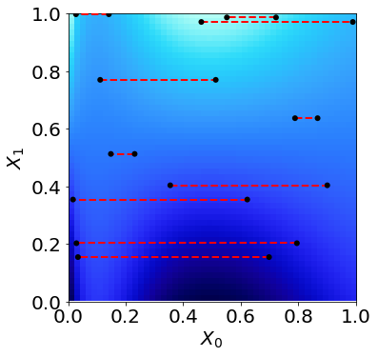
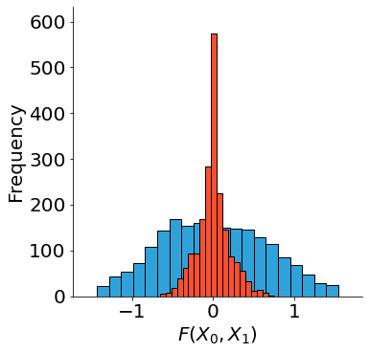
Total Sobol Index

Slide 17
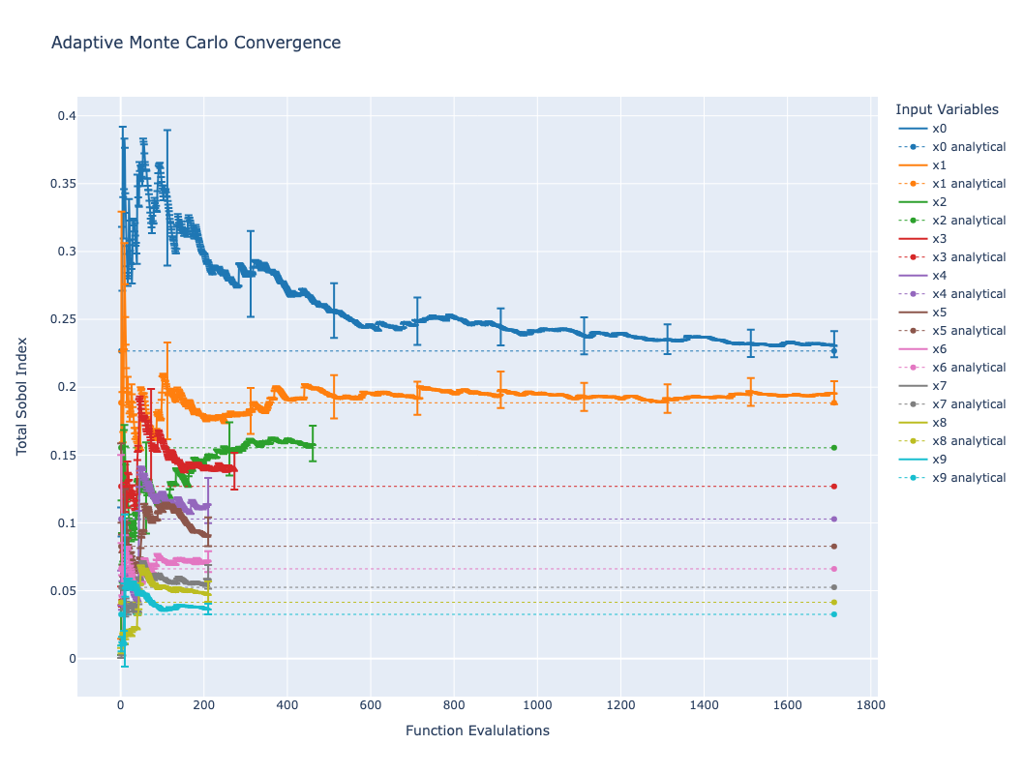
Adaptive Monte Carlo

Slide 18
Summary of Methods
Eight EAST shots
10 spectral regions
Two output variables per regions
  Integrated radiance
  Log Likelihood
DPLR-NEQAIR model
  819 chemical parameters
For each shot an adaptive Monte Carlo sensitivity analysis is performed.
Results:
  One total Sobol index calculated for each output against each input (131,040 indices)
  Histograms of output variables

Slide 19
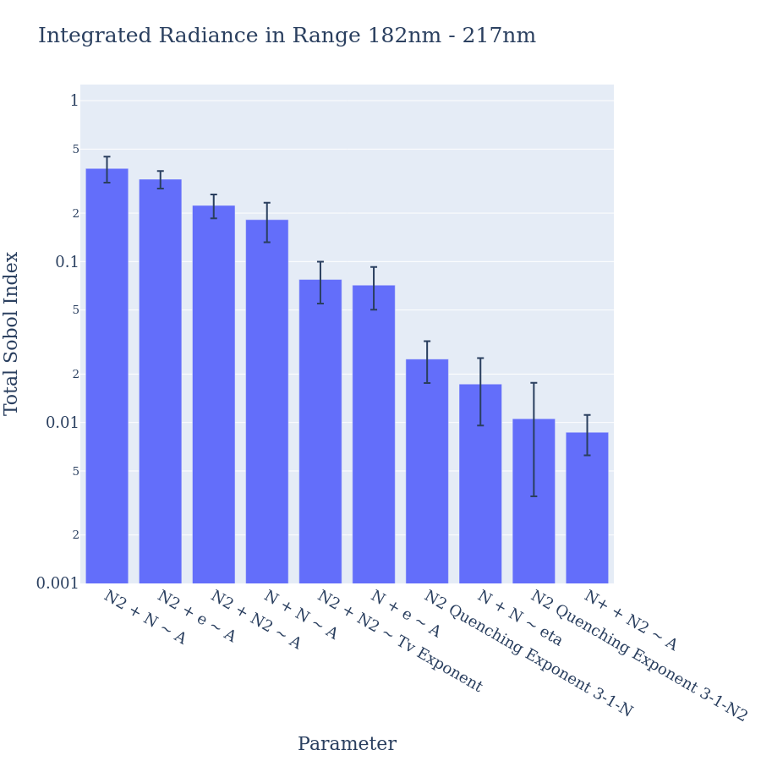
Results

Slide 20
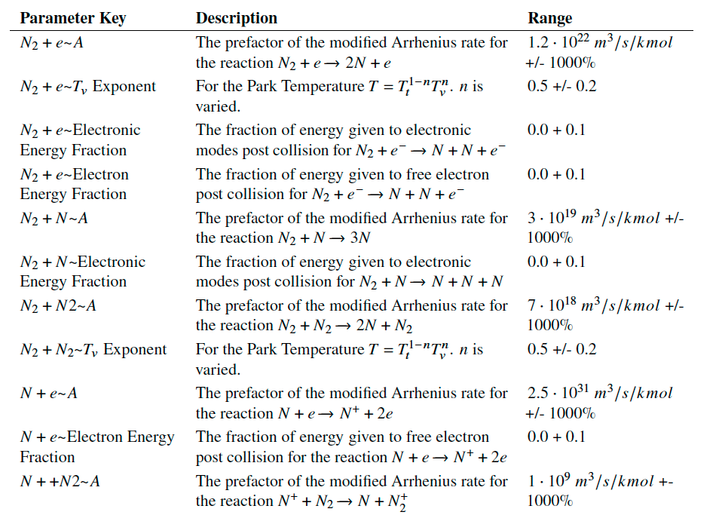
Important Parameters Part I

Slide 21
Important Parameters Part I
N₂ electron impact dissociation treated inconsistently
Dissociation
Ionization

Slide 22
Important Parameters Part I

Slide 23
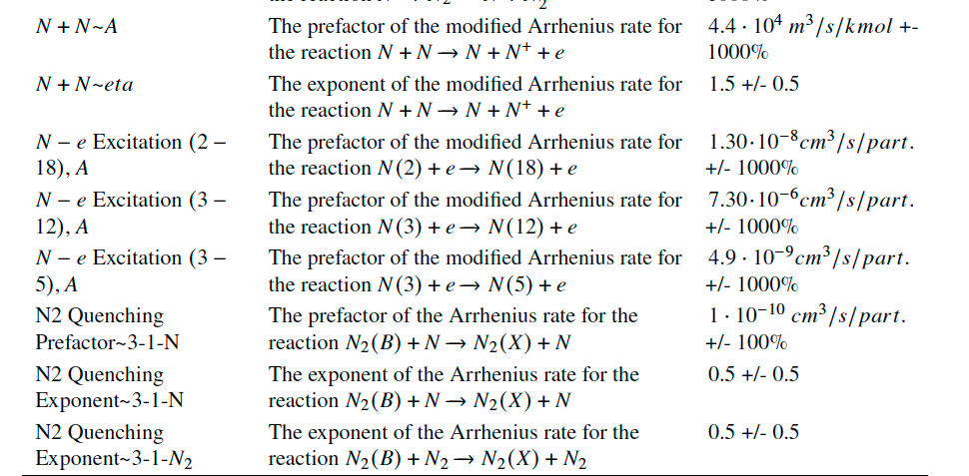
Important Parameters Part II

Slide 24
Important Parameters Part I

Slide 25
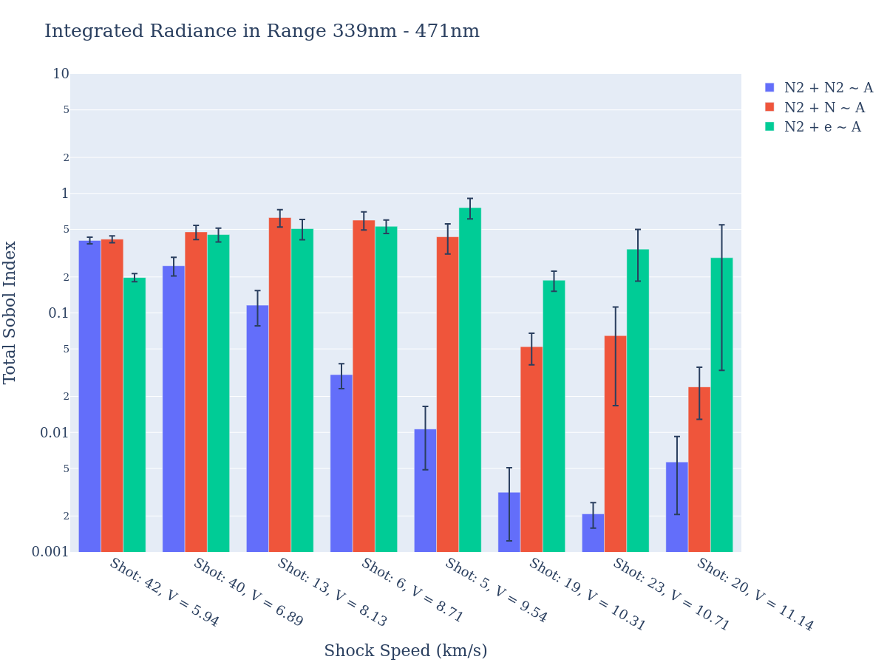
Relative Important of Partner

Slide 26
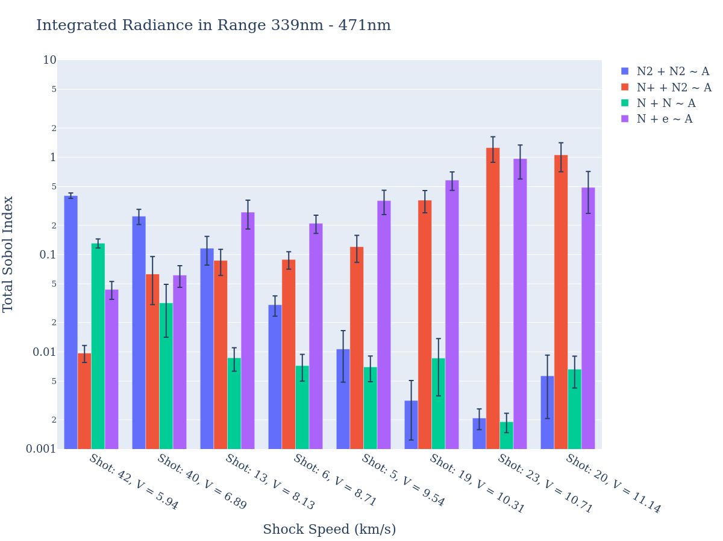
Dissociation vs. Ionization

Slide 27
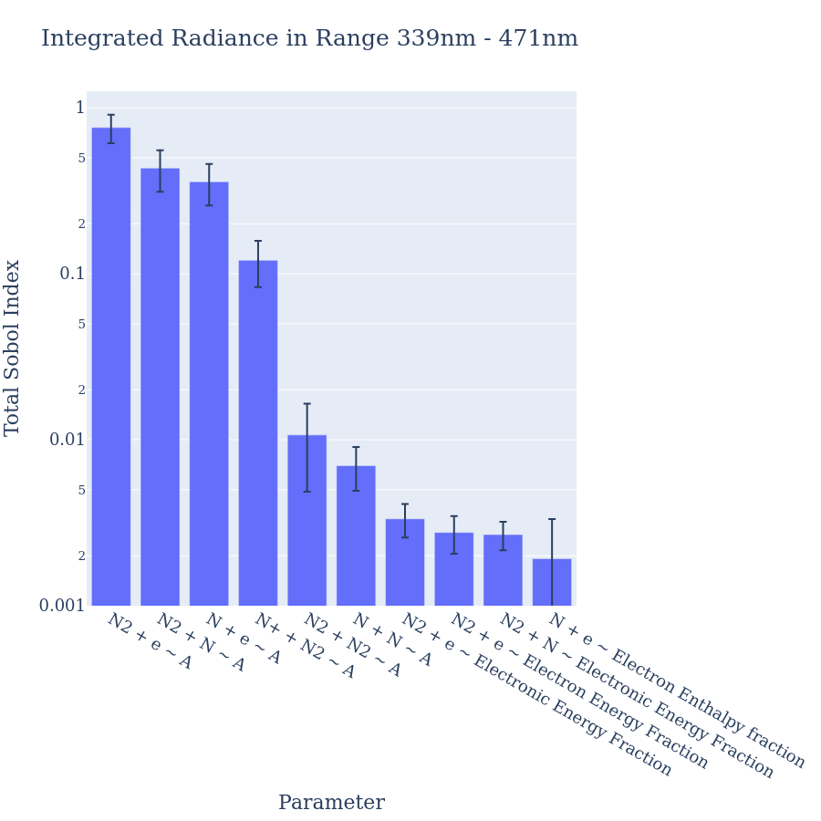
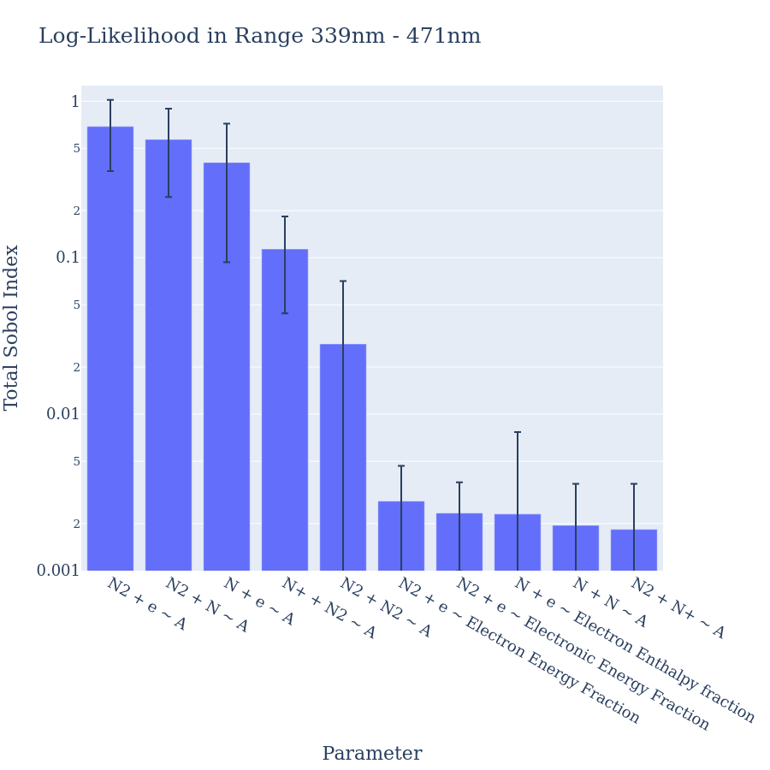
Integrated Radiance vs. Log Likelihood

Slide 28
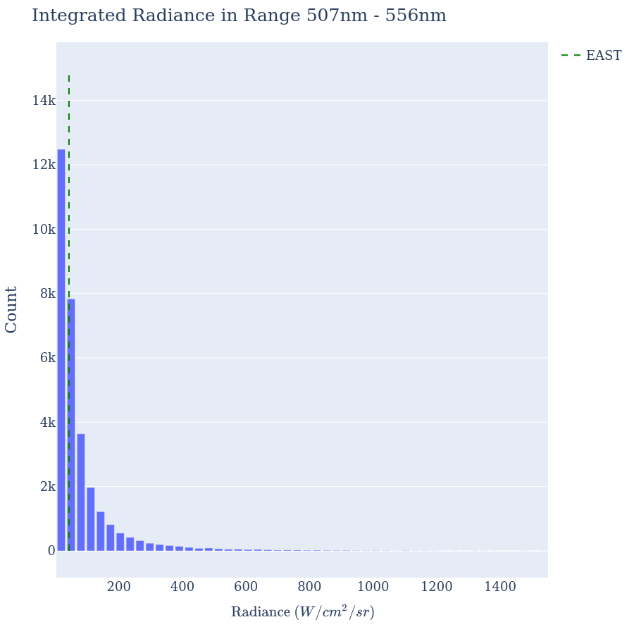
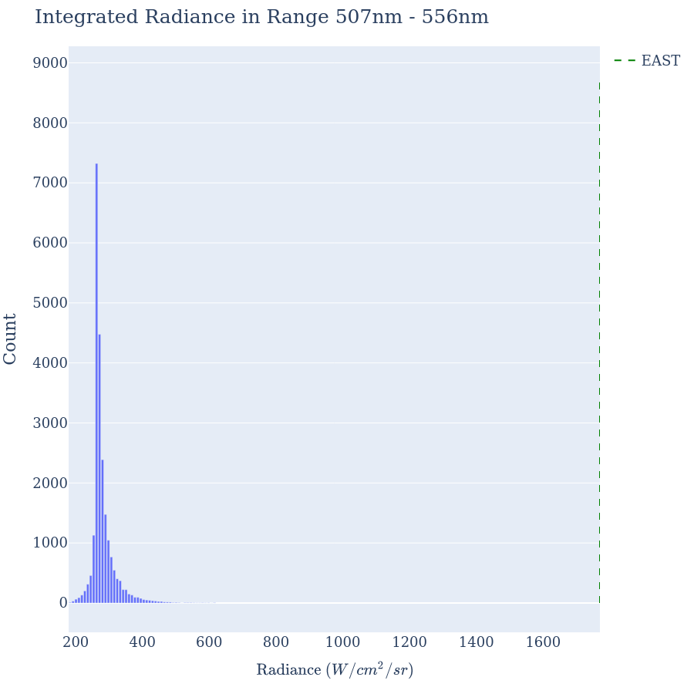
Total Variation of Output Parameters
6.89 km/s
11.14 km/s

Slide 29
Conclusions
Calculated Sobol indices of EAST spectral data against DPLR- NEQAIR database parameters
  Most import parameters identified
  N₂ + e⁻ Dissociation reaction both important and inconsistently sampled in DPLR – NEQAIR
Over a spectral region,

