Slide 1
Validation of Two-phase Flow Modeling Techniques in Loci-Stream using Axial Jet Pressure Control and Autogenous Pressurization Experiments
January 08, 2025
Chintan Patel – ASEG, Fluid Dynamics Branch (NASA MSFC-ER42)

Slide 2
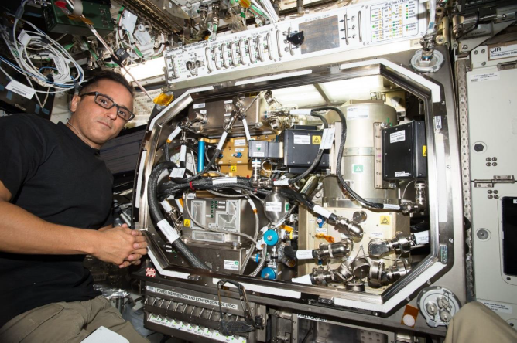
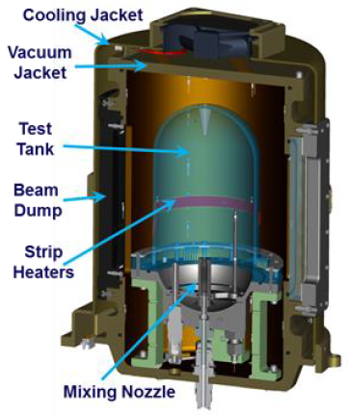
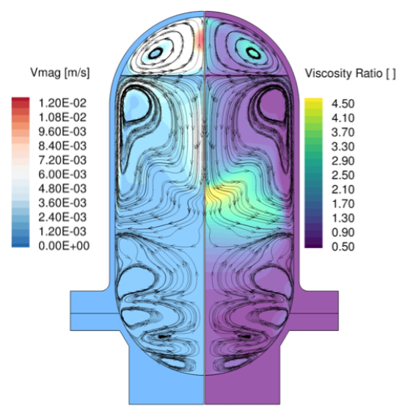
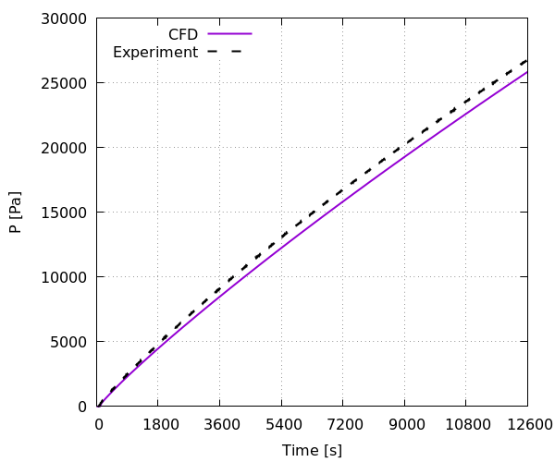
Background
Managing cryogens is a critical technology for NASA’s Artemis missions
Cryogenic fluid management (CFM) challenges
  Storage and delivery: evaporative loss due to heat leakage, liquid location tracking
  Pressure control: helium/autogenous pressurization, depressurization, cryocoolers
  Tank filling/draining: draining and pressurization, jet and spray injection filling
NASA’s CFM Modeling Portfolio develops, enhances and validates computational fluid dynamic (CFD) and nodal tools for mission and operations design
Fluid Dynamics Branch (ER42) at NASA Marshall Space Flight Center (MSFC) supports several CFM projects using CFD
  Human Landing System (HLS), Commercial Lunar Payload Services (CLPS), Space Launch System (SLS), etc.
ER42 has been validating Loci-Stream-VOF CFD solver to support current and future missions
Zero Boil-off Tank (ZBOT) Experiment^{[1]}
Self-pressurization of Zero Boil-off Tank (ZBOT)
CFM modeling validation at NASA MSFC using CFD
[1] M. Kassemi, S. Hylton and O. Kartuzova. "Zero-Boil-Off Tank (ZBOT) Experiment – Ground-Based Validation of Two – Phase Self-Pressurization CFD Model & Preliminary Microgravity Results," AIAA 2018-4940. 2018 Joint Propulsion Conference. July 2018
Acknowledgement: NASA MSFC ER42 CFM Portfolio team (Jacob Brodnick, H.Q. Yang, Ed Reske, Brandon Williams, Brian Richardson), and NASA Glenn Research Center CFM Modeling team for helpful discussions or collaborations

Slide 3
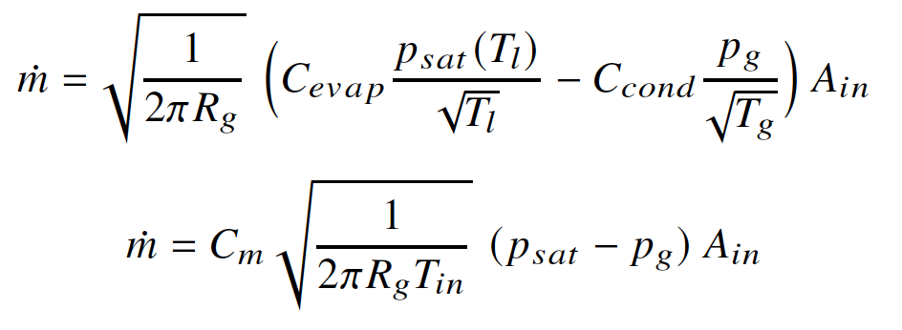
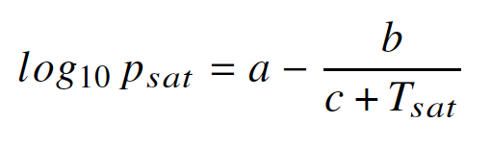

Interface Turbulence Transport
Important physical processes
  Phase transition
  Interface turbulence transport (ITT)
Reynolds-averaged Navier-Stokes (RANS) equations for mass, momentum and energy conservation
  Turbulence Model: Menter’s Shear Stress Transport (SST) model
Phase change model: Hertz-Knudsen-Schrage (HKS)
Interface Turbulence Transport
Thermal Transport (eddy conductivity)
Interface Temperature
Phase Change
Tank pressure prediction,
Pressurant requirement,
Propellant requirement,
Active cooling requirements
ITT modeling heavily influences crucial design parameters of spaceflight missions
Altered turbulence at the interface
  RANS models have no mechanism to account for it
CFM operations in spaceflights span days with large tanks
  Scales for ITT and phase change processes are much smaller
How to make reliable predictions for flight projects?
  Develop models and validate them with a variety of flight-scale CFM experiments
Impact of ITT on CFM

Slide 4
Interface Turbulence Transport Modeling
Sharp Interface Turbulence Modeling
Stationary/quasi-stationary gas-liquid interface modeled with a fixed interface boundary
  Velocity and stresses continuity
Significantly faster than volume of fluid method
  Allows large number of numerical experiments
Modeling Evidence
Experiments, direct numerical simulation and large eddy simulation studies demonstrate
  Diminished turbulence kinetic energy (TKE) on the gas side of the interface
  Either unaltered or enhanced TKE on the liquid side of the interface
Turbulence Modeling | Description | Applied to
Wall-like | Near interface modeled like a no-slip wall boundary | Gas side
Freestream-like | Turbulence unaffected by the boundary (extrapolated) | Liquid side
Gas Phase
Interface TKE is zero
Near Interface Region
Gas-side
Liquid-side
Liquid Phase
Interface TKE is typically extrapolated
Illustration of Sharp Interface ITT Modeling Technique

Slide 5
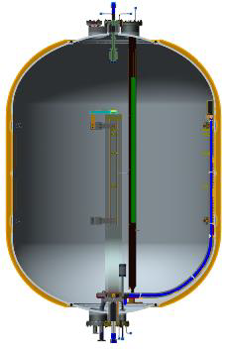
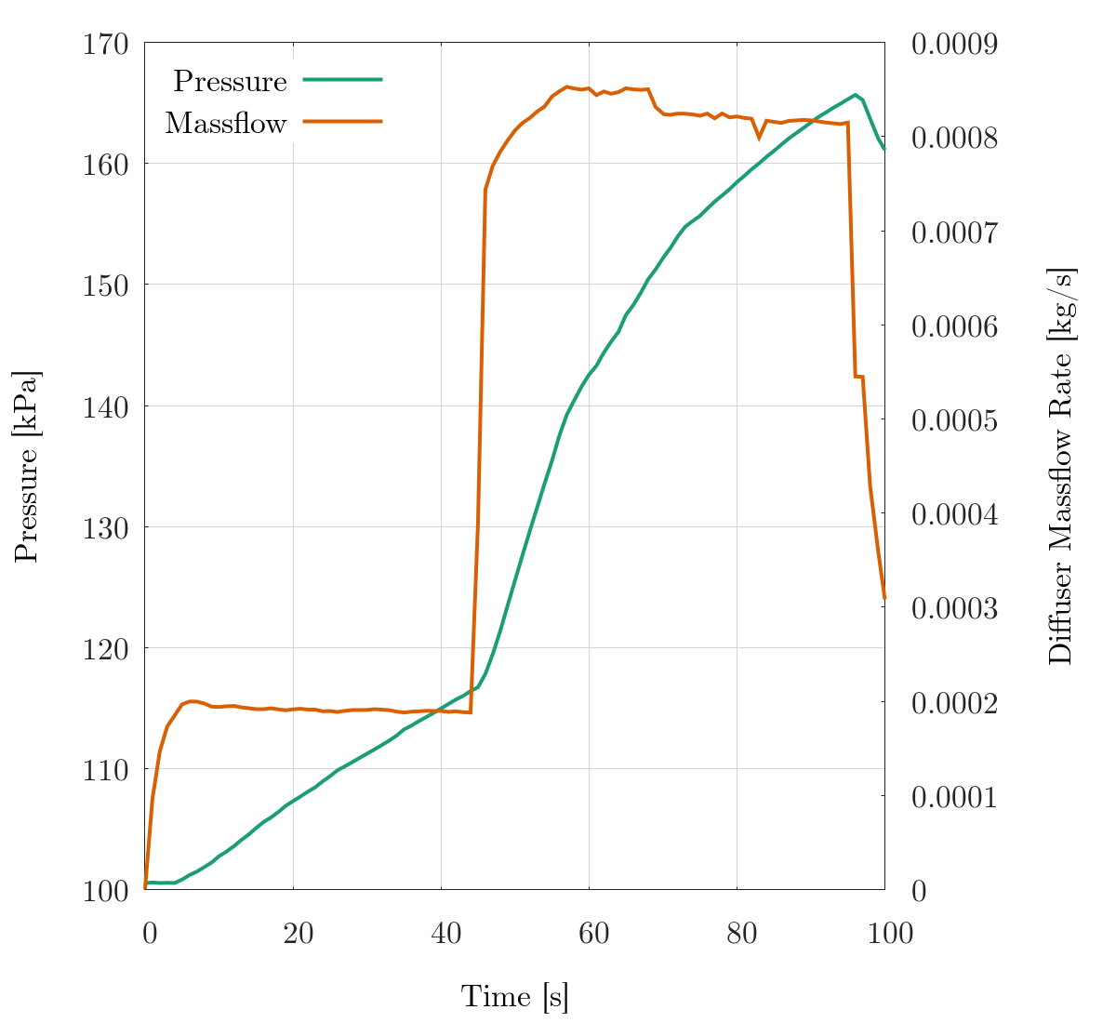
1. Autogenous Pressurization Test
Experiment
Performed at NASA MSFC using Engineering Design Unit tank with liquid hydrogen
The insulated double domed tank with 1.7 m diameter was filled to 90% volume
Uniform initial temperature of 20.345 K with saturation condition at the interface (1 bar ullage pressure)
Pressurized with room temperature gaseous hydrogen
CFD Model
Axisymmetric flow
Conjugate heat transfer
  Temperature dependent thermal properties for the solids
Cross Section View of the EDU Tank CAD Model
Diffuser Massflow and Tank Pressure over Time

Slide 6
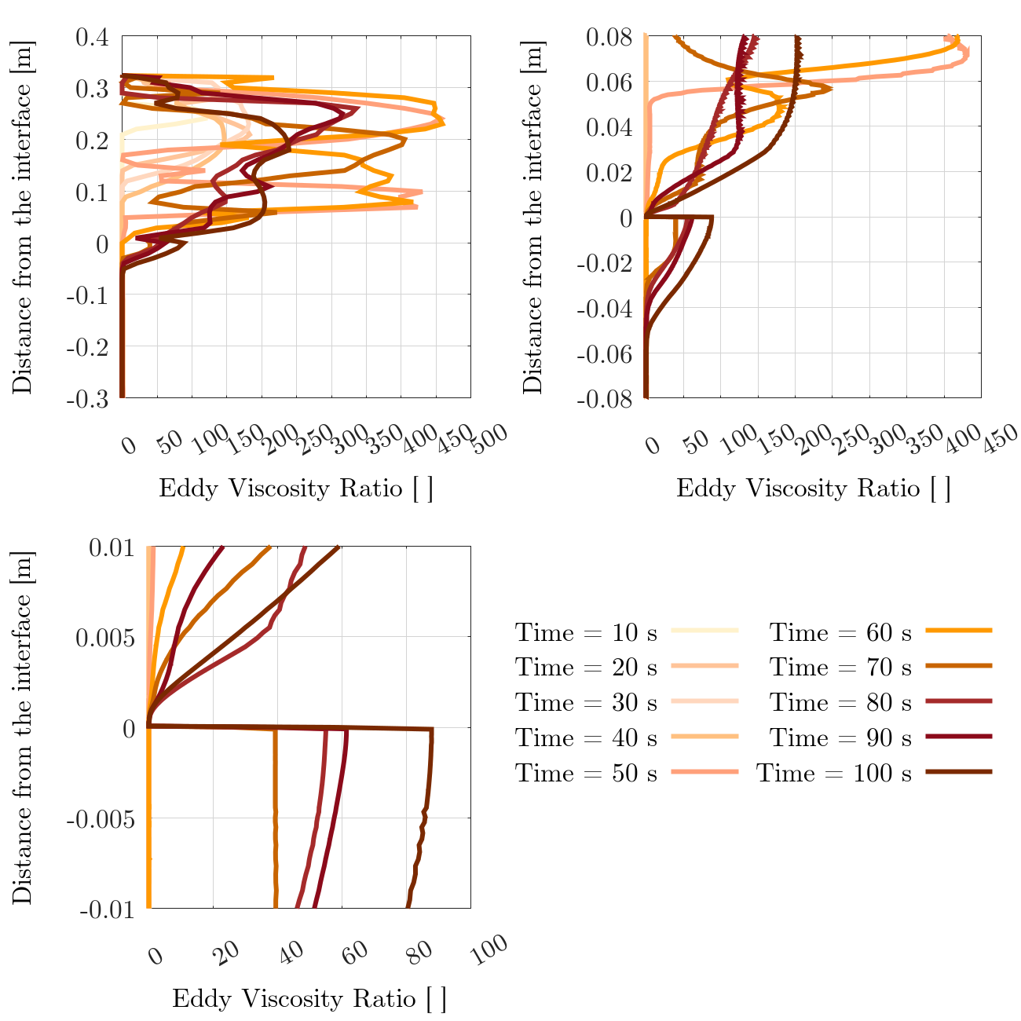
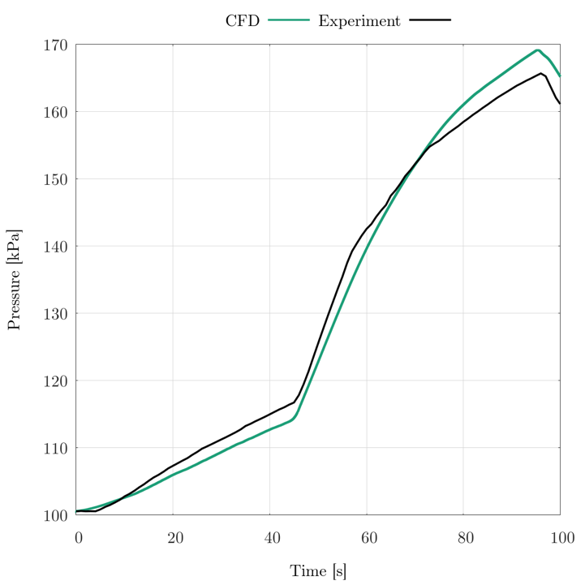
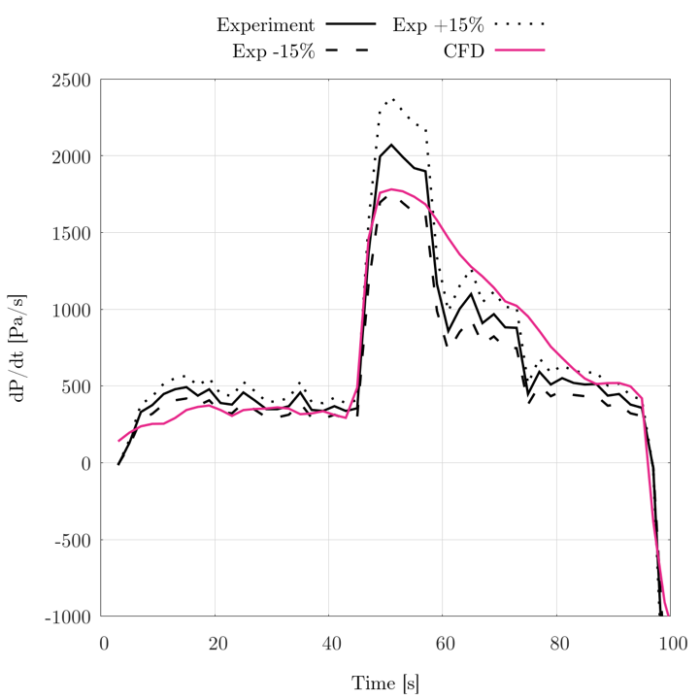
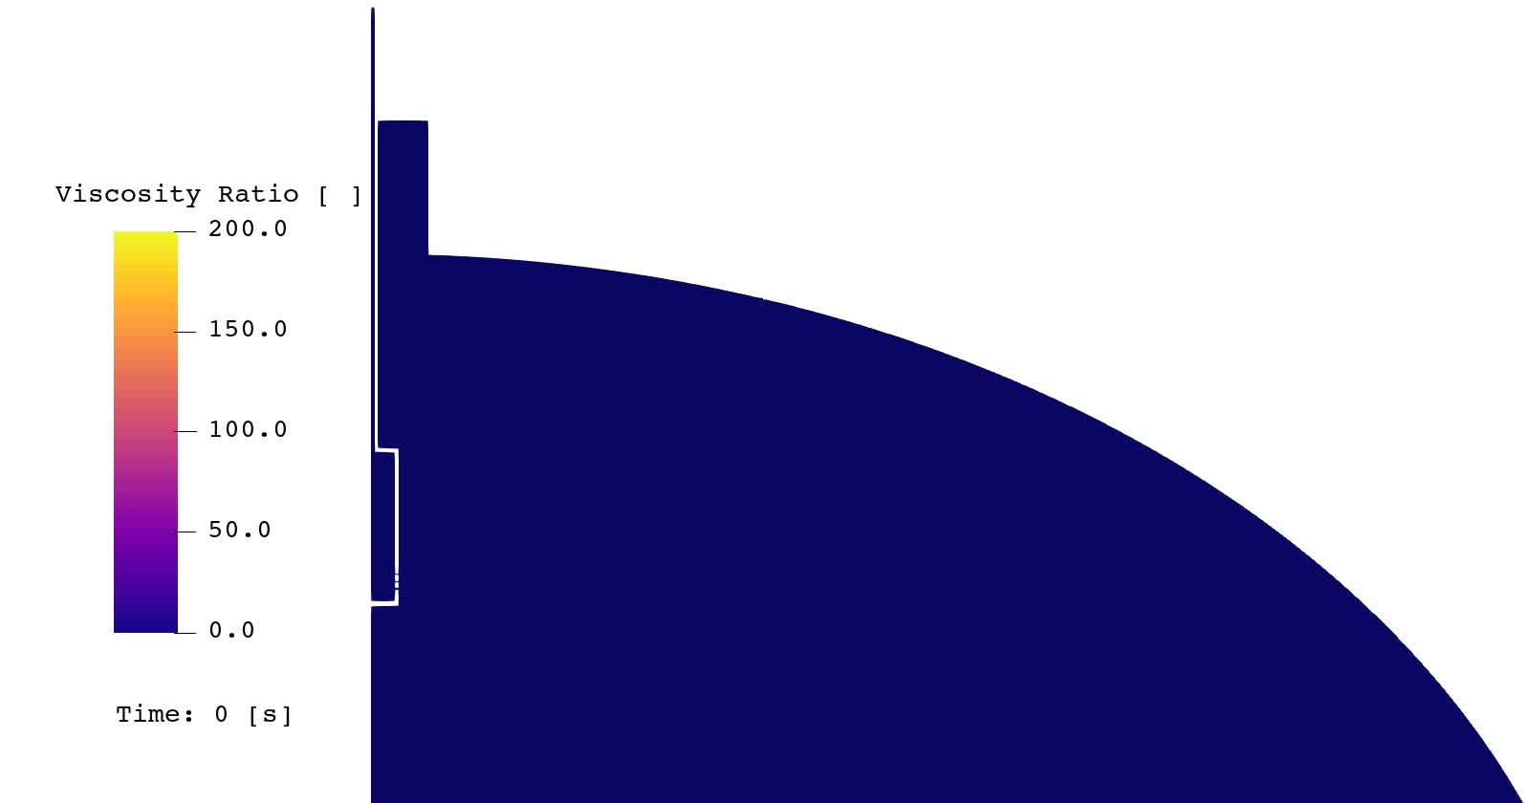
Validation – Autogenous Pressurization
Tank pressure was predicted successfully with 5% error
The modeling technique allows discontinuous turbulence viscosity ratio across the interface
Pressurization Rate vs Time
Interfacial Eddy Viscosity over Time at 0.1 m radius
Turbulence Viscosity Ratio over Time
Pressure vs Time – CFD vs Experiment

Slide 7
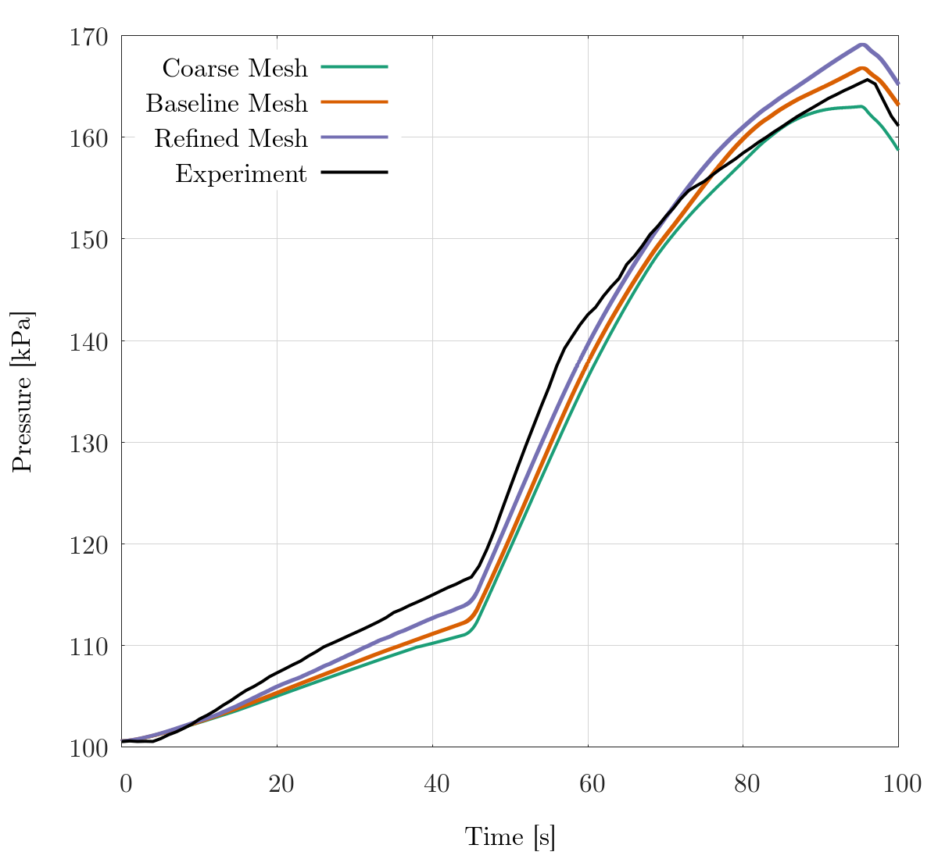
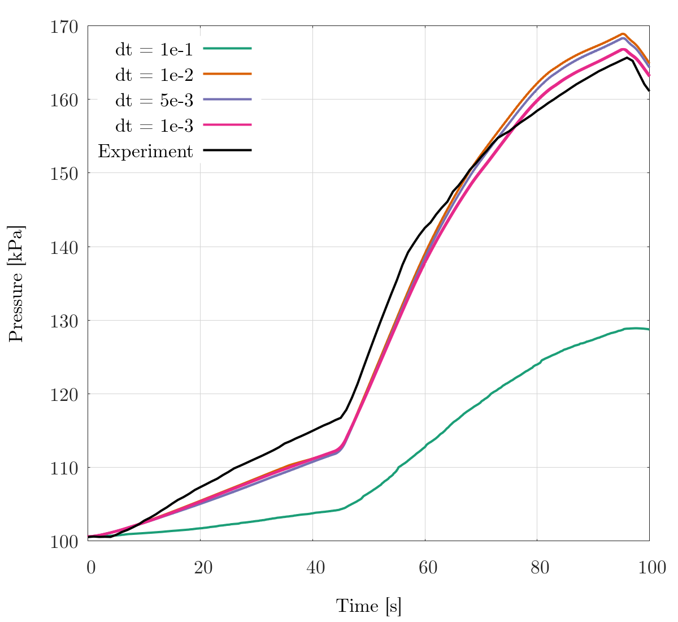
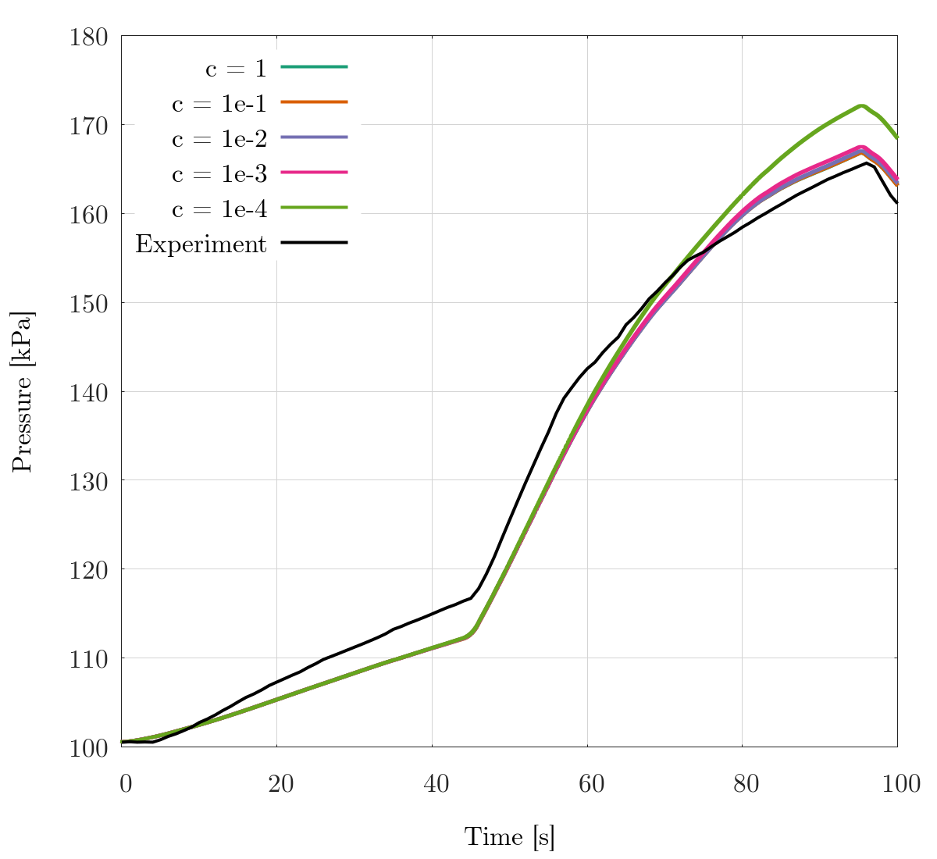
Validation – Autogenous Pressurization – Sensitivities
Spatial Resolution Sensitivity
Temporal Resolution Sensitivity
Accommodation Factor Sensitivity
Predictions independent of spatial and temporal resolutions are ensured
Accommodation factor in the phase change equation modulates the rate of evaporation/condensation. Materially closed systems have shown almost no sensitivity above the value of 1e-4. Same behavior is observed here above the value of 1e-3.

Slide 8
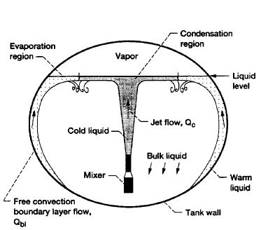
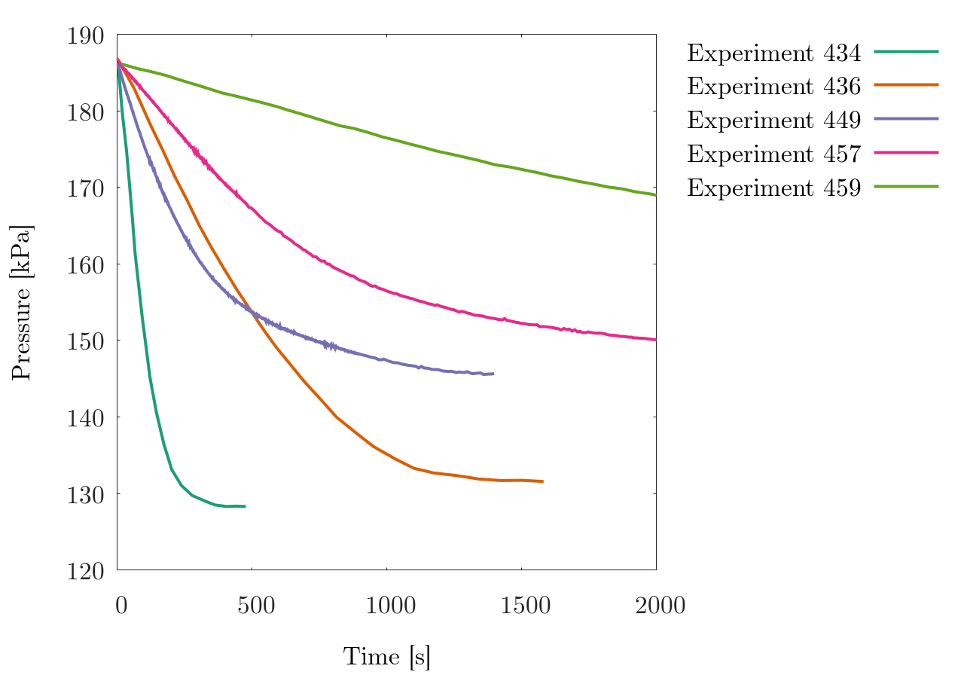
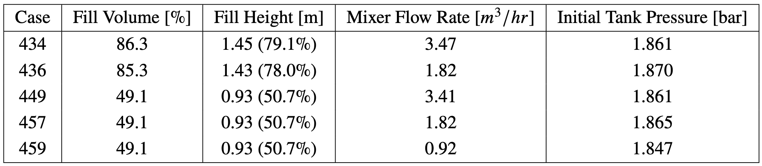
2. Axial Jet Pressure Control Test
Experiment
Performed at NASA Glenn Research Center’s (GRC) K-site facility with liquid hydrogen
The ellipsoidal tank with 2.2 m diameter in a vacuum chamber
  A mixer recirculates cold liquid to reduce tank pressure
Five tests – two fill levels and three mixer massflow rates
CFD Model and Solution
Axisymmetric flow
Predictions are independent of timestep, grid, and HKS accommodation factor
K-site Tank Schematic^{[1]}
Tank Pressure vs Time
Test Conditions
[1] C. Lin, M. Hasan and N. Van Dresar. "Experimental investigation of jet-induced mixing of a large liquid hydrogen storage tank," AIAA 1994-2079. 6th Joint Thermophysics and Heat Transfer Conference. June 1994.

Slide 9

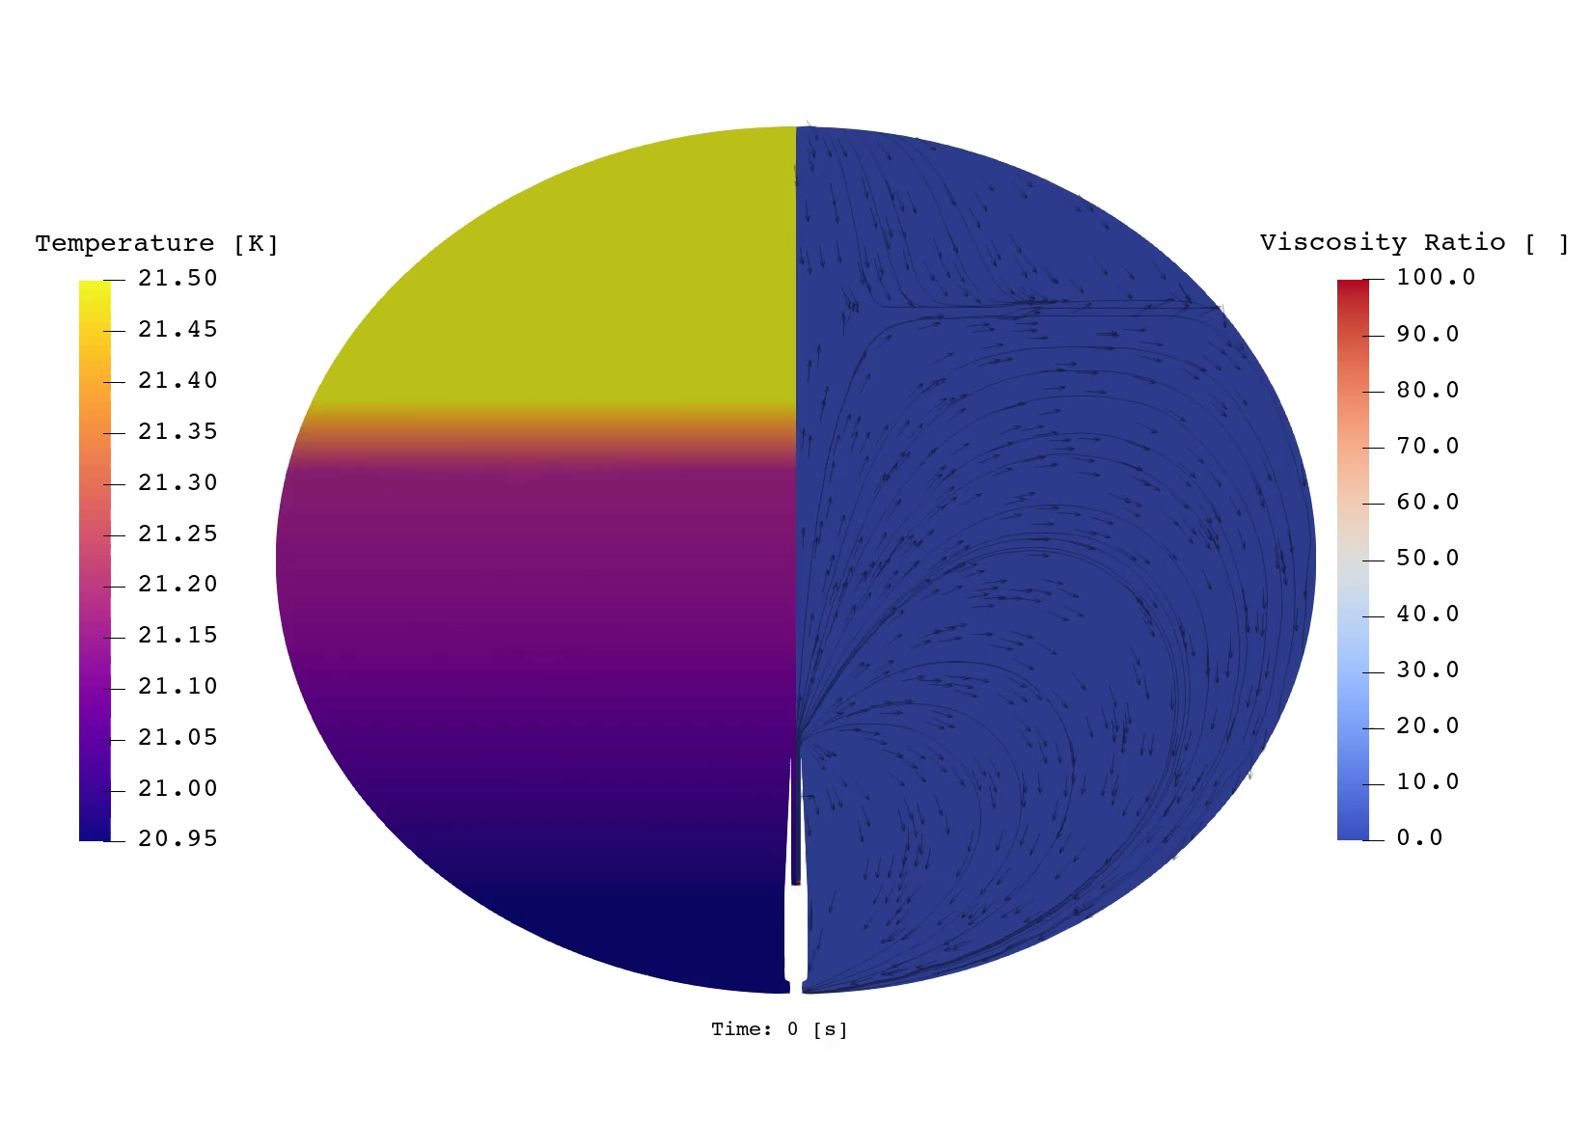
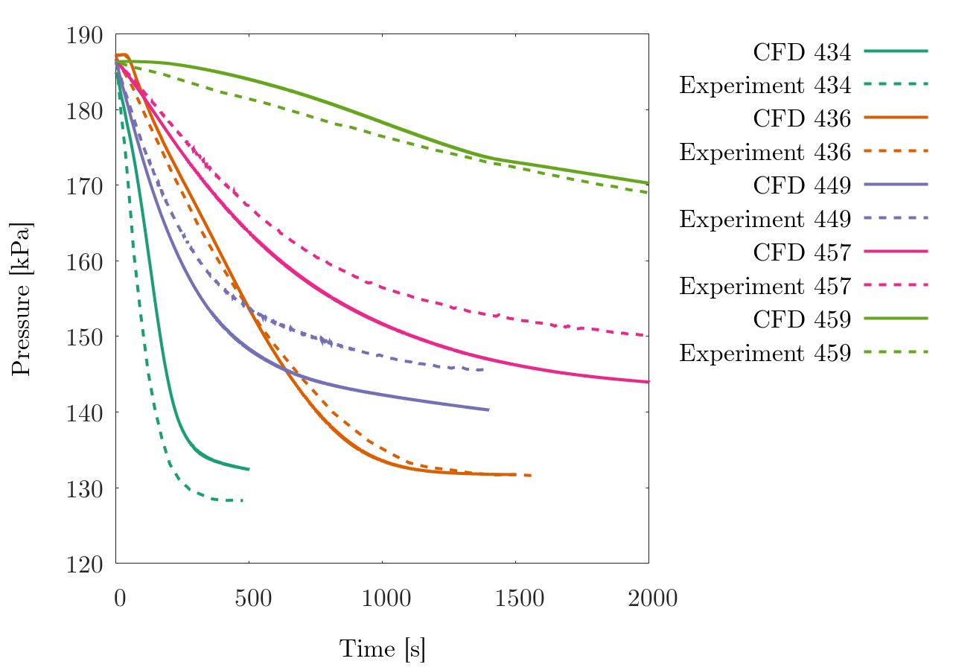
Validation – Axial Jet Pressure Control
Successful validation – Maximum pressure prediction error was less than 17%
Wall-like interface turbulence modeling was used on both sides of the interface
  Counterbalance overprediction due to flat interface assumption by lowering turbulence kinetic energy
Non-flat interface for Experiment 449 (captured by VOF)
Gas
Liquid
Temperature and Viscosity Ratio over Time (Exp 434)
Pressure vs Time – CFD vs Experiments

Slide 10
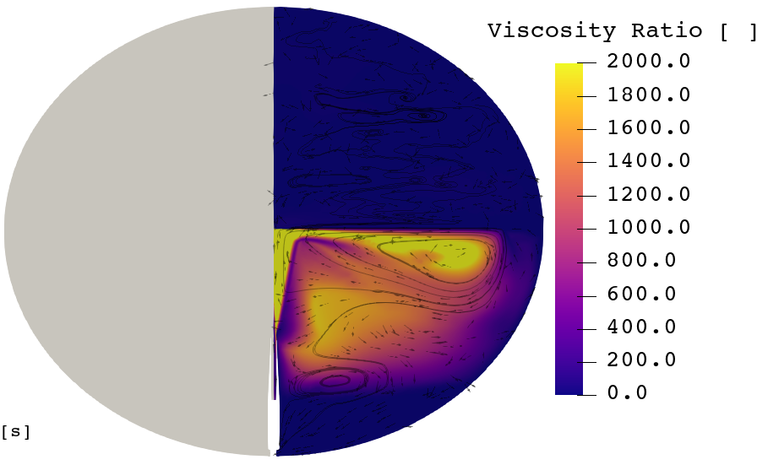
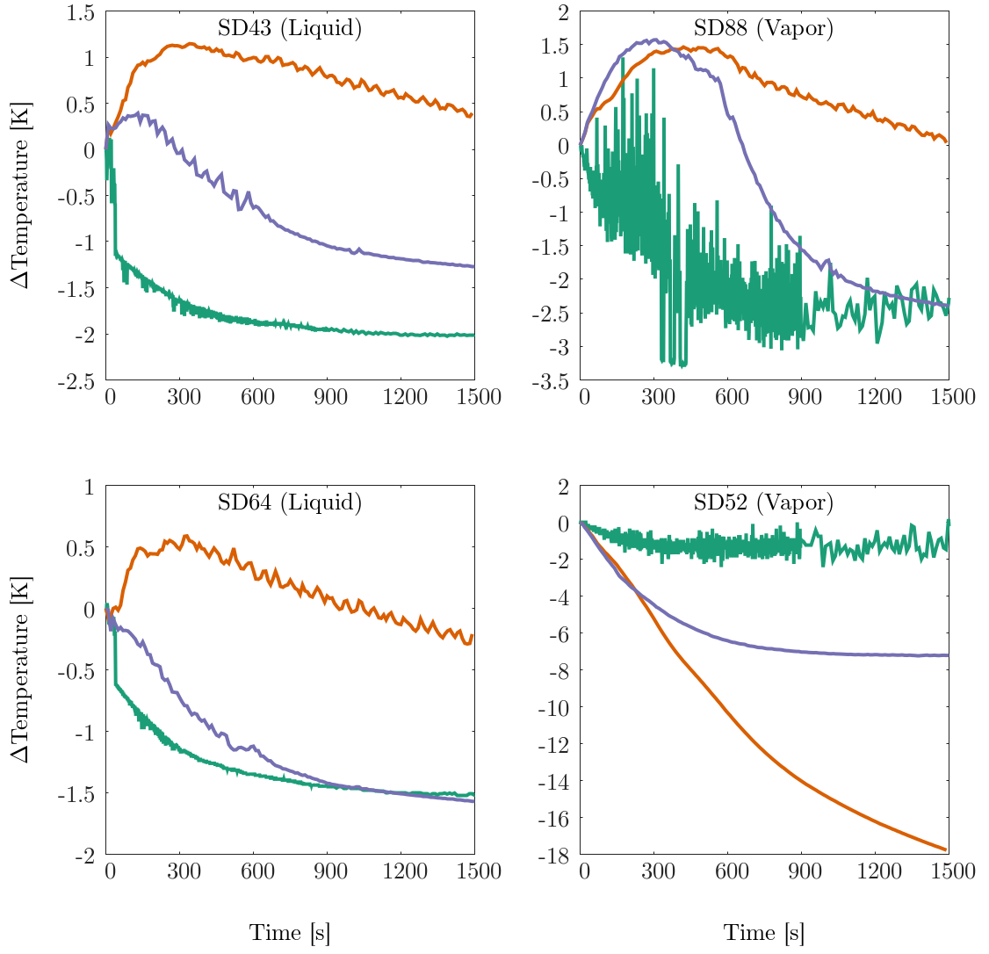
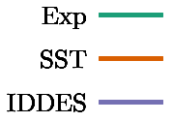
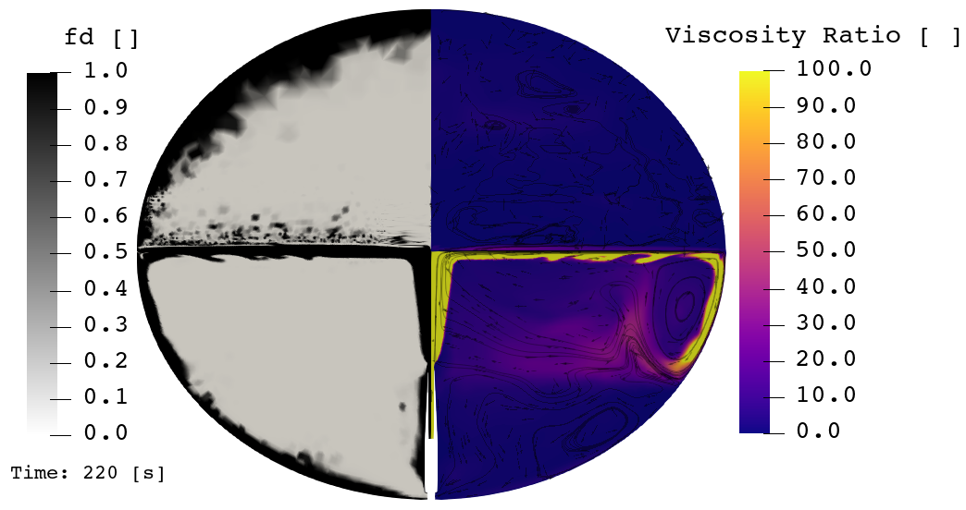
Axial Jet Pressure Control – Temperature and Turbulence (1/2)
RANS temperature prediction is improved by IDDES (Improved delayed detached eddy simulations) modeling of turbulence
IDDES inhibits non-physical turbulence transport seen in the RANS modeling
SD52
SST
SD88
SD64
SD43
IDDES
Temperature probe comparison (Exp 449)
SST vs IDDES Turbulence Viscosity Ratio (Exp 449, time: 220 s)

Slide 11
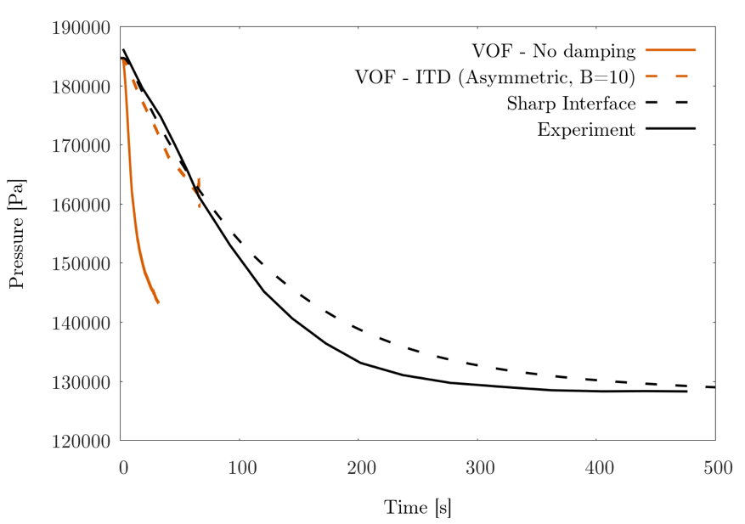
Conclusion
Successfully validated Loci-Stream and the interface turbulence transport (ITT) modeling technique using autogenous pressurization and axial jet-based depressurization tests
  ITT is crucial for reliable modeling of spaceflight CFM operations
The sharp interface model with simple ITT modeling is significantly faster than volume of fluid method and allows resolution of smaller scales
Demonstrated improved temperature predictions (and turbulence transport) compared to the RANS turbulence modeling using IDDES
Future work
  Continuing to expand the validation to more CFM operations
  Developing ITT model for volume of fluid method to simulate morphing interfaces
Validation against flight-scale tank experiments builds further confidence in reliability of our CFD tools for a wider range of CFM applications for supporting design/analysis of the long-term space flight missions
  Insights gained from the validations are helping in-line support of Human Landing System spaceflight projects
Improved Pressure Prediction using VOF with Interface Turbulence Damping

Slide 12
Back-up

Slide 13
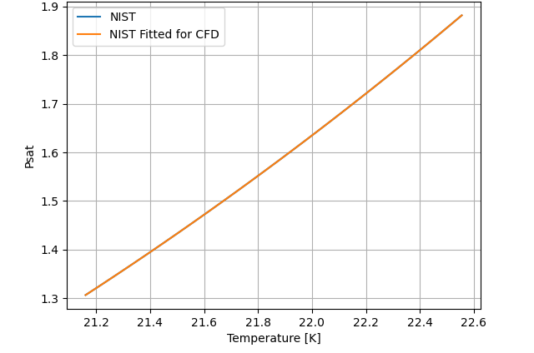
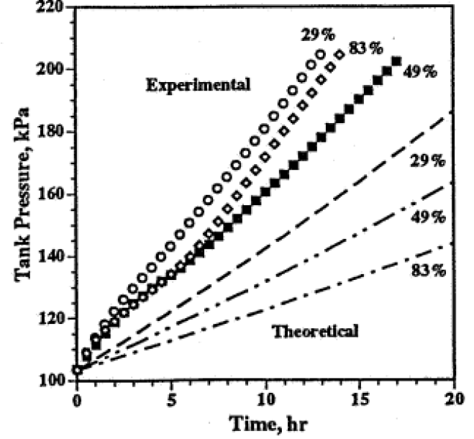
Phase Change Model
Saturation pressure is very sensitive to the interface temperature
Phase change rate ṁ is very sensitive to the interface temperature.
  For EDU tank autogenous pressurization experiment, 0.2 K error (1% error) in temperature results in 14% error in pressure
  For K-site tank self-pressurization, 1 K error (5% error) in temperature results in 50% error in predicting tank pressure. For an unsteady problem, this is equivalent to being off by several hours of self-pressurization.
Must resolve thermal gradients due to heat exchange (latent and sensible) at the interface
Parahydrogen Saturation Curve
EDU Tank Autogenous Pressurization
K-Site Tank Self-pressurization with 3.5 W/m² Heat Flux
For parahydrogen, L = 4.45e6 J/kg

Slide 14
Gas-Liquid Interface Turbulence Literature
Experiments like those by Fabre et al has shown that gas side turbulence is damped at the interface (“wall-like” behavior)
  Rashidi et al show streak formations at the interface that are similar to the wall
DNS from Lombardi et al shows turbulence on the gas side of the interface is wall-like, i.e., damped, but the turbulence on the liquid side is enhanced.
  For liquids, “The mean velocity distribution, turbulence intensities, Reynolds stress and various other statistical measures are significantly altered compared to those in the wall region of channel flows”
Fulgosi et al performed DNS analysis of stratified flow and found damped turbulence on the gas side interface similar to wall sublayer, but TKE is non-zero.
  Importantly, they observed "similarity in the distribution of the turbulence intensities near the interface”. A general RANS model is plausible.
Jofre et al studies bubbly flow using LES and found that damping on the gas side of the interface produced satisfactory comparison to DNS in the near interface region
Summary
  Gas-side interface turbulence: wall-like (Recall mesh requirements for heat transfer near a wall → need a low y+ mesh)
  Liquid-side interface turbulence: either unchanged or somewhat enhanced

