Slide 1
RANS Predictions of Inlet/Isolator Unstart at Mach 4
Ben Nikaido
NASA Ames Research Center
Garth Hobson, PhD
Naval Postgraduate School
AIAA SciTech, Jan 6 – 10, 2025
Published by the American Institute of Aeronautics and Astronautics, Inc., with permission.

Slide 2
Outline
Introduction
SWBLI V&V
Inlet/Isolator Model
Backpressure Mechanisms
Results
  Numerical Backpressure
  Louver Backpressure
Conclusions

Slide 3
Research Goals
  Predict shock train position and unstart limits for future tests
    Flow control implementation
    Kulite® placement
  Investigate validity of 2D simulation simplification for this aspect ratio duct (2.4)
  Compare results from:
    Different 2-equation turbulence models
    Solution advancement schemes
    Two CFD solvers

Slide 4
CFD Codes and Turbulence Models
OVERFLOW (2.4b)
  Finite difference solver for structured, overset grids
  Up to 6th order spatial accuracy
CREATE-AV Kestrel KCFD (v18.3)
  Finite volume (cell-centered) solver for general unstructured grids
  2nd order spatial accuracy
Both codes using HLLE++ (inviscid flux) and Kato-Launder for turbulent production variable formulation
Turbulence models:
  Wilcox k – ω [OVERFLOW]
  Menter Baseline (BSL) [Kestrel]
  SST [Both OVERFLOW and Kestrel]

Slide 5
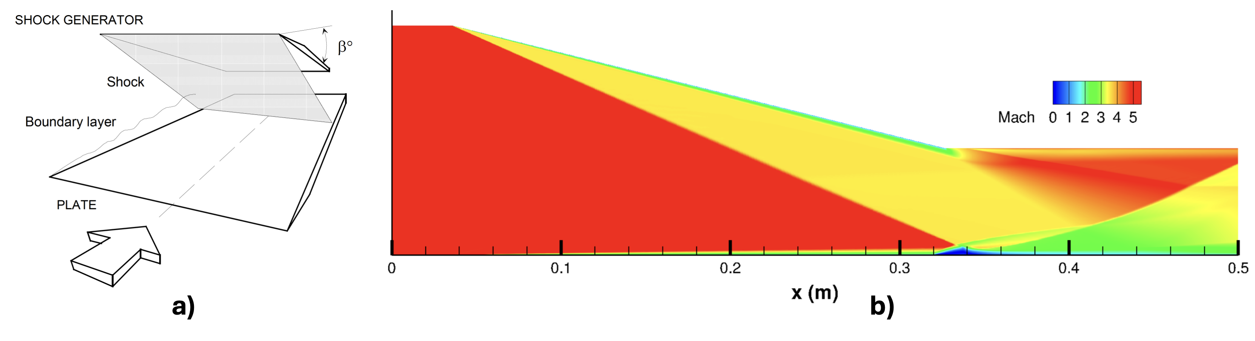
SWBLI V&V
T_{o} = 410 K
P_{o} = 21.2 bar
Re = 40e⁶ / m
Mach 5 impinging shock by Schulein^{[1]} et. al. β =14°
DLR Ludwieg Tube Wind Tunnel Facility (RWG, Tunnel B)
Shock Generator
Isothermal Wall (300K)
Schematic of experiment
OVERFLOW Mach Contours

Slide 6
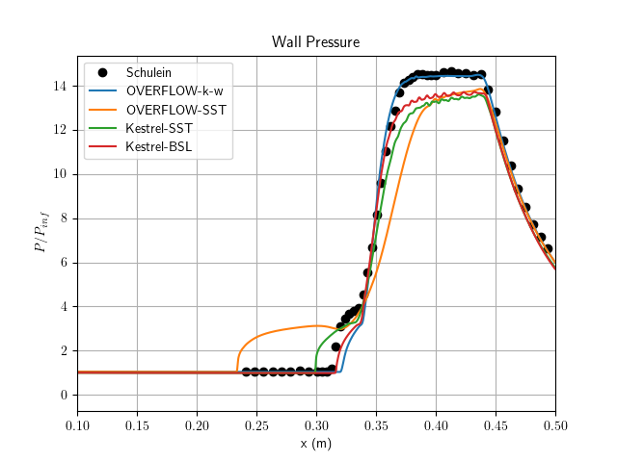
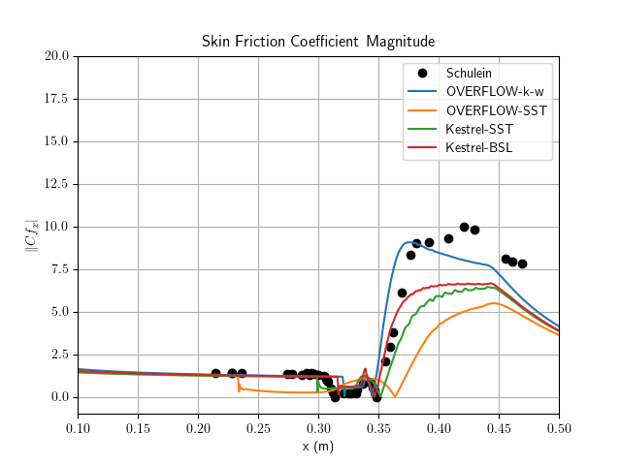
SWBLI V&V
(Exp.)
(Exp.)
Separation bubble
Impingement point

Slide 7
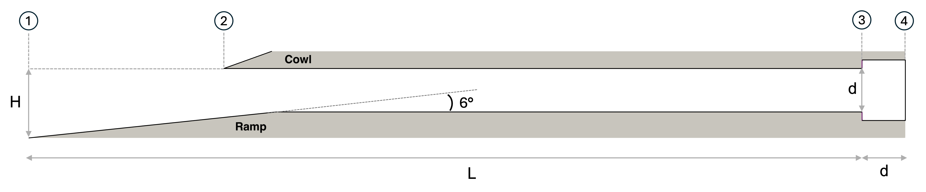
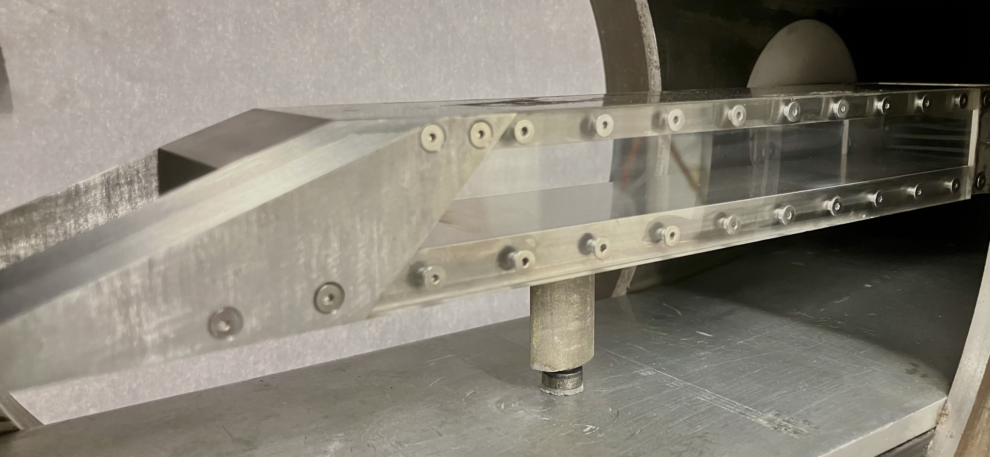
Inlet/Isolator Model
A_{cap} = 1.5 in²
L = 12 in, d = 0.625 in
Flow Conditions
M∞ = 4.0
T_{o} = 525°R (292 K)
P_{o} = 250 PSI
Re = 2.35e⁶ / in

Slide 8
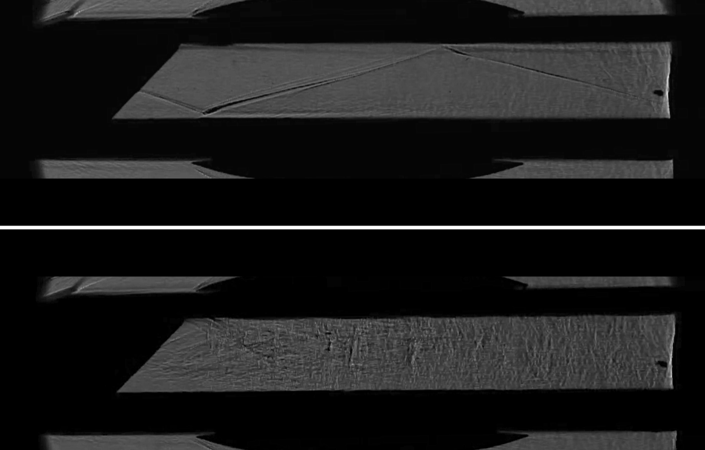
Inlet/Isolator Model Shadowgraph
Started
(Unbackpressured)
Unstarted

Slide 9
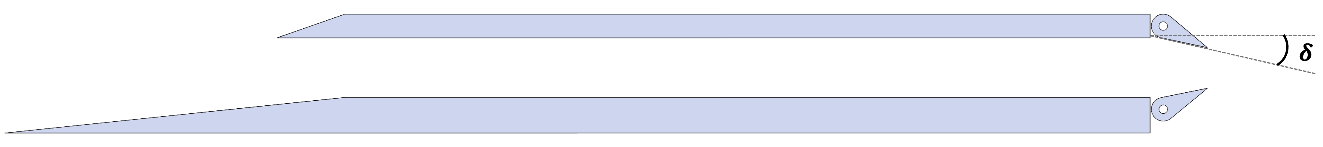
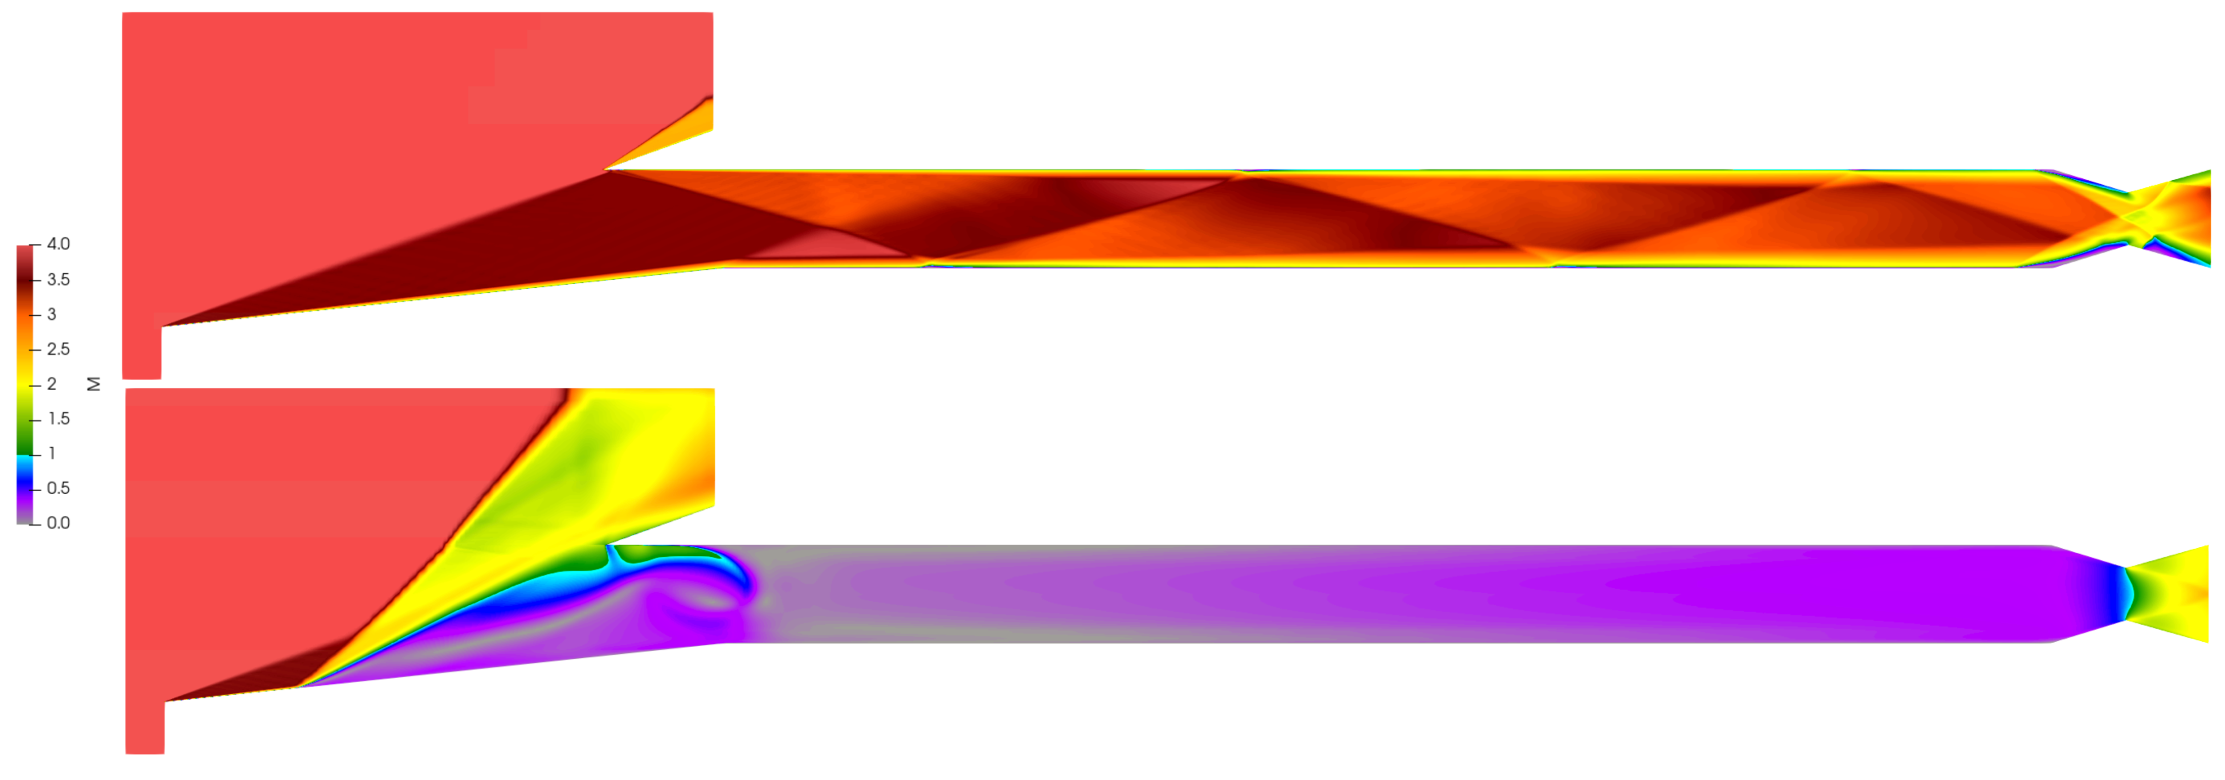
Backpressure Methods - Flaps
𝝳 = 17°
𝝳 = 18°
< 1°of flap angle between fully started and unstarted
No shock train formation

Slide 10
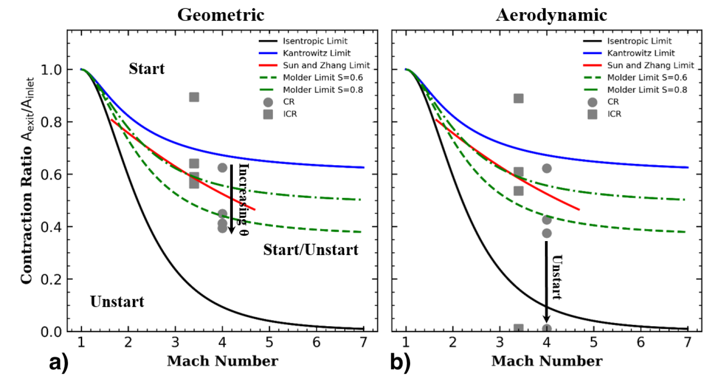
Analytic Startablity Limits
Courtesy [2]
Used by permission
𝝳
17°
18°

Slide 11
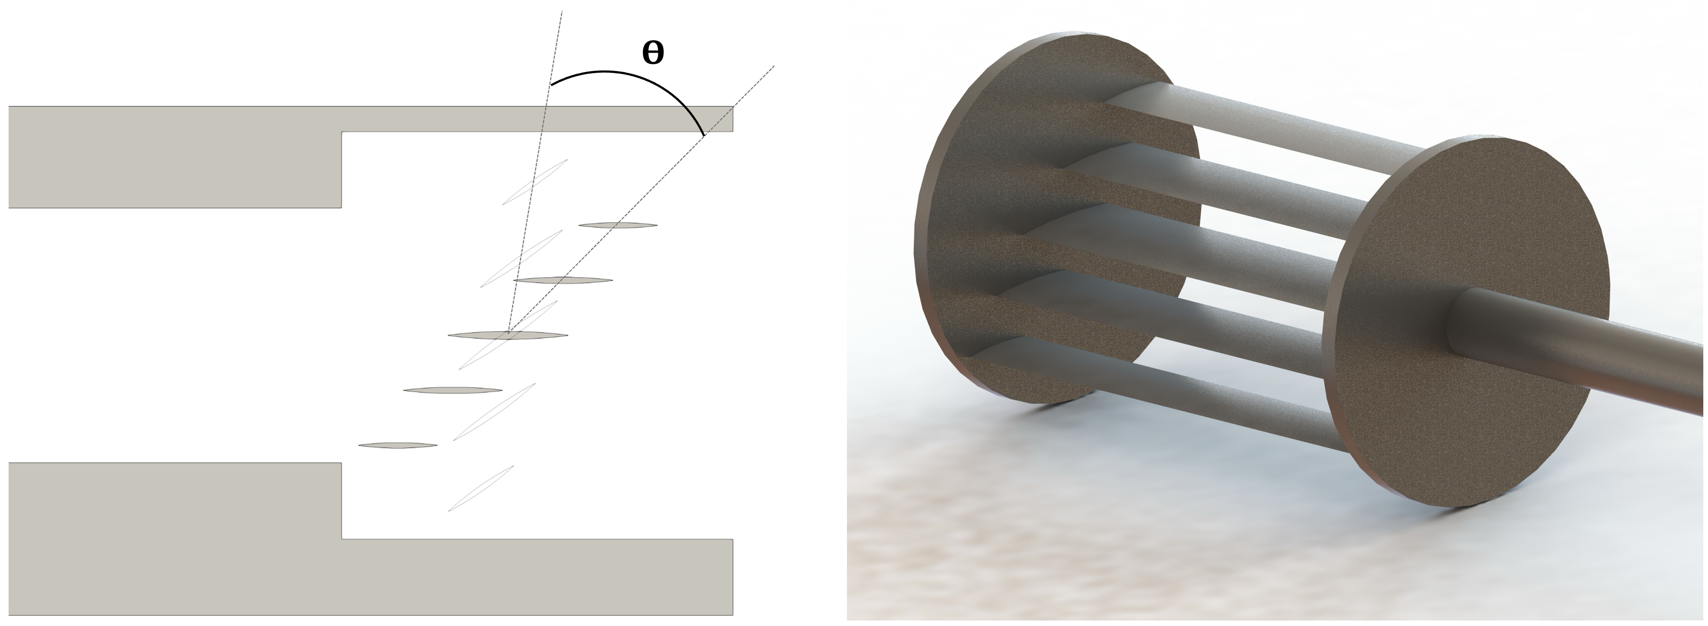
Backpressure Methods - Louver
Rendering of Louver Valve. Currently in Additive Manufacturing
Deflection Angle Convention
Novel ”louver” mechanism
  Provides controlled and uniform static backpressure increase in space-constrained tunnel
  Allows pre-combustion shock train
  Maintains startability

Slide 12
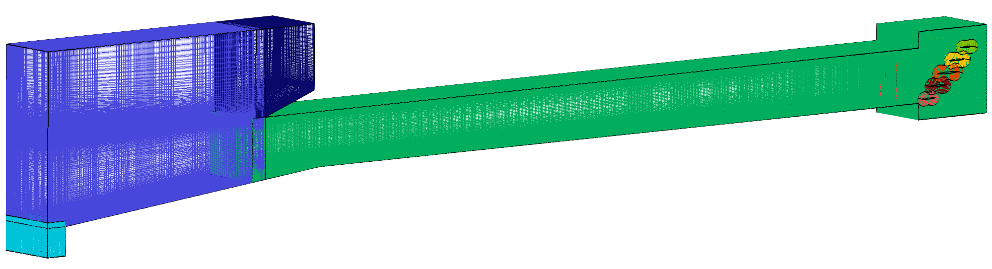
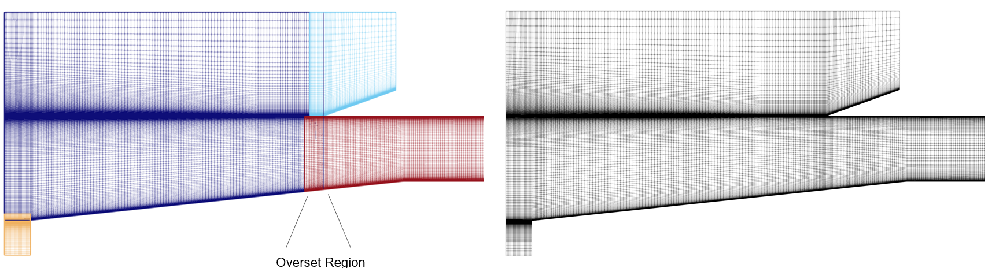
Grids
Freestream
3D OVERFLOW grid w/louvers
20M nodes
Supersonic
Extrapolation
(Specified P for
Numerical
Backpressure)
Y - symmetry
Triple-fringe
Connectivity by Pegasus
M∞

Slide 13
Results:
Numerical Backpressure
Outflow static pressure increased from 1 ≤ P₄/P∞ ≤ 30
Each simulation successively continued from lower backpressure solution

Slide 14
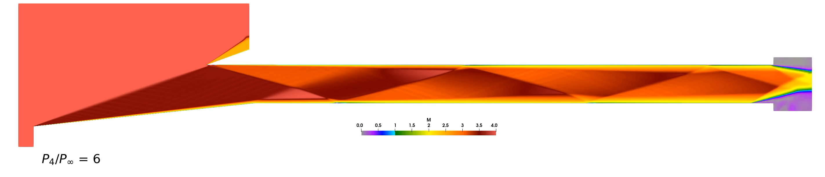
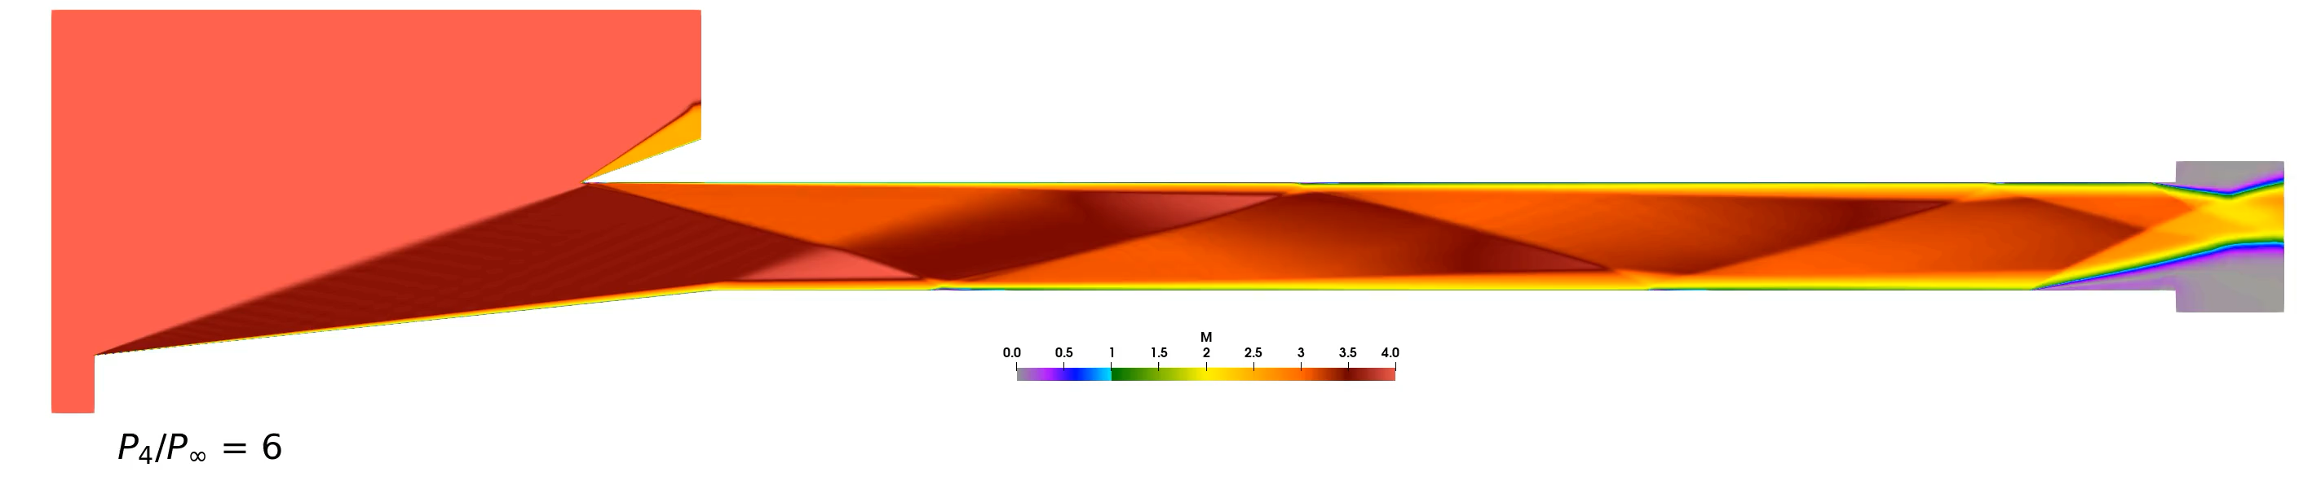
OVERFLOW URANS 2D (Mach) Increasing P₄/P∞
k - ω
SST

Slide 15
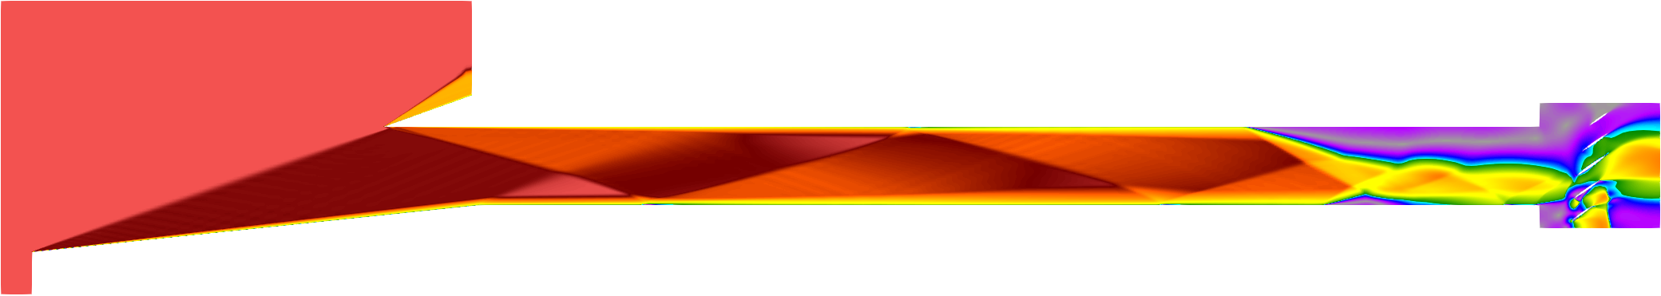
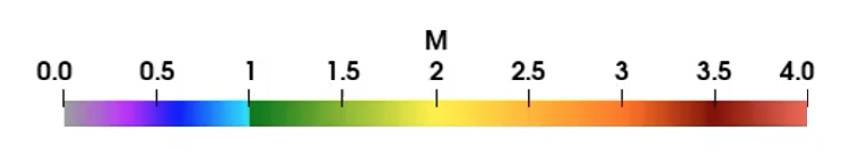
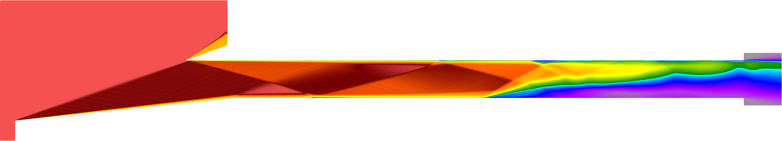
STLE Detection
x_{STLE}
L
x_{STLE}
L
2D solutions: Line probes just above boundary layer. STLE where most upstream M < 1 location
3D solutions: Surfaces just above boundary layer on ramp, cowl, and sidewall surfaces

Slide 16
STLE location vs. Backpressure Ratio
STLE vs. Backpressure Ratio
2D Steady and 2D Time-Accurate
STLE vs. Backpressure Ratio
2D Steady and 3D Steady

Slide 17
OVERFLOW 2D Time Resolution Study
STLE vs. Backpressure Ratio
STLE location vs. Iteration (time-marching)
P₄ / P∞ = 7

Slide 18
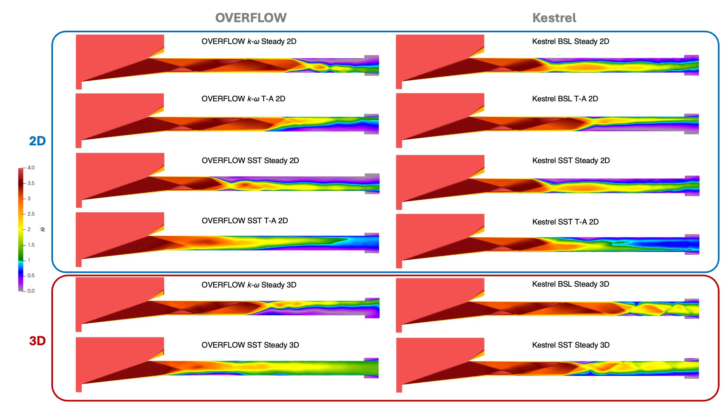
Mach Contours (Time-averaged)
P₄/P∞ = 18

Slide 19
Standard Deviation of Mach, Contours
P₄/P∞ = 18

Slide 20
Separated Flow Isosurfaces
P₄/P∞ = 15

Slide 21
Results:
Numerical Backpressure
Louver angle 𝜽 increased from 0°to 60°
Each simulation successively continued from lower backpressure solution

Slide 22
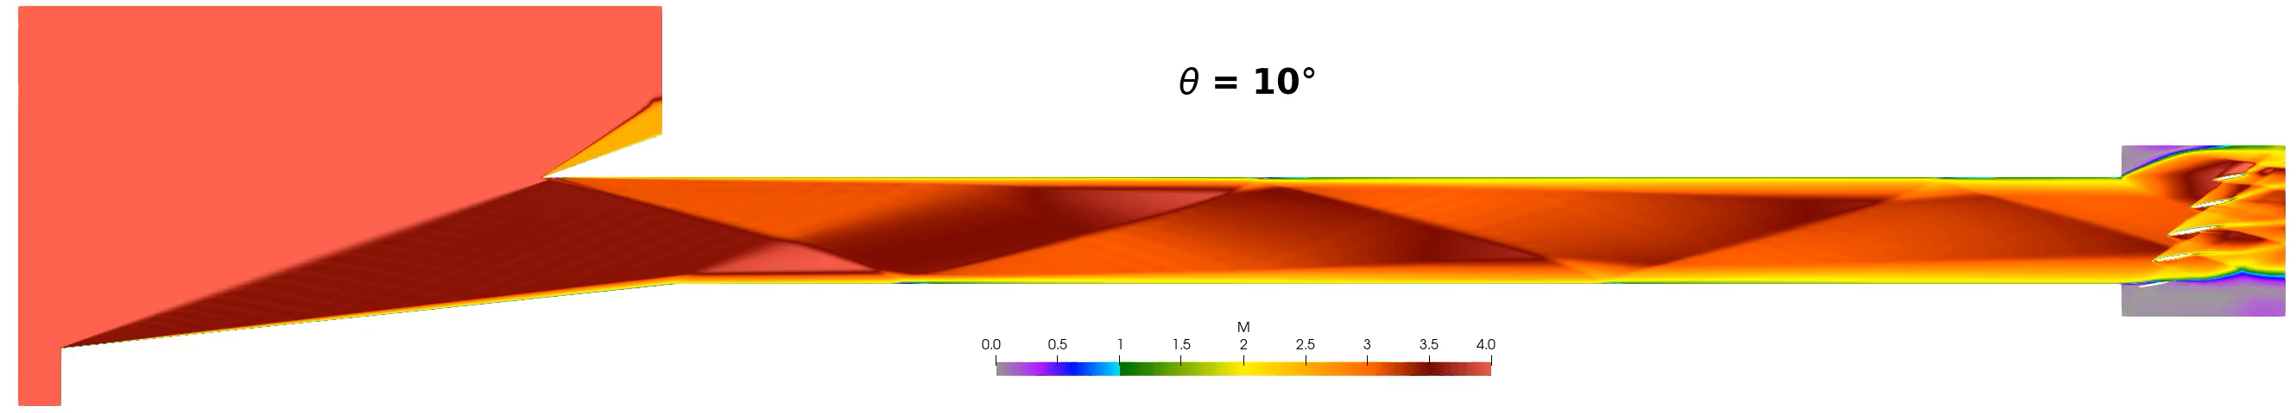
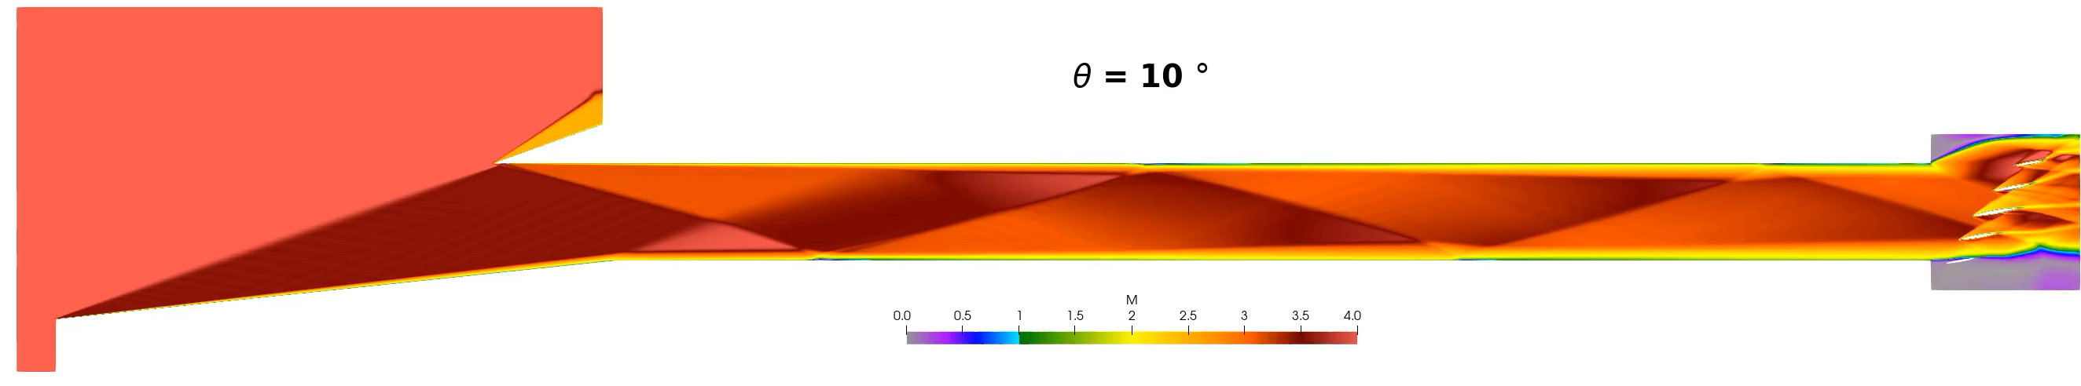
OVERFLOW URANS 2D (Mach) Increasing 𝜽
k - ω
SST

Slide 23
STLE location vs. Louver Rotation Angle

Slide 24
Mach Contours (Time-averaged)
𝜽 = 35°

Slide 25
Conclusions
Large difference in STLE location and unstart due to turbulence modeling
Temporal resolution affects STLE position and unstart
2D vs 3D difference in STLE position and unstart
  Span asymmetry
  Sidewall/corner separation
2D simulations show 25% difference in critical unstart backpressure
Surprising difference between OVERFLOW and Kestrel SST
SST predicts earliest unstart, concurrent with Reardon et. al. [3]
Optimal Kulite placements on ramp and cowl walls
Louver range of at least 0° ≤ 𝜽 ≤ 35° for stable shock train

Slide 26
References
[1] Schulein, E., Krogmann, P., and Stanewsky, E., “Documentation of two-dimensional impinging shock/turbulent boundarylayer interaction flow,” Tech. rep., 1996.
[2] Rising, C. and Sosa, J., “Exploration of the Influence of Various Backpressure Mechanisms to Inlet Unstart,” ICCFD, Kobe, Japan, July 2024
[3] Reardon, J. P., Schetz, J. A., and Lowe, K. T., “Computational Analysis of Unstart in Variable-Geometry Inlet,” Journal of Propulsion and Power, Vol. 37, No. 4, 2024/12/01 2021, pp. 564–576.
[4] Di Stefano, M. A., Hosder, S., and Baurle, R. A., “Effect of turbulence model uncertainty on Scramjet Isolator
Flowfield analysis,” Journal of Propulsion and Power, vol. 36, 2020, pp. 109–122.

Slide 28
Backup Slides

Slide 29
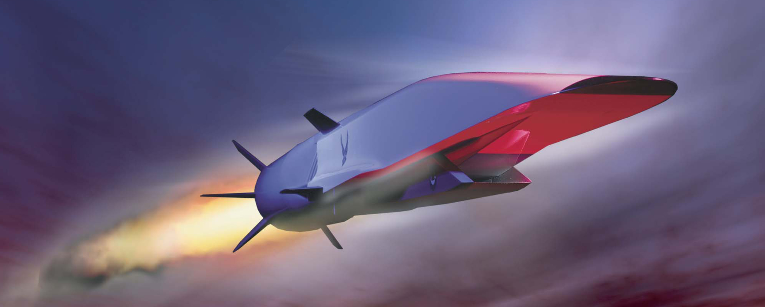
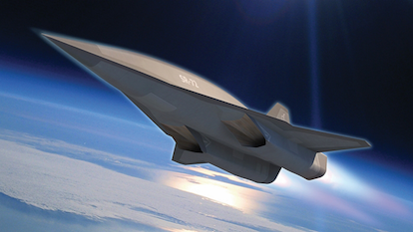
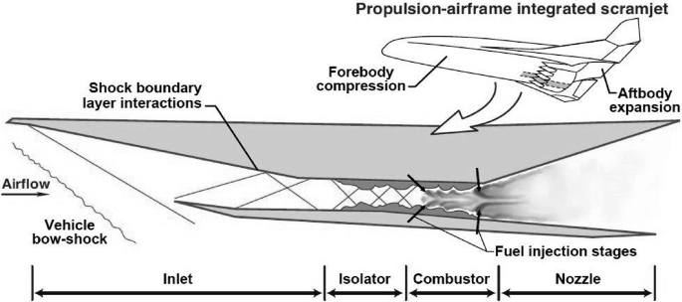
Hypersonic Airbreathing Propulsion

Slide 30
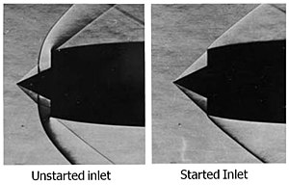
Unstart

Slide 31
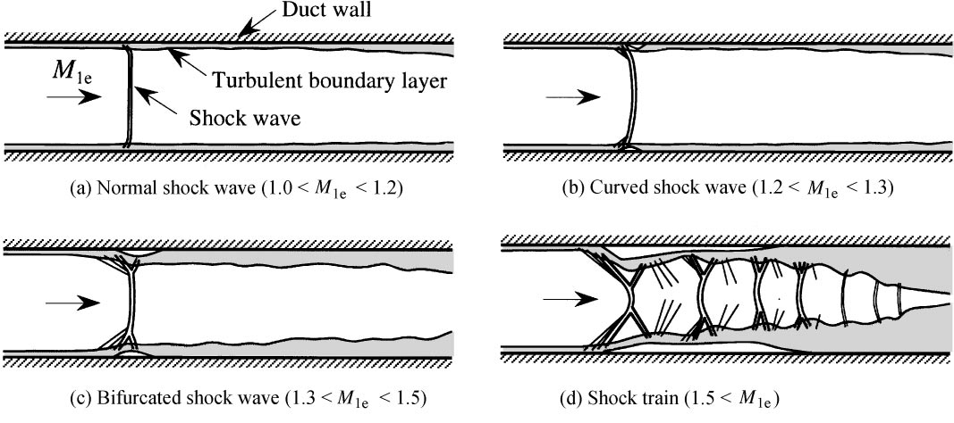
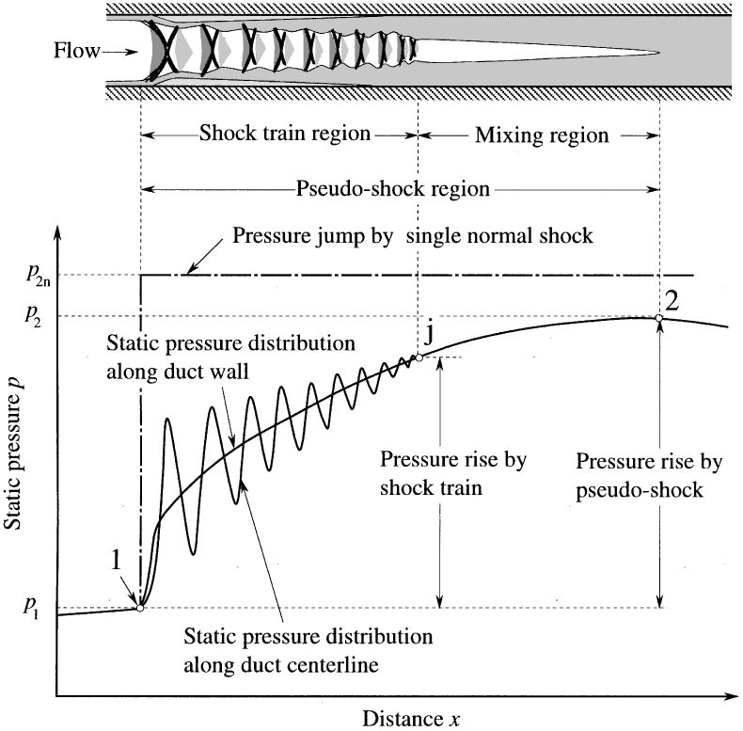
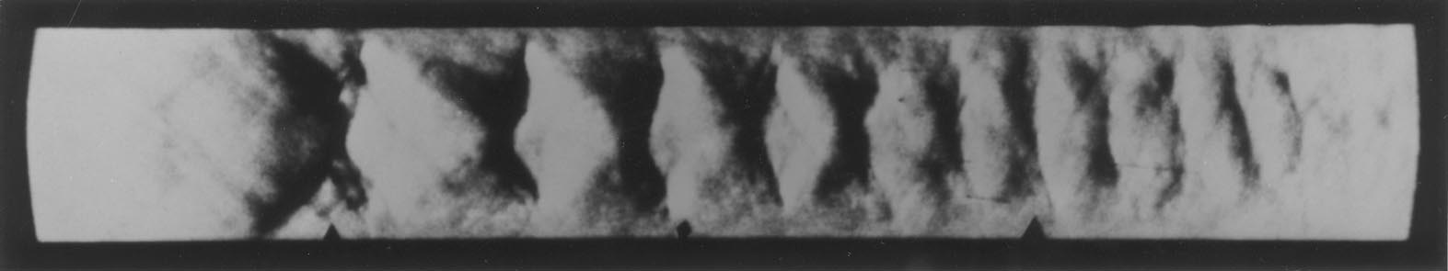
Isolator Shock Trains
* Matsuo et. al.

Slide 32
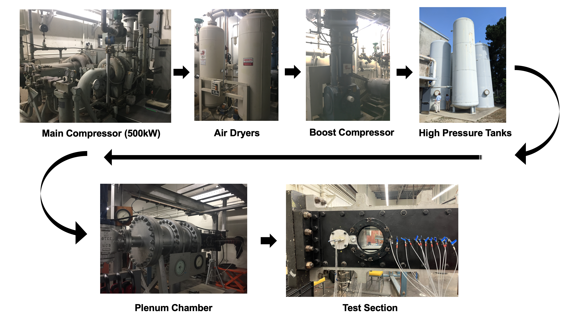
Backup

