Slide 1
Transformational Tools and Technologies (T³) Project
A Workflow to Rapidly Interrogate Multiscale Model Simulation Results Across Multiple Length Scales
Trenton M. Ricks, Brett A. Bednarcyk, Steven M. Arnold, Evan J. Pineda
NASA Glenn Research Center (GRC), Cleveland, OH
AIAA SciTech 2025 Forum, Orlando, FL
January 9, 2025

Slide 2
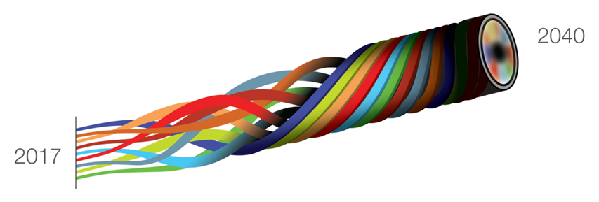
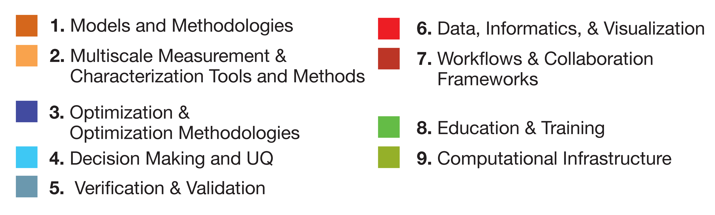
Vision 2040
A Roadmap for Integrated, Multiscale Modeling and Simulation of Materials and Systems
Provides a public/private investment strategy for the design of fit-for-purpose materials and structures
cyber-physical-social ecosystem
NASA CR 2018-219771
https://ntrs.nasa.gov
Nine Identified Key Element Discipline Areas
2040 Vision State:
A cyber-physical-social ecosystem that impacts the supply chain to accelerate model-based concurrent design, development, and deployment of materials and systems throughout the product lifecycle for affordable, producible aerospace applications

Slide 3
Why Should You Care About Multiscale Visualization?
Many materials have mechanisms and features at multiple length scales
  Allows a detailed interrogation of driving forces at appropriate subscales for a given mechanism
  Example problems in this presentation demonstrate this
Verification and validation of constitutive, damage, and failure models requires detailed visualization capabilities
  Becomes even more essential for multiscale problems
Most visualization tools show results at only one scale
  Q: how can you trust results and know they are accurate?
Allows users to leverage large amounts of data generated during an analysis to make better informed decisions
Multiscale visualization allows users to rapidly perform trade studies on individual methods

Slide 4
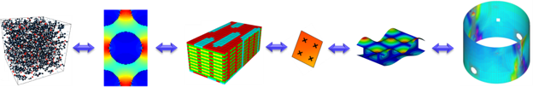

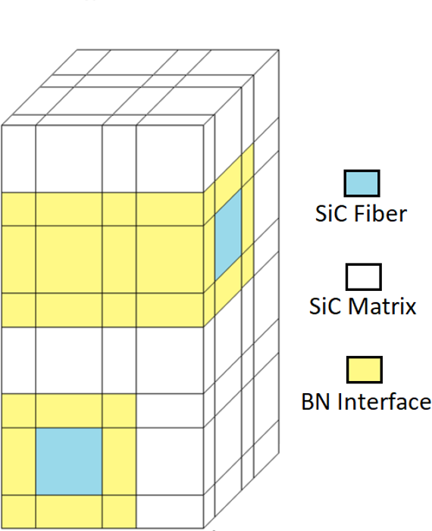
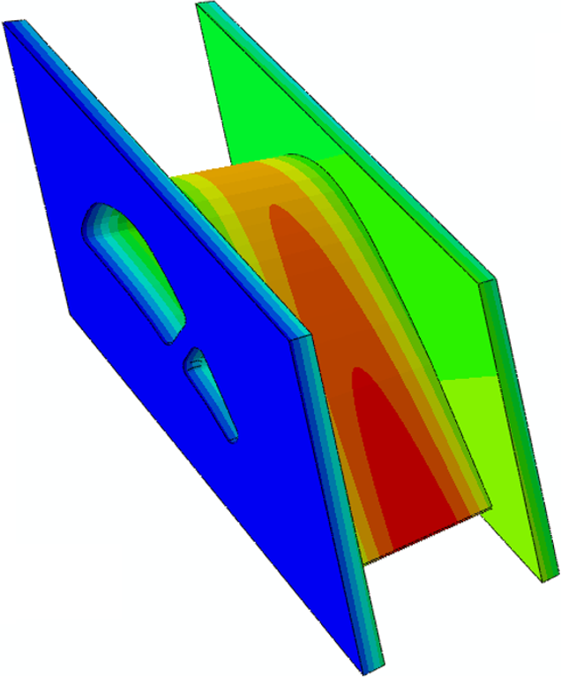
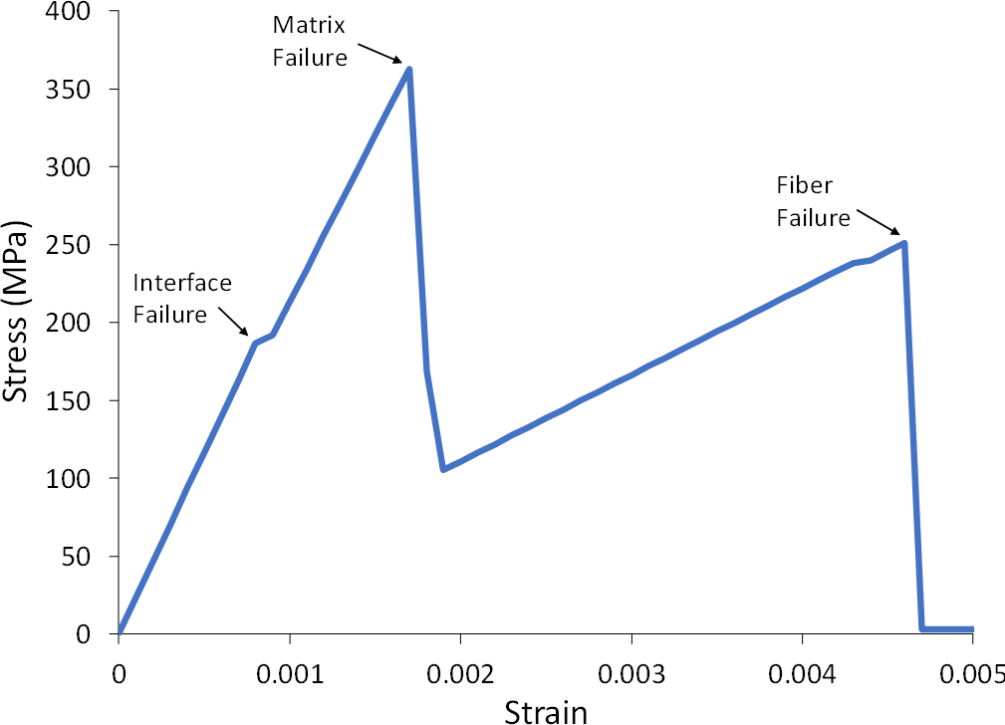
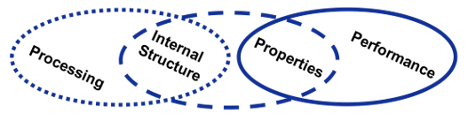
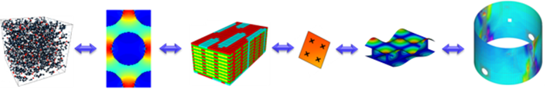
NASA Multiscale Analysis Tool (NASMAT)
Successor to MAC/GMC and FEAMAC toolsets
A framework designed to support massively multiscale modeling
    Solves real, large-scale, non-linear, thermo-mechanical problems
Modular design to support “plug-and-play” capabilities
    Operational components categorized into NASMAT procedures
Developed for enhanced interoperability
    Integrates with 3rd party structural analysis codes (e.g., FEA)
  Library of constitutive laws/damage models
Ideal for “design with” or “design of” the material
  Enables Integrated Computational Materials Engineering (ICME)
  Developed to support Vision 2040

Slide 5
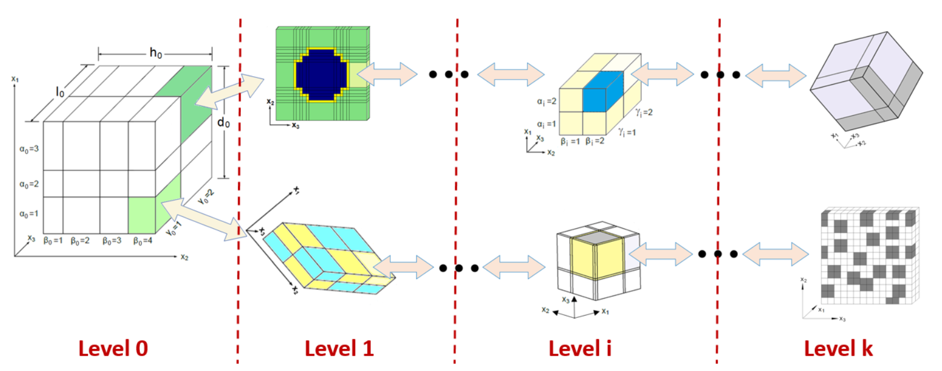
Multiscale Recursive Micromechanics (MsRM)
Level 1
Level 2

Slide 6
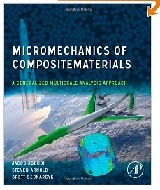
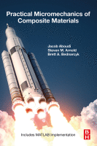
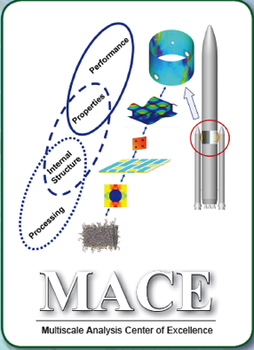
A Brief History of Micromechanics and Multiscale Analysis at NASA GRC*
1992 – 2002: Development of basic tools/theories/methods
Inelastic deformation/constitutive model development
Fiber-matrix debonding/interfaces
Fatigue, creep fatigue
Laminate dominated
Focus shift:
Woven/braided composites
Multiscale
Visualization tools
Damage/failure
NASMAT Dev. Starts
FEAMAC 2.0
FEAMAC-Pre/Post
NASMAT 3.0
HyperMAC
NASMAT 1.0
NASMAT 4.0
NASMAT 2.0
Aboudi Book
MAC/GMC 2.0
MAC/GMC 3.0
Book Pub.
MAC 1.0
FEAMAC 1.0
MACPOST
MAC/GMC 4.0
Book Pub.
GMC
HFGMC
GrantaMAC
MACE Est.
NASA Funded
GMC - 3D
MSGMC
MOC
2009
2010
2011
2013
2021
2022
1987
1991
2024
1992
1993
1994
1995
1996
1997
1999
2002
2003
2016
2018
2001
2005
2020
*Limited to our research group, not including seminal work of others (C. Chamis)

Slide 7
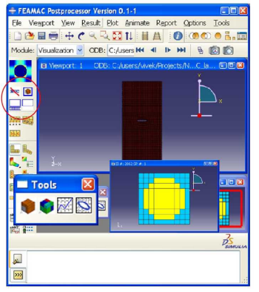
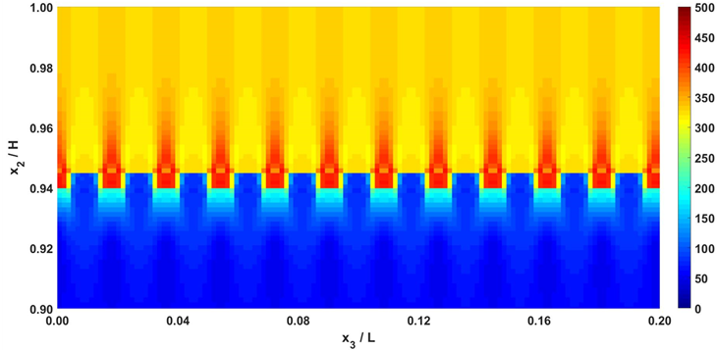
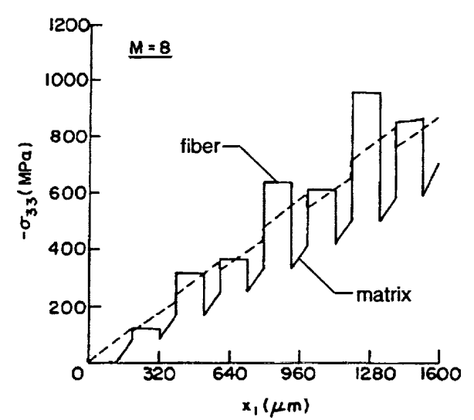
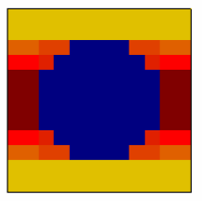
A Brief History of Micromechanics and Multiscale Analysis at NASA GRC
Detailed Visualization Limited to Two Scales!
NASMAT Dev. Starts
FEAMAC 2.0
FEAMAC-Pre/Post
NASMAT 3.0
HyperMAC
NASMAT 1.0
NASMAT 4.0
NASMAT 2.0
Aboudi Book
MAC/GMC 2.0
MAC/GMC 3.0
Book Pub.
MAC 1.0
FEAMAC 1.0
MACPOST
MAC/GMC 4.0
Book Pub.
GMC
HFGMC
GrantaMAC
MACE Est.
NASA Funded
GMC - 3D
MSGMC
MOC
2009
2010
2011
2013
2021
2022
1987
1991
2024
1992
1993
1994
1995
1996
1997
1999
2002
2003
2016
2018
2001
2005
2020
Pace of Methods Development and Application Has Far Exceeded Visualization Capabilities!
Notes:
Legacy visualization tools rely on paid software licenses
Implications for model validation

Slide 8
NASMAT PrePost
A Solution for Efficiently Visualizing Multiscale Modeling Results
Requirements
Features/Capabilities
Utilizes state-of-the-art visualization tools not dependent on paid software licenses
Able to generate NASMAT models and incorporate legacy tools
Can ingest large datasets and quickly visualize results at multiple scales
Separate user-interface and utility functions for flexibility
Python development primarily utilizing PyQt5, VTK, H5py packages
Standardized functions for developing NASMAT inputs and processing NASMAT outputs
Able to seamlessly transition between results at multiple length scales
User-interface separated from “guts” of code to allow standalone result viewing
Converter to input VTU/VTI geometries from tools such as TexGen or PuMA
Support utility to add NASMAT Abaqus results to NASMAT H5 file for viewing
Two example problems shown that capture relevant features across multiple length scales

Slide 9
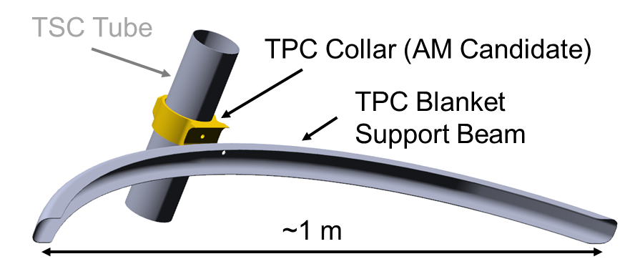
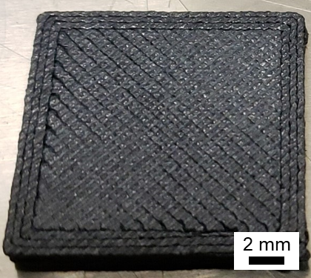
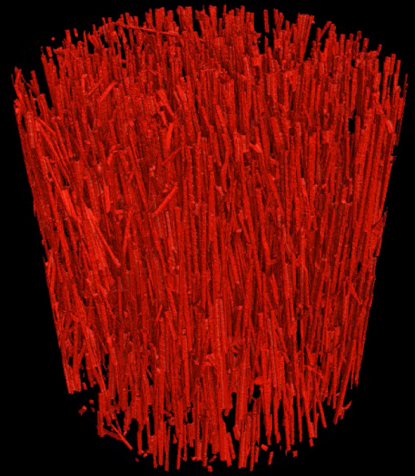
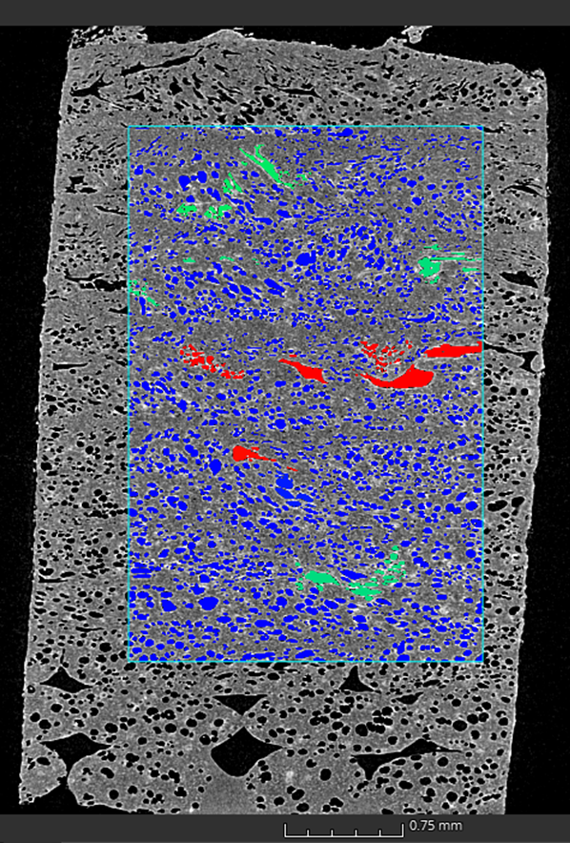
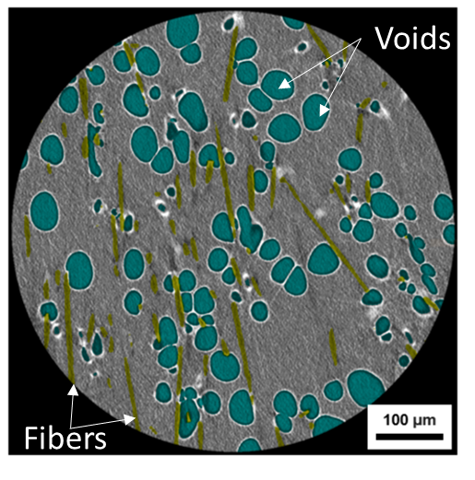
Thermoplastic Terrestrial Point Design Collar
Support collar and beam concept, adapted from hardware for Roman Space Telescope Deployable Aperture Cover
Fused deposition printing fills in layers with a specified raster pattern
Composite additive manufacture (AM) of collar sub-element
PEEK matrix + ~10 vol% discontinuous carbon fiber
Bednarcyk, B.A., Mulhearn, W.D., Kaleel, I., Pineda, E.J., Steele, P.E. “Multiscale Modeling of Short fiber Additively Manufactured Composites,” presented at the ASME ASME Aerospace Structures, Structural Dynamics, and Materials Conference, April 29 – May 1, 2024, Renton, WA.
Notes:
Features occurring at different scales in a multiscale analysis.

Slide 10
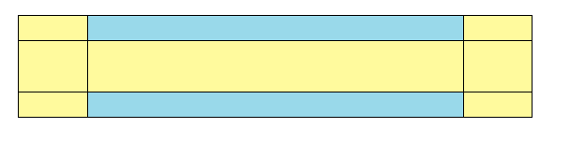
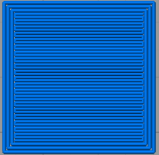
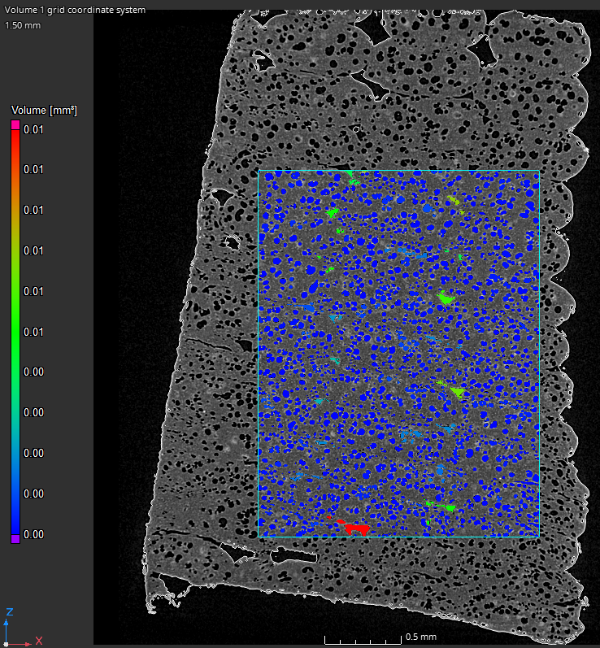
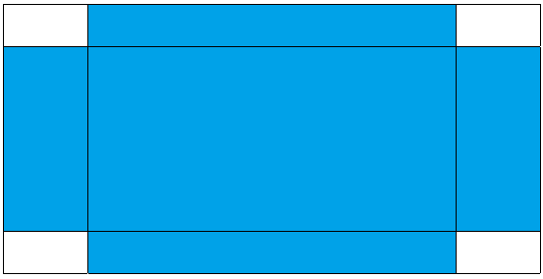
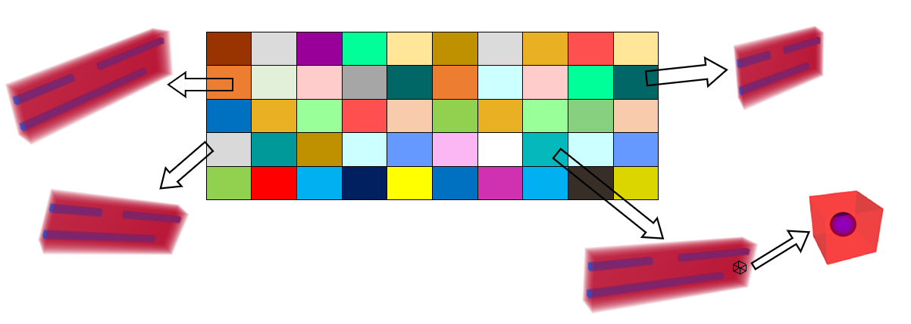
Multiscale AM Problem Setup
Level 1
Layered AM composite with framing
90°
0° frame
0°
0° frame
90°
frame
Level 2
Printed filament with macro voids between print passes
Macro voids between print passes
Level 3
Printed filament with as-measured fiber lengths and angles
Level 3
Micro voids in printed filaments
[effective]
Level 4
RUC with 2 short fibers
Level 4
Level 4
Level 4
NOTE: Overall void content in model = 21.9%
Level 5

Slide 11
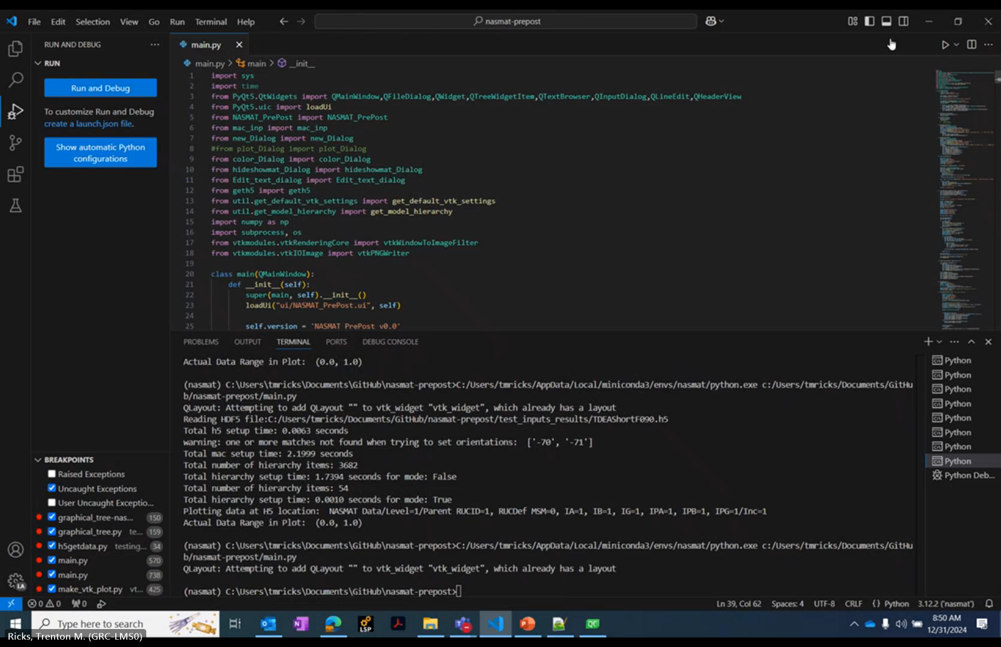
Thermoplastic AM Composite Visualization with NASMAT PrePost
Green Arrow
RUC 2-direction
Blue Arrow
RUC 3-direction

Slide 12
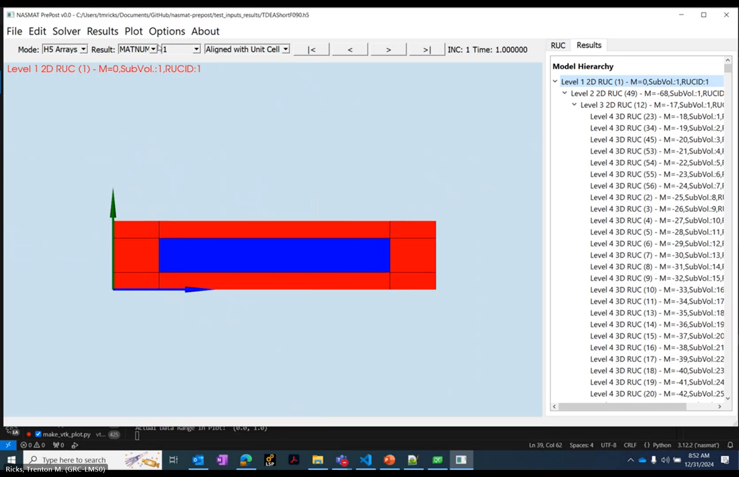
Thermoplastic AM Composite Visualization with NASMAT PrePost
Green Arrow
RUC 2-direction
Blue Arrow
RUC 3-direction

Slide 13
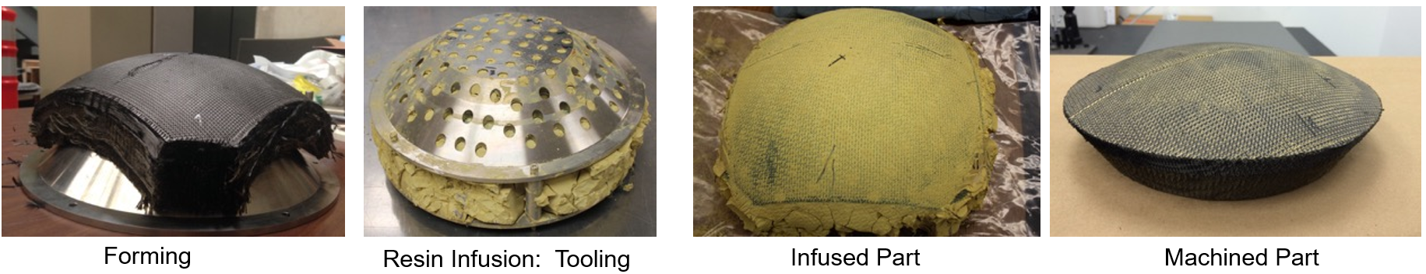
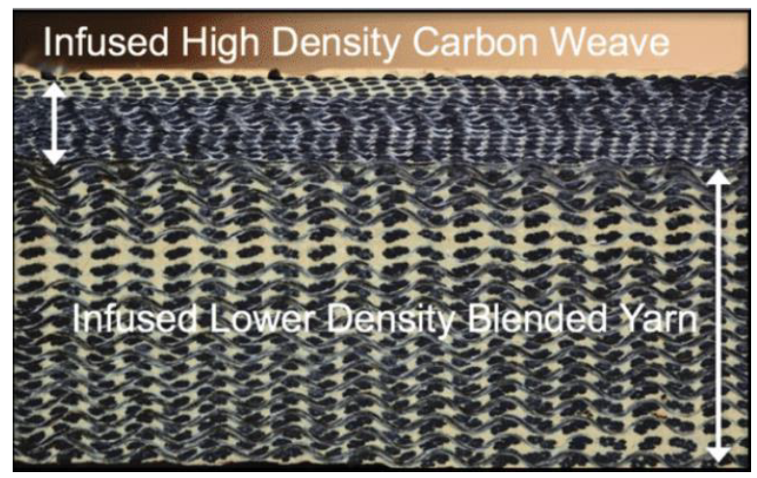
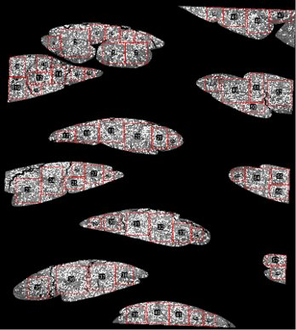
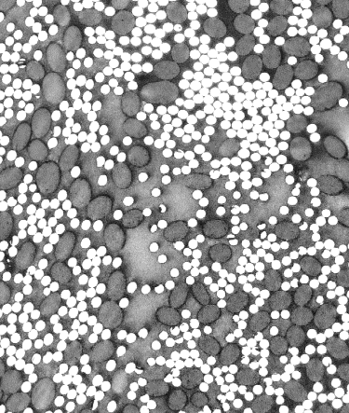
Heatshield for Extreme Entry Environment Technology (HEEET)
HEEET designed to be part of the thermal protection system for re-entry spacecraft
HEEET comprised of two 3D woven layers:
  Recession and Insulation (IL)
Blended carbon and phenolic fiber tows
Four tows twisted to form a yarn
Yarns are woven to create preform
Preform infused with a highly porous phenolic resin
  Inter-yarn porosity (local): 0.846
  Intra-yarn porosity (local): 0.552
Optical microscopy and x-ray computed tomography (CT) data obtained and analyzed
Images from: Gasch, M. (2019) “Heatshield for Extreme Entry Environment Technology (HEEET) Thermal Protection System (TPS)” MS&T19, Portland OR.
Recession Layer
Insulation Layer
Image from: Fahy, W.P., Chang, A., Wu, H., and Koo, J.H. “Recent Developments of Ablative Thermal Protection Systems for Atmospheric Entry”, AIAA SciTech 2021, 19–21 January, 2021.
Within Tows
Carbon Fiber (white)
Phenolic Fiber (dark gray)
Matrix:
Porous Phenolic
Ricks, T.M., Bednarcyk, B.A., Fraile Izquierdo, S., Abbott, L.J., & Aboudi, J. “Multiscale and Multifidelity Modeling of a 3D Woven Composite Thermal Protection System,” in the proceedings of the American Society for Composites Thirty-Ninth Technical Conference, October 21-23, 2024, San Diego, CA.

Slide 14
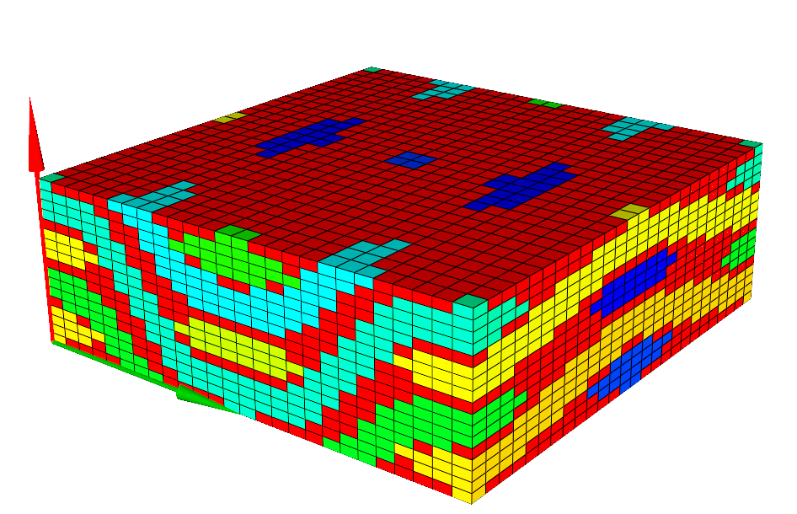
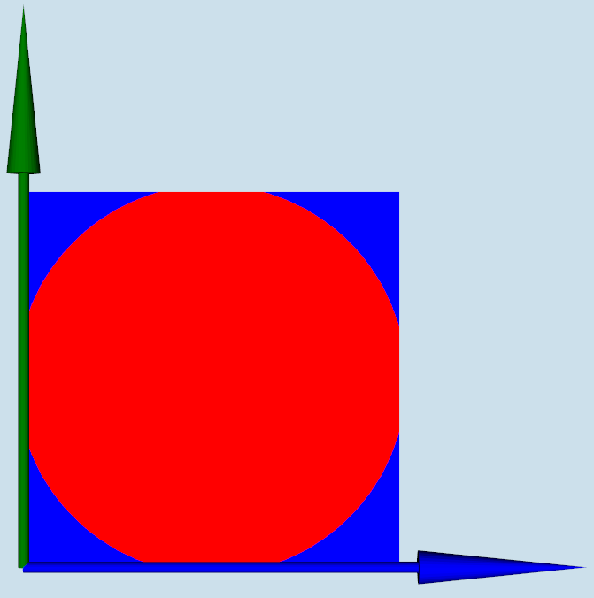
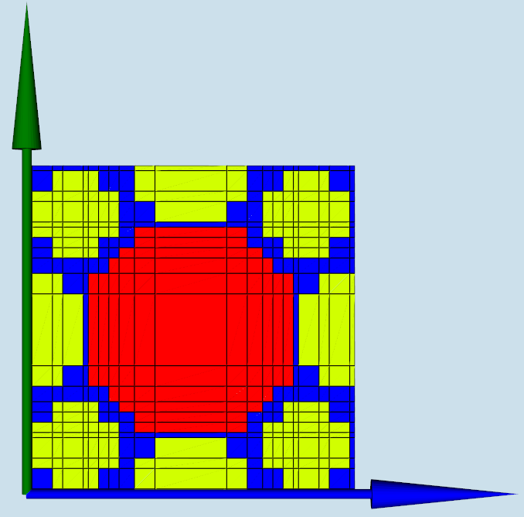
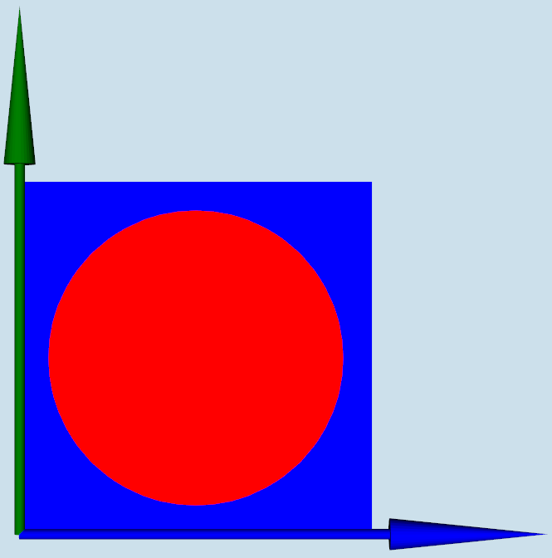
HEEET-IL Problem Setup
HEEET-IL Weave (Level 1)
Weave geometry and properties utilized from previous work*
17x26x26 subvolume grid generated in TexGen and solved with HFGMC3D
Blended carbon and phenolic fiber tows modeled with a 21x21 subvolume grid and solved with HFGMC2D
Inter-tow and intra-tow porosity modeled using spherical Mori-Tanaka
Applied mechanical strain in warp-direction
Subvolume elimination method used for failure
  Max strain failure criterion (carbon fiber)
  Hashin stress-based failure criterion (phenolic fiber and matrix)
Warp direction
Inter-tow Porous Matrix (Level 2)
Blended Fiber Tow (Level 2)
Intra-tow Porous Matrix (Level 3)
*Bednarcyk, Brett A., et al. "Effect of Damage Progression on the Thermal Conductivity of 3D Woven Composite Thermal Protection System Materials." AIAA SCITECH 2023 Forum.
*Izquierdo, Sergio Fraile, Andrew P. Santos, and Lauren J. Abbott. "Certification by Analysis of Woven TPS: Fiber-and Weave-Scale Modeling." NASA Ames EDL Summer Series. 2023.

Slide 15
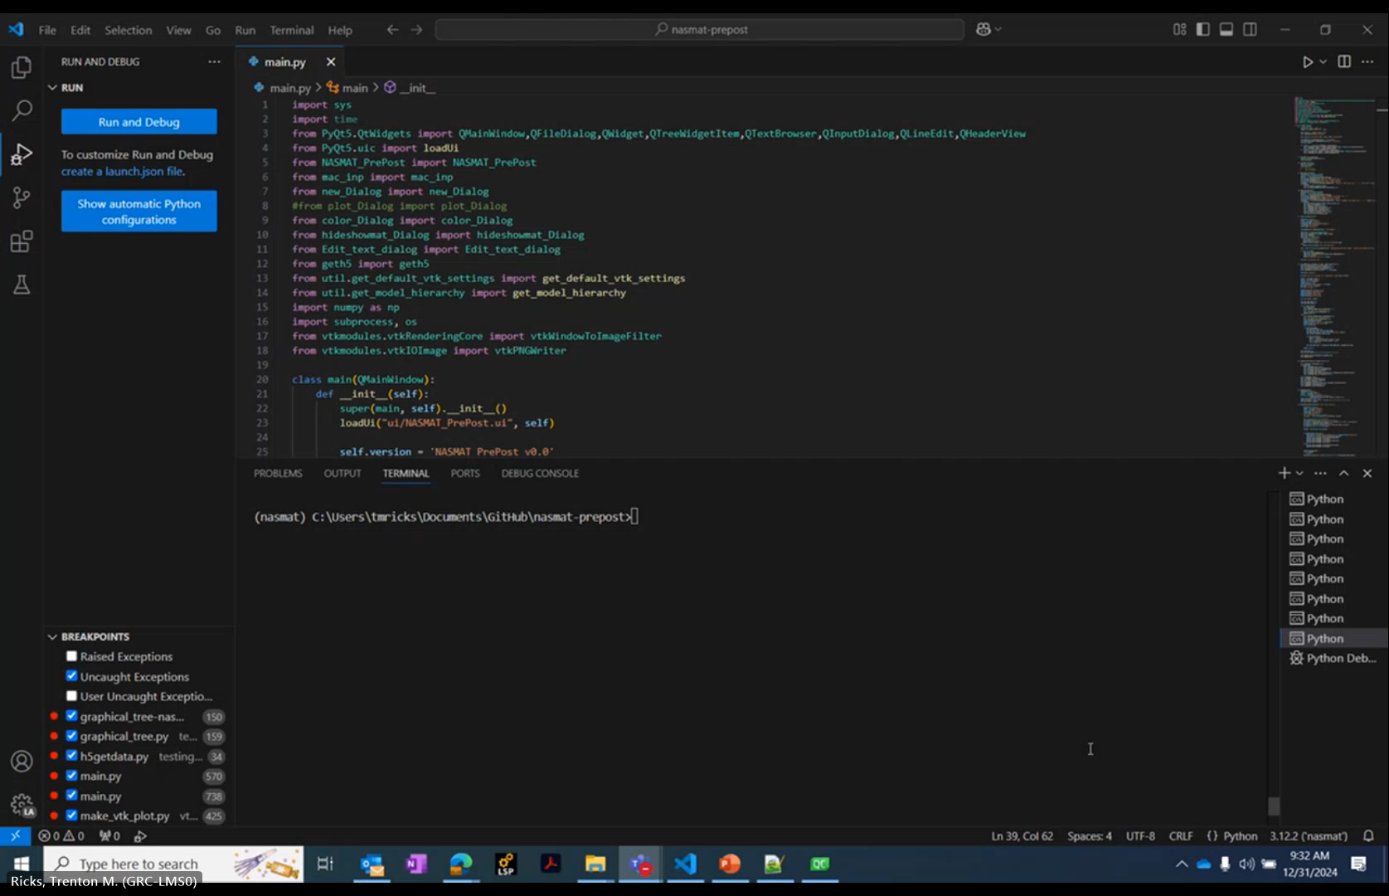
HEEET-IL Visualization with NASMAT PrePost
Red Arrow
RUC 1-direction
Green Arrow
RUC 2-direction
Blue Arrow
RUC 3-direction

Slide 16
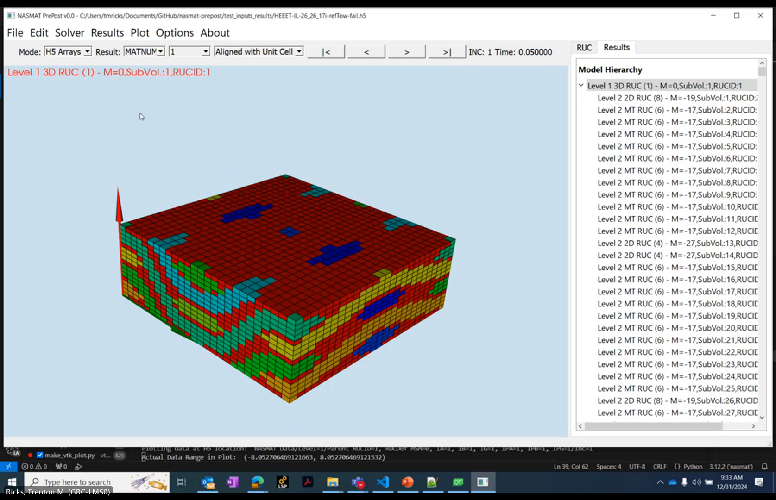
HEEET-IL Visualization with NASMAT PrePost
Red Arrow
RUC 1-direction
Green Arrow
RUC 2-direction
Blue Arrow
RUC 3-direction

Slide 17
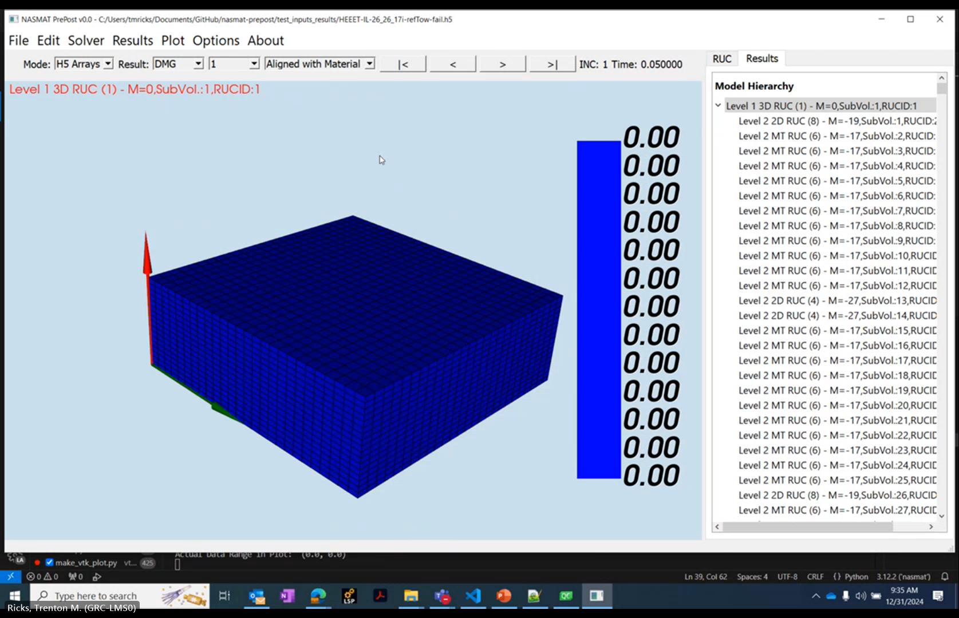
HEEET-IL Visualization with NASMAT PrePost
Red Arrow
RUC 1-direction
Green Arrow
RUC 2-direction
Blue Arrow
RUC 3-direction

Slide 18
What happened to the Intra-tow Matrix Results?
HEEET-IL Weave (Level 1)
HEEET-IL multiscale model included calculations for intra-tow porous matrix (including failure)
Entire problem took 3.7 hrs to run on a single CPU
Level 3 results not able to be efficiently output
  Methods to judiciously output results required
1 larger RUC (HF3D)
Circle size represents computational complexity
Blended Fiber Tow (Level 2)
Inter-tow Porous Matrix (Level 2)
4720 RUCs (HF2D)
6772 RUCs (MT)
Real-time results viewing is less of a problem than outputting results to view
Intra-tow Porous Matrix (Level 3)
172 RUCs (MT)
4720x172 = 811,840 unique Level 3 RUCs!

Slide 19
Summary and Conclusions
Developed a new open-source Python tool for visualizing multiscale model simulation results generated with NASMAT
Demonstrated workflow for two large multiscale analysis problems
Modern software visualization packages can efficiently handle large multiscale datasets
Data output limitation is a key challenge for visualizing multiscale results
  Methods under development to judiciously output relevant data
Version 1.0 specific to NASMAT, intent to generalize to allow multiscale visualization from other tools
NASMAT PrePost expected to be posted to NASA Github (open-source) in Spring 2025

Slide 20

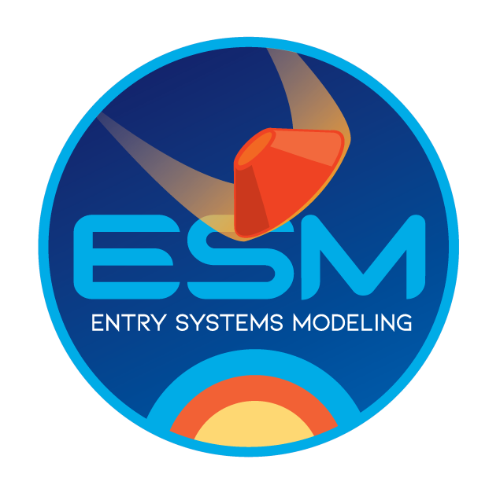

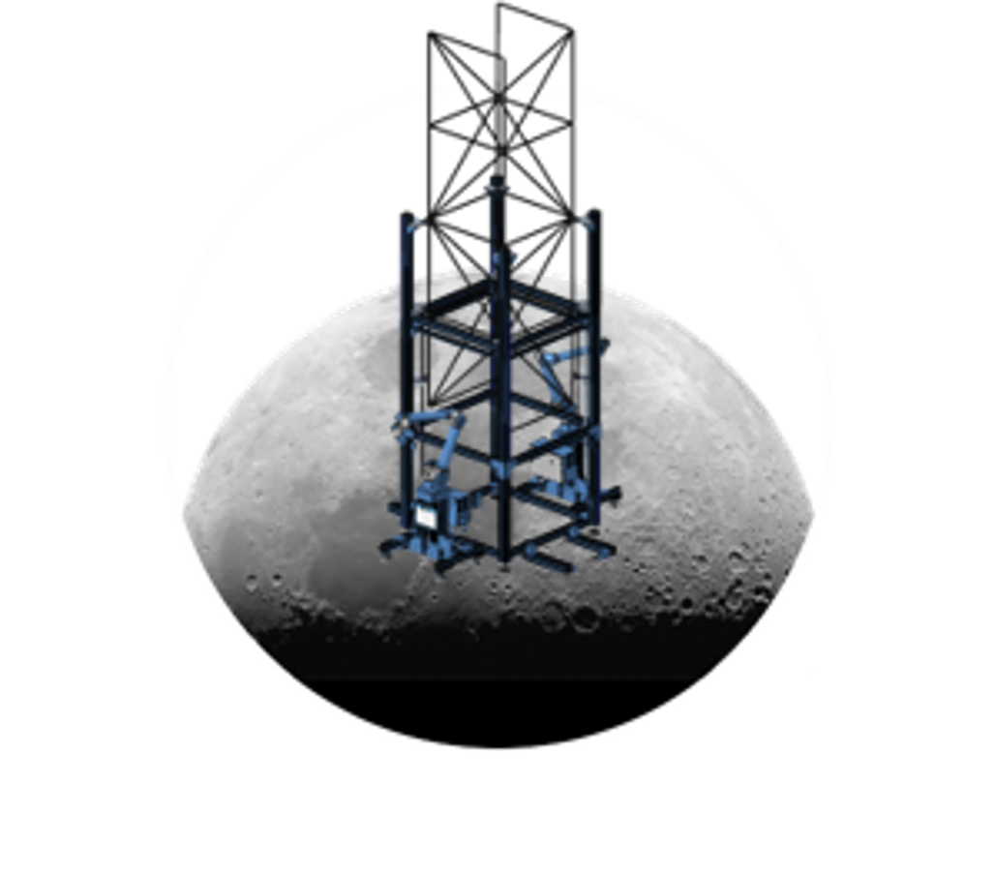
Acknowledgments
Software development supported by the NASA Aeronautics Research Mission Directorate’s Transformational Tools and Technologies Project
Example applications supported by the NASA Space Technology Mission Directorate’s Thermoplastics Development for Exploration Applications and Entry Systems Modeling projects
Request NASMAT via the NASA Software Catalog
- new version released Sept. 2024

