Slide 1

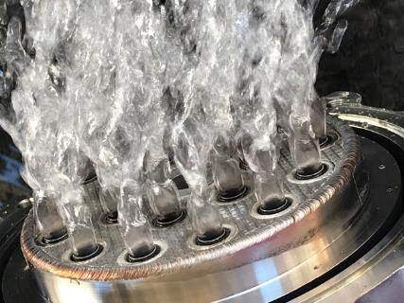

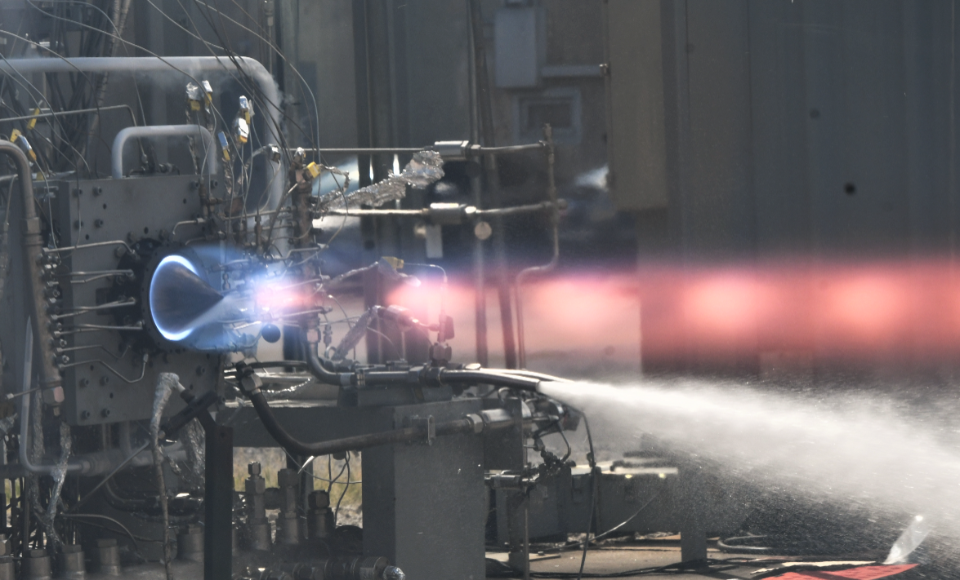
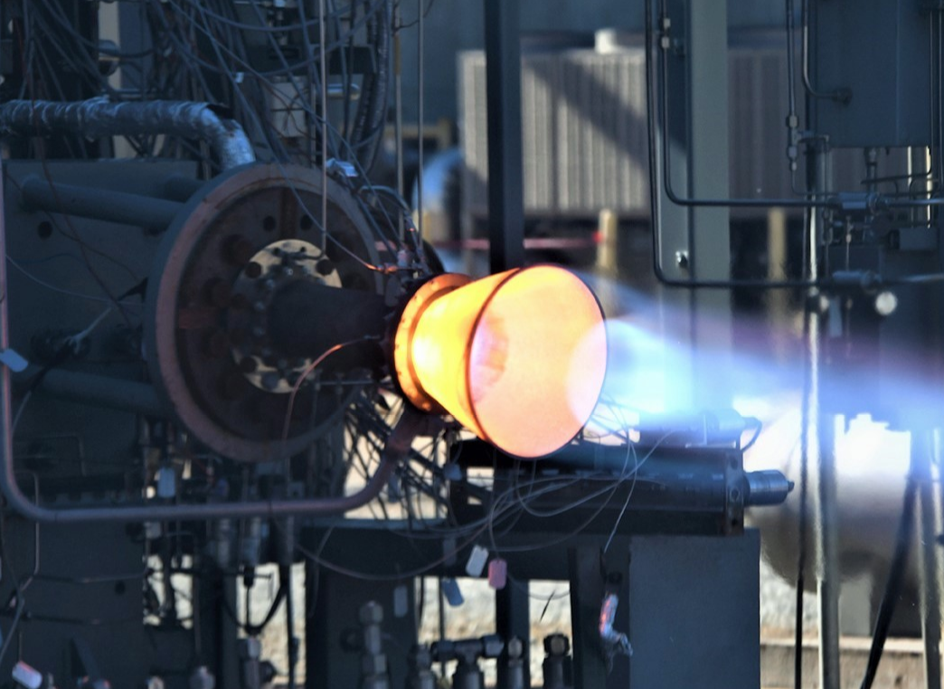
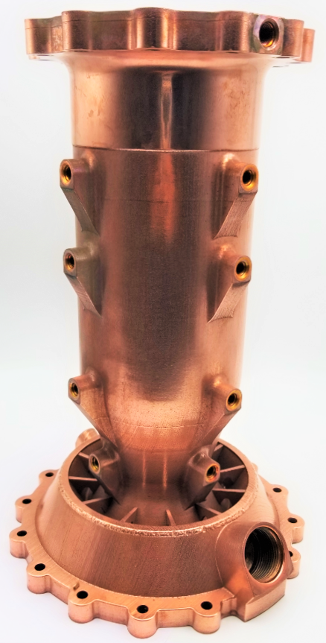
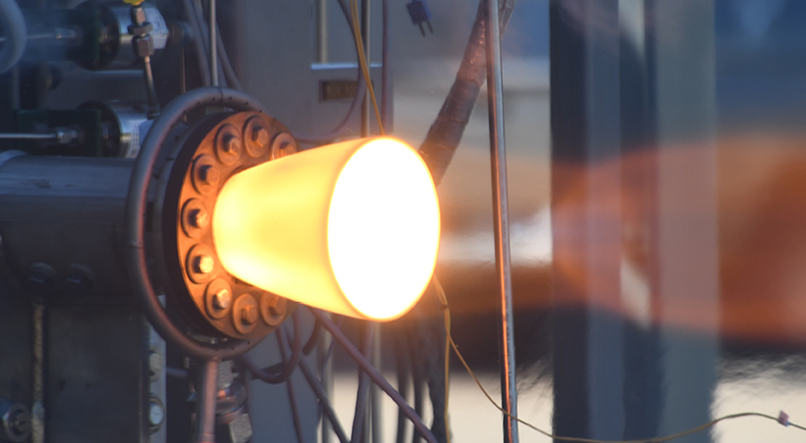
Parameterized Study of Heat Load Trends in a Subscale Rotating Detonation Rocket Engine
2025 AIAA Propulsion and Energy Forum, January 6-10, 2025
Dillon Petty*, Tom Teasley*, Joseph Hernandez-McCloskey^, and Ari Goldman^^.
*ER 13 Combustion Devices | NASA Marshall Space Flight Center,
^University of Texas San Antonio, ^^ Auburn University
This material is a work of the U.S. Government and is not subject to copyright protection in the United States.

Slide 2
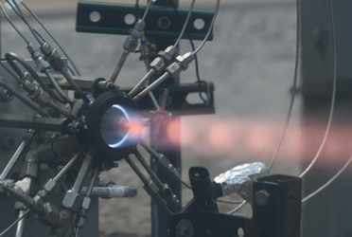
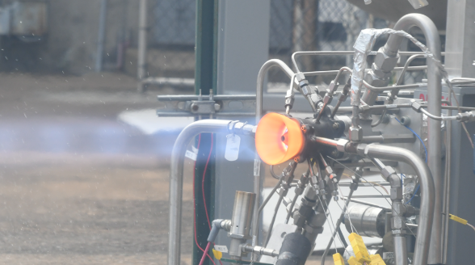
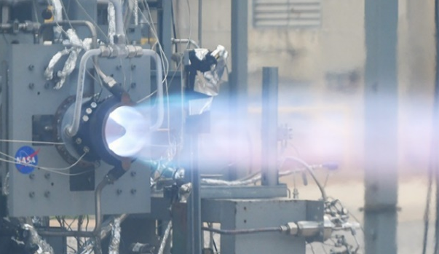
Benefits of Subscale Hardware
First iteration of subscale RDRE
More parts per build plate → faster schedule and cost-effective hardware production
Gaseous propellant testing allows for rapid test turnarounds
Several hardware configurations enable thorough parameterization studies

Slide 3

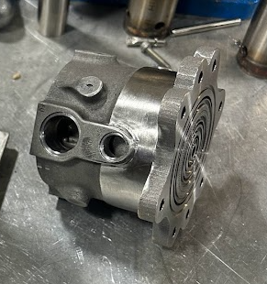
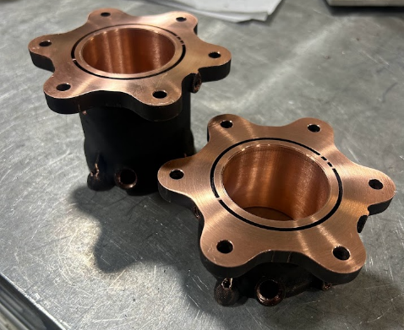
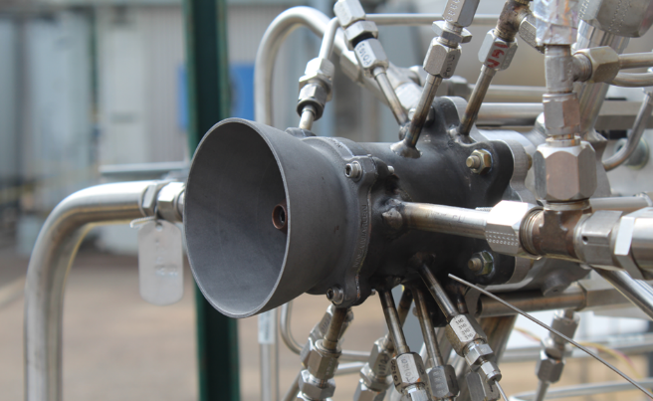
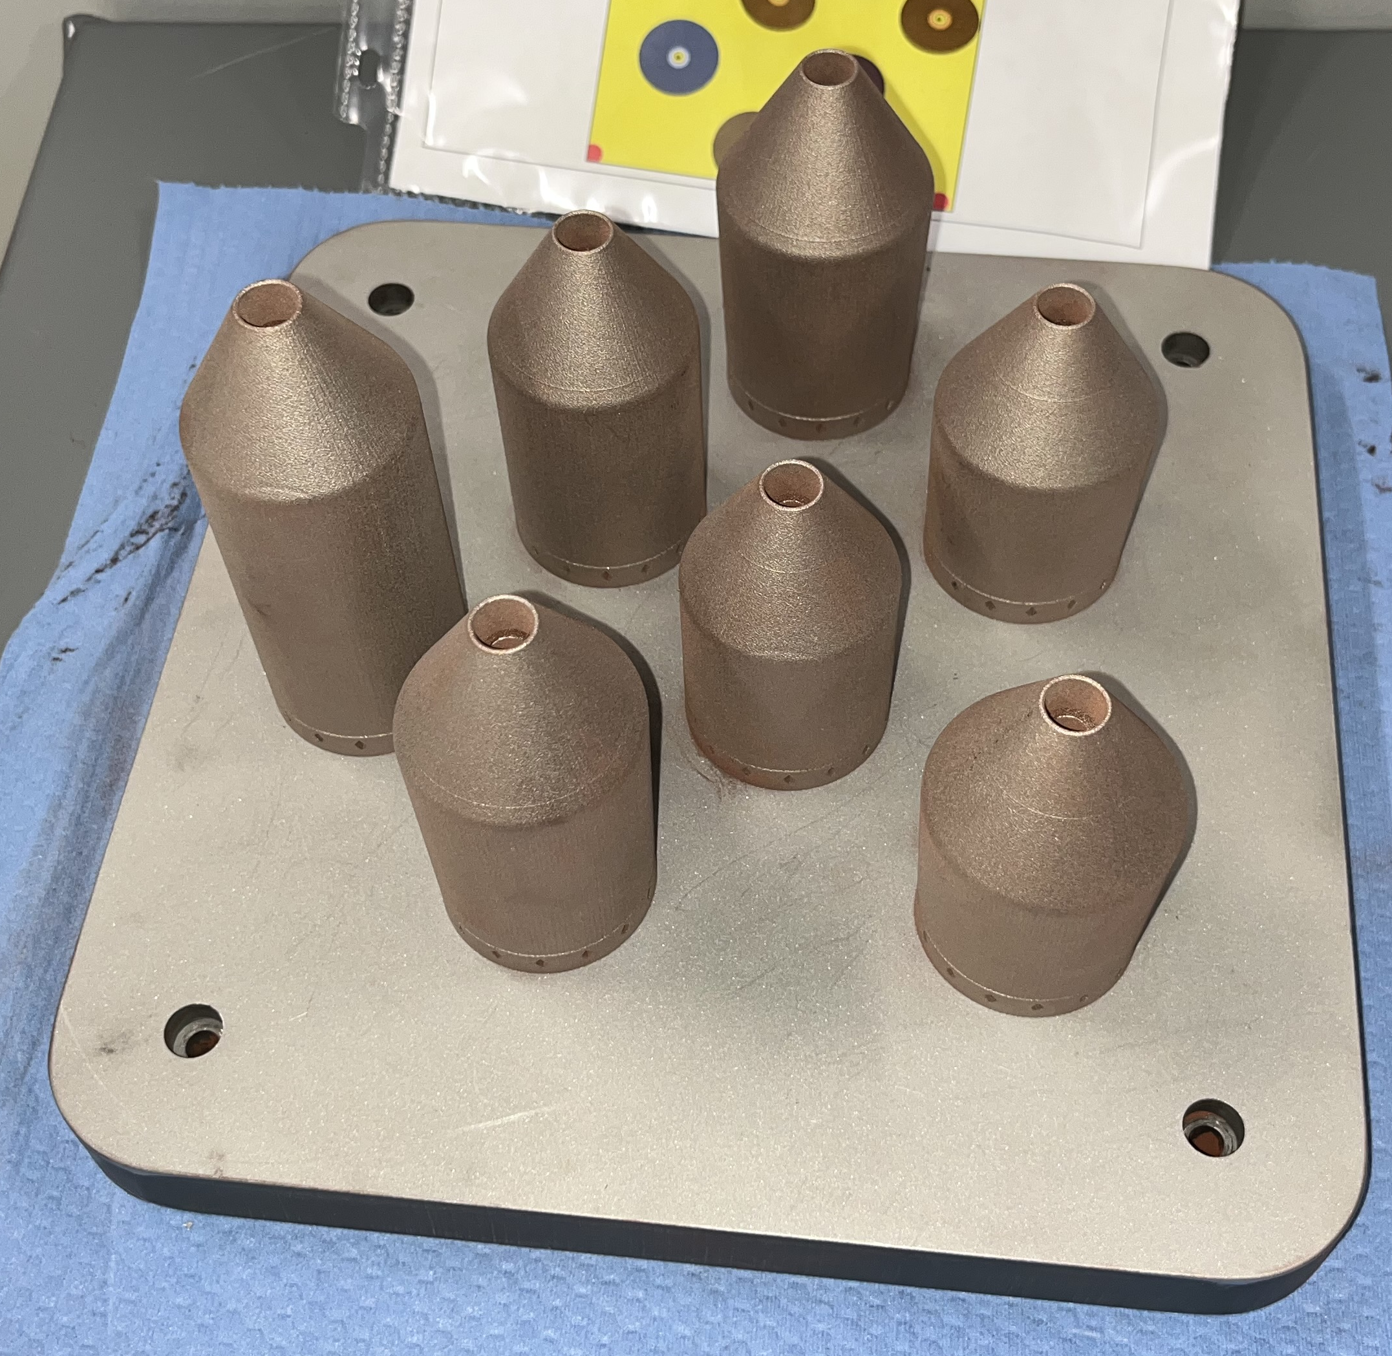
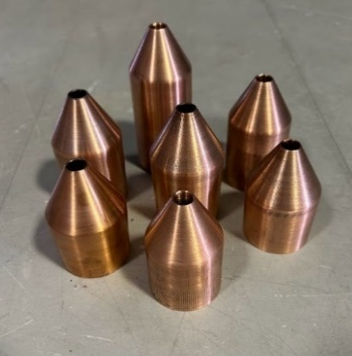
Hardware Overview
Inner Bodies
1.0 L', 1.25 AR
1.5 L' 1.0 AR
1.5 L' 1.25 AR
1.5 L' 1.5 AR
2.0 L' 1.0 AR
2.0 L' 1.25 AR
2.0 L' 1.5 AR
2.5L', 1.25 AR
3.0 L' 1.0 AR

Slide 4
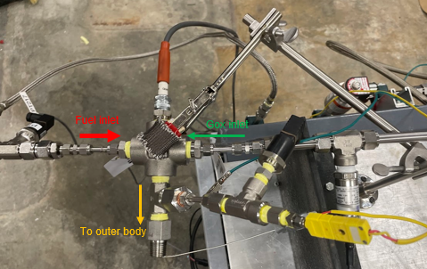
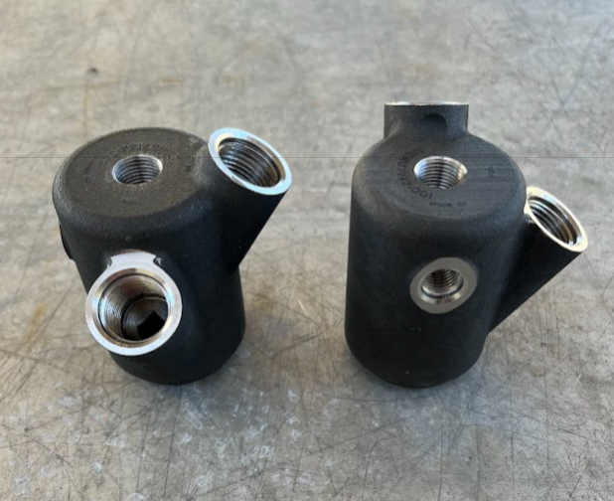
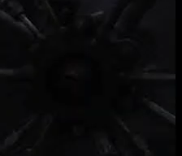
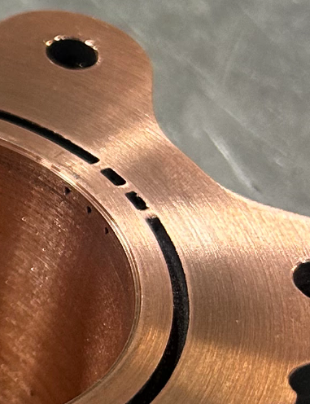
Igniter Overview
Redesigned RDRE igniter
GOX/GCH4 ASI fed through OB channel ribs
  Water cooled off hot gas
GH2 exhaust flare was used to backlight instead
New design increased flowrate and is connected to the injector

Slide 5
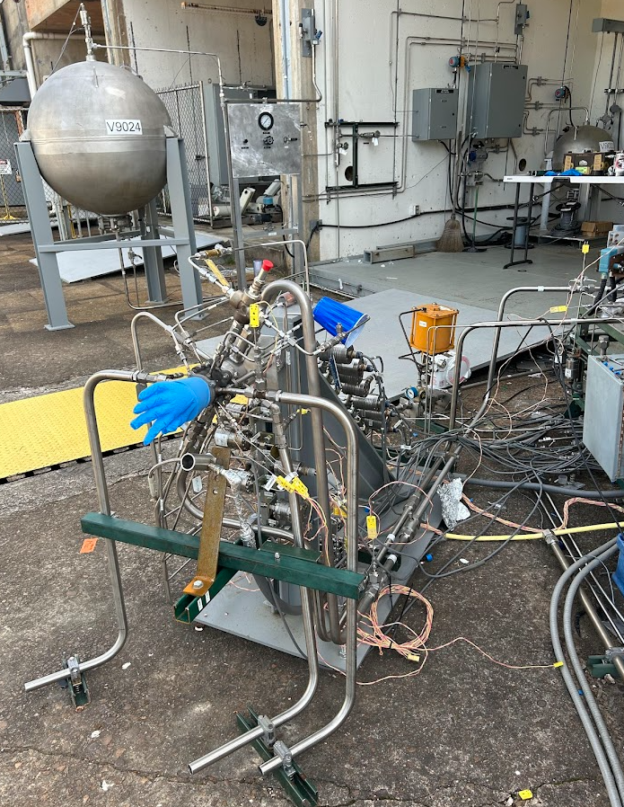
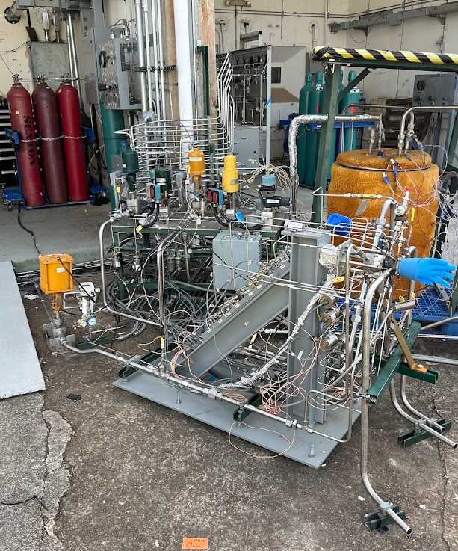
Test Cell 105 Position
Flow Rates:
GOX: ~3 lbm/s at 2000 psi
Fuel: ~1 lbm/s at 2000 psi
Water: 10.5 lbm/s at 1400 psi
Main propellant line purges up to 1500 psi
3K thrust rating
Quick test turn arounds
Notes:
New upgraded for RDRE development

Slide 6
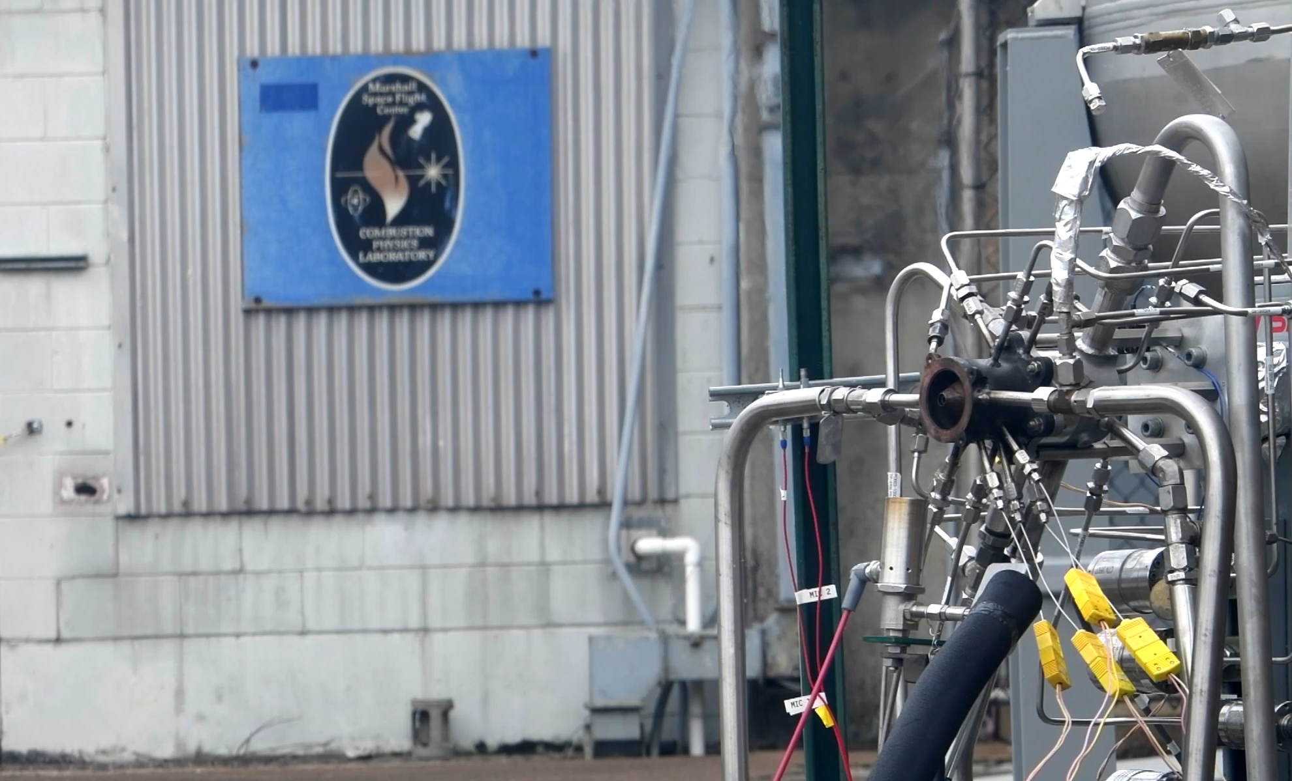
Hot Fire Testing

Slide 7
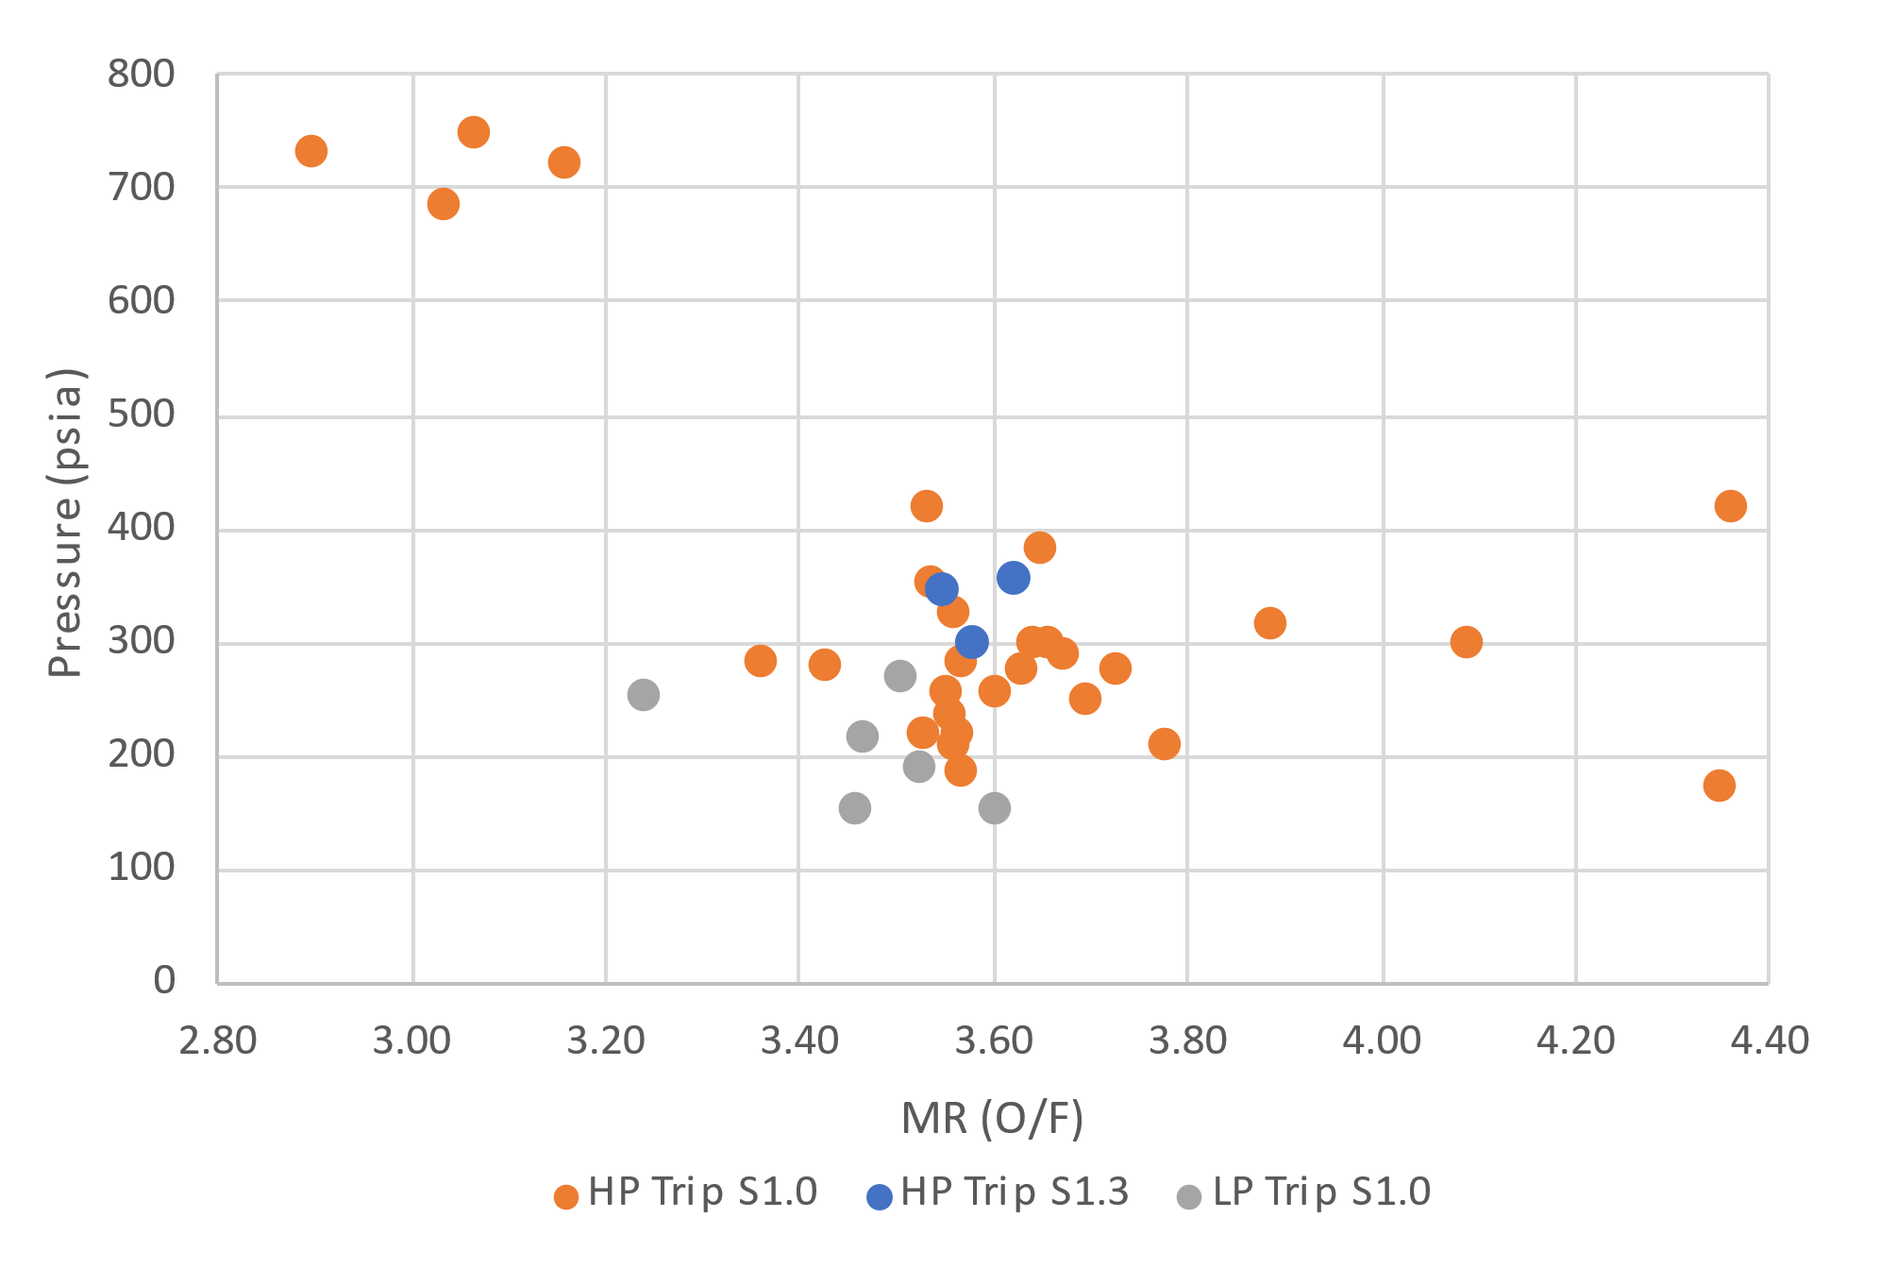
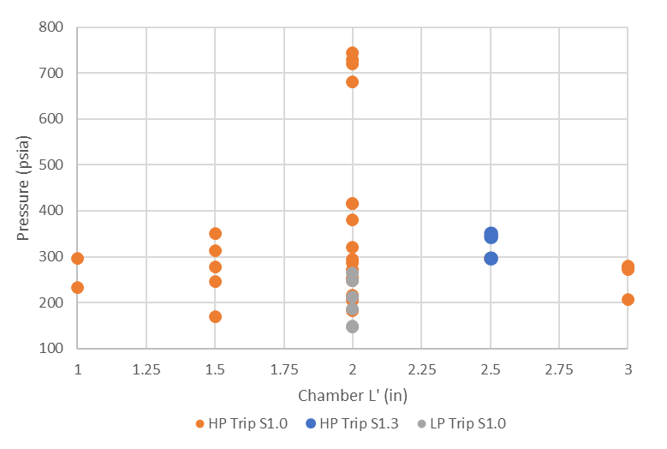
Test Conditions
Pc: 150 – 750 psia
MRs: 2.9 – 4.3 (baseline 3.5)

Slide 8
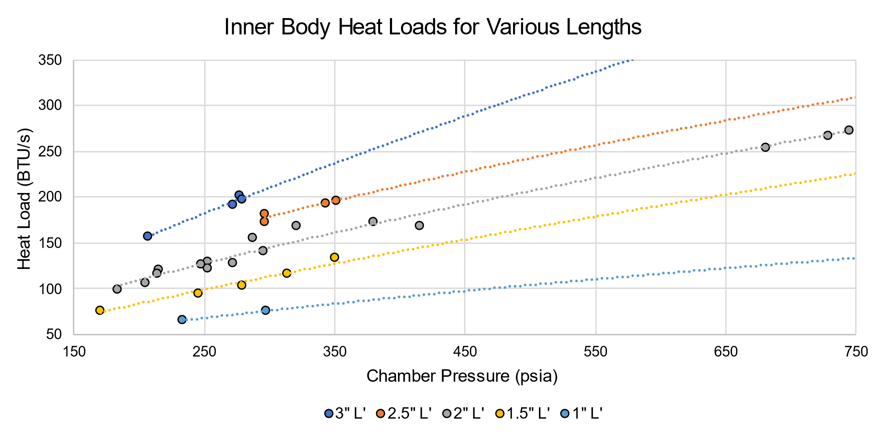
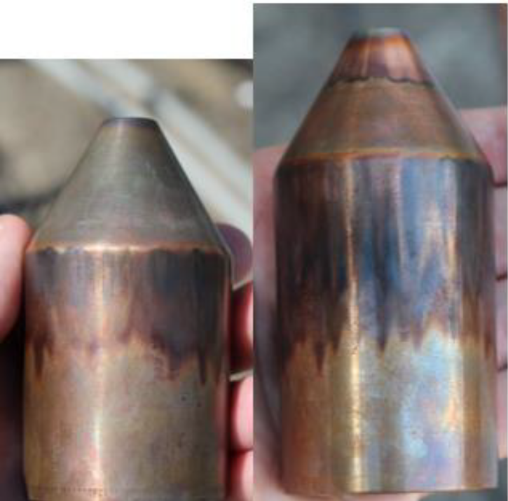
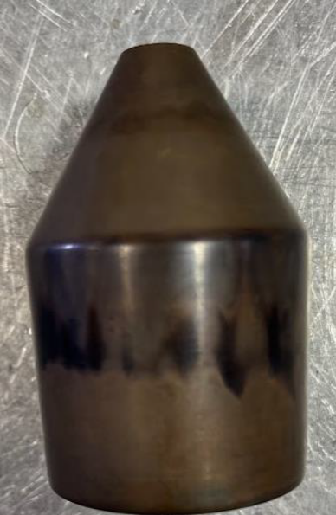
Inner Body Heat Load Trends
Strong correlation to chamber pressure (MR range of 2.9-4.3 did not have significant effect)
A fully shrouded plug nozzle had +10% heat load vs. no shroud
Power trendlines with powers from 0.59 – 0.78 (0.80 for Bartz)
Heat staining continues regardless of length, indicating extra length contributes consistent heat flux

Slide 9
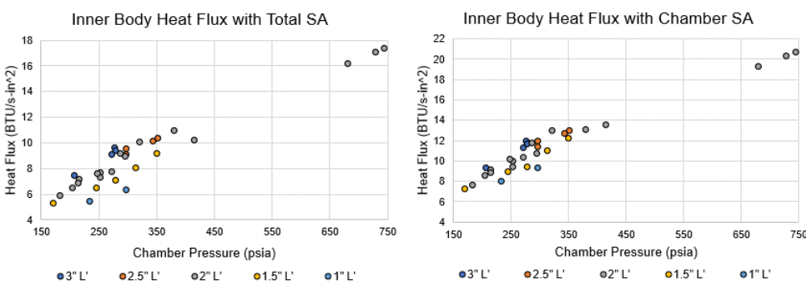
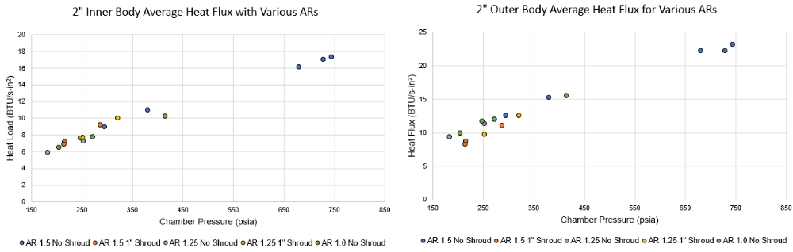
Inner Body Heat Flux Trends
±15%
Plug nozzle SA ignored to get a better estimate of chamber HF
Bulk HF is influenced by chamber length (15% per in.)
Subsonic AR (1.0 – 1.5) did not influence bulk HF.

Slide 10
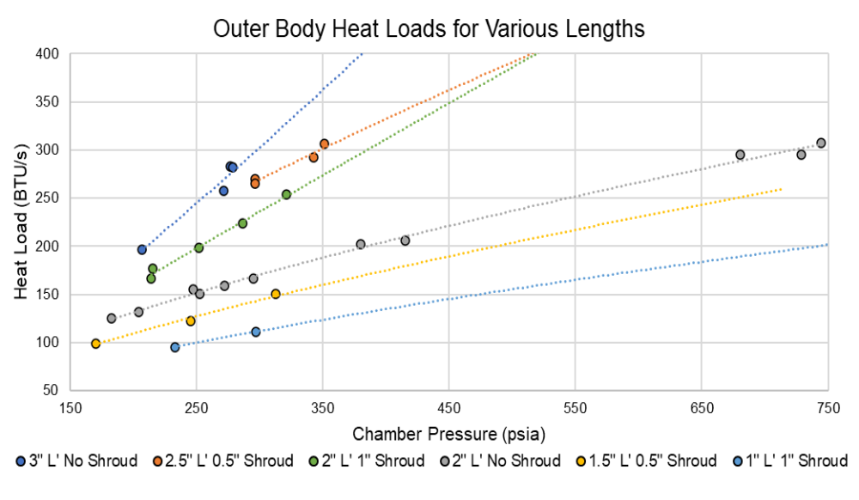
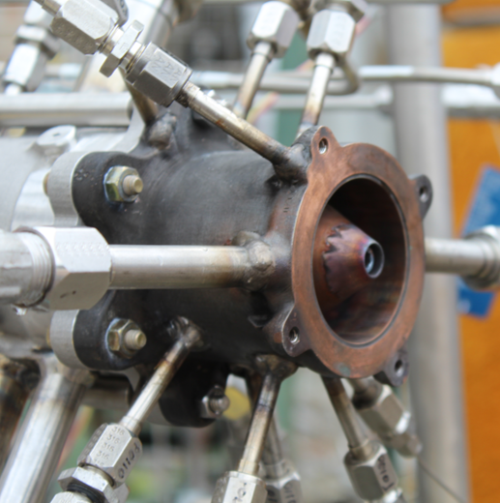
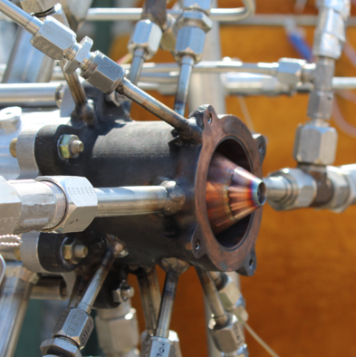
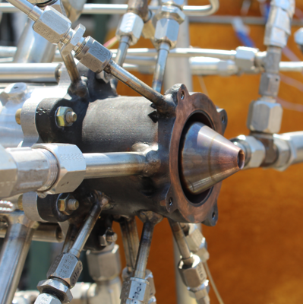
Outer Body Heat Load Trends
Strong relation to Pc for a given configuration
2 distinct groups separated by 2” vs 3” OB
Fully shrouded plug nozzle saw +30% heat load to outer body vs no shroud
Power trendlines with powers from 0.64 – 1.17 (0.80 for Bartz)
3” OB
1” Shroud
0.5” Shroud
No Shroud

Slide 11
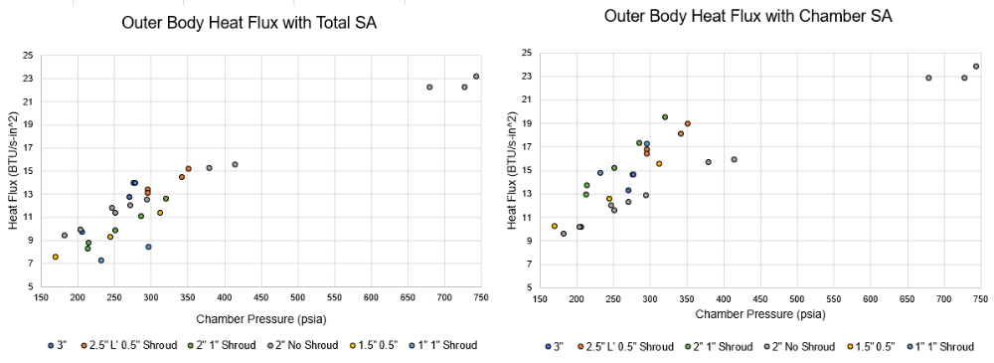
Outer Body Heat Flux Trends
Increased chamber length drives bulk heat flux up (~20% per in)
Nozzle shroud length reduces average heat flux

Slide 12
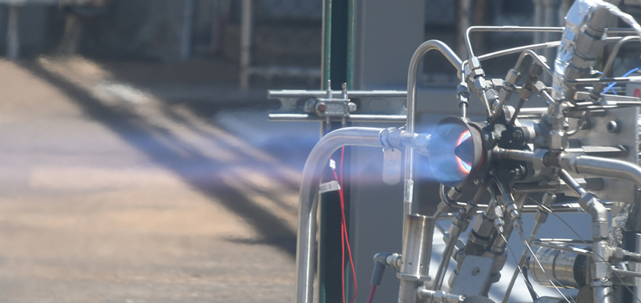
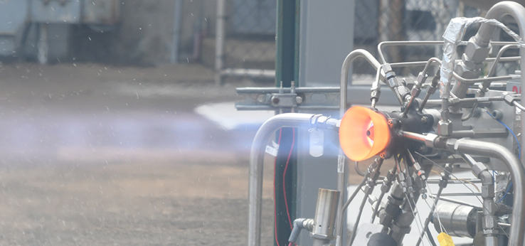
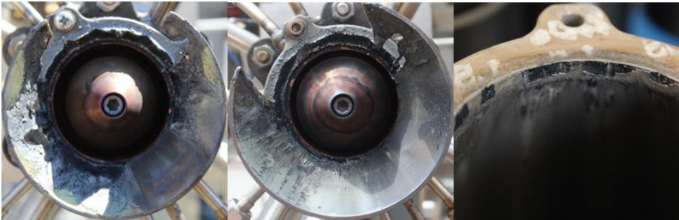
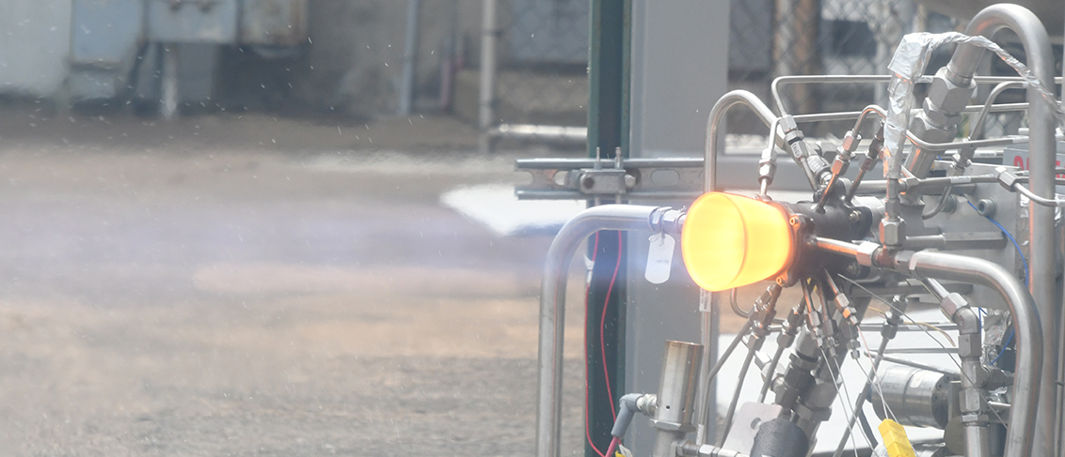
C-103 nozzles
All nozzles survived durations 10+ seconds at 280 psi
  16.8 sec max duration
+5% bulk heat load to inner body, +9% to outer body vs. no shroud case
Nozzles failed at ~720 psi, accelerated by maldistribution
1.4” Nozzle Length
2.0” Nozzle Length
3.0” Nozzle Length

Slide 13
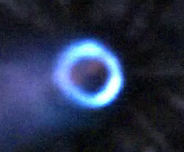
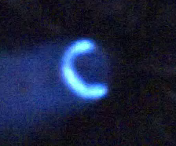
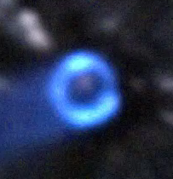
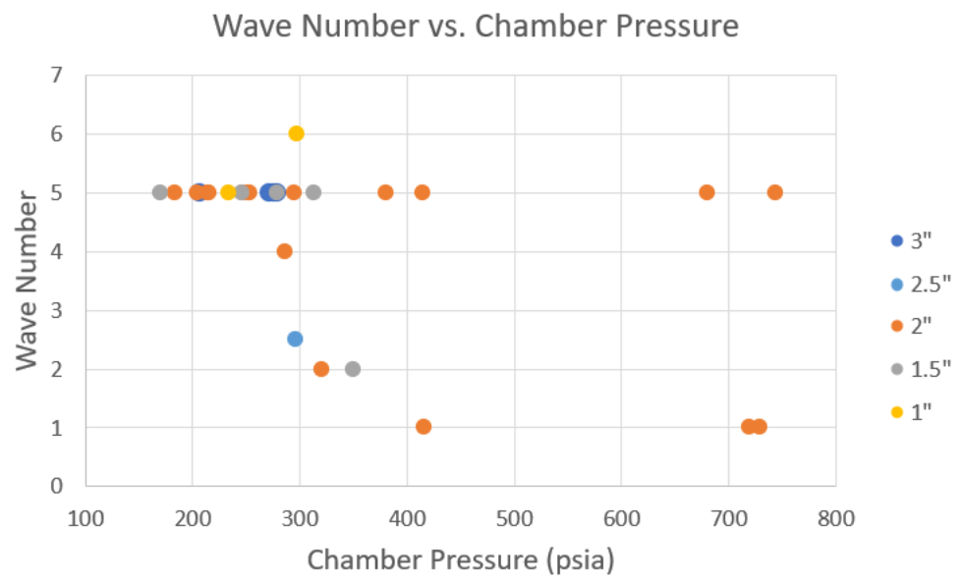
Wave Activity
2 wave counter-rotating
~416 psi
2 wave co-rotating
~350 psi
5 wave co-rotating
~313 psi
Hardware consistently favored 5 wave mode – 5+ waves hard to see on HS
No correlation between wave mode and bulk heat flux
Maldistribution may increase likelihood for 1 wave
Notes:
Injector did affect wave number
Effects of local heat flux unknown

Slide 14
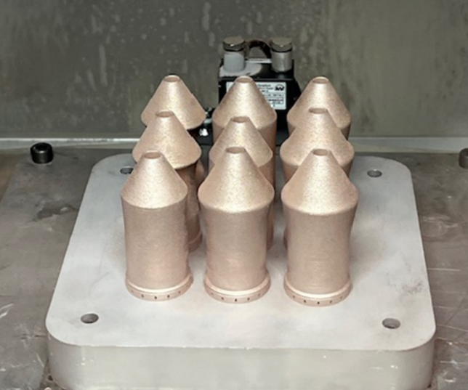
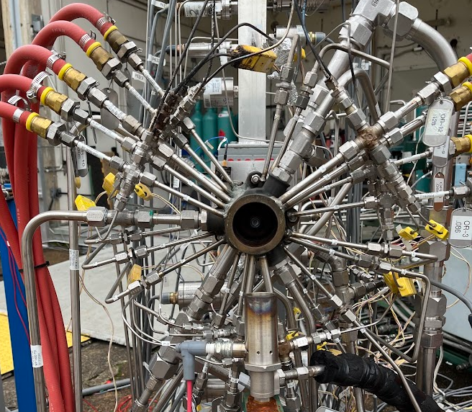
Future Work
Gap width, high subsonic AR, and propellant temperature studies
Test series for various injectors and C-103 nozzle designs
Full scale testing with subscale- informed hardware design

Slide 15
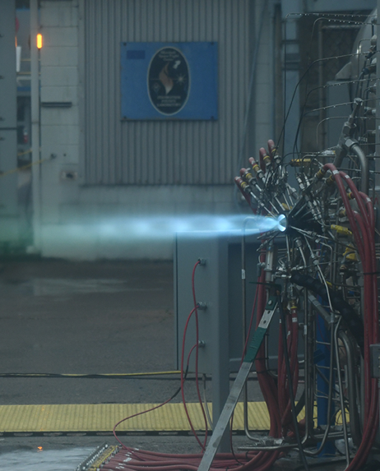
Conclusions
For same injector and Pc, MR and AR did not affect HF
Bulk heat flux remained roughly the same as chamber length increased → indicating heat flux in the extra length is extended
HF vs Pc for same configuration scales to a power relationship, but to a range of powers that are not consistent with Bartz
OB shroud increased measured heat load by ~30%

Slide 16

Dillon Petty
Liquid Propulsion Engineer
NASA Marshall Space Flight Center
Dillon.m.Petty@nasa.gov

