Slide 1
Earth Independent Medical Operations (EIMO)
29 January 2025
Science Integration Office (SIO)
Marina Parker, PhD, AMA LaRC
Mike Krihak, PhD, KBR JSC
Chris Laing, AMA LaRC
Jorge Bardina, PhD, NASA ARC
Prashant Parmar, MD, KBR JSC
Arian Anderson, MD, KBR/U. Colorado Sch. of Medicine

Slide 2
Agenda
Org update since IWS 2024
EIMO Background
  What is EIMO ?
  Why is EIMO relevant?
EIMO ConOps and Requirements
  How does it address EIMO?
  How was it created?
  Updates to EIMO work effort since IWS 2024
  Summary

Slide 3
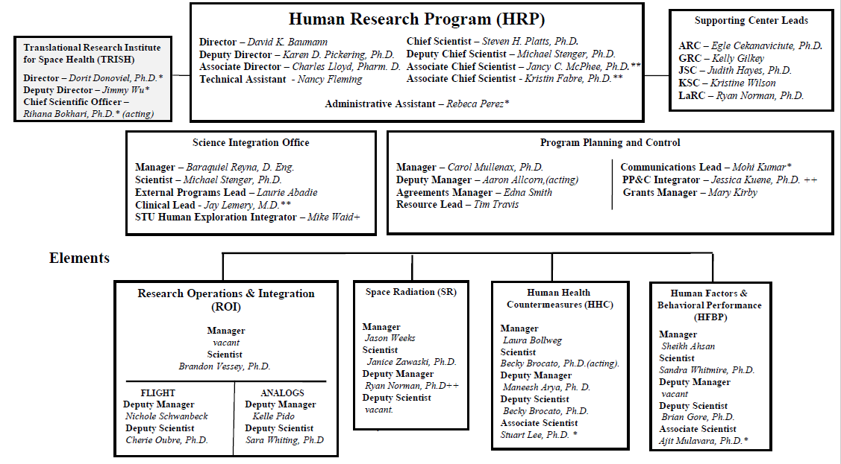
HRP Organizational Change

Slide 4
What is EIMO?
The gradual transition of medical care and decision making from terrestrial to space-based assets, enabling support of astronaut health and performance and reducing overall mission risk.

Slide 5
Why do we care about EIMO?
Various efforts within NASA are currently ongoing to better understand the capabilities needed to enable successful Mars missions.

Slide 6
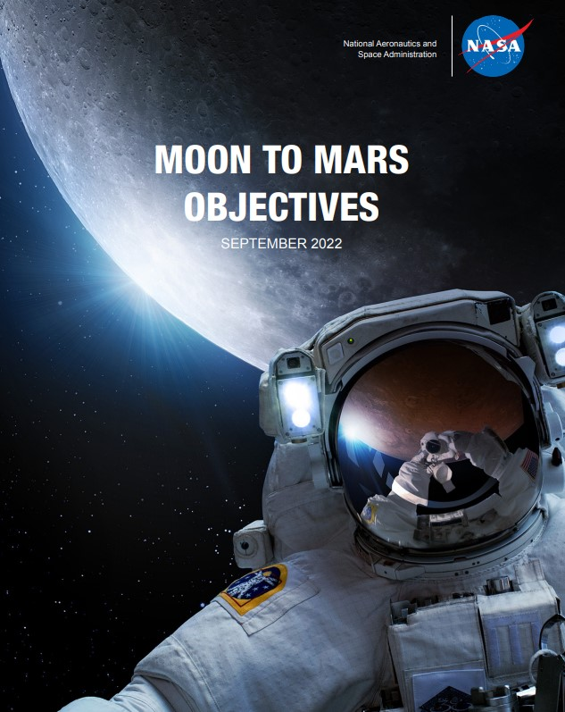
Progressive Earth-independent crew health & performance systems for Mars-class missions
Monitor and maintain crew health and performance during communication delays and in an environment that does not allow emergency evacuation or terrestrial medical assistance
Validate readiness of systems and operations to support crew health and performance for the initial human Mars exploration campaign

Slide 7
Medical Risk Increases with Distance From Earth
International Space Station
Gateway
Lunar Surface
Mars Transit
CURRENT STATE
EXPLORATION CLASS MISSION
180-day to 360-day mission duration
Strong consumables resupply
Real-time communications
Regular sample returns to Earth
Emergency evacuations possible
Relatively large internal volume
Limited onboard medical care (Earth-reliant)
650-day to > 900-day mission duration
Zero consumables resupply
No real-time communications + blackouts
No sample returns to Earth
No evacuations possible
Constrained internal volume
Expanded onboard medical care (crew/ vehicle -reliant)

Slide 8
Consider the example below on CMOs
Designating certain crewmembers as CMOs highlights their advanced training, deeper knowledge, greater medical system familiarity, and enhanced operational capability in medical response scenarios.
An ISS crew size up to 7 combined with, combined with the robust ISS medical hardware footprint enables a reasonable flow of a CMO training, and other training priorities to be proportioned among the non-CMO crewmembers
Near real-time ground communication allows the CMO training to rely heavily on the flight surgeon for step-by-step guidance for crew procedures if/when necessary, with limited crew autonomy
This is changing even for Artemis…
ISS Missions
Given the factors of:
  Small crew complement
  Communication delays
CMO: Crew Medical Officer
Notes:
While effective on the ISS, there have been cases where the CMO becomes the patient, limiting their ability to self-care and requiring assistance from non-CMO crewmembers.

Slide 9
Baseline approach for Orion:
Treat all crewmembers as interchangeable, with an equal expectation for familiarity with and skill using the different components of the medical system.
Crew are expected to display a degree of autonomy with the use of medical procedures and hardware that is above that typically demonstrated by, and certainly beyond that expected of an ISS CMO.
Given that all Orion crewmembers are trained to an equivalent level on the medical system, “CMO” is no longer a useful opnom in that context.
Artemis Missions
What about Mars missions?
To answer that, we need to understand:
  degree of autonomy needed
  scope of the medical system
  size of the total crew complement
Will the “CMO” term or an equivalent become a critical piece of how we train and build a crew complement?
Comm delays preclude any time-critical ground guidance
  crew must be capable of exercising the limits of their medical system capability, with no piece of hardware or procedure requiring non-local inputs.
Deep Space Missions
Can this be accomplished through a mix of ground-based training and in-flight training?
  Is this dependent on the severity of the medical event?

Slide 10
EIMO ConOps and Requirements
Our model-based Concept of Operations (ConOps) outlines an initial vision for EIMO, providing a foundation through in-mission scenarios that span a wide range of medical conditions.
  These scenarios demonstrate the system’s capabilities from basic to complex in-mission medical events.
Foundational requirements were created & traced to the NASA-STD-3001, V1 & 2.
  These traces were performed to gain insights on the alignment of EIMO requirements with the NASA standard.

Slide 11
EIMO Technical Interchange Meetings
  Datascope (Using data to enable autonomy)
  Crew Training
  Supply and Resource Management
  Task Load Management
Key takeaways from TIMs were incorporated into our ConOps and Requirements efforts

Slide 12
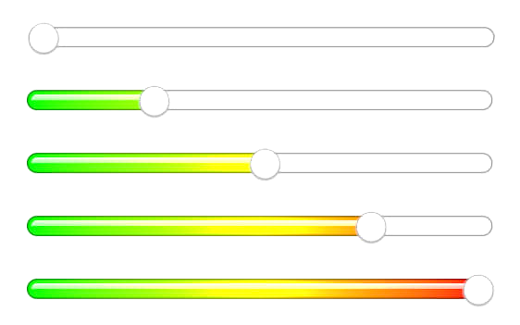
Outcomes from various EIMO TIMs
On-board care will increasingly become the responsibility of the astronauts for primary management.
Terrestrial assets will continue to be paramount in pre-mission screening and planning, as well as health maintenance and prevention activities.
New capabilities and procedures that enable progressively more robust and resilient systems and crews will reduce risk and increase probability of deep space exploration mission success.
A Progressive Approach

Slide 13
SIO SE Process: integrating clinical and systems engineering inputs to generate recommendations for medical system design
Medical Domain Activities
Systems Engineering Activities
Medical Domain Activities
Systems Engineering Activities
NASA Std’s & Req’s
Mission Env Assumptions
NASA Std’s & Req’s
Med System Context
Teams work closely together
Medical Conditions
Concept of Operations
Med Sys Capabilities
Medical System
Requirements
Medical System Functions
Medical domain products
KEY:
Systems engineering products
NASA documentation

Slide 14
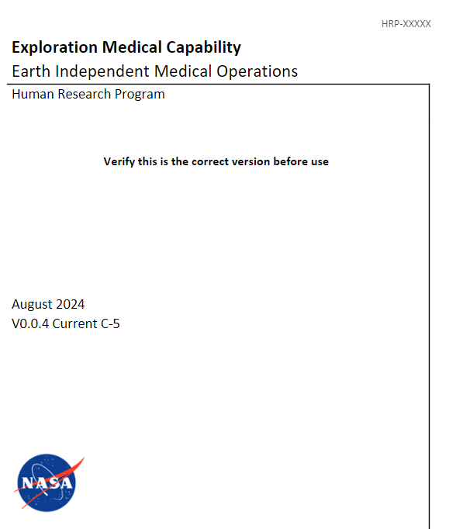
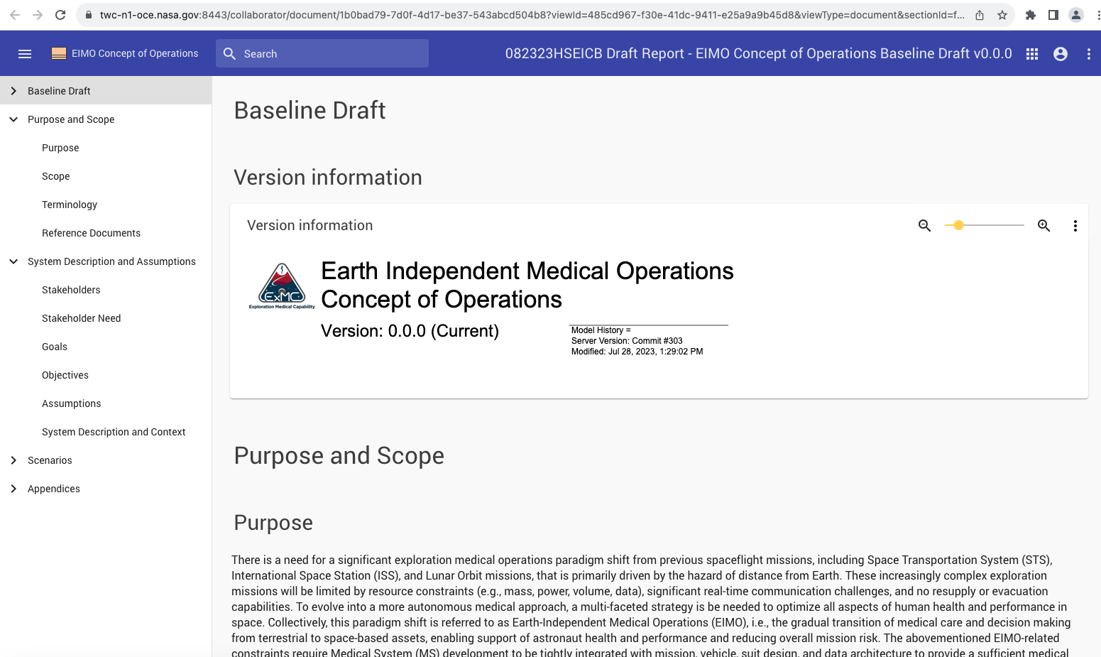
EIMO ConOps
MagicDraw Model
Word Document

Slide 15
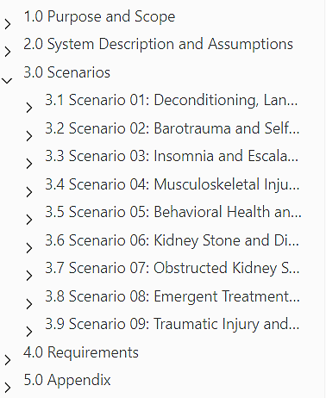
The revised EIMO ConOps
Contains two new scenarios:
  Barotrauma Medical Care
  Self-Medical Management and Behavioral Health and Chronic Medical Care
Implements findings from EIMO technical interchange meetings that focused on data and training.

Slide 16
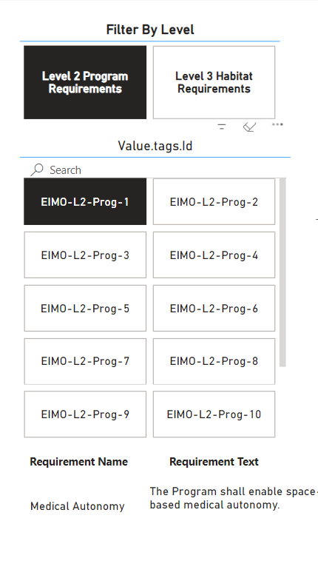
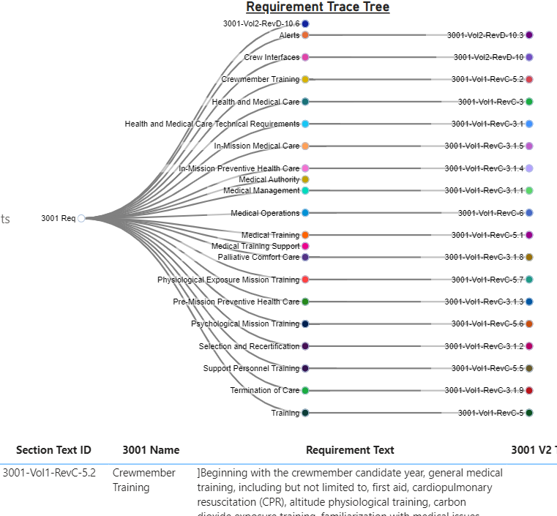
EIMO Requirements and Traces
Medical System functions and capabilities were decomposed from the scenarios to establish foundational requirements for EIMO and traced to the NASA Spaceflight Human-System Standard (NASA-STD-3001, Volumes 1 and 2).
These traces were performed to gain insights on the alignment of EIMO requirements with the NASA standard.

Slide 17
Summary
  EIMO is gradual transition of medical care and decision making from terrestrial to space-based assets, enabling support of astronaut health and performance and reducing overall mission risk
The EIMO ConOps was a joint development effort between the SIO System Engineering Team and the SIO Clinical Science Team
The ConOps serves as an initial recommendation to increase crew autonomy gradually and safely for Mars missions and future deep-space exploration.
Foundational requirements for EIMO were created & traced to the NASA-STD-3001, V1 & 2.
  These traces were performed to gain insights on the alignment of EIMO requirements with the NASA standard.
We expect to infuse the EIMO ConOps and Foundational Requirements into future SIO projects

Slide 18
Acknowledgements
EIMO Clinical Science Team
EIMO SE Team
  Lynn Boley
  David Hilmers
  Ariana Nelson
  Derek Nusbaum
  Gina Vega
  Sarah Lumpkins
  Jordan Blackwelder
  Alex Salimian
  Dan Jindra
  Tina Beard
  Abigail Johnson
  Bill Toscano
  Mareyna Karlin
  Bryan Kirsch
  Andrea Legreid
  Chris Brown
  Sean Winther
EIMO Human Factors Team
  Vicky Byrne
  Tyler Duke

