Slide 1
Ames Technologies/Capabilities CLDP Utilization Forum
Waste Group Task Summary
Jan 23, 2025
Steve Sepka, Waste Group Lead
Justine Richardson, Waste Group PI
Waste Group Members: Janine Young, Greg Pace, Serena Trieu, Lance Delzeit

Slide 2
WASTE GROUP TASKS
TCPS – Trash Compaction and Processing System
MPACTOR – Mechanical Compactor
Planetary Protection – Use of Filters for Long-Term Waste Storage

Slide 3
TRASH COMPACTION AND PROCESSING SYSTEM
What Does It Do?
Important capability for Moon to Mars exploration
Trash volume reduction by up to 70%
Trash stabilization
  Reduce smell
  Safens trash by heating it to 150C to inhibit biological growth
Water recovery greater than 90%
Treats exhaust gases for toxin removal by using a carbon bed, CatOx reactor, and LiOH bed
8 to 12 hours per completed TCPS cycle
Product “tile” can be used for radiation shielding

Slide 4
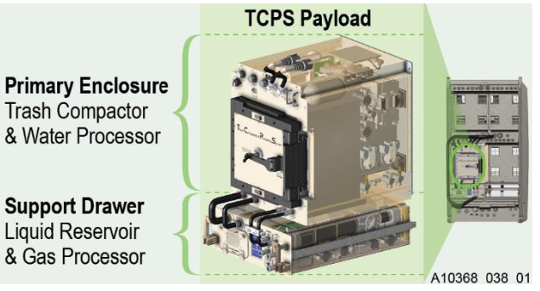
TRASH COMPACTION AND PROCESSING SYSTEM
ISS Tech Demo TCPS Development
Double mid-deck locker size for the compactor plus a drawer for water and gas handling components
Trash chamber is 11”x11”x7.5”
Pneumatic bellow system compacts the trash
Water is condensed and stored
500W average power, 750W peak power
2.2 kg trash per load
Gas is processed and can be vented to cabin or the vacuum exhaust system (VES)
Klopotic, J.M., and Wetzel, J.P., “Trash Compaction and Processing System Development and Testing,” 51st International Conference on Environmental Systems, July 2022, St. Paul, Minnesota ICES-2022-104

Slide 5
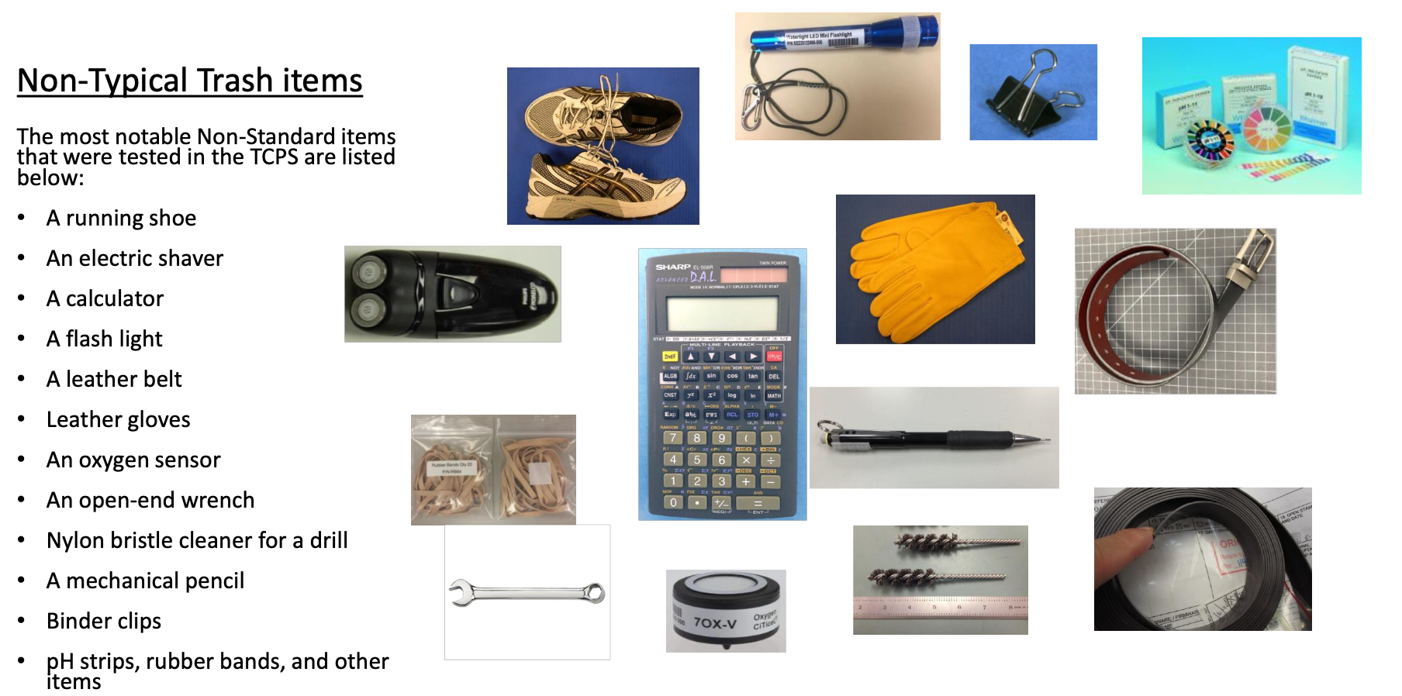
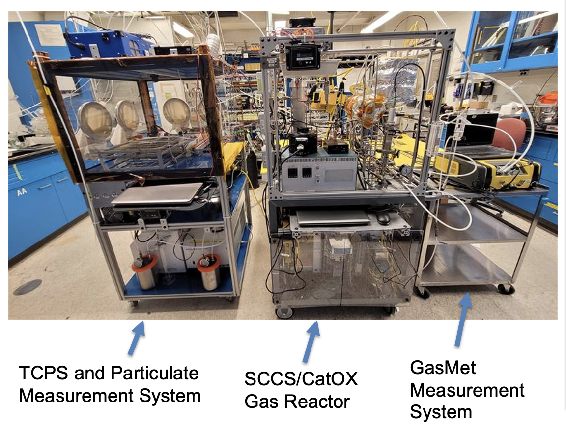
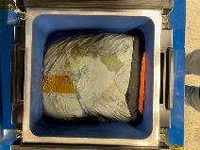
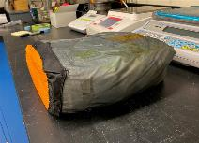
TRASH COMPACTION AND PROCESSING SYSTEM
NASA - Ames TCPS (Gen 3) Test System
TCPS Non-Typical Trash Testing
Processed Trash Tiles

Slide 6
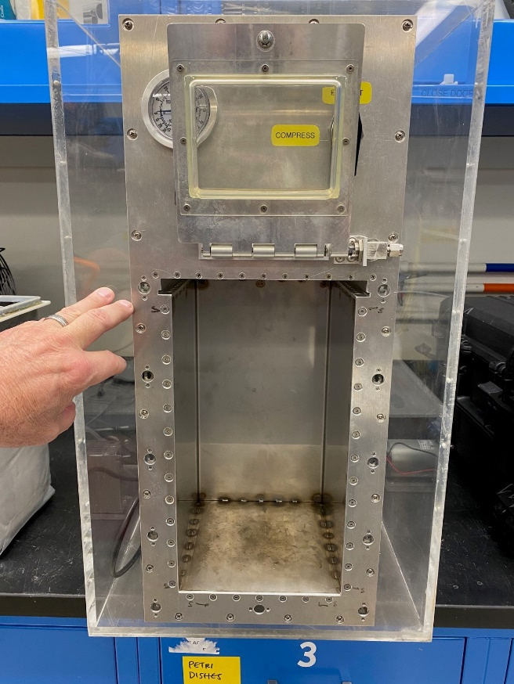
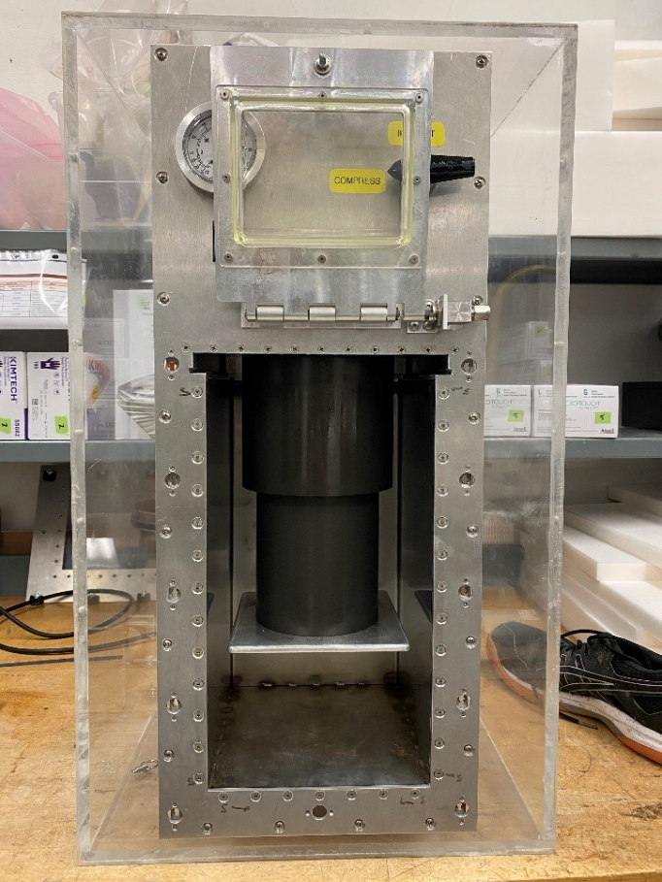
MPACTOR – Mechanical Trash Compactor
Task Description
This task is investigate a mechanical, non-heated, low mass, low volume, and easy to use mechanical trash compactor for use while in transit or on a planetary surface
A refurbished benchtop test rig will be used to study compaction pressure, dwell time, volume reduction, spring back and system capacity
The information obtained will be used to develop a prototype which minimizes mass, power, and volume, leading to a favorable Equivalent System Mass rating. Issues with odor and long-term storage will be investigated
Waste chamber
Telescoping piston
The 11 liter waste compaction chamber, piston fully retracted, door off
Telescoping pneumatic actuator piston, fully extended

Slide 7
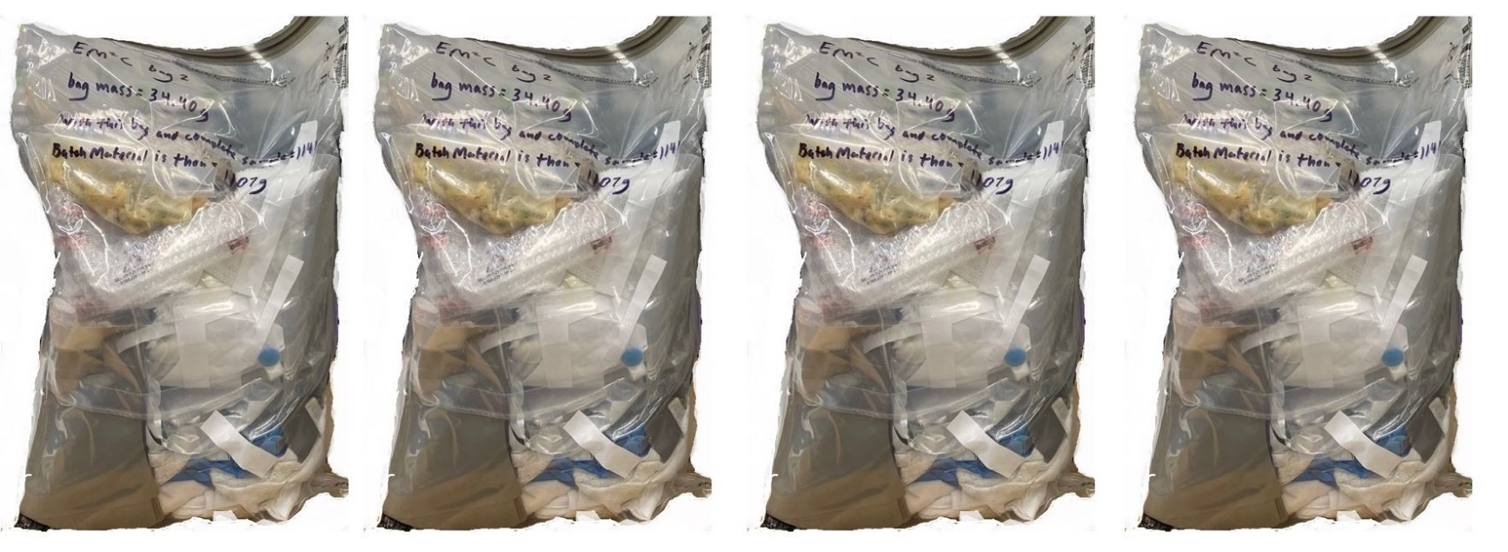
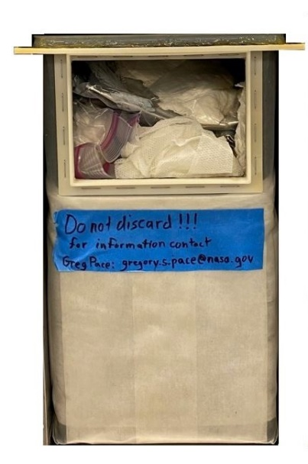
MPACTOR – Mechanical Trash Compactor
Preliminary Test Results
Daily trash generation of 4.4 kg of Nominal Trash for a 4 Person Crew Compacted into a single Mechanical Compactor trash bag (shown to scale)

Slide 8
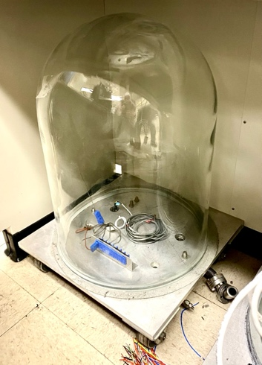
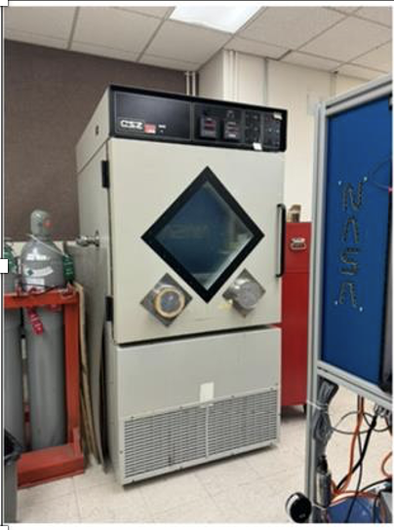
PLANETARY PROTECTION – Use of Filters for Long-Term Waste Storage
Task Description
This task is to develop long-term waste storage systems to prevent planetary contamination from terrestrial microbes escaping the waste containers. These microbes can confound planetary scientists in the search for extra-terrestrial life
Use of a filter is the simplest, direct, and most cost-effective potential solution
The filtration system that allows volatiles to boil off and escape containment but keeps microorganisms contained within
Filtration system is to last for at least 50 years
Filter clogging and phase change present significant challenges
The filter design will be handed over to the logistics container designer. Filters can work with nearly any type of containment system
Low pressure test system
Environmental chamber to simulate Mars surface conditions

