Slide 1
CFMPP Office Cryocooler Technology Strategy
Sean Kenny – Presenting
  NASA/MSFC
Jeremy Kenny - Project Manager
  NASA/MSFC
January 2025 AIAA SCITECH

Slide 2
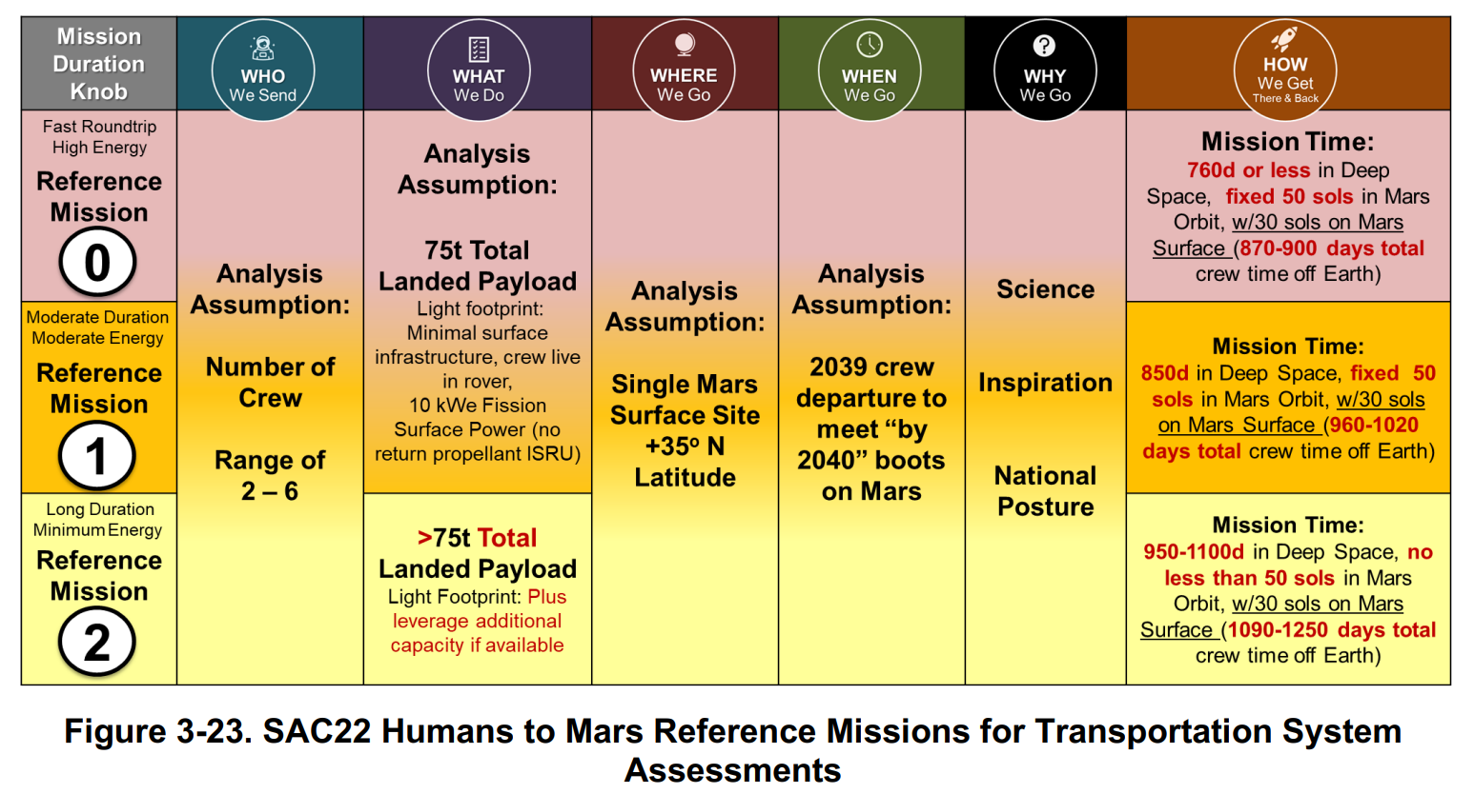
NASA Cryocooler Technology Reference Missions
Mission Duration Drives Cryocooler Design Life
(Longest Selected)
~ 5 years of operation
(Includes aggregation)
~ 120 Start/stop cycles defined by mission CONOPS

Slide 3
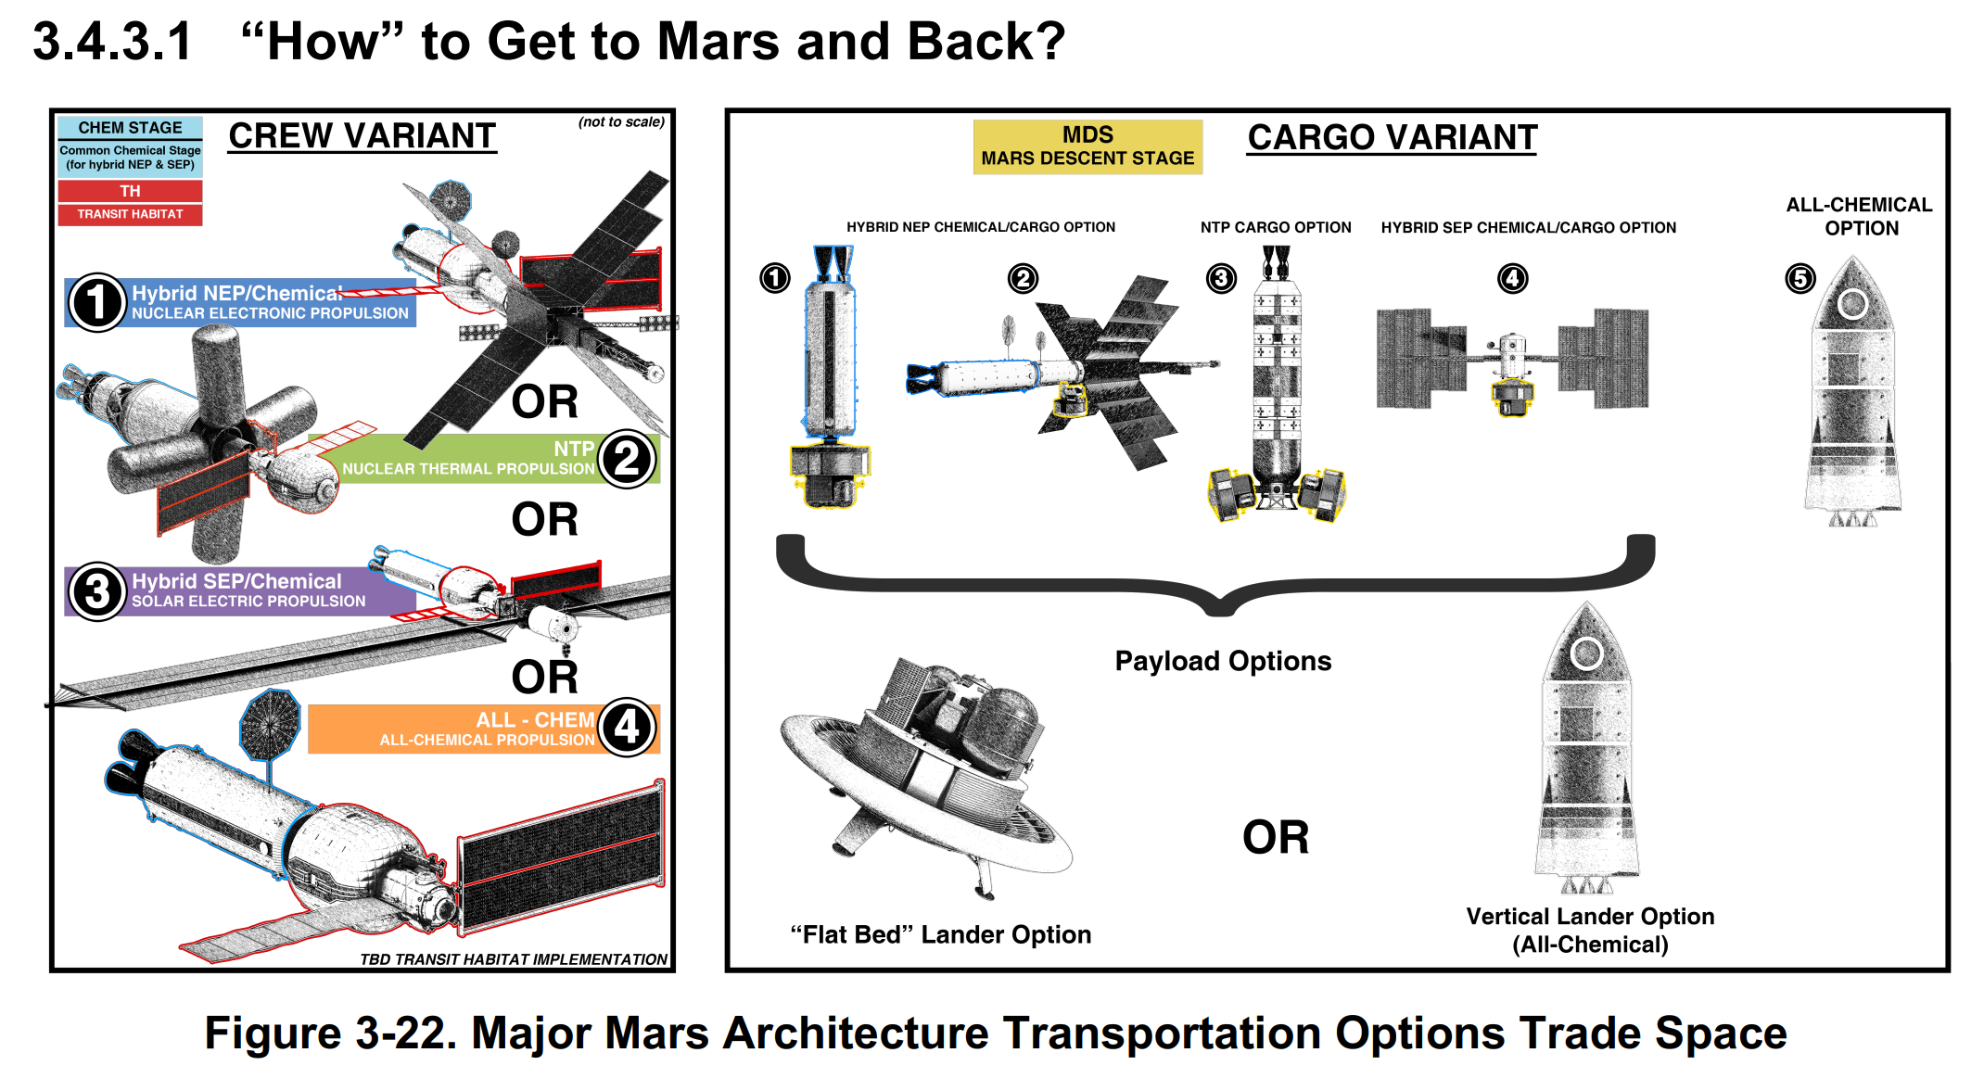
NASA Cryocooler Technology Reference Architectures
Propellant Summary
SNP
NEP Hybrid:
See below
NTP:
(Nuclear Thermal)
LH2
NEP/SEP Hybrid
(Solar Electric)
Chemical:
Methane and LOX
EP:
Xenon or Krypton
All-Chemical
Methane and LOX

Slide 4
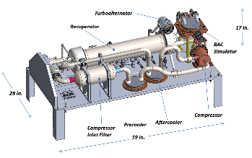
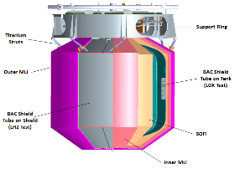
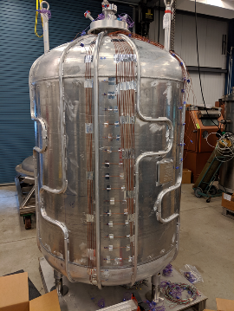
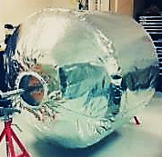
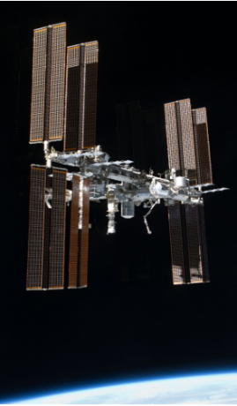
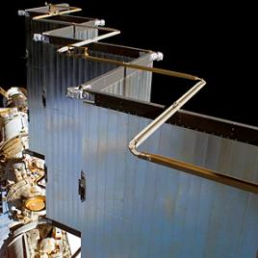
NASA Cryocooler Technology Need
Long duration cryogenic missions (Months to Years):
  Propellant Storage: LH2, LOX, LCH4 (Methane)
    Space Nuclear Propulsion (SNP)
      Nuclear Thermal Propulsion (NTP)
      Nuclear Electric Propulsion (NEP)
    Traditional Chemical Propulsion
  On-Orbit Operations (Types of vehicles & missions)
    Tanker / Receiver
    Cryogenic Depot
    Aggregation Missions
  ISRU (In Space Resource Utilization on Moon & Mars)
    Liquefaction, Storage, & Transfer
    LH2, LOX, LCH4 (Methane)
Cryocooler is the powered component of an active cooling system
  Uses thermodynamic refrigeration cycles to transport heat from a cold zone to a warm zone
Active cooling systems also require:
  Passive thermal management: Insulation & Low conductivity structure
  Coolant Distribution: Broad Area Cooling (BAC)
  Power: Solar Panels, etc.
  Heat Rejection: Radiators
Insulation
BAC
Cryocooler
Image by Creare LLC
Heat Rejection
(Radiators)
Power

Slide 5
Characteristics needed for spaceflight Cryocooler
  [Performance]
    Refrigeration Power, “Lift”
      NTP Mission: 50W each for 90K and 20K
  [Efficiency]
    Key Performance Parameters (KPP)
      Power & Thermodynamic Efficiency
        ~20% Carnot Efficiency (COP)
      Mass Efficiency (Mass/Watts_{lift})
  [System Integration]
    Flexible Packaging for improved thermal management
    Broad Area Cooling interface
      Coolant circulation for Tube-on-tank/shield
    Thermal Management
      Minimize parasitic heat
      Heat Rejection
  [Reliability]
    Operational life ~5 years
    Duty Cycle >120 start/stop
    Closed cycle cryocoolers are more reliable
      (Working fluid is closed cycle, ‘not prop’)
      Sealed from contamination
      More predictable and controllable operating conditions
  [Applicability to Hard & Soft Cryogens]
    Cycle + Working Fluid must be efficient at Target Temps
    Scalable technologies applicable to all needs
      (Reference missions and vehicles)
    “Hard Cryogens” Hydrogen, Helium
    “Soft Cryogens” Oxygen, Methane, LNG, Argon

Slide 6
Key Performance Parameters
  Design target temperature, Kelvin
  Heat Removal “Lift”, Watts
  Power Efficiency
    (Coefficient of Performance, COP) or % of Carnot [Is better scalable to compare point solutions]
    (Watts to power the cooler / Watts of heat removed) [Lower is Better]
  Mass Efficiency (Cryocooler Mass, KG / Watts of heat removed) [Lower is Better]
  CURRENT TECHNOLOGY DEVELOPMENTS
  FUTURE TECHNOLOGY INVESTMENTS (CACHE)
90 Kelvin Cryocooler | Threshold | Goal
Lift (W) | 120 | 150
W_{in}/W_{L} (TMU) | 15 | 8
kg/W (TMU) | 0.8 | 0.5
Assumption: 300K Heat Rejection Temp
20 Kelvin Cryocooler | Threshold | Goal
Lift (W) | 17 | 20
W_{in}/W_{L} (TMU) | 80 | 60
kg/W (TMU) | 5.5 | 4.4
Assumption: 285K Heat Rejection Temp
20 Kelvin Cryocooler | Threshold | Goal
Lift (W) | 45 | 50
COP | 15 | 20
kg/W (TMU) | 5.5 | 4.4
Assumption: 285K Heat Rejection Temp

Slide 7
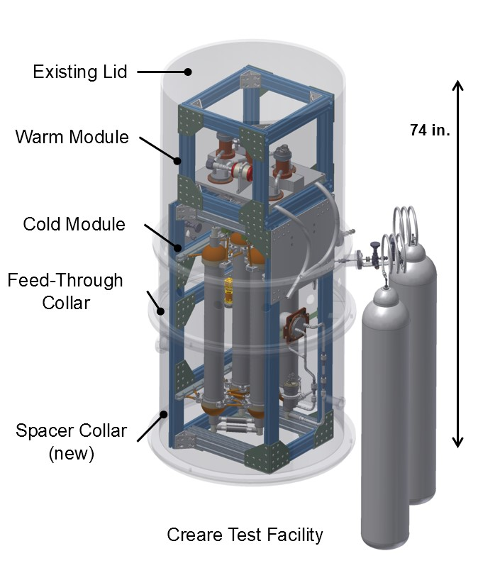
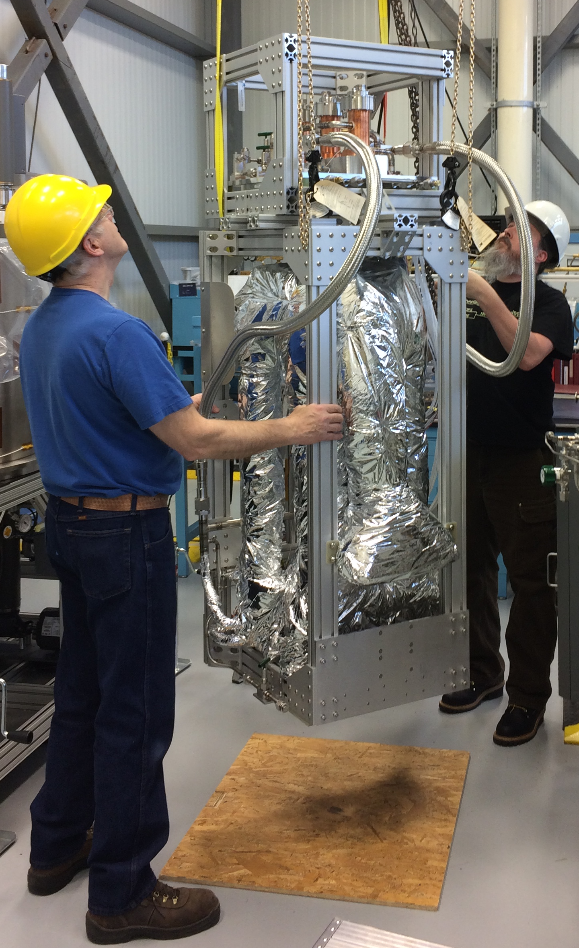
20 Kelvin 20 Watt Cryocooler Status
Technology Description:
The 20W 20K Cryocooler addresses the need for zero boil off storage of Liquid Hydrogen (LH2), critical to Nuclear Thermal Propulsion as well as LH2-based architectures for exploration and enable ISRU liquefaction.
The Reverse Turbo-Brayton (RTB) cycle cryocooler was recognized as having the ability to meet performance demands.
Objectives:
Design, build, and demonstrate a 20W 20K RTB cryocooler with a specific mass of 4.4 kg/W and a specific power requirement of 60 W/W.
Scope / Status:
Development under SBIR with CREARE LLC
All Components developed and integrated with initial performance verification completed
Next steps:
  Full operating range characterization in flight-like configuration
  Vibration & Thermal Vacuum Testing (with post test functional verification)
    TRL 6 Achievement in 2025
Mission Pull:
Nuclear Thermal Propulsion as well as LH2-based architectures for exploration, ISRU (LH2)
20W 20K Cryocooler Vacuum Chamber Model
Images by Creare LLC
20W 20K Cryocooler Configured for Test

Slide 8
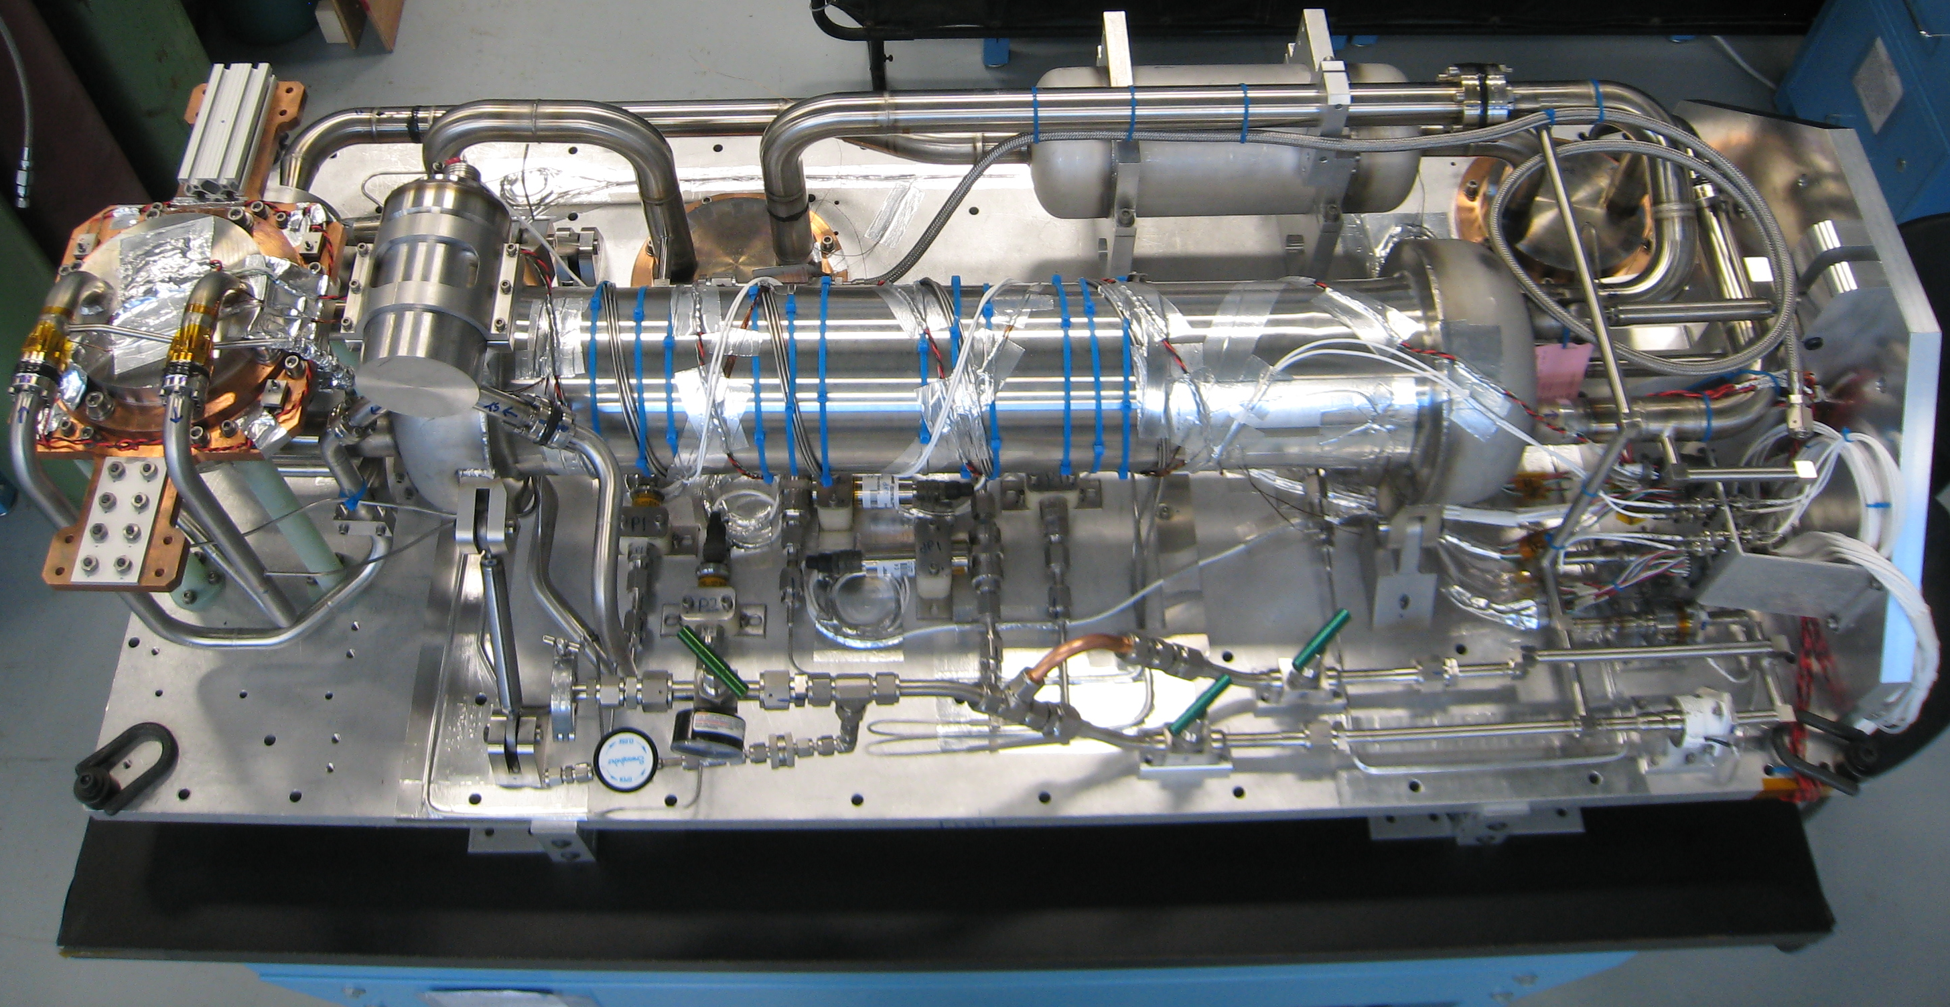
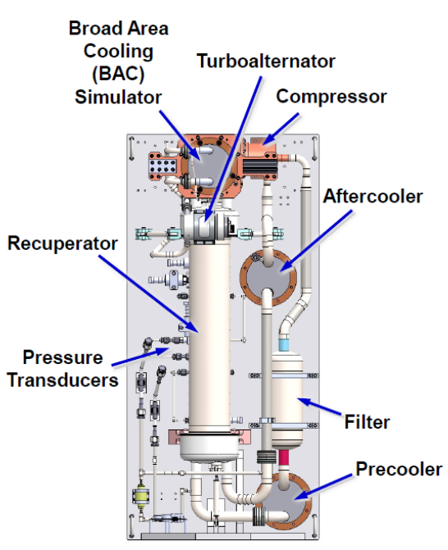
90 Kelvin 150 Watt Cryocooler TMU Status
(Thermo-Mechanical Unit)
Technology Description:
90K High Capacity Cryocoolers are deemed to be an enabling technology for the long duration storage of cryogens as well as ISRU liquefaction
The Reverse Turbo-Brayton (RTB) cycle cryocooler is recognized as having significant ability to meet performance demands
Objectives:
Design, build, demonstrate a 150W/ 90 K RTB cryocooler having a specific mass of 0.4 kg/W and a specific power requirement of 8.0 W/W.
Scope / Status:
Development under SBIR with CREARE LLC
All Components developed and integrated with initial performance verification completed (Brassboard)
Flight-like integration into Engineering Model (EM)
Full operating range characterization in flight-like configuration
Perform vibration testing on EM and repeat functional testing
Delivered to NASA for integrated liquefaction system demonstration
Mission Pull:
Nuclear Thermal Propulsion (2-Stage cooling application), ISRU (LOX)
Mars architecture studies
150W/ 90K Cryocooler
Images by Creare LLC
150W/ 90K Cryocooler in Vacuum Test Chamber

Slide 9
90 Kelvin 150 Watt Cryocooler CCE Status
(Cryocooler Control Electronics)
Technology Description:
Prototype Cryocooler Control Electronics Unit (CCE)
Matched to the 90K 150W RTB to Reliably enable TMU performance
Operate in defined environments (Mars Transit Missions)
Achieve power and weight efficiency requirements
Objectives:
Design, build, demonstrate a 150W/90K CCE that will control TMU (~1600 Watts input power) enabling its required performance (specific mass of 0.4 kg/W and a specific power requirement of 8.0 W/W)
Scope / Status:
(Development under SBIR Ph III, CREARE LLC)
Completed Detailed Engineering Model Design (“EMCCE”)
Completed Test Planning, Simulators, Facilities, etc. (PDR Level)
  Include Assessment of applicability to 20K20W TMU
Perform Developmental Testing (component, breadboard)
Next Steps: (Contract awarded November 2024)
Fabricate EMCCE
Perform Demonstration Phase Testing (TRL 5)
  Test using simulated TMU
Perform Environmental Testing: Vibration, EMI, TVAC testing (TRL 6 Achievement)
Images by Creare LLC
Key functions
Power conversion and conditioning
Turbomachine speed control
System level controls
Telemetry processing
Total mass: 21 kg
Total volume: 18 liters
Conductively cooled through baseplate
Low EMI

Slide 10

Future Investment: CACHE
(Cryogenic Active Cooling for Human Exploration)
Approach:
Utilize NextSTEP-3 BAA to solicit proposals to develop cryocooler and control electronics for Mars missions
Objectives:
Provide active cooling technologies
  Requirements derived from Mars Architecture Studies
Mature Cryocooler Technology to TRL-6
Mitigate risk factors for TRL 7 flight Demo Success
Enhance fundamental knowledge via focused research
  Needed for human rated flight certification
  Predictable and flight certifiable performance and reliability
Assure availability of high capacity cryocoolers for future NASA missions
Mature critical cryocooler component technologies
Scope of CACHE cryocooler contract (in development):
  Concept Study (Multiple Awards)
  Options:
    Risk Reduction Efforts
    Preliminary Design
    Detailed Design
    Fabrication, Assembly &
      Acceptance Test
    Performance Testing
    Environmental Testing
Schedule:
  Anticipated RFP Release 2Q FY25
  Anticipate completion by 2030
Completed Activities:
  A sources sought solicitation has been conducted summarizing needs and requesting feedback from industry on potential technologies and development strategies
  Requirements Development (in work)
  Acquisition Planning (in work)
https://sam.gov/opp/d1c28db10ae24119b62803d2cfeee485/view

Slide 11
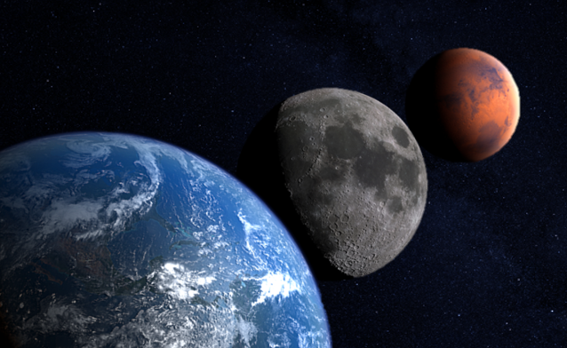
Summary
The NASA CFM Portfolio Project is enabling long duration cryogenic missions through maturation of critical technologies
Current Cryocooler investments are progressing via SBIR contracts with Creare LLC
  Reverse Turbo Brayton Cycle
    150W 90K & 20W 20K
    TMU & CCE
CFMPP will continue to mitigate risks for infusion for a TRL 7 demonstration opportunity
  Future Large Cryogenic Demonstration flight activity to incorporate 2-stage cooling
    Includes 90K and 20K coolers
  Will target risks that impact performance, reliability & life
    At system & component levels
Stakeholders include
  Earth/Moon missions, Transit and Surface
    Depots, Aggregation Architectures, ISRU
    HLS Sustaining Missions
  Mars Mission Architecture Studies, Surface and Transit
    NTP, NEP-Chem, SEP-Chem, All-Chem

Slide 12
Backup

Slide 13
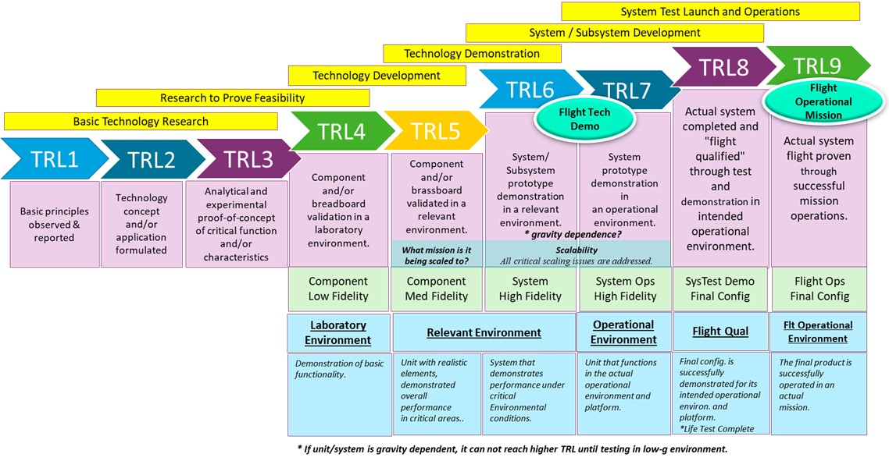
TRL Maturity Chart

