Slide 1
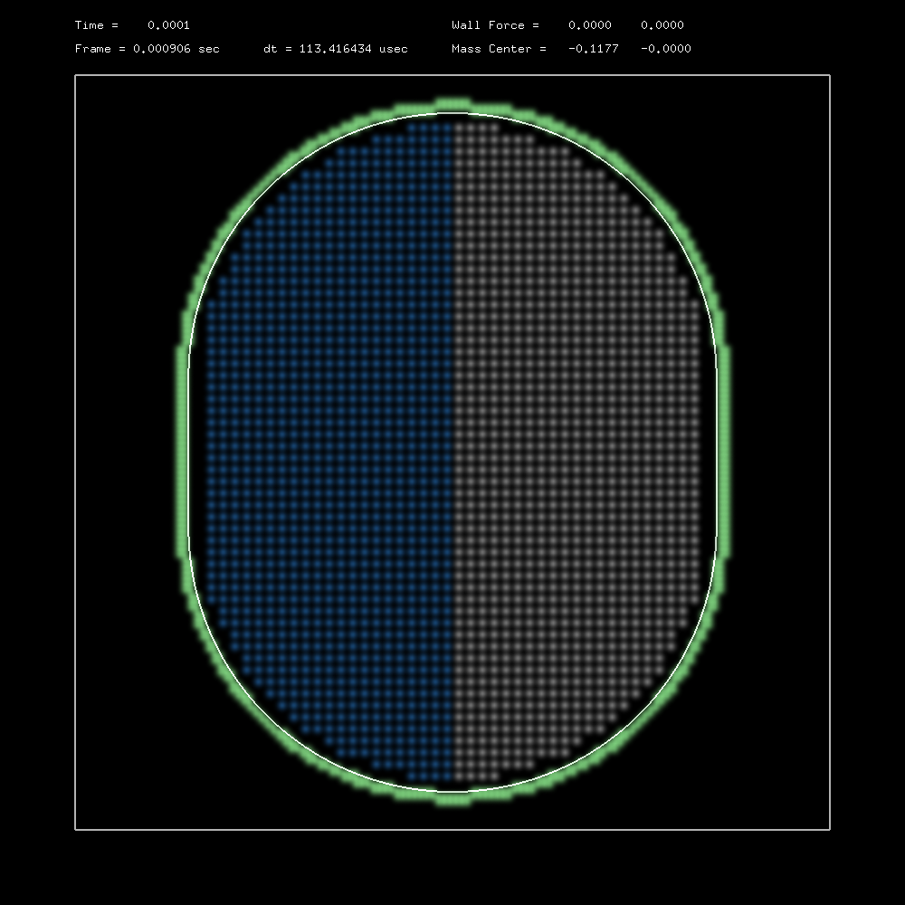
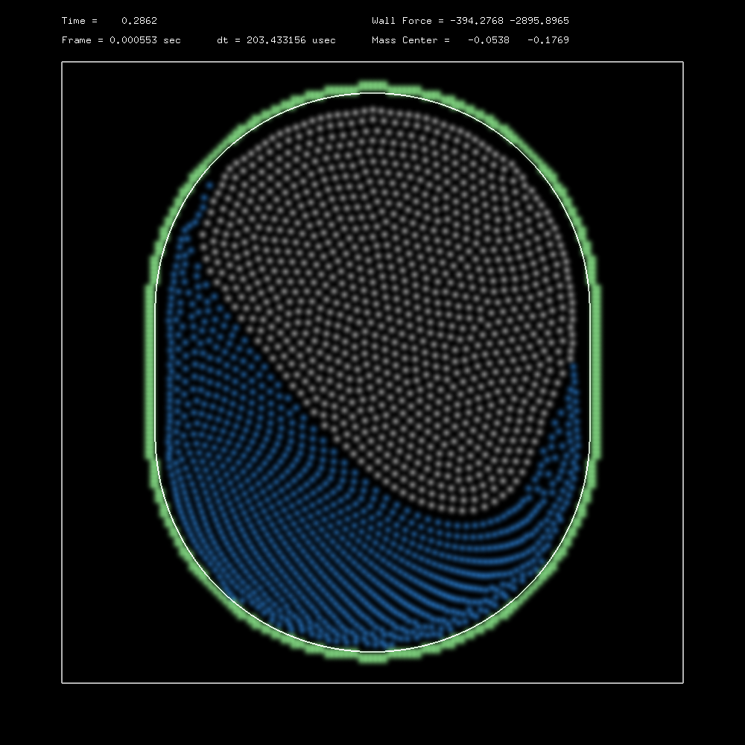
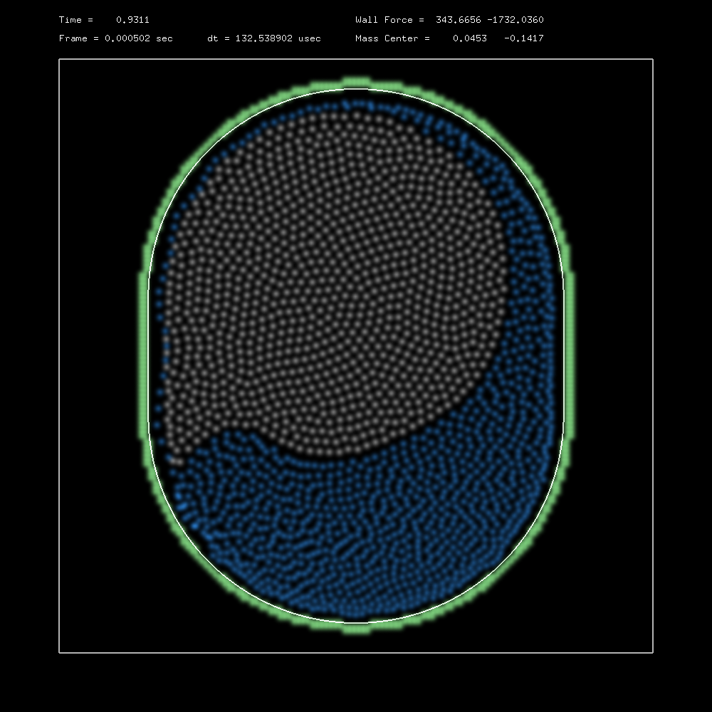
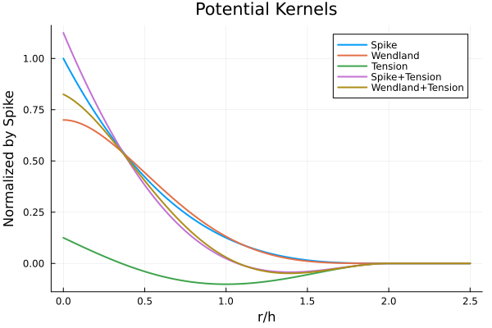
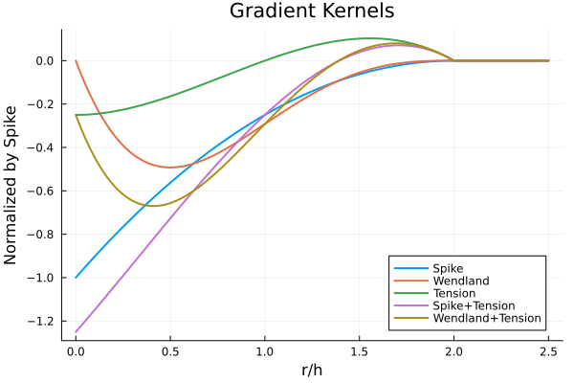
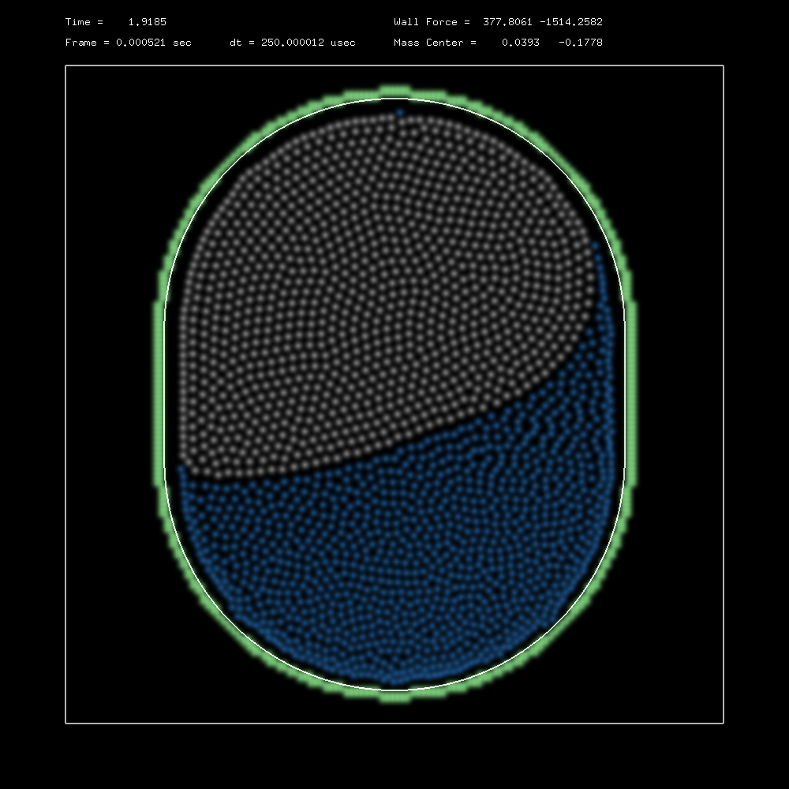
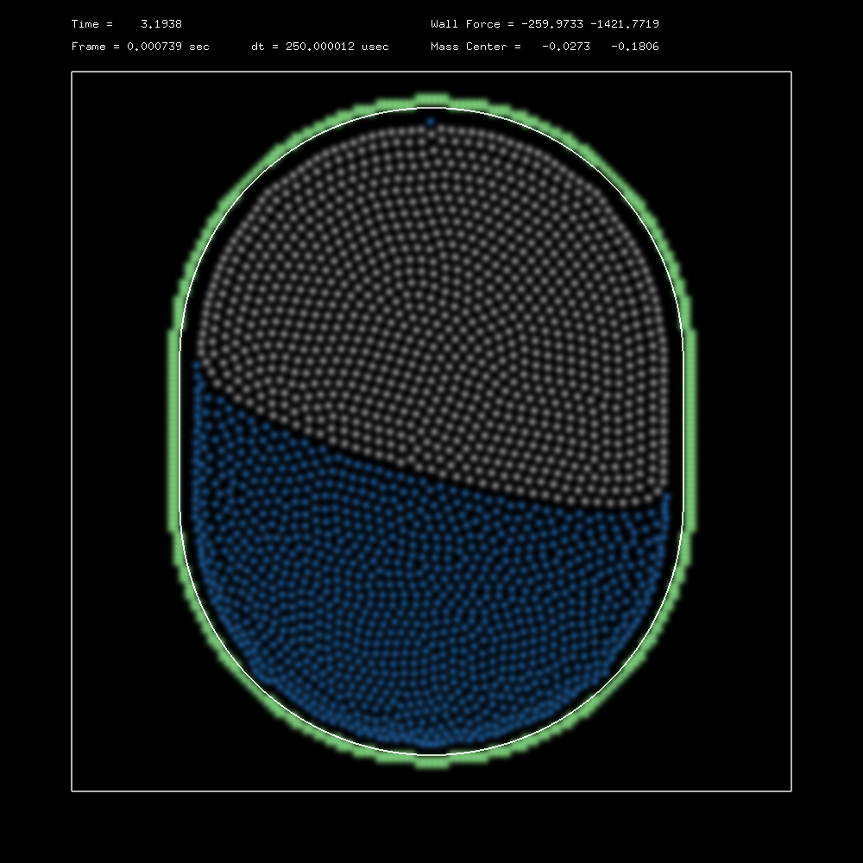
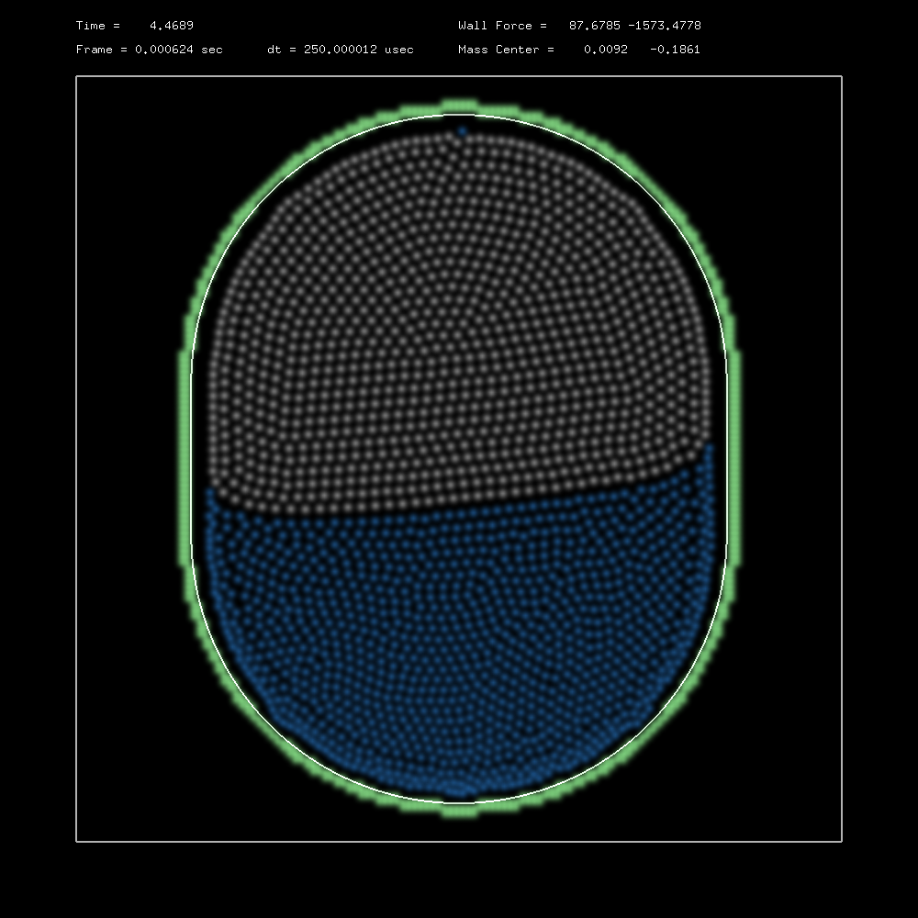
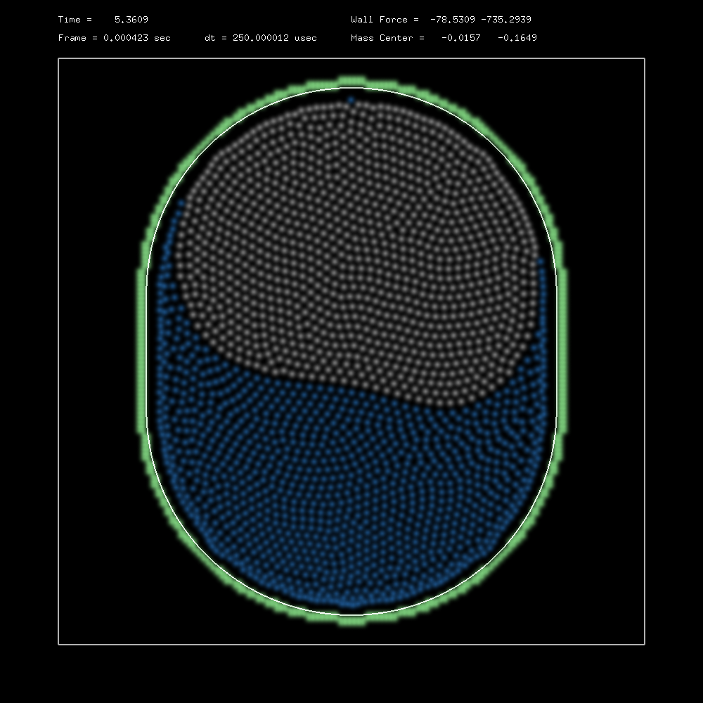
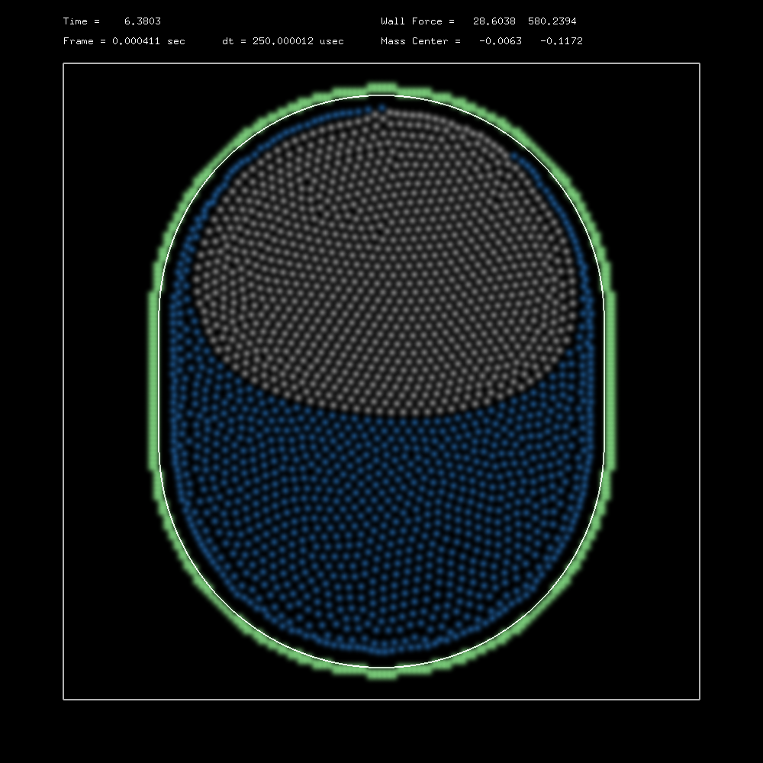
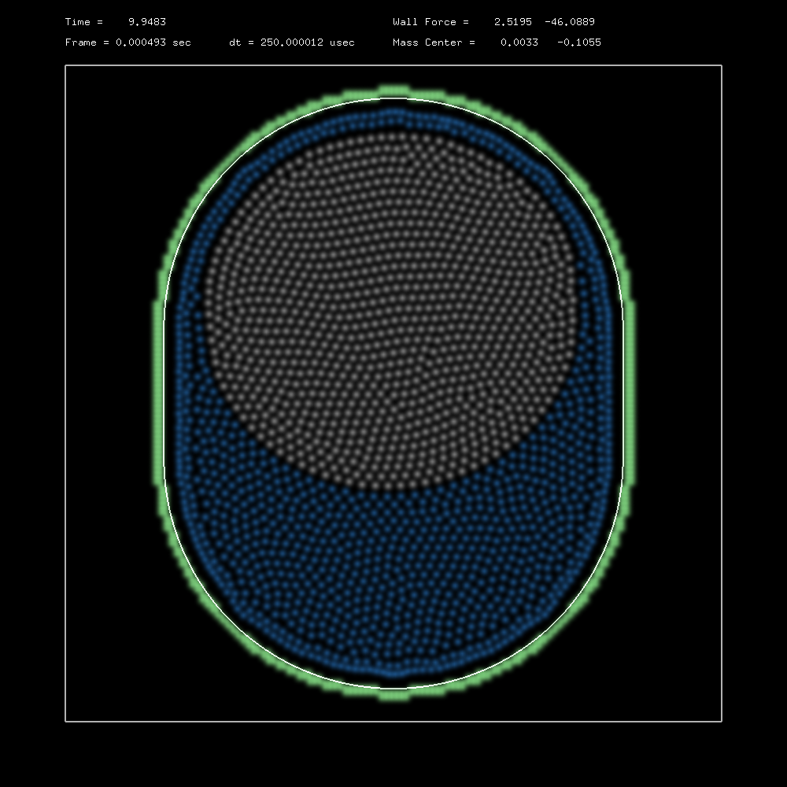
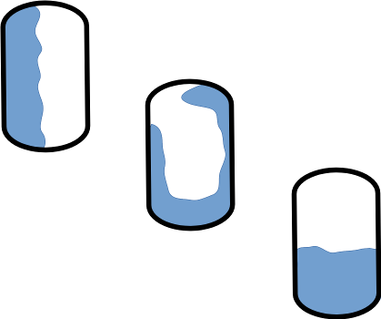
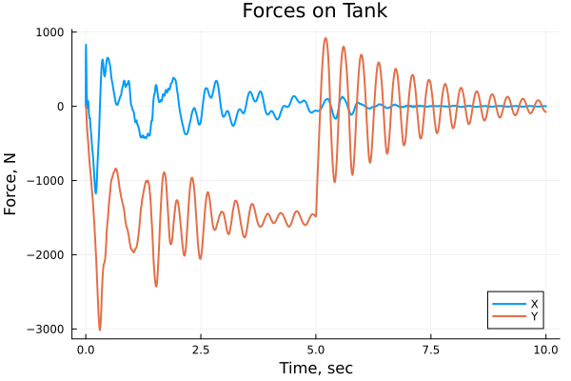
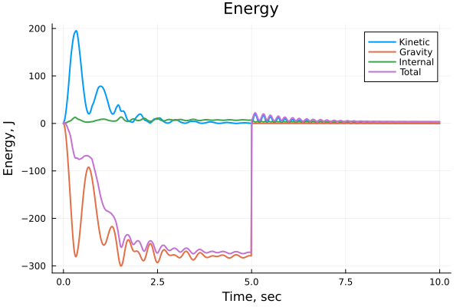
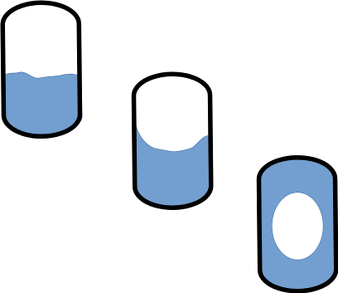

Proposed Benchmark Problems for Validation of Low-G Slosh Models
Eric Stoneking
NASA Goddard Space Flight Center
INTRODUCTION
Propellant slosh is a concern for ultra-stable pointing platforms such as the Nancy Grace Roman Space Telescope, and for spacecraft with stringent maneuvering requirements like OSIRIS-REx, Artemis, and robotic servicing vehicles. Modeling slosh well in the spacecraft design is important for retiring risk to mission performance and safety.
The ideal slosh model would be accurate over all flight regimes, computationally cheap, and backed by ample experimental experience. As might be expected, practical considerations impose constraints, and compromises must be made. Experimental data for low-g dynamics is qualitative and limited, due to the challenges of providing a low-g environment and instrumenting fluid.
Computational Fluid Dynamics (CFD) is more practical than experiment for supporting control system design, but is still quite expensive in time and computing resources. An economical technique is to model slosh as a pendulum suspended within the spacecraft body. The commonly-seen torsion pendulum assumes an acceleration field, so is of questionable suitability for the low-g regime. A more suitable choice for low-g is a translational pendulum[3]. Both types of pendulum are computationally cheap, but of limited accuracy. Multiple pendulums may be superposed to model multiple modes of motion, but some phenomena remain difficult to model well.
The high-g and low-g dynamic regimes pose distinct problems in modeling fluid dynamics. In high-g, the gravity and momentum forces dominate. Low-g dynamics are dominated by momentum and surface tension forces. The transition between low-g and high-g also has its own distinct transient phenomena, such as geysering, breakaway, and bubble formation. These transient phenomena are challenging to capture using pendulum models.
Consider CFD and pendulum models to be the two ends of the fidelity-vs-cost spectrum. We are investigating Smoothed Particle Hydrodynamics (SPH) as a fluid model that, by selecting the number of particles, could be tuned to balance accuracy against computational cost as desired. It still needs backing by CFD to select some model parameters. In addition, the trade between complexity and accuracy needs to be understood. For example, how many particles are required for bubble formation to be adequately modeled? Over what ranges of excitation may slosh motion be modeled as a linear system?
The benchmark problems presented here are intended to provide a common basis for anyone pursuing low-to-medium fidelity slosh models to ground their models in.
BENCHMARK PROBLEMS
Low-fidelity models need to be grounded in some higher-fidelity model to be validated. As experimentation is prohibitively expensive, CFD is the most practical means available to provide a high-fidelity reference.
Although we highlight SPH here as an example, we are not proposing SPH as the technique everyone should adopt. We are proposing a set of problems and performance measures to guide the investigator in tuning their model of choice and exposing any shortcomings it may have. A common set of benchmark problems makes it easier to compare models with each other, as well.
Three benchmark problems are proposed. These are selected because they highlight behaviors of particular importance to low-g slosh dynamics: large motion of the free surface, transition from high-g to low-g, and transient behavior near equilibrium.
SMOOTHED PARTICLE HYDRODYNAMICS (SPH)
SPH was pioneered by Monaghan[1] for astrophysics. It has become popular for a range of fluid dynamics problems, from shallow water hydraulics to computer animation. The heart of SPH is a particle described by a kernel function of finite radial extent. Bulk properties, like pressure, may be evaluated at any point by summing the kernel functions of nearby particles. Inter-particle forces are found using the gradients of potential energy kernels. We model surface tension forces with a gradient kernel that is attractive over a portion of its domain.
For slosh modeling, the principal outputs are the forces exerted on the tank (and thus the spacecraft) and the distribution of mass in the tank. It is important to account for all energy sources and sinks in the model. Some techniques, for instance, sacrifice energy conservation for numerical stability at larger integration timesteps[4]. This is perfectly appropriate for visual animation, but is questionable for the study of slosh. Violeau[2] gives an excellent accounting of SPH features and their basis in fluid dynamics theory.
Every SPH simulation has energy sources and sinks. The XSPH technique used to suppress high-speed signals corresponds to the eddy viscosity of the flow. SPH interactions are pairwise, so intrinsically conserve momentum and vorticity. We use a Verlet numerical integrator to conserve energy. The numerical timestep is limited by particle size and flow speed. Artificial viscosity is added to further damp high-frequency dynamics. By monitoring the system energy, the model’s parameters may be tuned, and the model’s accuracy may be evaluated.
SPH is readily scalable to trade speed against accuracy by varying the number of particles that make up the fluid. It is also readily scalable from two to three dimensions.
PROGRESS TO DATE
We have performed a simulation combining the Dam Break and G-Release problems. For the first 5 seconds a 1-G field is imposed, which is then zeroed for the last 5 seconds.
Dam Break
Potential kernels are used for interpolation
of bulk properties (eg. pressure)
Gradient kernels are used for computing
inter-particle forces
* Liquid/gas in bare tank in 1-g field
* Initial condition is non-equilibrium
* Settling due to gravity
* Track:
  - Liquid-gas interface
    - Forces on tank
    - Mass center of fluid
  - Energy
    - Internal
    - Potential
    - Kinetic
Simulation of Dam Break, G-release, and bubble formation.
Water and air in a tank. Tank walls are composed of boundary particles.
1976 fluid particles, 648 boundary particles.
10 seconds of simulation time requires 8 minutes on a PowerBook laptop using
OpenMP for parallelization.
G-Release and Bubble Formation
* Initial condition is equilibrium in
1-g field
* Gravity is zeroed
* Liquid redistributes under
surface tension
* Track:
- Liquid-gas-tank interface
- Mass center of fluid
- Energy
- Internal
- Potential
- Kinetic
* How long to achieve new equilibrium?
Tank forces and energy terms. Acceleration is 1-G “down” for t=0 to t=5 seconds, and
is zero for t=5 to t=10 seconds. Note that total energy should only increase at the
instant of g-release. The small oscillation subsequent indicates that some energy term
is not yet fully accounted for.
CALL TO ACTION
The GNC community needs to better characterize slosh in a low-g environment. Here’s how you can help.
CFD Practitioners: Run the benchmark problems proposed, or design your own. Publish enough detail that the problem may be replicated by ”low-fi” practitioners. Outputs of particular interest are time histories of energy terms and tank reaction forces, as well as equilibrium liquid-gas-tank interface shapes.
“Low-fi” Practitioners: Use these benchmarks to quantitatively evaluate and tune your models.
Slew Excitation
* Tank with PMD vanes in zero-g
* Propellant clings to PMD due to
surface tension
* Apply acceleration field simulating
attitude slew
* Track:
- Liquid shape
- Forces on tank
- Mass center of fluid
- Energy
* What oscillation frequencies,
damping?
* At what amplitudes are linear
assumptions valid?
REFERENCES
[1] Monaghan, J.J. and Rafiee, Ashkan. “A simple SPH algorithm for multi-fluid flow with high density ratios”. International Journal for Numerical Methods in Fluids, 71:537-561, 2013.
[2] Voileau, Damien. Fluid Mechanics and the SPH Method. Oxford University Press, 2015.
[3] Dodge, Franklin T. The New “Dynamic Behavior of Liquids in Moving Containers”. Southwest Research Institute, 2000.
[4] Muller-Fischer, Matthias. “Ten Minute Physics”. https://matthias-research.github.io/pages/tenMinutePhysics/index.html
Notes:
Poster template modified from - https://publicaffairs.illinois.edu/resources/research-poster-template/

