Slide 1
ExMC Systems Engineering Developments
30 January 2025
Science Integration Office (SIO)
Michael Krihak, PhD – KBR JSC
Philip Augustine – NASA JSC

Slide 2
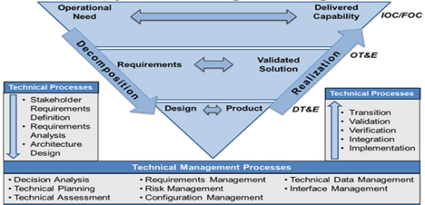
Highlights Since IWS 2024
Systems Engineering (SE) Team has new home!
Digital Engineering (DE)
  Earth Independent Medical Operations (EIMO) Revision
  Artemis III and IV Crew Health and Performance (CHP) System Model
  HHPD* Pilot studies
ConOps, scenarios
Systems Engineering Tools
(e.g., models, analyses)
“Problem space, not solution space”
Or “What, not How”
Requirements
Do we have solutions? If no, research & development are required!
*HHPD – Human Health and Performance Directorate

Slide 3
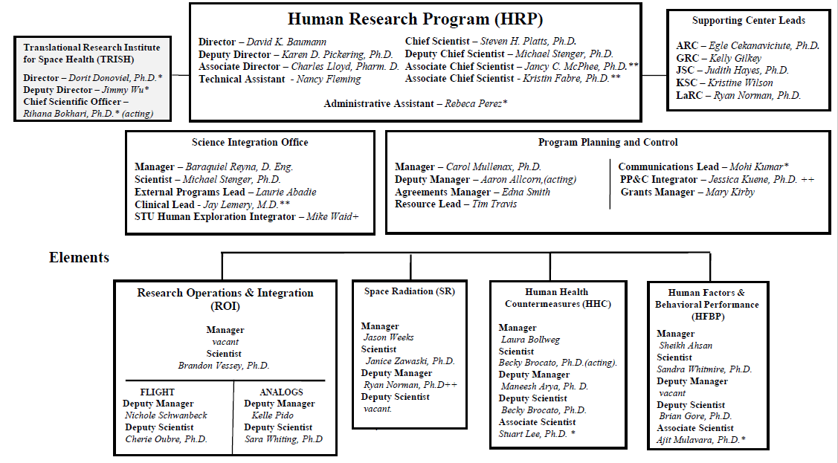
HRP – Organizational Change

Slide 4
Science Integration Office –
Functional Organization Chart
Science Integration Office
Manager: Baraquiel Reyna, D.Eng.
Scientist: Michael Stenger, PhD
Clinical Scientist: Jay Lemery, MD (IPA)
ESDMD Human Exploration Integrator: Michael Waid
External Programs Lead: Laurie Abadie
External Programs
Program Science Visualization
s
IWS Planning
New Science Approval
Standard Measures
Coordinate and integrate HRP utilization efforts across M2M, Artemis, International Partners, and Commercial Partners.
Develop communication tools to visualize HRP contributions in support of operational programs.
Plan and Execute the HRP Investigator’s Workshop.
Develop and Execute the process for HRP new science authority to proceed.
Collect and analyze a standard set of physiological measurements across flight and ground facilities.
Digital Engineering
Clinical Science
Pharm
PRA Tools
Technology Development
Leverage digital tools to provide engineering products (Con Ops, Functions, Requirements, Traces, etc.) in support of HRP and operational programs.
Provide clinical expertise in support of HRP and operational programs.
Execute research to mitigate the Risk of Ineffective or Toxic Medications During Long-Duration Exploration Spaceflight
Develop and Operate probabilistic risk assessment tools in support of HRP and operational programs.
Demonstrate new and innovative technologies that mitigate operational challenges for future missions.

Slide 5
Digital Engineering: Why are we interested?
Artemis missions and the number of Programs present an unprecedented integration challenge for the Human Health and Performance Directorate (HHPD)
HHPD consists of program support, medical operations, and research activities
Opportunities to streamline communication, data silos, transparent decision-making across the HHPD disciplines
Increase accessibility to correlated data/requirements, operations planning, and others
Digital Engineering (DE) capabilities provide a back-end data structure for enhancing processes while minimizing disruption to the workforce.
Important benefits include seamless integration, analysis efficiencies, data-driven insights, scalability, and reduced risk
Feeds into data analytics tools

Slide 6

Data Analytics
Visualizations of large data sets that can be manipulated
  Analyze data without changing source data
Using Microsoft Power BI
  Available to NASA users
  User-friendly platform
  Easy to connect with data sources for rapid prototyping
  Currently being used to explore HHP DE prototypes
Multiple tailorable use cases with a federated source of truth

Slide 7
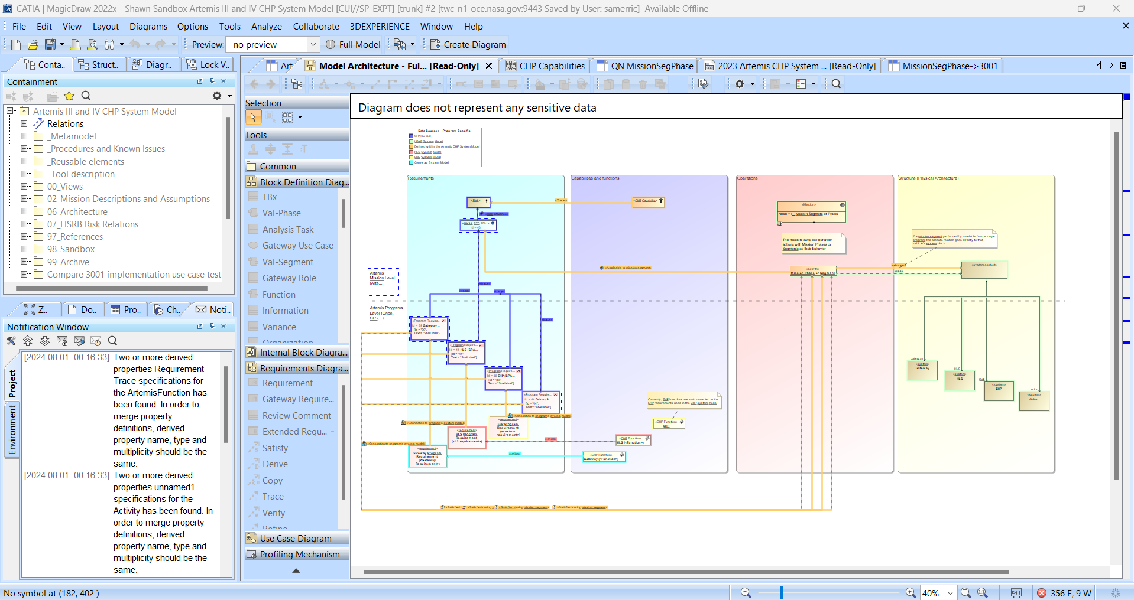
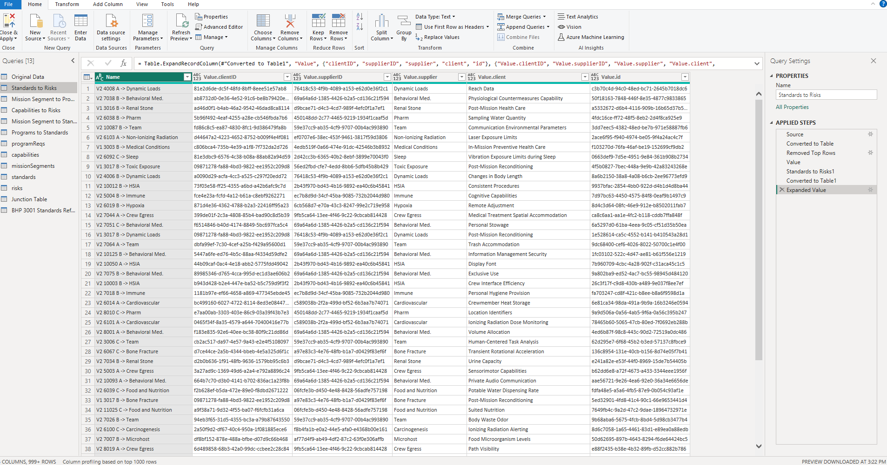
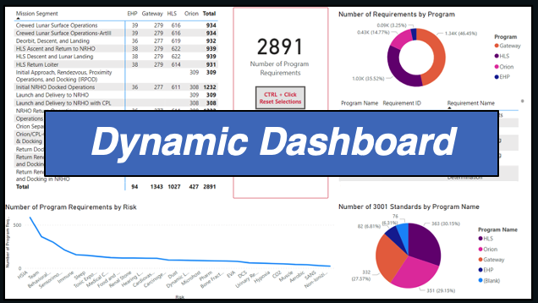
MBSE Data Visualization
Power BI-CHP Model Connectivity
Mitigates the complexity of MagicDraw and modeling
Collects the CHP Model including relationships to allow for tailorable and dynamic data visualization
Reduces the need for working in MagicDraw
Dashboards can be one-offs or sustained communication tool for Teams
MagicDraw Model
ExMC Organizes CHP Model in PowerBI
PowerBI Query
User or ExMC Creates Custom Dashboard
Publish on SharePoint or other WebApp

Slide 8
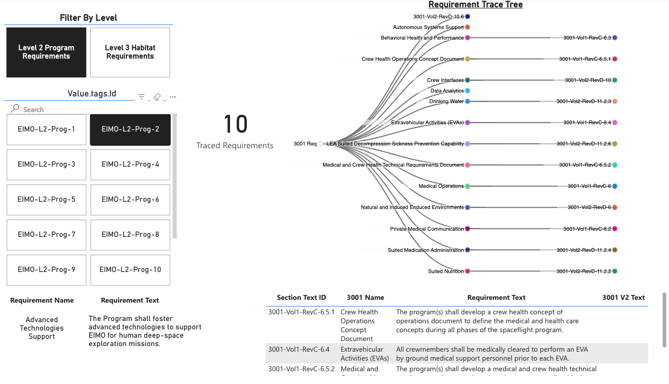
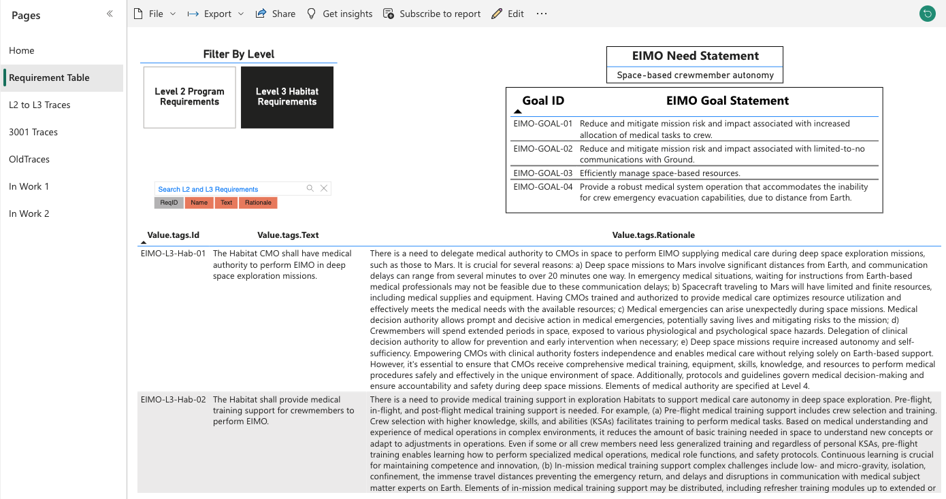
Earth Independent Medical Operations (EIMO)
Trace Tree
Sortable table

Slide 9
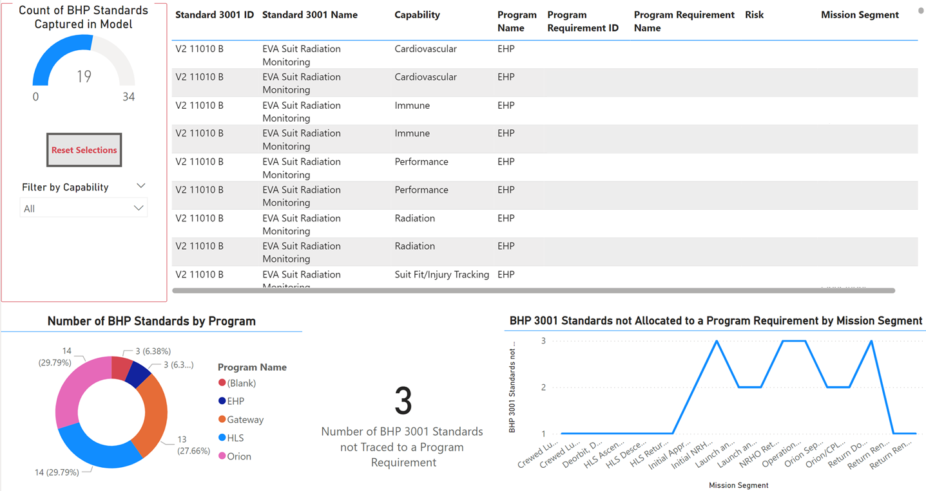
Artemis 3-4 Model: Tracing from NASA-STD-3001 to Program Spec
Connects to multiple sources to show read-only M2M program requirements
Allows a user to filter program requirements by Artemis Mission and Crew Health and Performance capabilities (Ex: What are my in-flight cardiovascular countermeasures for Artemis IV?)
Tool allows for an end user to add their own data and visuals

Slide 10
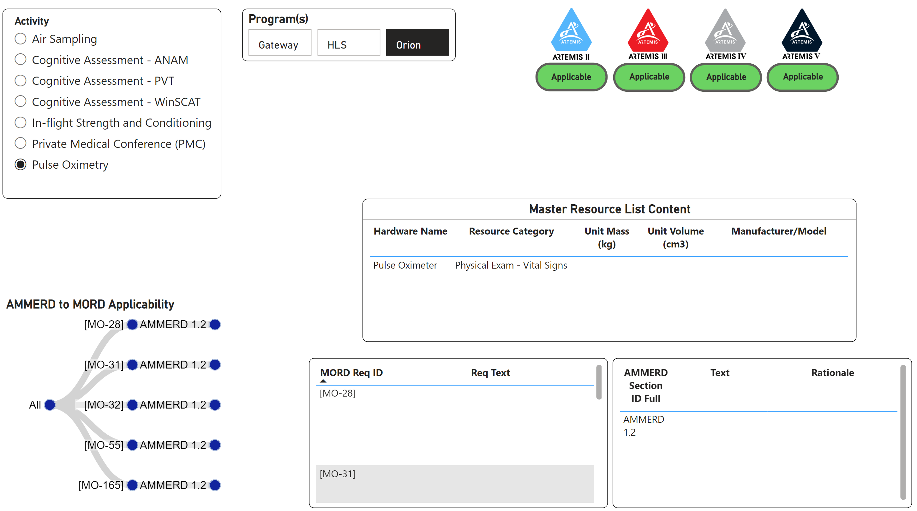
Operations to Hardware Traces

Slide 11
Summary and Forward Work
Completed EIMO Concept of Operations update and upper-level requirements
Complete the Artemis III and IV CHP System model
Work with our HHPD stakeholders to advance digital engineering practices where the benefits are well understood
  Mature pilot projects
  Take on additional pilot studies with accelerated development velocity
  Continue engaging stakeholders – medical operations, human system risk board, crew health and performance officers (CHPOs), human system engineering and integration, CHP system managers

