Slide 1
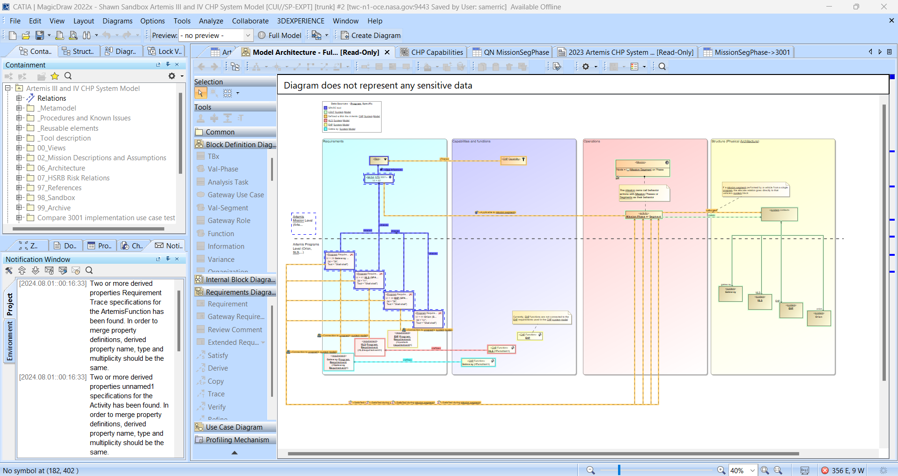
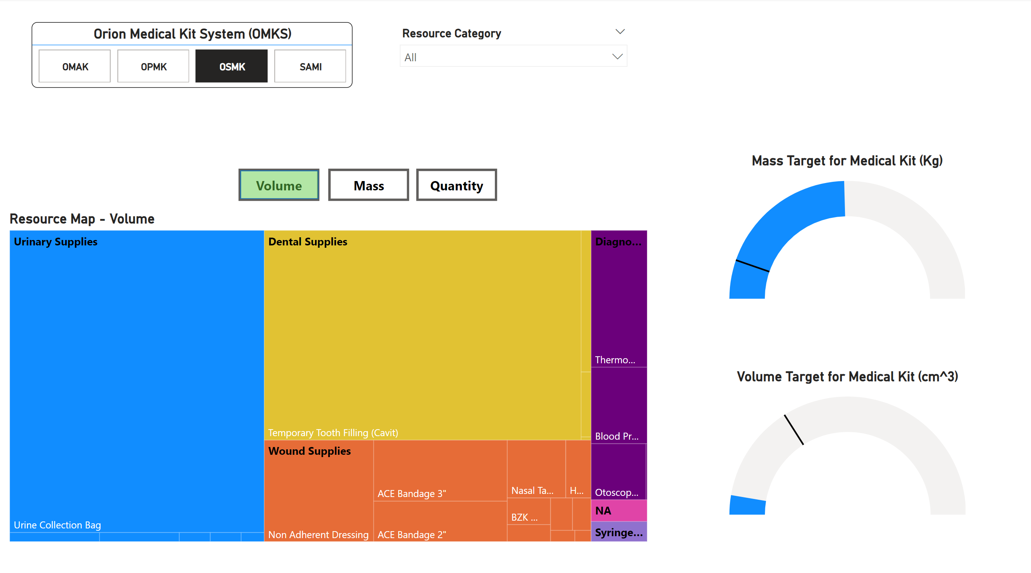


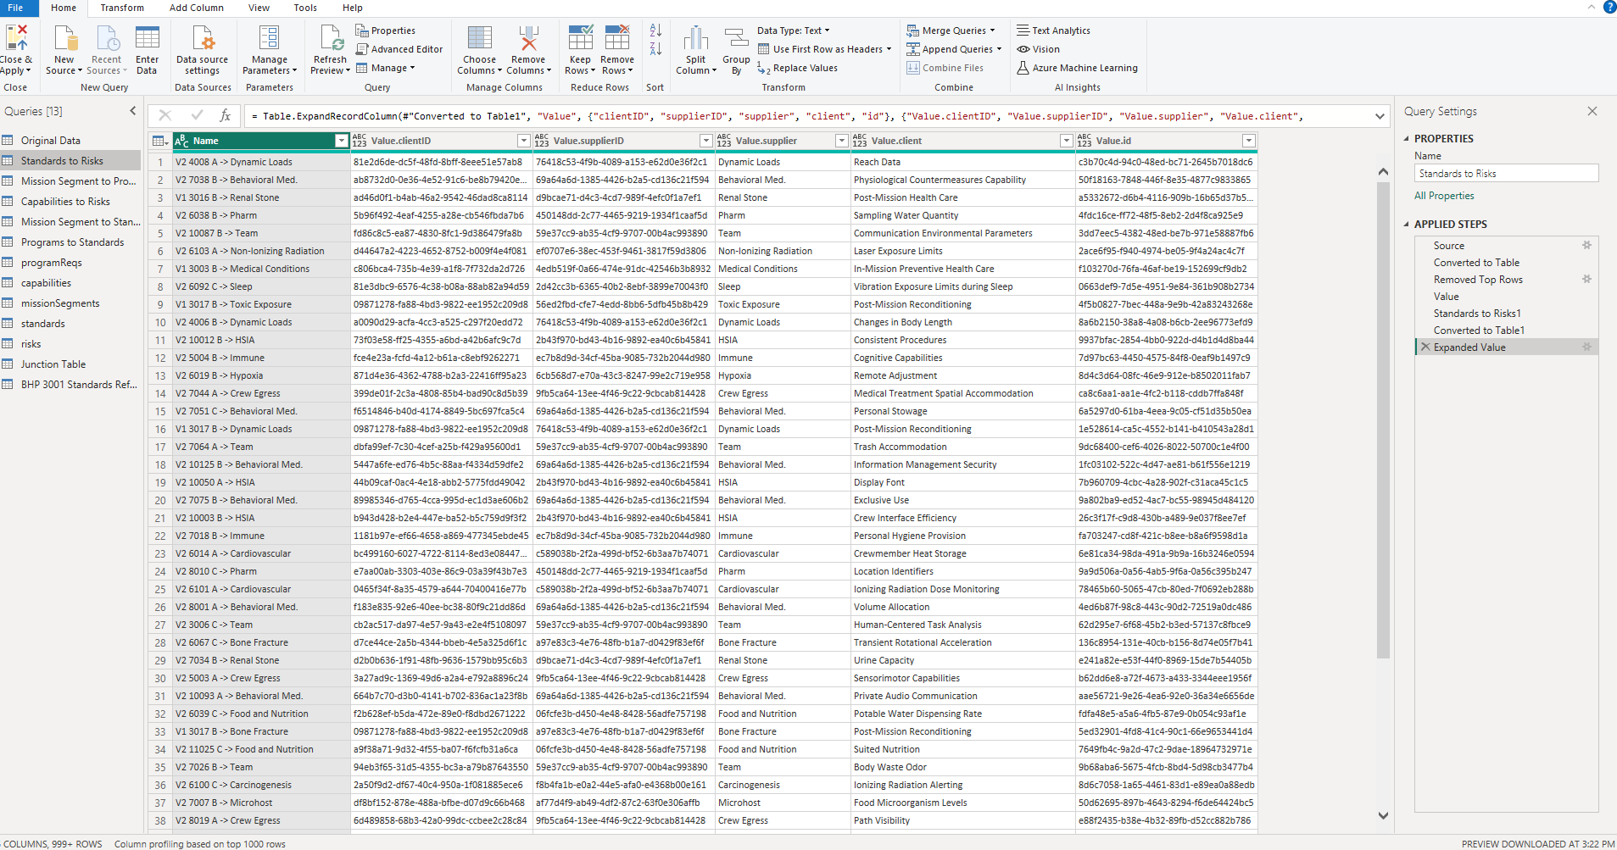
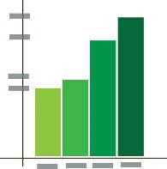
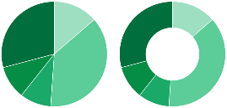

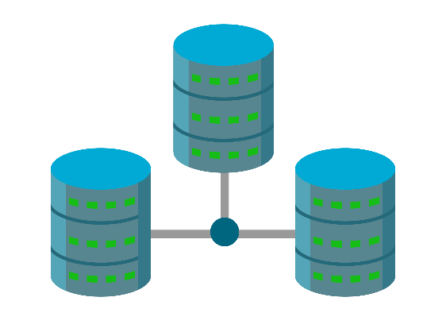






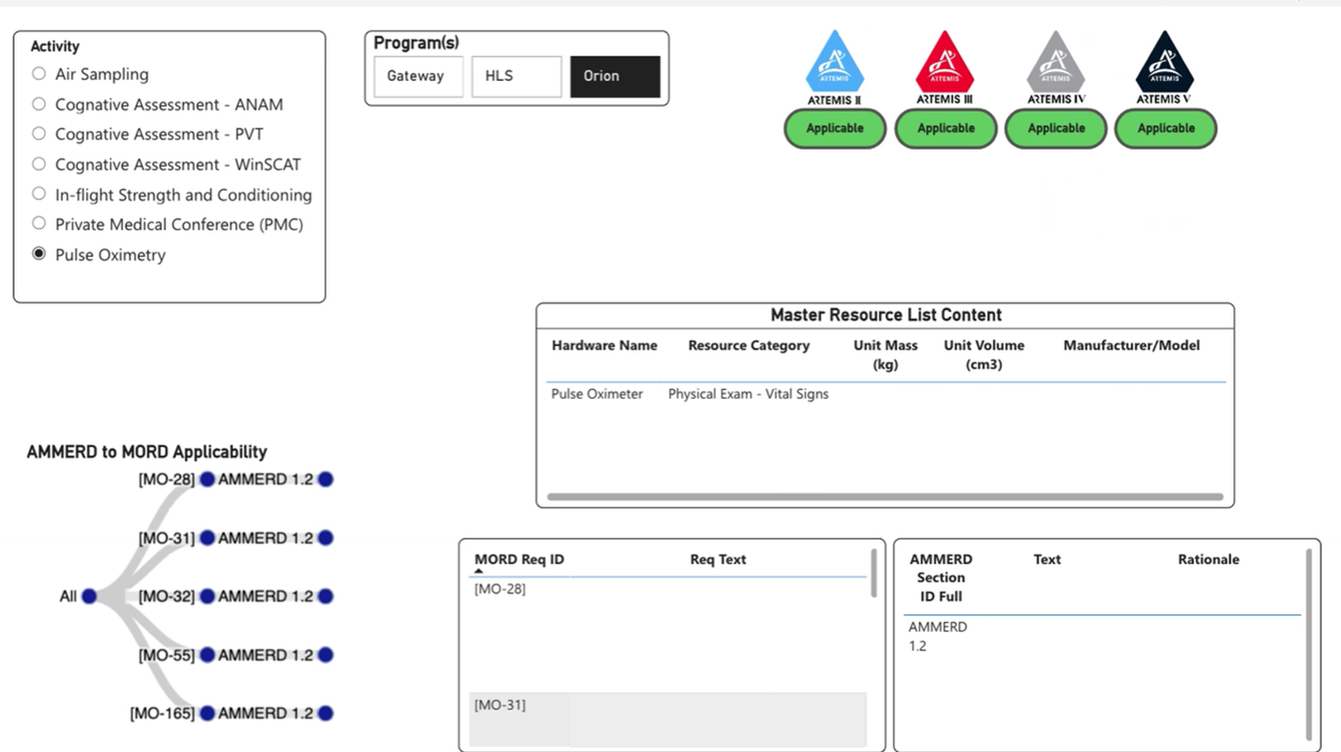
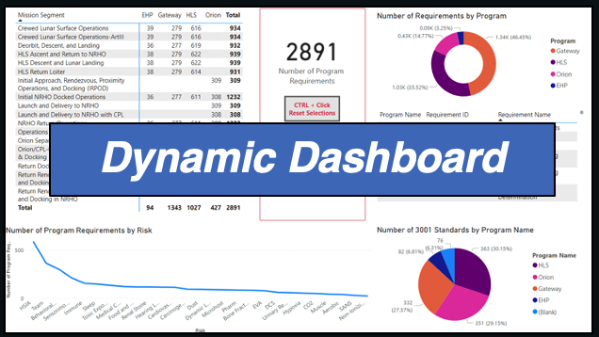
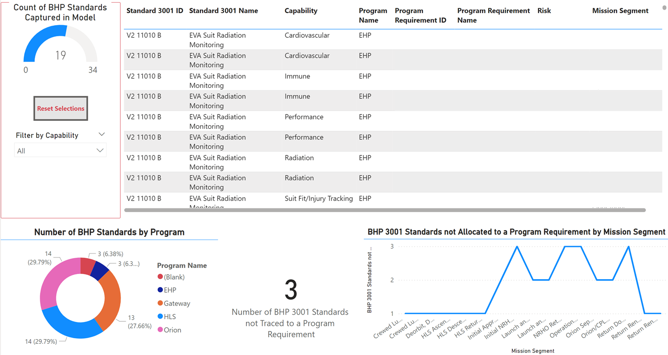
ExMC Digital Engineering
M. Krihak, PhD, KBR, S. Merrick Miller, NASA, J. Blackwelder, KBR, and M. Bernatovich, NASA
Digital Engineering Overview
SE Approach
Results
The NASA Human Research Program (HRP) Exploration Medical Capabilities (ExMC) Systems Engineering (SE) team supports the Human Health and Performance Directorate (HHPD) in piloting digital engineering (DE) capabilities that facilitate the development of enhanced back-end process structures without disrupting the day-to-day activities. The SE team seeks opportunities to streamline communication, overcome data silos, and advance transparent decision-making across the HHPD disciplines. HHPD is looking to transition from a document-centric to model-centric paradigm where all CHP mission data may be obtained in a single location. Additionally, the DE effort can address worker burnout and feed into data analytic tools.
Custom Dashboard Prototype for the Orion Medical Kit System
MagicDraw Model
SE Team Organizes CHP Model in PowerBI
Asynchronous Collaboration
Transparency
PowerBI Query
Federated Sources of Truth
Medical Operations Requirements Traced to Mission Hardware (Prototype)
User or SE Team Creates Custom Dashboard
Transition from document-centric to model-centric
Context with HHPD products/processes
3001 ↔ Program/Project Flow-down ↔ Operational Requirements
Streamlined mission analysis
Crew Health and Performance (CHP) subsystem development
Subject matter expert (SME) support
Human system risks
Medical operations
Establish a centralized repository for the integrated HHP Teams, with connections to existing Program authoritative sources.
Systems Platform for Aggregating and Relating Capabilities (SPARC) is a great DE tool and demonstrates part of the DE opportunity.
  Program applicability
  Risk association
  Cross-system traceability
  Requirement hierarchy
  Verification methods
  System/Subsystem allocations
  Mission applicability
others
Publish on SharePoint or other WebApp
Dashboard Prototype for Sorting Behavioral Health and Performance Requirements
Problem Areas
Crew Health and Performance (CHP) system design/development for exploration mission is difficult.
  Constant changes are made to design reference missions (DRMs), vehicle architecture, and mission architecture.
  Large number of hardware providers are coming from multiple NASA programs, international partners, and private industry.
  Severe constraints (mass, volume, power, difficult operating environments) levied on vehicles and habitats.
The above issues will worsen as missions become longer and more complex.
  Multiple vehicles will need a defined CHP and medical system as crew transition from one vehicle to the next.
  Ensure cross-program requirements are met.
  Track waivers and deviations.
  Review processes for Flight Readiness Reviews and Certification of Flight Readiness.
  Process Details
  Create digital architecture and data structure in MagicDraw
    MagicDraw is a systems engineering modeling tool used widely across NASA.
    Designed to create relationships among system components, requirements and
  Export and transform data for end user tools
    Several approaches investigated to export data
    Determined python macros to be an effective approach for generating a file readily imported by Power BI
  Create dashboard and/or other visualization that the end-user controls
    SE Team works with end-users to iteratively derive a solution
  Advantages of Microsoft Office 365 Tool Suite
    Dynamic Data Visualization and Query
    Visualizations of large data sets that can be manipulated
      Analyze data without changing source data
    Available to NASA users
      Easy to connect with data sources for rapid prototyping
      Currently being used to explore HHP DE prototypes
    Multiple tailorable use cases with a federated source of truth
Challenges to Success
HHPD adoption of DE tool(s) and accessibility to such tools
Data management and maintenance; synchronization of data from sources of truth
Developing adequate communications at the outset and maintaining such communications during the iterative development of DE tools
Provide adequate training for implementing DE tools.
Summary and Next Steps
Evaluate efficacy of the data dissemination
Demonstrate pipeline to automatically update dashboard
Use data visualization feedback to improve model construction
Identify common reviews to support
Track waivers and deviations
Evaluate alternatives to bring more data to HHPD in simpler ways

