Slide 1
Ames Technologies/Capabilities CLDP Utilization Forum -
Water Group Task Summary
Lance Delzeit, ARC SCB
AmesTechnologies/Capabilities CLDP Utilization Forum
1/23/25

Slide 2
Ames Technologies/
Capabilities CLDP Utilization Forum –
Water Group Task Summary
Three potential technologies for CLDP
Universal Urine Processor (UUP)
Fluid Dynamic Mass Gauging (FDMG)
Capillary DirectINJECT (CDI)

Slide 3
Universal Urine Processor (UUP)
UUP is a dormancy- tolerant water processor capable of 100% water recovery with minimal moving parts for increased reliability and maintainability and is compatible with all gravitational environments (micro, partial, and full)
  SOA: Currently , NASA has no water processor capable of 100% water recovery.
  Applications: urine, brine, humidity condensate, microgravity (transit) and partial gravity (planetary surface), and plant systems.
    Replaces the 3 processors (VCD, BPA, PUP) currently proposed for a Mars
      Saves over 2/3rd of the mass, volume, and complexity
UUP is a Shovel-ready Project with Proven Capabilities as it’s based off the Brine Evaporation Bag (BEB) which has already gone through prior development and demonstrated 100% water recovery.
UUP greatly reduces resupply with 100% water recovery. If the water recycler has only 97% efficiency, then 3% of the water is thrown away as waste. The minimum water required per crew is 2.5L/day; that’s 10L/day for a crew of 4. That’s 0.3L/day of water required in resupply resulting in 1/3rd metric ton of waste water for a 3-year (1000 day) Mars mission which could be recovered.

Slide 4
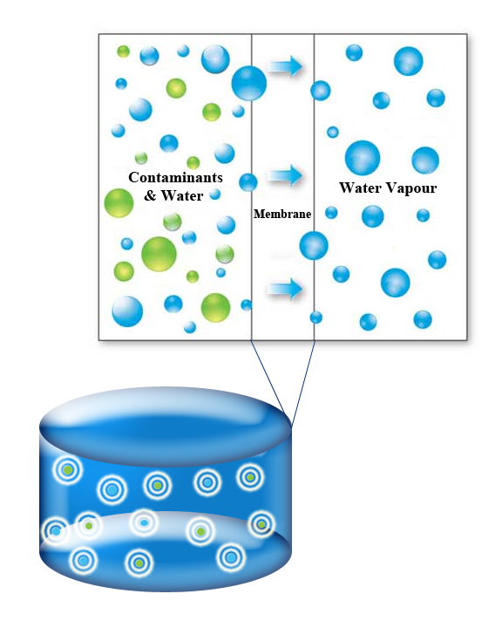
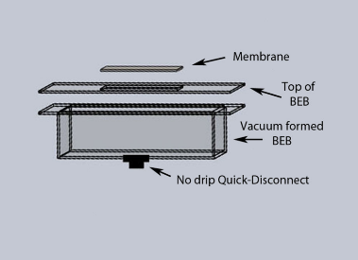
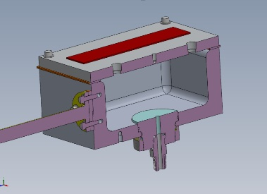
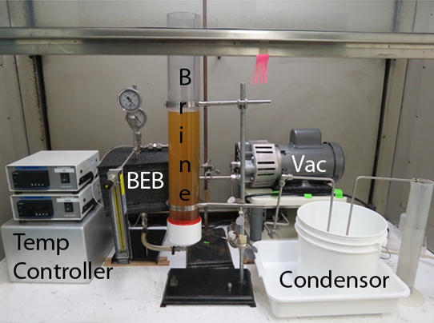
Universal Urine Processor (UUP)
Underlying Technology
Top left – A membrane bag capable of retaining liquid water, but allows water vapor to escape
Top right – Drawing of the membrane bag as built for BEB
Right middle – The vacuum evaporator which holds the membrane bag
Bottom – The lab based complete system (miniature demo unit)
  Only moving part is the scroll pump
Infusion
Mars and lunar planetary and transit
UUP will replace the need for 3 separate system (VCD and BPA for transit and PUP for planetary) in a Mars mission
Gas release ~0.6ml/min into the cabin vs the BPA’s 1000L/min
  Cabin “stench” release would be comparable to the VCD (UPA)

Slide 5
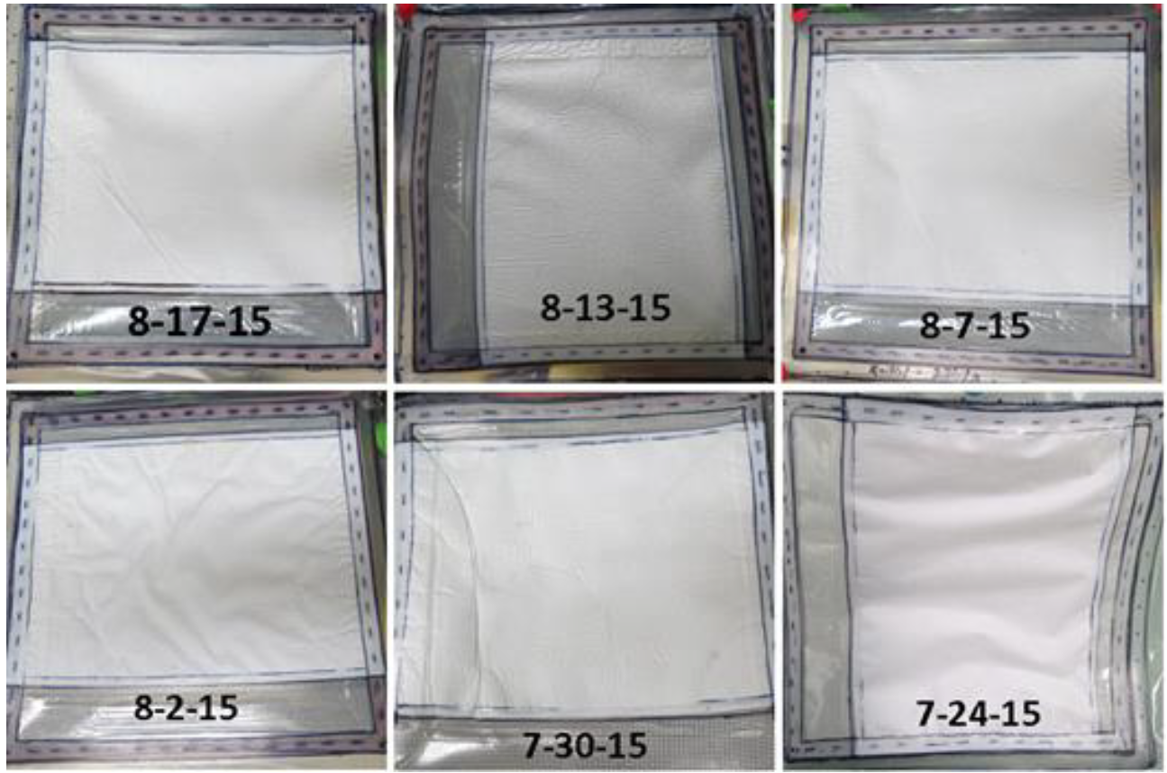
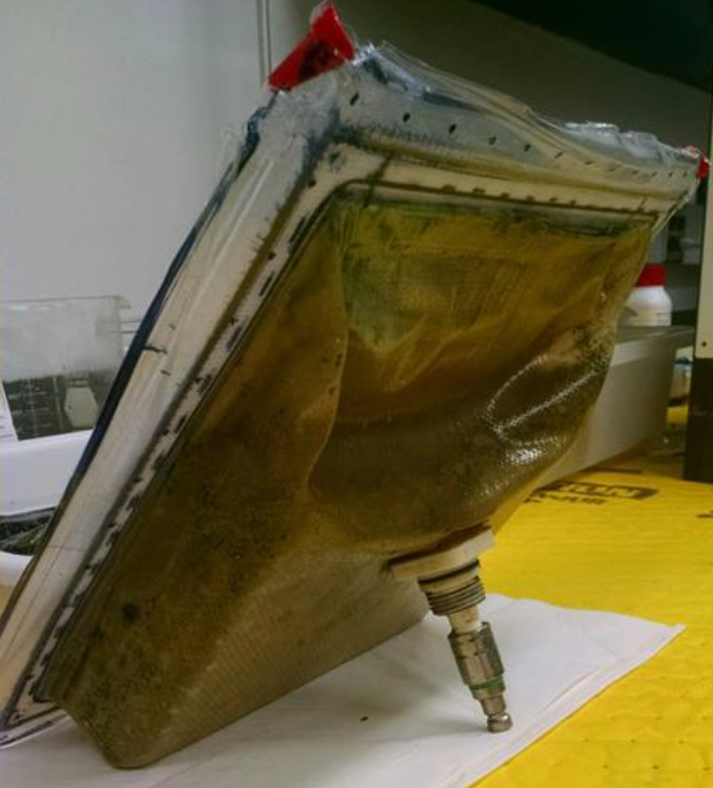
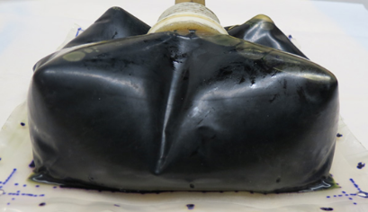
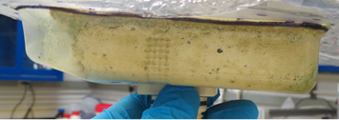
Universal Urine Processor (UUP)
Technical:
Several ICES paper are published (2012 – 2016) on the BEB and its performance
  2016 Results of the FY15 Brine Evaporation Bag (BEB) Technology Down Select Testing
Top image - The membrane of 6 BEBs at the end of their runs with no evidence of membrane leakage.
Bottom right images – Images of BEBs at the end of their run at 99.99% (left, water of hydration not removed so still green in color) and 100% (right) water recovery
Bottom left images - 100% water recovery in a BEB. Note that the “green” Cr(III) hexahydrate becomes bone white demonstrating the removal of even the waters of hydration leaving behind only a solid block.
Cr (III) Urine Brine 100% Dewatered Brine Residue
Demonstration of 100% water recovery with color changing from green to white

Slide 6
Fluid Dynamic Mass Gauging (FDMG)
FDMG is a technology for determining and monitoring the liquid volume within a tank that works in all gravitational environments (micro, partial, and full) with in-flight re-calibration capability.
  SOA: Currently, NASA has no method of determining the volume of liquid within a tank.
  Applications: Water storage, water processing, brine recovery, Urine Pretreat, EDV processing, Cryo tanks, plant systems, etc.
FDMG is a Shovel-ready Project with Proven Capabilities which has gone through prior development and demonstrated the ability to determine the liquid volume within a rigid bladder tank to <1% error of the tanks maximum volume.
  Estimated system mass/volume is 1kg/1L.
Achilles' Tendon: Takes 1-5 minutes to do volume determination
  Meant for static, not dynamic, systems

Slide 7
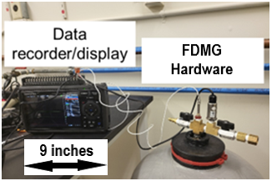
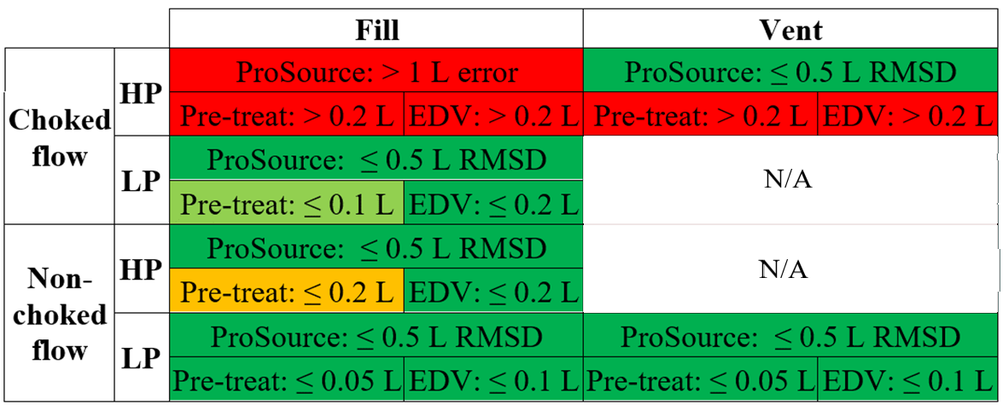
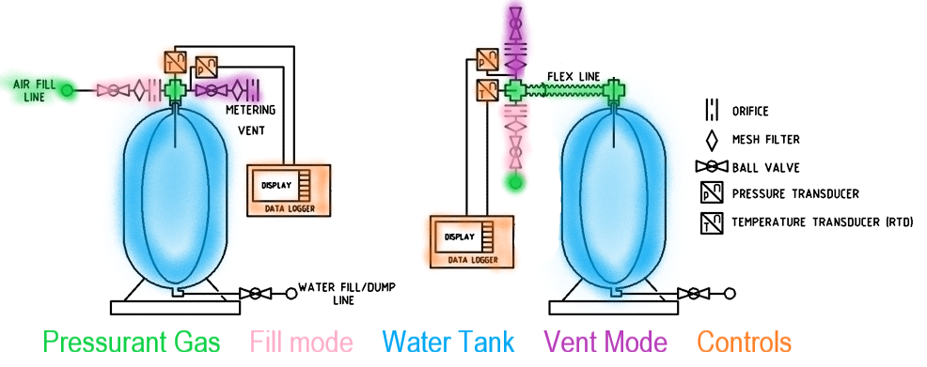
Universal Urine Processor (UUP)
Hardware and Operating Conditions:
Top Right – Image of FDMG in a manual, on-tank, Vent Mode configuration with data recorder.
  Nominally 1Kg and 1L
Bottom Right – Chart showing a plethora of operating conditions and accuracy
  Most conditions show high accuracy.
  Even the less accurate conditions show good results.
Bottom Left – Drawing of FDMG in both Vent and Fill Modes, both on-tank (left) and off-tank (right) configurations
  Off-tank allows multiple tanks to be serviced with a single unit

Slide 8
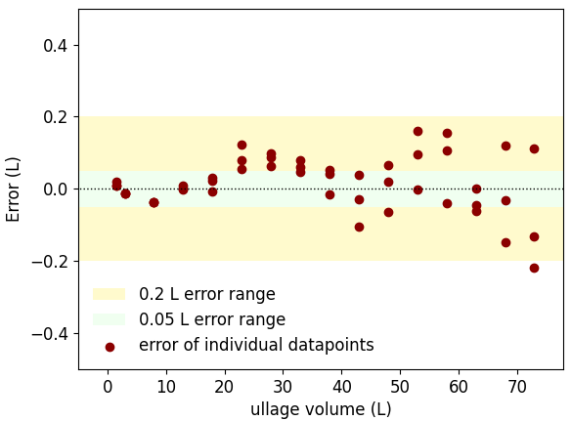
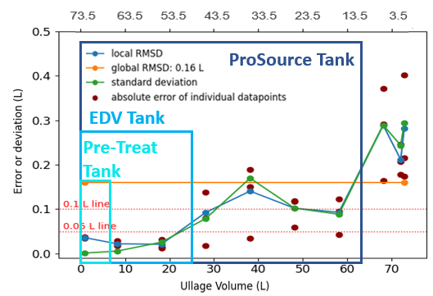
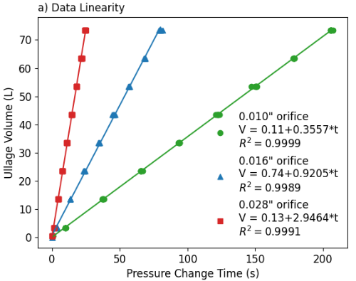
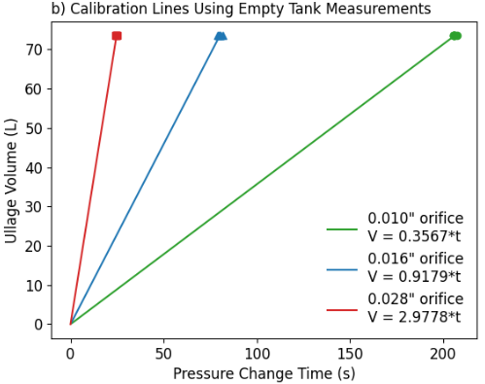
Universal Urine Processor (UUP)
Data, Calibration, and High Accuracy:
Bottom Left – Data is highly linear (R2 ~ 1)
Bottom Middle – Data linearity allows for single point calibration curve
  Allows for in-flight recalibration
Bottom Right – Delta between data and calibration curve gives error curve
  Calibration curve of the largest tank applicable to all attached tank in off-tank configuration since ullage volume is independent of tank volume.
Top Right – Best operating condition showing (including temperature affects) <0.27% error of the tanks maximum volume

Slide 9
Capillary DirectINJECT (CDI)
A technology capable of producing a stable injection flow with extreme control of flow rates.
  i.e., dosing Ag Biocide at both low biocidal (200-400 ppb) and high sterilization (10,000+ ppb) conc.
  Flow rates from low μL to high mL/min flow rates
  Low mass and volume
  SOA: Currently, NASA only uses various mechanical pumps.
  Applications: Biocide dosing, urine pretreat dosing, flow control, plant systems, etc
CDI is a Shovel-ready Project with Proven Capabilities which has gone through prior development and demonstrated the ability to control the flow rate to within +/- 10% using a 25μ capillary.
  Improved control expected with larger diameter constrictions.

Slide 10
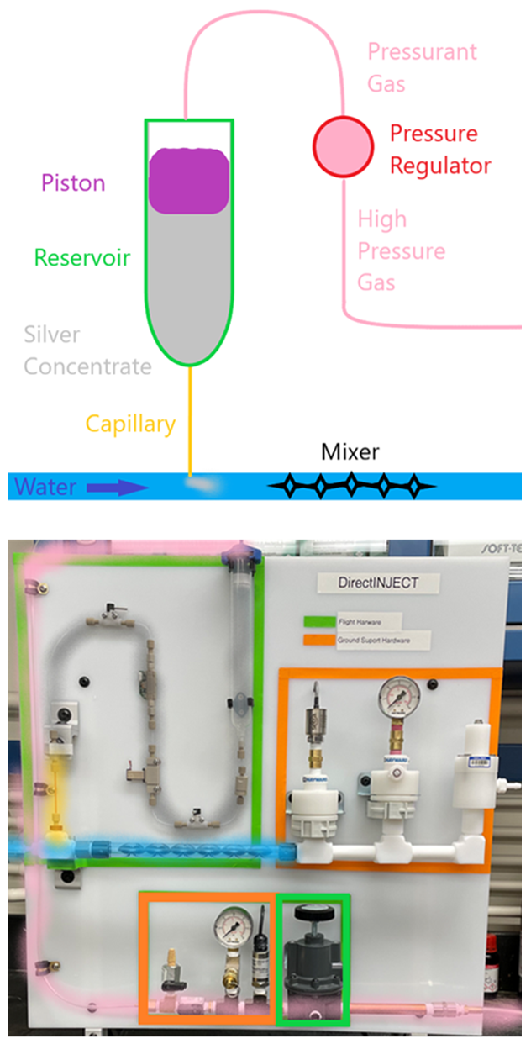
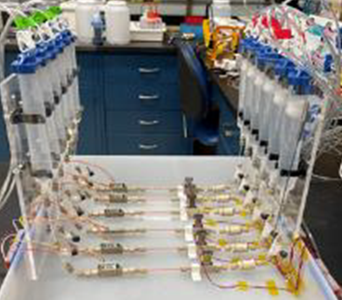
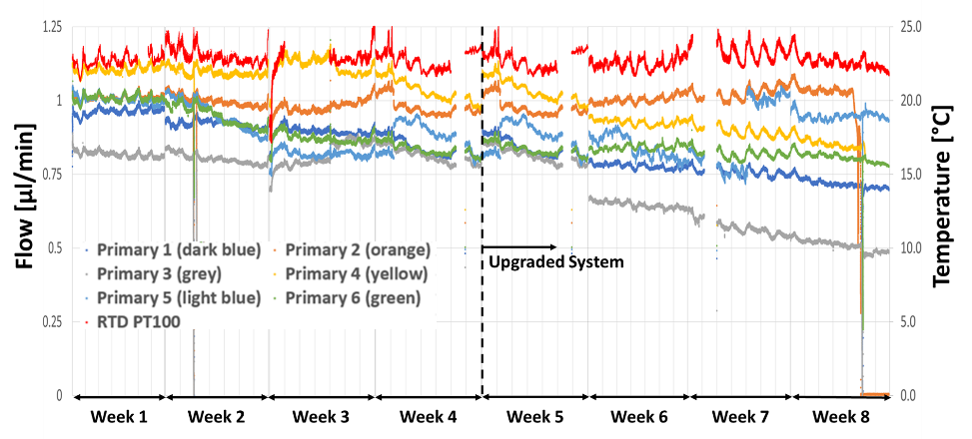
Universal Urine Processor (UUP)
Data for Silver dosing system
Top Right – Cartoon of basic system
Bottom Right – Single system built into an ISS-like system
Bottom Left – Picture of 6 parallel systems using a 25 μm capillary
Bottom Middle – Data collected from 6 systems
  5 systems stayed within +/-10%
  1 system within +/- 20%
  Larger diameter should be more stable
10

Slide 11
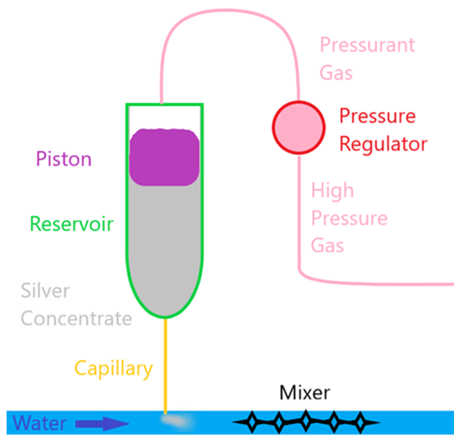

Universal Urine Processor (UUP)
Data for Silver dosing system
Bottom Right – Cartoon of basic system
Top Right –6 parallel systems using a 25 μm capillary
Bottom Left – Data collected from 6 systems
  5 systems stayed within +/-10%
  1 system within +/- 20%
  Larger diameter should be more stable

