Slide 1

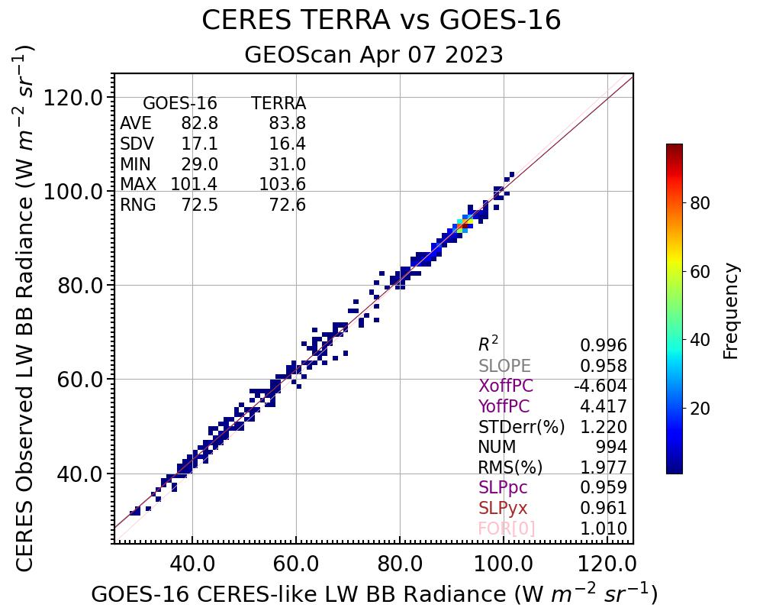
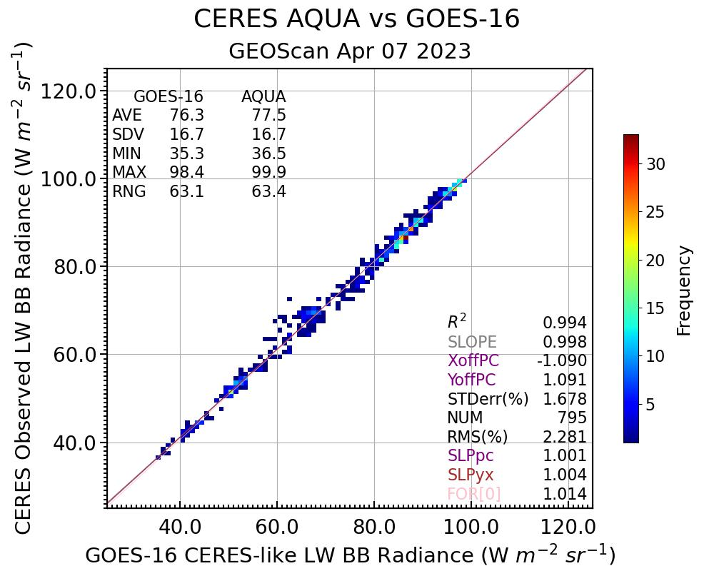
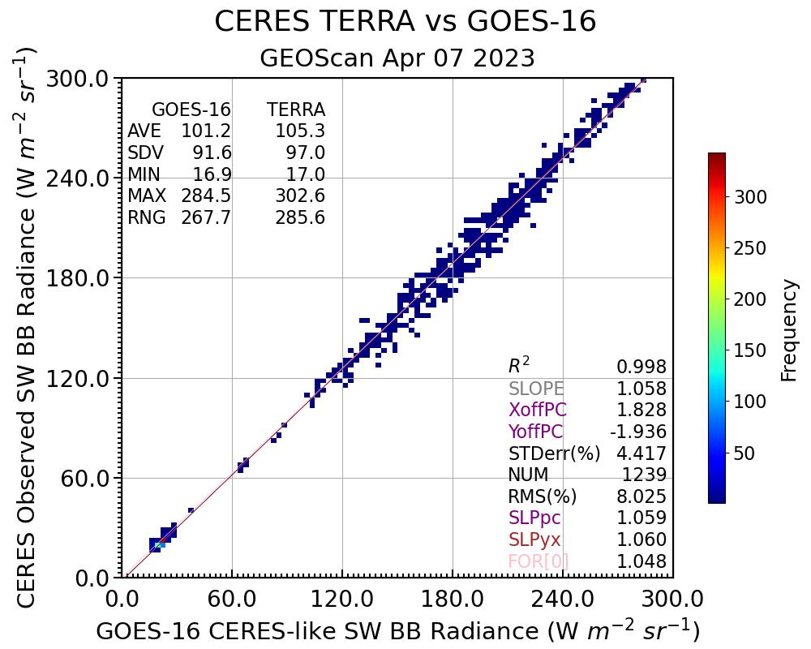
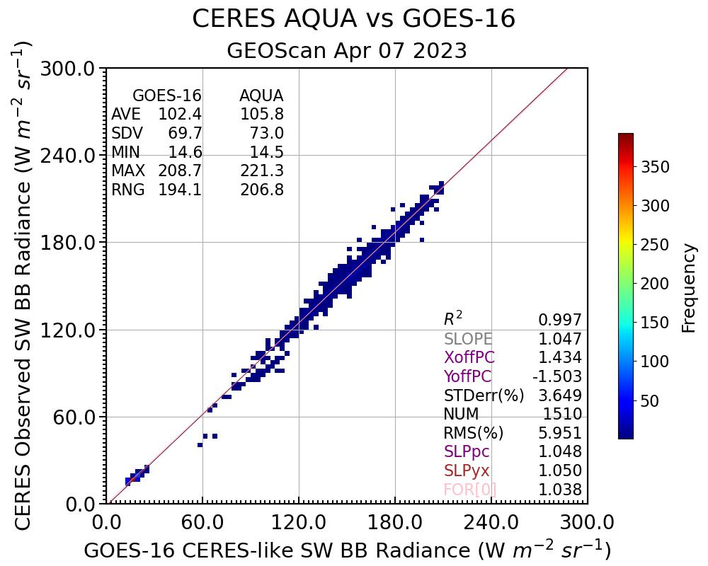
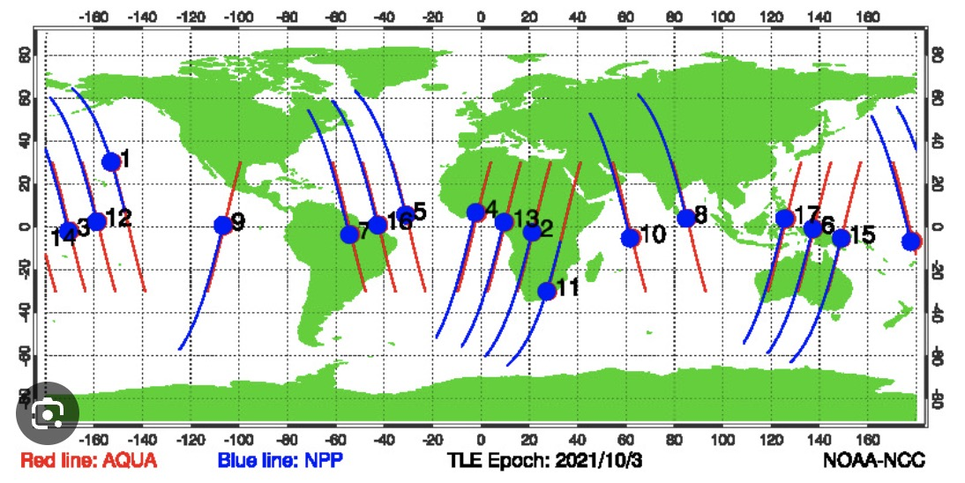
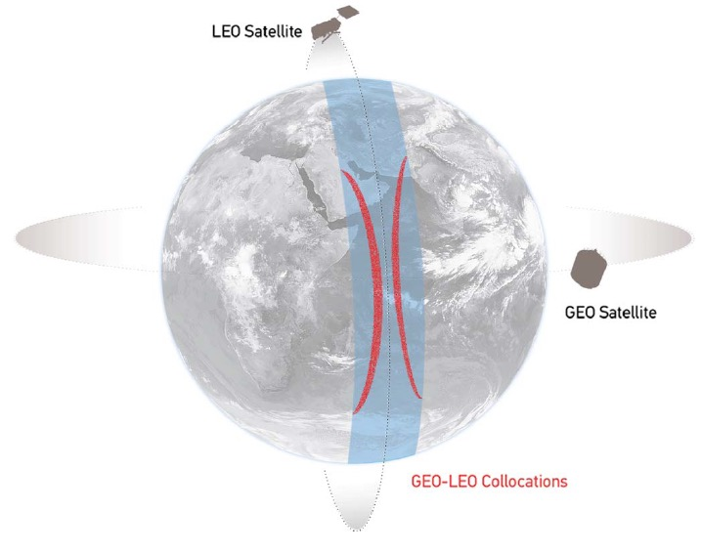
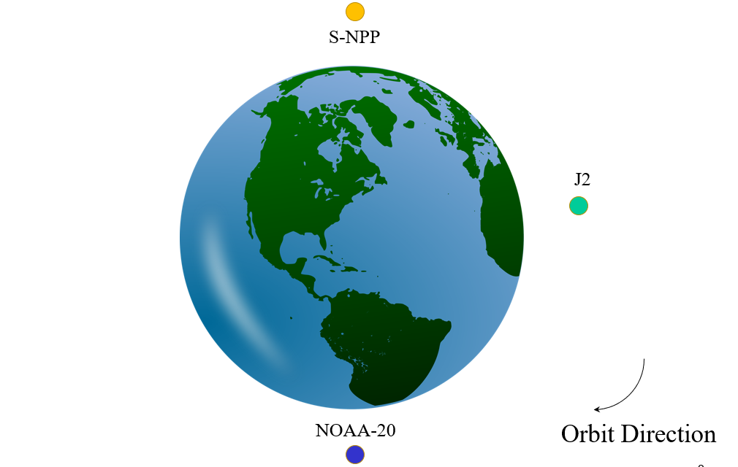
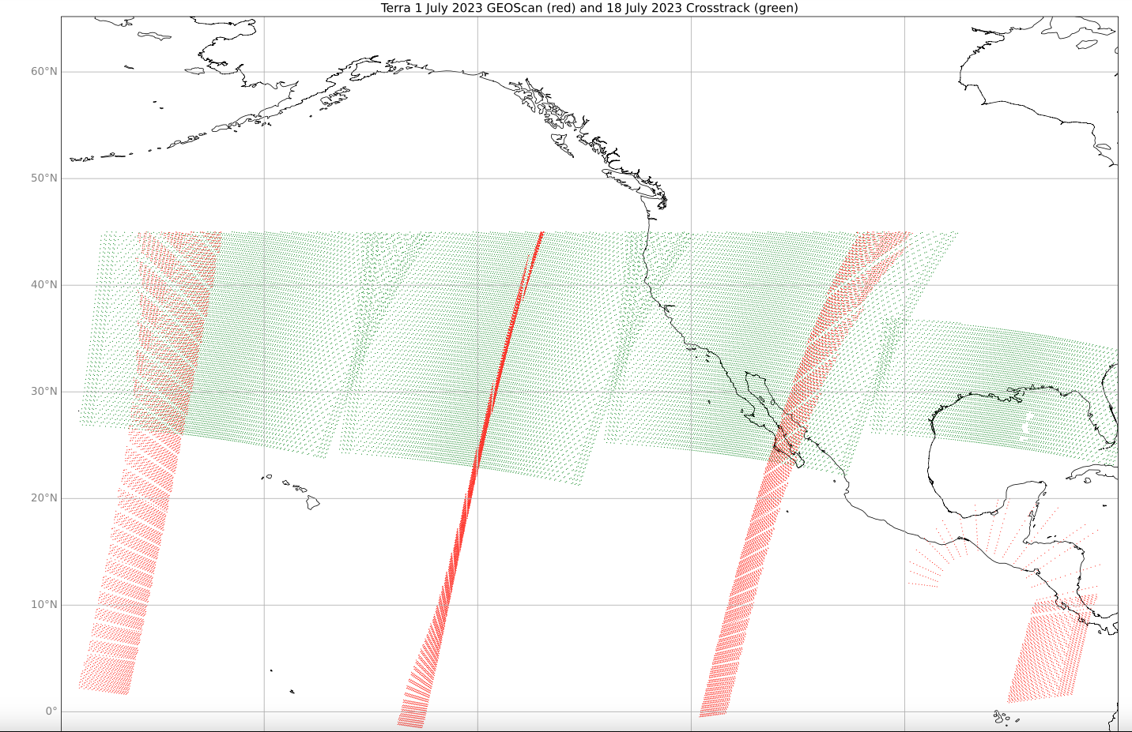
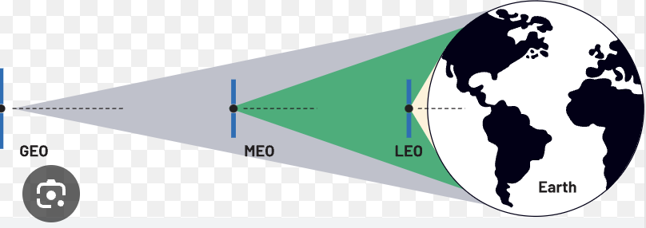
Inter-calibrating CERES instrument fluxes utilizing the CERES instrument geostationary scan mode observations
Kyle Itterly¹, David Doelling², Arun Gopalan¹, Conor Haney¹, Michele Nordeen¹, Moguo Sun¹ & Beau Branch³
¹Analytical Mechanics Associates, Hampton, VA, ²NASA Langley Research Center, Hampton, VA, ³Adnet Systems, Hampton, VA
AMS Annual Meeting 2025 • New Orleans, LA
1. Introduction and Motivation
7. Takeaway Messages
The CERES instruments onboard the Terra, Aqua, SNPP and NOAA-20 satellites need to be inter-calibrated to provide a seamless and consistent TOA flux record using multiple overlapping CERES records
  The CERES instrument calibration team utilizes simultaneous nadir observations (SNO) or matched in time and angle CERES instrument pair radiances for inter-calibration to a common reference
  Since the Aqua orbit is lower than either NPP or NOAA20 SNOs occur every 64 hours
  The NPP and NOAA20 satellites are in the same 1:30PM sun-synchronous orbit but positioned a quarter orbit apart. The orbit placement prevents any SNOs or intercalibration events
  Terra, Aqua, NPP satellites will be decommissioned in mid 2026
  The future NOAA22 Libera (launch in 2028) satellite will be in the same orbit as NOAA20 but positioned a quarter orbit apart. The orbit placement prevents any SNOs or intercalibration events
  The NASA CERES project will utilize CLARREO SNOs, Earth invariant targets (Deep Convective Clouds, Deserts, Dome-C), VIIRS narrowband to broadband after scaling the VIIRS sensors, as well as GEO scan observations to intercalibrate NOAA20-CERES and NOAA22-Libera
CERES instrument GEO scanning points the CERES instrument over the GEO domain that are view angle matched
  The CERES instrument is usually in cross-track scan mode to provide spatially complete sampling
  The CERES instrument also performs Rotating Azimuthal Plane Scans to build Angular Directional Models used to convert the CERES radiances into fluxes
  CERES placed the Terra and Aqua CERES instruments in GEOscan mode once every 6 days over a rotation of five geostationary domains beginning in February 2023 to validate the GEOscan inter-calibration approach
Compare the Terra and Aqua CERES observed radiances by using time and angle matched GEO imager narrowband to broadband derived radiances during the same day (Sec. 3)
  10:30 AM Terra radiance > 10:30 AM GEO NBtoBB radiance > 1:30 PM GEO NBtoBB radiance > 1:30 PM Aqua radiance
GEO imager narrowband to broadband approaches are validated within this framework (Sec. 4 & 5)
No time matched NOAA satellite CERES instrument observation pairs, investigate other approaches for CERES instrument inter-calibration
Compare the calibration of the future NOAA22 Libera with NOAA20 CERES BB radiances while in GEO scan mode using GEO based narrowband (NB) to broadband (BB) radiances
  The 5 GEO NB to BB radiances are compared to Terra and Aqua CERES radiances for this preliminary study
  The Terra and Aqua CERES radiances have been radiometrically scaled using simultaneous nadir observations; therefore, any Terra and Aqua difference would be associated with the GEO NB to BB algorithm (no ADM uncertainty in BB radiance space)
  The longwave and shortwave radiances are within 0.5% and 1.0% and are due to the GEOscan strategy
GEO SW NB to BB Ed4 versus experimental Ed5 sensitivity studies have mixed results. The Ed5 approach was designed mainly to improve land NB to BB.
GEO LW inter-calibration with VIIRS results in CERES/GEO radiance ratios closer to unity
3. Terra and Aqua CERES observed and GEO derived broadband (BB) radiance inter-calibration, April 2023
Ed4A Longwave BB Radiance
Ed4A Shortwave BB Radiance
Between 2012-2022, NPP/Aqua before Aqua drift
NOAA 3-satellite constellation prior to March 2024
CERES satellite
S-NPP
GEO satellite
Orbit time is 101 minutes for 360°
J2
GEO satellite position
relative slope difference is the GEOscan strategy calibration difference, the Terra and Aqua radiance have been radiometrically scaled
Aqua
NPP
• lower altitude has faster orbit
Aqua 1:30PM-MLT, 705km, 99 min.
SNPP 1:30PM-MLT, 830km, 101 min.
• Allows for a ground track intersect every 64 hours and provides a SNO pair for CERES instrument inter-calibration
CERES + GEO matched view angles
GEO | Terra / GEO Ratio | Aqua / GEO Ratio | Relative Diff (%) | Terra Std. Error (%) | Aqua Std. Error (%)
GOES-18 | 1.016 | 1.010 | -0.6% | 1.503 | 1.498
GOES-16 | 1.012 | 1.016 | +0.4% | 1.220 | 1.678
MET-10 | 1.013 | 1.008 | -0.5% | 1.825 | 2.523
MET-09 | 1.005 | 1.003 | -0.2% | 0.749 | 2.531
HIM-09 | 1.018 | 1.013 | -0.5% | 1.832 | 1.820
GEO | Terra FOR[0] Slope | Aqua FOR[0] Slope | Relative Diff (%) | Terra Std. Error (%) | Aqua Std. Error (%)
GOES-18 | 1.019 | 1.026 | +0.7% | 4.609 | 3.085
GOES-16 | 1.048 | 1.038 | -1.0% | 4.417 | 3.649
MET-10 | 0.991 | 0.998 | +0.7% | 5.977 | 7.731
MET-09 | 1.025 | 1.020 | -0.5% | 8.049 | 4.917
HIM-09 | 1.025 | 1.016 | -0.9% | 3.388 | 5.549
altitude
SNO
NOAA-20
GEO image swath
surface
NPP/NOAA-20 time difference is 50 minutes, no time matches
CERES swath
Hewison et al. 2013
GEO scan strategy
July 2023 Terra Footprints
Terra-CERES-channel
GEO NB to BB radiances
Aqua-CERES-channel
GEOScan CERES footprints view angle matched within 10° with GOES-18, designed for inter-calibration
Cross-track is not angle matched with GOES-18 designed for complete spatial sampling
Match criteria: 2.5° view angle and 7.5’ matching and applying a footprint spatial homogeneity filter to best match CERES
Match criteria: <50° VZA, 5.0° view angle, 10° scattering angle, 7.5’ matching, adjusting the radiance by the cosine solar zenith angle, and applying a dynamic range footprint spatial homogeneity filter to best match CERES
The GEOscan strategy can inter-calibrate the GEO derived broadband radiances within 0.5% in the LW
The GEOscan strategy can inter-calibrate most GEO derived broadband radiances within 1.0% in the SW
GEO altitude is 36000km and Terra+Aqua altitude is 705 km
4. GEO inter-calibration with VIIRS calibration sensitivity
5. GEO experimental Ed5 SW NB to BB sensitivity study
2. Datasets and Methods
Does the GEO inter-calibration with VIIRS result in ratios closer to unity?
Yes. Ratios become closer to unity by first calibrating to VIIRS.
Validate experimental NB2BB methods using the GEOscan strategy
Compare the Ed5 experimental table slopes and standard errors with the Section 3 SW table (above). The Ed5 experimental reveal mixed results, some GEOs improved.
GEO scan Terra and Aqua CERES SSF footprint-level Ed4a top-of-atmosphere (TOA) broadband (BB) radiances
  To avoid scanning in the RAM direction or in the path of the satellite forward motion, Terra (ascending orbit) GEO scans are in the Northern Hemisphere, whereas Aqua (descending orbit) are in the Southern hemisphere
GOES-18, GOES-16, Meteosat-10, Meteosat-9, Himawari-9 Geostationary (GEO) 2- or 3-km pixel-level narrowband (NB) radiances aggregated into a 30-km diameter centered at the CERES footprint latitude and longitude (not CERES footprint point spread function weighted)
  GEO radiances are inter-calibrated against NOAA20-VIIRS using angle and time matched analogous channel radiances
  The GEO/CERES time matches are between 5-7.5 minutes, given the GEO scan frequency of 10 or 15 minutes
  The LW NB to BB coefficients are based on multi-linear regression of Aqua footprint CERES LW radiances and MODIS 6.7µm and 11µm radiances as a function of 7 surface types, view angle, clear/cloud, and PW
  The SW GEO NB to BB is a two-step process. Step 1: Convert the GEO 0.65µm channel radiance to the MODIS Band 1 0.65µm radiance using SNOs. Step 2: Use radiative transfer to convert the MODIS NB to the CERES BB radiance as a function of 7 surface types, view, solar, and azimuthal angle, clear/cloud bins.
  The NB to BB approach is the same that is used in the CERES hourly GEO SYN1deg product
GEO scan Terra and Aqua CERES SSF footprint-level Ed4a top-of-atmosphere (TOA) broadband (BB) radiances are converted to fluxes using the TRMM based angular directional models (ADM)
Plot the instantaneous GEO derived BB and CERES observed footprint radiances and linear regressions statistics
  Compare the CERES/GEO radiance ratio for LW and the linear regressions force-fit through 0 linear slope for SW
  GEO radiometrically scaling to VIIRS sensitivity study (Sec. 4) test experimental Ed5 SW NB to BB approach (Sec 5)
Uncalibrated vs. Calibrated LW BB Radiance Ratios
GEO | Terra/GEO without Cal | Terra/GEO with Cal | Aqua/GEO without Cal | Aqua/GEO with Cal
GOES-18 | 1.029 | 1.016 | 1.024 | 1.010
GOES-16 | 1.023 | 1.012 | 1.025 | 1.016
MET-10 | 1.017 | 1.013 | 1.013 | 1.008
MET-09 | 1.015 | 1.005 | 1.010 | 1.003
HIM-09 | 1.033 | 1.018 | 1.029 | 1.013
Ed5 Experimental SW NB2BB
GEO | Terra FOR[0] Slope | Aqua FOR[0] Slope | Relative Diff (%) | Terra Std. Error (%) | Aqua Std. Error (%)
GOES-18 | 0.992 | 1.003 | +1.1% | 4.846 | 3.355
GOES-16 | 1.019 | 1.012 | +0.7% | 4.729 | 3.608
MET-10 | 0.960 | 0.977 | +1.7% | 5.835 | 6.883
MET-09 | 0.992 | 0.996 | +0.4% | 7.738 | 4.811
HIM-09 | 0.997 | 0.997 | +0.0% | 3.565 | 4.675
6. Are results sensitive to the GEO aggregation size? YES
The CERES footprints on Terra and Aqua are 20-km. The results in the tables utilized 30-km diameter GEO derived BB radiances, a 20-km footprint was tested and resulted in degraded statistics compared with the 30-km. The CERES point spread function and view angle dependent diameters were not applied

