Slide 1
This material is a work of the U.S. Government and is not subject to copyright protection in the United States.
SPACE LAUNCH SYSTEM
SLS Block-1B USA Separation Analysis and Requirements Evaluation Using the CLVTOPS Toolchain
Co-Authors: Benjamin Burger, NASA/MSFC
Peter McDonough, Amentum Carole J. Addona, Amentum
Rekesh Ali, McLaurin Aerospace Jared Rucker, Amentum
Michael Sanders, Amentum
Zach Muscha
NASA/MSFC/EV42/ESSCA/Amentum
2025 AAS GN&C Conference
February 3, 2025

Slide 2
Agenda (4-5 charts of content, 1 chart per bullet)
Overview
USA Separation Event
Requirements and Analysis Results
Requirements Simulation Rework
Requirement 2 Removal

Slide 3
Overview
NASA’s Space Launch System (SLS) is a launch vehicle designed to bring astronauts back to the moon.
Including the Block-1 and Block-1B configurations.
SLS Block-1B consists of a Core Stage, 2 SRBs, EUS, a mission-specific Co-Manifested Payload (CPL), Universal Stage Adapter (USA), and Orion Spacecraft.
MSFC’s Liftoff and Separation Dynamics Team uses the CLVTOPS toolchain for USA hardware simulation, minimum clearance analysis, and requirements analysis.

Slide 4
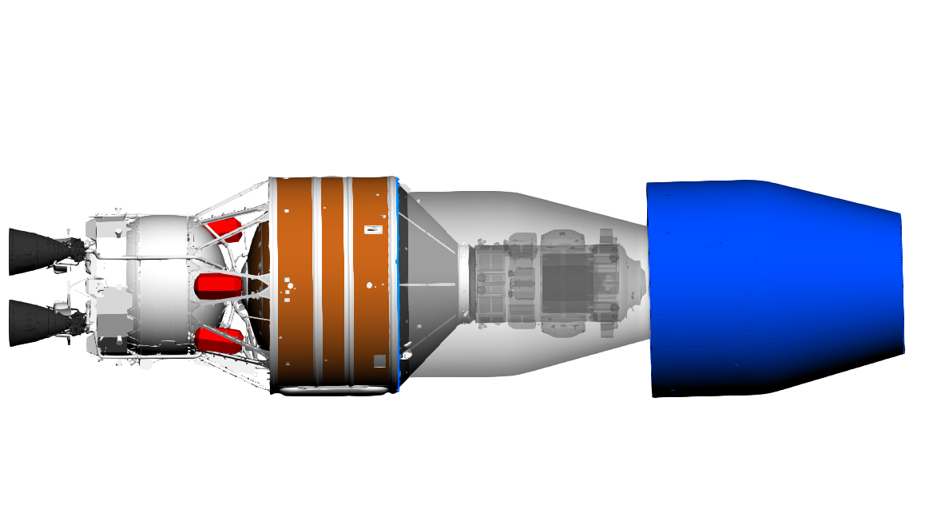
USA Separation Event
Non-Separable Portion of USA
Separable Portion of USA
USA Separation Concept of Operations
PLA
USA+SA
EUS
CPL KIZ
Lunar I-Hab
Separable portion of USA is a shell that surrounds the CPL (Lunar I-Hab shown).
CPL Keep-In-Zone (CPL KIZ) is a volume the USA must maintain positive clearance to.
Spring-based separation system pushes USA away from EUS.
(1) MPCV Separates
(2) USA Separates
(3) MPCV Docks

Slide 5
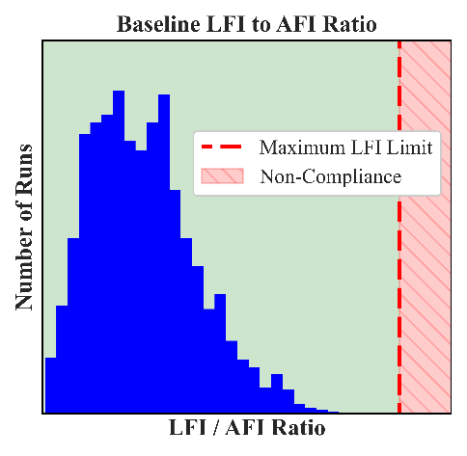
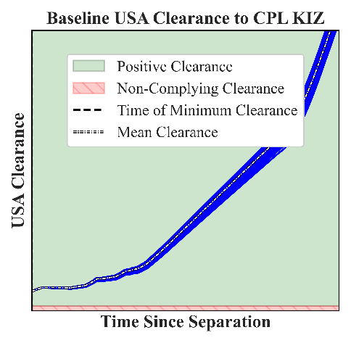
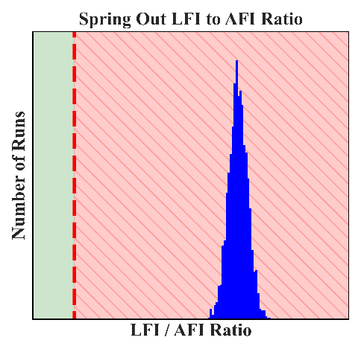
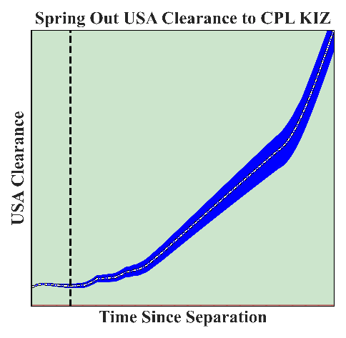
Requirements and Analysis Results
Requirement | Description
Requirement 1 | Envelope around allowable axial force impulse and lateral moment impulse.
Requirement 2 | A maximum limit for lateral force impulse fraction of axial force impulse.
Requirement 3 | A maximum equivalent moment arm limit for roll moment impulse.
Requirement 2 Results
Clearance Results
Three requirements protect for clearance for two simulation scenarios: baseline and single spring out.
Baseline scenario (top plots) passes all three requirements.
Single spring out scenario (bottom plots) doesn’t meet Requirement 2 but shows positive clearance with good clearance margin.
This led to reevaluating the need for Requirement 2.
Non-compliance
Positive Margin

Slide 6
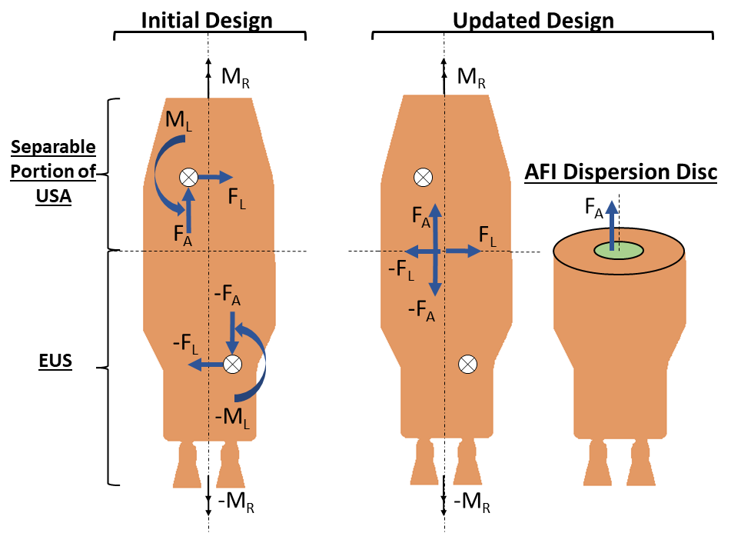
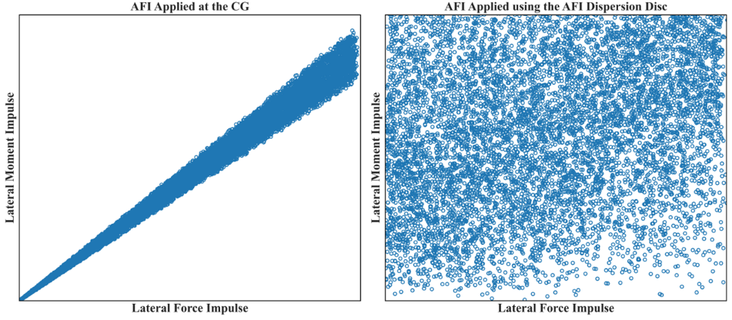
Requirements Simulation Rework
Updated design of the requirements simulation.
F_{A} moved from CG to the separation plane.
Dispersed within disc in separation plane centered on the vehicle centerline.
F_{L} moved from CG to the separation plane.
M_{L} removed.
No longer applying non-physical M_{L} equally-and-opposite to the 2 bodies.
AFI Dispersion Disc required to decouple resulting Lateral Moment Impulse from Lateral Force Impulse (shown on bottom plots).
F_{L} applied at the separation plane and F_{A} applied at the CG created a strong correlation between LFI and LMI.
AFI Dispersion Disc eliminates the coupling.
Tight Coupling Between LMI and LFI
Tight LMI-LFI Coupling Eliminated
Notes:
Maybe remove extra bit about AFI Dispersion Disc. Just leave last thought from this slide as: “requirements sim was updated to remove un-physicality, which is good. Now we move on to results.”

Slide 7
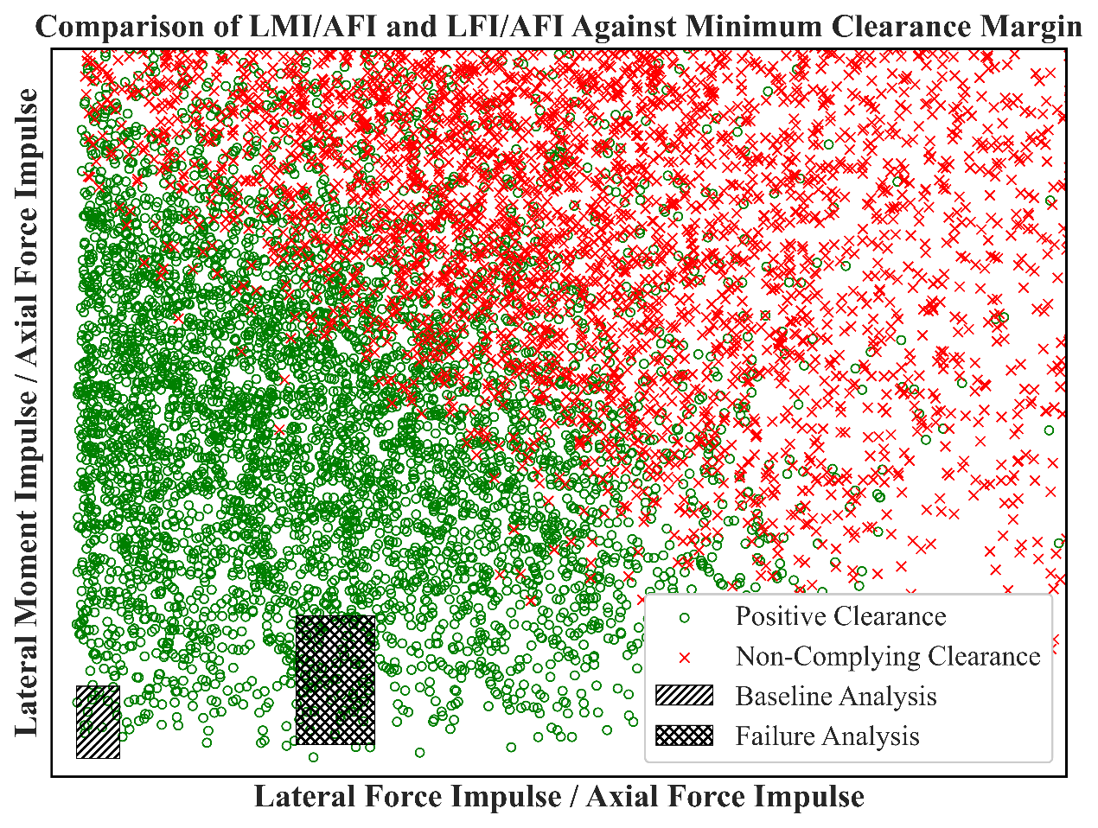
Requirement 2 Removal
Plot Description: Updated requirements simulation results are shown with the baseline and single spring out scenario results superimposed.
Takeaway: Baseline and single spring out scenarios show large positive clearance margin.
Resulting Action: The decision was made to remove Requirement 2 largely based on the clearance margin shown in the plot.
Baseline and Single Spring Out Both Show Good Margin
Notes:
CLVTOPS Toolchain Hierarchy image from: Burger, B., Addona, C., McDonough P., Muscha Z., et al., "Space Launch System Liftoff and Separation Dynamics Analysis Tool Chain." AIAA Scitech Forum, 2021.

Slide 8
Questions?
Contact info: zachary.t.muscha@nasa.gov
Marshall Space Flight Center Capabilities - NASA
Do Business with Marshall - NASA

