Slide 1
Post-Flight EDL Entry Guidance for the Mars 2020 Mission
“Perseverance will get you anywhere”
Lynn McGrew
Brian Killeen
Gavin Mendeck
NASA Johnson Space Center
2025 AAS/AIAA Space Flight Mechanics AAS 25-xxx

Slide 2
Introduction
Apollo Entry Final Phase algorithm was used on the Mars Science Laboratory (Curiosity Rover) Mission in August 2012
  Successful 1st use of Mars guided entry: Landed 2.2 km from target (19 km x 7 km touchdown ellipse)
Mars 2020 (Perseverance Rover) Mission sought to again utilize this algorithm and improve upon its performance
  Successful Landing in February 2021
  Landed 1.7 km from landing target (~1-sigma) (~6 km x 7 km touchdown ellipse)
      @Chute Deploy: ~625 m Downrange x ~350 m Crossrange
      @Touchdown: ~1.3 km Downrange x ~1.1 km Crossrange

Slide 3




Guidance Phases in Flight
Event Description & Nominal State
Phase
Guidance Actions
Attitude hold at a ground-commanded bank angle until Range Control Phase starts
Maneuver to Attitude Hold After Cruise Stage Separation
Pre-Bank
Prior to EI-9 min
Entry Interface Occurs
radius = 3522.2 km
E+0 sec, h=128 km, range=608 km, inertial vel=5554 m/s, inertial FPA=-15.48 deg
Begin Range Control Phase
Command bank angle magnitude to minimize predicted downrange error at deployment
Command bank reversals to manage crossrange error
Filtered drag acceleration ≥ 0.2g
E+51 sec, h=59 km, range=354 km, M=27, relative vel=5354 m/s
Range Control
(Start of
Guided
Entry)
Peak Heating Occurs
E+68 sec, h=35 km, range=250 km, M=24, v=4986 m/s, load=5g
Peak Loading Occurs
E+86 sec, h=22 km, range=182 km, M=17, v=3759 m/s, load =10.7g
Heading
Alignment
Command bank angle to minimize residual crossrange & maximize deploy altitude
Begin Heading Alignment Phase
v = 1100 m/s
E+140 sec, h=14 km, range=75 km, M=4.7, load=1.7g
Chute
Sequence
(End of
Guided
Entry)
Initiate sequence on velocity or range trigger to prepare for chute deploy
Initiate Chute Deploy Sequence
range = 16 km (@ SUFR), = 8.4 km (@ PD)
E+241 sec, h=9.6 km, v=429 m/s, M=1.77

Slide 4
Nav Delivery Uncertainties: Entry-5 days to EDL
+ Crosstrack
3 Trajectory Maneuvers Complete in December 2020. Record Nav precision for Mars lander!
1st EDL parameter update E-5d
  Req’d to upload/initialize parameters
Next EDL parameter update E-1d
  Nav position error just outside of 300m criteria
Steeper FPA
EFPA -15.48 deg
Crosstrack Error ~3 km

Slide 5
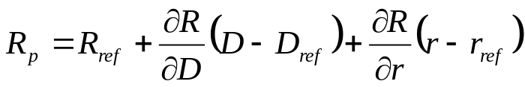
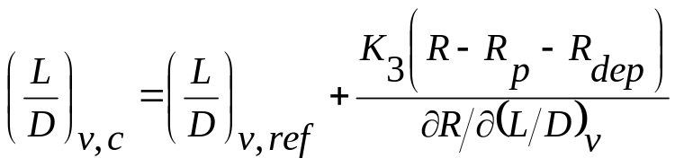
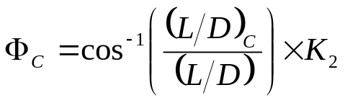

Guidance Algorithm Overview
Achieve safe deploy conditions of altitude, Mach, and dynamic pressure while minimizing the deploy range error
Varies the bank angle to control downrange based on deviations in range, estimated altitude rate, and filtered drag acceleration from a stored reference trajectory
Steers a trajectory that should have nearly the same terminal deploy point in dispersed conditions, but does not follow the reference trajectory
Influences deploy altitude through shaping of a reference trajectory and entry flight path angle but does not directly control altitude
R Range to Target
R_{p} Range, predicted
R_{ref} Range, reference
R_{dep} Range, deploy bias
D Drag
D_{ref} Drag, reference
L Lift
r Altitude Rate
r_{ref} Altitude Rate, ref
K₃ L/D Range over-control gain
K₂ Bank left/right control
K₄ Azimuth over-control gain
Predicted Range-To-Go:
•
•
•
Vertical L/D Required to Converge Range to Target:
Resulting Commanded
Bank Angle:
$$ΦC= \tan^{−1}{\frac{Crossrange}{Downrange}}$$
Heading Alignment Commanded
Bank Angle:
x K₄

Slide 6
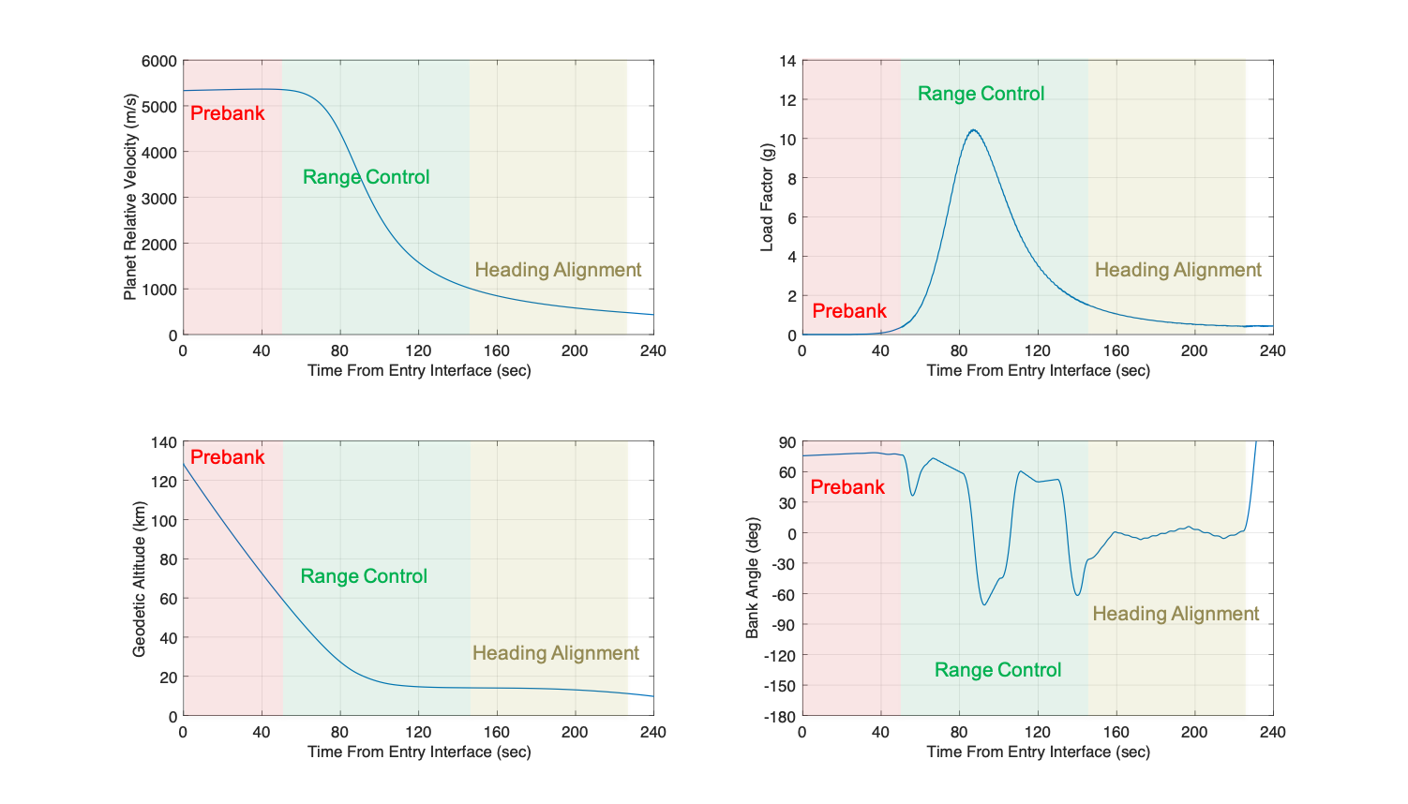
As-Flown Entry Trajectory

Slide 7
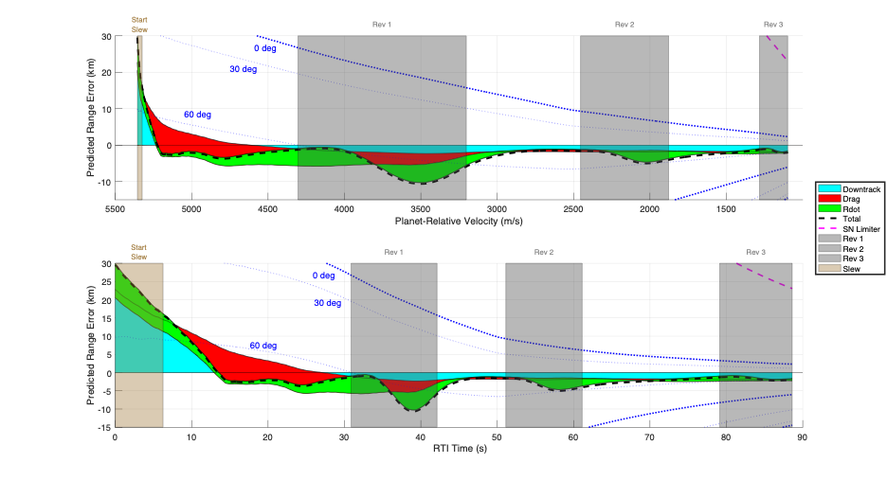
As-Flown Guidance Range Error Components
Total Range Error
Downrange partial
Drag partial
Alt Rate partial
Landing
Short
Landing
Long
Landing
Short
Landing
Long

Slide 8
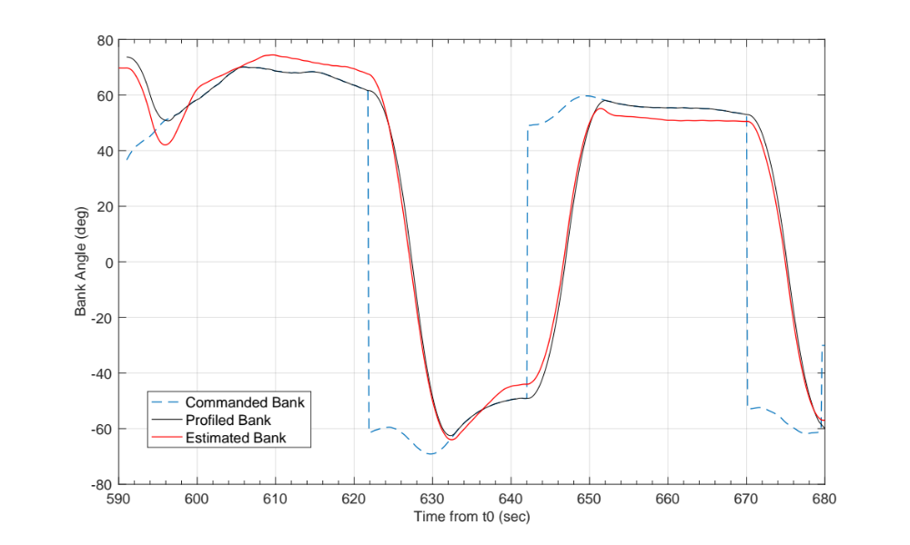
Bank Command/Response
PreBankSlew
Rev 1
Rev 2
Rev 3
11.25 sec
10 sec
9.5 sec
Peak-g’s

Slide 9
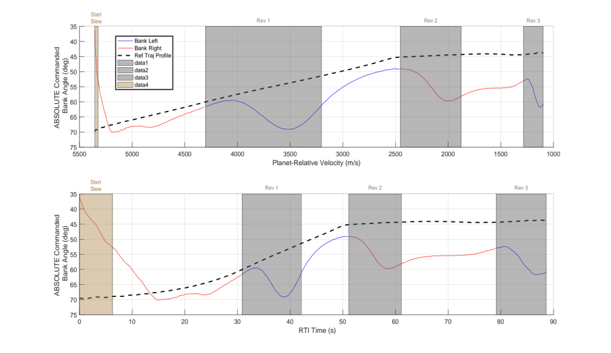
Prebank Error
Prebank Command = 36.2 deg (from telemetry)
  Prebank command on-board parameter = 73.7 deg
  Prebank Error → 37.5 deg (~4-sigma)
Density at given altitude was higher than expected / modeled
Guidance start occurred at a higher density, altitude and at a lower velocity
Bank Right
Bank Left
- - Reference Profile

Slide 10
Summary and Future Studies
February 18, 2021 14:55 CT – Tango Delta Nominal - Successful landing!
Received 1 off-nominal tone during EDL: “Range Control Off Nom 4”
  The commanded pre-bank angle differed from the first commanded bank angle by > 30 deg. Very small impact (mostly additional prop used)
  Guidance start occurred 4 seconds earlier than expected
Observed lower peak-g’s than anticipated (10.7 g’s in-flight vs 11.3 g’s simulation)
  Due to guidance early start, atmosphere modeling, or combo
Started all 3 bank reversals, did not quite finish the 3rd reversal prior to Heading Alignment start
  3rd rev duration = 9.5 sec; 50%ile = 9.75 sec in sim
Current and Future studies involve better atmosphere modeling techniques to help predict guidance response, as well as alternative guidance triggers to reduce landing ellipse size and improve landing accuracy.
  These are being actively worked into the design for the Mars Sample Return Lander Mission

