Slide 1
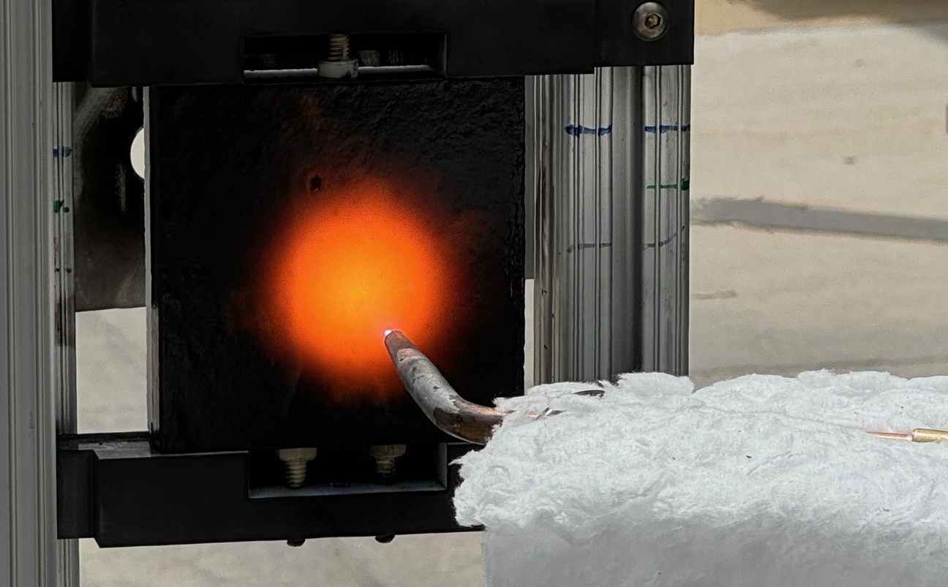

Canopy Aerospace Thermal Protection Systems
Image and/or Video
KEY ATTRIBUTES / COMPETENCY
Reusable thermal protection systems like that used on the Space Shuttle are in high demand throughout private aerospace where spacecraft and rocket reusability is sought.
Ames is supporting tech transfer of the Shuttle tiles and coatings (AETB/TUFI/RCG system) for Canopy to offer to the community.
In parallel, Canopy are developing lower cost systems that target similar capability through both raw material changes and manufacturing efficiencies.
The Canopy-produced heatshield materials will be tested in the Ames arc jets under Earth-reentry-like conditions to support qualification of these materials for flight.
TECHNICAL / SCIENTIFIC CHALLENGE ADDRESSED
Canopy Aerospace is working with NASA Ames to tech transfer Space Shuttle Orbiter thermal protection system technology so that they can offer it to the large customer base seeking heritage reusable heatshield materials for their space vehicles.
HERITAGE: SPACE SHUTTLE ORBITER
Alumina Enhanced Thermal Barrier (AETB) tiles
Toughened Unipiece Fibrous Insulation (TUFI) densification
Reaction Cured Glass (RCG) emissivity coating
SUMMARY
Canopy are onboarding the ceramic Shuttle tile material (AETB) and high emissivity black glass coating (RCG) thermal protection systems that are in high demand.
Canopy are also innovating with lower cost approaches to making similar materials, and both systems will be tested in the Ames arc jets to increase maturity and confidence in the Canopy-made materials.
APPLICATIONS BEYOND
Reusable thermal protection systems
High temperature ceramic insulation
Jay Feldman & David Hash, NASA Ames Research Center

