Slide 1
ISRU Overview for SPIE PW 2025
Desmond O’Connor
desmond.oconnor@nasa.gov
NASA Johnson Space Center
SPIE PW 2025

Slide 2
ISRU
What
Definition
Scope
Why
Launch costs
Sustainability
Where
Moon/Mars
How
Resources
Technologies
Involvement

Slide 3
What is ISRU?
In-Situ Resource Utilization
Making Something from said material
Where you are
A useful material
“Using what you have to make what you need”
Notes:
By definition:
In-Situ:
Where you are
Resource:
A useful material
Utilization:
Making something out of said materials
Using what you have where you are to make what you need.

Slide 4
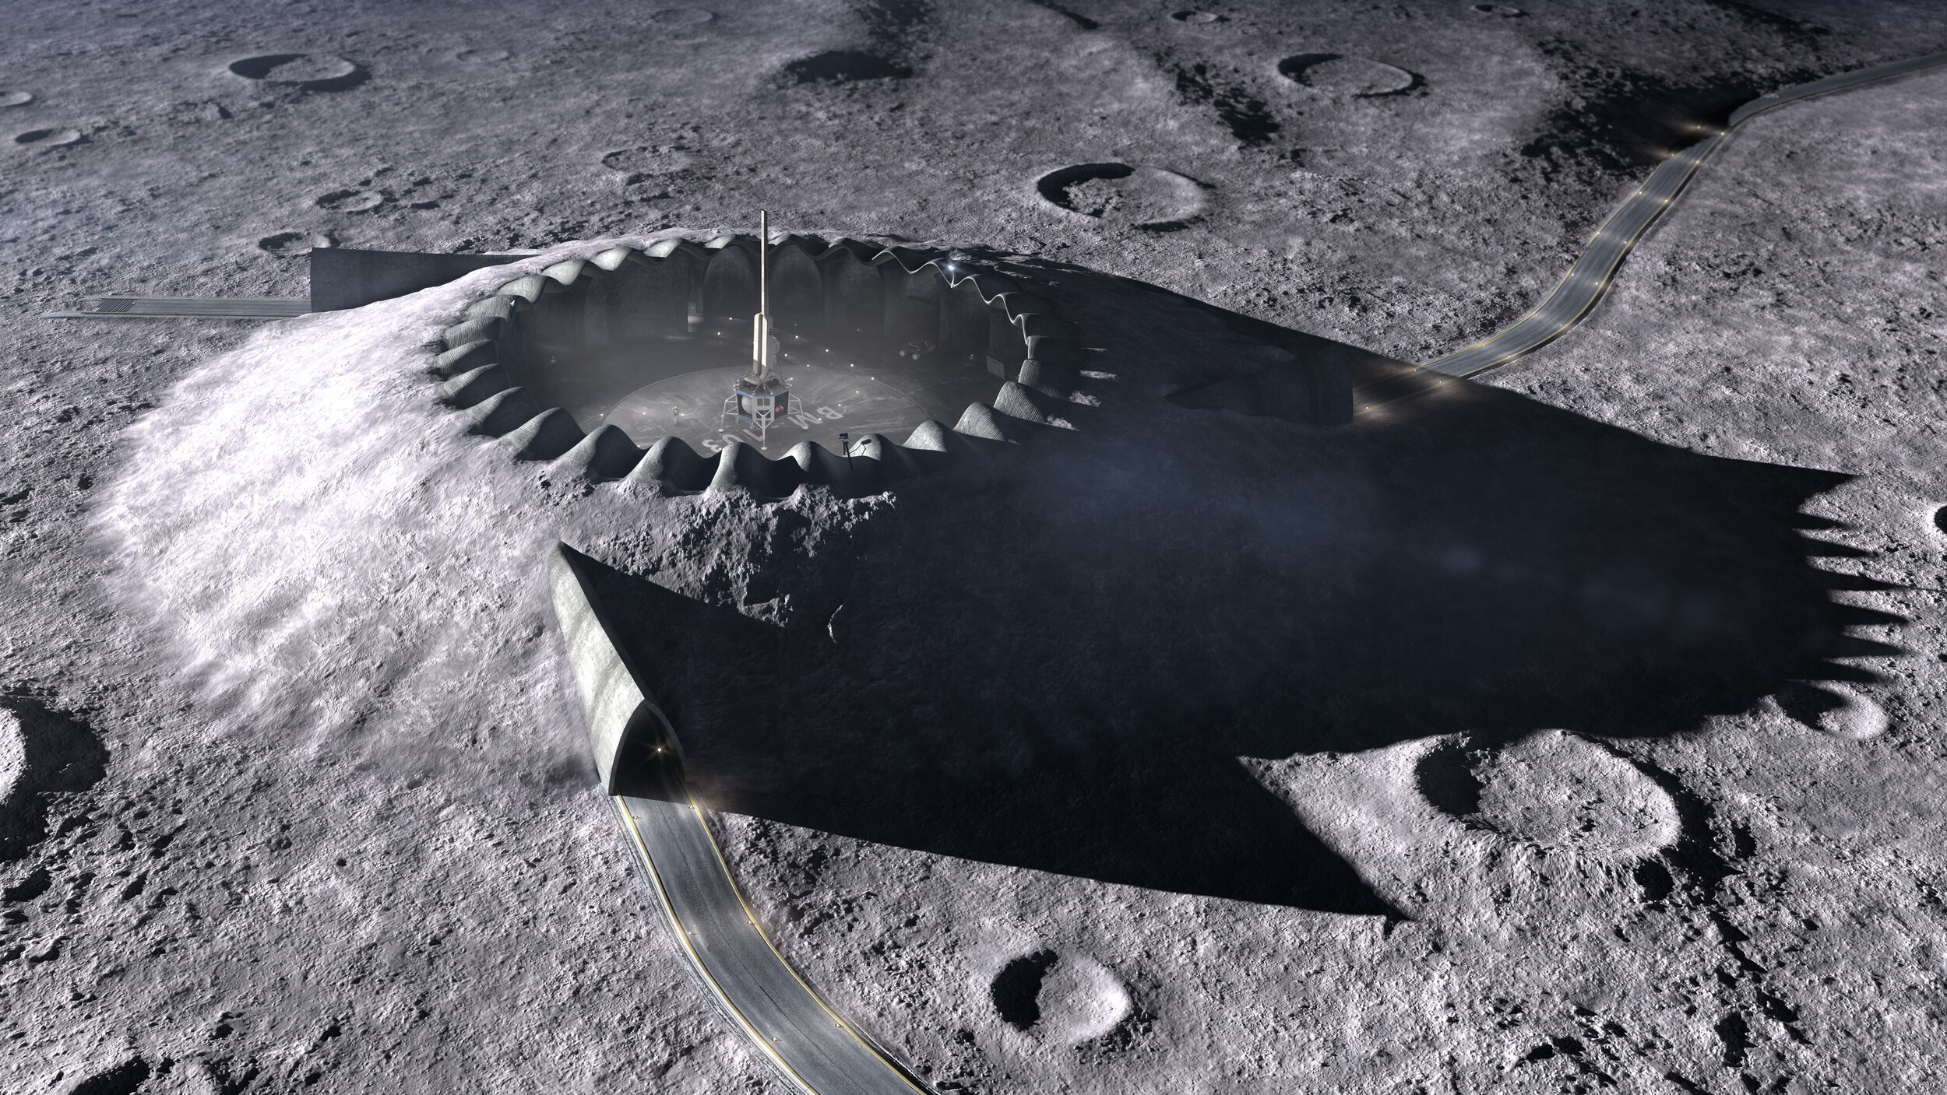
Scope
What does NASA want to do?
NASA’s Focus:
  Short term:
    Consumables (H2/O2/CH4/Water)
    Using regolith directly (berms/shielding/roads)
  Long term:
    Refining metals
    Manufacturing
https://www.melodieyashar.com/#/lunar-landing-pad/

Slide 5
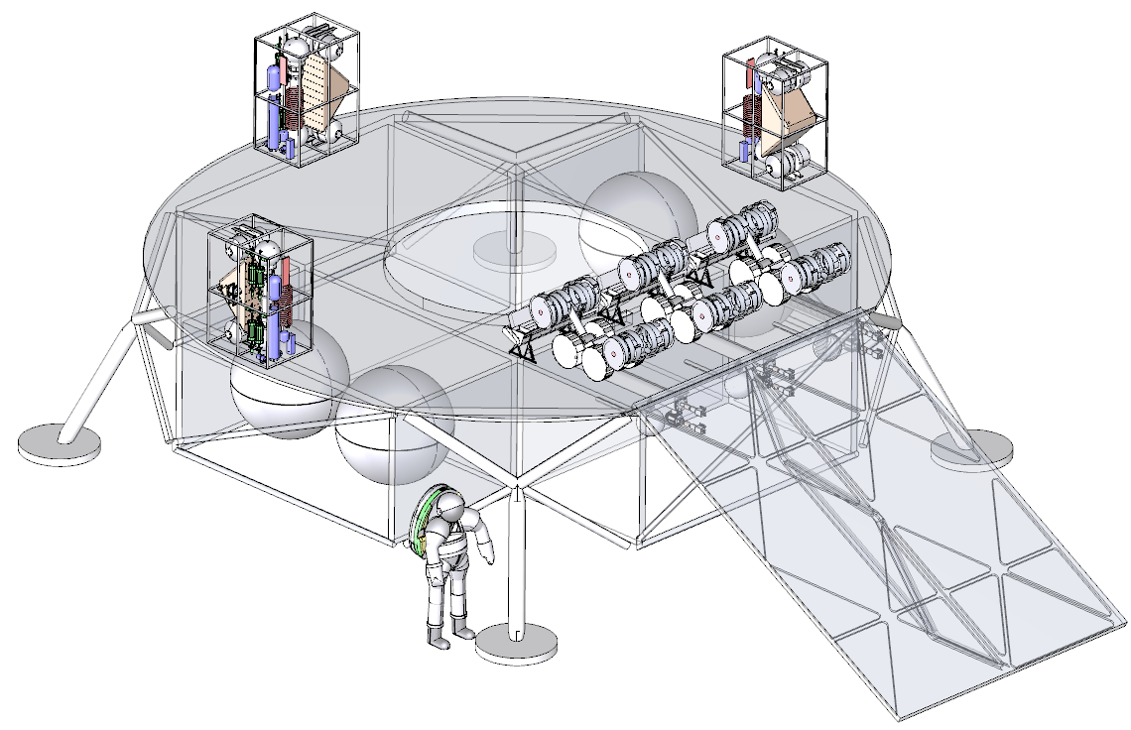
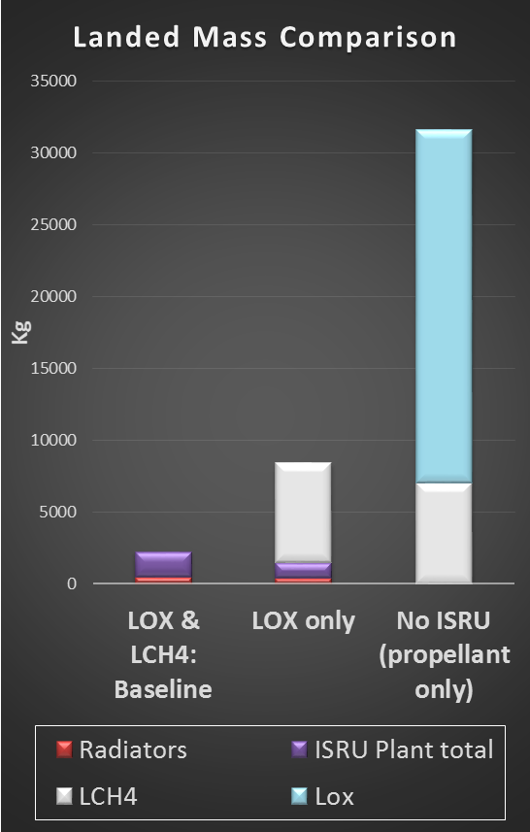
Why pursue ISRU?
CO₂
LOX
LCH₄
H₂O
ISRU Propellant Production Plant
An Oxygen-only propellant production plant on Mars could make ~3 times its own mass in oxygen in 480 days
An LOX/LCH4 propellant production plant on Mars could make ~ 18 times its own mass in propellant in 480 days
Kleinhenz, J. E., & Paz, A. (2017). An ISRU propellant production system for a fully fueled Mars Ascent Vehicle. In 10th Symposium on Space Resource Utilization (p. 0423).
Notes:
Terrestrial propellant alone (Lox and Methane propellant mass, not including additional tankage) is
18x the mass of a Lox/LCH₄ ISRU landed mass
4x the mass of a LOX ISRU landed mass
10-20 tons of propellant per ton landed on Mars

Slide 6
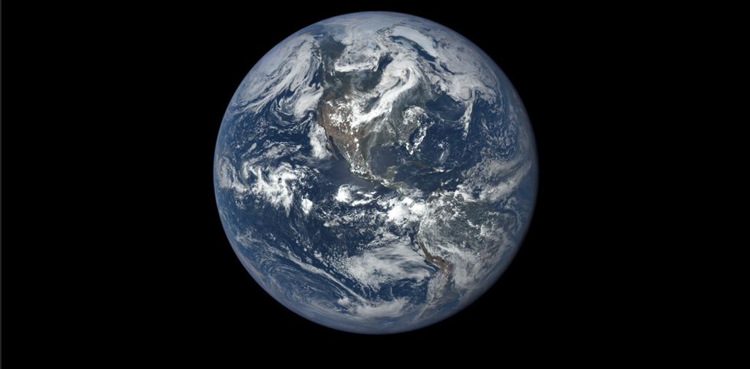
ISRU Technology Impact on Earth
Water electrolysis can be used to produce hydrogen at a large scale
Hydrogen reduction of iron oxides is being used to make steel with no carbon emissions
Solar-carbothermal reduction and molten regolith electrolysis can be used to produce silicon with no carbon emissions
Sabatier process can convert carbon dioxide and hydrogen into methane
Carbon dioxide and water can be used to make plastics
Image Credit: NASA

Slide 7
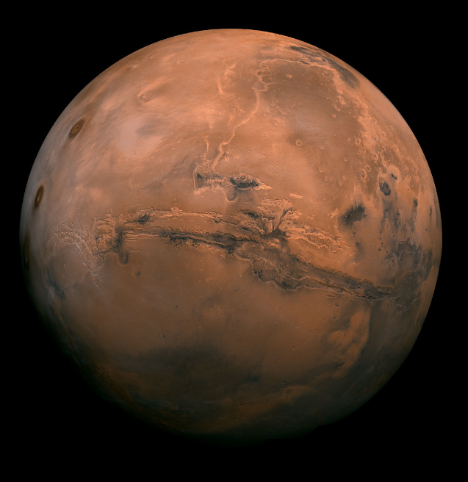
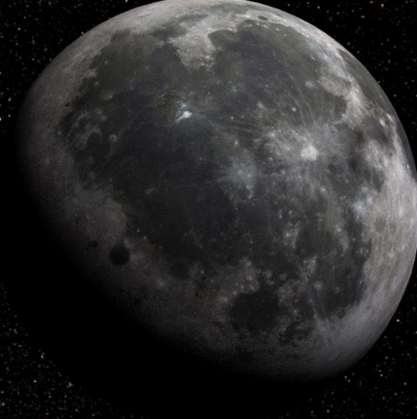
In-Situ Resource Utilization
The Moon
Oxygen – Lunar regolith is ~45% oxygen
Water Ice- Located at the poles
Metals – Iron, Aluminum, Titanium, Magnesium
Metalloids – Silicon
Regolith – Can be used as a construction material
Solar Wind Volatiles – Helium 3 can be used for nuclear fusion
Abundant solar energy
Mars
Oxygen – Can be extracted from CO₂ atmosphere
Water in Regolith – Anywhere on the surface
Water Ice – Under the surface in some locations
Metals – Iron, Aluminum, Titanium, Magnesium
Metalloids - Silicon
Regolith – Can be used as a construction material
Image Credit: NASA
Notes:
Analysis of Luna 24 samples showed the samples contained ~0.1% water by mass
Clementine indicated the presence of water ice at the poles based on the response of radar interactions with the surface
Lunar Prospector detected hydrogen using a neutron spectrometer and estimated the content of water ice to be 300 million metric tons
Chandrayaan-1 puts the estimate at 600 million metric tons
In 2008, an analysis of Apollo samples indicated the presence of water, with some debate over whether is was terrestrial contamination
LCROSS provided definitive proof of water in cabeus crater

Slide 8
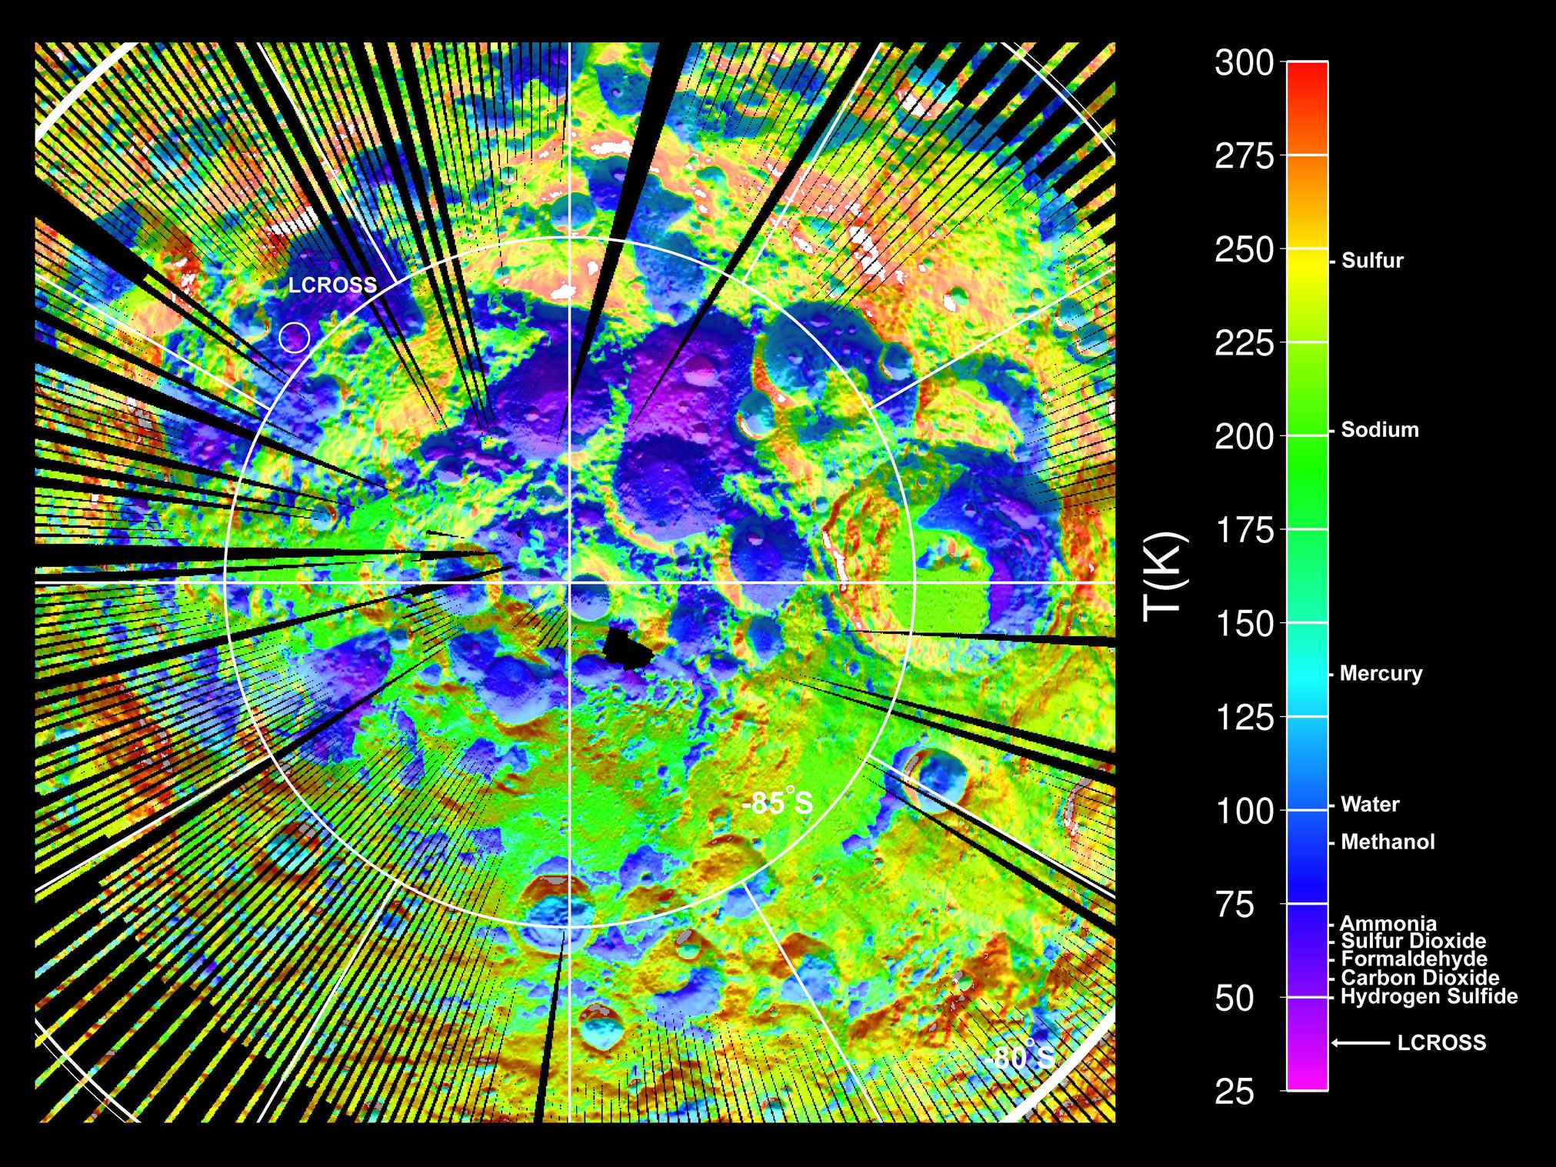
Water on the Moon
1994 : Clementine indicated the presence of water ice at the poles based on the response of radar interactions with the surface
1998: Lunar Prospector detected hydrogen using a neutron spectrometer and estimated the content of water ice to be 300 million metric tons
2008: Chandrayaan-1 puts the estimate at 600 million metric tons (240,000 Olympic swimming pools)
2009: LRO/LCROSS provided definitive proof of water ice in Cabeus crater
Image Credit: NASA/GSFC
Image Credit: UCLA/NASA/JPL/GSFC
Notes:
Analysis of Luna 24 samples showed the samples contained ~0.1% water by mass
Clementine indicated the presence of water ice at the poles based on the response of radar interactions with the surface
Lunar Prospector detected hydrogen using a neutron spectrometer and estimated the content of water ice to be 300 million metric tons
Chandrayaan-1 puts the estimate at 600 million metric tons
In 2008, an analysis of Apollo samples indicated the presence of water, with some debate over whether is was terrestrial contamination
LCROSS provided definitive proof of water in cabeus crater

Slide 9
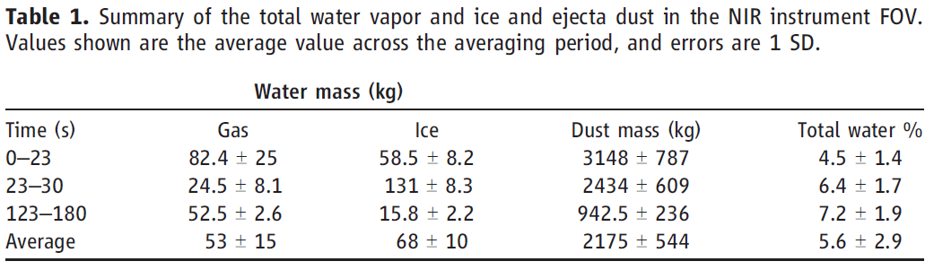
LRO/LCROSS
Lunar Reconnaissance Orbiter (LRO)
  Launched June 18, 2009
  Still active
Lunar Crater Observation and Sensing Satellite (LCROSS)
  Launched June 18, 2009
  Centaur crashed into the surface of Cabeus crater at 11:31 UT October 9th, 2009
  LCROSS crashed into the surface 4 minutes later after analyzing the impact plume
  LRO analyzed plume from orbit
Colaprete, A., Schultz, P., Heldmann, J., Wooden, D., Shirley, M., Ennico, K., ... & Sollitt, L. (2010). Detection of water in the LCROSS ejecta plume. science, 330(6003), 463-468.

Slide 10
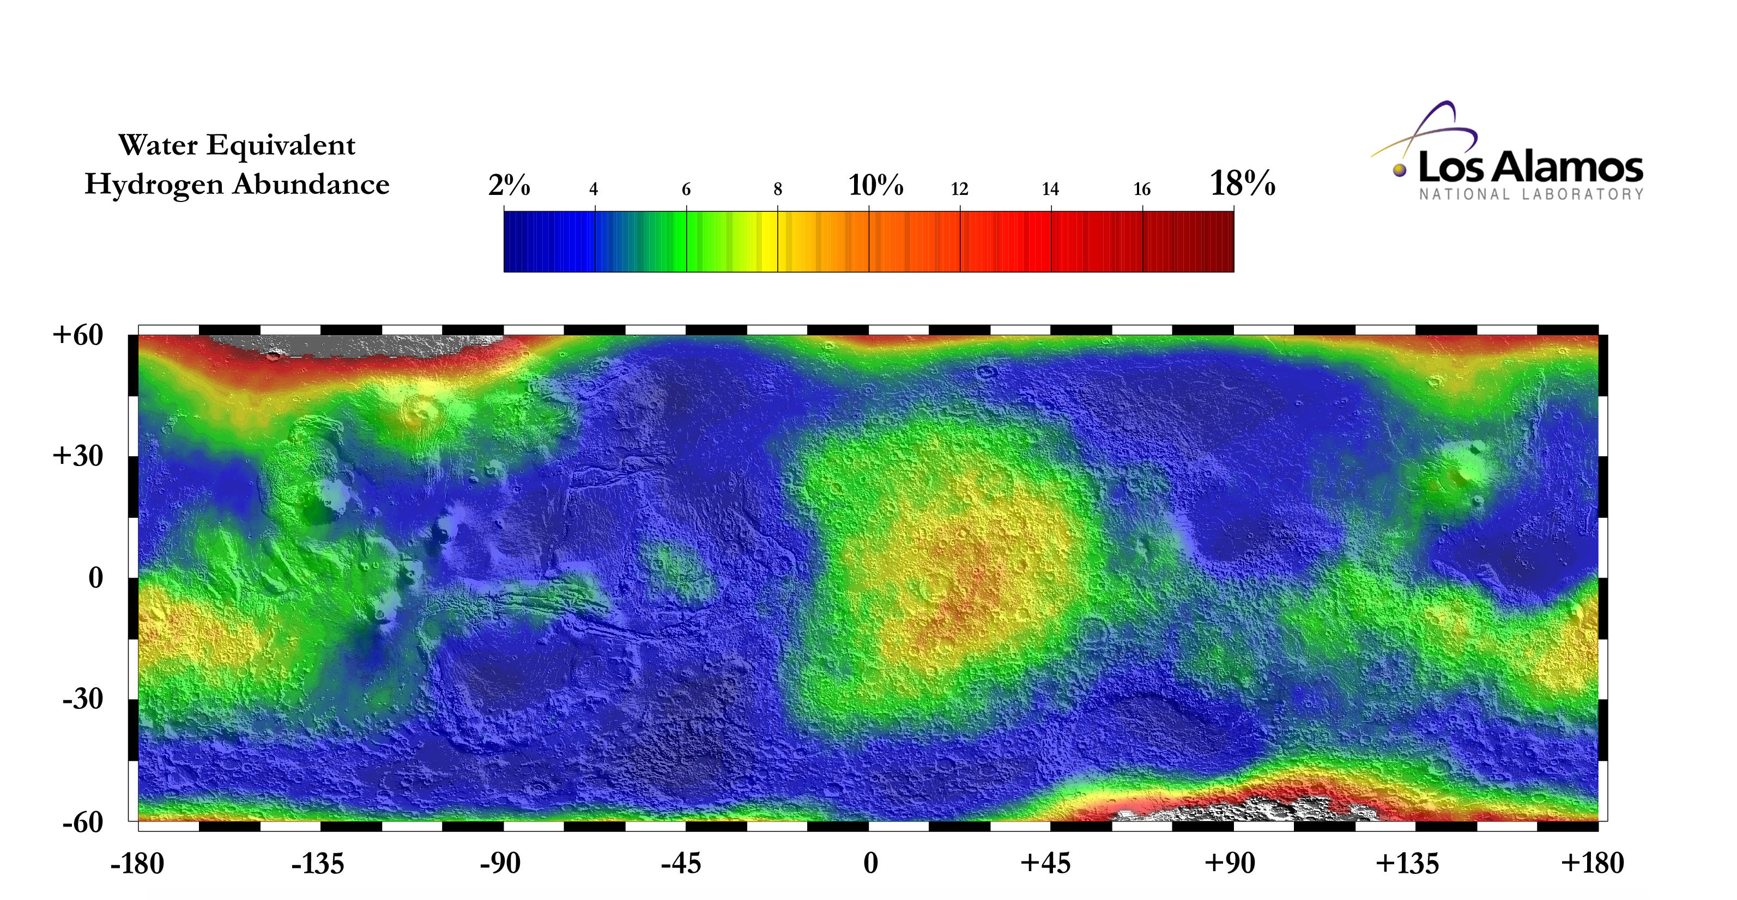
Water on Mars
Image Credit: NASA/JPL-Caltech
Notes:
Overlay of water equivalent hydrogen abundances and a shade relief map derived from MOLA topography. Mass percents of water were determined from epithermal neutron counting rates using the Neutron Spectrometer aboard Mars Odyssey between February 2002 and April 2003.
Image Source: https://mars.jpl.nasa.gov/odyssey/gallery/latestimages/20030724a.html

Slide 11
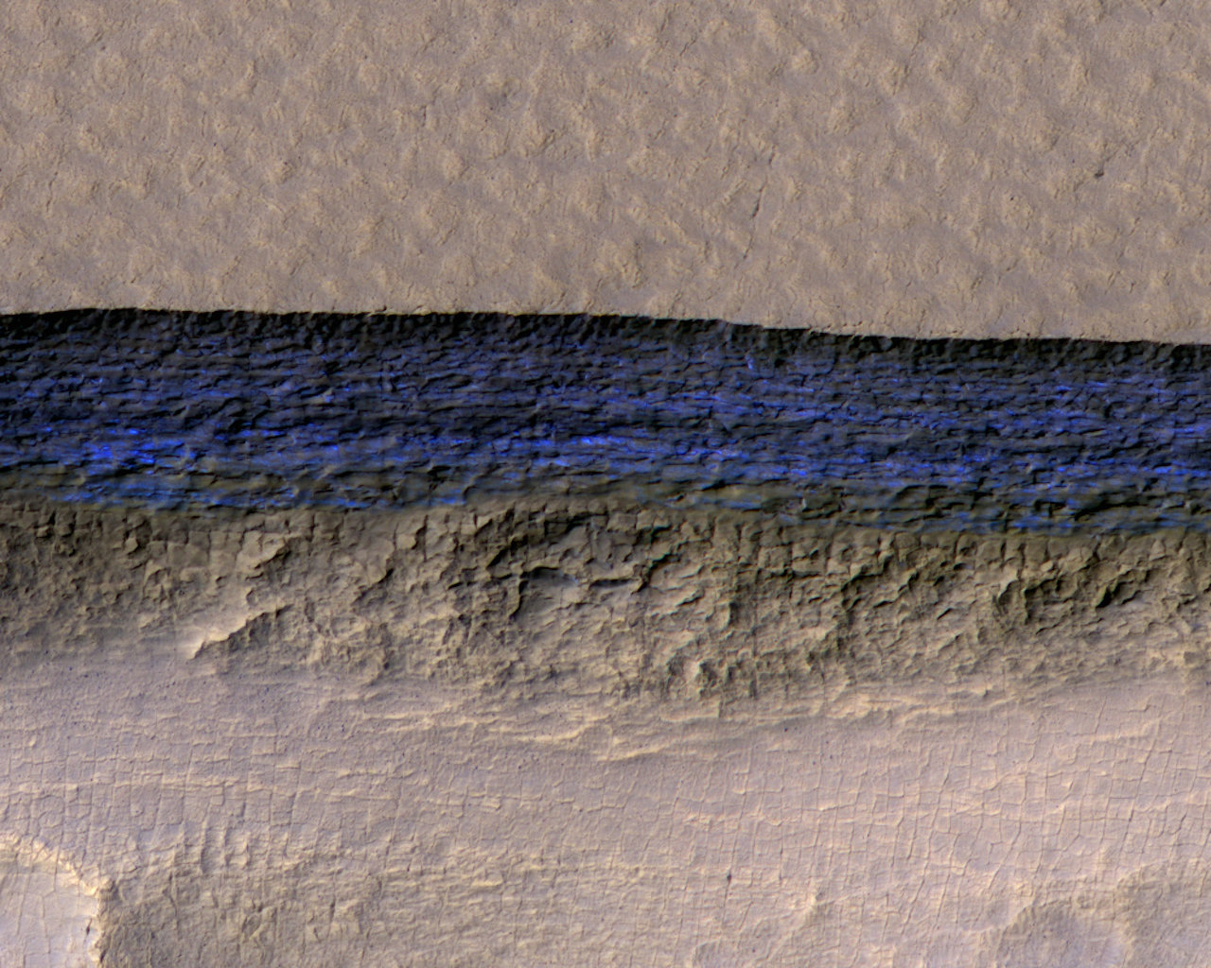
Water on Mars
Image Credit: NASA/JPL-Caltech/UA/USGS
A cross-section of underground ice is exposed at the steep slope that appears bright blue in this enhanced-color view from the HiRISE camera on NASA's Mars Reconnaissance Orbiter. The scene is about 550 yards wide. The scarp drops about 140 yards from the level ground in the upper third of the image.

Slide 12
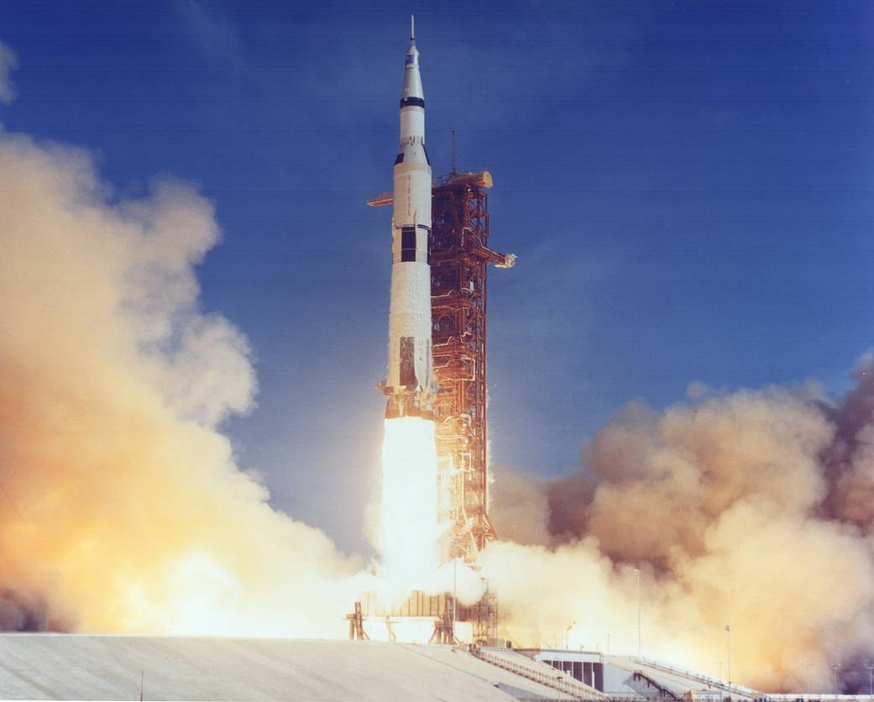
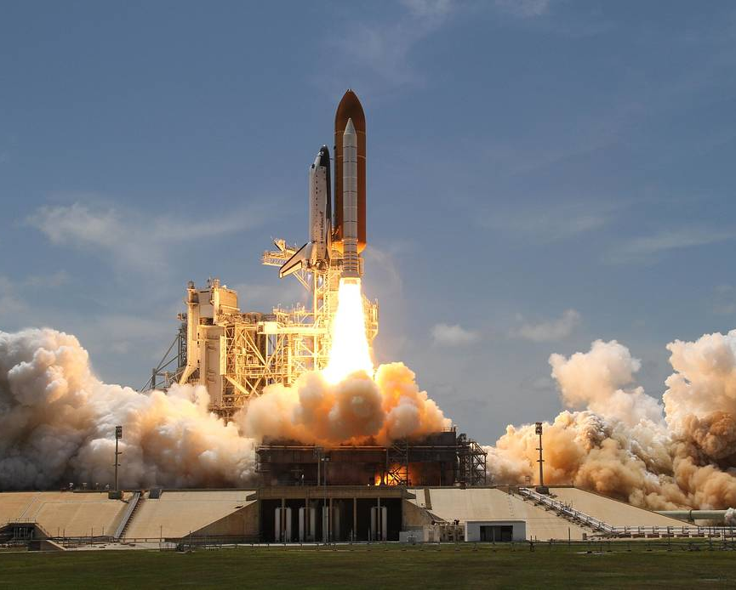
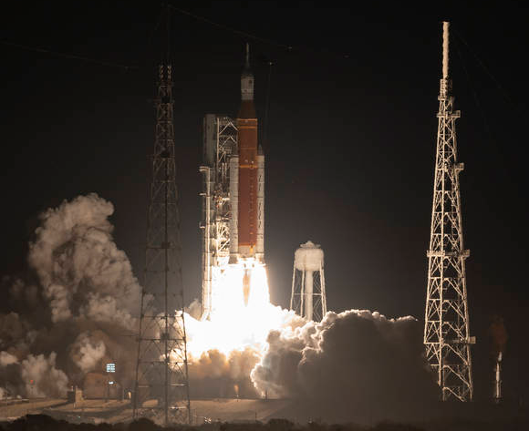
Water on the Moon
Water electrolysis can be used to convert water into hydrogen and oxygen using an electric current from a solar panel or other source of power
2H₂0
2H₂ + O₂
Oxygen gas can be used for breathing
Oxygen and hydrogen gas can be used to run a fuel cell
Liquid hydrogen and liquid oxygen can be used as rocket propellant
Saturn V , Space Shuttle , and SLS all use LOX/LH2 propellant
Image Credit: NASA

Slide 13
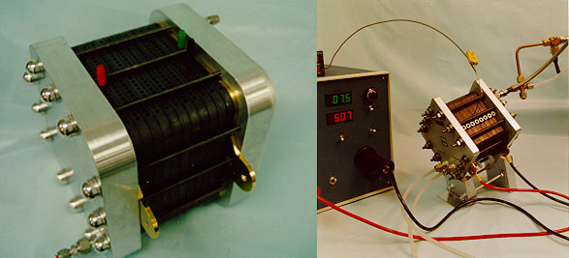
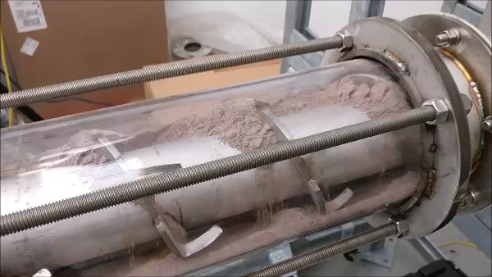

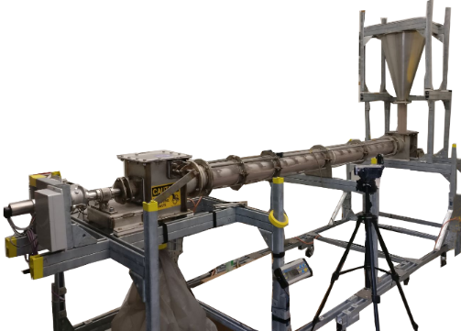
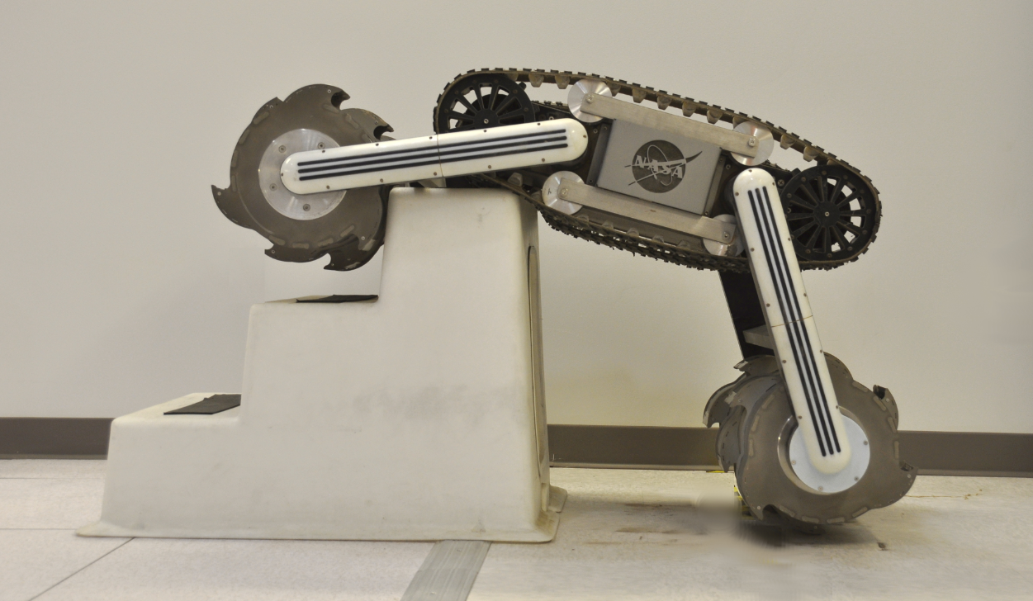
Lunar Water Utilization
Excavation
10 Tonnes (10,000kg) of oxygen per year is considered a full-scale production rate
Extraction
Water will need to be extracted from the regolith for processing
Heating the regolith will cause water to sublimate, so it must be done in a controlled fashion
Purification
Volatile contaminants (CO, H₂, H₂S, NH₃, SO₂, CH₃OH, CH₄, CO₂) and particulate must be removed and conductivity reduced for PEM electrolysis
Electrolysis
Different system can be used for electrolysis including PEM, SOE, or Alkaline stacks.
Liquefaction/Storage
Propellants need to be liquefied for storage and use.
Assuming 5% water ice, with an excavation depth of 5 cm, it would take ~67% of the area of a football pitch to produce 15 Tonnes of water
HYDROGEN LIQUEFACTION
Oxygen Mass | 10 | tonnes
LOX/Fuel Ratio | 6
H2 Mass Required | 1.67 | tonnes
Mass of 20W/20K crycooler | 106.3 | kg
Fuel Liquefaction Thermal Lift Required | 429 | W
Number of Cryocoolers Required | 22
Mass of Cryocoolers & Radiators | 2.34 | tonnes
Return on Landed Mass in 1 year | 0.71
Conductivity | Resistivity
0.056 | 18
0.063 | 16
0.071 | 14
0.083 | 12
0.100 | 10
0.133 | 7.5
0.200 | 5
0.500 | 2
1.000 | 1
1.333 | 0.75
2.000 | 0.5
4.000 | 0.25
10.000 | 0.1
20.000 | 0.05
40.000 | 0.25
100.000 | 0.01
200.000 | 0.005
500.000 | 0.002
1000.000 | 0.001
2000.000 | 0.0005
5000.000 | 0.0002
10000.000 | 0.0001
5% and 5cm deep
-
+
H₂
Solid Oxide
O₂
LADI
Cathode
Anode
H₂O
RASSOR
Notes:
Excavation
10 Tonnes (10,000kg) of oxygen per year is considered a full-scale production rate until more information becomes available on lunar landers
10 Tonnes of oxygen per year requires 15 Tonnes of water
Assuming 5% water ice, with a density of 1.25 g/cc and an excavation depth of 5 cm, it would take ~67% of the area of a football pitch to produce 15 Tonnes of water
Extraction
Water will need to be extracted from the regolith for processing
Heating the regolith will cause water to sublimate, so it must be done in a controlled fashion
This is an auger-dryer system developed at JSC for continuous water extraction from regolith
The auger geometry uses regolith at the inlet and outlet to create a plug, preventing water vapor from escaping during processing
Purification
Tap water has conductivity of 100-200 microsiemens/cm^2, PEM electrolyzers require high grade DI water (<0.1 cond)
Lunar water will also include volatiles and other contaminants (namely mercury and ammonia) that must be removed to prevent damage to electrolyzer stacks
Freeze distillation can be used to separate water from most volatiles
Electrolysis
Water must be split into H2/O2 for use a propellant or reactant
Most used technologies are Proton Exchange Membrane (PEM) or Solid Oxide Electrode (SOE)
Both have flight heritage
The O2 generator on ISS is PEM
MOXIE on the Perseverance rover
SOE operates at high temperatures, does not require deionized feed water, provides dry low pressure O2
PEM requires lower temperatures, needs very pure feed water, can provide high pressure O2
Liquefaction
One of the biggest challenges with using water to make propellant is hydrogen liquefaction. Using the current state-of-the-art liquefaction technology, it would take 2.34 Tonnes worth of liquefaction hardware to produce 1.67 Tonnes worth of liquid hydrogen per year.

Slide 14
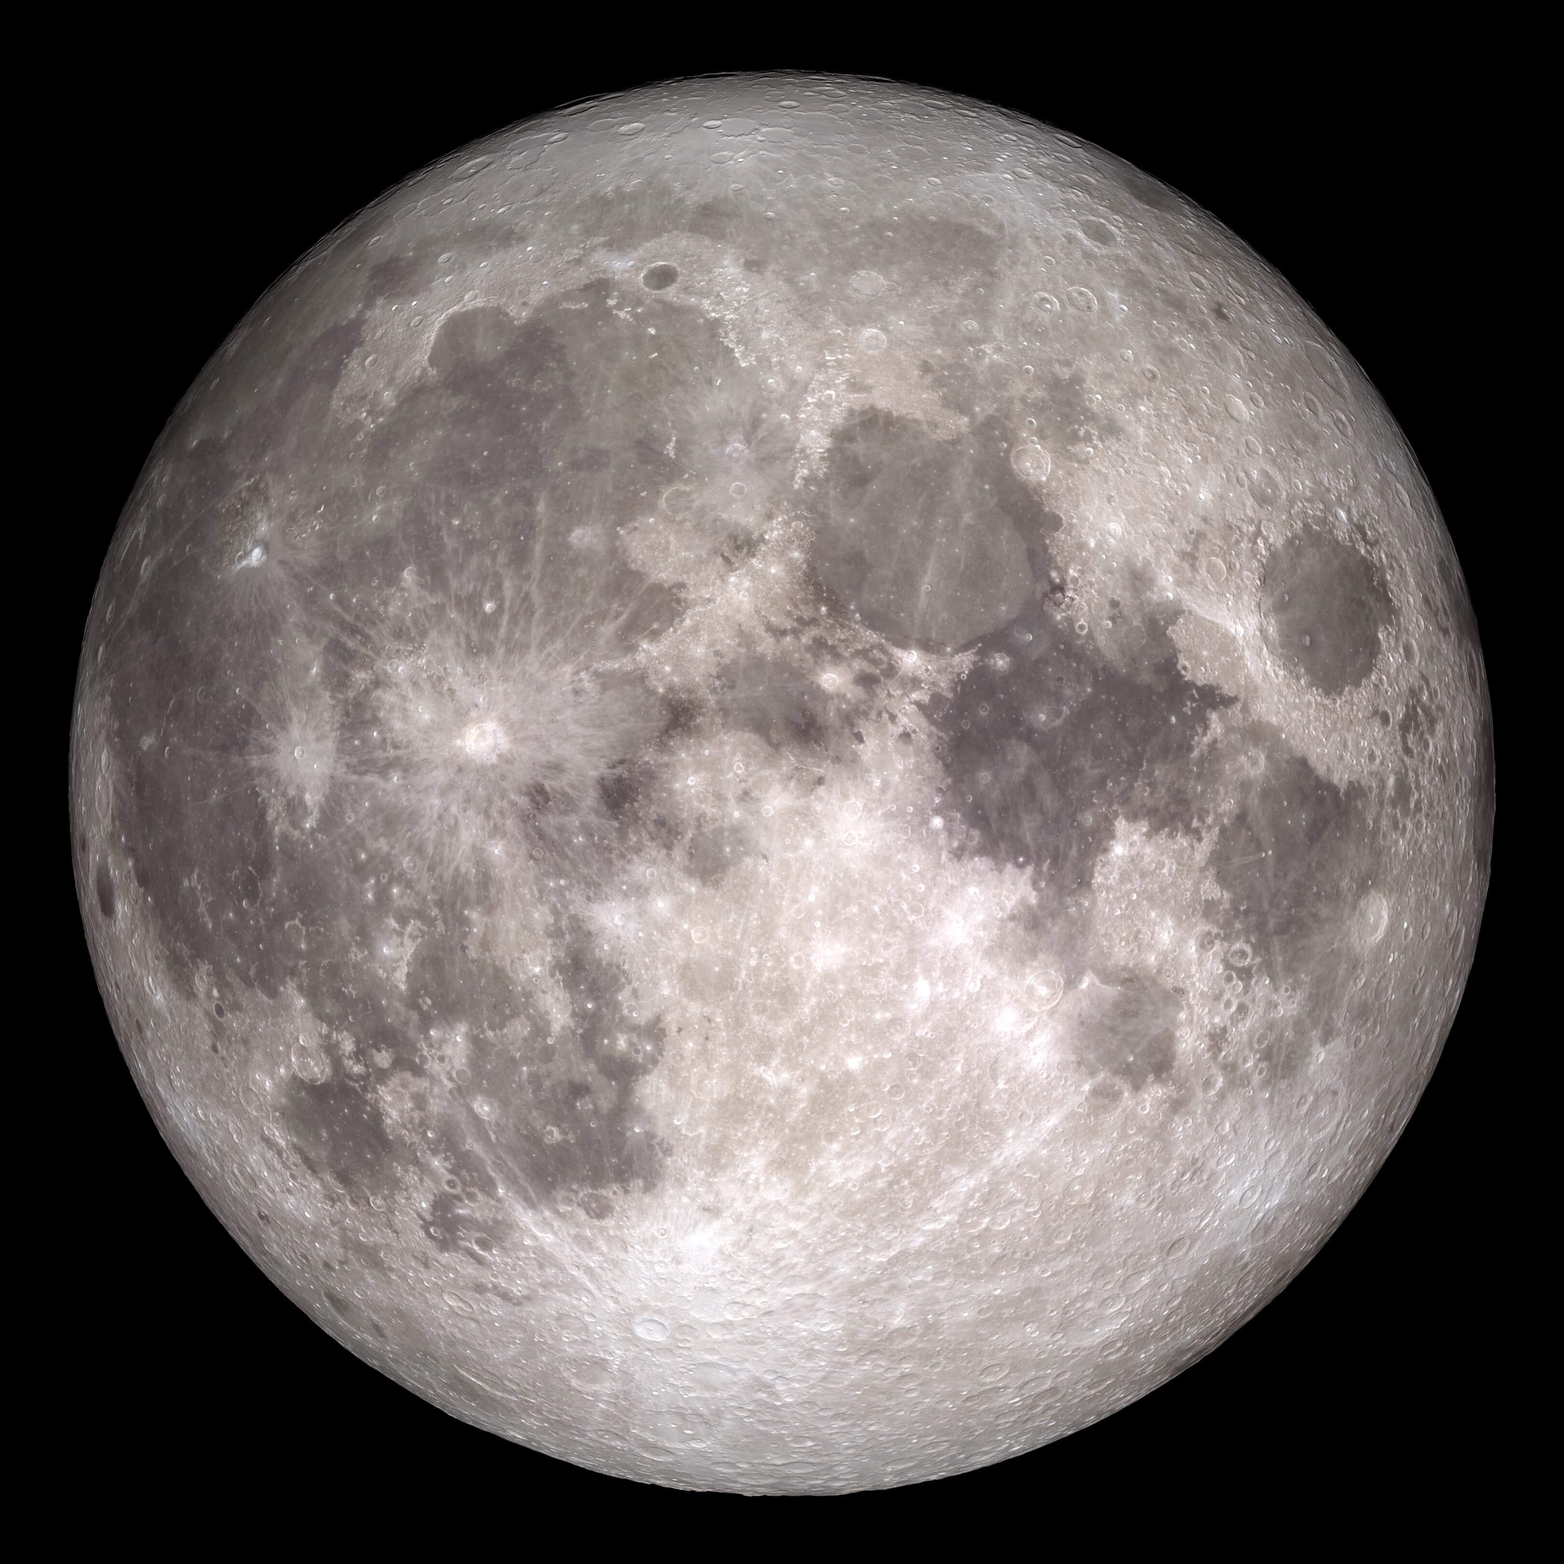
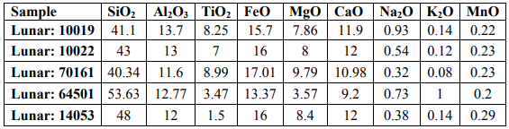
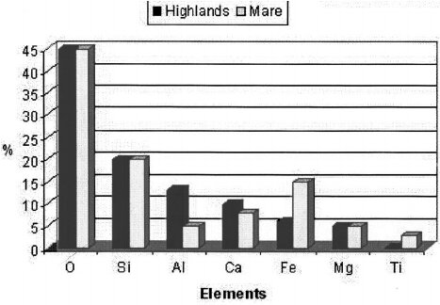
Oxygen from Regolith – Chemical Composition
Examples of Lunar Regolith Chemical Composition
Loftus, D. J., Tranfield, E. M., Rask, J. C., & McCrosssin, C. (2008). The chemical reactivity of lunar dust relevant to human exploration of the Moon.
Image Credit: NASA
The darker areas of the Moon are called Mare
The lighter areas of the Moon are called Highlands
Ruess, F., Schaenzlin, J., & Benaroya, H. (2006). Structural design of a lunar habitat. Journal of Aerospace Engineering, 19(3), 133-157.

Slide 15
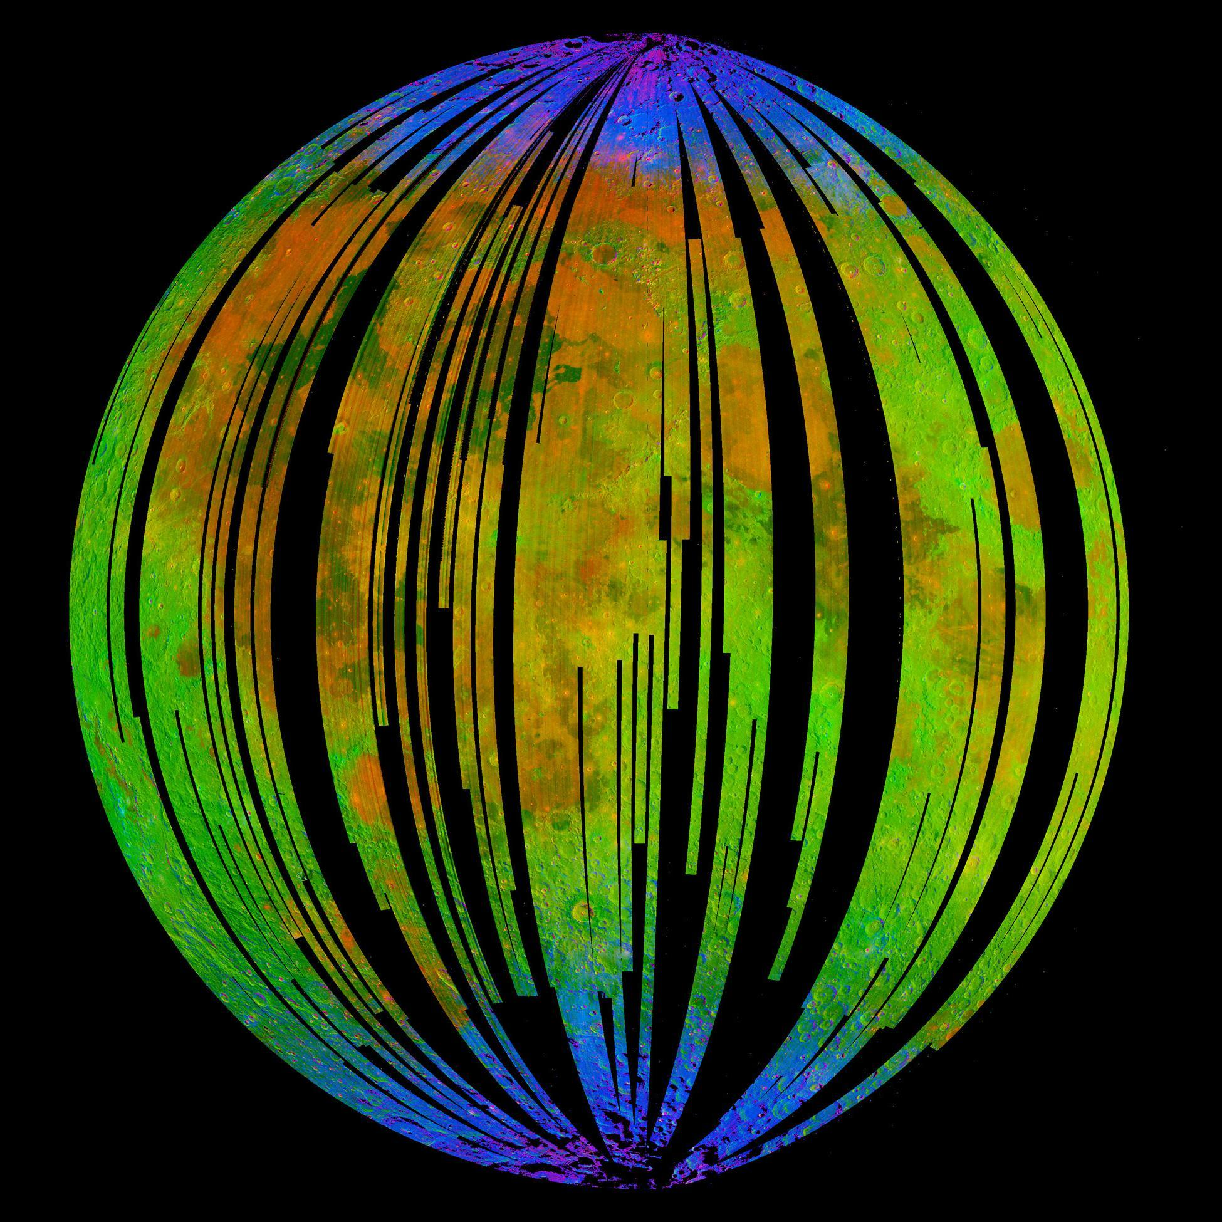
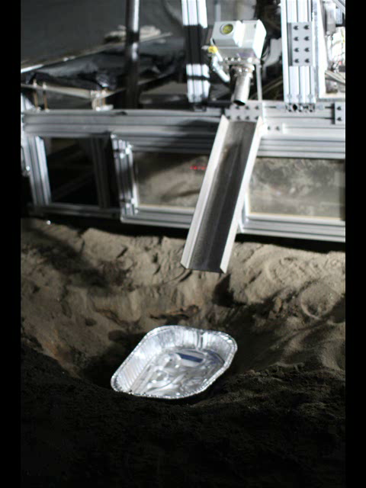
Oxygen from Regolith – Hydrogen Reduction
Fe0 + H₂
Fe + H₂O
Image Credit: ISRO/NASA/JPL-Caltech/Brown Univ./USGS
Notes:
Left: Image from NASA’s Moon Mineralogy Mapper, an instrument on the Indian Space Research Organization's Chandrayaan-1 mission.
Blue shows the signature of water, green shows the brightness of the surface as measured by reflected infrared radiation from the sun and red shows an iron-bearing mineral called pyroxene.
Right: Video of reduced tephra (Soil found on Mauna Kea) being removed from ROxygen reactor during 2008 field demonstration

Slide 16
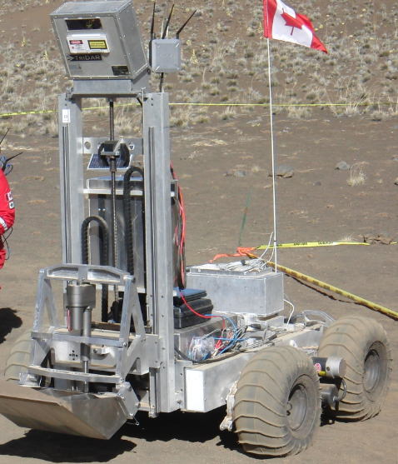
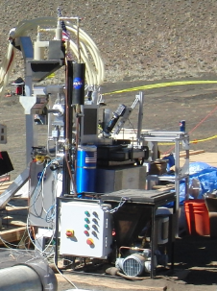
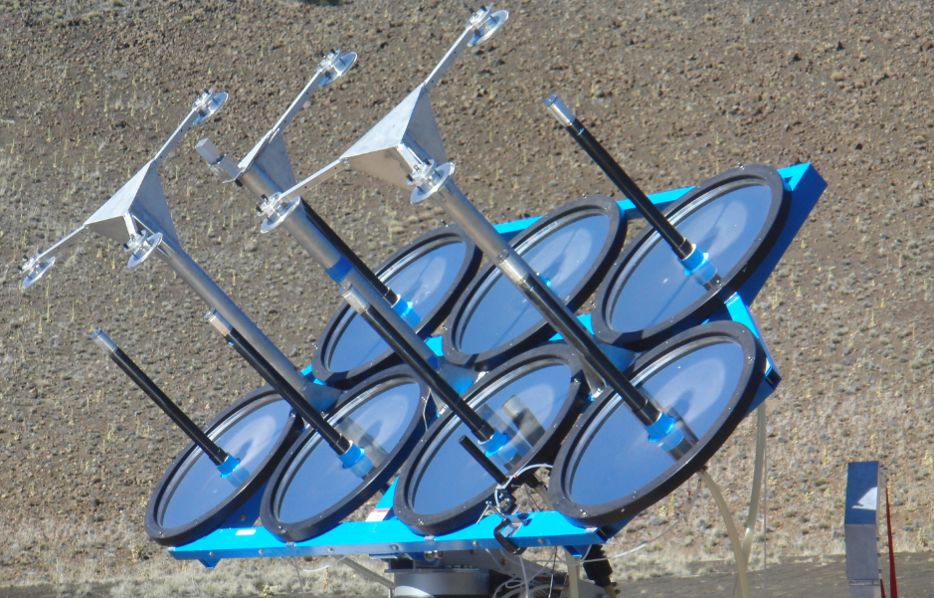

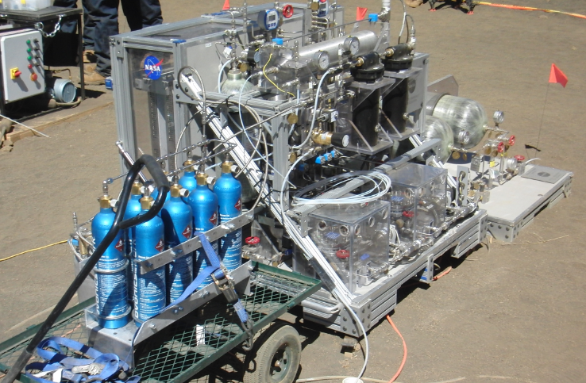
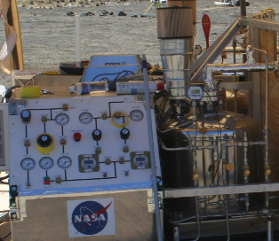
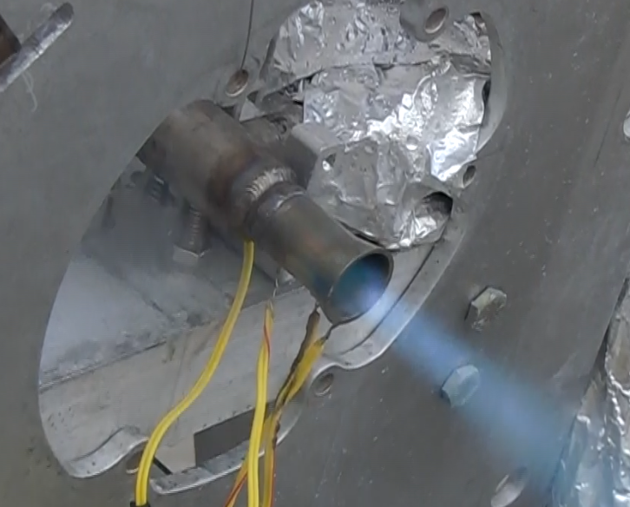
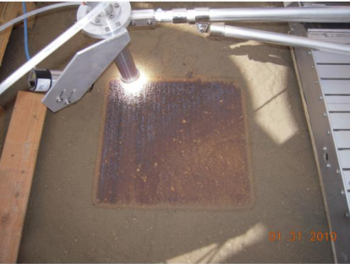
Oxygen from Regolith : Solar-Carbothermal Reduction
2H₂O
Tephra
Heat
Excavator
Canadian Space Agency
Carbothermal Reactor
Orbitec (Now Sierra Space)
Solar Concentrator
Physical Sciences Inc.
Si0 + C H₄
Si + CO+ 2H₂
H₂O
CO + 4H₂
CH₄+H₂O
Heat
2H₂O
2H₂ + O₂
O₂
LOX
Plume
Water Electrolysis
Johnson Space Center
Liquefaction
Johnson Space Center
Propulsion
Johnson Space Center
Sintered Pad
Physical Sciences Inc.
NORCAT
Notes:
Left: ROxygen electrolyzer and gaseous oxygen storage in the foreground. Solar Concentrator in the background
Upper Right: Melted tephra produced with solar concentrator
Lower Right: Sintered tephra using solar concentrator

Slide 17
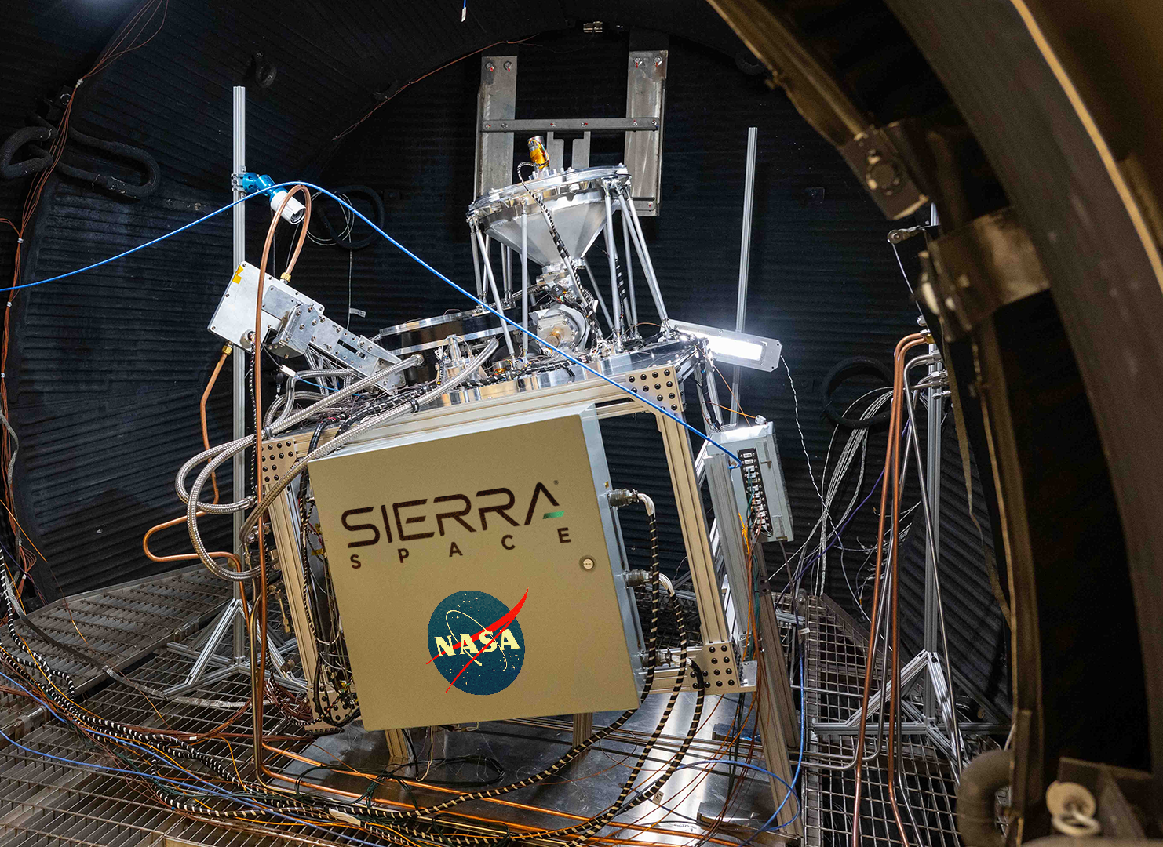
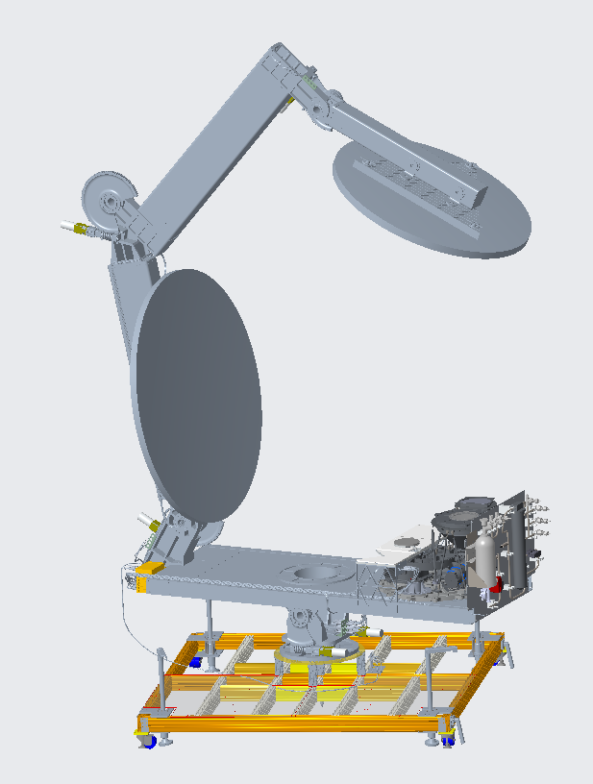
Carbothermal Reduction Demonstration (CaRD) Prototype
Prototype Reactor tested in Thermal-Vacuum
Integrated Test with Solar Concentrator

Slide 18
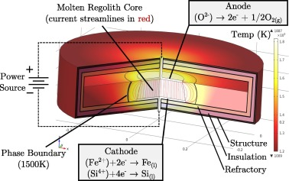
Molten Regolith Electrolysis (MRE)
MRE uses high voltage current to reduce Fe, Si, and Al
Generates oxygen as well as pure metals
No chemicals required, just power
MRE Reactor Cross Section

Slide 19
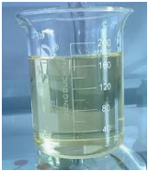
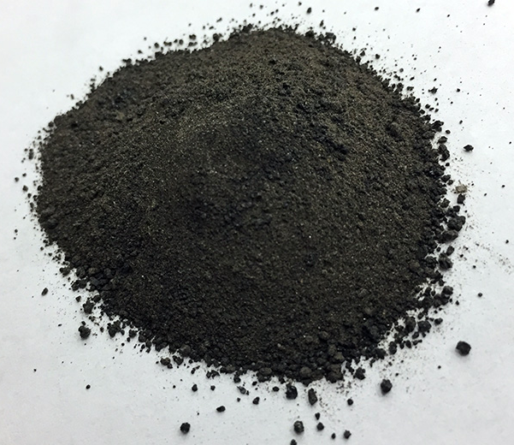
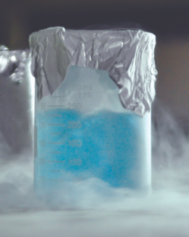
Moon to Mars
Modified Lunar Carbothermal Concept
Carbon
Methane Pyrolysis
Common to Mars ISRU and Life Support Systems
CH₄
Common to Mars ISRU
Carbothermal Reactor
CH_{4,} CO, H_{2,} CO₂
Sabatier Reactor
CH₄
CH₄ Liquefaction & Maintenance
Soil Excavation
Inlet Hopper
H₂O
Condenser
CH₄
CH₄ Dryer
H₂O
H₂
Spent Soil Disposal
Outlet Hopper
Water Cleanup
Water Electrolysis
O2 Dryer
O2 Liquefaction & Maintenance
O₂
HYDROGEN LIQUEFACTION
Oxygen Mass | 10 | tonnes
LOX/Fuel Ratio | 6
H2 Mass Required | 1.67 | tonnes
Carbon Mass Required (tonnes) | 0 | tonnes
Mass of 20W/20K crycooler | 106.3 | kg
Fuel Liquefaction Thermal Lift Required | 429 | W
Number of Cryocoolers Required | 22
Mass of Cryocoolers & Radiators | 2.34 | tonnes
Return on Landed Mass in 1 year | 0.71
METHANE LIQUEFACTION
Oxygen Mass | 10 | tonnes
LOX/Fuel Ratio | 3.6
CH4 Mass Required | 2.78 | tonnes
Carbon Mass Required (tonnes) | 2.08 | tonnes
Mass of Cryotel GT | 3.1 | kg
Fuel Liquefaction Thermal Lift Required | 169 | W
Number of Cryocoolers Required | 8
Mass of Cryocoolers & Radiators | 0.065 | tonnes
Return on Landed Mass in 1 year | 1.30
Water from Icy Regolith
If we bring carbon to the Moon
1) We can test all of the technologies required to produce propellant on Mars
2) We can utilize hydrogen from water by feeding water into a system that is already in place to extract oxygen from regolith
3) It will much easier to liquefy and store methane than hydrogen.
Notes:
This image was produced for the Evolvable Mars Campaign and has already cleared the DAA process

Slide 20
Instrumentation Challenges in ISRU
Common Instrumentation and Analysis
  Measurement of regolith composition before and after processing
    Monitoring input/output composition to evaluate system efficiency and efficacy
  Water quality monitoring
    Conductivity/resistivity
    Contamination
      Particulate
      Specific elements (Hg, NH3, Acids)
  Water Flow and Level
    Water separation
  Moisture Content Monitoring in Product Streams
    O2/H2/CH4
Instruments that can survive hostile environments
  High-Radiation
  Single Event Upsets
  Vacuum
  Large temperature swings from processes and environments
  Dust tolerance within the process and in the environment
  O2 Rich, corrosive, high current processes
Instrumentation that can maintain calibration or be recalibrated remotely

Slide 21
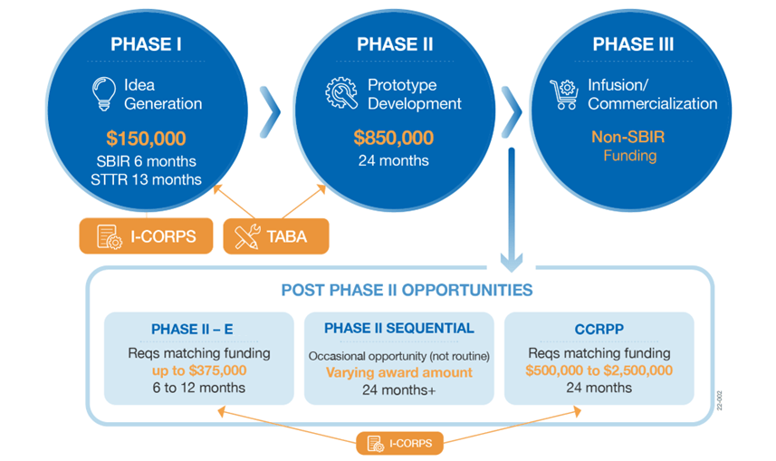
How to get involved
Small Business Innovation Research / Small Business Technology Transfer (SBIR/STTR)
Provides funding for ideation and prototype development
Limited matching funds available
Phase I submissions are currently open and will close “early March 2025”!
https://www.nasa.gov/sbir_sttr/

Slide 22
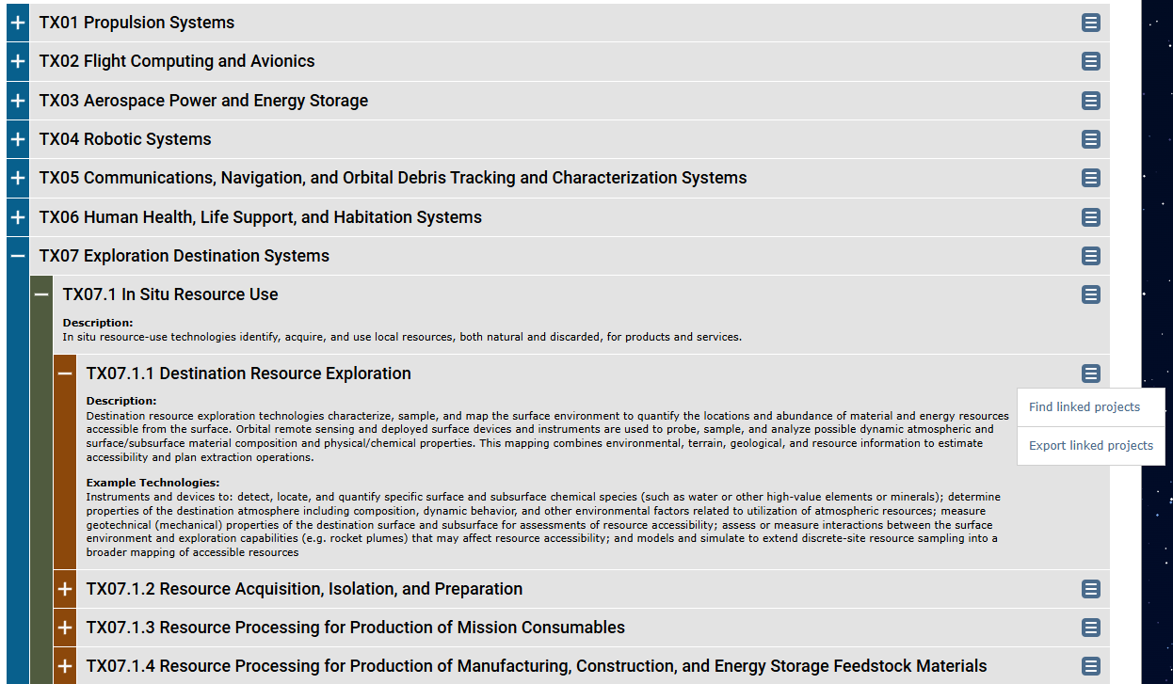
NASA Technology Taxonomy
Identifies and organizes technology gaps relevant to NASA
Also contains information on NASA funded projects in each technology
Prioritized shortfalls can be found at https://techport.nasa.gov/strategy
https://techport.nasa.gov/taxonomy

Slide 23
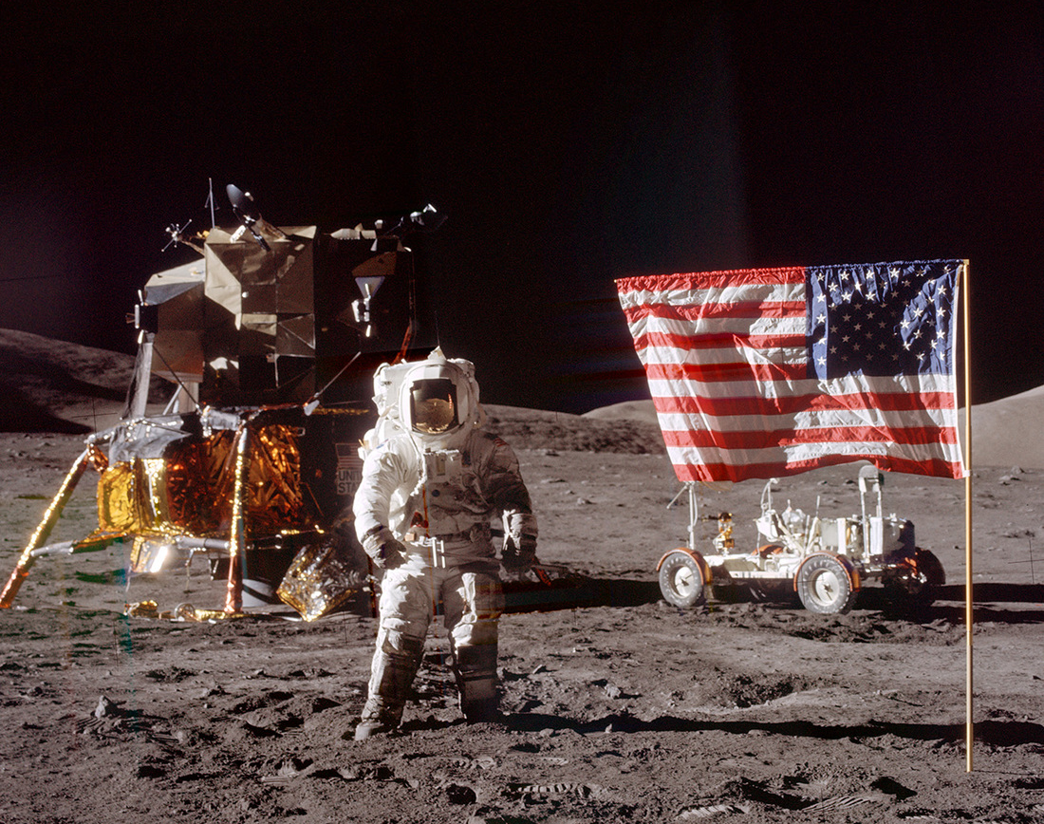
Thanks for listening!
Questions? Comments?
desmond.oconnor@nasa.gov
SBIR/STTR:
https://www.nasa.gov/sbir_sttr/
Tech Taxonomy:
https://techport.nasa.gov/taxonomy
Internships:
https://www.nasa.gov/learning-resources/internship-programs/

