Slide 1
Co-Development of Ensemble Modeling Applications to Advance Stakeholder Capabilities at NASA SERVIR Regional Hubs
Jonathan L. Case¹; Jayanthi Srikishen²; Amides Figueroa³; William Abarca³; Kiran Shakya⁴;
Timothy J. Mayer⁵; Lauren E. Carey⁵; and Betzy E. Hernandez⁵
¹ENSCO, Inc. ²Universities Space Research Association
³Ministerio de Medio Ambiente y Recursos Naturales
⁴International Centre for Integrated Mountain Development
⁵University of Alabama - Huntsville
Talk 8C.5; 14 Jan 2025; 15th Conf. Transition Research To Operations (15R2O)
105th AMS Annual Meeting, New Orleans, LA

Slide 2
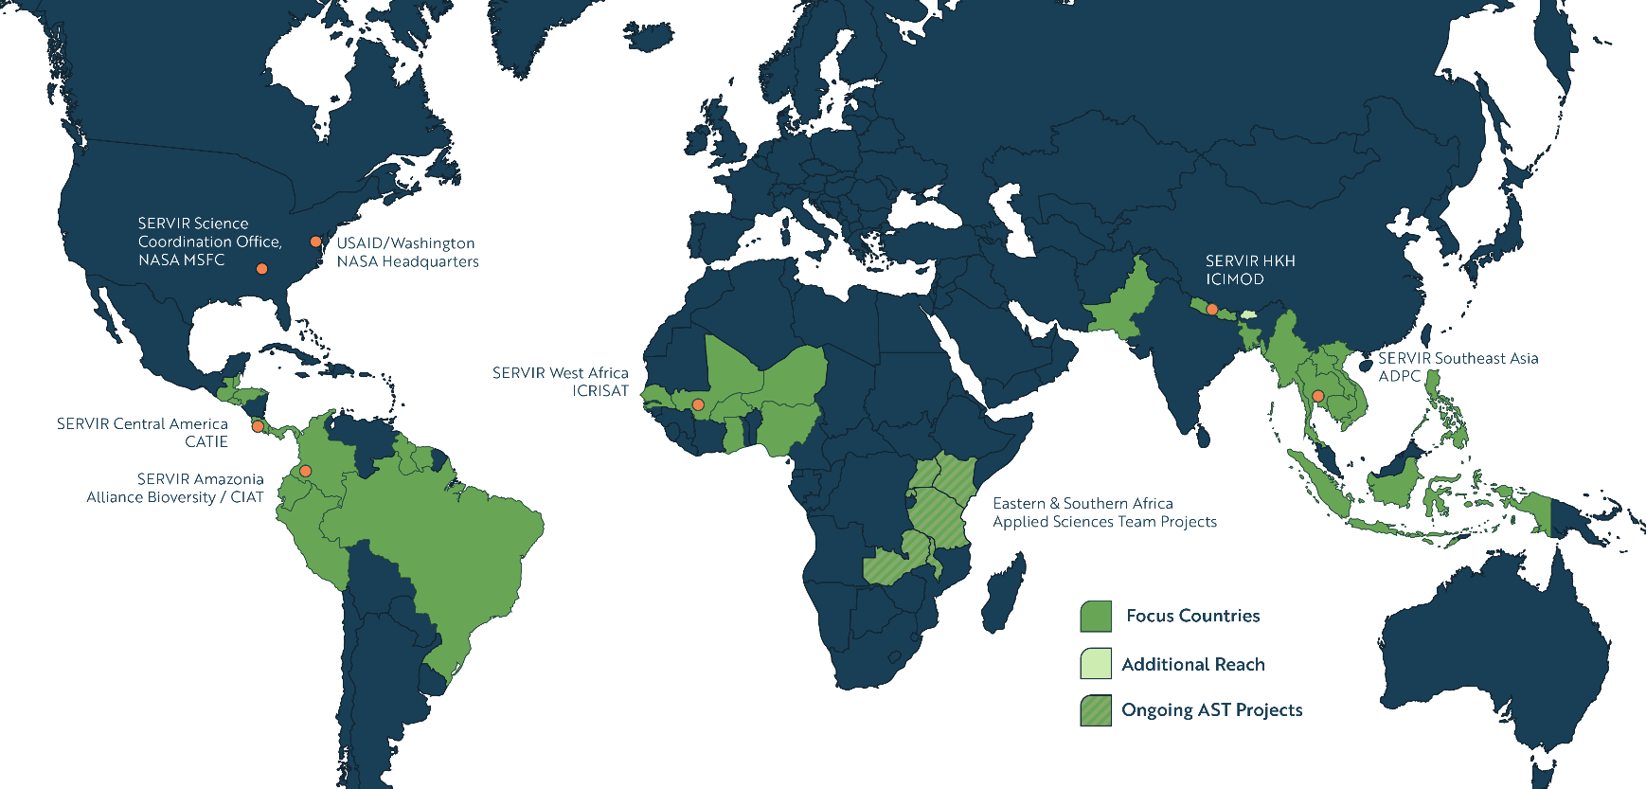
SERVIR Focuses on Countries in Asia, Africa, and the Americas

Slide 3
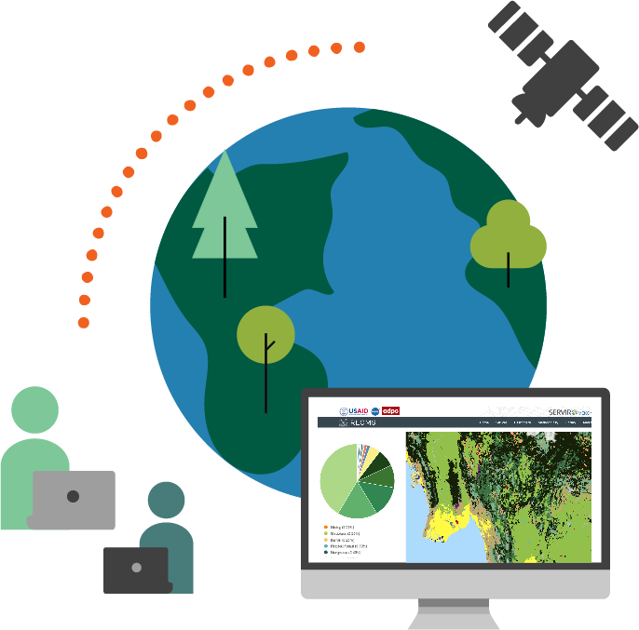
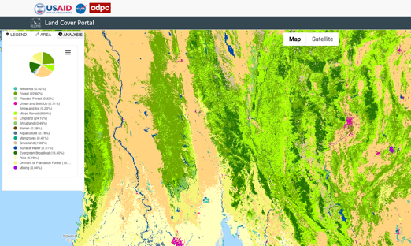
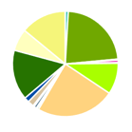

What Makes SERVIR Unique?
SERVIR services are…
Demand-driven to ensure each community’s needs and values are prioritized throughout the process
Co-developed with regional experts to bring together NASA science and
in-depth local knowledge
Inclusive; emphasize that services must be accessible and represent the needs of women and indigenous communities
Built to last; prioritize trainings and resources that strengthen capacity and foster sustained capabilities

Slide 4
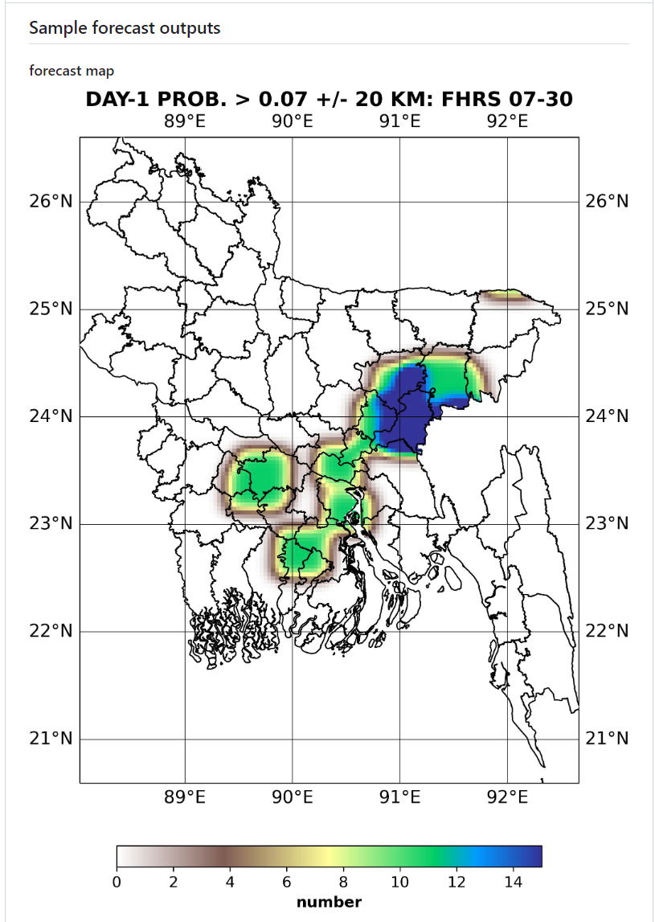
Challenge: Need to Connect Advanced [NASA] Technologies to Village in Vulnerable Regions
Developing countries need resources to better alert general populace about severe thunderstorm hazards
High vulnerability to intense convection in
Hindu Kush Himalaya (HKH) region of South Asia

Slide 5
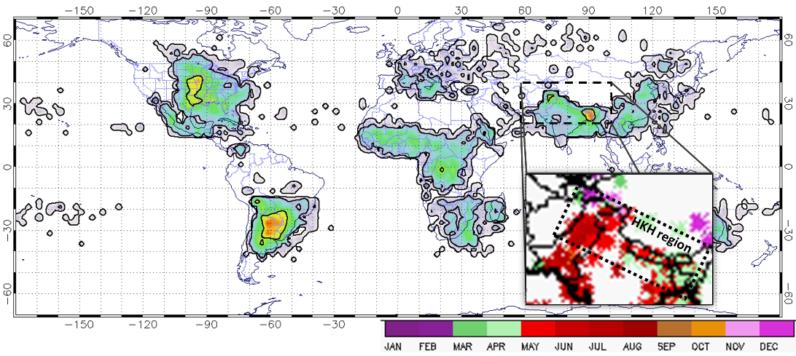
Motivation and Background: High Impact Weather Assessment Toolkit (HIWAT)
Motivation: South-central Asia experiences extreme weather in pre- and wet-monsoon
  Lightning, Nor’westers, tornadoes, large hail, flash flooding, cyclones
  Need for enhanced modeling capabilities in under-served regions
Background:
  Manuscript on near-storm environment of
  Bangladesh significant tornadoes: Bikos et al. (2016); https://doi.org/10.1016/j.atmosres.2015.08.002
  NASA SERVIR Applied Sciences Team project:
  Under-served Hindu Kush Himalaya region with
  disproportionately high number of casualties
  Development of ensemble modeling suite
  Training at SERVIR Nepal hub with stakeholders
    Theoretical concepts
    Ownership transfer of model production suite
Satellite-based
Annual Climatology of Intense Thunderstorms

Slide 6
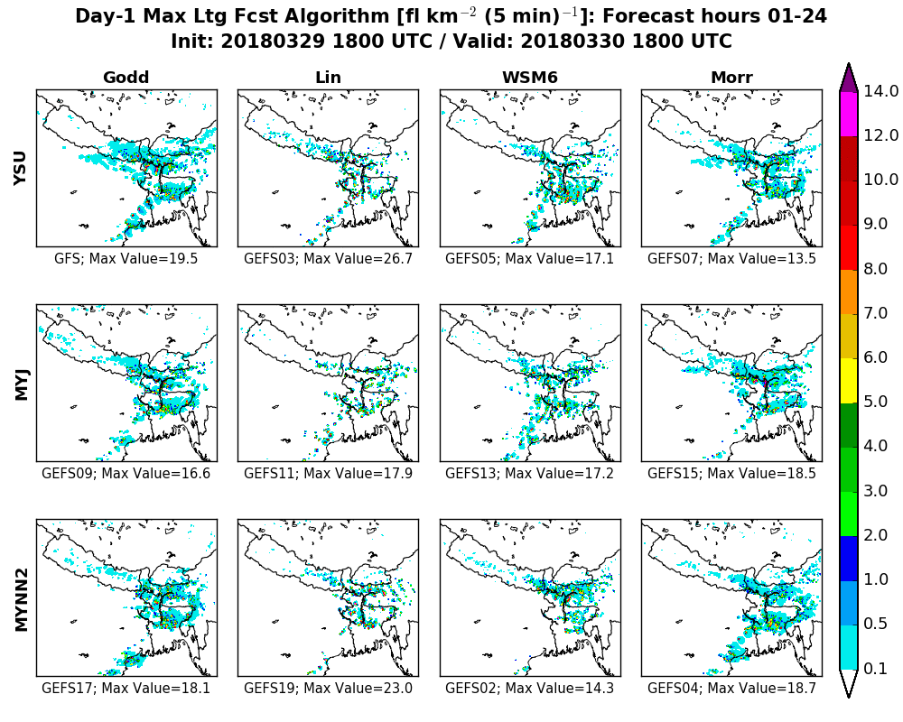
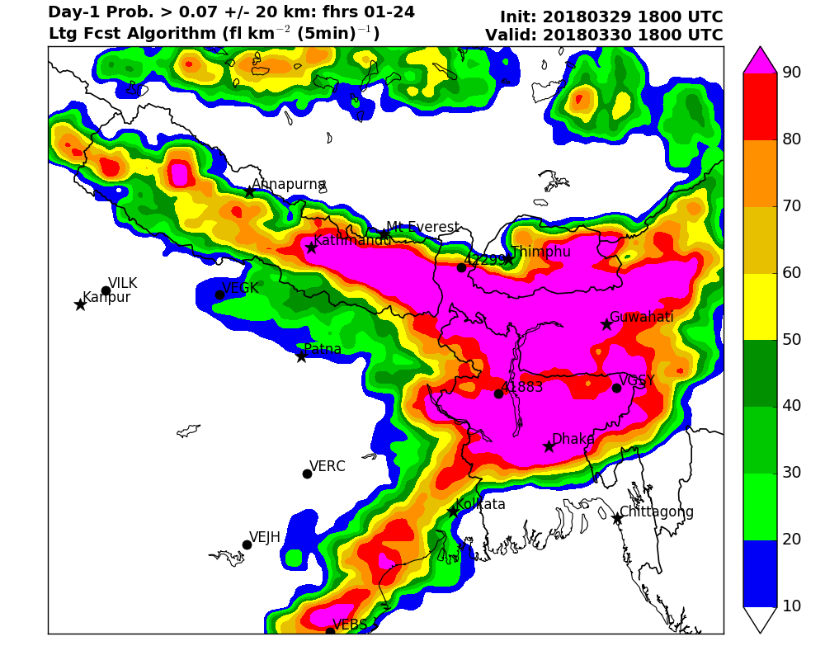
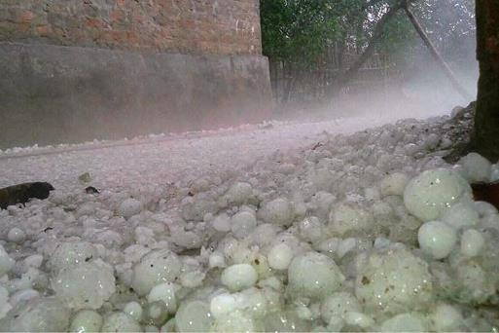
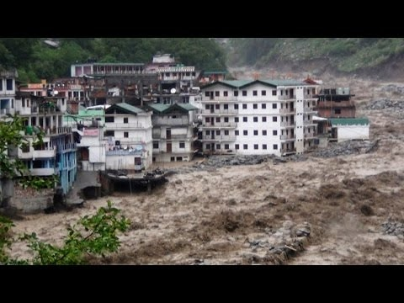
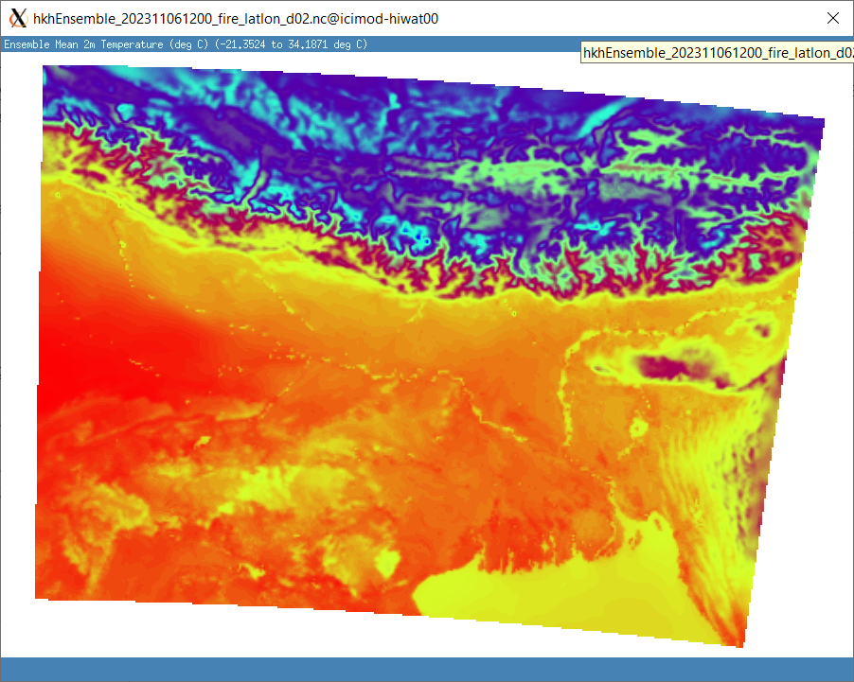
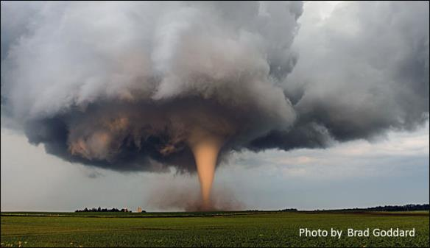
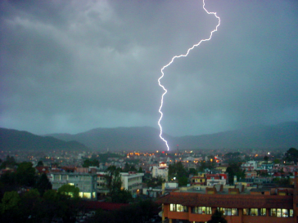
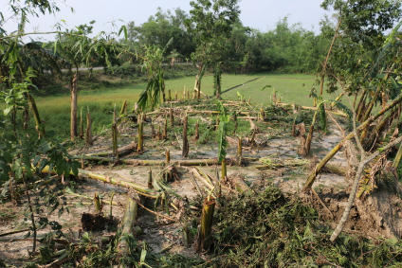
What is HIWAT? (Ensemble model tool)
HIWAT: Addresses hazardous weather through ensemble NWP approach, using Weather Research and Forecasting (WRF) model
Generate spread through physics and initial condition variability
Suite of ensemble products for efficient assessment
Focus on high-impact hazards:
  Large hail
  Flash flooding
  High temperatures
  Tornadoes
  Lightning
  Damaging straight-line winds
  Inputs to RAPID Streamflow and Nepal Fire Weather Index
Nepal
Bhutan
Large Hail
Flash Flooding
Temperature
Probability Products
India
Bangl.
Tornado
Lightning
Straight-line wind damage

Slide 7
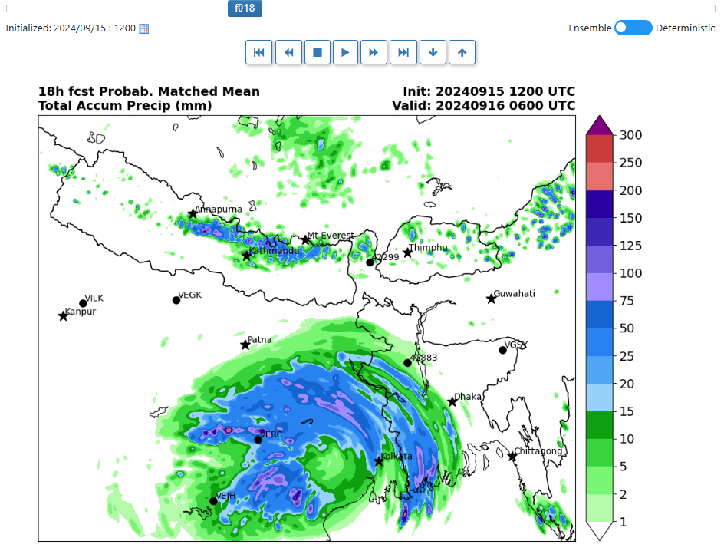
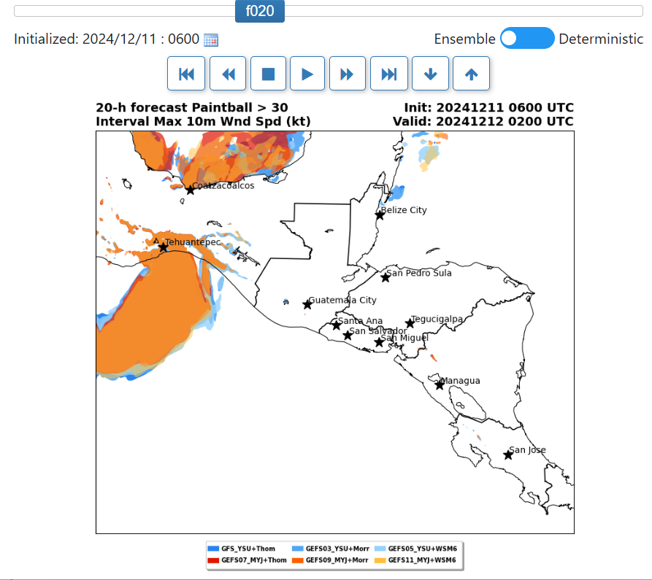
HIWAT Major R2O Milestones
Real-time prototype system (2018 – 2022)
  Convection-allowing ensemble solution
  BAMS: https://doi.org/10.1175/BAMS-D-21-0260.1
NASA DAAC archive of prototype (2023)
  “wrfout” native netcdf and GRIB2 derived fields
  https://doi.org/10.5067/MODEL/HIWAT/DATA101
Transition to real-time (2022 - present)
  Bangladesh Meteorological Dept. (2022)
  International Centre for Integrated Mountain Development (ICIMOD; 2023)
  Trained personnel on maintaining model and output production suite
  Co-developed new applications (e.g., fire index)
  Transitioning to other stakeholders (ongoing)

Slide 8
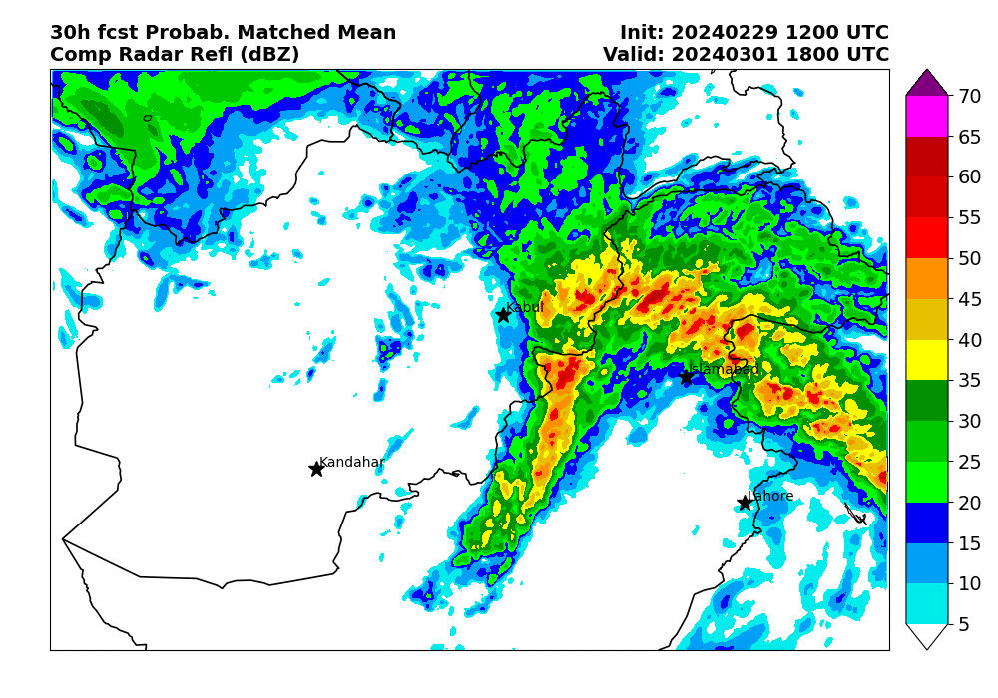
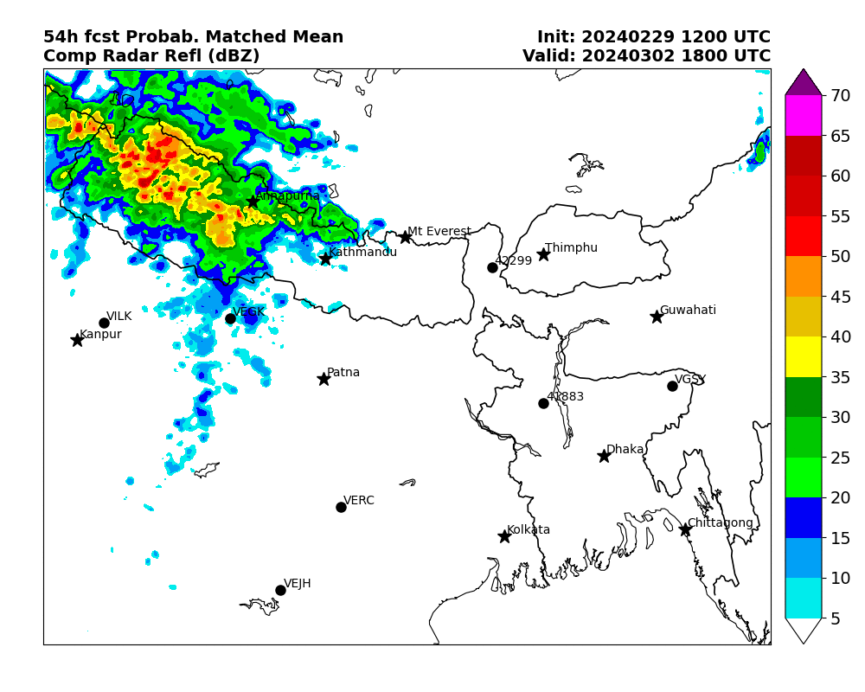
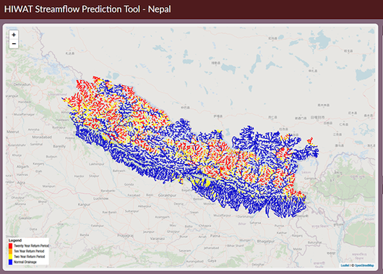
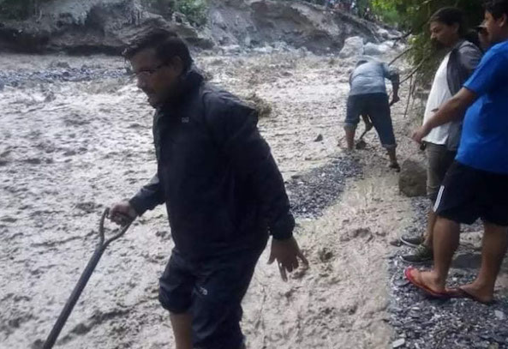
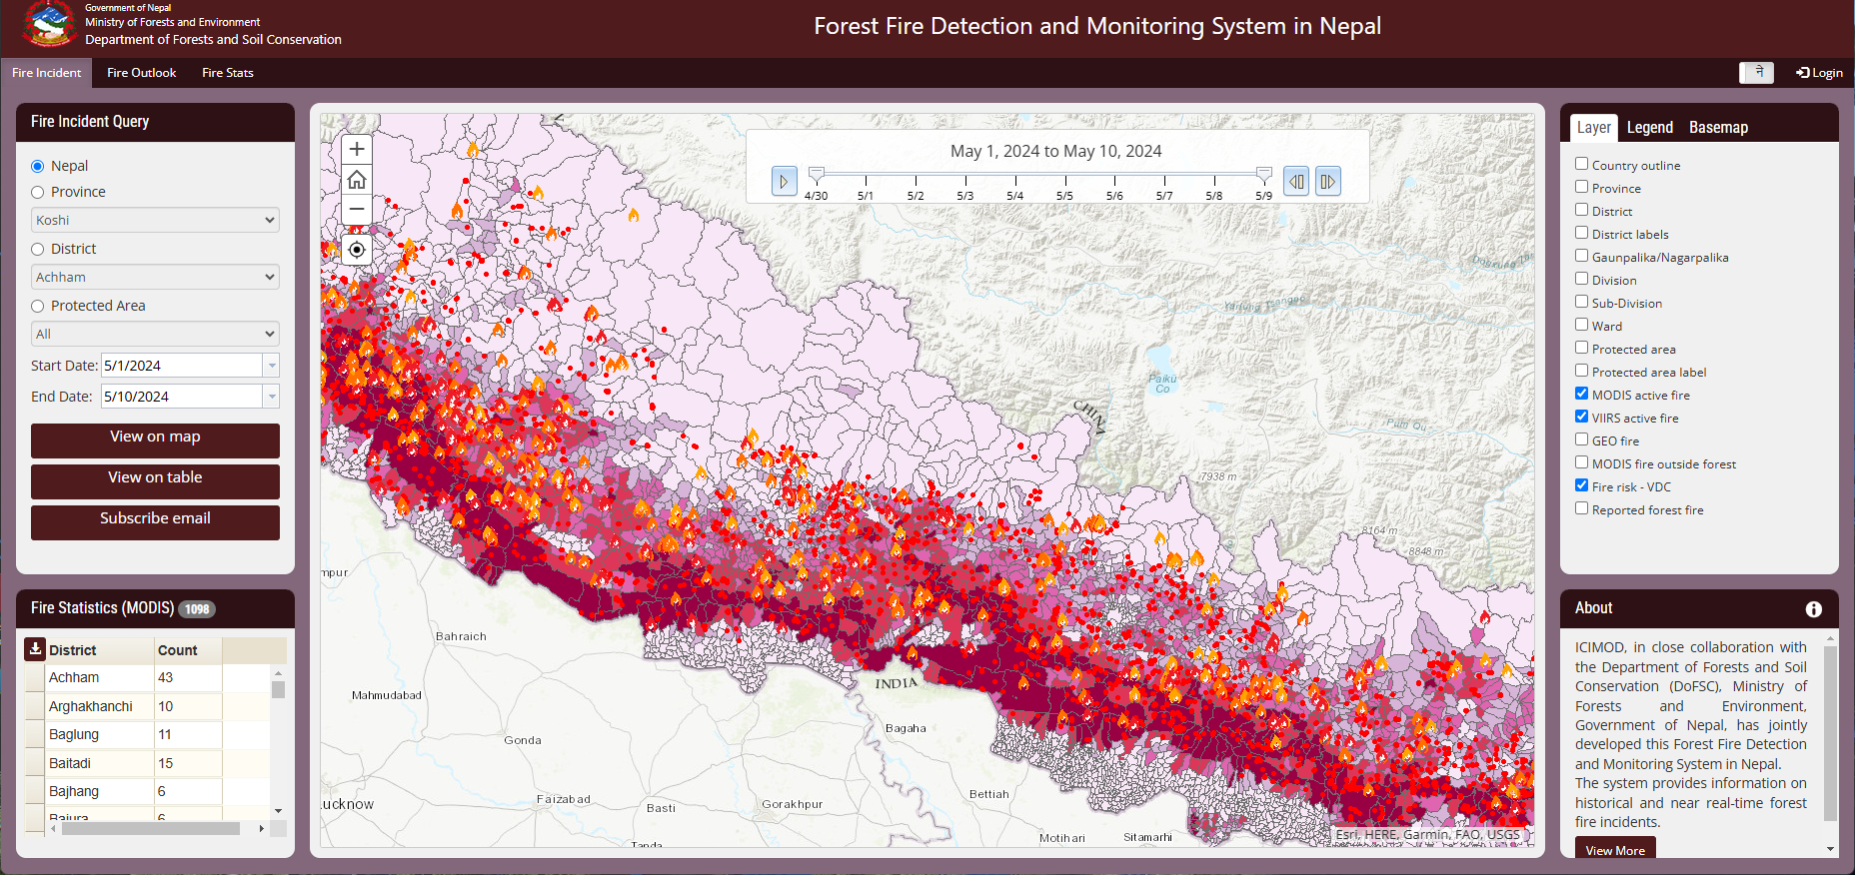
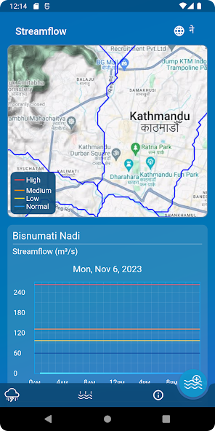
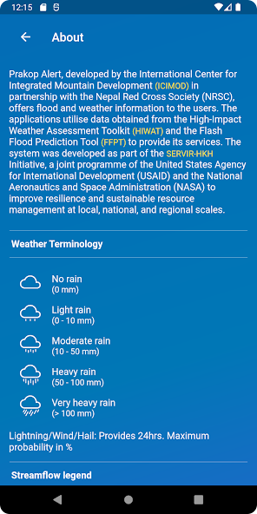
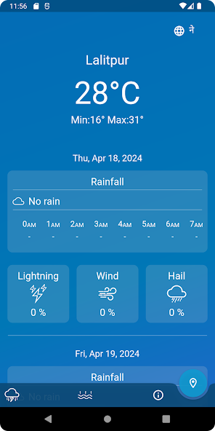

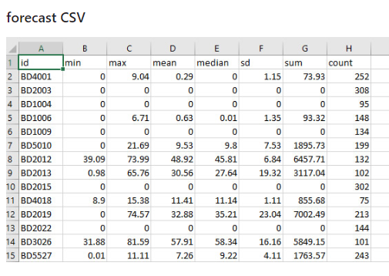
Examples of Co-Developed Geospatial Tools
HIWAT Model Web Viewers
Rainfall input to Nepal Flash Flood Tool
Nepal Forest Fire Detection and Outlook
HIWAT Mobile App “PrakopAlert”
Bangladesh-Extreme-Weather-Alert (BEWA)

Slide 9

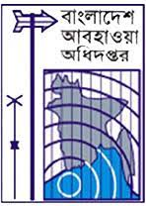


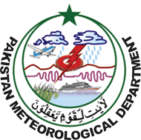
Global Growth of HIWAT
AST-2
HIWAT SOCRATES
Large HPC
Pilot HIWAT Bangladesh Met. Dept. (BMD)
HIWAT-BMD World Bank Large HPC
2022
2024
Ongoing
2018
2022
HIWAT Enhanced
Large HPC
2023
Ongoing
Pilot HIWAT Ministry of Env. & Natural Resources (MARN)
HIWAT (MARN)
Large HPC
2024
Ongoing
HIWAT Pakistan Met. Dept. (PMD)
2024
Ongoing

Slide 10
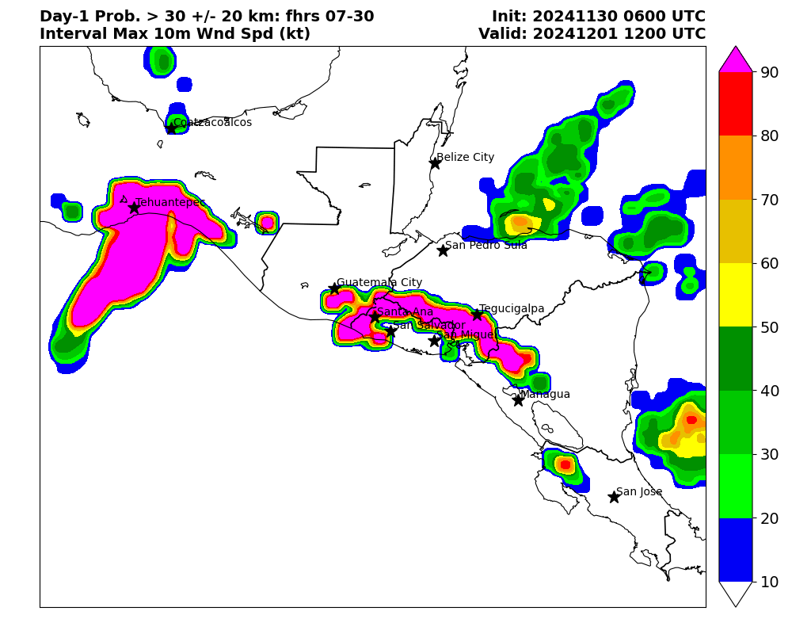
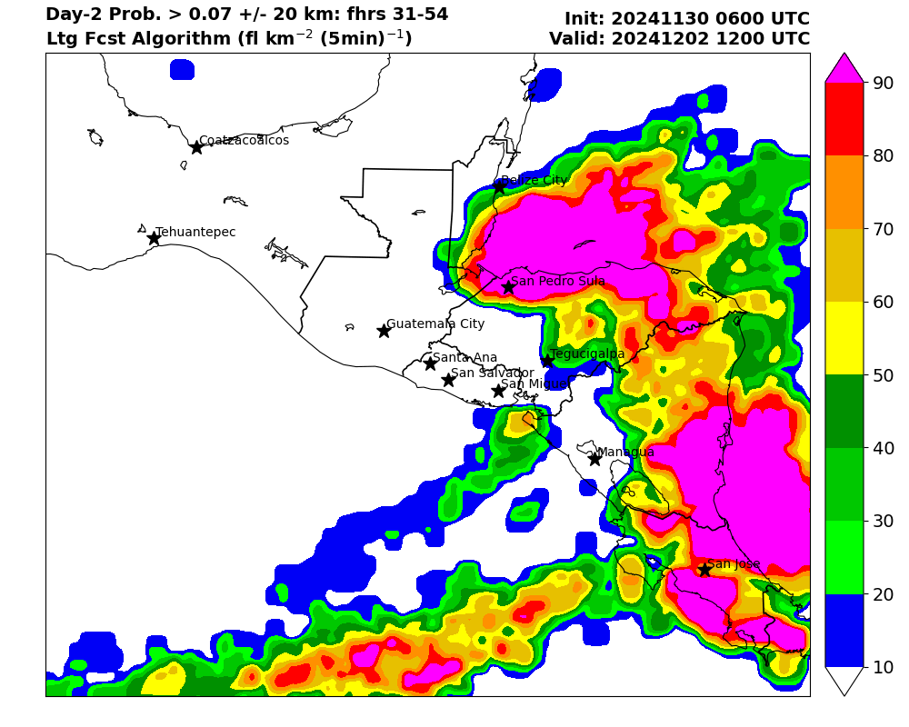
Prototype HIWAT in Central America
HIWAT prototype over Central America
  6-member mini-ensemble, Feb-Dec 2024
  Once-daily 54-h forecasts, 00z initialization
  Real-time product delivery demo (at right)
  Focus on convective and flooding hazards
    Lightning
    High wind speeds
    Heavy rainfall and tropical systems
Once-daily ensemble run on 6 nodes
  SERVIR Operational Cluster Resource for Applications - Terabytes for Earth Science [SOCRATES]
  One compute node per ensemble member
  Each node: 18 processors and 128 GB RAM
  10+ TB mounted drive
Probability of Wind Speed > 30 kt
Associated with Tehuantepecer Event
Probability of Day-2
Lightning Activity
Notes:
https://hmv-marn.servirglobal.net/#

Slide 11
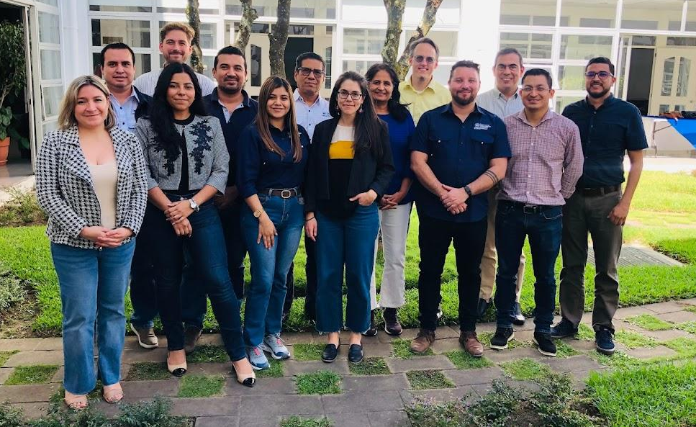
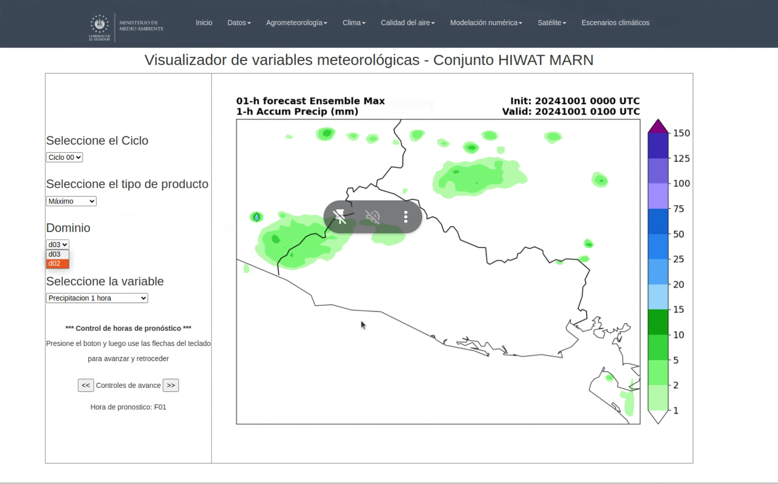
El Salvador In-Person Training Workshop: Feb 2024
Capacity-building with El Salvador
  Ministerio de Medio Ambiente y Recursos Naturales [MARN; Ministry of Environment
  and Natural Resources]
  4-day in-person workshop in San Salvador
  Recurring virtual technical exchanges
  Trained MARN personnel on:
    Theoretical ensemble modeling components
    Maintenance of product generation scripts
  MARN applying ensemble tools to in-house
  model runs (lower-right)
Goal: Full HIWAT implementation in 2025
on MARN HPC cluster
Notes:
https://hmv-marn.servirglobal.net/#

Slide 12

New Central America SERVIR Hub in Costa Rica
Centro Agronómico Tropical de Investigación y Enseñanza (CATIE)
HIWAT prototype: Multi-nation capability
demonstrating hub responsive science
source: SERVIR CA / CATIE

Slide 13
Presentation Summary
HIWAT: Successful R2O exemplifying responsive science
  Simple and practical implementation of convection-allowing ensemble
  Focus on underserved countries and communities
  Technology to village impacts with co-developed tools and capabilities
R2O highlights
  Fully transitioned HIWAT to ICIMOD computing cluster in Kathmandu, Nepal
  Trained ICIMOD, Bangladesh and El Salvador operational agencies
  on managing HIWAT model runs and/or ensemble product generation
Expanding capability footprint
  Ministry of Environment and Natural Resources in El Salvador
  Pakistan Meteorological Department

