Slide 1
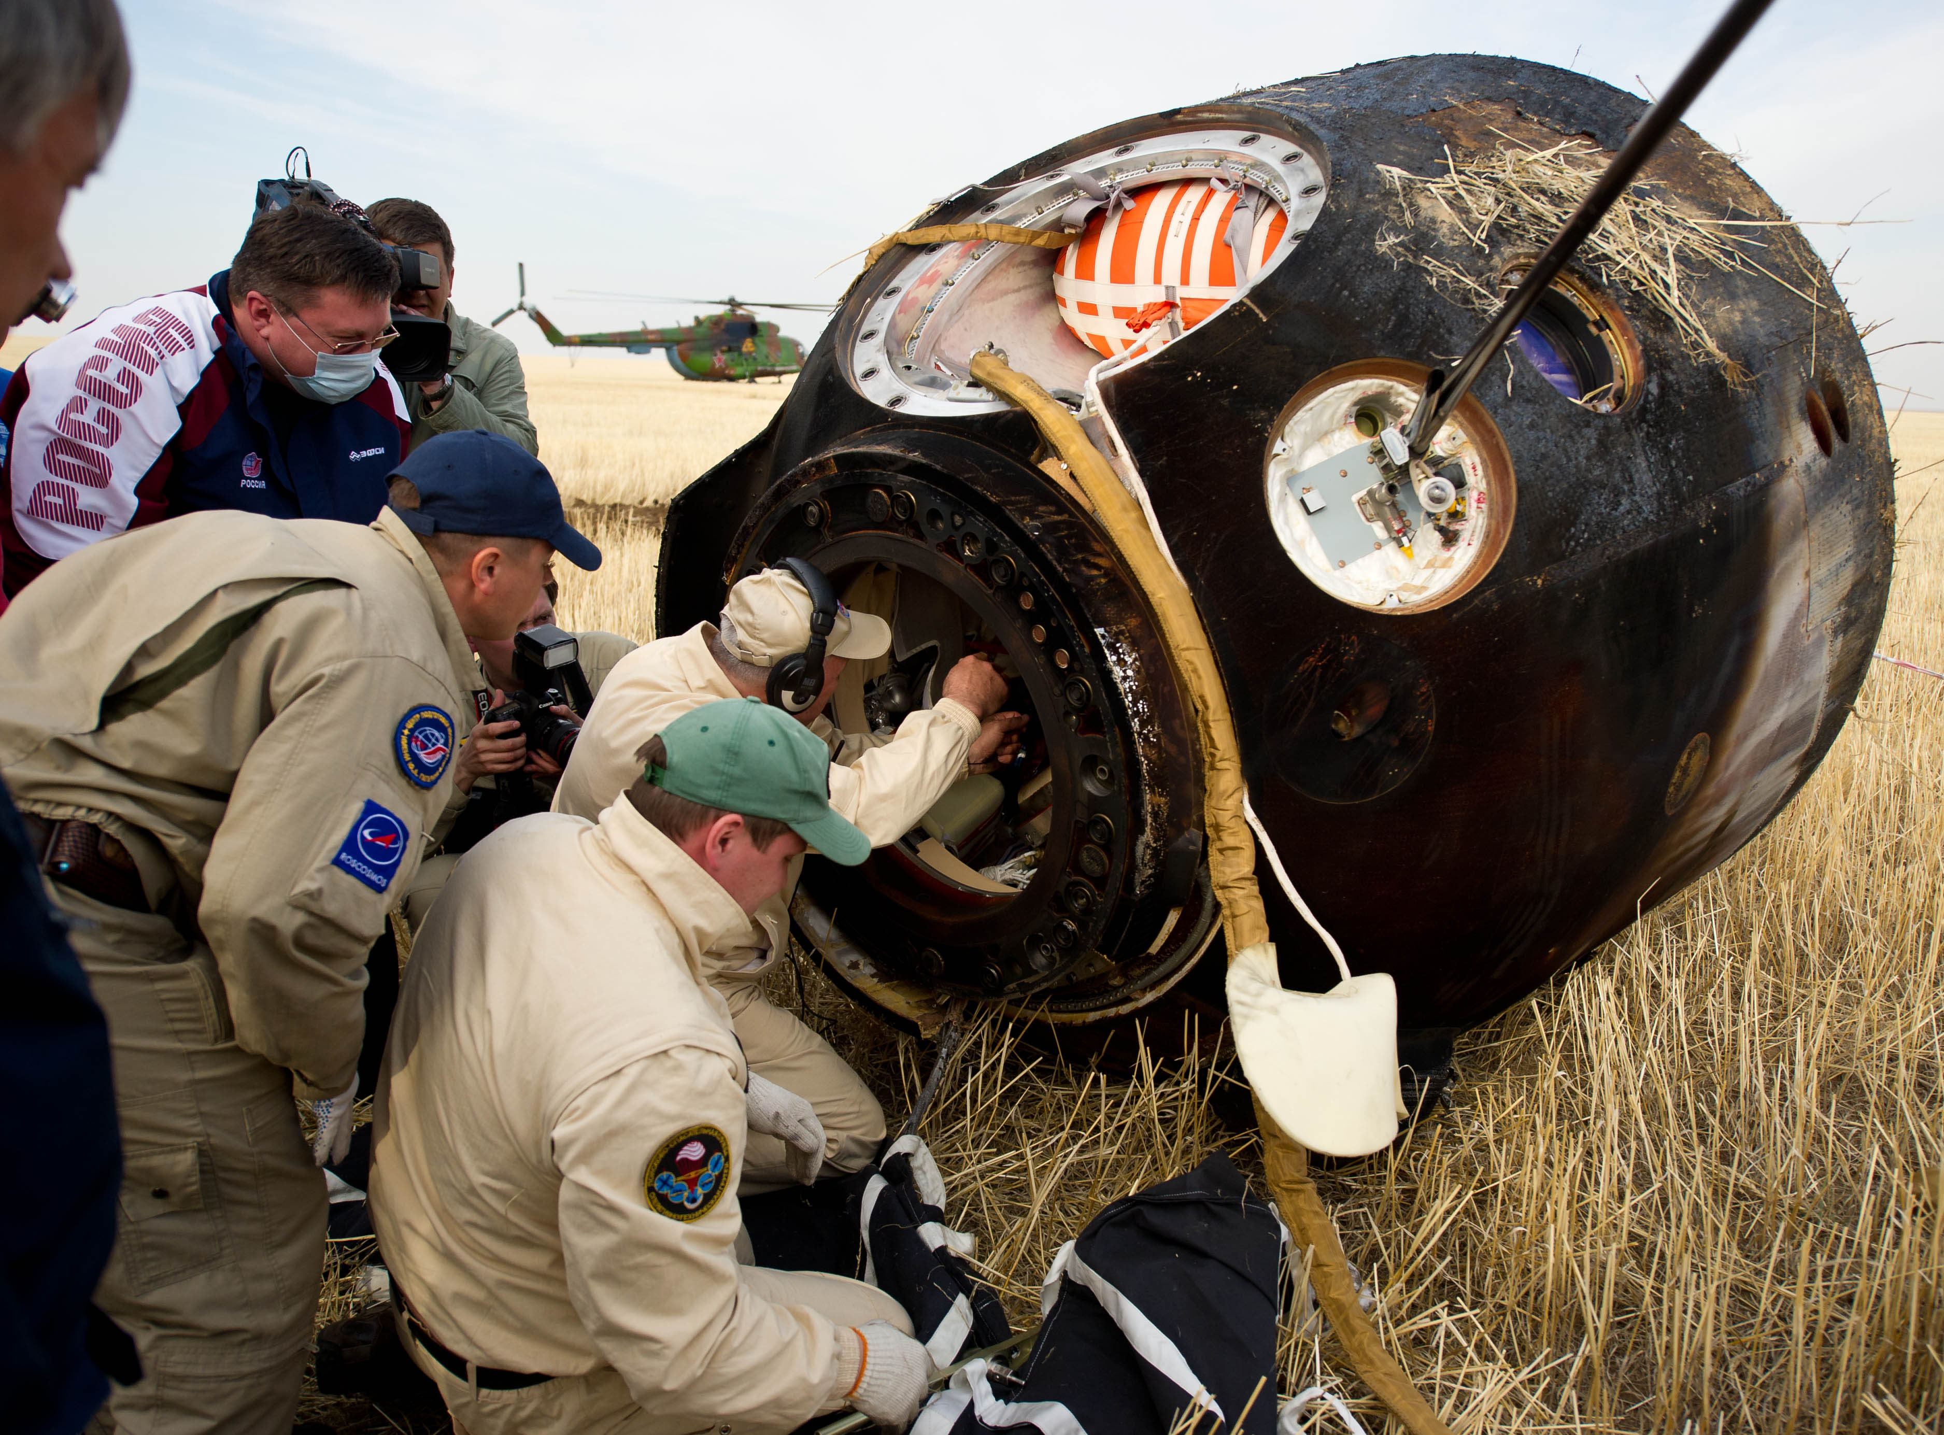
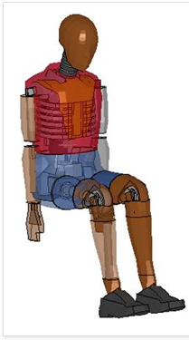
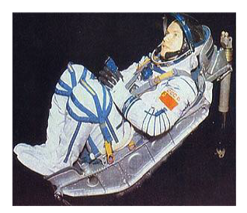
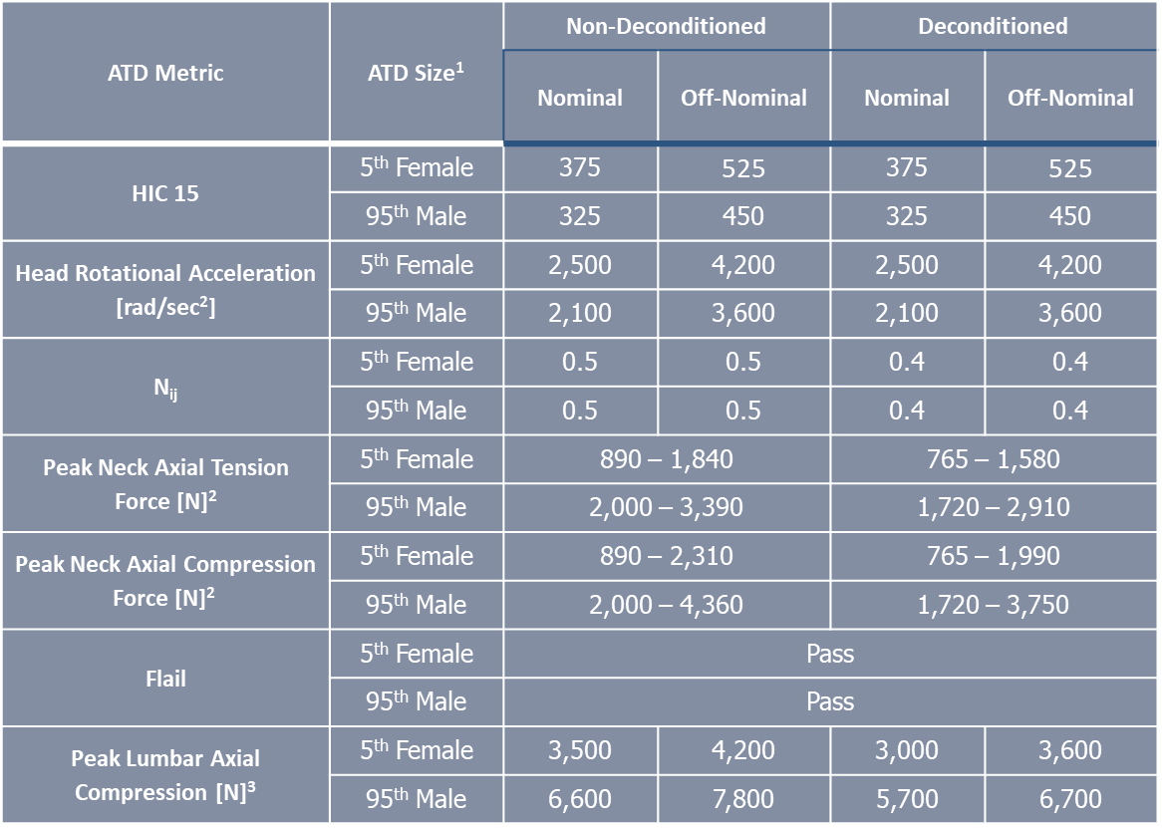

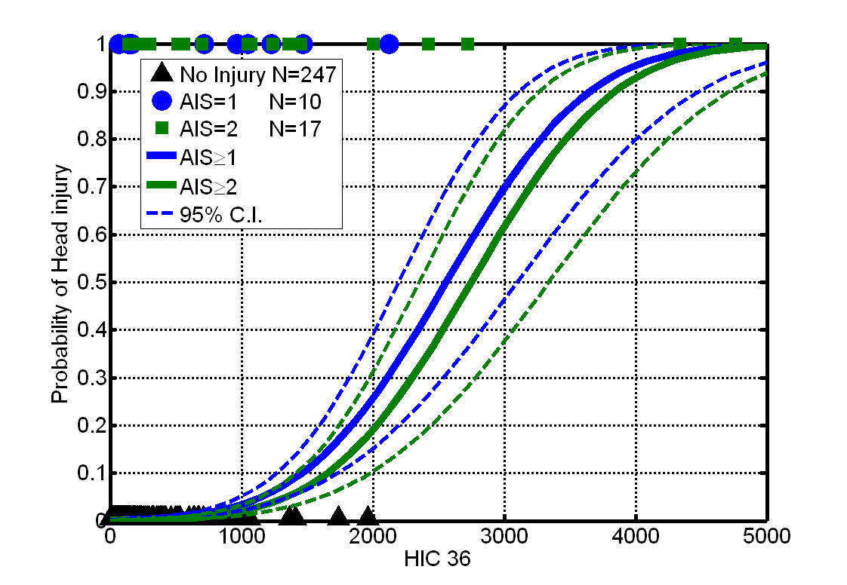
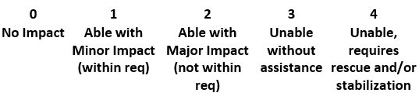
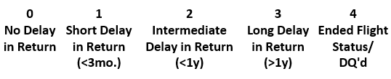

SOYUZ/SPACECRAFT LANDING RISK CHARACTERIZATION
P. Greenhalgh¹, K Yates¹, T. Reiber¹, N. Newby¹
¹KBR, 2400 NASA PKWY, Houston, TX 77058
BACKGROUND
RESULTS
Currently it is unknown how Soyuz landing accelerations and numbers and types of associated injuries relate to the new occupant protection requirements levied upon future space vehicles. Understanding this relation will allow for better quantification of the risk of injury for future spacecraft designs. Specific aims include:
New Landing Injury Information
More injuries have been occurring on Soyuz landings than anticipated. Most injuries are minor in nature but are unexpected due to the low energetics of the landing. This may be an indication that Soyuz landings are harder than previously thought, that spaceflight-induced physiological deconditioning reduces human tolerance to impacts, that our predictive tools are inadequate, or some combination.
Soyuz Landing Injury Data to Date
1. Collect post-landing health questionnaire and develop injury database
2. Determine the occurrence of landing injuries to crewmembers
3. Determine whether the Soyuz meets current Multi-Purpose Crew Vehicle (MPCV) and Commercial Crew Program (CCP) requirements
4. Evaluate whether injury rates are consistent with the results of Finite Element (FE) modeling
Number of injuries
https://commons.wikimedia.org/wiki/File:Russian_support_personnel_with_the_Soyuz_TMA-22_capsule_shortly_after_landing.jpg
Injury Rates vs. Future Vehicle Requirements
Finite Element Modeling and Injury Assessment Reference Values
METHODS
Injury Classification | Number of Crew Injured | Injury Rate [%] | Future Vehicle Injury Rate Requirements [%]
0 (Contusion/Abrasion) | 17 | 21 | <5
I (Minor) | 4 | 4.9 | <5
II (Moderate) | 3 | 3.7 | <1
III (Significant) | 0 | 0 | 0
IV (Severe) | 0 | 0 | 0
Data is obtained from 2 potential sources:
  The Electronic Medical Record (EMR) maintained by the Lifetime Surveillance of Astronaut Health (LSAH)
  Crew survey
To date the study has obtained data from one or both sources for Soyuz TM-32 through Soyuz MS-19
 | Soyuz Landers | Consented to Medical Data | Declined Medical Data | Consented | Declined | Completed Survey | Survey In Progress
US | 60 | 48 | 2 | 52 | 2 | 42 | 10
USOS | 31 | N/A | N/A | 22 | 1 | 22 | 0
SP | 6 | N/A | N/A | 1 | 0 | 1 | 0
Totals | 97 | 48 | 2 | 75 | 3 | 65 | 10
FE ATD & Human Models
Soyuz Seat Model
ATD Injury Metrics
In addition, an accelerometer is attached to the Soyuz-TMA seat. These data would be extremely useful in describing the impact environment crewmembers are exposed to during landing, though we have not been able to obtain this information from the Russian team. Since this data is not available, information about nominal and off-nominal landings are collected to develop a statistical model of possible landing distributions.
In parallel, a FE model of the Soyuz seat has been developed and the Hybrid III anthropometric test device (ATD) and human FE models has been fitted into the seat model. Using the Soyuz dynamics data, either obtained or calculated, computational landing simulations have been conducted.
Drive Model with Soyuz Impact Pulse
Correlate with Actual Soyuz Injuries
  Injury Classifications:
  Class 0: Contusion/Abrasion
  Class I: Minor
  Class II: Moderate
  Class III: Severe
  Class IV: Life threatening/fatal
Injury Severity (IS)
Self-Egress Capability (SE)
Return to Flight Status (FS)
Operationally Relevant Injury Class
Update Injury Assessment Reference Values to Account for Deconditioning if Needed
Challenges:
1. Obtaining Soyuz seat acceleration data.
2. In the absence of accelerometer data, developing a method for estimating seat acceleration.
3. Developing a method for capturing crew kinematics at impact.
CONCLUSIONS
Soyuz landing dynamics are the most comparable analog environment for the anticipated loads associated with future space vehicle landings. Further, the Soyuz has landed numerous deconditioned crewmembers after long-duration spaceflight missions. Microgravity-induced deconditioning is a difficult factor to quantify and account for in human and ATD models. Correlating injury types and incidences with actual accelerations will greatly improve the models and occupant protection requirements.
Supported by the NASA Human Research Program

