Slide 1

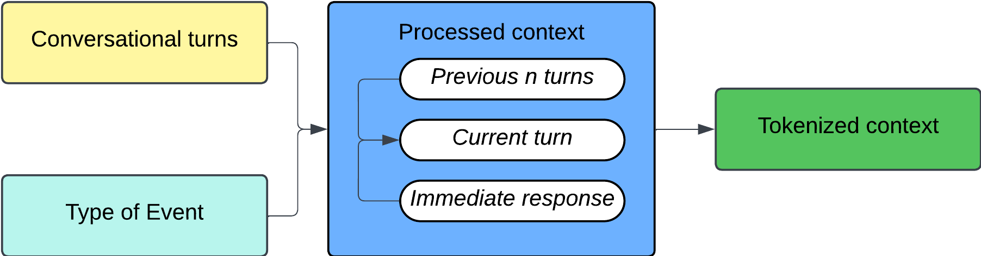
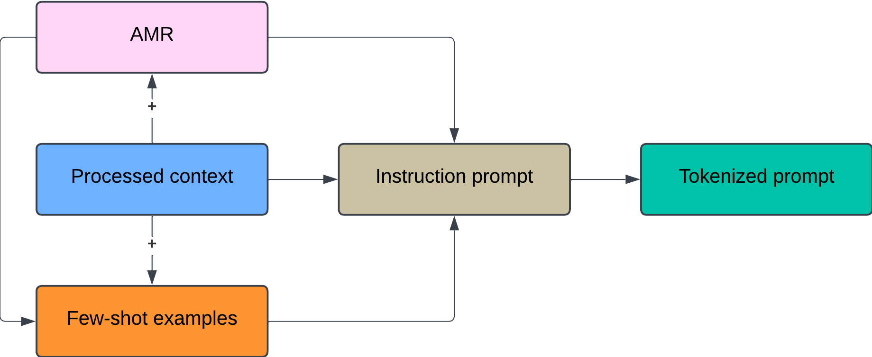
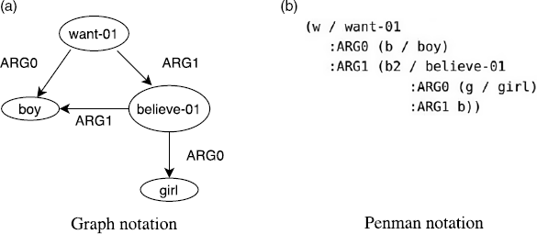
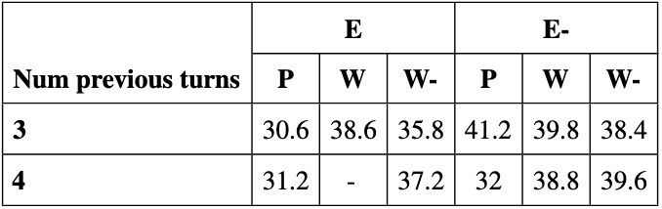
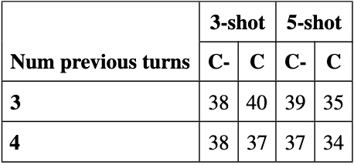
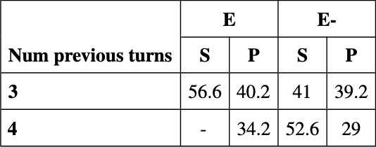





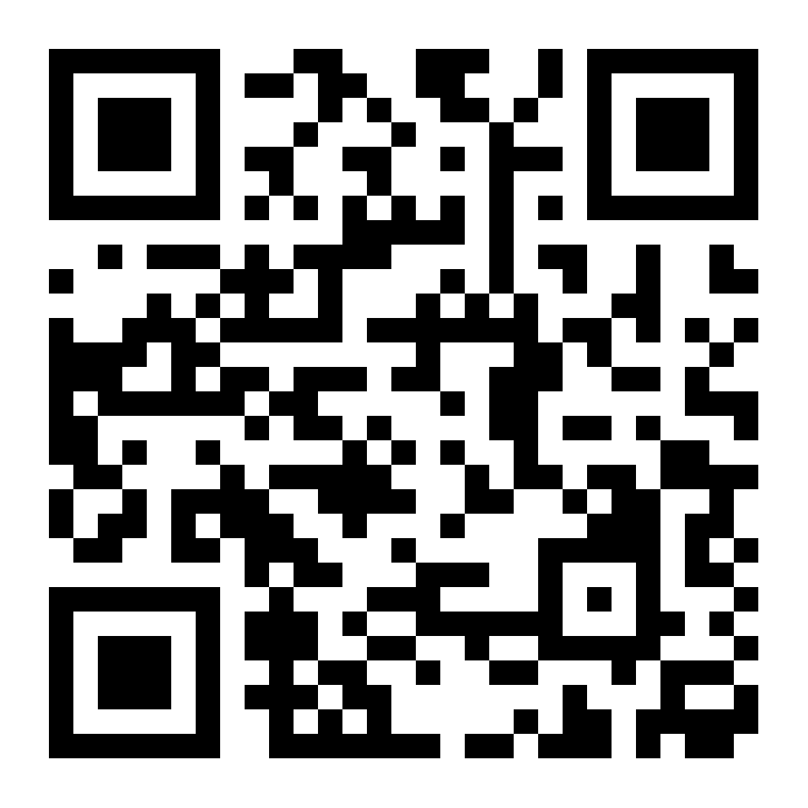
Large Language Models (LLMs) for micro-behavior detection in space missions
Ankush Raut¹, Projna Paromita² , Alaa Khader³, Sydney Begerowski⁴, Suzanne T. Bell⁵, Theodora Chaspari¹
¹University of Colorado Boulder, ²Texas A&M University,
³JESTech, ⁴KBR, ⁵NASA Johnson Space Center
54
Introduction
Subtle team interactions called micro-behaviors (uplifting, discouraging, neutral) can affect team dynamics in space missions
Methods inspired by the success of LLMs in SLU
Investigation of the feasibility of LLMs for micro-behavior detection in NASA’s Human Exploration Research Analog (HERA) missions, analyzing conversations from Team Interaction Battery (TIB) tasks spanning 5 days
Method – Overview
Data:
13,058 conversational turns (17.8% uplifting, 3.3% discouraging, 75.76% neutral, 3.14% nulls)
Model Architectures:
Encoder-only models: RoBERTa and DistilBERT for 3-way and binary sequence classification, respectively
Decoder-only models: LLaMA-2 and LLaMA-3.1 for causal text generation; both models 8-bit quantized
Chance macro-F1 score: 3-way – 26% | binary – 43%
Encoder-only models
Input:
Paradigms: Out-of-the-box (OOB) labelling, fine-tuning, paraphrase-augmented fine-tuning (P)
Decoder-only models
Input:
Paradigms: Few-shot prompting, AMR-augmented prompting, fine-tuning, inclusion of coding definition in the prompt
Training and Evaluation
5 cross-validation folds with each team in the hold-out set once
Conversations from the remaining teams split randomly into training and validation (for early stopping) sets in 3:1 ratio
Weighted cross entropy (W) loss for RoBERTa, standard cross-entropy loss for all other models
Average macro-F1 score across all folds
Results – Encoder models
RoBERTa OOB – 37% | DistilBERT OOB – 44%
AMR structure for The boy wanted to believe the girl.
Results – Decoder models
RoBERTa results
LLaMA-2 results
DistilBERT results
LLaMA-3.1 results
Conclusion
LLMs hold potential to detect subtle behaviors in conversations, which could be valuable in assessing team behavior in space exploration missions
Future directions including proposed models that can incorporate additional mission days and tasks beyond the TIB for objectively quantifying team behavior at high temporal resolution in space exploration missions
References
[1] Stoyanov et al. (2019), RoBERTa: A Robustly Optimized BERT Pretraining Approach. arXiv:1907.11692
[2] Sanh et al. (2019), DistilBERT, a distilled version of BERT: smaller, faster, cheaper and lighter. arXiv:1910.01108
[3] Touvron et al. (2023), Llama 2: Open Foundation and Fine-Tuned Chat Models. arXiv:2307.09288
[4] Brown et al. (2020), Language Models are Few-Shot Learners. arXiv:2005.14165
[5] Smith, I. A. & Griffiths, A. (2022). Microaggressions, everyday discrimination, workplace incivilities, and other subtle slights at work: A meta-synthesis. Human Resource Development Review, 21(3), 275-299.
[6] Oral E, Acar A, Eryiğit G. Abstract meaning representation of Turkish. Natural Language Engineering. 2024;30(1):171-200. doi:10.1017/S1351324922000183
Let's get connected on LinkedIn!

