Slide 1
Why We Do What We Do: Data Reuse, Open Access and Privacy in Data Management at the Life Sciences Data Archive
Sara C. Jorgensen¹, Diedre M. Thomas² and Kathryn A. Breslin²
¹Aegis Aerospace, ²Leidos

Slide 2
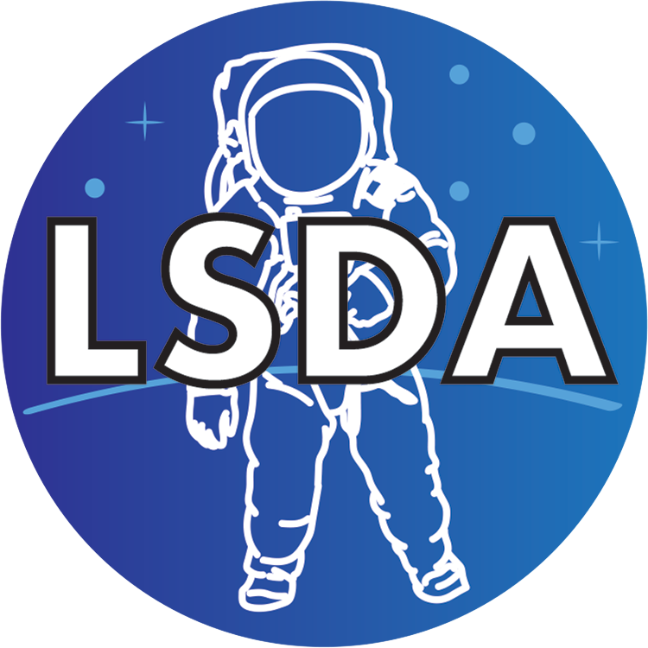
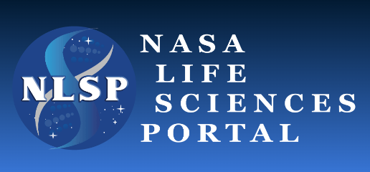
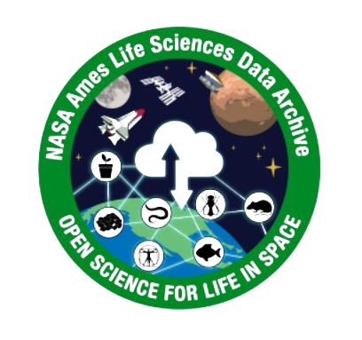
About LSDA
NASA repositories for unique and high-value space life sciences data.
Three-decade project for permanent data archiving and preservation.
Repositories house data from space flight, analog, and non-analog terrestrial studies.
Work with researchers to ingest data and metadata.
Provide data and supporting documentation for reuse in new research activities.
Focus is human data (but also archives some non-human data)
Works closely with LSAH (Lifetime Surveillance of Astronaut Health)
Primary access portal is NLSP
Based at Johnson Space Center
Focus is non-human data (but also archives some human data)
Works closely with GeneLab, NBISC (NASA Biological Institutional Scientific Collection) and BSP (Biospecimen Sharing Program)
Primary access portal is OSDR
Based at Ames Research Center
Federated

Slide 3
LSDA and Open Science (not Open Access)
“Open Science is the principle and practice of making research products and processes available to all, while respecting diverse cultures, maintaining security and privacy, and fostering collaborations, reproducibility, and equity.”
--Open Science Announcements from Federal Agencies
Astronaut corps as subjects:
Need to maintain confidentiality for public figures
Small pool of potential participants
Collaboration with LSAH:
Can improve understanding of physiology, health and performance
Need to respect sensitivity of data from medical context
“Astronaut” created by Freepik, from flaticon

Slide 4
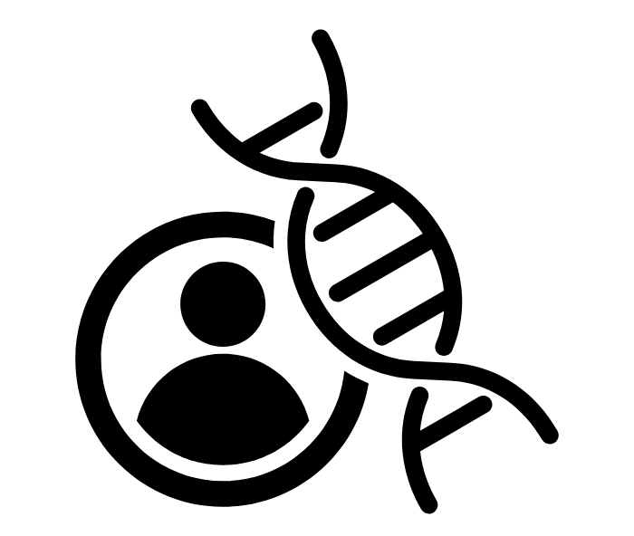
Paths for Human-Subject Data Reuse
Aggregate data: Some grouped/pooled data can be downloaded directly from NLSP.
Individual data: All potentially-identifiable and de-identified data and some grouped/pooled data must be requested using the Data Request form in NLSP.
Genetic data: All genetic data must be requested using the Data Request form.
For data provided in response to a data request:
Requestor works with repository staff to finalize needed variables and constraints;
LSDA and/or LSAH locate data, normalize and de-identify datasets where possible and requested (not all datasets can be de-identified);
Requestor receives data tailored to their specific needs.
Consent required for reuse of any genetic data.
“gene” created by Hendrick Hermawan from Noun Project (CC BY 3.0)

Slide 5
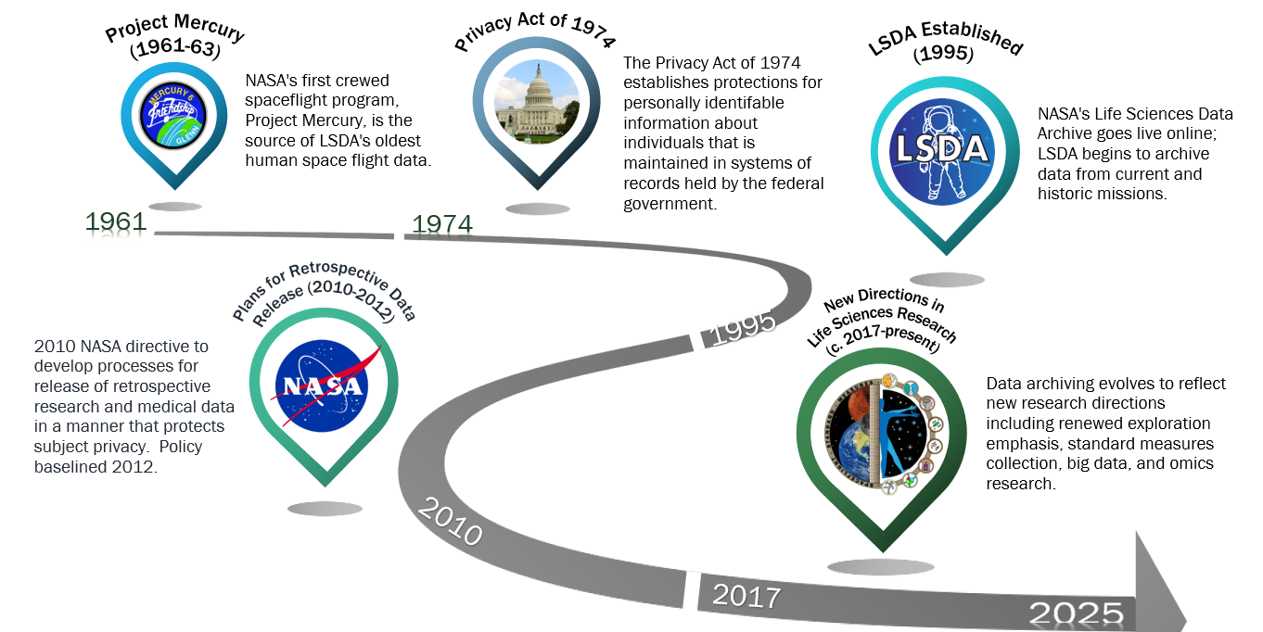
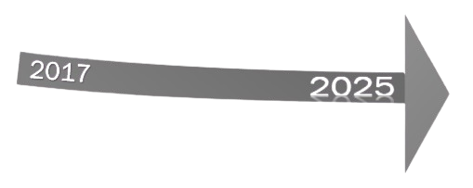
An Evolving Framework for Data Archiving

Slide 6
Data Protection and Consent
Spectrum of Consent Options
Broad consent
Broad-informed consent hybrid
Informed consent
No reuse
Participant broadly consents to data release for reuse
Participant broadly consents to reuse of some data
Retains informed consent option for some data
Participant provides consent on a case-by-case basis
(required for genetic data)
Participant does not consent to data reuse
Conservative Protection Practices in Providing Data for Reuse
Planned data set assessed for identifiability
Data assembled and provided to researchers
Request approved by LSAH Advisory Board (identifiable data)
IRB approves protocol (identifiable data) or issues NHSR determination (de-identified data)
Researchers complete and sign Data Use Agreement
Pre-publication privacy review of results
Informed consent obtained for data reuse
Consent for publication of identifiable data (if applicable)
“Data Collection” created by Ragil Heru Fitriyan. From flaticon
“Informed Consent” created by Uniconlabs. From flaticon
“Digital_publication” created by Julian Kücklich. From Wikimedia Commons (CC0)

Slide 7
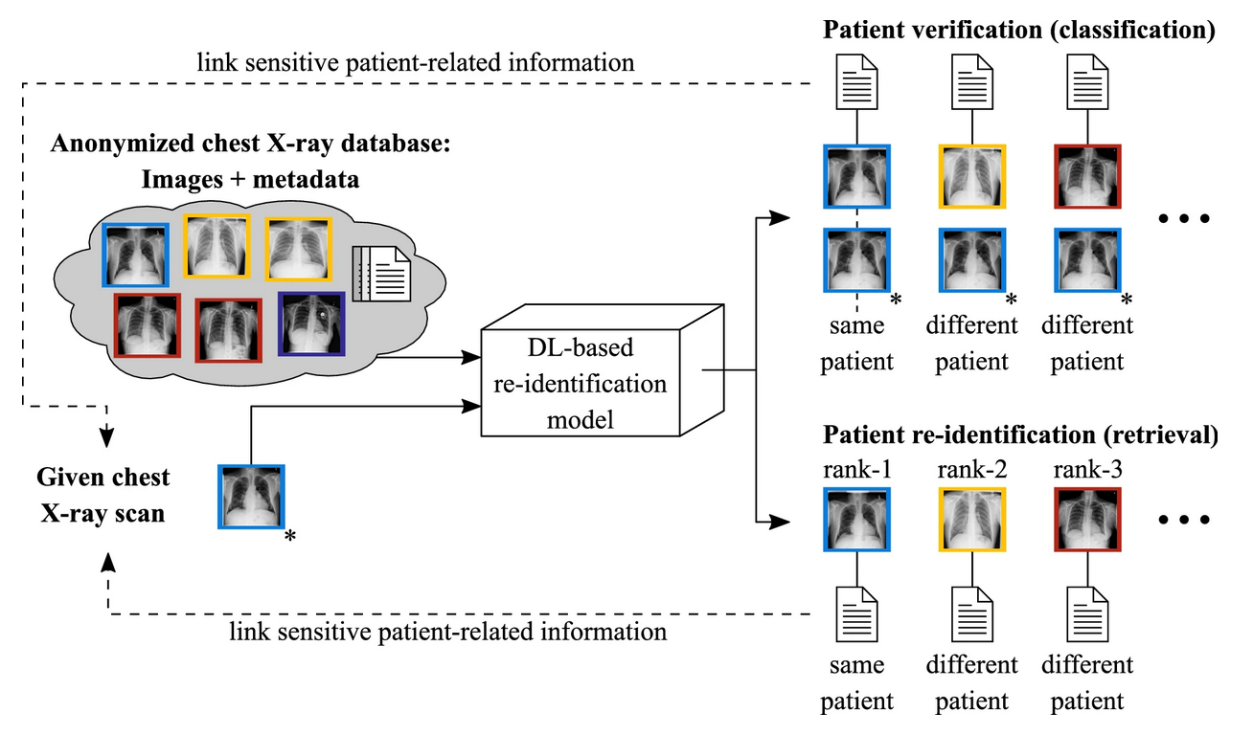
Privacy and Trust
“To call something private… was almost never to make recourse to an agreed-upon definition. It was to make an argument about the proper relationship between citizen, state, and society.”
--Sarah Igo, The Known Citizen
Historic concerns:
Fear of adverse professional consequences from release of data
Breaches of privacy due to public nature of space flight activity
Image: NASA
Current concerns:
Limitations of de-identification methods for privacy protection in the age of “big data” and AI/ML analysis tools
Possible adverse impacts from release of confidential data
Image: K. Packhäuser et al., “Deep Learning-based Patient Re-identification is Able to Exploit the Biometric Nature of Medical Chest X-ray Data,” Sci Rep 12, 14851 (2022), https://doi.org/10.1038/s41598-022-19045-3. CC By 4.0

Slide 8
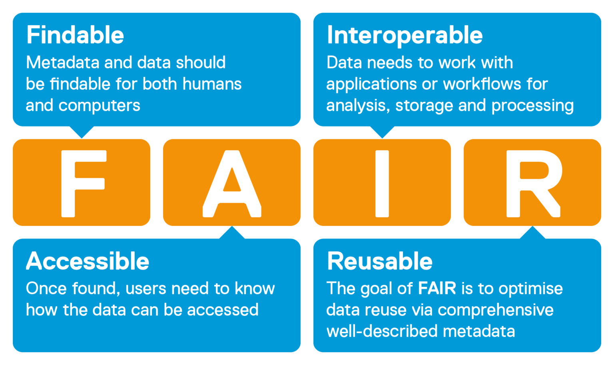
LSDA Work to Enhance Data and Metadata FAIRness
Repository tasks:
Addition of DOIs to public experiment records
Metadata cleanup across record sets
Work on development of Space Life Sciences Ontology
Cleanup and curation of historic datasets for enhanced reusability
Continued provision of rich public metadata to enable reuse of protected datasets
Collaboration with researchers:
Updated RDSA (Research Data Submission Agreement) and data submission guidelines support submission of FAIR-compatible data and metadata for ingestion into LSDA.
These efforts contribute to the content of Experiment records in NLSP, improving the findability of data on the platform.

Slide 9
Summing Up: Why We Do What We Do
“Increases in computing power, coupled with the increasing availability of data, are leading to amazing advances in science, but also result in new risks…. It is vital to build trust and mitigate the risk brought on by the use and reuse of data.”
--National Science and Technology Council, “Innovating the Data Ecosystem” (11.2024)
Strong data protections and consent practices
Maintaining accessibility, security and privacy
New studies and continuing participation
“Informed-consent” created by Uniconlabs, from flaticon
“Data security” by HJ Studio, from Freepik
“Access control” created by zero_wing, from flaticon
“Reliability” created by Pojok D, from flaticon
“Medical research” created by FBJan, from flaticon

Slide 10
Acknowledgements
Thanks to:
The LSDA Archivist team: Tyler Aguilar, Robert Beaton, Nyaia Liddell, Aimen Majeed, Rachel Shoop, Charlie Warren, Brenna Wheeler, Dayna Window
Sasha Portillo and Tayma Machkhas, LSDA/LSAH Science Coordinators
LSDA “Astronaut” icon designed by Rachel Shoop

Slide 11
Questions?
To request data, please submit a data request through NLSP:
https://nlsp.nasa.gov/explore/lsdahome/datarequest
To contact LSDA: jsc-lsda@mail.nasa.gov

