Slide 1



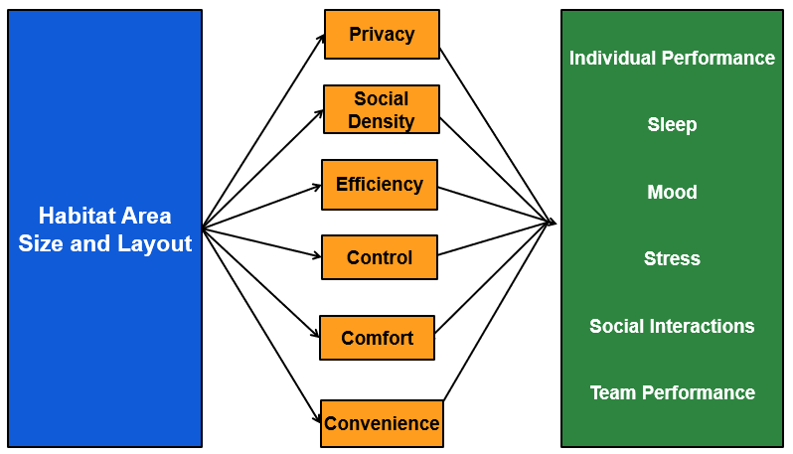
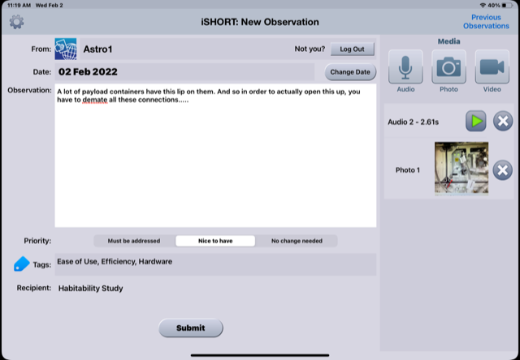
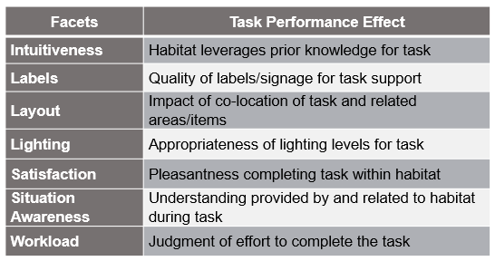
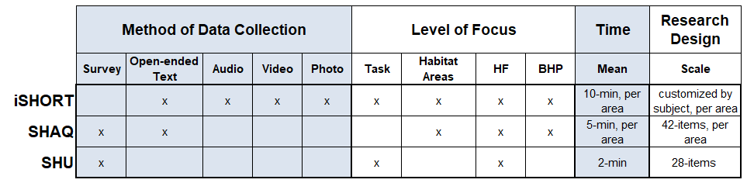
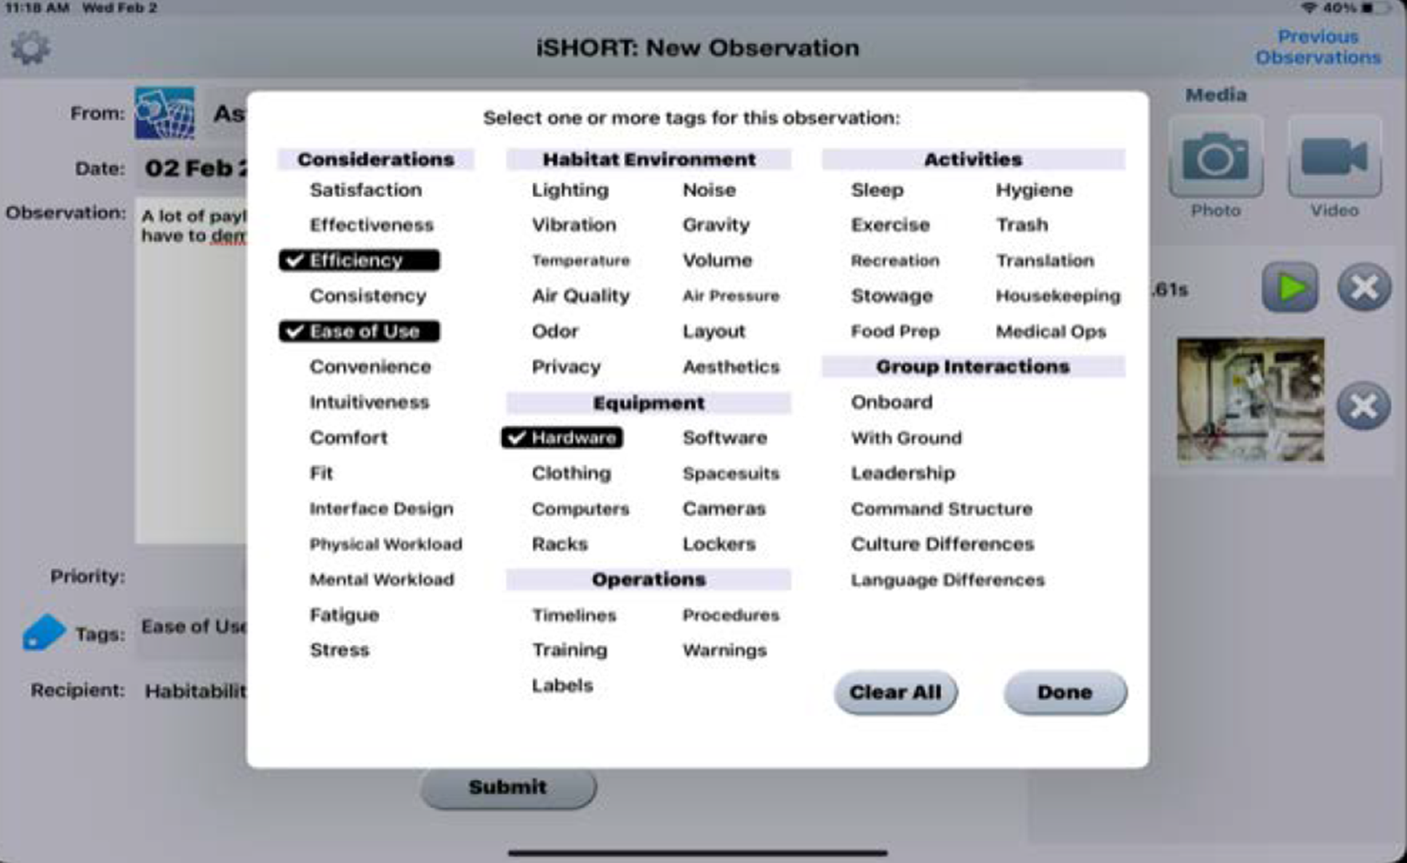
Habitability and Human Factors Assessment
Maya FarrHenderson¹, Jennifer C.W. Miller¹, Ian W.T. Robertson², Suzanne T. Bell³, & Lauren B. Landon²
¹JES Tech, ²KBR, Inc., ³NASA Johnson Space Center, Houston, TX
As long-duration habitats become a reality, a consideration of habitability and human factors (HF) is crucial. The habitat is more than just a place to live and work:
It is the crew’s perception of the space, and the psychological impacts of size, layout, and usage over time
It can support or strain behavioral health and performance (BHP)
Assess three habitability measures to better understand efficient deployment while maintaining the ability over time to:
Identify HF design concerns and related BHP impacts of a habitat
Detect individual well-being and team dynamics relationships to HF concerns
Capture habitability and HF change
Inform future standards for HF design
Background
Research Aims
iSHORT App
SHAQ Survey
The Scale for Habitat Usability (SHU) is a brief scale that captures how habitat design impacts perceived usability of the built environment in relation to task performance via different facets.
iSHORT (Space Habitability Observation Reporting Tool) collects detailed data about habitability and human factors related to the habitat, equipment, and tasks.
SHU Survey
The Subjective Habitability & Acceptability Questionnaire (SHAQ) evaluates:
each habitat’s unique areas (blue)
via Psychological Aspects of Habitability (gold)
to understand BHP impacts (green) of individual and team outcomes
Novel, subject-curated observation
Think-aloud protocol
Video record points of interest while narrating thoughts and actions
Offers multiple media options
Provides priority ratings
Include tags and other considerations
Three Measure Comparison
Initial Collections
Data collected from n = 6 individuals living in an isolated, confined, and extreme environment
iSHORT Standalone collected 4 times
SHAQ collected 9 times
iSHORT with SHAQ collected 3 times
Additional data collections are planned
Acknowledgments
This project was funded by a NASA Human Research Program Human Factors and Behavioral Performance Element directed task: Habitability and Human Factors Assessment (LB Landon, PI). KBR Inc. and JES Tech authors were supported by KBR’s Human Health and Performance Contract NNJ15HK11B with NASA.
Notes:
Include updates to SHAQ

