Slide 1
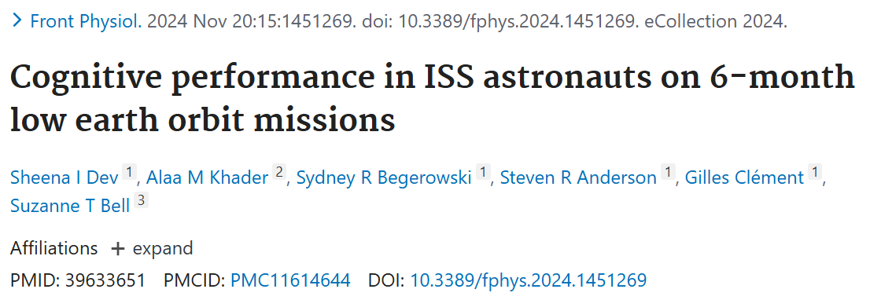
Cognitive Performance in ISS Astronauts on 6-month Low Earth Orbit Missions
Sheena I. Dev¹, Alaa M. Khader², Sydney R. Begerowski¹, Steven R. Anderson¹, Gilles Clement¹, & Suzanne T. Bell³
¹KBR, Inc; ²JES Tech; ³NASA Johnson Space Center
Notes:
Thank you all for the opportunity to present this data that was recently published just a few short weeks ago. We are very excited to share these findings with the community. This paper aims to characterize cognitive performance in 6 month low earth orbit mission.

Slide 2



Background
Spaceflight studies suggest mild and reversible decrements in specific cognitive domains
Shuttle missions¹⁻⁴: multiple stressor hypothesis
↓ Dual tasking
6-month ISS missions⁵⁻⁷: isolated domains sensitive to prolonged microgravity/adaptation, sleep
Early flight and early post flight: ↓ spatial working memory RT, spatial orientation, dual tasking
  Resolved up to 30 days post flight
No changes in processing speed, cognitive dual tasking, and visual memory
<6 hours of sleep: ↓ Sustained attention
1 year ISS mission⁸: comprehensive cognitive assessment
Early flight: improvements in most domains and ↓ visual memory and abstract reasoning
Late flight: ↓ emotion recognition speed and abstract reasoning accuracy
Widespread decrements that persisted up to 6 months post mission
Photo credit: NASA
Notes:
There has been much anecdotal evidence from astronaut crew that many experience cognitive difficulties, often described as brain fog, while in flight. Objective evidence from spaceflight studies are somewhat mixed but suggest mild and often reversible decrements in specific cognitive domains.
So for example there studies on shuttle missions documented weaknesses in dual task performance that some attribute to a consequence of multiple stressors experienced by the crew simultaneously.
Studies assessing cognitive performance on 6 month ISS missions have typically focused on specific domains hypothesized to be vulnerable to specific stressors, such as adaption to gravitational shifts or sleep restriction. Broadly, these have found worse sustained attention will 5 hours of sleep or less, and decrements in aspects of spatial working memory, spatial orientation, and dual tasking during phases with acute gravitational transitions that resolved in the post flight phase. But importantly, these 6 month ISS studies lack data assessing cognitive domains that may impact operational tasks, such as higher order executive functions and emotional processing.
New era that includes more comprehensive assessment of cognitive functions across a wide range of relevant cognitive domains using a battery of tests specifically designed for high performing populations. Prior to our study, only the NASA Twin study used this approach, and they identified early flight, late flight, and post flight decrements in specific cognitive domains in one astronaut on a 1 year ISS mission.
Other notes:
Results from these studies appear mixed and disjointed, largely due to differences in mission duration, standardization in testing procedures, at times the use of assessments not necessarily appropriate for high performing astronauts, or strong study designs that were specifically assessing the impact of a single hazard (like altered gravity). Gary strangman two reviews that highlights strengths and weaknesses

Slide 3
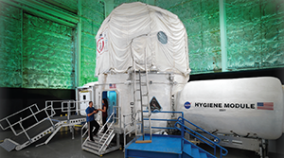
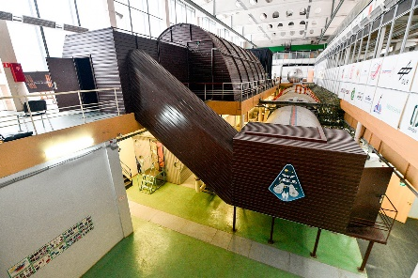


Background
Analog studies suggest mild and reversible decrements in the context of spaceflight stressors
Sleep restriction⁹⁻¹⁰
Head down bed rest ¹¹⁻¹⁵
Parabolic flight¹⁵⁻¹⁶
Isolation and confinement
+ variability in mood and sleep^{10,17}
Photo credits: NASA, NEK-IBMP/Oleg Voloshin
No studies has systematically assessed cognitive performance across a wide range of cognitive domains in a cohort of astronaut crew aboard the ISS for 6-month missions
Notes:
Analog studies have also documented changes in cognitive performance in the context of spaceflight stressors, including sleep restrictions, HDBR (prolonged microgravity), parabolic flight (acute gravitational transitions), and diet enhancements. Some have also demonstrated individual variability in cognitive outcomes in the context of combined stressors (such as isolation and confinement and sleep restriction). The specifics of each of these can be found in the publications, but I’ll point out that the decrements observed were not global, rather restricted to specific cognitive domains such as sustained attention and processing speed.
Taken together, the extant literature documenting cognitive performance in spaceflight or spaceflight analogs suggests possible mild decrements in some, but not necessarily all, cognitive domains and that these decrements may be singularly or synergistically influenced by multiple spaceflight hazards (e.g., altered gravity) and stressors (e.g., sleep restriction). Spaceflight is dynamic and thus there is potential for hazards and stressors to interact in varying degrees within a mission, it is also possible that there are specific mission phases in which performance is more vulnerable to decrements.

Slide 4
Aims
To examine cognitive performance in a cohort of astronaut crew aboard the ISS for 6-month missions:
  Provide a descriptive summary of performance across several cognitive domains
  Characterize cognitive performance over time and between distinct mission phases
  Examine the prevalence of low scores across tests during flight and post-flight
Exploratory Aim: To explore the relationship between self-reported sleep and ratings of alertness
Notes:
Therefore, the primary aims of this study
Focus on differences between mission phases for this

Slide 5
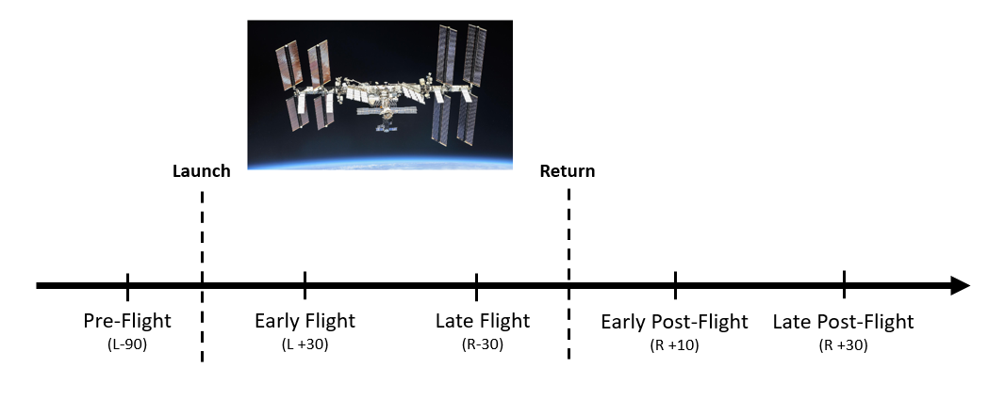
Methods
Spaceflight Standard Measures Project (PI: Gilles Clement, PhD)
25 Astronauts on 6-month ISS missions
Age: 33-61 years; Mean= 45.12
8 Female, 17 male
Photo credit: NASA
Notes:
To address these aims we leveraged data from the Spaceflight Standards Measures, which is a cross-cutting multidisciplinary study that aims to characterize risk across a number of different human systems. Cognitive performance was assessed under this protocol and the current analysis includes 25 astronauts on approximately 6 month ISS missions. Relevant age and gender information is presented on this slide. Cognitive performance was assessed at 5 timepoints, or mission phases, for each individual. The data collection protocol is represented in this figure here, with a solid horizontal black line representing time, the dotted vertical lines representing launch and return. There was one session during the pre-flight mission phase around 90 days before flight; 2 inflight session corresponding to an early flight mission phase at around FD 30 and a late flight mission phase occurring around 30 days before return; and two post flight sessions which included an Early post flight mission phase around R+10 and late post flight mission around R+30.
Repeat the concept that these are pairwise comparisons between mission phases, repeat over and over again
SD = 7.14

Slide 6
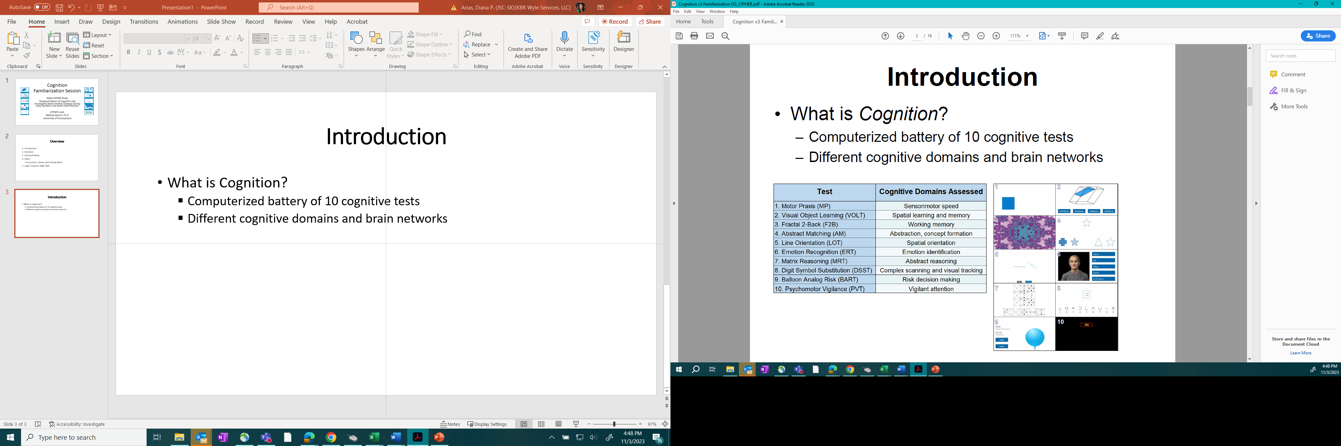
Methods
Cognition Battery¹⁹⁻²¹
Speed and Accuracy z-scores calculated from sample’s baseline data
Notes:
Cognitive performance was assessed with Cognition Battery is a computerized test that was developed to assess a range of cognitive domains in high performing individuals, specifically astronaut or astronaut-like populations (Basner et al., 2015). The table on the right of this slide highlights the 10 subtests in the battery and the cognitive domains they assess. Each subtest has a speed and accuracy metric, and there are published practice effect corrections available to account for study designs with repeated administrations. For this analysis, we used the samples baseline mean and standard deviation scores to create z scores for across all datapoints such that higher z scores represent either faster or more accurate performance, respectively.
We created z scores for each participants score at each mission phase by removing the participant from the sample and using the remaining samples baseline mean and standard deviation scores.; we repeated this iteratively for each subtest for each individual. These z scores then represent deviation from the samples baseline mean performance.

Slide 7
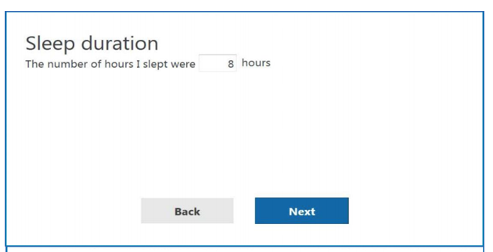
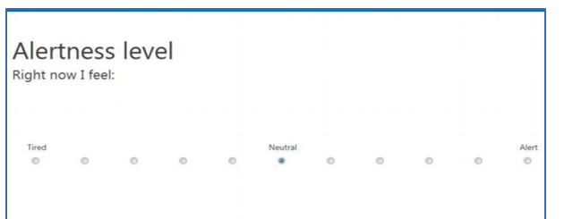
Methods
Cognition Battery¹⁹⁻²¹
Survey:
Wake time: 24hr clock
Sleep duration: Hours
Consumption: Caffeine, alcohol, other meds
Alertness level: 0-10 Likert scale
Notes:
The Cognition Battery begins with a survey that is administered immediately prior to the cognitive tests. The items are presented here. To address our exploratory aims, we focused on the two items highlighted in blue. Sleep duration, or the self-reported number of hours of sleep obtained the night prior; and an item assessing the individual’s current level of alertness on an 11 pt Likert scale, where 0 = tired and 10 = Alert

Slide 8
Analytical Approach
Provide a descriptive summary of performance across cognitive domains
  Descriptive information of raw baseline scores and z-scores at each mission phase
Characterize performance over time and between distinct mission phases
  Linear mixed models to assess relationship over time
  Follow up pairwise comparisons to compare distinct mission phases
Examine the prevalence of low scores in flight and post mission
  Percent frequency of scores ≤ 1.5 standard deviations of baseline (≤ -1.5z)
To explore the relationship between self-reported sleep and ratings of alertness
  Linear mixed models to assess the relationship between cognitive outcomes and survey responses
Notes:
For our first aim, we generated tables with raw and zscores at each mission phase
For our second aim, we utilized linear mixed models with random subject intercepts to assess relationship over time, but we really focused on the follow up pairwise comparisons to compare distinct mission phases, which I have defined for you on previous slide to include preflight, early flight, late flight, early post flight, late post flight
For our third aim, calculated the percent frequency of in flight and postflight scores that fell below 1.5 standard deviations of the samples baseline. This cut off was chosen due to its use as a notable decrement in clinical settings.
Finally, to address our exploratory aim we utilized linear mixed models with random subject intercepts to assess the relationship between cognitive outcomes and survey response

Slide 9
Results

Slide 10
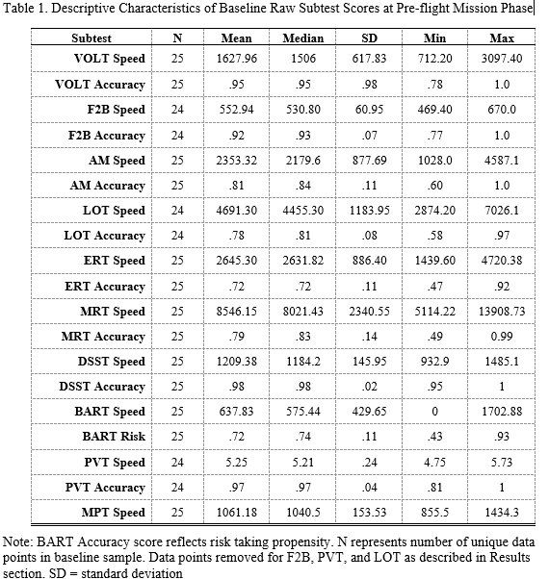
Aim 1: Provide a descriptive summary of performance across several cognitive domains
Preliminary normative database of 25 astronaut crew
Table with descriptive summary of z-scores by subtest and mission phase not shown
Notes:
We present a pre-flight normative database of 25 astronaut crew that can be used to contextualize future performance. Supplementary tables also include descriptive information for raw and z transformed scores for all subtests across all mission phases.
Note, sample size too small to stratify by age bins

Slide 11
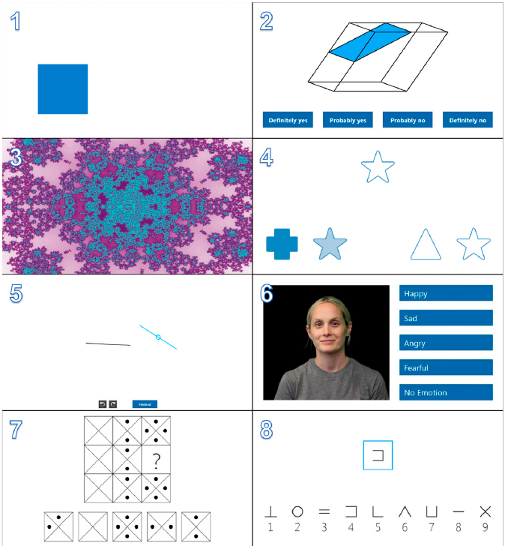
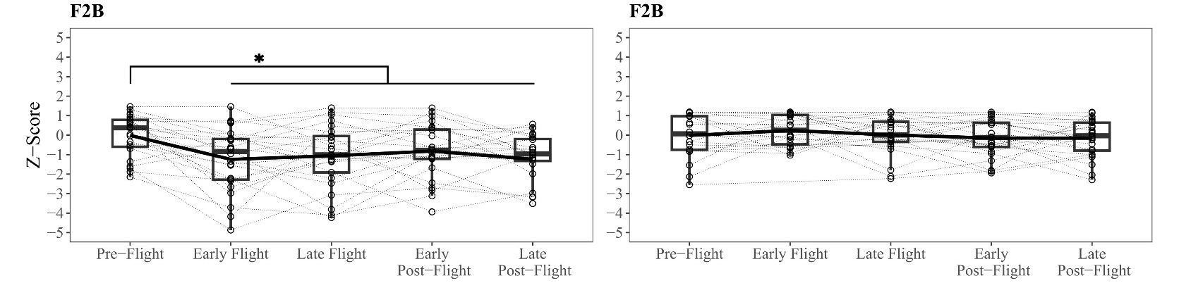
Aim 2: Characterize cognitive performance between distinct mission phases
Speed
Accuracy
Preserved accuracy but slower performance in visuospatial working memory in early flight through post flight phases.
Sheena I. Dev PhD | sheena.i.dev@nasa.gov
Notes:
Our second aim utilized linear mixed models with follow up pairwise comparisons to compare performance between distinction mission phases.
This slide depicts results from the fractal 2-back task, which is a measure of visual working memory. This is our ability to hold and manipulate information in your mind. For example, doing mental math at the grocery store to keep track of your running total as you are shopping. Here our analysis revealed preserved accuracy (on the right) but slower performance at the early flight mission phase that was persistent but stable through the end of data collection at the late post flight time point.
Difference between preflight and early flight on averages was approx. 75ms

Slide 12
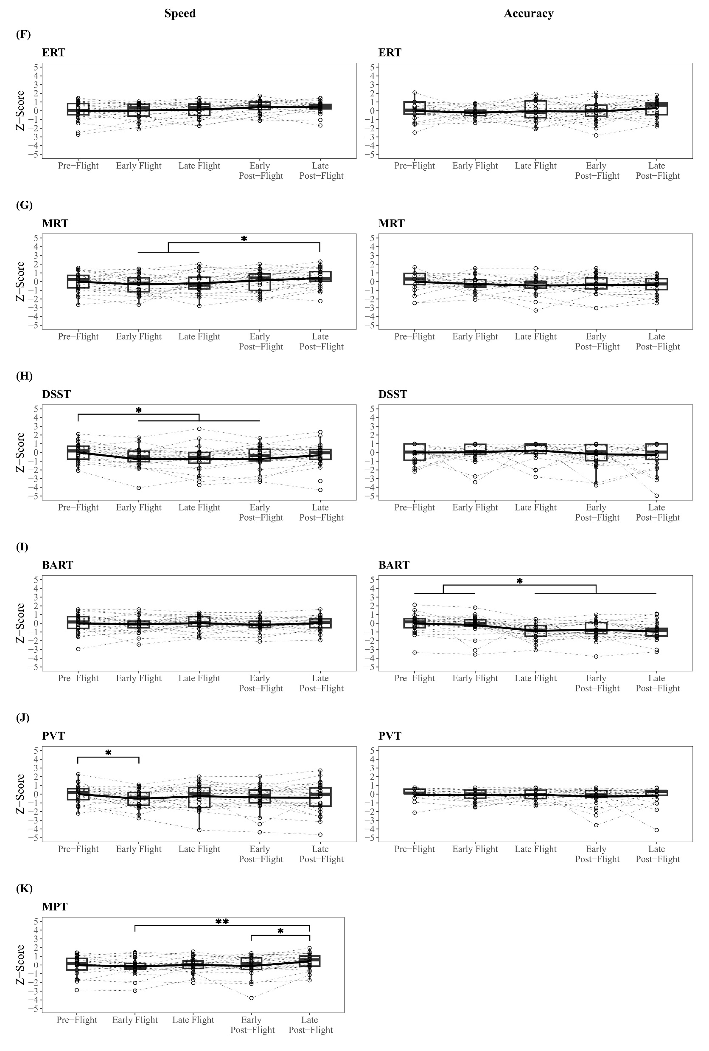
Aim 2: Characterize cognitive performance between distinct mission phases
Speed
Accuracy
Preserved accuracy but slower performance in processing speed in early flight that recovered in late post-flight
Sheena I. Dev PhD | sheena.i.dev@nasa.gov
Notes:
This slide presents results from the Digit Symbol Substitution tests, which is a task assessing processing speed, which refers to how quickly information is received, interpreted and ultimately acted upon. So how quickly are you taking in and interpreting the items on the shelf and choosing your target can of soup. Here we report preserved accuracy over mission phases. Response times were significantly slower starting at the early flight mission phase, that was persistent yet stable through the remainder of flight and early post flight mission phase. Scores returned to preflight baseline by the late post flight mission phase.
Difference between preflight and early flight on averages was approx. 113

Slide 13
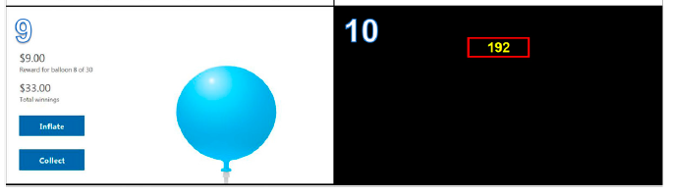
Aim 2: Characterize cognitive performance between distinct mission phases
Speed
Accuracy
Preserved accuracy but slower performance in sustained attention in early flight only
Sheena I. Dev PhD | sheena.i.dev@nasa.gov
Notes:
Panel J presents results from the Psychomotor vigilance Task assessing sustained attention, or the ability to maintain attention to a stimulus for prolonged periods of time. Most classic example of this is maintaining attention while driving. Our results show preserved accuracy between mission phases. Slower performance was observed at the early flight mission phase though this had resolved by the late flight.
Eleven and 20 lapses (355-ms threshold) on the PVT optimally divided SLST performance into high-, medium-, and low-performance bouts with significantly decreasing threat detection performance A'. Assignment to the different SLST performance groups replicated homeostatic and circadian patterns during total sleep deprivation.

Slide 14
Aim 2: Characterize cognitive performance between distinct mission phases
Speed
Accuracy
Reduced risk-taking propensity in late flight and post flight
Sheena I. Dev PhD | sheena.i.dev@nasa.gov
Notes:
Panel I presents results from The balloon analog risk task. This is a measure of risk tolerance. Here accuracy is better characterized as a measure of risk taking propensity, so higher scores represent greater risk-taking propensity (or more likely to take risks). Our results revealed reduced risk-taking propensity in late flight and both post flight mission phases compared to pre flight baseline and early flight mission phases.
Individuals are asked to make decisions about how much they are willing to inflate a virtual balloon in return for a reward. The reward is lost if they over inflate and pop the balloon.

Slide 15
Aim 2: Characterize cognitive performance between distinct mission phases
Stable or improved performance between mission phases:
Visual Memory
Abstract Reasoning
Concept Formation
Emotion Recognition
Spatial Orientation
Sensorimotor
Sheena I. Dev PhD | sheena.i.dev@nasa.gov
Notes:
We observed either stable or improved performance between mission phases in all remaining tasks. So in other words no group level decrements were observed between mission phases. This includes the tasks displayed here: visual memory (B; visual object learning test), concept formation (D; abstract matching), and spatial orientation (E; line orientation task), abstract reasoning (G; Matrix reasoning), emotion recognition (F; emotion recognition task), and sensorimotor function (K; Motor praxis task).
Visual memory – ability to learn and recall visual information's
Concept formation – novel problem solving or ability to change strategy after obtaining feedback/new information
Spatial orientation – book on a book shelf
Abstract reasoning is pattern recognition

Slide 16
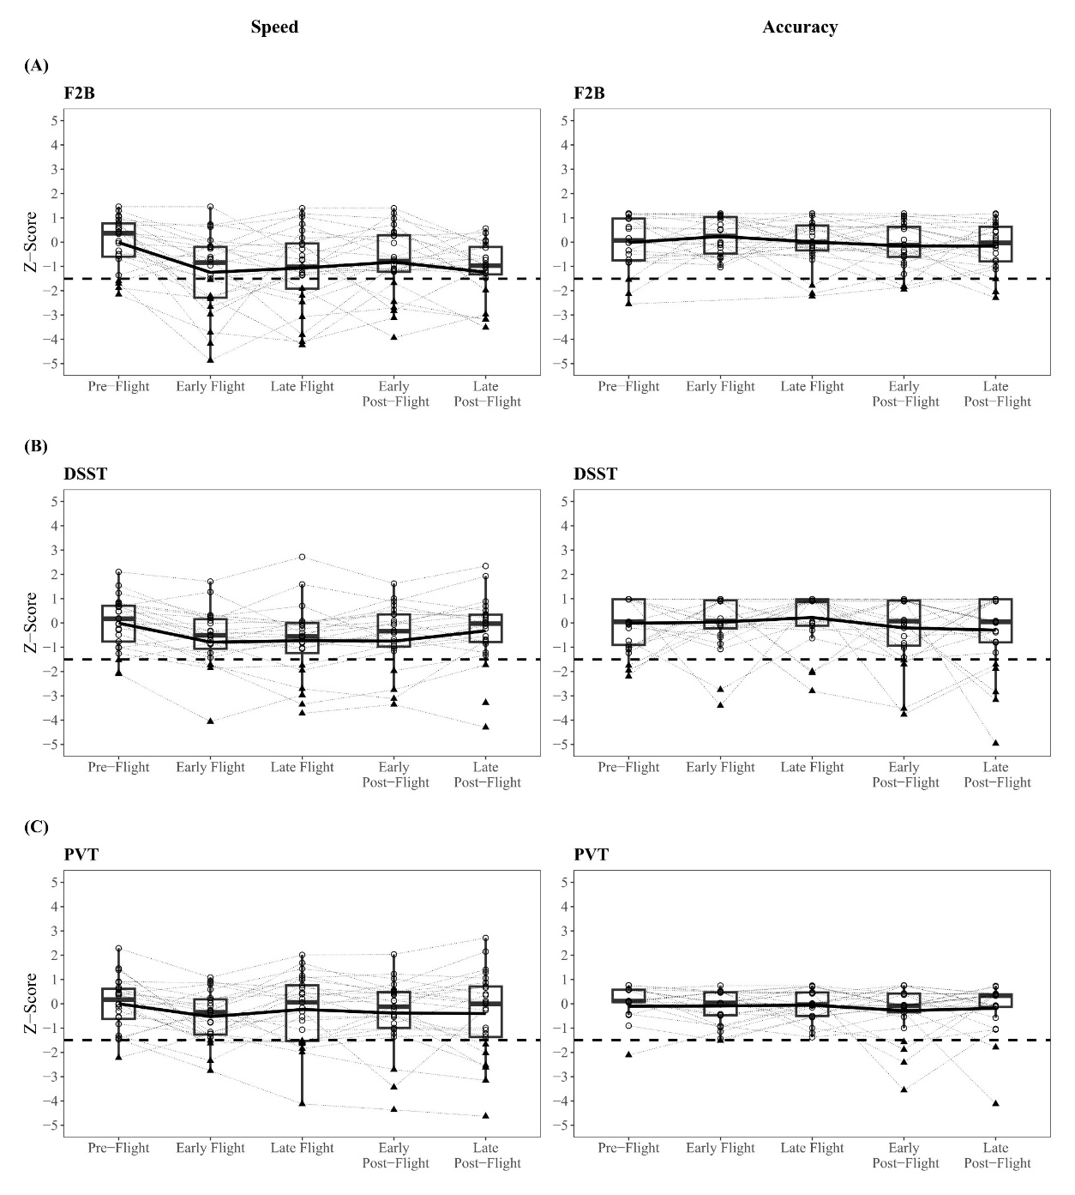
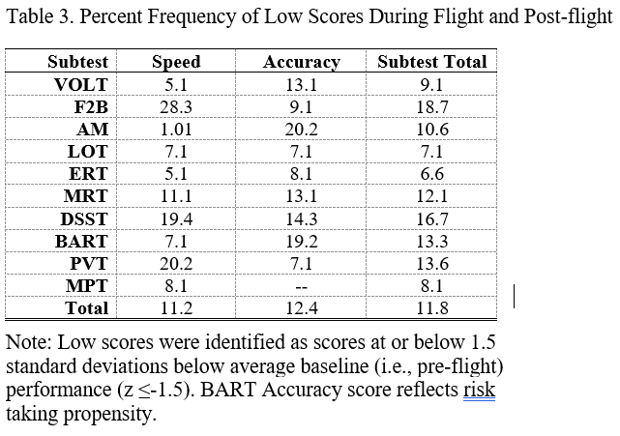
Aim 3: Examine the prevalence of low scores across tests during flight and post flight mission phases
1
2
3
Greatest frequency of low scores on tasks of visuospatial working memory, processing speed, and sustained attention
Presentation Text | Additional Text
Sheena I. Dev PhD | sheena.i.dev@nasa.gov
Notes:
Aim 3 focused on quantifying the percent frequency of in flight and post flight data points that classified as a “low score” compared to the samples pre-flight baseline. Again we utilized a cut off of ≤1.5 standard deviations.
Table on the right presents the percent frequency of low scores by subtests. Three subtests with the highest frequency of low scores are tasks of visuo spatial working memory, processing speed, and sustained attention. This is visualized in the figure to the left, which is organized much the same and previous figures; Our cut off is represented by the additional dotted horizontal line and individual data points classified as “low score” are represented by triangles. This really highlights that even among those domains with group level changes between mission phases, there is a degree of interindividual variability that is also observed. And in fact we can also see that in some subtest in which we did not see group level changes between mission phases. The VOLT and AM test are highlighted in the table. So in other words, whether or not there are observed group level changes between mission phases, there is a degree of interindividual variability in performance that may be important to assess in our crew.
Interestingly, I highlighted accuracy scores of visual memory and abstract matching

Slide 17
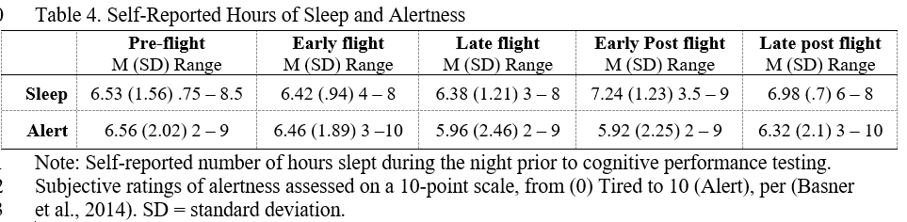
Exploratory aim: To explore the relationship between self-reported sleep and ratings of alertness
No clear relationships between hours of sleep reported or alertness and performance on any subtest of the Cognition battery
Sheena I. Dev PhD | sheena.i.dev@nasa.gov
Notes:
Note, sample size too small to stratify by age bins
Across all mission phases, there were no relationships between hours of sleep reported and performance on any subtest of the Cognition battery. Alertness was inversely related to DSST accuracy (β = -.1, p = .05) only.
Alertness was inversely related to DSST accuracy (β = -.1, p = .05) only.

Slide 18
Summary
Generally stable or improved speed and accuracy across most tasks
Early slowed processing speed, visual working memory, and sustained attention
  Greatest frequency of low scores (≤ 1.5 below baseline mean) in these same domains, highlighting individual level deviation from preflight means
Reduced risk taking at late flight and post flight phases
Stable memory and executive functions
No clear relationships between performance and self-reported hours of sleep obtained or ratings of alertness
Notes:
Astronauts may modulate risk taking propensity to adapt to mission demands
Operational insight into their perceptions of how comfort with risk taking may impact interactions
May be prudent to see to what extend will that impact decision making, warrants further investigation, particularly in late mission tasks.
May not be that higher or lower scores are adaptive or maladaptive

Slide 19
Discussion
Living and working on the ISS in LEO for 6 months was not associated with widespread cognitive impairment or neurodegeneration.
Observed variability at group and individual level in domains vulnerable to state-like changes expected in the context of combined operational stressors
Observed changes in specific domains across mission phases can inform mission support, including planning, scheduling, and medical monitoring
Preliminary normative dataset of astronaut crew that can be used for further study and operational support
Notes:
Overall, the outcomes of this study are very positive. We have demonstrated that living and working in low earth orbit for approx. 6 months was not associated with widespread cognitive impairment or neurodegeneration. This is notable not only just for our NASA professional astronauts, but also for future private astronauts as the commercialization of space in low earth orbit continues to evolve.
The group and individual level changes and variability that we did observe were primarily in those domains that terrestrial literature has shown to be vulnerable to state-like changed in the context of stressors. This is particularly salient in these operational settings where there are both spaceflight hazards as well as operational stressors that could influence these domains.
This characterization is helpful and can inform mission support, including in operational planning and scheduling, medical monitoring, and development of human system interactions that reduce the demands of these vulnerable domains to support operational tasks
Finally, I would argue that the most important outcome of this study is a normative dataset that characterizes both preflight baseline and also expected changes in cognitive performance in flight. This is an evidence base that can supplement decision making for medical and psychological support by characterizing individual or group level deviations from expectations. As we move toward lunar and mars mission, this can also contribute to a LEO comparison with which we may be able to quantify additional risk to behavioral health outcomes as additional risk drivers are introduced to missions. “ENTIRELY NEW SET OF STRESSORS TO FUTURE MISSIONS”
Lauren discussion:
Different domains are at risk, and then there are individual differences in how people experience this. So some will have ar eally hard time and others will be able to compensate effectively
Celebrate the box
We have this diverse, broader group entering space, going to be more a part of humanity extending to commercial thought

Slide 20


Acknowledgements
NASA Astronaut Crew
NASA Standard Measures Team
  Corey Theriot, PhD
NASA Behavioral Health and Performance Laboratory
  Diana Arias, MS
  Pete Roma, PhD
  Lindsey Sirianni, MS
  Cara Spencer, MS
  Sara Whiting, PhD
NASA Research Operations and Integration
  Scott Humbert, MS
  Alexis Little
  Cherie Oubre, PhD
  Gwen Sandoz
  Sophia Vargas, MPH
  Shelby Weyand
NASA Human Research Program HFBP Element
  Jayati Roy Choudhury, PhD
  Brian Gore, PhD
  Ajit Mulavara, PhD
  Sandra Whitmire, PhD
  Thomas Williams, PhD
Millennia Young, PhD
Mathias Basner, PhD

Slide 21
References
Heuer, H., Manzey, D., Lorenz, B., & Sangals, J. (2003). Impairments of manual tracking performance during spaceflight are associated with specific effects of microgravity on visuomotor transformations. Ergonomics, 46(9), 920-934. https://doi.org/10.1080/0014013031000107559
Manzey, D., Lorenz, T. B., Heuers, H., & Sangals, J. (2000). Impairments of manual tracking performance during spaceflight: more converging evidence from a 20-day space mission. Ergonomics, 43(5), 589-609. https://doi.org/10.1080/001401300184279
Manzey, D., Lorenz, B., Schiewe, A., Finell, G., & Thiele, G. (1995). Dual-task performance in space: results from a single-case study during a short-term space mission. Hum Factors, 37(4), 667-681. https://doi.org/10.1518/001872095778995599
Burles, F., & Iaria, G. (2023). Neurocognitive Adaptations for Spatial Orientation and Navigation in Astronauts. Brain Sci, 13(11). https://doi.org/10.3390/brainsci13111592
Moore, S. T., Dilda, V., Morris, T. R., Yungher, D. A., MacDougall, H. G., & Wood, S. J. (2019). Long-duration spaceflight adversely affects post-landing operator proficiency. Sci Rep, 9(1), 2677. https://doi.org/10.1038/s41598-019-39058-9
Takács, E., Barkaszi, I., Czigler, I., Pató, L. G., Altbäcker, A., McIntyre, J., Cheron, G., & Balázs, L. (2021). Persistent deterioration of visuospatial performance in spaceflight. Sci Rep, 11(1), 9590. https://doi.org/10.1038/s41598-021-88938-6
Tays, G. D., Hupfeld, K. E., McGregor, H. R., Salazar, A. P., De Dios, Y. E., Beltran, N. E., Reuter-Lorenz, P. A., Kofman, I. S., Wood, S. J., Bloomberg, J. J., Mulavara, A. P., & Seidler, R. D. (2021). The Effects of Long Duration Spaceflight on Sensorimotor Control and Cognition. Front Neural Circuits, 15, 723504. https://doi.org/10.3389/fncir.2021.723504
Garrett-Bakelman, F. E., ….Snyder, M. P., & Turek, F. W. (2019). The NASA Twins Study: A multidimensional analysis of a year-long human spaceflight. Science, 364(6436). https://doi.org/10.1126/science.aau8650
Nasrini, J., Hermosillo, E., Dinges, D. F., Moore, T. M., Gur, R. C., & Basner, M. (2020). Cognitive performance during confinement and sleep restriction in NASA’s Human Exploration Research Analog (HERA). Frontiers in physiology, 11, 394.
Basner, M., Dinges, D. F., Mollicone, D. J., Savelev, I., Ecker, A. J., Di Antonio, A., Jones, C. W., Hyder, E. C., Kan, K., Morukov, B. V., & Sutton, J. P. (2014). Psychological and behavioral changes during confinement in a 520-day simulated interplanetary mission to mars. PloS one, 9(3), e93298-e93298. https://doi.org/10.1371/journal.pone.0093298
Basner, M., Dinges, D. F., Howard, K., Moore, T. M., Gur, R. C., Mühl, C., & Stahn, A. C. (2021). Continuous and Intermittent Artificial Gravity as a Countermeasure to the Cognitive Effects of 60 Days of Head-Down Tilt Bed Rest. Front Physiol, 12, 643854. https://doi.org/10.3389/fphys.2021.643854
Yuan, P., Koppelmans, V., Reuter-Lorenz, P. A., De Dios, Y. E., Gadd, N. E., Wood, S. J., Riascos, R., Kofman, I. S., Bloomberg, J. J., Mulavara, A. P., & Seidler, R. D. (2016). Increased Brain Activation for Dual Tasking with 70-Days Head-Down Bed Rest. Front Syst Neurosci, 10, 71. https://doi.org/10.3389/fnsys.2016.00071
Basner, M., Stahn, A. C., Nasrini, J., Dinges, D. F., Moore, T. M., Gur, R. C., Mühl, C., Macias, B. R., & Laurie, S. S. (2021). Effects of head-down tilt bed rest plus elevated CO(2) on cognitive performance. J Appl Physiol (1985), 130(4), 1235-1246. https://doi.org/10.1152/japplphysiol.00865.2020
Brauns, K., Werner, A., Gunga, H. C., Maggioni, M. A., Dinges, D. F., & Stahn, A. (2019). Electrocortical Evidence for Impaired Affective Picture Processing after Long-Term Immobilization. Sci Rep, 9(1), 16610. https://doi.org/10.1038/s41598-019-52555-1
Messerotti Benvenuti, S., Bianchin, M., & Angrilli, A. (2013). Posture affects emotional responses: a Head Down Bed Rest and ERP study. Brain Cogn, 82(3), 313-318. https://doi.org/10.1016/j.bandc.2013.05.006
Stahn, A. C., Riemer, M., Wolbers, T., Werner, A., Brauns, K., Besnard, S., Denise, P., Kühn, S., & Gunga, H. C. (2020). Spatial Updating Depends on Gravity. Front Neural Circuits, 14, 20. https://doi.org/10.3389/fncir.2020.00020
Friedl-Werner, A., Machado, M. L., Balestra, C., Liegard, Y., Philoxene, B., Brauns, K., Stahn, A. C., Hitier, M., & Besnard, S. (2021). Impaired Attentional Processing During Parabolic Flight. Front Physiol, 12, 675426. https://doi.org/10.3389/fphys.2021.675426
Stahn, A. C., Gunga, H. C., Kohlberg, E., Gallinat, J., Dinges, D. F., & Kühn, S. (2019). Brain Changes in Response to Long Antarctic Expeditions. N Engl J Med, 381(23), 2273-2275. https://doi.org/10.1056/NEJMc1904905
Basner, M., Savitt, A., Moore, T. M., Port, A. M., McGuire, S., Ecker, A. J., Nasrini, J., Mollicone, D. J., Mott, C. M., McCann, T., Dinges, D. F., & Gur, R. C. (2015). Development and Validation of the Cognition Test Battery for Spaceflight. Aerosp Med Hum Perform, 86(11), 942-952. https://doi.org/10.3357/amhp.4343.2015
Lee, G., Moore, T. M., Basner, M., Nasrini, J., Roalf, D. R., Ruparel, K., Port, A. M., Dinges, D. F., & Gur, R. C. (2020). Age, Sex, and Repeated Measures Effects on NASA's "Cognition" Test Battery in STEM Educated Adults. Aerosp Med Hum Perform, 91(1), 18-25. https://doi.org/10.3357/amhp.5485.2020
Basner, M., Hermosillo, E., Nasrini, J., Saxena, S., Dinges, D. F., Moore, T. M., & Gur, R. C. (2020). Cognition test battery: Adjusting for practice and stimulus set effects for varying administration intervals in high performing individuals. J Clin Exp Neuropsychol, 42(5), 516-529. https://doi.org/10.1080/13803395.2020.1773765

Slide 22
Thank you!

