Slide 1

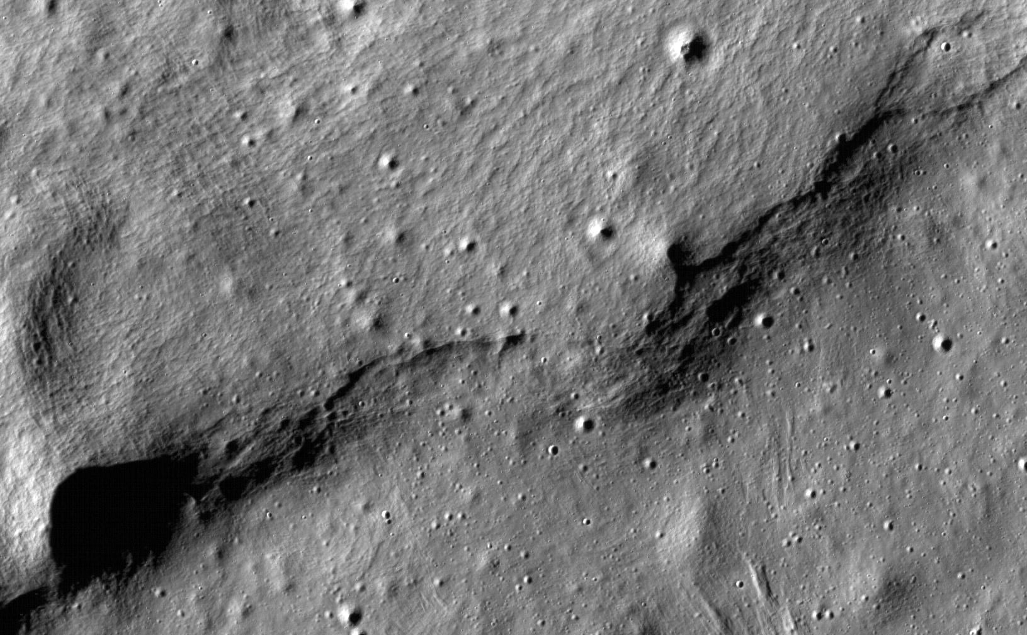


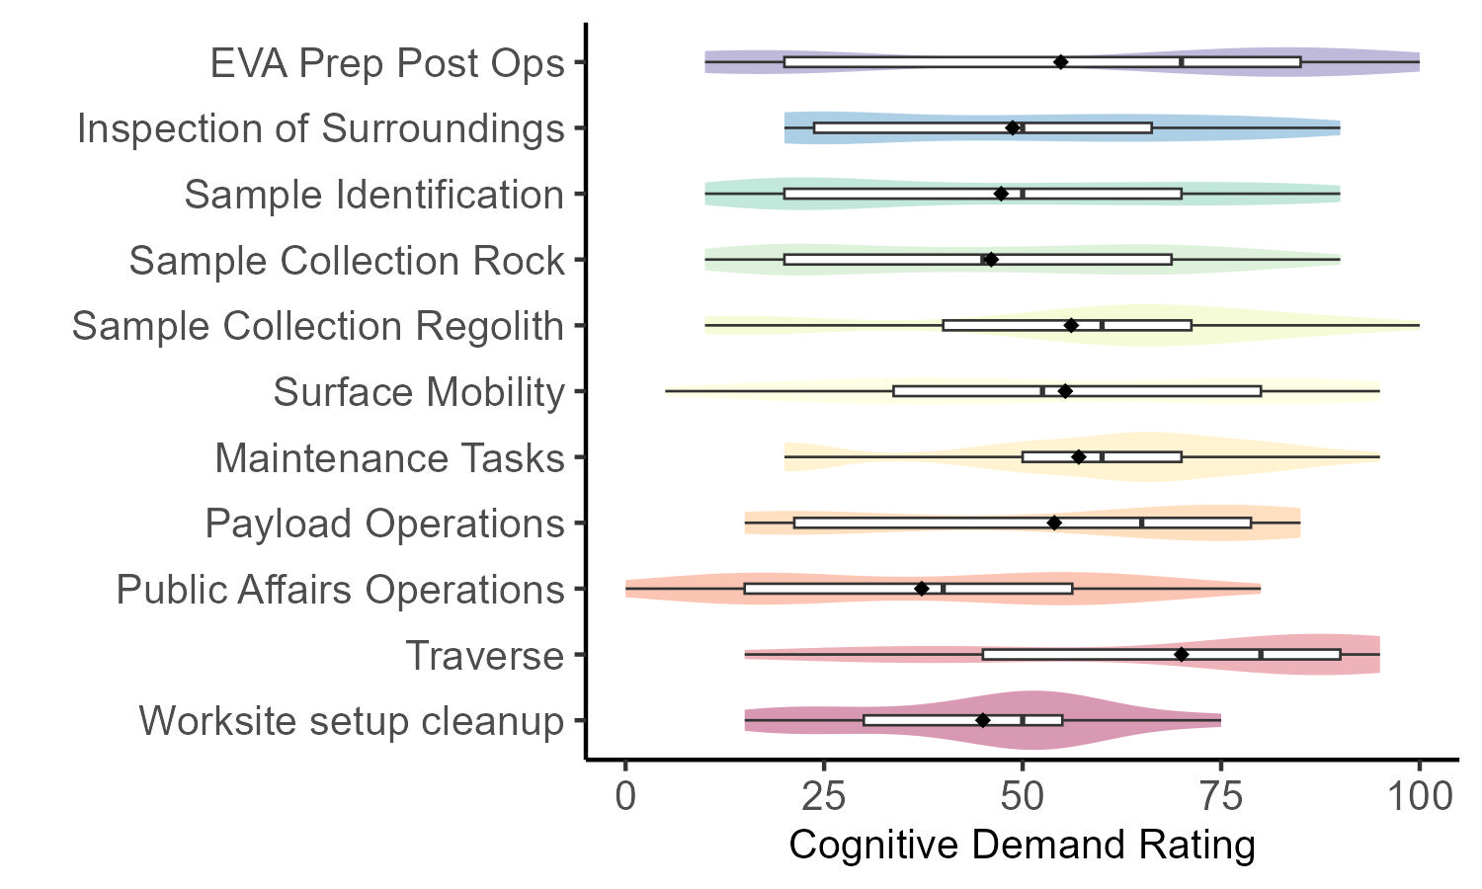
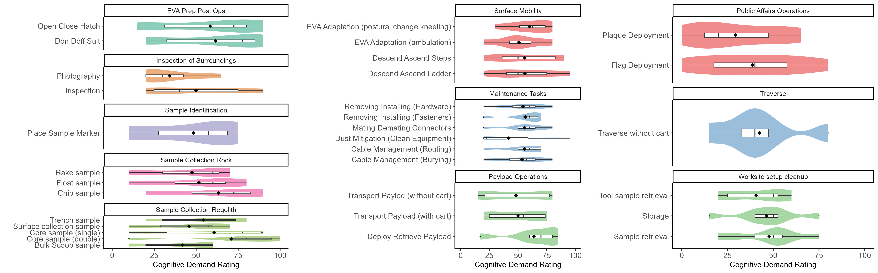
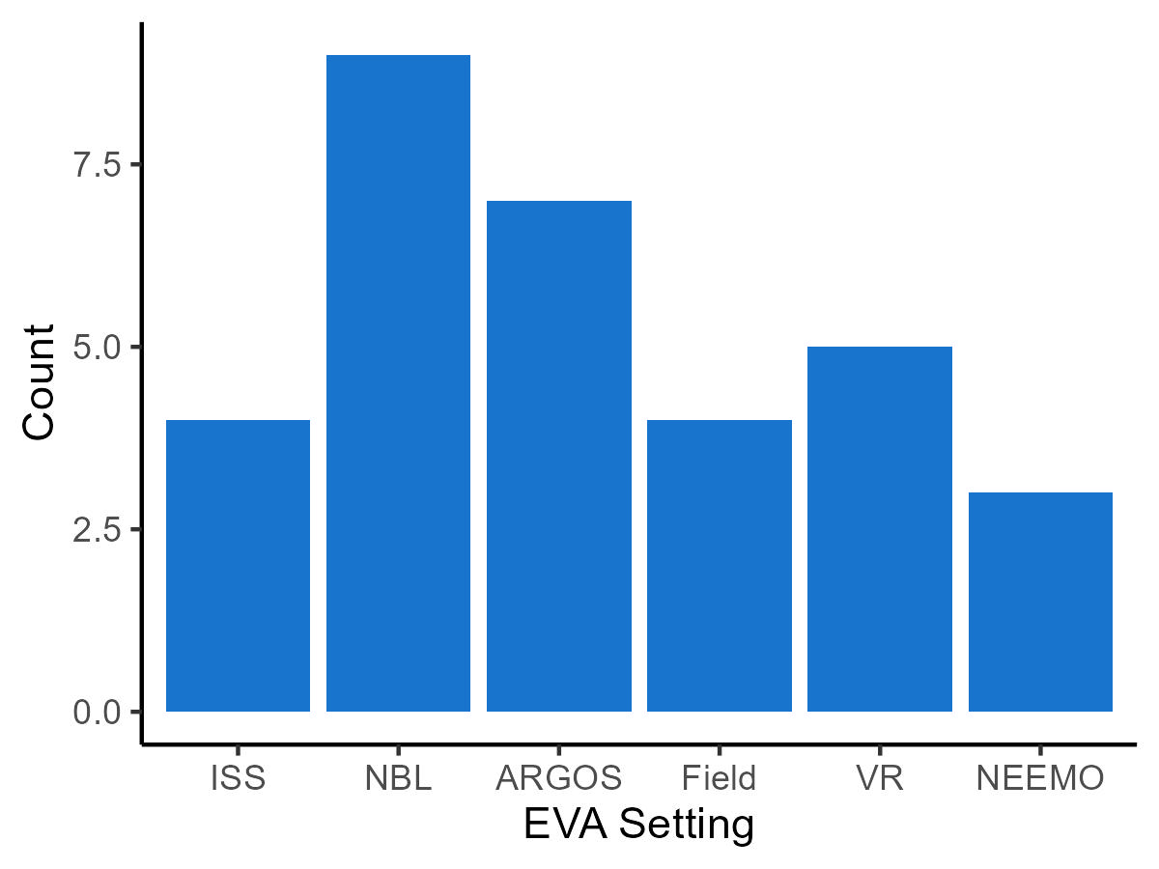
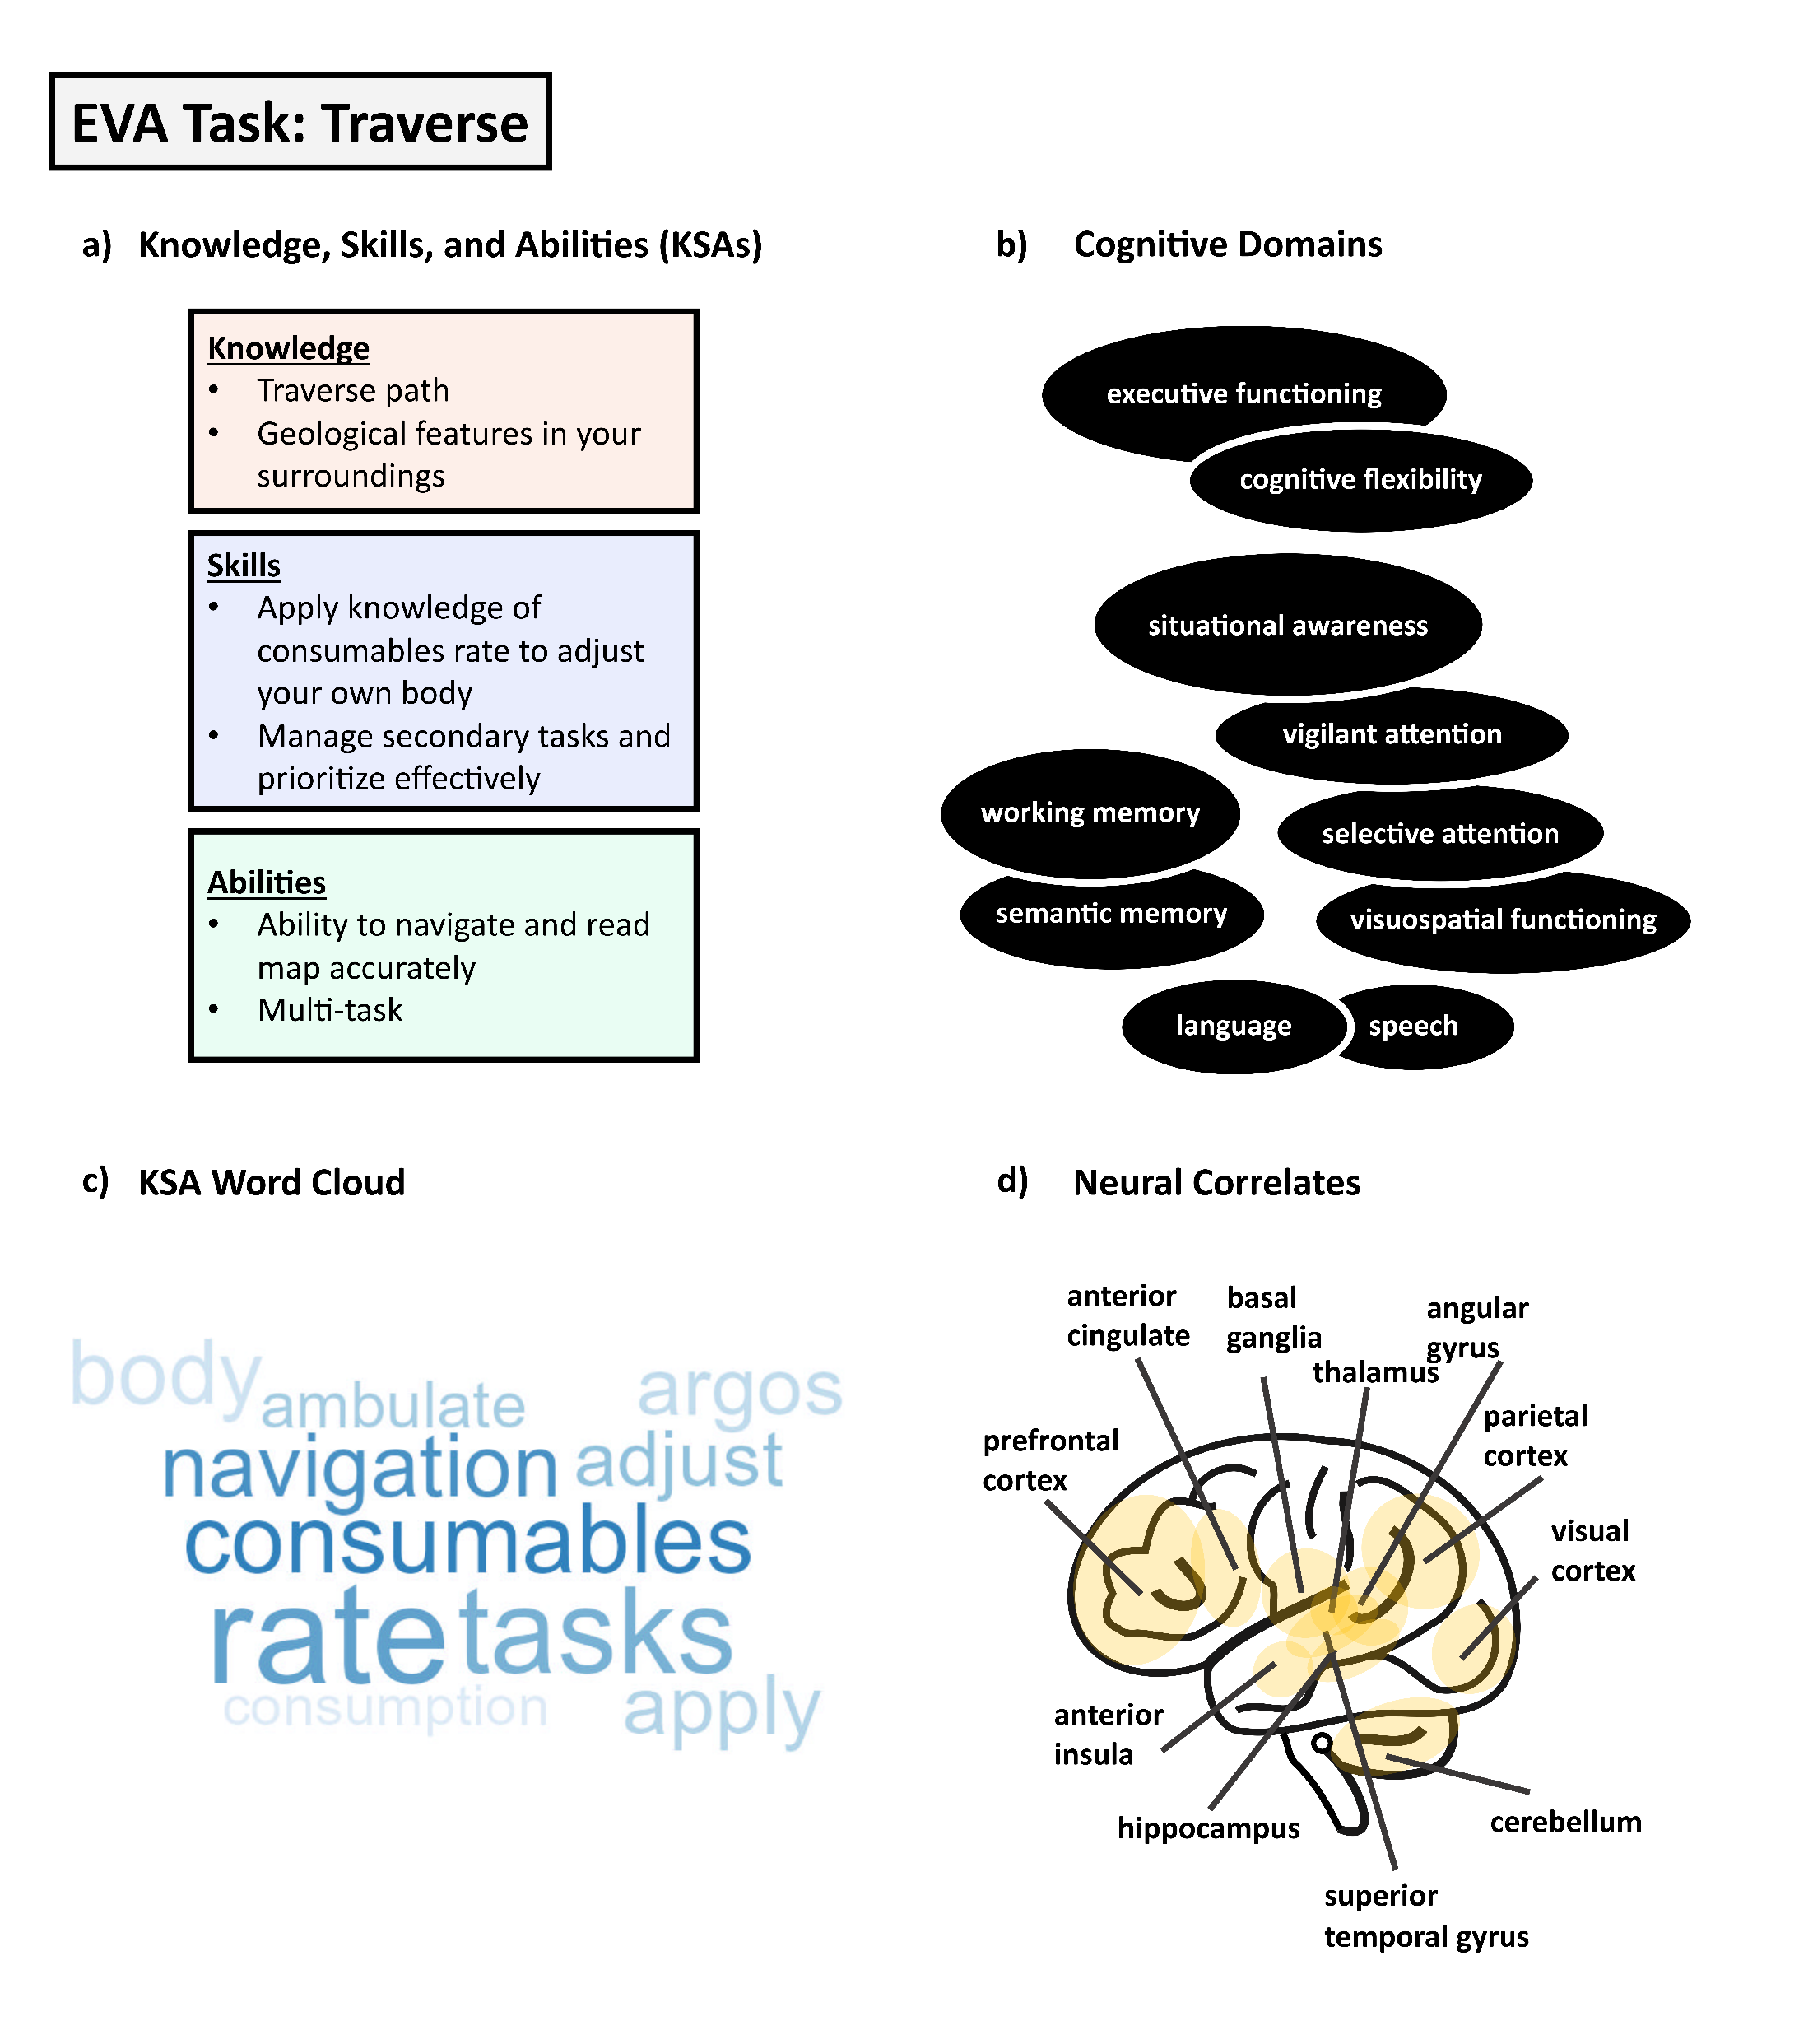
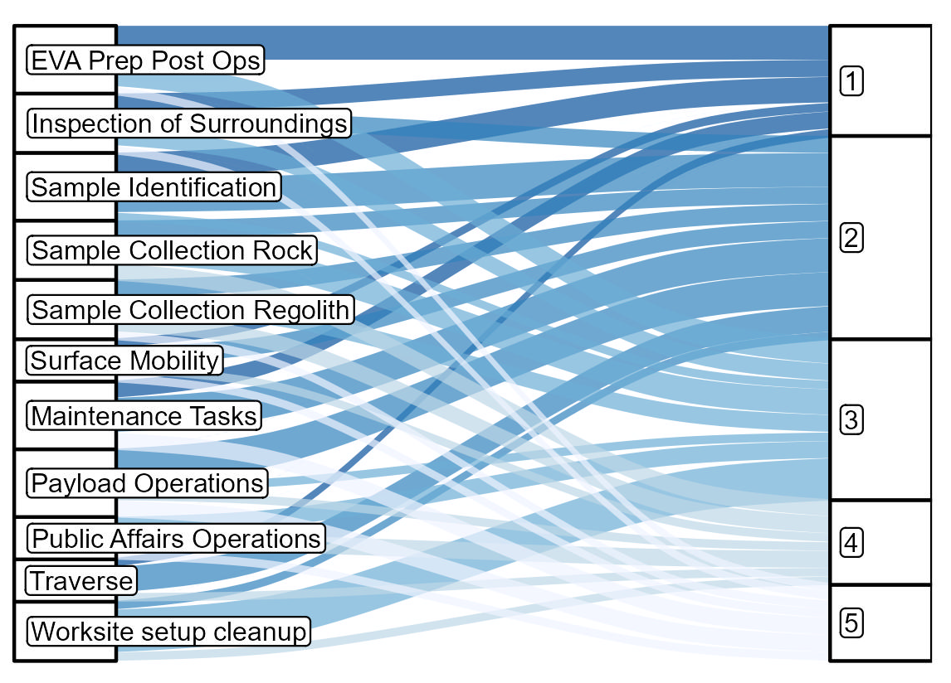
IDENTIFYING COGNITIVE CAPABILITIES REQUIRED FOR OPTIMAL EXPLORATION EVA PERFORMANCE: A COGNITIVE TASK ANALYSIS
Steven R. Anderson¹, Mercedes Jorge², & Suzanne T. Bell³
¹ KBR, Inc., Houston, TX, ² JES Tech, Houston, TX, ³ NASA Johnson Space Center, Houston, TX
BACKGROUND
RESULTS
Decrements in cognitive performance present an important risk to crew safety during exploration mission class EVA.
There is currently insufficient characterization of the cognitive capabilities required prior to, during, and following EVA.
It is still unclear which cognitive domains are most important for conducting mission critical decisions with crew safety implications.
We conducted a cognitive task analysis of exploration EVA to characterize the cognitive capabilities, critical safety decisions, and contributing factors (e.g., lunar communications delay) important to consider for optimal performance in future exploration EVA.
Results are presented in Figures 2-4: Figure 2 depicts expert rankings of EVA tasks by cognitive demand; Figure 3 depicts expert ratings of how much cognitive demand (0 = Low, 100 = High) was required for optimal performance in each EVA task and subtask; Figure 4 depicts the results of the cognitive domain mapping and linkage analysis for surface EVA traverse, which was rated as the most cognitively demanding EVA task.
Figure 3
Cognitive demand ratings by EVA task (a) and subtask (b)
The following EVA Tasks were rated as having the highest cognitive demand by experts: Traverse (M = 70.0, SD = 27.0), Maintenance Tasks (M = 57.1, SD = 22.0), Sample Collection: Regolith (M = 56.1, SD = 26.3), Surface Mobility (M = 55.4, SD = 27.4), and EVA Prep/Post Ops (M = 54.8, SD = 33.8)
The following EVA subtasks were rated as having the highest cognitive demand: Core Sample (Double) (M = 71.0, SD = 36.1), Deploy/Retrieve Payload (M = 63.7, SD = 25.3), Chip Sample (M = 63.3, SD = 27.5), and Don/Doff Suit (M = 61.7, SD = 33.0)
a) Cognitive Demand
Ratings by EVA Task
MATERIALS & METHODS
We conducted an applied cognitive task analysis (Militello & Hutton, 1998) with 15 astronauts and subject matter experts in EVA operations and research at NASA Johnson Space Center in summer 2024.
Participants comprised 6 experts in EVA research, 5 experts in EVA operations, and 4 astronauts. See Figure 1.
There were two interview protocols, with different sets of experts interviewed for each protocol. Each interview was led by a PhD-level scientist in the NASA Behavioral Health & Performance Laboratory with expertise in health psychology and cognitive neuroscience (first author), and notes were taken by a Master’s-level research coordinator in the BHP Laboratory (second author). Interviews were recorded on Microsoft Teams to assist with notetaking.
b) Cognitive Demand
Ratings by EVA Subtask
Figure 1
EVA experience by setting
Experts had an average of 7.5 (range = 2-19, SD = 5.3) years of experience with EVA across multiple spaceflight and spaceflight analog settings
Astronauts had a total of 71 hours 33 minutes of EVA time on ISS
Figure 4
Cognitive domain mapping and linkage analysis
Knowledge, skills, and abilities (a), cognitive domains (b), most commonly reported words in traverse task KSAs, and d) neural correlates associated with surface EVA traverse
Figure 2
Cognitive demand rankings by EVA task
Experts ranked the following EVA tasks as highest (#1) in cognitive demand: EVA Prep/Post Ops (4 experts), Sample Identification (3 experts), Inspection of Surroundings (2 experts), and Maintenance Tasks (2 experts).
Discussion
ACKNOWLEDGEMENTS
Our results:
  Identify cognitive domains needed for functional cognitive and performance testing
  Link cognitive domains to operationally relevant performance metrics; these domains and performance metrics can be tracked by NASA mission operations to ensure safe decision-making for exploration class mission EVA.
  Cognitive performance characterization informs exploration EVA concept of operations (ConOps), training prior to flight in simulation environments such as the Neutral Buoyancy Laboratory (NBL), just-in-time training in-flight, and countermeasures targeting all mission phases.
Research was funded by NASA’s Mars Campaign Office (MCO) in research projects to the Behavioral Health & Performance Laboratory. SA and MJ were supported by KBR’s Human Health and Performance Contract NNJ15HK11B through NASA. The authors thank Dr. Sheena Dev for feedback on cognitive mapping domains and Dr. Lauren Landon for providing feedback on contributing factors.

