Slide 1



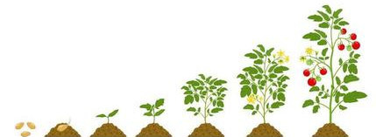
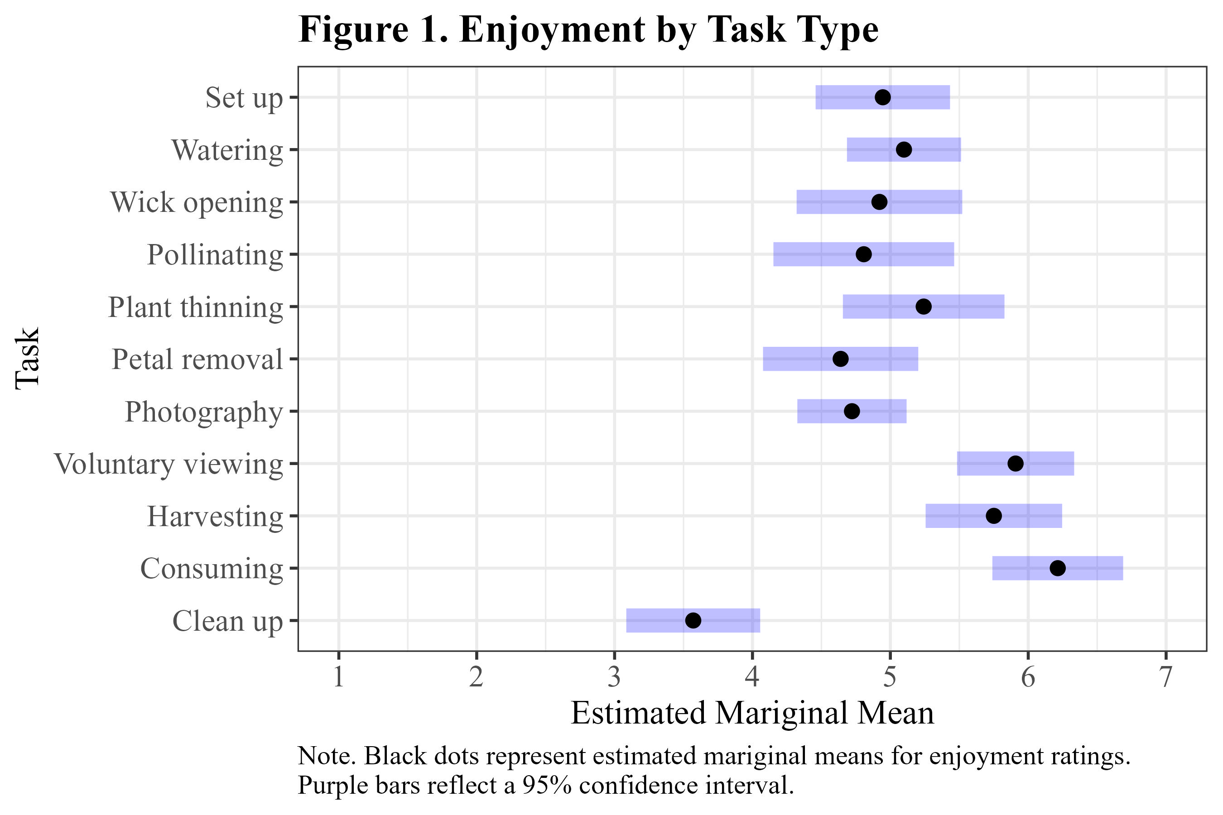
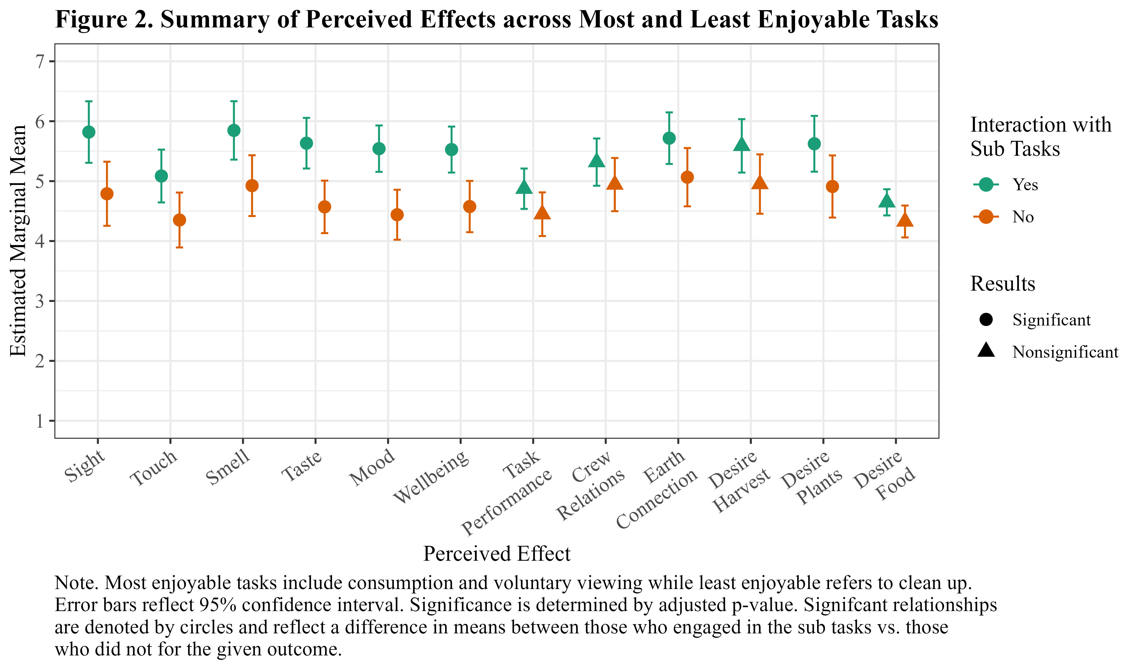
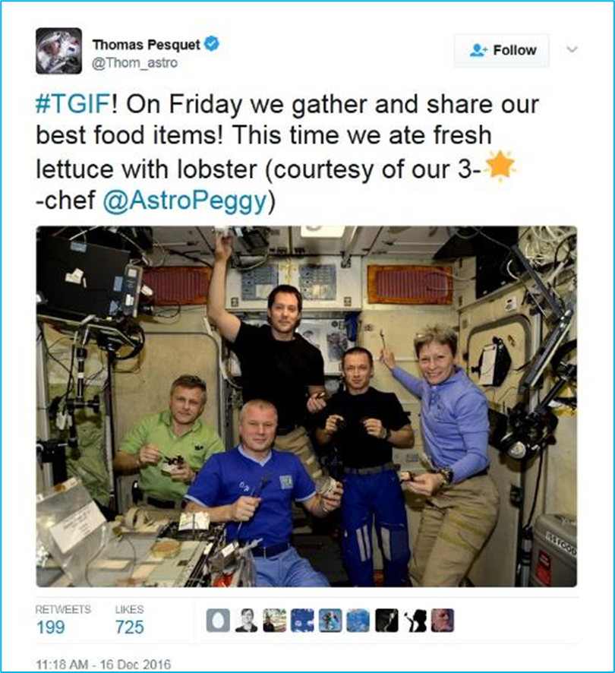
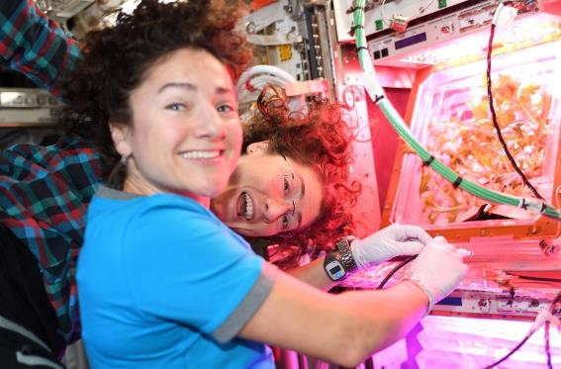
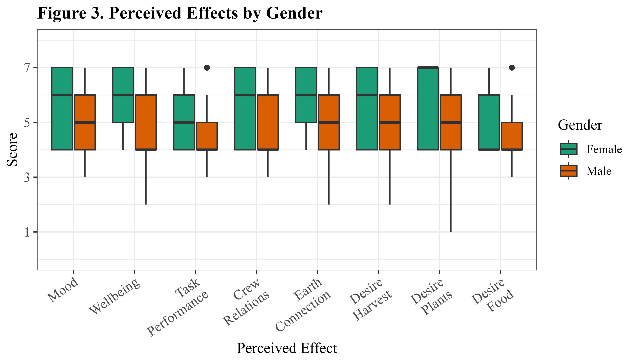
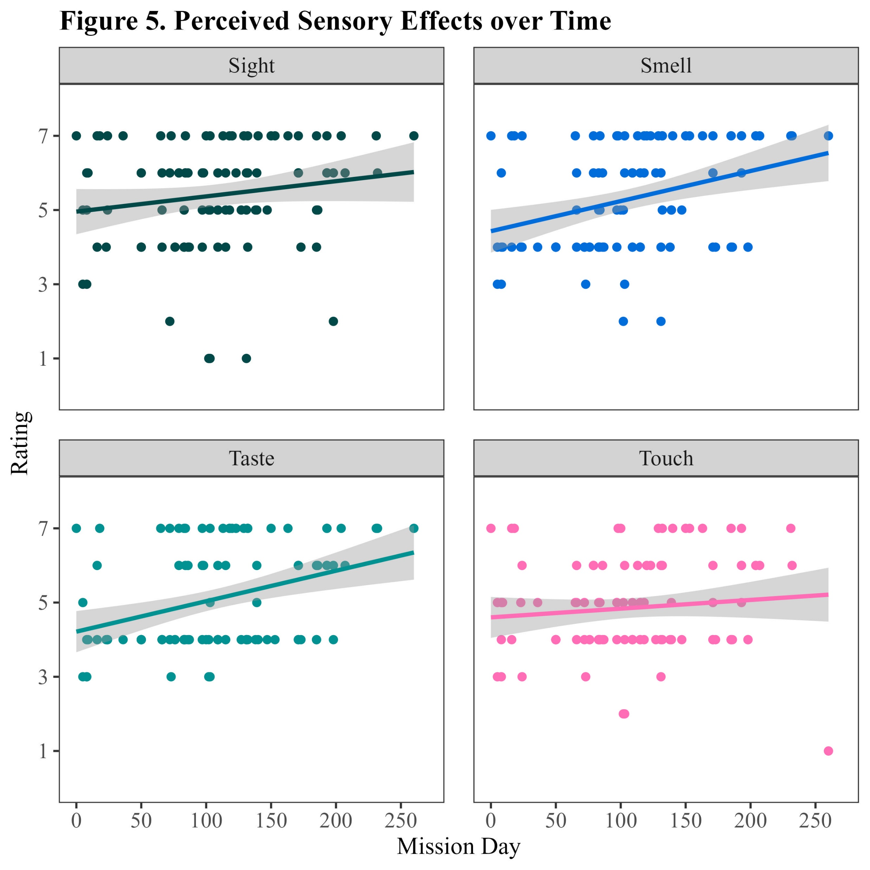
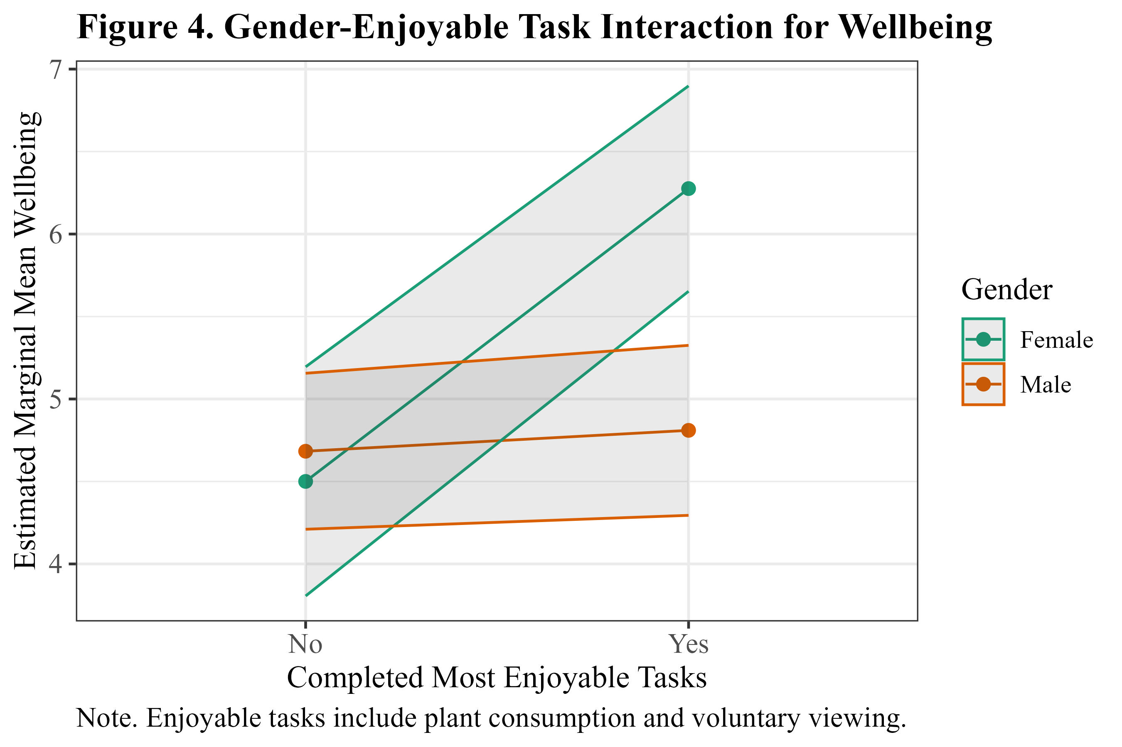
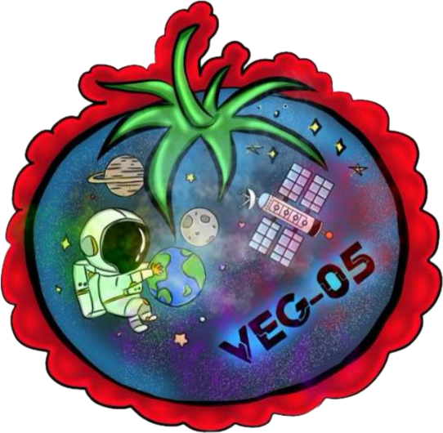
Behavioral Health Benefits of the ISS Pick-and-Eat Crop Growth System
Lauren Landon^{1*}, Sydney Begerowski^{1*}, Sara Whiting², Cara Spencer^{3*}, Suzanne Bell^{4*}, Pete Roma⁵, & Gioia Massa⁶
¹KBR, JSC; ²NASA, Research Operations and Integration Element, JSC; ³JESTech, JSC; ⁴NASA, JSC; ⁵Leidos, Naval Health Research Center; ⁶NASA, KSC; *Behavioral Health & Performance Laboratory (lauren.landon@nasa.gov)
Background
Growing crops and gardening can provide:
Fresh food and nutrients
Menu variety and sensory stimulation
Oxygen
Meaningful work
Exposure to nature
Enhanced mood and reduced stress
Social connectedness
Improved health outcomes ^{[1-3]}
Aims
Examine behavioral health outcomes associated with tending to plants and consuming crops grown during long-duration spaceflight missions
Explore which aspects of horticulture are most salient and psychologically beneficial to astronaut health and wellbeing
Examine trends over time
Methods
Participants
27 long-duration ISS astronauts (19 men, 8 women)
Crop growth studies
VEG-03 I-L, VEG-04 A-B, VEG-05, and PH-04 - several cultivars (i.e., multiple greens, tomatoes, peppers)
Veggie Habitat (visible plants, open) or Advanced Plant Habitat (closed)
BHP Veggie Survey
Timing: Crew answered questions at plant installation and monthly thereafter
34 items about individual experiences with plants and interacting with the ISS crop growth system
Participants rated items on 7-point scale:
  Enjoyment of performed subtasks
  BHP outcomes: mood, well-being, relationships, meaningfulness, desire to consume food, Earth connection, performance, sensory effects
Subtask Enjoyment
Gender Effects
Temporal Effects
Conclusions
The ISS crop growth system offers behavioral health and sensory stimulus benefits during long-duration spaceflight missions.
Most tasks were rated as moderately enjoyable. Ratings were consistent over time.
Few significant temporal effects: crop growth remained moderately engaging (M=5.29, SD=1.21) and meaningful (M=5.36, SD=1.21).
  BHP outcomes remained moderately positive over time
  Perceived sensory stimulation enjoyment increased over time
  ISS astronauts with leafy greens
*
*
*
  References [1] Schlacht I, et al. (2020) Impact of plants in isolation: The EDEN-ISS…in Antarctica. In Advances in Human Factors of Transportation, Washington DC. [2] Vessel E, Russo S (2015) Effects of reduced sensory stimulation and…countermeasures…. NASA/TM-2015-218576. [3] Odeh R, Guy C (2017) Gardening for therapeutic people-plant interactions during LDSM. Open Agriculture, 2(1), 1-13.
  Acknowledgements: We thank our astronaut participants and the Research Operations and Integration Element for assistance with procedures and survey implementation on ISS. This research was supported by the Human Health and Performance Contract NNJ15HK11B, and NASA grant MTL #1075 to Principal Investigator Gioia D. Massa). Photo credit: Shutterstock, NASA, Twitter.

