Slide 1
The Design of a Flexible, Interoperable Navigation Signal for Future Lunar Missions
P. A. Dafesh, N. Wong, G. K. Khadge, G. Djuknic, The Aerospace Corp.
J. Crenshaw, B. C. Peters, C. Gramling, NASA
F. Melman, C. Stallo, R. Swinden, ESA
M. Murata, JAXA
13 January, 2025
  Presented by:
  Dr. Philip Dafesh
  The Aerospace Corporation

Slide 2
Outline
Introduction
Use Case and Design Objectives
Signal Overview
Data Channel (I) Channel Ranging Code and Cross-correlation Performance
Dataless Pilot (Q) channel Ranging and Overlay Codes
  Cross-correlation performance
  Acquisition flexibility
  Frame sync and absolute time
Data channel structure
Sync word performance
AFS data channel and performance
Summary and conclusions

Slide 3
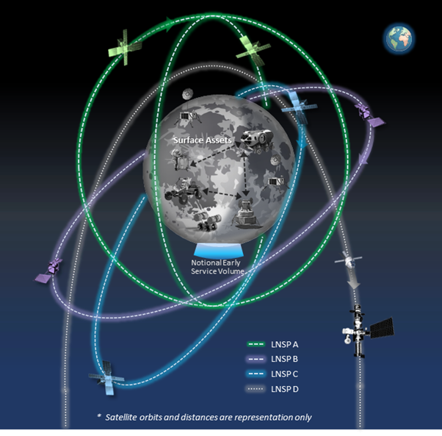
Introduction
The future cislunar regime will rely on the delivery of PNT services by satellite and terrestrial providers through a framework of mutually agreed-upon standards in support of future lunar missions including:
  NASA’s Lunar Communications Relay and Navigation Systems (LCRNS), ESA’s Moonlight Lunar Communication and Navigation System (LCNS), and Japan’s Lunar Navigation Satellite System (LNSS).
  Ground stations, such as NASA’s Lunar Exploration Ground Segment (LEGS).
The LunaNet Interoperability Specification (LNIS) is a standard that defines interoperable communications and PNT signal specifications for service providers and equipment manufacturers.
In the spirit of the Artemis accords, NASA, ESA, and JAXA have collaborated to define the LunaNet Interoperability Specification (LNIS), a key component defined being the Augmented Forward Signal.
This work describes the S-band AFS, a broadcast signal described in release version 5 of the LNIS and the accompanying Applicable Document #1 Volume A (2025).

Slide 4
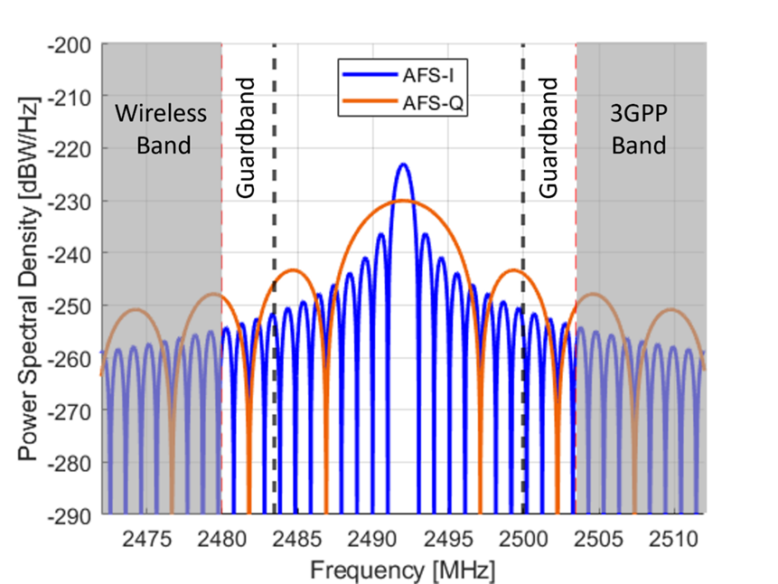
LunaNet AFS Use Cases and Design Objectives
Flexibility to operate under wide range of carrier power to noise-density ratio (C/N0) conditions
  e.g., Signal blockage, co-channel interference.
Support a wide range of user requirements (e.g. precision vehicle navigation or alerts)
  Low-SWaP receivers only process a 1.023 Mchip/sec C/A-like signal with modern FEC and data messages.
  High performance receivers also process a data-less 5.115 Mchip/sec signal with enhanced performance and features.
Leverage GNSS standards to facilitate user adoption.
Definition of the AFS required finalizing several key design aspects:
  Data Forward Error Control (FEC) Coding
  Frame structure and bit allocations for each subframe block (SB)
  Sync word
  Interleaving
  Primary spreading codes for I-channel with data
  Primary spreading codes for and the Q channel data-less pilot
  Tiered overlay codes and structure for the Q channel
FEC = Forward Error Control Coding, SWaP = Size Weight and Power

Slide 5
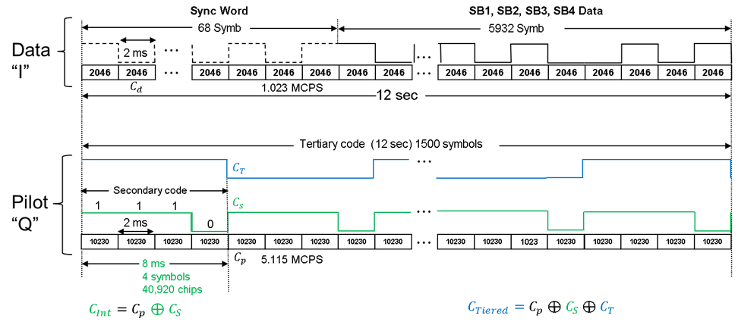
Signal Overview

Slide 6
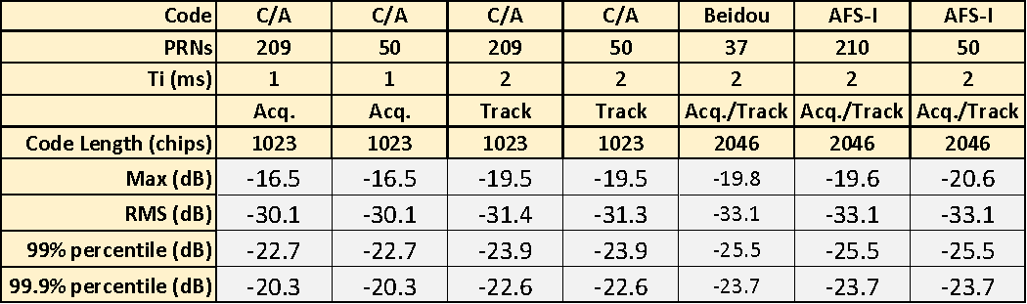
Data Channel (I) Ranging Code and Cross-correlation Performance
The I channel employs a 1.023 Mchip/sec BPSK spreading code,
  with period matched to the 2 ms symbol period.
  Unlike C/A code, this permits immediate bit Sync.
210 Length 2046 Spreading codes were selected from a 2047 length Gold Code family short cycled by 1.
  A 2046-chip short cycled 2053-length Weil sequence was found to have comparable correlation performance, but a
  Gold code was selected to simplify implementation.
The 2046-chip AFS I channel spreading code was found to provide a 3 dB improvement 99.9 % of the time during acquisition, compared to the GPS L1 C/A spreading code and over 1 dB while tracking, assuming random data symbols.
The 210 AFS Gold codes have performance that is comparable to Beidou’s 37 Length 2046 gold codes.

Slide 7
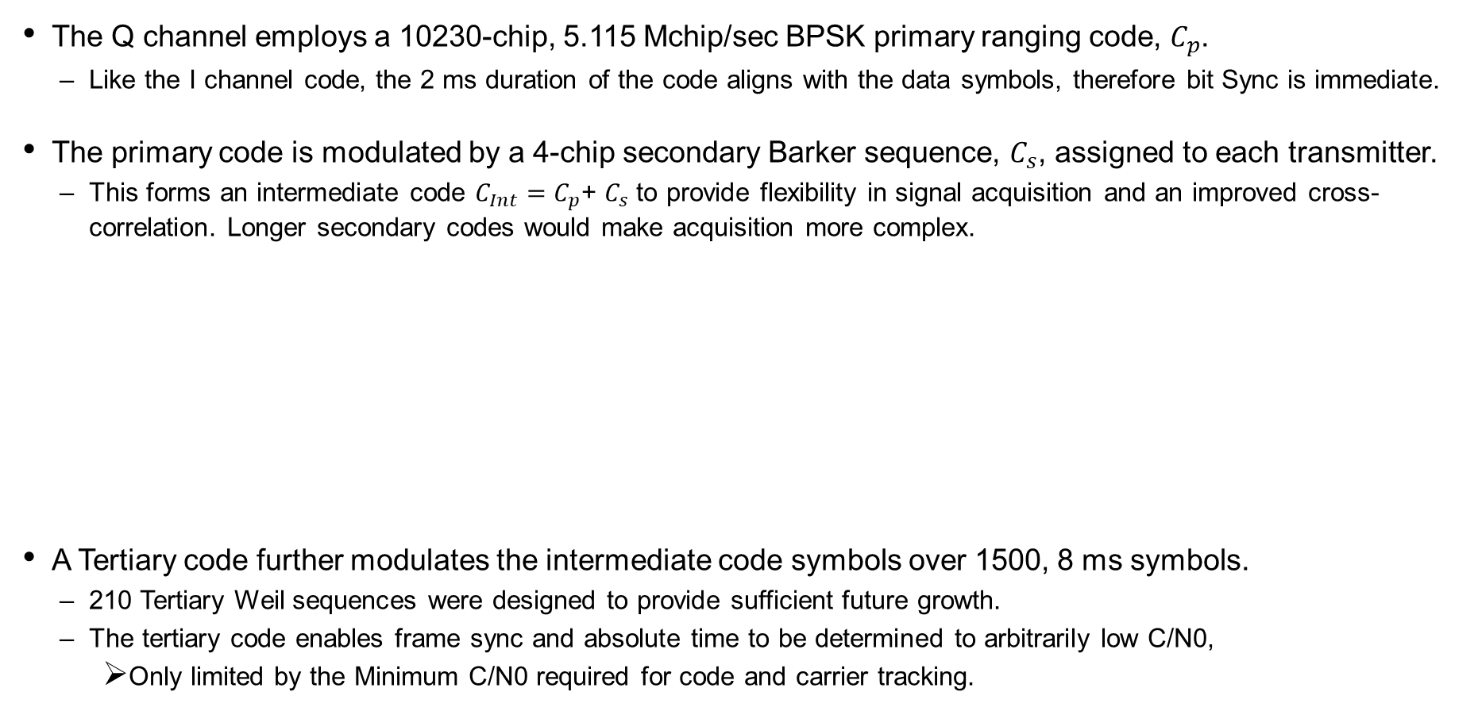
Dataless Pilot Channel (Q)
The Q channel employs a 10230-chip, 5.115 Mchip/sec BPSK primary ranging code, $C_{p}$.
  Like the I channel code, the 2 ms duration of the code aligns with the data symbols, therefore bit Sync is immediate.
The primary code is modulated by a 4-chip secondary Barker sequence, $C_{s}$, assigned to each transmitter.
  This forms an intermediate code $C_{Int}=$ $C_{p}$+ $C_{s}$ to provide flexibility in signal acquisition and an improved cross-correlation. Longer secondary codes would make acquisition more complex.
A Tertiary code further modulates the intermediate code symbols over 1500, 8 ms symbols.
  210 Tertiary Weil sequences were designed to provide sufficient future growth.
  The tertiary code enables frame sync and absolute time to be determined to arbitrarily low C/N0,
    Only limited by the Minimum C/N0 required for code and carrier tracking.
 | Binary Representation |  |  |  | NRZ Representation
 | B₄ | B₃ | B₂ | B₀ | N₄ | N₃ | N₂ | N₁
C₀ | 1 | 1 | 1 | 0 | -1 | -1 | -1 | 1
C₁ | 0 | 1 | 1 | 1 | 1 | -1 | -1 | -1
C₂ | 1 | 0 | 1 | 1 | -1 | 1 | -1 | -1
C₃ | 1 | 1 | 0 | 1 | -1 | -1 | 1 | -1

Slide 8
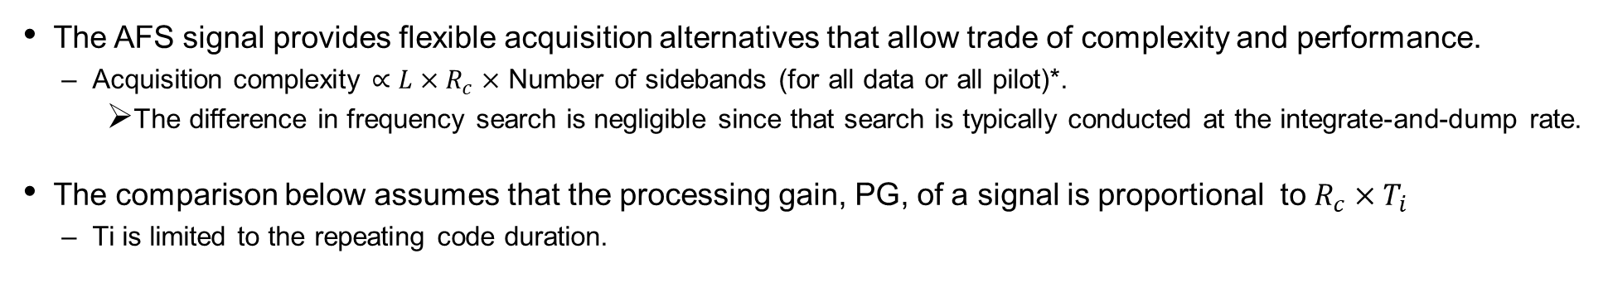
Comparing Acquisition Alternatives
The AFS signal provides flexible acquisition alternatives that allow trade of complexity and performance.
  Acquisition complexity $∝L×R_{c}×$ Number of sidebands (for all data or all pilot)*.
    The difference in frequency search is negligible since that search is typically conducted at the integrate-and-dump rate.
The comparison below assumes that the processing gain, PG, of a signal is proportional to $R_{c}×T_{i}$
  Ti is limited to the repeating code duration.
Acquisition Code | Complexity Relative to L5 Primary | Processing Gain Relative to L5 (dB)
2046 chip I Primary | 2% | -7.0
10230 chip Q Primary | 50% | 0.0
40920 chip Q Intermediate | 200% | 6.0
10230 chip L5 Primary Code | 100% | 0.0
The Q channel intermediate code provides 6 dB more processing gain than the L5 signal
for improved immunity to interference.
*L = code length, Rc = chip rate

Slide 9
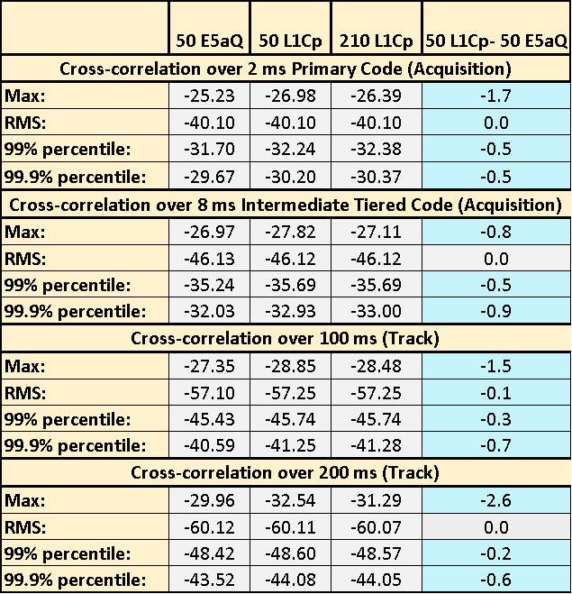
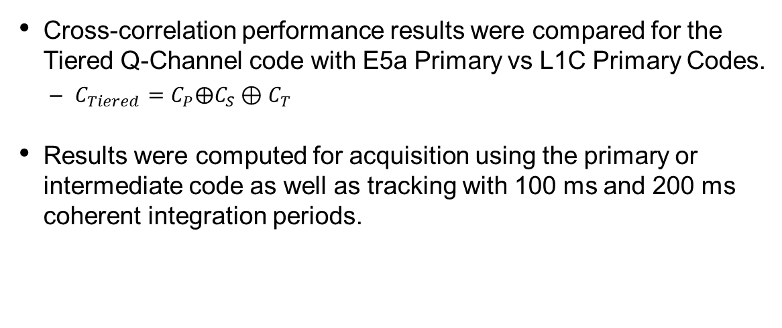
AFS Tiered Q channel Spreading code Cross-correlation Performance
Cross-correlation performance results were compared for the
Tiered Q-Channel code with E5a Primary vs L1C Primary Codes.
  $C_{Tiered}=C_{P}⨁C_{S}{⊕C}_{T}$
Results were computed for acquisition using the primary or intermediate code as well as tracking with 100 ms and 200 ms coherent integration periods.
Cross-correlation performance with L1C as the primary code for AFS-Q exceeds that of E5aQ in most of the cases.
The use of L1Cp as the primary code improves cross-correlation up to ~1 dB.

Slide 10
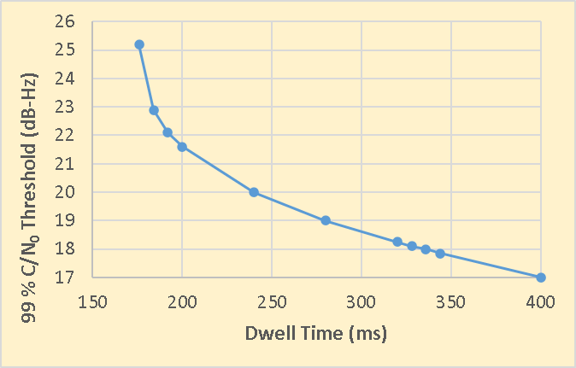
Tertiary Overlay Code Synchronization Performance
Acquire one of the primary or Intermediate codes
Track Intermediate code with 8 ms Coherent integration
Store a number of correlator outputs
(e.g., 50 for 400 ms Dwell)
Conduct maximum likelihood search over 1500 possible Tertiary symbols
Resolve absolute time and Frame Sync
JC: ITU?
The Tertiary code provides resolution of absolute time with Initial Time Uncertainty (ITU) < 12 sec (frame length).
The 1500 symbol code can be searched very rapidly and robustly by only dwelling over < 1 sec.
  Enables robust time aiding and frame Sync. not possible by reading the data message.

Slide 11
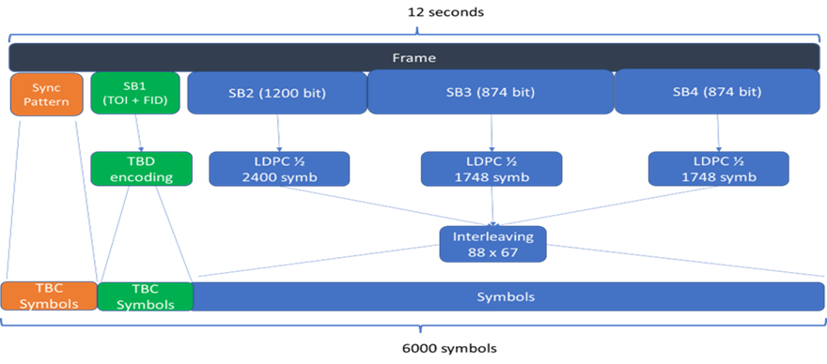
Data performance
The AFS Data channel leveraged the L1C design but with some significant differences:
  BPSK(1) Modulation instead of BOC(1,1),
  2.046 Mchips/sec instead of 1.023 Mchips/sec,
  250 bits/sec instead of 50 bits/sec,
  50 % Power is in the data channel instead of 25% as L1C,
  Sync word for low complexity receivers that do not acquire and track the pilot channel,
  LDPC decoding as described in the 5G NR standard.
Starting Point for L1C data Message structure:
Design of the AFS data channel involved a tradeoff between the sync word size, interleaver factorization
and the use of block sizes that are compatible with 5GNR LDPC encoding design techniques.

Slide 12

Sync Word Design and FID
Initial design approach was to select a sync word length that met the desired performance of L1C’s Rate 9/52 BCH code, and I channel carrier tracking thresholds.
  $\frac{E_{b}}{N_{0}}=5.61$ for BER =1E-05 ⇒ $\frac{C}{N_{0}}=\frac{E_{b}}{N_{0}}+10\log_{10}\left(500 \frac{sym}{sec}× \frac{9}{52}\frac{bits}{sym}\right)=25 dB Hz$
68 Symbol provides the best balance between No. of data symbols, C/N₀ and interleaver factorization.
Two out of 9 BCH code bits are assigned to the FID, permitting the flexibility to change the data frame structure in the future, with the default structure identified by FID = 00.
The remaining 7 bits are used for the TOI count over which the SB2 (Clock and Ephemeris) is unchanged.
*Assumed sync word detection and false alarm probabilities: $P_{d}$ = 0.99 and $P_{fa}={10}^{−6}$

Slide 13
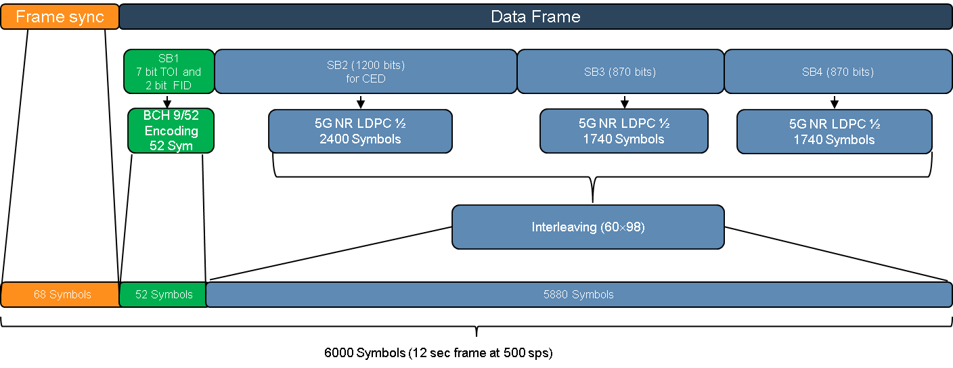
Data Message Structure
The AFS Data message frame structure begins with a sync word for lightweight “data only” receivers.
The structure was optimized to maintain the subframe block (SB) sizes as large as possible for future growth.
  The 5G NR LDPC encoding was selected to leverage a commercial standard for the the forward error control coding design.

Slide 14
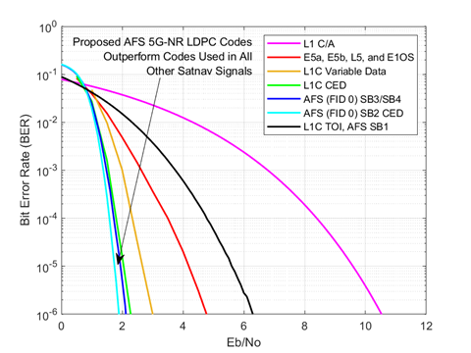
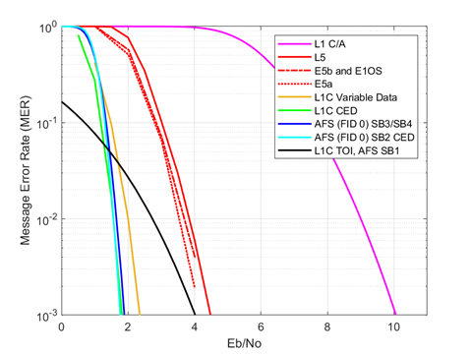
Data Message Performance
Rate ½ LDPC codes were designed using methodology specified for 3GPP*,
Exceeding performance of all other nav messages in terms of Eb/No.
*3rd Generation Partnership Project (3GPP) (Jul. 2020). Technical Specification Group Radio Access Network; NR; Multiplexing and Channel Coding, Release 16, V16.2.0, 3GPP Standard TS 38.212.

Slide 15
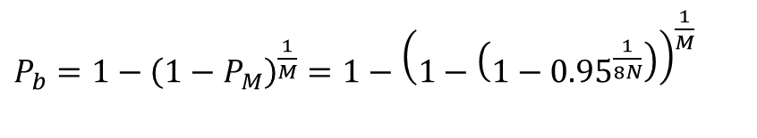
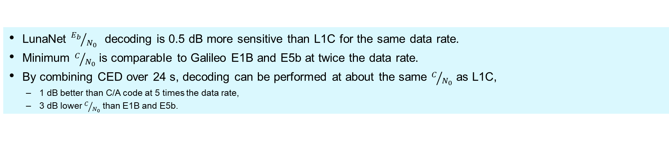

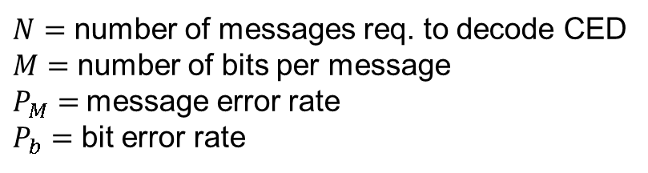
Performance to Achieve 95% Confidence (Acq. and CED decoding)
$P_{b}=1−{\left(1−P_{M}\right)}^{\frac{1}{M}}=1−{\left(1−\left(1−{0.95}^{\frac{1}{8N}}\right)\right)}^{\frac{1}{M}}$
$N=$ number of messages req. to decode CED
$M=$ number of bits per message
$P_{M}=$ message error rate
$P_{b}=$ bit error rate
$P_{M}=1−{\left(1−P_{b}\right)}^{M}$
(See Paper)
LunaNet ${E_{b}}/{N_{0} }$ decoding is 0.5 dB more sensitive than L1C for the same data rate.
Minimum $C/{N_{0}}$ is comparable to Galileo E1B and E5b at twice the data rate.
By combining CED over 24 s, decoding can be performed at about the same $C/{N_{0}}$ as L1C,
  1 dB better than C/A code at 5 times the data rate,
  3 dB lower $C/{N_{0}}$ than E1B and E5b.
* Includes power split and 1 dB implementation loss (7 dB for L1C, 4 dB for LunaNet)

Slide 16
Summary and Conclusions
LunaNet’s AFS was designed to provide an interoperable standard for future PNT services currently under development by NASA, ESA, and JAXA.
The signal leverages lessons learned from terrestrial GNSS, and will service both high performance and low-SWaP users in the lunar vicinity.
The AFS provides several enhancements compared to other GNSS signals:
  Employs 5G-NR Forward Error Control coding with the best decoding performance of any GNSS signal.
  Three-tiered ranging codes permit receivers to trade acquisition complexity with sensitivity.
  Tertiary overlay code that enables rapid time dissemination, high integrity code acquisition, and frame Sync.
  A high integrity data sync word is provided to enable low-SWaP single-channel decode data without a pilot overlay.
  The signal structure also supports future changes through the robust BCH encoding of the FID field without sacrificing the ability to improve data message performance using CED combining.
  Overall, the AFS provides ample flexibility and performance by accommodating a range of use cases and operational modes.

Slide 17
Acknowledgements
A significant portion of this work was funded by the National Aeronautics and Space Administration’s (NASA) Lunar Communications Relay and Navigation Systems (LCRNS) project to inform the LunaNet Interoperability Specifications, with Aerospace funded under contract 80GSFC19D0011.

Slide 18
Thank you

Slide 20
Backup

Slide 21
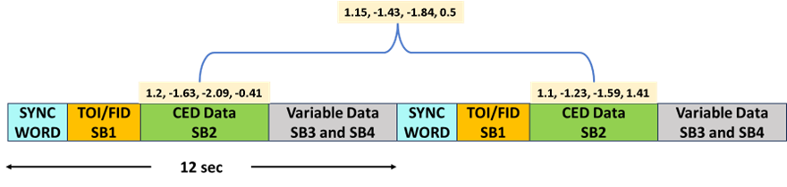
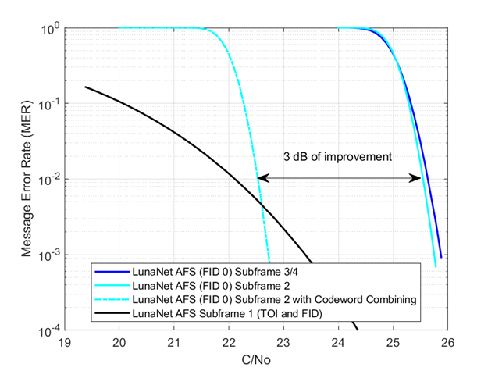
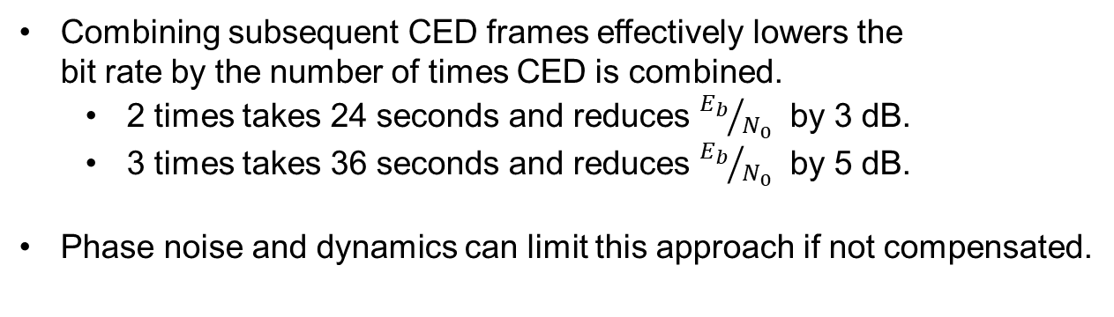
Illustration of CED Combining
Combining subsequent CED frames effectively lowers the
bit rate by the number of times CED is combined.
  2 times takes 24 seconds and reduces ${E_{b}}/{N_{0} }$by 3 dB.
  3 times takes 36 seconds and reduces ${E_{b}}/{N_{0} }$by 5 dB.
Phase noise and dynamics can limit this approach if not compensated.
*
* Without loss

