Slide 1
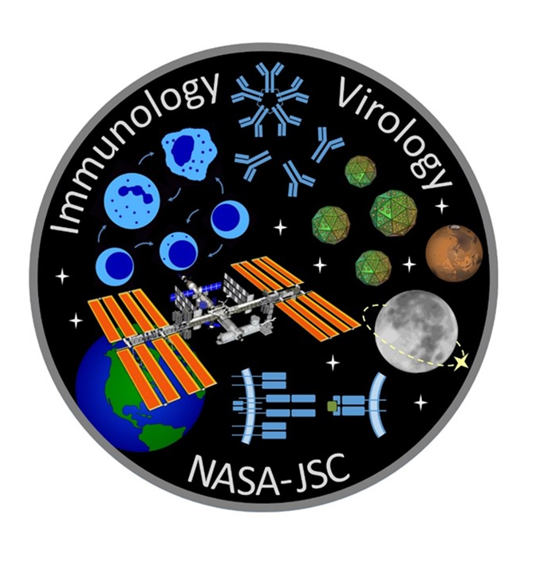

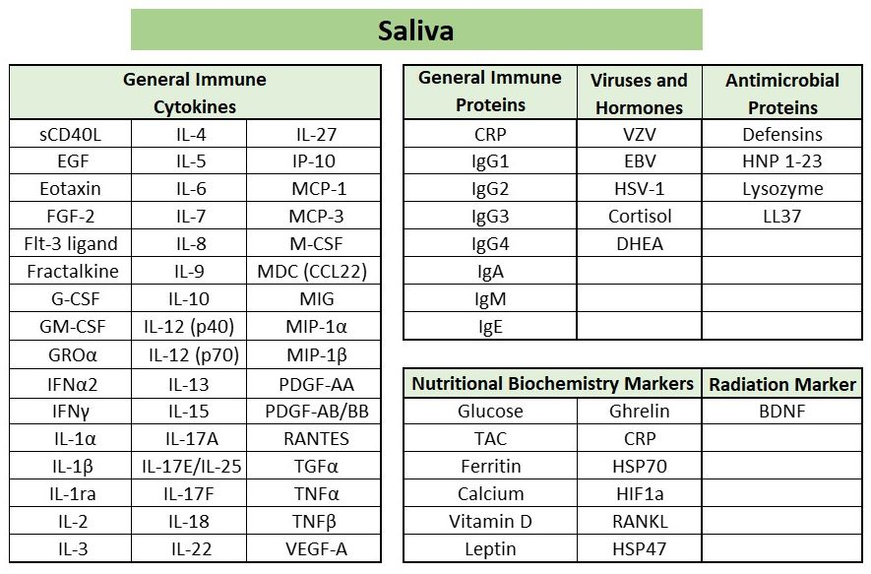
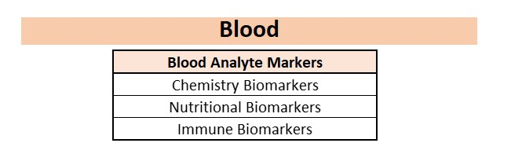
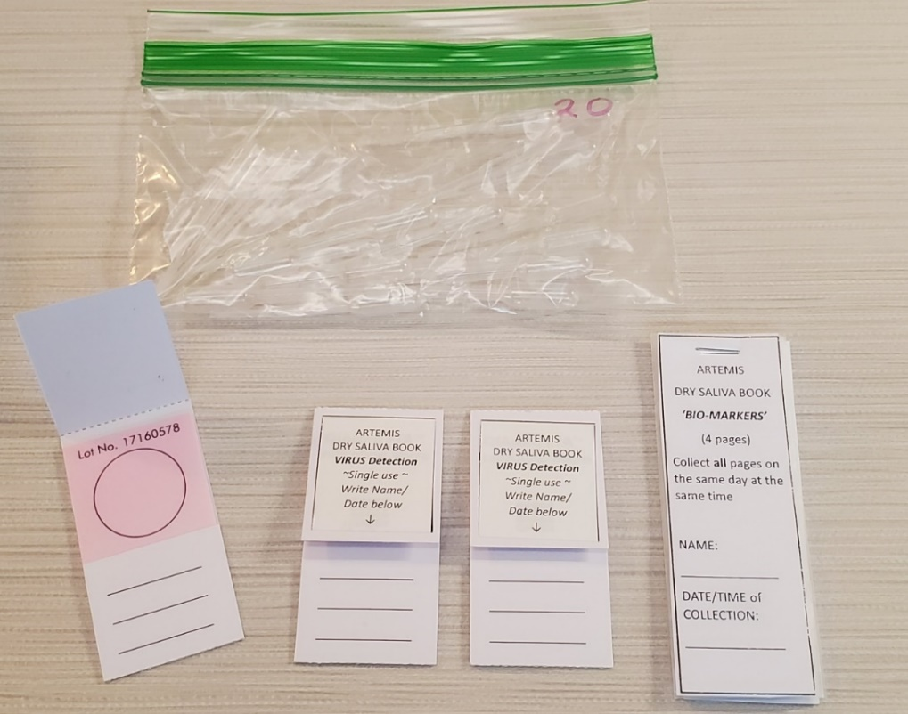
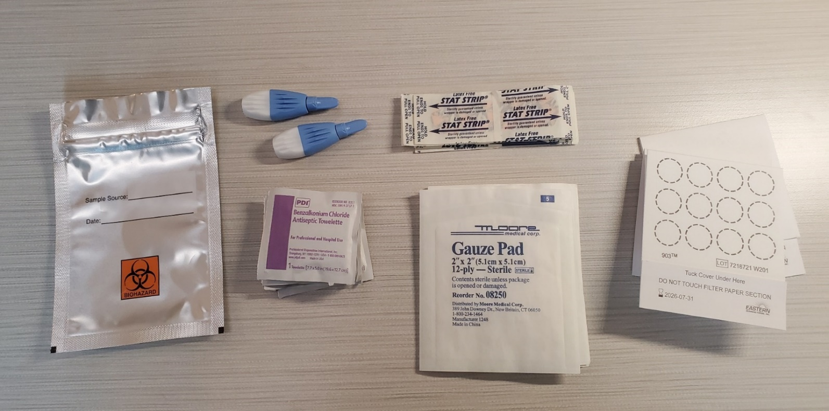
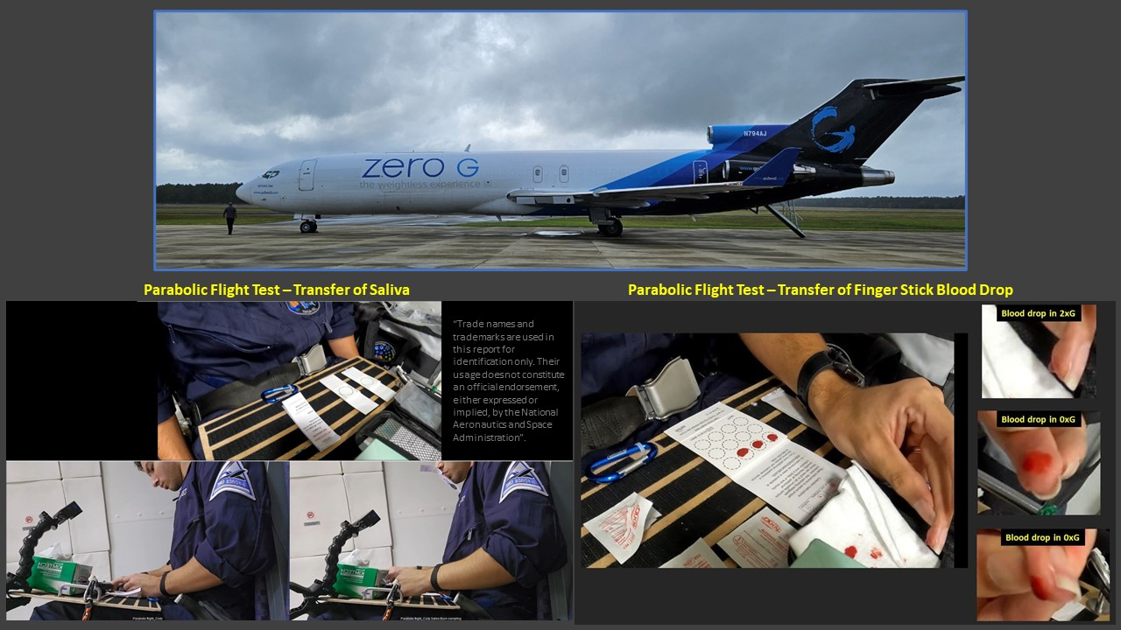
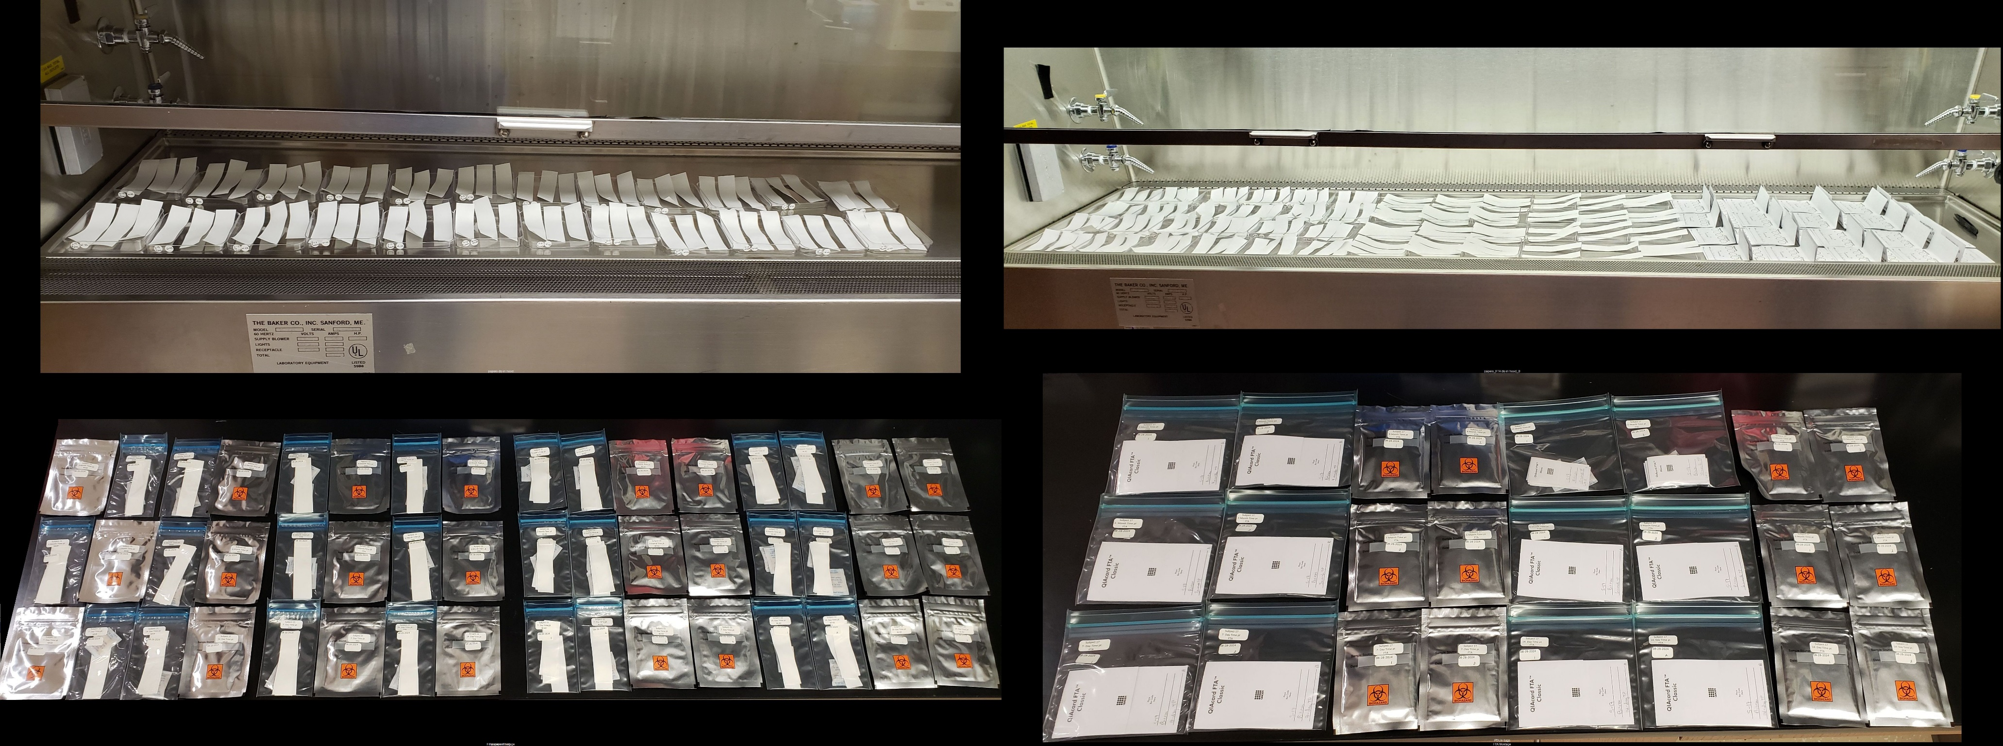

DRY SALIVA DEVELOPMENT - ARTEMIS
Mayra Nelman-Gonzalez¹, Sara Bustos Lopez², Douglass Diak³, Cody Gutierrez², Satish Mehta², Audrie Colorado¹, Scott M. Smith⁴, Sara R. Zwart⁵, Richard Simpson⁶, Grace M. McKenzie⁶, Forrest L. Baker⁶, Alexander Chouker⁷, and Brian Crucian⁴
(1) KBR, Houston, Texas; (2) JES Tech, TX; (3) Aegis Aerospace, Inc., Houston, Texas; (4) NASA Johnson Space Center, Houston, Texas; (5) UTMB, Galveston, Texas; (6) Univ Arizona, Tucson, Arizona; (7) LMU, Munich, Germany.
BACKGROUND
Prolonged deep space missions may carry increased crew health risks making it
essential to determine effect on crew physiology during missions beyond the Van Allen Belt.
The NASA Human Research Program (HRP) has developed, conducted research to maintain the health and safety of crews during missions.
Transition to Gateway and Artemis lunar exploration have limited availability of upmass and sample return, posing new challenges of available options for tracking crew health during missions.
Dried biosample chemistry, offers a potential technology that can enable the collection, ambient storage and return of samples for the continued tracking of crew health during these exploration class missions.
TARGET ANALYTES
GOAL
The goal of this study is the development of dried biosampling as a technology that enables sample collection and tracking of crew health during exploration class missions that have limited conditioned stowage and limited upmass/downmass capabilities.
HYPOTHESIS
We hypothesize that dry saliva on a specialized paper matrix provides a viable method for the in-flight collection and dry (non-conditioned) storage of saliva samples for continued tracking of crew health specific measures on Artemis. Dry blood spot sampling increase the platform of available analytes that can similarly be collected and stored using the same methodology, enabling the tracking of an expanded list of important blood analytes not available in saliva samples.
This methodology provides a viable option for the collection, preservation, and analyte recovery of a various important human health biochemical targets. For saliva, this includes, hormones, latent herpes viruses, cytokines, proteins, and various immune and inflammatory markers. Similarly in blood, target analytes are a broad spectrum of biochemical markers relevant to tracking the adaptation to flight.
This technology provides a simple alternative strategy for sample return with minimal mass that requires no conditioned stowage or specialized sample storage requirements.
1A
Artemis Saliva Kit
1B
Artemis Blood Kit
SPECIFIC AIMS – Expanded Analyte Targets
Aim 1: To identify the best paper/filters and storage conditions for successful saliva and blood sample collection, storage and reconstitution/recovery of expanded analyte targets with a 14-Day stability study.
Selection of paper/filters and storage conditions best suited for drying and extraction of samples.
    Test subject saliva and blood dried on various membranes and storage systems.
    Replicate control samples were frozen at -80°C to allow for comparison against the standard preservation method.
    Dried samples extracted with buffers that maximize extraction and stability of the analytes.
    Analysis of extracted samples by the appropriate testing platforms for down selection of papers and storage condition.
Aim 2: To establish the long-term stability of each detectable analyte under dry storage conditions as it relates to the duration relevant to Gateway collection and return.
  Stability of dry sample storage technology compared to equivalent frozen sample control.
    Samples were collected and dried on their appropriate paper/filter and stored at room temperature.
    Replicate control samples were frozen at -80°C to allow for comparison against the standard preservation method.
    Samples extracted and analyzed at designated time points to confirm stability.
    Each time point is compared to a frozen control which represents the baseline.
Figure 1A: Saliva collection kit for saliva sample collection and storage on Artemis missions.
Image: In house image, courtesy of Immunology/Virology Laboratory.
Figure 1B: Blood collection kit for blood sample collection and storage on Artemis missions.
Image: In house image, courtesy of Immunology/Virology Laboratory.
"Trade names and trademarks are used in this report for identification only. Their usage does not constitute an official endorsement, either expressed or implied, by the National Aeronautics and Space Administration”.
Parabolic Flight Test
Stability Study Set Up
STUDY PROGRESS
Successful set up of 14-Day and 1-Year expanded analyte stability study.
Completion of 14-Day stability study set up and sample collection with sample analysis under way.
Completion of a 3-month stability sample extraction with 6, 9 and 12 month time points remaining.
Successful completion of parabolic flight test for validation of saliva and blood collection procedures.
This development supports the Artemis II-V ‘Immune Biomarkers’ study.

