Slide 1
HERA in the Artemis Era
Sara Whiting, Ph.D.
Deputy Element Scientist, Analogs
NASA

Slide 2
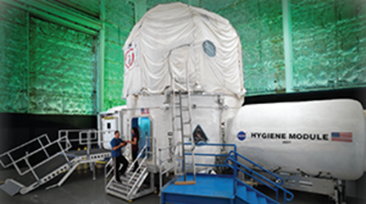
HERA in Context
Bryan Caldwell, Ph.D.
Mission Science Sub Task Lead for Analogs
International Analogs Campaign Lead
KBR Inc.

Slide 3
Introduction
Analog missions prepare us for near-future exploration to asteroids, Mars, and the moon.
Not all experiments can be done in space – there is not enough time, money, equipment, and crew time.
Measures, countermeasures, procedures, and equipment can be tested in analogs to address issues prior to flying them in space.
Ground-based analog studies are completed more quickly and less expensively.
Analogs provide conditions similar to some (but not all) conditions encountered in space flight.
Analogs provide a more “controlled” environment, often more repeatable scenarios, and higher “n” than available in space.
Notes:
It could be said that we are entering a time of increased interest in spaceflight analogs around the world

Slide 4
Analog Types
Mission-Based Ground analogs can be grouped into three types of platforms often with overlapping conditions:
  Isolation and Confinement
    HERA, CHAPEA, NEK, HISEAS, Biosphere 2, LunAres, D-Mars, Lunar Palace
  Field Analogs
    CAVES, DRATS, Haughton-Mars Project, ARES, Zuni-Bandera
  Isolated, Confined, and Extreme Environments (ICE)
    Antarctica, Concordia, NEEMO, PISCES ISRU, Hydronaut, Space Exploration Initiative
Notes:
Mention physiological analogs as another type of platform

Slide 5
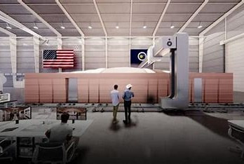


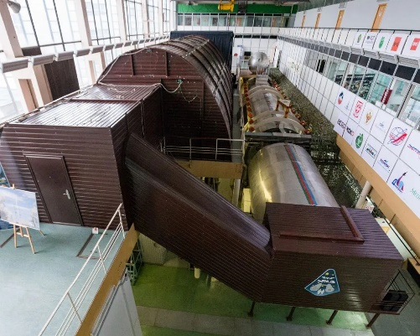
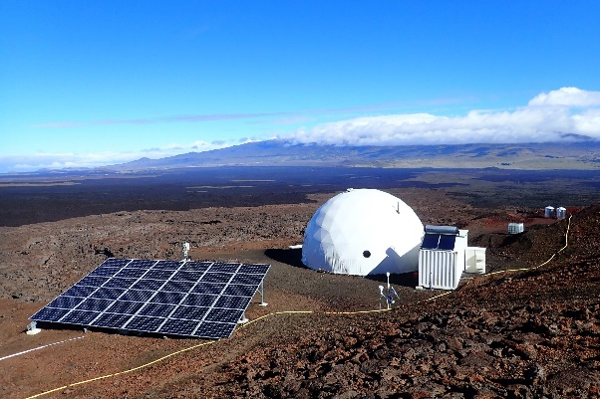
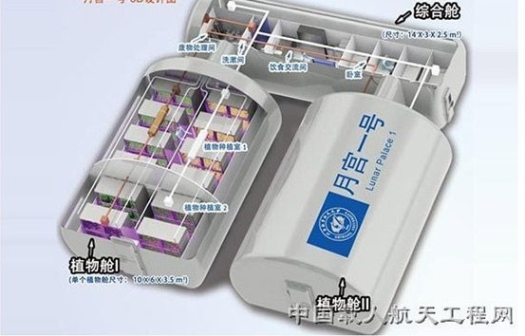
Isolation and Confinement
HERA falls into this type as it performs missions where the crew are physically cutoff from the outside world in a compact habitat with limited external communication.
CHAPEA
HERA
BioSphere 2
NEK
HISEAS
Lunar Palace

Slide 6
HERA History
45 days
Harvey
30 days
14 days
COVID Delay
7 days
Studies:
9
15
23
22
15
17
20
Asteroid FLT SIM
Asteroid FLT SIM, VR
Mars FLT SIM, VR

Slide 7
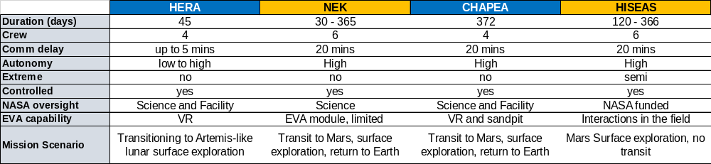
Isolation and Confinement

Slide 8
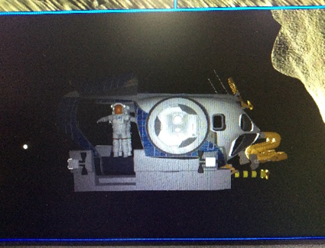
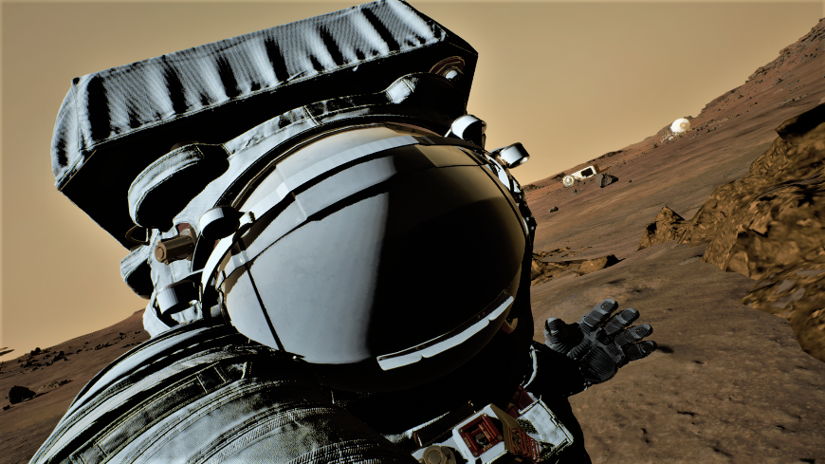
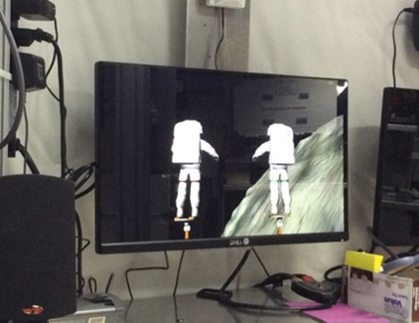
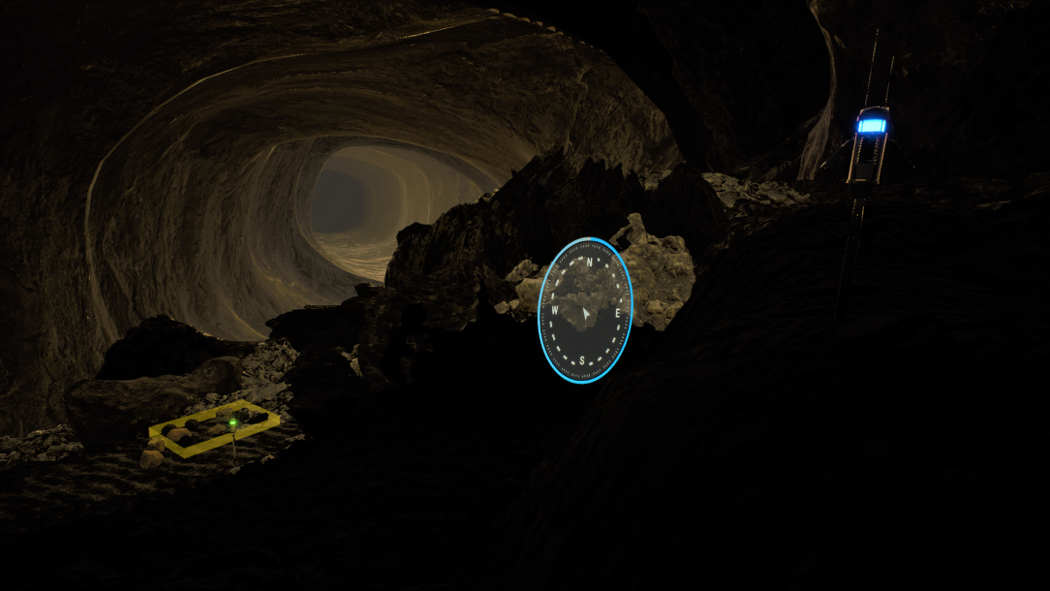
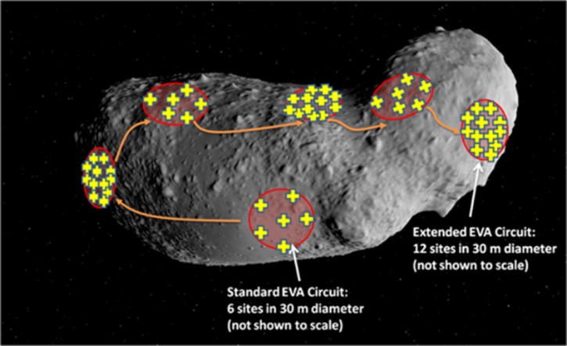
Comparison of simulated EVA Capabilities
HERA
Two crewmembers operate Flight Simulator on L1 module and two crewmembers perform VR EVAs in the airlock

Slide 9
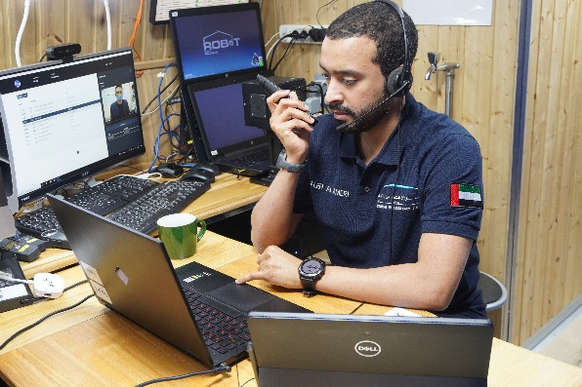
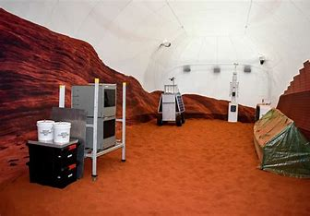
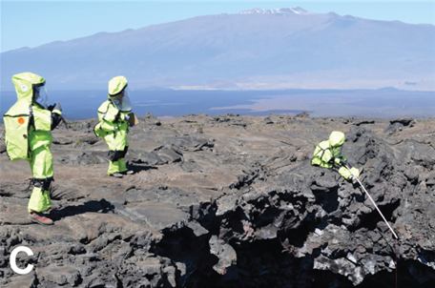
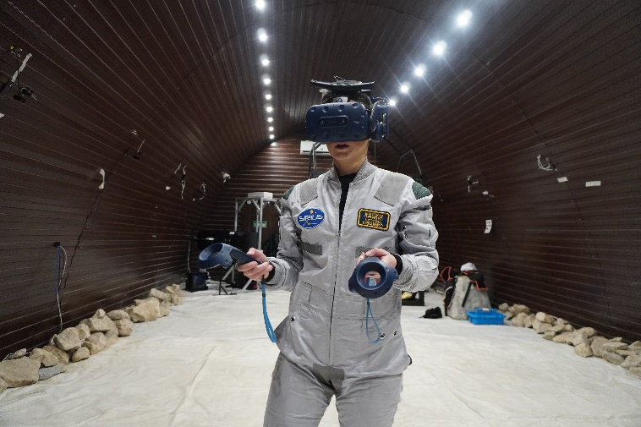

Comparison of simulated EVA Capabilities
CHAPEA
NEK
HISEAS
Crew split into two groups for several days
1,200-square-foot sandbox filled with red sand to mimic the Martian landscape.
Crew performed geological surveys and other tasks within a 2-mile radius of the habitat remaining in contact with HABCOM

Slide 10
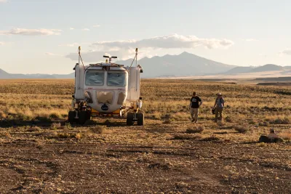
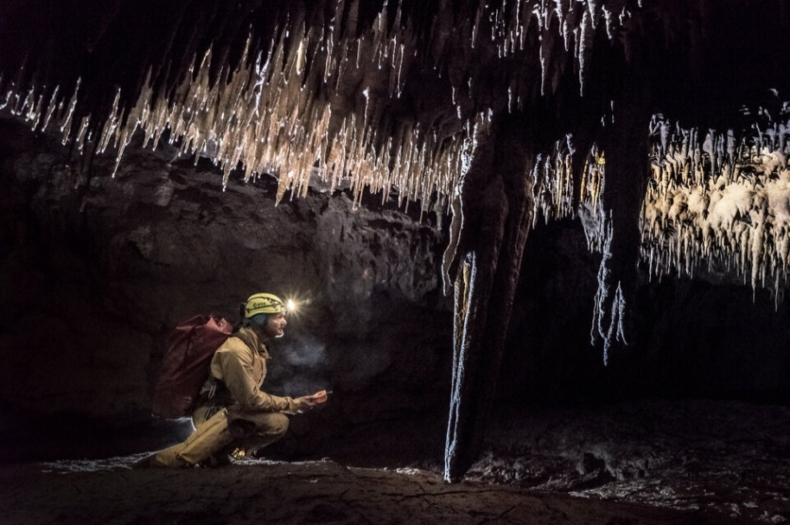
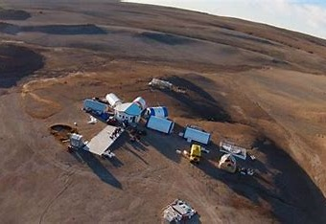
Field Analogs
Field analogs typically conduct exploration activities in natural environments often without a habitat.
HERA crews perform surface operations together in VR simulated environments.
DRATS
CAVES
Haughton Mars
CREDIT: ESA–A. Romeo

Slide 11
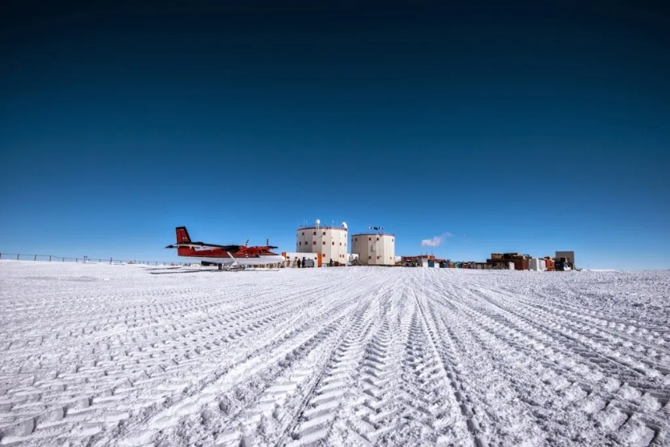
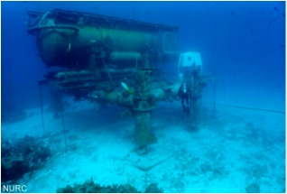
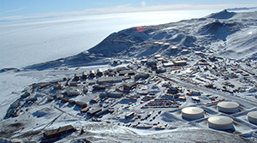
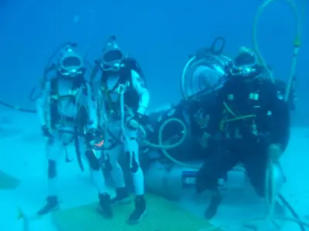
Isolated, Confined, and Extreme Environments
Locations that have extreme conditions are used to research human adaptation and resilience in unhospitable environments.
HERA does not operate in an extreme environment so cannot model this effect on the crew.
NEEMO
Antarctica
Credit: Beth Healey

Slide 12
Summary
HERA is an Isolated Confined and Controlled environment supporting HRP’s science objectives
The habitat is designed to enhance mission fidelity with internal spaces and systems that emulate current NASA spacecraft capabilities
HERA uses VR environments to simulate surface operations
Crews follow a planned timeline of activities and have some autonomy in organizing their tasks

Slide 13
Artemis Lunar Surface Ops Overview
Justin Mason
Increment Lead
KBR Inc.

Slide 14
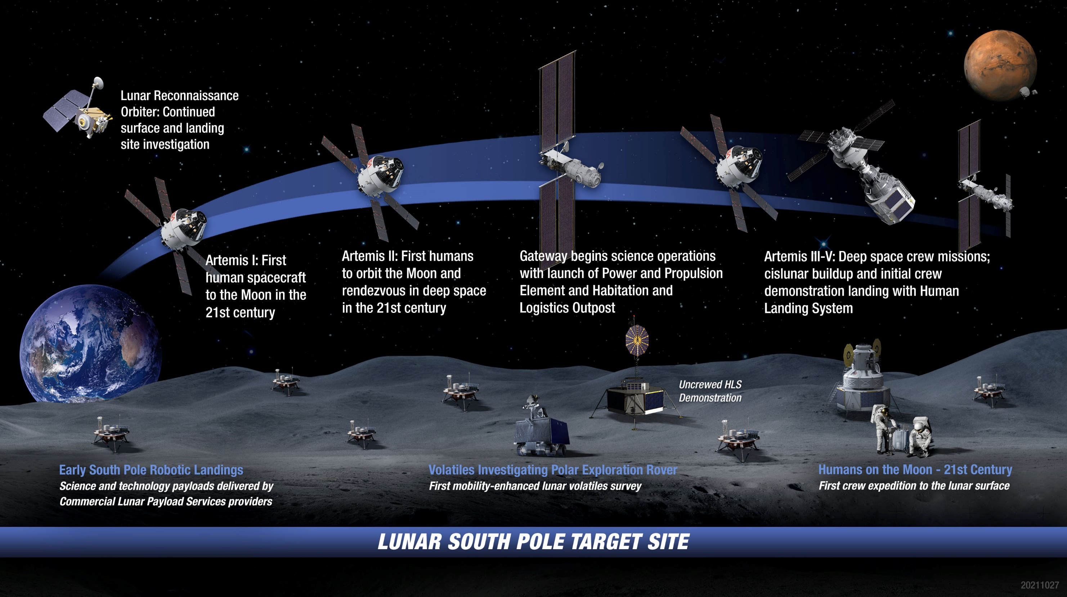
Artemis: Landing Humans On the Moon

Slide 15
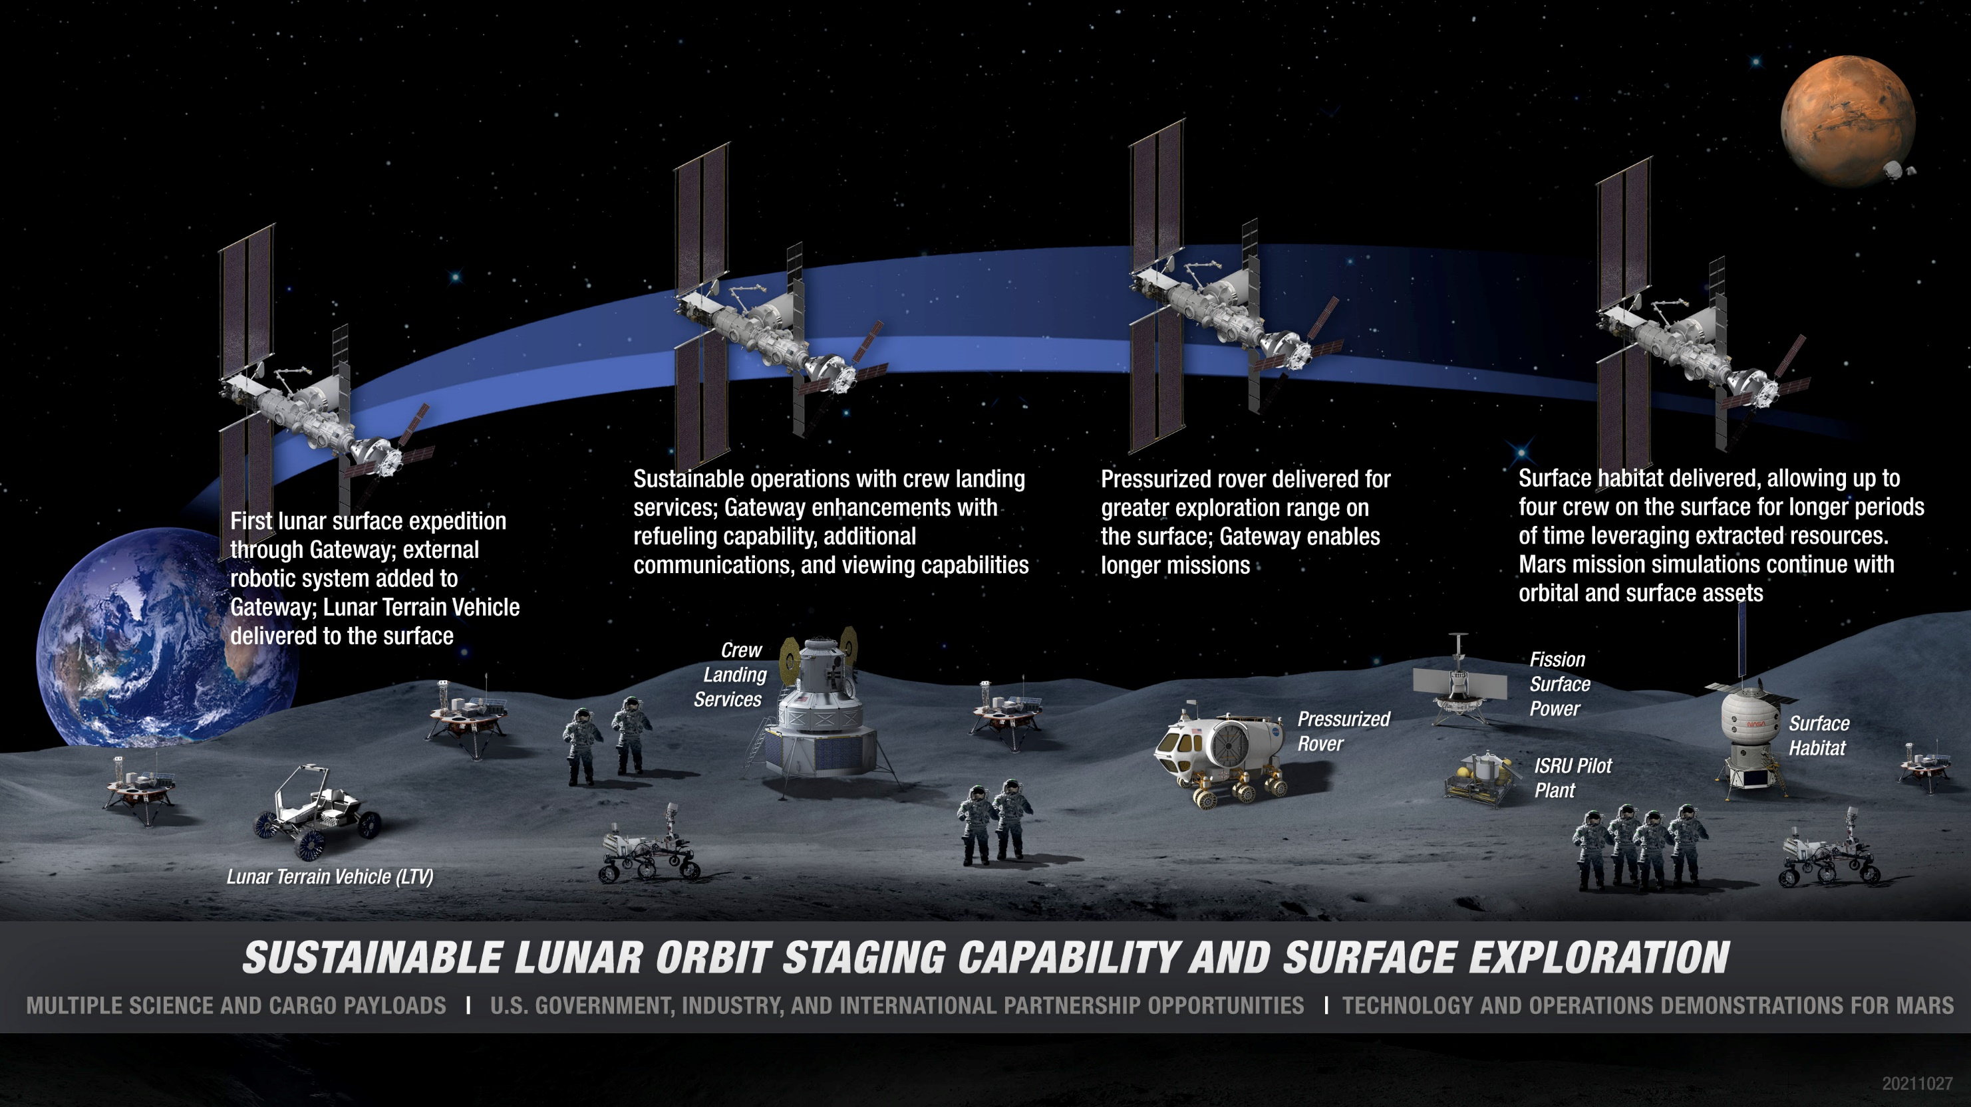
Artemis Base Camp Buildup

Slide 16
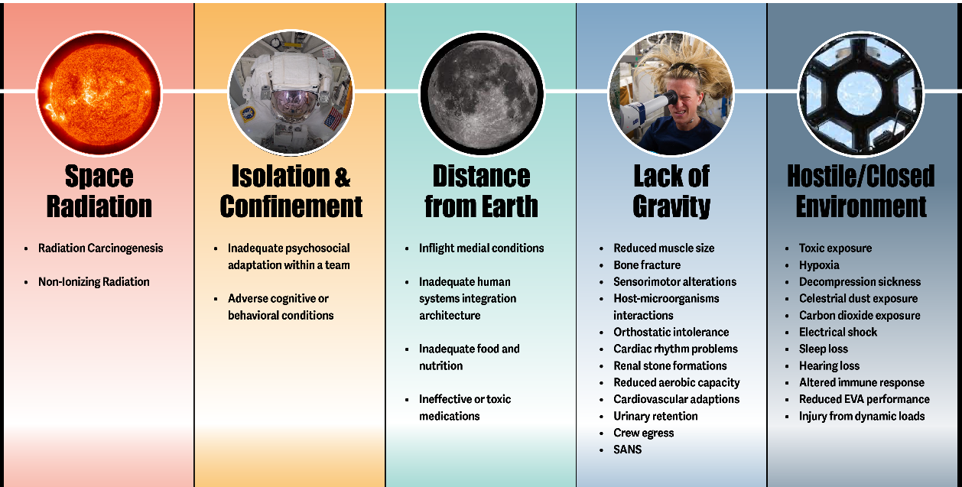
Evidence: Hazards and Risks of Human Spaceflight
Radiation
Isolation & Confinement
Distance from Earth
Altered Gravity
Deep space ionizing radiation dose rate and composition different than ISS and NASA Space Radiation Laboratory
Limited resupply, multi-day return to Earth, near real-time communication, more crew & vehicle autonomy
Ability to study effects of microgravity/partial gravity transitions and multi-day exposure to partial gravity of lunar surface (pre/post surface measurements)
Notes:
Deep space ionizing radiation dose rate and composition different than ISS and NASA Space Radiation Laboratory
Habitation modules smaller than ISS and ground-based analog habitats; times without view of the Earth
Limited resupply, multi-day return to Earth, near real-time communication, more crew & vehicle autonomy
Ability to study effects of microgravity/partial gravity transitions and multi-day exposure to partial gravity of lunar surface (pre/post surface measurements)
Different atmospheric pressure/partial pressure of oxygen (TBD), different microbial environment, limited food system, different exercise capability

Slide 17
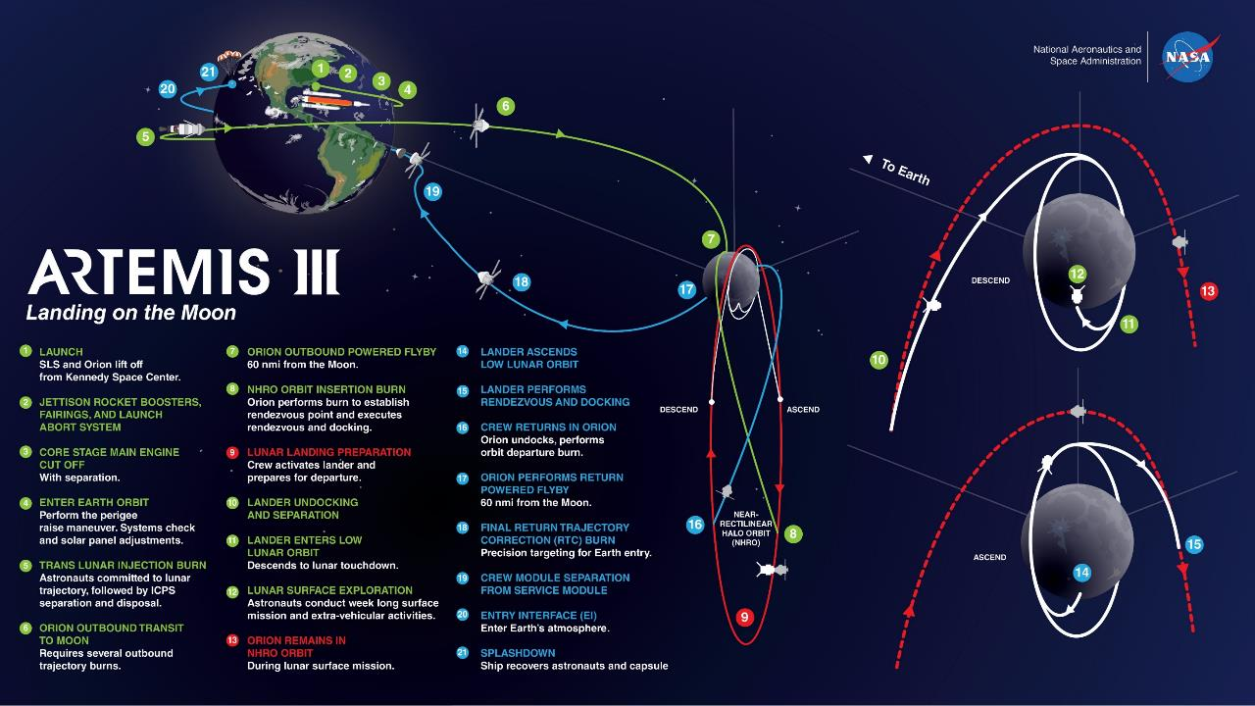
Artemis III Mission Profile
Notes:
Mission design assumptions:
Crew time estimates assume 5 transit days with 4 crew workdays on which utilization can be performed
Note: Outbound transit duration can be between 5 and 11 days depending on launch date and phasing.
4 crew total: 2 to the lunar surface, 2 remain on Orion
SpaceX has capability to perform up to 4 EVAs on surface, average 5 hours each:
Lunar Surface Mission Definition Forum tasked to determine plan for #EVAs and duration
Mandatory activities each EVA include egress, ingress, dust mitigation, and tool configurations
The remaining EVA time is for Artemis mission objectives and includes science (e.g., instrument deploy, sampling), traverse time, and PAO

Slide 18

Lunar Surface at the Pole
This visualization shows the unusual motions of the Earth and Sun as viewed from the South Pole of the Moon. The animation compresses three months (a little over three lunar days) into two minutes. The virtual camera is on the rim of Shackleton Crater, partially visible in the bottom right, and is aimed at the Earth. The mountain on the horizon, about 85 miles away, is unofficially known as Mons Malapert.
Here, the Sun glides around the horizon, never more than 1.5 degrees above or below it, while the Earth bobs up and down, never veering far from 0° longitude. The Earth appears to be upside-down and rotating backwards. The perpetually low Sun angle produces extremely long shadows that rotate across the rugged lunar terrain.

Slide 19
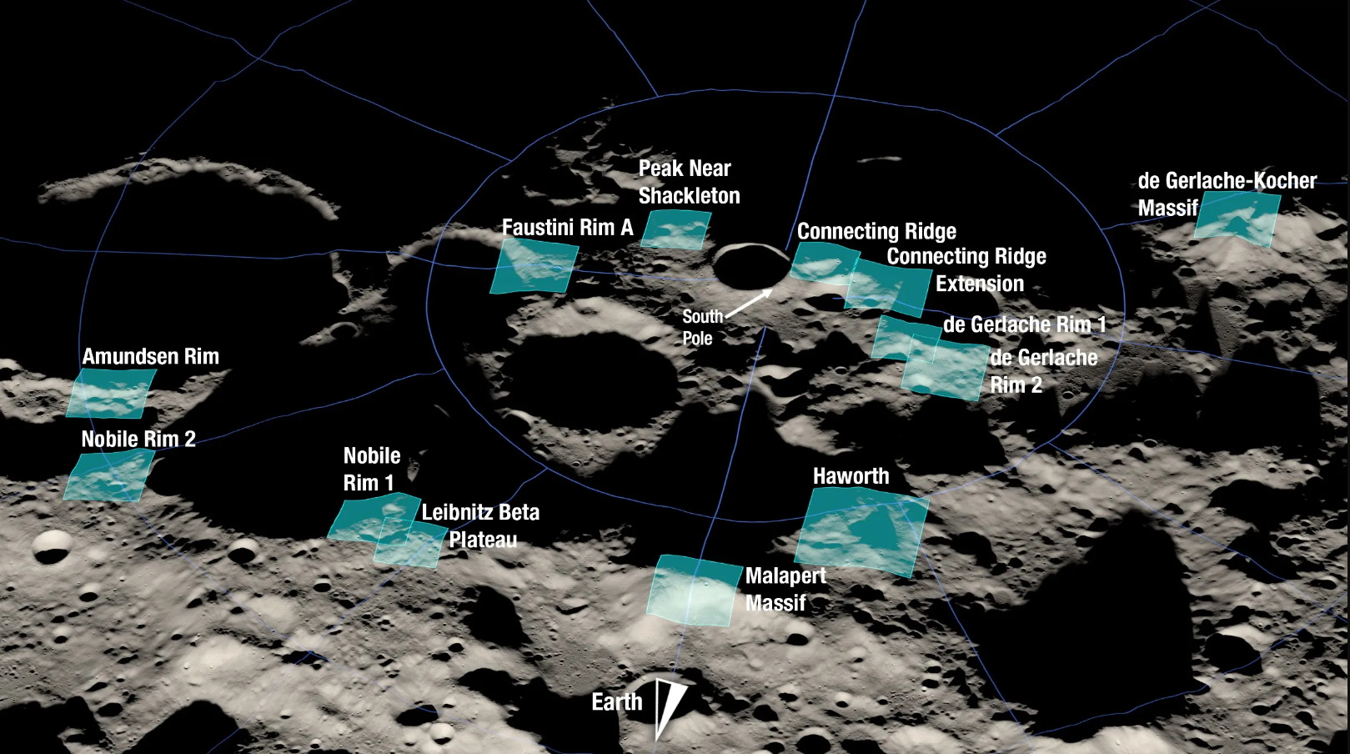
Artemis III Landing Sites
rendering of 13 candidate landing regions for Artemis III. Each region is approximately 9.3 by 9.3 miles (15 by 15 kilometers)
Each of these regions is located within six degrees of latitude of the lunar South Pole and, collectively, contain diverse geologic features. Together, the regions provide landing options for all potential Artemis III launch opportunities. Specific landing sites are tightly coupled to the timing of the launch window, so multiple regions ensure flexibility to launch throughout the year.

Slide 20
Sample EVA Timeline
0:00
12:00
EVA Prep (1:30)
EVA (6:00)
EVA Post Ops
EVA Study
Depress (0:30)
Ingress (0:30)
EVA Conf (0:30)
Upon egressing the Airlock, the 2-person crew travels to the surface performing a variety of tasks that could include:
  Deploying, setting up, transporting and retrieving payloads
  Setting up, transporting, and retrieving science experiments
  Traversing (up to 2 km) to identified areas of interest to collect photographic and geological samples
  EVA Public Affairs activities
  Safe work areas, stowing tools, and samples as needed
  Performing dust mitigation activities
  Ingress airlock

Slide 21
HLS EVA Key Attributes
Capability to support up to 6 EVAs during the lunar surface stay
Capability to support EVAs up to 8 hours (6 ± 2 hours) in duration each
Ship to EVA suit surface operations communication (voice, data, and video)
Appropriate volume to don, doff, and maintain suits
Allowance for performing incapacitated crewmember operations
A cabin atmosphere that would allow for the shortest prebreathe and require the least amount of crew time
Layered engineering defense protocols for lunar dust
Margin to bring back EVA equipment from the lunar surface

Slide 22
EVA Ranges
Walking Range 2 km
  Assumes ~2km/hr walking pace on relatively level regolith
  Does not account for slope or boulders
  Distance may decrease due to terrain or operational considerations
  Apollo 14 walked 1.45 km from lander
Unpressurised Rover Range ~10 km (~5 hour walk back)
  Distance must be balanced with consumables remaining
  Apollo 17 drove 7.6 km from lander
Single Pressurized Rover Range ~12 km (~8 hour walk back)

Slide 23
Summary
  Surface operations will be EVA focused and intensive
  South pole lighting will be a primary issue the crew will be dealing with during surface ops
  IVA operations will be limited in the short term until there is a sustainable base camp

Slide 24
Mission Scenario & Science Objectives
Mary Jo Maciejeski, PhD
Complement Scientist
KBR Inc.

Slide 25
Science Objectives
Analog mission design is driven by science objectives
Changing landscape of the space program:
  ISS retirement
  Development of Commercial Space Travel
  Gateway
  Transitioning to Lunar Surface Operations
Grant calls are more related to preparing for the future
Leads to development of mission scenario

Slide 26
Science Objectives
Influence of Human Research Program Roadmap
  Risks
  Gaps
HERA Campaign development
  Example, sleep studies will influence mission timeline/science priorities and number of ops tasks performed during sleep deprivation period
  Example, crew autonomy studies will influence daily schedule organization and communications with MCC

Slide 27
Science Objectives for C8
Change to levels of crew autonomy
New training environment and transfer of skills
Exploration-mission sleep schedules
  Modification of schedule for Lunar based mission

Slide 28
Mission Scenario Purpose
Allows crewmembers to stay engaged in the simulation and forget about the realities of the outside world
Provides a sense of purpose, goals, and teamwork environment
Produces high quality data for science objectives

Slide 29
Mission Scenario for HERA
Mars Moon Phobos based transit mission – C5 & C6
Mars based surface landing mission – C7
Lunar surface with sustaining habitat mission – C8
  Lunar surface activities and mission timeline
    Mixed Lunar base
      Sleep and work timelines change
    Rover sortie activities
    Communication delays
    Communication differences

Slide 30
Mission Scenario Changes
Sleep/wake and duty-day times
Changes to how crew interacts
  MCC changes
  Private family conferences
  Private medical conferences
  Private psychological conferences
Level of crew autonomy

Slide 31
HERA Virtual Reality EVA Simulation Historical Overview
Patrick Petty and Leslie Garner
Mission Support Specialists
KBR, Inc.

Slide 32
General Overview
Virtual Reality events were specific to the overall HERA mission scenario and have evolved with each campaign
  Used to improve mission fidelity and to provide PIs with team performance data
All iterations of HERA Virtual Reality contained the following:
  4 crew members working together
    broken into 2 teams
  All crew used assigned voice protocol and follow the mission communication delay profile
  Feedback was provided to the crew using a rubric
    The rubric was used to track crew performance and decision making
Notes:
Fun fact: The feedback rubric was introduced in campaign 4 because the crew wouldn’t stick to the assigned tasks in campaign 3.

Slide 33
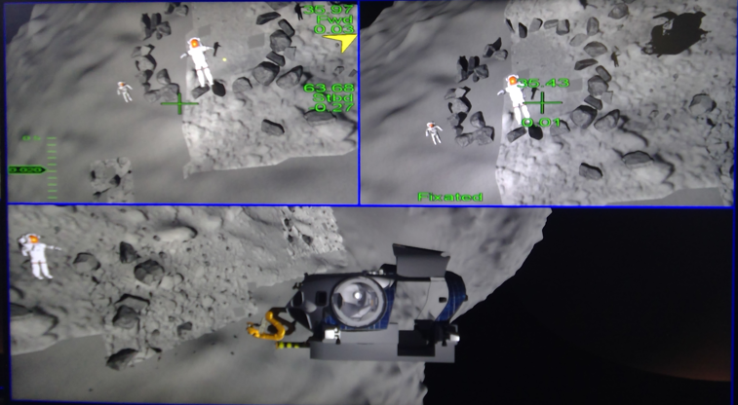
Multi-Mission Space Exploration Vehicle (MMSEV)
HERA Campaigns 3 through 4 (Astroid) and Campaigns 5 through 6 (Phobos)
General Overview:
Transited for surface operations
Completed objectives for assigned route
  each route contained 3 different sites
At each site EVA’s assigned different objectives concurrently
  objectives completed by positioning the EVA character in specific orientations
EVAs returned to the MMSEV, and the pilots' transit the MMSEV back to Space Craft
Notes:
All 4 crew members started in the spaceship, undocked from the solar panels and flew to the air space that was located near the surface. The airlock doors were opened, and the 2 EVAs were released to fly to the surface for operations. The Pilot and the Flight Engineer would call out the objectives and the EVAs would maneuver themselves into certain positions to complete the objectives. At the end of surface ops the EVAs would traverse back to the spaceship, fly onto the arms and once locked in place the pilot would then fly them to the next site. Once the 3 sites were completed the EVAs would re-enter the suit port, the airlock doors would close, and the team would fly back to the solar panels to dock the spaceship.

Slide 34
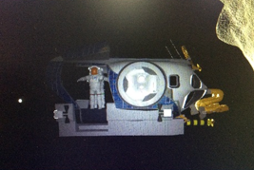
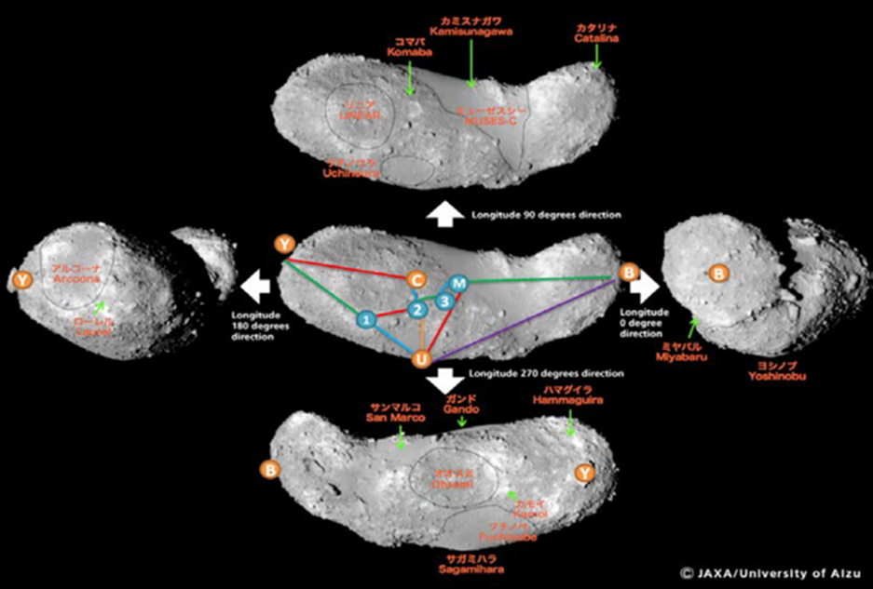
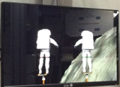
MMSEV cont’d
Hardware:
Playstation Controllers
Oculus Odyssey VIVE headset
General Setup:
EVAs in airlock
Pilots on level 1 of HERA habitat
Crew members stay in assigned roles throughout mission
Notes:
On this slide the top picture shows an EVA leaving the airlock, the next picture shows the different sites and a map of Phobos, and the bottom picture shows the EVAs locked onto the arms.

Slide 35
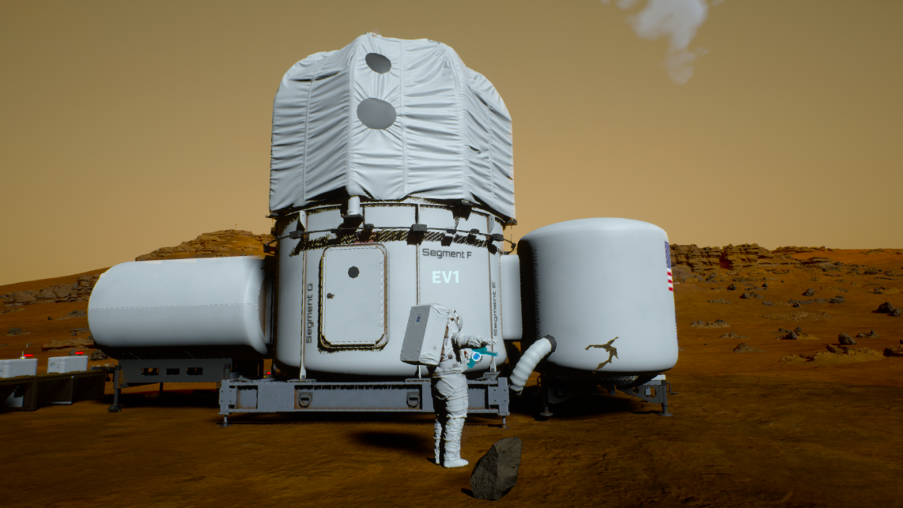
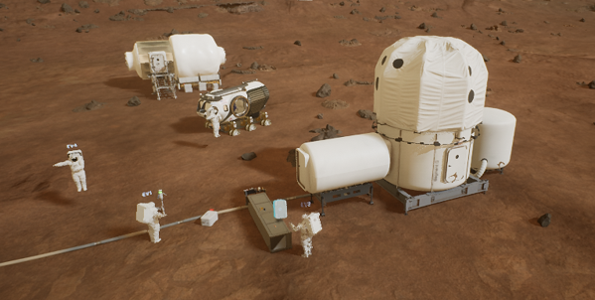
Virtual Reality Operations on Mars (VROOM)
HERA Campaign 7
General Overview
EVAs began on the Martian surface
Pilots operated drones for navigation and document information at each site
Each route contained 3 specific sites with various objectives
EVAs worked together to complete one set of objectives
  EVAs manipulated avatar to physically complete objectives (take pictures, break a rock sample)
EVAs returned to habitat with guidance from drones

Slide 36
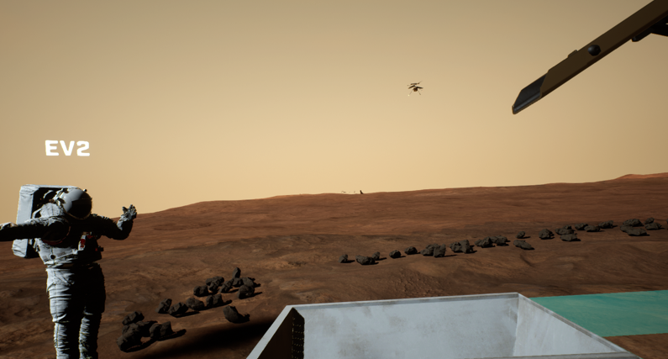
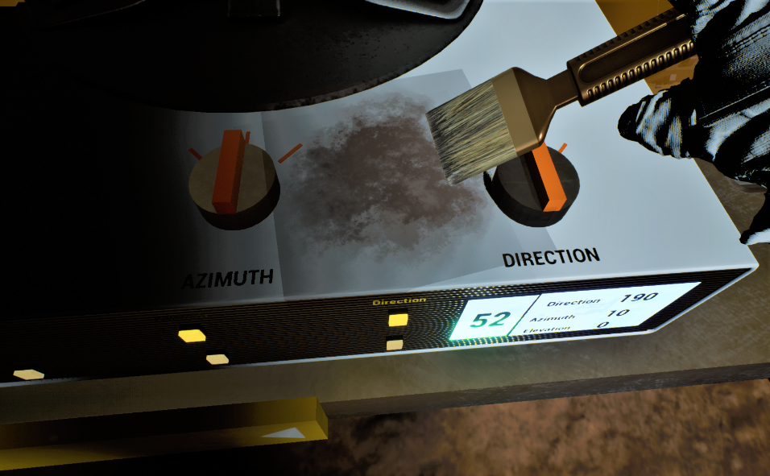
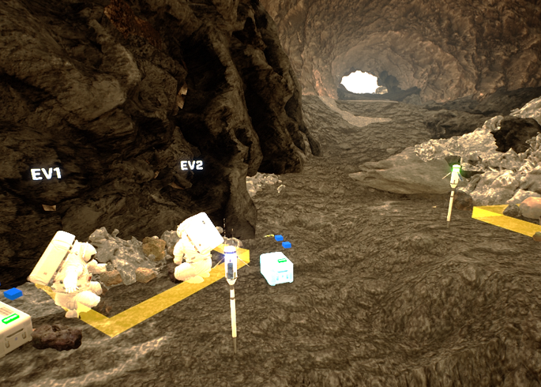
VROOM cont’d
Hardware:
Xbox Video game controllers
HTC VIVE Pro Headset
HOTAS Joystick Controller
General Setup:
EVAs in airlock
Drone Operators on level 1 of HERA habitat
Crew members stay in assigned roles throughout mission

Slide 37
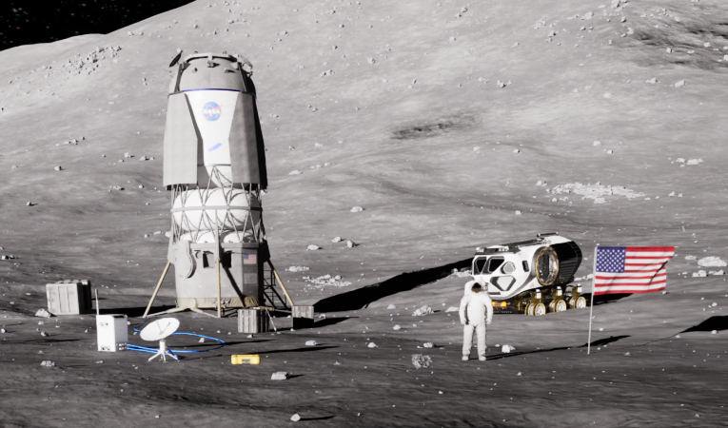
HERA Lunar VR Simulation (in development)
HERA Campaign 8 and beyond:
General Overview
EVAs will begin on surface of moon
Will include driving the rover
Objective actions will be more realistic
  rock sampling, turning dials, fixing hardware
Tools will model Artemis hardware
Crew will manipulate other items on the lunar surface

Slide 38
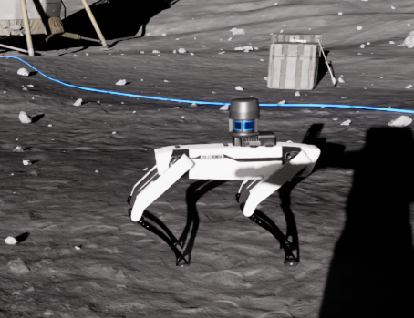
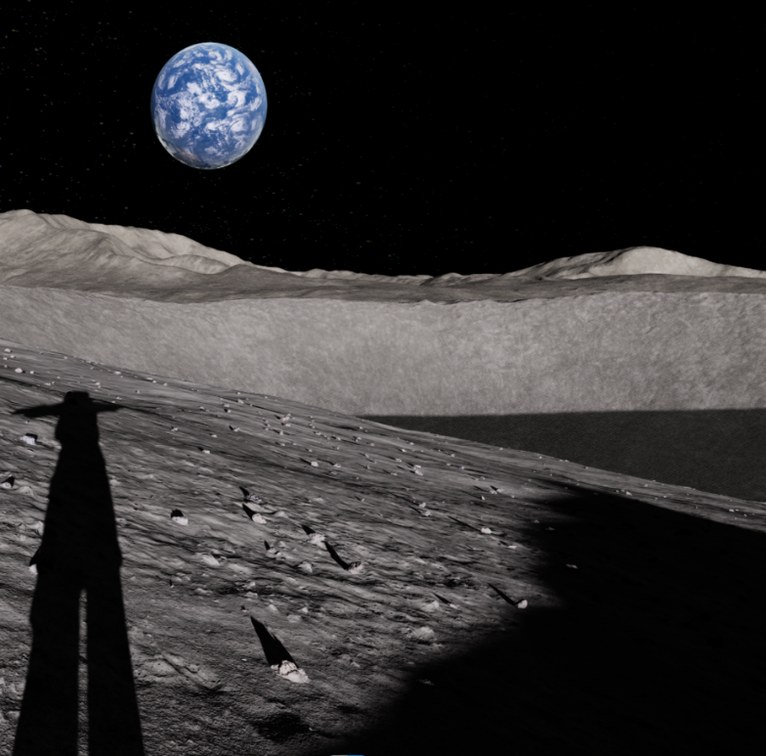
Lunar VR Simulation cont’d
Hardware:
HTC VIVE Pro 2 Headset
VIVE VR remotes
Joystick Controllers
General Setup:
EVAs (2 crew members) in physical rover mock-up
2 crew members on level 1 of HERA habitat
Crew members will rotate through all 4 positions throughout course of mission

Slide 39
Summary
The Simulation changes to match HERA scenario needs
The user experience continues to improve with the advancements in VR technology
  For the crew members this includes :
    Controller capabilities, Graphics, Usability
  For the operators this includes:
    Designing more complex and unique experiences that can be easily customized to fit mission and experiment needs
    Creating rubric and voice protocols that are developed internally and can be adjusted to meet special requests

Slide 40
C8 Updates to Operations and Scenario
Ted Babic
Mission Operations Lead
KBR, Inc.

Slide 41
Mission Fidelity – What and Why?
Mission Fidelity is making the crew feel immersed in the scenario or “World” of their mission.
  They are there to work on the moon and complete science tasks for humanity, not to sit in an oddly decorated 2 story apartment and do weird games while they think about their mortgage or other real-world needs.
What does this provide?
  Allows crewmembers to stay engaged in the simulation and forget about the realities of the outside world
    Focus on the tasks at hand, not work pile up at their jobs
      HERA is isolated and confined, not just physically, but mentally.
  Provides a sense of purpose, goals and teamwork environment
    Keeps them on task and motivated.
    Helps maintain good behavior.
    Encourages the completion of tasks that are more tedious.
  Produces high quality data for science objectives
    Engagement drives completion of tasks.
    Solid reasoning to the “Why” drives accuracy when answering questions or performing tasks.

Slide 42
Implementation of a Realistic Scenario
Outlining an overarching goal
  Where are they going, what are they doing.
    This ties everything together and gives a lot of the justification for activities
Planned activities need to fit the scenario
  Radiation storms, Meteor impacts, ECLSS systems, medical emergencies, system failures, Routine maintenance, etc.
    All help engage and immerse them in the world you are creating.
  Events cannot break your scenario or lead to undesirable outcomes.
Tying unplanned events into your scenario
  Power outages
  IT systems failing or being patched
  Unexplained noises
    Jets, busses, pyrotechnic labs setting off explosions are machinery shifting or thrusters firing
Ensuring it does not violate the constraints and needs of implemented studies
  Otherwise, it defeats the whole purpose.

Slide 43
The Handling of Anomalies, Sim Breaks, and other Surprises
Trained MCC and On-Call Team
  All Ground Support Personal are provided training on Tasks and studies,
    Provided One-pagers and Troubleshooting documentation
    Clear On-Call system, with 24-hour support.
    Training Sims to prepare the team of off-nominal situations
Off-Nominal System
  Issues are tracked, saved, resolved, and debriefed.
  Information is provided in the Daily Status Report (DSR), and End of Mission Reports.
Emergency Call tree
  Handles Operational, Facility, Medical, Adverse weather events, etc.
    Careful coordinated action is taken to mitigate impacts up until the point of crew removal

Slide 44
We Work With You!
If you want to implement any of our operational tasks into your study, want to ensure that operational tasks do not conflict with your study, or have any questions about the mission scenario, reach out to our team
  The ESS assigned to your study is your friend. Either they are the right person to talk to, or they can get you in touch with the correct person
Many Things are not set in stone
  We are early in the development phase, much of what you will see is being assessed or adaptable.

Slide 45
Mission Scenario
C7 Scenario
  Long Transit from earth to Mars
  Perform operations on Mars for a week
    EVAS, sample collections, PAO, various science tasks.
  Long Transit back to Earth
C8 Scenario
  0.5 day transit
  45 day -Lunar Base
    Rover Sorties
    Various VR-EVA activities
      Repairs
      Sample collection
      Site mapping
      Etc.
    Habitat maintenance, repairs, ops, EVAs, various science tasks, etc.
  0.5 transit back

Slide 46
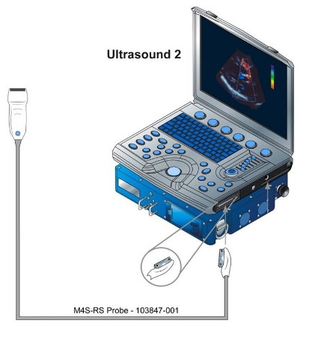
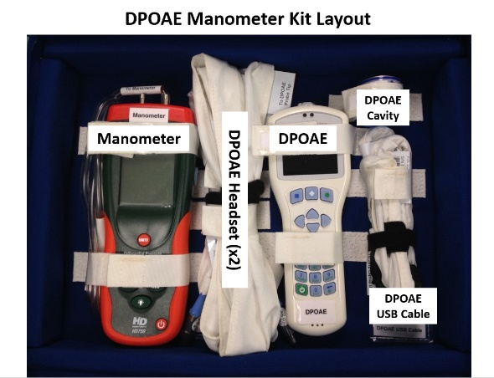
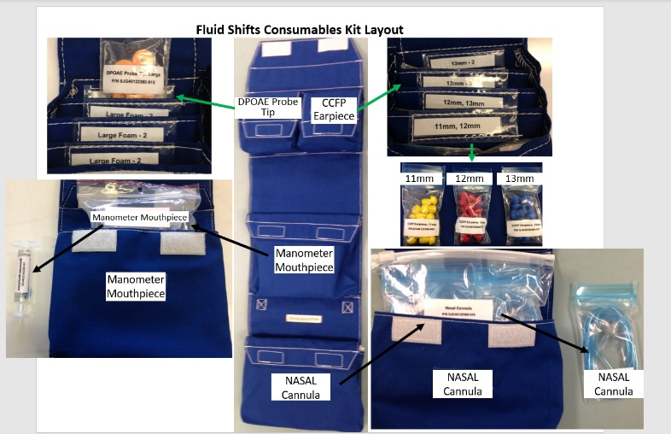
New and Updated Tasks
Planned Updated Tasks
  More involved geologic sampling – handling simulated moon rocks.
  Updated hydroponics – More plants, possibly using them as food.
  Higher fidelity emergency events.
  Cubesat upgrades, improvements, and activity tie ins.
  Increased PAO tasks.
  Older Habitat Simulated System (HSS) tasks updated to fit lunar scenario.
  HSS Cascading anomalies.
New tasks/Events
  Artemis Hardware tasks
    Cerebral and Cochlear Fluid Pressure (CCFP) Analyzer
    DPOAE Manometer
    Ultrasound 2
  New anomalies with a lunar focus
  Lunar landing and lift-off.
Notes:
Fun fact: The feedback rubric was introduced in campaign 4 because the crew wouldn’t stick to the assigned tasks in campaign 3.

Slide 47
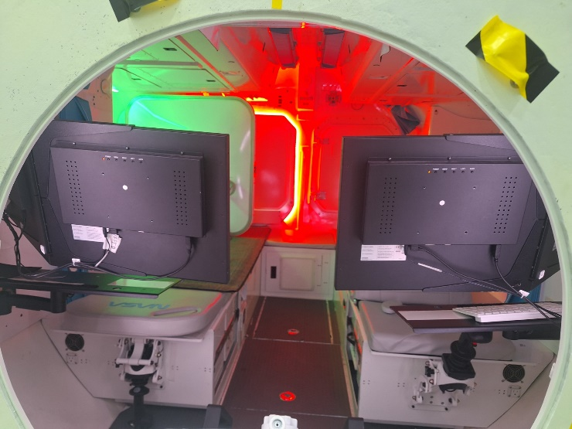
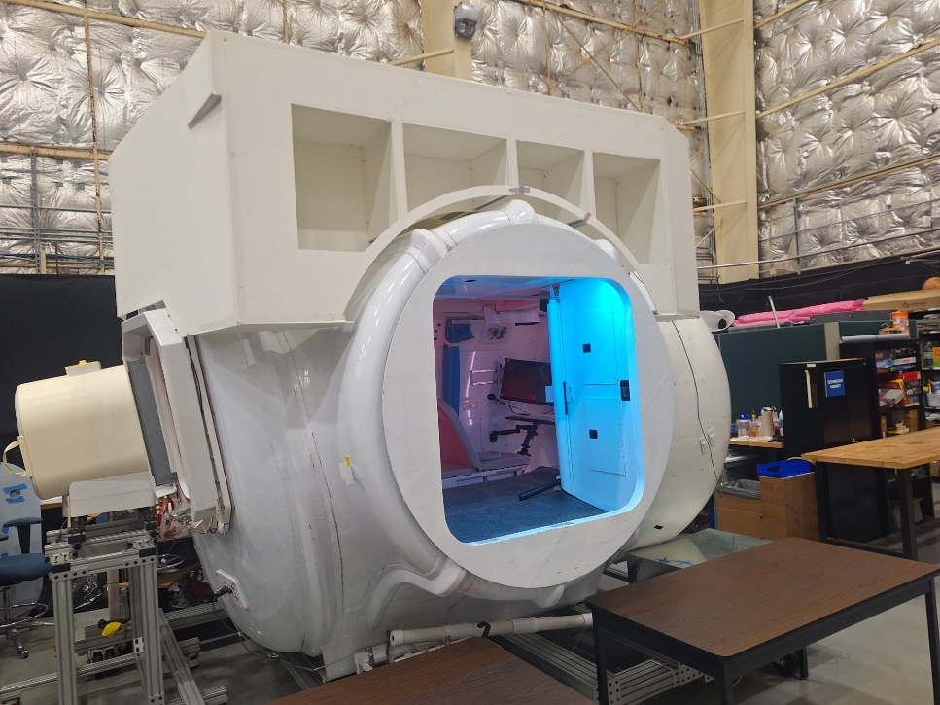
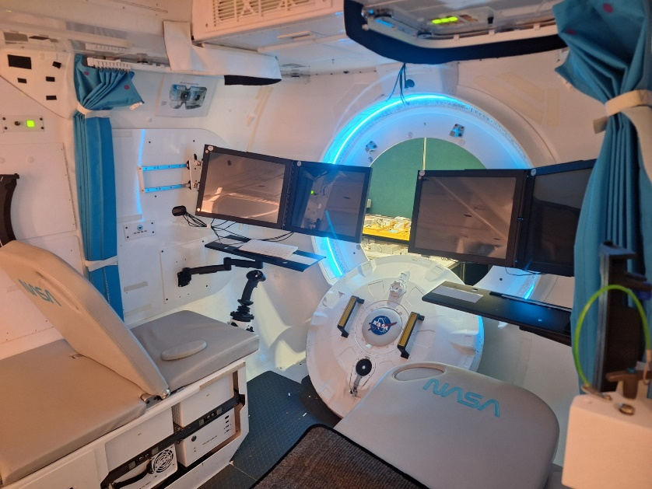
Simulated Lunar Operations - Rover
Rover
  Transfer vehicle from earth to moon
  Houses part of the VR systems for more realistic Moon operations
  Two planned “Split operations” events.
    2-3 day stretches with two crew members isolated in the rover, and two in the habitat.
    Different pair each time
    Toilet, food, water, etc. all in the rover.
Notes:
Fun fact: The feedback rubric was introduced in campaign 4 because the crew wouldn’t stick to the assigned tasks in campaign 3.

Slide 48
MCC Changes
New Communication delay
  2-14 sec. one way delay vs. 0-5 min
    DVICE still being used – This is the actual communication system used by flight.
    Comm delay system is adjustable by time and channel.
Private Family Conference (PFC) changes
  Recordings or delayed video being assessed.
  Increased frequency.
  New messaging system – More email-like.
General improvements
  Better tools for Subject Monitors.
  Simplified execution of VROOM and HSS systems.
  Additional troubleshooting material.
  Regularly scheduled Training and Simulation Sessions.
Notes:
Fun fact: The feedback rubric was introduced in campaign 4 because the crew wouldn’t stick to the assigned tasks in campaign 3.

Slide 49
QUESTIONS & DISCUSSION
Notes:
Fun fact: The feedback rubric was introduced in campaign 4 because the crew wouldn’t stick to the assigned tasks in campaign 3.

