Slide 1

Mars Sample Return:
Risk Management & Sample Safety Assessment
Dr. Alvin L. Smith,
Project Manager, MSR Sample Receiving Project, NASA
Dr. Gerald McDonnell,
Vice President, Johnson & Johnson
This document has been reviewed and determined not to contain export-controlled data.

Slide 2
Agenda
Mars Sample Return Mission
Sample Safety Assessment Protocol Team and Deliverables
Definitions and Abiotic Baseline
3 step protocol
Perspectives for the Future
01
02
03
04
05
This document has been reviewed and determined not to contain export-controlled data.

Slide 3


Slide 4
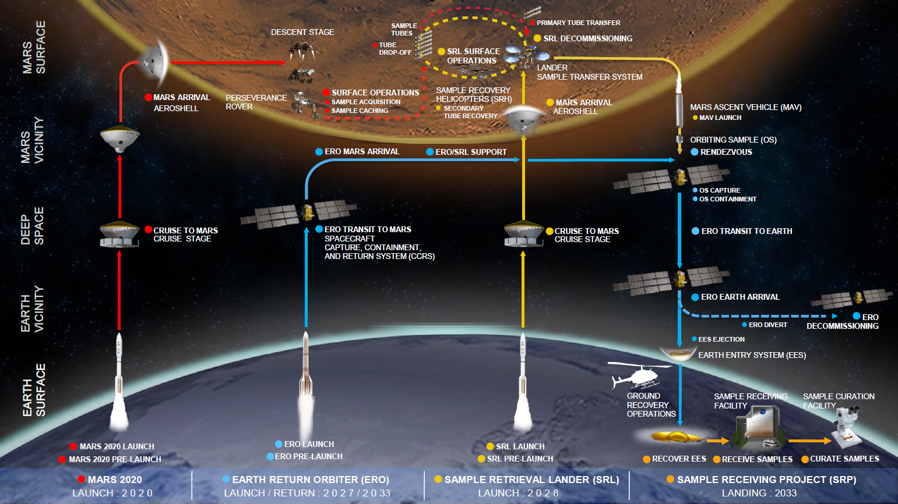
Mars Sample Return Campaign
Mars Sample Return (MSR) is a joint venture between NASA and ESA.
The Campaign will notionally return between 10-30 geologically diverse samples (plus witness tubes) able to answer an array of science objectives.
The Sample Receiving Project (SRP) is the last component of the MSR Campaign with operations beginning when the samples arrive on Earth.
MSR Campaign Architecture under evaluation
This document has been reviewed and determined not to contain export-controlled data.

Slide 5
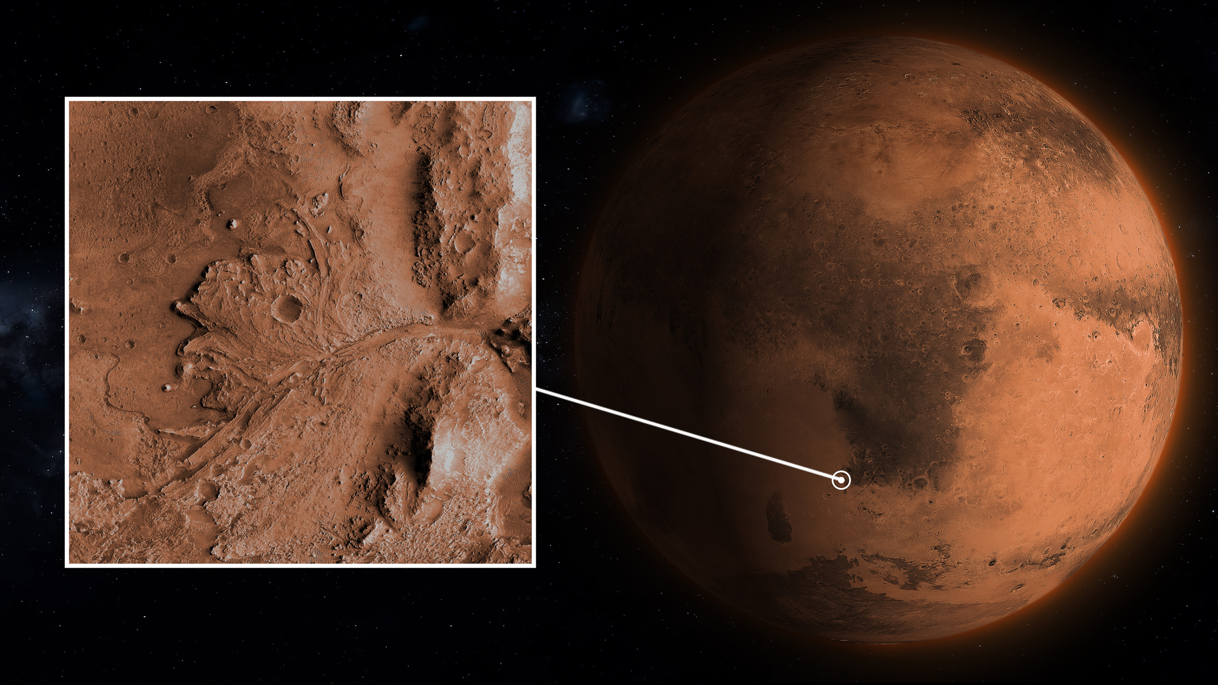
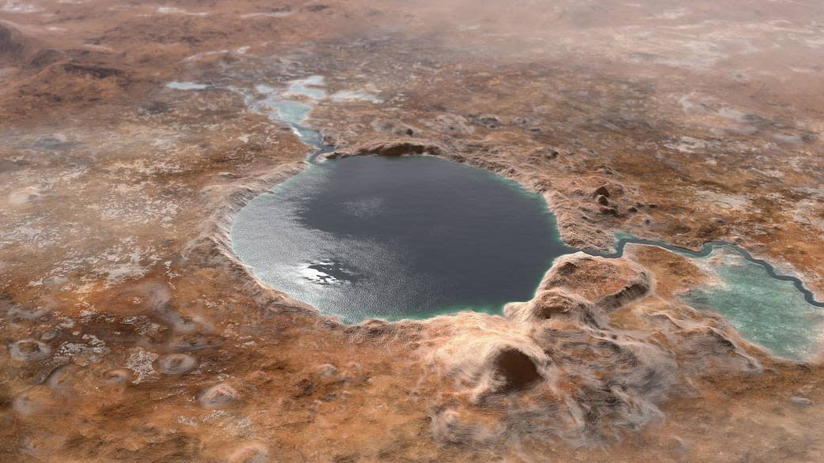
Follow The Water: Jezero Delta Crater
Perseverance was designed to characterize the geology, investigate records of past climate, and seek evidence of possible ancient life contained in rocks laid down when martian surface conditions were more habitable than they are today
Jezero crater, with a diameter of 45 km, was formed by an impact. The crater later hosted an open-basin lake, fed by a large system of river valleys that were active ~3.6 billion years ago
The probability for finding extant or “living” life is extremely low, but not zero
This document has been reviewed and determined not to contain export-controlled data.

Slide 6
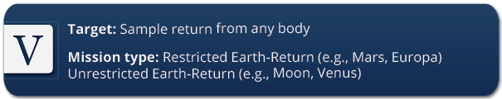
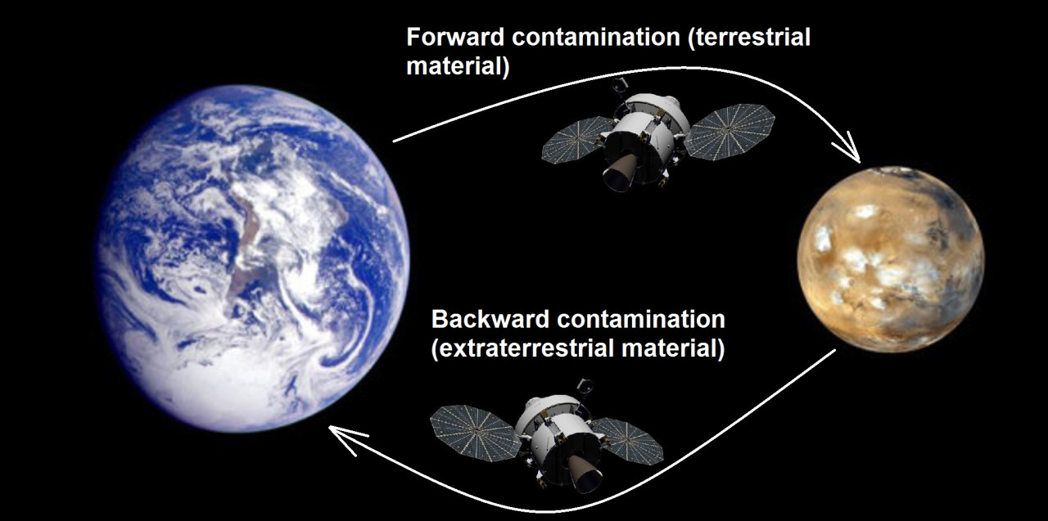
Why Is Mars so Special? - Restricted Earth Return Missions
NASA’s Planetary Protection (PP) imposes controls on biological contamination for certain combinations of mission type and target body. There are five categories.
Category V missions, sample return missions.
“Restricted Earth return,” missions from bodies that have a scientific potential for life. Need containment throughout the return phase of all returned hardware which directly contacted the target body.
Need to conduct timely analyses of any unsterilized sample collected and returned to Earth, under strict containment, and using the most sensitive techniques.
This document has been reviewed and determined not to contain export-controlled data.
Notes:
The highest degree of concern is expressed by the absolute prohibition of destructive impact upon return, the or unsterilized material from the body, and the need for containment of any unsterilized sample collected and returned to Earth. Post-mission, If any sign of the existence of a nonterrestrial replicating entity is found, the returned sample must remain contained unless treated by an effective sterilizing procedure. Category V concerns are reflected in requirements that encompass those of Category IV plus a continuing monitoring of project activities, studies and research (i.e., in sterilization procedures and containment techniques).

Slide 7
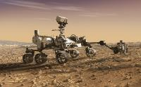
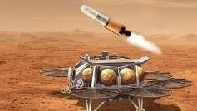

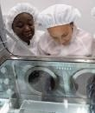
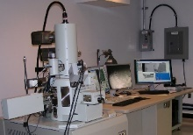

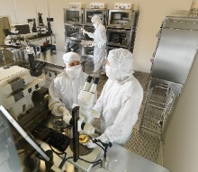
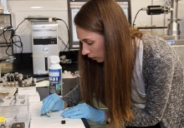
Mars Sample Return Campaign—Following the Samples
Mars Sample Return Program
1 2 3 4
Long-term Curation and Science
Mars 2020 Sample Caching
Collect samples of rock, regolith, and atmosphere
Cache samples on the surface for retrieval
Sample Retrieval Lander (SRL)
Retrieve samples cached by Mars 2020 rover
Launch samples into orbit around Mars
Earth Return Orbiter (ERO)
Capture and contain samples in Mars orbit
Safely return samples to Earth for recovery at landing site
Sample Receiving Project
Recover and transport contained samples to receiving facility
Safety assessment and sample containment
Initial sample science and curation
Primary transitions in sample custody
This document has been reviewed and determined not to contain export-controlled data.

Slide 8
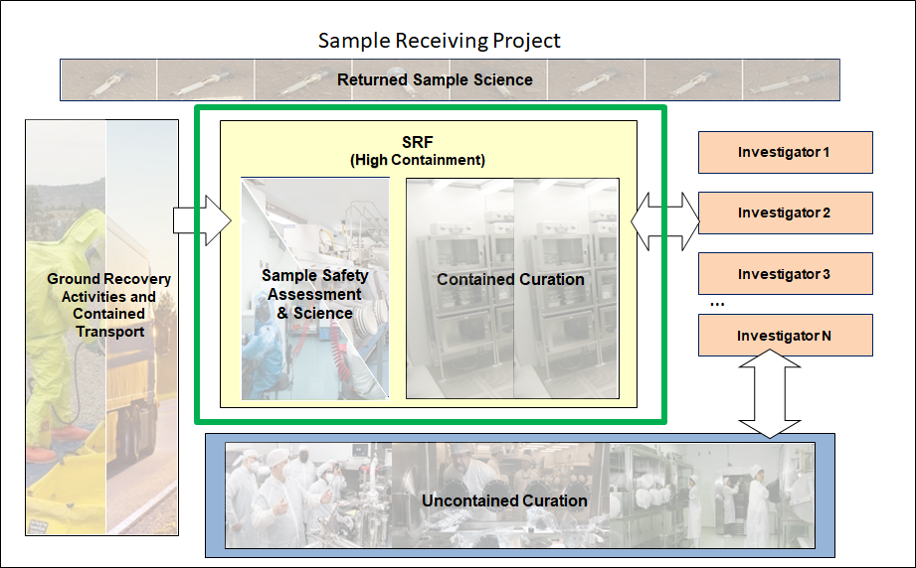
Sample Receiving Project Scope
Achieve Science Objectives
Complete project scientific objectives
Planetary Protection
Category V Restricted Earth Return
Facilities
Provide facility(s) for science, curation, and planetary protection
Ground Recovery
Take responsibility of the flown hardware, samples, and landing site artifacts and securely transport to SRF
Sample Curation
Curation of flown hardware, samples, CK artifacts
This document has been reviewed and determined not to contain export-controlled data.
Notes:
So our overall project scope for this SRP really hinges on our ability to maximize the return science on these samples. And this is an perspective that is captured across the entire project from:
ground recovery where we take custody for the flown hardware, and samples and transport them to the facility.
To building and designing an SRF capable of meeting with the stringent planetary protection containment requirements where some elements the sample safety assessment and initial curation must happen inside containment as identified by the green box.
When the samples are safe for release either by test or by sterilization they can then leave the facility to be distributed to outside laboratories to principal investigators, through a competitive process and can further study these samples, completing the science objectives in uncontained environments and facilities.

Slide 9
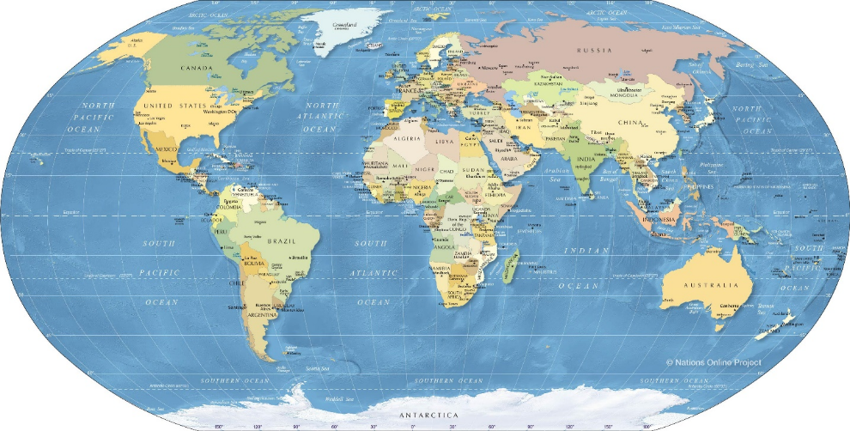
MSR Sample Receiving Facility Capabilities
Receive Spacecraft
Provide High-Containment & Contamination Control
Accommodate highest priority instrumentation
Fully operational by sample arrival
Enable rapid of release of samples
Hardware Disassembly
Sample Tube
Pre-Basic Characterization
Samples Opened and
Basic Characterization
Sample Safety Assessment, Preliminary Examination, and/or Select Early Science
Samples Picked and/or subdivided
Allocated Sample
Sterilization Process
(Irradiation or Heat)
Global Safe Sample Distribution for
Earth-based Science Investigations
This document has been reviewed and determined not to contain export-controlled data.

Slide 10
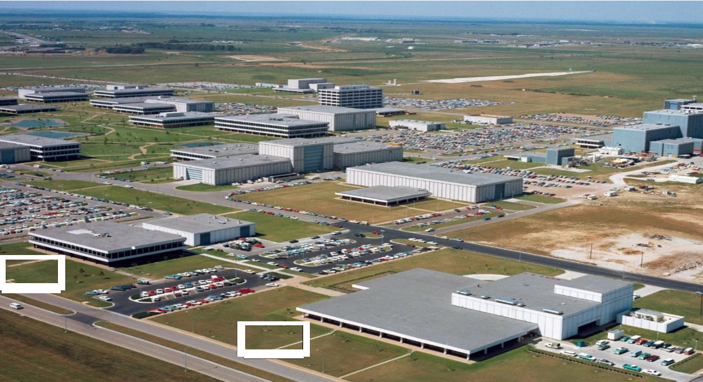
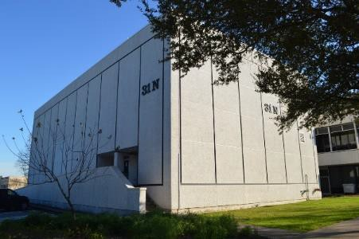
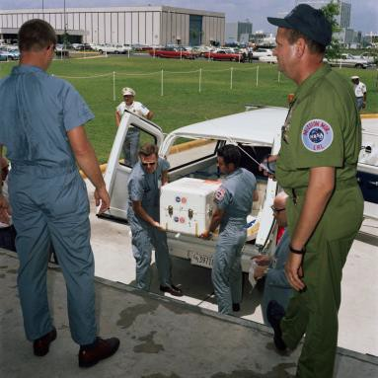




APOLLO LUNAR RECEIVING LAB
The 84,326 ft² (7,834 m²) LRL facility was designed to the following functional requirements:
Biological quarantine of astronauts, spacecraft,
equipment, and samples
Biohazard clearance testing
Preparation of sample return containers and astronaut geologic hand tools before flight
Receiving sample return containers and conducting
preliminary sample characterization
Time-sensitive primary scientific analyses
Sample curation: cataloging, sample storage, re- packaging and distribution of lunar samples to the scientific community for analysis
B31
B37
1967 Site Aerial Photo
This document has been reviewed and determined not to contain export-controlled data.

Slide 11
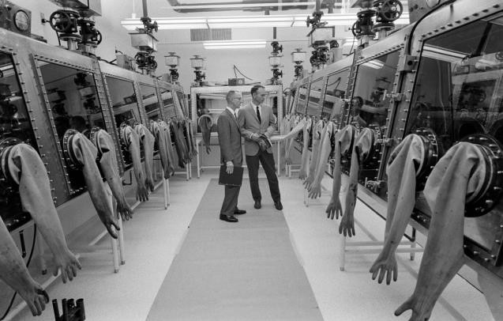
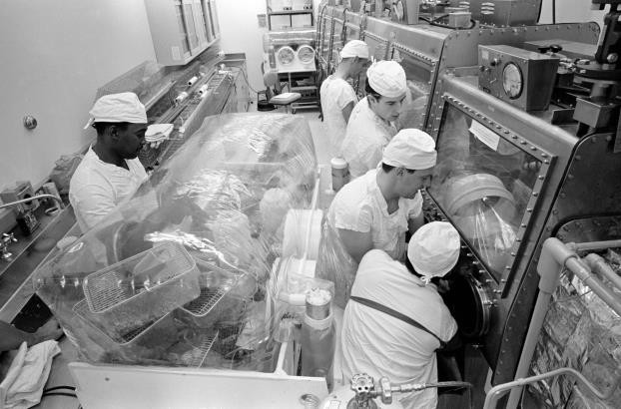

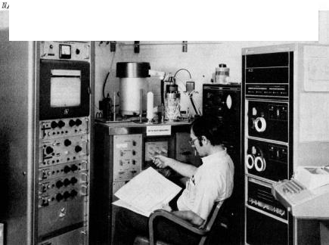
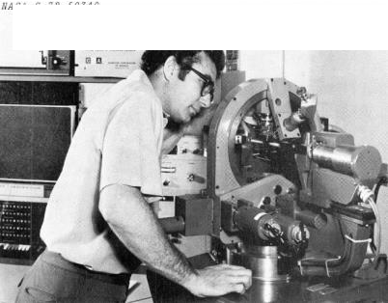
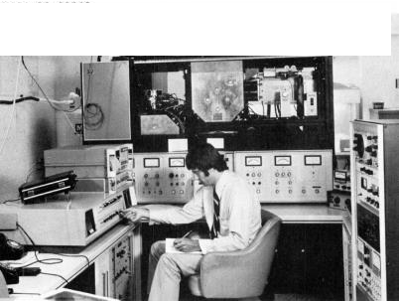





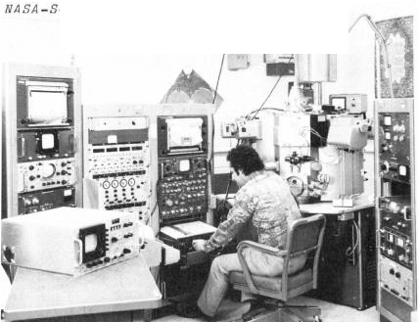
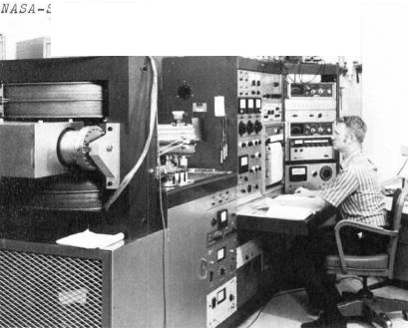
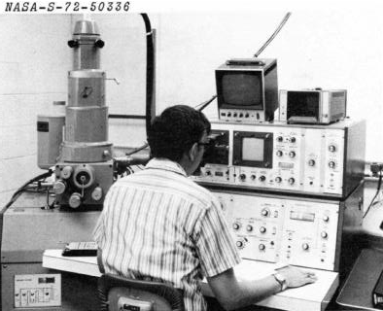


APOLLO LUNAR RECEIVING LAB
Thermal Analyzer/Mass Spec.
Single-Crystal X-Ray Diffractometer
Ion Microprobe Mass Analyzer
B31
Electron Microprobe
Mass Spectrometer
Scanning Electron Microprobe
B37
1967 Site Aerial Photo
This document has been reviewed and determined not to contain export-controlled data.

Slide 12
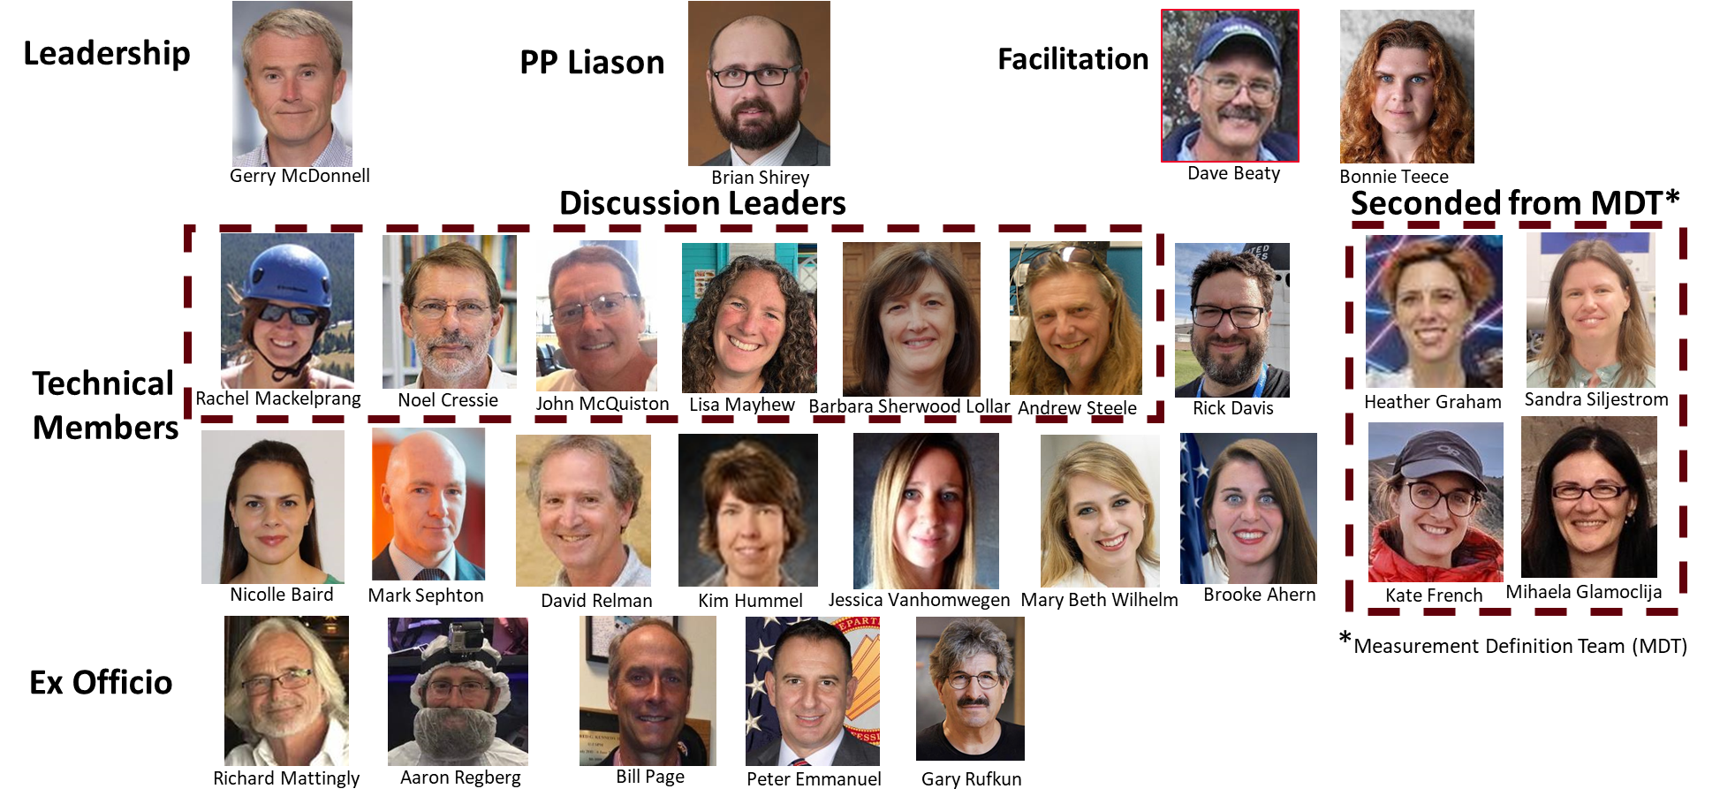
Sample Safety Assessment Protocol Tiger Team
This section of the presentation is intended for educational purposes only and does not replace independent professional judgment. Statements of fact and opinions expressed are those of the participant individually and, unless expressly stated to the contrary, are not the opinion or position of Johnson & Johnson, NASA, ESA, or their affiliates.
This document has been reviewed and determined not to contain export-controlled data.

Slide 13
Deliverables
Develop a definition for “biological hazard.”
Develop a strategy for statistical analysis.
Develop an appropriate subsampling strategy.
Develop a list of required measurements to test for potential biohazards.
Identify the minimum number of measurements that would be necessary to adequately assess safety.
Identify measurements that could potentially be conducted safely outside SRF-contained areas.
Integrate the above components to produce a safety assessment test sequence protocol.
This document has been reviewed and determined not to contain export-controlled data.

Slide 14
Definitions
Biological hazard: a biologically active Martian agent of organic origin capable of causing substantial harm to any component of the Earth’s biosphere if allowed out of containment.
Biosignatures: an object, substance, and/or pattern whose origin specifically requires a biological agent.
Harm: presence of a biological hazard outside of containment not associated with Earth contamination.
Non-viable: [biological agent] no longer capable of growing, replicating, infecting, or causing disease.
This document has been reviewed and determined not to contain export-controlled data.

Slide 15
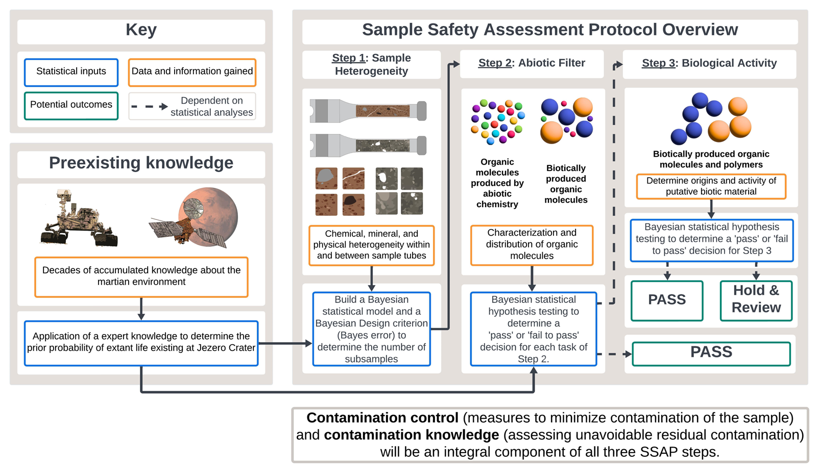
Overview-3 Major Steps with Bayesian Statistics
This document has been reviewed and determined not to contain export-controlled data.

Slide 16
Statistics
Two primary approaches: Bayesian v’s Frequentist methodology
Why Bayesian?
  Based on prior knowledge (‘prior’)
  Bayes Rule: updated as new evidence becomes available (‘posterior’) and cumulative
  Can accommodate small sample sizes and limited prior knowledge
  Considered more ‘modern’ and applicable in a digital environment
This document has been reviewed and determined not to contain export-controlled data.

Slide 17
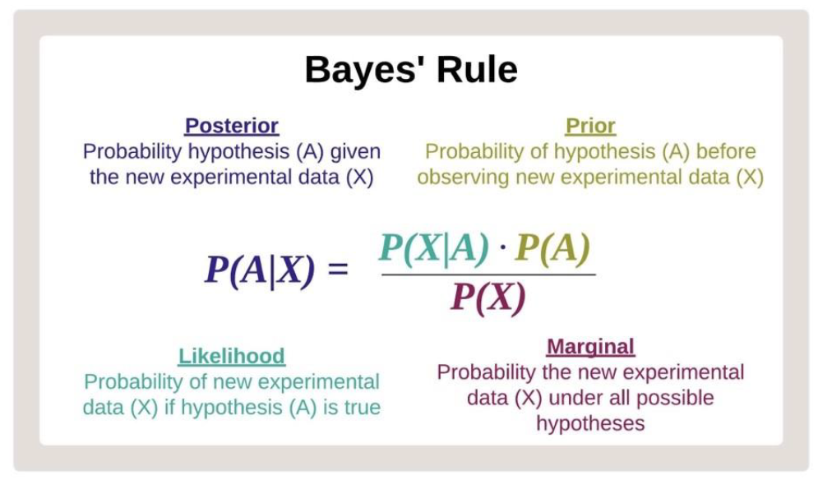
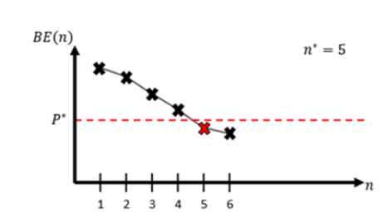
Bayesian Statistics
Sampling and sub-sampling
Threshold of acceptable risk
Bayes Error
Sample Size
Threshold Level
of Risk
This document has been reviewed and determined not to contain export-controlled data.

Slide 18
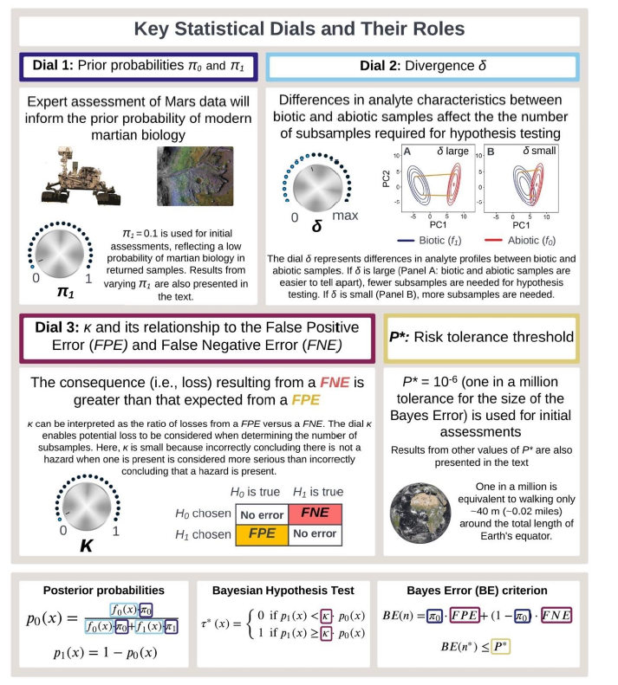
Key Statistical Dials and their Roles
Not Defined
This document has been reviewed and determined not to contain export-controlled data.

Slide 19
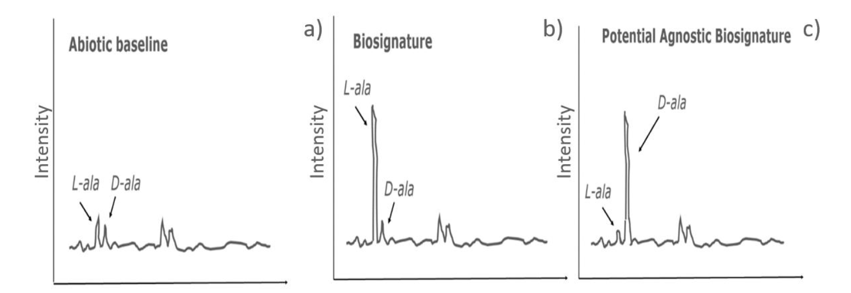
Abiotic Baseline
Products of non-life catalyzed organic reactions that produce compounds independent of life. ‘Non-life’ background in an environment.
This document has been reviewed and determined not to contain export-controlled data.

Slide 20
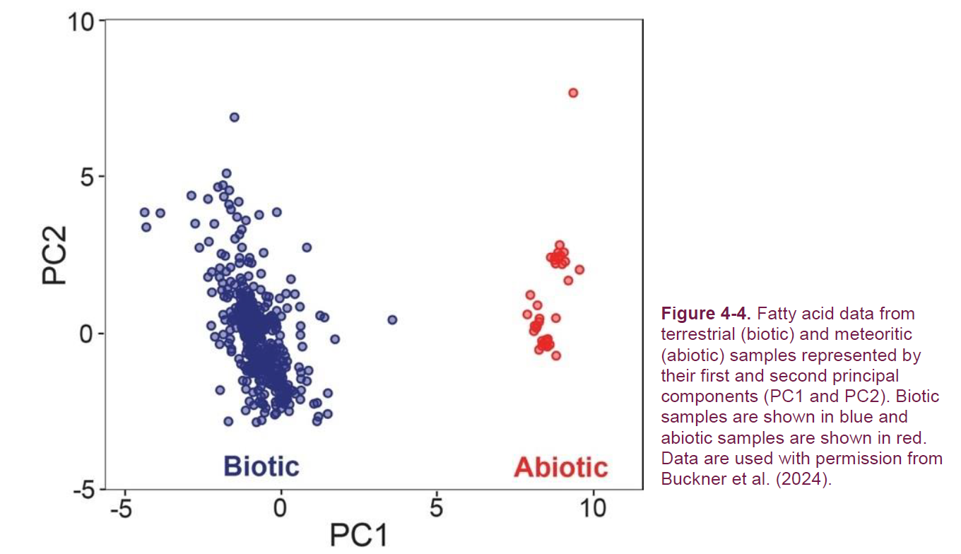
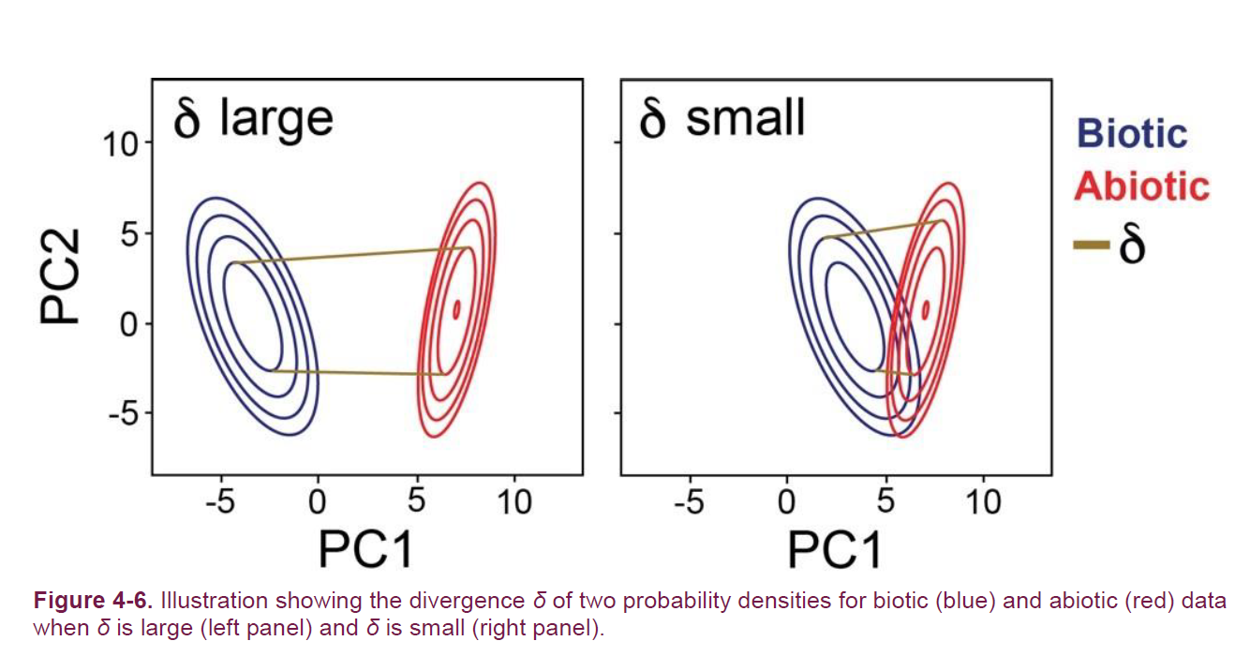
Digital Twin (Monte Carlo Simulations)
Single to Multiple Statistical Tests (Cumulative Risk Assessment)
This document has been reviewed and determined not to contain export-controlled data.

Slide 21
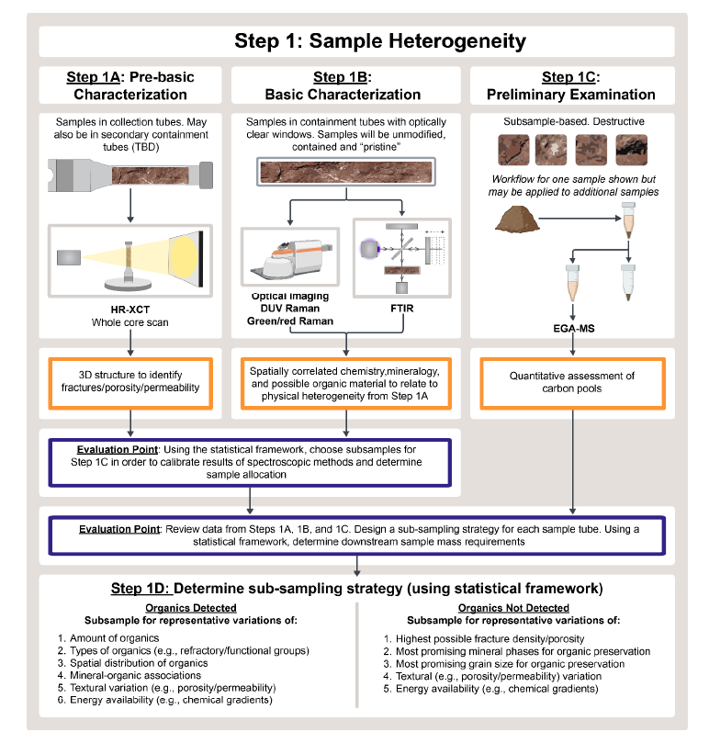
Step 1: Sample Heterogeneity
This document has been reviewed and determined not to contain export-controlled data.

Slide 22
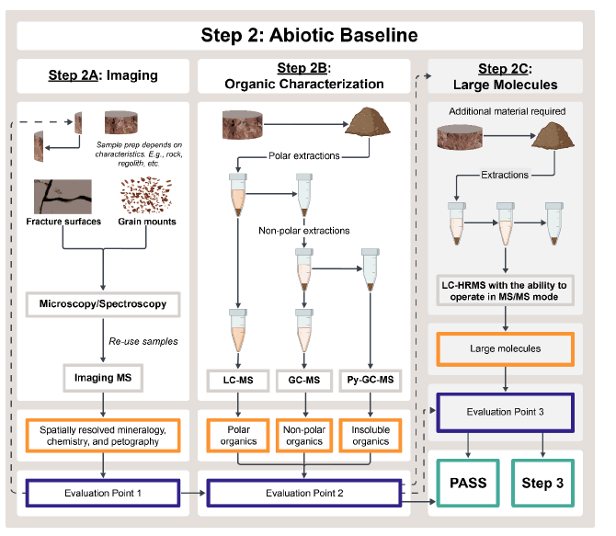
Step 2: Abiotic Baseline
This document has been reviewed and determined not to contain export-controlled data.

Slide 23
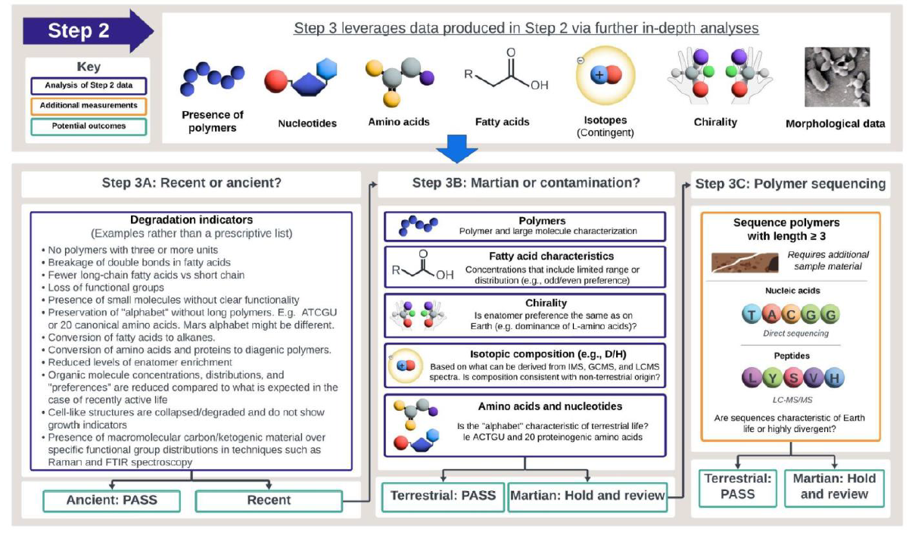
Step 3: Biological Activity
This document has been reviewed and determined not to contain export-controlled data.

Slide 24
Next Steps
Publication
Research needs
Defining an acceptable risk tolerance threshold (e.g., safety level)
Contamination knowledge (flight hardware, handling in the lab)
Contamination controls and test equipment (SRF: Sample Receiving Facility)
This document has been reviewed and determined not to contain export-controlled data.

Slide 25



What Space Travel may teach us about Infection Prevention?
How we access a situation when trying to prove the absence of a risk (e.g., sterile or non-sterile)
  What is an acceptable risk tolerance threshold (e.g., safety level)?
Use of alternative methods to detect microorganisms
  Biosignatures and abiotic baselines
  Next generation, direct sequencing
Understanding baselines for what is possible in contamination controls
  Contamination knowledge
  Balance requirements for preventing contamination and sample containment
This document has been reviewed and determined not to contain export-controlled data.

