Slide 1
CGUL – A Modular Approach to cFS
Robin Onsay
R5 Flight Software Lead
Spacecraft Software Engineering
NASA Johnson Space Center

Slide 2

R5 and CGUL Origins
R5 is a rapid-iteration high performance CubeSat project
  Capable of proximity operations
  Supports technology demonstrations
  Spacecraft iteration cycles of less than 6 months
  Rapidly changing ConOps and interfaces
    Hardware interfaces and payloads change frequently
R5 needed to instantiate a new cFS project for missions and ConOps defined 6 months prior to launch
A new approach to cFS was needed to develop software for this dynamic project

Slide 3
Terminology
Vanilla cFS
  The current paradigm for developing a cFS application
CGUL cFS
  An application that is based off the CGUL Template app and uses CGUL abstractions instead of direct CFE/OSAL calls
Monolithic Software
  An application that is tightly integrated into a single, unified codebase
    All application layers are interconnected and operate as a single, indivisible unit
Modular Software
  An application is divided into smaller, independent, and interchangeable components, called modules

Slide 4
Modularity in Vanilla cFS
Vanilla cFS Flight Software (FSW) is modular, but only at a high level
Applications are individual modules
  Operate and developed independent of each other
Vanilla cFS applications are typically monolithic
  Direct function calls to the CFE/OSAL
  Interconnected and tightly integrated components acting as a single layer
  A single change to one part of the application often cascades into a much larger development effort within the application

Slide 5
Vanilla cFS Applications
Monolithic Application Design
Hard-coupling between function calls to CFE/OSAL
  i.e. direct function calls
Complex unit-test system
Benefits:
  Low initial complexity
  Fast development at first
Downfalls:
  Complex to maintain
  Difficult to understand for new developers
  Difficult to unit-test
  Difficult to develop in parallel
  Difficult to share code between projects
Example Application
Message Structure
Data Storage Structure
Data Storage Logic
Hardware Calls

Slide 6
Testing Vanilla cFS Applications
Developers spend a lot of time looking under-the-hood
  Each dependent function requires a stub
  The implementation of the dependent function needs to be known to create the stub
    Developers have to peer into the black box
Creating and utilizing stubs is complex
  Added complexity becomes a time sink
Discourages modularity
  High friction associated with stubs discourages modular code design
Developers routinely complain about complexity of UtAssert
Bar Black Box Implementation
Foo(…)
Bar(…)
Bar(…)
Bar Implementation

Slide 7
Modular Architectures
Web developers have already solved this problem!
Software and applications in the ’80s and ’90s were typically monolithic
Developers transitioned from monolithic design to modular architectures in the 2000s
  AJAX
  AngularJS
  Other frameworks
Modern web applications are modular not monolithic
Even Linux Kernel Modules are modular
Potential Downsides:
  Higher up-front schedule costs
    Modular architectures have a high ROI and are often worth it
  Possible performance impact due to abstraction
    Depends on how abstraction is implemented and is often negligible

Slide 8
Modular Software at a High Level
Software designed as independent and interchangeable components
Data and functionality is accessed through an interface
  This is known as encapsulation
Modules make it easier to update software
  Changes are isolated to the module
Developers can work on separate modules in parallel
Modules are easier to test
  Modules typically utilize Dependency Injection (DI)
  Leads to more reliable software

Slide 9
Modular Architecture Example
Changes in the codebase are isolated within the corresponding software module
Message Manager
Message Structure
Example Application
Message Manager API
Data Storage Manager
Data Storage Structure
Data Storage Manager API
Data Storage Logic
Hardware Manager API
Hardware Manager
Hardware Calls

Slide 10

Introducing CGUL
CGUL – the cFS Glue and Unit-Test Library
  A cFS library that isolates the biggest dependencies of any cFS app
    CFE and OSAL
  Provides minimal abstraction to improve developer experience and unit-testing capabilities
  Includes error handling and detailed error messages to improve debugging experience

Slide 11
Benefits of CGUL
CGUL cFS apps are easier to test due to encapsulation and DI
CGUL utilizes C structures to define APIs
  CGUL API is supported by C99 and is interoperable with vanilla cFS
  CGUL is interoperable with C++ implementations
CGUL encourages modularity through out the codebase
It is 2-3x faster to write and test CGUL cFS applications vs. Vanilla cFS*
*Based on anecdotal experience from CFS developers

Slide 12
Testing with CGUL
Intuitive and simple mocking architecture
  Developers can direct function pointers to desired implementations
  Developers find it easier and faster to write tests
Dependencies are a black box
  The dependency implementation does not need to be known in order to test the function
Encourages modularity
Bar Black Box Implementation
Foo(…)
Bar(…)
Bar(…)
Bar Implementation

Slide 13
CGUL just isn’t CGUL without TMP
The TMP app is the CGUL template application
  Applications can be built from this starting point
Encapsulates boilerplate that most cFS apps use
  e.g., the main run loop
Enforces an event-driven paradigm
  App event handlers
  Software bus message handlers
    No giant switch-case statements
COMM App
OnCreate(…)
OnStart(…)
OnInit(…)
OnProcess(…)
OnExit(…)

Slide 14
Modularity and
Interface Based Design (IBD)
Software is written from an interface-first approach
  Determine what modules are needed to accomplish a feature
  Divide complex features into layers of modules
  Create an API for the modules
  Implement the modules
    Can be implemented sequentially or in parallel
Let’s look at a real example!

Slide 15
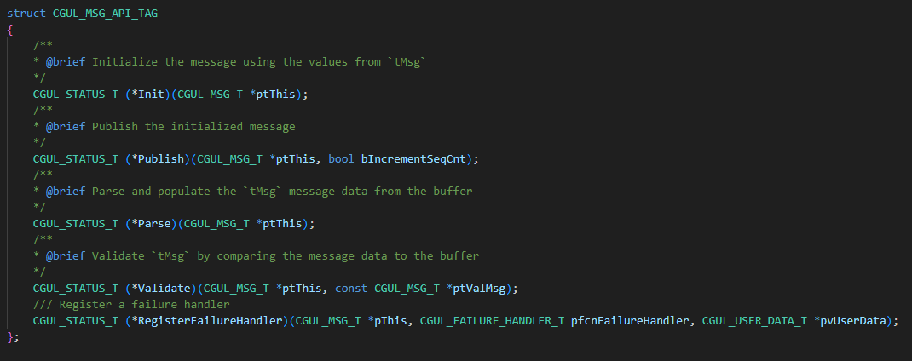
Interface-Based Design (IBD) with CGUL
Modularity can be achieved through the module’s API
  Encapsulation through function pointers

Slide 16
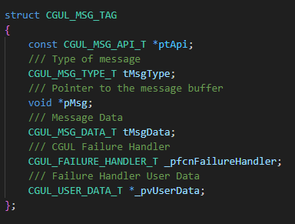
Interface-Based Design (IBD) with CGUL
A separate struct describes the data and dependencies for the module

Slide 17
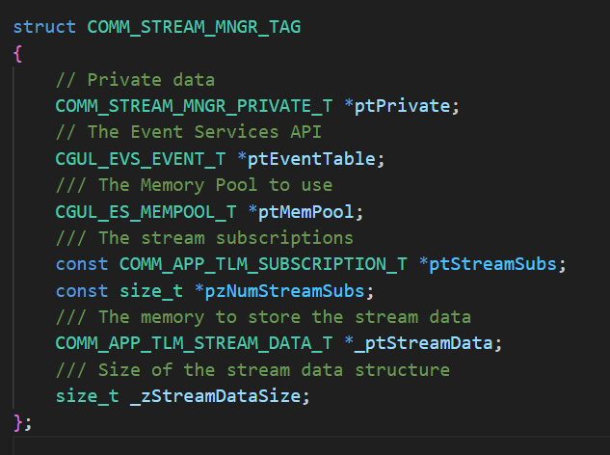
Interface-Based Design (IBD) with CGUL
CGUL Dependencies are “injected” using a pointer to the dependency
  This is Dependency Injection
Modules are not responsible for dependency instantiation or initialization
  Compared to instantiating and initializing dependencies within the module

Slide 18
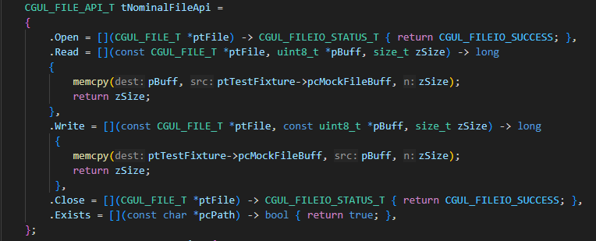
IBD and Unit-Testing
Functions are truly independent of one another with IBD and CGUL
  Unit-tests are faster to write
  Unit-tests are more effective
Different implementations can be used for different types of testing
Data Manager Module Unit Test
CGUL File API
Mock File Implementation

Slide 19
IBD, CGUL and TMP in Action
A new communication app (COMM app) was needed within 10 days
Over 5000 SLOC and 1000 SLOC of test code written by one developer
  In under an hour 80% code coverage was achieved for a ~400 SLOC module
The deadline was successfully met
The code has undergone multiple iterations and successfully isolates changes to modules
COMM App
Hardware Interface API
Data Manager API
CGUL API
Hardware Interface Implementation
Data Manager Implementation
CGUL CFE Implementation

Slide 20
IBD, CGUL and TMP in Action
Created a UDP implementation of the A3LA (RF) modem for the COMM App
  UDP “modem” took only 2 hours to fully implement
  Allows R5 to perform highly integrated benchtop testing of FSW and hardware
    Tests are independent of an actual RF comm link
    Does not replace fully integrated testing
The COMM app is now more reliable because it is easier to test often
Hardware-In-The-Loop tests have fast turn-around times due to increased benchtop testing
COMM App
Hardware Interface API
Data Manager API
CGUL API
Mock Implementation
Data Manager Implementation
CGUL CFE Implementation

Slide 21
Acknowledgements
Matthew Noyes et al. (NASA JSC/ER6)
  STAR Graphics Engine (Joint AR)
Dominick Allen (NASA JSC/EG4)
  cfs-cpp (SPLICE)

Slide 22

Interested in CGUL?
Join the CGUL Mailing List to get notified about the CGUL Open-Source Release!
  https://forms.gle/qSnEFb21vnxHYgMD7
  Coming as soon as March 2025

Slide 23
Backup

Slide 24
Verification for CGUL
Unit-Tests verify a single unit of code or function independent of all other units
  Unit-tests alone cannot verify a system
Integrated tests verify the integrated interfaces between modules
  Integrated tests + Unit-tests can verify a system
  Integrated tests verify the interfaces

Slide 25
Why not Abstract Classes?
C++ abstraction is typically achieved through abstract classes and virtual functions
cFS is a C framework and does not support C++
This approach has runtime overhead
(opinion) Software can be complex and cumbersome when using abstract classes
Software could be less predictable due to runtime polymorphism
  Depends on developer implementation

