Slide 1

Webinar
South Pole Safety:
Designing the NASA Lunar Rescue System
NASA Johnson Space Center, Houston TX
Technology integration: Katrien Morgan
EVA Development: Ben Greene
Human Systems Integration: Jerri Stephenson
Crew Survival Safety: Anne Vaughan
Operations: Fiona Antkowiak
This document has been reviewed for Proprietary, CUI, and Export Control (ITAR/EAR) and has been determined to be non-sensitive. It has been approved for public release via the NASA Scientific and Technical Information (STI) Process DAA #20250000528."

Slide 2
Outline
Background
“Designing the NASA Lunar Rescue System” Challenge Overview
Performance Criteria
  Must-have requirements
  Nice-to-have features
Judging Criteria
Q&A Session
Notes:
Preparation Notes:
Include this slide to put your presentation into context for the Decision-Maker.
Check one or more options. To insert a check-mark, place the cursor on the line you wish to select, click on the Format drop-down menu, click on Bullets and Numbering, then on Character. Select the checked box character from the menu.
Check Information Only if you are not seeking a decision or direction; this category includes response to an action item or description of a new anomaly.
For ISS Anomalies, note the Anomaly Priority Designation per MGT-OA-019; for other Programs or institutions, delete this designation.
If you’ve pre-coordinated with other stakeholders, list them. These can be other Directorates, lower-level Boards, your management, or International Partner counterparts.

Slide 3
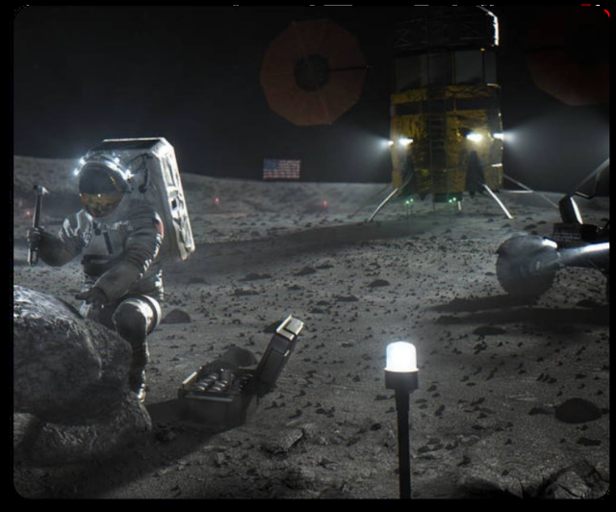
Background - Initial Artemis Missions Overview
Initial Artemis missions will focus on lunar surface operations, science sample return, testing of new technologies for long-term lunar human presence, and gathering data for future Mars exploration.
Initial Artemis missions will include the following aspects and parameters:
  Artemis III mission is scheduled for mid-2027.
  Missions will take place in lunar daylight (near the Lunar South Pole)
  Landing sites remain undefined (9 potential sites for Artemis III)
  Four crewmembers will fly to cislunar orbit
    Two crewmembers will stay in cislunar orbit while
    The other two crewmembers will land and explore lunar surface
  Surface stay duration: 6.5 days
  Total number of EVAs: 2 - 4
  EVA* Duration: 4 to 8-hour excursions (limited by suit consumables)
  EVA excursions may take the crew up to 2 km away from their lunar lander
  No access to Lunar Rover(s) (prior to Artemis V+)
  * - Extra Vehicular Activity (EVA) is a moon walk with crew in spacesuit.
This document does not contain export-controlled Information. This document has been approved for public release per DAA #20250000528

Slide 4
Background - Issue
Historically, EVAs are considered one of the Top 3 risk events in Human Spaceflight
During a lunar EVA, one of the two crewmembers could become fully incapacitated because of:
  Space Suit hardware failure
  Crew physical injury caused by a fall
  Decompression Sickness
  Other illness, etc.
The imminent risk of a fully incapacitated crew leading to a catastrophic event during a lunar EVA requires urgent and thorough planning, flawless execution, and the proactive implementation of comprehensive risk mitigation strategy including assistive systems and tools.
NASA is excited to engage the public for innovative and forward-thinking ideas to help solve this very important challenge.
This document does not contain export-controlled Information. This document has been approved for public release per DAA #20250000528

Slide 5

“Designing the NASA Lunar Rescue System” - The Challenge
The Problem
  “The Lunar South Pole presents extreme challenges, including:
    Rugged terrain,
    Temperature fluctuations
    Low-angle lighting, and
    Reduced gravity,
    increasing the risk of crewmember incapacitation.
  Early Artemis missions require rescue capability that would allow a single crewmember to transport a fully incapacitated crewmember (up to 755 lbs. (terrestrial weight)) up to 2 kilometers across the lunar terrain to the lunar lander without relying on a lunar rover.”
The Challenge
  “Create a compact, efficient system for astronaut rescue on the lunar surface - helping ensure swift, safe evacuation in extreme conditions.”
YOU can play a vital role in enhancing the safety measures for our future lunar explorers!
This document does not contain export-controlled Information. This document has been approved for public release per DAA #20250000528
Notes:
Preparation Notes:
Expand on why it’s a problem or issue
Include any evidence you have of the impacts, and specify a time frame, if not specified on other slides

Slide 6
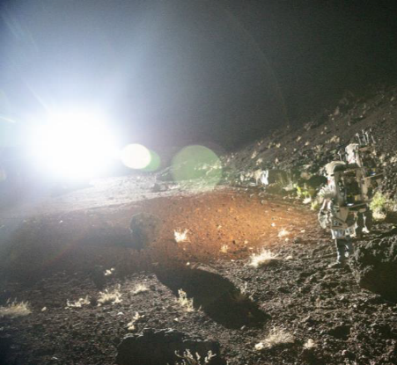
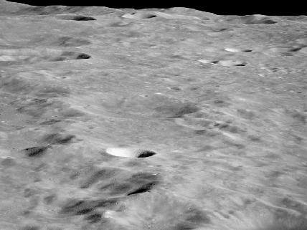
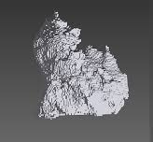
“Designing the NASA Lunar Rescue System” - Lunar-specific Challenges
The South Pole Environment
Extreme temperature variations, with sunlit areas reaching 130°F (54°C) and shaded areas dropping to -334°F (-203°C)
Poor lighting - Low-angle sunlight and long shadows. Sun could be between 2 and 7 deg above horizon depending on time of year
Lunar terrain is rugged with:
  Rocks ranging from 0,15 meters up to 20 meters in diameter,
  Craters ranging from 1 meter up to 30 meters, and
  Slopes of up to 20 degrees (up, down and cross slope)
Lunar gravity is on-sixth of Earth gravity.
Lunar dust “Regolith” is sharp and electrostatically charged.
Lack of atmosphere.
Note: Copy of Design Specification for Natural Environments (DSNE) is provided in the Challenge Resources tab
This document does not contain export-controlled Information. This document has been approved for public release per DAA #20250000528
Notes:
Preparation Notes:
Expand on why it’s a problem or issue
Include any evidence you have of the impacts, and specify a time frame, if not specified on other slides

Slide 7
“Designing the NASA Lunar Rescue System” - Lunar-specific Challenges
The Challenges of the South Pole Environment
Temperature variations: equipment and suits must be able to perform across this wide temperature range.
Unique lighting conditions create navigation challenges and impair depth perception, increasing the risk of falls.
Traversing the rugged Lunar terrain requires careful planning.
Lunar gravity affects mobility and object handling. Inertia is a concern and poses challenges for movement and equipment manipulation.
Lunar “regolith” could damage equipment or impact movement.
Lack of atmosphere exposes crewmembers to solar radiation and micro-meteoroid impacts.
This document does not contain export-controlled Information. This document has been approved for public release per DAA #20250000528
Notes:
Preparation Notes:
Expand on why it’s a problem or issue
Include any evidence you have of the impacts, and specify a time frame, if not specified on other slides

Slide 8
Challenge Performance Criteria
A successful design concept should consider the following must-have requirements:
Low Mass and Minimal Volume: Aim for total mass (terrestrial weight) no greater than 23 kilograms (~50 pounds). The lighter the design solution, the better. Design should also minimize stowed volume for ease of transport.
Effectiveness in Safe Transportation: Design solution should enable a single crewmember to transport a fully incapacitated crewmember a range of up to 2 kilometers with up to 20 degrees lunar terrain slope. The design should also facilitate a prompt return to the entry point of the lunar lander, considering limited EVA consumables.
Ease of Deployment and Use: Design solution should be deployable and operable by a single suited crewmember; as well as be capable of rapid deployment in an emergency situation with limited dexterity.
Compatibility with Lunar Environment: Design solution should integrate materials that can withstand extreme temperatures, lunar dust, and vacuum conditions, and capable of functioning through rugged terrain.
Safety and Reliability: Design solution should not introduce additional risks during deployment or operation. Functions consistently without failure or hazards under expected lunar conditions.
Minimal Impact on Suit Design: Design solution should require minimal to no modifications to AxEMU spacesuit. Use of attachment points on Spacesuit is acceptable – details cannot be shared at this time
This document does not contain export-controlled Information. This document has been approved for public release per DAA #20250000528
Notes:
Preparation Notes:
State your conclusion or recommendation, with one or two supporting rationale statements.
If there are multiple options, outline the priority in which you would recommend them.
Previous slides should support your conclusion or recommendation; if they don’t, go back and fill in the gaps with missing information, or reconsider your conclusion/recommendation.
Be sure to address the following:
When do you need a decision/change implemented?
Clearly state why the recommended solution is better than the other options
- What are you asking the Program to do?
- What action do you need from the panel/board?

Slide 9
Challenge Performance Criteria (Continued)
The following nice-to-have features will enhance your submission:
Collapsibility and Storage Efficiency: Design solution can be collapsed or folded for minimum and efficient stowage needs during transport to the Moon.
Adaptability: Design solution can accommodate various incapacitation scenarios and can adjust to different mission requirements.
Anthropometric Accommodation: Design solution can accommodate crewmembers across a broad range of body sizes and shapes (1st to 99th percentile male/female).
Ease of Manufacturing: Design solution utilizes materials and manufacturing processes that are practical and cost-effective with current technology.
Multi-functionality: Design solution serves other purposes beyond casualty evacuation, adding value to the mission.
This document does not contain export-controlled Information. This document has been approved for public release per DAA #20250000528
Notes:
Preparation Notes:
State your conclusion or recommendation, with one or two supporting rationale statements.
If there are multiple options, outline the priority in which you would recommend them.
Previous slides should support your conclusion or recommendation; if they don’t, go back and fill in the gaps with missing information, or reconsider your conclusion/recommendation.
Be sure to address the following:
When do you need a decision/change implemented?
Clearly state why the recommended solution is better than the other options
- What are you asking the Program to do?
- What action do you need from the panel/board?

Slide 10
Judging Criteria
Criterion | Sub-criterion | Weight
Innovation (20% Total) | N/A | 20%
Performance Requirements (55% Total) | Mass/Volume | 17%
 | Safe Transportation | 12%
 | Ease of Deployment/Use | 7%
 | Compatibility with Lunar Environment | 7%
 | Safety/Reliability | 7%
 | Impact on Suit Design | 5%
Nice-to-have features (25% Total) | Collapsibility/Storage Efficiency | 7%
 | Adaptability | 6%
 | Anthropometric Accommodation | 5%
 | Ease of Manufacturing | 4%
 | Muti-functionality | 3%
This document does not contain export-controlled Information. This document has been approved for public release per DAA #20250000528
Notes:
Preparation Notes:
State your conclusion or recommendation, with one or two supporting rationale statements.
If there are multiple options, outline the priority in which you would recommend them.
Previous slides should support your conclusion or recommendation; if they don’t, go back and fill in the gaps with missing information, or reconsider your conclusion/recommendation.
Be sure to address the following:
When do you need a decision/change implemented?
Clearly state why the recommended solution is better than the other options
- What are you asking the Program to do?
- What action do you need from the panel/board?

Slide 11
Q&A Session
Selected Questions & Answers (Q&As) responses from the Forum
Open Discussion
This document does not contain export-controlled Information. This document has been approved for public release per DAA #20250000528
Notes:
Preparation Notes:
State your conclusion or recommendation, with one or two supporting rationale statements.
If there are multiple options, outline the priority in which you would recommend them.
Previous slides should support your conclusion or recommendation; if they don’t, go back and fill in the gaps with missing information, or reconsider your conclusion/recommendation.
Be sure to address the following:
When do you need a decision/change implemented?
Clearly state why the recommended solution is better than the other options
- What are you asking the Program to do?
- What action do you need from the panel/board?

Slide 12
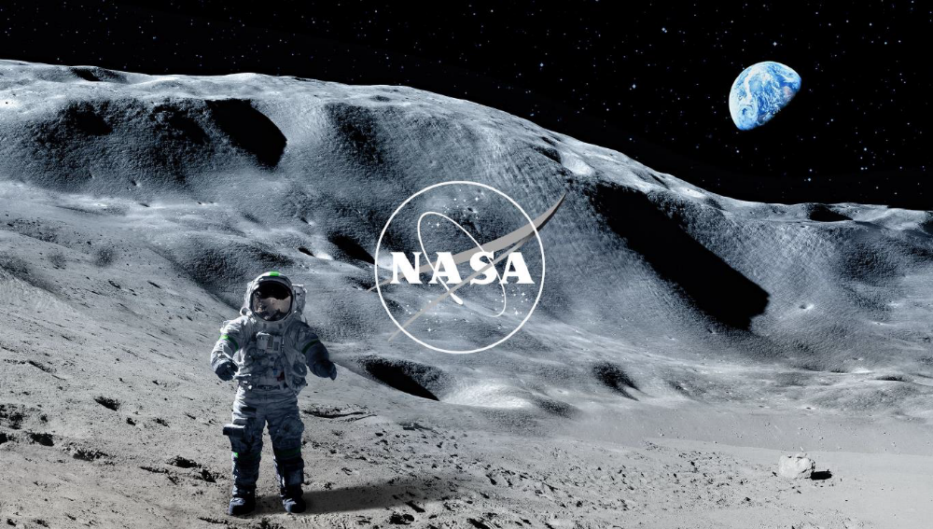
Thank you for your interest in this Challenge and for attending the webinar. We are excited to see your innovative and forward-thinking ideas and look forward to reviewing them!
This document does not contain export-controlled Information. This document has been approved for public release per DAA #20250000528

