Slide 1


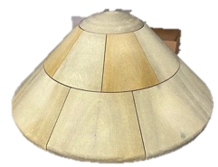

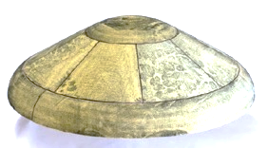
Ablative TPS for VARDA and Inversion Space RSAAs
KEY ATTRIBUTES / COMPETENCY
Conformal PICA is a NASA invented TPS that is more efficient than State-Of-The-Art rigid PICA, and it does not rely on proprietary FiberForm.
Addresses STMD shortfalls:
1567: Entry Capabilities for Small-Scale and Commercial missions
1572: Performance-Optimized Low-Cost Aeroshells for EDL
Varda Space Industries - Work performed under Reimbursable Space Act Agreement SAA2-403669
Inversion Space - Work performed under Reimbursable Space Act Agreement SAA2-403668
TECHNICAL / SCIENTIFIC CHALLENGE ADDRESSED
NASA provided the Conformal PICA TPS for the first 4 initial flights of the Varda Space Industries capsule and the Conformal PICA (Phenolic Impregnated Carbon Ablator) and SIRCA (Silicone Infused Refractory Ceramic Ablator) for the initial Inversion Space entry aeroshell.
HERITAGE
Rigid PICA that flew on MSL/M2020, Stardust, and OSIRIS-REx.
Made by FMI who makes the FiberForm (FF). FF is no-longer commercially available and is only made for NASA (Dragonfly and MSR SRL). Min order is in the $millions.
SUMMARY
Varda Space Industries and Inversion Space are pioneering ways to provide in-space manufacturing as well as provide LEO down-mass options. Most existing commercial space companies (SpaceX, Lockheed, Boeing) only produce TPS for their missions, and costs to develop and test new TPS are prohibitive. NASA was able to provide Government Know how/IP to enable them to show investors successful proof of concept of their aeroshell designs.
Previously provided TPS is now being tech-transferred through RSAAs, allowing these companies to make their own material for subsequent missions and further commercial growth.
APPLICATIONS BEYOND
Potential RSAAs to further tech transfer C-PICA for LEO Commercial, Lunar Sample Return and Mars Missions.
POC: Matt Gasch – NASA Ames Research Center

