Slide 1
Maximizing Operator Impact
Leveraging Machine Learning to Improve Trending Analysis for the Magnetospheric Multiscale Mission
Shannon Bull
NASA’s Goddard Space Flight Center
GSAW 2025
Track: Anomaly Detection
Tuesday, Feb. 25th, 2025
Los Angeles, California

Slide 2
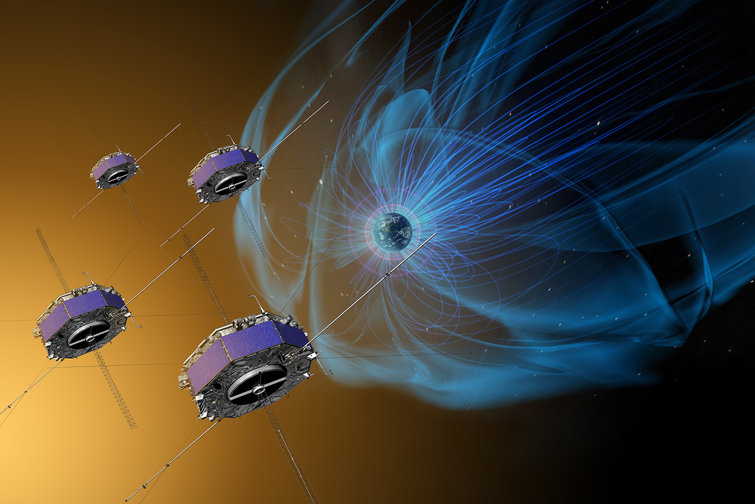
The Magnetospheric Multiscale (MMS) mission
Launched in 2015
Consists of 4 identical spacecraft flying in a tetrahedral formation
Explores magnetic reconnection - connection and disconnection of the Sun and Earth’s magnetic fields
Its data products are used to improve the models that predict space weather, benefiting both terrestrial and space exploration activities
Currently in second extended mission phase
GSFC manages MMS mission operations
The mission’s four identical spacecraft fly in a pyramid-shape to measure magnetic field lines and charged particles in three-dimensions (Source: nasa.gov)

Slide 3

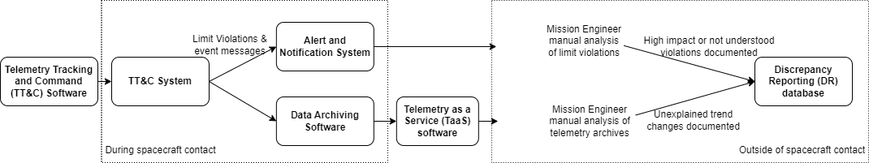



MMS Mission Operations
Telemetry analysis consistently takes place throughout operations:
  During spacecraft contact
  Back orbit analysis
  All other analysis outside of contact periods
Telemetry analysis is necessary to detect and diagnose mission anomalies
  There are currently thresholding techniques to automatically detect possible anomalies

Slide 4



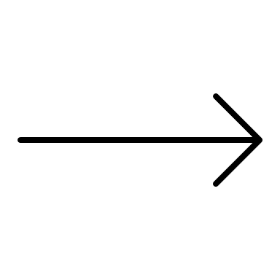


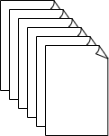


Objectives
Objective: Use Machine Learning (ML) techniques on MMS mission telemetry data to develop a suite of algorithms capable of predicting and detecting mission anomalies
  Go beyond existing rules-based automation
  Provide operators with new insights into telemetry data patterns
  Reduce the time it takes to identify anomalies
Currently: Mission Engineers manually review all subsystem data for trend performance.
In the future: Mission Engineers leverage model outputs to review subsystem data.

Slide 5
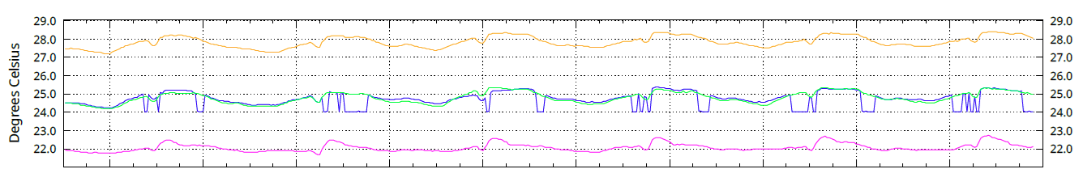
Methods: Our Data
Training Data: telemetry archives from TaaS software
  Focus on mnemonics from one subsystem for one of the four spacecraft at a time
Testing Data: previously documented mission anomalies
Electronics Board Thermistor
Legend:
MMS1
MMS2
MMS3
MMS4
Degrees Celsius
Time
The graph above contains data from an anomalous trend that did not trigger automatic limit violations

Slide 6
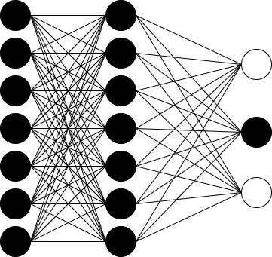



Methods: Our Model
We use a specialized version of a Convolutional Neural Network (CNN) called a Temporal Convolutional Network (TCN). Classic CNNs use filters to extract features. The combination of these features can help in classification problems.
Output:
animal classification
Input:
panda image
In the above example, 2-Dimensional filters may look at a body part and capture the shape, color, or texture of a particular body part. Feeding a modified image should still result in proper classification

Slide 7




Methods: Our Model
We use a specialized version of a Convolutional Neural Network (CNN) called a Temporal Convolutional Network (TCN). Classic CNNs use filters to extract features. The combination of these features can help in classification problems.
Output:
instrument classification
Input:
National anthem
When considering music. 1-Dimensional CNN filters may qualify the pitch, volume, brightness of a sound. Modifying (slowing down, reversing) the audio file should not impact classification.

Slide 8
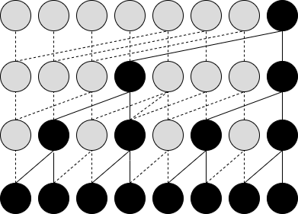

Methods: Our Model
A TCN is used with sequential data, when order matters.
Causal (temporal) convolutions preserve temporal order
Dilated convolutions capture long term dependencies
YES
Output:
Is this song the National anthem?
Input:
National anthem
The TCN’s modified architecture maintains the temporal integrity and captures short and long-term features in the data. Slowing down, reversing, or rearranging the audio will change the classification.

Slide 9

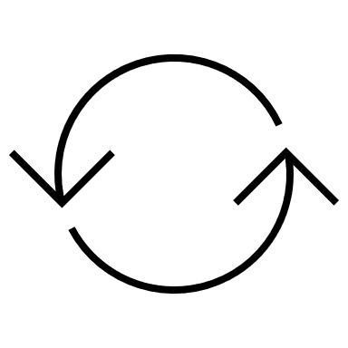
Methods: Training Our Model
Inspired by Carmona et. al’s publication “Neural Contextual Anomaly Detection (NCAD) for Time Series” we use a TCN to detect anomalous trends in telemetry data.
dist(z(c),z(c+s))
The distance between these vectors is computed. The model aims to produce a distance near 0 when the suspect window is nominal.
z(c)
z(c+s)
The context window (c) and the full window (c+s) are each passed through our TCN which produces new vector representations of the input data
TCN
As we train, we look at one section of data at a time, splitting it into the context and suspect windows
Context Window (c)
Suspect Window (s)

Slide 10
Methods: Training Our Model
Inspired by Carmona et. al’s publication “Neural Contextual Anomaly Detection (NCAD) for Time Series” we use a TCN to detect anomalous trends in telemetry data.
dist(z(c),z(c+s))
The vector representations of the context window and the full window containing the anomalous suspect window should differ, resulting in a greater distance. The model learns from these anomalies.
z(c)
z(c+s)
TCN
During training we inject synthetic anomalies into a percentage of suspect windows. Labeling these as anomalous.
Context Window (c)
Suspect Window (s)

Slide 11
Methods: Training Our Model
Inspired by Carmona et. al’s publication “Neural Contextual Anomaly Detection (NCAD) for Time Series” we use a TCN to detect anomalous trends in telemetry data.
dist(z(c),z(c+s))
z(c)
z(c+s)
TCN
Context Window (c)
Suspect Window (s)

Slide 12
Methods: Training Our Model
Inspired by Carmona et. al’s publication “Neural Contextual Anomaly Detection (NCAD) for Time Series” we use a TCN to detect anomalous trends in telemetry data.
The injected synthetic anomalies include known behavior that has caused previous anomalies:
Spikes
Flatlines
Other irregular patterns
dist(z(c),z(c+s))
z(c)
z(c+s)
TCN
Context Window (c)
Suspect Window (s)

Slide 13
Methods: Testing Our Model
We use the trained TCN model on new test data, sliding the context and suspect windows down one time step at a time
The computed distance acts as our anomaly score. We threshold our scores using the median absolute deviation
dist(z(c),z(c+s))
z(c)
z(c+s)
TCN
Context Window (c)
Suspect Window (s)

Slide 14
Methods: Testing Our Model
We use the trained TCN model on new test data, sliding the context and suspect windows down one time step at a time
The computed distance acts as our anomaly score. We threshold our scores using the median absolute deviation
If the distance is greater than our threshold (p), we flag the suspect window as an anomaly
dist(z(c),z(c+s))
> p
z(c)
z(c+s)
TCN
Context Window (c)
Suspect Window (s)

Slide 15
Methods: Testing Our Model
We use the trained TCN model on new test data, sliding the context and suspect windows down one time step at a time
The computed distance acts as our anomaly score. We threshold our scores using the median absolute deviation
If the distance is greater than our threshold (p), we flag the suspect window as an anomaly
dist(z(c),z(c+s))
< p
z(c)
z(c+s)
TCN
Context Window (c)
Suspect Window (s)

Slide 16
Methods: Testing Our Model
We use the trained TCN model on new test data, sliding the context and suspect windows down one time step at a time
The computed distance acts as our anomaly score. We threshold our scores using the median absolute deviation
If the distance is greater than our threshold (p), we flag the suspect window as an anomaly
dist(z(c),z(c+s))
> p
z(c)
z(c+s)
TCN
Context Window (c)
Suspect Window (s)

Slide 17
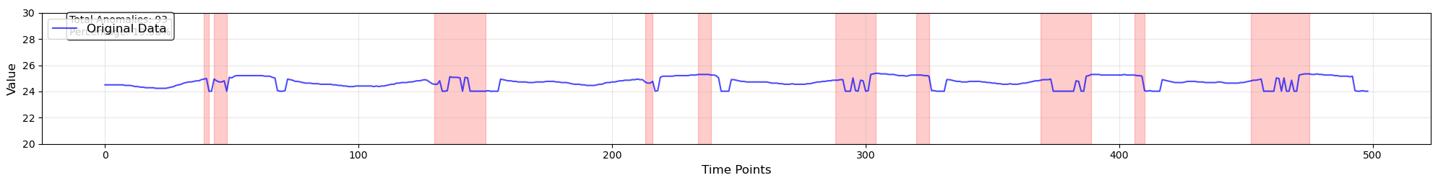
Results
The results when applying our TCN across the entirety of the thermistor anomaly are visualized below. The red bars indicate a flagged anomaly.
Our results are encouraging, and further tuning of the model will improve accuracy.
Notes:
This is all unsupervised! We’re using live data that’s not expertly labeled by operator.
(Results show a few false positives but no false negatives) - Optional talking point
What was happening: electronics board that was reporting health & safety of subsystem started to fail such that it changed bits of how it was reporting. So it introduced false jumps in the data. Temperatures should not change that rapidly!
Can say: failure in the onboard circuitry
Looks like some additional dips weren’t flagged

Slide 18
Future Work
Experiment with variations of the model architecture
Apply model to new datasets
Fine tune models with domain experts
  Address false positives
  Account for known events that impact data trends: (eclipse periods and maneuvers)
Integrate models with existing GSFC telemetry processing tools like TaaS
Apply a ‘library of models’ technique, giving operators more flexibility and insight

Slide 19
Questions? Comments?
Thank you J
Special thank you to the following major contributors:
Andre Williams, Software Engineer, NASA GSFC, andreali.williams.@nasa.gov
William Stanton, Systems Engineer, NASA GSFC, william.m.stanton@nasa.gov
James Clapsadle, MMS Mission Director, NASA GSFC, james.e.clapsadle@nasa.gov
Christopher Riley, MMS Mission Manager, KBR WYLE SERVICES LLC, christopher.m.riley@nasa.gov

Slide 20
Acronyms
Acronym | Definition
ANS | Alert and Notification System
CNN | Convolutional Neural Network
DR | Discrepancy Reporting
GSFC | Goddard Space Flight Center
ML | Machine Learning
MMS | Magnetospheric Multiscale
NCAD | Neural Contextual Anomaly Detection
TaaS | Telemetry as a Service
TCN | Temporal Convolution Network
TT&C | Telemetry Tracking and Command System

Slide 21
References
Carmona C., Aubet F., Flunkert V., Gasthaus J. Neural Contextual Anomaly Detection for Time Series, URL https://arxiv.org/abs/2107.07702

