Slide 1
Space Technology Mission Directorate
Space Nuclear Propulsion Office
Marshall Space Flight Center
Jason Reynolds | February 5, 2025
Nuclear Fuel Development for Nuclear Thermal Propulsion

Slide 2
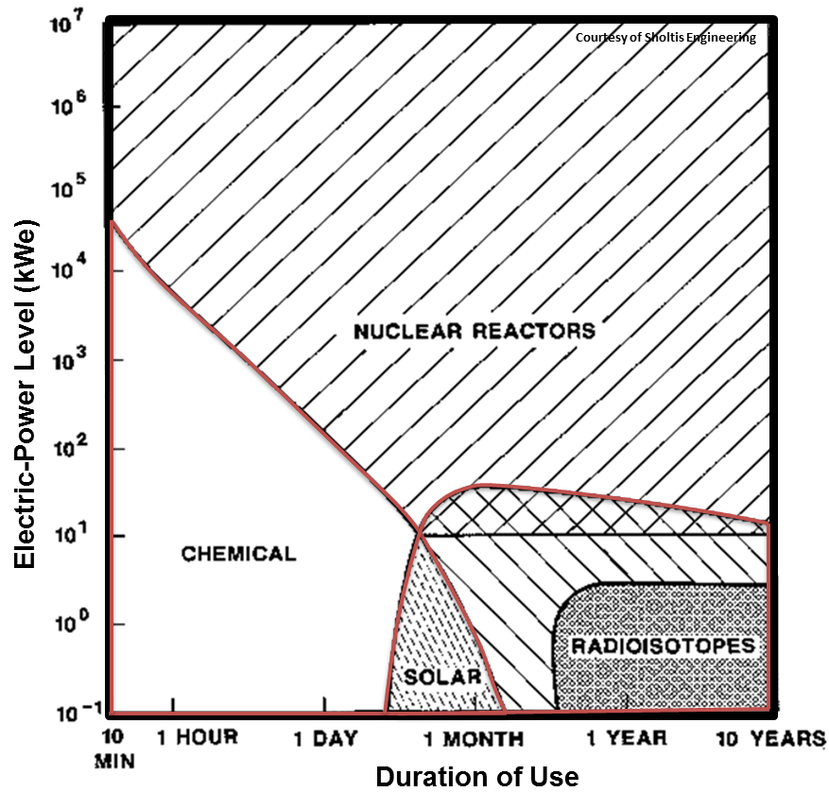
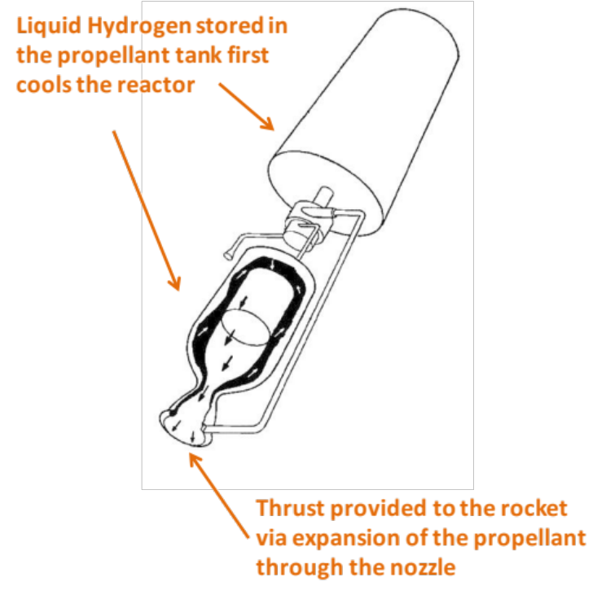
Background
Nuclear Thermal Engine
Development of nuclear technologies can allow a safer, more efficient, and effective space exploration [1].
Nuclear fuel housing
[1]
Notes:
In order to guarantee the efficiency of NTRs, our operating conditions are really constrained.
Diatomic Hydrogen is the lowest molecular mass propellant and is usually required for NTRs.
Here is a figure whats going on inside, first liquid hydrogen …
It’s flow rate will control the reactor and provide thrust through expansion of the propellant out the nozzle.

Slide 3

Background
[1]
Specific Impulse (I_{sp})
$$Isp=\frac{FT}{ṁ}$$
2x
Ratio of thrust (F_{t} ) and mass flow rate (ṁ) during ejection. Measures the overall performance of the rocket engine. Unit (s).
90 – 120 minute total operation time at maximum temperature
Notes:
NTP is an in-space propulsion technology capable of high specific impulse and thrust
A propulsion system with a higher specific impulse uses the mass of the propellant more efficiently
M:kg/s
F:N :kg*m/s2
Multiply by 9.8066 m/s^2 to acquire SI units (m/s)
Ammonia with LO2

Slide 4
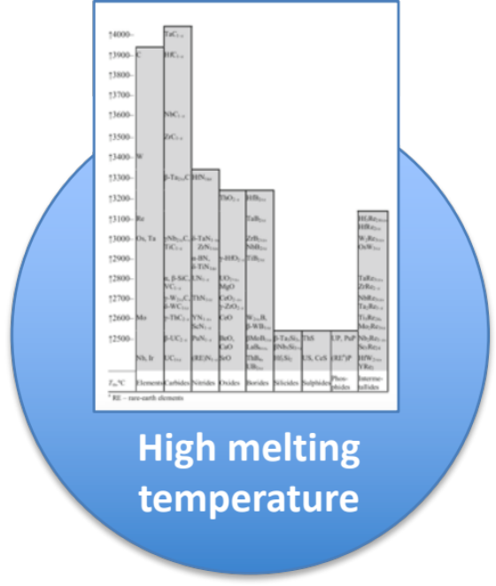
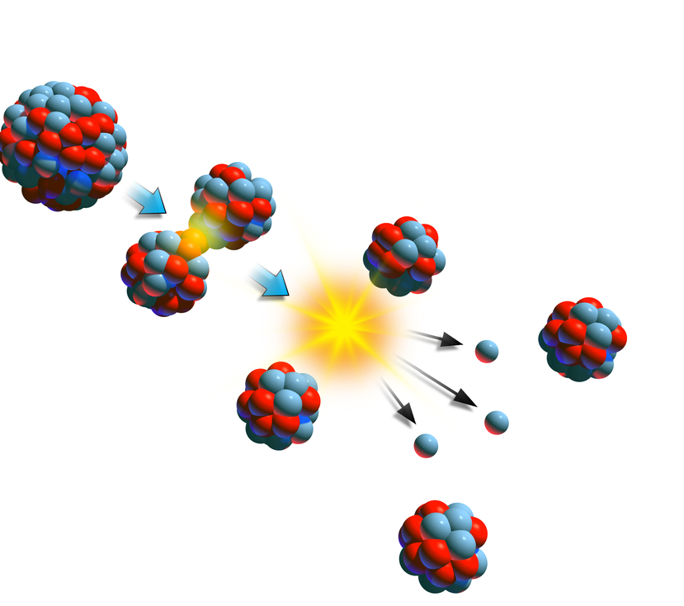
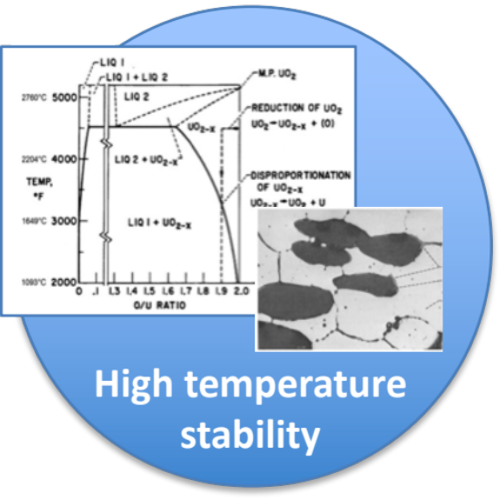
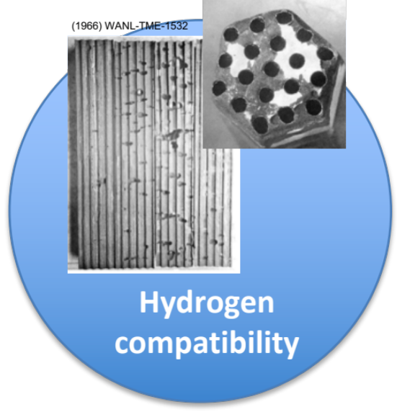
Limited material systems exist with the attributes desired for space nuclear propulsion applications
Overview
Low neutron absorption

Slide 5
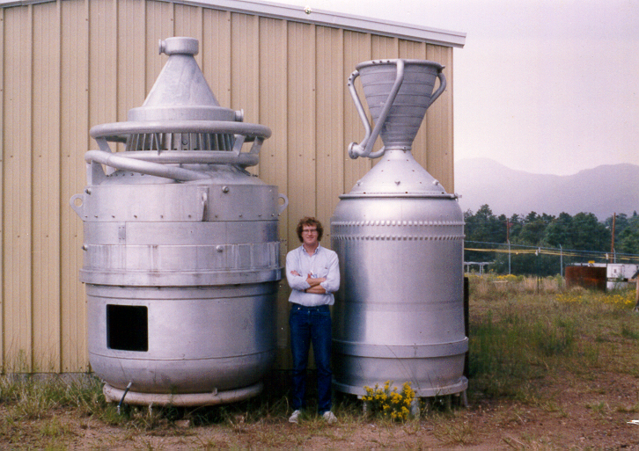
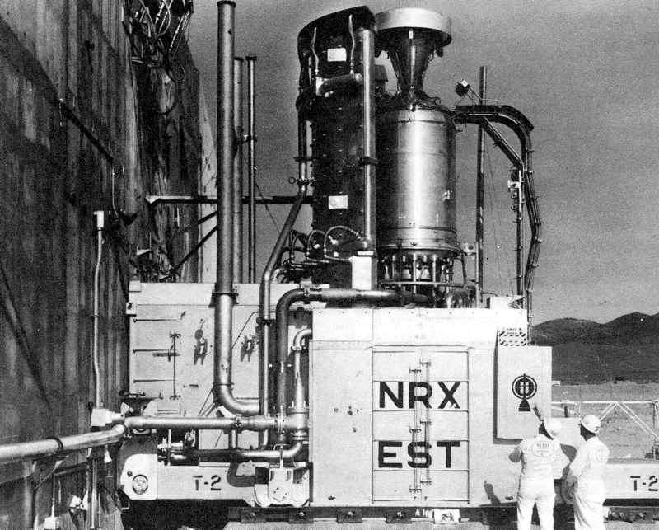
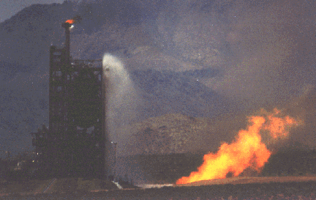
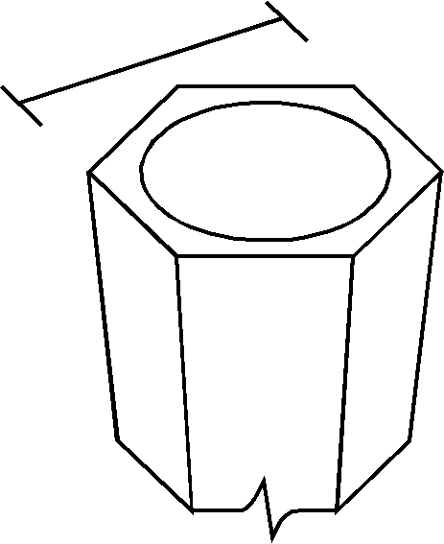
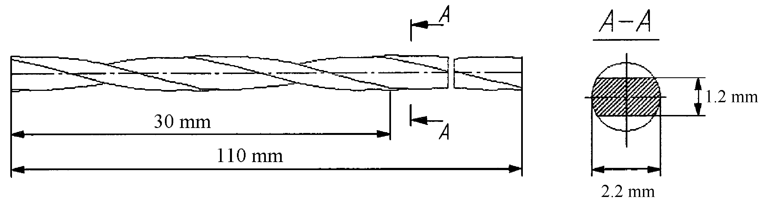
Rover/NERVA Accomplishments
Program duration from 1955 to 1973
  4500 MW/m³ max. power density
  2600 K exhaust temperature
  250,000 lbf thrust
  Isp=850 seconds
  90 min. burn time
  T/W of 3 to 4
Rover/NERVA Program test reactors
5.5 mm
23 tests conducted at the Nevada Test Site; Nuclear Rocket Development Station, NRDS
  NRX-A6 (1972): Hydrogen exit temperature=2556 K, 1 hr.
Rover/NERVA
fuel element,
(U, Zr)C
0.64 m length
3.2 mm
Soviets continued development after U.S. cancelled
program in 1973; Twisted ribbon fuel element:
(U, Zr, Nb)C or (U, Zr, Ta)C
Note: twisted ribbon was a U.S. invention

Slide 6
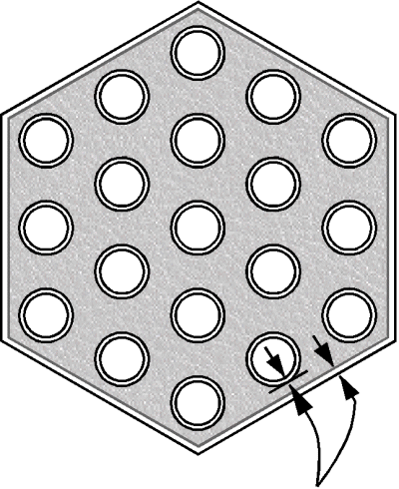
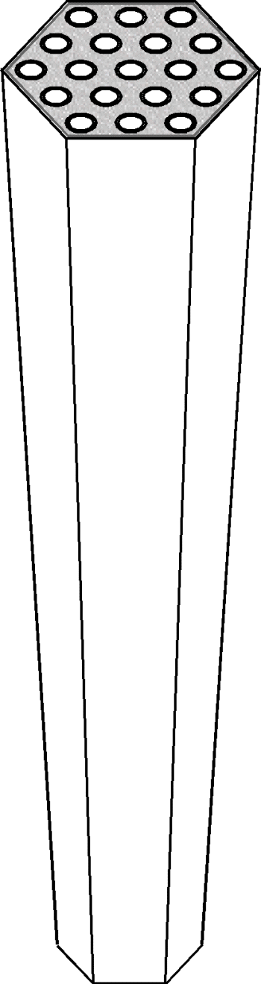
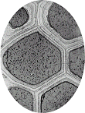
Fuel Facts
Rover/NERVA
(U, Zr)C/graphite
composite
1.1 m length
*Table after Matthews, et al. (1994)
(U,Zr)C/graphite composite
 | UO₂ | UN | UC | UC₂ | (U,Zr)C | (U,Zr,Ta)C
Den g/cc | 9.66 | 13.52 | 12.97 | 10.6 | 8.24 | 8.62
Melt K | 3100 | 3035 | 2775 | 2710 | 3500 | 3800
Thermal Con. | Low | High | High | Mid | High | High
Relative Stability | Mid | Low | High | High | High | High
Hydrogen Compatibility | Not Compatible | Low | Mid | Mid | High | High
Swelling | Low | Mid | Mid | Low | Low | Low
Fiss. Gas Release | High | Low | Mid | Low | Mid | Mid
Fabricability | Easy | Mid | Easy | Difficult | Easy | Mid
Coolant channels
2.3 mm diameter
ZrC coating
19 mm
5.5 mm
Rover/NERVA
(U, Zr)C
0.64 m length
3.2 mm
Russian Twisted Ribbon
(U, Zr, Nb)C or (U, Zr, Ta)C
UO₂ fuel, W matrix
W-Re-Mo clad
metal tube and sheath
  UO₂/W-Re, and UN/W-Re cermet
Note: twisted ribbon was a U.S. invention

Slide 7
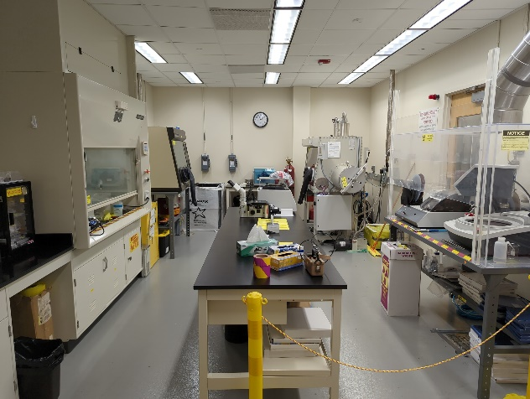
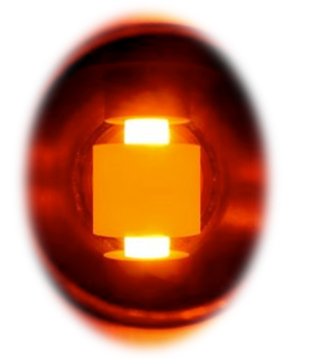
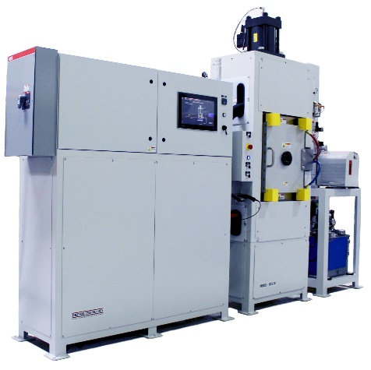
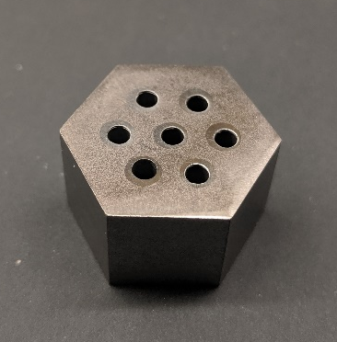
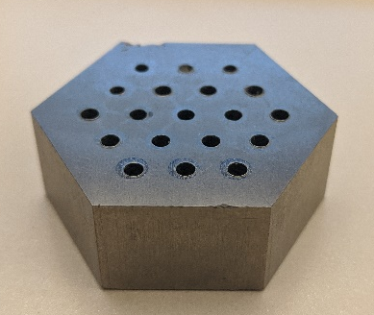
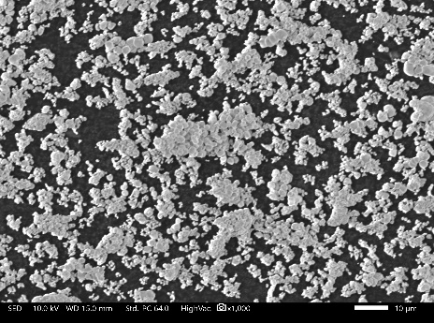
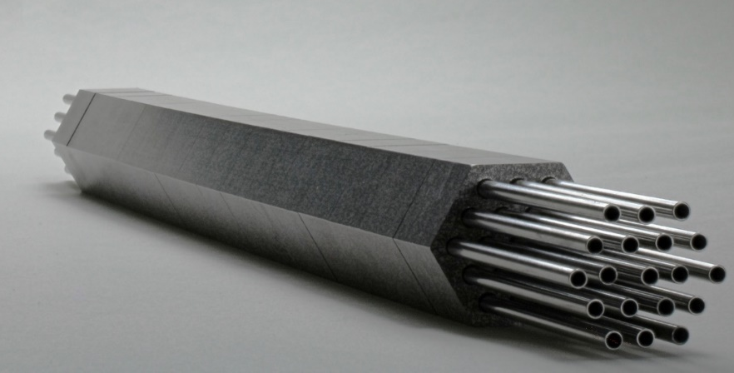
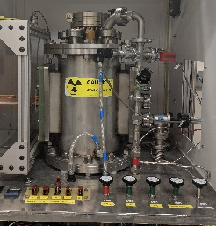
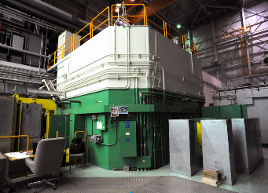
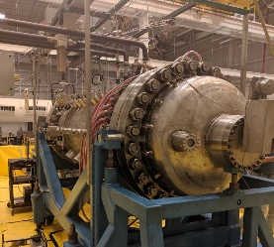
Nuclear Fuel Fabrication
Nuclear fuel wafer fabrication
Nuclear fuel powder feedstock preparation in radiological laboratory
Consolidation via Spark Plasma Sintering (SPS)
Nuclear Fuel Testing
CFEET (MSFC).
TREAT Reactor (INL).
Nuclear fuel article assembly with multiple wafers
NTREES (MSFC).

Slide 8
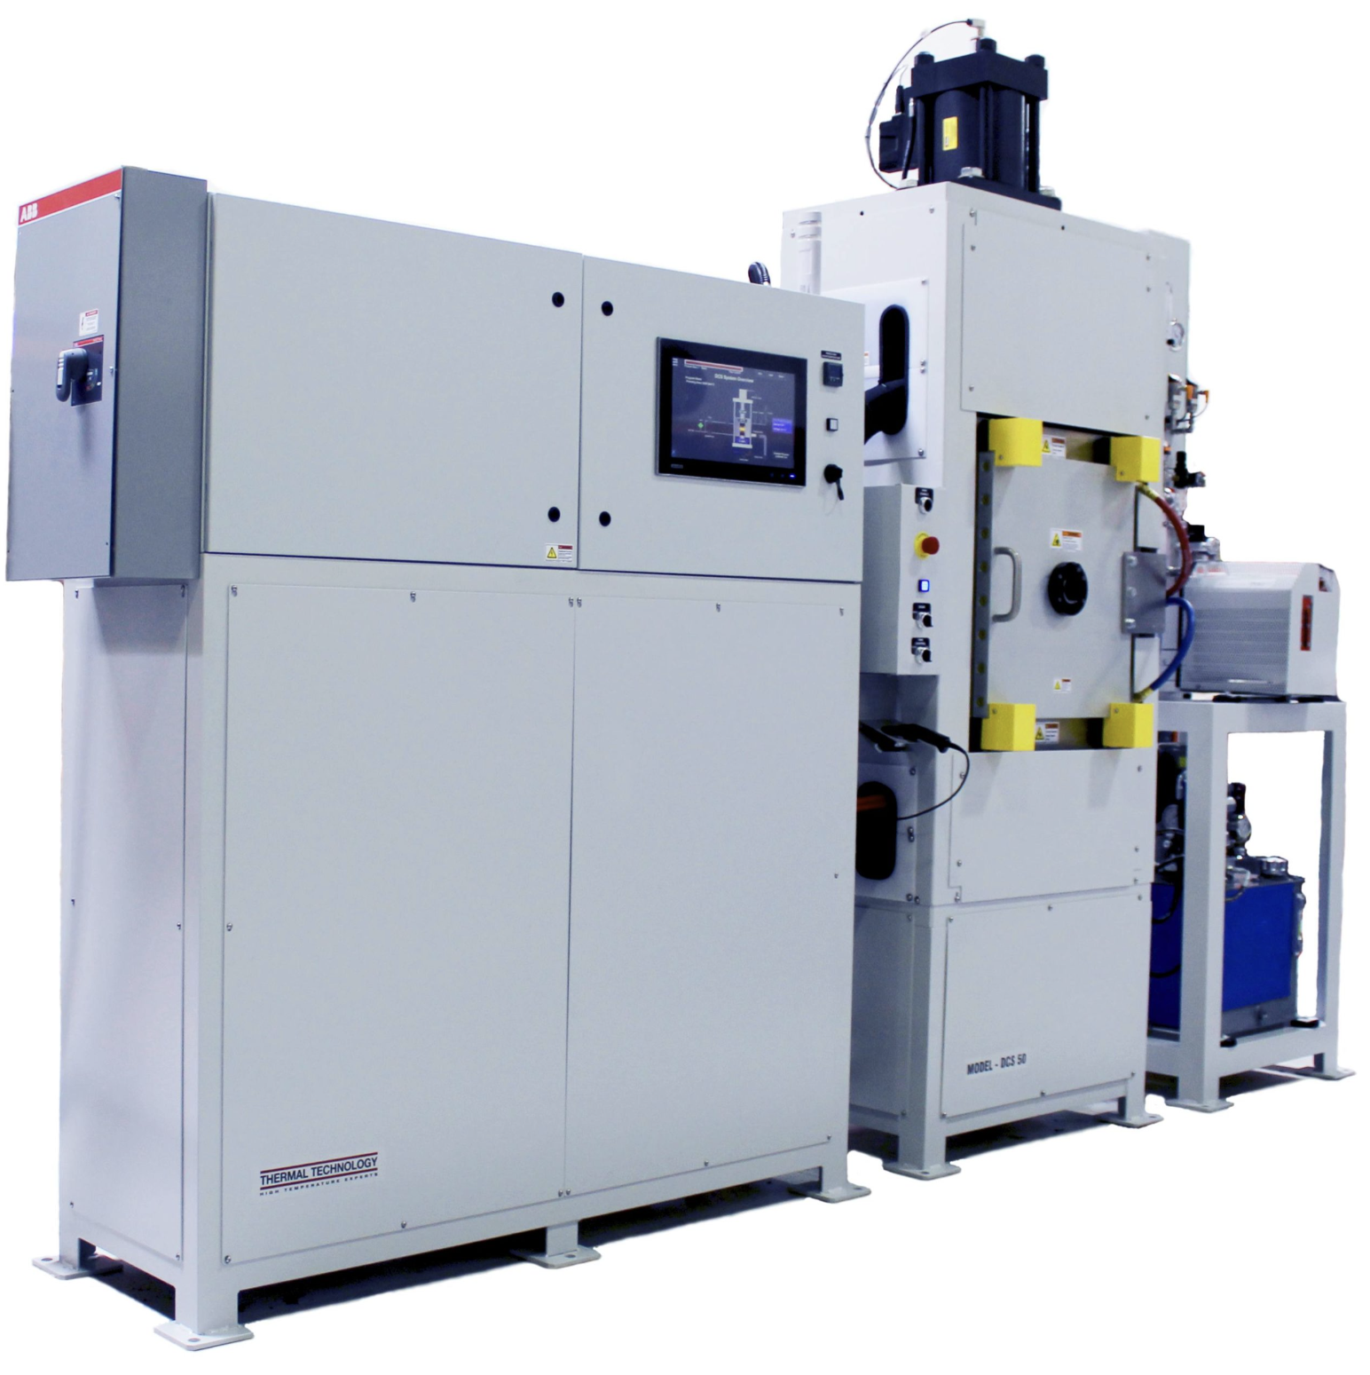
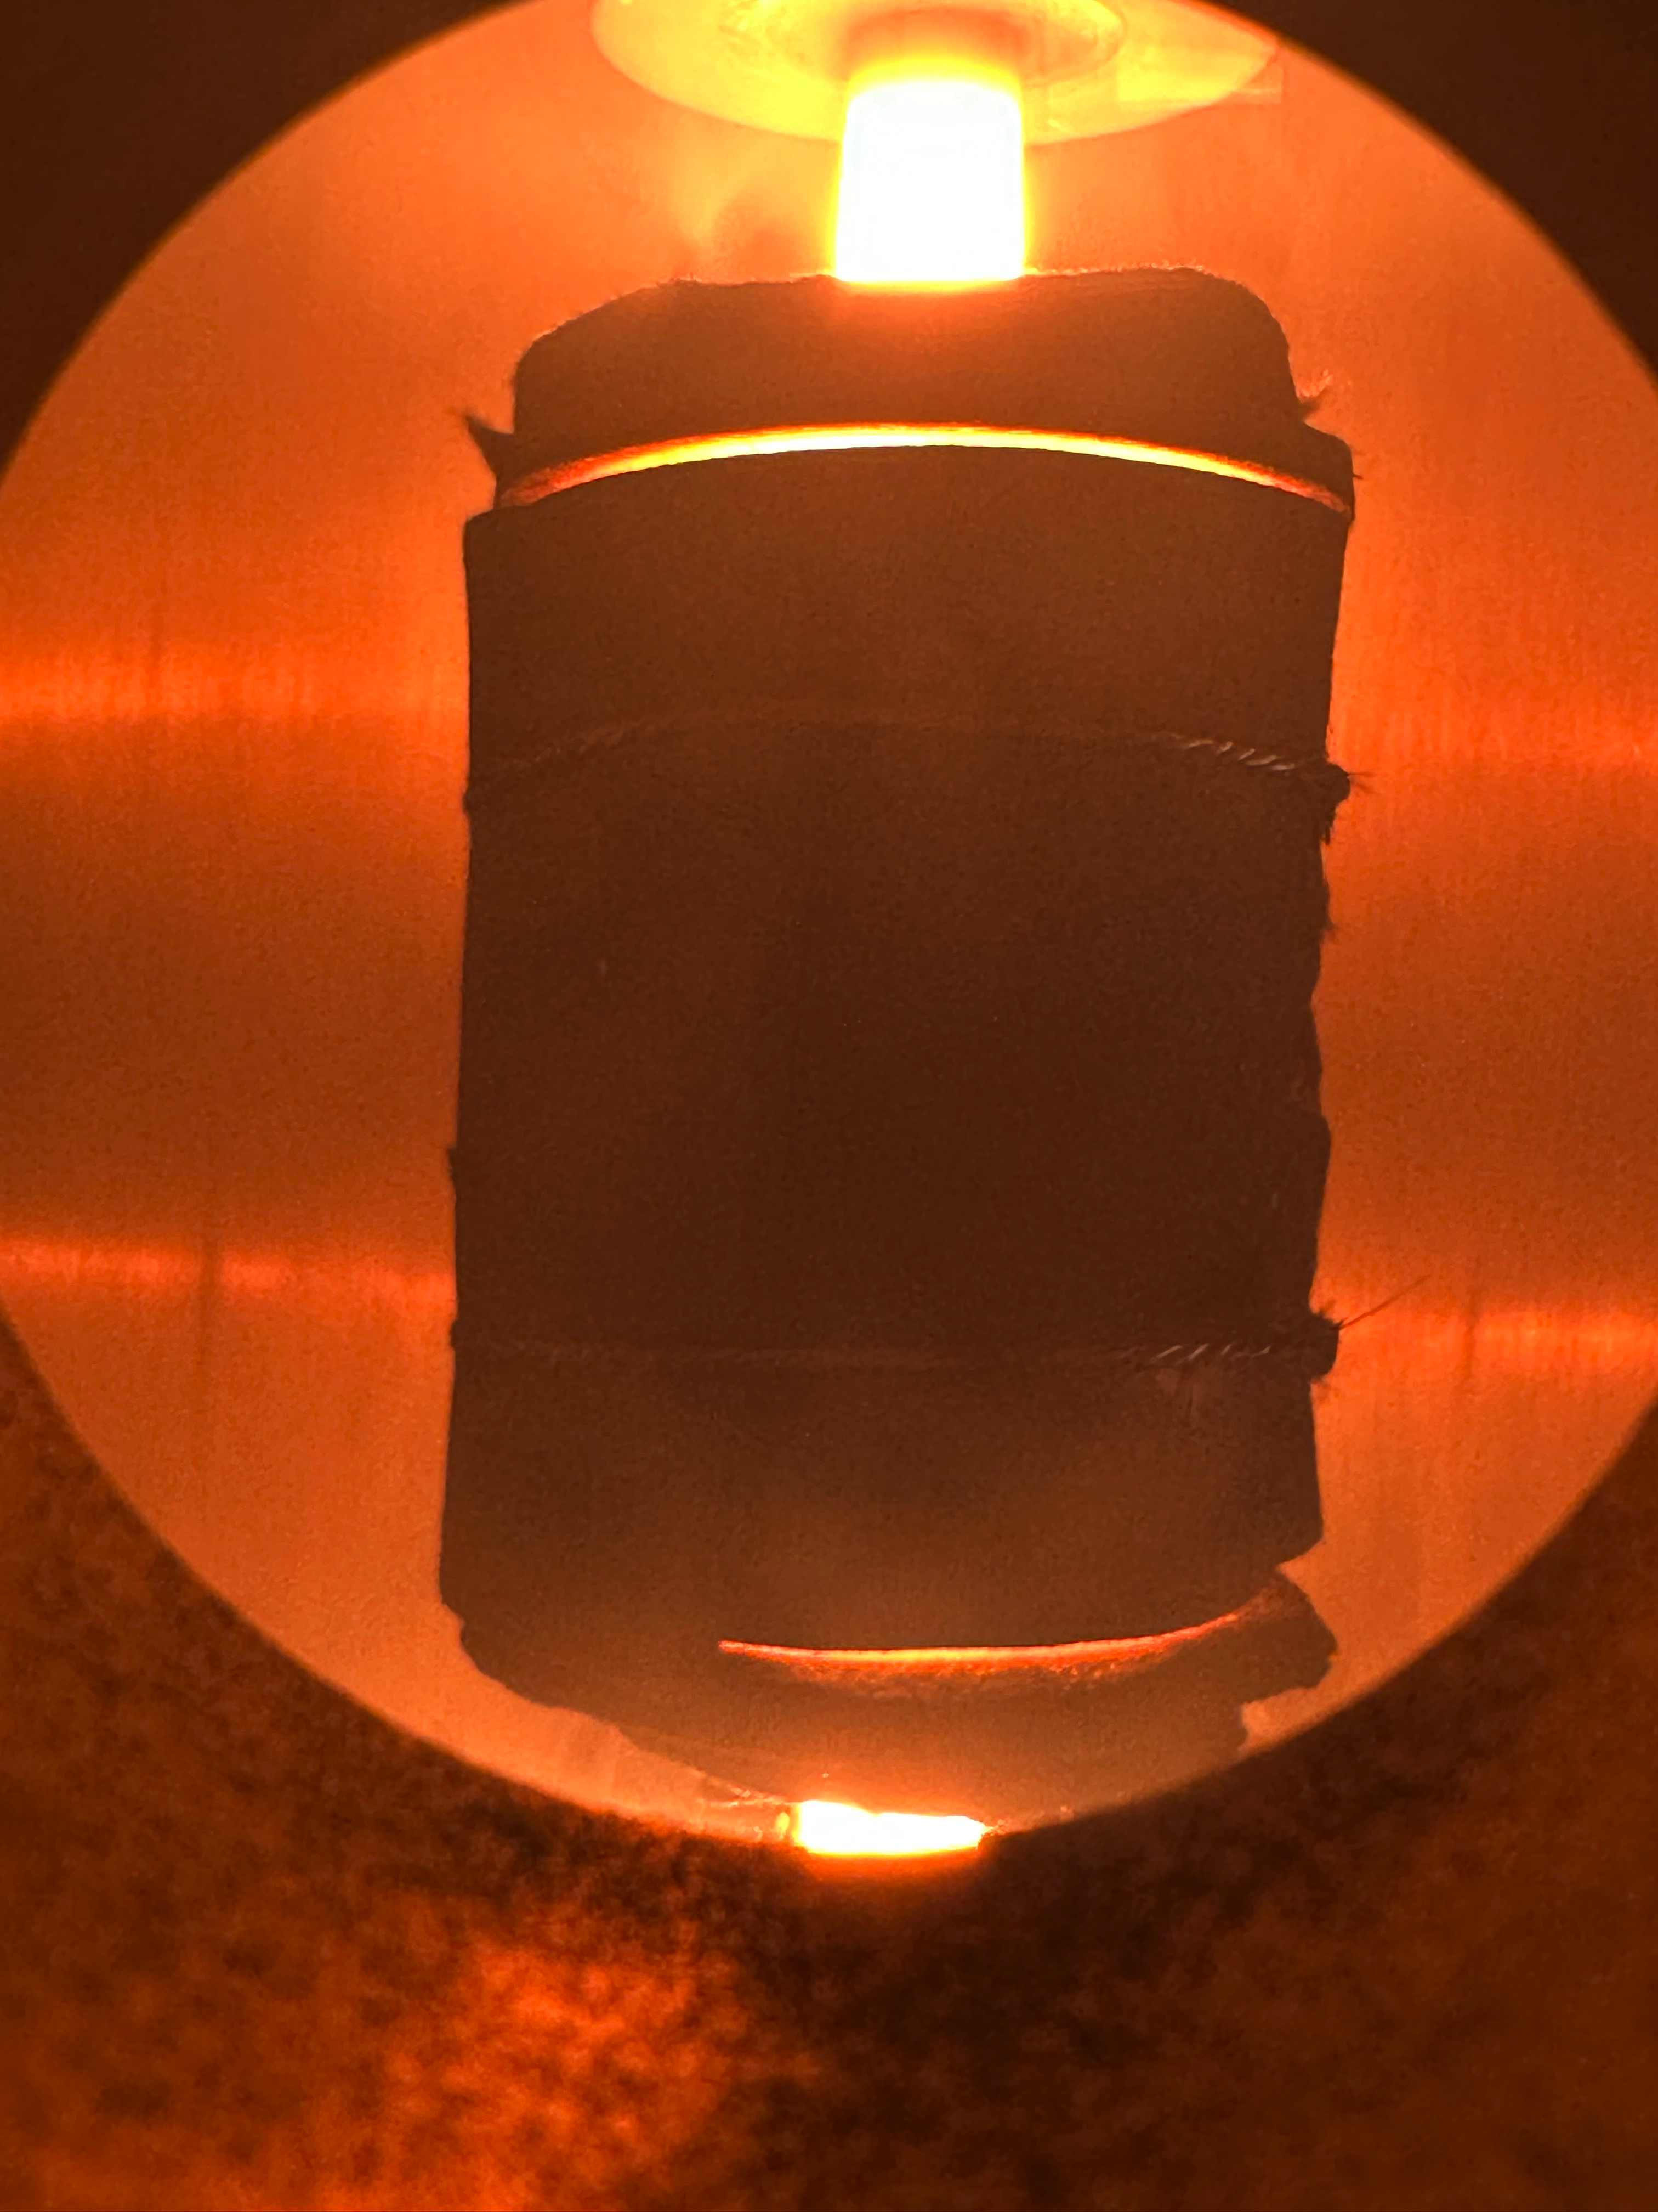
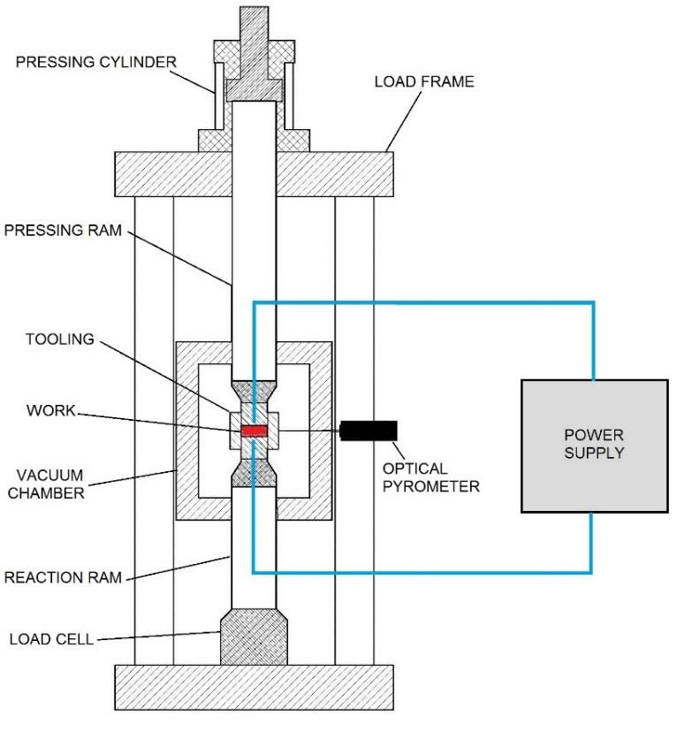
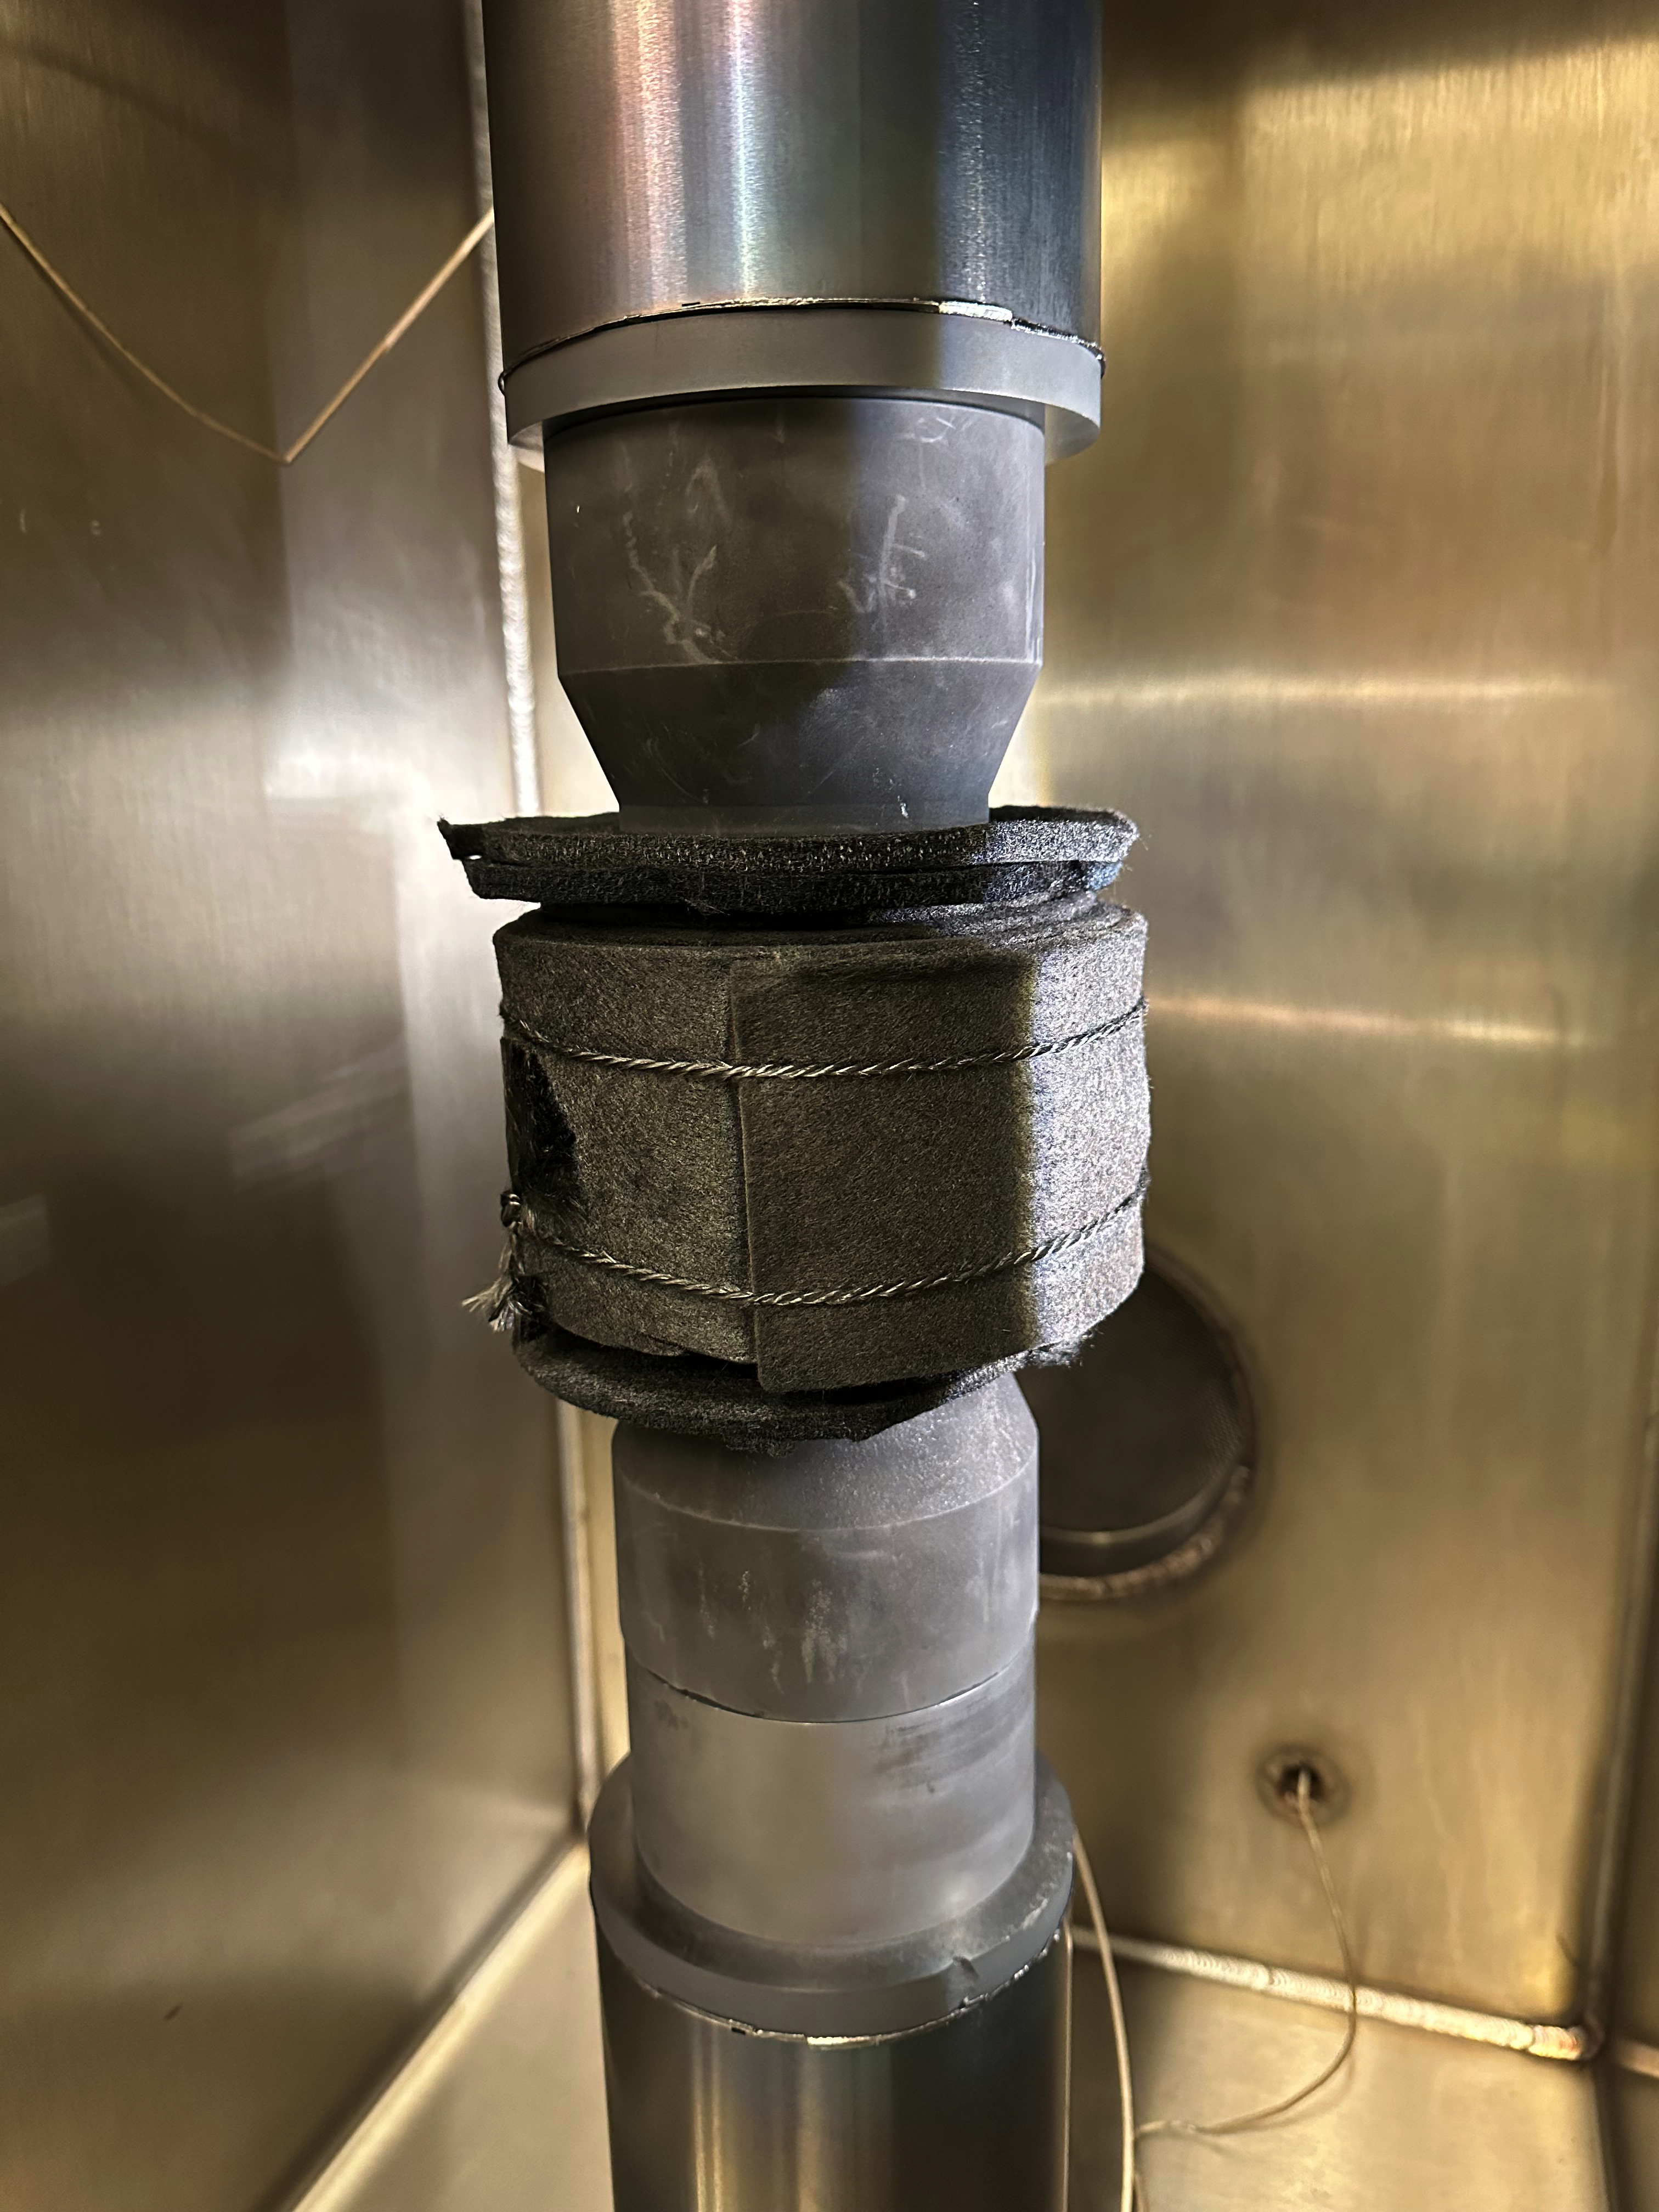
Direct Current Sintering Capabilities
Max Temp – ≈ 2,500°C
Max Pressure – 15 & 25 Metric Tons
Time to full density - < 1hr
Rad and Non-Rad Capabilities
Thermal Technologies DCS 15 & 25

Slide 9
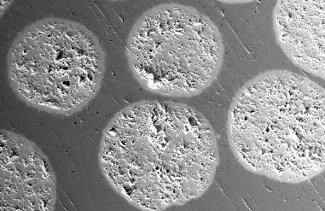
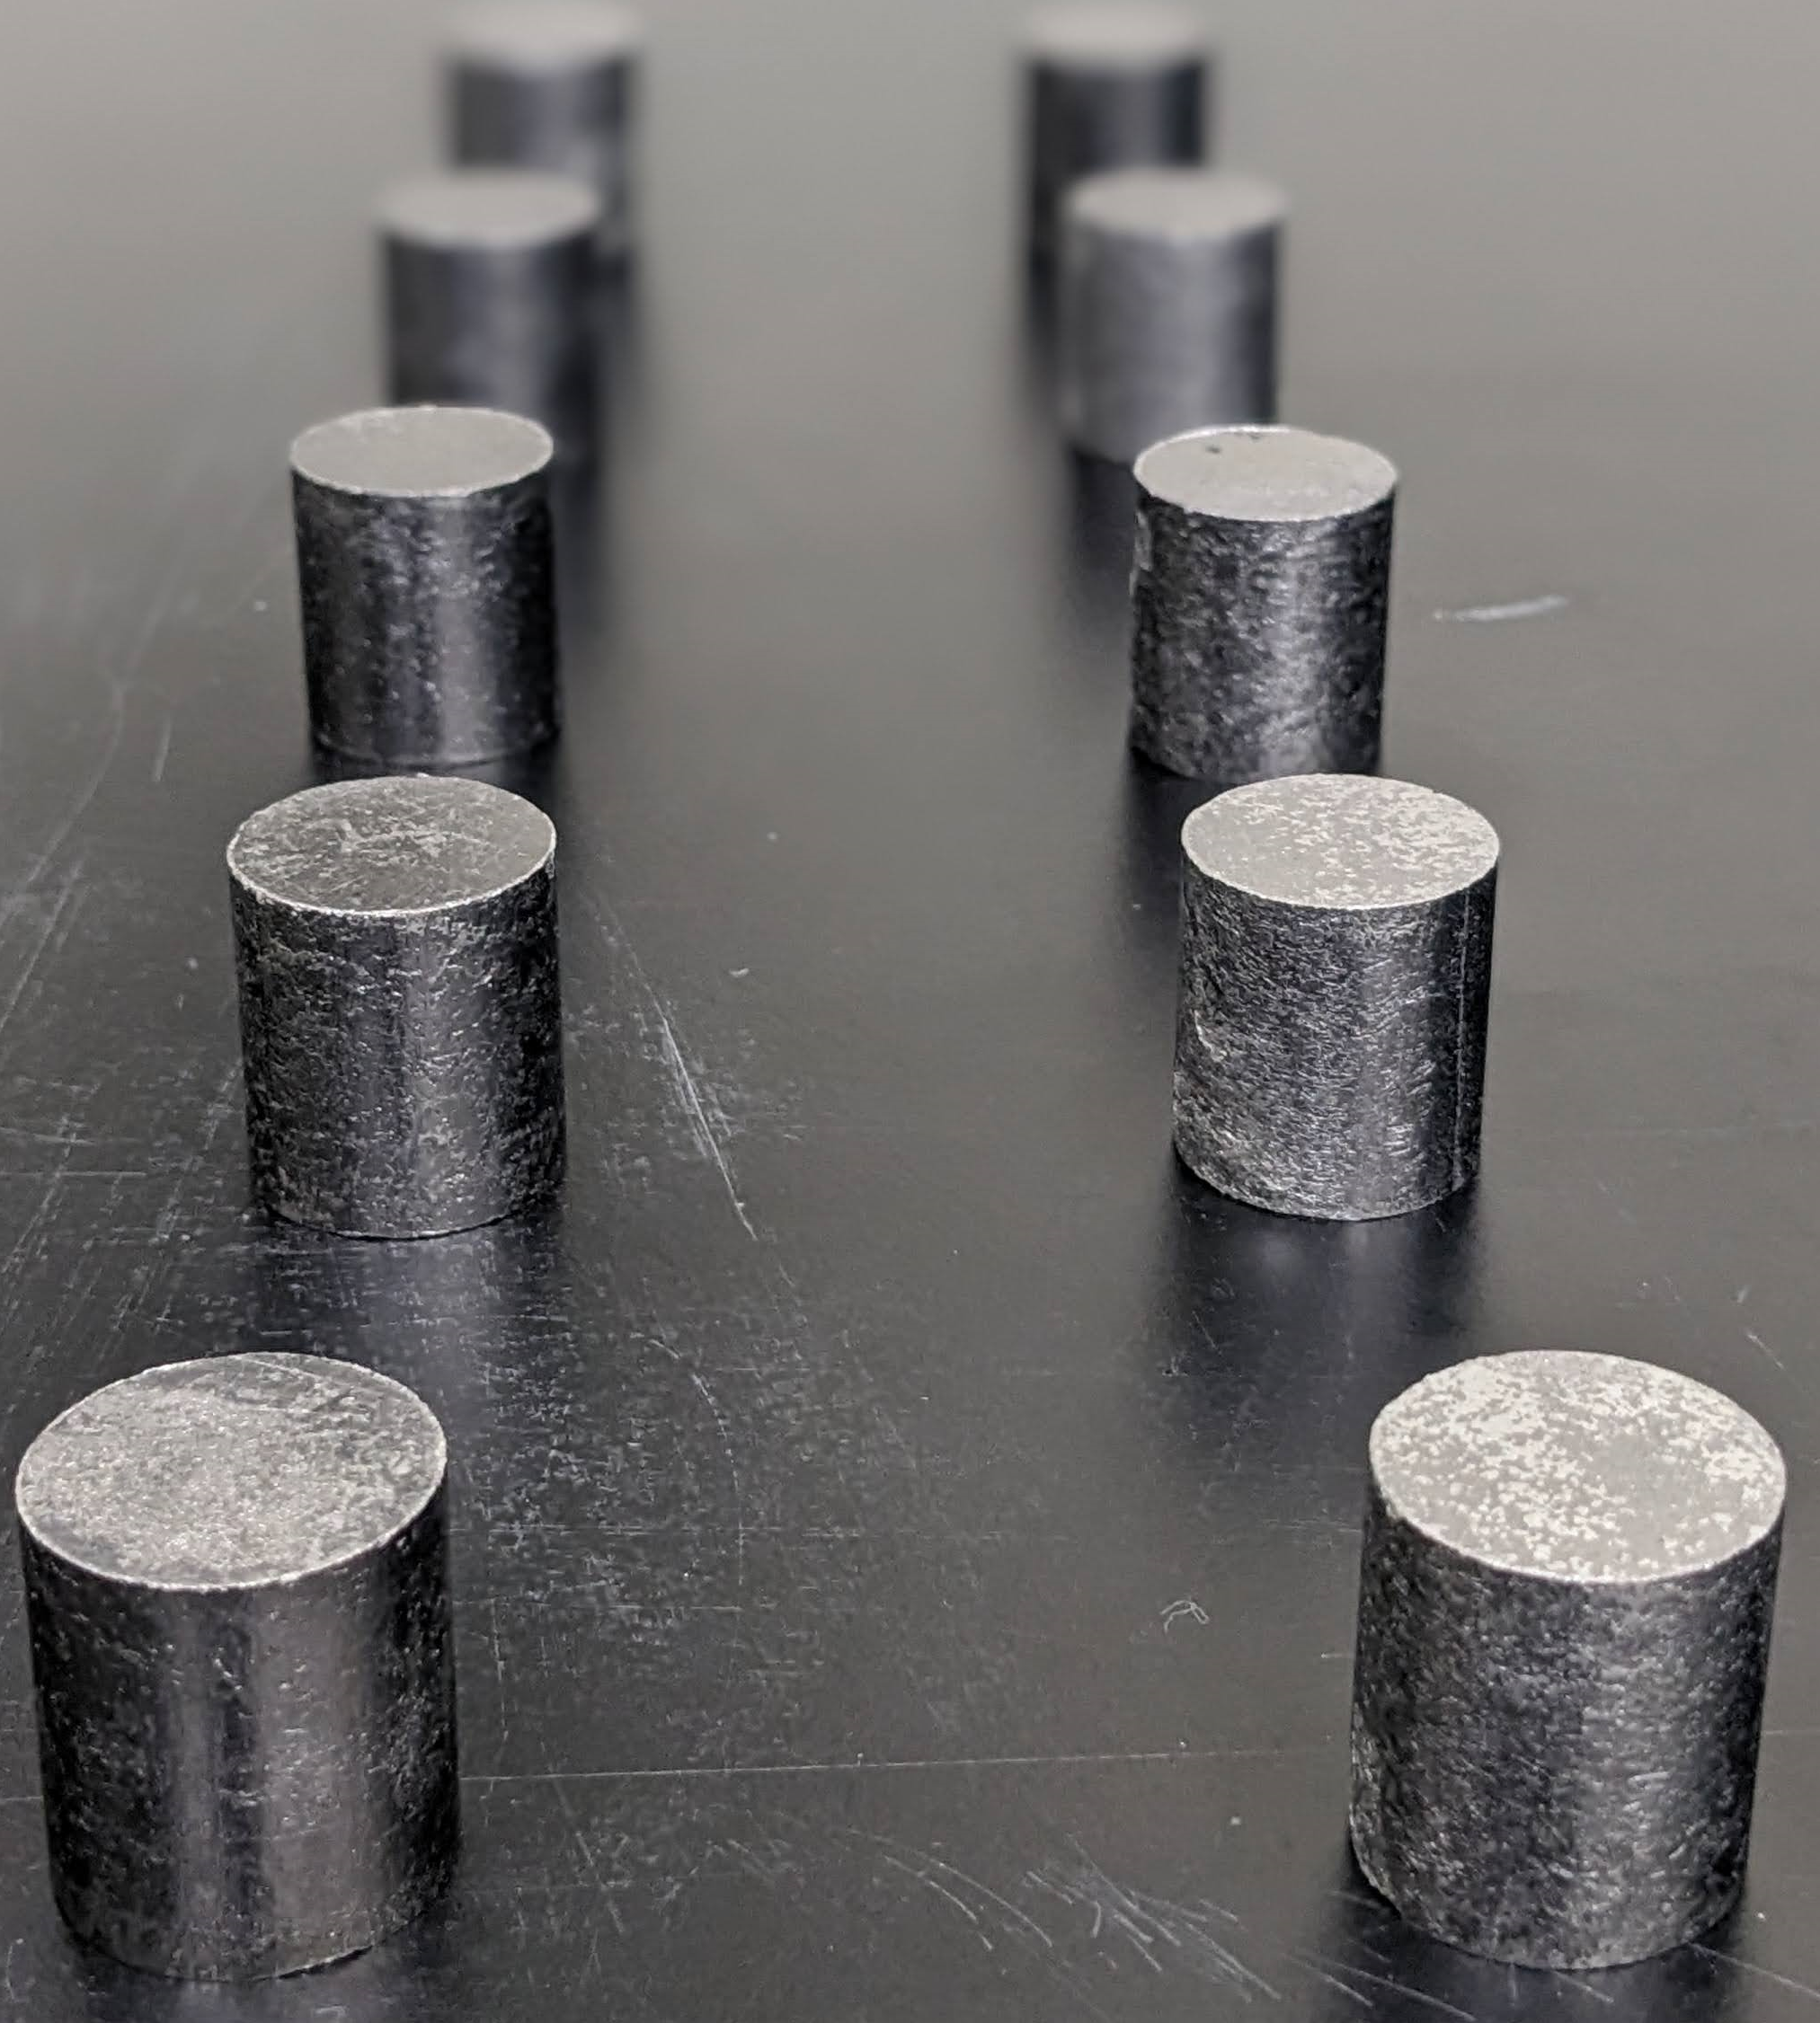
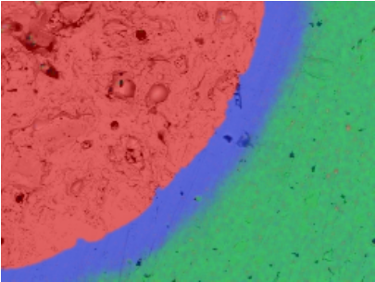
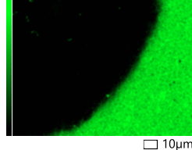

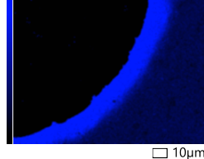
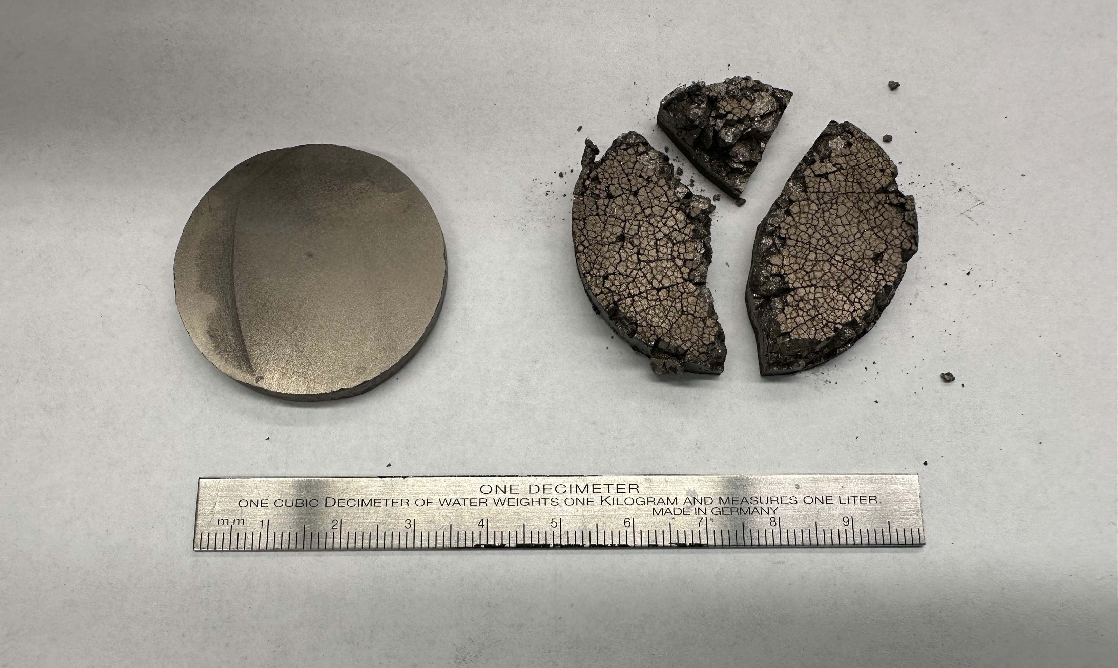

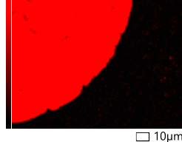
Development of Consolidation Parameters
  Development:
  Powder feedstock mixing if needed
  Develop sintering parameters in Spark Plasma Sintering (SPS) furnace
  Process parameters established and met fuel specifications:
    Sample densities above 90% TD
    Produce crack-free samples
  Successfully developed a repetitive process to consolidate this fuel configuration meeting fuel specifications
25 mm
100 µm
Consolidated cermets
Consolidated UN kernels in Mo30W matrix
Energy dispersive spectroscopy maps displaying chemical elements in UN kernel in a Mo30W matrix
Bicarbide Sample
UN Fuel Wafer

Slide 10
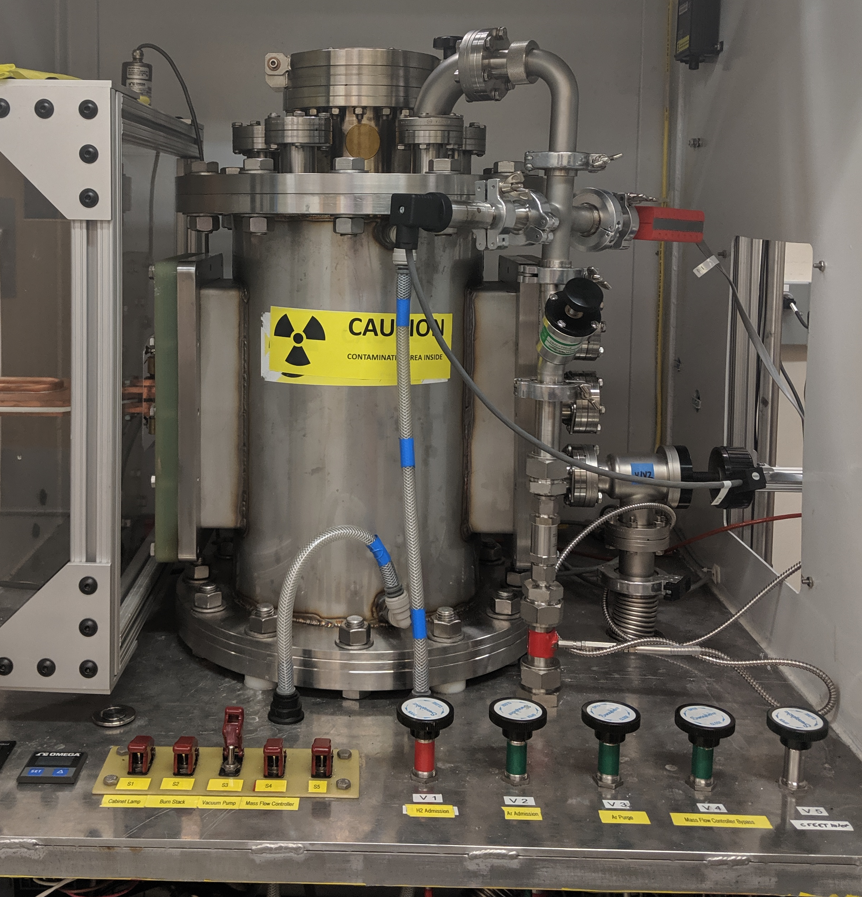

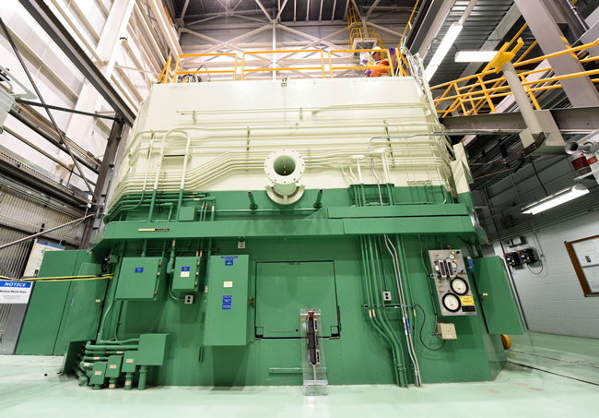
Nuclear Fuel Testing
CFEET – Compact Fuel Element Environmental Test (MSFC)
  Nuclear reactor temperatures, hydrogen rich environment
  Specimen size ~ 0.5-3” in length
NTREES – Nuclear Thermal Reactor Element Environmental Simulator (MSFC)
  Nuclear reactor temperatures and pressures, hydrogen environment
  Specimen size +20” in length
TREAT – Transient Test Reactor Facility at Idaho National Laboratory
  Nuclear Reactor temperatures and pressures
  Test nuclear fuel under severe reactor accident conditions
CFEET furnace - MSFC
NTREES Facility - MSFC
Transient Test Reactor Facility (TREAT).
Notes:
TREAT tests nuclear reactor fuels and materials under extreme conditions. It produces sudden bursts of energy that bring fuels to failure on a small scale in a very controlled way. This allows researchers to examine fuel performance under simulated accident conditions.

Slide 11
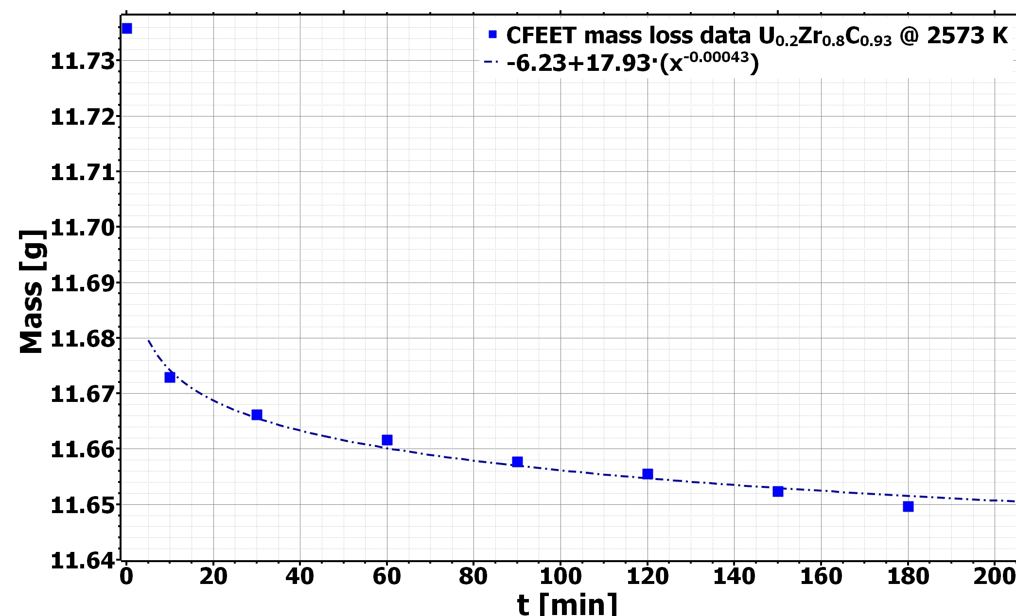
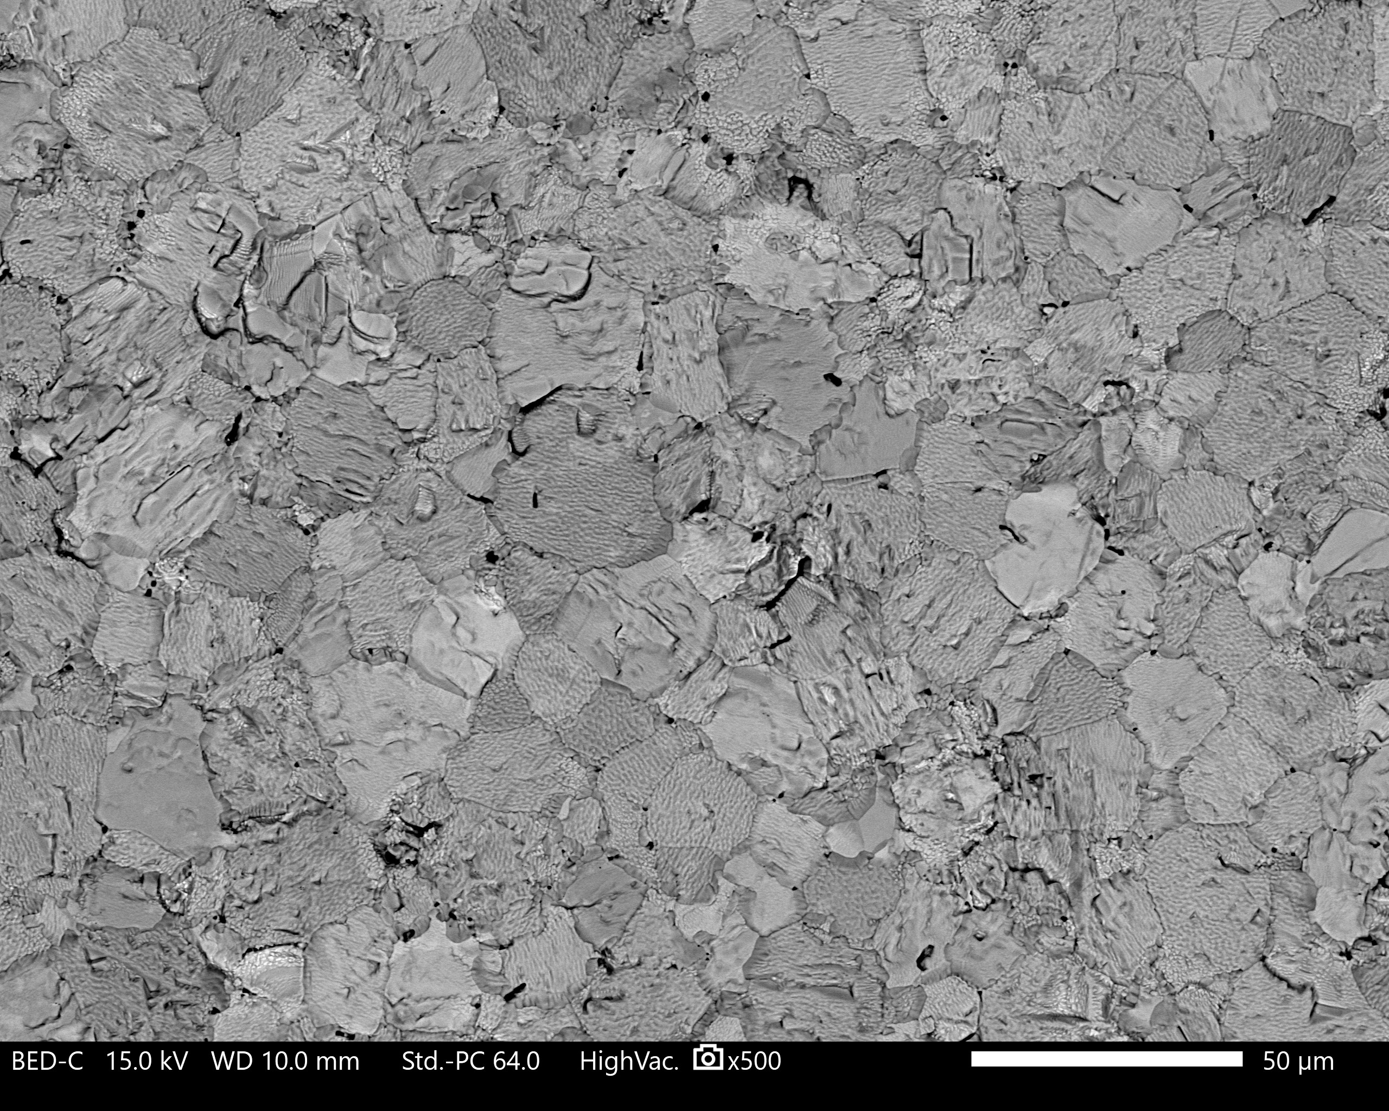
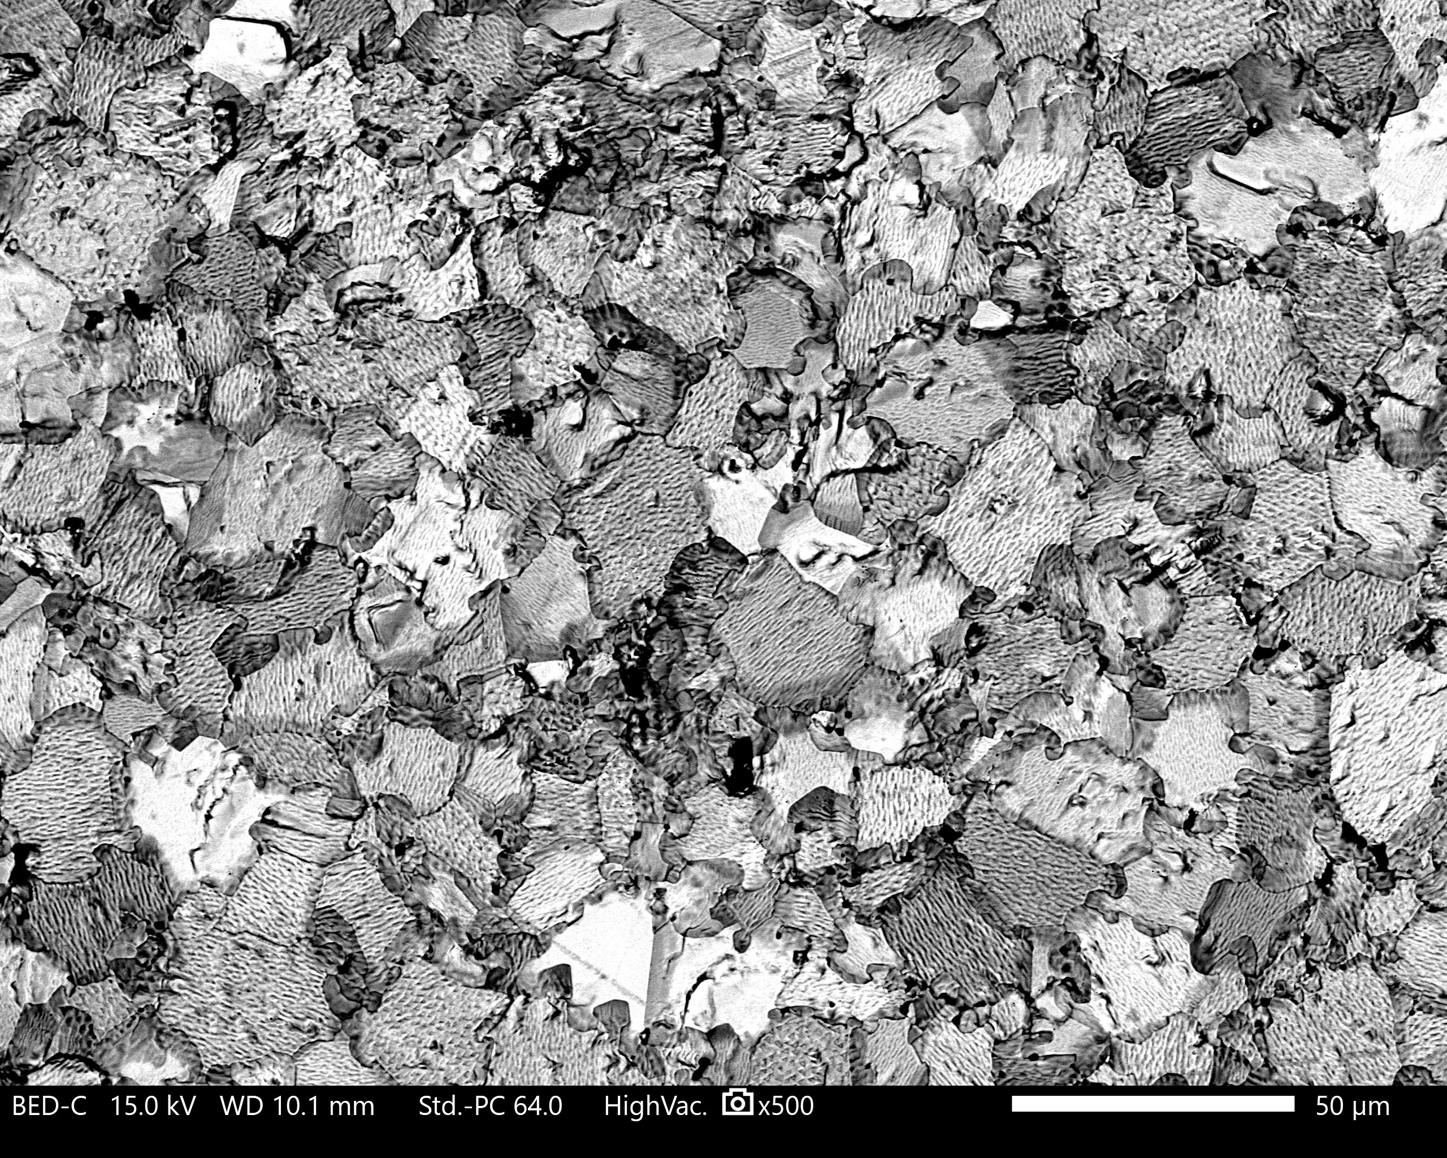
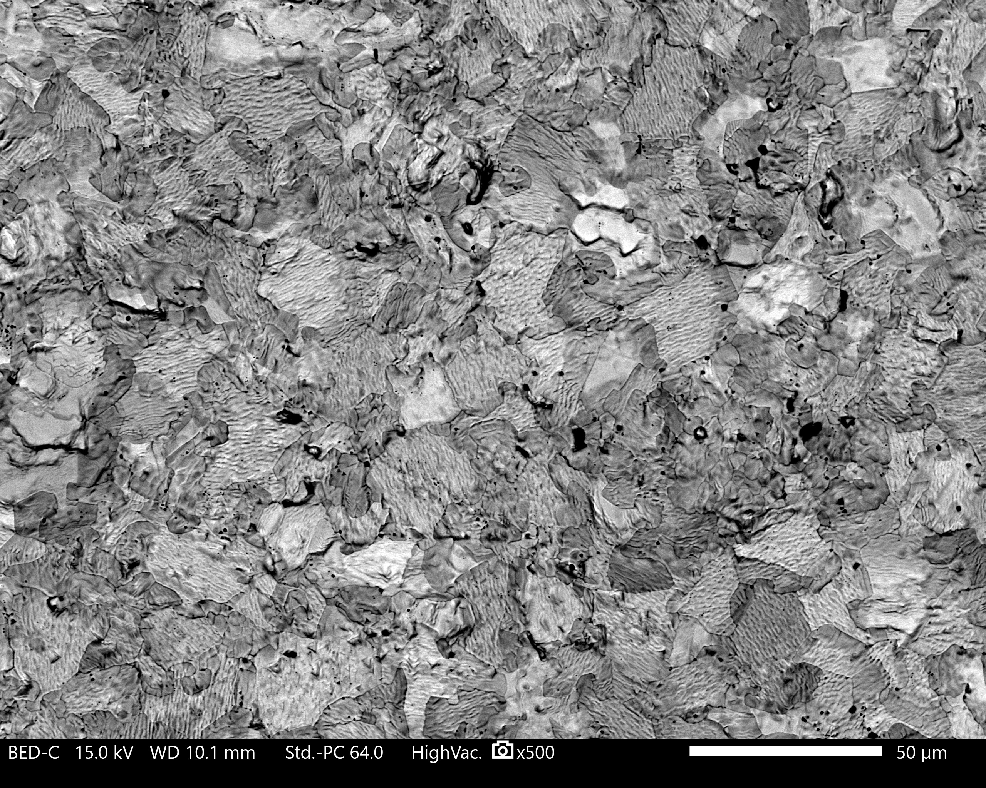
Hot Hydrogen Testing of Bicarbide Fuel
  Bi carbide fuel (U_{0.2}Zr_{0.8})C was tested at 2300°C (2573K) for 3 hours under hot H₂
  SEM imaging and X-ray diffraction was performed on the samples at 30, 90, and 180 minutes of hot hydrogen exposure
  The predominant feature in the microstructure was thermal etching
  The formation of surface porosity was observed after 90 and 180 minutes of hot hydrogen exposure
Mass loss recorded on U_{0.2}Zr_{0.8}C_{0.93} fuel sample during hot hydrogen testing
a)
30 min
b)
90 min
c)
180 min
50 µm
50 µm
50 µm
SEM imaging of U_{0.2}Zr_{0.8}C_{0.93} fuel sample during hot hydrogen testing at (a) 30 minutes, (b) 90 minutes, and (c)180 minutes.

Slide 12
Hot Hydrogen Testing of Bicarbide Fuel
  The XRD data confirmed that the initial phase of (U_{0.2}Zr_{0.8})C_{0.93} was preserved during sample consolidation and all cycles of hot H₂ exposure
  The material did not undergo any chemical changes nor reacted with hydrogen during 3 hours of testing at 2,300 °C (2573 K)
  Upon completion of all hydrogen testing intervals, the sample density was reported as 90.01% TD (initial density: 98.6%TD)
  The cumulative mass loss recorded (~3 hours) was less than 0.75% of initial mass
  (U,Zr)C fuel shows a high temperature stability, hot hydrogen compatibility, and minimum mass losses after 3 hours of hot hydrogen exposure. Making solid solution refractory carbide fuel an excellent candidate for SNP applications
XRD spectra for powder feedstock, consolidated sample, and selected tests under hydrogen gas
Exposure time [min] | Sample Mass [g] | Mass loss [mg] | Mass loss [%]
0 | 11.7358 | N/A | N/A
10 | 11.6729 | 62.9 | 0.54
30 | 11.6662 | 6.70 | 0.06
60 | 11.6616 | 4.60 | 0.04
90 | 11.6577 | 3.90 | 0.03
120 | 11.6555 | 2.20 | 0.02
150 | 11.6523 | 3.20 | 0.03
180 | 11.6496 | 2.70 | 0.02
Mass loss recorded on U_{0.2}Zr_{0.8}C_{0.93} fuel sample during hot hydrogen testing

Slide 13
TAMU Experiment
Develop TriCarbide Surrogate for Reactor Testing
  (W, Zr, Ta)C and (W, Zr, Nb)C
  Tungsten as surrogate for uranium due to similarities in:
    Atomic radius
    Crystal structure
    Valency
Reactor Experiment
  ZrH Moderator Thermal Spectrum
  10¹³ n/cm² flux in core
    NTP Flux is 3x TRIGA reactor, so ~2,000 hrs of irradiation needed to replicate Mars mission
  Characterization
    Thermal conductivity
    Heat capacity
    Modulus of elasticity
    Hardness
    Electron backscatter diffraction (EBSD)

Slide 14
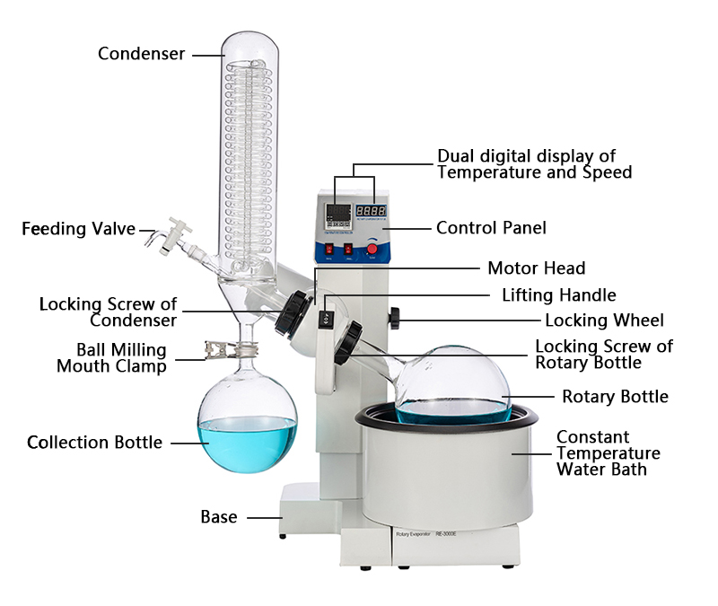
Powder Development
Why improve? Higher densities and solid solutions are needed for the ultimate performance of NTP fuels. Further powder research is needed prior to “plug and play” sintering. Process allows for higher densities, formation of solid solutions, and lower oxidation/contamination
Proof of Concept: Hafnium Carbide (HfC)
HfC Melting Point – 3,900°C
  Highest known melting point – more difficult to sinter
HfC pulled straight from vender bottle
  2200°C at 50 MPa for 10 min dwell
  Resulted in 92.7% TD
HfC same vendor - milled and processed
  2000°C at 50 MPa for 10 min dwell
  Resulted in 99.2% TD
Milling and rotary vaporization is the process of manually reducing the powder particle size with ball media (WC in this case) in an organic solvent (toluene) to avoid oxidation. The distillation unit then uses vapor distillation to remove off the toluene for a super fine and clean powder. The reduction of particle size and oxygen increases the sintered densities and homogeneity of the material due to the finer particles (increased surface area for diffusion across the boundaries).

Slide 15
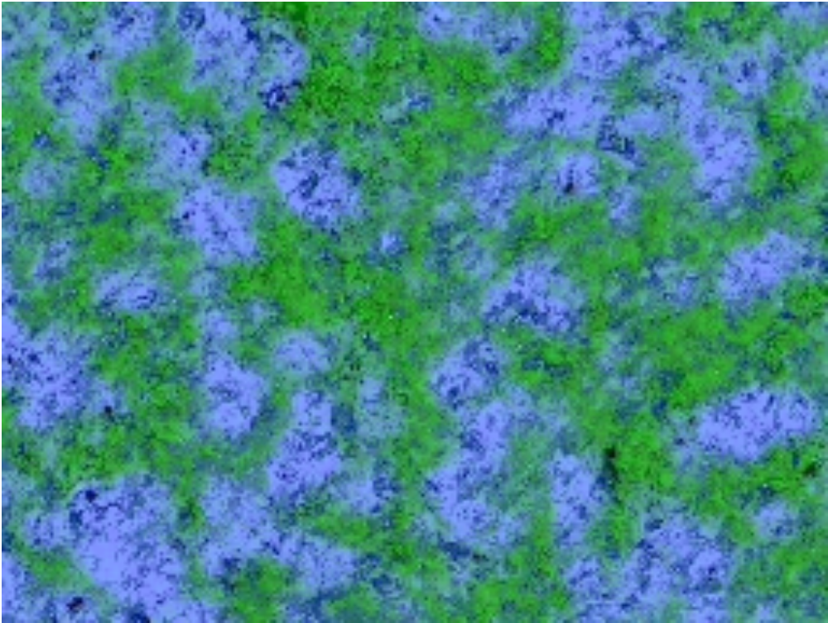

(W, Zr, Ta)C TriCarbide Homogeneity
Unprocessed TriCarbide
92.7% TD
Processed TriCarbide
97.3% TD
Unprocessed TriCarbide shows segregation of elements in EDS, while processed TriCarbide shows homogeneity

Slide 16
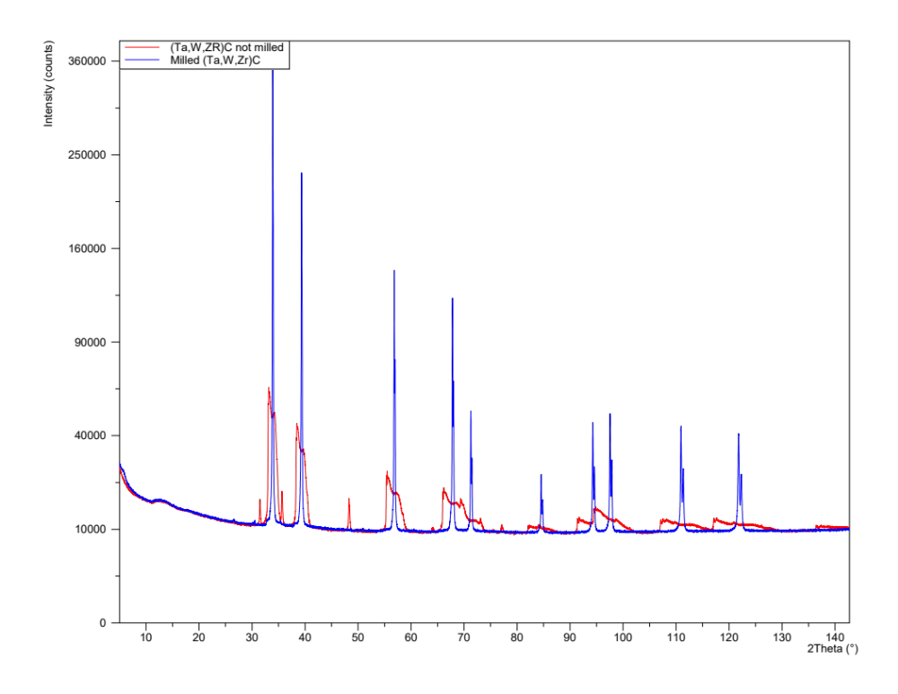
XRD Analysis - TriCarbide Solid Solution
Although EDS showing homogeneity is very important, it is not the entire story
XRD results show solid solution within sharp peaks vs previous scattered and broad peaks
  Important for performance of NTP fuels – better mass loss rates, densities, and thermal/mechanical stress resistance

Slide 17
Conclusion
Nuclear thermal propulsion offers fastest travel to Mars and beyond
US and USSR program ended with bicarbide (U,Zr)C and tricarbide (U,Zr,Ta)C fuel as optimal fuel choices
MSFC R&D has further improved fuel candidates via powder processing and direct current sintering
Surrogate fuel will be irradiated in TAMU TRIGA reactor to study irradiation effects
Thermophysical properties and microscopy captured in study

Slide 18


Questions?

