Slide 1
SPACE LAUNCH SYSTEM
CLVTOPS Toolchain for SLS Liftoff Separation Analysis
Co-Authors:
Carole Addona, Amentum
Peter McDonough, Amentum
Benjamin Burger, NASA/MSFC
Michael Sanders, Amentum
William Harlin, McLaurin Aerospace
Jared Rucker, Amentum
Zachary Muscha, Amentum
Rekesh Ali
NASA/MSFC/EV42/ESSCA/Mclaurin Aerospace
2025 AAS GN&C Conference
February 2, 2025

Slide 2
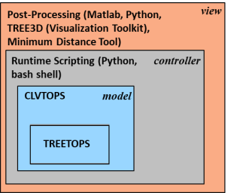
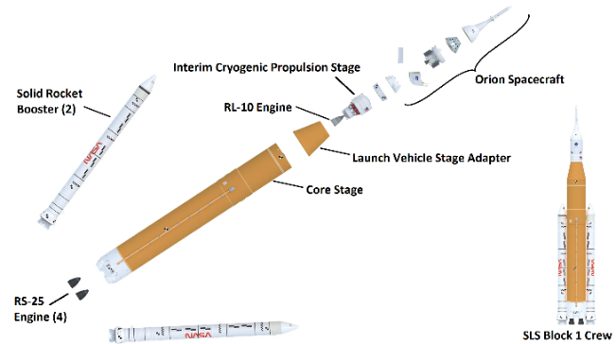
CLVTOPS Toolchain for SLS Analysis
The CLVTOPS toolchain¹ consists of many tools tied together with scripting languages
TREETOPS: Dynamics simulation core, implements Kane’s Method for multibody dynamics
CLVTOPS extends the functionality of TREETOPS, and handles I/O to TREETOPS core
Runtime scripts allow the user to define a simulation environment, and control I/O to CLVTOPS
Post processing tools liked TREE3D are used to interpret and visualize the CLVTOPS output data
CLVTOPS is currently being used for separation clearance analysis and separation event certification at NASA MSFC for the Space Launch System
Capabilities are mission-agnostic. CLVTOPS has been used for Ares (flight validated), SpaceX, Europa Lander, Soyuz, MAV, and more.
¹ Burger, Benjamin et al. (2021). Space Launch System Liftoff and Separation Dynamics Analysis Tool Chain. 10.2514/6.2021-0822.

Slide 3
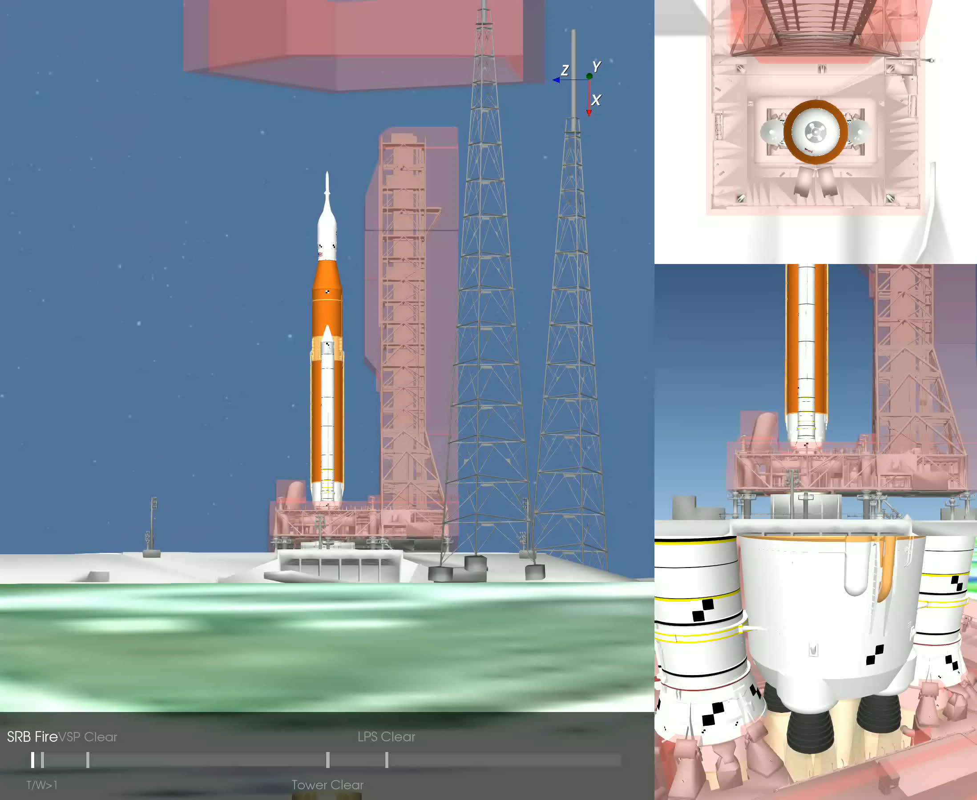
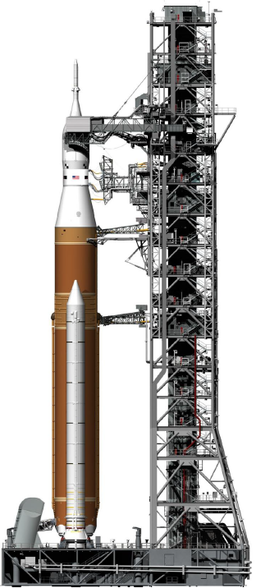
SLS Liftoff Overview
TREE3D Animation
Event | Time Relative to Liftoff (s)
RS-25 Ignition | T-6
SRB Ignition | T-0
Stabilizer arms retract | T-0
RS-25s throttle up to full power | T-0
Liftoff (Thrust to Weight > 1) | T+1
SRB nozzles clear VSPs | T+2
Vehicle clears tower | T+8
Vehicle clears LPS | T+10
Launch pad/0-Deck
Vehicle Stabilization System
(VSS)
Generic SLS B1 Liftoff
Trajectory
No Winds
Tower
T-0 to T+15s
Tail Service Masts
(TSM)
Static
KOZ Shaded Red
N
Vehicle Support
Posts (VSP)

Slide 4
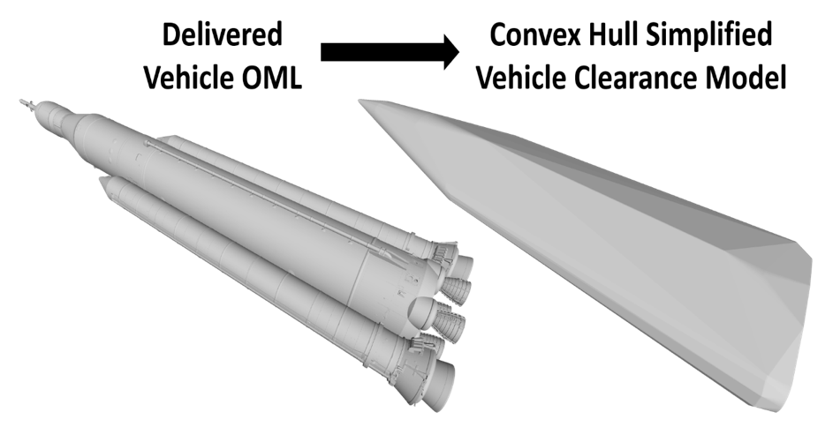
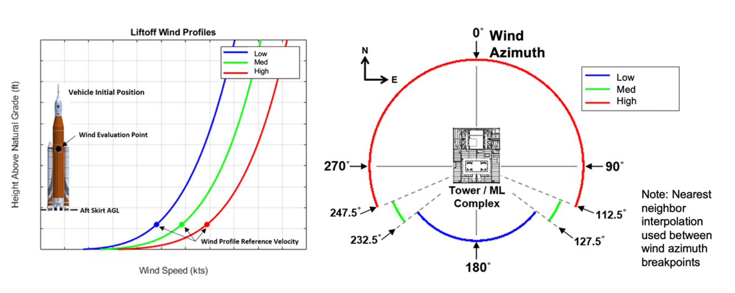
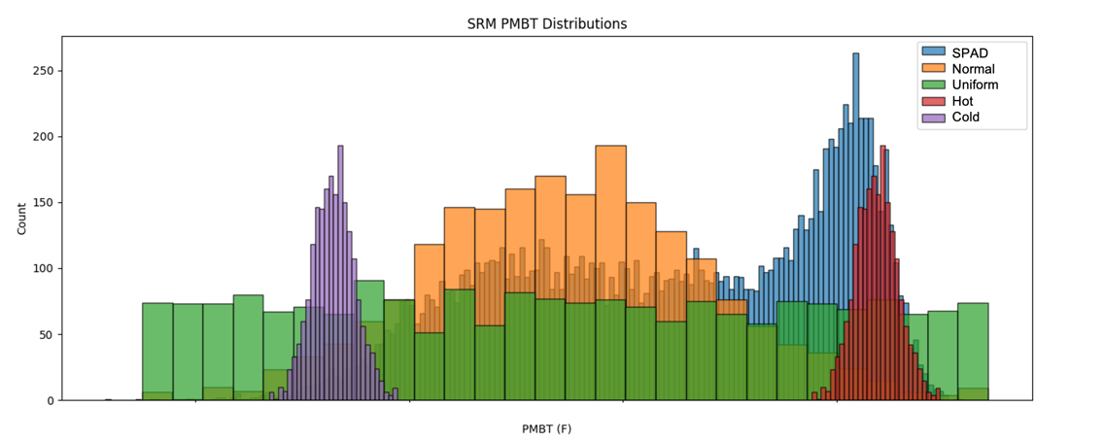
Models That Drive Liftoff Clearance
CAD Models are used for Minimum Distance calculations
Vehicle convex hulls generated from OML Geometries
Simplify original mesh to reduce file size and simulation time
Minimal conservatism added in critical areas
Engine nozzles are separate, articulating bodies
Static KOZ encloses ML assembly including 0-Deck, VSPs, TSMs, tower, stabilizer arms, umbilicals, and LPS
ML KOZ includes additional margin to hardware for conservatism
Winds provide aerodynamic forces that can drive vehicle into tower
Wind direction is uniformly distributed from 0 to 360°
Fixed reference wind profile per run, thus all drift in one direction
High reference profile (red) based on 99th percentile peak wind speed measured at launch pad during Shuttle era; Used for Artemis I
Ensures launch availability under extreme conditions
Medium & low wind speeds (green & blue) introduced in Artemis II and future missions
Lower speeds trade off launch availability for ML clearance
Booster propellant temperature (PMBT) affects vehicle rise rate
High PMBT: More thrust, faster ascent, quicker tower clearance
Low PMBT: Less thrust, slower ascent, increased drift into tower
NASA historical Shuttle Program measurements (SPAD) show yearly distribution of warmer PMBTs due to sub-tropical climate
Normal & uniform distributions capture more mid-range and low-range PMBT scenarios for added conservatism
Targeted hot & cold distributions address supplemental analyses on dynamic umbilical clearance and ML plume pressure loads

Slide 5
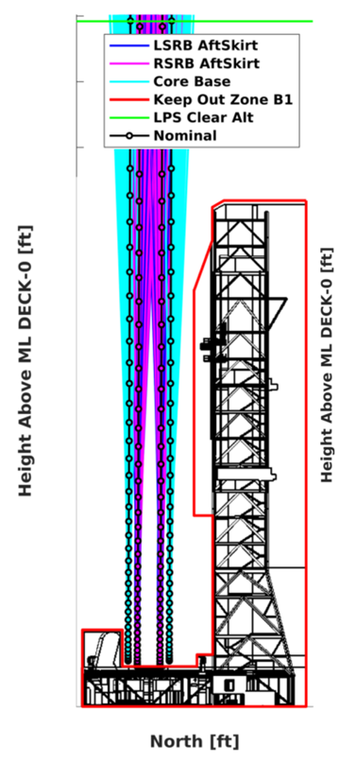
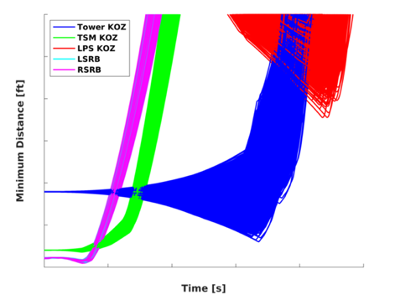
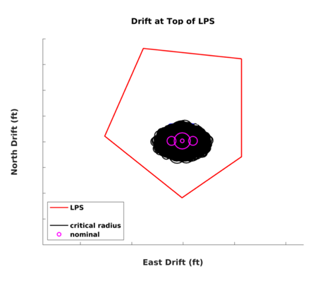
Monte Carlo Clearance Analysis
NASA MSFC mandates clearances reported at 3σ level
3σ level statistic is equivalent to 99.865% percentile at 10% consumer risk²
Requires 2,000 simulation runs at minimum
3σ low bound is between first and second lowest clearance values, meaning only a fraction of the last run can be ignored
Any KOZ violation in 2,000 runs fails certification
Left image: SLS drift in North-Up plane
Drift expands with elevation due to wind
Minimum distance to tower occurs in critical area
Clearance tied to wind-driven drift and thrust-driven rise rate (nominal case has no winds)
Top-right image: Minimum clearance over time
Clearance begins at some design condition, minimizes at closest approach, then increases
Tower clearance curves show exponential drift growth due to increasing winds
Bottom-right image: Overhead view at LPS elevation
LPS clearance most affected by wind due to it being at highest elevation
Critical area
Critical area
²Hanson, J. M. and Beard, B. B., “Applying Monte Carlo Simulation to Launch Vehicle Design and Requirements Analysis”, Report Number NASA/TP-2010-216447.

Slide 6
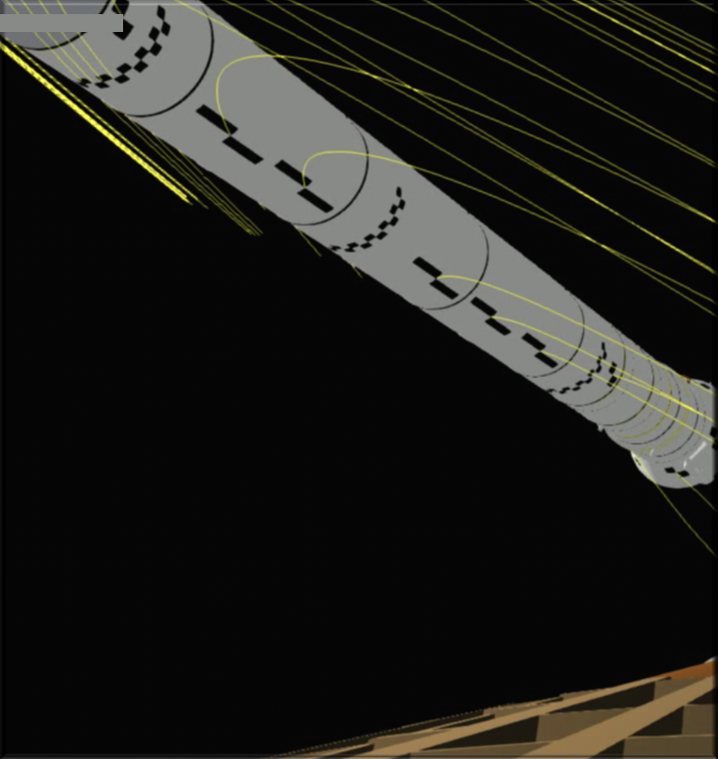
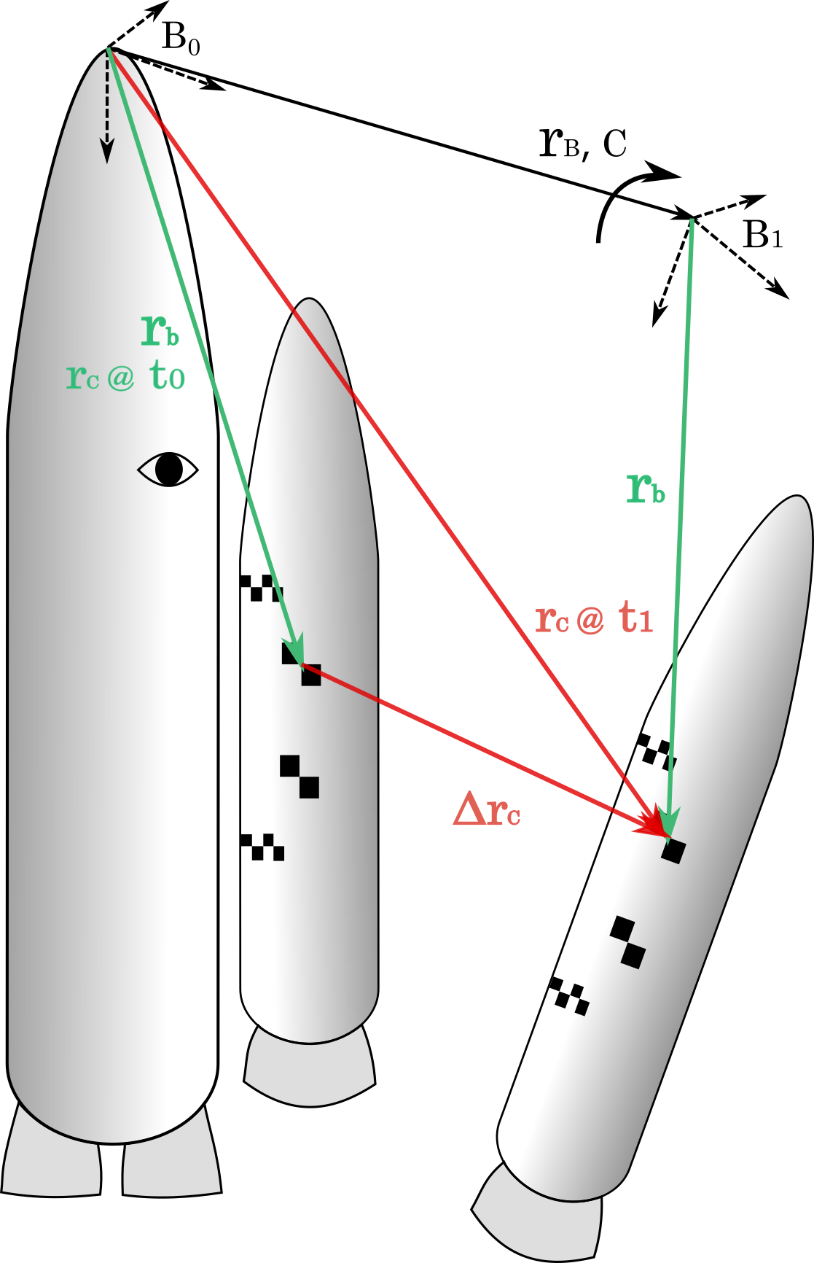
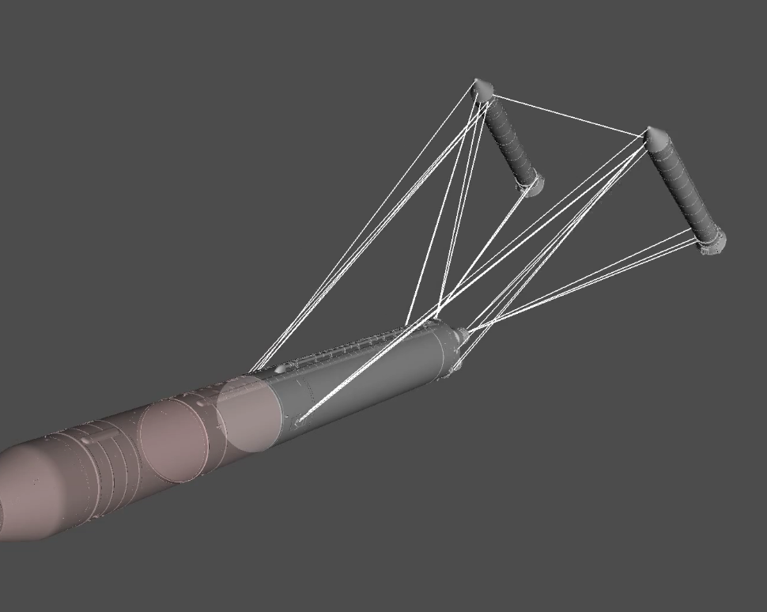

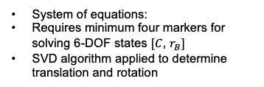
Photogrammetric Reconstruction
Photogrammetric 3-DOF Photo-Target Tracking*
Rigid Body 6-DOF State Reconstruction
Clearance Computation in Minimum Distance Tool
$$Δr_{c}=r_{B}+Cr_{c}$$
Reconstructed 6-DOF fed into Minimum Distance Tool for clearance calculations
Tool verified by comparing reconstructed TREE3D (video of simulation) states to truth states from CLVTOPS (simulation)
Computer vision algorithm detects and tracks pixel centers of high-contrast photo-targets
Converts 2-DOF pixel coordinates to 3-DOF world coordinates using triangulation or distance constraints
System of equations:
Requires minimum four markers for solving 6-DOF states $[C$, $r_{B}]$
SVD algorithm applied to determine translation and rotation
*Acknowledgements to Daniel Osbourne and Bo Parker of the Integrated Avionics & Software organization at NASA Marshall Space Flight Center for photogrammetry contributions.

Slide 7
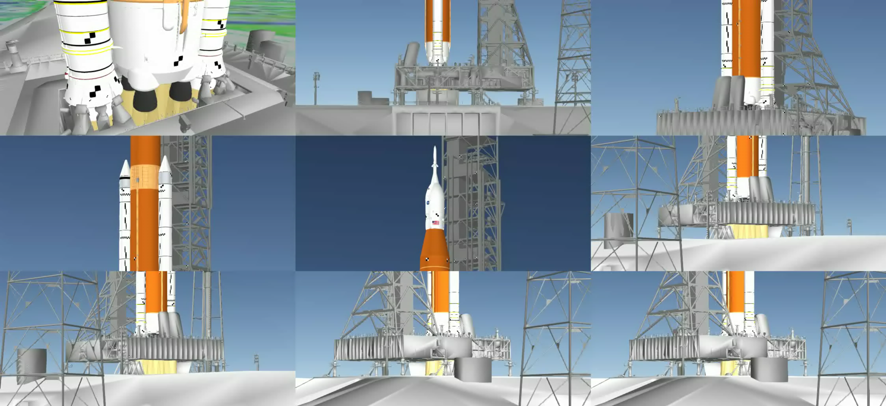
Liftoff Photogrammetry Cameras in TREE3D

Slide 8
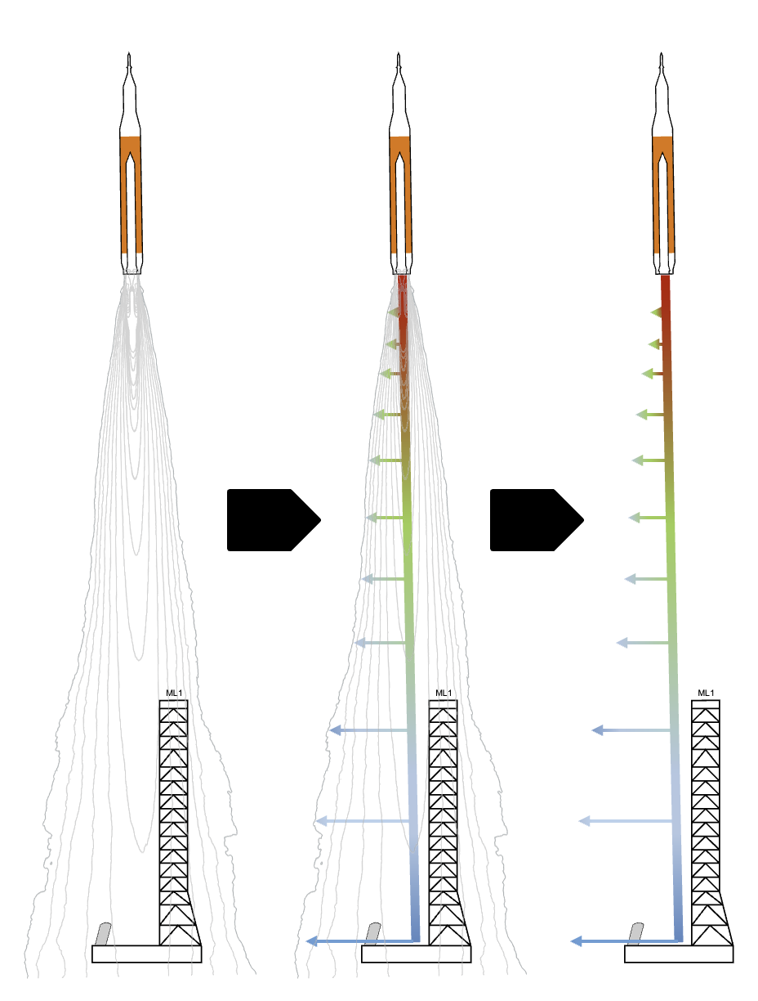
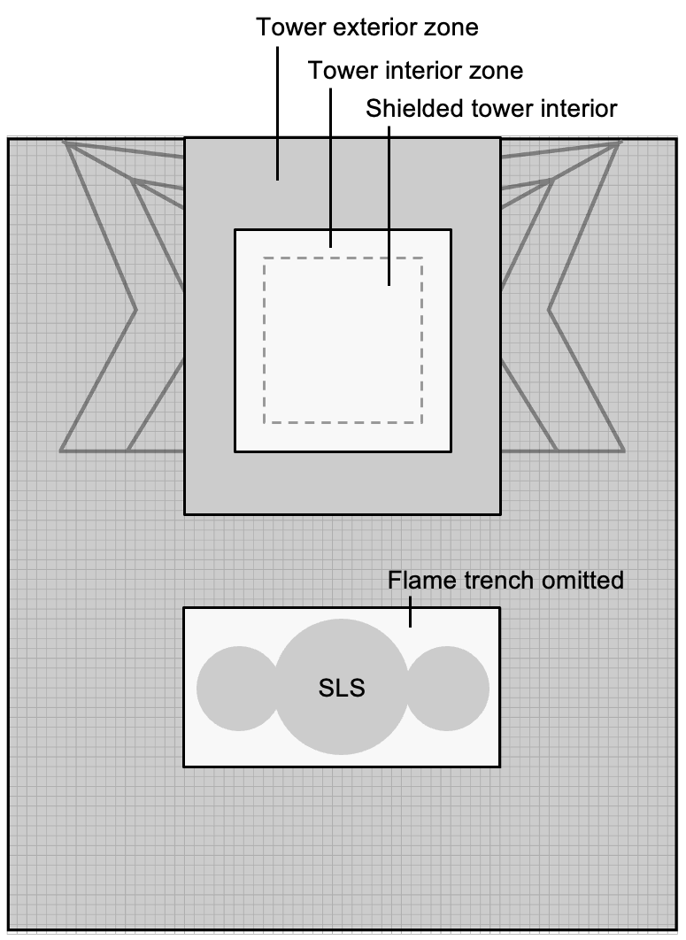
Plume Impingement Analysis
Engine plumes expose Mobile Launcher to high-pressure fields that cause damaging loads
Plume impingement analysis in CLVTOPS supports early ML design trades to better withstand loads
CFD plume is simplified into Quick Look Fields
Circular iso-pressures for each booster as a function of elevation and radius
Multiple plume models are interpolated between to capture time evolution of field
ML is discretized vertically into North-East planes and horizontally into micro-zones
Plume is projected onto plane
Pressure in micro-zone interpolated from QLF
Plume pressures aggregated across Monte Carlos to estimate statistical impingement pressures
CFD
Plume
QLF
Plume
Discretize
North
East
Micro-zone
Plume Simplification*
Mobile Launcher Discretization
*Acknowledgements to David Chesnutt of Exploration Ground Systems at NASA Kennedy Space Center for QLF generation.

Slide 9
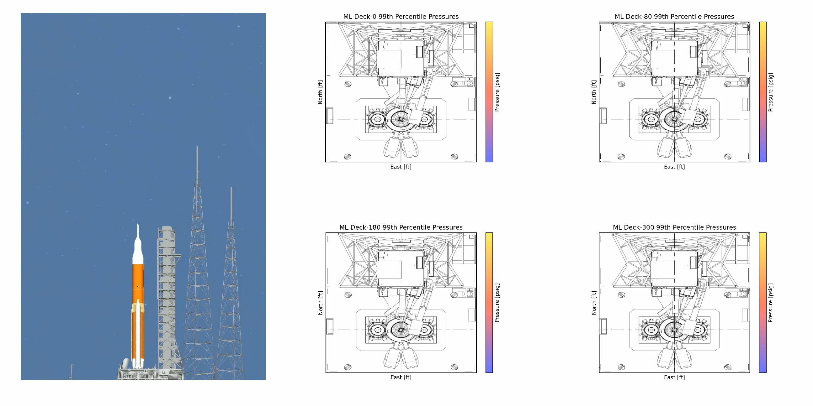
Monte Carlo Plume Impingement Visualization
300
180
80
0
Plume in TREE3D is for illustrative purposes only, does not represent actual QLF.

Slide 10
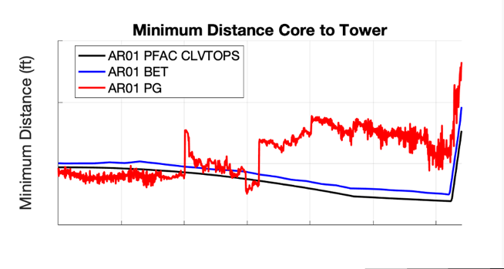
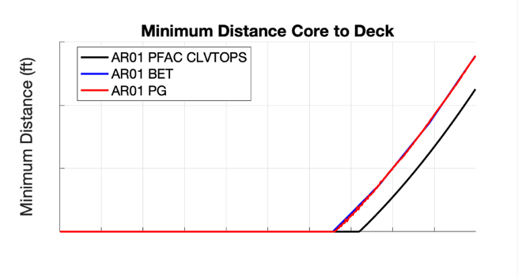
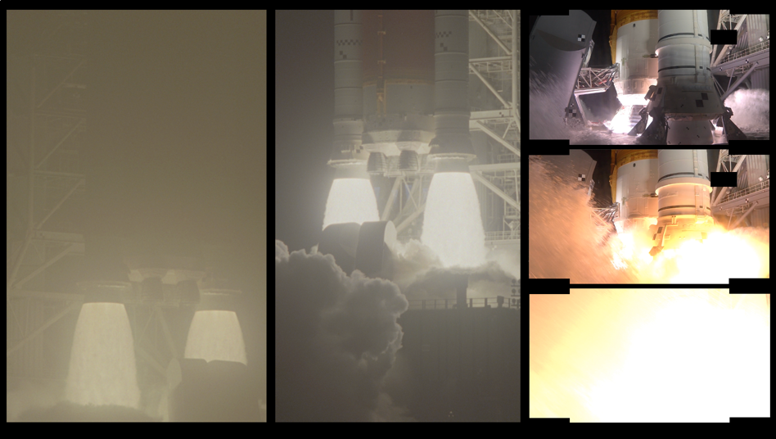
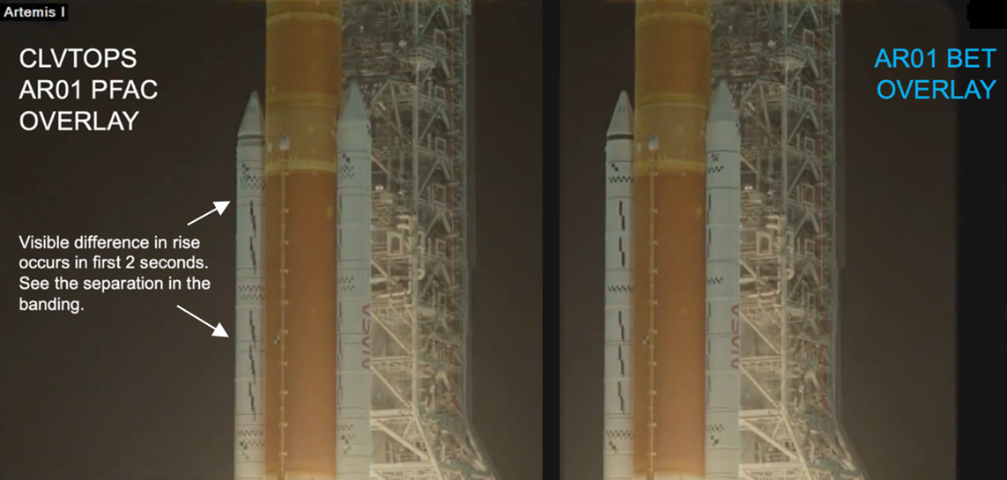
Artemis I Post-Flight Comparisons
Post-flight analysis provides opportunity to validate simulation models and improve future capabilities. Comparisons include:
CLVTOPS post-flight simulation (AR01 PFAC)
Navigation based Best Estimated Trajectory
Imagery based photogrammetry
Night launch degraded imagery quality
Left-side images illustrate obscured views due to overexposure from light and debris
Limited visibility of side mounted photo-targets introduced noise in tower clearance
CLVTOPS captures liftoff dynamics well with the exception of a slower rise rate
TREE3D overlay of CLVTOPS and BET trajectories on flight video show close alignment with BET
Time (s)
Time (s)

Slide 11

Questions? Contact me: rekesh.ali@nasa.gov
Thank you!

